Slide 1
Status of the RAON Heavy Ion Accelerator
Dong-O Jeon, Ji-Ho Jang, Hyunchang Jin*, Hyung Jin Kim, Jeongil Heo,
Bum Sik Park, Jangwon Kwon, Yujung Ahn, Chul Jin Choi, Eun Hun Lim,
Sangyoon Bae, Kyung Tae Seol, Yoochul Jung, Youngkwon Kim, Hyojae Jang,
Heetae Kim, Ju Wan Kim, Joonsun Kang, Hyungjoo Son, Chang Seok Seo, Yeon Sei Chung
IBS/IRIS
*KBSI
ICABU 2024.11.

Slide 2
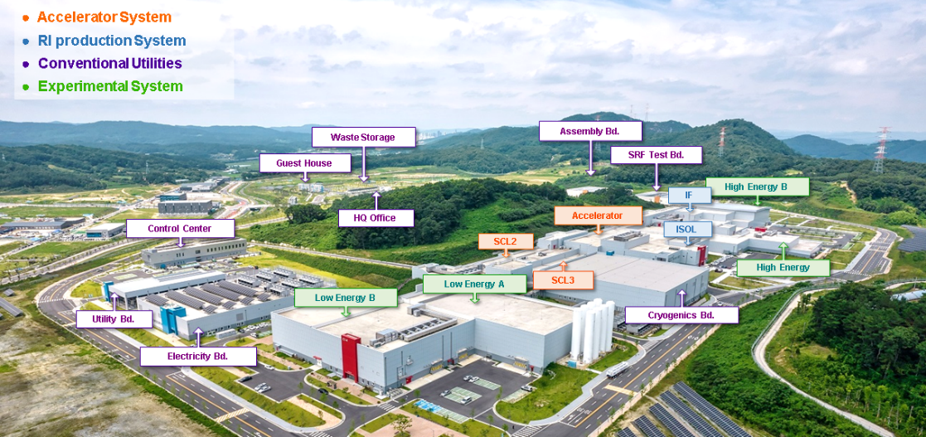
The RAON Facility
Campus Area: 952,066 m²

Slide 3
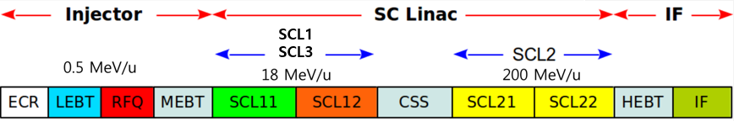
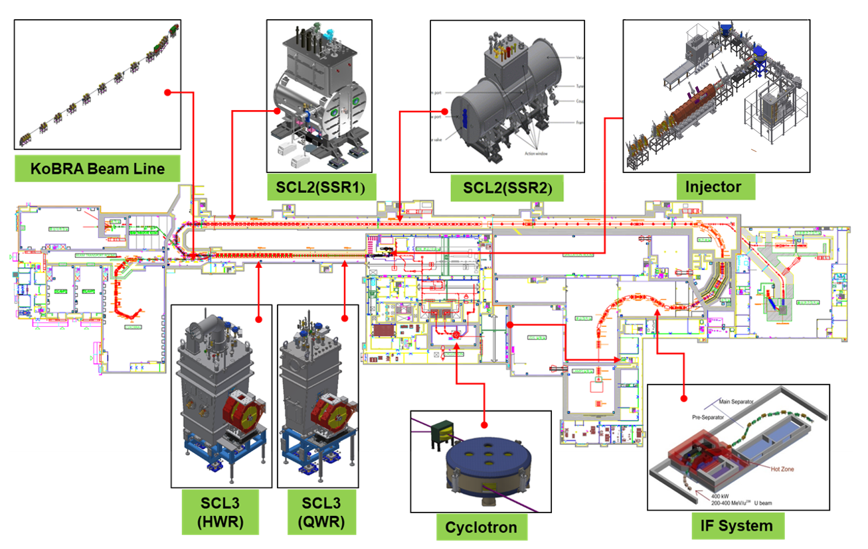
Accelerator Systems
ISOL
SCL31
SCL32

Slide 4
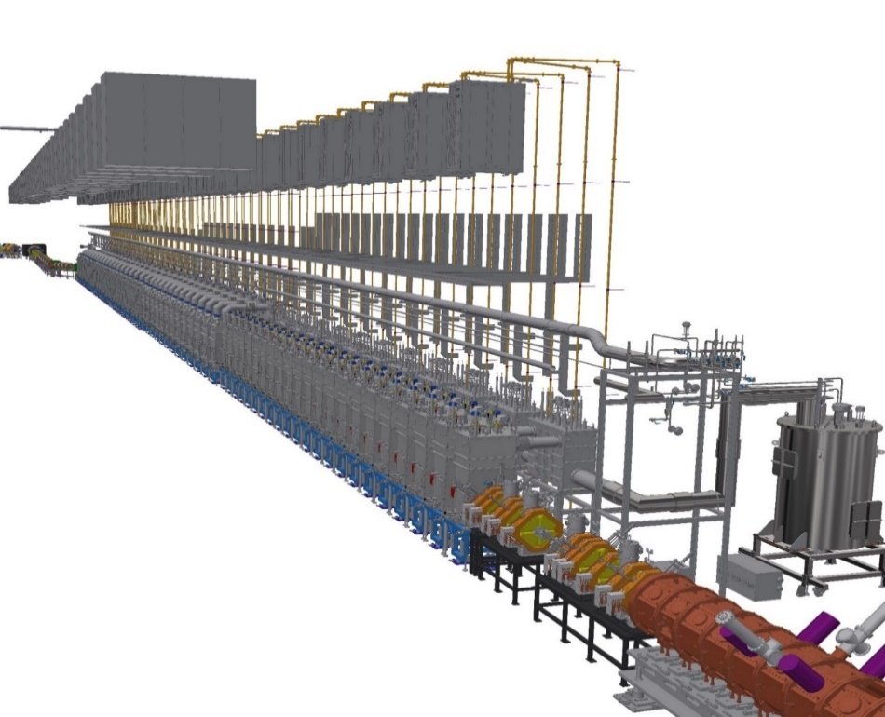
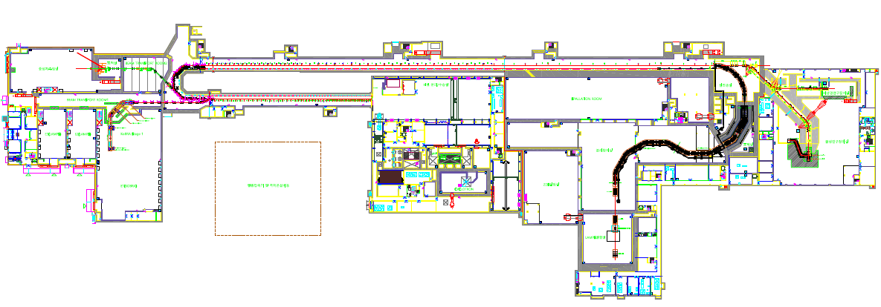
Accelerator Systems
Construction Phase 1 & 2
Phase 1 (2012~2022)
Injector, SCL3, ISOL
All the experiment systems including IF separator system
Phase 2 (~2030)
SCL2 (high energy linac)
SCL3
SCL3
Injector
SCL2
Injector
IF Separator
KoBRA
SCL3
ISOL
Low energy
Experiment Hall
Very Low energy Experiment Hall
High energy Experiment Hall
4

Slide 5
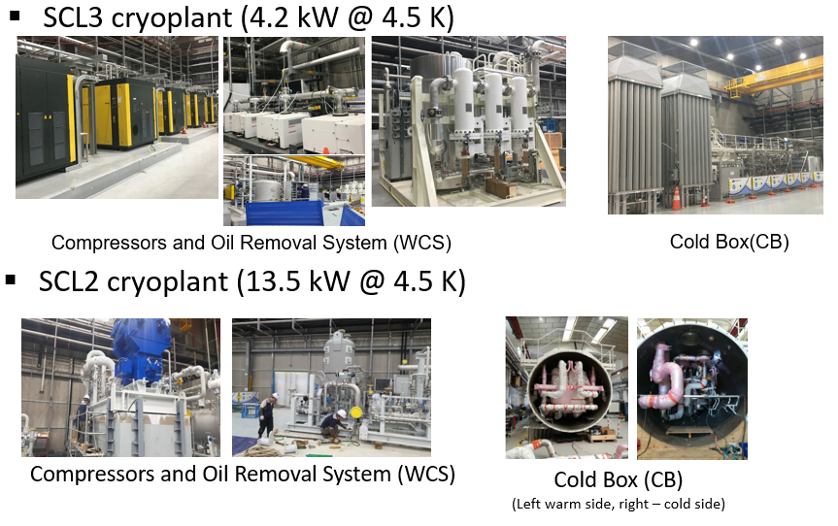
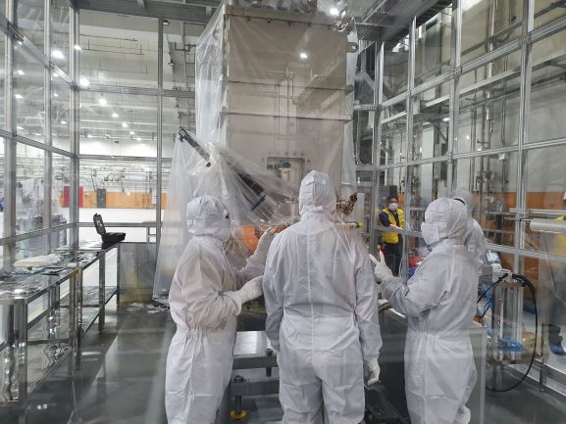
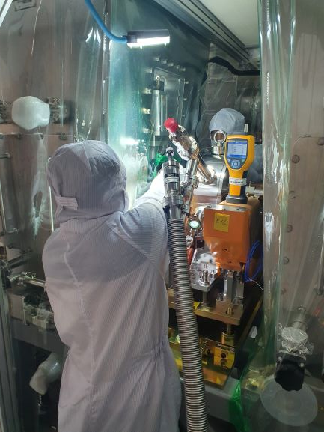
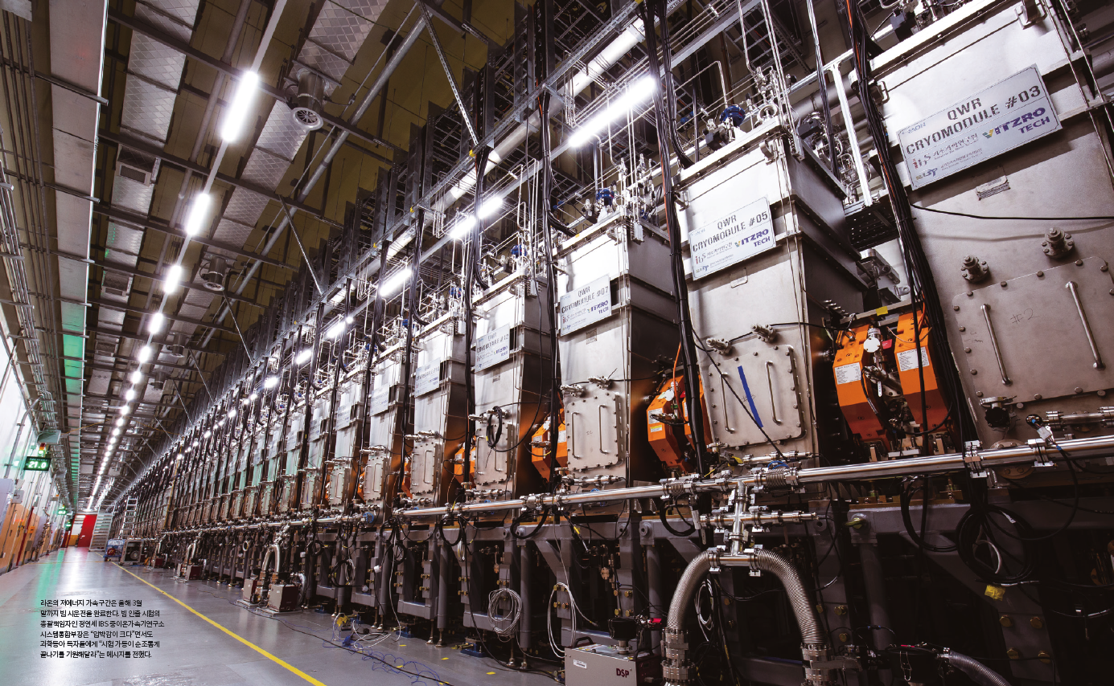
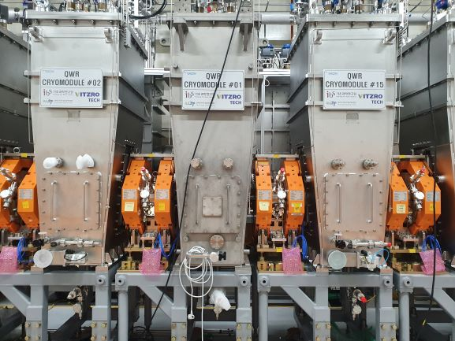
Accelerator Systems
Low Energy Superconducting Linac (SCL3)
Beam commissioning started in Oct, 2022
Cryomodule(CM) & Warm section is assembled in the clean booth at tunnel
Total Particle counts < 30 counts / 10min (size > 0.5um)
SSPA(60kW*2EA)
CM
CM
CM
Warm section
SCL3
5

Slide 6
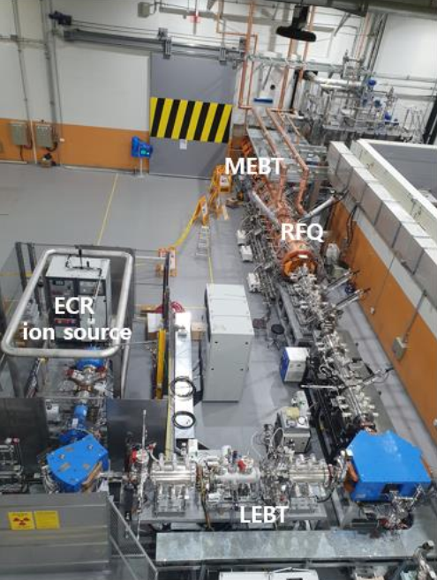
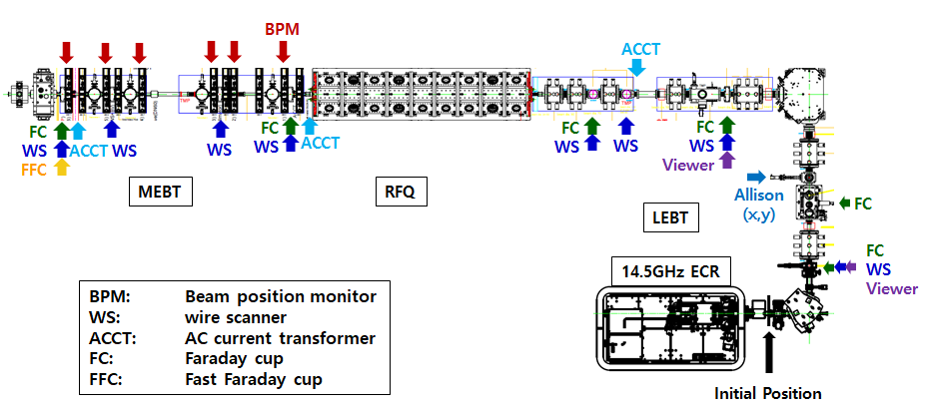
The RAON Injector
- RAON injector: 14.5 GHz ECR IS (10keV/u), LEBT (charge selection, matching),
RFQ (507 keV/u, 98% transmission) , MEBT (matching)
- Injector beam commissioning:
Ion | Argon | Neon | Oxygen | Helium | Proton
A (Q) | 40 (8, 9, 11) | 20 (4) | 16 (6) | 4 (2) | 1(1)
Current [μA] | 50, 30, 50 | 40 | 40 | 50 | 50 ~ 160
[ RAON injector ]
[ Beam Diagnostics in RAON injector ]

Slide 7
Beam Commissioning
Measurements for commissioning
Emittance (X and Y) : Allison scanners, wirescanners, quad scan methods
Cavity RF set-point (phase scan, BPM)
Beam energy (phase scan, TOF with BPMs)
Beam current, transmission (ACCT, FC)
Orbit correction (BPM / Wirescanner & dipole steerer)
Beam transverse profile (wirescanner)
Beam longitudinal profiles (Fast Faraday Cup)
Transverse matching (wirescanner)
Physics applications for commissioning
BIPAM (Beam Input Parameters And Matching)
CAPS (Cavity Amplitude and Phase Scan)
Orbit correction application
Emittance data analysis & wirescanner data analysis
7

Slide 8
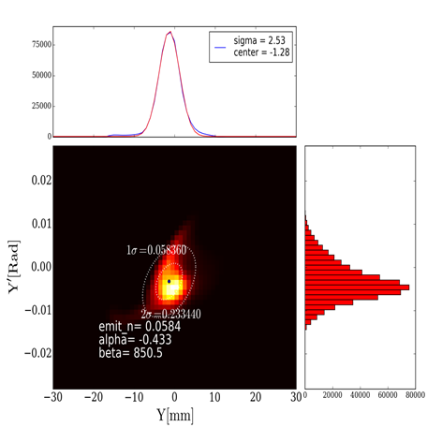
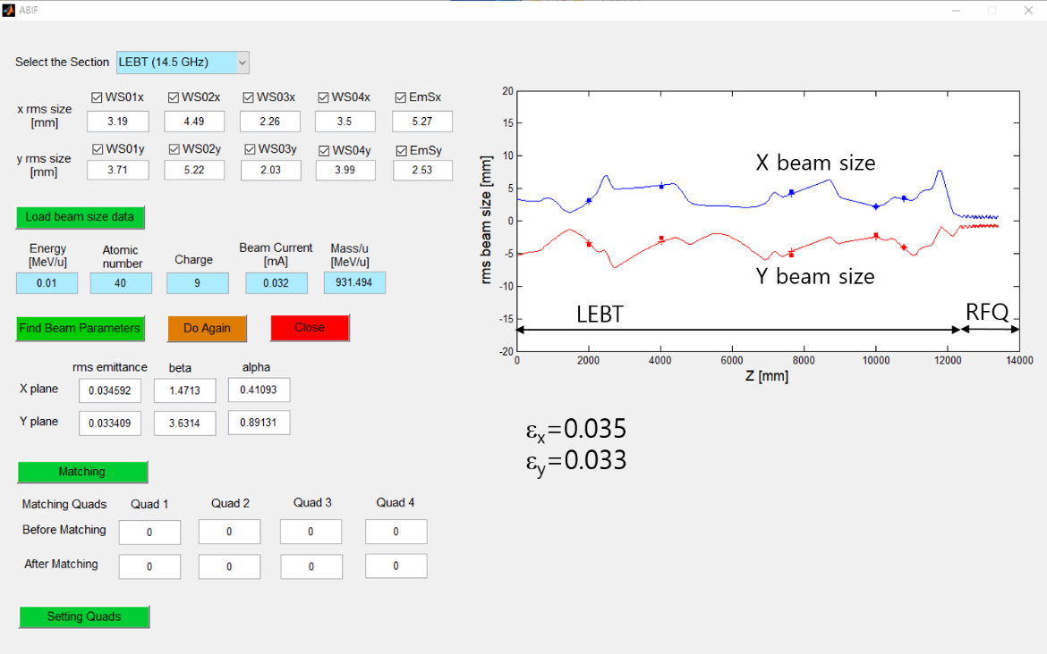
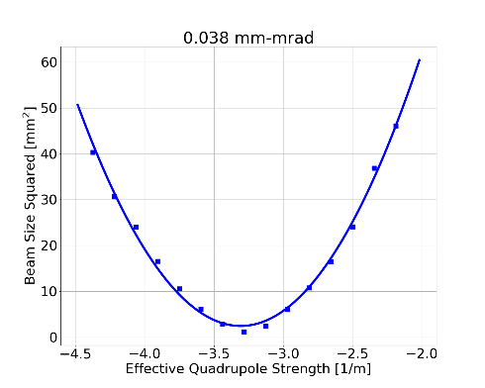
LEBT beam parameter measurements
Beam parameter measurement (Allison scanners, wirescanners)
- using emittance data or beam sizes of wirescanners
controlling beam optics
Emittance measurement (Allison scanner, BIPAM, quad scan)
Beams: Ar⁹⁺, Ar⁸⁺, O⁶⁺, Ne⁴⁺, He²⁺, proton
Beam emittance
(Allison scanner)
BIPAM: beam emittance & parameters
Quad scan
(beam emittance)
emittance comparison
 | X | Y
Allison | 0.048 | 0.067
Quad Scan | 0.041 | 0.038

Slide 9
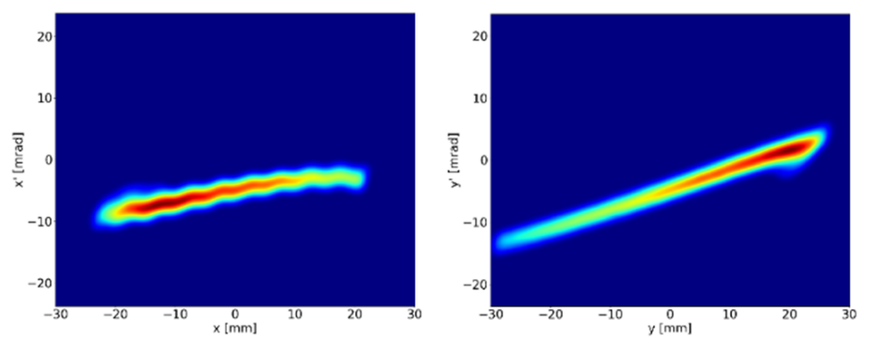
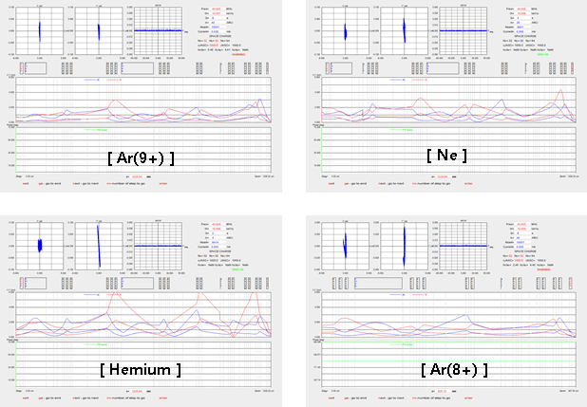
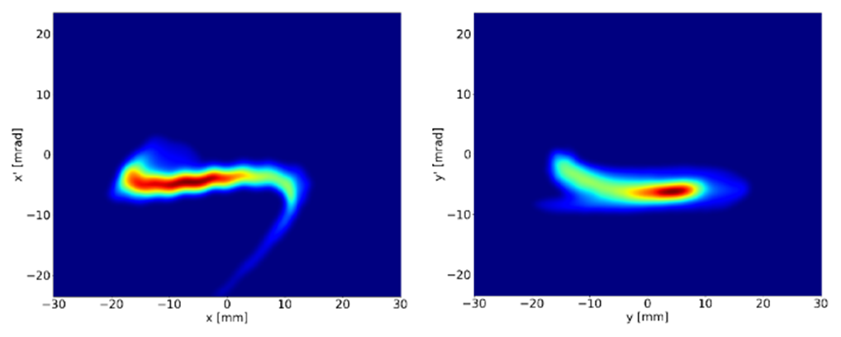
LEBT beam measurements for various beams
- By using the Allison data and wirescanner data, we established beam matching to RFQ.
- Beam dynamics: using TRACK or DYNAC codes
Initial result of Allison scanner Ne4+
Allison result after adjusting quadrupoles
for Ne4+
TRACK results after beam matching to RFQ

Slide 10
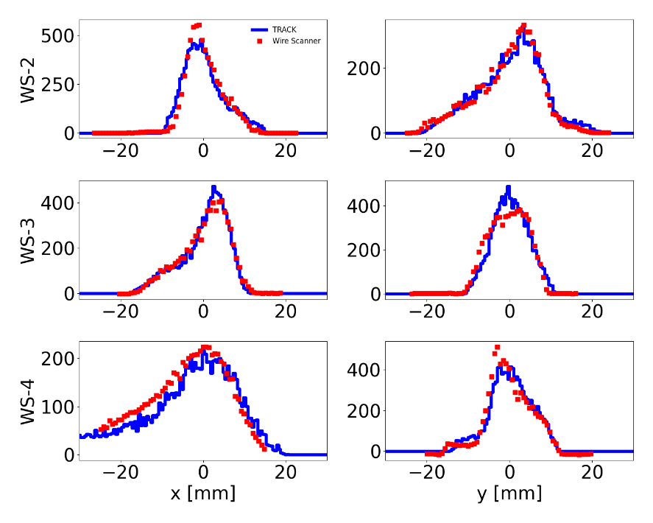
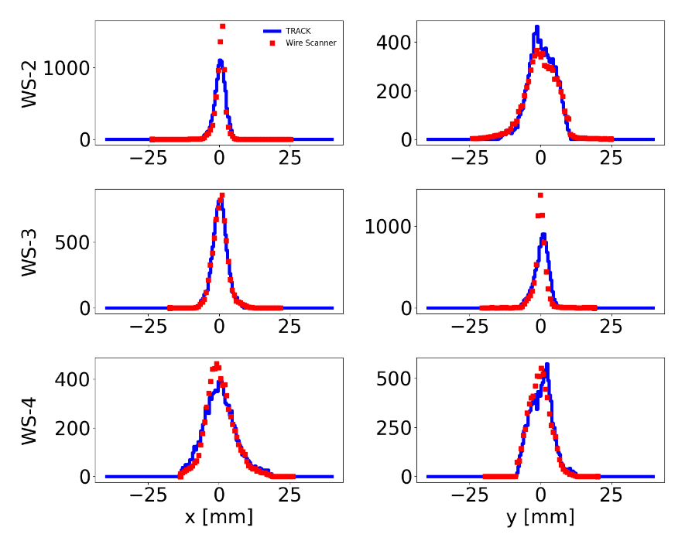
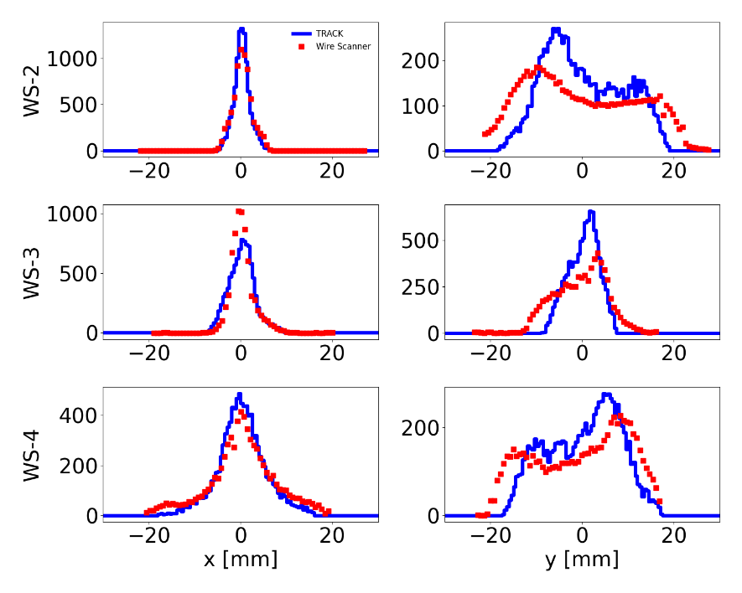
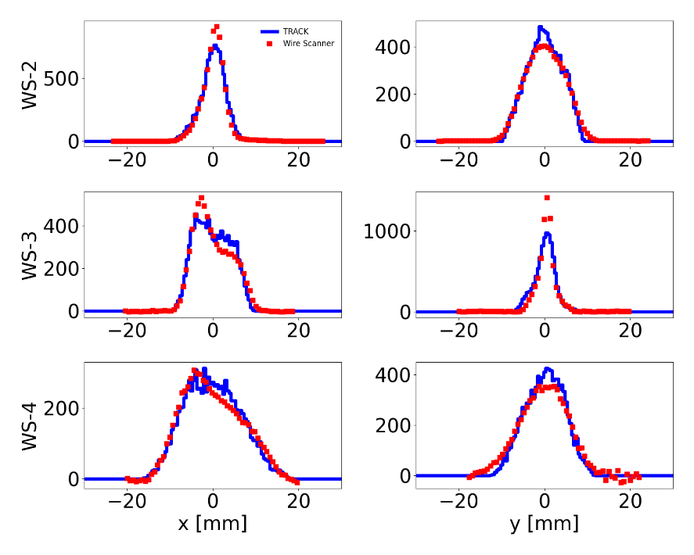
Wire-scanner and TRACK in LEBT for various beams
- We compared WS data with TRACK simulation in LEBT
* TRACK input: calculated from Allison data
* In general, TRACK simulations and WS data are in good agreement
with each other.
J.H. Jang
He2+
Ar9+
Ne4+
Ar8+

Slide 11
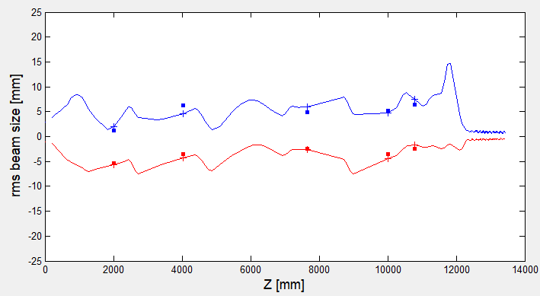
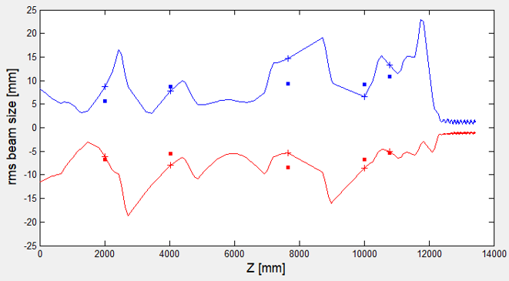
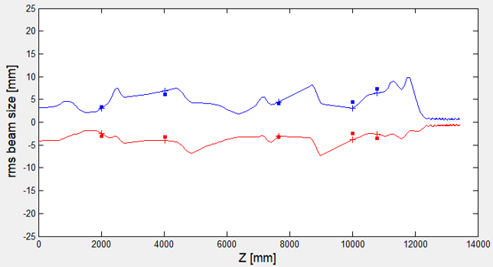
LEBT wire-scanner measurements for various beams
O6+ 48uA
injector transmission: 90%
H+ 160uA
LEBT transmission: 75%
X beam size
Y beam size
LEBT
RFQ
LEBT
RFQ
Ar8+ 50uA
injector transmission: 95%
Beam parameters are measured using BIPAM for various beams.
Beam optics is controlled with measured beam parameters.
Matching can be performed.
LEBT
RFQ
11

Slide 12
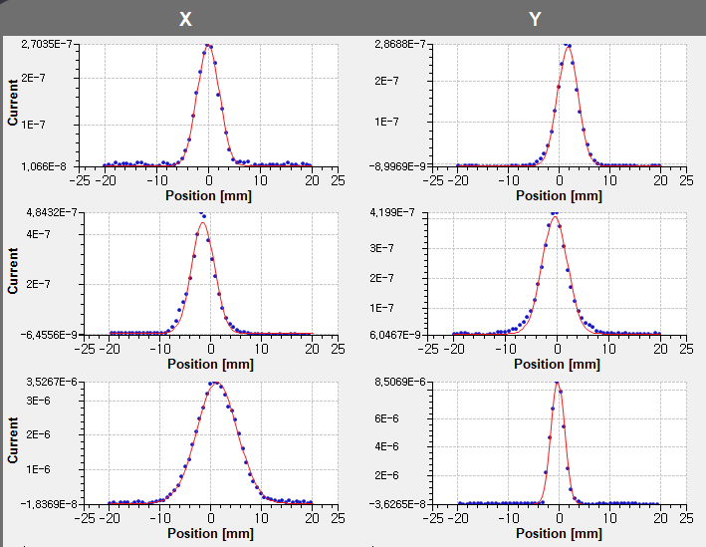
Matching to RFQ
MEBT wirescanners
Matching Ar⁸⁺ beam to RFQ improves beam quality in MEBT.
Beam profiles are almost Gaussian.
12

Slide 13
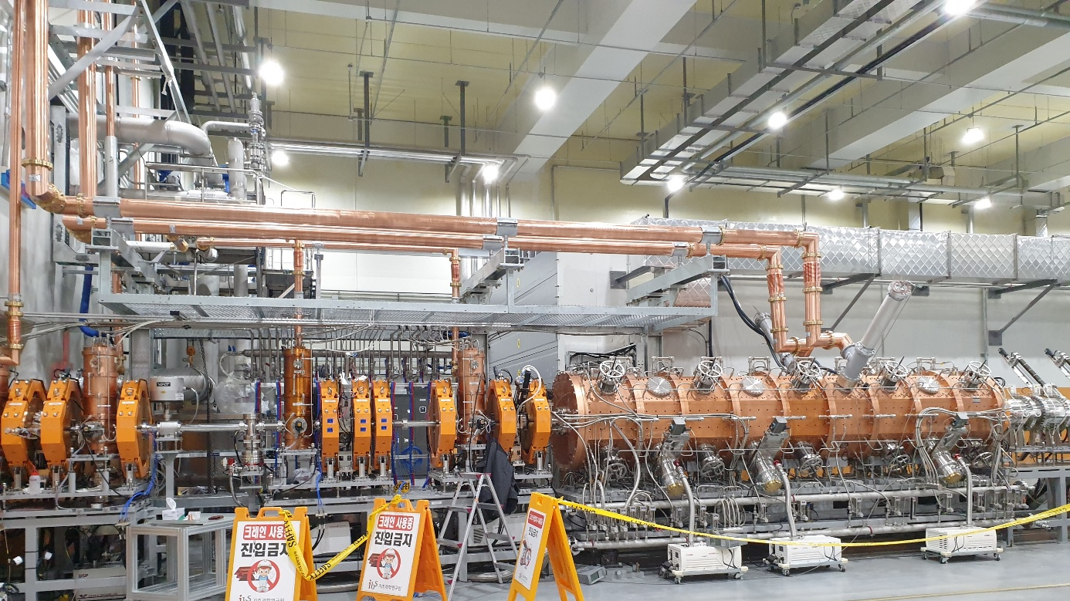
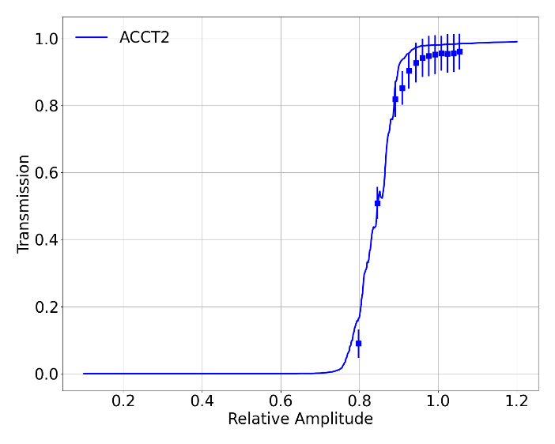
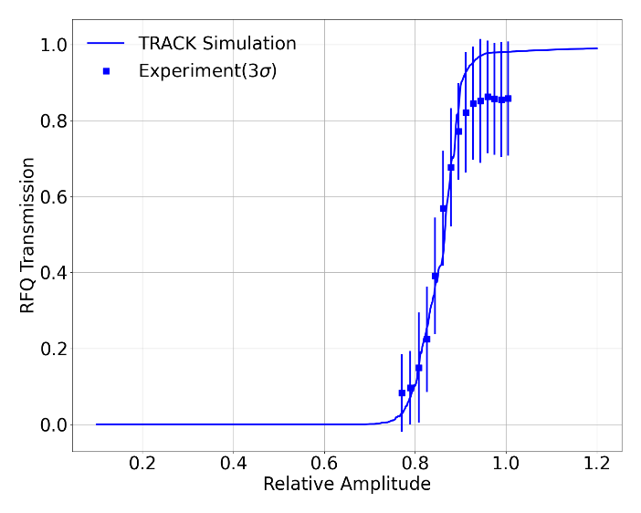
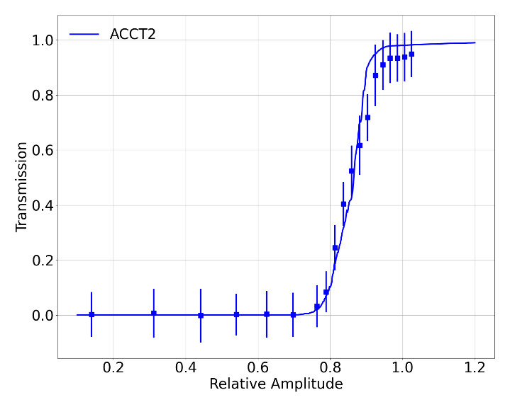
RFQ RF set-point
- RFQ transmission: (ACCT in LEBT and ACCT in MEBT)
* RFQ transmission is larger than 90%.
* We found low RFQ transmission for Ne beams
⇒ We can improve it by using slit in LEBT
 | Ar9+ | Ar8+ | Ne4+
Transmission | 93.4% | 95.4% | 85.7%
Set value | 51.5 kW | 62.9 kW | 67.4 kW
MEBT
RFQ
RFQ set-point for Ar9+
RFQ set-point for Ar8+
RFQ set-point for Ne4+

Slide 14
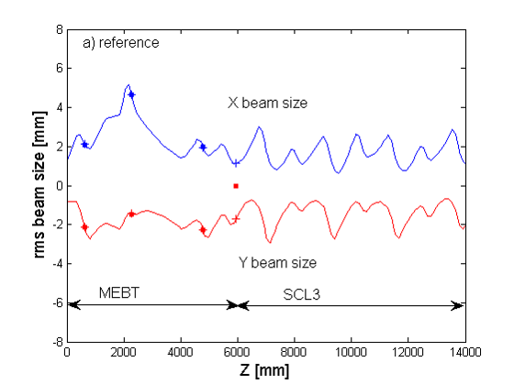
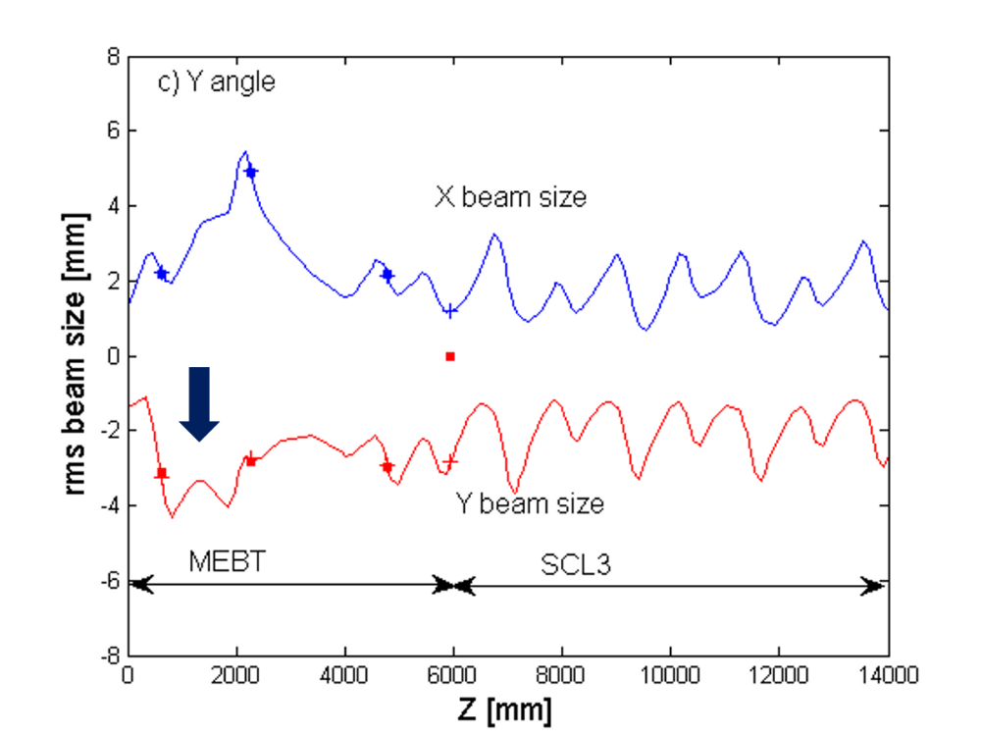
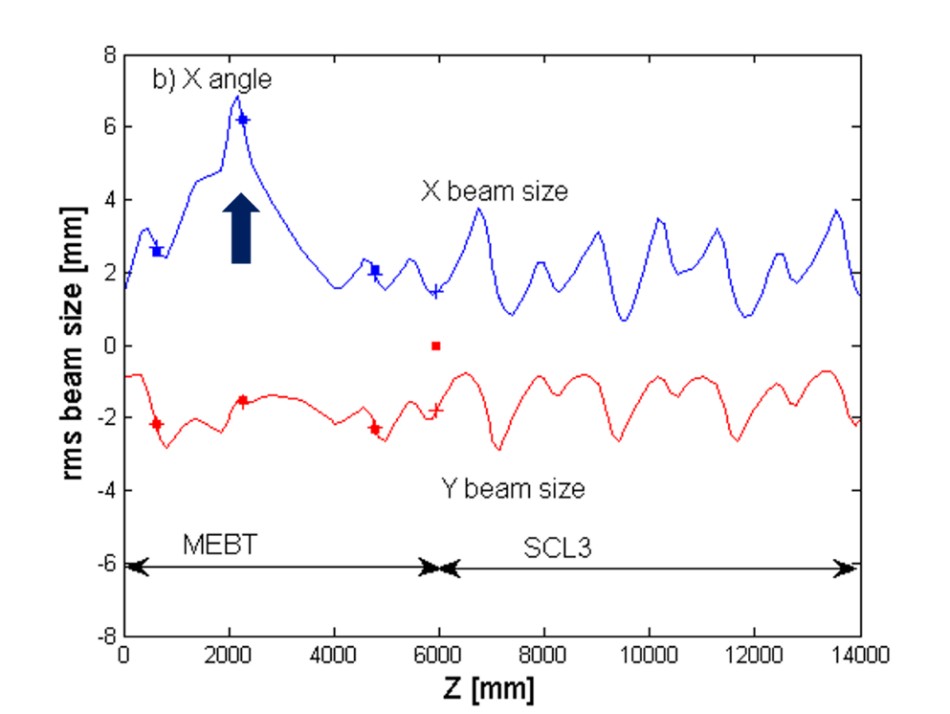
Off-axis injection affects RFQ output beam
reference
ε_{x}=0.086 mm-mrad
ε_{y}=0.064 mm-mrad
X kick
ε_{x}=0.114 mm-mrad
ε_{y}=0.068 mm-mrad
ε_{x}=0.098 mm-mrad
ε_{y}=0.146 mm-mrad
Y kick
On-axis injection to the RFQ is crucial: Off-axis injection increases output beam rms emittances and beam tails.
Jeon et al, NIM A 1052, 168250 (2023)
14

Slide 15
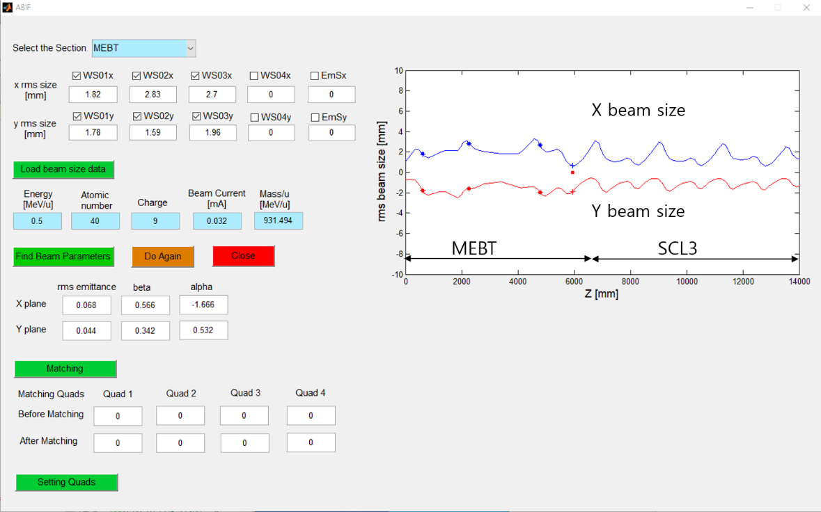
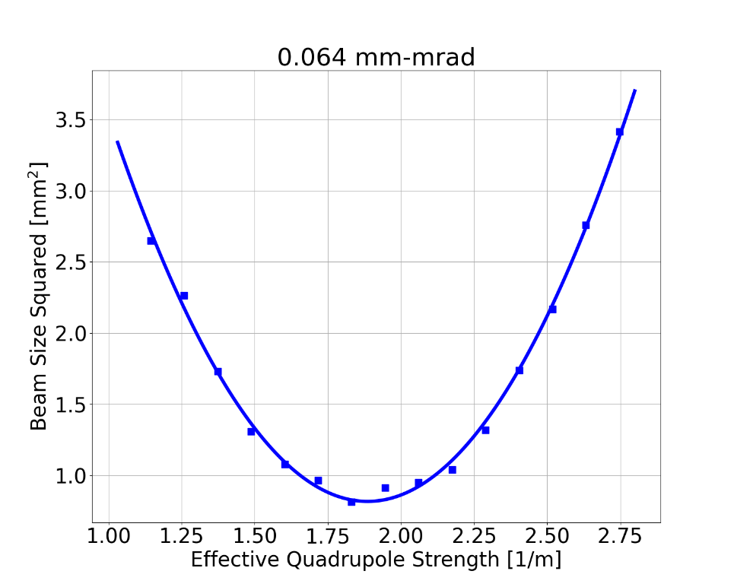
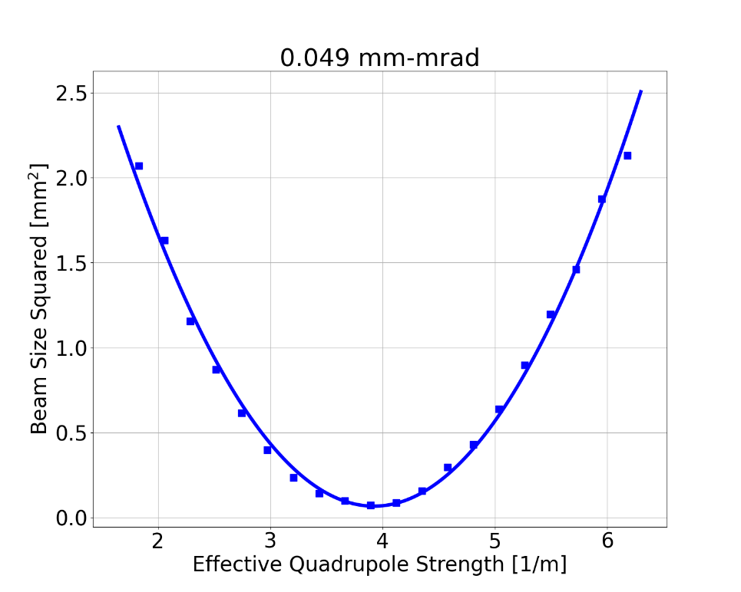
MEBT beam emittance
BIPAM
WS data
MEBT beam parameter measurements:
using wirescanner data
measure the initial beam emittances & parameters
matching to SCL3
BIPAM method and quad scan show consistent results.
quad scan technique takes rather long time
BIPAM requires one scan per wirescanners
Quad scan
emittance comparison
 | ε_{x} _{mm-mrad} | ε_{y} _{mm-mrad}
BIPAM | 0.068 | 0.044
Quad Scan | 0.064 | 0.049
X plane
Y plane

Slide 16
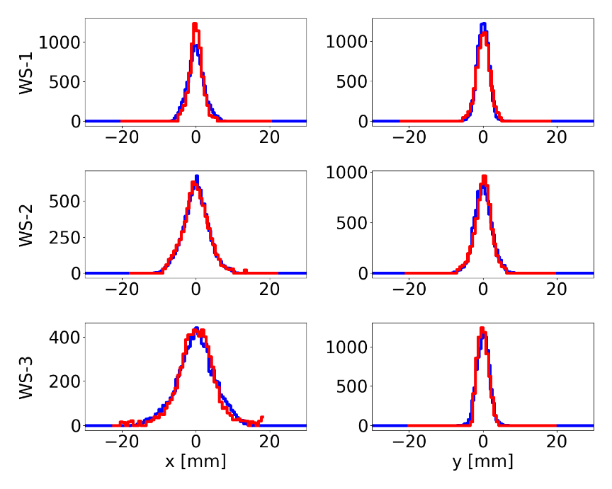
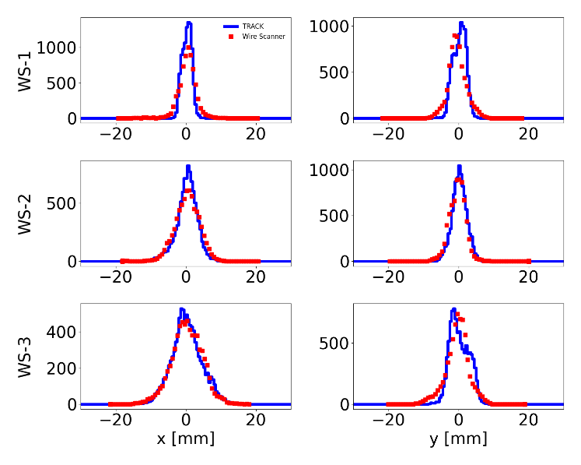
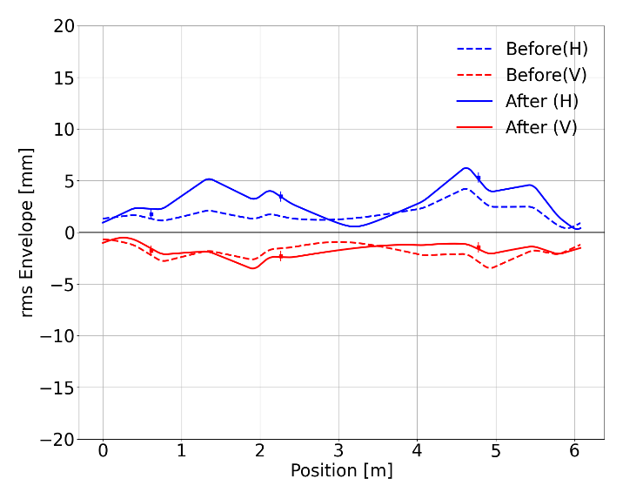
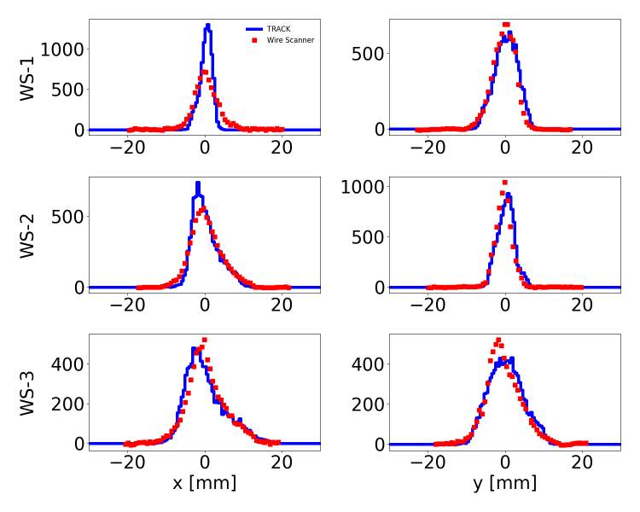
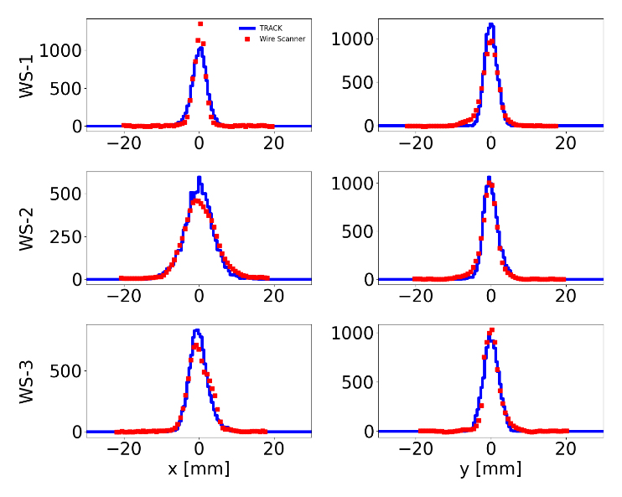
MEBT Beam profile Exp. vs Simulation
J.H. Jang
- Adjust RFQ output beam parameters
by using WS results in MEBT.
- Compare TRACK simulation and 3 WS data
* Different results between TRACK simulation
and WS data ⇒ Adjust RFQ output beam
Ar9+ in MEBT
Ne4+ in MEBT
rms beam size through MEBT
He2+ in MEBT
Ar8+ in MEBT

Slide 17
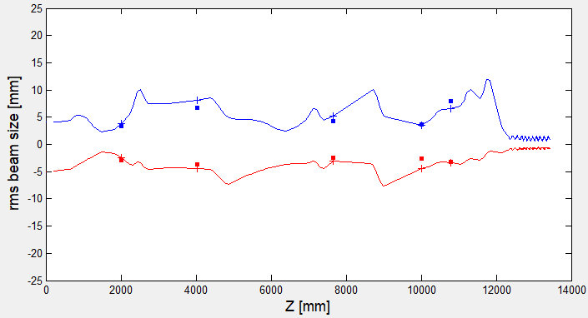
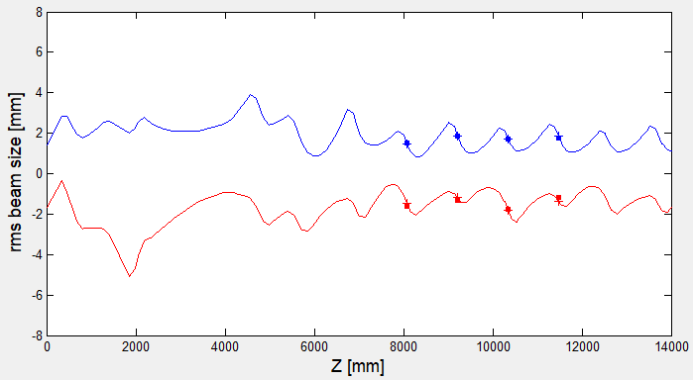
Ar8+ beam in Injector and SCL3
Ar8+ 45uA
injector transmission: 95%
X beam size
X beam size
Y beam size
Y beam size
LEBT
RFQ
MEBT
SCL3(QWR)
ε_{x}=0.059 mm-mrad
ε_{y}=0.033 mm-mrad
(BIPAM)
ε_{x}=0.091 mm-mrad
ε_{y}=0.063 mm-mrad
(BIPAM)
17

Slide 18
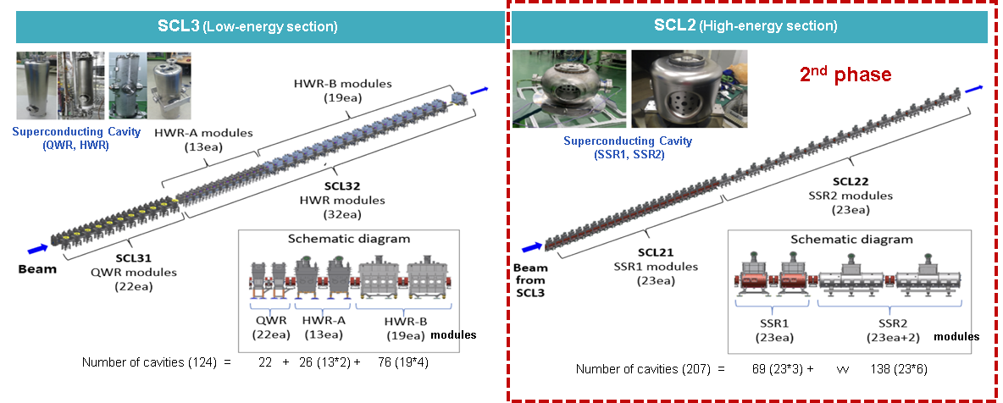
RAON Superconducting Linac
- RAON superconducting linac: SCL3(low energy), SCL2(high energy, 2nd phase)
- Low energy superconducting linac (SCL3):
* 2 types of cavities: QWR (4K), HWR (2K)
* Normal conducting quadrupole doublet for transverse focusing
* Large aperture diameter for small beam loss: 40 mm

Slide 19
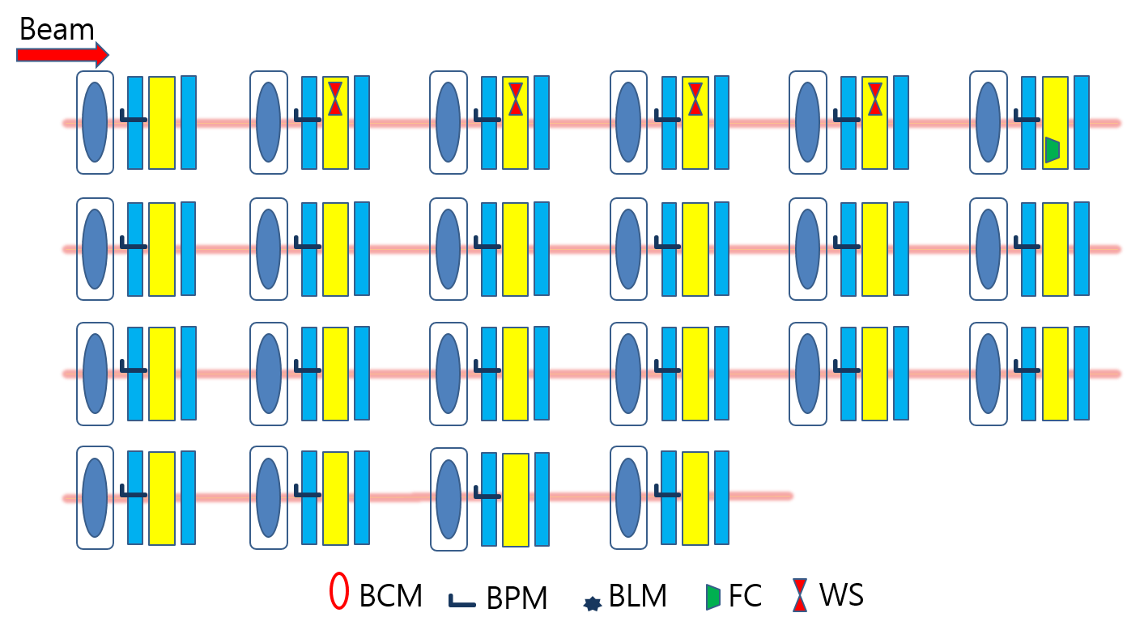
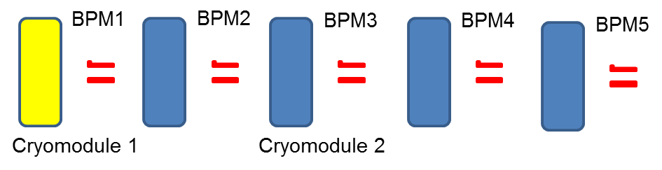
SCL3 Diagnostics and Phase Scan
cryomodule
quadrupole
beam box
For RF set-point, phase scan technique is used to set the RF set-point.
19

Slide 20
Beam Commissioning of SCL3
First Beam commissioning with ⁴⁰Ar⁺⁹ beam: 1Hz, 100 μsec
- Sep. 2022: Start cool-down
- Oct. 2022: Cool down to 4.5K finished
- Oct. 2022: Beam commissioning with initial 5 cavities of QWR finished
- Dec. 2022: QWR beam commissioning finished
- Jan. 2023: Cool down to 2K finished
- May 2023: SCL3 beam commissioning finished
* 10 cavities (out of 124) were not used due to control issues, cold leak, etc.
* Accelerating fields: QWR < 5 MV/m (design 6.1 MV/m), HWR < 4 MV/m (design 6.6 MV/m)
- June 2023: KoBRA beam test (May 30 ~ June 2)
Second Beam commissioning with ⁴⁰Ar⁺⁸ beam: 1Hz, 100 μsec
- March 2024: Cooled down to 2K
- April 29, 2024: SCL3 beam commissioning started
* 8 cavities are excluded for similar reasons
* Accelerating fields: QWR < 5 MV/m (design 6.1 MV/m), HWR < 5 MV/m (design 6.6 MV/m)

Slide 21
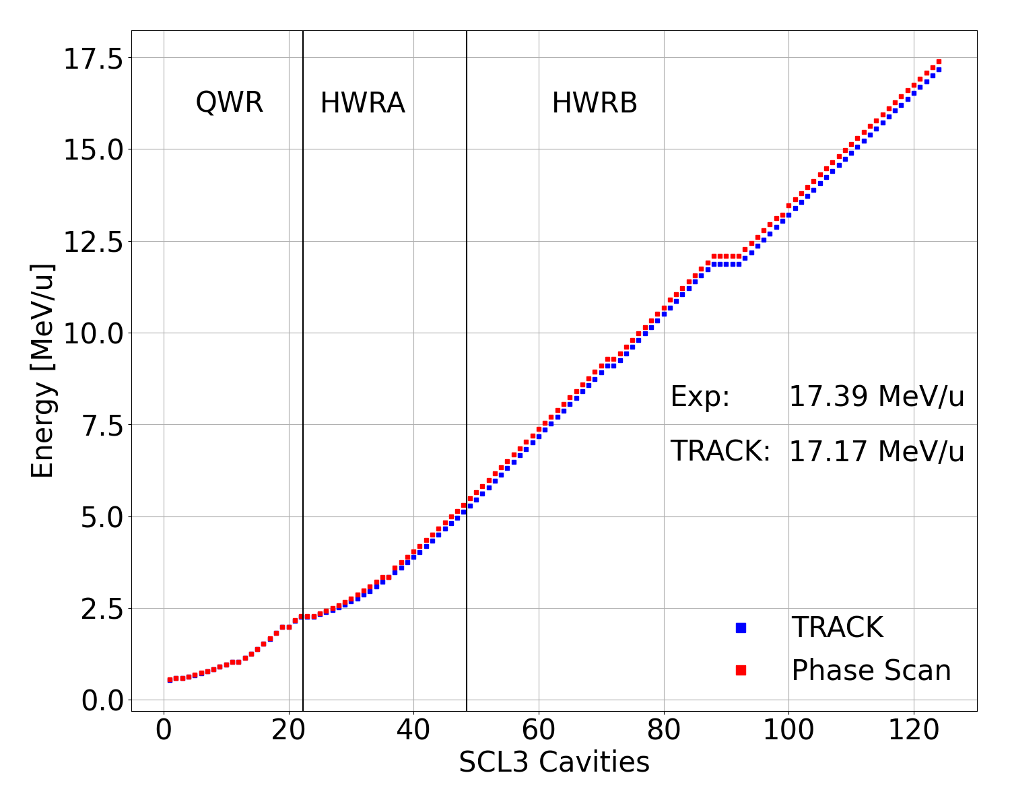
2023 Ar9+ beam commissioning
3 QWR cavities were turned off.
7 HWR cavities were turned off.
RF set-points of near-by cavities were adjusted to minimize beam loss.
Cavities were set using phase scan:
beam energy: 17.39 MeV/u
Beam transmission: 64%
Beam phase jitters were big in 2023.
21

Slide 22
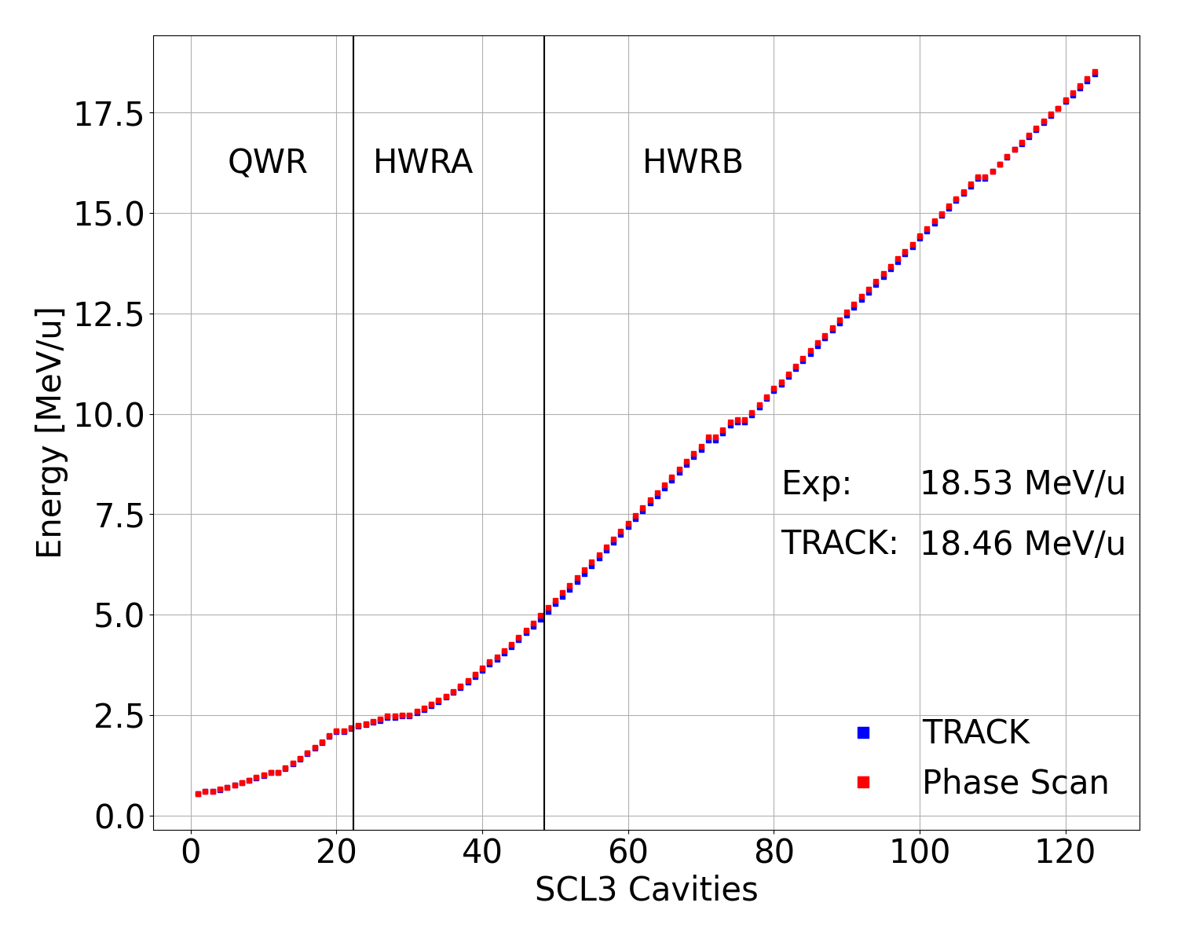
2024 Ar8+ beam commissioning
3 QWR cavities were turned off.
5 HWR cavities were turned off.
RF set-points of near-by cavities were adjusted to minimize beam loss.
Cavities were set using phase scan:
beam energy: 18.53 MeV/u
Beam transmission improved: 93%.
Energy discrepancy observed (phase scan vs dipole) → BPM calibration is needed and check against dipole will be performed.
22

Slide 23
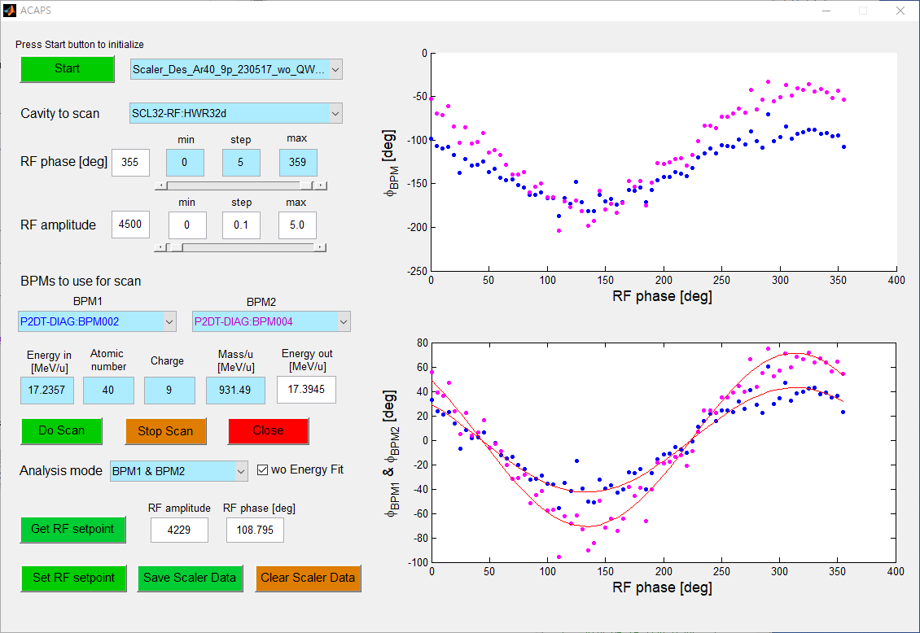
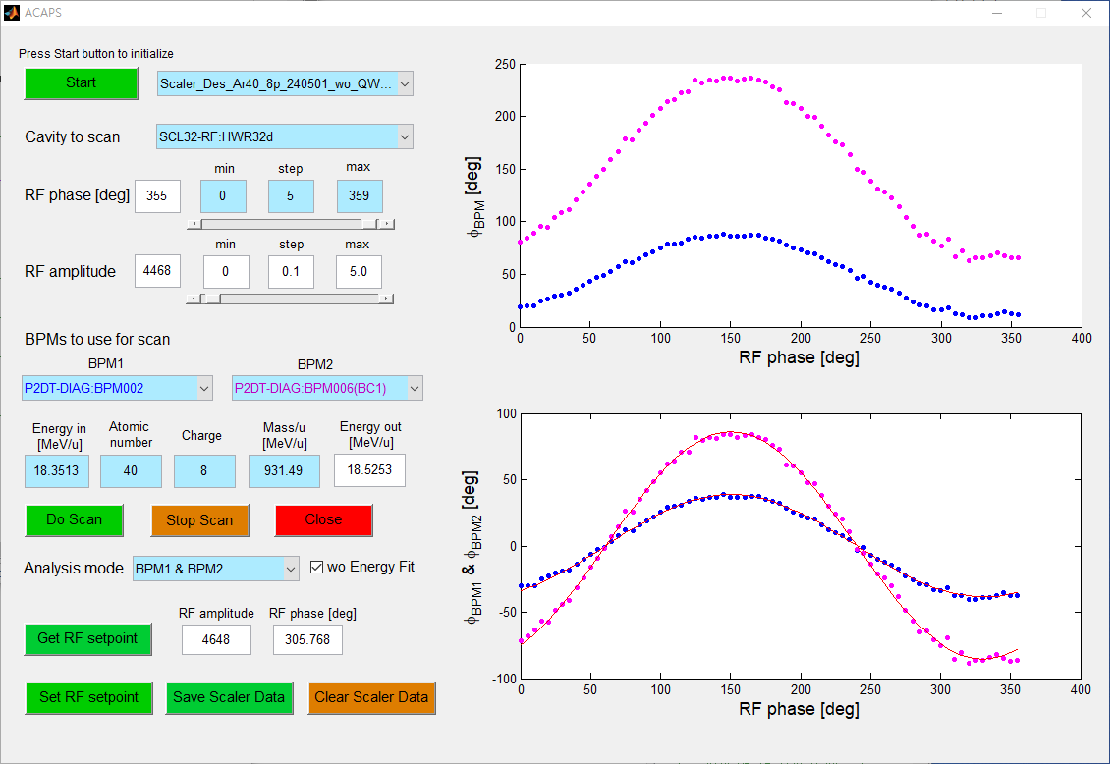
BPM phase jitters improved
Last HWR cavity (2023)
Last HWR cavity (2024)
Cavity RF set-points were obtained using phase scan technique (2 BPMs).
In 2024 BPM phase jitters were reduced compared with the 2023 run.
Beam phase jitter is still large and tighter LLRF control is necessary.
23

Slide 24

Beam Loss and RF control in SCL3
Beam transmission through SCL3:
QWR orbit correction reduced beam loss during HWR commissioning.
Beam transmission: 64% in 2023 ⇒ 93% in 2024.
RF control of SCL3 cavities continues only several minutes.
RF powers ⇒ coupler temperature rising ⇒ cavity frequency shift ⇒ slow tuners moves, but we lose RF control of some cavity. (It is why we use smaller amplitudes): Need to improve couplers and tuners
Beam transmission (2023)
Beam transmission (2024)

Slide 25

Beam Loss & Longitudinal Acceptance
- Longitudinal Acceptance decrease induces beam loss.
- Estimated beam loss through the Error Analysis.
- To increase beam transmission, we need to turn on more cavities.
Ji-Ho Jang
[ Longitudinal
Acceptance ]
[ Beam Loss
(Error Analysis) ]
[ All cavity ON ]
[ 8 cavities OFF ]
[ 8 OFF ⇒ QWR3 ON ]
[ 8 OFF ⇒ QWR3,12 ON ]
25

Slide 26


Stripped Ar+18 beam to the NDPS (neutron facility)
2024.06.12.
⁴⁰Ar 빔 (NDPS 표적 위치)
Preliminary
중성자 빔
감마선
26

Slide 27


First Rare Isotope Beam Acceleration
- RI beam (²⁵Na⁵⁺) acceleration through SCL3 (July 19, 2024)
* The beam is generated by the ISOL facility,
* Accelerated by the SCL3 and transported to the KoBRA.
* All plots in this page are provided by the experimental system team in IRIS.
[ Separation of ²⁵Na⁵⁺ beams from impurities and the measured value of the life-time ]

Slide 28
Summary
Superconducting linac (SCL3) beam commissioning has been conducted:
We have made significant progresses.
Beam commissioning with Ar⁹⁺ beam was in 2023.
Beam commissioning with Ar⁸⁺ beam conducted in 2024.
Beam was sent to KoBRA for user service and to NDPS.
Beam transmission improved from 64% (2023) to 93% (2024).
Beam phase jitter is reduced due to tighter LLRF control.
Injector beam commissioning has been conducted: Ar⁹⁺, Ar⁸⁺, O⁶⁺, Ne⁴⁺, He²⁺, proton beams.
Issues:
superconducting cavity stability issues.
HWR cavities run at 76%, QWR cavities at 82%.
BPM calibration is needed to do Time-of-Flight measurement.
Beam energy inconsistency between phase scans and dipole scans
28

Slide 29
Summary
Experiment systems commissioning & user service in 2024
Ar⁸⁺ beam to KoBRA for user service
Stripped Ar¹⁸⁺ beam to NDPS for experiment system commissioning
Na⁵⁺ Rare Isotope beam from the ISOL to KoBRA in 2024
RI beam is planned for user service in 2025:
High energy SCL2 development
R&D underway to prototype SSR1 and SSR2.
Timely completion of the R&D is crucial.
Thanks for your attention!!
29

Slide 30




Accelerator Systems
SRF Test Facility & Cavity Tests
SRF Test Facility: 3 Vert. Test pits (3 cavities per pit), 3 Hor. Test bunkers
Test all the RAON cavities: 22 QWR (82.25 MHz), 102 HWR (162.5 MHz) and SSR1,2 (325 MHz)
QWR
HWR
30
30

