Slide 1
ICABU’2024
26th International Conference on Accelerator and Beam Utilizations
Development of EPICS-based DAQ system for real-time data acquisition during beam and RF operation
2024.11.14
KOMAC, KAERI
YOUNG-GI SONG

Slide 2
Contents
Facility overview
  KOMAC, which provides 24-hour beam
Data Acquisition System
  DAQs we have used
Summary

Slide 3
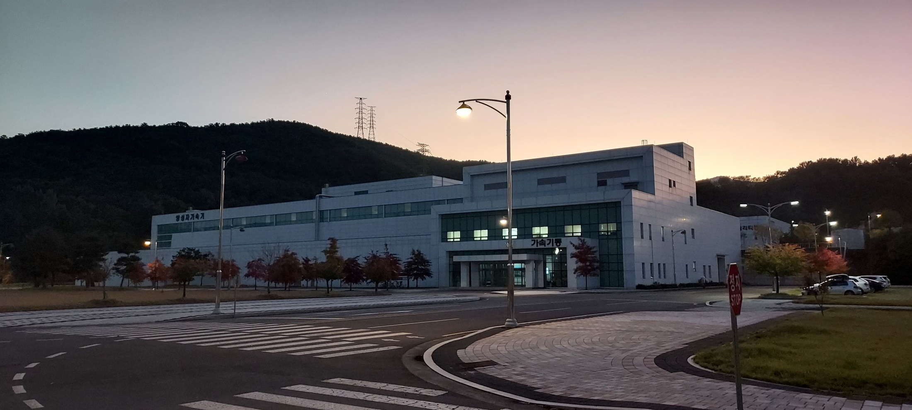
100MeV Linac and Beamline
Developed via Proton Engineering Frontier Project (2002.7~2012.12)
Linac commissioning at 2013
Started user beam services from July 22, 2013
Total 4 proton beamlines are under user service at 2024

Slide 4
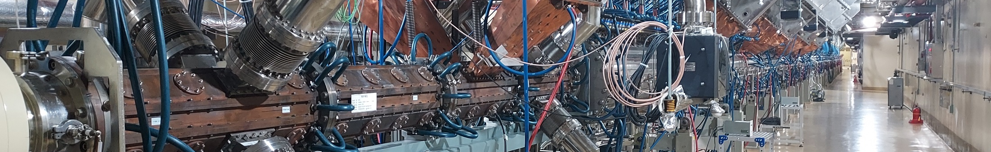
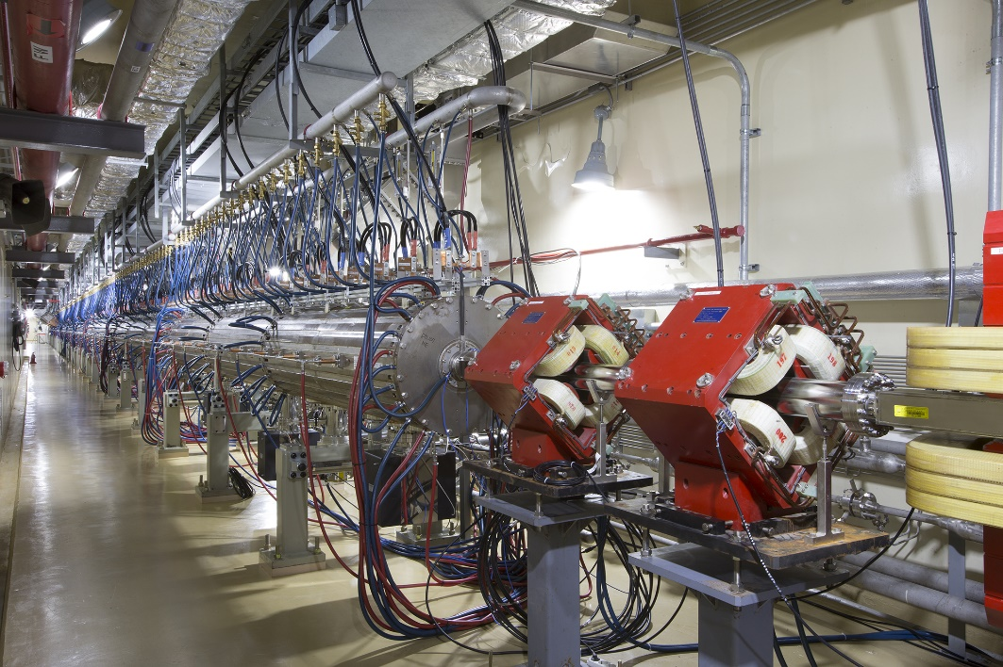
Linac
Features of KOMAC 100MeV linac
50-keV Injector (Ion source + LEBT) 3-MeV RFQ (4-vane type) 20 & 100-MeV DTL RF Frequency : 350 MHz Beam Extractions at 20 or 100 MeV 6 Beamlines for 20 MeV & 100 MeV
Output Energy (MeV) | 20 | 100
Max. Peak Beam Current (mA) | 1 ~ 20 | 1 ~ 20
Max. Beam Duty (%) | 24 | 8
Avg. Beam Current (mA) | 0.1 ~ 4.8 | 0.1 ~ 1.6
Pulse Length (ms) | 0.1 ~ 2 | 0.1 ~ 1.33
Max. Repetition Rate (Hz) | 120 | 60
Max. Avg. Beam Power (kW) | 96 | 160

Slide 5
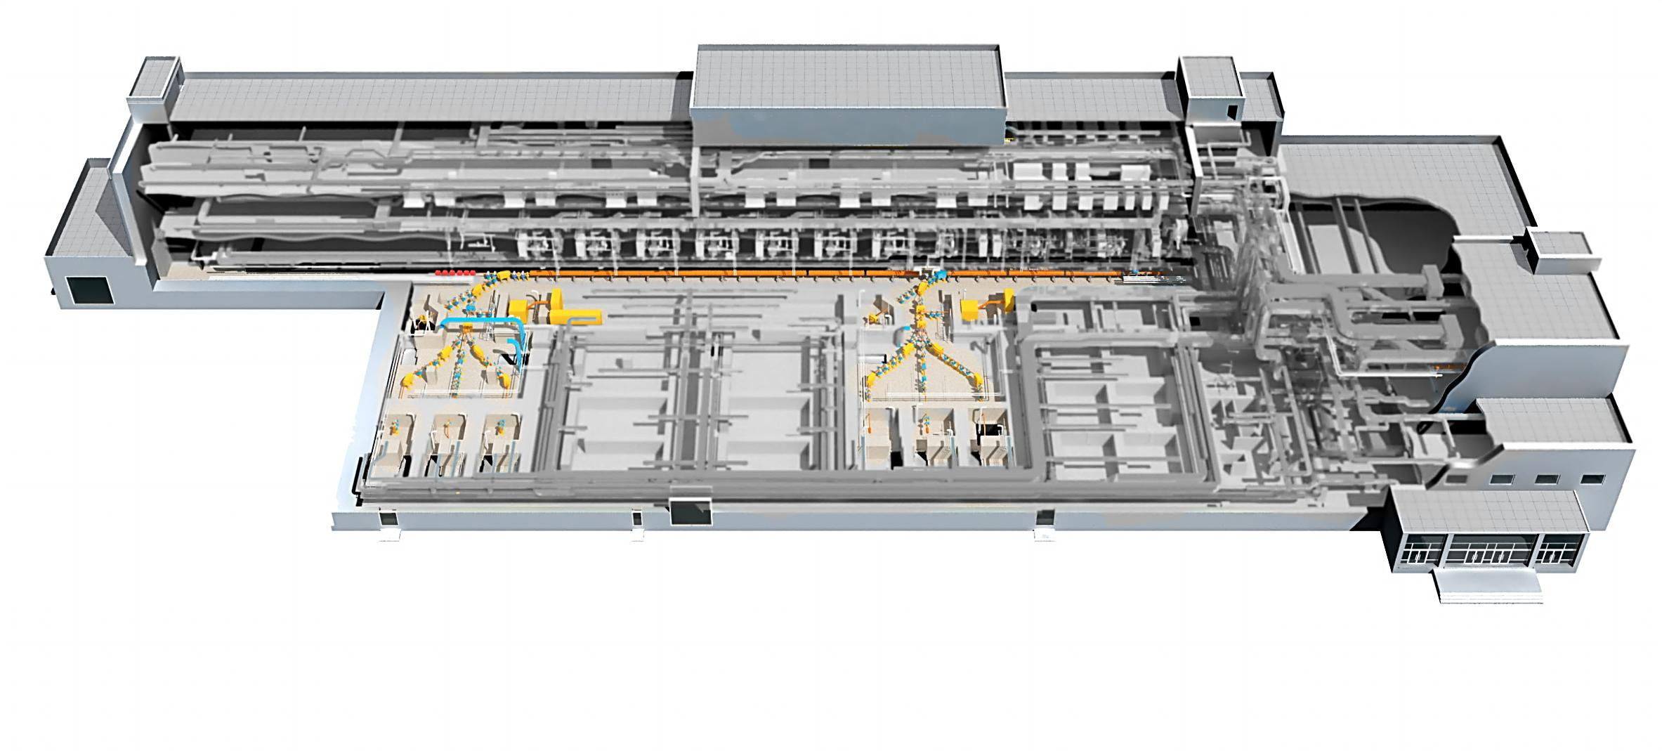
Beamlines
Neutron beamline
Linac
Ion Source
Test Beamline
RI production
Under operation
General purpose
Under operation
Low-flux
Under operation
General purpose
Under operation
Beamlines
Features and Utilization
General purpose beamline
(TR23, TR103)
Since July 2013
General purpose beamlines : 20/ 33~100 MeV proton beams, 10 kW @ 100 MeV
Applications : material / nano-science, nuclear physics, semiconductor etc
RI Beamline
(TR101)
RI production beamline : 33~100 MeV proton beams, 30 kW @ 100 MeV
Applications : Medical purpose RI production (Cu-67, Sr-82)
Preparing for operation
Low flux Beamline
(TR102)
Since Feb. 2018
Low flux beamline: 33~100 MeV proton beams
Flux 1x105 ~ 1x108/cm2 per pulse
Applications : Space radiation, Detector R&D, Bio etc.
Neutron Beamline
(Dump)
Neutron beamline: Spallation neutron beam using 100 MeV proton beams
Applications : Terrestrial radiation simulation test on semiconductors
Under pilot operation

Slide 6
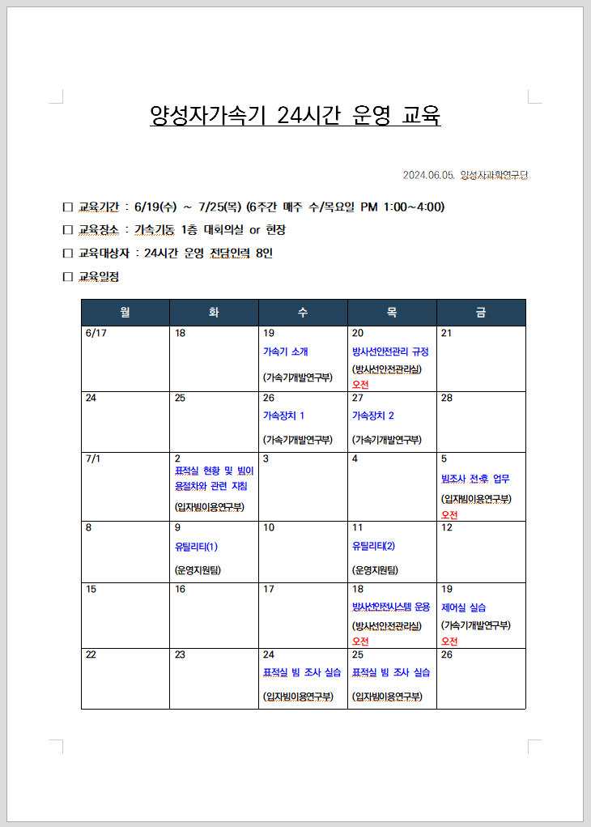
KOMAC, which provides 24-hour beam
Typical schedule (2013 ~ 2023)
Annual operation ( 52 Weeks)
28 weeks for beam service
7 weeks for Machine study
17 weeks for Maintenance
Beam service
Monday 13:00 ~ Friday 18:00, daily service
Operation shift (day shift)
1 for linac and 2 for beam line
operator training schedule
24-hour operation (2024)
Start 24-hour beam service in August
Shift work
2 shifts in four groups (2 people in 1 group)
1 for linac and 1 for beam line
Prepare 24-hour linac operation

Slide 7
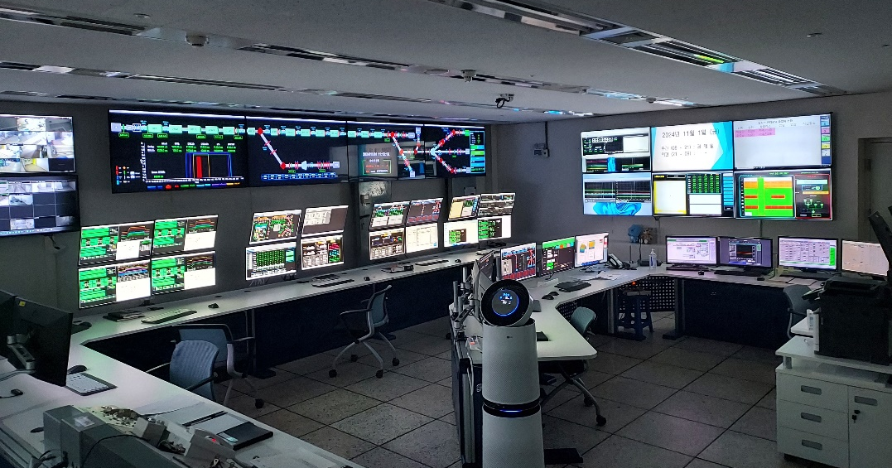
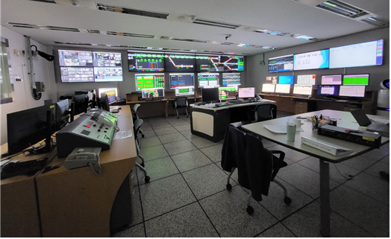
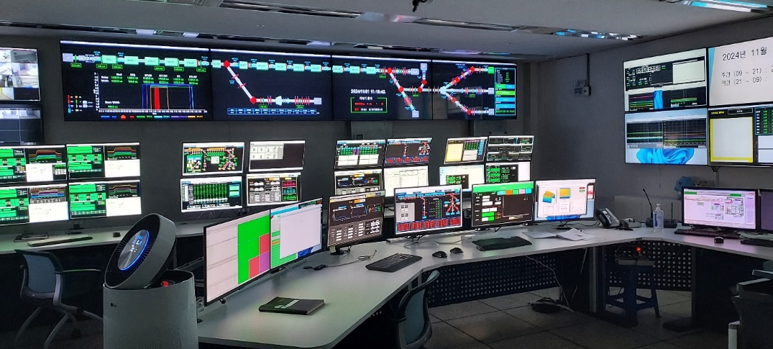
Rearrangement of control room
For 24-hour Linac operation
A well-equipped control room
Enhance the efficiency and safety of Linac operation
Ensure that experiments run smoothly and effectively
  User-friendly applications
  Auto startup environments
After
Before
operator
operator

Slide 8
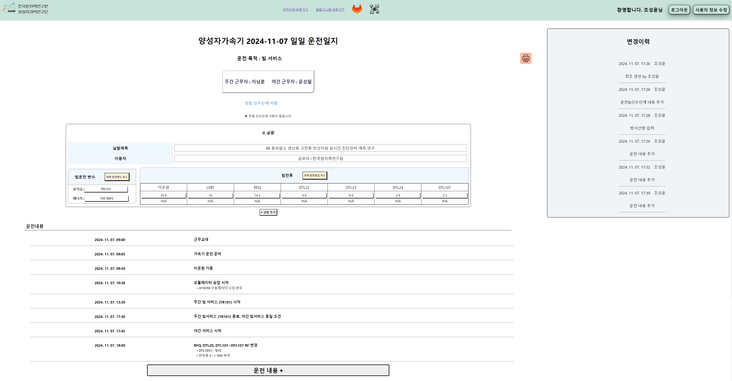
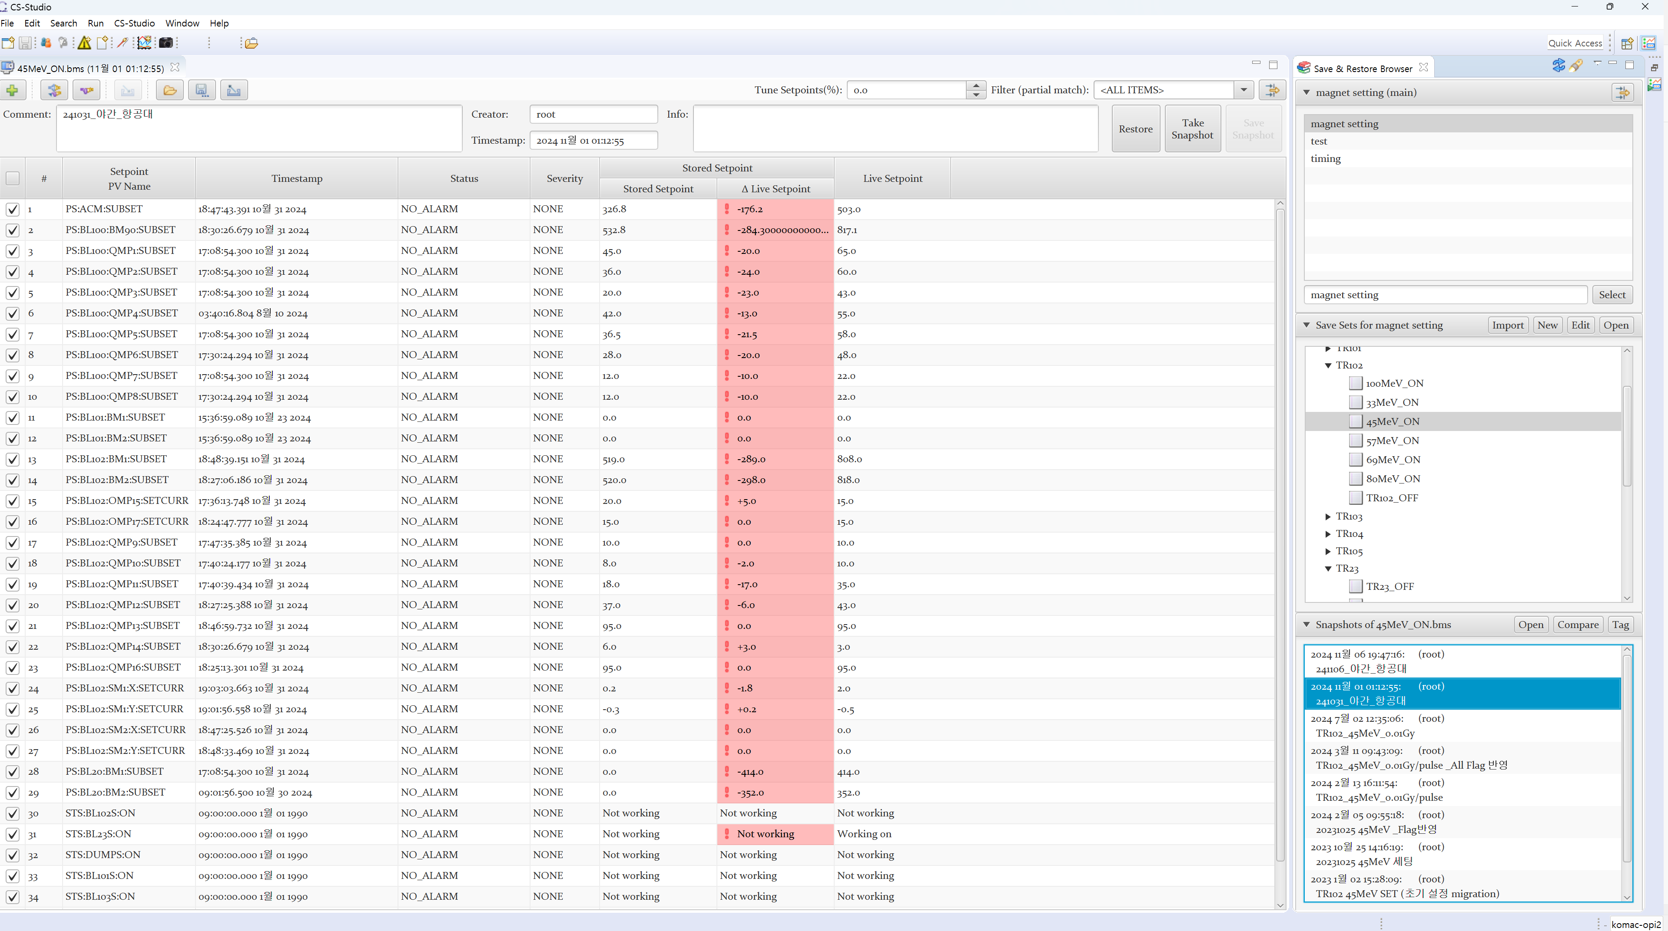
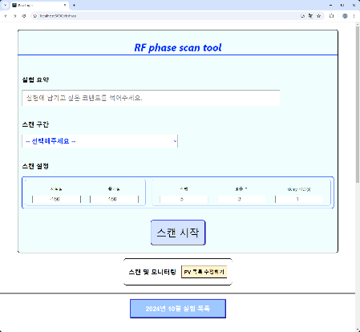
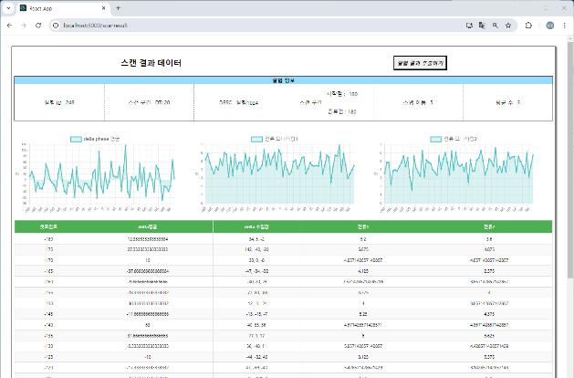
Operator-only application
For 24-hour Linac operation
Alarm log search
Develop operator’s applications
Scan tools for RF phase, Quad, LEBT
Save & restore for beam tuning
Logbook for daily operation log and event log
Search tool for alarm log and data statistics
Logbook
Save & restore
RF phase scan

Slide 9
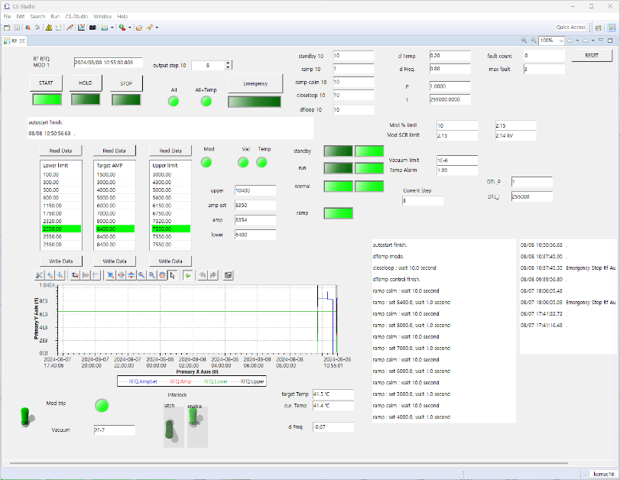
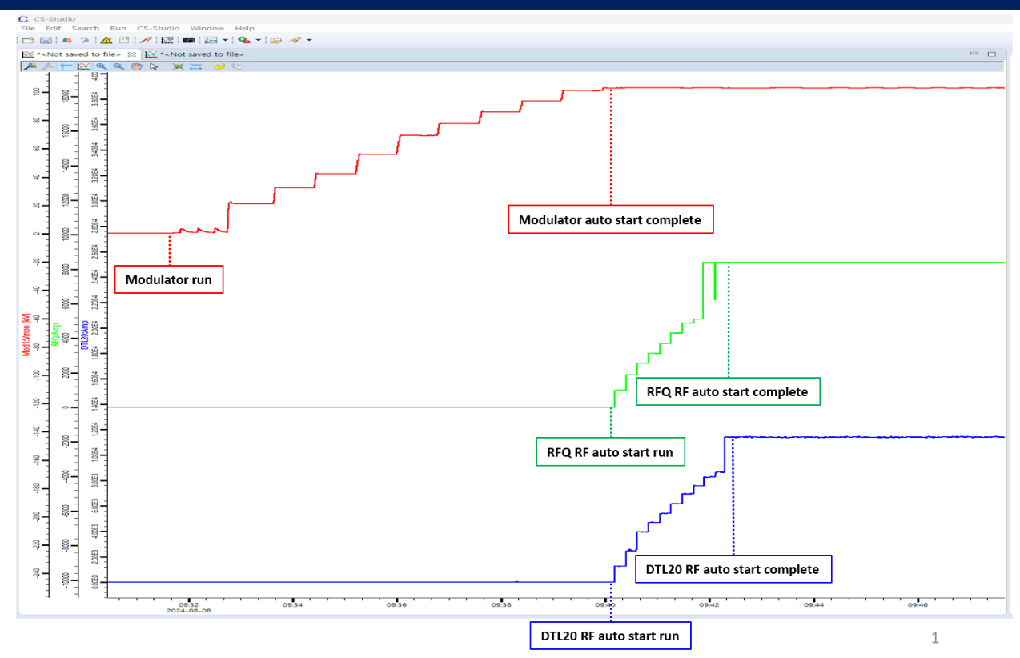
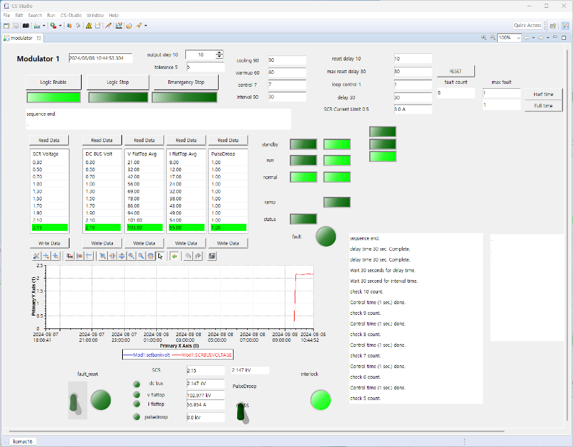
Auto startup
For 24-hour Linac operation
Reducing operator’s workload with auto recovery from machine trips
Developing automatic driving logic for klystron, modulator, and HPRF
Monitor the interlock signal of all equipment in real time
Start automatic operation of RF and modulator
Apply auto start system to all the HPRF system and in operation
HPRF auto start UI
Auto start in actual operation
HVCM auto start UI

Slide 10
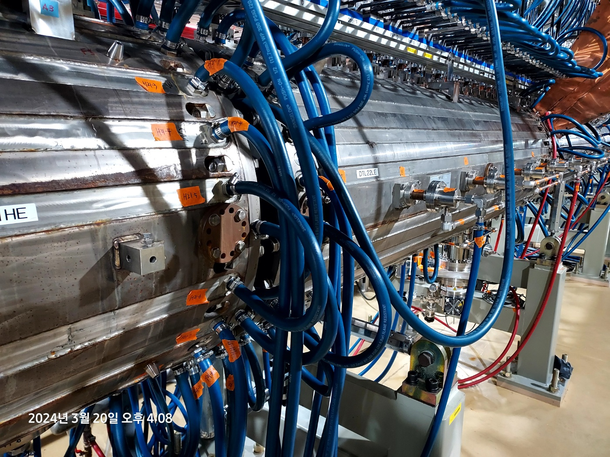
DAQ
Collect and analyze data from various sensors and detectors
BEAM
COOLING
POWER
HPRF
profile
voltage
VACUUM
phase
position
current
pressure
current
temperature
levels
amplitude
phase
KOMAC DAQ
Key functions of a DAQ system include signal conditioning, analog-to-digital conversion (ADC), data processing, and feedback or control

Slide 11
DAQs in KOMAC
Data acquisition system classified as slow DAQ and fast DAQ
Slow DAQ
long-term monitoring and control, logging data over hours or even years
Fast DAQ
precise, high-speed data acquisition needed in feedback loops and control system
Feature | Slow DAQ | Fast DAQ
Sampling Rate | Low (Hz to kHz) | High (MHz to GHz)
Data Type | Slowly changing parameters | Rapidly changing signals
Latency | High latency | Low latency, real-time capability
Usage | Long-term monitoring | Real-time feedback and control
Example Data | Temperature, vacuum, power status | Beam position, RF phase, beam losses
Hardware | Basic ADCs, lower bandwidth | High-speed ADCs, FPGAs, DSPs

Slide 12
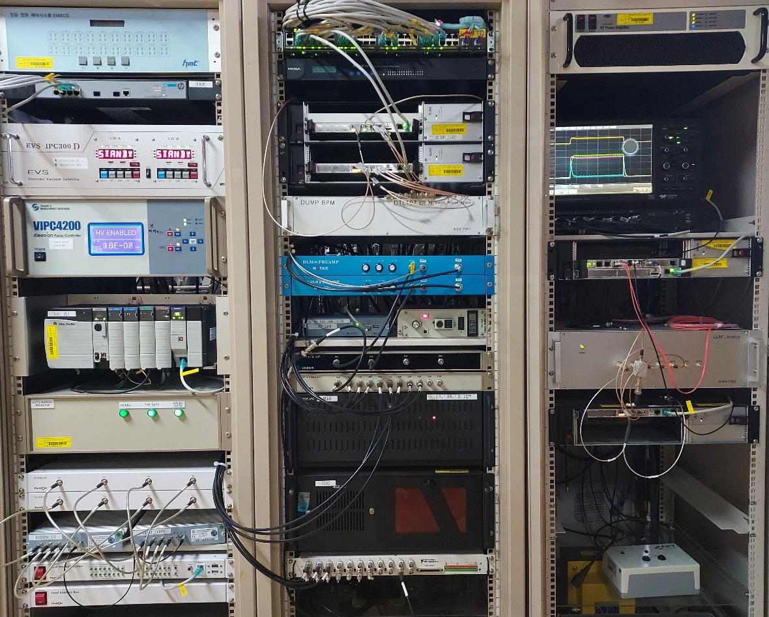
Types of DAQ, we’ve used
Data acquisition systems (DAQ) are crucial for several reasons:
Real-time monitoring
High data throughput
Trigger systems
Event reconstruction
QMPS
LINAC BPM
DAQ HW
Pentek ADC
ZYNQ SoM + ADC
Libera ADC
NI PXI series
PCI-6143
cRIO-9068
cDAQ-9137
Industry Pack ADC with VME64x
ADLINK DAQe-2200 series
PLC
MOXA series
Timing system
BCM
Vacuum PLC
LLRF
BL BPM
BLM

Slide 13
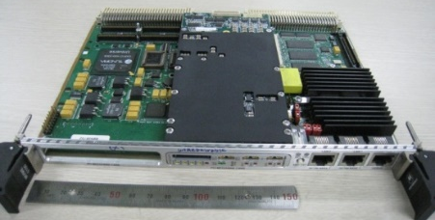
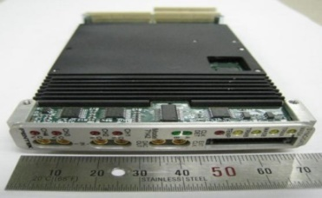
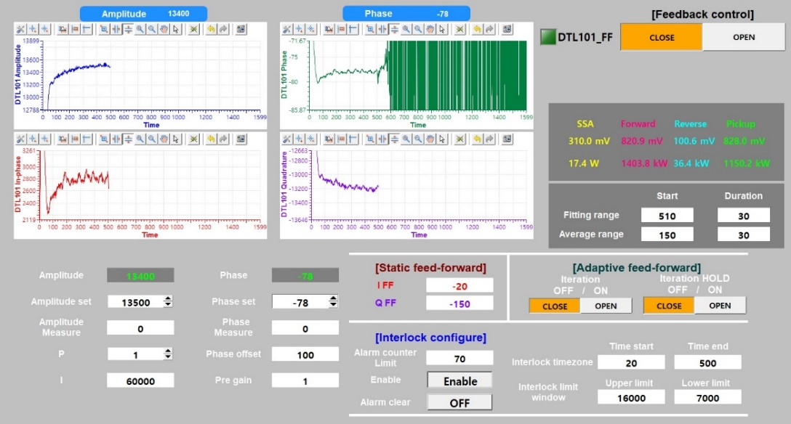
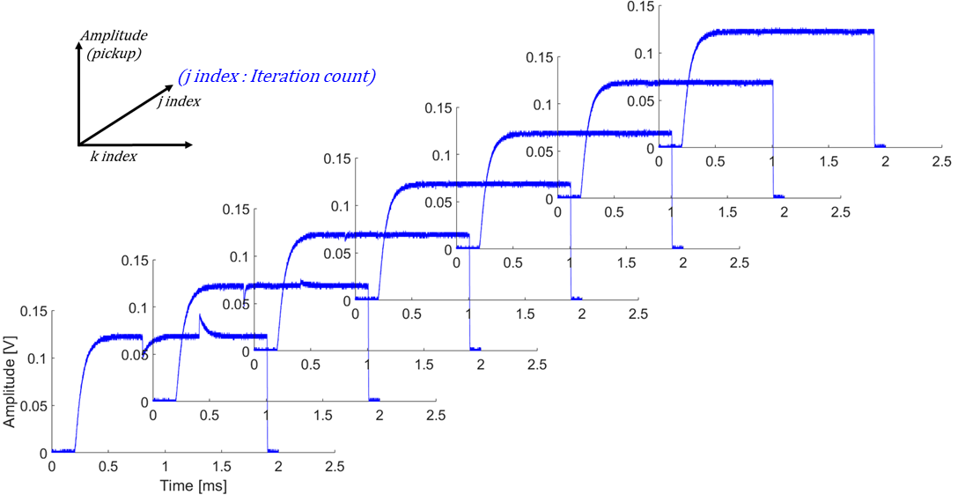
LLRF DAQ
LLRF DAQ: PENTEK7142
Xilinx Virtex-4 FPGA
ADC 4ch 125 MHz 14bits
DAC 1ch 500 MHz 16bits
RF digital feedback control system
Control RF amplitude/phase within 1% and 1°
Compensate for disturbances from beam loading effects
Static feedforward : verification completed with 100MeV LINAC
Adaptive feedforward : verification completed with dummy cavity

Slide 14
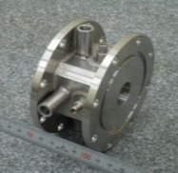
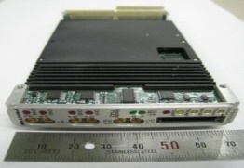
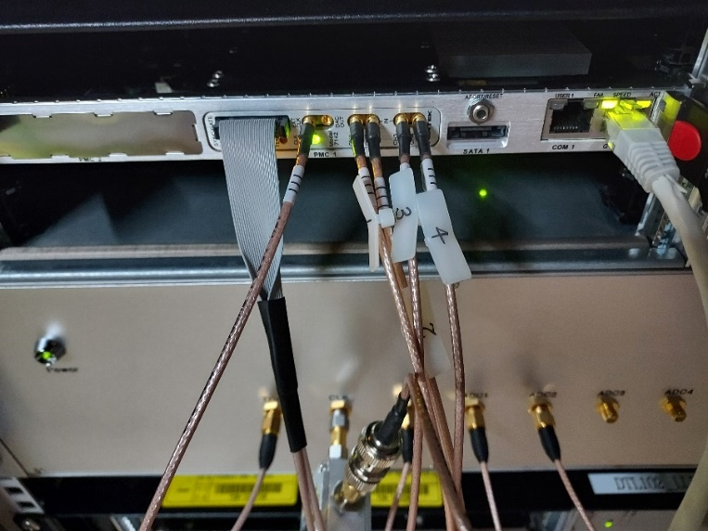
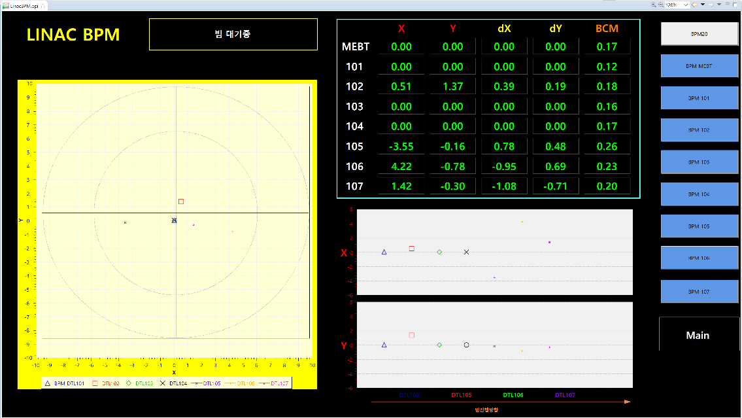
BPM DAQ
BPM DAQ
Acquire bpm signals and generates beam position, phase, current
BPM DAQ: PENTEK7142
Xilinx Virtex-4 FPGA, ADC 4ch 125 MHz 14bits, DAC 1ch 500 MHz 16bits
Reuse LLRF DAQ HW for BPM DAQ (HW reliability)
  Reduce development time
  Share spare parts with LLRF
  Cost saving and efficient maintenance effects
Linac BPM
LO (300MHz)
BPF (350MHz)
IF (50MHz)
x
-x
trig
clk
y
-y
MVME3100
Analog box

Slide 15
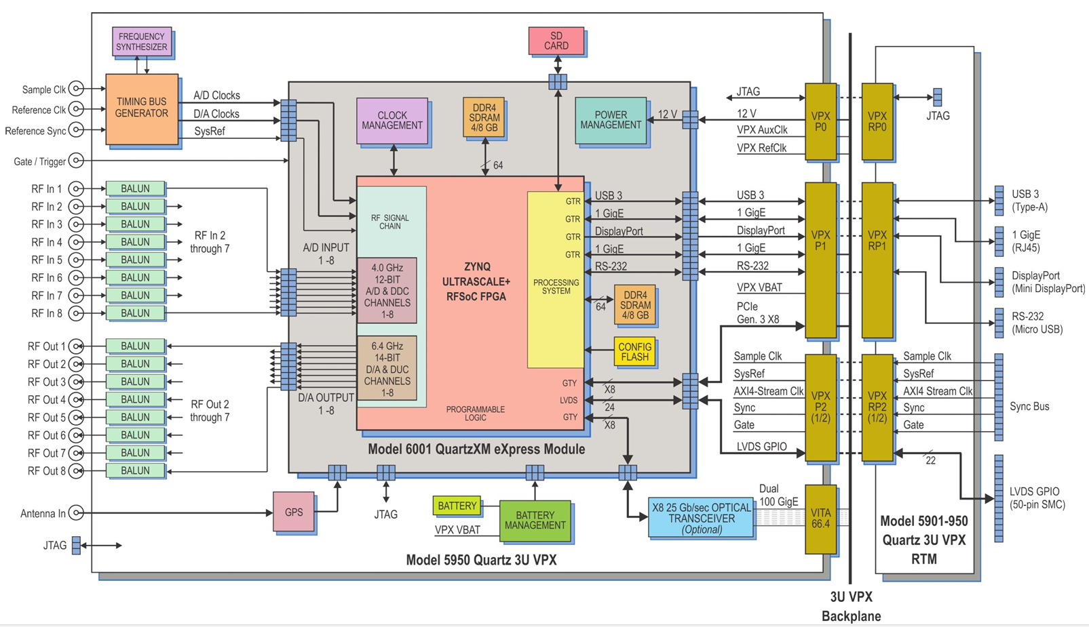
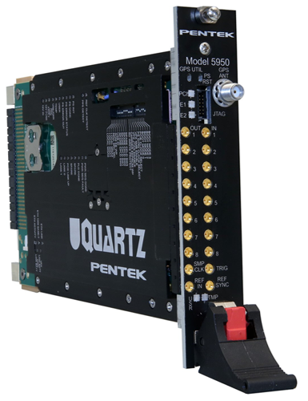
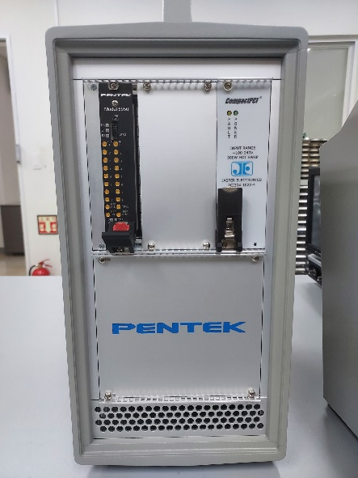
ZYNQ based LLRF DAQ
  Develop a multi-DAQ system handling LLRF and BPM in one DAQ
  UltraScale+RFSoC (PENTEK Model 5950) for new LLRF development
    FPGA of digital processing part
    Analog RF block, ADC, 8 CH, 4 GSPS, 12-bit, DAC, 8 CH, 6.4 GSPS, 14-bit
    DSP Block of signal processing operations
  Allowing for a wide range of application in embedded systems
  Enabling developers to create high-performance and highly adaptable system
PENTEK Model 5950
Model 8257

Slide 16
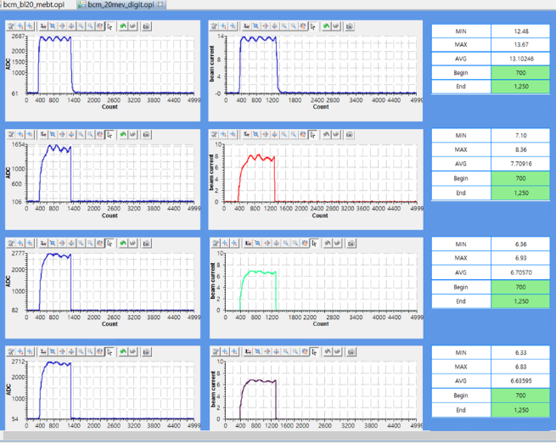
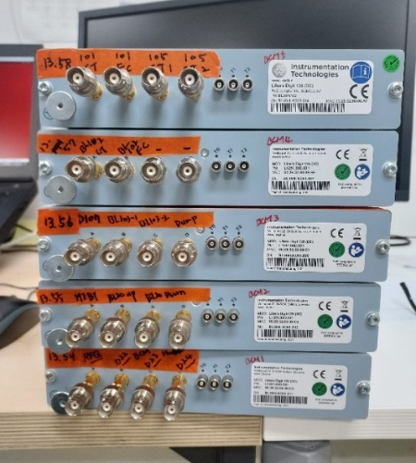
Libera DAQ
Libera Digit 125 (I-TECH product)
XILINX Zynq 7020 System On Chip (SoC)
ADC 80~125 MS/s, 14-bit, 4 ch
External trigger
PoE (Power of Ethernet)
Buffer size : 1 ~ 8 M
Max. Repetition rate 5Hz
LEBERA Technical Support : Integrated Development Environment
Upgrade EPICS modules for data conversion & statistical processing
Proton beam pulse width 100 us, repetition rate 20 Hz
  Array calculation
    Supports array operands and expressions for array calculation and output
  Waveform analysis
    Generate statistical parameter of an input array for waveform analysis
    Maximum / Minimum / Mean / Mean absolute deviation / Variance / Standard deviation
Use like an oscilloscope
Generate waveform data, conversion data, statistical parameter
Measure the signal synchronized to beam pulse

Slide 17
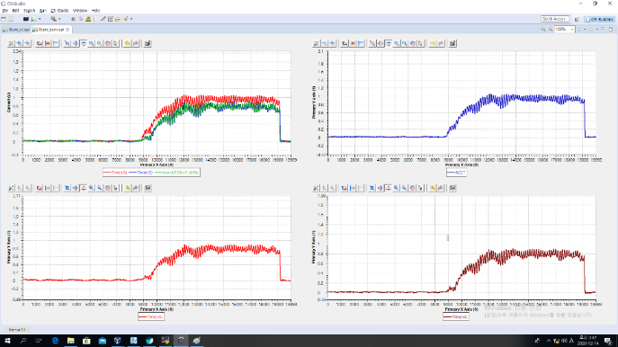
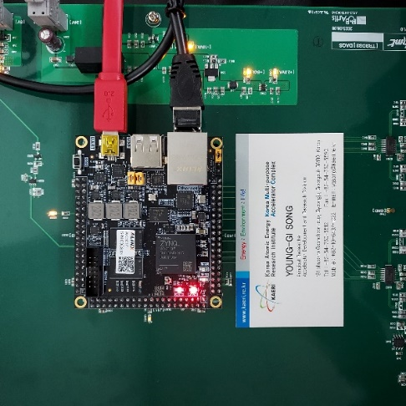
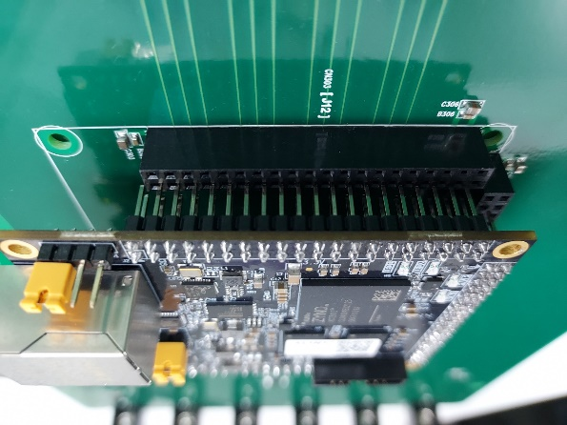
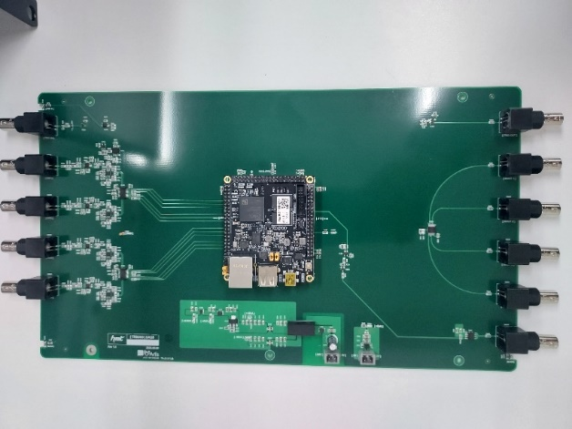
pDAQ (proton DAQ)
Develop Zynq-based pDAQ for Beam Loss Monitoring (BLM)
XILINX Zynq-7010 System On Module (SoM)
SoM with SoC (FPGA, Cortex-A9) + RAM, power regulation, I/O ports, Ethernet
Carrier board with ADC, DAC, external trigger
Without designing and integrating each individual component
1.3ms & 60Hz data acquisition with external trigger
Data stored in BRAM at every Busy cycle
BRAM data transmitted from PL to the PS via SPI

Slide 18
Summary
Over the past year
  Start 24-hour operation
  Develop operator’s applications and data analysis tools
  Establish program development environment using various software
Data Acquisition System (DAQ)
  Use DAQs of various products
  Focus on self-development of software based on hardware reliability
  Cost saving and efficient maintenance effects from H/W reuse
  Develop more advanced software with new DAQ hardware

