Slide 1
ISIS EPICS – TwinCAT update (2024)
Jack Harper – Experiment Controls Group - ISIS Neutron and Muon Source
jack.harper@stfc.ac.uk
https://github.com/ISISComputingGroup

Slide 2
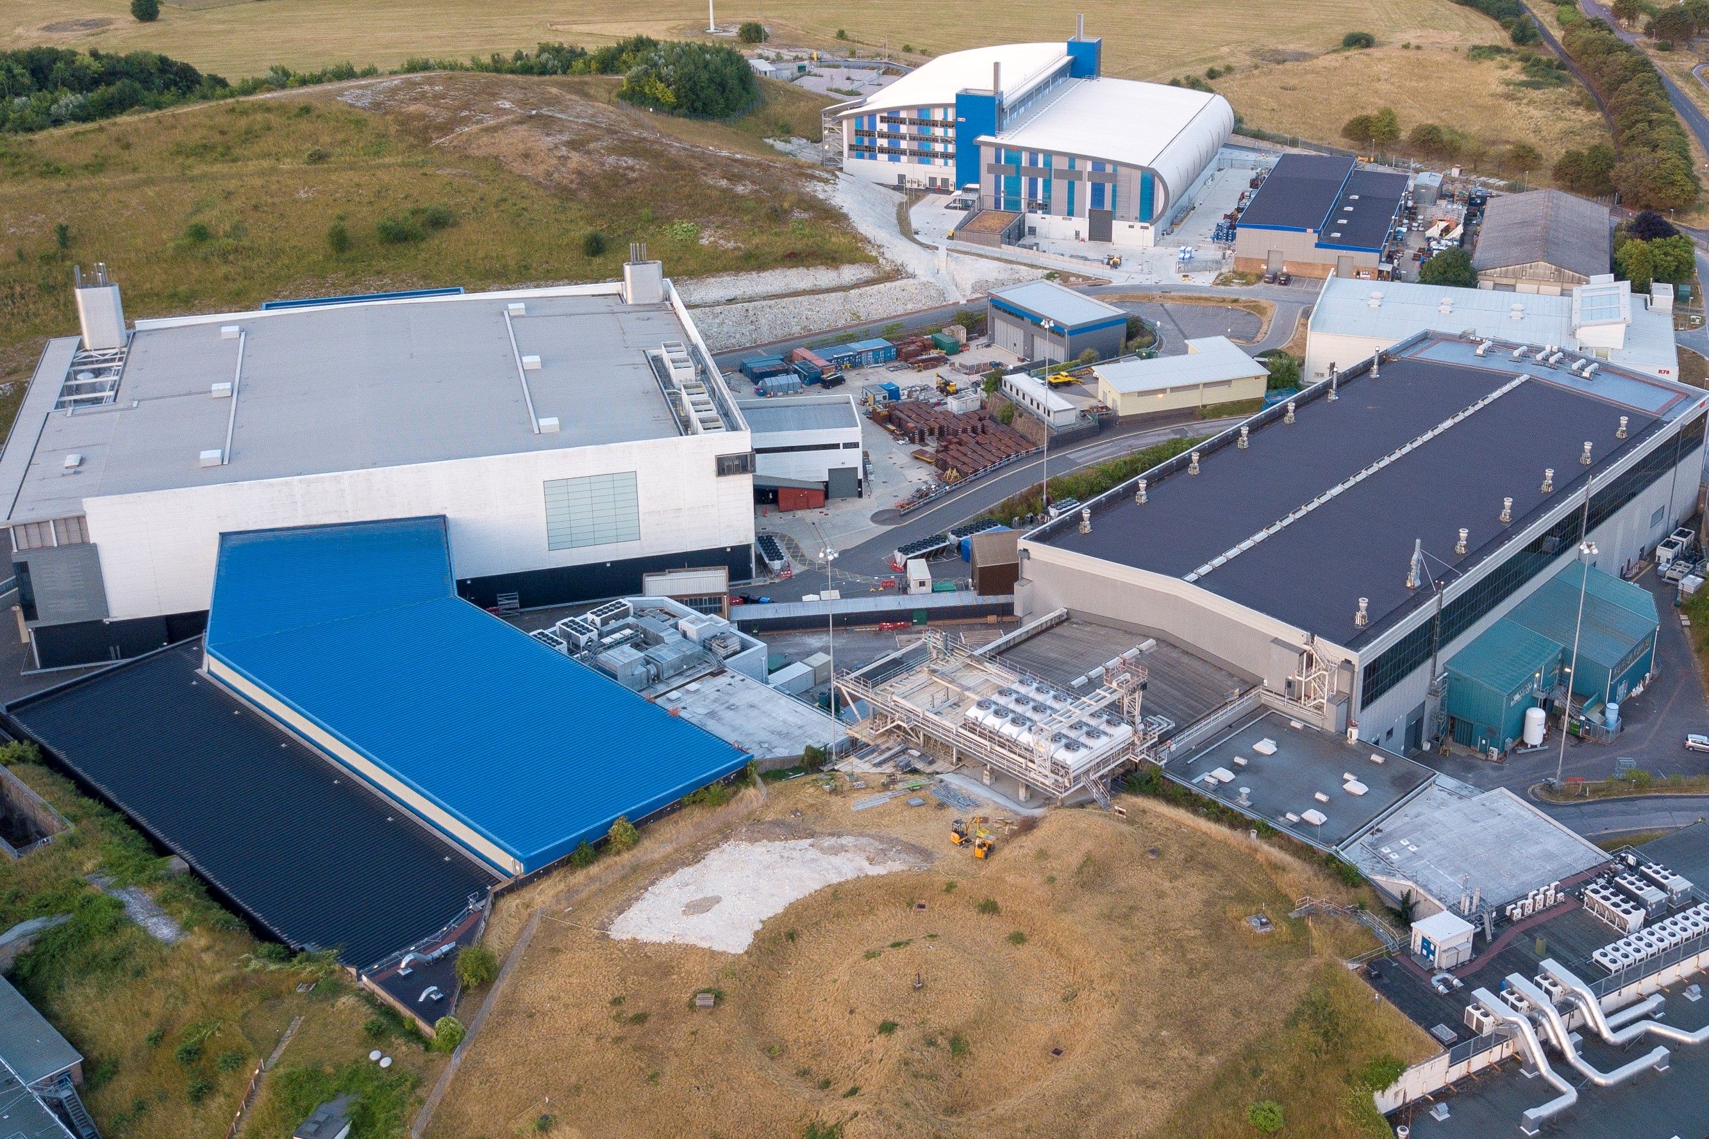
Introduction
ISIS Neutron and Muon source – Harwell, Oxfordshire, England

Slide 3
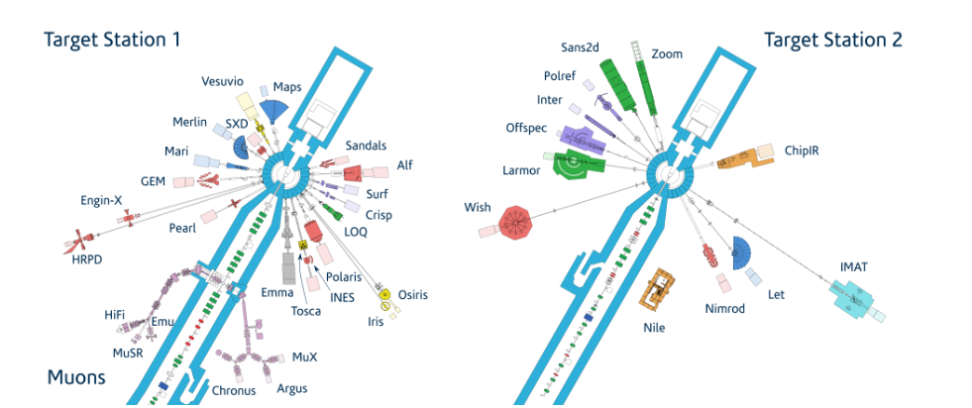
Introduction
Notes:
Minus endeavour

Slide 4
Introduction
Experiment Controls group - Responsible for support, development of controls instrument-end – not accelerator
Main control system called IBEX, though some instruments on old labview-based system – being migrated. ~4 instruments left to exorcise migrate from SECI
We are an (expanding) small team that covers most areas of controls

Slide 5
Infrastructure
Windows 10 Instrument machine (VM) running IBEX (EPICS, Abstractions + GUI)
Eclipse-RCP based (Java) GUI using Control Systems Studio (CSS) with a table of motors for general motion control
EPICS V7 using CA.
Python based user scripting framework (genie_python)
Some other things like a web dashboard for users to view
Most devices serial or ethernet. Serial handled using Moxa Nport boxes
Procserv for IOCs, blockserver for procserver management
Large collection of system tests using lewis and python’s unittest framework
https://github.com/ISISComputingGroup/EPICS-inst_servers/tree/master/BlockServer

Slide 6
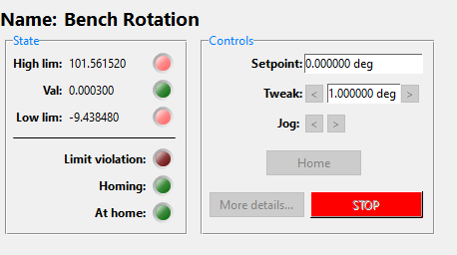
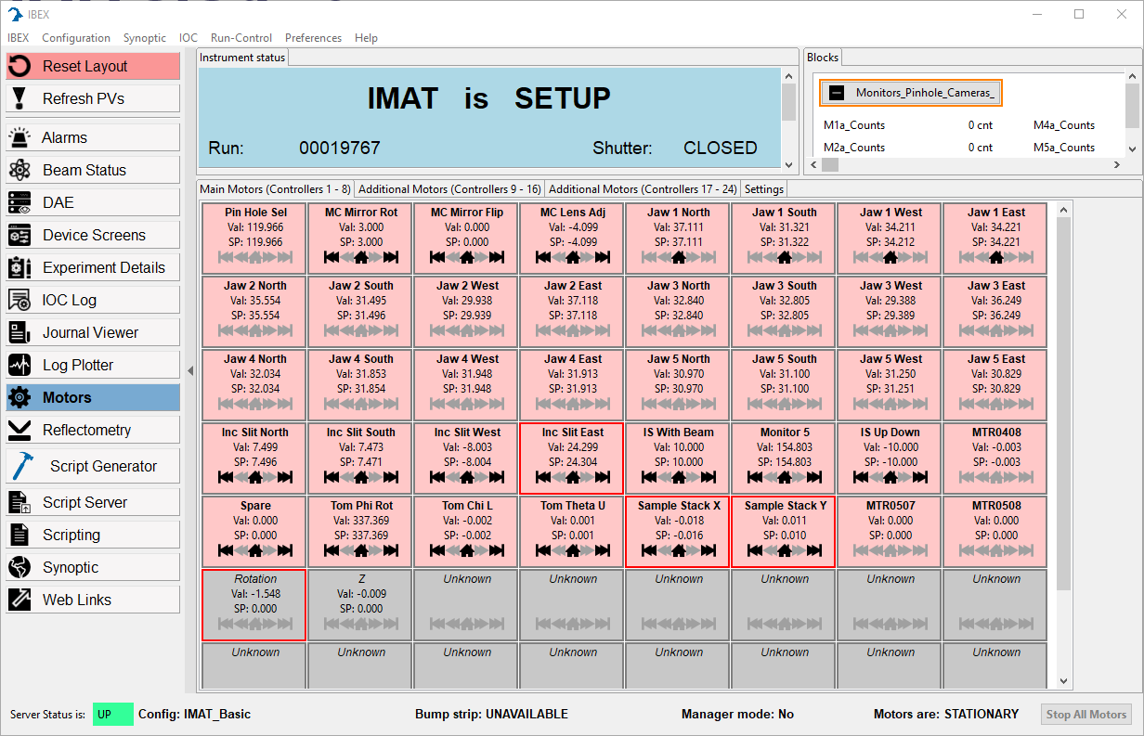
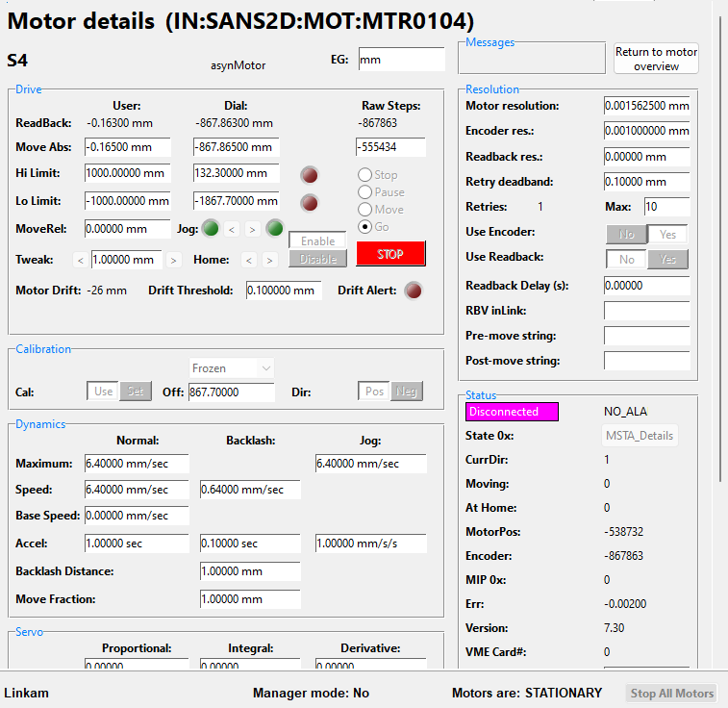
IBEX GUI – Table of Motors
https://github.com/ISISComputingGroup/ibex_gui
Notes:
Here is a screenshot of the table of motors, opening one of these up gives control over a motor. This can also be done through scripting via the motor record or an axis alias (explained later)
We grey out the “disabled” motors in the table of motors, as you can see here the rotation and z stage are disabled in the PLC.

Slide 7
Infrastructure – motion control
Lots of MCs in use at ISIS.
Most Commonly, Galil DMC2XXX
Others: Mclennan PM641/1000, Linmot, Newport XPS, SMC100, attocube etc.
Galils have their limitations, we are upgrading to use Beckhoff PLCs for future motion control
To use the Beckhoffs as “motion controllers” we need to use epics motor record!

Slide 8
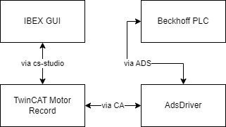
System Overview
Notes:
Very simple – there are a few layers that data travels around, but the main ones are the ADS comms between TwinCAT and the TcIoc library and the TC IOC itself and the motor record

Slide 9
Applications
So far we have successfully driven from EPICS:
LARMOR Rotating Bench
IMAT Height & Rotation stage
SANS2D Collimating Guides
SANDALS Jaws/Slits & Sample Changer
INTER secondary flight path upgrade
Future Installations:
IMAT Detector column
SURF redesign
Image © STFC John Dawson
Notes:
PLEASE DELETE/REPLACE PHOTO CREDIT IF CHANGING THE IMAGE.

Slide 10
Recent changes
Switched from TCIOC to AdsDriver – much simpler design
Removed dependency on TPY/TMC descriptors – this is a positive and a negative
Because of the TPY removal, OPC tags no longer necessary plc code, comments don’t break everything
Supported 8+ axes per PLC – INTER has 30! This is a record for a single motor controller at ISIS
EGU, VELO, DESC forwarding from PLC
Added cmd util to get ads var at startup. May push upstream.

Slide 11
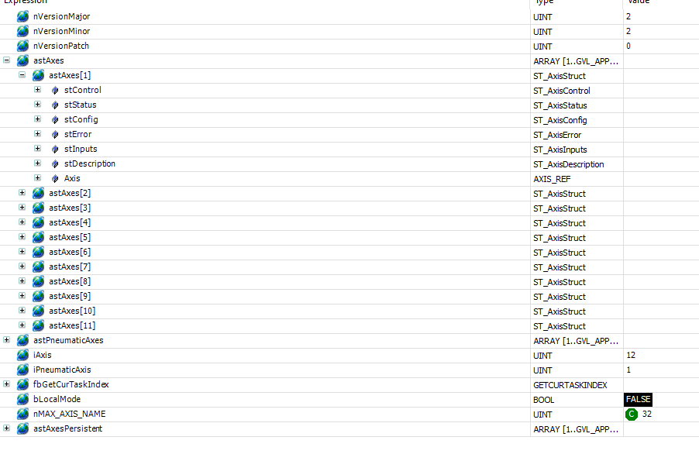
PLC code
VAR_GLOBAL
// Semantic version in machine-readable format.
// Update it and commit it immediatly before setting a tag
nVersionMajor: UINT := 2; // Major Version
nVersionMinor: UINT := 2; // Minor Version
nVersionPatch: UINT := 0; // Patch level
astAxes: ARRAY [1..GVL_APP.nAXIS_NUM] OF ST_AxisStruct; //Array of ST_AxisStruct for holding axis parameters and controls
astPneumaticAxes: ARRAY [1..GVL_APP.nPNEUMATIC_AXIS_NUM] OF ST_PneumaticAxisStruct; //Array of ST_PneumaticAxisStruct for holding pneumatic axis parameters and controls
iAxis: UINT; //Index for for loops while going through axes
iPneumaticAxis: UINT := 1; //Index for for loops while going through pneumatic axes
fbGetCurTaskIndex: GETCURTASKINDEX;
bLocalMode: BOOL;
END_VAR
VAR_GLOBAL CONSTANT
nMAX_AXIS_NAME: UINT := 32;
END_VAR
VAR_GLOBAL PERSISTENT
astAxesPersistent: ARRAY [1..GVL_APP.nAXIS_NUM] OF ST_AxisPersistent;
END_VAR

Slide 12
ADSDriver
AdsOpen("plc-01", "10.5.0.115", "10.5.0.115.1.1")
@asyn($(PORT) 0 0) PLCTYPE R/W ADSPORT VARNAME)
https://github.com/Cosylab/adsDriver

Slide 13
Std library template
## Writable fields
#bools
record(longout,"$(P)ASTAXES_$(AXIS_NUM):STCONTROL-BEXECUTE") {
field(DTYP,"asynInt32")
field(OUT,"@asyn($(PORT) 0 0) BOOL W P=$(ADSPORT) V=GVL.astAxes[$(AXIS_NUM)].stControl.bExecute")
}
record(longout,"$(P)ASTAXES_$(AXIS_NUM):STCONTROL-BRESET") {
field(DTYP,"asynInt32")
field(OUT,"@asyn($(PORT) 0 0) BOOL W P=$(ADSPORT) V=GVL.astAxes[$(AXIS_NUM)].stControl.bReset")
}
record(longout,"$(P)ASTAXES_$(AXIS_NUM):STCONTROL-BSTOP") {
field(DTYP,"asynInt32")
field(OUT,"@asyn($(PORT) 0 0) BOOL W P=$(ADSPORT) V=GVL.astAxes[$(AXIS_NUM)].stControl.bStop")
}
record(longout,"$(P)ASTAXES_$(AXIS_NUM):STCONTROL-BHALT") {
field(DTYP,"asynInt32")
field(OUT,"@asyn($(PORT) 0 0) BOOL W P=$(ADSPORT) V=GVL.astAxes[$(AXIS_NUM)].stControl.bHalt")
}
record(longout,"$(P)ASTAXES_$(AXIS_NUM):STCONTROL-BENABLE") {
field(DTYP,"asynInt32")
field(OUT,"@asyn($(PORT) 0 0) BOOL W P=$(ADSPORT) V=GVL.astAxes[$(AXIS_NUM)].stControl.bEnable")
}
...
https://github.com/ISISComputingGroup/EPICS-motorExtensions/blob/master/beckhoffApp/Db/single_axis_tc.substitutions

Slide 14
Std library template
### read-only fields
#bools
record(longin,"$(P)ASTAXES_$(AXIS_NUM):STSTATUS-BENABLED") {
field(SCAN,"I/O Intr")
field(DTYP,"asynInt32")
field(INP,"@asyn($(PORT) 0 0) BOOL R P=$(ADSPORT) V=GVL.astAxes[$(AXIS_NUM)].stStatus.bEnabled")
}
record(longin,"$(P)ASTAXES_$(AXIS_NUM):STSTATUS-BDONE") {
field(SCAN,"I/O Intr")
field(DTYP,"asynInt32")
field(INP,"@asyn($(PORT) 0 0) BOOL R P=$(ADSPORT) V=GVL.astAxes[$(AXIS_NUM)].stStatus.bDone")
}
record(longin,"$(P)ASTAXES_$(AXIS_NUM):STSTATUS-BHOMED") {
field(SCAN,"I/O Intr")
field(DTYP,"asynInt32")
field(INP,"@asyn($(PORT) 0 0) BOOL R P=$(ADSPORT) V=GVL.astAxes[$(AXIS_NUM)].stStatus.bHomed")
}
record(longin,"$(P)ASTAXES_$(AXIS_NUM):STSTATUS-BMOVING") {
field(SCAN,"I/O Intr")
field(DTYP,"asynInt32")
field(INP,"@asyn($(PORT) 0 0) BOOL R P=$(ADSPORT) V=GVL.astAxes[$(AXIS_NUM)].stStatus.bMoving")
}
...
https://github.com/ISISComputingGroup/EPICS-motorExtensions/blob/master/beckhoffApp/Db/single_axis_tc.substitutions

Slide 15
Twincat Motor Record
Motor record interface maps to ADS PVs (see previous slide)
Poll loop retrieves PV values and sets them to (and from) respective motor record fields via dbgf/dbpf
Not very much logic involved as the PLC stores engineering units and deals with scaling, retries, mres etc.
class epicsShareClass twincatMotorAxis : public devMotorAxis
{
public:
twincatMotorAxis(class devMotorController *pC, int axisNo): devMotorAxis(pC, axisNo) {};
private:
std::string ENABLE_STATUS() { return "STSTATUS-BENABLED"; };
std::string EXECUTE() { return "STCONTROL-BEXECUTE"; };
std::string STOP() { return "STCONTROL-BSTOP"; };
std::string VELOCITY_SP() { return "STCONTROL-FVELOCITY"; };
std::string POSITION_SP() { return "STCONTROL-FPOSITION"; };
std::string DISTANCE_SP() { return "STCONTROL-FPOSITION"; };
std::string ERROR_STATUS() { return "STSTATUS-BERROR"; };
std::string POSITION_RBV() { return "STSTATUS-FACTPOSITION"; };
std::string VELOCITY_RBV() { return "STSTATUS-FACTVELOCITY"; };
std::string HOMED() { return "STSTATUS-BHOMED"; };
std::string MOVING() { return "STSTATUS-BMOVING"; };
std::string COMMAND() { return "STCONTROL-ECOMMAND"; };
std::string POSITIVE_DIR() { return "STSTATUS-BMOVINGFORWARD"; };
std::string NEGATIVE_DIR() { return "STSTATUS-BMOVINGBACKWARD"; };
epicsInt32 HOME_COMMAND() { return 10; };
epicsInt32 STOP_COMMAND() { return 15; };
epicsInt32 MOVE_ABS_COMMAND() { return 0; };
epicsInt32 MOVE_RELATIVE_COMMAND() { return 1; };
epicsInt32 MOVE_VELO_COMMAND() { return 3; };
void populateLimitStatus(st_axis_status_type *axis_status);
asynStatus sendStop();
};
https://github.com/ISISComputingGroup/EPICS-TwincatMotor/tree/main/motorSupportApp/src

Slide 16
IOC startup
epicsEnvSet("TWINCATCONFIG","$(TWINCATCONFIG=$(ICPCONFIGROOT)/twincat)")
luash("st-common.lua")
## configure jaws
< $(TWINCATCONFIG)/jaws.cmd
## configure barndoors
< $(TWINCATCONFIG)/barndoors.cmd
## configure axes
< $(TWINCATCONFIG)/axes.cmd
## motion set points
< $(TWINCATCONFIG)/motionsetpoints.cmd
## sample changer
< $(TWINCATCONFIG)/sampleChanger.cmd
## motor extensions
< $(TWINCATCONFIG)/motorExtensions.cmd
dbLoadRecords("$(MOTOR)/db/motorUtil.db","P=$(MYPVPREFIX)$(IOCNAME):,$(IFIOC)= ,PVPREFIX=$(MYPVPREFIX)")
cd "${TOP}/iocBoot/${IOC}"
iocInit
motorUtilInit("$(MYPVPREFIX)$(IOCNAME):")
https://github.com/ISISComputingGroup/EPICS-ioc/blob/master/TC/iocBoot/iocTC-IOC-01/st-common.cmd
Notes:
At IOC startup we set a TWINCATCONFIG macro to wherever the TPY file lives. This is also where the generated DB goes.
This is calling some Lua code (shown more on next slide) as well as some abstractions above the motor record (explained in slide after Lua)

Slide 17
IOC startup - Lua
function twincat_stcommon_main()
...
local ioc_prefix = pv_prefix .. ioc_name .. ":"
iocsh.devMotorCreateController(motor_port, "Controller", num_axes, ioc_prefix)
db_args = string.format("P=%s,Q=MOT:MTR%02i:,AXES_NUM=%s", pv_prefix, mtrctrl, num_axes)
iocsh.dbLoadRecords("$(MOTOR)/db/motorController.db", db_args)
for axis_num=1,num_axes,1
do
local single_axis_tc_args = string.format("P=%s,AXIS_NUM=%s,ADSPORT=%s,PORT=%s", ioc_prefix, axis_num, ads_port, asyn_port)
iocsh.dbLoadRecords("$(TOP)/db/single_axis_tc.db", single_axis_tc_args)
motor_pv = string.format("MTR%02i%02i", mtrctrl, axis_num)
single_axis_db = "$(TOP)/db/single_axis.db"
db_args = string.format("MYPVPREFIX=%s,MOTOR_PV=%s,MOTOR_PORT=%s,ADDR=%s", pv_prefix, motor_pv, motor_port, axis_num-1)
iocsh.devMotorCreateAxis(motor_port, axis_num-1, plc_version)
iocsh.dbLoadRecords(single_axis_db, db_args)
status_args = string.format("P=%s,M=MOT:%s,IOCNAME=%s", pv_prefix, motor_pv, ioc_name)
iocsh.dbLoadRecords("$(MOTOR)/db/motorStatus.db", status_args)
axis_monitors = "$(TOP)/db/axis_monitors.db"
axis_monitors_args = string.format("P=%s,I=%s,AXIS_NUM=%s,MOTOR_PV=%s", pv_prefix, ioc_name, axis_num, motor_pv)
iocsh.dbLoadRecords(axis_monitors, axis_monitors_args)
-- wrap around to next MTRCTRL - this is so we can show >8 axes in the IBEX table of motors.
if axis_num > 8 then
alias_args_orig = string.format("$(MYPVPREFIX)MOT:%s(.*)", motor_pv)
alias_args_aliased = string.format("$(MYPVPREFIX)MOT:MTR%02i%02i\\1", ((axis_num-1)//8) + mtrctrl, (axis_num-1)%8 + 1)
iocsh.dbAliasRecordsRE(alias_args_orig, alias_args_aliased)
end
end
https://github.com/ISISComputingGroup/EPICS-ioc/blob/master/TC/iocBoot/iocTC-IOC-01/st-common.lua
Notes:
We use some Lua at IOC startup to determine how many axes the motor record needs to load – this is because we haven’t served any PVs yet so can’t just call ADS directly.
It also passes through the version number here – this is so that any breaking changes in the collab code can be given a major version to differentiate.
We haven’t used much Lua but it is fairly flexible so we’re keen to use it more

Slide 18
Axes + MotionSetpoints
Axes abstraction – we use “human readable” PV aliases for ease of use in scripts, if a controller is being re-commissioned we don’t have to set up surrounding configurations etc.
Motion setpoints – Driving to “set” setpoints e.g. for collimation, for example the guide blocks and apertures on SANS2D
https://github.com/ISISComputingGroup/EPICS-motionSetPoints
Notes:
Also used for slits/jaws, sample changers and so on. Motion setpoints example on next slide

Slide 19
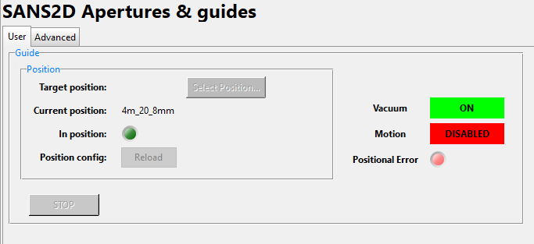
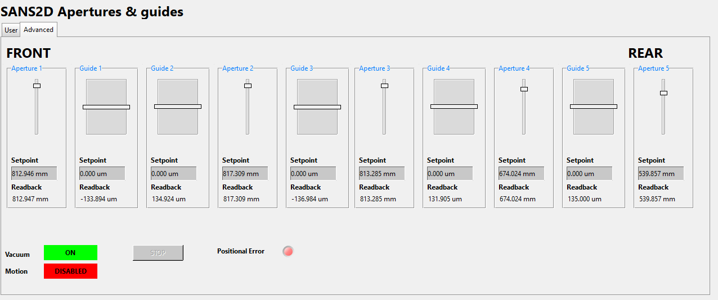
MotionSetpoints
# Guides Apertures
# Position 1 2 3 4 5 1 2 3 4 5
4m_20_8mm -133.9 134.9 -137.0 131.9 135.0 812.9 817.2 813.2 674.0 539.8
4m_20_12mm -133.9 134.9 -137.0 131.9 135.0 812.9 817.2 813.2 674.0 674.6
4m_30x20_12mm -133.9 134.9 -137.0 131.9 135.0 812.9 817.2 813.2 809.0 674.6
6m_20_8mm -133.9 134.9 -137.0 -135.0 135.0 811.6 816.6 677.5 673.5 540.0
6m_16_8mm -133.9 134.9 -137.0 -135.0 135.0 811.6 816.6 543.3 539.7 404.9
6m_GISANS -133.9 134.9 -137.0 -135.0 135.0 811.6 816.6 002.0 673.5 540.0
8m_20_8mm -133.9 134.9 135.0 -135.0 135.0 811.6 681.6 678.0 540.0 404.8
8m_GISANS -133.9 134.9 135.0 -135.0 135.0 811.6 006.1 678.0 674.5 539.0
12m_20_8mm 135.0 -135.0 135.0 -135.0 135.0 677.1 683.9 544.0 541.0 405.0
12m_GISANS 135.0 -135.0 135.0 -135.0 135.0 001.8 683.9 679.0 675.5 539.3
https://github.com/ISISComputingGroup/EPICS-motionSetPoints
Notes:
Also used for slits/jaws, sample changers and so on. A user can just click on a set position for a certain type of experiment and in this case it’ll move 10 axes together.

Slide 20
What works well – improvements on Galil MCs
Galils (and other MCs in use at ISIS) usually limited to 8 axes
Ethercat integration is easy
Motion logic is abstracted to the controller rather than at db level
Much more robust control loops
Absolute encoders are now commonplace
Synchronous moves now being used
Not just limited to motion –pass through bump strips, light curtains, safety system signals through the PLC.
Built-in diagnosis info through error codes

Slide 21
Future improvements
Things we would like in the standard library:
- Human-readable axes descriptions (.DESC field in motor record) – now working
- Engineering units per axis (.EGU field in motor record)
Things we are working on currently:
Auto enabling/energising – though some debate on whether this is done EPICS level or PLC
- Better system tests – Beckhoff automation interface is somewhat unreliable
Improving jaws/slits logic on PLC
More applications!

Slide 22
Thank you for listening!
- Demo/Questions?
jack.harper@stfc.ac.uk
https://github.com/ISISComputingGroup
Facebook: Science and Technology Facilities Council
Twitter:@STFC_matters
YouTube: Science and Technology Facilities Council

