Slide 1
Portable Channel Access Server for Node.js
Lin Wang
wanglin@ihep.ac.cn
Controls Group, Accelerator System Division, CSNS
Dongguan Campus of IHEP (Institute of High Energy Physics)
EPICS Collaboration Meeting 2024
Apr 15 – 18, 2024, hosted by the Pohang Accelerator Laboratory

Slide 2
Content
（1）Scenario
（2）Design
（3）Implementation
（4）Usage examples
（5）Issues and use cases
（6）Summary

Slide 3
Scenario
Why?
node-epics-pcas: Portable Channel Access Server for Node.js
Motivation #1
EPICS has excellent support for C++, Java and Python.
EPICS has very little support for JavaScript or Node.js.
JavaScript and Node.js are very popular in web development.
I am interested in developing EPICS-related tools for Node.js.
Motivation #2
As a high-level application developer, starting an IOC is not very convenient for me.
Although there is already pcaspy, I am not familiar with Python.
If PVs can be published in Node.js environment, it is convenient.

Slide 4
Design
FFI (Foreign Function Interface) is used to talk to the shared libraries of PCAS
libca, libcas, libCom, libgdd
Which FFI library to use?
node-addon-api
https://www.npmjs.com/package/node-addon-api
Learning curve is deep
Does not support callback
SWIG (Simplified Wrapper and Interface Generator)
https://swig.org/
Support for JavaScript is not as good as Python
Mailing list support is too slow (~ 1 week)
koffi
https://www.npmjs.com/package/koffi
Fast and easy-to-use C FFI module for Node.js
Well maintained, well documented, quick response on GitHub issue tracker

Slide 5
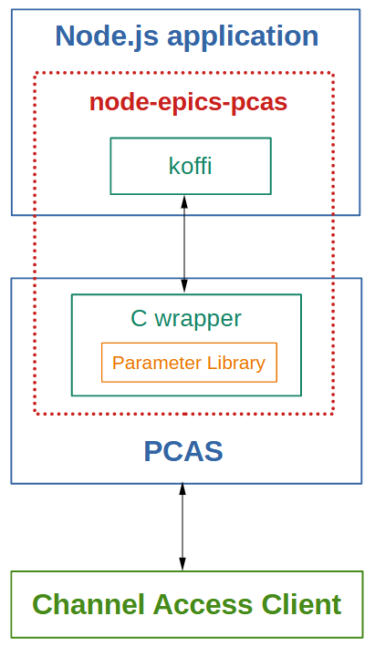
Design
Borrows idea and implementation from pcaspy
https://pypi.org/project/pcaspy
Portable Channel Access Server in Python
Most of the logic has been moved from the scripting language to C++
Wraps PCAS C++ shared library and provide C interfaces for Node.js
libca, libcas, libCom, libgdd
Uses koffi in Node.js to interact with the C interfaces.
Provides APIs in node-epics-pcas for Node.js applications.

Slide 6
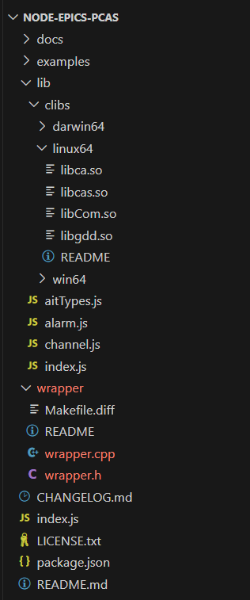
File structure
wrapper.h and wrapper.cpp files
Wrapper of PCAS C++ code which provide C interface for Node.js
clibs folder
Prebuilt shared libraries: libca, libcas, libCom, libgdd
Built from EPICS base 3.15.9 together with wrapper.h / wrapper.cpp
channel.js file
Interacts with the C interface and provides APIs for Node.js applications
aitTypes.js file
Architecture Independent Type (AIT) definitions in PCAS
alarm.js file
EPICS alarm status and severity definitions

Slide 7
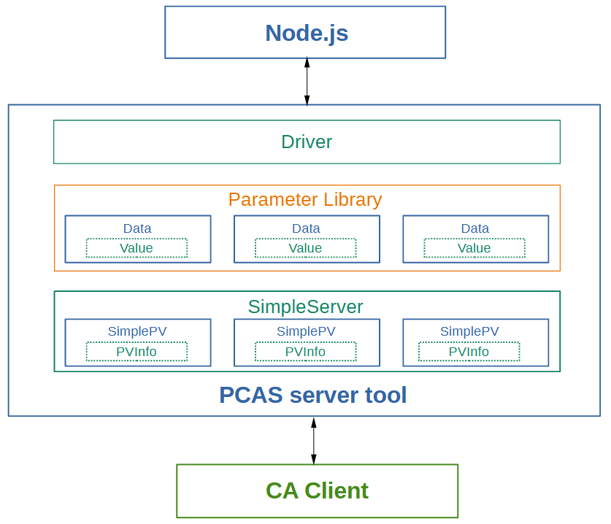
All C++ classes in the wrapper
class SimpleServer: public caServer
The server instance of PCAS
class SimplePV: public casPV
PV instance for the server tool
class PVInfo
PV info associated with the PV instance
class Driver
Interfaces for Node.js to operate the parameter library
class Data
PV value and status in parameter library
class Value
Data structure for PV value field
All C++ classes in the PCAS server tool

Slide 8
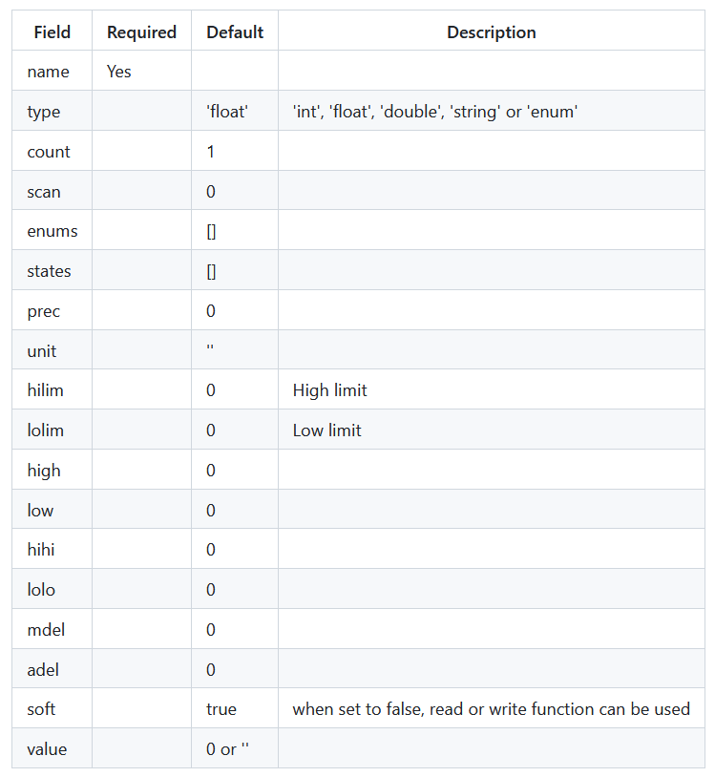
APIs for Node.js applications
createServer()
Create the PCAS server
getParam()
Get value from the parameter library
setParam()
Set value to the parameter library
setParamStatus()
Set alarm and severity to the parameter library
updatePVs()
Post event to monitor clients when value or alarm status changes
setDebugLevel()
Set debug level (0, 1 or 2) to print more information
Supported PV fields

Slide 9
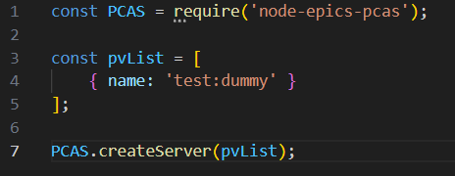
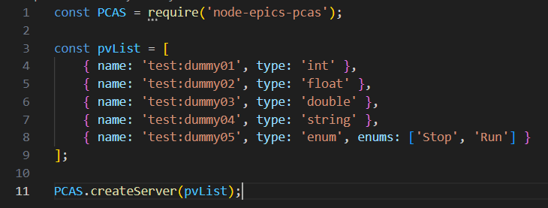
Usage examples
A dummy PV
Dummy array PVs
Dummy scalar PVs

Slide 10
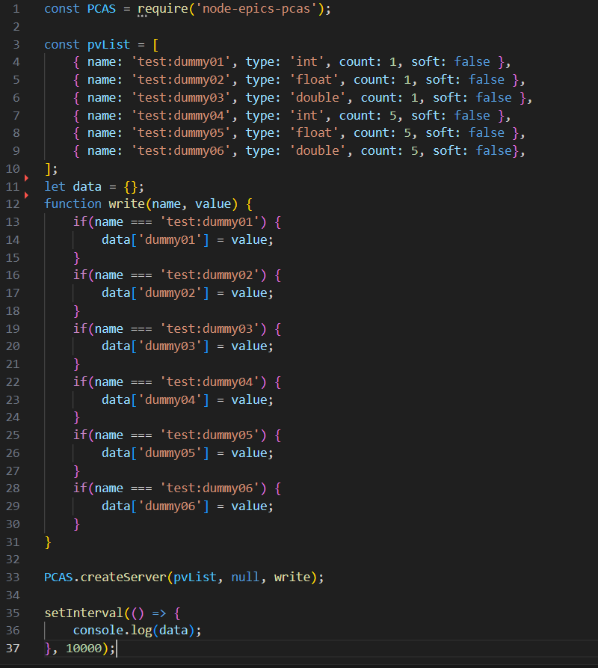
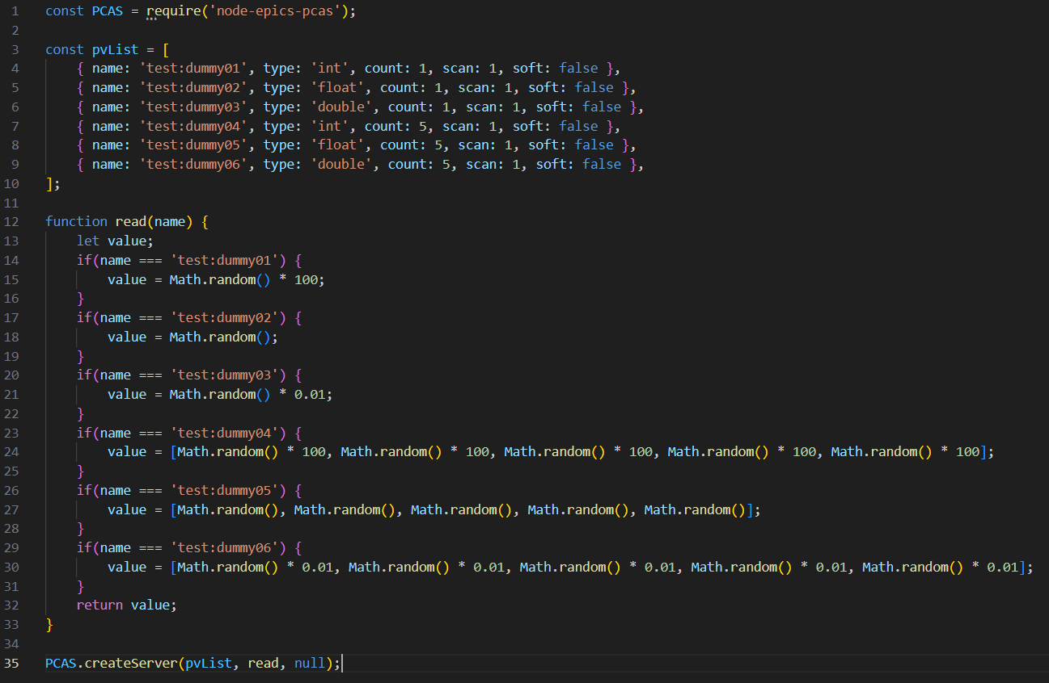
Usage examples
Read data from Node.js
Write data to Node.js

Slide 11
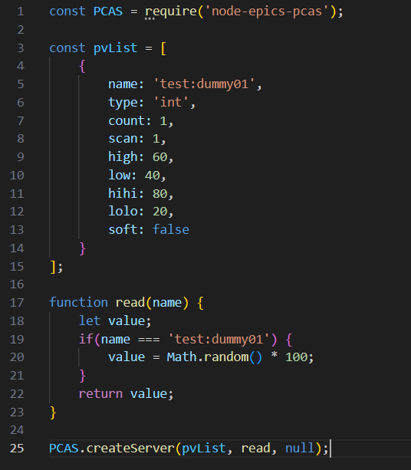
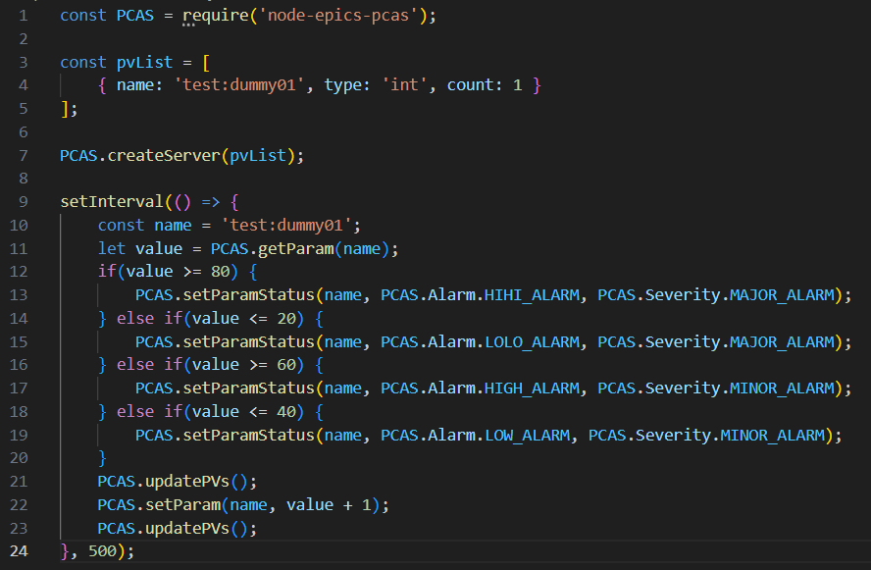
Usage examples
Raise alarm automatically
Raise alarm manually

Slide 12
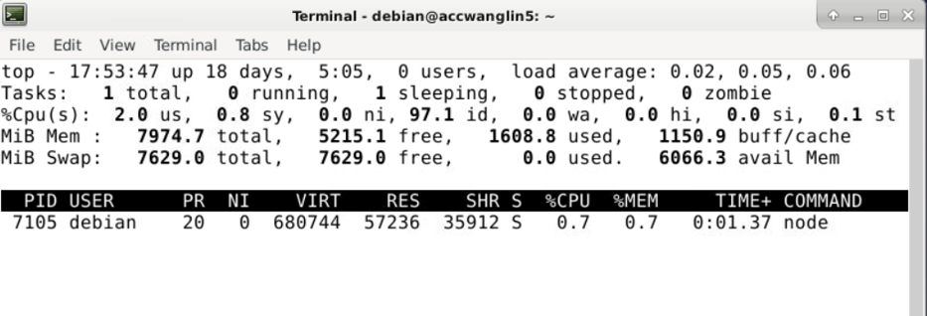
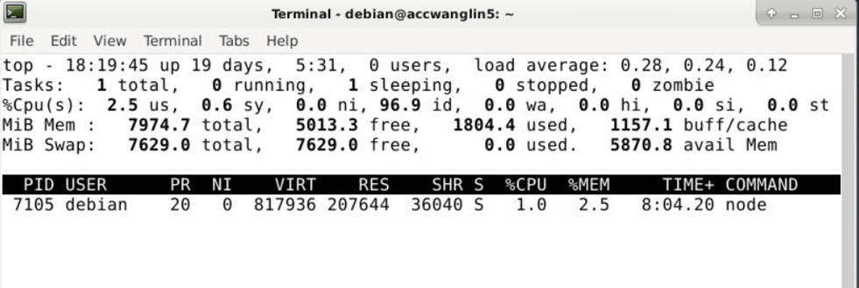
Issues
Memory leak problem exists.
Currently it is not clear what the root cause is.
A memory leak test
Running the usage example to publish Archiver Appliance status as PVs
Running for 24 hours
Linux virtual machine with 8GB memory
Memory usage rose from 0.7% to 2.5%
Due to the memory leak issue, node-epics-pcas is not recommended for production use.
It can be used to publish PVs for test purpose.
Use cases

Slide 13
Summary
node-epics-pcas is an EPICS Channel Access server for Node.js with FFI implementation.
The FFI package in use is koffi.
The implementation is very similar to the pcaspy package.
Github and npm package links
https://github.com/wanglin86769/node-epics-pcas
https://www.npmjs.com/package/node-epics-pcas
Development team
Design & Implementation: Lin Wang wanglin@ihep.ac.cn
Line Manager: Yuliang Zhang zhangyl@ihep.ac.cn

Slide 14
Thanks for your attention!

