Slide 1
Phoebus Alarm Test Environment for ALS-U – Accelerator Controls System
Sangil Lee(Osprey DCS)
Jeong Han Lee(ALS-U Control System Technical Lead )

Slide 2
Outline
ALS-U Controls Software Architecture
Overview of Alarm on Process Control
Alarm Test Environment for ALS-U
Deploy Alarm Test Environment
Conclusions

Slide 3
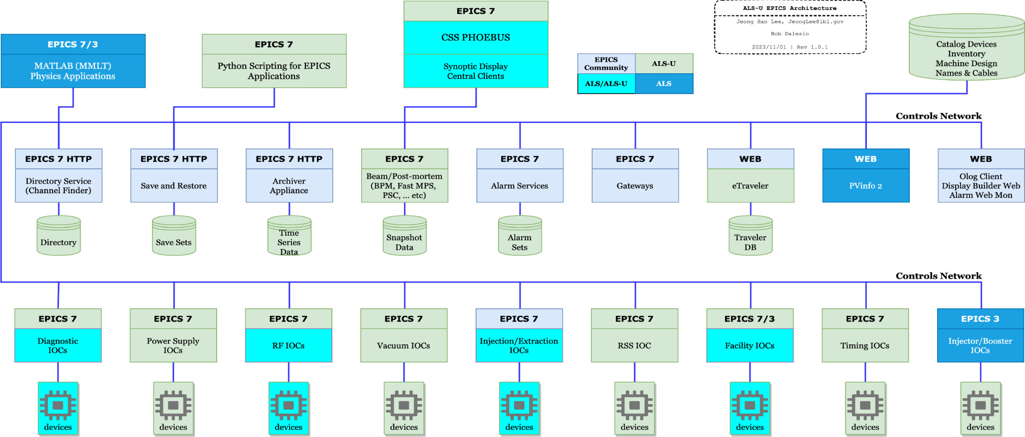
ALS-U Controls Software Architecture
- ALS-U Accelerator Control System Status by Jeong Han Lee (Apr 17, 2024)
Alarm service is major one of the full control software services of ALS-U.
The purpose of this presentation is to understand the phoebus alarm service and how to test it on a standalone virtualized system.
Notes:
This picture shows ALS-U Controls Software Architecture.
It was presented by jeong han lee yesterday.
Alarm service is major one of the full control software services of ALS-U.

Slide 4
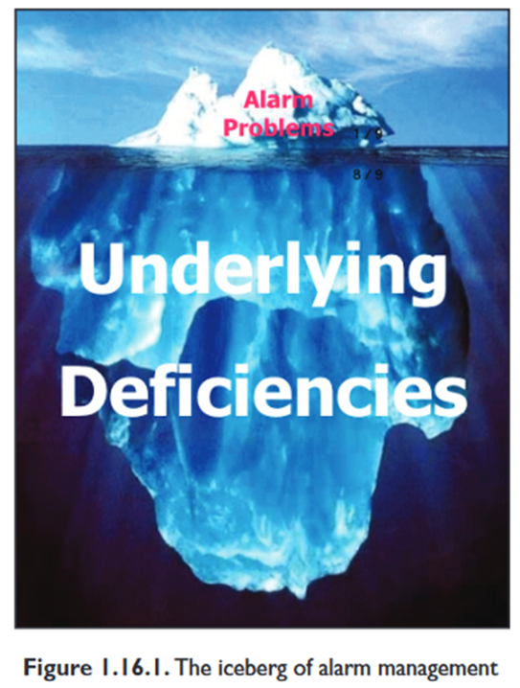
Overview alarm on process control
Industrial alarms are important event signals for notifying operators of abnormal or potentially hazardous situations, deviations from operation setpoints, equipment malfunctions, or when process variables fall outside defined limits with undesirable or unsafe values.
A common cause of major industrial accidents as follows: - Persistently incorrect decision made by the operator based on the incorrect information. - Failure to respond appropriately for the case where various problems occur continuously, rather than a problem caused by a single malfunction.
Does the effective alarm management system help what?
- Protects property and valuables from critical malfunctions
- Ensure the soundness of the system for plant process
- Makes the system operation predictable

Slide 5
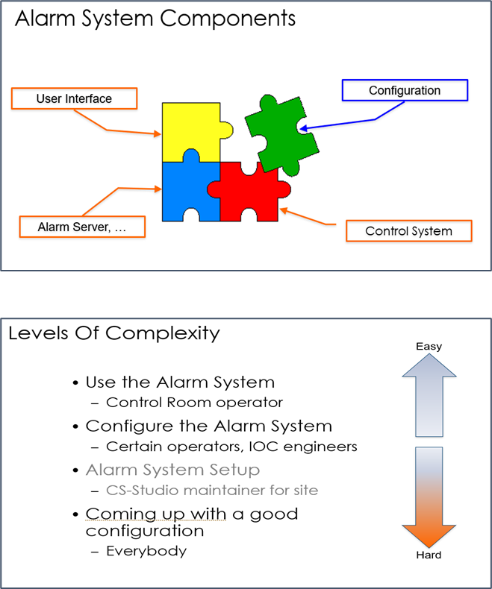
Overview alarm on process control
Alarm (USPAS 2022) by Kay Kasemir
Level of complexity for alarm management
Easier to prepare for alarm server, control system and alarm UIs relatively.
Increases the complexity of good alarm configuration depending on the requirements.
Why is the good alarm configuration difficult?
Requires analysis and diagnosis for fundamental problems among the stakeholders.
Sometimes, need a dynamic alarm setting values according to operation stage.
Appropriated action based on the diagnosis and analysis for those alarms.
Basically recommendation, keep in mind two things to simplify the alarm configuration as a principles
Should not be a process that requires handling more than 10 alarms within an hour.
One alarm procedure should be provided for removing one alarm item.

Slide 6
Alarm Test Environment for ALS-U
Phoebus Alarm Management System
ALS-U will utilize a phoebus-based alarm system for control system operation.
Created the virtual machine to enable independent and self-testing.
Allows you to understand how the alarm operates by changing manual alarm setting values.
Can be tested the alarm system under a dynamic operation environment through fishtank PID control simulation.
Can make plans for how to operate the alarm system into your facility.

Slide 7
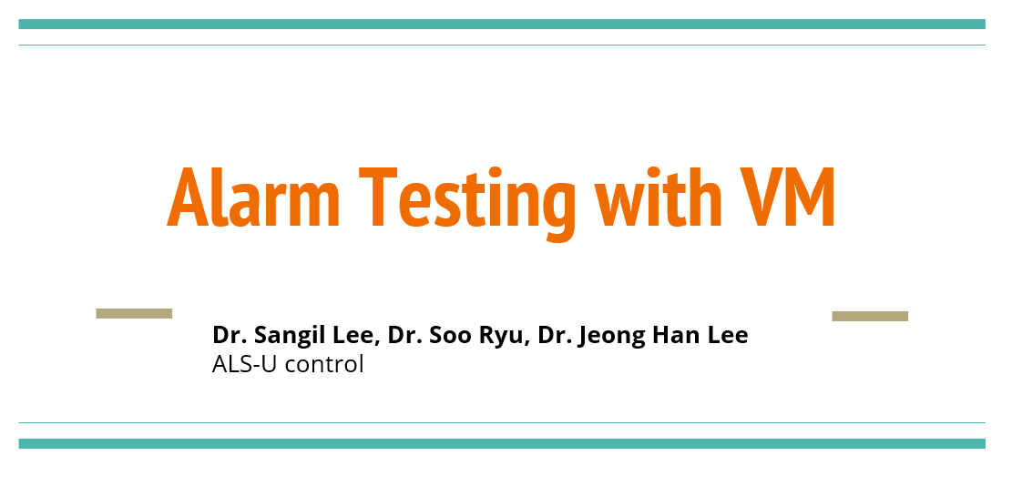
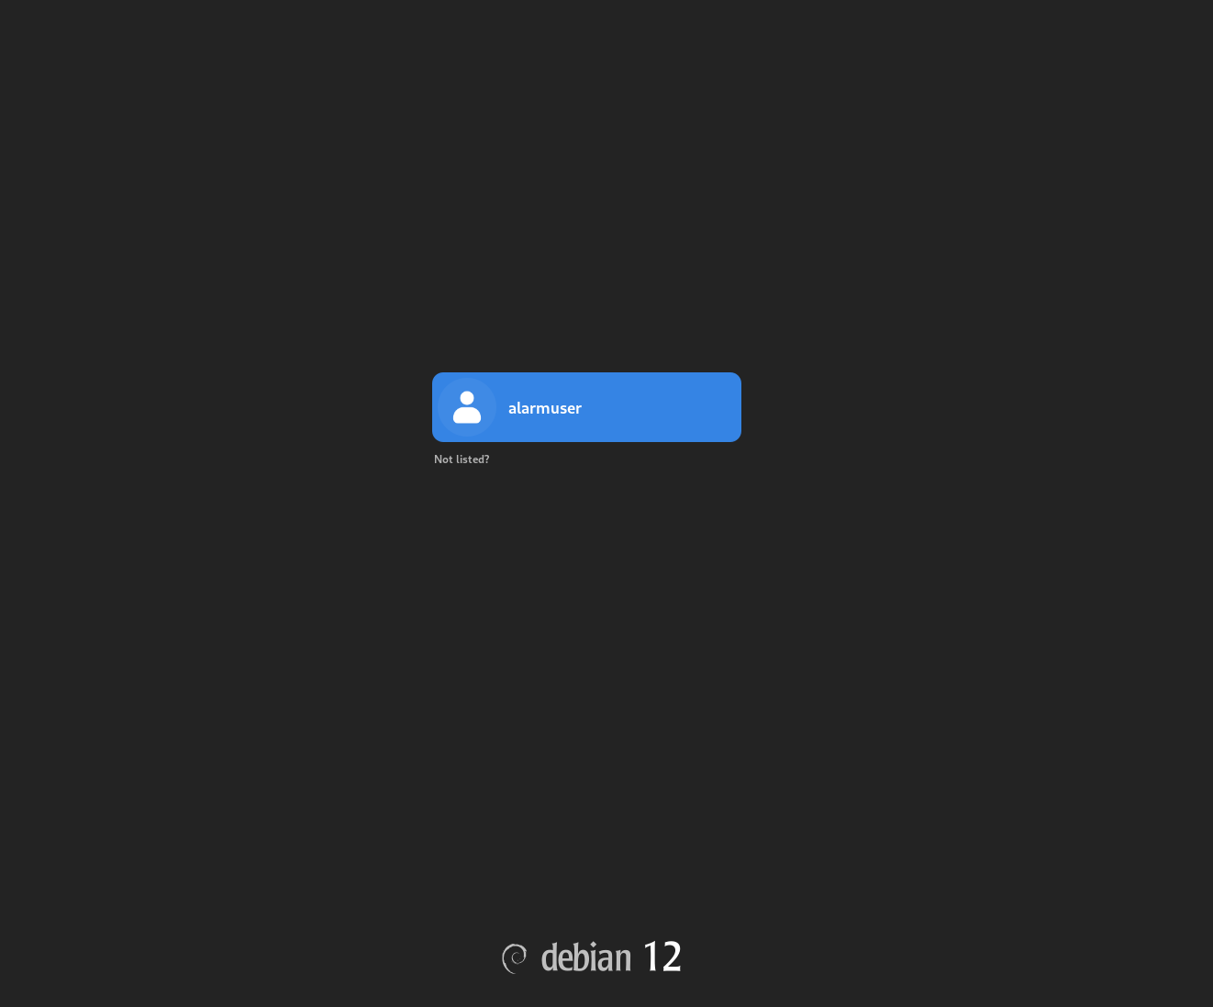
Alarm Test Environment for ALS-U
Phoebus Alarm Management System
https://drive.google.com/drive/folders/1E8em5bsPzDdRZ8VVijdkhfPALwT5QlFg
1. Alarm Test Guidance with VM
Two steps to verify alarm system following the guide:
$>startAlarm.sh // start alarm trio services
$>phoebus // then, follows the test guideline.
$>stopAlarm.sh // stop alarm services.
2. Debian12VM_Alarm.ova(Virtual Box 7.0.x higher)

Slide 8
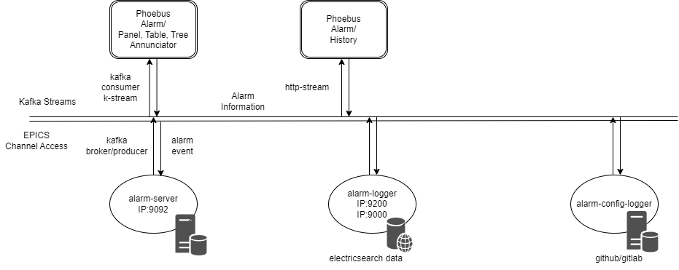
Alarm Test Environment for ALS-U
Phoebus Alarm Management System
Need to 3rd party software packages
Kafka Message Broker
Elasticsearch
Git
Alarm trio services(phoebus/services/
Alarm server based on Kafka : alarm event/config to kafka message
Alarm logger based on elasticsearch : alarm message to elasticsearch data
Alarm config logger based on git : alarm config version control with git
Alarm UIs
Area Panel
Alarm Tree
Alarm Table
Annunciator
Alarm Log Table

Slide 9
Alarm Test Environment for ALS-U
Phoebus alarm parameters in settings.ini(example), Red are crucial parameters to connect to alarm service.
Alarm server service setting
org.phoebus.applications.alarm/server=Alarm_IP:9092 # kafka broker config IP:port
org.phoebus.applications.alarm/config_name=Accelerator
org.phoebus.applications.alarm/config_names=Accelerator, Demo
org.phoebus.applications.alarm/alarm_area_level=2
org.phoebus.applications.alarm/alarm_area_column_count=3
org.phoebus.applications.alarm/alarm_table_max_rows=1000 #In case alarm flooding, should be set
Alarm logger service setting
org.phoebus.applications.alarm.logging.ui/service_uri=http://Elasticsearch_IP:9000 #Alarm log table REST service
org.phoebus.applications.alarm.logging.ui/results_max_size=1000 #In case alarm flooding, should be set

Slide 10
Alarm Test Environment for ALS-U
Phoebus Alarm UI(1/5) – Area Panel
Major functions
Load Alarm Config (i.e. Accelerator or Demo)
Must be designed so that the current system status can be comprehensively assessed at once.
Displays the status of a group for a representative system (i.e. Alarm Groups for LLRF, Cryo, Control, AR, SR, …)
Displays alarm information based on the “alarm_area_ level” setting in the initial alarm config(Accelerator, Demo)
Generally, “alarm_area_level=2” is used as the most appropriate value for the alarm.(setting.ini)
Default color: red(major: HIHI, LOLO), orange(minor: HIGH, LOW), green(normal), brown(acknowledged alarm), purple( disconnected alarm)
Milestone display that allows you to see at a glance the status of representative alarms by group for the entire system.

Slide 11
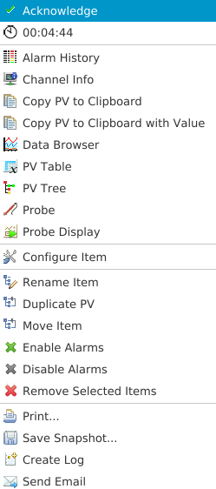
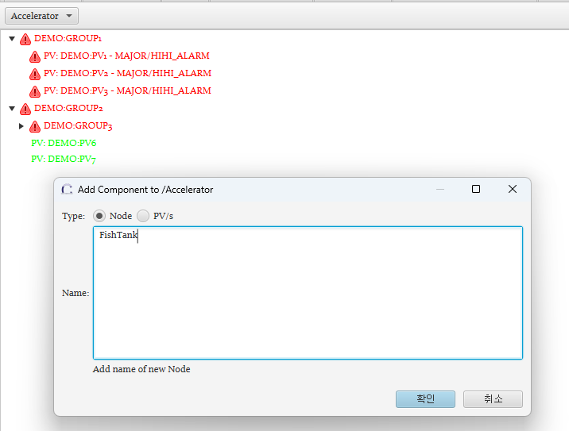
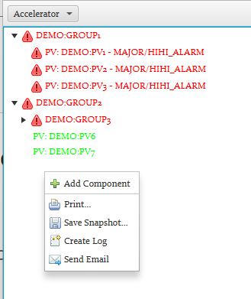
Alarm Test Environment for ALS-U
Phoebus Alarm UI(2/5) – Alarm Tree
Major functions
Display the status of all alarms in tree form(node and leaf) according to alarm config.
Adding new alarm group and new pv list into the group in the config file.
Update alarm event with alarm color.
Can modifying the configured items(Rename, Move, Enable/Disable alarms)
Can move to configure panel for each alarm.
Design a systematic alarm configuration for each system.

Slide 12
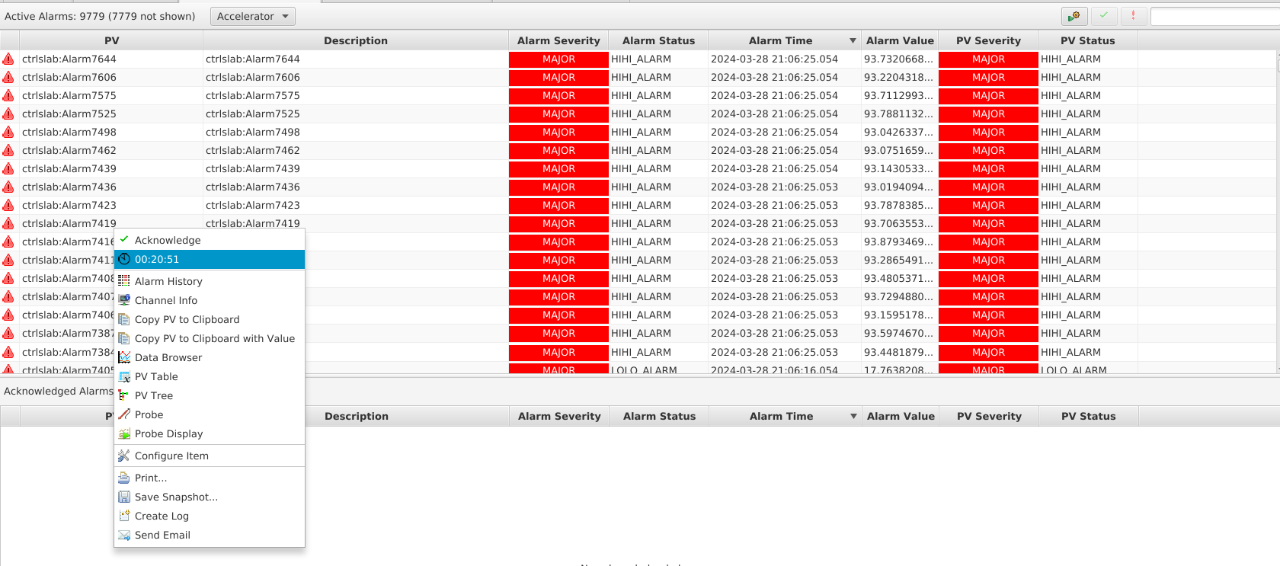
Alarm Test Environment for ALS-U
Phoebus Alarm UI(3/5) – Alarm Table
Major functions
Screen that operators use most frequently among the alarm UIs.
Display alarm information(PV, Description, Alarm Severity, Alarm Status, Alarm Time, Alarm Value, PV Severity, PV Status) with alarm color according to alarm config.
Display acknowledged alarm list based on alarm priority.
Can be operated by interacting with the alarm configure screen(guidance, alarmed screen, command, actions).
Operators can perform the remedy procedure according to alarm guidance from this screen

Slide 13
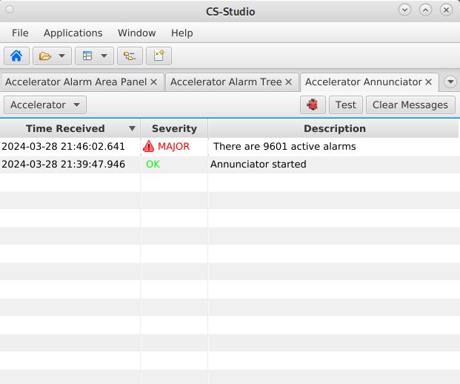
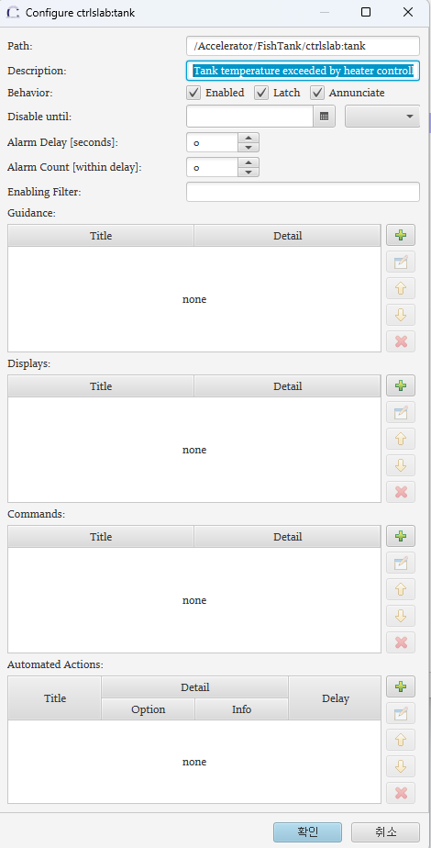
Alarm Test Environment for ALS-U
Phoebus Alarm UI(4/5) – Annunciator
Major functions
When activate the annunciator screen, alarm voice can be serviced.
Voice service for alarm occurrence in situations where the operator does not recognize the alarm screens.
First, should be set annunciate parameter in configure panel

Slide 14
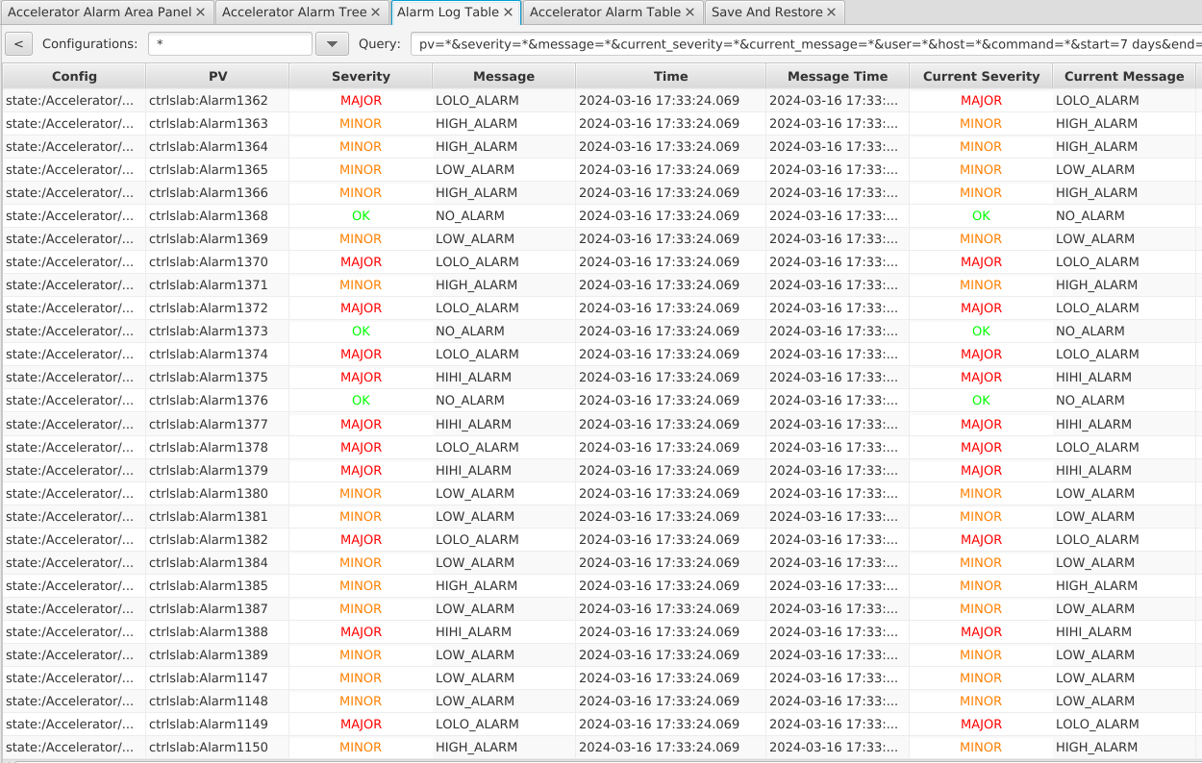
Alarm Test Environment for ALS-U
Phoebus Alarm UI(5/5) – Alarm Log Table
Major functions
Save alarm historical data to elasticsearch data(elasticsearch/data/…)
When the alarm state changed, alarm items configured newly, alarm command(ack/nonack, cmd, actions)
Works based on elasticsearch service.
Using http stream on REST API

Slide 15
Phoebus Alarm UI – Alarm Configure Panel
Most important to config the alarm procedure.
Description: Describes information for operator to understand the alarm. It serves as a starting point for tracking alarm.
Enabled: Alarm activation or deactivation
Latch: Even if the alarm goes into normal state after an alarm occurs, the alarm is maintained. It is released only when ACK is issued in normal state.
Annunciate: When an alarm occurs, notify by voice.
Disable until: Deactivates the alarm until a specific period of time.
Alarm Delay: Delay by a set number of seconds after alarm occurrence.
Alarm Count: Alarm delay according to alarm occurrence count.
Enabling Filter: Alarms are filtered using filter conditions based on the mutual relationships between alarms.
Guidance: When an alarm occurs, action procedures for the alarm are written sequentially.
Displays: Write a process screen path to show the screen for an alarm that occurred.
Commands: Can execute and register batch processing commands for the alarm.
Automated Action: Performs automated actions on alarm event triggers.
- mailto: Notify the alarm by means of e-mail. - cmd: Execute the automated procedures - sevrpv: Triggering the registered severity PV

Slide 16
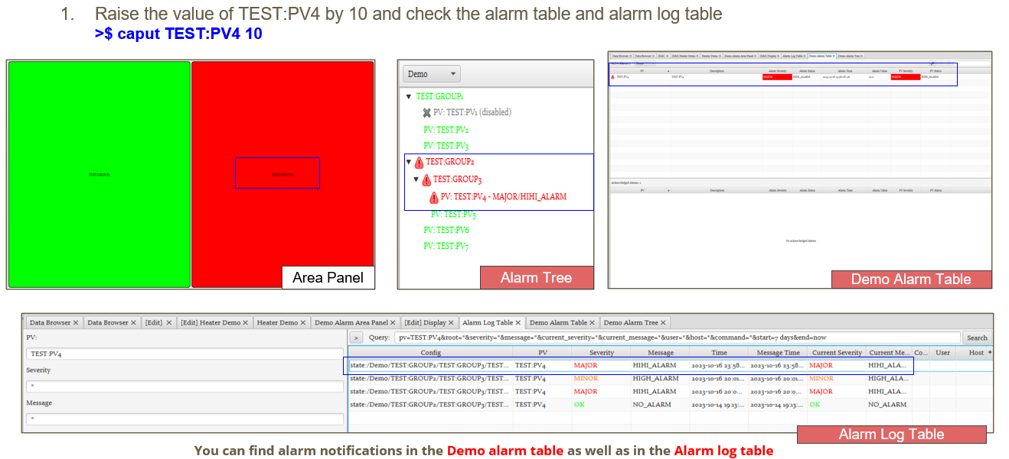
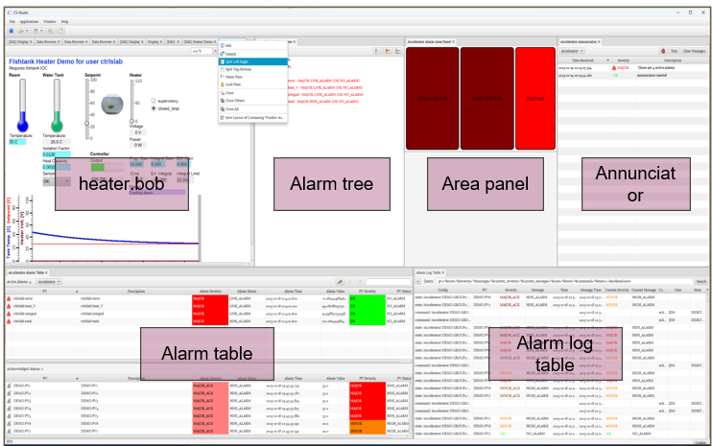
Example testing - using alarm test environment for ALS-U
1. Static alarm testing
Users can change value of alarm limit.
Check changes in Alarm UIs.
Users operate Alarm UIs to test settings that follow the alarm procedure.
2. Dynamic operation alarm testing
PID logic of heater controller operate by itself.
Users change only control setting value.
Verify how to operate alarm UIs according to the operation logic.

Slide 17
Deploy Alarm Testing Environment for ALS-U
ALS-U Practical Guide to Alarm Testing
https://dodocs.google.com/presentation/d/1rJvOe0SQ66hR3CHDI1UMzrPm-DJmr17Hklwi6O-p-vI/edit#slide=id.g28c54658ec3_0_143
Alarm Testing Environment(VirtaulBox VM) for ALS-U
https://drive.google.com/file/d/1hFdzPKgpybOtlzesfGcN5EsjWMwxqLgw/view?usp=drive_link
Alarm Testing with VM (document to start)
https://docs.google.com/presentation/d/1Lp5tsifau1KFIs1Ga4tZHak_2T-PWAR98We-uQQ4f60/edit?usp=drive_link
Contact person
Authorization issues to download: Jeong Han Lee(jeonglee@lbl.gov)
Technical Issues to use the alarm test environment : Sangil Lee(silee7103@gmail.com)

Slide 18
Conclusions
An effective alarm system relies on generating and configuring meaningful alarms.
Basically, remember two things to setup for effective alarms
- Takes 1 hour to proceed 10 alarms(Process less than 10 alarms per hour).
- One alarm requires a remedy procedure to remove the alarm.
Alarm test environment for ALS-U will be a good starting point for you to understand, test and verify your phoebus alarm system.
Phoebus alarm system is not a completed version so far.
On developing with gradually improved functions.
Please contact Jeong Han if you need the alarm test environment. Jeong Han Lee(e-mail: jeonglee@lbl.gov): In case need a access authorization Sangil Lee(e-mail: silee7103@gmail.com): Technical issues to use test environment.

Slide 19
Thanks for your attention!
The best is the enemy of good enough.
- Russian folk wisdom

Slide 20
Backup Slides

Slide 21
Overview alarm on process control
Industrial alarms are important event signals for notifying operators of abnormal or potentially hazardous situations, deviations from operation setpoints, equipment malfunctions, or when process variables fall outside defined limits and approach undesirable or unsafe values.
Alarms are deeply involved in the work process of a specific field. An alarm management system exists to effectively manage these event signals.
Alarm problem is a phenomenon seen above the surface of iceberg for the fundamental defect beneath the surface of the iceberg.
A common cause of major industrial accidents is the persistently incorrect decision made by the operator based on the information about the current situation. In conclusion, it can be said that a major disaster is likely to occur if we fail to respond appropriately to the case where various problems occur continuously, rather than a problem caused by a single malfunction.

Slide 22
Overview alarm on process control
Necessity of alarm management
Protect property and valuables from critical malfunctions
Ensure the soundness of the system for plant process
Makes the system operation predictable
Milestone regarding the accelerator as each process phase progresses in the operation sequence
The alarm management system is an interconnected combination between work processes and technology in a specific field and becomes part of the overall process control system.
Worst of alarm management system - misrecognizes the state of the system and does not recognize the problematic alarm until the moment of collision.

Slide 23
Overview alarm on process control
Alarm (USPAS 2022) by Kay Kasemir
Difficulties for alarm management? - Is there a good alarm management system? No - Have a gool alarm configuration!
Why is difficulty a good alarm configuration? - alarm configuration: completion of the level is a last puzzle never ending => stakeholders, requires analysis and diagnosis among them. - Dynamic alarm setting values according to operation stage sometimes. - Remedy!!, appropriated action based on the diagnosis and analysis for those.
-

Slide 24
Overview alarm on process control
Best approach in the situation given to us? - Alarm philosophy / alarm convention - Alarm documentation (alarm guidance / procedure to ~ - Alarm management system(Phoebus alarm based on EPICS) help operators take correct actions! - Listen to the 2 references
Alarm Management for Process Control
Alarm Management Seven Effective for Optimum Performace
Patient : to Good – Better – Best to complete the configuration of alarm. - Accumulation of the operation experience is the process of increasing completeness of alarm configuration.

Slide 25
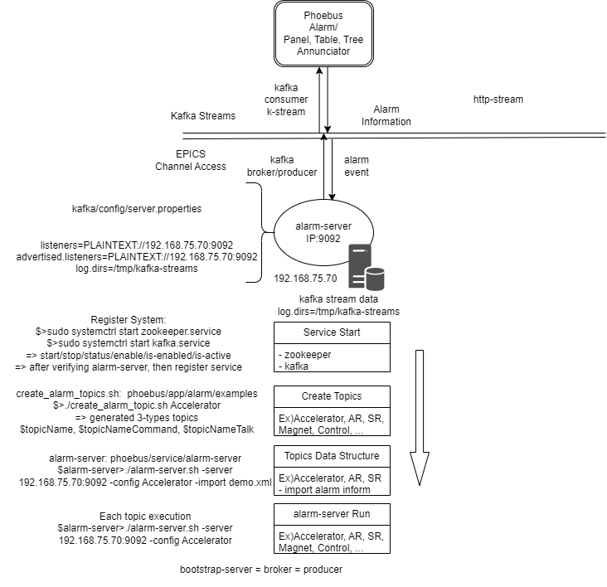
Phoebus Alarm Trio Services (1/3) – Alarm Server
Alarm server service
Detecting alarm events based on EPICS channel access
Sending the information messages(EPICS alarm events, alarm command/configuration) to each consumer as a producer of the kafka message broker
Need to property files for service
zookeeper.properties(default configuration OK)
server.properties in kafka(kafka/config/server.properties)
Change alarm server properties
Alarm UIs related upon alarm-server service
Area Panel / Alarm Tree / Alarm Table / Annunciator
Procedure to start service
1. Start zookeeper/kafka service using systemd(systemctrl)
2. Creation message topics(i.e. Accelerator, Demo, …) using kafka scripts given to alarm example
3. Run alarm-server

Slide 26
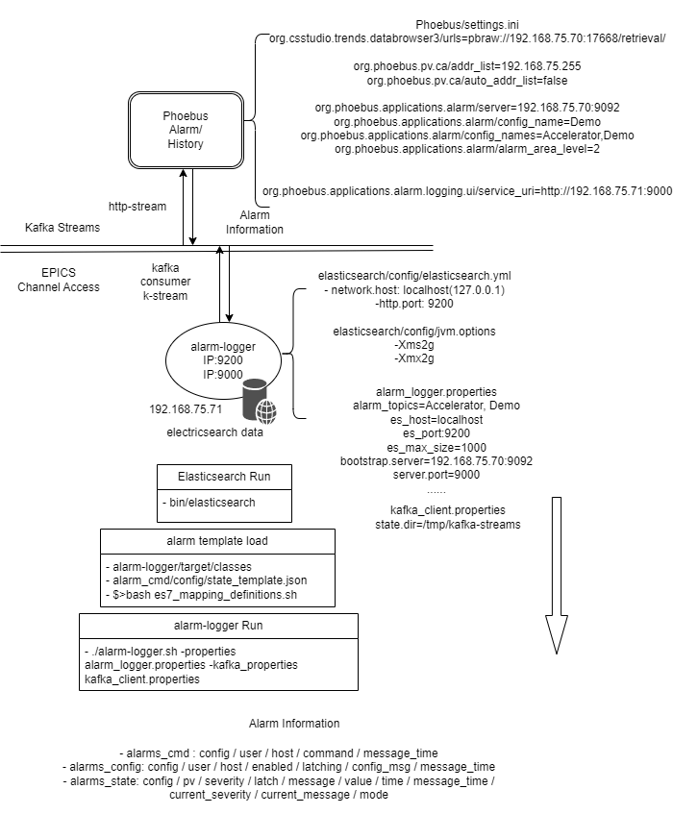
Phoebus Alarm Trio Services (2/3) – Alarm logger
Alarm logger based on elasticsearch
Based on elasticsearch
Historical data management for alarm state, alarm command and alarm configuration
http stream with REST API
Need to property files for service
elasticsearch.yml (elasticsearch/config/elasticsearch.yml)
Change alarm logger properties
Alarm UI related upon alarm-logger service
Alarm Log Table
Procedure to start service
1. Start elasticsearch service using systemd(systemctrl)
2. Run alarm-logger with properties file(option parameters)

Slide 27
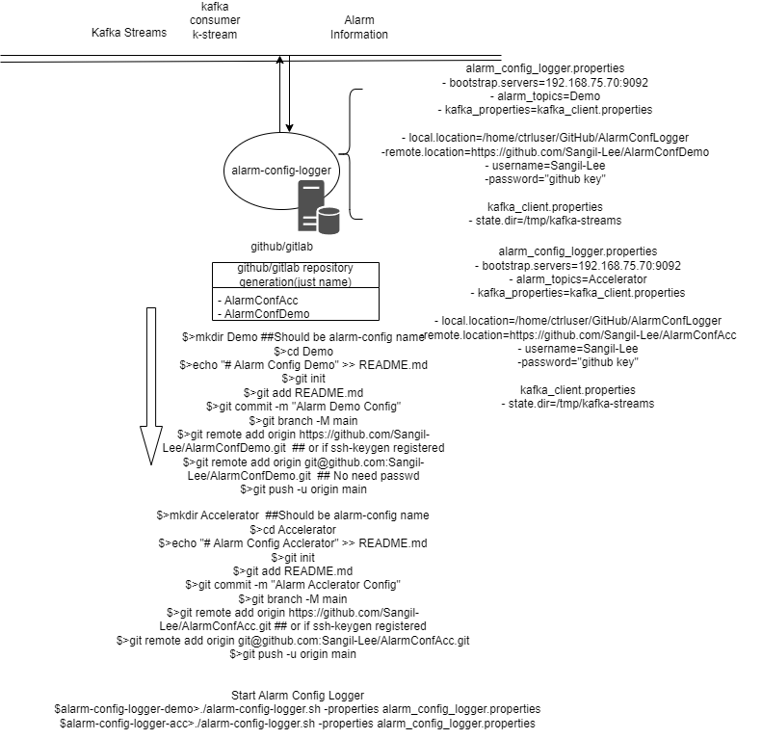
Phoebus Alarm Trio Services (3/3) – Alarm config logger
Alarm config logger with git(github/gitlab)
Version control for alarm configs using git service
Support for account / password
Support for ssh keygen registered
Related to phoebus alarm UI
None

Slide 28
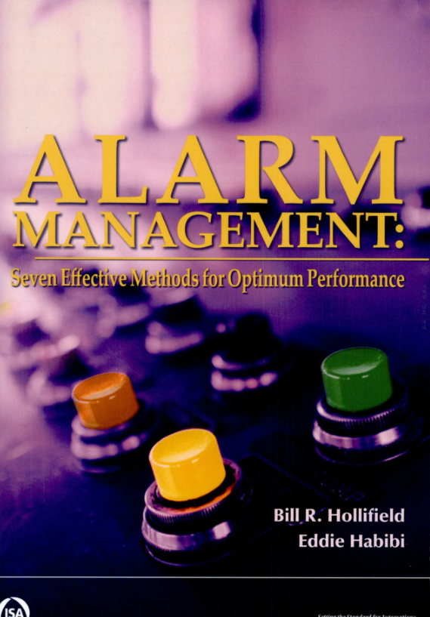
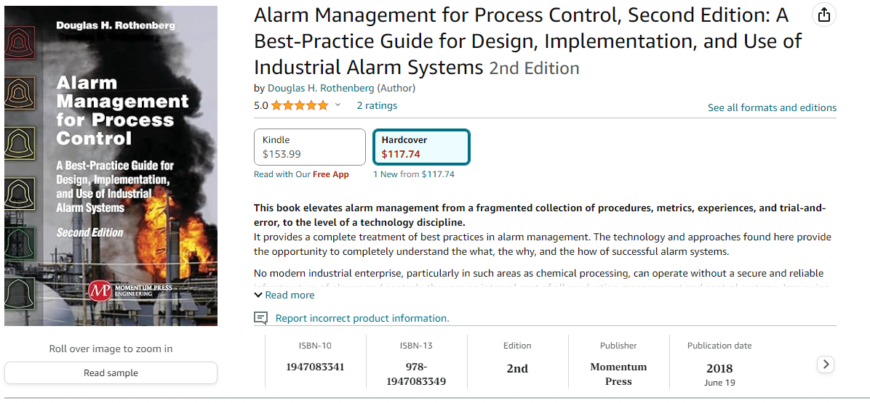
2 References
Alarm Management: Seven Effective Methods for Optimum Performance
Alarm Management for Process Control

