Slide 2
From Configuration to Simulation: “vd” in EPICS IOC Development
Marcin Lukaszewski
E9 Controls Ltd
2024 Spring EPICS Collaboration Meeting, Pohang

Slide 3
simulate device communication without coding

Slide 4
device
documentation
EPICS knowledge
time

Slide 5
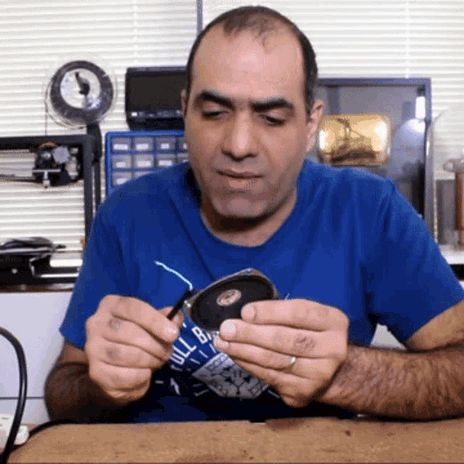

Slide 6
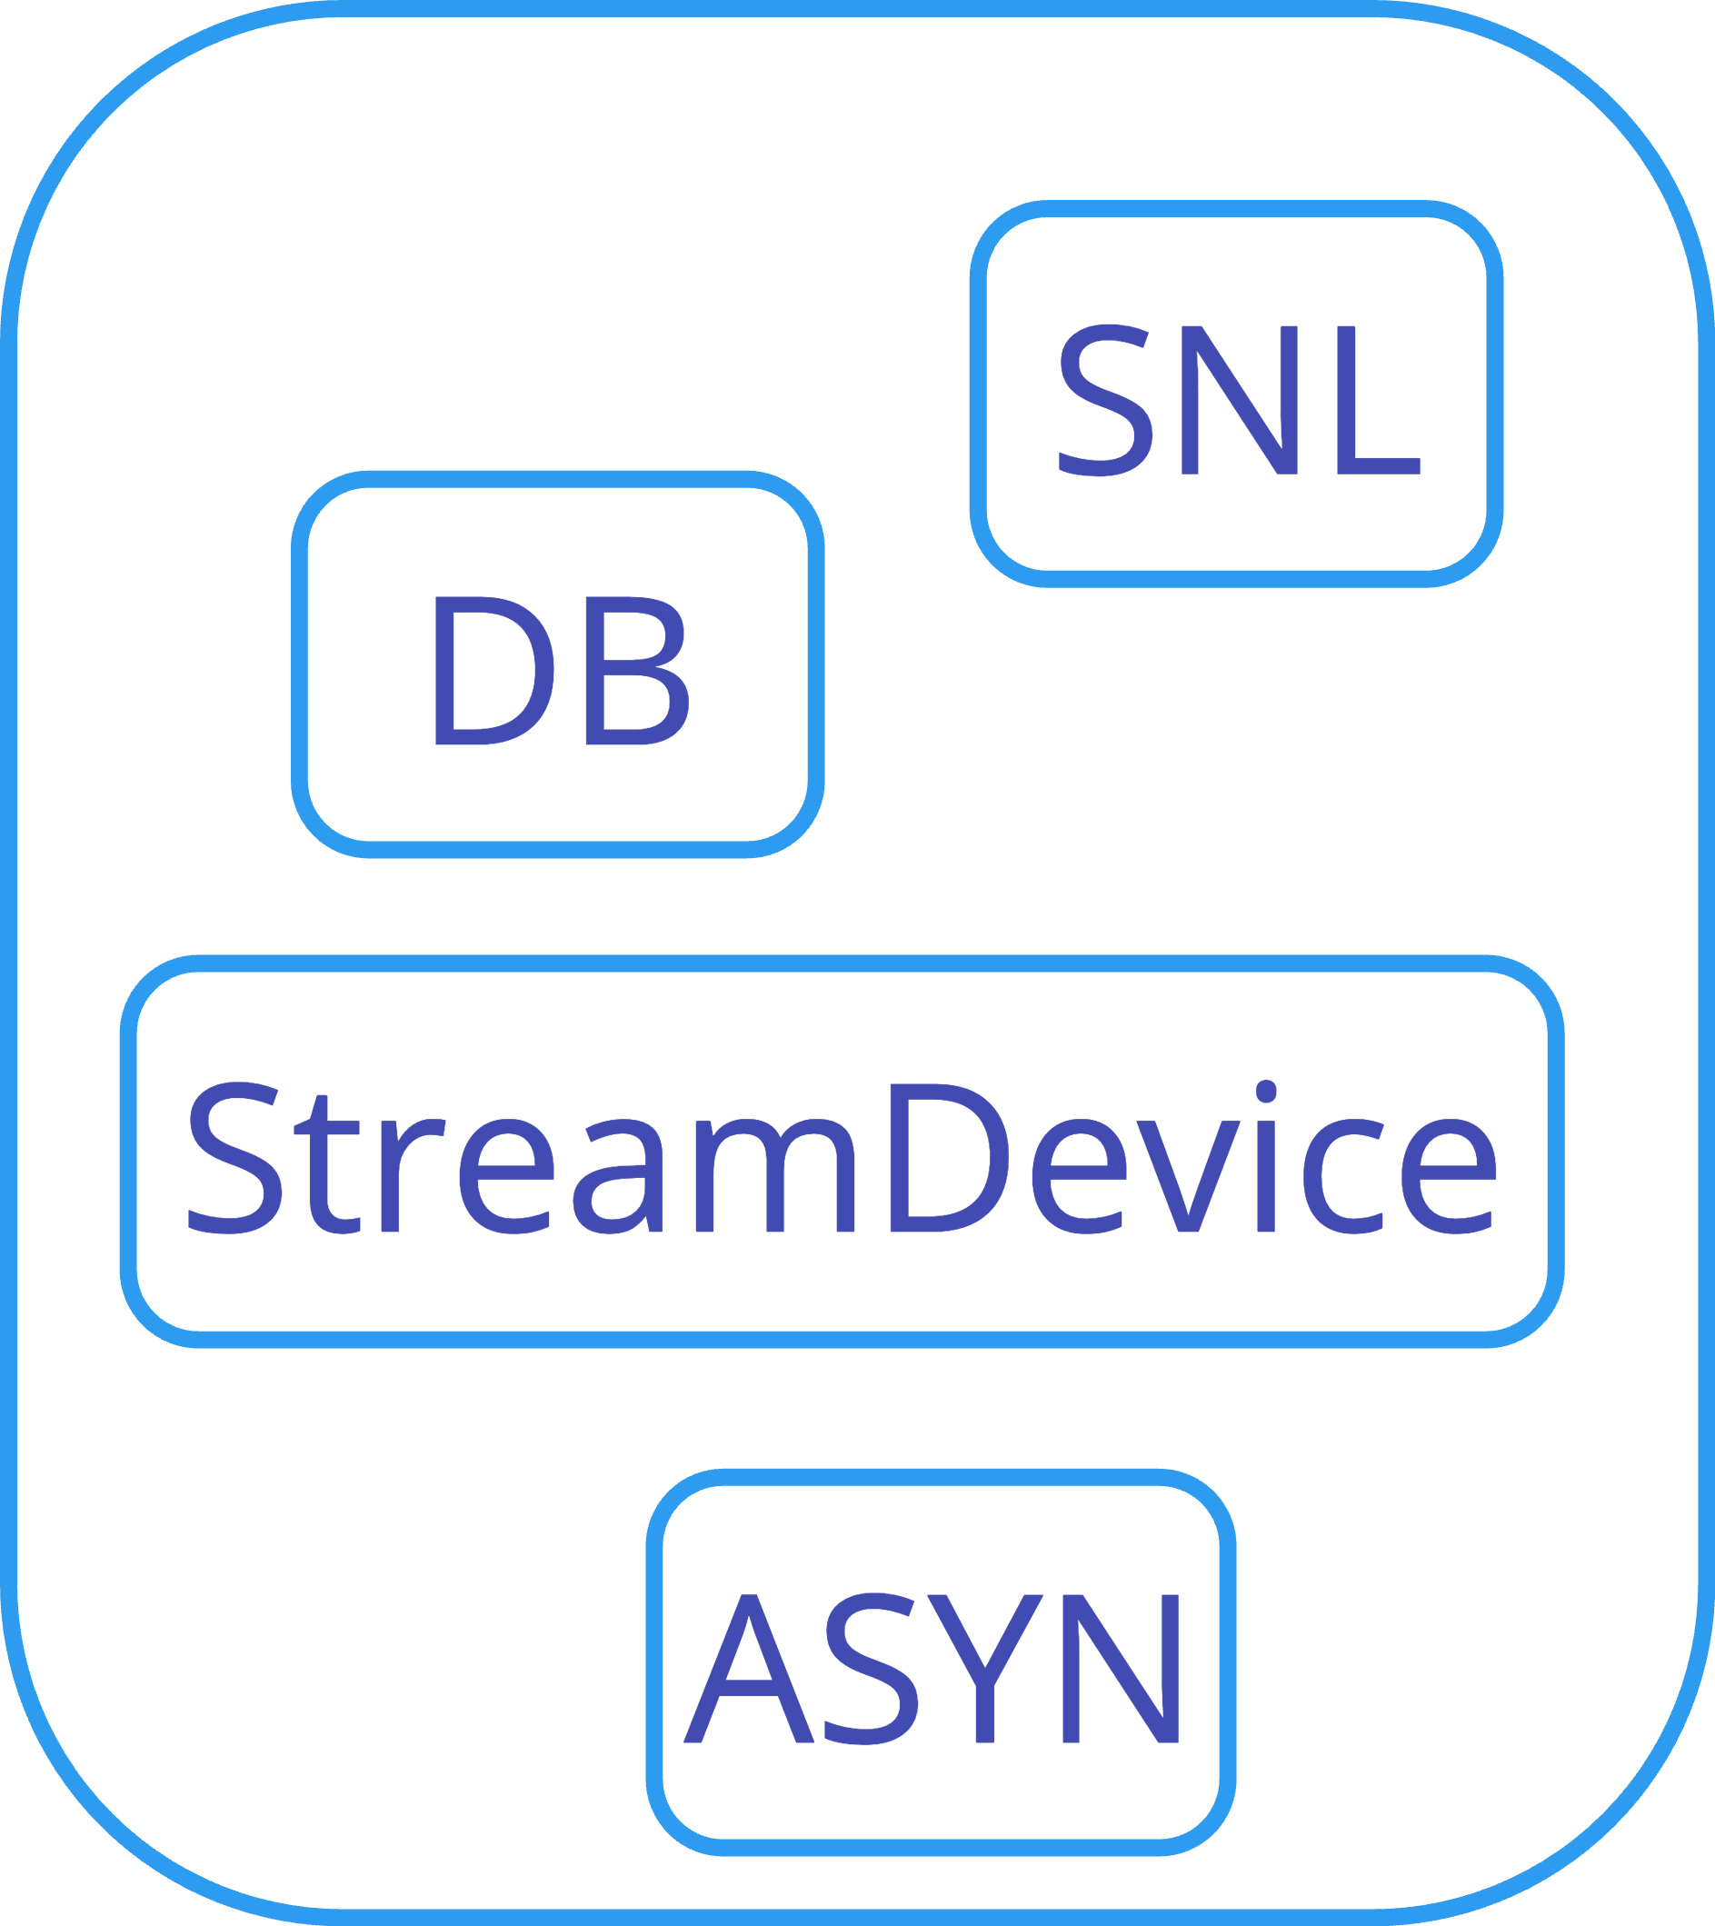

Slide 7
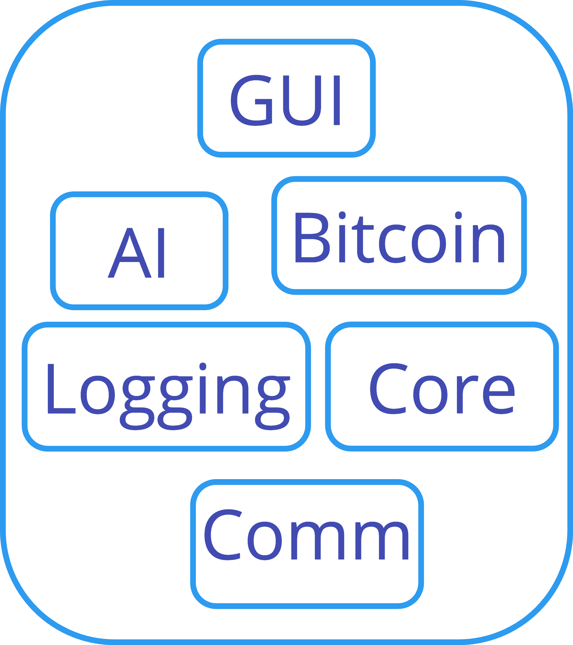

Slide 13
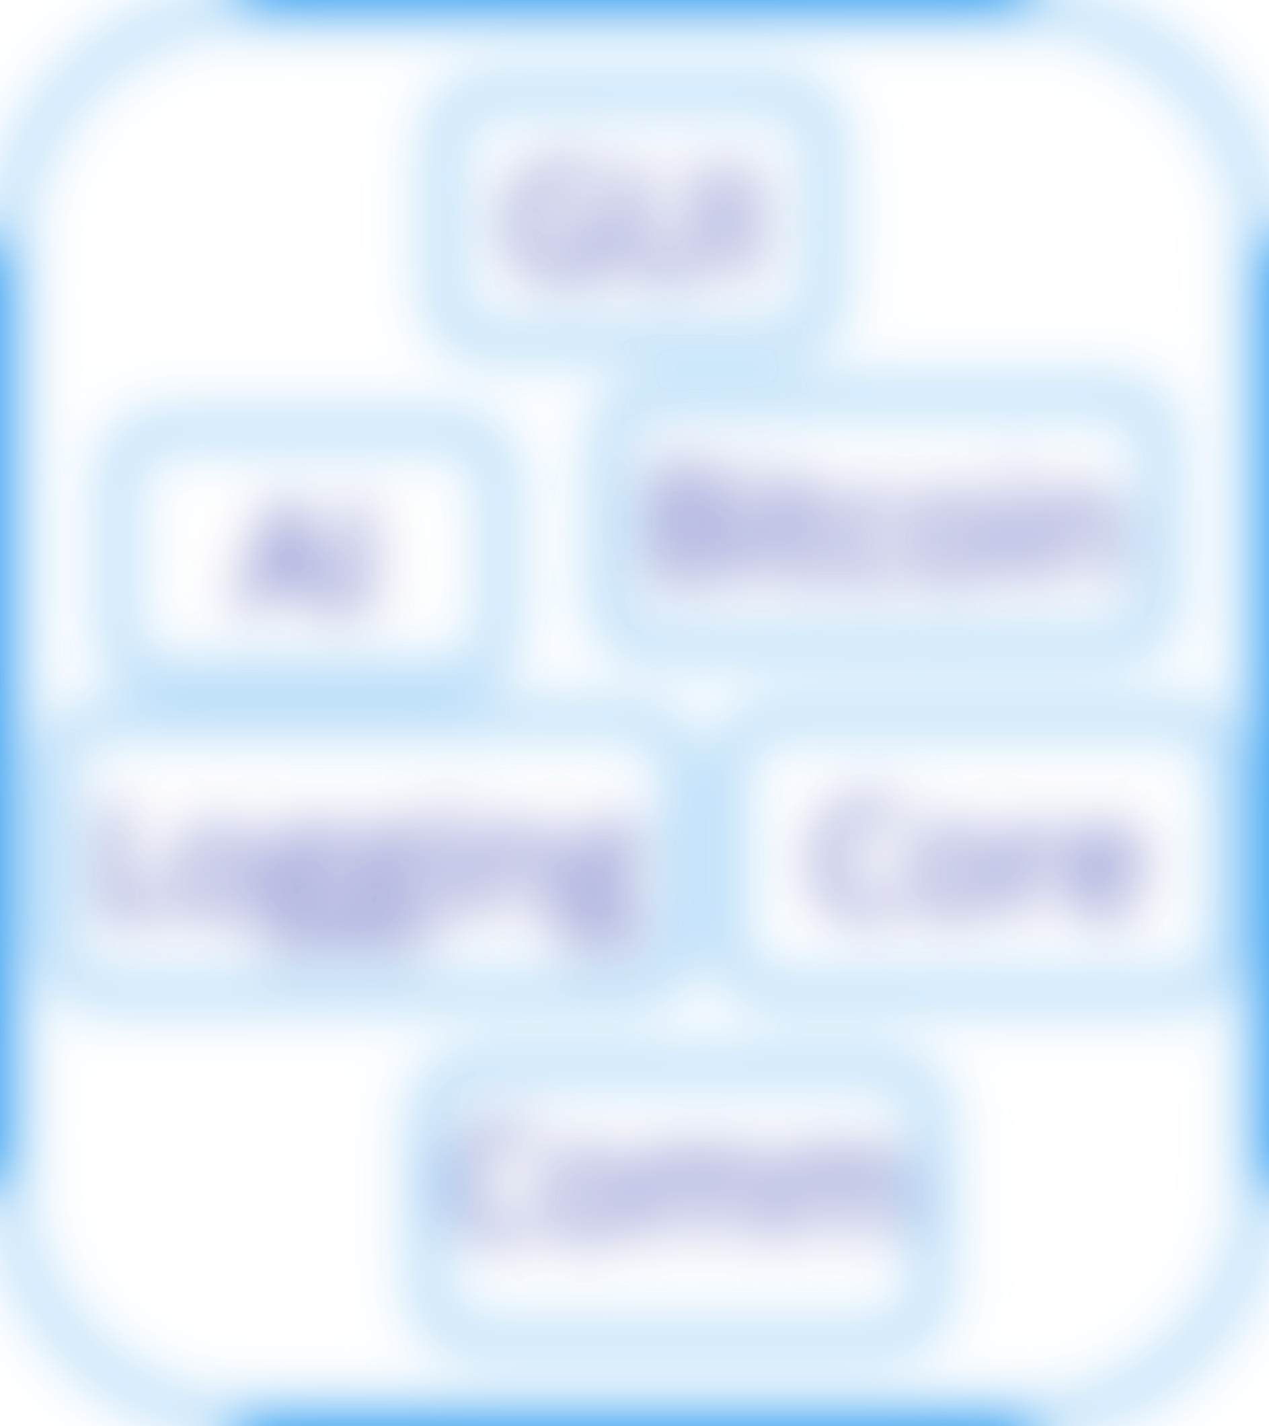

Slide 15
write a small script every single time
use existing tool
(LEWIS)

Slide 16
build a new tool

Slide 17
vd – virtual device

Slide 18
easy to configure
with a decent defaults
multi-platform
easy to install & run
developer and CI-friendly

Slide 19
single binary
low boilerplate
good support (open source)
design for cloud & network services
used widely in DevOps & SRE
good fit for CLI

Slide 20
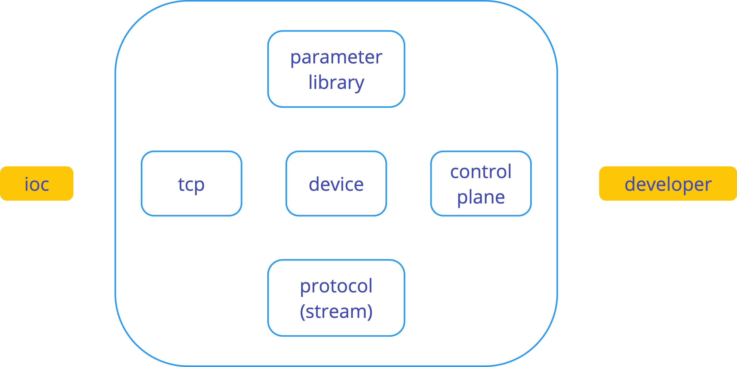

Slide 21
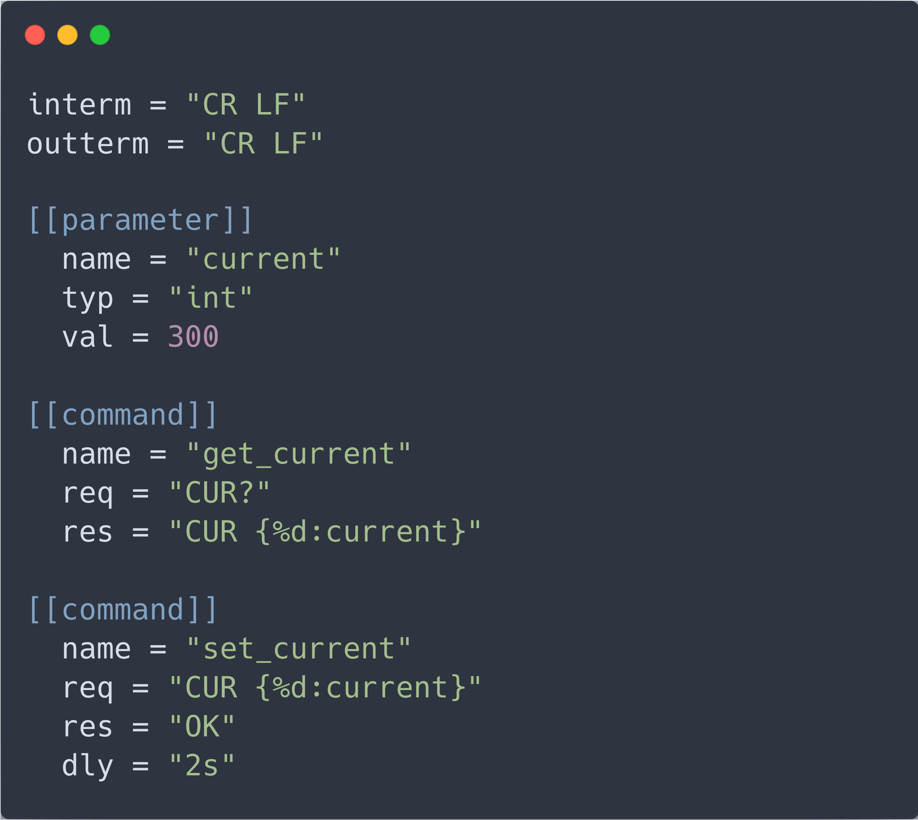

Slide 22
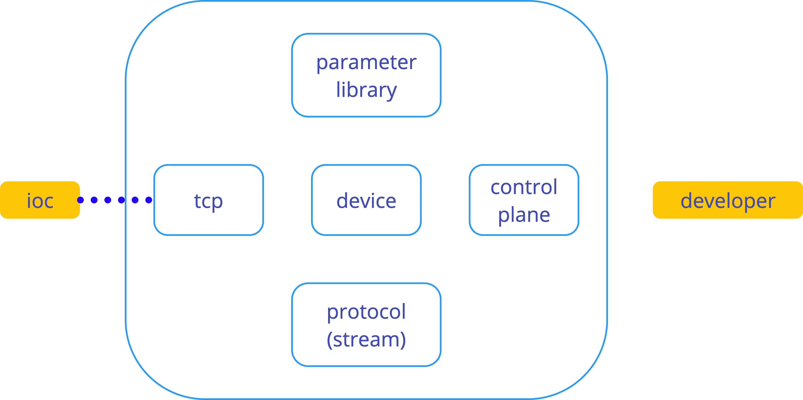
client connects

Slide 23
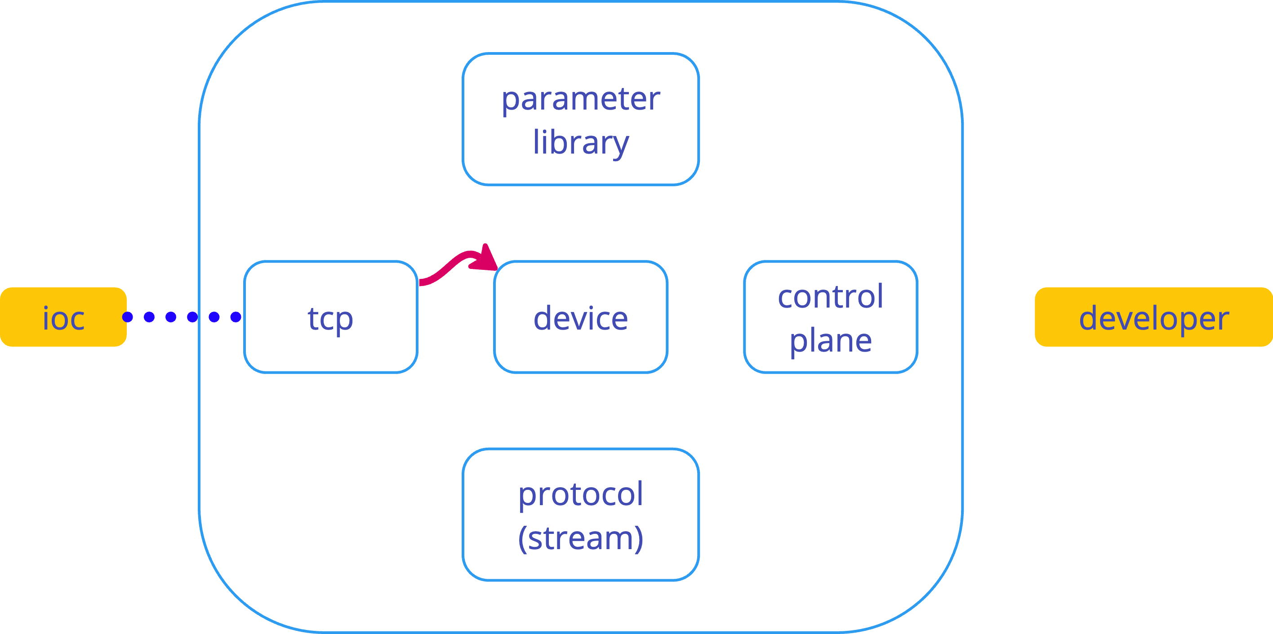
bytes received

Slide 24
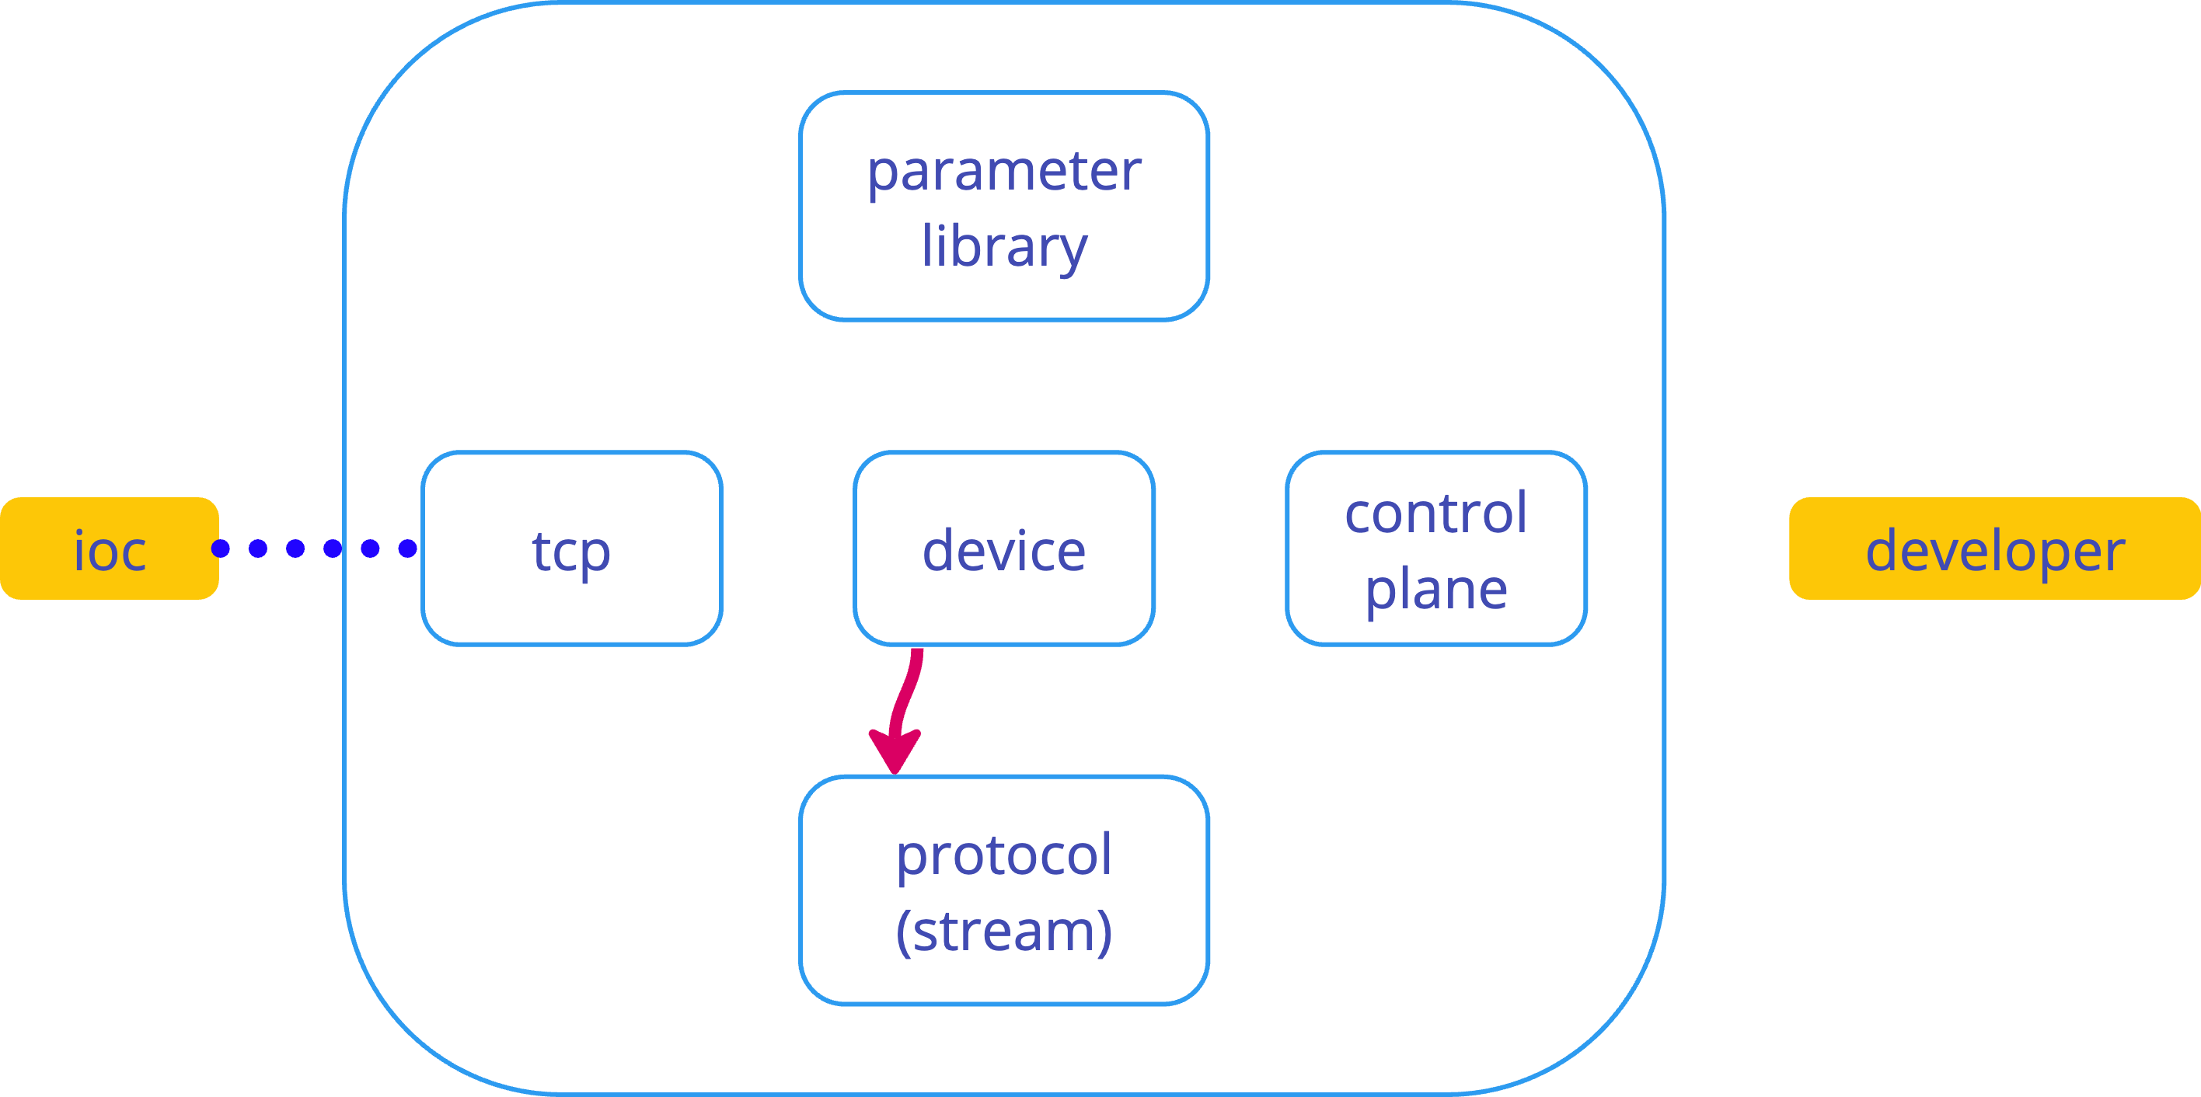
decode bytes

Slide 25
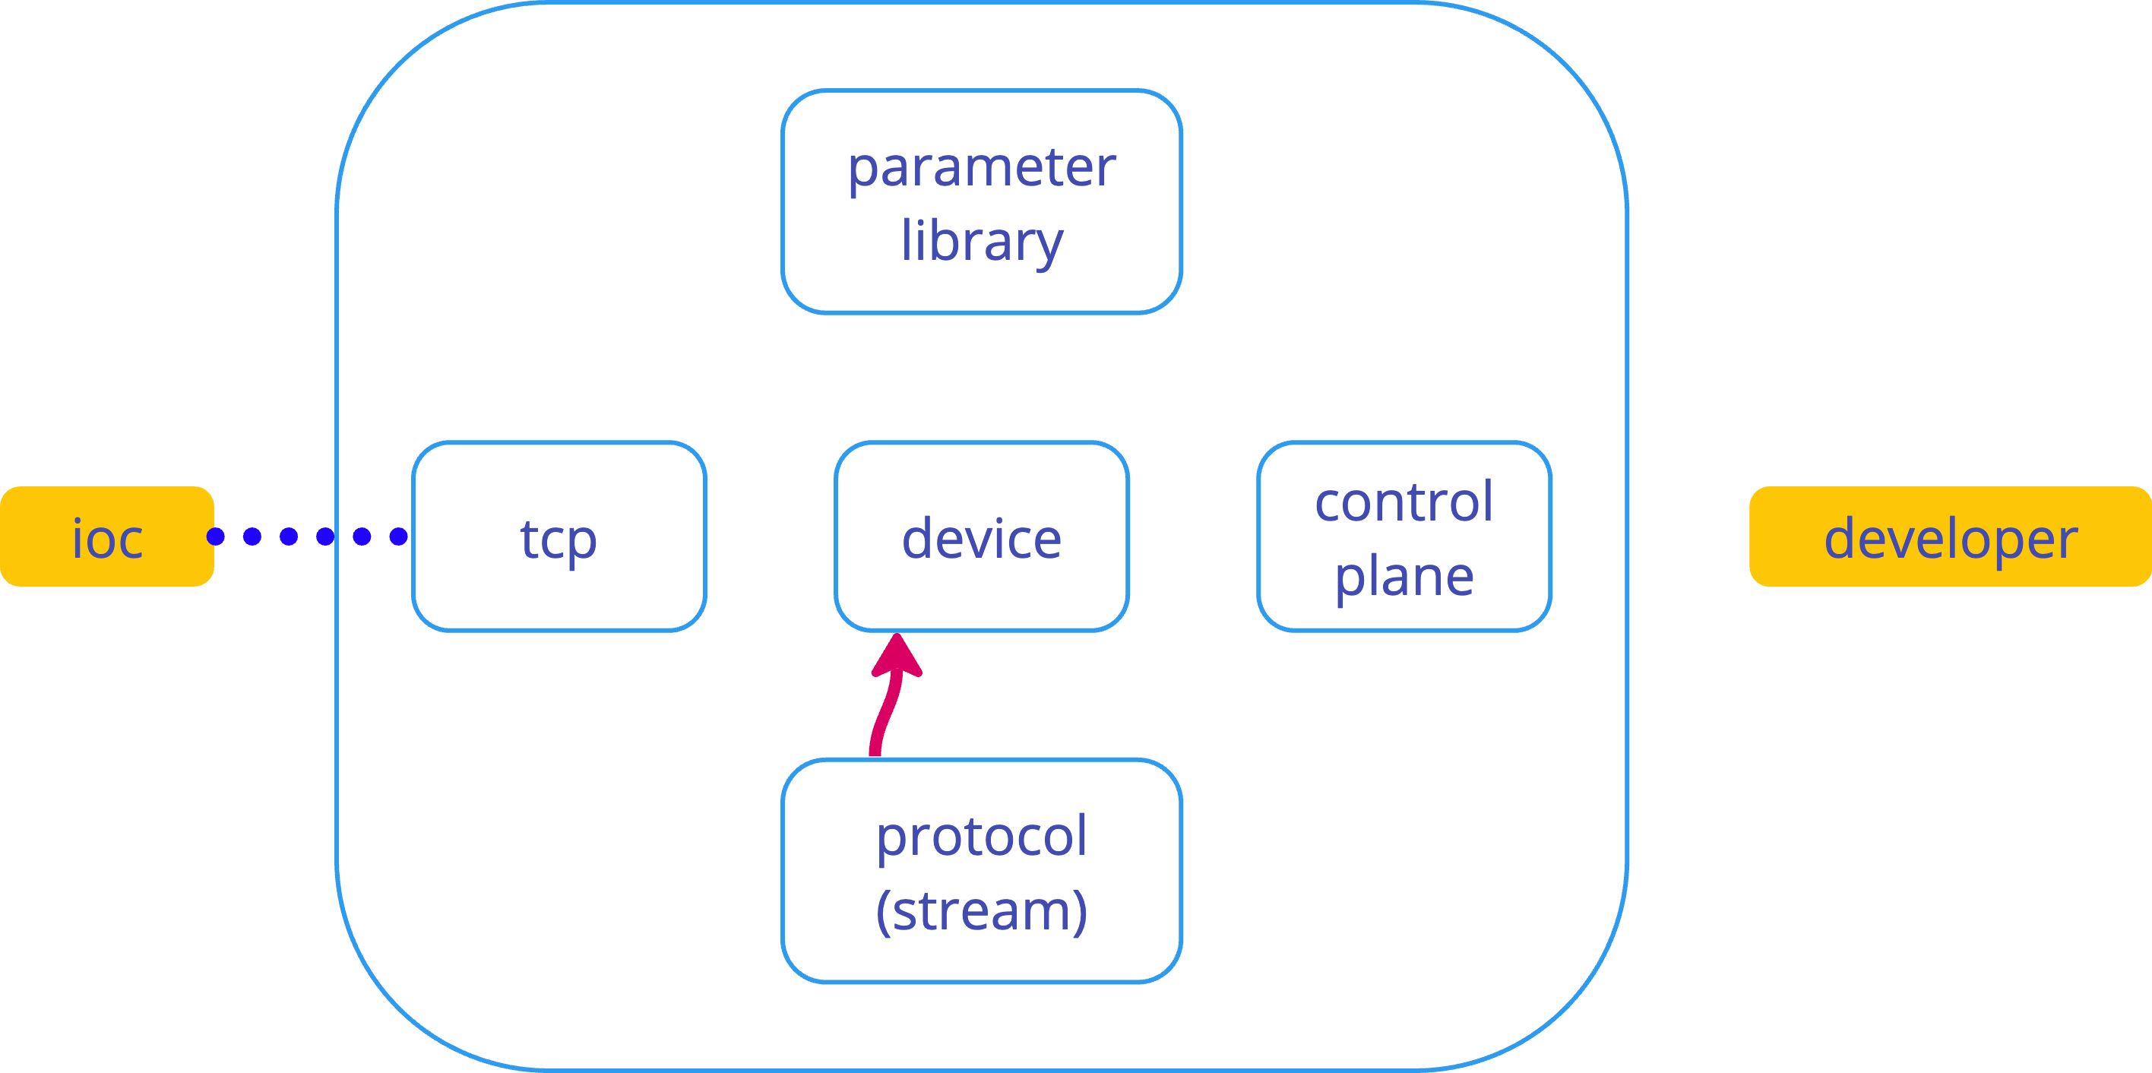
transaction

Slide 26
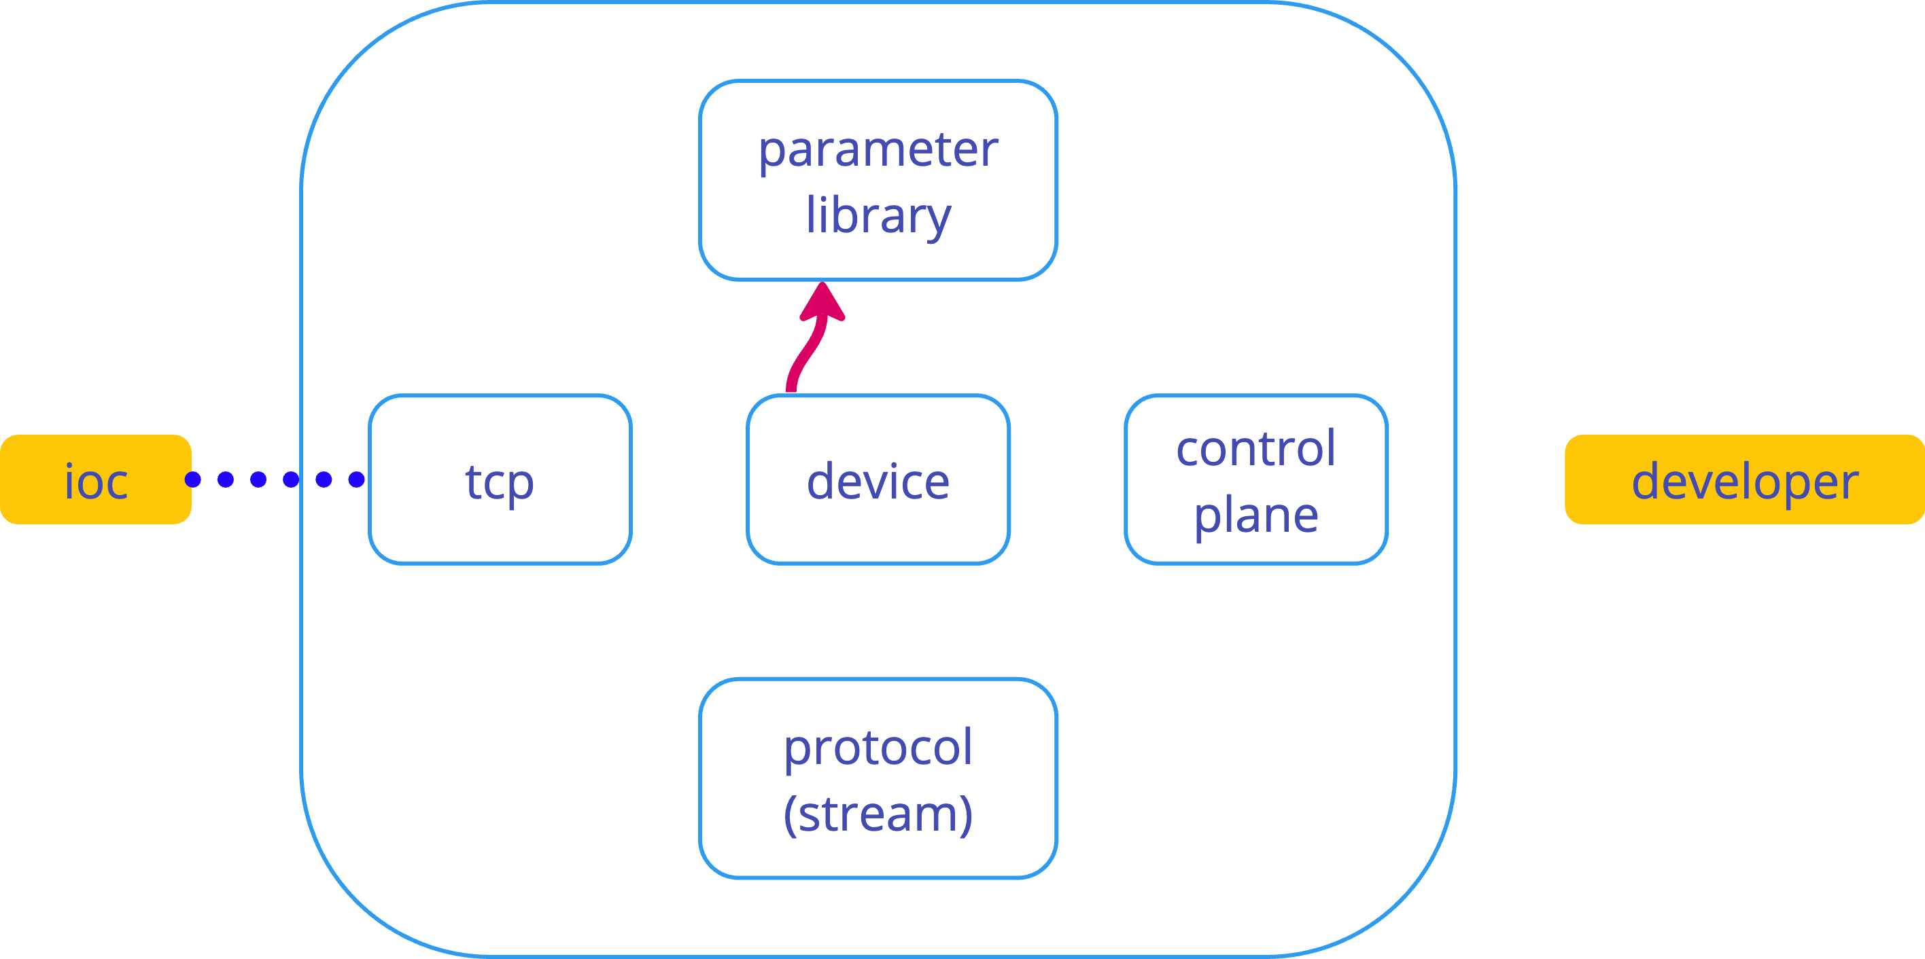
get/set value

Slide 27
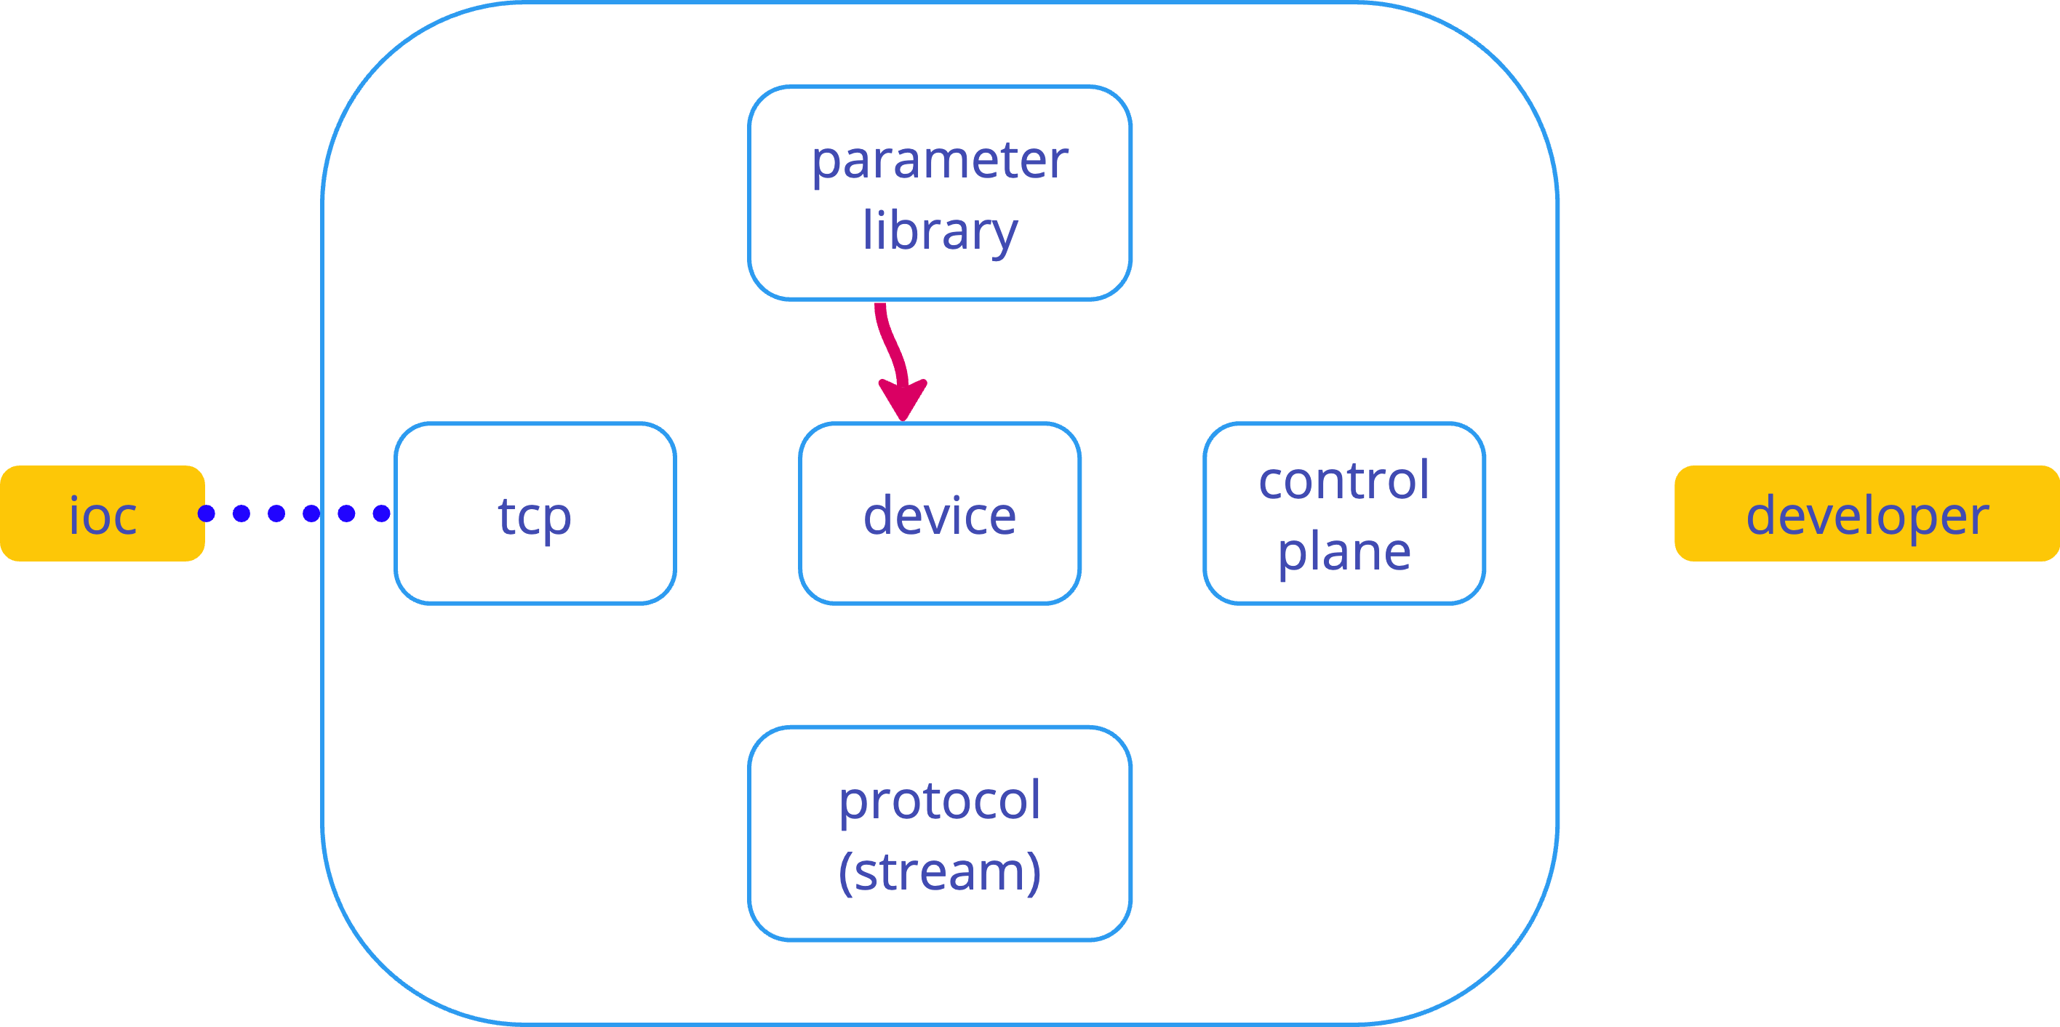
value/confirmation

Slide 28
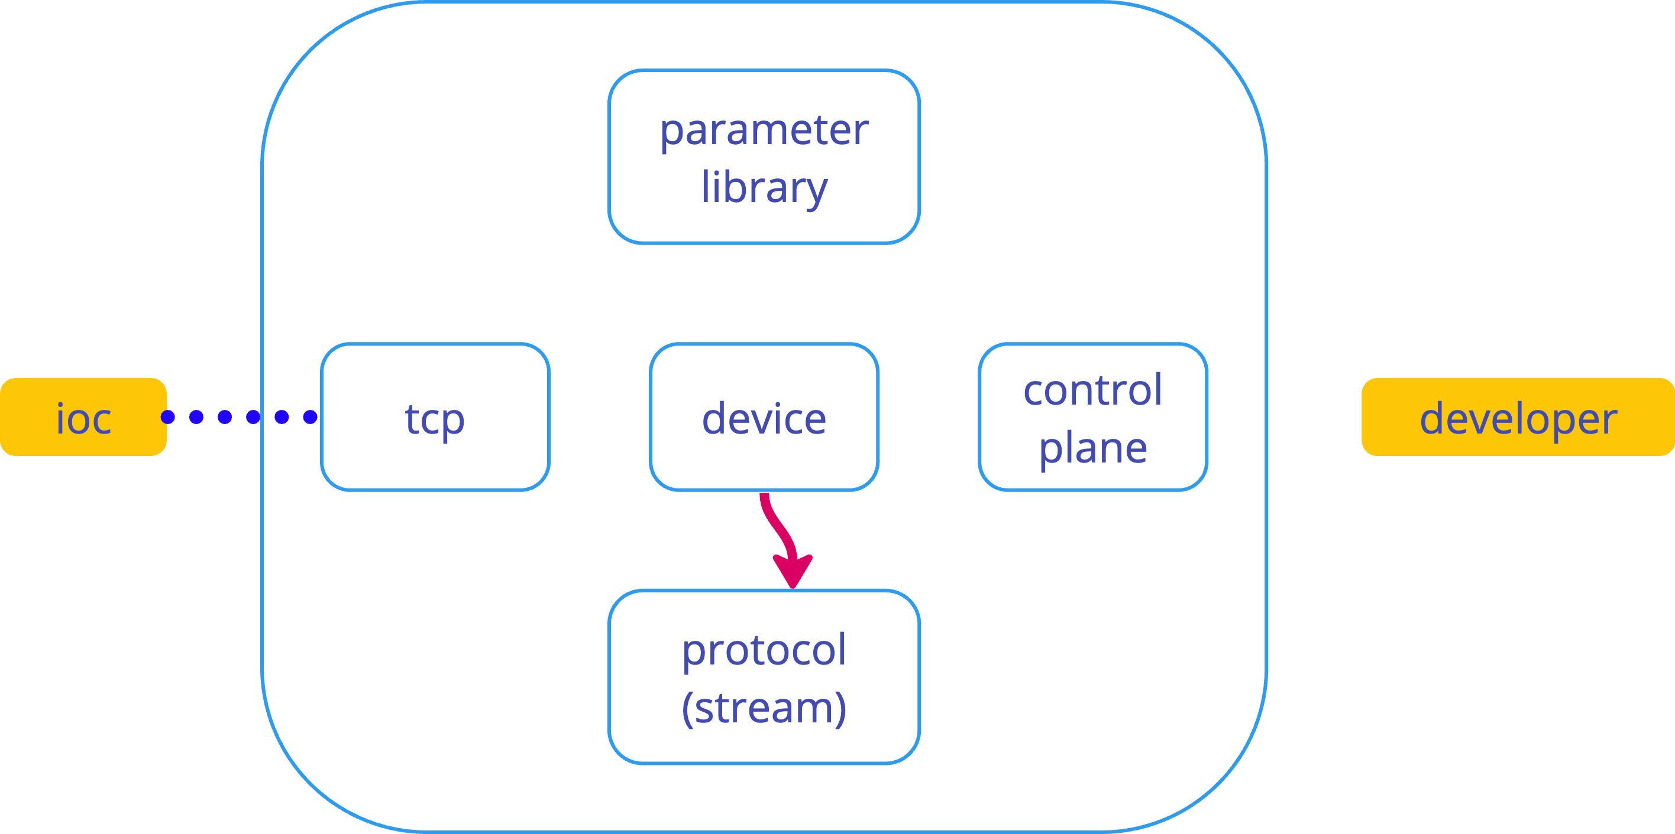
encode answer

Slide 29
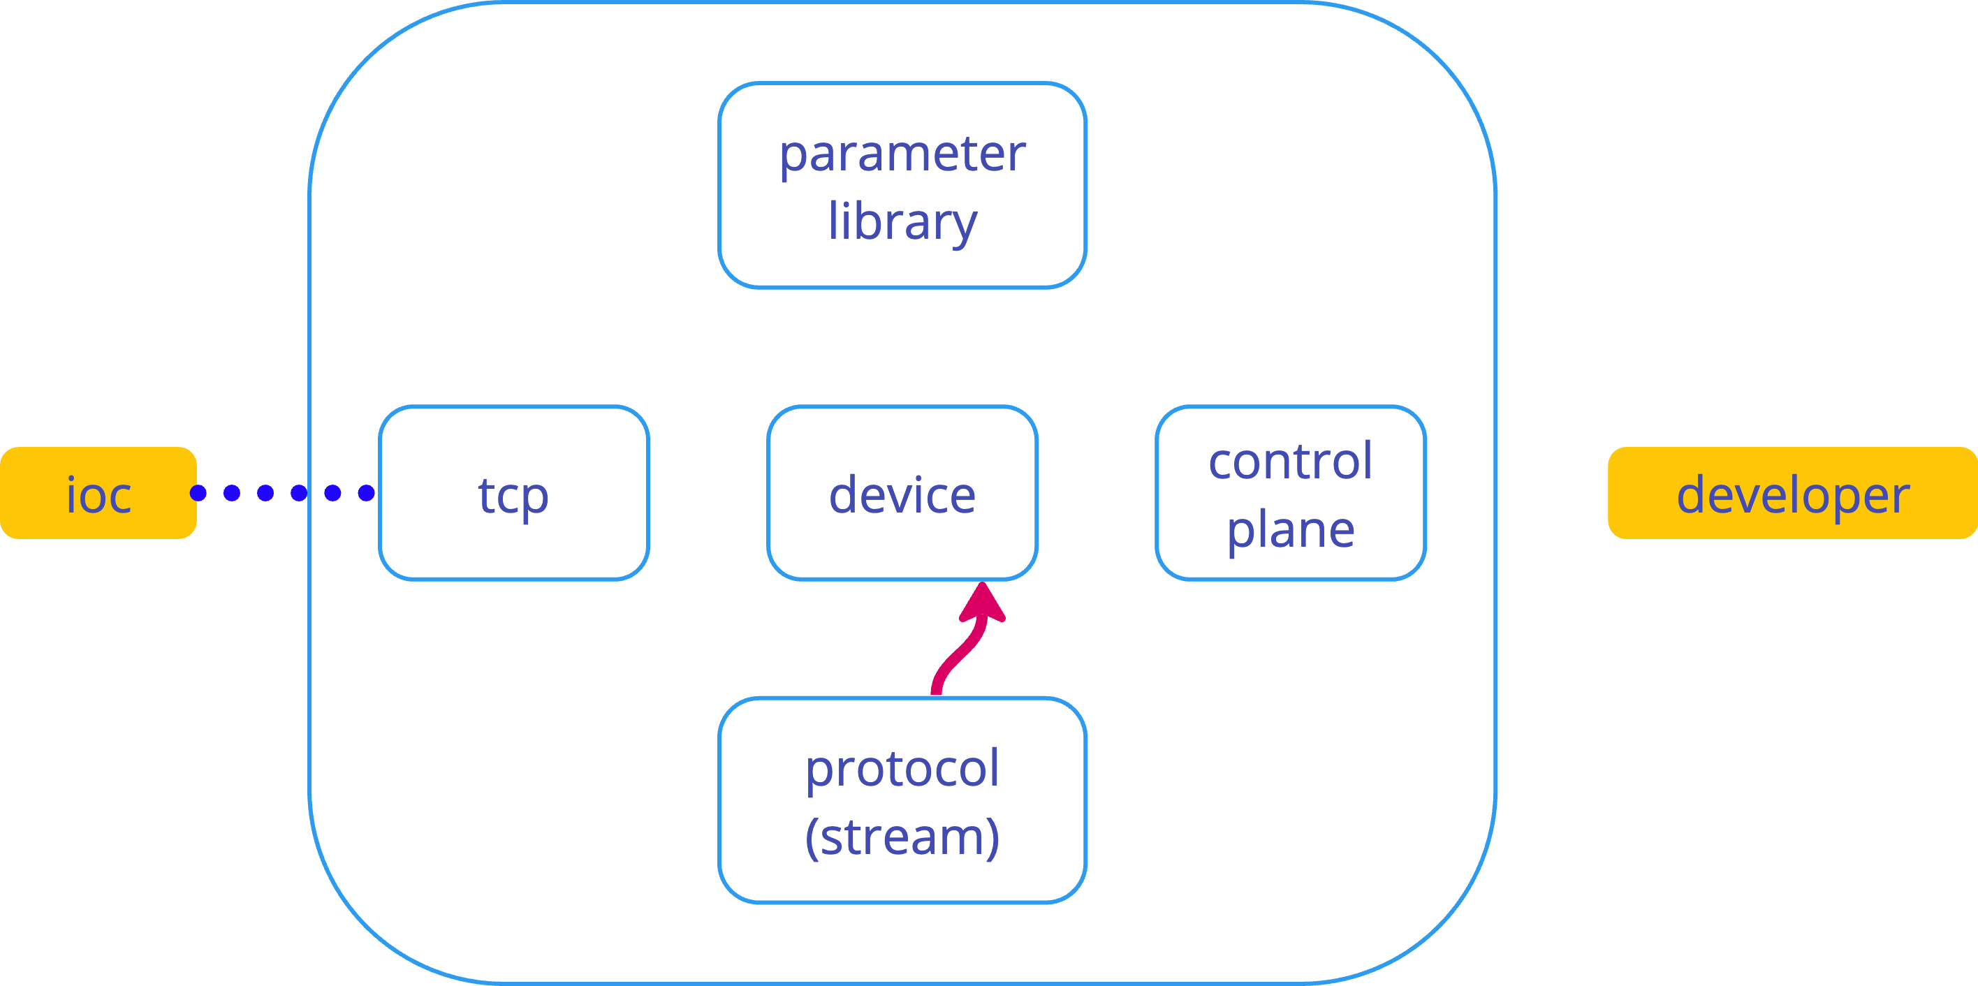
bytes

Slide 30
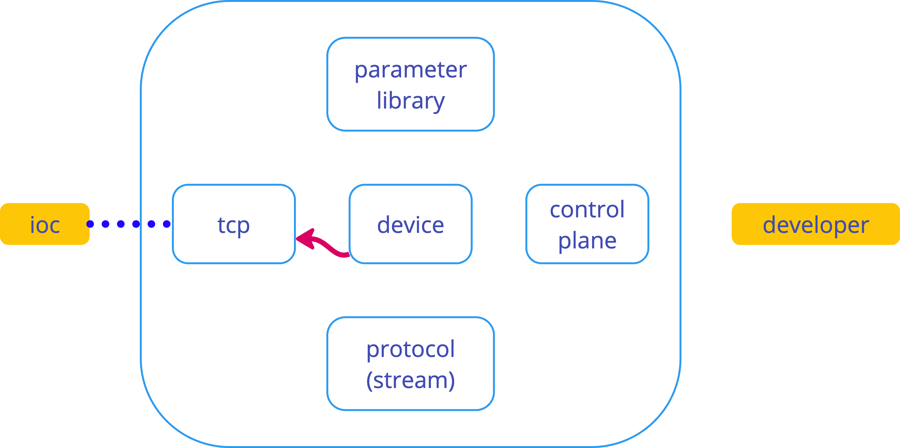
return bytes

Slide 31
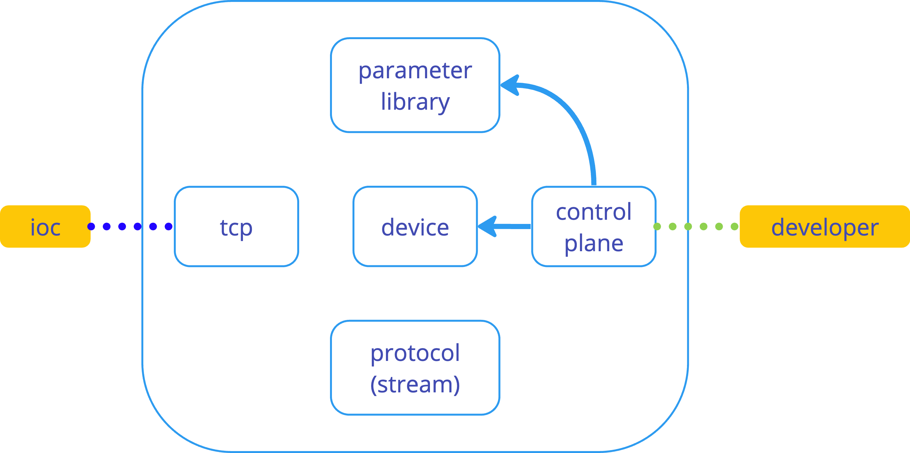
control internals

Slide 32
demo

Slide 33
new tool that helps troubleshoot communication
easy to use
more protocols are around the corner
can be used in CI
free & open source (AGPLv3)

Slide 34
github.com/e9ctrl/vd

Slide 35
marcin@e9controls.com

Slide 36
kacper klys & indra kurniawan

Slide 37
questions?

