Slide 1
epics-containers
Pohang, April 2024
Supervised by Giles Knap & James O'Hea
Beamline Controls – Diamond Light Source

Slide 2
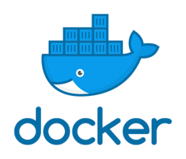
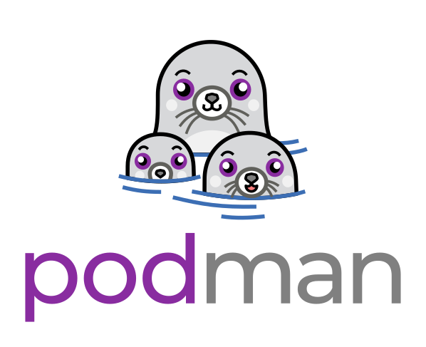
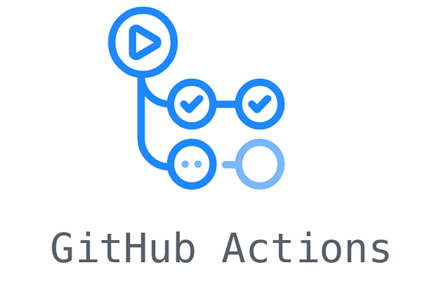
epics-containers?
Applying modern industry practices for software delivery to EPICS IOCs
Containers:
Package IOC software and execute it in a lightweight virtual environment​
Centrally orchestrates all IOCs at a facility​
Deploy IOCs into Kubernetes with version management​
Source and container repositories manage all the above assets
Source repositories automatically build assets from source when updated
Kubernetes:​
Helm Charts:​
Repositories:
​Continuous Integration:

Slide 3
Why?
IOCs are decoupled from the OS
No modifying support modules to suit facility infrastructure
Allows us to use upstream support modules with no need for local forks
Develop and test anywhere
Protection from many security vulnerabilities
Simple server setup: any Linux + container runtime only.
Very easy server OS upgrades
Remove maintenance of internal management tools
Kubernetes provides (not just for IOCs):
Shared software deployment and management
Shared Logging and monitoring
Shared resource management: Disk / CPU / Memory
Connect to IOC and interact with its shell
IOC debugging
Monitor IOC status
Just Google it when things go wrong

Slide 4
How?
Generic IOC Source Repo
Continuous integration
Beamline IOC Instance Repo
Continuous integration
Running Container Instance
st.cmd
ioc.db
Generic IOC Container Image
/epics/
epics-base/
lib/
dbd/
bin/
configure/
support/
ADSimDetector
...
IOC Instance Description
/epics/
ioc/
lib/
dbd/
bin/
configure/ ...
ioc.yaml
make a detector ...
make some plugins ...
values.yaml
image: image-URI
Notes:
Container images are built by layering on top of existing images. EPICS base and essential tools are compiled into one image in what we call our Generic IOC image.
We mentioned continious integration - every published generic ioc image has a version number . When we release an image we tag it with a version number. In github and gitlab this causes Ci to build the source, publish the results and tag it with the same version number. At diamond we use githubactions for open source assets and gitlab CI for in diamond specific/ private assets.

Slide 5
Supporting Tools
ec – edge containers CLI for developers
Runs outside the container
Deploying, monitoring and managing IOC Instances
Also used by Continuous Integration
CLI tool is a wrapper around kubectl, Docker/podman, Helm and git - simplifies Bash Scripts
ibek – IOC builder for EPICS and Kubernetes
Runs inside the container at build time
Helpers for building Support and Generic IOC in the container environment
Runs inside the container at runtime startup
Makes IOC instance startup script and database from a YAML description

Slide 6
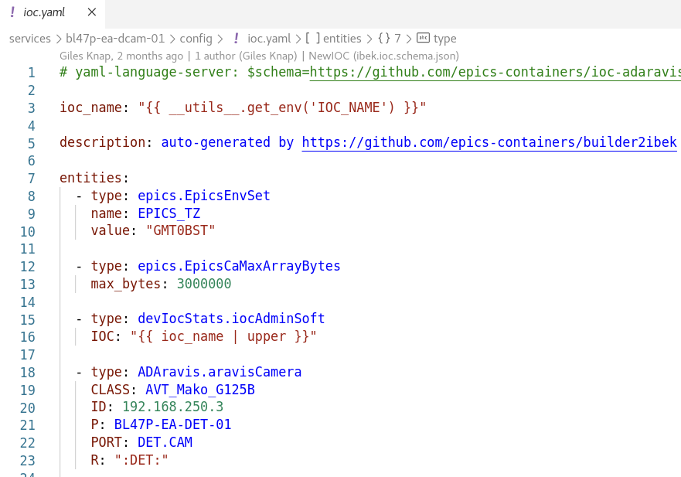
How to make an IOC Instance?
1. Create a beamline repo
Using copier template
add a subfolder to `services`
create new IOC Instance config
A helm chart values override file for the beamline helm chart. The only required field is the URL of the
Generic IOC to use.
An ibek IOC YAML file listing the support entities that we want to
instantiate for this IOC instance.
2. Deploy the IOC instance:
Tag and push the beamline repo
ec deploy bl45p-ea-ioc-01 2023.11.1

Slide 7
edge-containers-cli in action

Slide 8
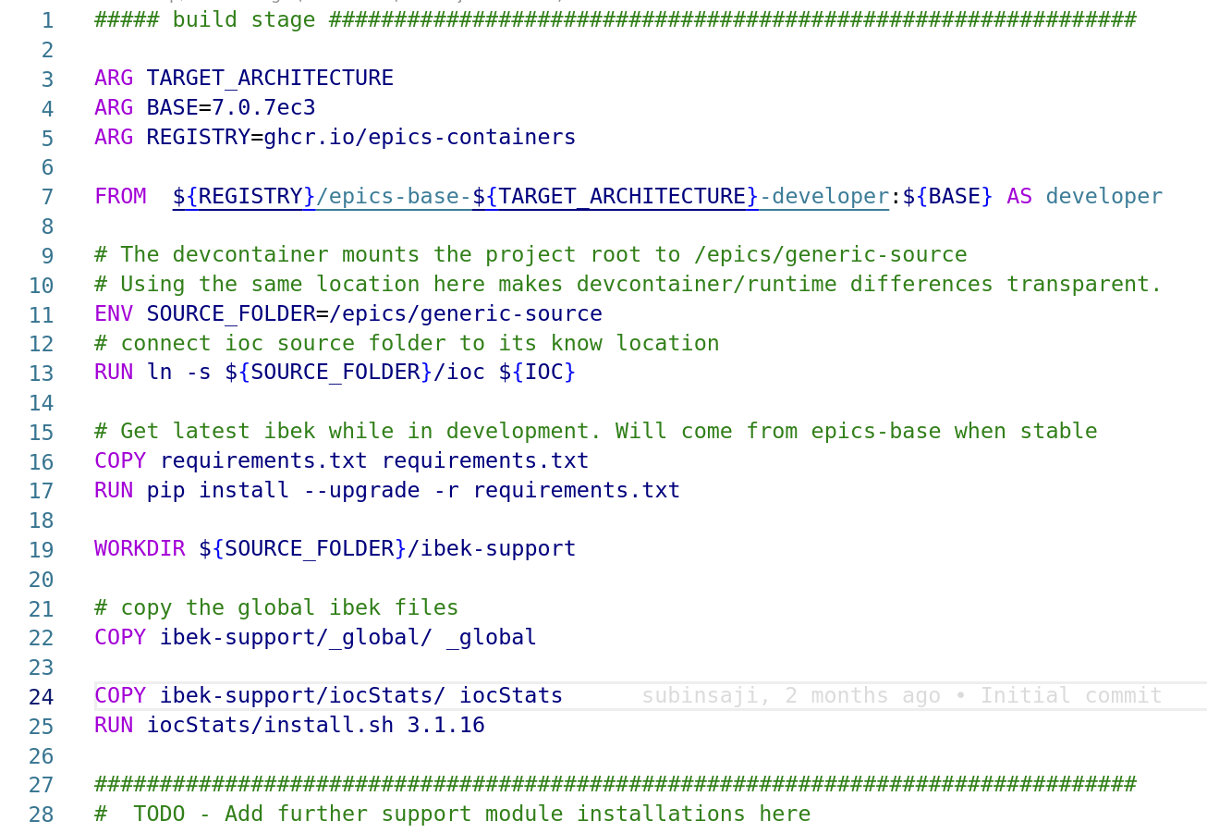
How to make a Generic IOC?
1. Create a Generic IOC repo
using Copier template on GitHub
edit Dockerfile and ReadMe
2. Deploy Generic IOC to your container registry:
Tag and push the generic IOC repo
CI builds image
To make a new generic IOC add the additional support modules required to the template Dockerfile

Slide 9
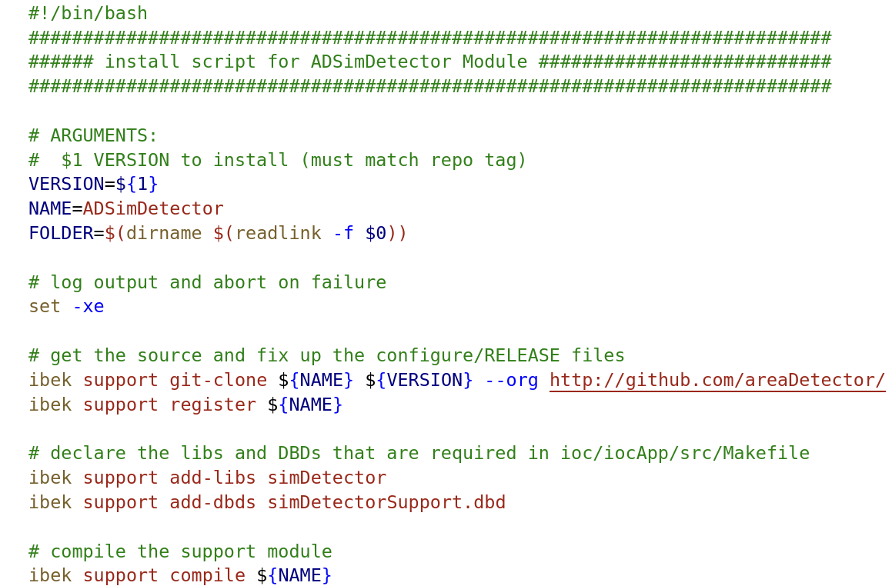
How to Add a new Support Module
1. Add a folder in the ibek-support repo
Shared ibek-support on GitHub
Or private ibek-support per facility
2. Add a new install.sh file:
Use the new support in your Generic IOC Dockerfile
Install.sh example for ADSimDetector. Most install.sh would look identical to this but
You can add custom steps as
Needed.

Slide 10
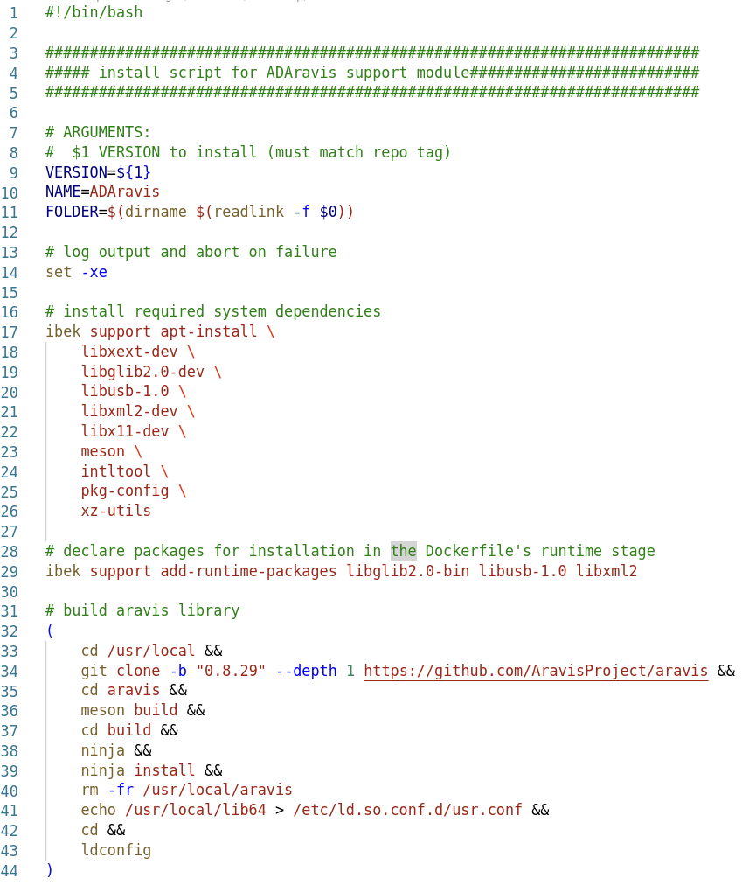
Example of install.sh for ADAravis support module

Slide 11
Need for Developer Containers
Types of changes:
Changing IOC instance
Changing EPICS DB records
Making changes to the IOC instance
Changing the Generic IOC
Altering how the Generic IOC container is built
Changing EPICS version
Adding new support module
Changing the dependencies
Sometimes you need to alter the support module used by Generic IOC
New release of the support module
Updating and publishing the Generic IOC
Updating and publishing the IOC instance
Order of decreasing frequency of change but increasing complexity

Slide 12
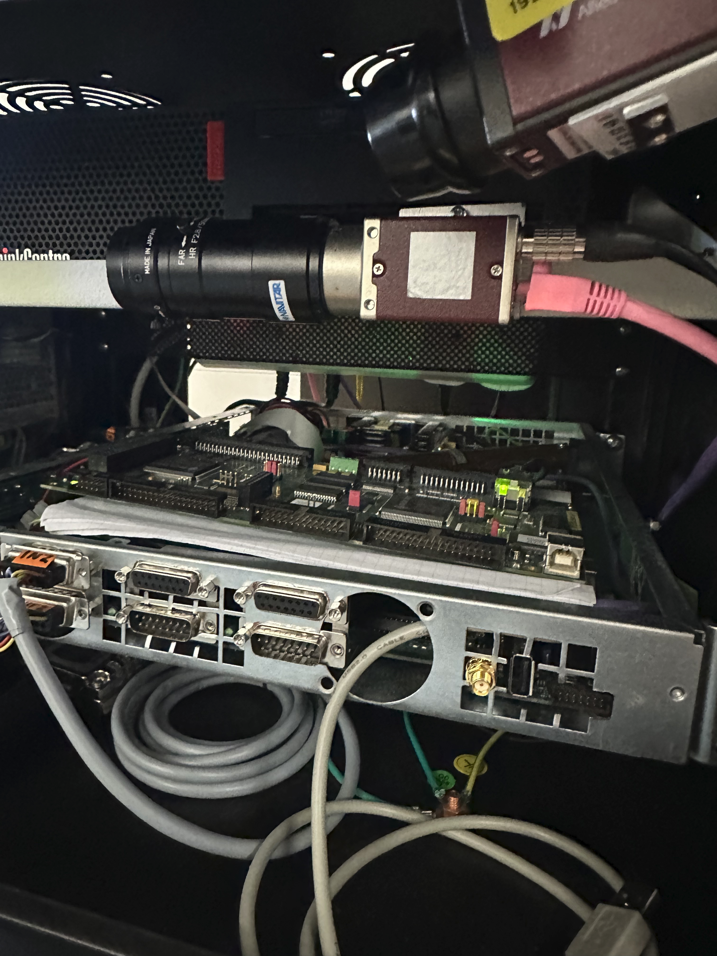
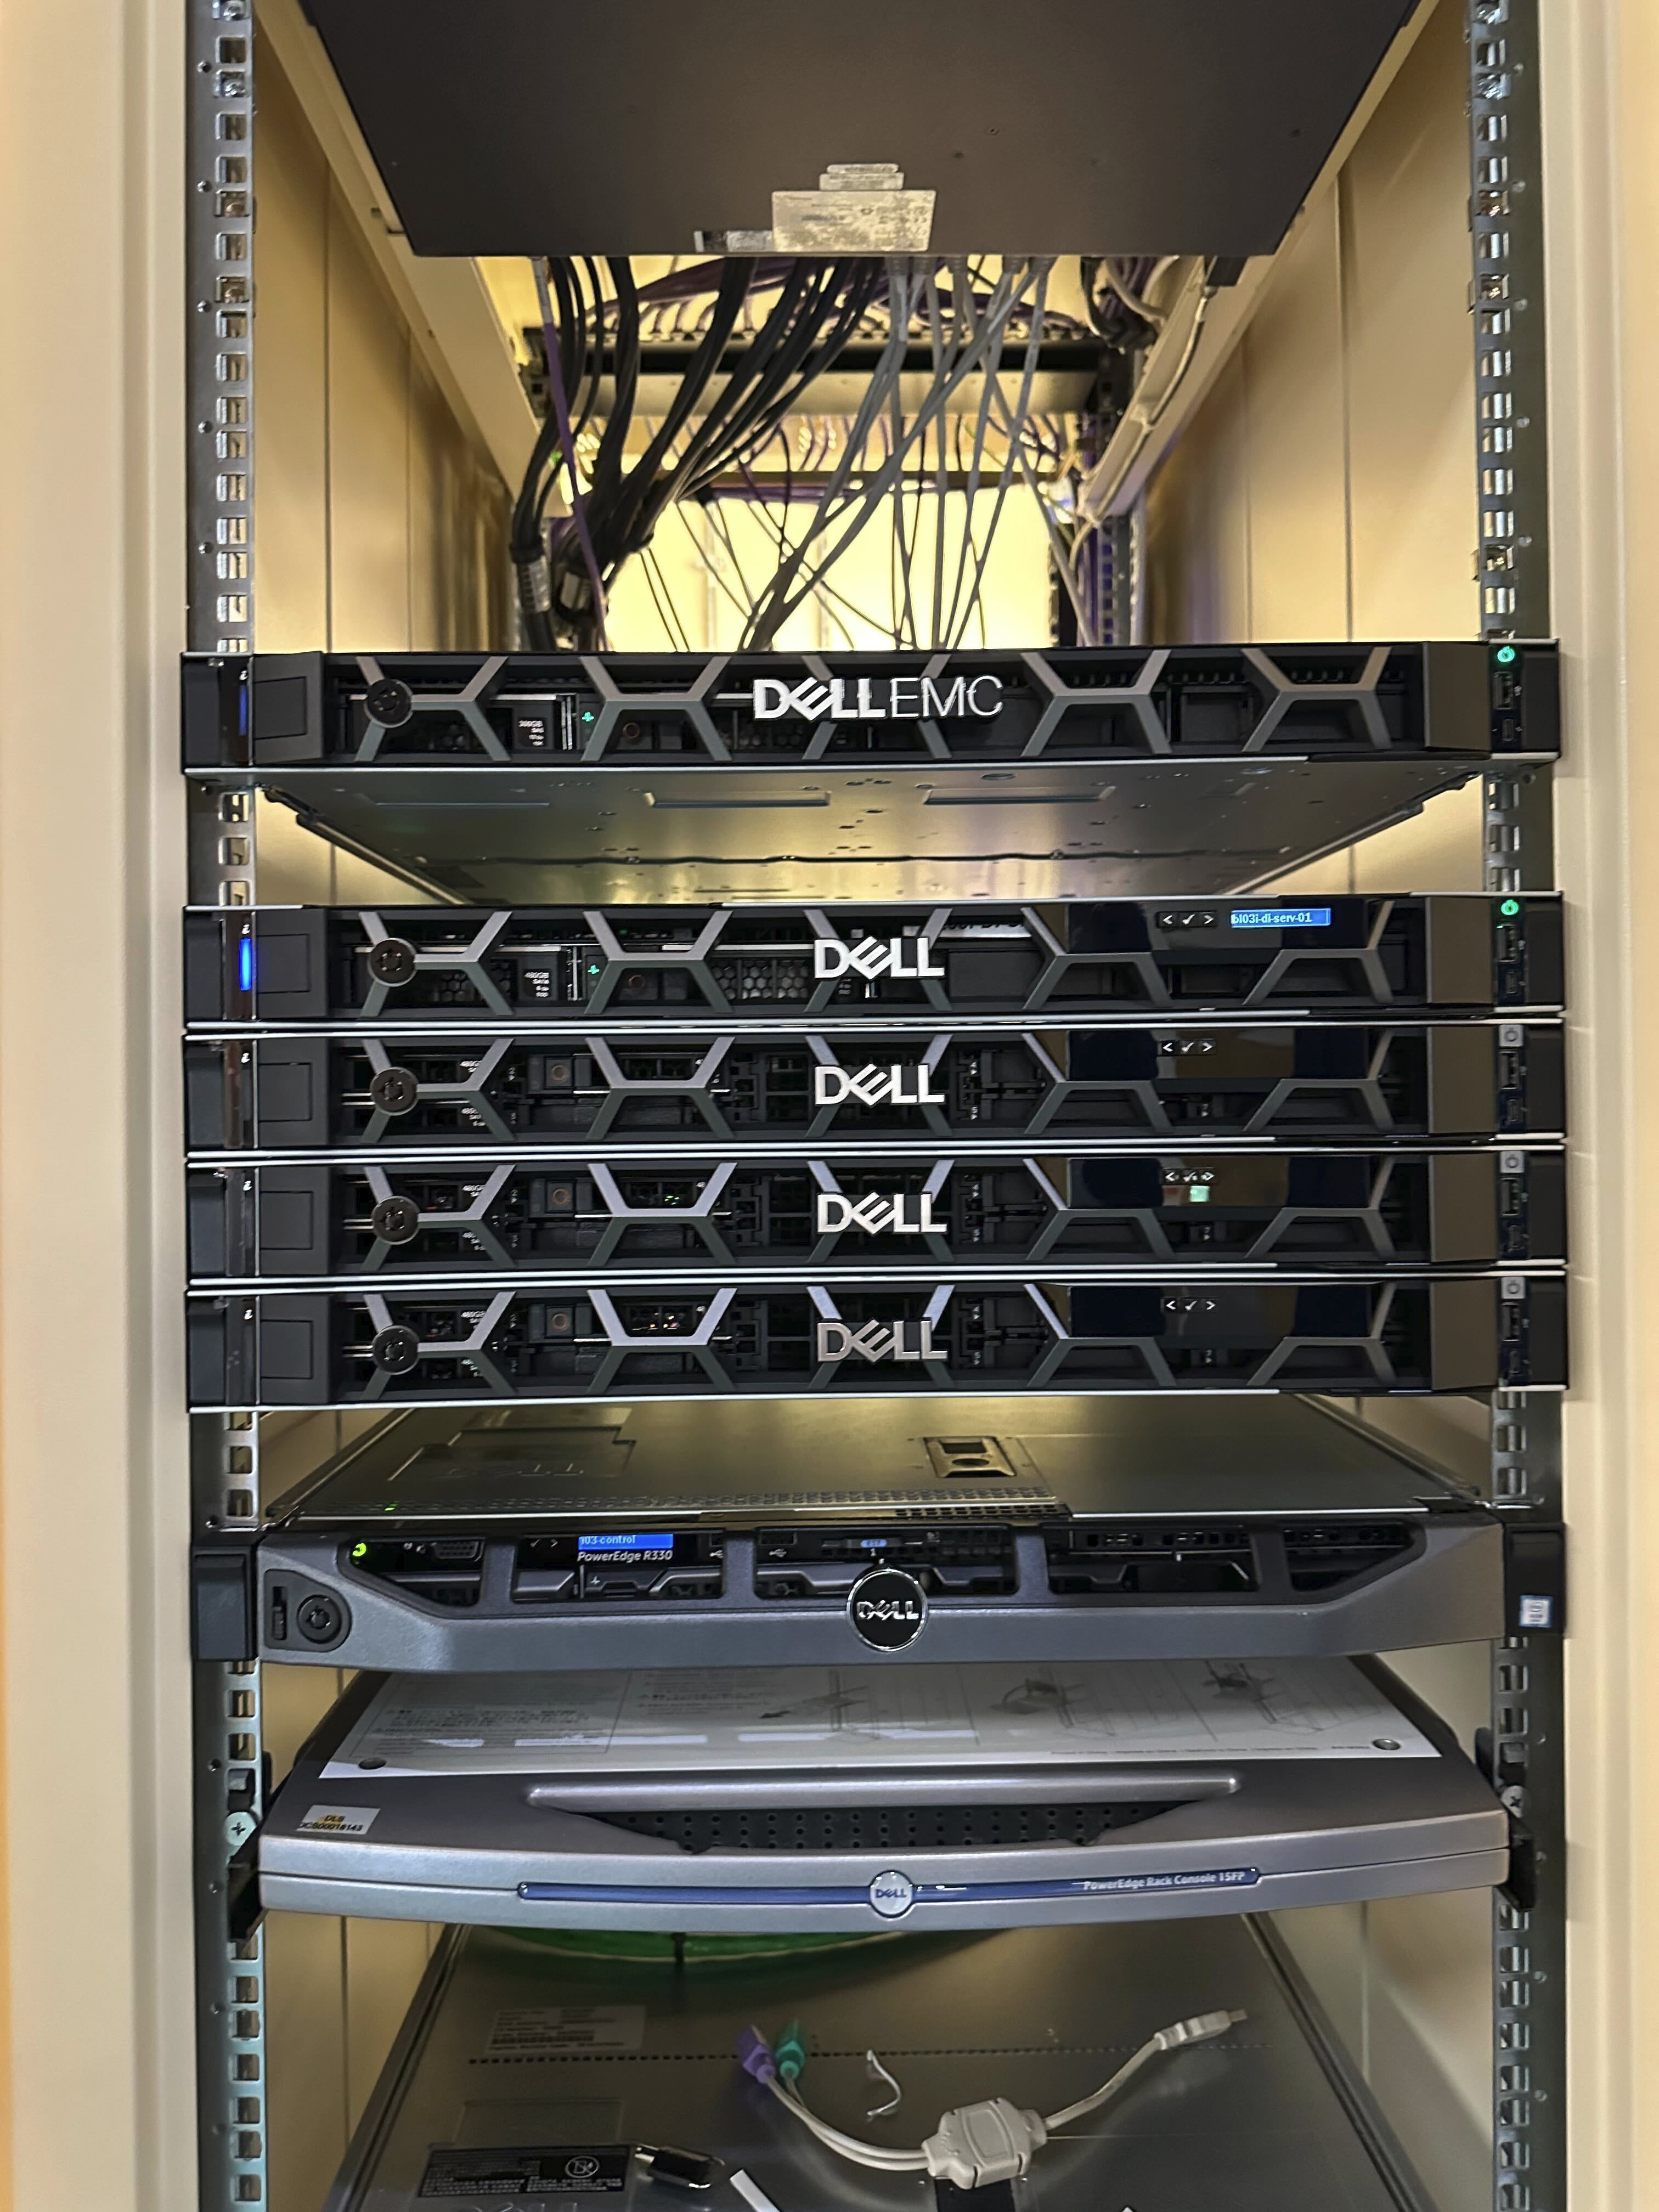
BL46p test rig "beamline in a box" and beamline K8S cluster
2 GigE cameras, 1 is detector and other is diagnostic camera
Kubernetes cluster on beamline IO3 – Cluster per beamline
However, BL46p's cluster is on Pollux – a namespace on a shared central cluster
Pandabox
Delta Tau turbo clipper motion board + motor encoder and decoder

Slide 13
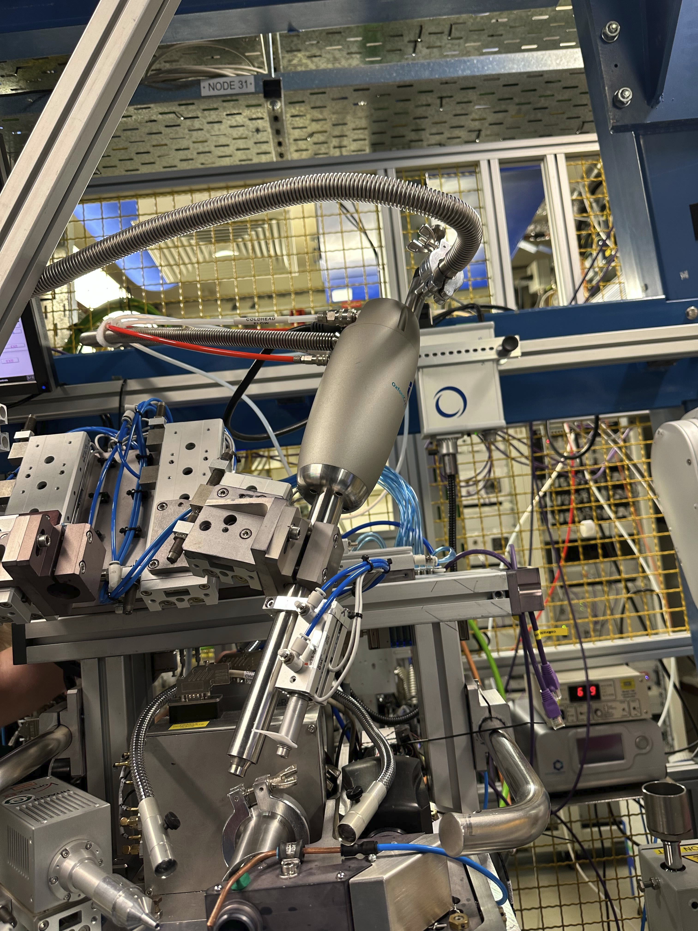
Containerising device on beamline: oxcs700
Cryostream device in IO3
epics-modules does not have published support for oxcs700
Took EPICS support and "de-dls-ify" to make an as generic as possible
Added to ibek-support
Created a generic IOC for device
Testing in the near future

Slide 14
The future: MXBridge and DLS wide
MX beamline 'out in the field' deployed at APS, Chicago during the Diamond-II upgrade dark period
Early rollout of key components of Diamond-II beamline software stack
Directly applicable for new flagship beamline K04 and I03, IO4 at later stage
At its peak collecting 5,000 samples per day (K04 to peak with 10,000 samples per day with multi-sample pins)
MXBrigde will test the future architecture for Diamond II beamlines

Slide 15
Thanks for listening
Thanks to Giles Knap for the slides and other materials
For more information see
https://github.com/epics-containers
Tutorials
Documentation
Templates
Source code
Growing number of Generic IOC images

