Slide 1
Application and Improvement of Clog 2.0
Lin Wang
wanglin@ihep.ac.cn
Controls Group, Accelerator System Division, CSNS
Dongguan Campus of IHEP (Institute of High Energy Physics)
EPICS Collaboration Meeting 2024
Apr 15 – 18, 2024, hosted by the Pohang Accelerator Laboratory

Slide 2
Content
（1）Introduction
（2）Application
（3）Improvement
（4）Summary

Slide 3
Introduction
Clog (Compact Electronic Logbook System) 2.0
Developed and released by controls group of CSNS in 2022, based on:
Development experience of Clog 1.0
https://accelconf.web.cern.ch/icalepcs2019/papers/mopha158.pdf
Experience in using PSI Elog and Olog
Quite a few years web development experience at CSNS
Presented at hybrid EPICS Collaboration Meeting 2022 hosted by Cosylab
https://indico.cern.ch/event/1173788/contributions/5045177/
Modern web technology and simple implementation
Easy to develop, deploy, maintain and customize
Architecture similar to Olog, UI style similar to PSI Elog
Will be used for facilities at IHEP, can also be used for other facilities

Slide 4
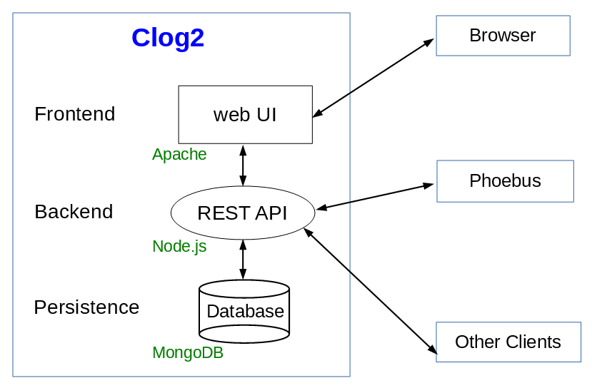
Technical solution
Frontend
Vue.js framework
PrimeVue UI component
Backend
Node.js runtime environment
Persistence
MongoDB document database
Attachment
MongoDB File system
Session management
JWT (JSON Web Token)
Architecture of Clog 2.0

Slide 5
Advantages of the technical solution
Frontend backend separation architecture
Frontend and backend can use different frameworks, flexible for development
Other client can interact with the backend, leaving the frontend undisturbed
Consistent programming language: JavaScript
Frontend UI development involves JavaScript programming
Backend Node.js development involves JavaScript programming
Consistent data format: JSON
Data interaction between frontend and backend uses JSON format
JavaScript objects in Node.js is JSON-like format
MongoDB stores JSON-like format
MongoDB
No need to create tables or collections in database
No need to store structured data
Easy to develop and maintain!

Slide 6
Application of Clog 2.0
HEPS (High Energy Photon Source)
Fourth generation synchrotron radiation light source
Being constructed by IHEP (Institute of High Energy Physics) in Beijing, China
Started on June 29, 2019
Will be completed on December 31, 2025
Construction period: 6 years and 6 months
The LINAC successfully produced beam, and HEPS successfully accelerated the first electron beam on March 14, 2023
HEPS started to deploy Clog 2.0 as the logbook system on August, 2023

Slide 7
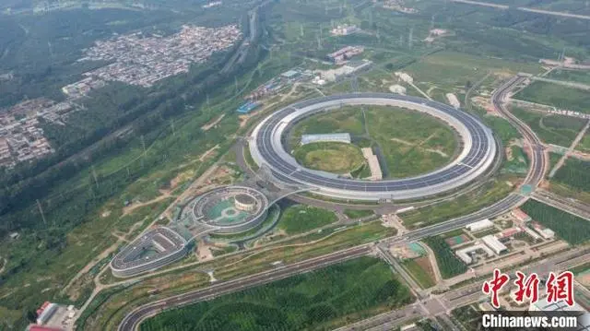
Application of Clog 2.0
Bird’s eye view of HEPS

Slide 8
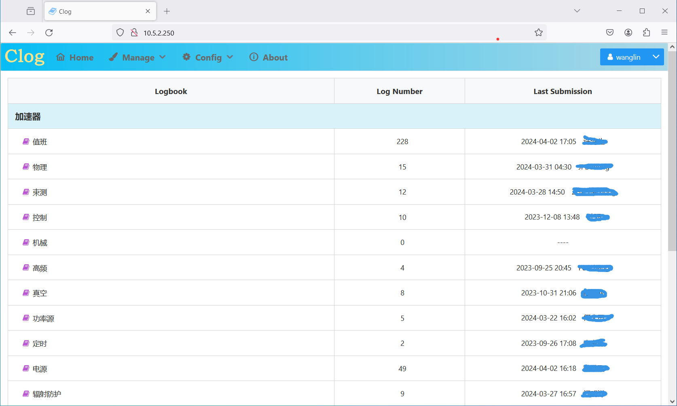
Application of Clog 2.0
More than 300 logs have been stored
More than half are shift logs in the control room
Other logs are recorded by specific systems such as physics, diagnostic, controls, RF, vacuum, timing, power supply, radiation protection MPS and magnet
Home page of Clog 2.0

Slide 9
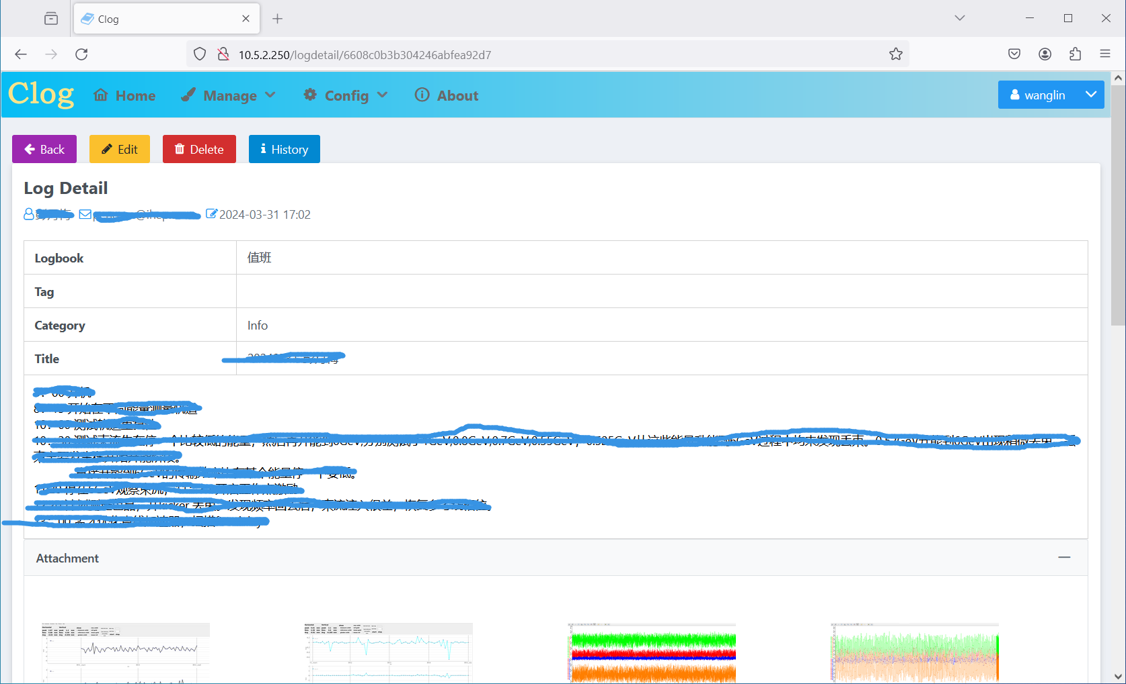
Application of Clog 2.0
A shift log recorded in the control room

Slide 10
Improvement
Improvements have been made according to the requirements of HEPS accelerator.
#1. API token generation
#2. Change attachment storage strategy
#3. Logbook admin role
#4. Private logbook support
#5. Attachment icons for Microsoft Word, Excel, PowerPoint and mp4 files
#6. Image attachment navigation
#7. Mobile web client
#8. Phoebus client

Slide 11
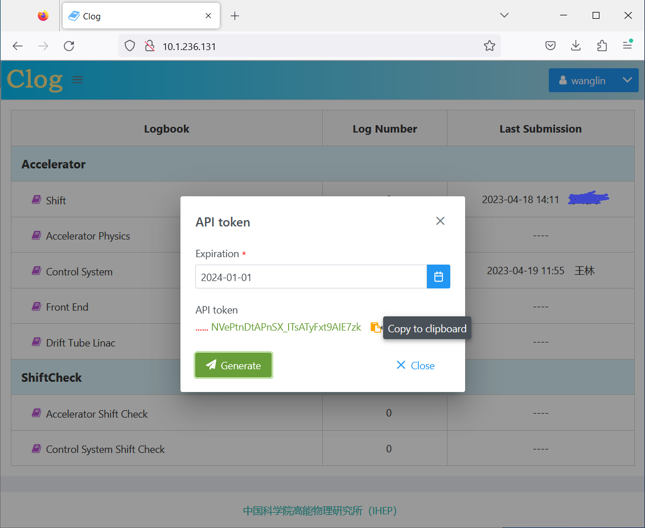
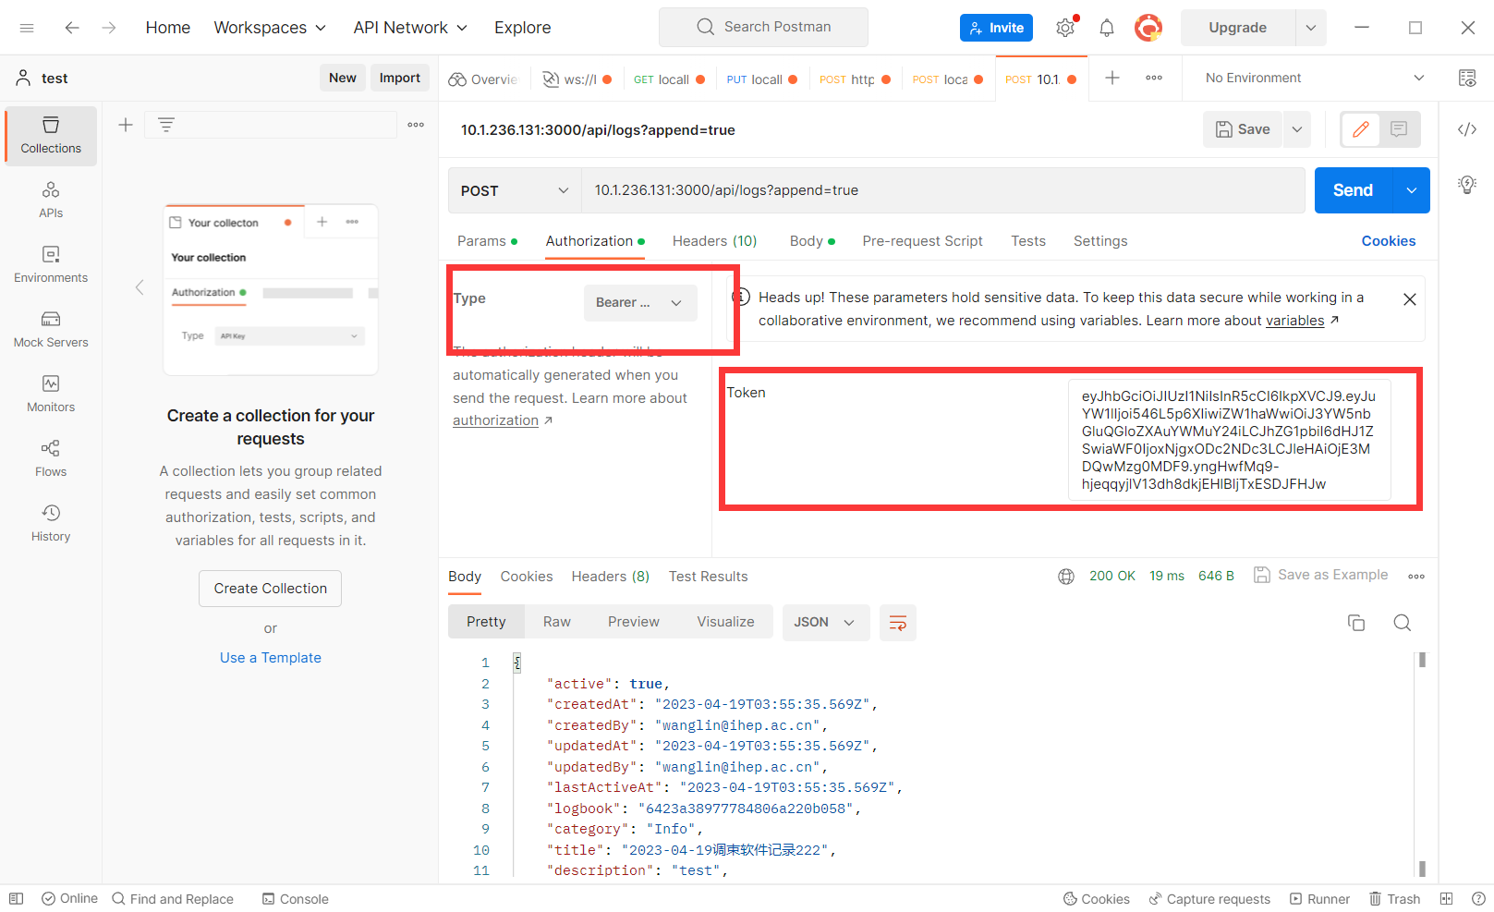
#1. API token generation
API token instead of user credential can be used by other clients to write logs to backend API
Use case: Physics software at HEPS writes logs to Clog
API token generation page
API token usage in Postman

Slide 12
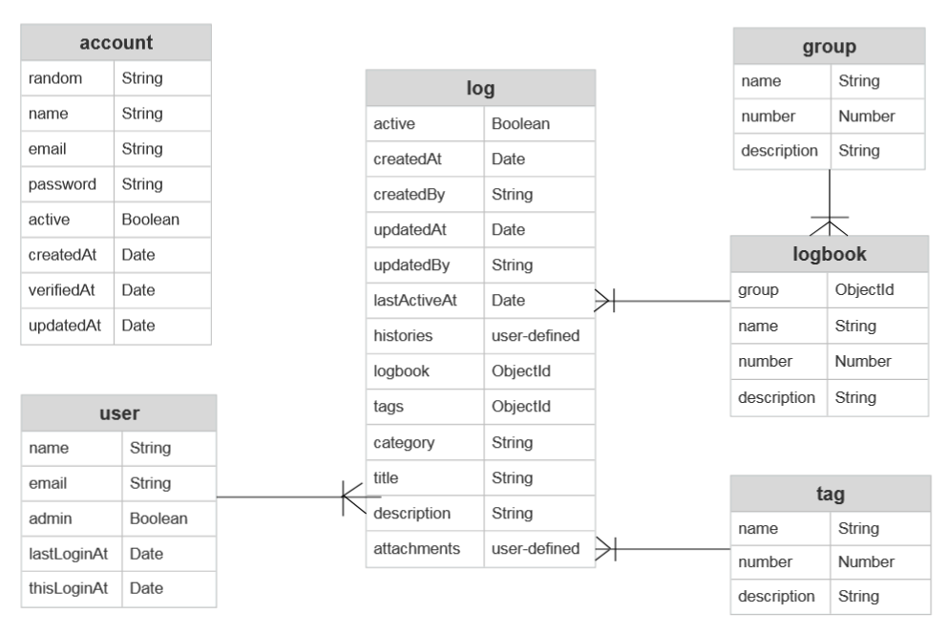
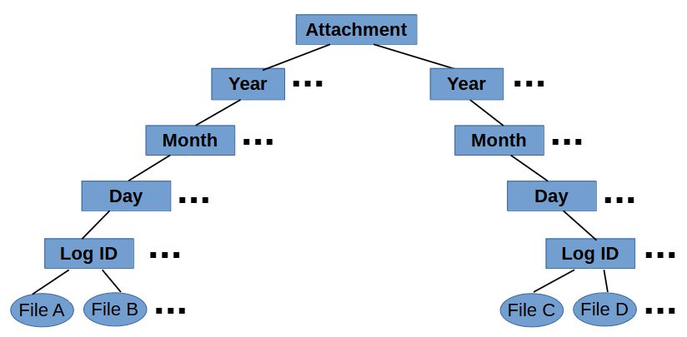
#2. Change attachment storage strategy
From MongoDB to file system
Maximum document size for MongoDB (non GridFS) is 16 MB
Attachment file structure
MongoDB schema for Clog 2.0

Slide 13
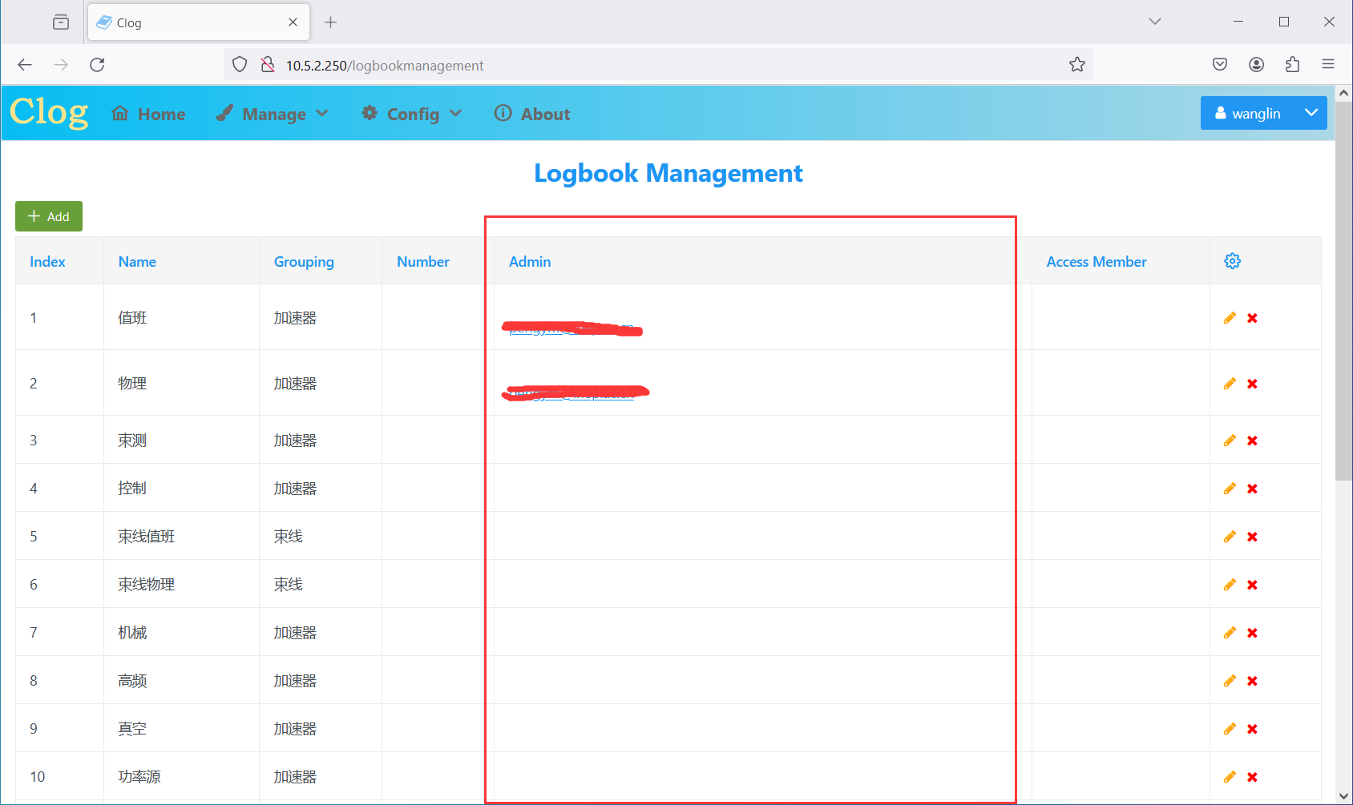
#3. Logbook admin role
Logbook administrators can edit all logs in the logbook
Differs from global administrator who can edit all logs in Clog system
Logbook management page

Slide 14
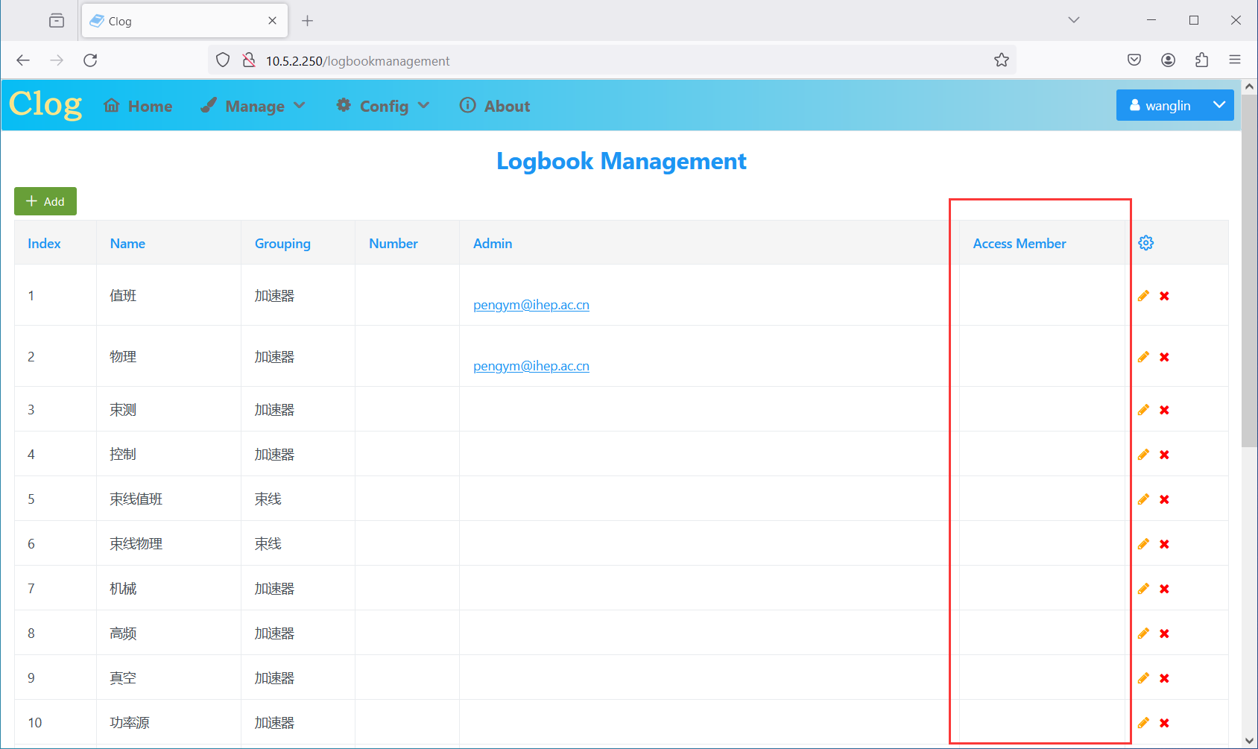
#4. Private logbook support
If Access Member field of logbook is not empty, the logbook becomes private
For private logbooks, only logbook admins and logbook members can access
Logbook management page

Slide 15
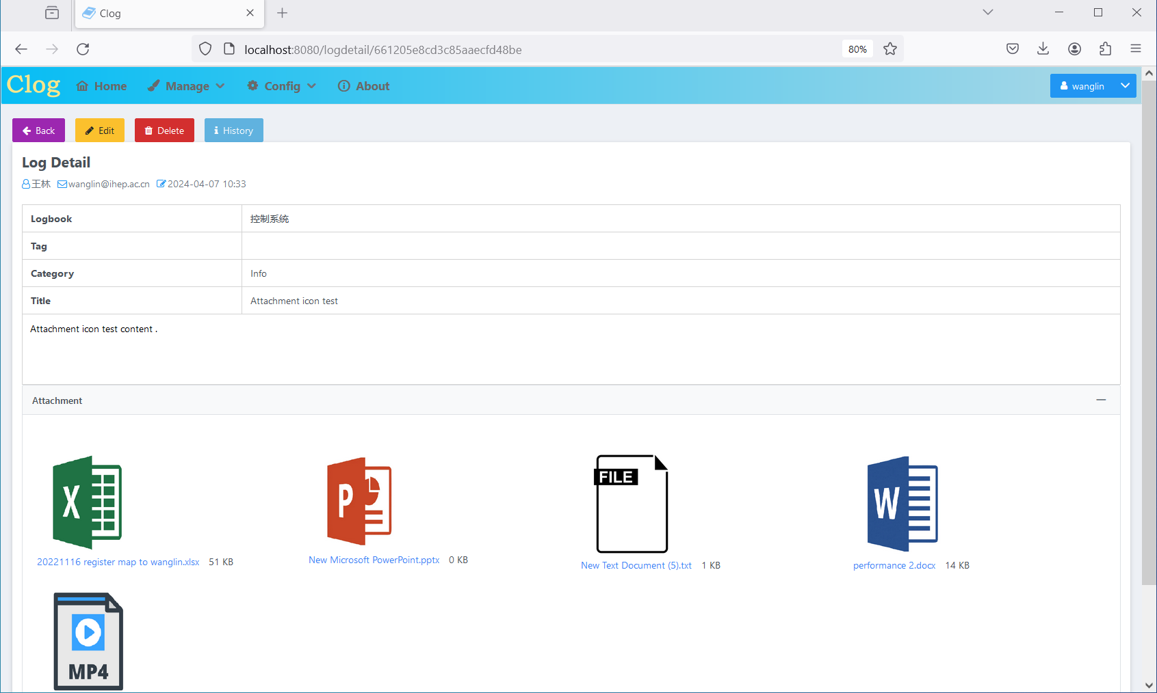
#5. Attachment icons
Microsoft Word, Excel, PowerPoint and mp4 files
A log with different types of attachments

Slide 16
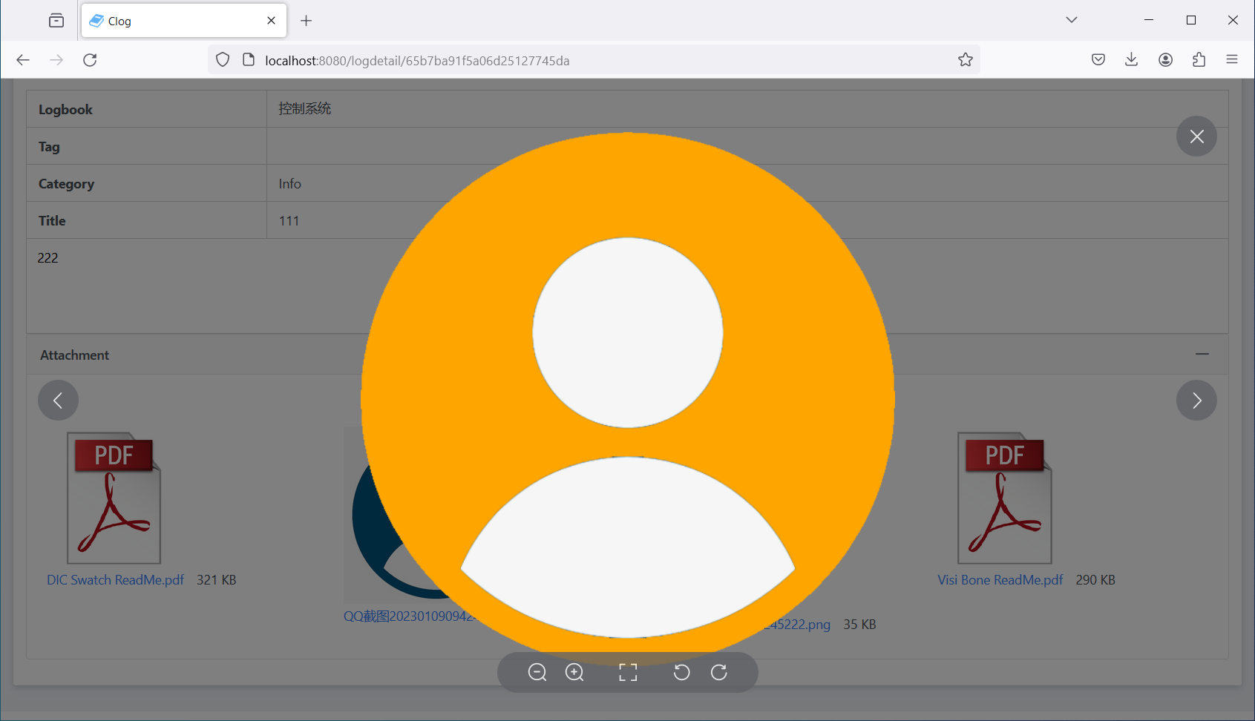
#6. Image attachment navigation
Uses Image component of Element Plus component library for image navigation function
Image files can be switched with left arrow and right arrow buttons
Image attachment display

Slide 17
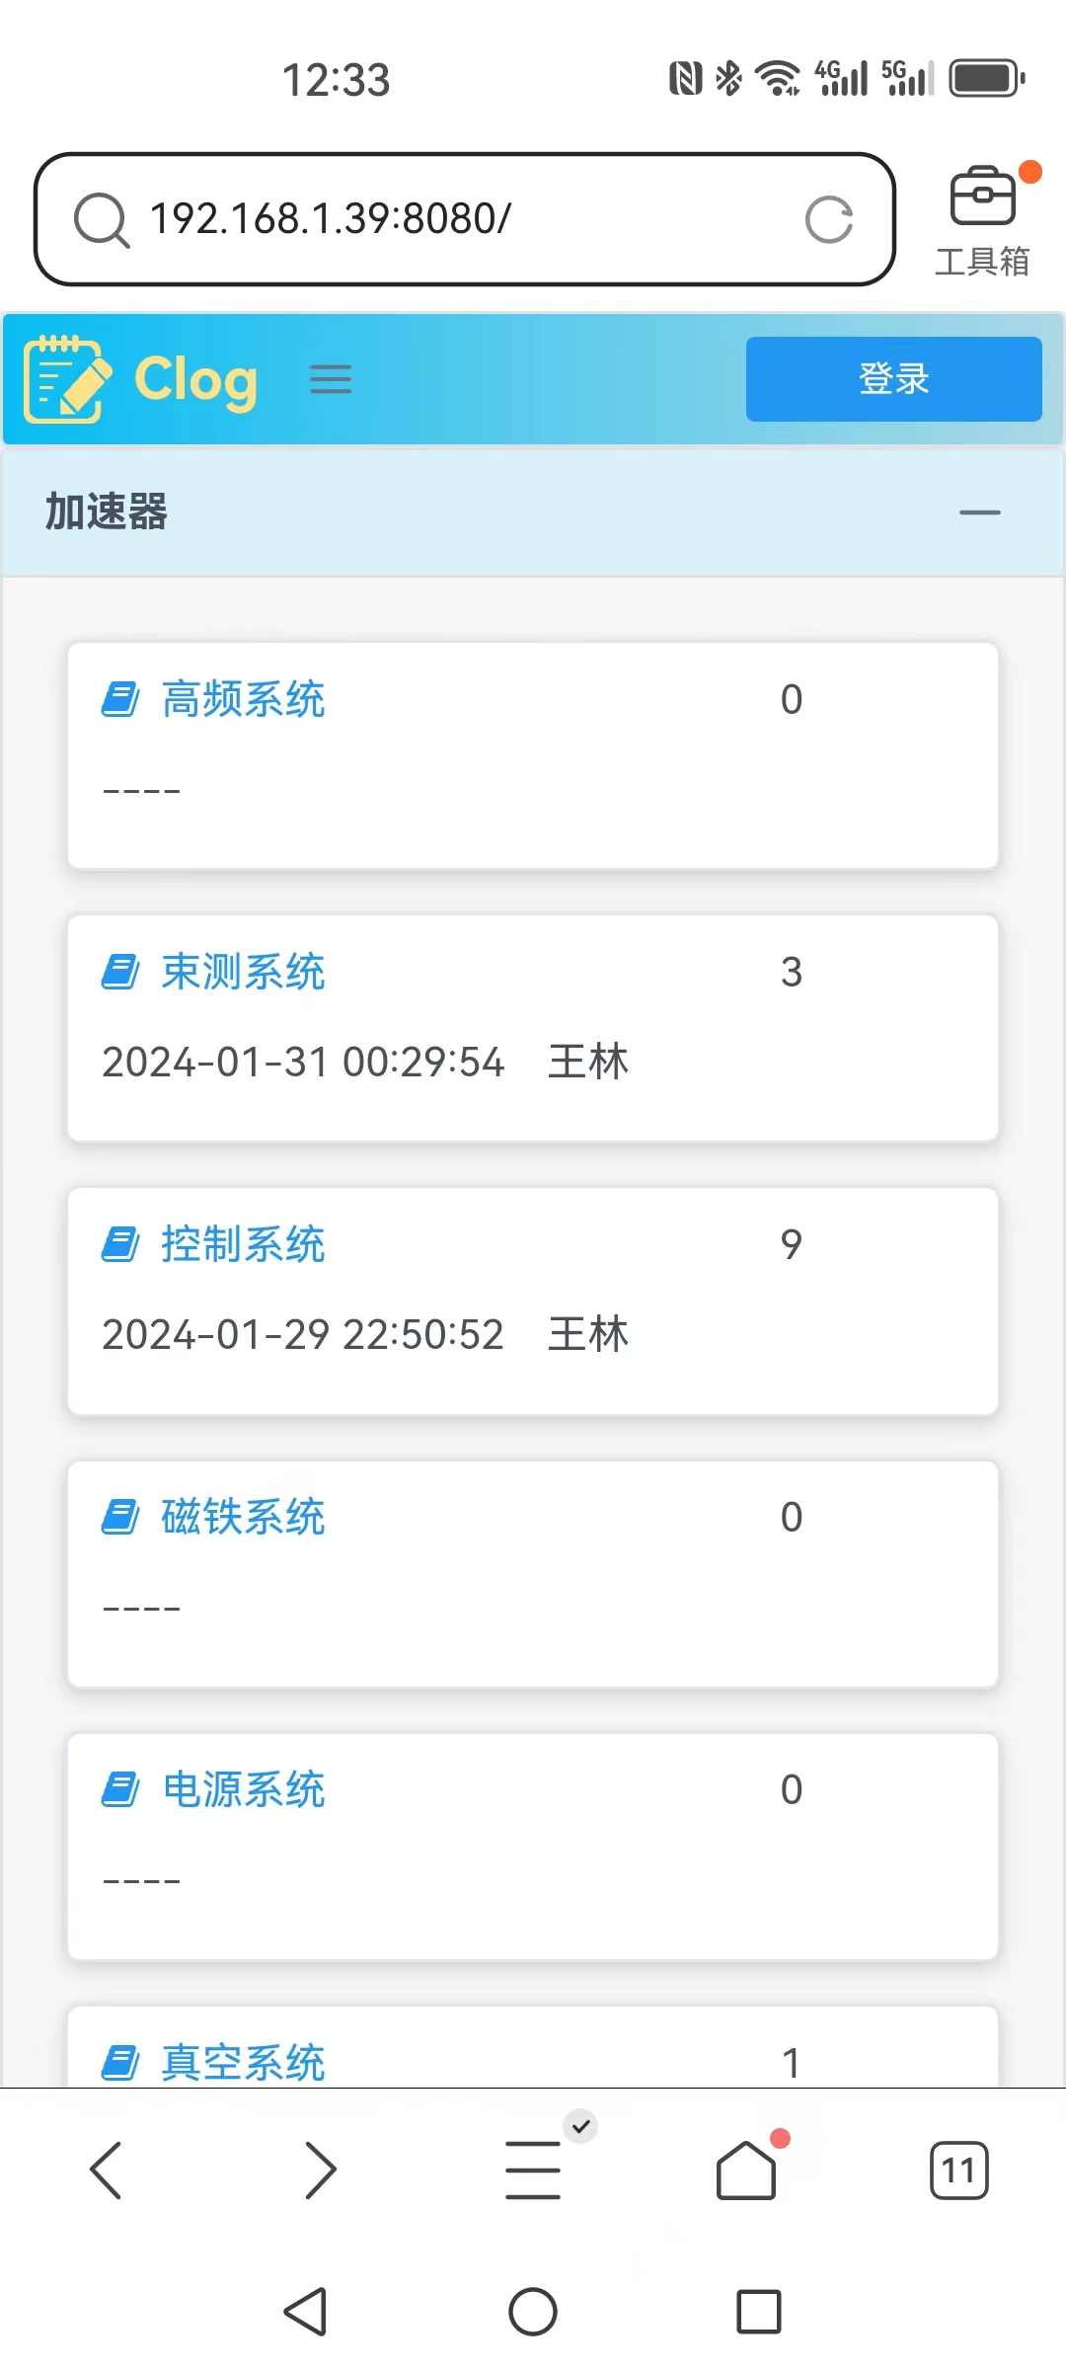
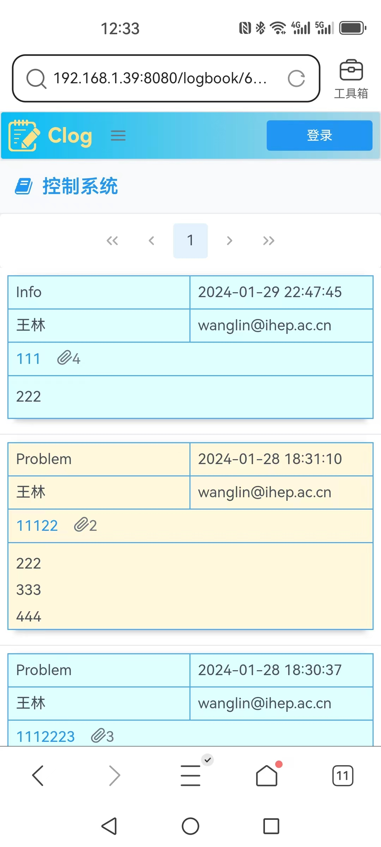
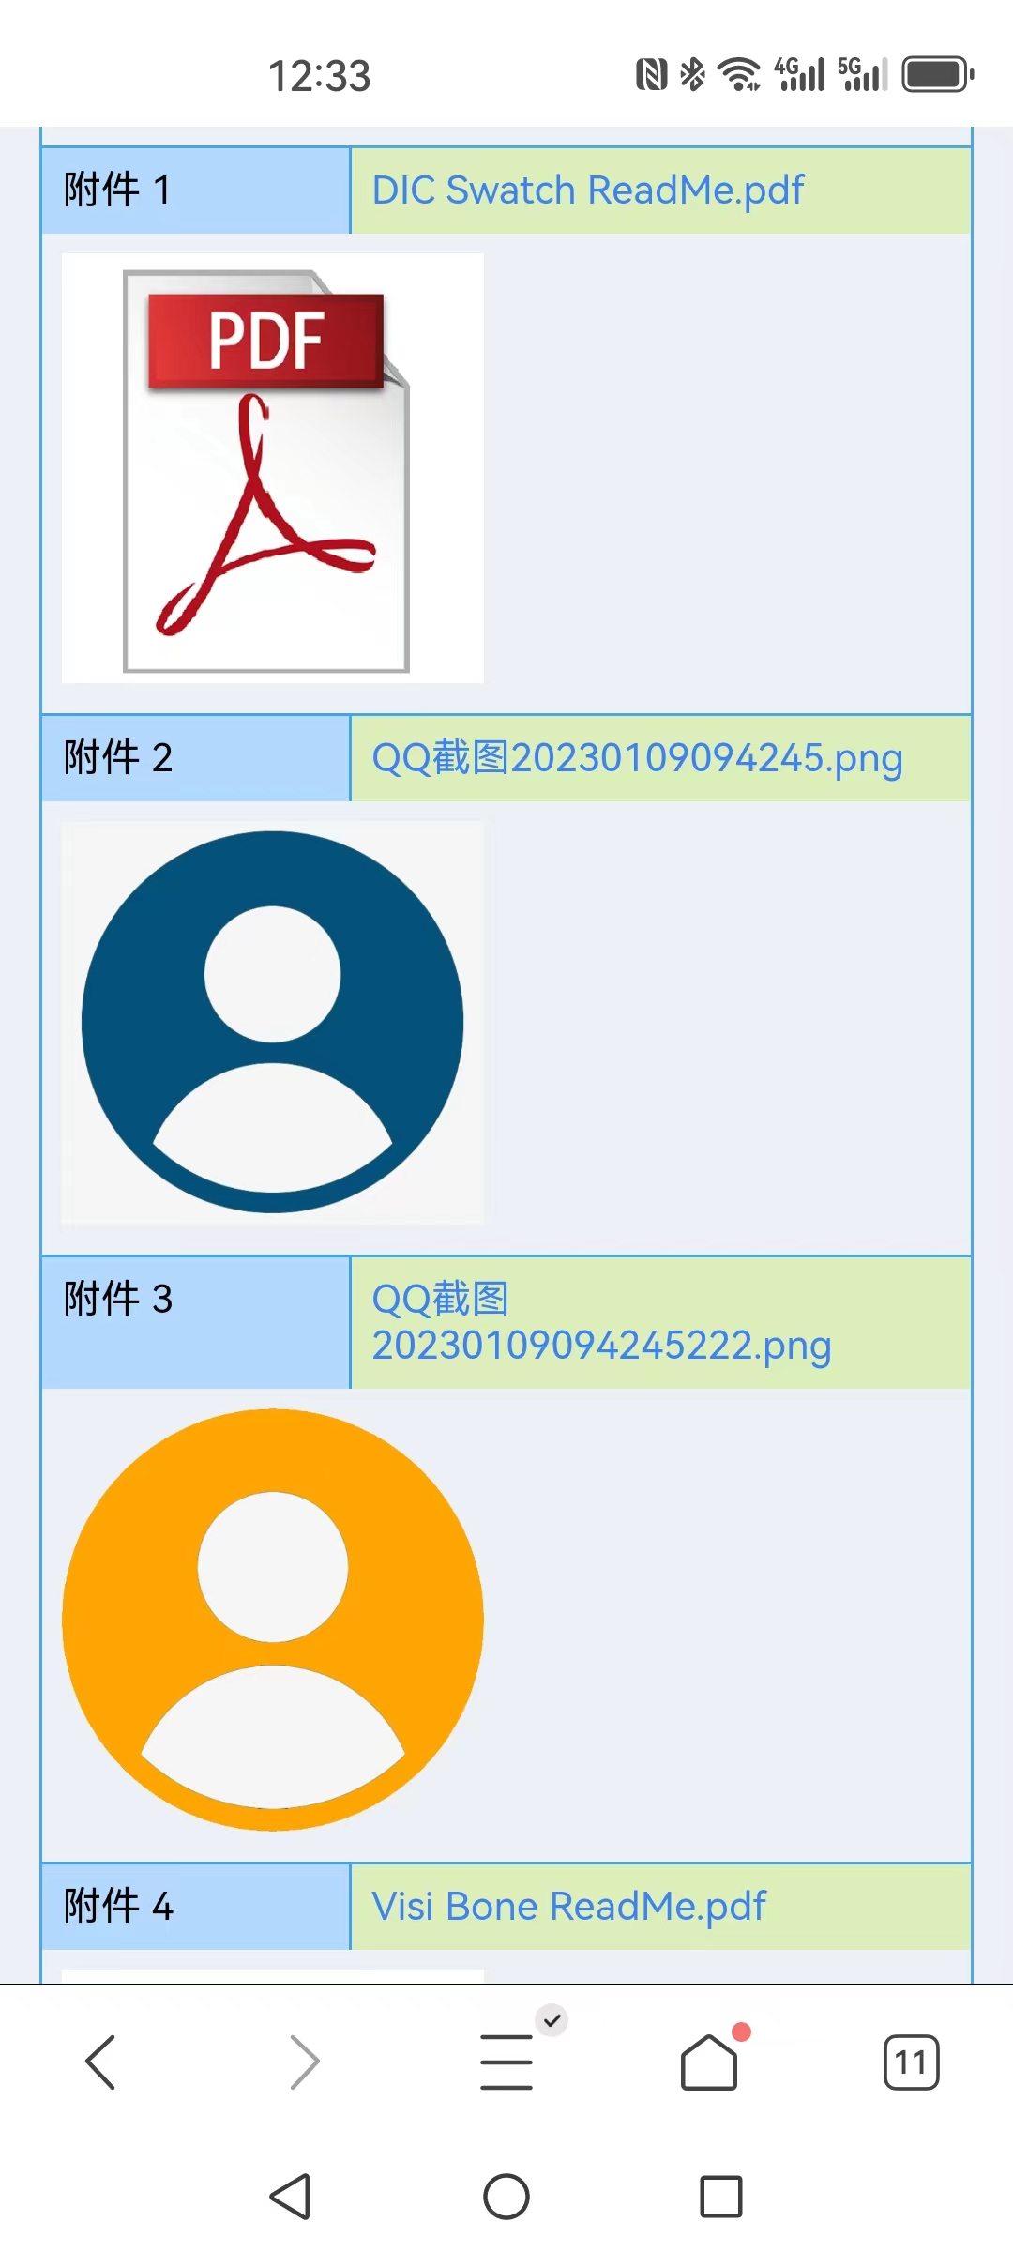
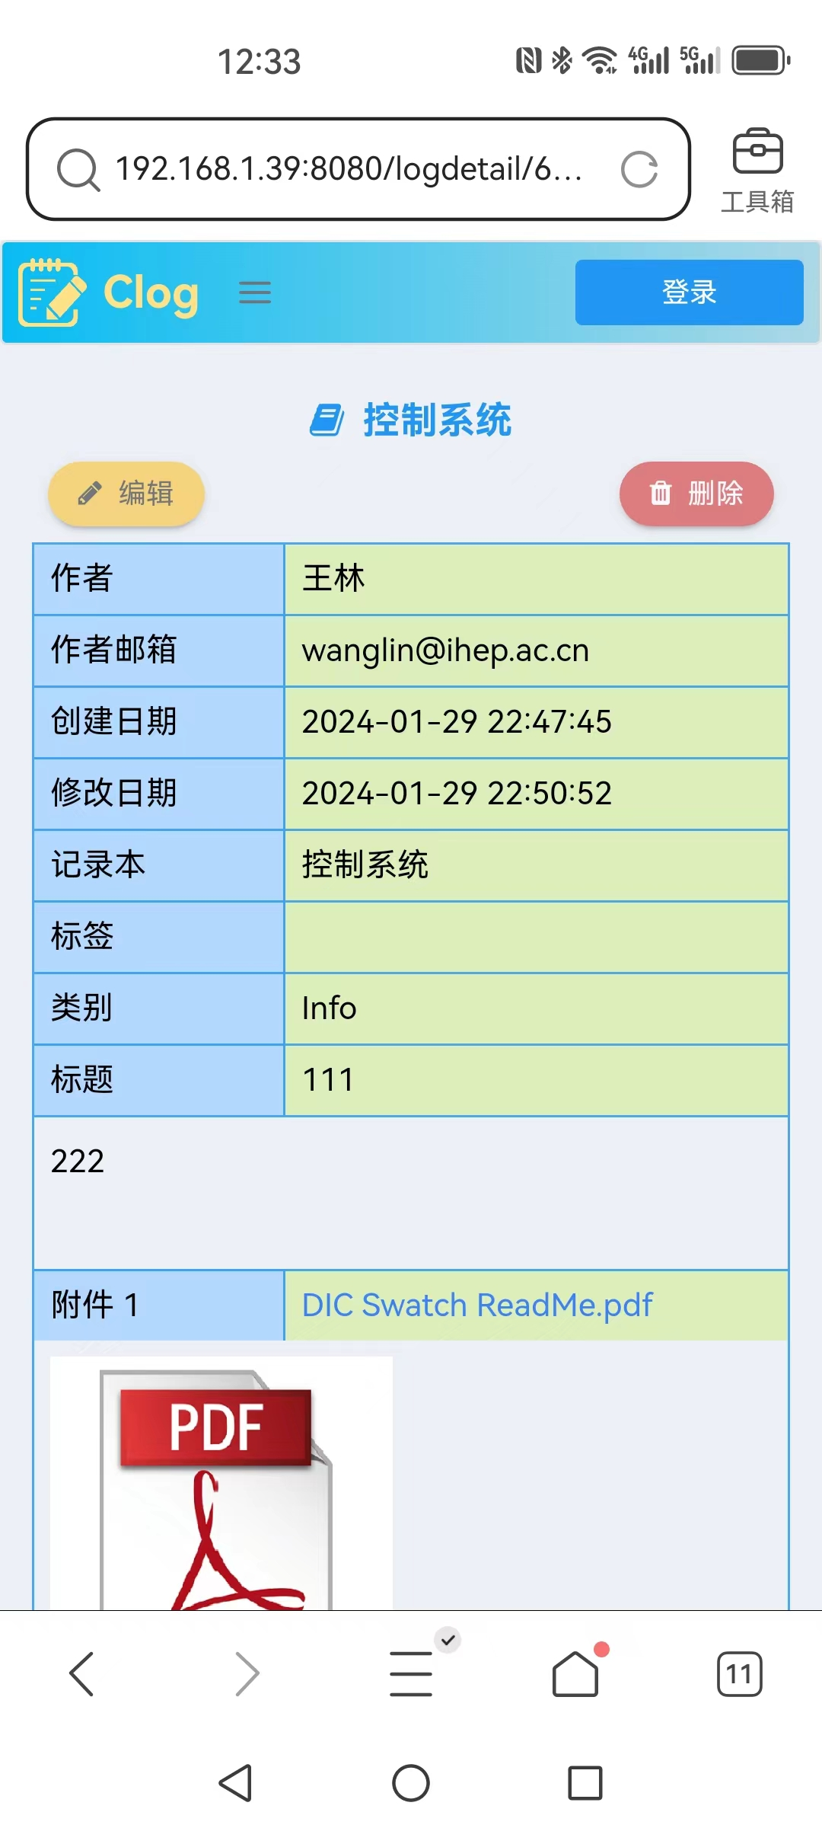
#7. Mobile web client
A separate web client is provided for mobile devices access
Home page
Log preview page
Part 1 of log detail page
Part 2 of log detail page

Slide 18
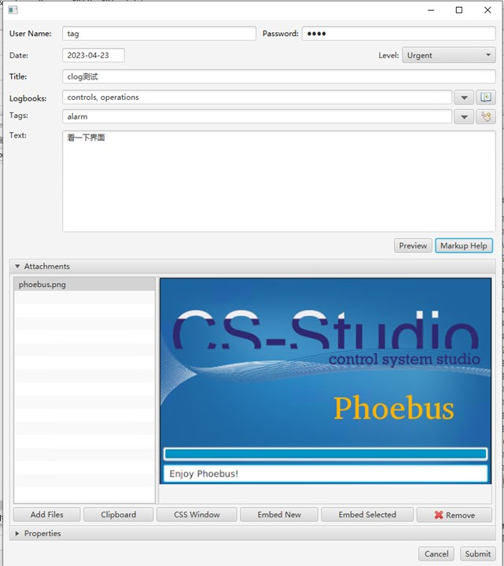
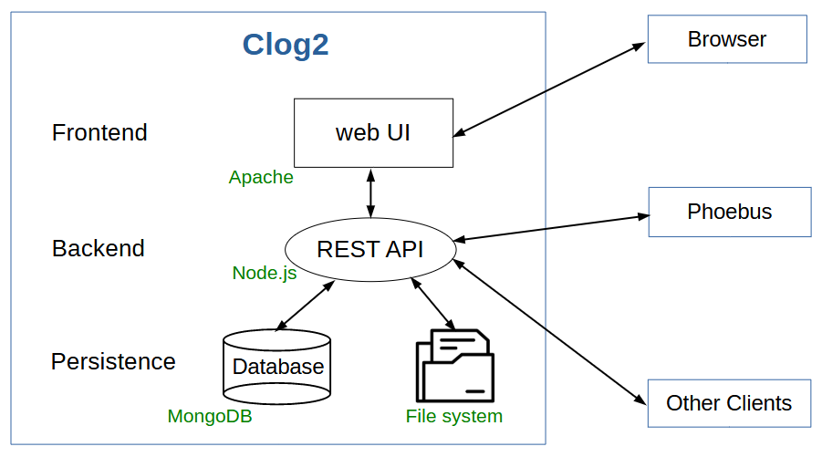
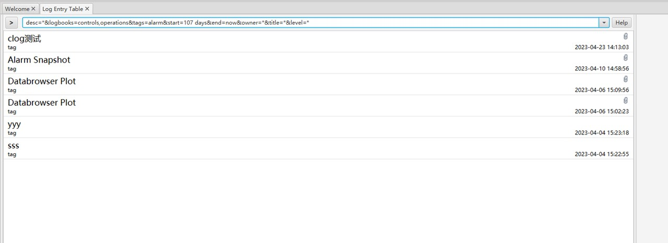
#8. Phoebus client (By Mingtao Li)
Architecture of Clog 2.0
Log preview UI
Log editing UI

Slide 19
Summary
Clog 2 has been developed and released by CSNS on 2022.
Clog 2 has been deployed at HEPS accelerator on 2023.
A series of improvement has been made to Clog 2 according to requirements of HEPS.
GitHub links for Clog 2.0 and Clog mobile web client
https://github.com/wanglin86769/clog2
https://github.com/wanglin86769/clog-mobile
Development team
Frontend & backend & mobile: Lin Wang wanglin@ihep.ac.cn
Phoebus client: Mingtao Li limt@ihep.ac.cn
Line Manager: Yuliang Zhang zhangyl@ihep.ac.cn

Slide 20
Thanks for your attention!

