Slide 1
PV Browser - A Web Based EPICS PV Information Query System
Yuliang Zhang, Kangjia Xue
CSNS@IHEP
2024 Spring EPICS Collaboration Meeting, Pohang

Slide 2
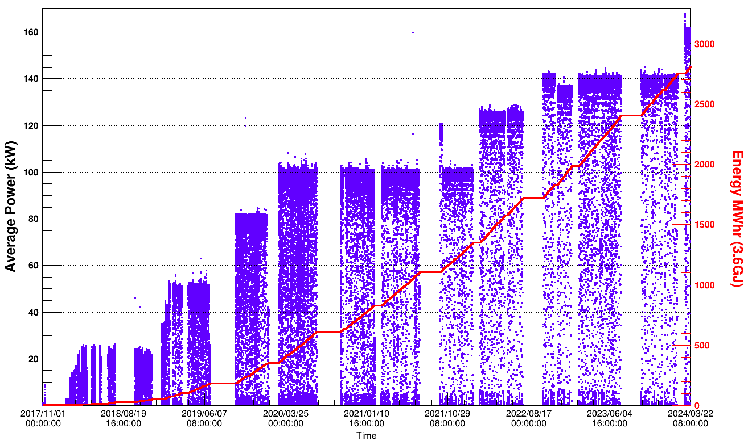
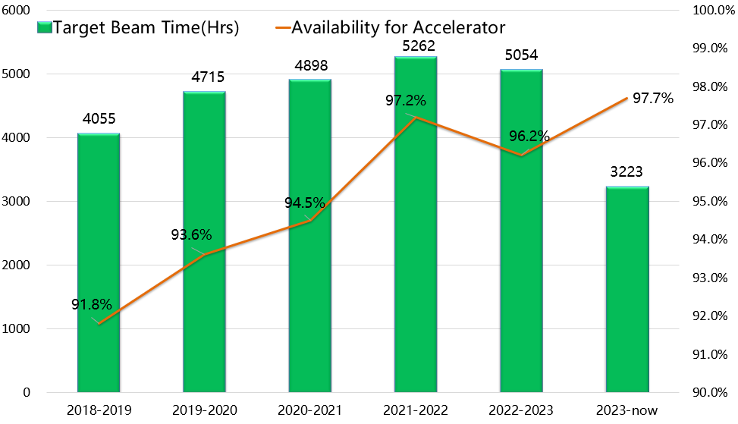
Brief Introduction of CSNS Operation and CSNS-II
CSNS is operating at 160kW beam power since March 2024
Total number of PVs accelerator only is about 100,000
25/50kW
80/100kW
100kW
100/125kW
140kW
140/160kW
Beam power ramp history
Beam time and availability

Slide 3
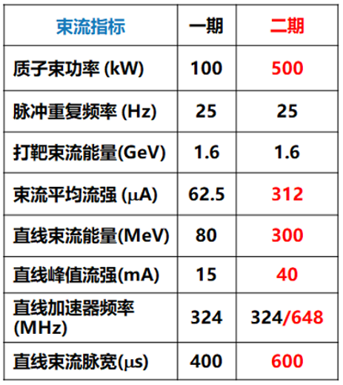
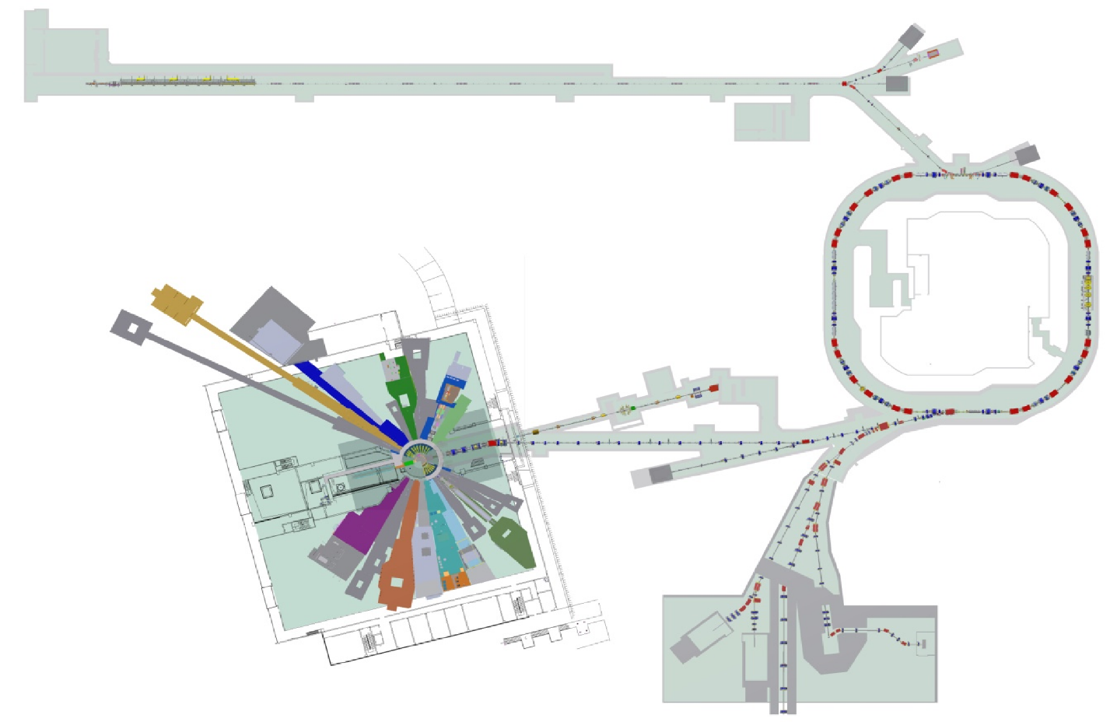
Brief Introduction of CSNS Operation and CSNS-II
Beam power will be upgraded from 160kW to 500kW
Total number of PVs accelerator only will be 200,000+
New Injection System
Parameters
CSNS
CSNS-II
Beam Power（KW）
SSC, 80MeV->300MeV
Rep-Rate（Hz）
Beam Energy（GeV）
Avg Current (µA)
Linac Energy(MeV)
Linac Pk Current (mA)
Linac RF Frequency（MHz）
NEW：9 neutron beam line, 1 muon and 1 proton line
Linac Beam Width(µS）

Slide 4
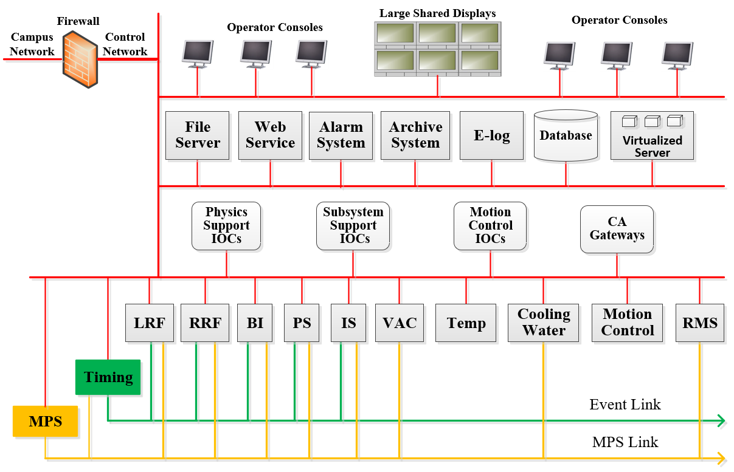
Accelerator Control System Upgrade Towards CSNS-II
EPICS V3 and V7 mixed control system
Total number of V3 and V7 IOCs will be more than 200

Slide 5
Information we care about PV
Live Value
Owner
Historical Value
Location
EPICS
PV
Put Log
IP Address
Alarm State
Number of PV

Slide 6
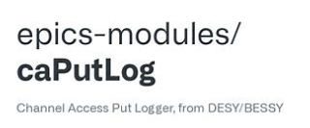
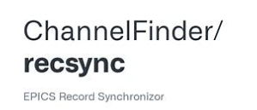
Information we care about PV
There are many tools to collect these information in EPICS community
Browsing these PV related information via web pages is more convenient

Slide 7
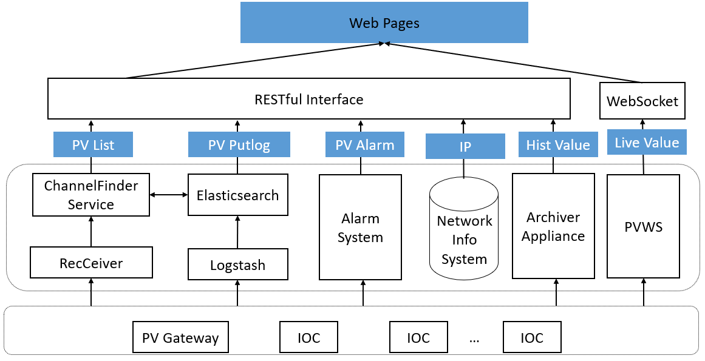
Design of PV Browser
Front end：Vue.js framework +PrimeVue component library
Backend：Node.js and community existing tools

Slide 8
PV List
Directory service tool ChannelFinder and EPICS record synchronizer tool RecSync
Web pages get PV record data from ChannelFinder service and ElasticSearch directly
PV list module

Slide 9
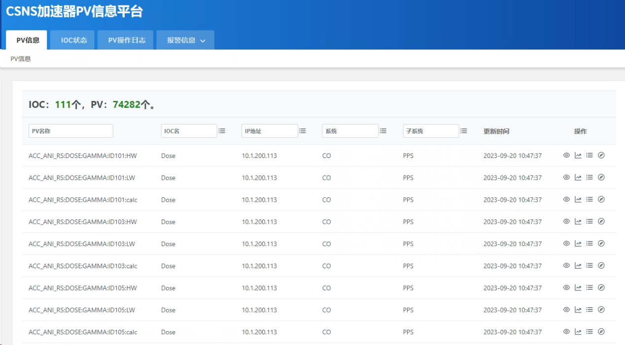
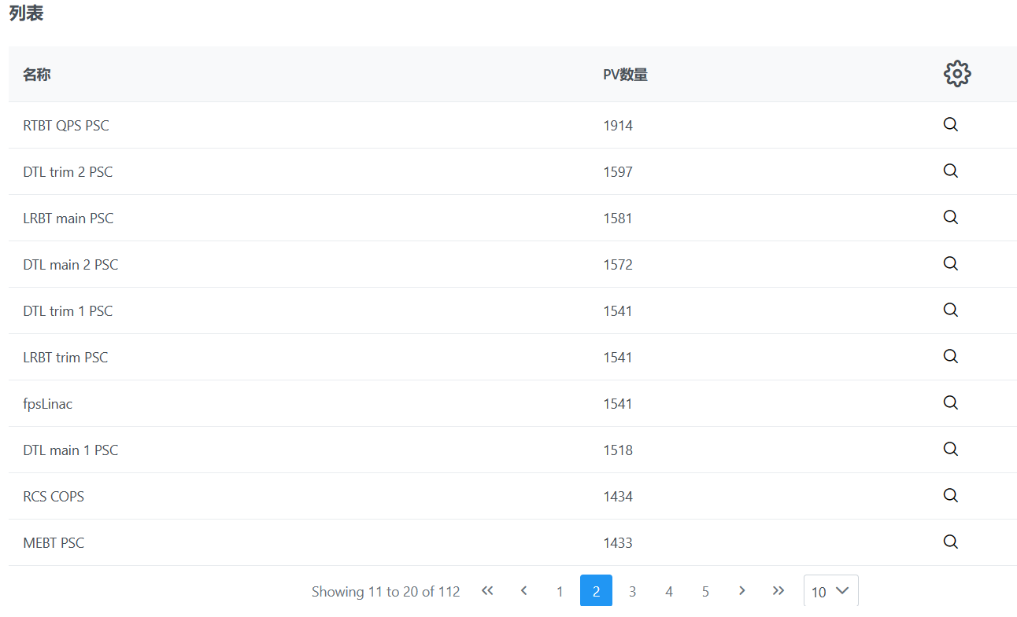
PV List
PV name list, IOC name list, IOC IP list and PV detailed information can be showed in the main page
List Data
Hist Data
Putlog
Network
IOC List
PV List main page

Slide 10
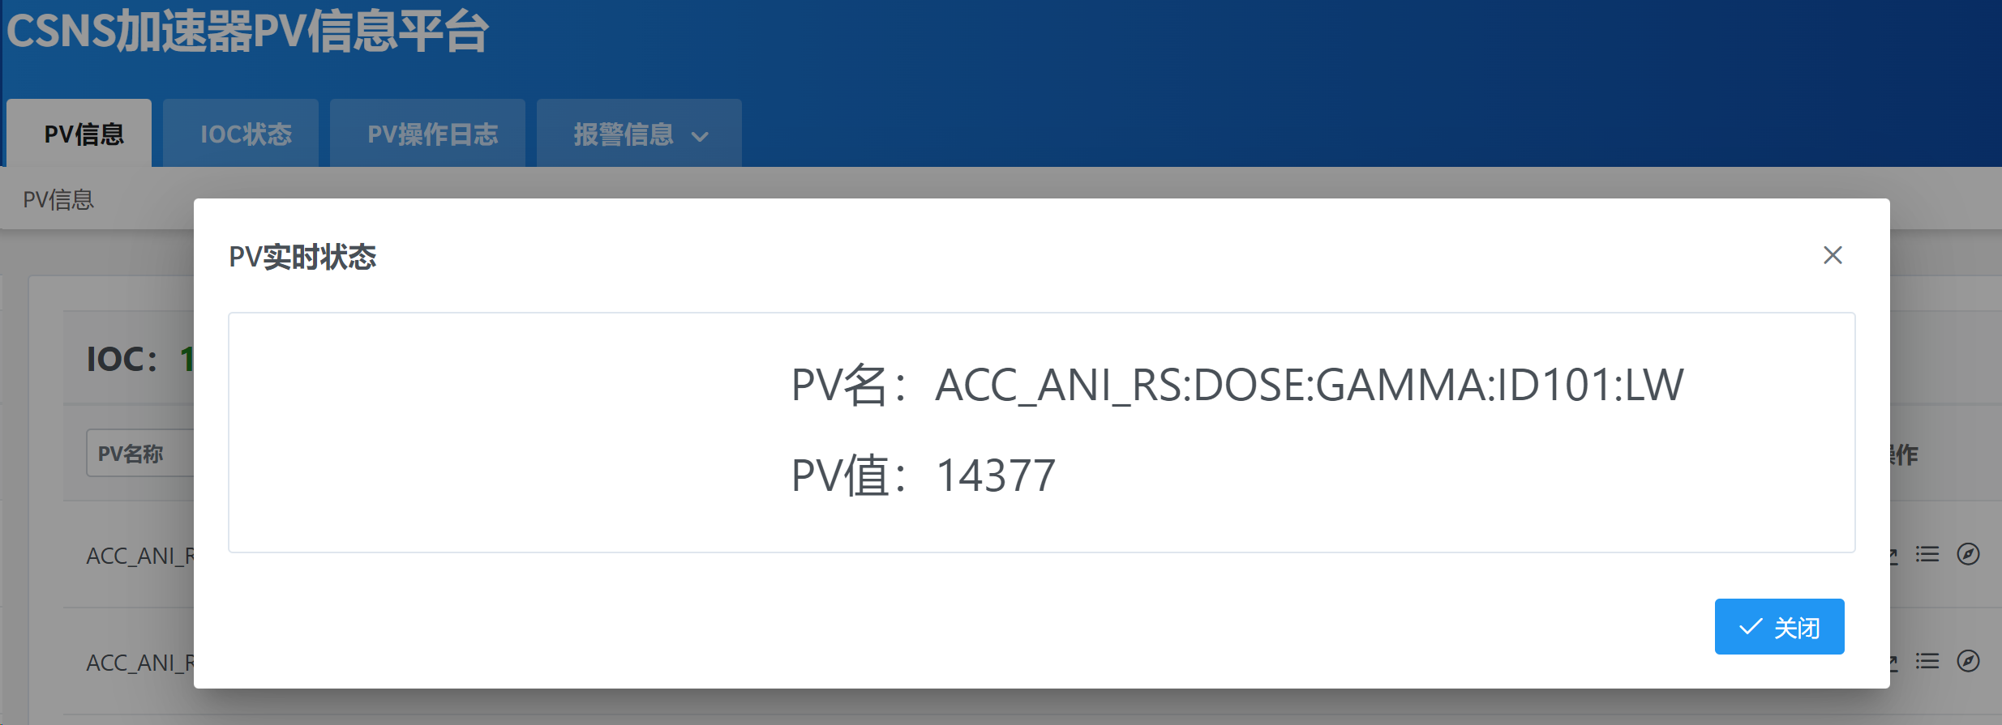
PV Live Data
PV Web Socket tool PVWS was adopted as the backend
Web page subscribes the PV live data and alarm state
PV Live data
PV live data module

Slide 11
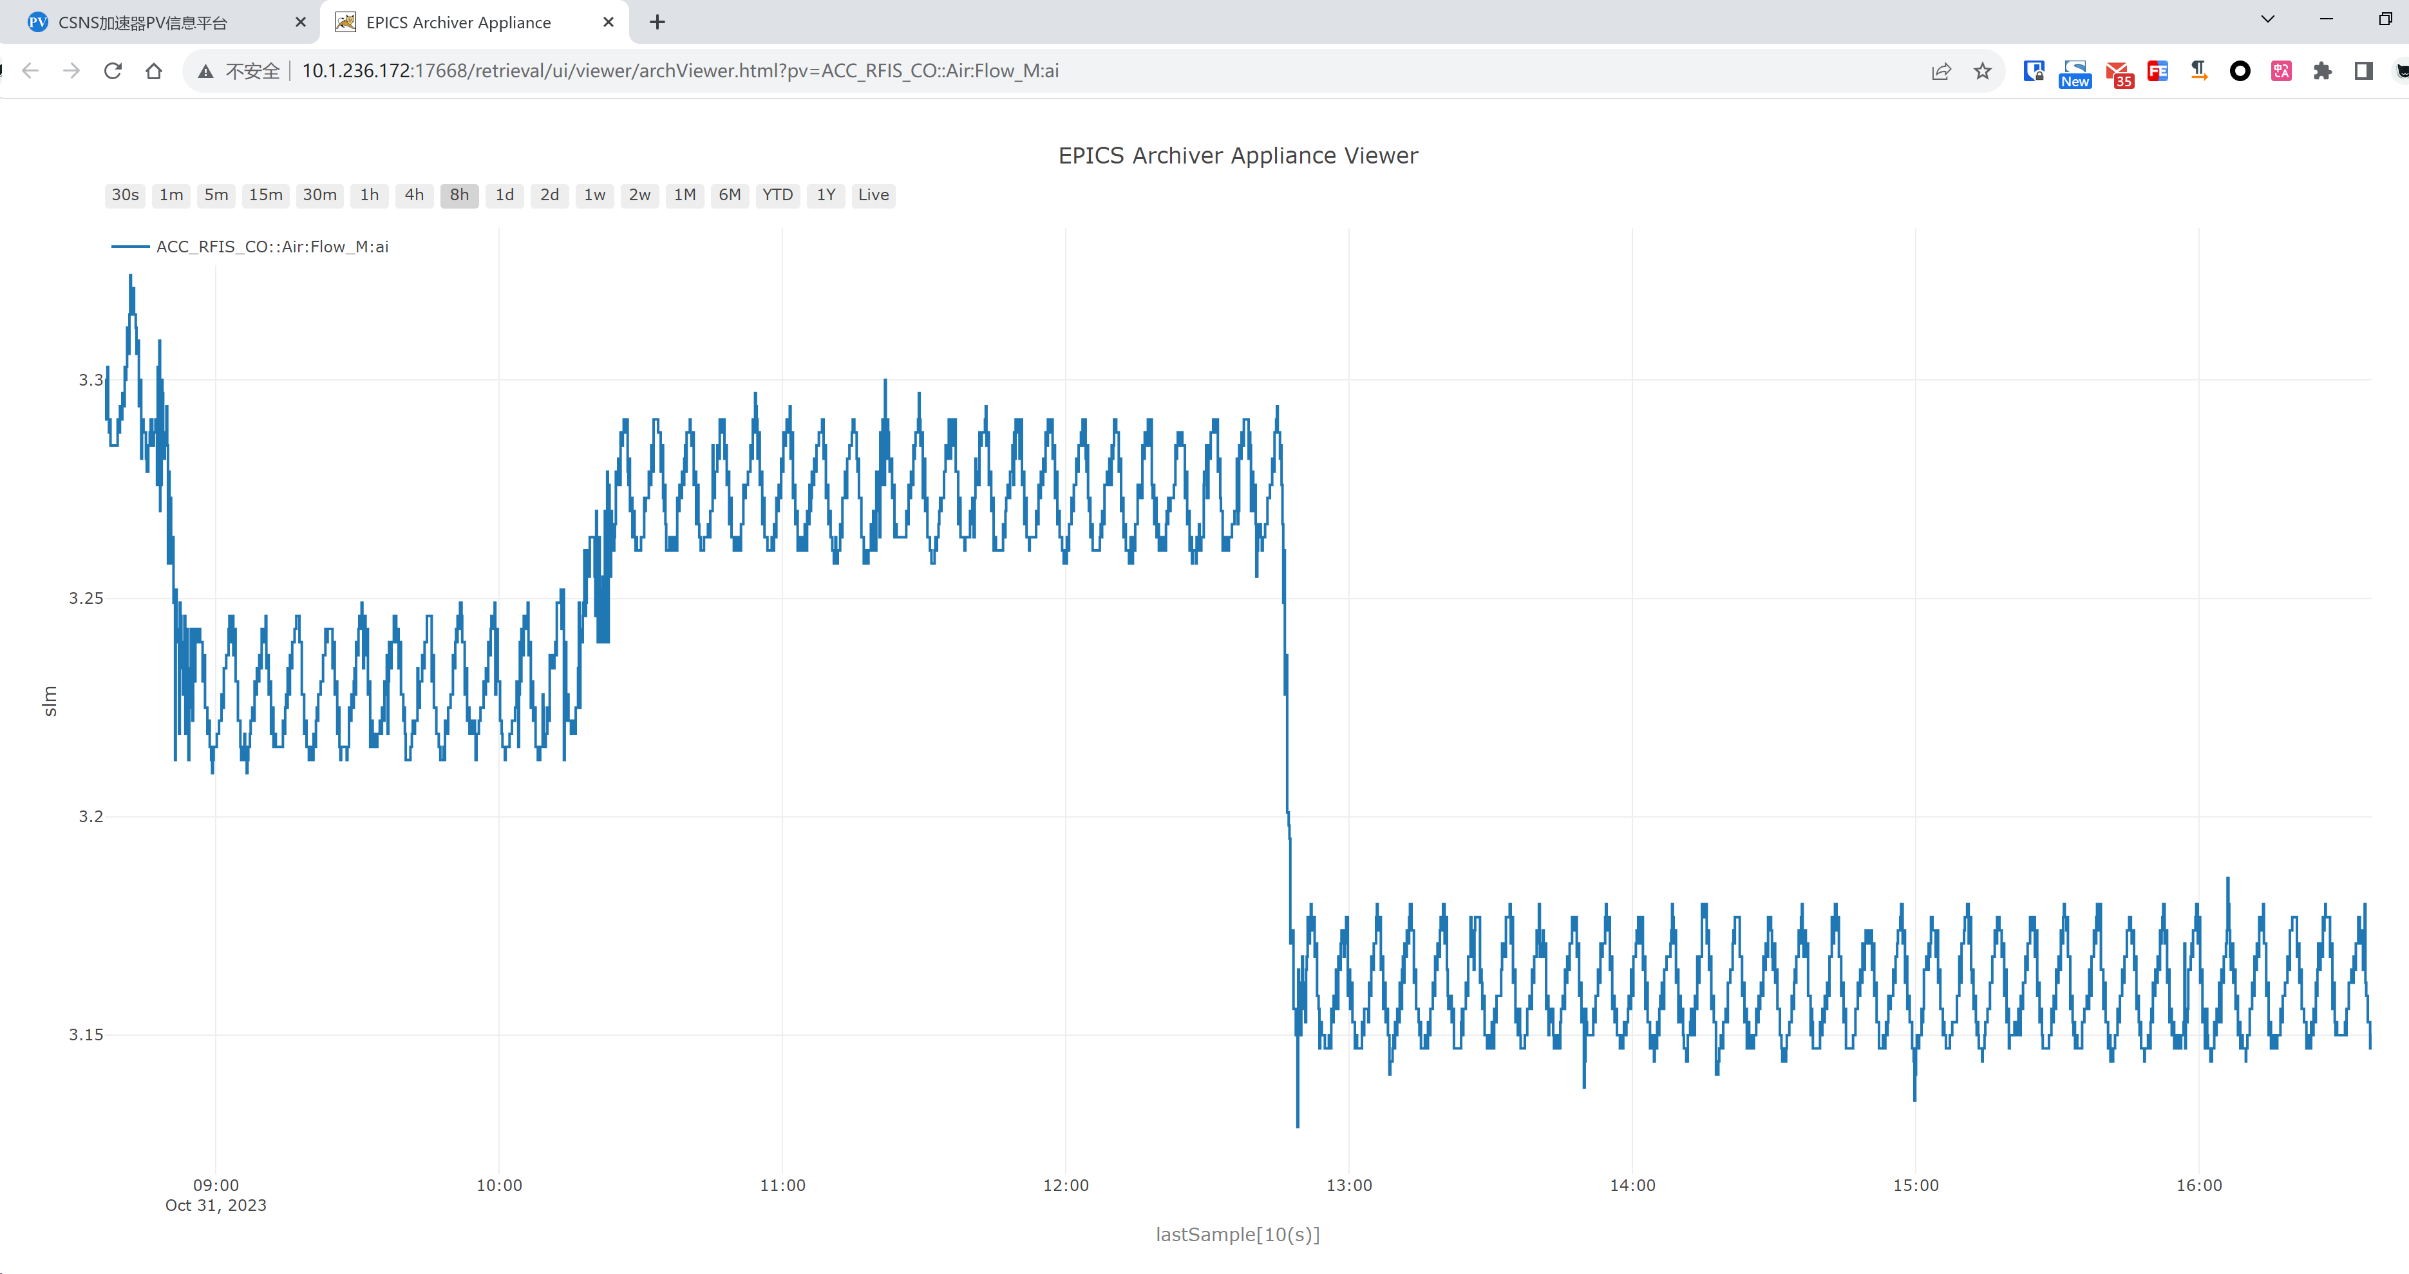
PV Historical Data
The EPICS Archiver Appliance supports data retrieval in multiple formats/MIME types. PV browser calls the in-built web service to show the historical data
PV Historical Data

Slide 12
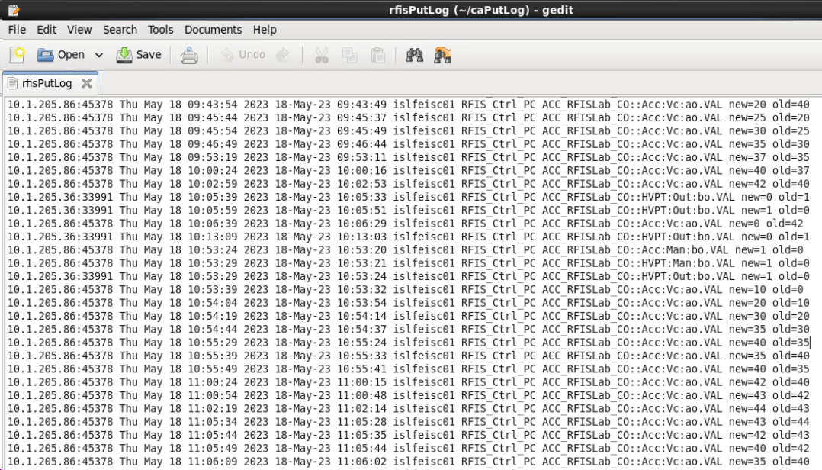
PV Putlog
Usually, CaPutLog module and iocLogServer were used to collect the PV put log , the Put log was stored in separated local files, it is hard to read
The content of iocLogServer log file

Slide 13
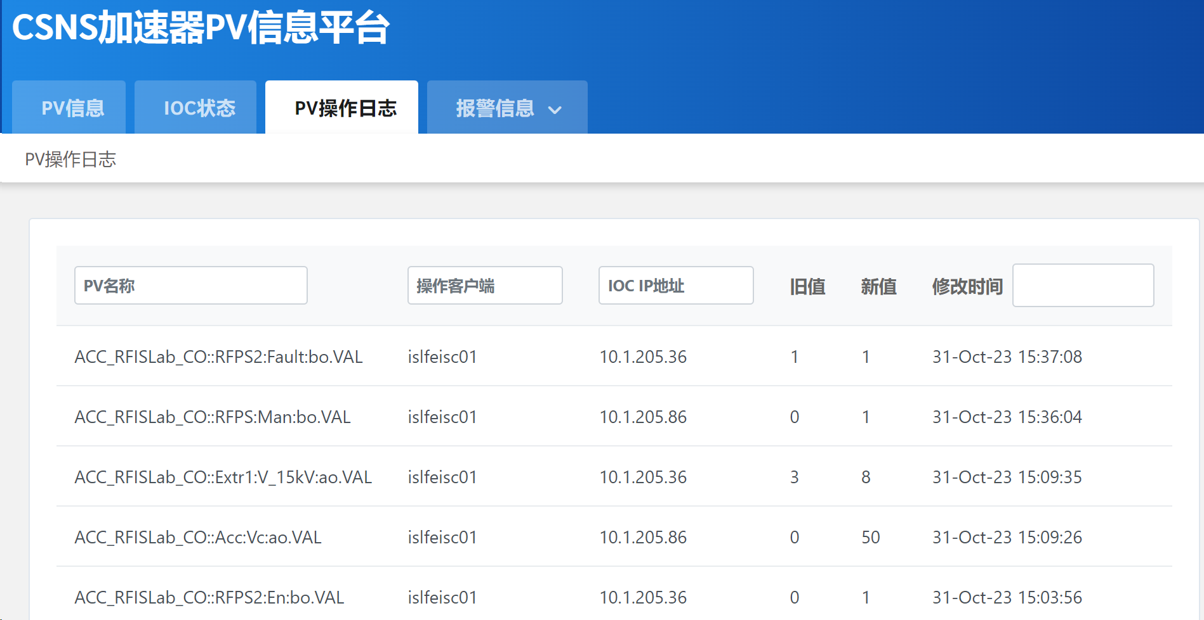
PV Putlog
CaPutLog module and Logstash were adopted, the put log was saved into ElasticSearch
Web page gets PV put log from ElesticSearch
PV Put log module
PV put log page

Slide 14
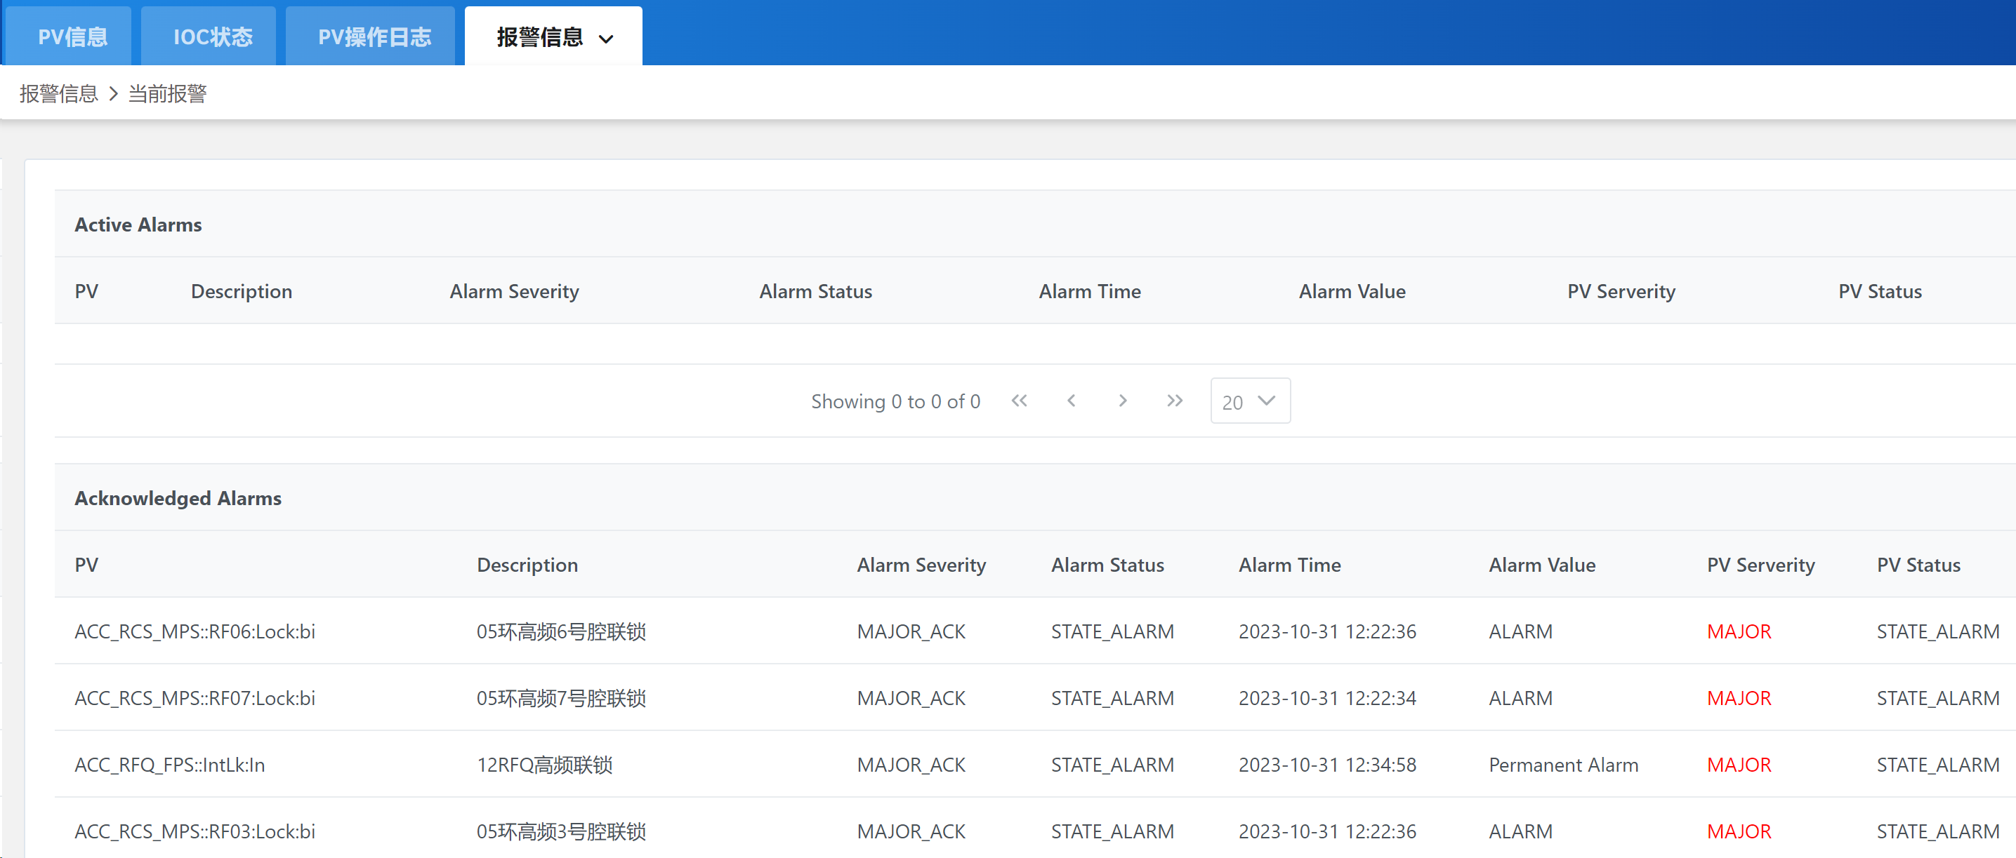
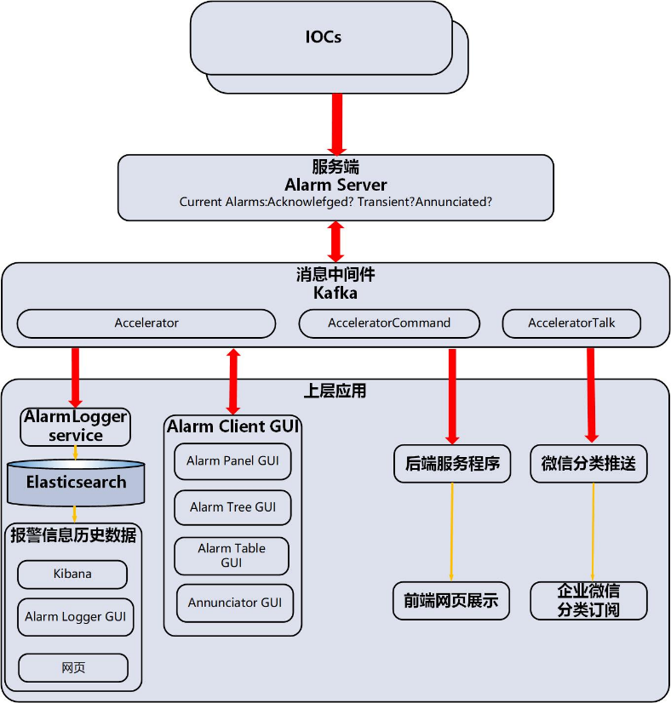
PV Alarm State
Pheobus kafka based alarm system was used
Web page get the active alarms directly from kafka
The Phoebus kafka alarm system deployed at CSNS
Active alarm page

Slide 15
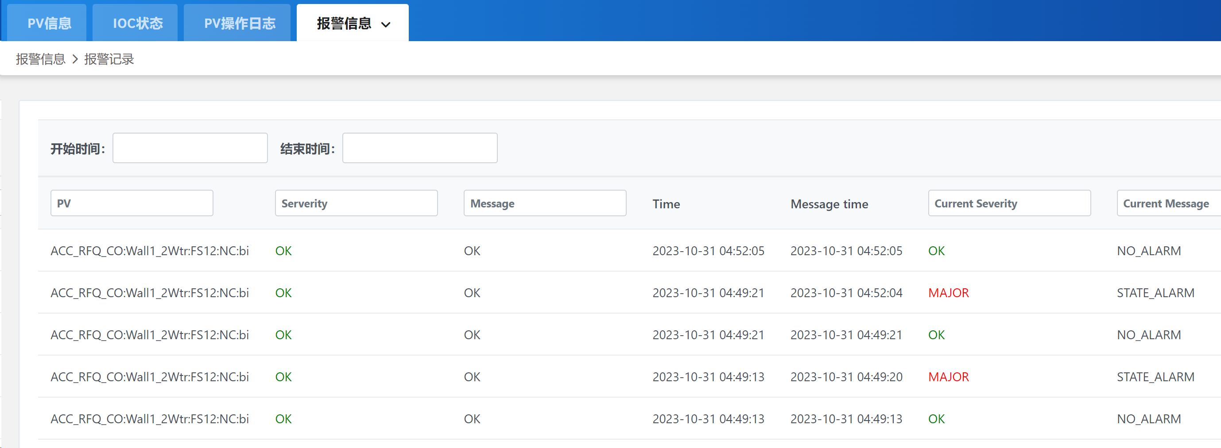
PV Alarm State
Web page gets alarm history from the Phoebus alarm system in-built RESTful API
Alarm history page

Slide 16
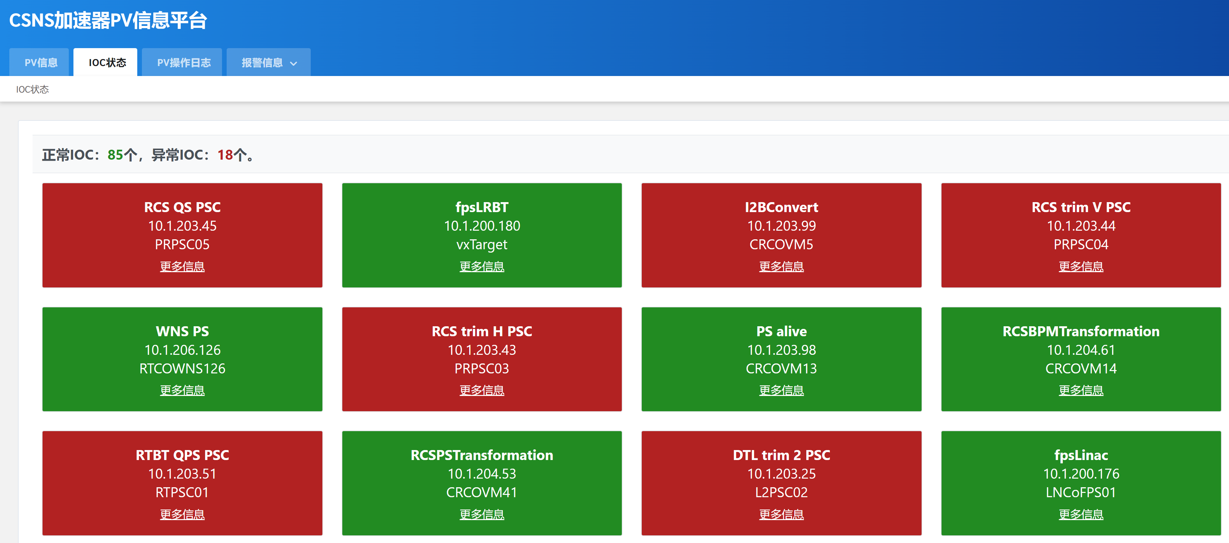
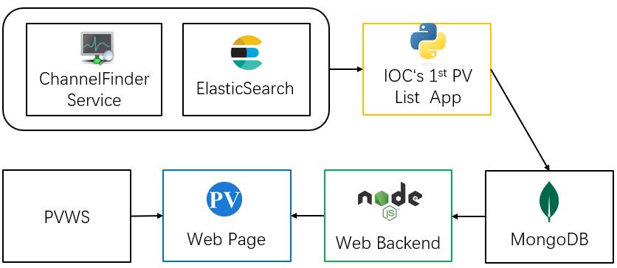
IOC Status
A python application periodically get the 1st PV of each IOC from ElasticSearch, and save to MongoDB
Get the value of these PVs via PVWS, if these PVs are all alive, then the IOCs are all alive
IOC status module
IOC Status page

Slide 17
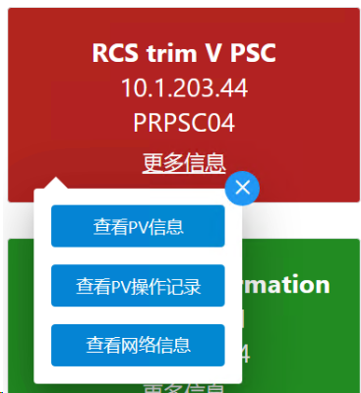
IOC Status
From this page, more detailed PV information can be acquired
This page is useful after the long shutdown of the accelerator
IOC Status page

Slide 18
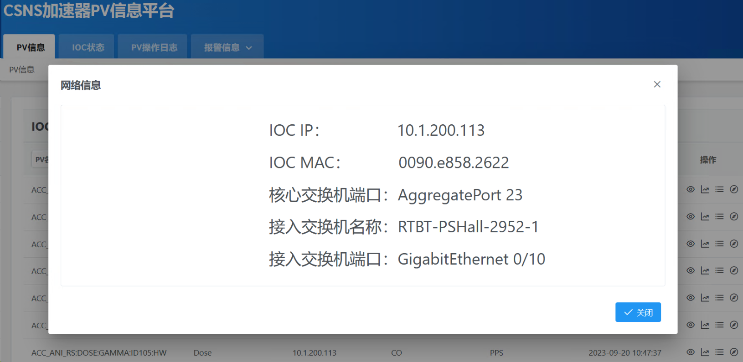
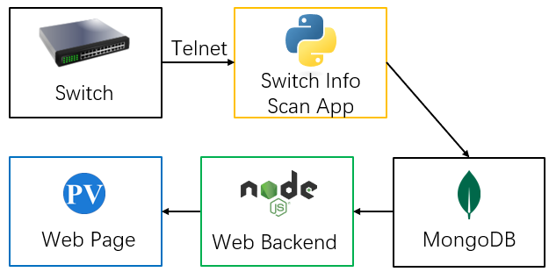
IOC Network Information
The IOC detailed network information can also be queried
Operators can quickly get the related switch information
The detailed IOC network information

Slide 19
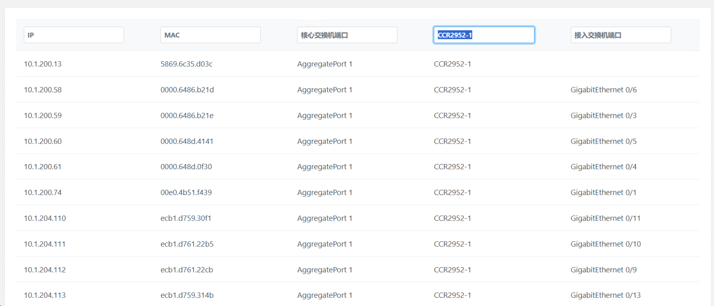
IOC Network Information
List all the IP addresses used for EPICS IOCs, then we can go to the each of the IOC for the detailed information

Slide 20
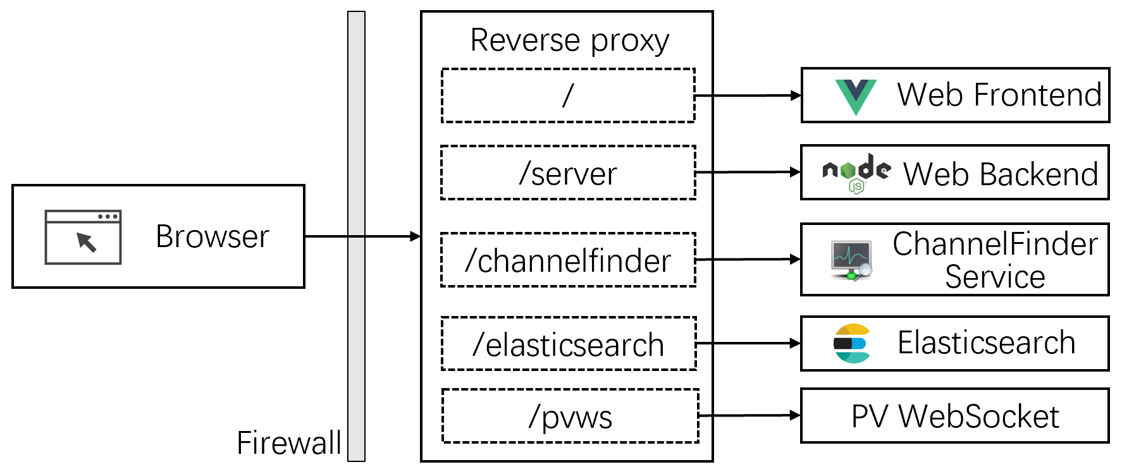
Deployment of PV Browser at CSNS
Proxy server Nginx was adopted to deploy the PV Browser
The system was deployed at CSNS accelerator in 2022. Now, it is frequently used by the operator
Campus Network
Accelerator Network

Slide 21
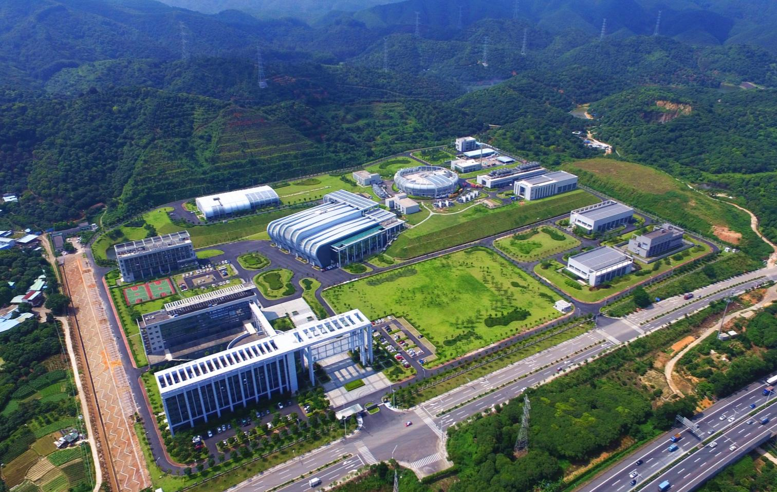
Thank you for your attention!

