Slide 1
OACTree Sequencer
Operation, Automation and Control using Behavior Trees
Walter Van Herck, Gennady Pospelov – presented by R. Lange
EPICS Collaboration Meeting, Pohang
15-18 April 2024

Slide 2
Overview
Motivation
Behavior tree semantics
Extensible and composable:
New Instructions and/or Variables can be provided through plugins
Decoupled user interactions (input/output) allows for CLI, daemon, GUI, etc.
Include(Procedure) allows building procedures from a collection of input procedure files
Instructions & Variables
Plugins allow custom extensions
GUI
Status and Plans

Slide 3
text
Motivation
The traditional EPICS SNC-Sequencer is a powerful tool, very well documented and tested
ITER systems are very large and complex; often commissioned in stages
E.g., the start-up procedure for the CC2D cooling loop (1/6) has about 1k instructions
Finite state machines don’t scale well enough
Behavior Trees are a concept that allows for better modularization and parametrization of large procedures
text
text
text

Slide 4
text
Behavior tree semantics
Goal based, rather than action based
Decompose main goal into subgoals
Used in AI, robotics, control systems and video games
a
text
text
text

Slide 5
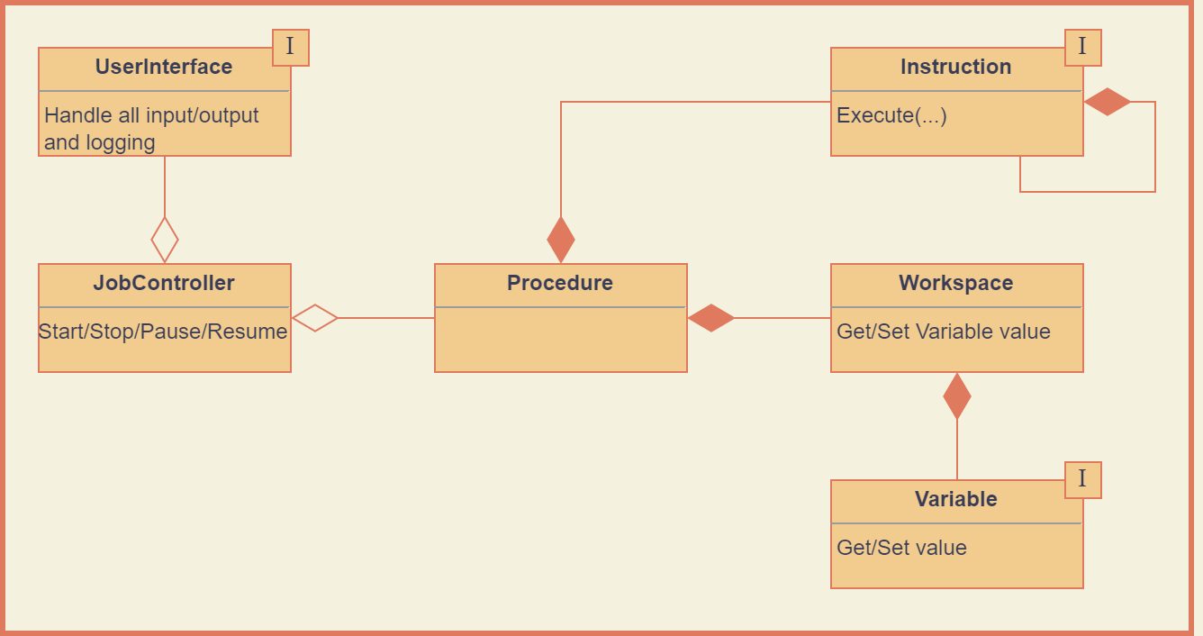

Slide 6
text
Instruction categories
Composite
Sequence
Fallback
ParallelSequence
Decorator
Inverter
Listen
Include(Procedure)
Action
Wait
Copy
Output
Input
a
text
text
text

Slide 7
text
Workspace variables
Procedure-scoped workspace of variables
a
text
text
text

Slide 8
Plugins
New instructions and variables can be added with the use of plugins.
Current plugins:
sequencer-plugin-control : composite instructions that are common in control systems
sequencer-plugin-epics : read/write process variables; RPC client; supports both ChannelAccess and PvAccess
sequencer-plugin-mathexpr : exposes sup-mathexpr to sequencer
sequencer-plugin-sup : for configuration reading/writing and calling CVVF functions
sequencer-plugin-psps : provides interface to pulse schedule database

Slide 9
text
text
text
OACTree GUI
text

Slide 10
text
Status and Plans
Core libraries: Complete and in maintenance mode
Plugins: Depends on the plugin. EPICS Plugin needs more testing.
GUI: Stable, still needing UX improvements
Next: Remote Sequencer Servers to allow running procedures continuously
Availability: Currently still under ITER IP rules… Please contact us !!
a
text
text
text

Slide 11
Thank you!
OACTree Sequencer
Walter Van Herck, Gennady Pospelov
EPICS Collaboration Meeting
15-18 April 2024

