Slide 1
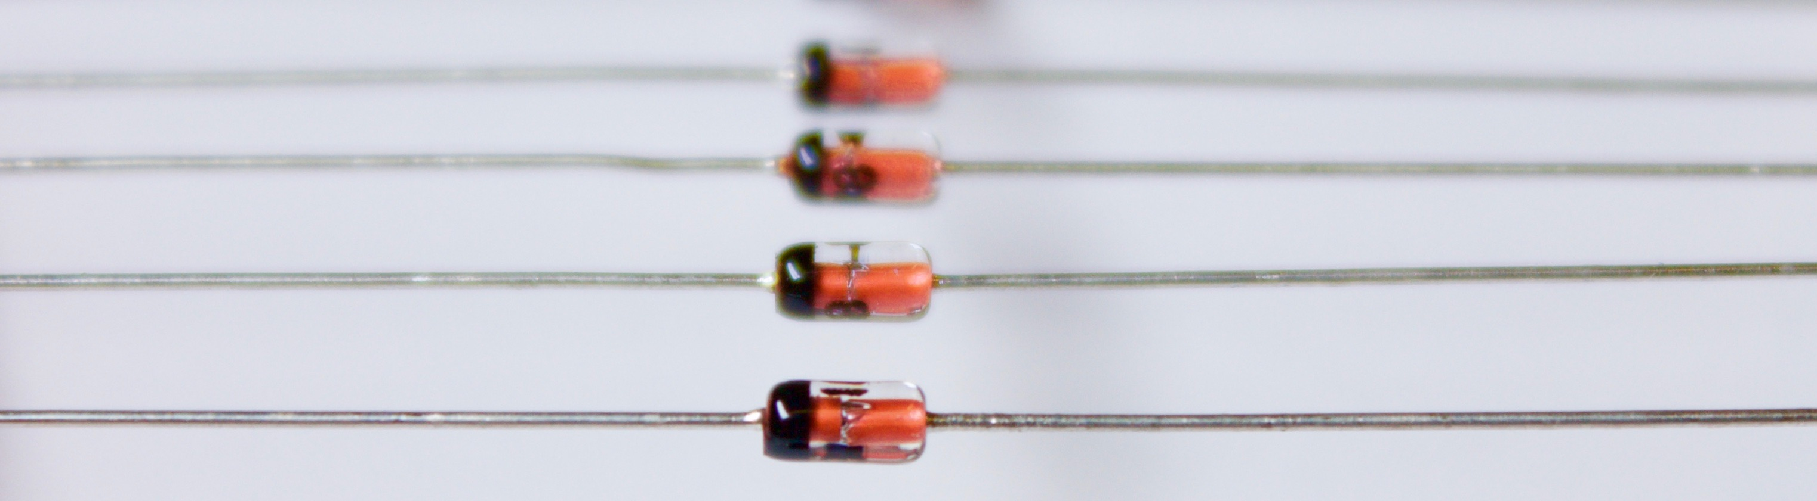

(Yet Another) EPICS Diode
One-Way Data for ITER Remote Participation
Denis Stepanov, Leonid Lobes, Ralph Lange – ITER Organization
EPICS Collaboration Meeting, Pohang
15-18 April 2024

Slide 2
Remote Participation – NOT Remote Control
ITER is a Nuclear Facility. There are strict access rules in place.
Requirements:
Strict rules to limit external connections to the facility.
No remote operation.
Network traffic is enforced to be strictly one-directional from the inside to the outside.
(E.g., using a commercial “network diode” box.)
F4E (Giuseppe Ferro et al.) developed an EPICS Data Diode
(presented at the EPICS Collaboration Meeting in 2020).
Their implementation uses HTTP on the long distance.
ITER (Leonid Lobes) has tested CA working fine over long distance (presented at the EPICS Collaboration Meeting in 2022).
ITER decided to do another implementation, using a UDP stream across the diode, which meets the ‘strictly one-directional’ requirement.
Don’t reinvent
the wheel,
just realign it.
Anthony D’Angelo
A Re-Implementation of the EPICS Data Diode

Slide 3
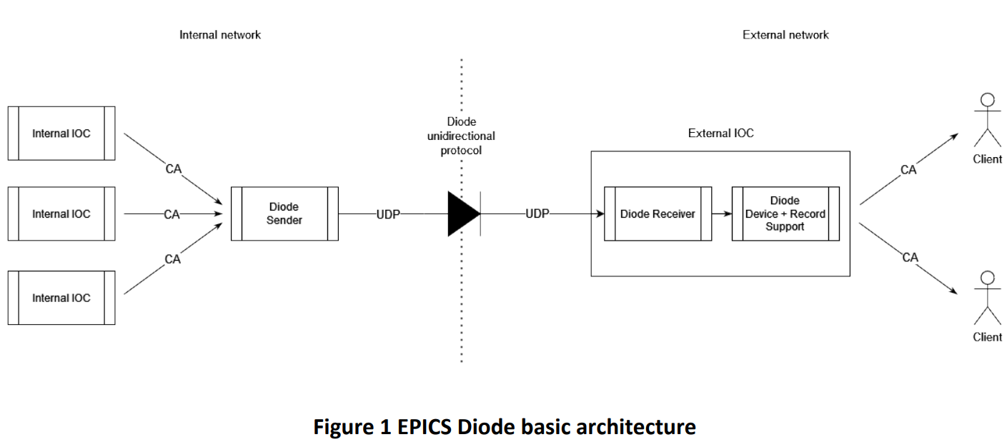

text
Replicated Records
text
text
Replicating an IOC Using a UDP Stream
Both sides (sender and receiver) are fully configured.
Sender has CA subscriptions and sends updates (value/time/status) through a mostly binary UDP streaming protocol.
Receiver pushes data into the EPICS Database and sends out CA updates.
This setup will be local, with CA being used across the long distance.
text

Slide 4
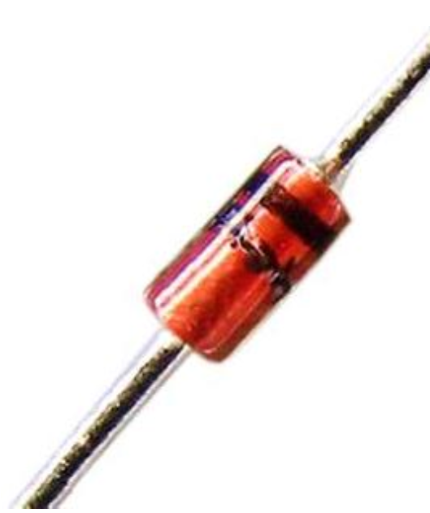
Status and Roadmap
Requirements and Design Documents are approved, including a specification of the UDP streaming protocol.
Our contractor (Cosylab) delivered a proof-of-concept implementation in early 2023, using specialized Record and Device Support in the receiver IOC.
The first full implementation, using a “hollowed-out” receiver IOC and supporting all fields and record types, has been finished and will be delivered in late summer 2024.
There are no ITER specifics in this code. It will be made available to the EPICS collaboration.
We would like to get additional feedback.
Currently the ITER IP rules apply… Please contact us!
Thank you!

