Slide 1
2024 Spring EPICS Collaboration Meeting
Enhancing Performance in EPICS Control System: Leveraging asyn/portDriver with Custom Device Support
April 15, 2024
Kukhee Kim for Algorithmic Data System SLAC National Accelerator Laboratory

Slide 2
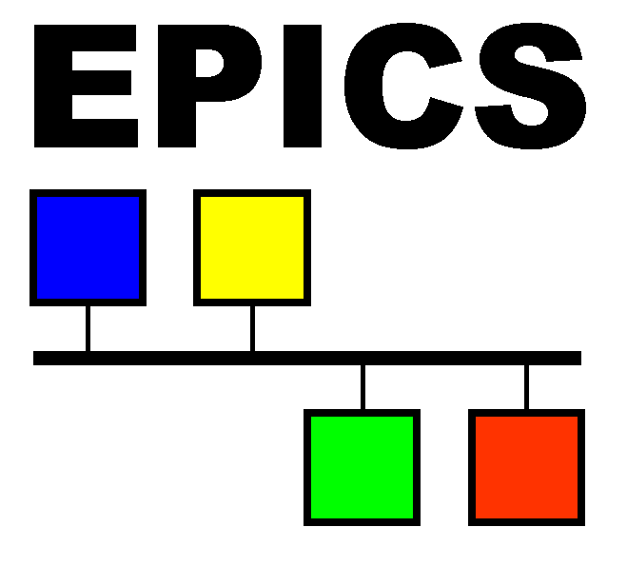
Abstract
The adoption of asyn/portDriver as a standard interface for EPICS (Experimental Physics and Industrial Control System) records has been integral to various control system projects at SLAC. Renowned for its stability, well-documented behavior, and reduced incidence of bugs, asyn/portDriver offers a straightforward and efficient means of developing EPICS drivers without necessitating extensive programming for device support. However, our endeavors revealed the necessity of crafting custom device support for specialized cases, such as the processing of records for Beam Synchronous Acquisition (BSA) and its associated services which requires EPICS IOC (Input/Output Controller) to manage and update a large volume of records with rapid rates. Consequently, we encountered heightened CPU load and performance degradation when operating numerous EPICS IOCs on a single server.
Our investigation into the elevated CPU load, memory footprint, and other performance metrics pertaining to BSA Process Variables (PVs) and their associated services involved a comparative analysis between asyn/portDriver and customized device support. Our findings demonstrated that custom device support yielded superior performance, with reduced CPU load and a smaller memory footprint. As a result, we transitioned to utilizing custom device support specifically for BSA and its related services, while retaining asyn/portDriver for most other generic records due to its myriad of benefits.
In this presentation, we share detailed insights gleaned from our test results and performance enhancements achieved through the adoption of custom device support. Additionally, we recount our successful experiences with asyn/portDriver, underscoring its continued relevance and efficacy in EPICS control systems.
2024 Spring EPICS Collaboration Meeting

Slide 3
Contents
Control System Platform Changes for LCLS2
Standard Interfaces
Common Platform Software
Asyn port driver
Issues with new Platform
Multiple iocs run on a single server
Large memory consumption for LCLS2 BSA and related services
Memory footprint
Performance Issues
Using own device support to reduce memory footprint and better performance

Slide 4
Control System Platform Changes in LCLS2
High Performance System (HPS)
Real-Time Requirement: bunch by bunch response (sub-microseconds response), Timing System, Machine Protection, etc
High bandwidth for data collecting from every bunch and aligning data across multiple systems including BPMs, LLRF, PCAV, XTCAV, etc
Both may be required simultaneously
Platform Changes from VME/RTEMS to ATCA/LinuxRT
Advanced Telecommunications Computing Architecture (ATCA)
Hardware functions are implemented on AMC cards and RTM board
Example of AMC cards: fast digitizer, RF up-converter and down-converter, etc
Example of RTM cards: Debug RTM for timing interface and Ethernet, RF interlock RTM, etc
Real-time requirements and Data Processing are implemented in FPGA firmware on the Carrier Board
Examples including digital demodulation for RF system, digital phase lock loop for various applications, bunch by bunch feedback for RF system
Software runs on LinuxRT CPU, meeting to minimum real-time requirements and provides EPICS PV interface
Non-HPS
PCIe form factor, FPGA firmware-based system
Examples including PCIe Timing Pattern Receiver (TPR), Frame Grabber with TPR, etc
Real-Time requirements are implemented in Firmware
Software provides minimum real-time requirements and provides EPICS interface

Slide 5
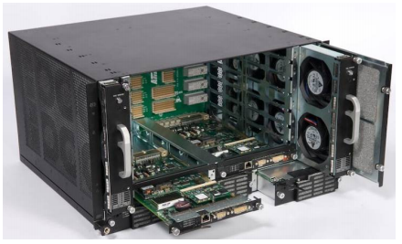
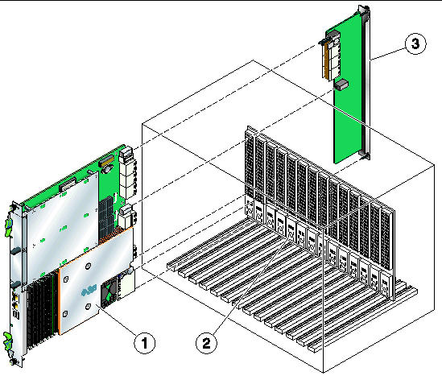
ATCA Crate: Description
Slots for application cards (blades)
Intake Fans
Air Intake Filter
Power supply
DC or AC input
Exit Fans
Backplane
Shelf Manager
Almost all components can be replaced in the field (FRU).
Build around redundancy.

Slide 6
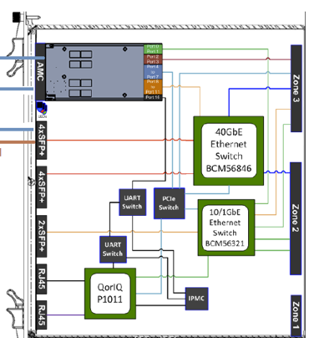
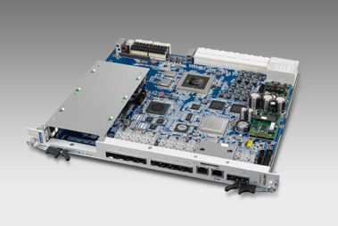
ATCA Switch Card
Advantech ATCA-9112
Switches
BI: Broadcom BCM56321 (24x1G)
FI: Broadcom BCM56846 (24x10G)
Front panel
8x SFP+ (FI)
2x SFP+ (BI)
Managment (1x LAN, 1x Conole)

Slide 7
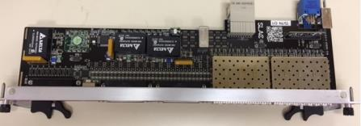
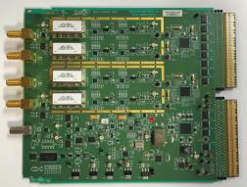
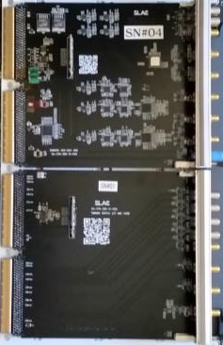
HPS: AMC daughter cards and RTM
MPS/Timing Rear Transition Module
Multi-use ADC/DAC AMC (MPS, BLEN, BCM)
BPM AMC
Timing Digital AMC (Timing)
Every card contains an EEPROM which contains information about the board
Board type
Serial number
Personality options

Slide 8
LCLS-II System example
120VAC Power
IPMI
Network
Epics
Network
Linux Server
10.x.y.1
External
Timing
Network
Carrier Board Slot 2
IPMI
IPMI
Busses Not
Shown
Ethernet
Switch Card
Slot 1
AMC 0
AMC 1
RTM
MPS
Update
Network
10.x.y.102
Standard off-the-shelf
“Dual Star” backplane
10/40 Gbps
Internal
Network
Timing
Distribution
MPS
Update
Network
10.x.y.103
10.x.y.104
10.x.y.105
10.x.y.106
Carrier Board Slot 3
Carrier Board Slot 4
Carrier Board Slot 5
Carrier Board Slot 6
AMC 0
AMC 1
AMC 0
AMC 1
AMC 0
AMC 1
AMC 0
AMC 1

Slide 9
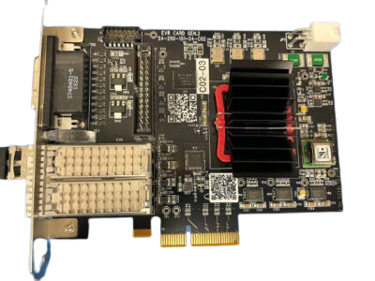
PCIe for Non-HPS (ex, PCIe TPR)
DSUB (DB-25)
TTL level trigger output
LEDs
SFP port for LCLS-I
SFP port for LCLS-II
FPGA
PCIe Edge Connector

Slide 10
Modular Design and Standard Interface
Firmware and Software have been designed with the modular concepts
Select and Reuse common firmware and software modules to develop the system
Minimize new development
Minimize potential bug and issues using proven modules
Standard Interfaces
Common Platform Software (CPSW) for between Firmware and Software Interface
Abstract Firmware Register and Memory, mmio as directory hierarchy with path names
Abstract large DRAM space and messages from the firmware to a stream interface
Abstract communication details and hardware interface: udp/RSSI for ATCA HPS, PCIe for Non-HPS, software doesn’t need to recognize different hardware platform
Firmware uses yaml files to describe mmio and stream interface details, software downloads the yaml files during initialization and learns about the firmware
Using asyn port Driver as standard PV interface
Minimize development for the application driver (EPICS driver for application)
Using proven code, Minimize potential bug
No need to develop device support, short learning curve and less maintenance effort

Slide 11
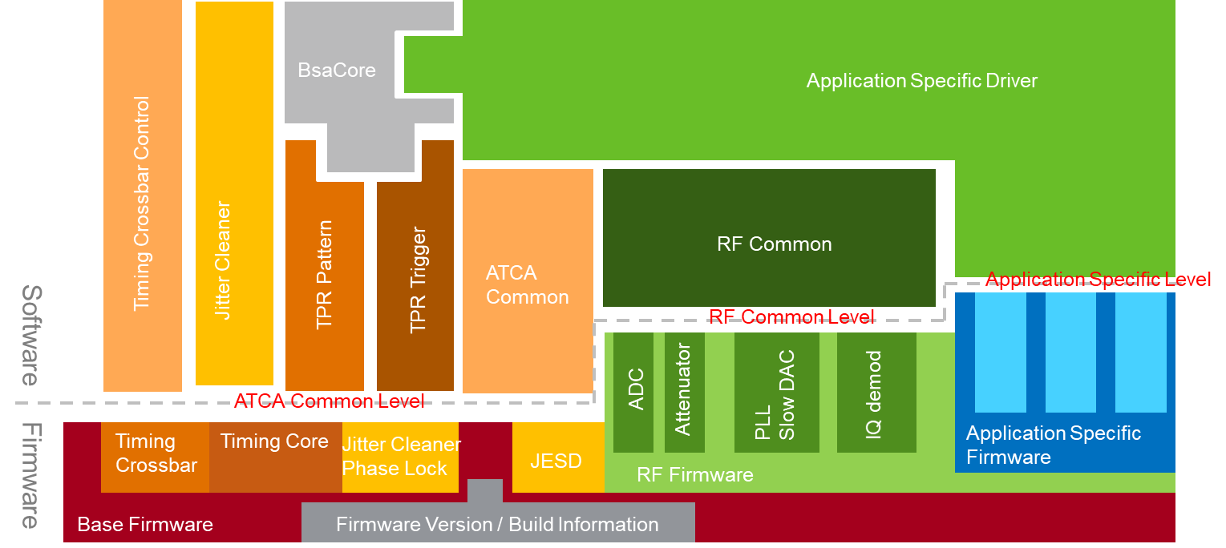
ATCA RF Common Platform Stack
Application Specific Driver llrfHlsAsyn for LLRF Application
Application Specific Firmware llrf_hls firmware
Window average
Channel weighted
Phase/Amplitude Feedback
Baseband RF profile
llrf_hls
Common Firmware Written in VHDL

Slide 12
Software Stacks for modularization
External Modules
Bundled driver in ioc application
External Modules
EPICS Databases
BSA
Db Template
cpswLlrf
Db Template
LlrfProc
Db Template
tprTrigger
db
tprPattern
db
rfCommon Db Template
atcaCommon Db Template
EPICS Modules
LlrfProc
rfCommon
BsaCore
yamlLoader
atcaCommon
tprTrigger
tprPattern
cpswLlrf
InterlockRTM
API (non-epics)
timing/hpsTpr
rf/llrfLib
rf/ interlockRTM
rf/ common
atcaCommon
cpsw/framework
Software
Firmware/
Hardware
Firmware

Slide 13
Performance/Resource Issues with the new Platform
A LinuxRT server hosts for multiple ATCA crates and operates multiple IOCs
Beam Synchronous Acquisition and its related services (BSA, BSSS, BSAS, BLD) requires large memory footprint and more processing
Large memory requirement and performance issue (high CPU load) are raised
Service | Definitions
BSA | Beam Synchronous Acquisition, Organizes data in Arrays, all aligned with the same pulse
BSSS | Beam Synchronous Scalar Service. Samples data with the BSA rates and publishes it as a single value
BSAS | Beam Synchronous Acquisition Service. Organizes statistical data in 2D table. There are common columns (timestamp, 64bit pulse id) and each data channel has columns for average, rms, minimum, maximum and delegate value. The table has 1k of rows to store time series of each column. It published as new EPICS7 NTTable PV. Mainly used by machine learning
BLD | Beam Line Data. Send data directly to a multicast network without sorting it. There is no PV to see the data contents. Mainly used by the photon side

Slide 14
LCLS2 BSA Memory Consumptions (Buffer Memory for BSA PVs)
5 different history buffers for LCLS2 BSA, 40 bytes per sample
BSA history buffer PVs | Descriptions | Type | Size (Bytes)/Sample
mean | Average | Double | 8
cnt | Count | ULong | 8
rms | RMS | Double | 8
pidL | PID Lower Word | Ulong | 8
pidU | PID Upper Word | Ulong | 8
Total Byes per Sample |  |  | 40
50 EDEFs with 20,000 samples of buffer length
4 fault buffers with 1,000,000 samples of buffer length
EDEFs / Fault Buffer | Descriptions | Calculations
EDEFs | Bytes x EDEFs x 20,000 | 40 x 50 x 20,000 = 40MB (0.04GB)
Fault Buffers | Bytes x Fault Buffers x 1,000,000 | 40 x 4 x 1,000,000 = 160MB (0.16GB)
Total Bytes per BSA Channel |  | 0.04GB + 0.16GB = 0.2GB
0.2GB of memory requires for PVs of a single BSA channel
Example) If system has 12 BSA channels 12 x 0.2 GB = 2.4GB for for PVs a similar amount of memory requires for the bsaDriver to maintain the driver internal buffers Thus, 5.4GB of memory consumptions are expected

Slide 15
SC Diagnostic Bus Input
Diagnostics Bus Inputs: BSA input for SC, firmware based BSA
Data: 18bits or even more, if more than 18 bits are used, then the possibility for an overflow/underflow exists in the statistics calculations
Fixed Input:
Marked: the statistics are not computed, last valid input value will be advertised as the average
Un-marked: firmware attempts to calculate the statistics
BSA Statistics, DSP48 (48 bits arithmetic) in firmware
(18 bits)
(18 bits) + (13 bits) = (31 bits)
Data
Diagnostic Bus
(36 bits) + (13 bits) = (49 bits)
Output to the software
Fixed Input Flag
(18 bits) x 2 = (36 bits)
Remarks, max number of average is 8191
is mostly equivalent to (x 8192),

Slide 16
Current Implementation in SC BSA and SC BSAS
Mean and (n-1) Standard Deviation
BSA Implementation, Firmware/API/BSA Driver Separation
BSAS Implementation, Firmware/API/BSAS Driver Separation
The firmware provides yellow portion, the API provides green portion and all other portion is done by the bsaDriver.
The firmware provides yellow portion, and all other portion is done by the bsasDriver.

Slide 17
Performance Issue on BSA driver
Symptoms
Extending 44 Edefs for BSSS makes extra load, especially for TPG which has 31 data channels,
a single thread could not catch up the BSSS processing (15 system Edefs with 31 data channels)
The busy BSSS/BSAS/BLD listener thread makes fragile for the CPSW communication
Improvement
Using multiple processing queue and worker threads to implement parallel processing
The listener thread recognize the packet type and dispatches the data pointer to a proper queue/worker thread
Using free list for the buffer and zero copy buffer to avoid overhead on the queueing
Allocate 4 worker threads for BSSS
Allocate 1 worker thread for BSAS
Allocate 1 worker thread for BLD
Parallelizing BSSS is easy, but need more consideration for BSAS (ex, waiting all rows are updated in the buffer, then post out the table into PVXS)

Slide 18
Cont’d Performance Issue: Listener and Worker thread
Work Q for BLD
Worker Thread for BLD
Work Q for BSAS
Worker Thread for BSAS
CPSW UDP Thread
Work Q0 for BSSS
Worker Thread0 for BSSS
Listener
Dispatcher
Work Q1 for BSSS
Worker Thread1 for BSSS
Work Q2 for BSSS
Worker Thread2 for BSSS
Work Q3 for BSSS
Worker Thread3 for BSSS
The dispatcher uses
round-robin for the BSSS threads (parallel processing)

Slide 19
Cont’d Performance Issue: CPU Load for the Listener and Worker Threads
PID PPID TID RTPRIO TIME %CPU STAT COMMAND WCHAN WCHAN
-----------------------------------------------------------------------
1864 1863 2113 79 00:00:07 1.3 SLsl+ bldStrm_root_0 - -
1864 1863 2114 64 00:02:50 31.1 SLsl+ bsssQ0_root_0 - -
1864 1863 2115 64 00:02:45 30.3 SLsl+ bsssQ1_root_0 - -
1864 1863 2116 64 00:02:53 31.6 SLsl+ bsssQ2_root_0 - -
1864 1863 2117 64 00:02:45 30.3 SLsl+ bsssQ3_root_0 - -
1864 1863 2119 64 00:00:06 1.2 SLsl+ bsasQ0_root_0 - -
1864 1863 2120 10 00:00:00 0.0 SLsl+ taskwd - -
(%CPU) > 100%
bsssQ<n>

Slide 20
Cont’d Performance Issues: Monitoring Pending Queue and its Water-marker
sioc-b084-ts01>dbior bldStreamDriver
Driver: bldStreamDriver
BLD Stream for root_0
read size : 768
read count : 95387403
bld count : 0
bsss count : 4542715
bsas count : 90844688
else count : 0
bld callback : (nil)
bld_usr : (nil)
bsss_callback: 0x6c2d90
bsss_usr : 0x2ff8960
bsas_callback: 0x6c95c0
bsas_usr : 0x2e0a2d0
free list : 0x30bfa30
bldQueue[0]
name of thread: (null)
pending count : 0
water mark : 0
fail count : 0
overrun count : 0
bsssQueue[0]
name of thread: bsssQ0_root_0
pending count : 0
water mark : 1
fail count : 0
overrun count : 0
bsssQueue[1]
name of thread: bsssQ1_root_0
pending count : 0
water mark : 1
fail count : 0
overrun count : 0
bsssQueue[2]
name of thread: bsssQ2_root_0
pending count : 0
water mark : 1
fail count : 0
overrun count : 0
bsssQueue[3]
name of thread: bsssQ3_root_0
pending count : 0
water mark : 1
fail count : 0
overrun count : 0
bsasQueue[0]
name of thread: bsasQ0_root_0
pending count : 1
water mark : 8
fail count : 0
overrun count : 0

Slide 21
Consideration for number of ioc vs. number of CPU cores
Generic Application (AmcCarrierTpr)
Accumulated Average CPU load
Required Core per ioc
3 cores = 2 cores x 1.5 (safety factor)
Generic ioc requires 3 cores per ioc
TPG Application (AmcCarrierTimingGenerator)
Accumulated Average CPU load
Required Core per ioc
3.45 cores = 2.25 cores x 1.5 (safety factor)
TPG requires approximately 4 cores per ioc
(%CPU) ≈ 185%
Threads for AmcCarrierTpr
Test stand servers (cpu-b084-ts01, cpu-b084-sp18) have 5 cores CPU at 1.9GHz
The production servers have few configurations:
6 cores model has 1.9GHz
8 cores model has 1.7GHz
Since, the production servers have similar clock speed to the test stand, the estimation (number of cores per ioc) is still valid for the production.
(%CPU) ≈ 225%
Thread for AmcCarrierTimingGenerator

Slide 22
Scenario for the number of ioc vs. Number of cores
1 Crate (7 slots ATCA crate) + 1 Server Configuration
6 AMC Carriers, thus 6 iocs are in the system
Required CPU cores: 18 cores = 6 iocs x 3 cores/ioc
2 Crates (7 slots ATCA crate) + 1 Server Configuration
12 AMC Carriers = (2 crate x 6 AMC Carrier/crate), thus 12 iocs should be in the system
Require CPU cores: 36 cores = 12 iocs x 3 cores/ioc

Slide 23
Cont’d Performance Issues: Record Processing and Bsa Poll
Relatively High CPU load for the Record Processing
Separate out Record Processing to two callbacks
cbLow: BSA PVs, Fault Buffers and All others
cbMedium: BSSS exclusively
High CPU load on BSA poll thread
The poll thread in TPG > 50%
The poll thread in Amc TPR < 35%
Good candidate to make parallel processing, but need some changes on the API layer to make it ready for the parallel processing
Keep eyes on it, but no need to make change right now
PID PPID TID RTPRIO TIME %CPU STAT COMMAND WCHAN WCHAN
-----------------------------------------------------------------------
1864 1863 2122 58 00:29:23 3.8 SLsl+ cbLow - -
1864 1863 2123 63 01:55:51 15.1 RLsl+ cbMedium - -
1864 1863 2124 70 00:00:00 0.0 SLsl+ cbHigh - -
1864 1863 2125 50 00:00:00 0.0 SLsl+ dbCaLink - -
1864 1863 2126 50 00:00:00 0.0 SLsl+ PVAL - -
1864 1863 2127 50 00:05:30 0.7 SLsl+ serviceDrvPoll 1 hrtimer_nanosleep
1864 1863 2128 50 06:50:57 53.6 SLsl+ bsaDrvPoll 1 hrtimer_nanosleep
1864 1863 2129 98 00:00:26 0.0 SLsl+ tpgIrqPollingTa 1 hrtimer_nanosleep
1864 1863 2130 89 00:12:40 1.6 SLsl+ tpgSoftPollingT 1 hrtimer_nanosleep
1864 1863 2131 50 00:25:27 3.3 SLsl+ tpgBsaPollingTa 1 hrtimer_nanosleep
1864 1863 2132 10 01:14:48 9.7 RLsl+ tpgRateMeasureP - -
1864 1863 2133 10 00:02:32 0.3 SLsl+ tpgDiagnosticsT 1 hrtimer_nanosleep
1864 1863 2134 57 00:00:03 0.0 SLsl+ timerQueue - -
1864 1863 2135 50 00:00:00 0.0 SLsl+ devSeqCarScan 1 hrtimer_nanosleep
1864 1863 2136 19 00:00:00 0.0 SLsl+ PDB-event - -
1864 1863 2137 35 00:00:02 0.0 SLsl+ pvAccess-client - -

Slide 24
Cont’d Performance Issue: Checking up Pending Queue and Water-Mark for Record Processing Callbacks
sioc-b084-ts01>callbackQueueShow()
PRIORITY HIGH-WATER MARK ITEMS IN Q Q SIZE % USED Q OVERFLOWS
cbLow 1387 0 12000 0.0 0
cbMedium 68 0 12000 0.0 0
cbHigh 0 0 12000 0.0 0
No pending queue count for cbLow and cbMedium,
but there are some water-mark.
Probably, the water mark comes from the burden during the iocInit()
we need to adjust the queue size to give enough headroom
(we have adjusted the queue size to 12,000 for TPG)
Consideration for Parallel Callback
We have tried to use Parallel Callback for the record processing in TPG,
found a few issues:
Record processing are stop without any precursor: suspect deadlock
Shows double free exception
We are not sure, the issues are caused by our side (API or epics driver modules which we developed), or epics base. Need more time for debugging

Slide 25
Backup: Study for the Overhead of Asyn Port Driver for the BSSS
Compare CPU load before/after comment out the aysn port driver API calling for BSSS Scalar PV update in the Worker Threads
1 time of setInteger64Param() for PID PV update
2 times of setDoubleParam() for Scalar PV update
1 time of callParamCallbacks() to make record processing
Before
PID PPID TID RTPRIO TIME %CPU STAT COMMAND WCHAN WCHAN
-----------------------------------------------------------------------
1864 1863 2113 79 00:00:07 1.3 SLsl+ bldStrm_root_0 - -
1864 1863 2114 64 00:02:50 31.1 SLsl+ bsssQ0_root_0 - -
1864 1863 2115 64 00:02:45 30.3 SLsl+ bsssQ1_root_0 - -
1864 1863 2116 64 00:02:53 31.6 SLsl+ bsssQ2_root_0 - -
1864 1863 2117 64 00:02:45 30.3 SLsl+ bsssQ3_root_0 - -
1864 1863 2119 64 00:00:06 1.2 SLsl+ bsasQ0_root_0 - -
1864 1863 2120 10 00:00:00 0.0 SLsl+ taskwd - -
(%CPU) > 120%
bsssQ<n>
Most of CPU load for the BSSS operation comes from the overhead of asyn port driver
We can reduce most of CPU load on the BSSS worker thread with using own device support, instead of the using asyn port driver.
After
PID PPID TID RTPRIO TIME %CPU STAT COMMAND WCHAN WCHAN
-----------------------------------------------------------------------
3377 3376 3616 79 00:00:06 1.3 SLsl+ bldStrm_root_0 - -
3377 3376 3617 64 00:00:00 0.0 SLsl+ bsssQ0_root_0 - -
3377 3376 3618 64 00:00:00 0.0 SLsl+ bsssQ1_root_0 - -
3377 3376 3619 64 00:00:00 0.0 SLsl+ bsssQ2_root_0 - -
3377 3376 3620 64 00:00:00 0.0 SLsl+ bsssQ3_root_0 - -
3377 3376 3622 64 00:00:05 1.1 SLsl+ bsasQ0_root_0 - -
3377 3376 3623 10 00:00:00 0.0 SLsl+ taskwd - -
(%CPU) ≈ 0%
bsssQ<n>

Slide 26
Using own Device Support for BSSS and BSA
Overhead of the asyn port driver
Performance dragging on BSSS worker thread and BSA poll thread – heavy overhead on set value/waveform to PV and queueing callback
Performance dragging on cbLow and cbMedium callback – heavy overhead on record processing, especially large number of scalar PV update with relatively high rates
Own Device Support for BSSS and BSA
Enhance the performance only executes the necessary instructions
Using Zero copy buffer to avoid memcpy() for the buffer copy – performance improvement
Free the pre-allocated memory buffer for waveform record, since using the Zero copy buffer
Make NORD work with camonitor, the NORD can be used for the indication for the BSA PV is ready to read
Reduce the accumulate CPU usage
TPG: 225% to 40%
AmcCarrierTpr: 185% to 20%
Reduce Memory footprint: reduce ~3.6GB (for 31 BSA data source channels)

Slide 27
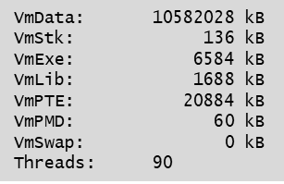
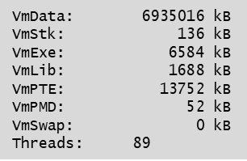
Improvement on TPG
Using asyn port driver
Using own device support
(%CPU) ≈ 225%
(%CPU) ≈ 40%
Thread for AmcCarrierTimingGenerator
Thread for AmcCarrierTimingGenerator
Memory footprint for data session: 10.58GB
Memory footprint for data session: 6.94GB
Captured from /proc/<pid>/status
Captured from /proc/<pid>/status

Slide 28
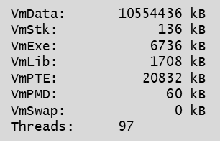
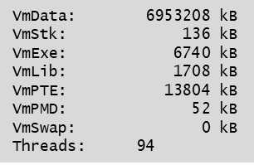
Improvement on AmcCarrierTpr
Using asyn port driver
Using own device support
(%CPU) ≈ 185%
(%CPU) ≈ 20%
Thread for AmcCarrierTpr
Thread for AmcCarrierTpr
Memory footprint for data session: 10.55GB
Memory footprint for data session: 6.95GB
Captured from /proc/<pid>/status
Captured from /proc/<pid>/status

Slide 29
Summary
The LCLS2 control system has been developed on a new platform, featuring an ATCA-based HPS and PCIe-based Non-HPS architecture.
This innovative platform allows multiple IOCs to operate on a single server, streamlining operations.
Additionally, LCLS2 BSA and its associated services necessitate significant memory consumption and increased software processing.
These factors have led to memory footprint and performance issues on the new platform.
To address these challenges, we implemented modularization in both firmware and software components, utilizing standard interfaces such as CPSW for firmware/software communication and asyn/portDriver for managing EPICS records and PVs.
However, we discovered that the asyn/portDriver solution lacked the necessary memory footprint and performance capabilities for handling BSA and its related services.
By replacing the asyn/portDriver with custom device support tailored specifically for BSA and its services, we were able to reduce memory footprint and significantly improve overall performance.
Nonetheless, we continue to leverage asyn/portDriver for managing generic EPICS records, recognizing its myriad benefits and advantages over alternative solutions.

