Slide 1
Transition to Phoebus at the Karlsruhe Institute of Technology
Edmund Blomley
Copyright M. Breig

Slide 2
Outline
KIT accelerators
Current environment
Custom systems
Transition to Phoebus

Slide 3
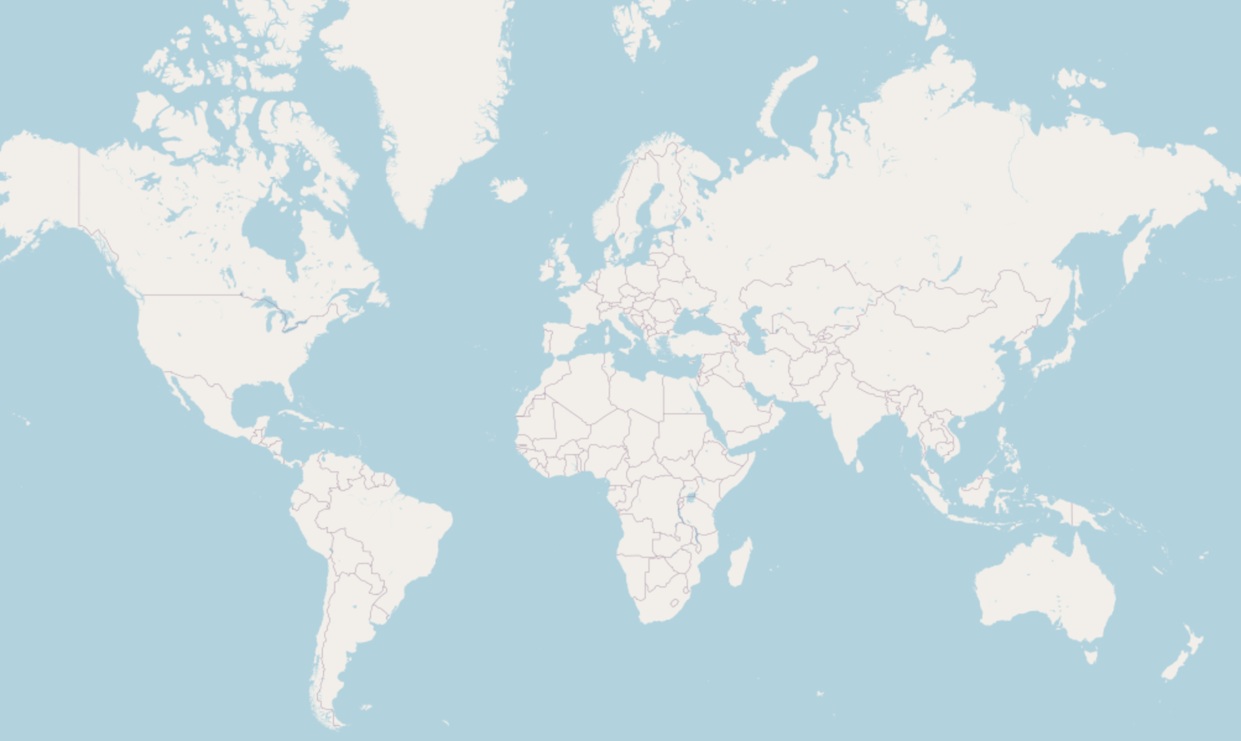
Location: Karlsruhe – Germany
OpenStreetMap.org

Slide 4
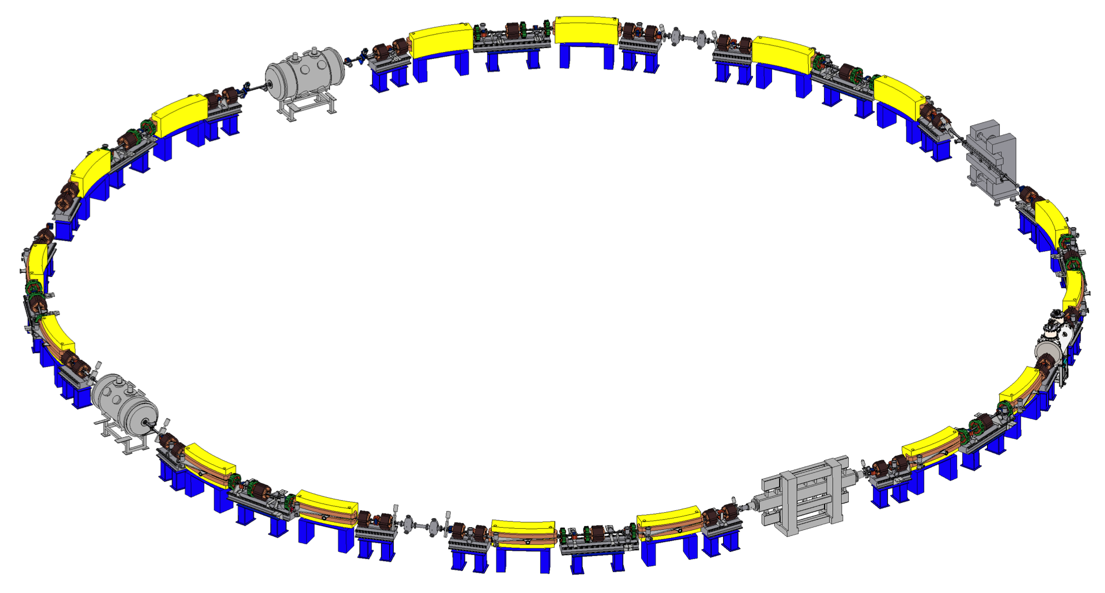
Karlsruhe Research Accelerator (KARA)
KIT synchrotron light source & accelerator test facility
until 2015 known as “ANKA“
Circumference: 110.4 m
Ramped storage ring: 0.5 - 2.5 GeV
Mostly “stable“ IOCs & panels
One week per month:
Beam physics experiments and tests
Very variable in energy, filing pattern, bunch current and operational condition
Default user operation
1 Hz injection at 0.5 GeV
accumulation for 30-45 minutes
energy ramp up to 2.5 GeV
beam decay for 23 hours
Image: U. Herberger

Slide 5
Far-Infrared Linac and Test Experiment
50 MeV linear electron accelerator
Goal: Ultra short electron pulses (1-300 fs)
Panels and IOCs much more fluid
Overlap in panels, IOC support and general controls infrastructure
But separate network, building, operators and users

Slide 6
Current Setup

Slide 7
Controls Environment
EPICS 7
IOCs mostly on virtual machines
(Historically) quite a few complex EPICS applications run in Java
Example: Orbit correction
Recently more and more Python
Including Python SoftIOC
Ubuntu LTS for all servers and terminals
Code repository: historically Subversion
Migration to GitLab ongoing, using CI for automation
IT orchestration: Salt Project

Slide 8
Control System Studio
Transition to EPICS started around 2012
Control System Studio was chosen as the main GUI
Required to build our own CSS flavour
Site specific settings
Custom plugins
Archiving system
Save and restore system
Alternative EPICS Java library (Jackie)
Building was quite complex, so did not update base version of CSS regularly
Current CSS base version 4.1

Slide 9
Software and Panel Distribution
Archive
Main
Archive
Main
Alarm
Alarm
Dev
Dev
Layouts
Layouts
Custom
Custom
start
start
KARA CSS
KARA Panels
FLUTE CSS
include
Shared Panels
Python Launcher
Python Launcher
include
FLUTE Panels
download
download
Accelerator Binaries
Office Binaries
Accelerator Binaries
Office Binaries

Slide 10
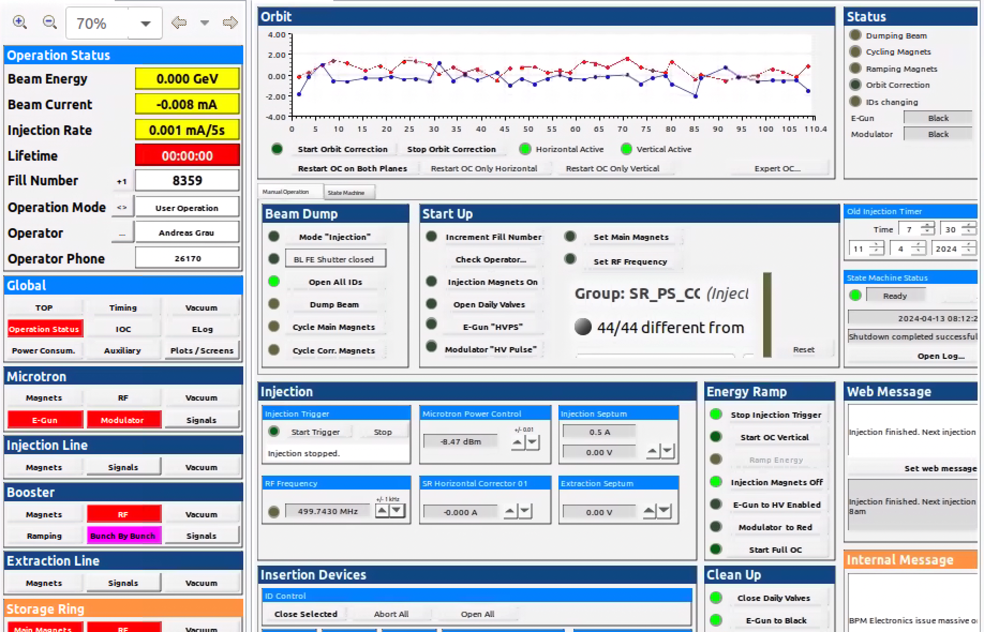
Panels

Slide 11
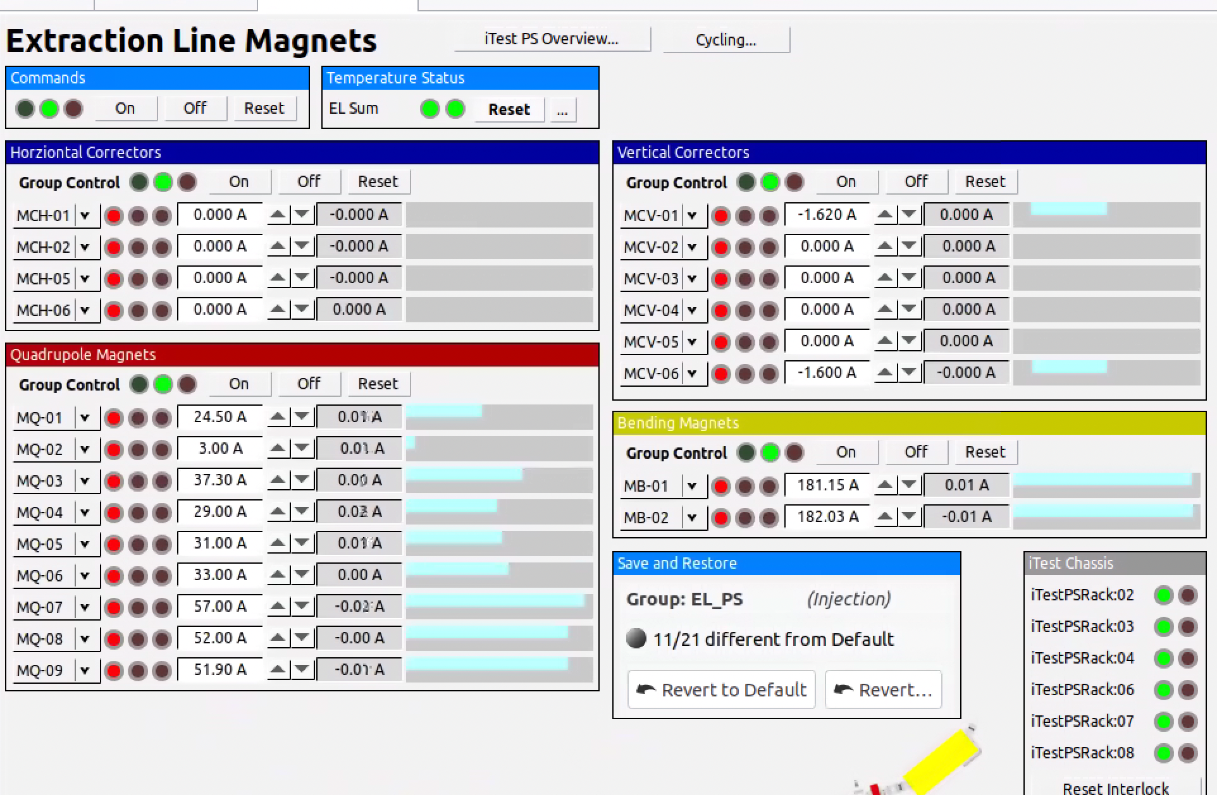
Panels

Slide 12
Custom Tools

Slide 13
Archiver
NoSQL Cassandra cluster
High data throughput for writing
CSS integration via custom JSON protocol
Also Python module
Central archive configuration
Monitor or scan
Compression or no compression
…
Making data available of 12+ years of operation

Slide 14
Alarming
Due to very variable operational conditions for KARA we require a “dynamic“ alarm system
Certain states should only be an alarm depending on the operation state
Example – injection kicker:
If not on during injection -> ALARM
If not off during ramping/operation -> ALARM
IOC independent alarm configuration
Multiple configurations for one record, based on “status PV“ (operation state)
Without additional effort also possible for embedded devices

Slide 15
Alarming
Layer 1
Layer 2
Layer 3
EPICS Alarming
JAVA Alarming
CSS Alarming
Change record files
+
Restart IOC
Change XML files
+
Restart Java application
Run script to update alarm table
High risk during operation
Low risk during operation. Might confuse operator
No risk during operation

Slide 16
Alarming
Pros
Cons
Centralised alarm configuration
Dynamic alarm state switching
Embedded and native IOCs managed in the same format
More flexible
Complex summaries
Integrate non-EPICS alarms
Ping alarm
Centralised alarm configuration
Keeping alarms synchronised to IOC development
Philosophy shift over time
Each alarm creates additional PV
Panel integration?
Custom software layer
Bugs
Adds Java to the mix
Scaling
Maintenance

Slide 17
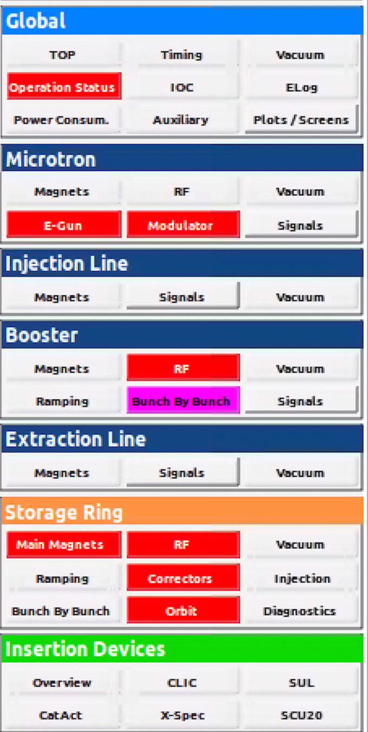
Alarm Status Panel
Summary alarms
Also used for the launcher

Slide 18
Save and Restore
Around 2013-2014 looking for a save and restore system
Also “track“ any operator change to machine parameters
“So, what were all the changes made during last shift?”
View, compare and restore operator changes over any period of time
Set labels and defaults for groups of PVs
→ Yet another custom solution with another (sql) database and external configuration

Slide 19
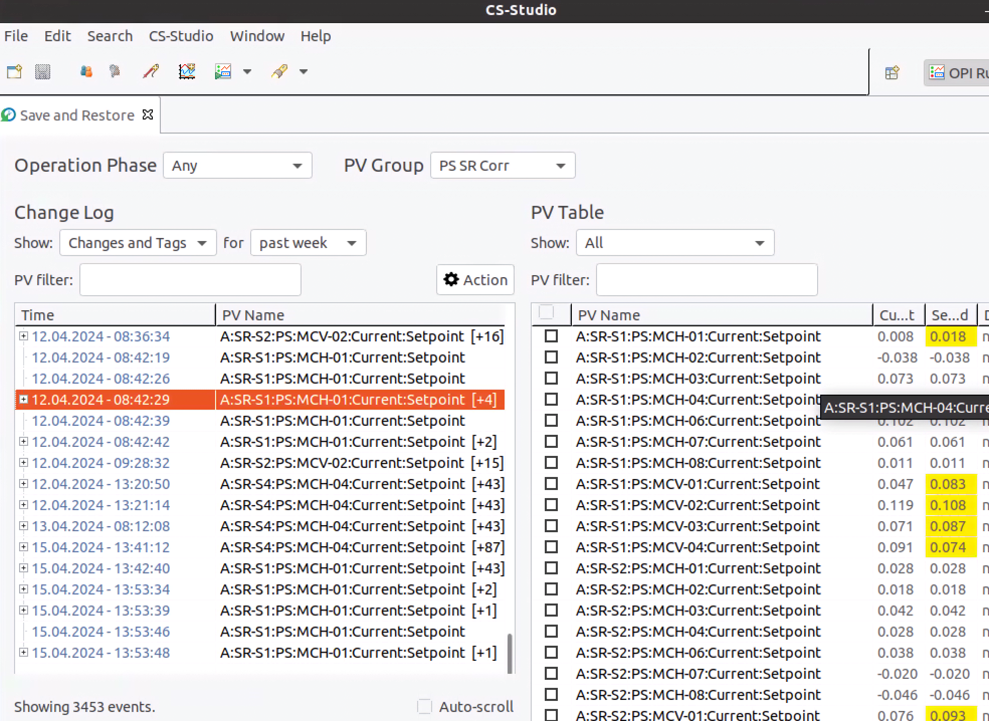
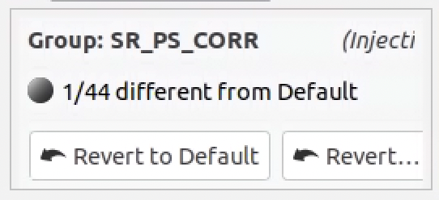
Save and Restore
CSS View
Custom CSS integration
Lots of custom code
Maintenance overhead, yet another external configuration
CSS Widget

Slide 20
Transition to Phoebus

Slide 21
Transition to Phoebus
Use opportunity to re-evaluate current features
Try to rely on less custom code
Try to get necessary adjustments to Phoebus upstream from the beginning
Dockerize as much as possible
Use opportunity to add long-wanted features
Channel Finder
Highly available network storage for panels (but also autosave, layouts, etc.)

Slide 22
Contributions to Phoebus Upstream
Support for alternative Java channel access library (merged)
EPICS Jackie, can be used via jackie:// instead of ca://
(Based on experience with lots of Java applications)
Support for JSON-Archive-Access-Protocol (merged)
for Cassandra PV Archiver
Improvements to the menu bar in macOS (yet to be submitted)
Support for loading Mementos/layouts via URLs (planned)

Slide 23
ChannelFinder and Alarm Server
Run in high availability Docker setup
Use more features of the Phoebus alarm server instead of custom Java server
Summary alarms
ChannelFinder makes use of already existing infrastructure
Each IOC already exports PV lists, filtered by some keywords
Does not require additional IOC integration (no RecCaster)
Meta data from IOC deployment
Add authentication
Resources will be available in the office versions
Added for ChannelFinder -> ElasticSearch
tbd for alarm logger -> ElasticSearch

Slide 24
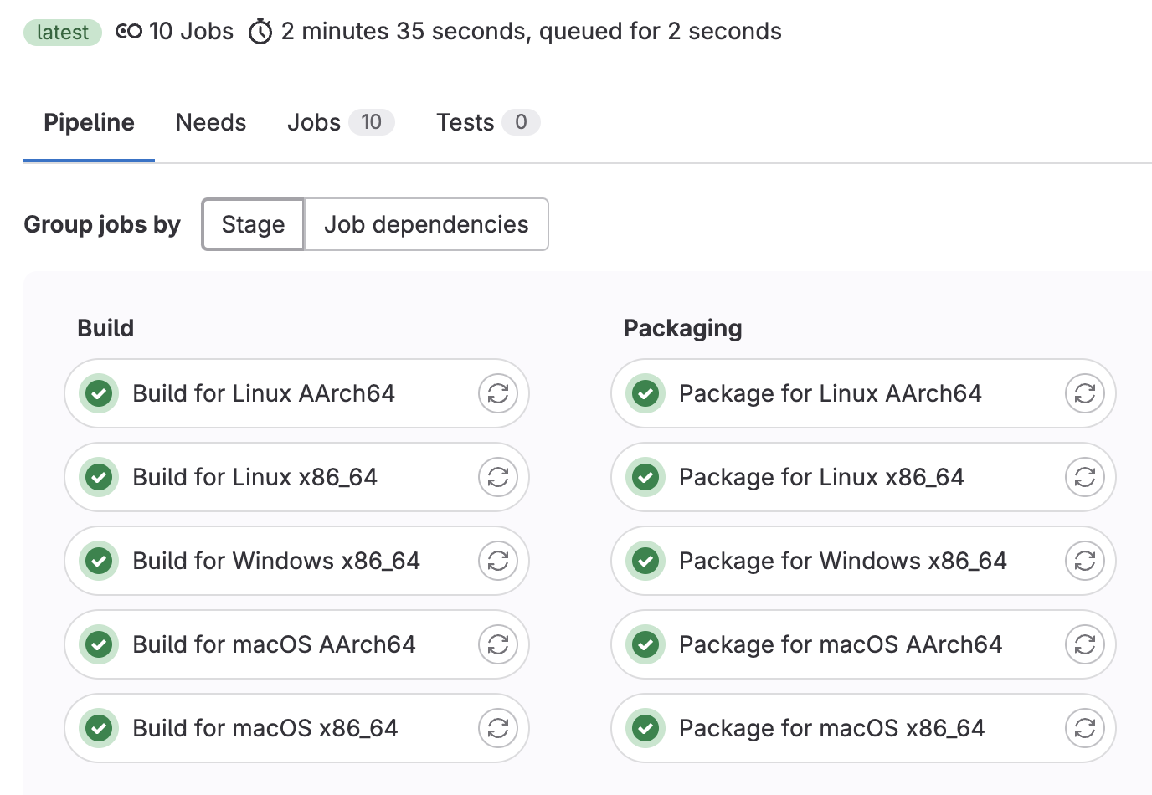
Cross-Plattform-Builds for Native Launcher
jpackage allows to build native launcher
but can only built for platform it is being used with
Core features of jpackage re-implemented in Python
Use GitLab CI to build for all platforms
Using Linux Docker images
Limitations compared to jpackage:
Slightly larger builds
Currently not possible to create installer (but might be possible with external tools)
At the moment available only internally on our GitLab
but can be shared if interest exists

Slide 25
Next Steps
Panel transition
Tests so far look promising, as only visual effects (and file handling) was done with JavaScript/Rules
Considerations for replacement of SNR system by using archiving data
Current system cannot be used with Phoebus
Use archiving interface and labeled timestamps instead
Integrate into Phoebus upstream
Evaluation for alarming system
Current system can still be used
Remove additional alarm PVs, instead adjusting EPICS record alarm fields dynamically (using Python SoftIOC instead of Java)

