Slide 1
Diamond EPICS Web UI
Martin Gaughran
Diamond Light Source, UK

Slide 2
Introduction

Slide 3
EPICS Web UI prototype
Bulk of work done 2019-2021
React and Typescript
Uses Coniql as EPICS backend
Uses .bob file format, compatible with CSS Phoebus
Only focused on screen display, with limited additional functionality

Slide 4
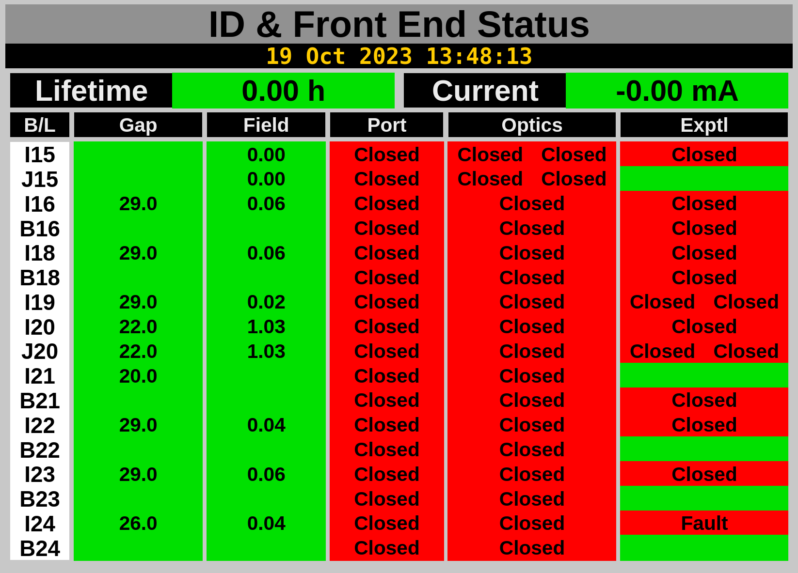
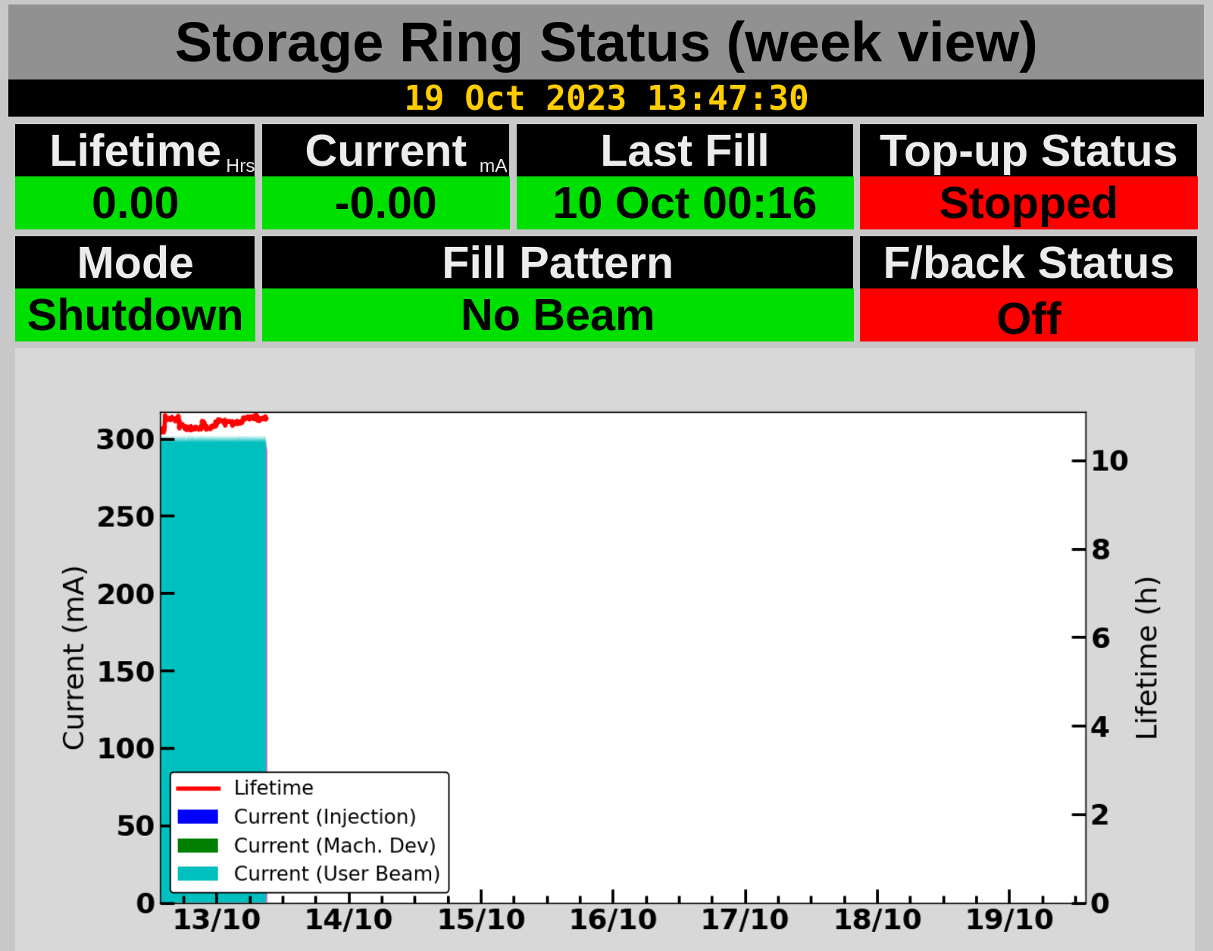
Machine status displays
Provide view of synchrotron status
Developed using our Web UI library
Currently used for all standard SDMs at Diamond

Slide 5
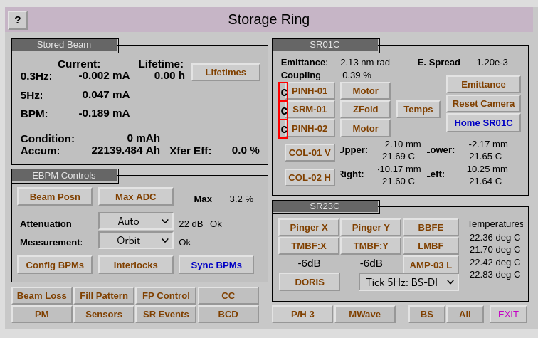
Prototype screens
Test of Web UI prototype using existing .opi files
Not all widgets have been implemented
Handles .opi, .bob and native .json files

Slide 6
Existing Web UIs at Diamond

Slide 7
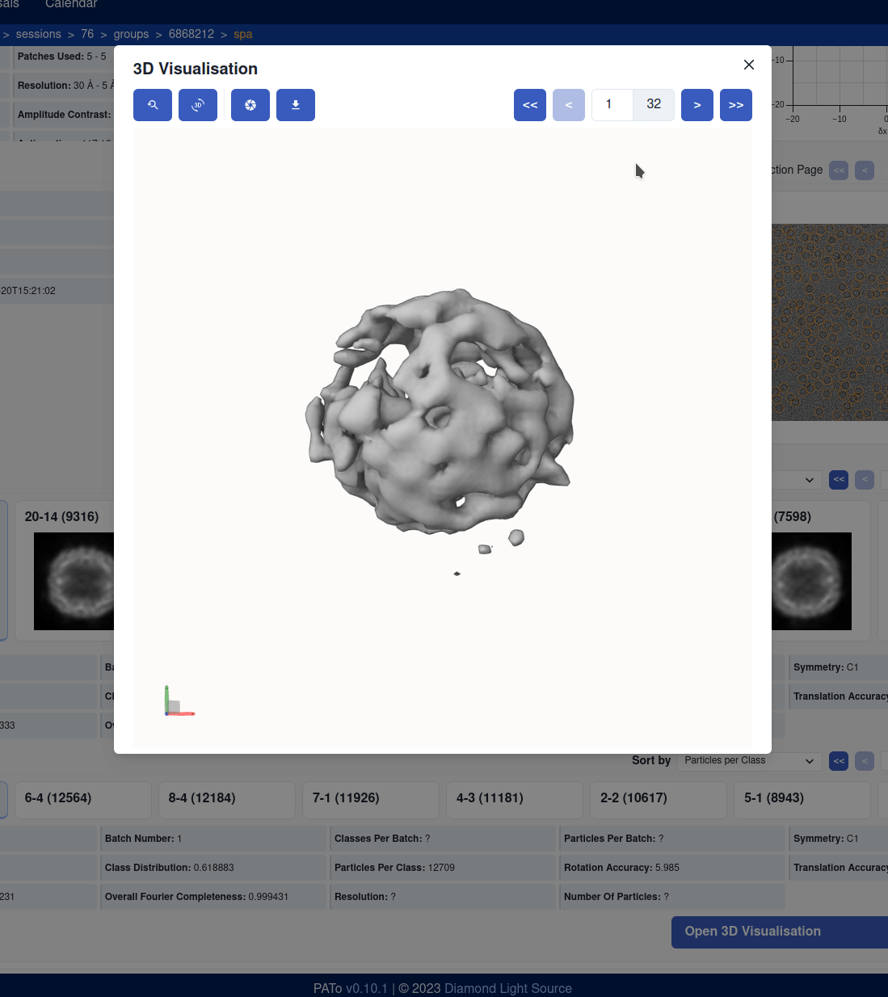
Davidia & PATo

Slide 8
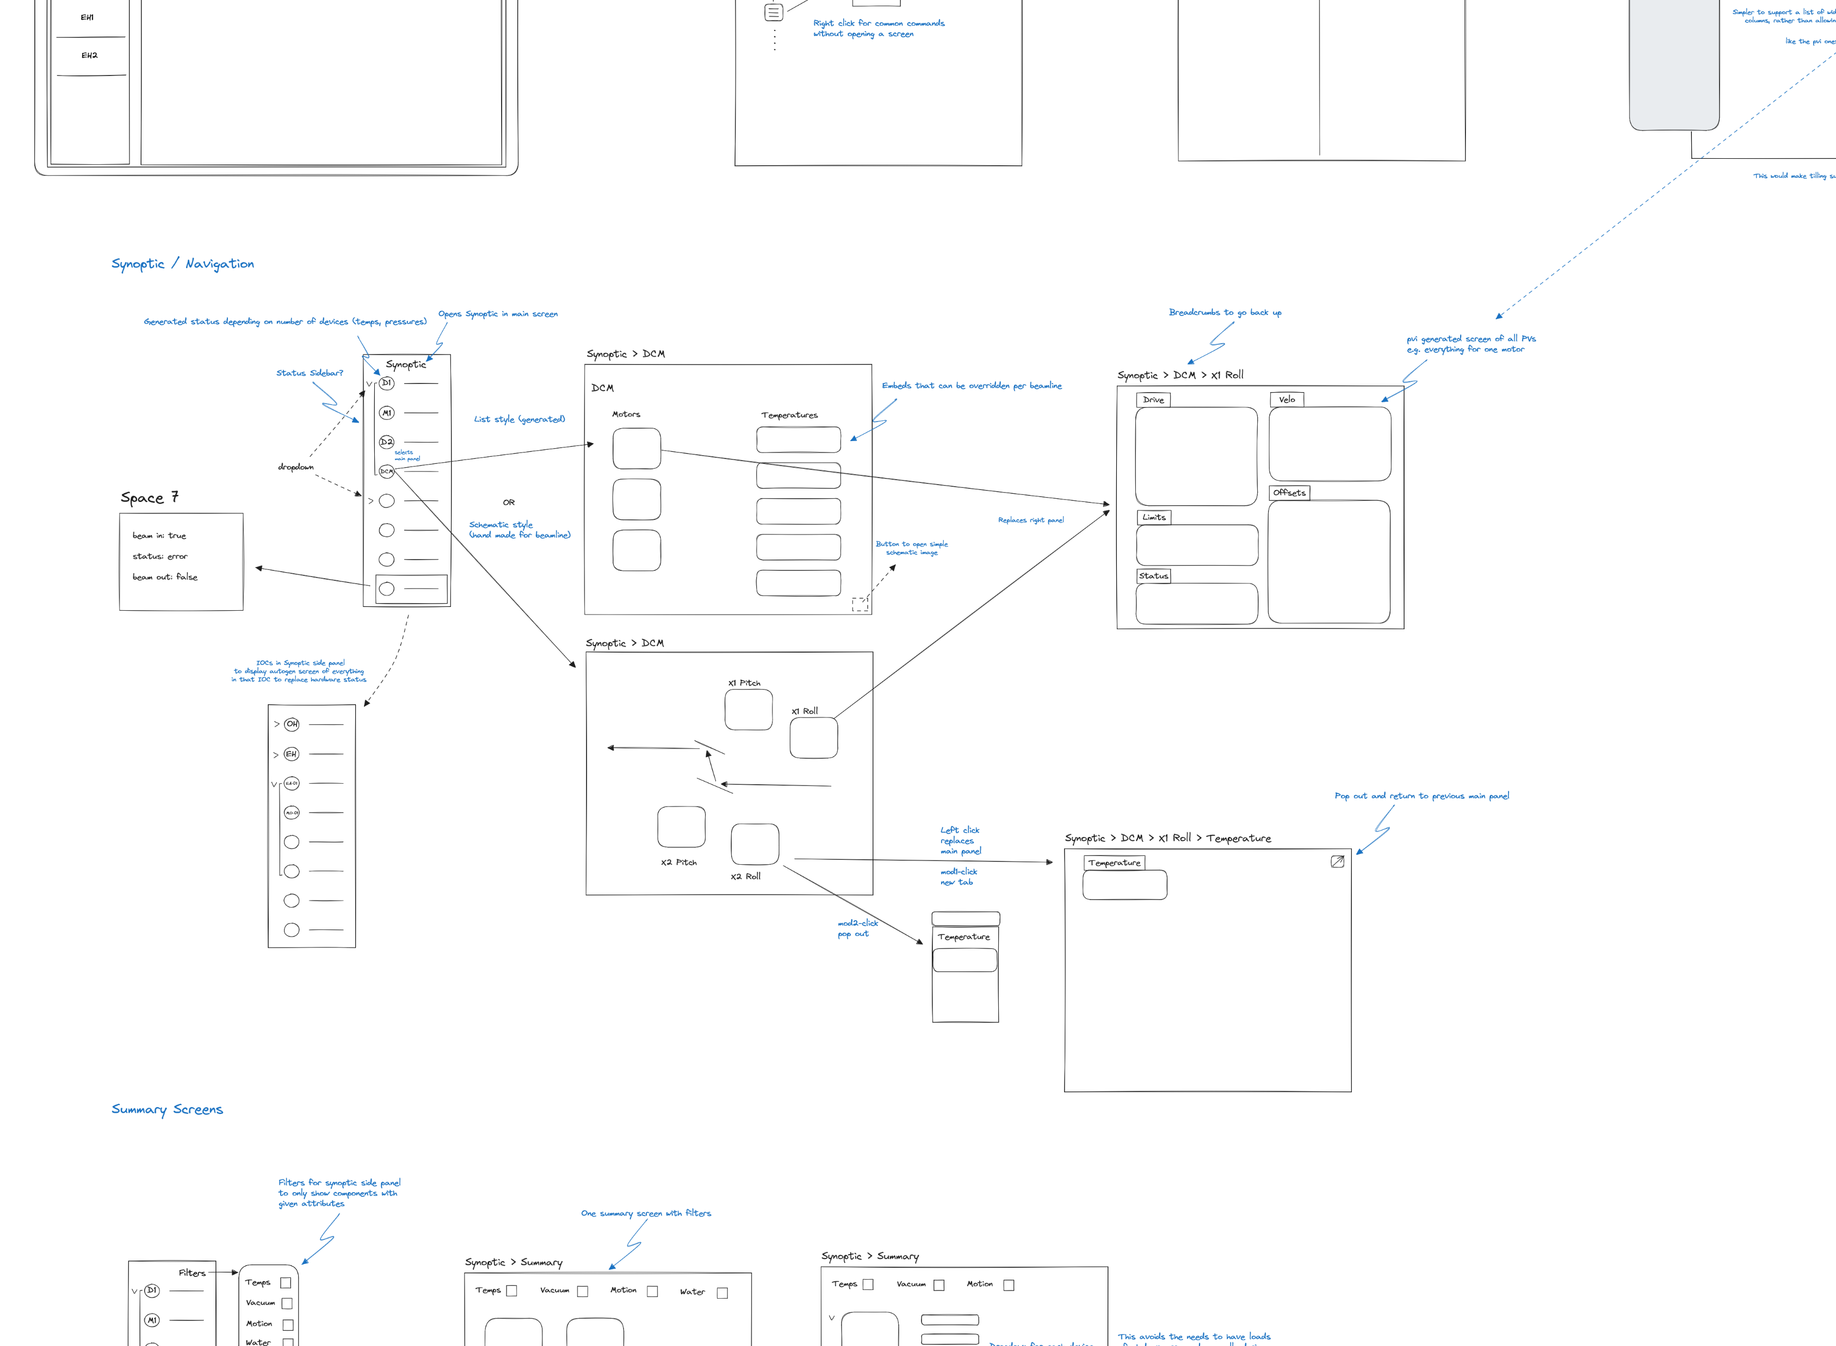
UX review
Intended to update and modernise the Diamond user interfaces
Trialling the process with the EPICS UIs
Interest in accessibility requirements etc.
Very hard with legacy display tools

Slide 9
Remote access
Diamond is interested in fully remote access with Web UIs
Component integration is very important for overall user experience
Authentication and Authorisation important considerations at all levels
Will guide development goals of the EPICS Web UI

Slide 10
EPICS Web UI

Slide 11
Intended Features
Screen display
Including file selection etc.
Screen editor
More focus on end users
Data browser
Lightweight, convenient and integrated

Slide 12
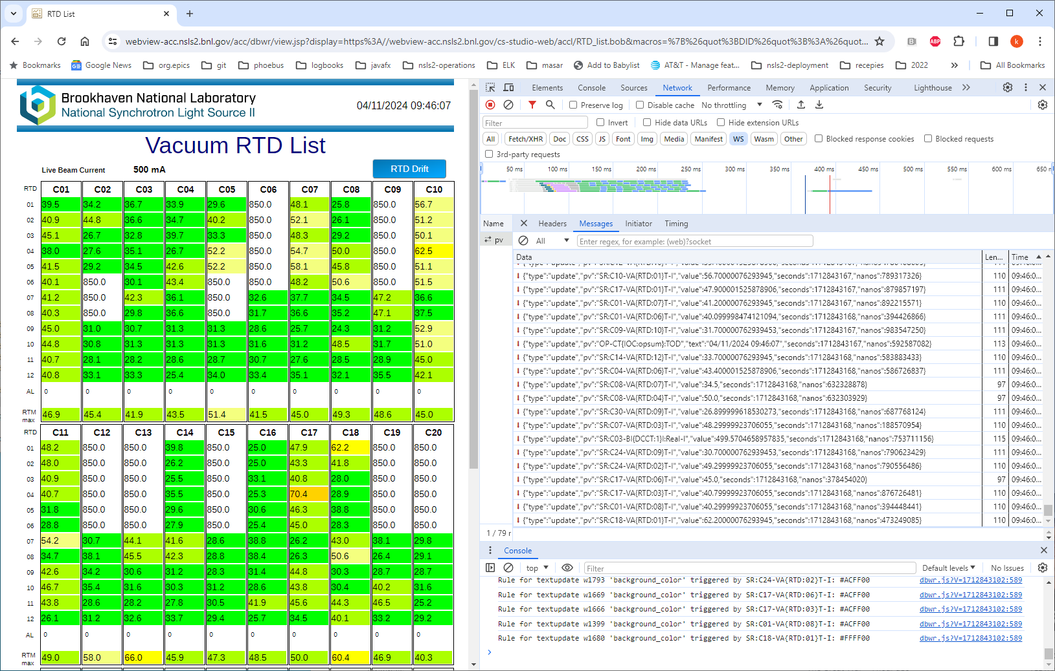
Phoebus Compatibility
Intended to have .bob file compatibility
Useful for external collaboration
Phoebus already has DBWR
May look at replacing this with our system
We are likely to adopt pvws (PV WebSocket)
Possibility of integrating .bob screens in more flexible top-level layouts
Not (too) limited by Phoebus screen file formats
Demonstration of existing DBWR in development mode

Slide 13
Working alongside Phoebus
We do not intend for this tool to completely replace Phoebus
Many users (e.g. beamlines) will find Phoebus unnecessary
Allows us to focus on user-friendly features, rather than being feature-equivalent with Phoebus
Operations room will likely migrate to Phoebus for the near future, until we redesign their screen layouts and organisation

Slide 14
Final Comments
Full development to start later this year
Covid delayed development
Near-term focus on providing tools to demo improved UI / UX
Initial budget for EPICS Web UI adopted for this purpose
Link:
https://github.com/dls-controls/cs-web-lib

Slide 15
Thanks for Listening!

