Slide 1
Update on BESSY-II beamlines
EPICS COLLABORATION MEETING POHANG 2024
12.04.2024
Marcel Bajdel, Luca Porzio, Will Smith, Simone Vadilonga and the WI-AOS

Slide 2
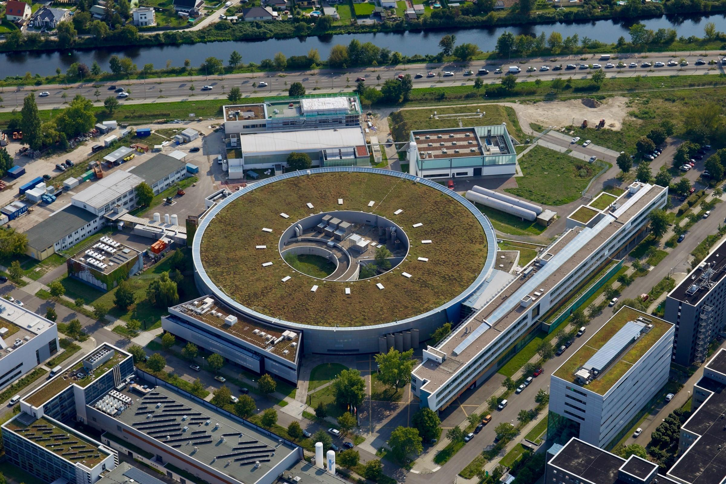
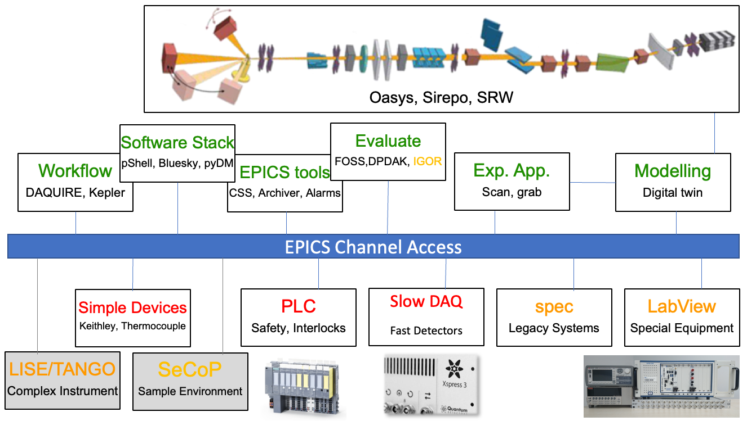
Introduction
Update on BESSY-II beamlines
Since 2015 strategic shift with main focus on renewable energy, materials and technology.
2019: Modernization concept for DAQ and Automation at BESSY II Beamlines and Instruments worked out, presented at ICALEPCS
https://accelconf.web.cern.ch/icalepcs2019/doi/JACoW-ICALEPCS2019-MOCPL02.html
Need for a new control system approach:
require automated build and deployment procedures,
standardize on an experiment orchestration tools,
Enable machine learning for beamlines and experiments, develop digital twins for beamlines,
require extensive testing.
Helmholtz-Zentrum Berlin emerged from a large center (HMI) and a small light source provider (BESSY)
HMI: Wannsee site, nuclear reactor, ion implantation – now eye tumor therapy BESSY: Adlershof site, accelerator based light sources
1992: With the help of DESY - BESSY first EPICS facility in Europe

Slide 3
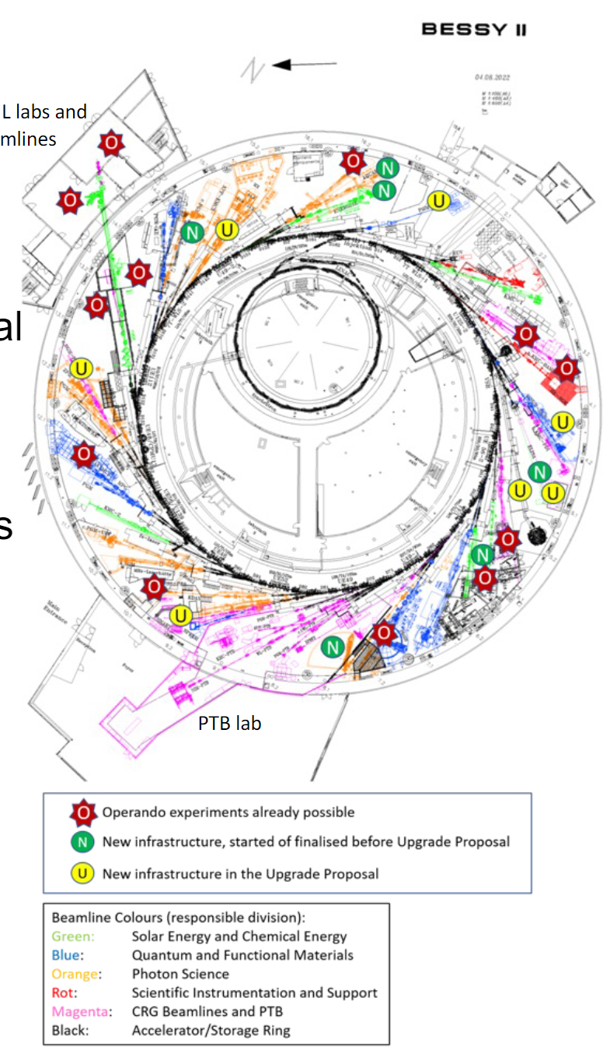
Current Status
Update on BESSY-II beamlines
Project based: upgrade, commissioning, construction, operational, legacy status.
Mixture of staff, external and temporary positions.
Beamlines are staff operated, less coherent than accelerator.
Footprints of external partners span beamlines, instruments, labs.
Post-cyber attack status
Experimental hall network segmented into production zones after cyber attack.
Zero trust network works for accelerator but not for the beamlines.
Upgrade BESSY II+ and BESSY III already after CDR.
Develop workflow that will potentially span over all beamlines to deploy microservices and maintain them

Slide 4
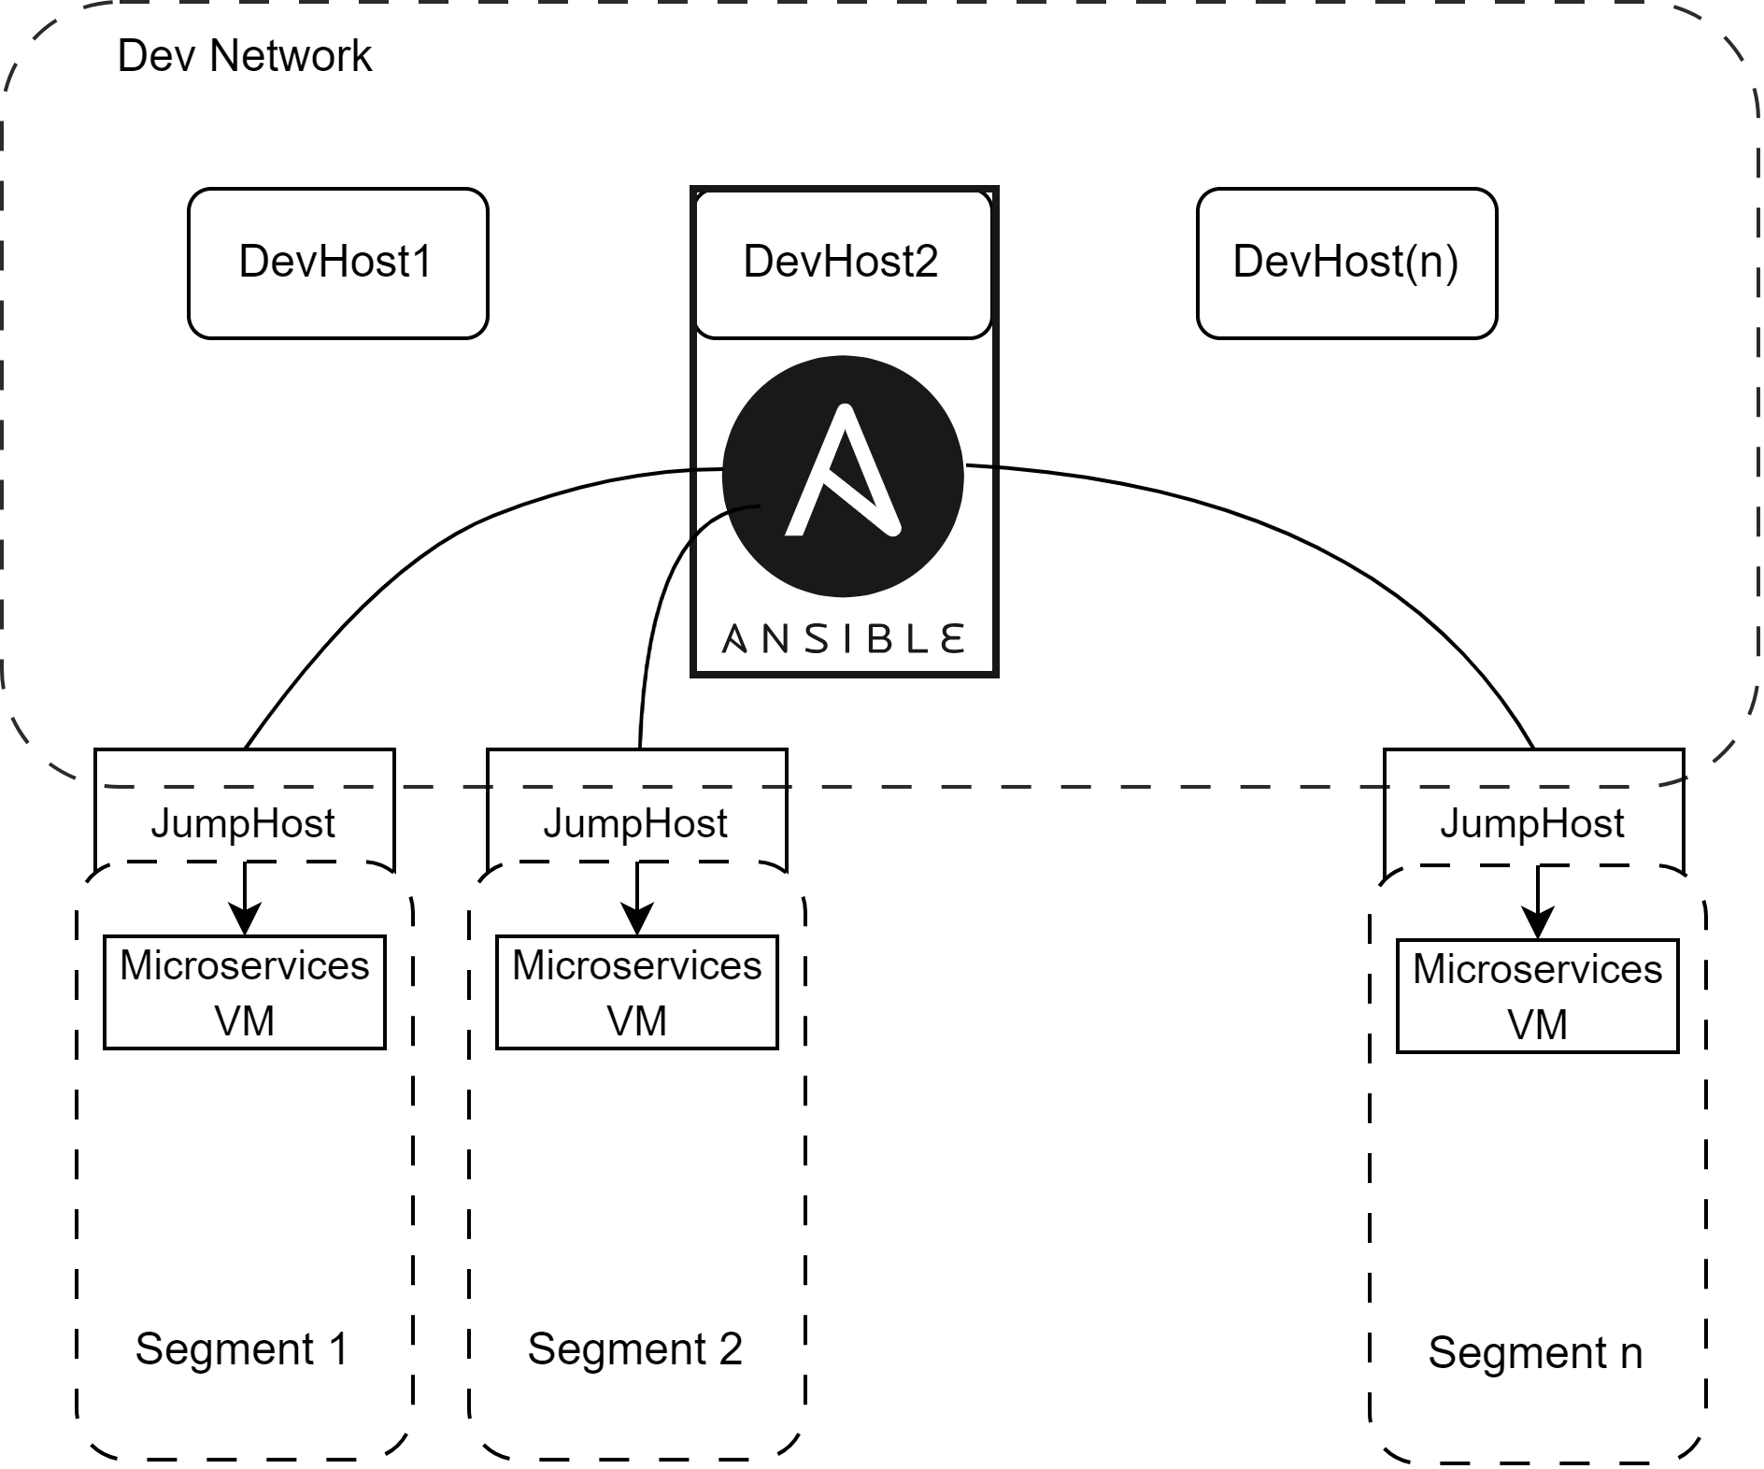
Deployment workflow
Update on BESSY-II beamlines
Microservices
IOCs
Graphical interfaces
Databases
Bluesky related services
Containers monitoring
Every microservice, perceived as a separate software agent, which can be containerized.
Environments to run applications are also held in container images (epics base, python based image to run ipython shell).
We try to use community standard tools only and keep it simple.
We aim to enhance newcomers' ability to quickly become productive in their work.
JumpHost (a gateway) that is used for a secure access to segmented networks

Slide 5
Deployment workflow
Update on BESSY-II beamlines
Microservices
IOCs
Graphical interfaces
Databases
Bluesky related services
Containers monitoring
Every microservice, perceived as a separate software agent, which can be containerized
Environments to run applications are also held in container images (epics base, python based image to run ipython shell)
We try to use community standard tools only and keep it simple
We aim to enhance newcomers' ability to quickly become productive in their work.
JumpHost (a gateway) that is used for a secure access to segmented networks

Slide 6
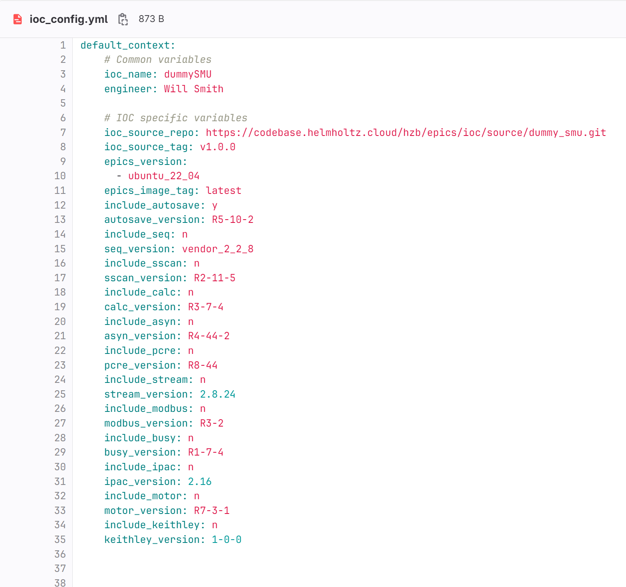
IOC templating
Update on BESSY-II beamlines
Requirements for the IOC automation:
IOC source files templating
IOC support modules templating
Templating engine based on jinja2
Works for existing EPICS IOCs
Works for new EPICS IOCs
EPICS 7.0.7
List of support modules together with versions
Single yml file defining
the environment for an IOC
Dockerfile
Support modules config
Gitlab pipeline to scan for security issues, image manifest and build/push to container registry with tag

Slide 7
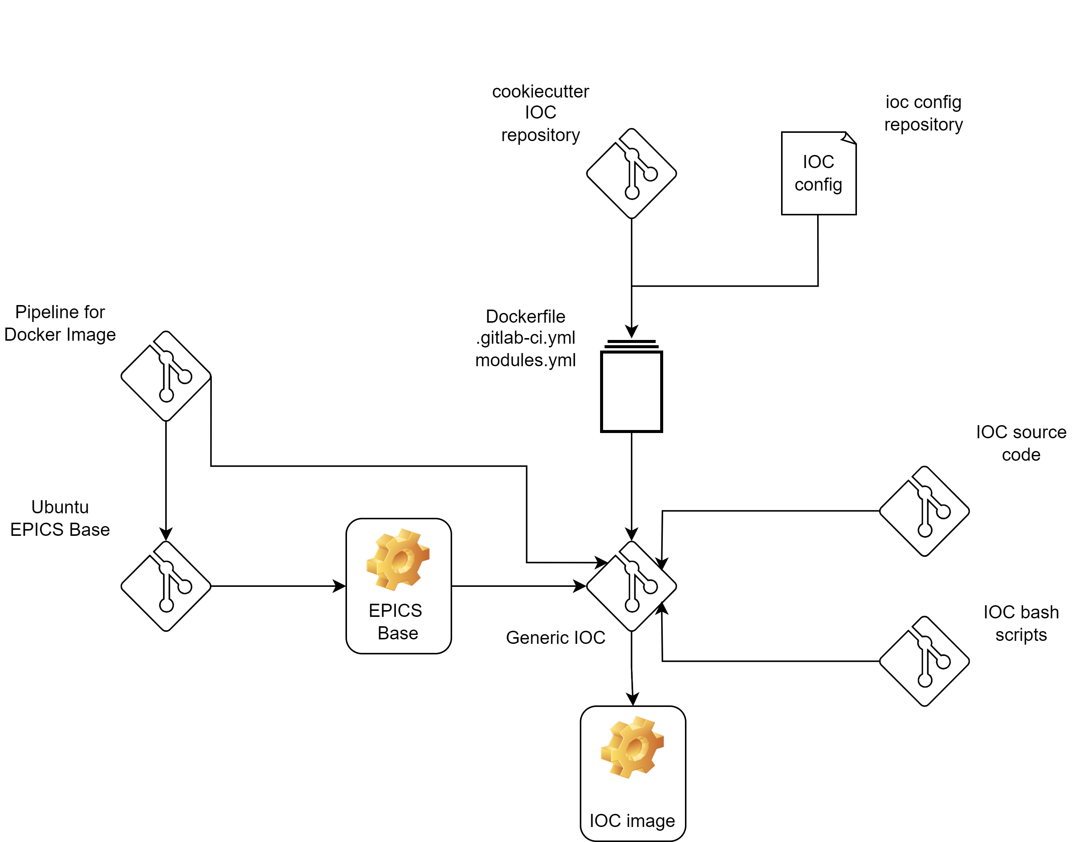
IOC automation workflow
Update on BESSY-II beamlines
IOC config for every device.
Ubuntu as base for EPICS 7.0.x.
We develop the IOCs using development containers (source files repository is cloned at build).
Bash scripts used to create a RELEASE.local, download and compile support modules, patch Makefiles in the IOCApp.
We deploy the containers on hosts with Ansible and a .yml file which defines macros.

Slide 8
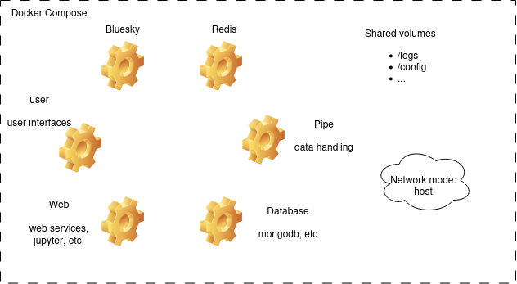
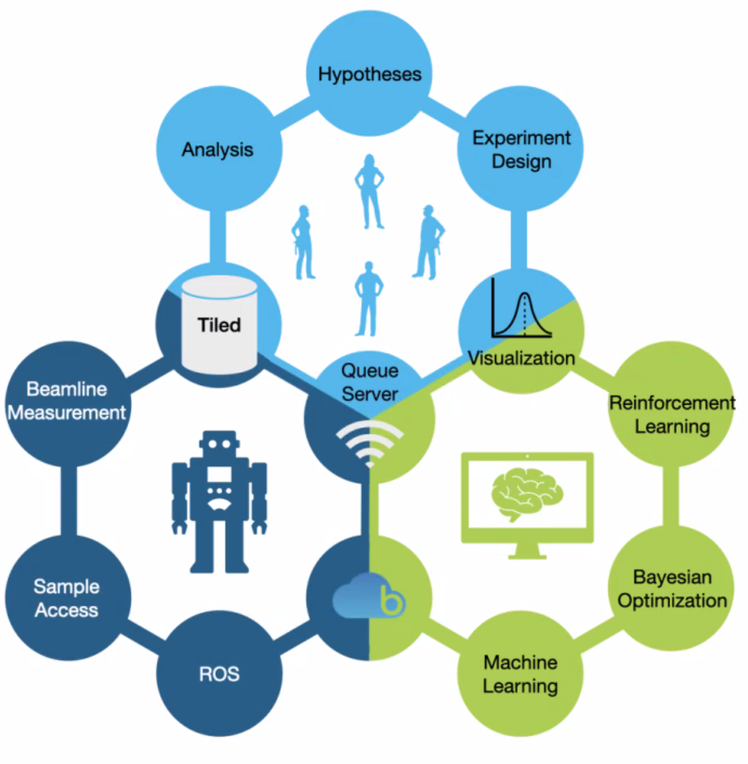
ROCK-IT project
Update on BESSY-II beamlines
(Remote, Operando-Controlled, Knowledge-driven, and IT-based)
ROCK-IT starter pack
User-friendly automated experiment environments with similar ’look and feel’ at different facilities, aiming to reduce access barriers and accelerate innovation.
enhanced remote-access protocols, holistic experiment development, and the implementation of machine learning for automation and real-time analysis
System design for the ROCK-IT

Slide 9
ROCK-IT project
Update on BESSY-II beamlines
Implement the full deployment workflow and test it.
Multiple machine level controls at the machine-level within experiment
Experiment Control System based on Bluesky unifies the machine-level controls

Slide 10
Summary
Update on BESSY-II beamlines
Nothing is written in stone – we’ve been developing, testing and trying out different approaches.
We aim to use opensource frameworks that a newcomer might already be familiar with(jinja2, python, Gitlab CI/CD).
HZB is a user facility – we try to find a balance between the best practices, user needs and available solutions.
To do’s:
Develop more unit tests, functional tests, stress tests (Gitlab CI/CD).
Develop effective way of monitoring the whole control infrastructure (containers, log and data aggregation, remote access).
Implement the building and deployment workflow and integrate with the central-IT (scientific IT).

