Slide 1
Probe & PV Tree
Inspector of PV Values
Kunal Shroff, Kay Kasemir, Georg Weiss and many other

Slide 2
Prerequisite
Motor Simulator
Start the motor simulator:
Open a Terminal window (Press Activities, then Applications, then Terminal),
Then type the following
﻿ cd ~/motorsim/
./startSimMotor.sh
Don’t close the Terminal window.
Start the CS-Studio:
:
phoebus

Slide 3
Prerequisite
Motor Simulator
Start the CS-Studio:
phoebus

Slide 4
Probe
A simple application to connect to PV’s
Monitor PV’s (camonitor)
Write to PV’s (caput)
Opening Probe
Menu: Applications ▸ Display ▸ Probe
Context Menu: Process Variable ▸ Probe
(right-click)

Slide 5
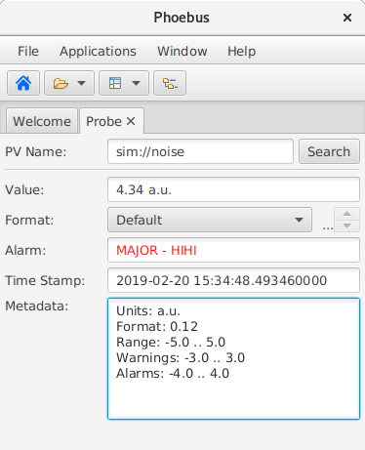
Getting Started
Connect to a simple scalar PV (simulation)
In the PV Name field type:
sim://noise
and hit the RETURN key.

Slide 6
Prerequisite
Motor Simulator
Start the motor simulator:
6 simulated motor XF:31IDA-OP{Tbl-Ax:X1}Mtr > motor setpoint XF:31IDA-OP{Tbl-Ax:X1}Mtr.RBV > motor readback XF:31IDA-OP{Tbl-Ax:X1}Mtr.MOVN > motor moving flag XF:31IDA-OP{Tbl-Ax:X1}Mtr.S > motor speed XF:31IDA-OP{Tbl-Ax:X1}Mtr_Alarm > generated alarm XF:31IDA-BI{DEV:1}E-I > instrument reading

Slide 7
Getting Started
Connect to a simple scalar PV (softIOC)
In the PV Name field type:
XF:31IDA-OP{Tbl-Ax:X1}Mtr.RBV
and hit the RETURN key.

Slide 8
Getting Started

Slide 9
Deciphering the Data #1
Value:
Shows the current value of the PV and the timestamp associated with it.
The value field is also used to write new values to the PV If the PV is read only this field is disabled.
Metadata:
Additional information about the PV Type, Display limits, Alarm limits, units...

Slide 10
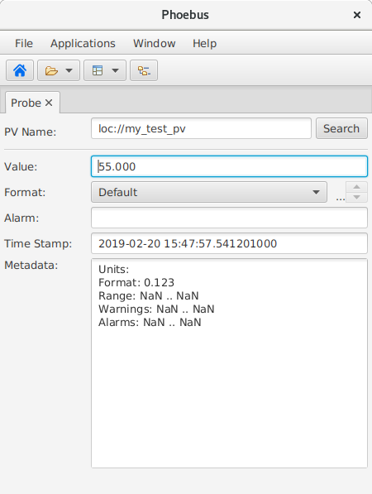
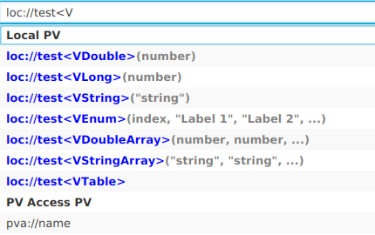
Writing a Value #1
Connect to a simple scalar PV (local)
In the PV Name field type:
loc://my_test_pv(0)
and hit the RETURN key.
In the Value: field enter any valid number and hit RETURN.

Slide 11
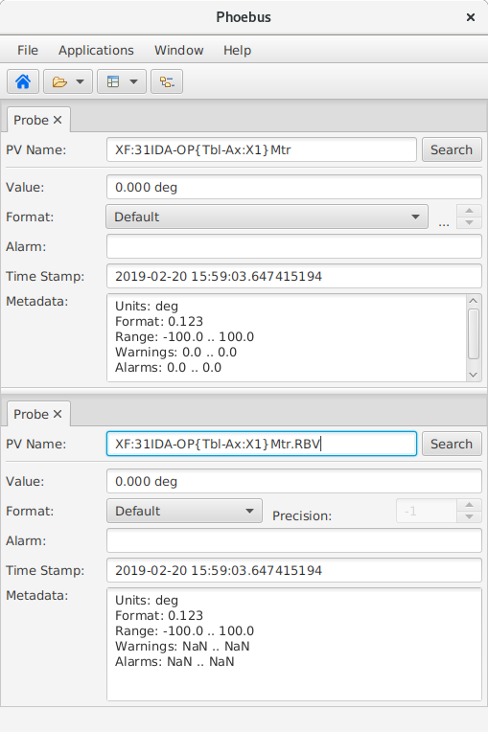
Writing a Value #2
Open two Probes.
Move the probe views so that they can be both viewed simultaneously.
In the first probe enter the setpoint PV: XF:31IDA-OP{Tbl-Ax:X1}Mtr
In the second probe enter the readback PV: XF:31IDA-OP{Tbl-Ax:X1}Mtr.RBV
Set a new motor position (between -100 and 100).
Notes:
Tab Context Menu:
Split Horizontally/Vertically
Detach
Lock Pane
Window Menu:
Show/Hide Toolbar
Always show tabs?
Save Layout As .. / Load Layout

Slide 12
Process Variable (Data Source)
Syntax
type://some_pv_name
Data Source type
Local loc://
Simulation sim://
ChannelAccess ca://
PVAccess pva://
For help use the application menu
Help ▸ Help Content
then select
Applications ▸ Process Variables

Slide 13
Autocomplete
Autocomplete
History
Channel Finder
Predefined simulation PV’s (Data Sources)
Formula functions

Slide 14
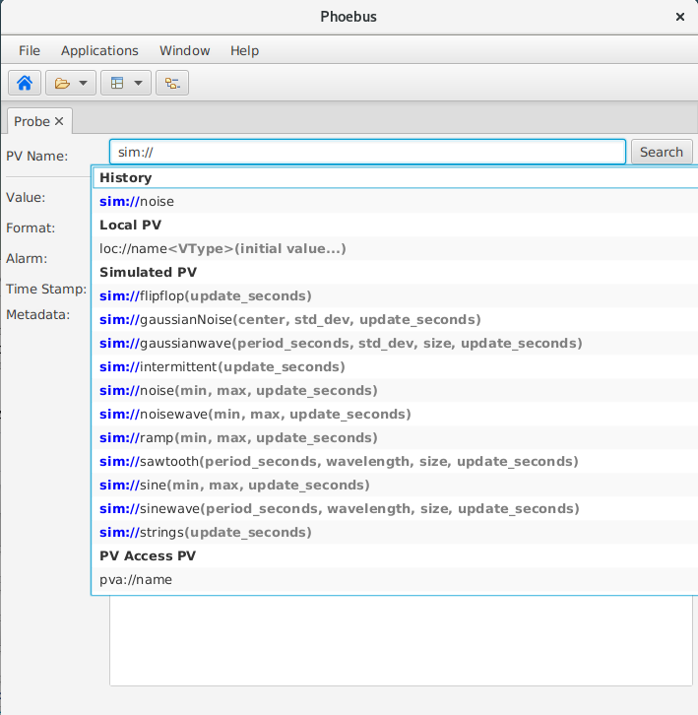
Autocomplete Data Sources
Autocomplete will list the various PV’s available for a particular Data Source.

Slide 15
PV Tree
The PV Tree displays the hierarchical data flow between EPICS records.
It displays the record types and their current values as well as severity/status. It attempts to reflect the data flow by traversing input links (INP, INPA, DOL, …).
Example:
Connect to:
XF:31IDA-OP{Tbl-Ax:X1}Mtr_Alarm or XF:31IDA-BI{Dev:1}E-I
Notes:
fields=aai(INP);ai(INP);bi(INP);compress(INP);longin(INP);mbbi(INP);mbbiDirect(INP);mbboDirect(INP);stringin(INP);subArray(INP);waveform(INP);aao(DOL);ao(DOL);bo(DOL);fanout(DOL);longout(DOL);mbbo(DOL);stringout(DOL);sub(INPA-L);genSub(INPA-L);calc(INPA-L);calcout(INPA-L);aSub(INPA-U);seq(SELN);bigASub(INP001-128);scalcout(INPA-L,INAA,INBB,INCC,INDD,INEE,INFF,INGG,INHH,INII,INJJ,INKK,INLL)

Slide 16
Thank You for Your Attention
Any Questions? Just Ask!

