Slide 1
Display Builder
The New OPI Editor and Runtime Engine
Kunal Shroff, Kay Kasemir, Georg Weiss and many other

Slide 2
Prerequisite
Motor Simulator
Start the motor simulator:
Open a Terminal window (Press Activities, then Applications, then Terminal),
Then type the following
﻿cd ~/build-epics/motorsim/
./startSimMotor.sh
Don’t close the Terminal window.

Slide 3
Prerequisite
Location of Demos
On GitHub
https://github.com/osprey-dcs/training_resources.git
On training Virtual Machine:
/opt/training_resources
Display Builder Examples:
Toolbar menu File ▸ Example Display
File ▸ Main Launcher

Slide 4
Introduction
#1
Display Builder is an Operator Interface (OPI) development and runtime environment.
An OPI is a general GUI with extra facilities to connect to live EPICS data directly:
Display Builder allows building OPI with drag and drop and connecting to EPICS data instantly;
Display Builder allows using JavaScript, Jython or Python to manipulate the GUI.
An OPI file (.bob) is a regular XML file that can be edited in Display Builder Editor or text editor, and run in Display Builder Runtime.
No compilation is needed.

Slide 5
Introduction
#2
The Display Builder Editor is a WYSIWYG (What You See Is What You Get) editor which allows you to create OPIs in a similar way of creating PowerPoint presentations.
The Display Builder Runtime works in a similar way as modern web browsers.
OPIs can be displayed either in tabs, windows or views, and can be navigated forward or backward.
The data communication layer allows Display BUilder connecting to various data sources seamlessly: EPICS, local, simulated, and system.

Slide 6
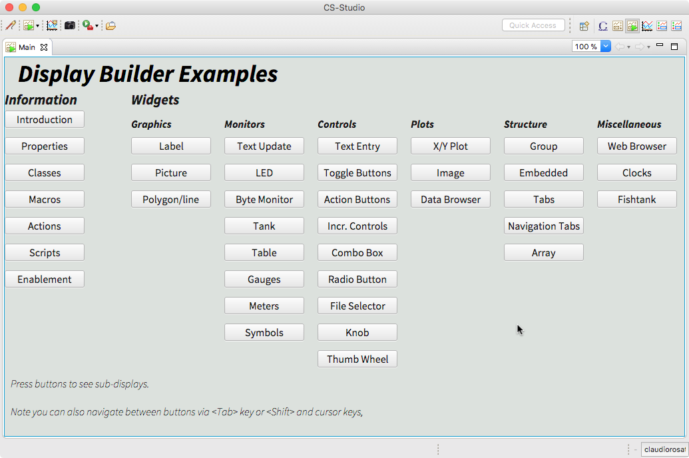
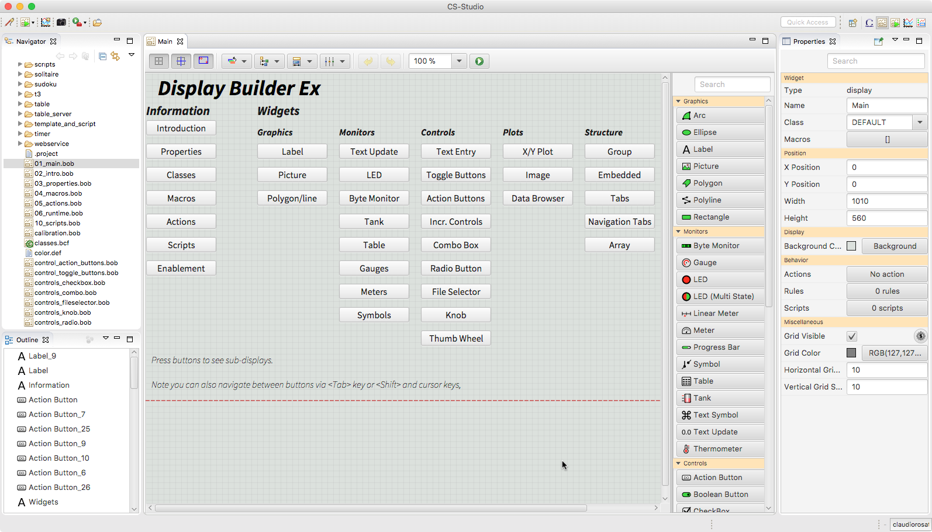
Introduction
#3
Notes:
Editor and Runtime

Slide 7
Display Builder Runtime

Slide 8
OPI Runtime
Running OPI Screens
Menu: File ▸Top Displays
Toolbar: Top Displays dropdown menu
List the top level OPIs,
Example:
Beamline Status Page,
Storage Ring Overview Page.
Notes:
Launching the main screen from tool bar – main set of examples
Explore the drop down
Main, Motor_main, tank_main

Slide 9
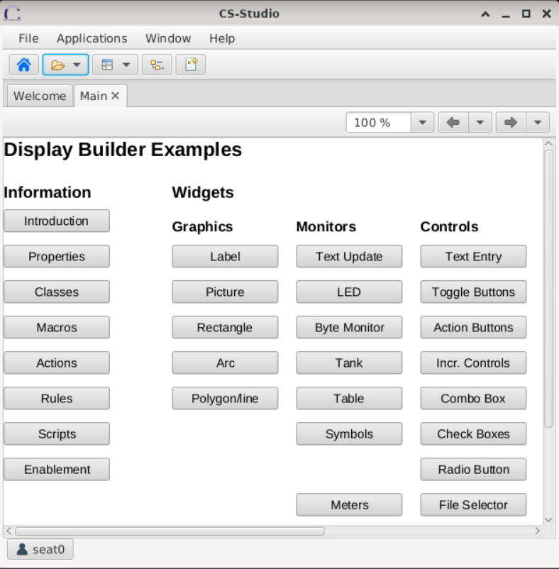
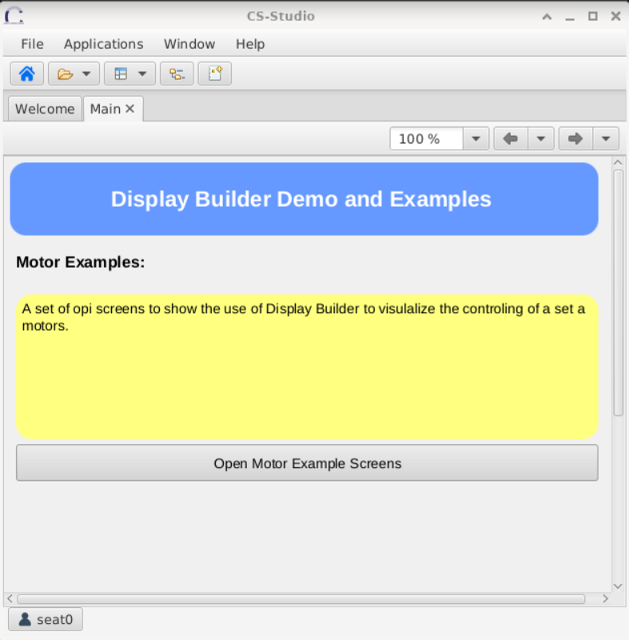
OPI Runtime
Perspective #2

Slide 10
OPI Runtime
Navigation
Tabs
Give and overview of the open opi ( or application)
Can be moved or detached
Can be split to accommodate multiple displays
Navigation toolbar
Context Menu

Slide 11
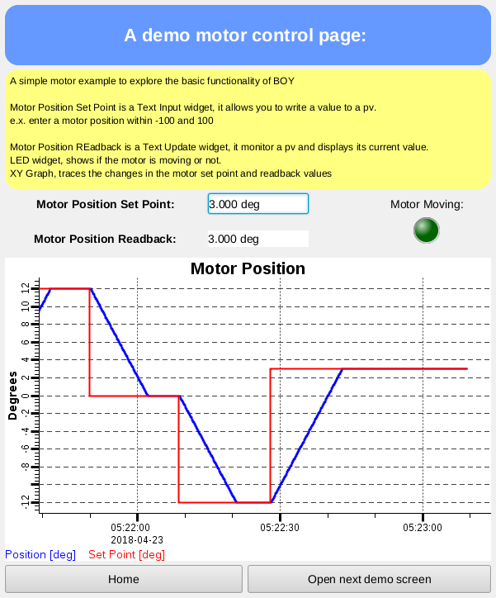
OPI Runtime
Motor Demo #1
The screen allows you to enter a new position(in degrees) for the motor and then tracks the motor movement using various widgets.
Input PV:
Motor Position Set Point.
Monitor PVs:
Motor Position Readback,
Motor Moving LED,
XY Graph.
Notes:
Open Motor page 1:
Explain the basic widgets here
Have users change the PV set point

Slide 12
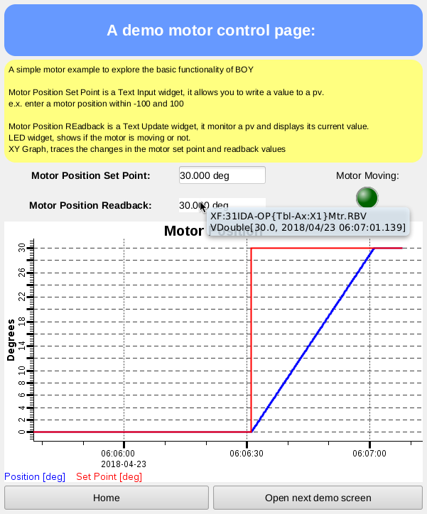
OPI Runtime
Tooltips
Show status summary, brief descriptions, hints:
OPI screen title: the complete file path;
“Live” widget: PV value, PV connection status, alarm information;
Action/Menu button: description of action to be performed.

Slide 13
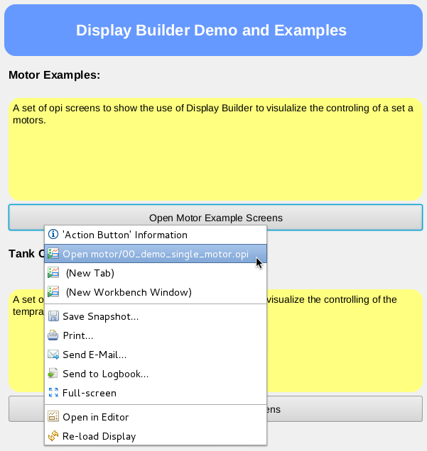
OPI Runtime
Context Menu #1
To open the context menu Right Click anywhere on the screen
It consists of a list of actions and information based on where you have clicked:
Right click on the Open Motor Example Screen button. The context menu lists the actions associated with this button.
Right click anywhere other than the button. The context menu does not contain any actions.
Notes:
Tooltip and right click
Mouse over, tooltip will have instructions or hints on what control widgets are going to go
If active PVs, tooltips will give information about the pv associated with the widget underneath
Context menu:
Action button – list of actions
Options on where to open the screen
You will see how the context menu contains different commands based on where and what you have right clicked on

Slide 14
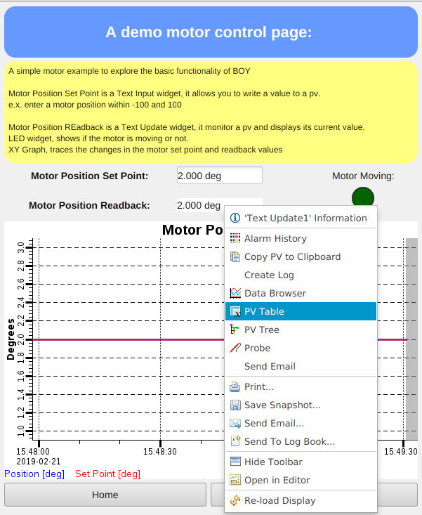
OPI Runtime
Context Menu #2
Context menu associated with “live” widgets:
‘<widget>’ Info,
Process Variables sub-menu to send these PVs to different applications.
Exercise:
Open the PVs associated with the Set Point and Readback in Probe.
Open the PVs in Data Browser to see the historic values of these PVs.
Notes:
Tooltip and right click
Mouse over, tooltip will have instructions or hints on what control widgets are going to go
If active PVs, tooltips will give information about the pv associated with the widget underneath
Context menu:
Action button – list of actions
Options on where to open the screen
You will see how the context menu contains different commands based on where and what you have right clicked on

Slide 15
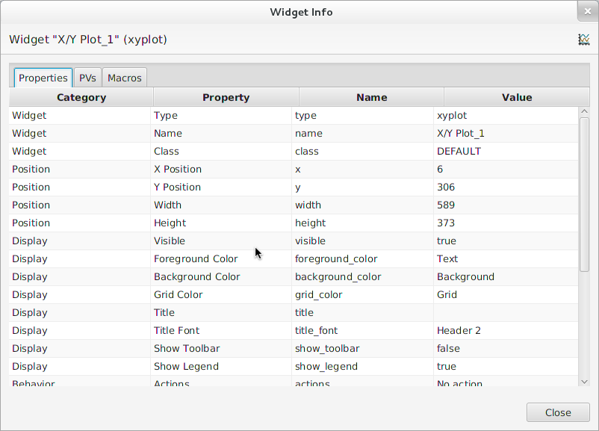
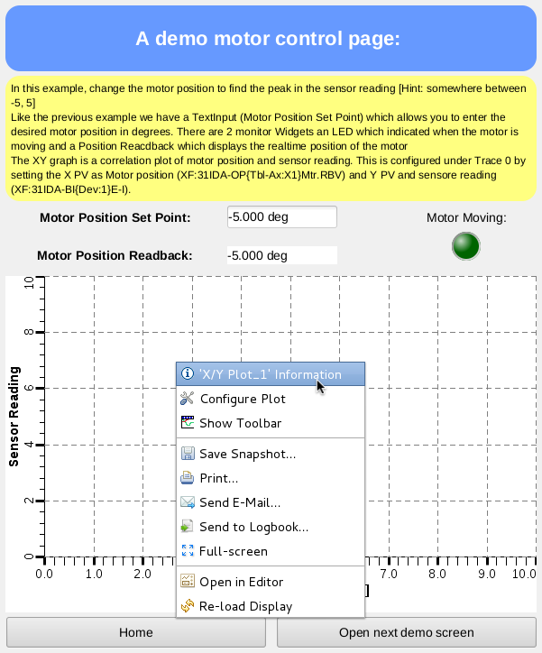
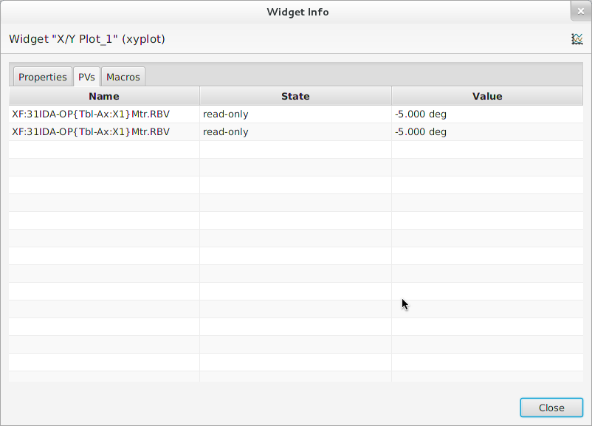
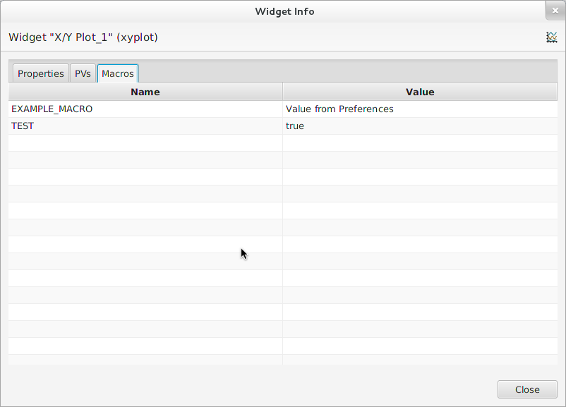
OPI Runtime
Context Menu #3

Slide 16
Display Builder Editor

Slide 17
Display Builder Editor
Creating Your First Display Builder Screen
Menu: File ▸New
Then select Display Editor ▸New Display.
Type ﻿first.bob in the File Name field.
Drag a Text Update widget from the Palette.
Set the PV Name property to: sim://sine
Save the file.
Notes:
In CSS project create a new Display Builder file
A test screen – with a single text update PV
sim://sine
Show how to use the SEARCH filed inside the Palette to simplify finding a widget type.
Add a Widget
Enter Label’s Text or Widget’s PV Name
Done
At Runtime, widget will
Show PV’s value, formatted, with units
Indicate alarm, disconnect
Show tool-tip with PV name and value
Combo options read from Enum PV, slider range from numeric PV
Disabled when ‘control’ widget has no PV write access

Slide 18
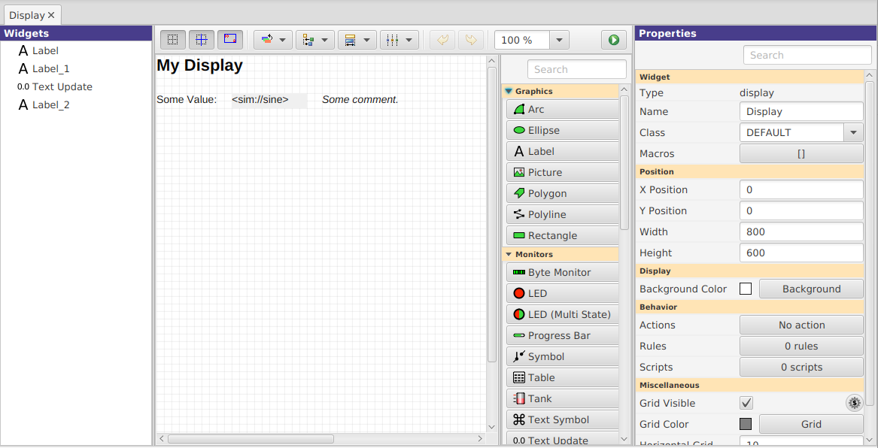
Create New Display
Applications ▸ Display ▸ New Display
Notes:
Main Editor Area Select Widgets Move, resize widgets Ctrl-C, V, X to copy, paste, delete (⌘ on Mac)
Save & Execute the Display
Property Panel Edit properties of selected widgets

Slide 19
Create New Display
Toolbar: Execute Display button.
Notes:
Main Editor Area Select Widgets Move, resize widgets Ctrl-C, V, X to copy, paste, delete (⌘ on Mac)
Save & Execute the Display
Property Panel Edit properties of selected widgets

Slide 20
Create New Display
Notes:
Main Editor Area Select Widgets Move, resize widgets Ctrl-C, V, X to copy, paste, delete (⌘ on Mac)
Save & Execute the Display
Property Panel Edit properties of selected widgets

Slide 21
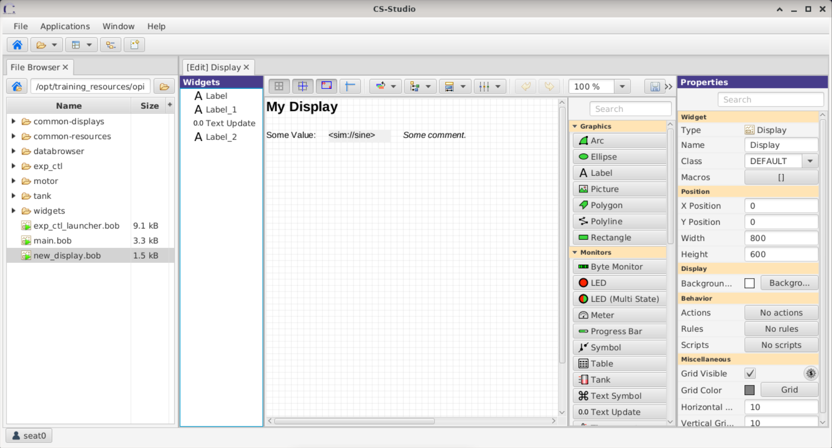
Suggested Setup for Editing
Pick a top directory, for example where you installed the example files
Open Applications, Utility, File Browser
Set it to your top directory
On file browser tab, open context menu, “Split Horizontally”, then “Lock Pane”
Menu Window, Save Layout As..
“My Editing”
Menu Applications, Display, New Display
Create new file in your top directory
Notes:
Editing layout

Slide 22
Process Variables
ca://some_pv_name
EPICS Channel Access PV
some_pv_name
Typically same, since “ca://” is the default
sim://sine
Simulated PV. See auto-completion hints
loc://x(4)
Local PV. See auto-completion hints
pva://x
EPICS pvAccess

Slide 23
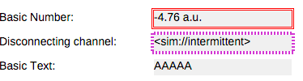
Keep It Simple
Add a Widget
Enter Label’s Text or Widget’s PV Name
Done
At Runtime, widget will
Show PV’s value, formatted, with units
Indicate alarm, disconnect
Show tool-tip with PV name and value
Combo options read from Enum PV, slider range from numeric PV
Disabled when ‘control’ widget has no PV write access

Slide 24
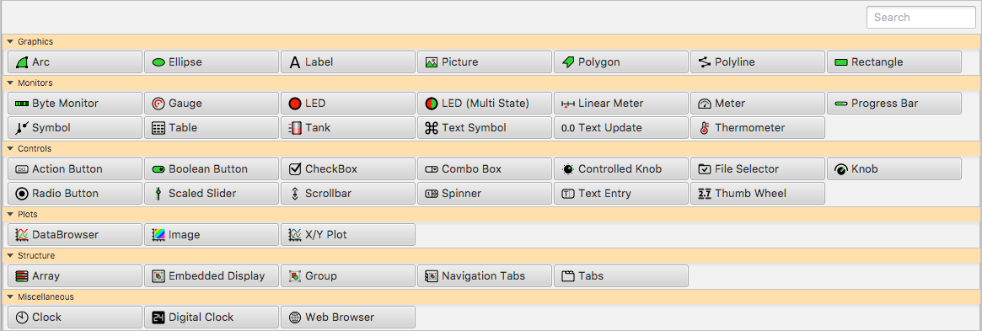
Display Builder Editor
Widgets Palette #1
Displays the available widgets grouped by behavior:
Graphics,
Monitor,
Controls,
Plots
Structure,
Miscellaneous.
Notes:
Shows all available widgets
Enter name for ”Search”
Hover mouse for description
Drag -or- Select & Rubberband
Categories
Graphics show static label, picture, ..
Monitors update based on reading a PV
Controls read a PV and can write to the PV
Plots tend to read from one or more (waveform) PVs
Structures group widgets, embed sub-displays

Slide 25
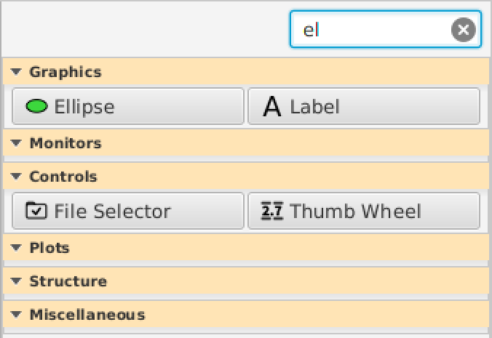
Display Builder Editor
Widgets Palette #2
Navigating the Palette:
Click section heading to minimize/maximize that section,
Drag the Palette left border to resize it,
Use the Search field to display only matching widgets.
Notes:
Show how to use the search filter.
Show how to hide/show a section.
Show how to resize the palette.

Slide 26
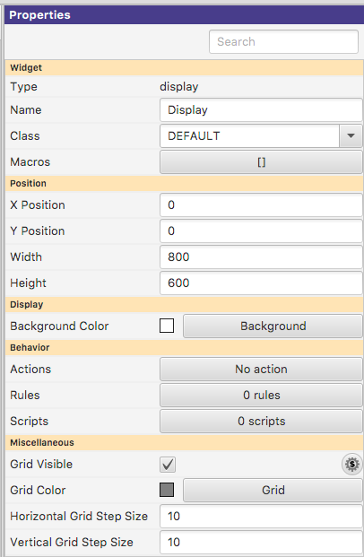
Display Properties
Click on display background to select no widget for editing overall display properties
Name
Shown in Tab
Macros
Used by all widgets in this display
Grid size
Can aid with placing widgets

Slide 27
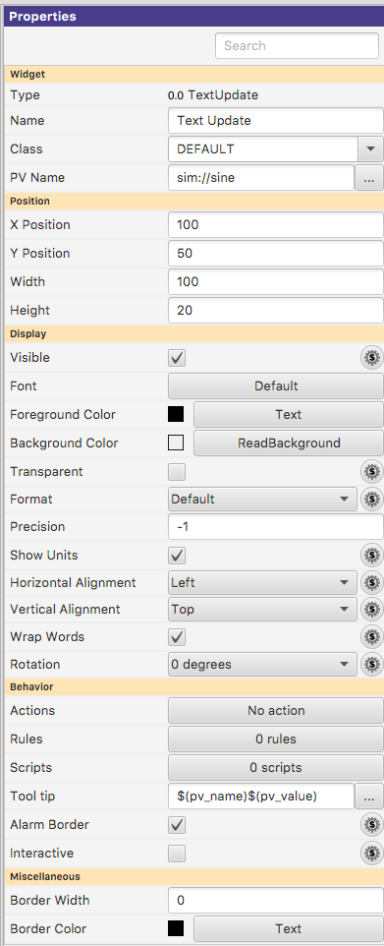
Widget Properties
PV Name
Most important property for most widgets
Details depend on the widget type
Defaults tend to be reasonable:
Format with precision set by PV
Show units provided by PV
Alarm-sensitive Border
Fetch Items (Combo, …) from PV
Select one (or more) widgets to edit their
(common) properties

Slide 28
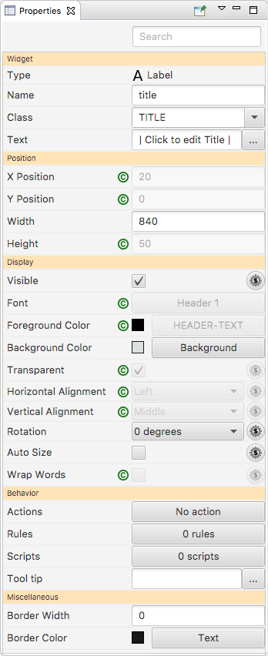
Display Builder Editor
Widget Properties
Describe the visual and behavioral attributes of the selected widget.
Properties are functionally grouped.
The most important properties are displayed first.
Properties change depending on the selected widgets.
A widget class define properties defaults that cannot be edited.
Use the Search field to display only matching properties.
Notes:
Show how to re-open the properties panel by resetting the perspective.
Show examples with classes.
Show how the search field works.

Slide 29
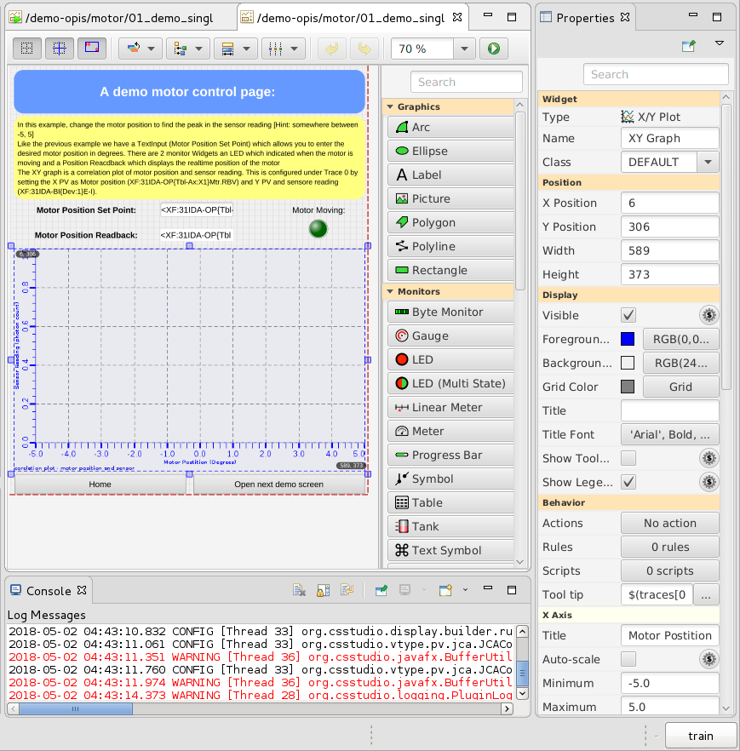
Display Builder Editor
Editing Widgets
Select, Move or Resize.
Clone Widgets (copy-paste).
Various tools:
Snap to Grid and to Widgets,
Show Coordinates,
Order, Align, Match Size, Distribute,
Undo/Redo,
Zoom.
Notes:
Create another widget,
Show alignment tools
Show contextual menu.
Replace with…
Selecting Widgets a) Click single widget
b) Ctrl-click to add widget (⌘ on Mac)
c) Drag ‘rubberband’ around widgets
d) Click or Ctrl/ ⌘ click in widget list
Quick Edit Double-click widget to
a) Edit text of Label
b) Edit PV of widgets that use a PV

Slide 30
Display Builder Editor
LED Widget Exercise #1

Slide 31
Display Builder Editor
LED Widget Exercise #2
Boolean LED:
Create a LED widget with
PV Name: sim://flipflop
Copy-paste the LED to create an array of LEDs.
Copy the PV Name property from the LED to a Text Update widget.
Multi State LED:
Create a LED (Multi State) widget with
PV Name: loc://multi_state_value(0)
Square: true
States: 4
Change the Color property for the four states.
Delete the value of the Label property for the four states.
Create a Spinner widget with
PV Name: loc://multi_state_value(0)
Maximum: 4.0
Limits from PV: false
Change the value in the Text Input.

Slide 32
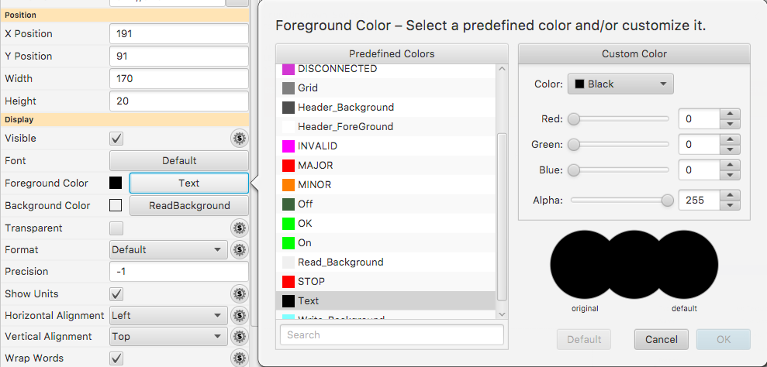
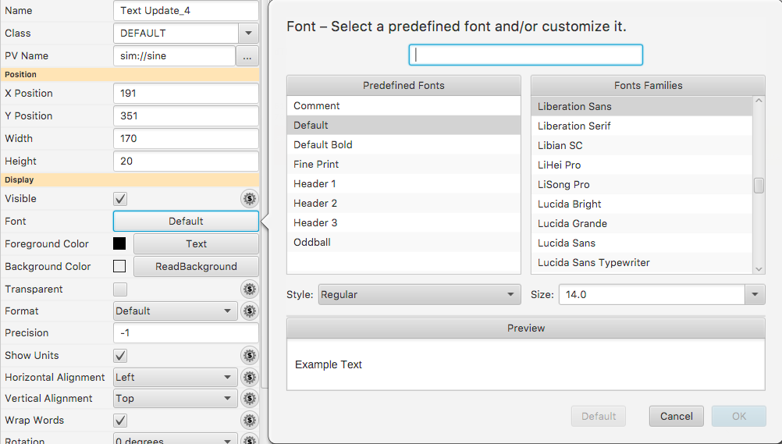
Predefined “Named” Colors and Fonts
Use whenever possible!

Slide 33
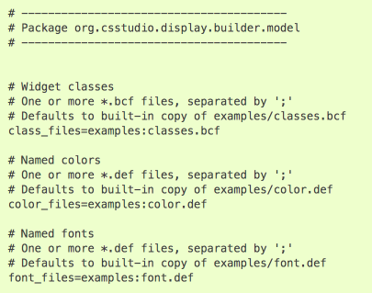
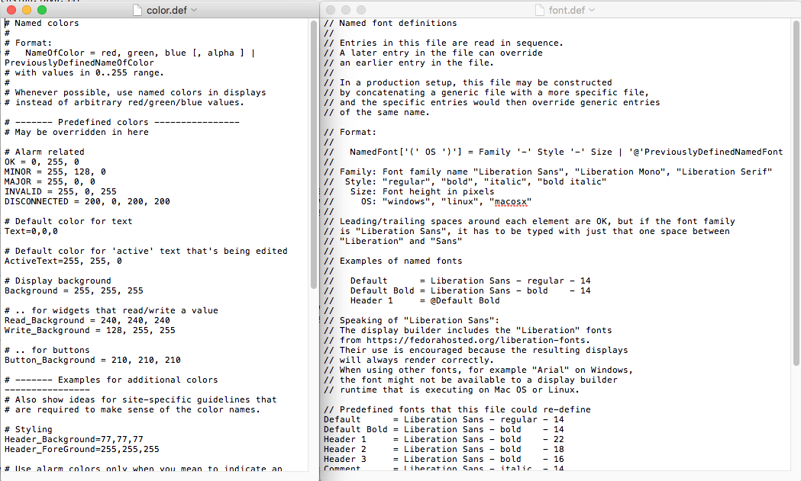
Configuring Named Colors, Fonts
Ideally set at start of project

Slide 34
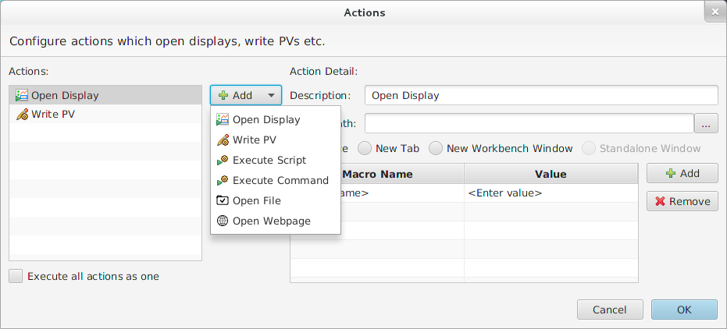
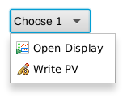
Display Builder Editor
Button Widgets
Action Button is a button widget which is used to execute one or more actions on a mouse click:
Open Display,
Write PV,
Execute Script,
Execute Command,
Open File,
Open Webpage.
When more than one actions are provided, the buttons will open a menu on click, where to chose the action to be executed.
Notes:
Actions button
Actions can be attached to any widget so that actions can be executed from that widget. They are configured from the Actions Property. There are several types of actions that can be associated with any type of widget. You may also add customzied action through Eclipse plugin mechanism.
Open OPI Open a related OPI. If Repalce is selected, it will replace the current OPI. You can send macros to the OPI to be opened by setting the Macros property. If a widget has this action hooked to its mouse click event, user will also be able to open the related OPI from its context menu: Open, Open in New Tab or Open in New Window. Or user can hold the Ctrl/Shift key while clicking on the widget to open the related OPI in new Tab/Window.
Open OPI in ViewOpen an OPI in view. The view can be place in five possible positions: Left, Right, Top, Bottom or Detached. An undetached View can also be detached as standalone window floating on top by right clicking the view tab and click Detached. By clicking Detached again, you can put it back to the workbench window.
Write PV Write a PV. If the widget is a button, it is recommended to set the PV name in the "PV Name" property of the widget, and use $(pv_name) as PV Name of the action. This will allow the PV getting connected on OPI startup instead of connecting to it on each write. If Confirm Message is not empty, a confirm dialog will pop up before writing the new value to PV.
Execute Command Execute system command just as executing command from shell or command line on Windows. The command should be searchable from system PATH, otherwise, it should be a full path to the command. The output will be displayed in the console if there is. The property "Command Directory" is where the command will be executed. In most cases, you can just use the default directory which is user's home directory.
Execute JavaScriptExecute a Javascript file, in which there are two accessible objects: widget and display so that you can access the widget or the display. See Access Widget
Execute Python ScriptExecute a Python script file, in which there are two accessible objects: widget and display so that you can access the widget or the display. See Access Widget
Play WAV file Play a sound file in WAV format.
Open File Open a file with the default editor. For example, you can open a databrowser file in databrowser.
Open Webpage Open a webpage in system default web browser.

Slide 35
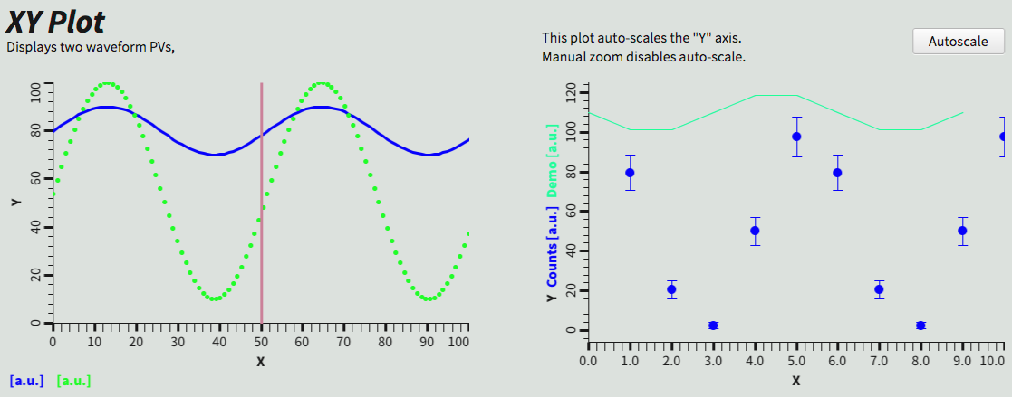
Display Builder Editor
X/Y Plot Widget
XY Plot is a widget that is able to plot data from waveform PVs into an X/Y graph.
Notes:
Explain the differences with the corresponding BOY widget.

Slide 36
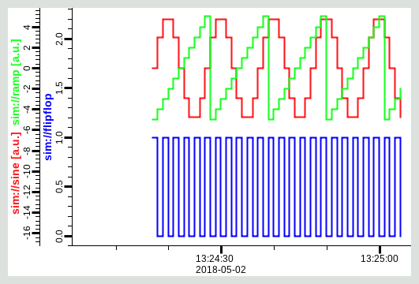
Display Builder Editor
Data Browser Widget
Displays PVs over time, using a separate Data Browser .plt file for configuration.

Slide 37
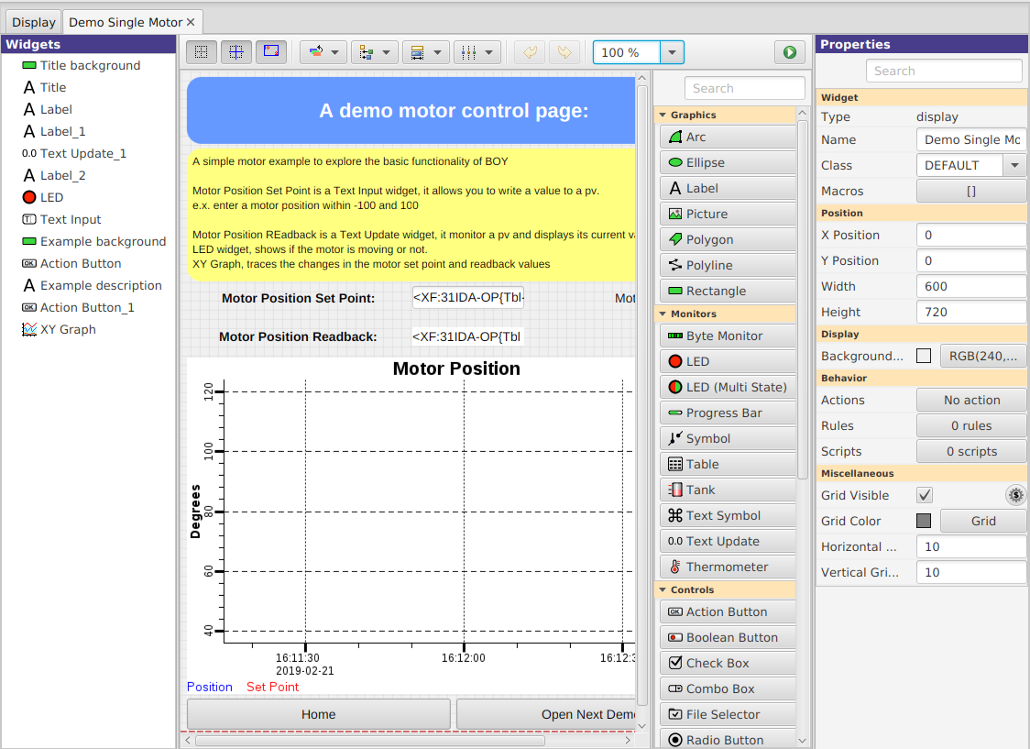
Display Builder Editor
Exercise: Create a Simple Motor Control Screen #1
Notes:
Explain what the red, dashed lines are.

Slide 38
Display Builder Editor
Exercise: Create a Simple Motor Control Screen #2
Text Entry [Controls] widget for entering the set point
PV Name: XF:31IDA-OP{Tbl-Ax:X1}Mtr.VAL
Text Update [Monitor] widget for monitoring the readback
PV Name: XF:31IDA-OP{Tbl-Ax:X1}Mtr.RBV
LED [Monitor] widget to indicate the motor is moving
PV Name: XF:31IDA-OP{Tbl-Ax:X1}Mtr.MOVN
DataBrowser [Plots] widget to plot the changes in the motor setpoint and position
Trace 0
Y PV: XF:31IDA-OP{Tbl-Ax:X1}Mtr.RBV
Trace 1
Y PV: XF:31IDA-OP{Tbl-Ax:X1}Mtr.VAL

Slide 39
Display Builder Editor
Macros #1
Macros are some predefined strings that can be embedded in any widget property.
Often used as PV name or partial PV name: $(pv), $(pvprefix)_setpoint.
Macros are resolved at runtime when the screen is loaded.
Macros can be notated as $(macro) or ${macro}.
Notes:
Explaining why is not safe using { and } as part of a PV name.
Macros are passed into displays from
Enclosing Group or Tab Widget
Display
Embedded widget container or Action that loaded the display
Phoebus preferences
To use: $(NameOfMacro)
Examples:
PV Name: $(PV) with PV=TheFullPVName
PV Name: Motor$(N) with N=1, 2, 3, …
Width: $(WID) with WID=200
Visible: $(SHOW) with SHOW=true
$(DID): Unique display identifier, useful for per-display PVs
loc://x$(DID)(10)
$(DNAME): Display Name

Slide 40
Display Builder Editor
Example Usage:
XF:31IDA-BI{Dev:$(M)}E-I
Where are Macros defined

Slide 41
Display Builder Editor
Macros #2
Macros can also be used for numeric and boolean values, as long as their value is numeric or “true”/“false”.
Macros can be defined at various levels, and are resolved in the following order:
Preferences,
Open Display action,
Embedded widget,
Display,
Group widget or Tab widget.
Notes:
$(DID): Unique display identifier, useful for per-display PVs
loc://x$(DID)(10)
$(DNAME): Display Name

Slide 42
Display Builder Editor
Macros #2
Default values: $(MACRO=default)
Allows standalone testing without passing values into display
Prevent invalid name resolution broadcasts
Predefined Macros
$(DID): Unique display identifier, useful for per-display PVs
loc://x$(DID)(10)
$(DNAME): Display Name
Notes:
$(DID): Unique display identifier, useful for per-display PVs
loc://x$(DID)(10)
$(DNAME): Display Name

Slide 43
Display Properties
Click on display background to select no widget for editing overall display properties
Name
Shown in Tab
Macros
Used by all widgets in this display
Grid size
Can aid with placing widgets

Slide 44
Group Widget
Contains other widgets
Visual Effect:
Border, Name
Practical Effect:
Group can define macros for contained widgets
Group can be moved, copied/pasted as one unit in editor
Create from Widget View or Context Menu
Notes:
Name: Shown in border
Style: “Group Box” for named border
Macros: Passed to contained widgets Create from Widget View or Context Menu

Slide 45
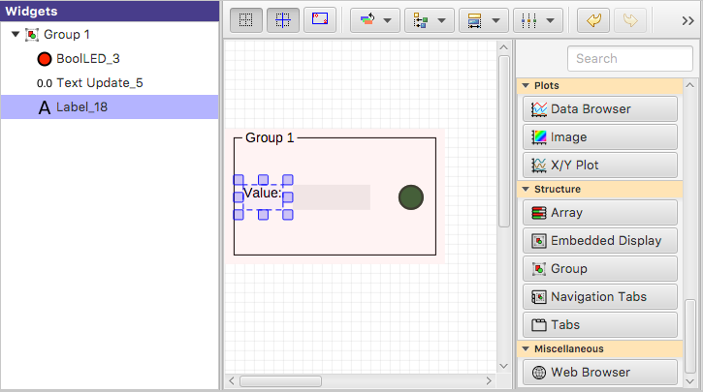
Group Widget
1) Add Group Widget
2) Move other widgets inside the Group
Active Group is highlighted

Slide 46
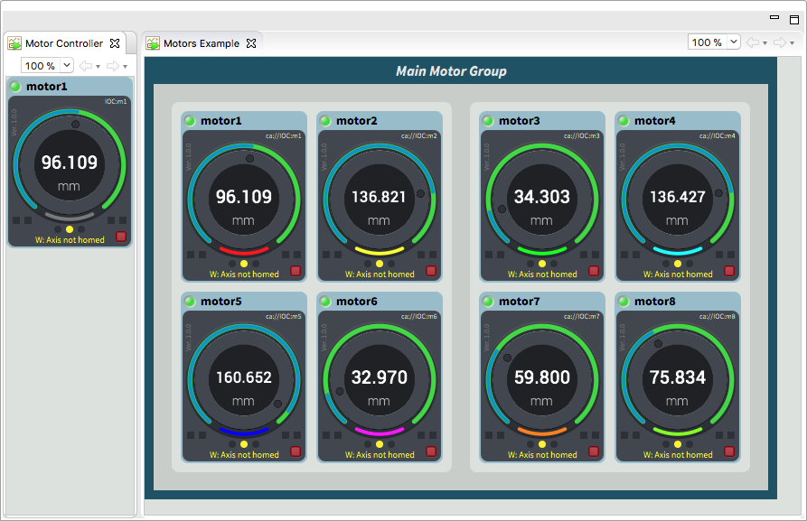
Display Builder Editor
Containers
Embedded Display allows the creation of composite screens by embedding different OPI screens or groups.

Slide 47
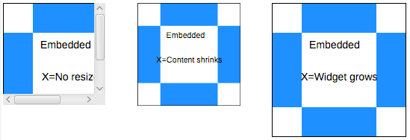
Embedded Display Resize Options
Size content to fit widget
Size widget to fit content
No Resize
No Resize usually best. Scrollbars appear as needed.
Resizing results in odd font sizes or widgets that outgrow their initial space.

Slide 48
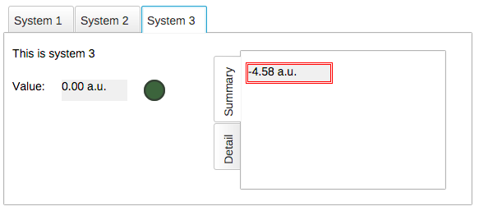
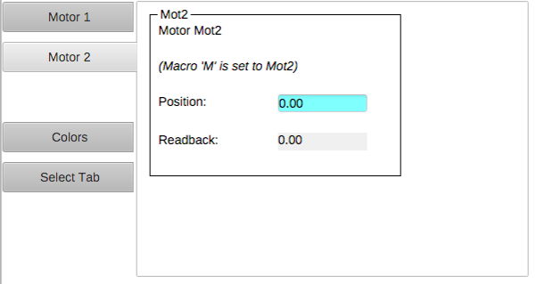
Screen Navigation: Tabs
Tabs
Each tab is in-memory, same *.bob
Appears immediately when selected
Uses CPU and memory when hidden
Navigation Tabs
Tab is loaded from separate *.bob when selected
May need a little time to load
No CPU and memory when hidden

Slide 49
Display Builder Editor
Exercise: Containers & Macros #1

Slide 50
Display Builder Editor
Exercise: Containers & Macros #2
Create a simple screen (_motor_overview.bob) which represents a reusable segment with:
a Label
Text: Motor $(N)
a Text Entry
PV Name: XF:31IDA-OP{Tbl-Ax:X$(N)}Mtr.VAL
a Text Update
PV Name: XF:31IDA-OP{Tbl-Ax:X$(N)}Mtr.RBV
a LED
PV Name: XF:31IDA-OP{Tbl-Ax:X$(N)}Mtr.MOVN
Notes:
Reorder widgets from left to right using the Outline view: first widget from left must be the first one in Outline.

Slide 51
Display Builder Editor
Exercise: Containers & Macros #3

Slide 52
Display Builder Editor
Exercise: Containers & Macros #4
Create another OPI screen with 6 Embedded Displays:
File: Path to _motor_overview.bob
Macros: For each linking container set N = 1, 2,…6
Run
Notes:
Embedded Display Size
Size of the widget that will host the *.bob
Defined by the widget Width and Height properties
Content Size
Size of the *.bob
Defined by that Display Width and Height properties
What if those sizes differ?

Slide 53
Rules
Ideally, use widgets’ built-in functionality
Value of PV displayed in TextUpdate, LED, ..
Alarm indicated via Border
Sometimes useful to for example hide a widget, i.e. change visibility or disable a widget based on a PV
Rules can accomplish this
.. But functionality may not be obvious to the next person who needs to maintain a display

Slide 54
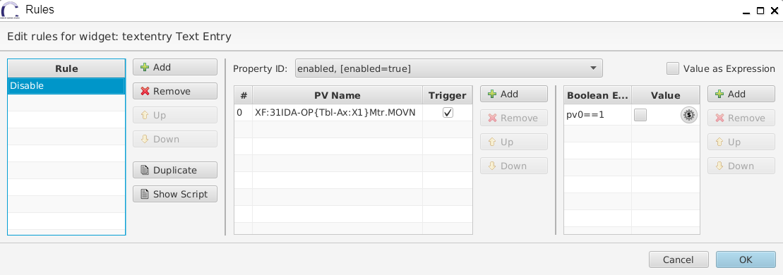
Rules
Rules details
Name
1-N trigger PVs
Some logical processing
Output

Slide 55
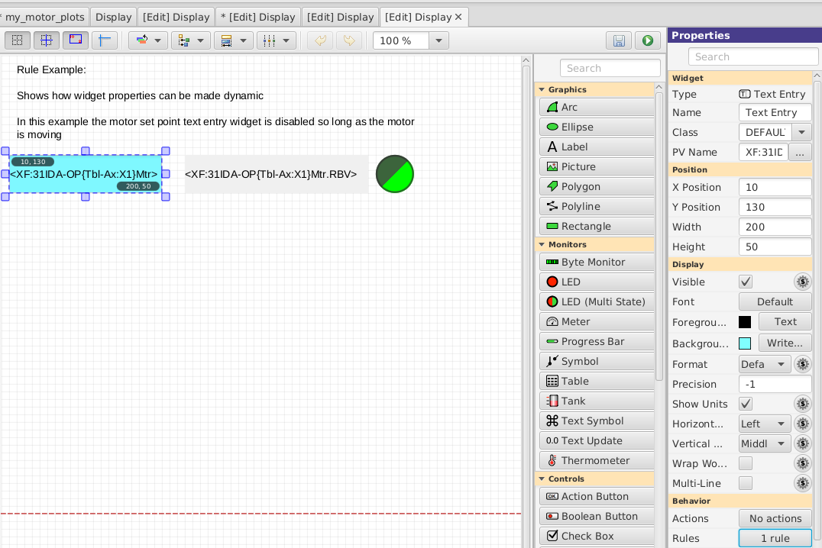
Adding a Rule
Adding a rule to disable the changing the Setpoint when the motor is moving
Add TextUpdate widget
Set PV to XF:31IDA-OP{Tbl-Ax:X1}Mtr
Add Rule, name it “Disable”
Select “enabled” property
Add PV XF:31IDA-OP{Tbl-Ax:X1}Mtr.MOVN
Add Boolean Expression “pv0==1”
Un-check value

Slide 56
More Information
Help ▸Help Contents
Applications ▸ Display Builder

Slide 57
Thank You for Your Attention
Any Questions? Just Ask!

