Slide 1
Data Browser
Visualizer of PV Values
Kunal Shroff, Kay Kasemir, Georg Weiss and many other

Slide 2
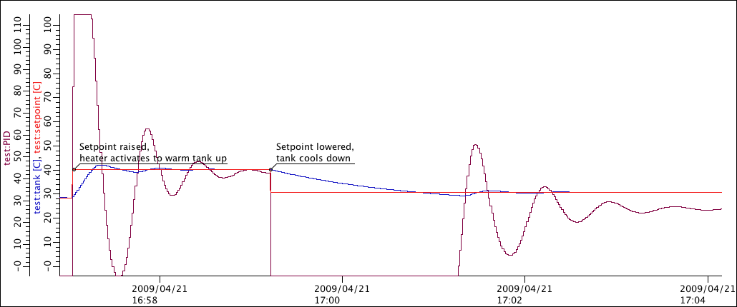
Archivers & Stripcharts
Archiver
IOC
CA Server
PVA Server
IOC
CA Server
PVA Server
IOC
CA Server
PVA Server
IOC
CA Server
PVA Server
Notes:
Monitor – Tries to save every received update – Based on ADEL – Might need an expected-update-rate to allocate buffers, skipping samples if there are too many • Scan – Writes the most recent value every N seconds – Stores original time stamps

Slide 3
EPICS Archiver Appliance
The EPICS Archiver Appliance is an implementation of an archiver for EPICS control systems that aims to archive millions of PVs.
Ability to cluster appliances and to scale by adding appliances to the cluster.
Multiple stages and an inbuilt process to move data between the stages.
Focus on data retrieval performance.
Focus on zero oversight.

Slide 4
Databrowser
Developed at ORNL by Kay Kasemir, Chen Xihui
The Data Browser is a trending tool. It can display the values of 'live' Process Variables (PVs) as well as historic data in a Stripchart-type plot.
Live Data
For each PV, the Data Browser collects 'live' samples from the control system and plots them over time.
Historic Data
The Data Browser queries archive data sources for historic samples to obtain data for time ranges 'before' the live sample buffer. You can configure one or more archive data source for each PV.

Slide 5
Prerequisite
Motor Simulator
Start the motor simulator:
Open a Terminal window (Press Activities, then Applications, then Terminal),
Then type the following
﻿cd ~/build-epics/motorsim/
./startSimMotor.sh
Don’t close the Terminal window.

Slide 6
Prerequisite
Motor Simulator
Start the archiver:
Open a Terminal window (Press Activities, then Applications, then Terminal),
Then type the following
systemctl start archappl

Slide 7
Data Browser
Displays “live” and historic values of PVs.
Opening Data Browser
Menu: Applications ▸ Display ▸ Data Browser
Context Menu: Process Variable ▸ Data Browser
(right-click)

Slide 8
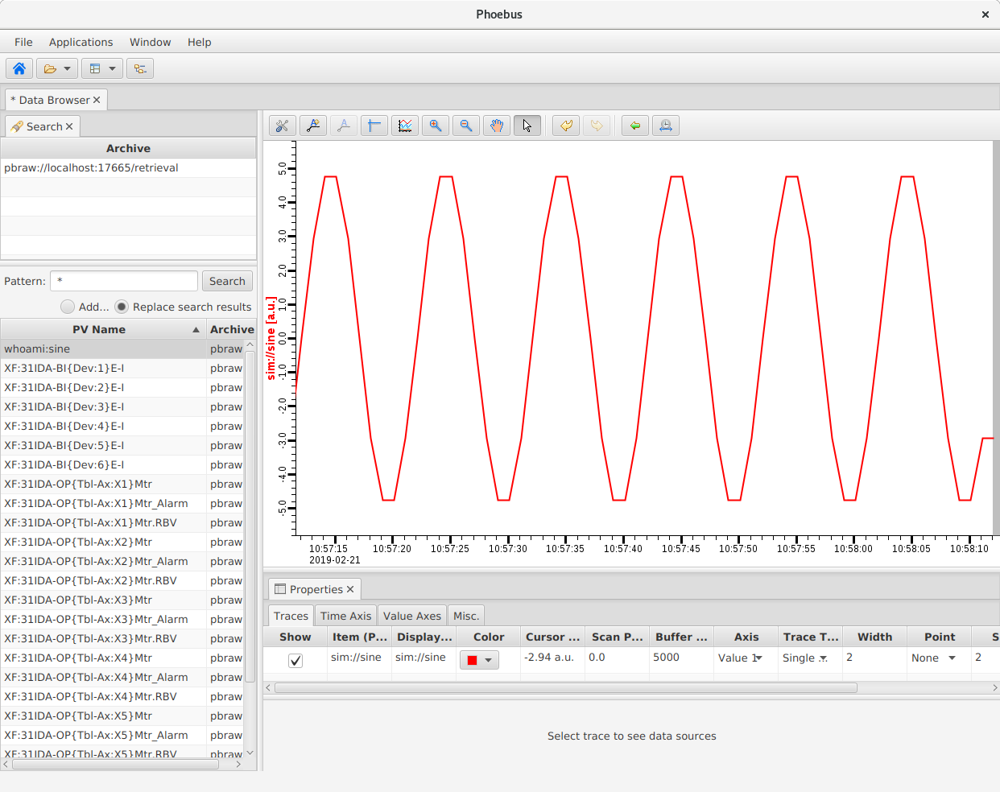
Layout
Opening Data Browser layout
Layouts: Load Layout ▸ Data Browser
Views:
Plot,
Archive Search,
Properties
Traces,
Time Axis,
Value Axis,
Misc,
Export Samples
Inspect Samples
Inspect Waveforms

Slide 9
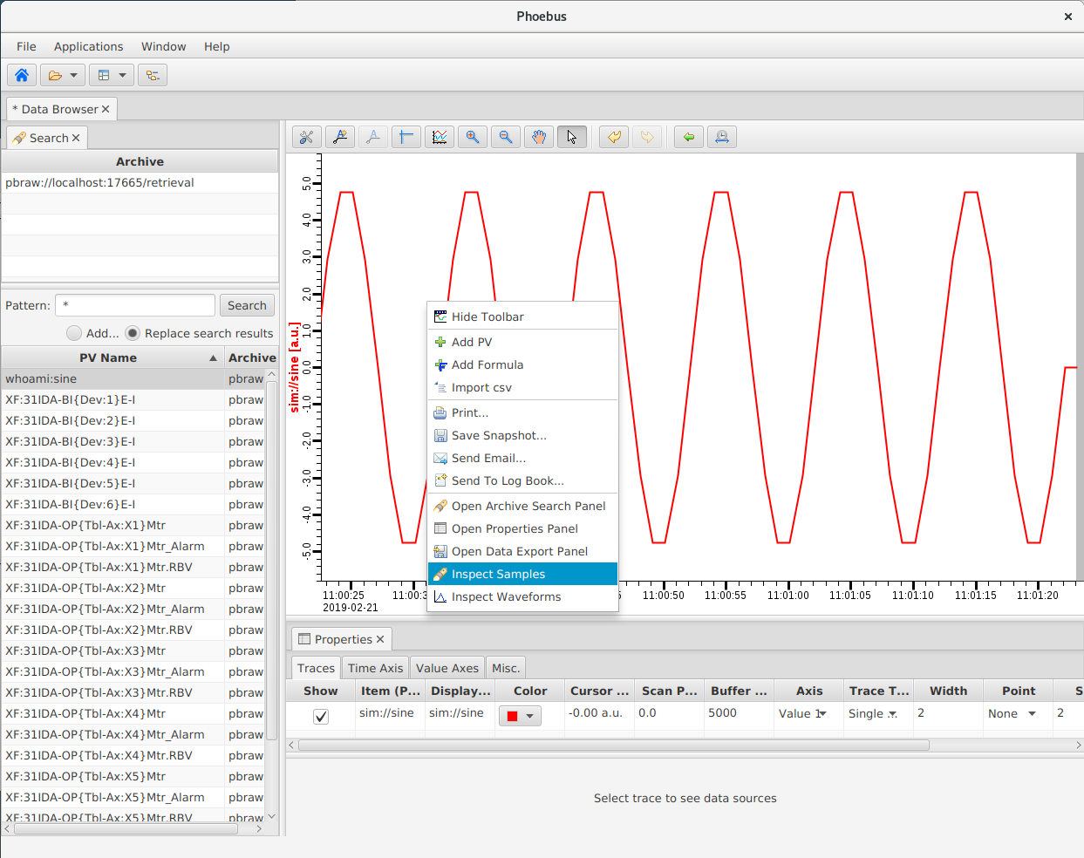
Adding PVs
Right-click on the Plot area;
Select Add PV
Type the PV name
XF:31IDA-OP{Tbl-Ax:X2}Mtr

Slide 10
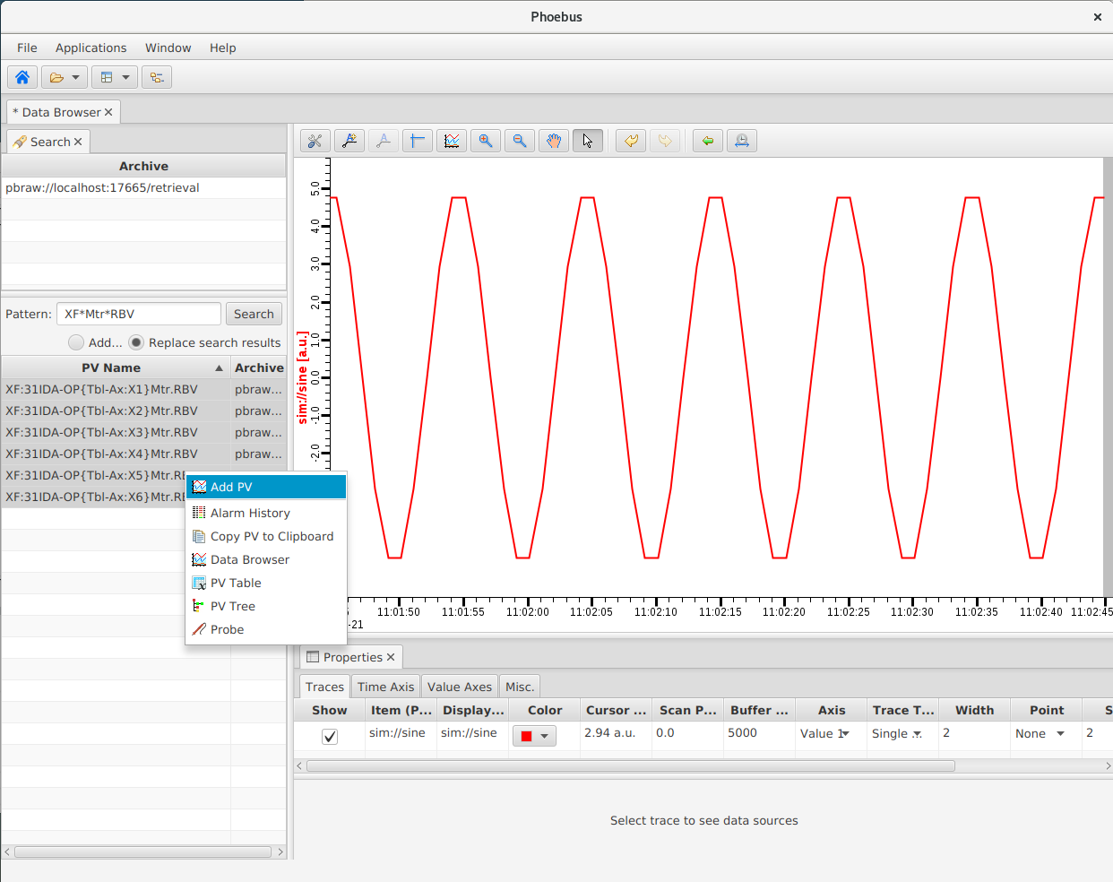
Searching for PVs
Activate the Archive Search view;
Select the archive:
Local Archiver
Specify a pattern:
XF*Mtr*RBV
Right-click on the result pane
Process Variable ▸Data Browser

Slide 11
Details
Plot Toolbar:
Zoom in & out,
Rubber-band zoom,
Scroll back and forth in time, …
Annotations
Undo/redo

Slide 12
Details
Traces View:
Lists of PVs being displayed, together with the visual characteristics of their associated tracks, and Data Sources info.

Slide 13
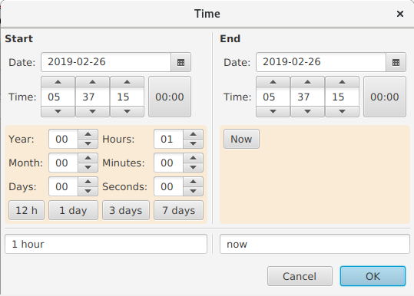
Details
Time Axis View:
Define start and end time of the plot, in either relative or absolute terms.

Slide 14
Details
Value Axis View:
Manage the vertical axis/axes (i.e. colour, range, title, …).

Slide 15
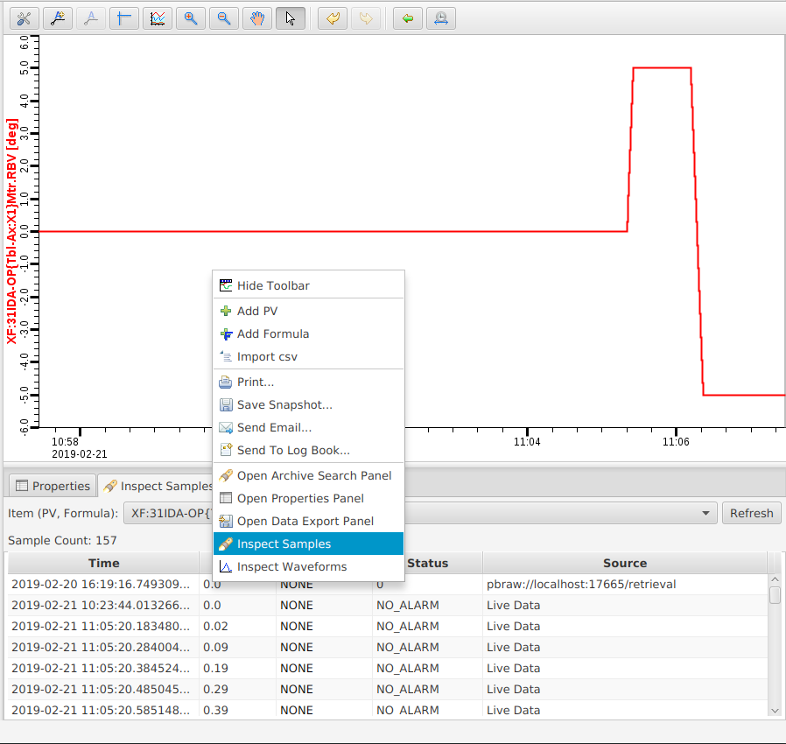
Sample Inspection
Allows inspection of PV values being plotted.
Right-click on the Plot view
Inspect Samples

Slide 16
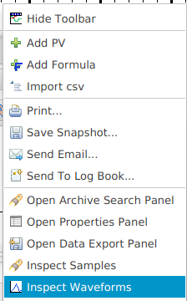
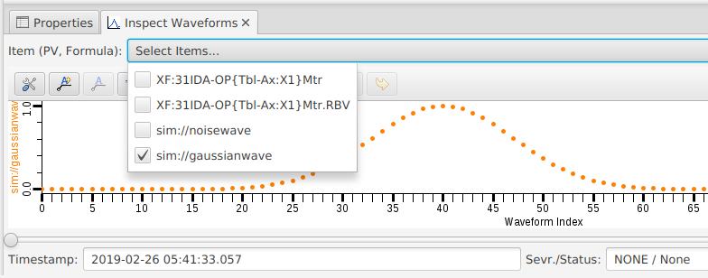
Waveform Inspection
Allows inspection of waveform PVs
Add a waveform pv to the databrowser plot sim://gaussianwave sim://noisewave
Right-click on the Plot view
Inspect Waveforms

Slide 17
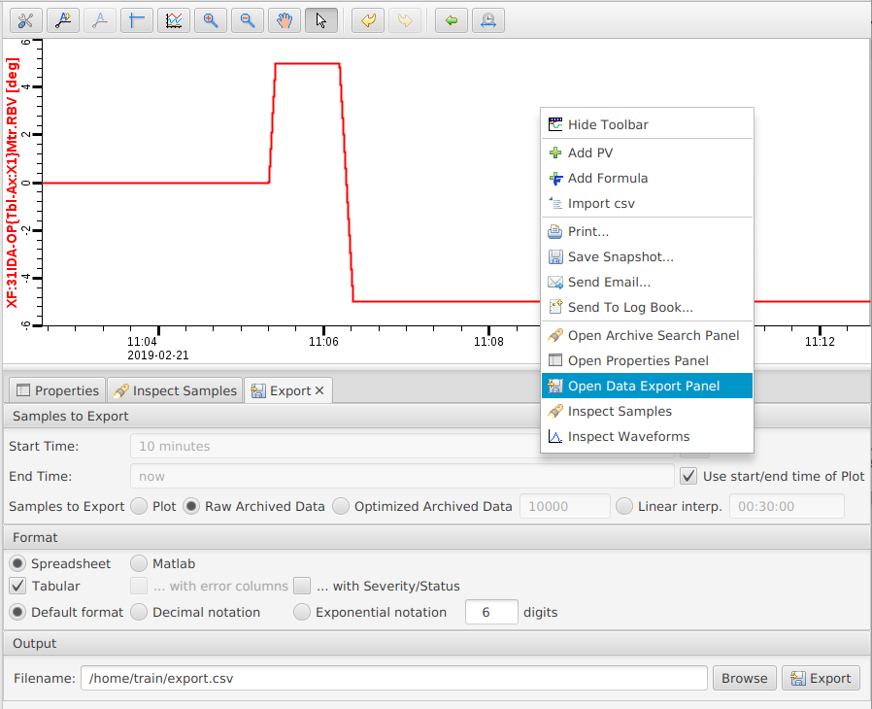
Export Samples
Samples to Export:
Define the amount and the source of the data to be exported.
Format:
Select the output format exported for the data.
Output:
Select the output file.

Slide 18
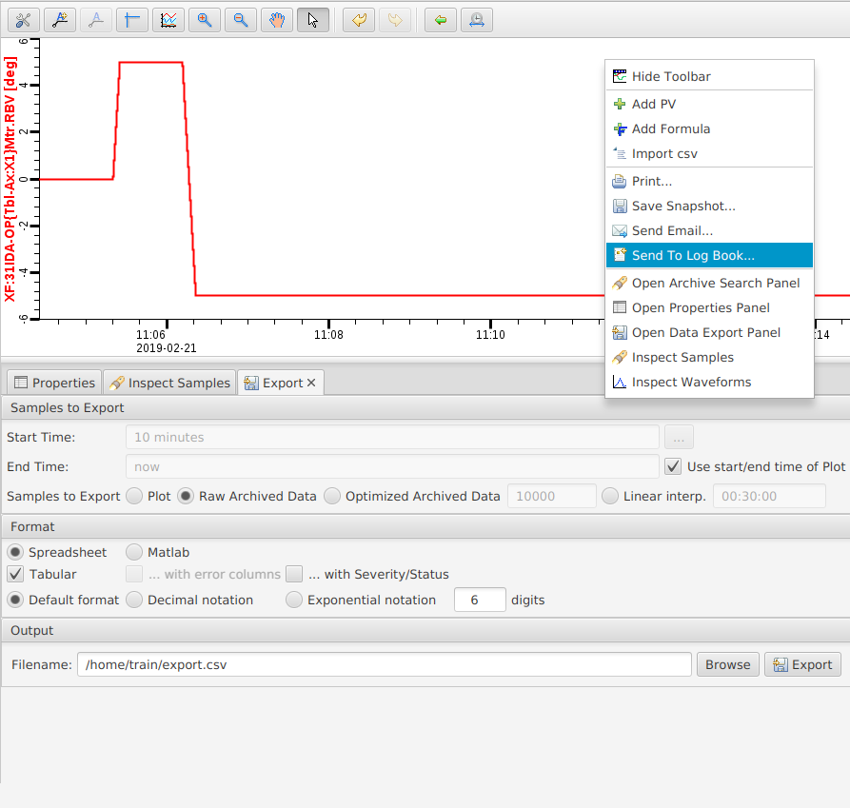
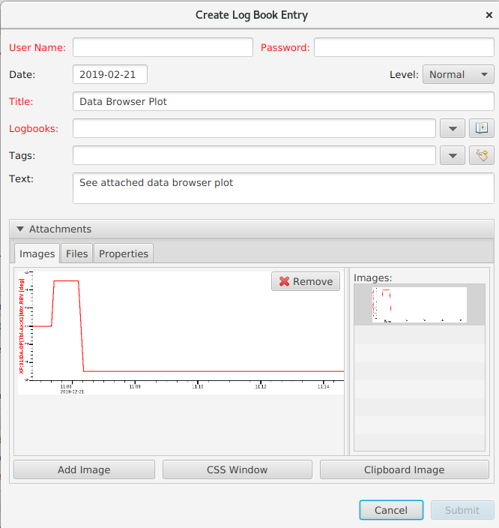
Create Log Entry
Right-click on the Plot view
Process Variable ▸Create Log Entry
A Log Entry dialog pre-populated with appropriate opens.
Add Username and Password and press Submit.

Slide 19
Archiver Appliance

Slide 20
Motivation
The EPICS Archiver Appliance is an implementation of an archiver for EPICS control systems that aims to archive millions of PVs.
Ability to cluster appliances and to scale by adding appliances to the cluster.
Multiple stages and an inbuilt process to move data between the stages.
Focus on data retrieval performance.
Focus on zero oversight.

Slide 21
Appliance Archiver
https://slacmshankar.github.io/epicsarchiver_docs/details.html

Slide 22
Appliance Archiver
https://slacmshankar.github.io/epicsarchiver_docs/details.html

Slide 23
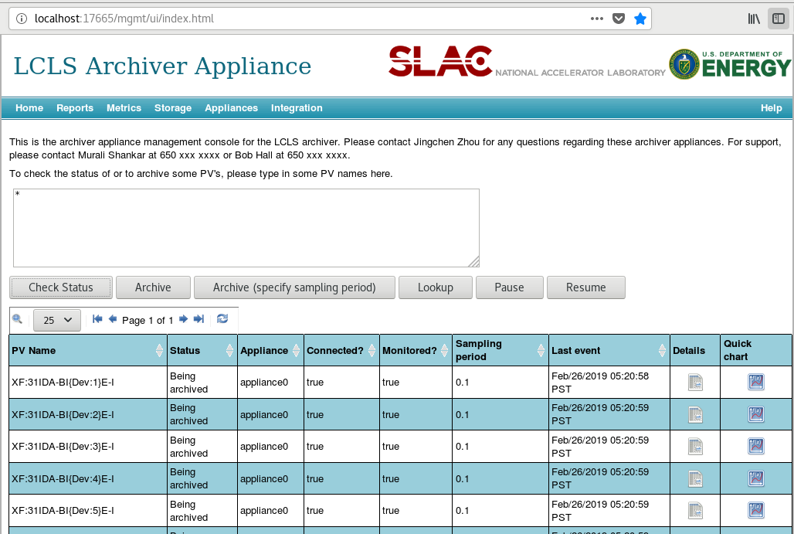
Archive a PV
Add a pv for archive
test:sine
test:sine:cnt
Ensuring correct archiving parameters
Sampling and buffer allocation
.ADEL
Notes:
Enter any number of PV's in the text area (one per line) and click on the Archive button.
If you wish to specify the sampling period, then click on the Archive (specify sampling period) button instead.
When adding a new PV to the cluster, the archiver appliance measures various parameters about the PV. This takes about 4-5 minutes during which the PV is in an Initial sampling state.
Once the PV's characteristics have been measured, the appliance assigns the PV to an appliance in the cluster and the PV transitions to a Being archived state.
If the archiver appliance is not able to connect to a PV, the PV stays in the Initial sampling state until it is able to connect.
You an request a PV to be archived before it is available on the network. The request to archive the PV is stored in the persistent configuration until the archiver appliance can connect. Once the archiver appliance is able to connect to the PV, it continues on the normal workflow (where various parameters about the PV are measured etc).
Using Archive (specify sampling period), you can additionally specify
Archival method: Whether the archiver will use CA monitors/scan threads to sample at the specified sampling period.
Conditional archiving PV: The archiving for this PV is performed only when the conditional archiving PV's .VAL field is non-zero.
Policy: The archiver appliance uses policies set up the administrator to configure how the PV is to be archived. You can override this by choosing a policy yourself. This lets your system administrator set up a set of policies and lets the user choose manually from among those

Slide 24
Archive a PV
policies.py
Management policies.py file
# We limit BPM PVs to 1GB/year We reduce the sampling rate
pvPolicyDict['samplingPeriod’] = pvInfoDict['storageRate']/(35*pvInfoDict['eventRate'])
pvPolicyDict['samplingMethod'] = 'MONITOR'
pvPolicyDict['dataStores'] = [
shorttermstore_plugin_url,
mediumtermstore_plugin_url,
longtermstore_plugin_url
]
pvPolicyDict['policyName'] = 'BPMS’;
# List of fields to be archived if pvRTYP=="ao":
archiveFields=['HIHI','HIGH','LOW','LOLO','LOPR','HOPR','DRVH','DRVL’]

Slide 25
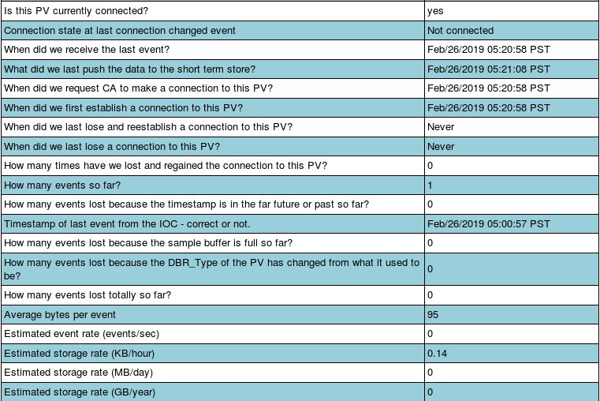
Archive a PV
Explore PV archiving details

Slide 26
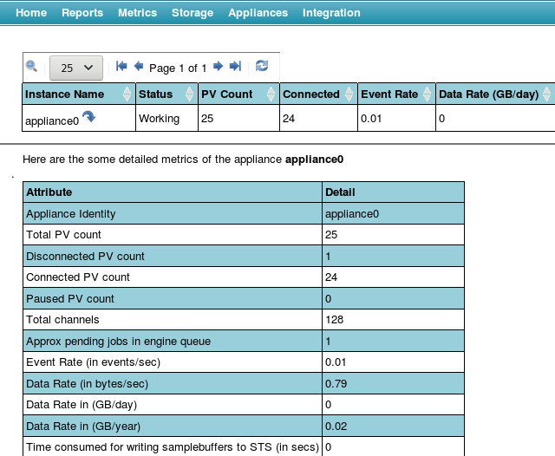
Archiver Management

Slide 27
Archiver REST API
REST API’s to management and data retrieval services
http://archiver/retrieval/data/getData.json?pv=...
.json, .svg, .csv, .raw
pv
from & to
Data decimation
binning the data into bins using bin size and data decimation processing
e.g. mean_3600(pv_name, start_time, end_time)

Slide 28
Archiver REST API
REST API’s to management and data retrieval service
http://archiver/mgmt/bpl/
read archiving status and metrics add PV’s for archiving
manage PV archiving configuration
https://slacmshankar.github.io/epicsarchiver_docs/api/mgmt_scriptables.html

Slide 29
Appliance Archiver pva services
pva
RPC
pva
RPC

Slide 30
pvaMgmtService:getAllPVs
Get all the PVs in the cluster.
limit - An optional argument that specifies the number of matched PV's that are retured. If unspecified, we return 500 PV names.

Slide 31
pvaMgmtService:archivedPVStatus
Given a list of PVs, determine those that are being archived.

Slide 32
pvaMgmtService:archivePVs
Add one or more pvs to the archiver.
The requests for archiving pv's, the request consists of an NTTable with a list of pv's to be archived, optional attributes include sampling period and/or samplingmethod

Slide 33
pvaMgmtService:PVStatus
Get the status of a PV.
pv - The name(s) of the pv for which status is to be determined.

Slide 34
pvaDataRetrievalService:getPVsData
request:
epics:nt/NTURI:1.0 string scheme string path getPVsData
response:
NTComplexTable string[] labels [] epics:nt/NTScalar:1.0[] value epics:nt/NTScalar:1.0 double value -10.0 alarm_t alarm int severity 0 int status 0 string message epics:nt/NTScalar:1.0 double value -9.8 alarm_t alarm int severity 0 int status 0 string message

Slide 35
Appliance Archiver

