Slide 1
Alarms
Kunal Shroff, Kay Kasemir, Georg Weiss and many other

Slide 2
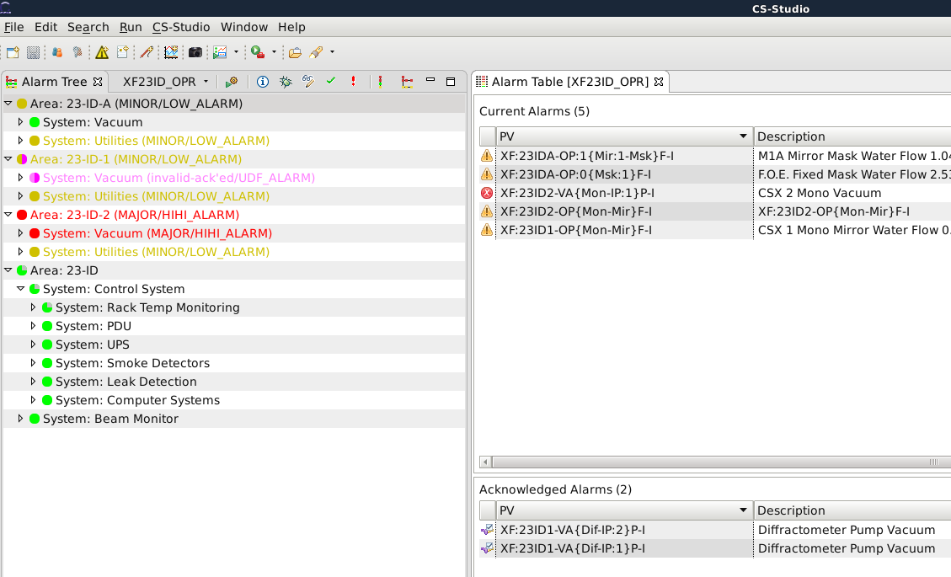
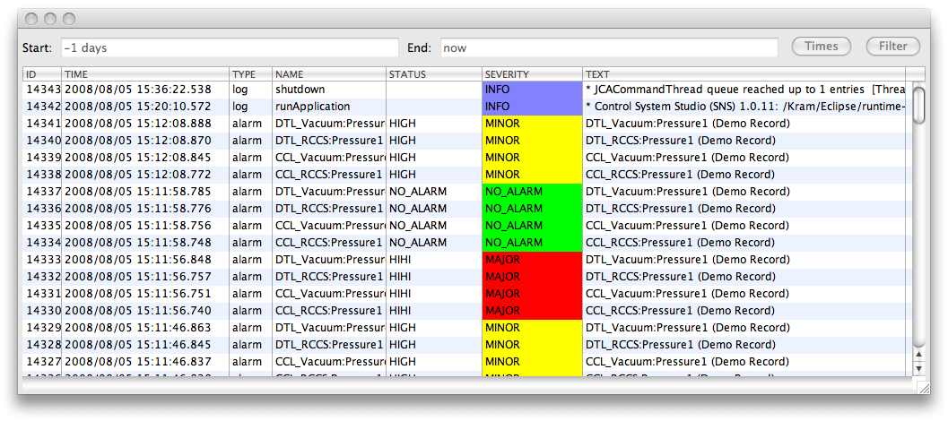
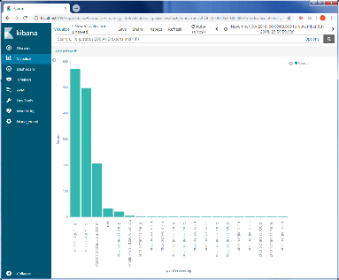
Alarm
Clients
CS-Studio
…
Alarm micro services
Alarm
Server
Alarm
Configuration
Server
Alarm
Message
Logger
Control
Systems
Channel
Access
IOC
PVA
IOC
…

Slide 3
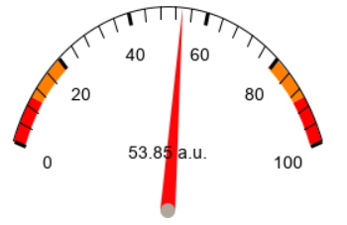
EPICS Alarms
record(ai, "…") {
field(VAL, "53.85")
… field(LOLO, "10")
field(LLSV, "MAJOR")
field(LOW, "20")
field(LSV, "MAJOR"
field(HIGH, "80")
field(HSV, "MINOR")
field(HIHI, "90")
field(HHSV, "MINOR")
}
NTScalar
double value
alarm_t alarm
int severity
int status
string message
time_t timeStamp
long secondsPastEpoch
int nanoseconds
int userTag
valueAlarm_t valueAlarm
boolean active false
double lowAlarmLimit 10
double lowWarningLimit 20
double highWarningLimit 80
double highAlarmLimit 100
int lowAlarmSeverity 0
int lowWarningSeverity 0
int highWarningSeverity 0
int highAlarmSeverity 0
byte hysteresis 0

Slide 4
EPICS Alarms
Each record has an alarm severity and status
Severity:
NO_ALARM
MINOR
MAJOR
INVALID
Status: READ, WRITE, LINK, …

Slide 5
Alarm Server
CS-Studio
Architecture
Alarm Server - monitor
Alarm monitors on a list of PVs
Monitor for changes in alarm severity and status
Alarm
Server
NTScalar
double value 8.1
alarm_t alarm
int severity 3
int status 2
string message High High Ex
time_t timeStamp
long secondsPastEpoch 1460589145
int nanoseconds 588698520
int userTag 0
Channel
Access
IOC
PVA
IOC
…
Notes:
Kafka
Alarm Configuration - Which PVs to monitor - Guidance - Display Links
Current State - Which PVs are in alarm?

Slide 6
Alarm Server
CS-Studio
Architecture
Alarm Server – create/manage
Manages alarm configuration
Guidance for handling alarms
Latch
Enable/Disable
Annunciate/notifying
Manage the current alarm state
List of current active alarms
List of acknowledged alarms
Alarm
Server
Channel
Access
IOC
PVA
IOC
…
Notes:
Kafka
Alarm Configuration - Which PVs to monitor - Guidance - Display Links
Current State - Which PVs are in alarm?

Slide 7
Alarm Server
CS-Studio
Architecture
Alarm Server - notify
Generate alarm messages when there is any change in the alarm state
Alarm
Server
Channel
Access
IOC
PVA
IOC
…
Notes:
Kafka
Alarm Configuration - Which PVs to monitor - Guidance - Display Links
Current State - Which PVs are in alarm?

Slide 8
Alarm Philosophy
B. Hollifield, E. Habibi, "Alarm Management: Seven Effective Methods for Optimum Performance", ISA, 2007

Slide 9
Alarm Philosophy
A good alarm system
Alarms with guidance
Manageable alarm rate (<150/day)

Slide 10
Alarm Philosophy
Goal:
Help users take correct actions
Identify the problem
Alarm
System
Channel
Access
IOC
Help locating useful information
Notify subject matter expert
PVA
IOC
Determine patterns & trends

Slide 11
Alarm Philosophy
Goal:
It takes many experts to create a good alarm system
Channel
Access
IOC
Alarm
System
Identify the problem
Help locating useful information
PVA
IOC
Notify subject matter expert
Alarm
Configuration
System Expert
Determine patterns & trends
Control System Eng
Operations Expert
Notes:
System Expert
Provide useful alarm levels
Explain what to to when alarm happens
Control System Engineer
Configure alarm levels
Maybe create new alarm trigger PV
Create displays
Operations Expert
Add alarm trigger PV to alarm system, with guidance and links to displays

Slide 12
Good Practices
Adding pvs
Alarm triggers: PVs on IOCs
Not all PV’s need to be included
HYST is good idea
Dynamic limits, enable based on machine state,...
Requires thought, communication, documentation
Added to alarm server with
Guidance: How to respond
Related screen: Reason for alarm (limits, …), link to screens mentioned in guidance
Link to rationalization info (wiki)

Slide 13
Good Practices
Avoid Multiple Alarm Levels
Analog PVs for Temp/Press/Res.Err./…:
Easy to set LOLO, LOW, HIGH, HIHI
Consider:
Do they require significantly different operator actions?
Will there be a lot of time after the HIGH to react before a follow-up HIHI alarm?
In most cases, HIGH & HIHI only double the alarm traffic
Set only HSV to generate single, early alarm
Adding HHSV alarm assuming that the first one is ignored only worsens the problem

Slide 14
Alarm Server
Architecture
Alarm Clients:
GUI’s display alarms
GUI’s provide tools to handle alarms
Enable/Disable
Acknowledge,
Open related display
Show guidance
…
Annunciator
Alarm message loggers

Slide 15
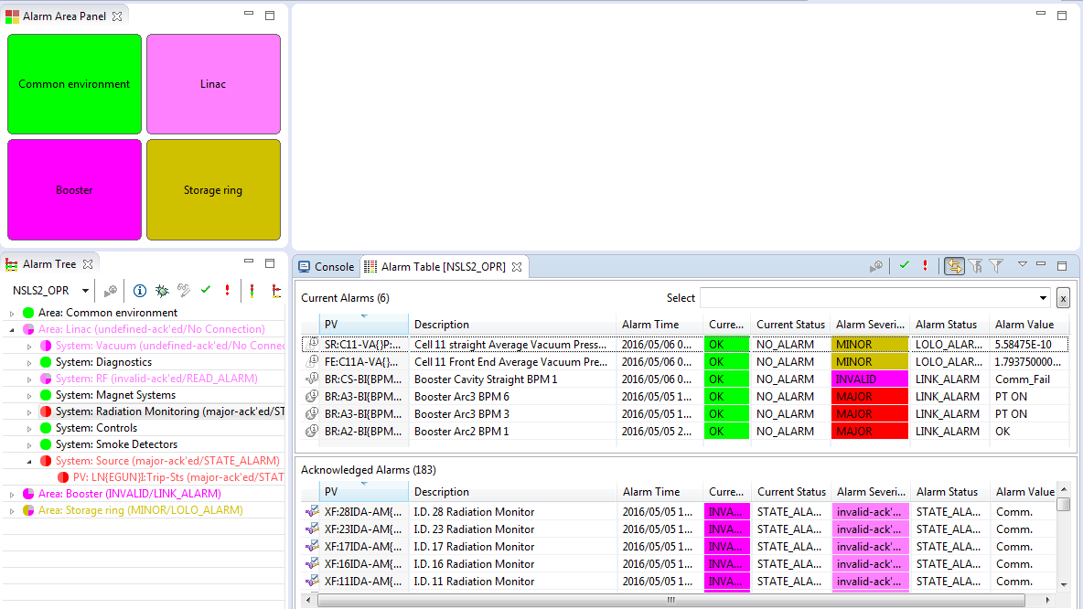
Layout
Window ▸ Open Layout ▸ alarm

Slide 16
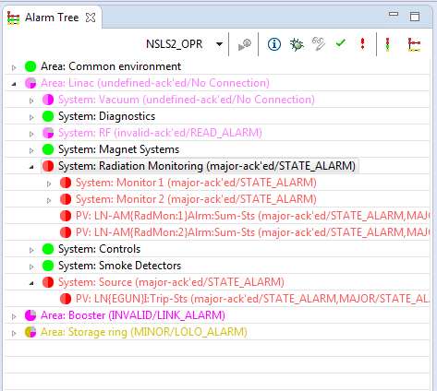
Alarm Tree
Hierarchical view of alarms
Organizes alarms by Area, System, (sub system), PV;
Organizes guidance and actions.
Alarm handling tools
Acknowledge/Un-acknowledge,
Enable/Disable,
Guidance, Instructions.
Alarm configuration actions

Slide 17
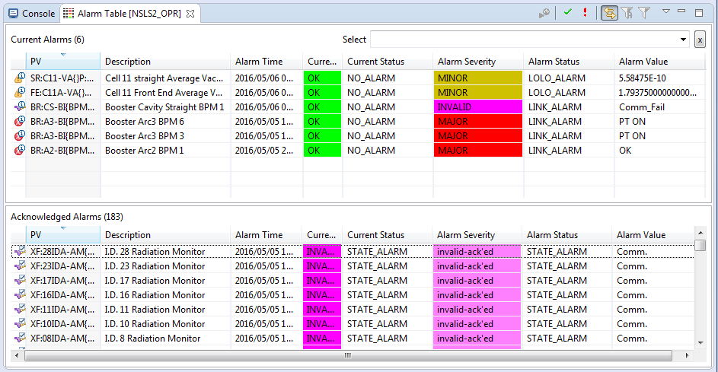
Alarm Table

Slide 18
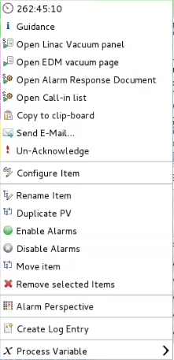
Alarm Context Menu
Alarm information.
Alarm handling instructions and actions.
Alarm configuration tools.

Slide 19
Prerequisite
Motor Simulator
Start the motor simulator:
Open a Terminal window (Press Activities, then Applications, then Terminal),
Then type the following
﻿cd ~/build-epics/motorsim/
./startSimMotor.sh
Don’t close the Terminal window.
On another terminal window start the Alarm server:
systemctl start zookeeper
systemctl start kafka
cd ~/epics-tools/setup/start/
./start_alarm_server.sh

Slide 20
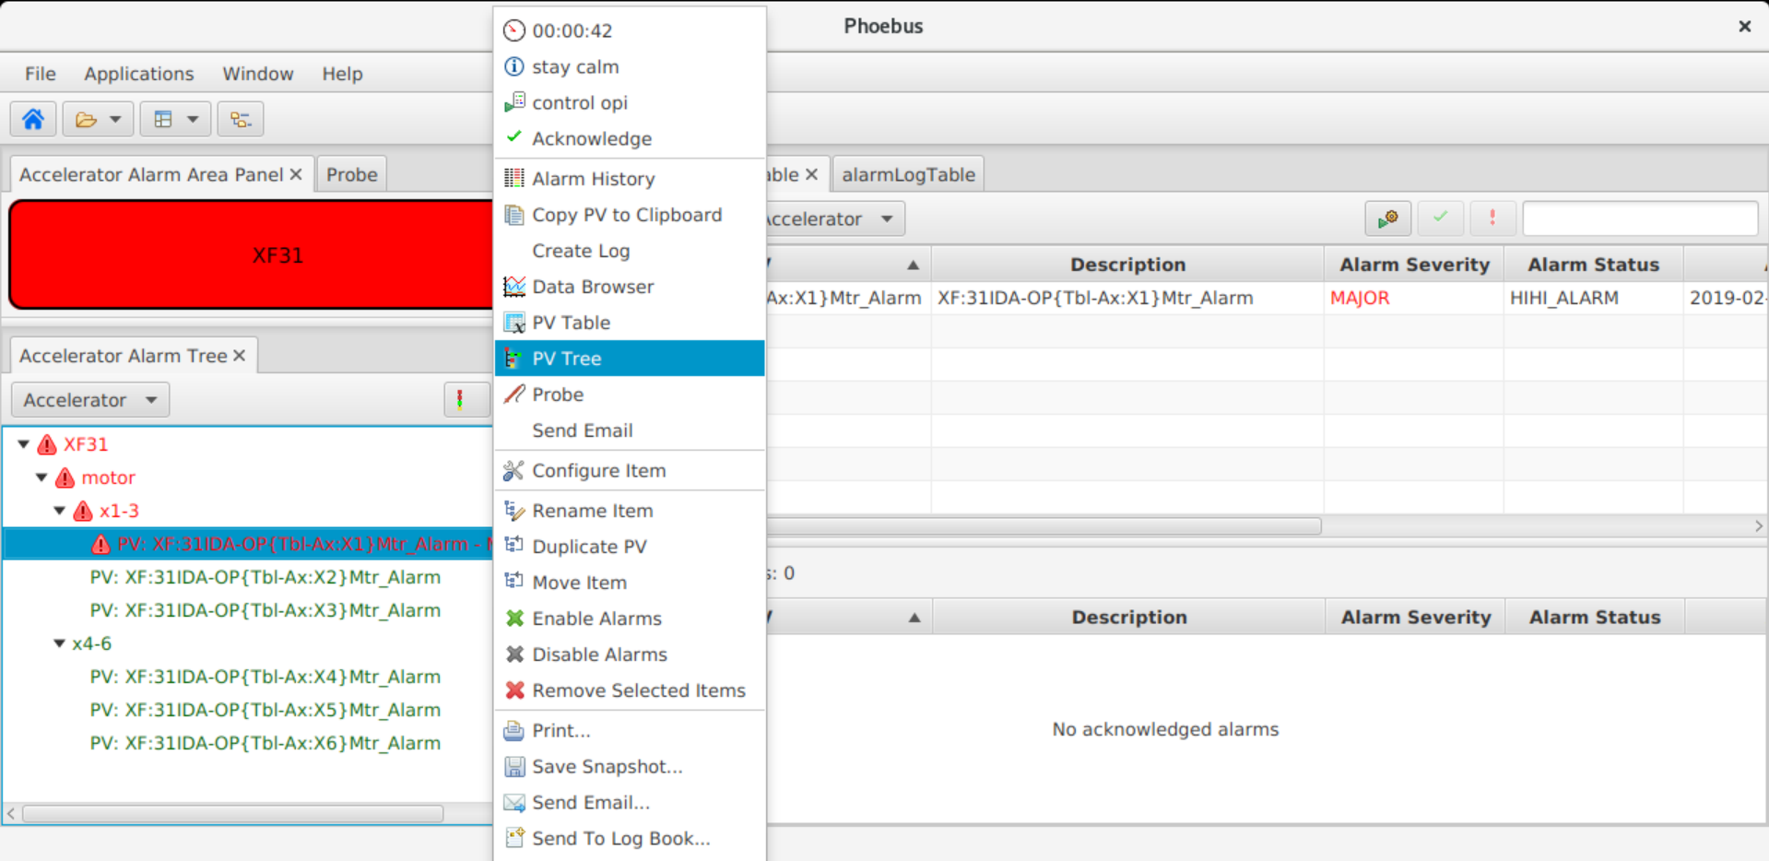
Handling Alarms

Slide 21
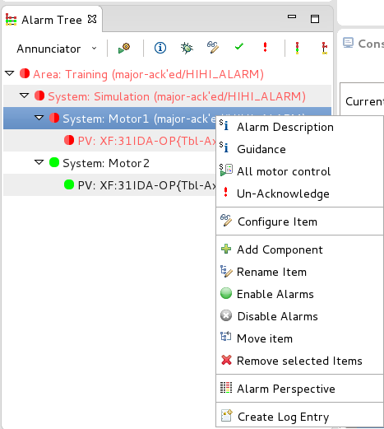
Configuring BEAST
The context menu of the alarm tree provides commands to:
Add/Remove new alarm components;
Reorganize existing components in the alarm hierarchy;
Configure the information and actions associated with alarms.

Slide 22
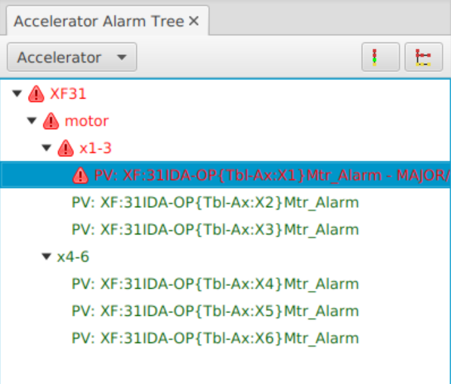
Configuration

Slide 23
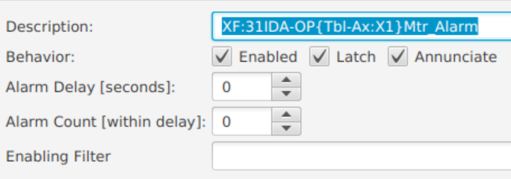
BEAST Configuration Dialog
Other
Alarm Trigger PV Configuration
Alarm Delay & Alarm Count
Wait for alarms that are active for at least the specified delay or occur more than the specified count.
Latch
The highest alarm states are remembered until acknowledged.

Slide 24
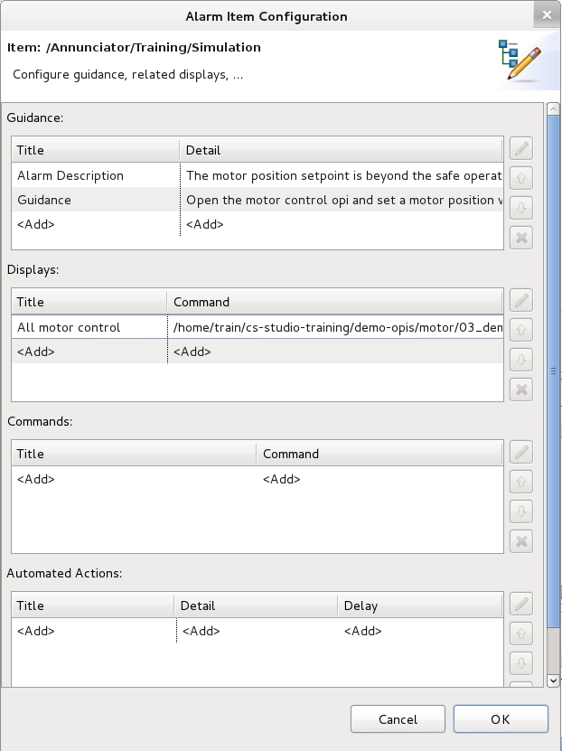
BEAST Configuration Dialog
Guidance
Simple text messages which can be used to:
Describe the alarm condition, including possible causes;
Provide information/instructions on how this alarm should be handled.

Slide 25
BEAST Configuration Dialog
Displays
Links alarms with the related OPI screens:
Allow users to directly open BOY/Data Browsers files without navigation;
Link to .opi, .bob, and .plt files.

Slide 26
BEAST Configuration Dialog
Commands and Actions
Commands:
Allows defining actions which invoke external commands.
Automated Actions:
If alarms persist for a certain time without being acknowledged or cleared and automated notification can be generated.
mailto:
cmd:

Slide 27
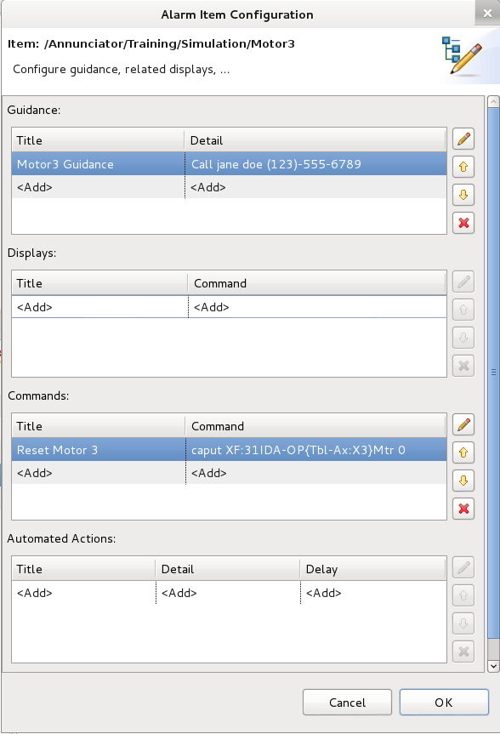
Exercise
Configuring Alarms
Add Guidance/Instructions on how this alarm should be handled.
Add a command that will reset the motor set point:
Title: Reset Motor 5
Command: caput caput XF:31IDA-OP{Tbl-Ax:X5}Mtr 0.0

Slide 28
More Information
Help ▸Applications ▸Alarm

Slide 29
Alarm Logger Service

Slide 30
Alarm
Clients
CS-Studio
…
Alarm micro services
Alarm
Server
Alarm
Configuration
Server
Alarm
Message
Logger
Control
Systems
Channel
Access
IOC
PVA
IOC
…

Slide 31
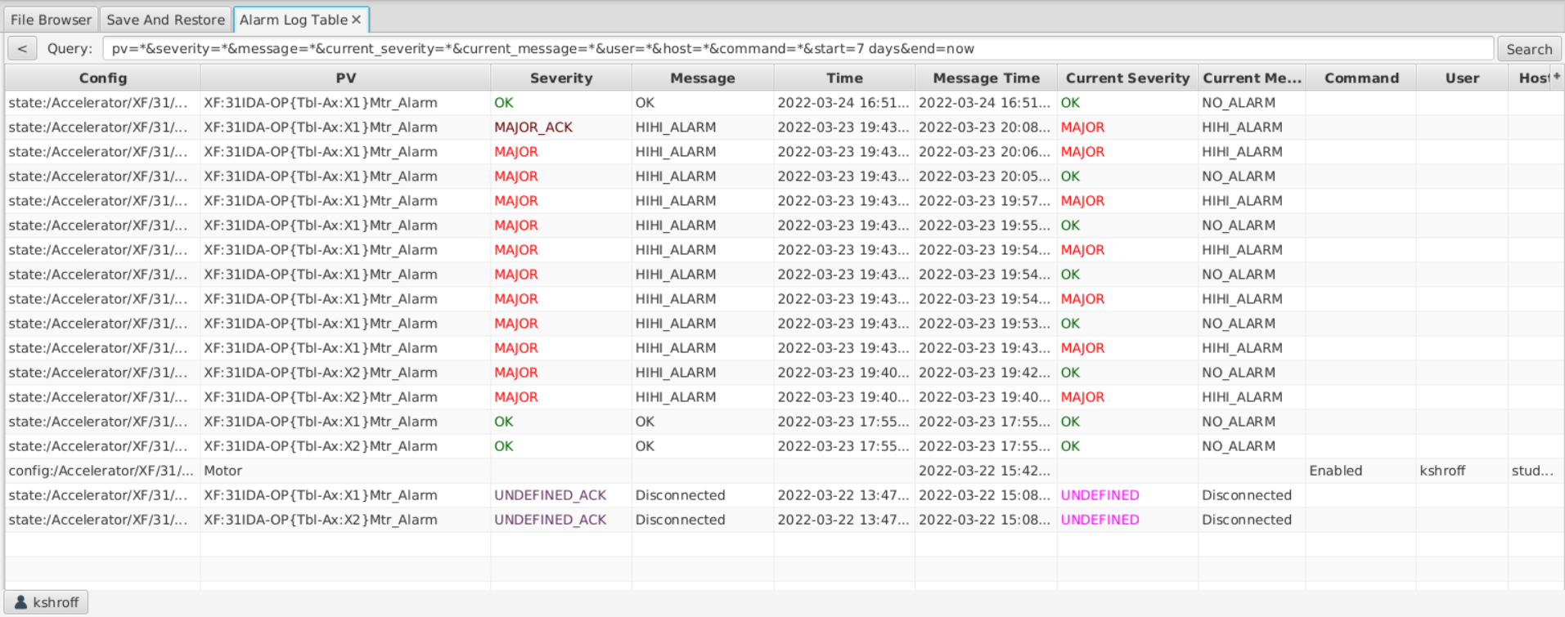
Alarm Message Logger
Phoebus
Motivation
Logs alarm state from the alarm server and other messages to an elastic backend
Build and Run
git https://github.com/shroffk/phoebus.git
cd services/alarm-logger
mvn exec:java
Alarm
Message
Logger

Slide 32
Alarm history log
A table view of alarm history
Alarm events
User actions
Changes to Alarm Configuration

Slide 33
Alarm Message Logger
Notes:
Once you have the logging service up and running, the messages in the elastic backend can then be consumed through kibana
Kibana is a web tool to help visualize the data from the elastic server
This first slide shows the raw text log in time series of all alarm messages
Can zoom in on some of this data to understand what was happening
This shows a burst of 800 messages – so we can look at the events here to understand what is going on.

Slide 34
Alarm Message Logger
Notes:
For this time selected, we can get statstics on which PVs are triggering most of the laarm events. 2 PVs in this case responsible for 80% of alarms

Slide 35
Alarm Message Logger
Notes:
Same data from previous slide visualized in a bar graph – the alarm configuration should be revisited for these 3 noisy PVs and reassessed.

Slide 36
Alarm Configuration Service

Slide 37
Alarm
Clients
CS-Studio
…
Alarm micro services
Alarm
Server
Alarm
Configuration
Server
Alarm
Message
Logger
Control
Systems
Channel
Access
IOC
PVA
IOC
…

Slide 38
Alarm Configuration Service
Alarm Configuration Messages
Motivation
Log the configuration changes made to the alarm server configuration
Build and Run
git https://github.com/shroffk/phoebus.git
cd services/alarm-config-logger
mvn exec:java
Alarm
Configuration
Server
Subscribe,
Filter,
Timestamp,
Process

Slide 39
Alarm Configuration Tree
Notes:
Mapping of the alarm tree to the file structure

Slide 40
Configuration History

Slide 41
Configuration events

Slide 42
Configuration events

Slide 43
Restore Scripts
Each alarm configuration change results in the creation or an update to the config.xml file.
The config.xml can be directly imported into the alarm server to restore it to the alarm configuration to that instant.

Slide 44
Thank You for Your Attention
Any Questions? Just Ask!

