Slide 1
Save Restore
Kunal Shroff, Kay Kasemir, Georg Weiss and many other

Slide 2
Motivation and Objectives
To provide users to take a snapshot of your current machine state, and to allow users to restore it back to this state anytime in the future.

Slide 3
Save Restore
Core features
Allows for the creation of user defined collection of PV’s across multiple IOCs called configurations
Save machine state for given configuration, i.e. create snapshot
Restore machine state back to snapshot point
Composite snapshots aggregate existing snapshots, facilitates restore operations
Snapshots and composite snapshots can be tagged to facilitate search.
Search tool: find configurations and snapshots based on meta-data (name, date, contained PV name, tags…)
Filtering: search criteria can be saved as a filter and applied in the UI to highlight matching snapshots or configurations
Authentication and authorization: protects data and restricts access to restore operations

Slide 4
Save Restore
Similar, but different purpose tools
Autosave
Single IOC bumpless rebooting
Archiver
Archive periodically
Save time serially data

Slide 5
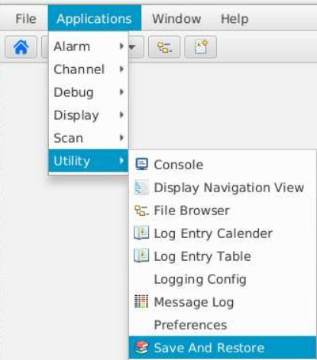
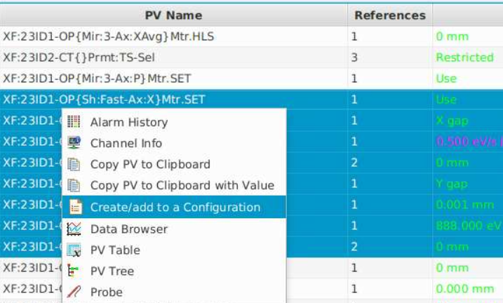
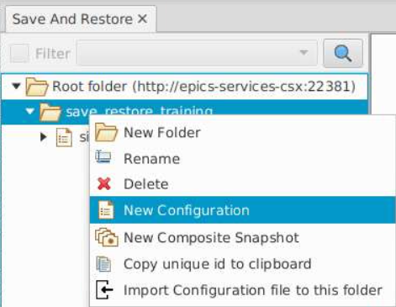
Create a Save Restore Configuration
New configuration can be created using
The Save and Restore App
Context menu in Channel Table

Slide 6
Create a Save Restore Configuration
Name and description (mandatory)
List of PVs (set point PVs)
List of Readback PVs (optional)
Read only flag

Slide 7
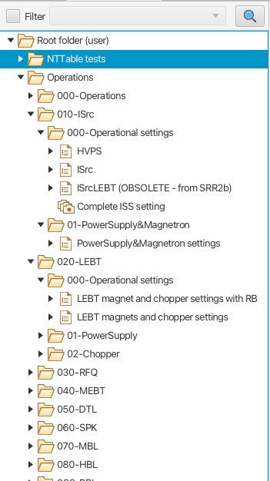
Create a Save Restore Configuration
Organize your Save Restore Configuration
Save Restore Configurations can be organized in a tree structure
“Folders” is an abstraction to support a fine-grained hierarchy

Slide 8
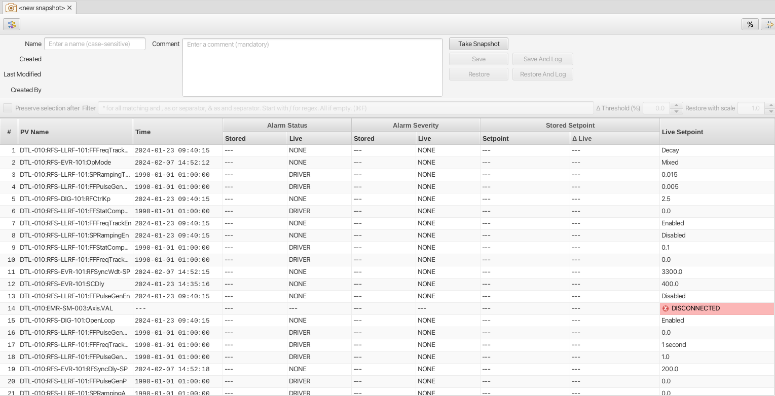
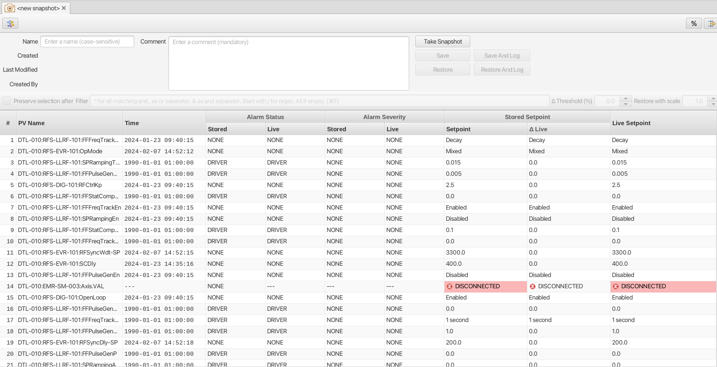
Take a Snapshot
Before clicking “Take Snapshot”
Read PVs, i.e. interact with IOCs
After clicking “Take Snapshot”

Slide 9
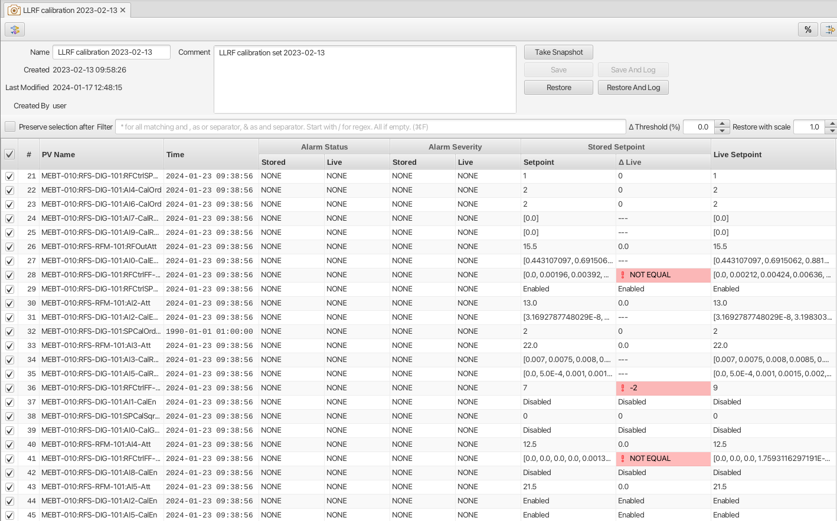
Compare snapshot values to live values

Slide 10
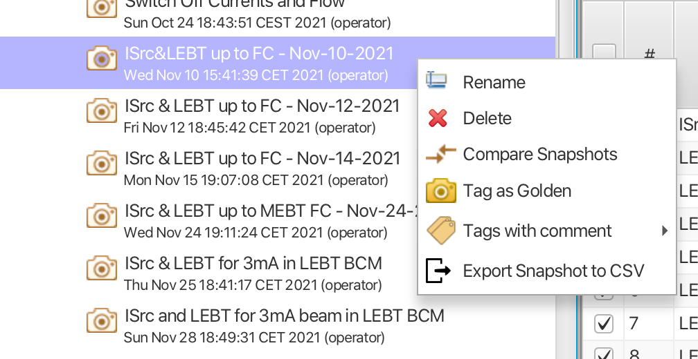
Manage your Snapshots
Tag “Golden”
Tag with some comment
Rename
Delete
Export to CSV

Slide 11
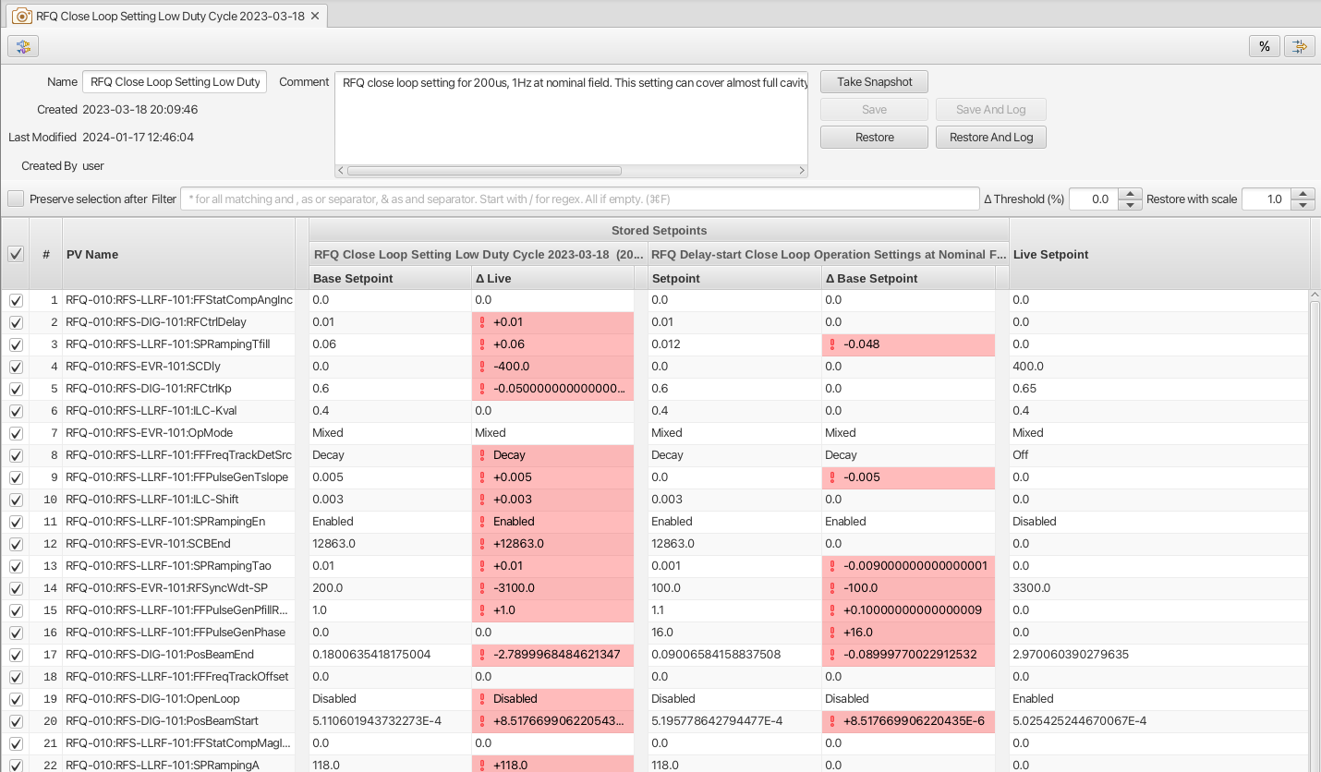
Restore a Snapshot

Slide 12
Composite Snapshots
Created using drag-n-drop
Restore view same as single snasphot restoreview

Slide 13
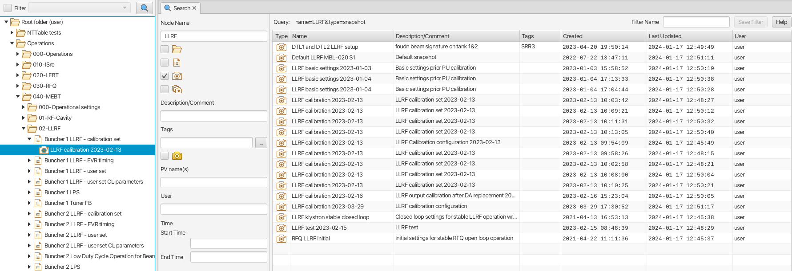
Search for saved objects
Search for snapshots
Search based on name, comment, tags, date or PV name(s)

Slide 14
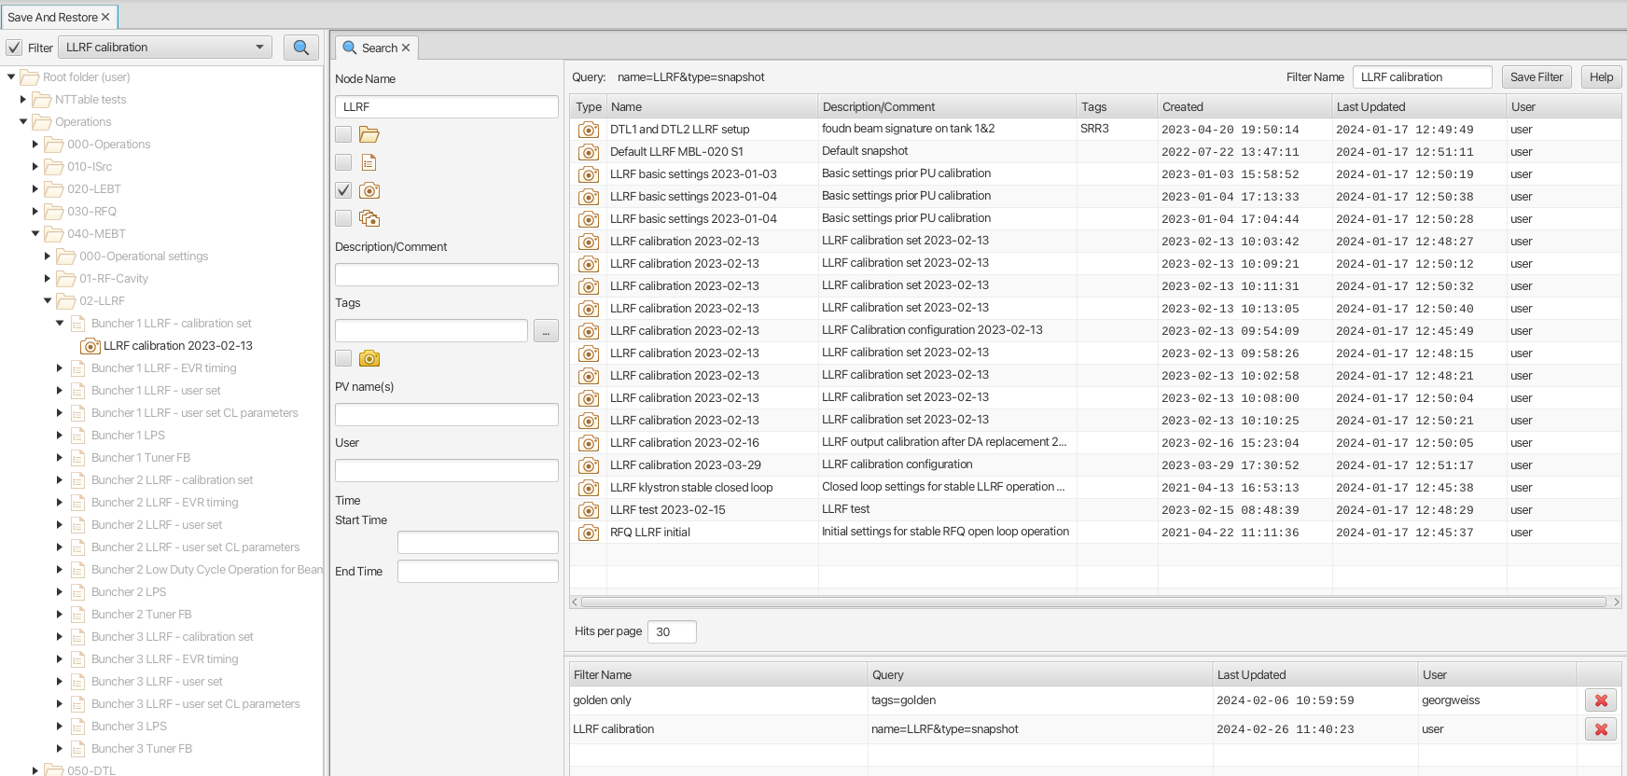
Create and use filters
Search criteria as filters
Matching items ”highlighted”

Slide 15
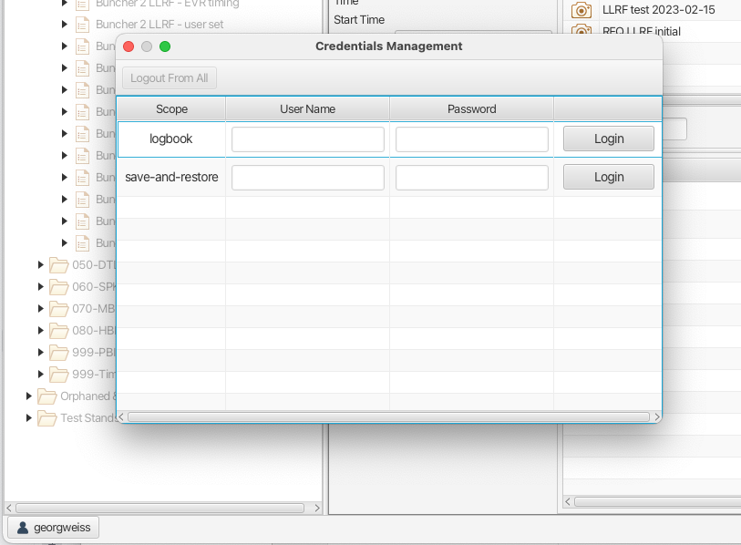
Authentication and Authorization
Protects data and operations
Unauthenticated users can browse data
Authenticated users can invoke restore operation
Authorized users (level 1) can create/delete/modify configurations and snapshots, and add tags (except “golden”)
Delete/modify only on objects with matching user id
Authorized users (level 2): no restrictions
Sign-in using Credentials Manager
NOTE: authentication is mandatory, authorization is optional (default off).

Slide 16
Authentication and Authorization
User authroization/authentication (AA) on service
Supported AA providers:
Simple, hard coded on server side in properties file. Primarily for testing/development purposes.
Embedded LDAP. Uses ldif file on service Ldif updates requires restart.
Open LDAP.
Active Directory.

Slide 17
Save Restore Architecture
Other REST client
Save & Restore Client (Phoebus)
Other REST client
Save & Restore Service (Spring Boot)
REST

Slide 18
Save Restore Exercise
Create a Save Restore Configuration of all the motor position setpoints

Slide 19
Documentation
Save Restore Service Documentation and API
https://control-system-studio.readthedocs.io/en/latest/services/save-and-restore/doc/index.html
Save Restore Client
https://control-system-studio.readthedocs.io/en/latest/app/save-and-restore/app/doc/index.html

Slide 20
Thank You for Your Attention
Any Questions? Just Ask!

