Slide 1
Channel Finder
A Directory Service
Kunal Shroff, Kay Kasemir, Georg Weiss and many other

Slide 2
Motivation and Objectives
A flat name space restricts seriously:
Clients need to know all channel names beforehand,
Portable generic clients must be simple,
Apps need full configuration or framework supplied service,
Develop a Directory Service
Generic
No dependency on installation and local conventions;
Simple and fast (enough)
Use standards wherever possible;
Provides “query-by-functionality”.

Slide 3
Channel Finder – Developer View

Slide 4
Channel Finder Data
Simple directory service consisting of a set of Channels (unique PV names).
Each Channel has an arbitrary number of Properties (name/value pairs) and Tags (names).
Each Channel, Property, or Tag has an Owner (group) to allow basic access control.
All names and values are strings.

Slide 5
Channel Definition Example
"name": "XF:31IDA-OP{Tbl-Ax:X1}Mtr",
"owner": "train",
"properties": [
"handle":"Setpoint“,
"axis":"1",
"hostname":"training.org.epics",
"iocName":"motorsim",
"time":"2016-03-21”
]
"tags": ["motor", "sys.XF:31"]

Slide 6
Query Example
All PVs from the insertion device 31: XF:31*IDA*
All PVs from the insertion device 31 belonging to axis 4: XF:31*IDA*&axis=4*
All PVs from the insertion device 31 belonging to axis 4 and with pvStatus active: XF:31*IDA*&axis=4*&pvStatus=active
All PVs from the insertion device 31 belonging to axis 4 with tag sys.XF:31: XF:31*IDA*&axis=4*&~tag=aphla.sys.SR

Slide 7
Example Data Set
Device FM1G4C02A
Channel Name | SR:C02-MG:G04A{HFCor:FM1} |  | SR:C02-MG:G04A{VFCor:FM1}
 | Fld-I | Fld-SP | Fld-I | Fld-SP
handle | READBACK | SETPOINT | READBACK | SETPOINT
elemName | FXM1G4C02A |  | FYM1G4C02A
elemType | HFCOR |  | VFCOR
elemField | x |  | y
devName | FM1G4C02A
sEnd | 65.5222
cell | C02
girder | G4
symmetry | A
length | 0.44
ordinal | 263 |  | 264
tags | eget | eput | eget | eput
 | x |  | y
 | sys.SR

Slide 8
Example Data Set
Device FM1G4C02A
Channel Name | SR:C02-MG:G04A{HFCor:FM1} |  | SR:C02-MG:G04A{VFCor:FM1}
 | Fld-I | Fld-SP | Fld-I | Fld-SP
hostName | ps-psioc-c02.cs.nsls2.local
iocName | ps-C02A
updateTime | 2015-03-13
active | True
Tags | archive

Slide 9
Usage from high level physics
Example*
corrector = Corrector(deviceName=`FM1G4C02A`)
>> channels = cf.find(deviceName=‘FM1G4CO2A’)
xPos, yPos = corrector.getPositions()
>> xPosPv = cf.find([(deviceName,‘FM1G4CO2A’), (elemField, ‘x’)])
>> yPosPv = cf.find([(deviceName,‘FM1G4CO2A’), (elemField, ‘y’)])
>> caget(xPosPv ) and caget(yPosPv )
corrector.setPositions(xPos=1.23, yPos=3.21)
>> caput(‘SR:C02-MG:G04A{HFCor:FM1} Fld-SP’, 1.23)
>> caput(‘SR:C02-MG:G04A{VFCor:FM1} Fld-SP’, 3.21)
Notes:
High level applications (HLA) deals with thousands of magnets, instruments and more channels.
Organized/structured channel information is necessary.
Channels linked to accelerator lattice and diagnostics are even better.
Searching instead of remembering is easier for HLA users.

Slide 10
Populating Channel Finder with Rescyn

Slide 11
Recsync : cfStore
How to add new channels
Without having to learn the client api's
How to manage existing channels
Orphaned channels
Moved channels

Slide 12
Recsync : cfStore
The record synchronizer
A client (RecCaster) which running as part of an EPICS IOC (EPICS support module)
A server (RecCeiver) which is a stand alone daemon.
Together they work to ensure the the server(s) have a complete list of all records currently provided by the client IOCs.
Recsync Information
The EPICS Base Version
A white listed set of environment variables
The name and type of all records
Any info() tags associated with these records
https://github.com/ChannelFinder/recsync

Slide 13
Recsync : cfStore
The properties currently managed with cfStore
hostName
iocName
pvStatus : Active or InActive
time : The last time the above properties were updated

Slide 14
Recsync : cfStore
1) Modify configure/RELEASE. This file is a good place to check what modules an IOC supports. Just copy-paste somewhere before the EPICS_BASE variable declaration:
RECCASTER=$(EPICS_BASE)
2) Install the standard status database for the IOC by adjusting the <iocname>App/Db/Makefile. Just copy-paste:
DB_INSTALLS += $(RECCASTER)/db/reccaster.db
3) Add .dbd and library support by adjusting the <iocname>App/src/Makefile. Make sure to put a correct <target>:
<target>_DBD += reccaster.dbd <target>_LIBS += reccaster
4) 'make clean && make' the <iocname>App folder to rebuild the binary.
5) For each IOC using the binary, in st.cmd add the database support. Note that path to the .db file changes depending on how the IOC was deployed. The .db file itself was generated thanks to steps 1 and 2.
dbLoadRecords("<path-to-db-installs>/db/reccaster.db", "P=<system>{IOC:<iocname>}RecSync")
6) Restart the IOC for changes to become effective.
Using "P=<system>{IOC:<iocname>}RecSync" as prefix follows the same convention that is used for iocstats.

Slide 15
Channel Finder integration in CS-Studio

Slide 16
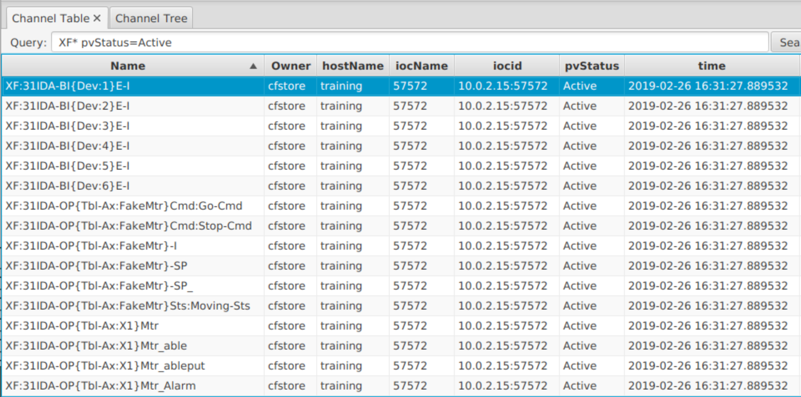
Channel Viewer
Applications ▸ Channel ▸Channel Table

Slide 17
Channel Viewer
Channel Viewer displays in a table the channel found according a given query string.
Queries can be constructed for the Name, Property values, and Tags associated with channels.
Wildcard character like "*", "?" can be used in the queries.
prop=v1||v2 equivalent to prop=v1 OR prop=v2
prop=v1 tag=t1 equivalent to prop=v1 AND tag=t1

Slide 18
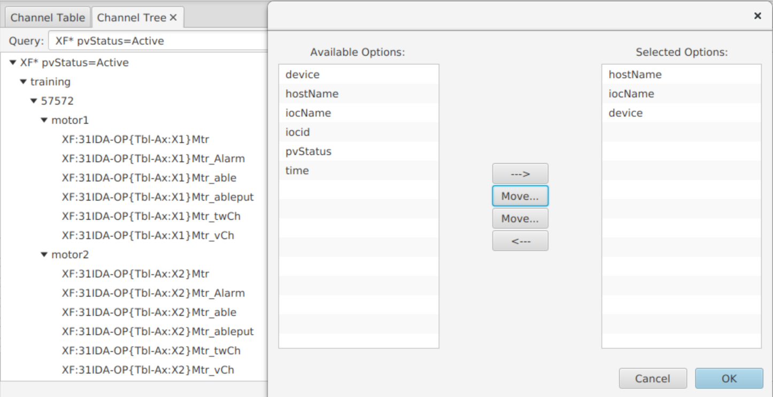
Channel Viewer
Applications ▸ Channel ▸Channel Tree

Slide 19
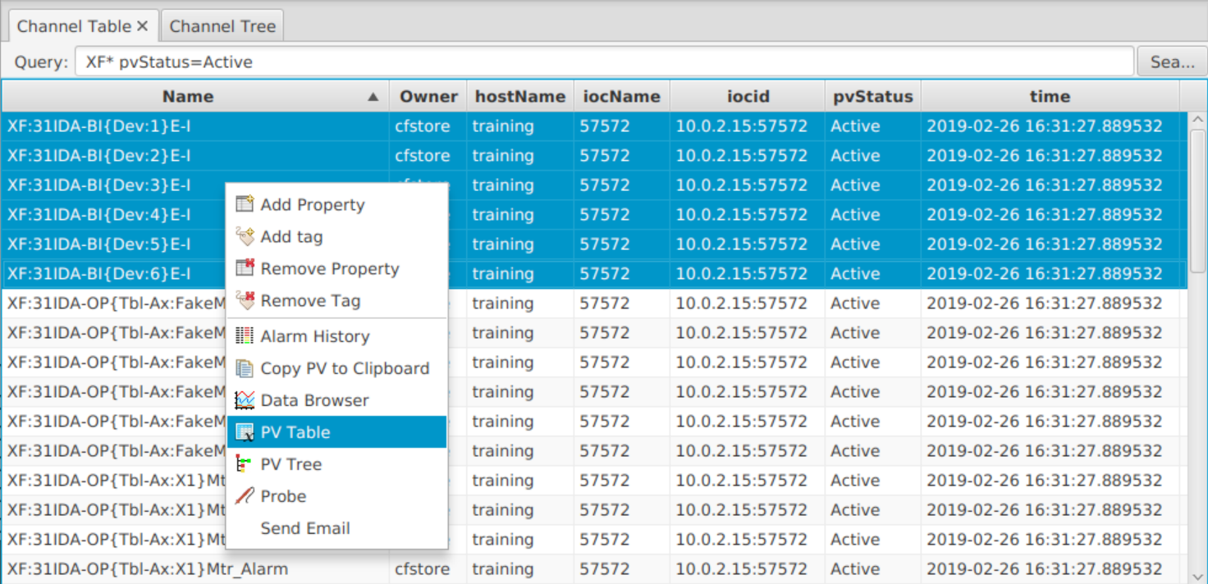
Channel Viewer
Channels can be forwarded to other CS-Studio applications.

Slide 20
Channel Viewer

Slide 21
Channel Viewer
Editing
Add a tag/property to a channel or a group of channels.
Remove a tag/property from a channel or a group of channels.

Slide 22
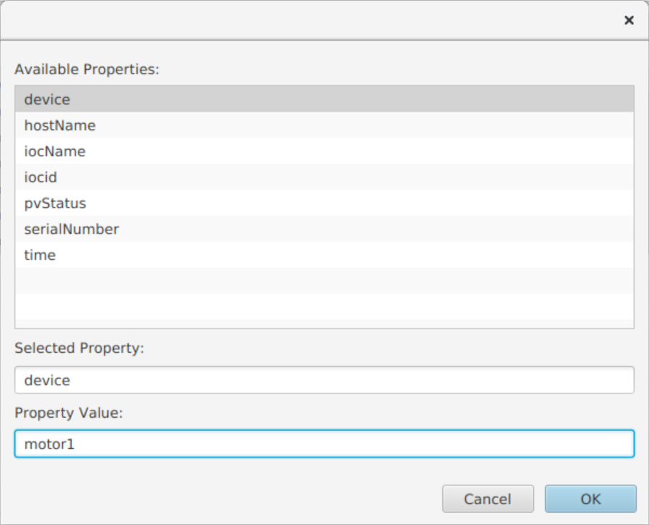
Channel Viewer
Editing
Add a tag/property to a channel or a group of channels.
Remove a tag/property from a channel or a group of channels.

Slide 23
Channel Viewer
Editing Exercise #1
Query *X6*Mtr to select all the channels for associated with motor 6.
Select all PV’s, right-click and choose Channel ▸Add Property
Add property device with value motor6

Slide 24
Channel Tree
CS-Studio ▸Display ▸Channel Tree by Property
Channel Tree allows to create an hierarchical view of the channels by using properties and their values.

Slide 25
Channel Viewer
Applications ▸ Channel ▸Channel Tree Channel Tree creates an hierarchical view of channels using properties and their values.

Slide 26
Auto-complete
The phoebus autocomplete service queries channelfinder to populate the autocomplete list for PV Names

Slide 27
Channel Finder with Infrastructure

Slide 28
ChannelFinder Infrastructure
ChannelFinderService is built using GlassFish, which is the source of the issues
GlassFish Version in use has reached its end of life
The GlassFish server is hard to maintain
Keeping the GlassFish server running requires a large amount of memory and CPU
GlassFish is hard to learn, understand, and use
While useful for heavier applications, GlassFish is not well suited to the needs of ChannelFinder
GlassFish is a full Java EE server which includes EJB, JMS, JTA, etc

Slide 29
SpringBoot
SpringBoot is an extension of the Spring Framework (application framework for Java) that simplifies the process of creating a java application or webservice
For ChannelFinder service
Embedded http server
A pluggable Authentication and Authorization framework
A modular testing framework
A well defined and configurable application startup and initialization

Slide 30
ChannelFinder-SpringBoot: Installation
ChannelFinderService
Install GlassFish (v 3.1.2)
Install elastic search
Create elastic indices and set up mapping
Create and configure Glassfish authentication realms. One of 3 auth options, if choice is LDAP then:
Install LDAP server
Create the LDAP realm
Create the LDAP connection
Deploy Application
For Testing:
Load and configure trust stores to use rest clients for SSL connections
Clone the separate python testing repo
ChannelFinder-SpringBoot
Install elastic search
Create elastic indices and set up mapping
Start ChannelFinder service

Slide 31
ChannelFinder-SpringBoot: Installation
ChannelFinderService
Installation configuration:
Configuration is split between ChannelFinder properties files, GlassFish domain.xml files, GlassFish config.xml files, & some java system variables
Testing configuration:
No effective way to create a separate testing configuration
ChannelFinder-SpringBoot
Installation configuration:
All configuration in a single applications.properties file
Testing configuration:
The tests can be configured to use a separate test_applications.properties file

Slide 32
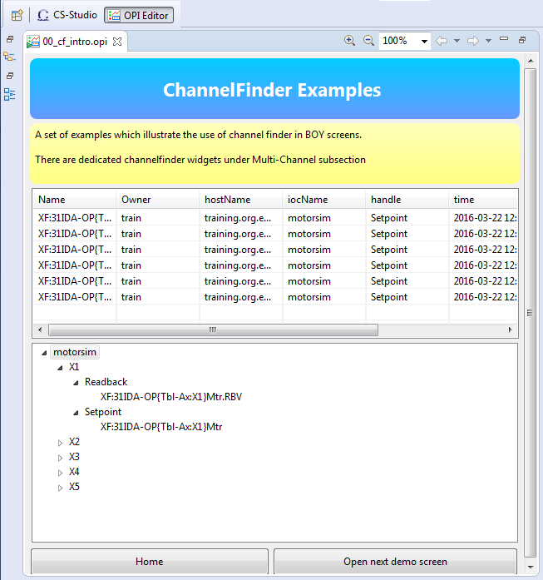
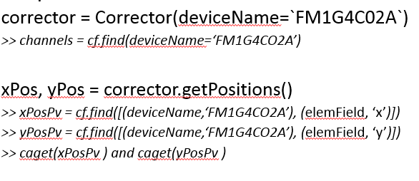
CS-Studio
Python hla modules
https://github.com/ChannelFinder/hla
CS-Studio Clients
Python Clients
Clients
Java client library
Python client library
https://github.com/ChannelFinder/pyCFClient
https://github.com/ChannelFinder/javaCFClient
Servers
ChannelFinder
(REST)
pvaChannelFinder
(pvaccess)
Recsync (cfstore)
IOC’s
epics recsync
IOC’s
epics recsync
https://github.com/ChannelFinder/ChannelFinderService
https://github.com/ChannelFinder/pvaChannelFinder
ElasticSearch
Automatic population
https://github.com/ChannelFinder/recsync
Notes:
https://github.com/ChannelFinder/ChannelFinderService
https://github.com/ChannelFinder/pvaChannelFinder
https://github.com/ChannelFinder/javaCFClient
https://github.com/ChannelFinder/pyCFClient
https://github.com/ChannelFinder/recsync
https://github.com/ChannelFinder/hla

Slide 33
Embedded pvaChannelFinder
A EPICS7 RPC service
Request is a NTURI
name, tag, or property value
* & % wildcard chars
Result is a NTTable
List of all the matching channels and their associated properties and tags

Slide 34
ChannelFinder-SpringBoot
https://github.com/ChannelFinder/ChannelFinder-SpringBoot
ChannelFinder-SpringBoot has all the functionality of ChannelFinderService and a few additional features

Slide 35
Performance Environment
Database
1500k channels
40 properties
60 tags
Queries
Search using wildcards for channel names and property values
Result Size
Each channel is 1127 bytes

Slide 36
CF v3: performance

Slide 37
CF v3: performance

Slide 38
Roadmap

Slide 39
CFNameServer

Slide 40
Populating ChannelFinder with Connection data
ChannelFinder Clients
clients
CFNameserver Clients
Phoebus
CFNameServer
Clients
aphla
Alarm Server
https://github.com/epics-base/epics-base/pull/269
EPICS 7.0.7 the TCP port used by RSRV was exposed as an environment variable RSRV_SERVER_PORT
RecCaster provides both host IP & RSRV port
RecCeiver populates ChannelFinder with the PV name and properties containing the IP and port info
java
Phoebus
Archiver Appliance
python
CFNameServer
REST API
ChannelFinder
Server
RecCeiver
RecCaster
IOC’s
RecCaster

Slide 41
Populating ChannelFinder with Connection data
ChannelFinder Clients
clients
CFNameserver Clients
Phoebus
CFNameServer
Clients
aphla
Alarm Server
Example data populated by the receiver in ChannelFinder
{
"name": "tst:counter",
"properties": [
{
"name": "socket_address",
"value": "130.199.219.181:5078"
}
]
}
java
Phoebus
Archiver Appliance
python
CFNameServer
REST API
ChannelFinder
Server
RecCeiver
RecCaster
IOC’s
RecCaster

Slide 42
Name Resolution using ChannelFinder data
ChannelFinder Clients
clients
CFNameserver Clients
Phoebus
CFNameServer
Clients
aphla
Alarm Server
A PVAccess Nameserver using ChannelFinder service
Upon receipt of a name resolution request, CFNameServer queries the ChannelFinder service for information about the host IP and port associated with the PV GET http://ChannelFinder/../channels/tst:cnt
Using the "socket_address" property value, CFNameserver responds to the PV name resolution requests with information about the IOC IP port
java
Phoebus
Archiver Appliance
python
CFNameServer
REST API
ChannelFinder
Server
RecCeiver
RecCaster
IOC’s
RecCaster

Slide 43
Client to CFNameServer
ChannelFinder Clients
clients
CFNameserver Clients
Phoebus
CFNameServer
Clients
aphla
Alarm Server
core-pva
pvxs
Client using the above libraries can be configure via an environment variable to use the CFNameServer
EPICS_PVA_NAME_SERVERS=CFNameServer.nsls2.bnl.gov:5076
pvget/pvmonitor/pvput tst:cnt
java
Phoebus
Archiver Appliance
python
CFNameServer
REST API
ChannelFinder
Server
RecCeiver
RecCaster
IOC’s
RecCaster

Slide 44
Performance Environment
Embed a name server into the channelfinder service

Slide 45
More Information
Help ▸ Help Contents
Applications ▸ Channel ▸ Channel Viewer
Applications ▸ Channel ▸ Channel Tree by Property

Slide 46
Thank You for Your Attention
Any Questions? Just Ask!

