Slide 1
Phoebus Olog
Kunal Shroff – NSLS2
Georg Weiss – ESS

Slide 2
Olog?
Digital logbook, no more, no less.

Slide 3
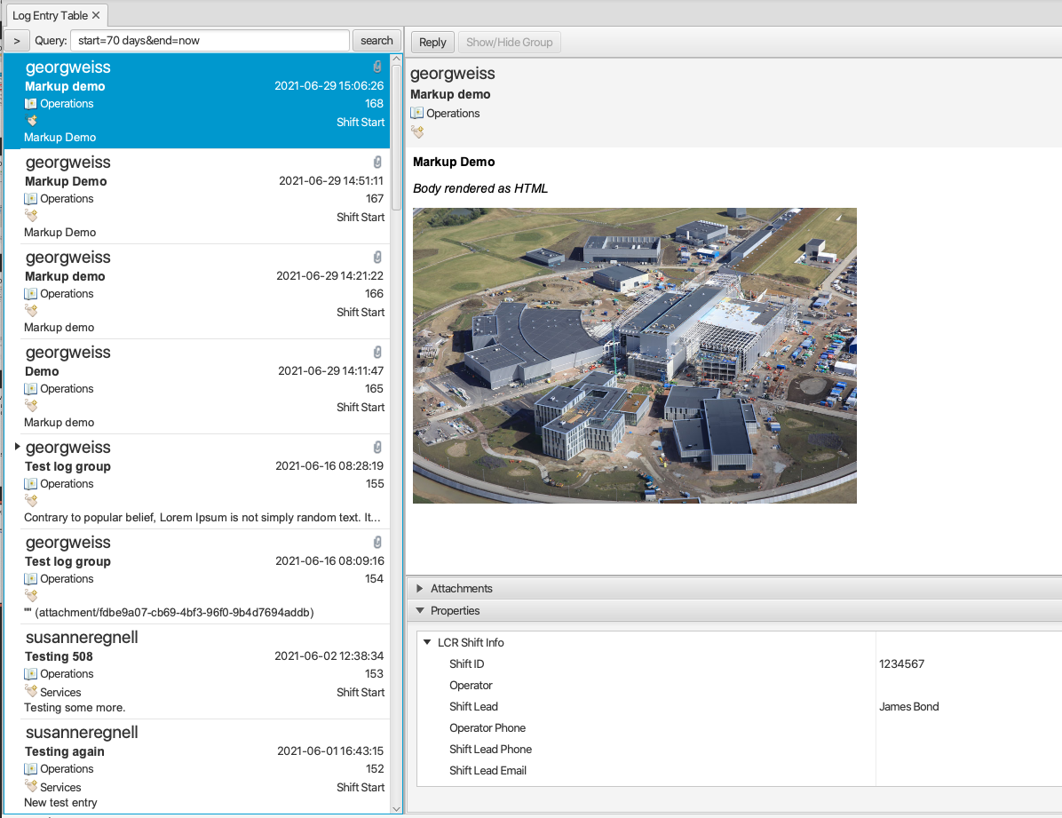
Olog?
Digital logbook
Create log entries
Meta-data
Attachments
Search
Authentication
Integrated in CS Studio (Phoebus)
Different clients for different users and workflows
Creating log entries programmatically
Notes:
Motivation

Slide 4
Driving factors
“Legacy” Olog in production at NSLS2 (Brookhaven) for about 10 years
Integrated in “legacy” CS Studio (Eclipse)
Used in the control room and beamlines
Client in CS Studio and stand-alone web client
Difficult to maintain, does not scale well
Elog used at ESS ~5 years
Feature rich
Difficult to customize and maintain
Very difficult to integrate with CS Studio
Joint effort to create up-to-date logbook: Phoebus Olog
NSLS2, ESS, Argonne

Slide 5
Creating a Log Entry

Slide 6
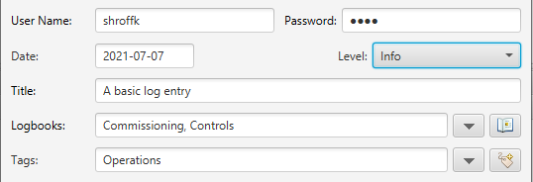
Creating a Log Entry
Basic components
Authentication Info
Title
Level
Logbooks
Tags
Notes:
Title, Logbook, Tags

Slide 7
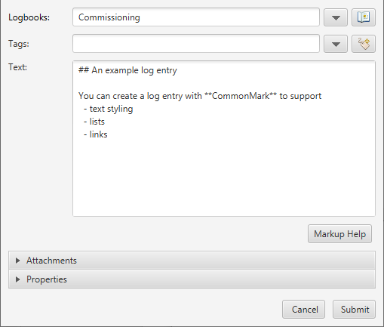
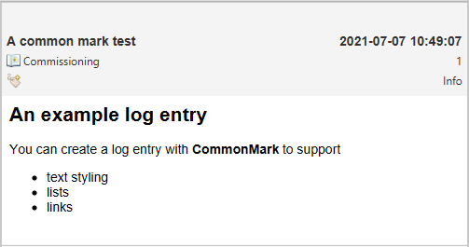
Creating a Log Entry
Phoebus Olog supports markup
Commonmark (https://commonmark.org/)
Well defined and maintained spec
Basic text styling (heading, bold, italic)
Lists
URLs
Images
Block quotes
Extensions: image resize and tables
Widely used (GitHub)
Implementation available for various languages
java
js
python
Notes:
Body
A strongly defined, highly compatible specification of Markdown

Slide 8
Creating a Log Entry
Embedded Images in the log entry body

Slide 9
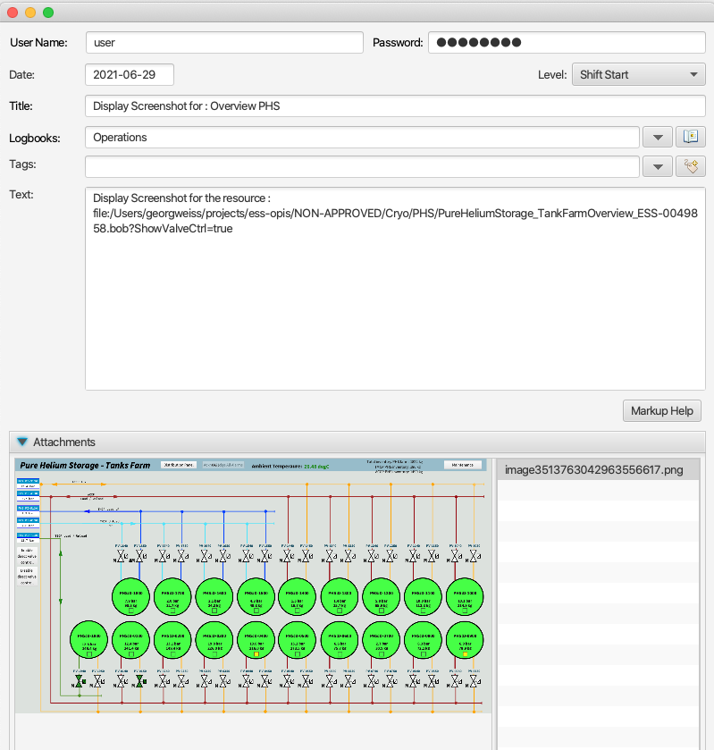
Creating a Log Entry
Display Builder Context Menu
Includes
screenshot
complete resource URI ( with macros )
Notes:
Olog Client Phoebus

Slide 10
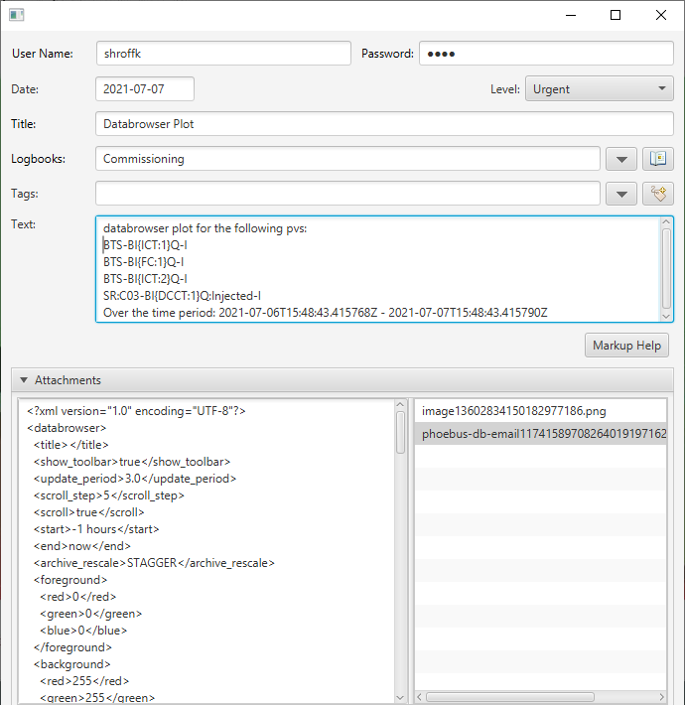
Creating a Log Entry
Databrowser Context Menu
Includes
screenshot
databrowser plot properties
List of pv’s
Time span
.plt file
Notes:
Olog Client Phoebus

Slide 11
Log entry properties
A property is a named list of key value pairs
E.g. Experimental Scan Parameters
Useful for integration with other services
e.g. Shift Service, Issue Tracking, Component Directory…
LogPropertyProvider
Programmatically include properties when creating log entries using java SPI
Notes:
Properties

Slide 12
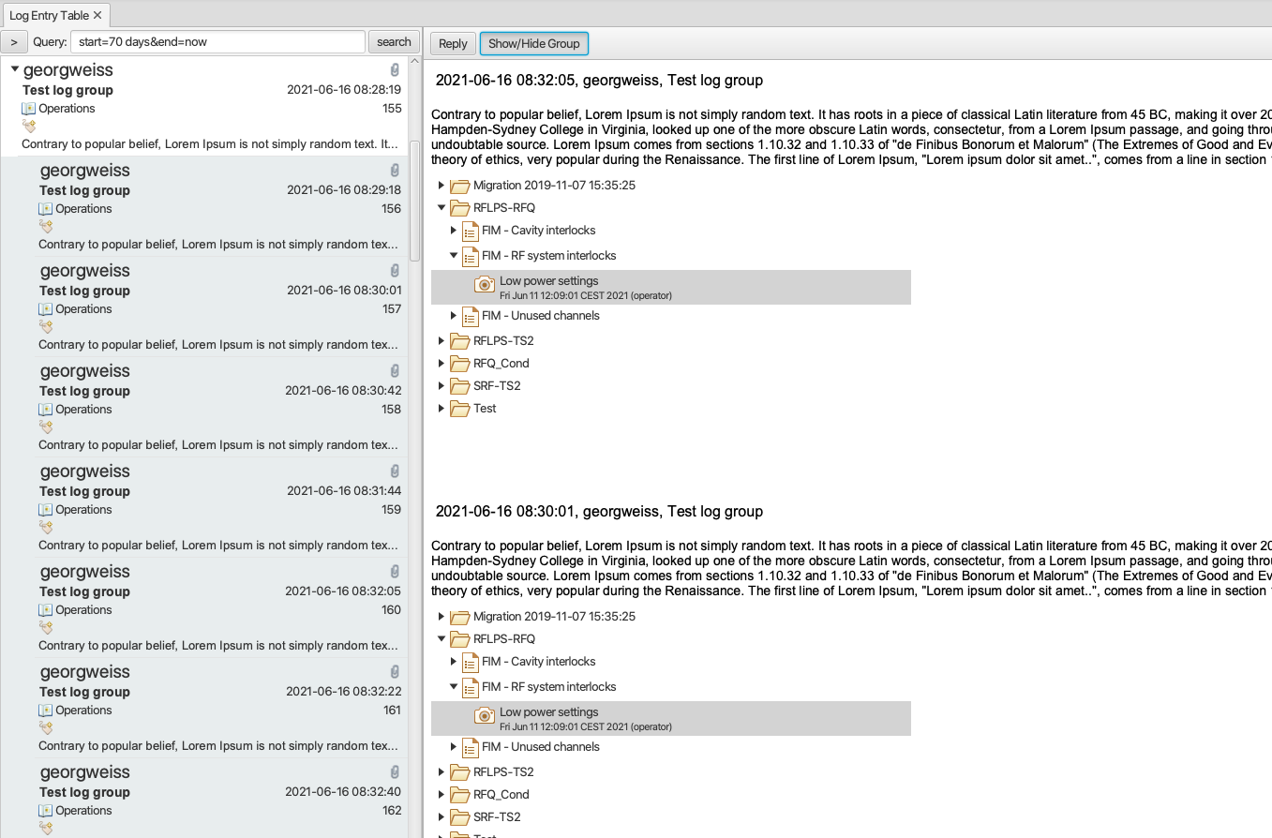
Grouping Log Entries
Users may create a group of log entries (a “thread”).
Explicitly by selecting a number of entries.
Implicitly by “replying” to an entry.
Log entry +
replies

Slide 13
Viewing Log Entries

Slide 14
Searching
Basic Search
Time
Owner (=user account)
Logbooks, Tags, and Properties
e.g. desc=*&logbooks=Operations&start=7 days&end=now
Natural Language Searching: handles typos & spelling mistakes
https://olog.readthedocs.io/en/latest/#searching-for-log-entries

Slide 15
Web client
React-based JavaScript client: https://github.com/Olog/phoebus-olog-web-client
Notes:
React is a free and open-source front-end JavaScript library for building user interfaces or UI components. It is maintained by Facebook and a community of individual developers and companies.

Slide 16
Phoebus client
Similar Look and Feel
Work in progress:
Launch attached .plt, .opi, .bob files
Notes:
Olog Viewer Phoebus

Slide 17
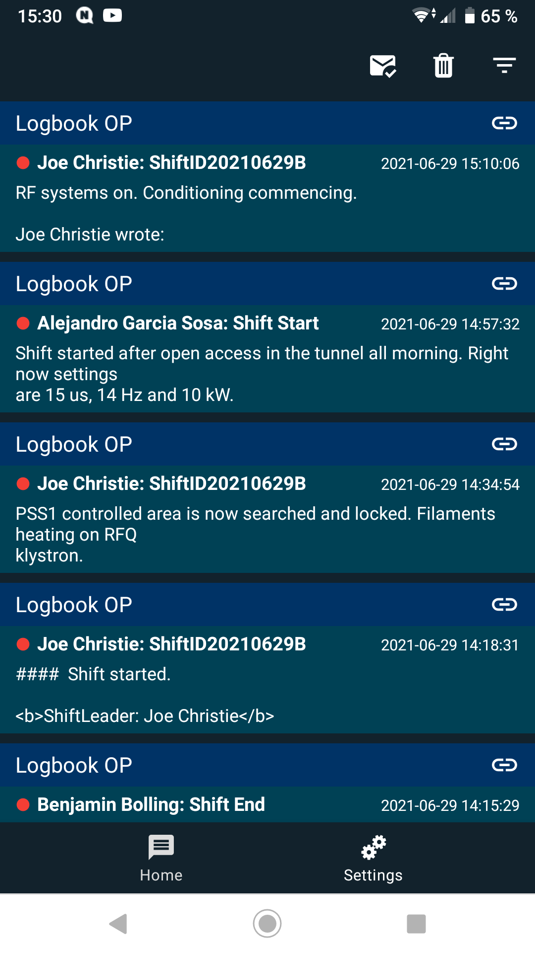
Notifiers
LogEntryNotifier public interface LogEntryNotifier {
void notify(Log logEntry);
}
Interface for notifying when a new log record has been created.
Implementations should register through the regular Java SPI.
Example: Kafka Integration (at ESS)
Consists of a Kafka producer which publishes a message when a new log entry is created.
https://github.com/Olog/phoebus-olog-modules
Notes:
Notification client1

Slide 18
ESS Notify clients
IOS
https://gitlab.esss.lu.se/ics-software/ess-notify
App not approved by Apple, must be provisioned over device management.
Android
https://gitlab.esss.lu.se/ics-software/ess-notify-android
App available on Google Play.
See also paper “Notifications with Native Mobile Applications” (THPV011).

Slide 19
Under the hood

Slide 20
Phoebus Olog Architecture
Phoebus
Web client
Other
NoSQL backend
Simple
NoSQL backend are easy to maintain
Flexible schema
Scalability & Reliability
Horizontal scaling
Easy to set up clusters
Easy to set up replication in Elastic
Spring Boot
Open source Java-based framework used to create a Micro Service
Phoebus Olog service is generic
Can be used in any type of electronic logbook context
Markup not mandated
REST API (JSON)
Phoebus Olog
MongoDB
elastic
MongoDB
elastic
MongoDB
elastic
MongoDB
Elastic
Phoebus Olog Architecture
Notes:
Architecture

Slide 21
Containerization
For Development and Integration testing https://github.com/Olog/phoebus-olog/blob/master/src/test/resources/docker/docker-compose.yml
Elastic
MongoDB
A Complete Deployment solution for Phoebus Olog https://github.com/willrogers/olog-es-docker
Elastic
MongoDB
Phoebus Olog Service

Slide 22
Links and References
Documentation and API description
https://olog.readthedocs.io/en/latest/
Fork us on GitHub
https://github.com/Olog/phoebus-olog https://github.com/Olog
Notes:
Links

Slide 23
Q & A

