Slide 1
4th ICFA Workshop
Machine Learning Applications for Particle Accelerators
Mar 8, 2024
D. Ratner
SLAC National Accelerator Laboratory

Slide 2
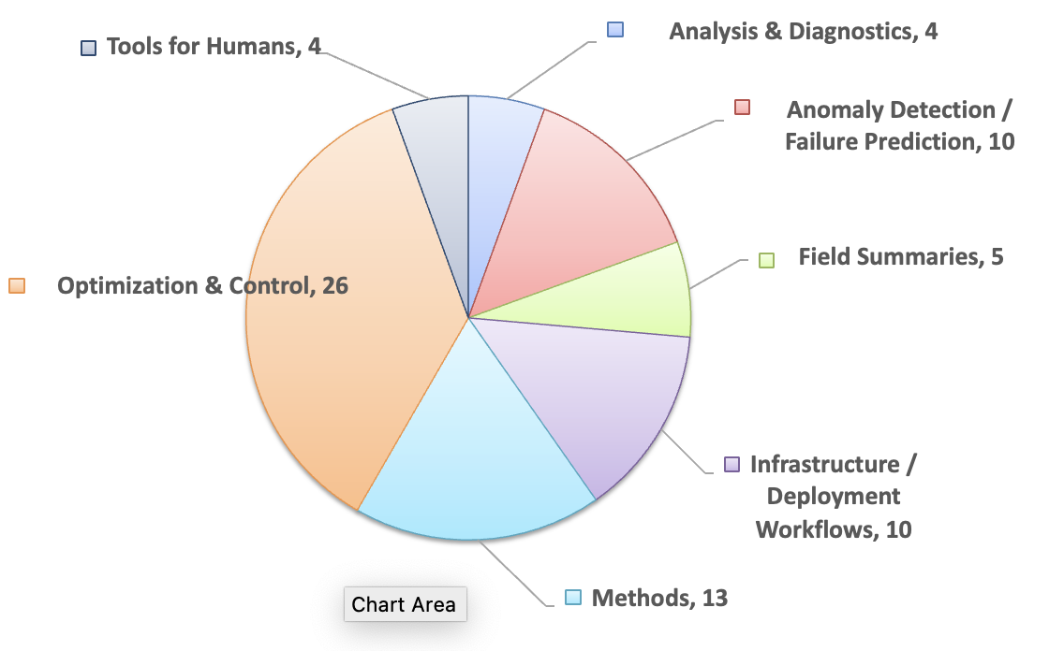
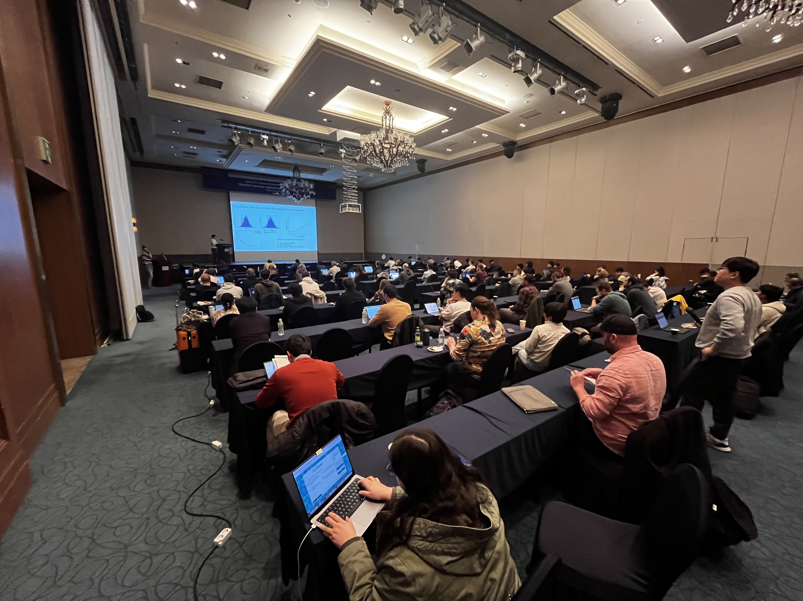
Workshop summary
Workshop summary by the numbers
3 Tutorials
41 Talks
32 Flash talks / posters

Slide 3
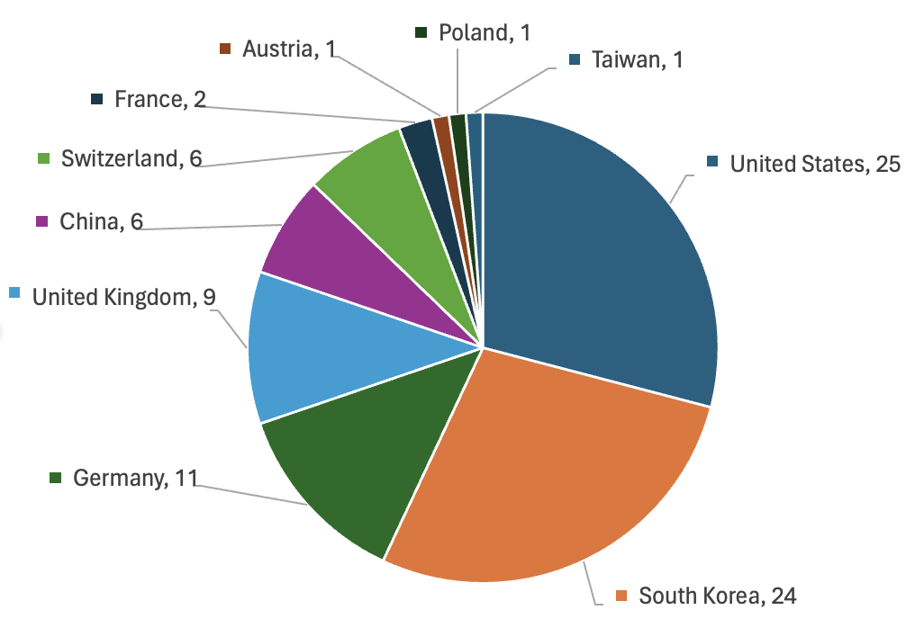
Workshop summary
Workshop summary by the numbers
3 Tutorials
41 Talks
32 Flash talks / posters
91 Participants from around the world

Slide 4
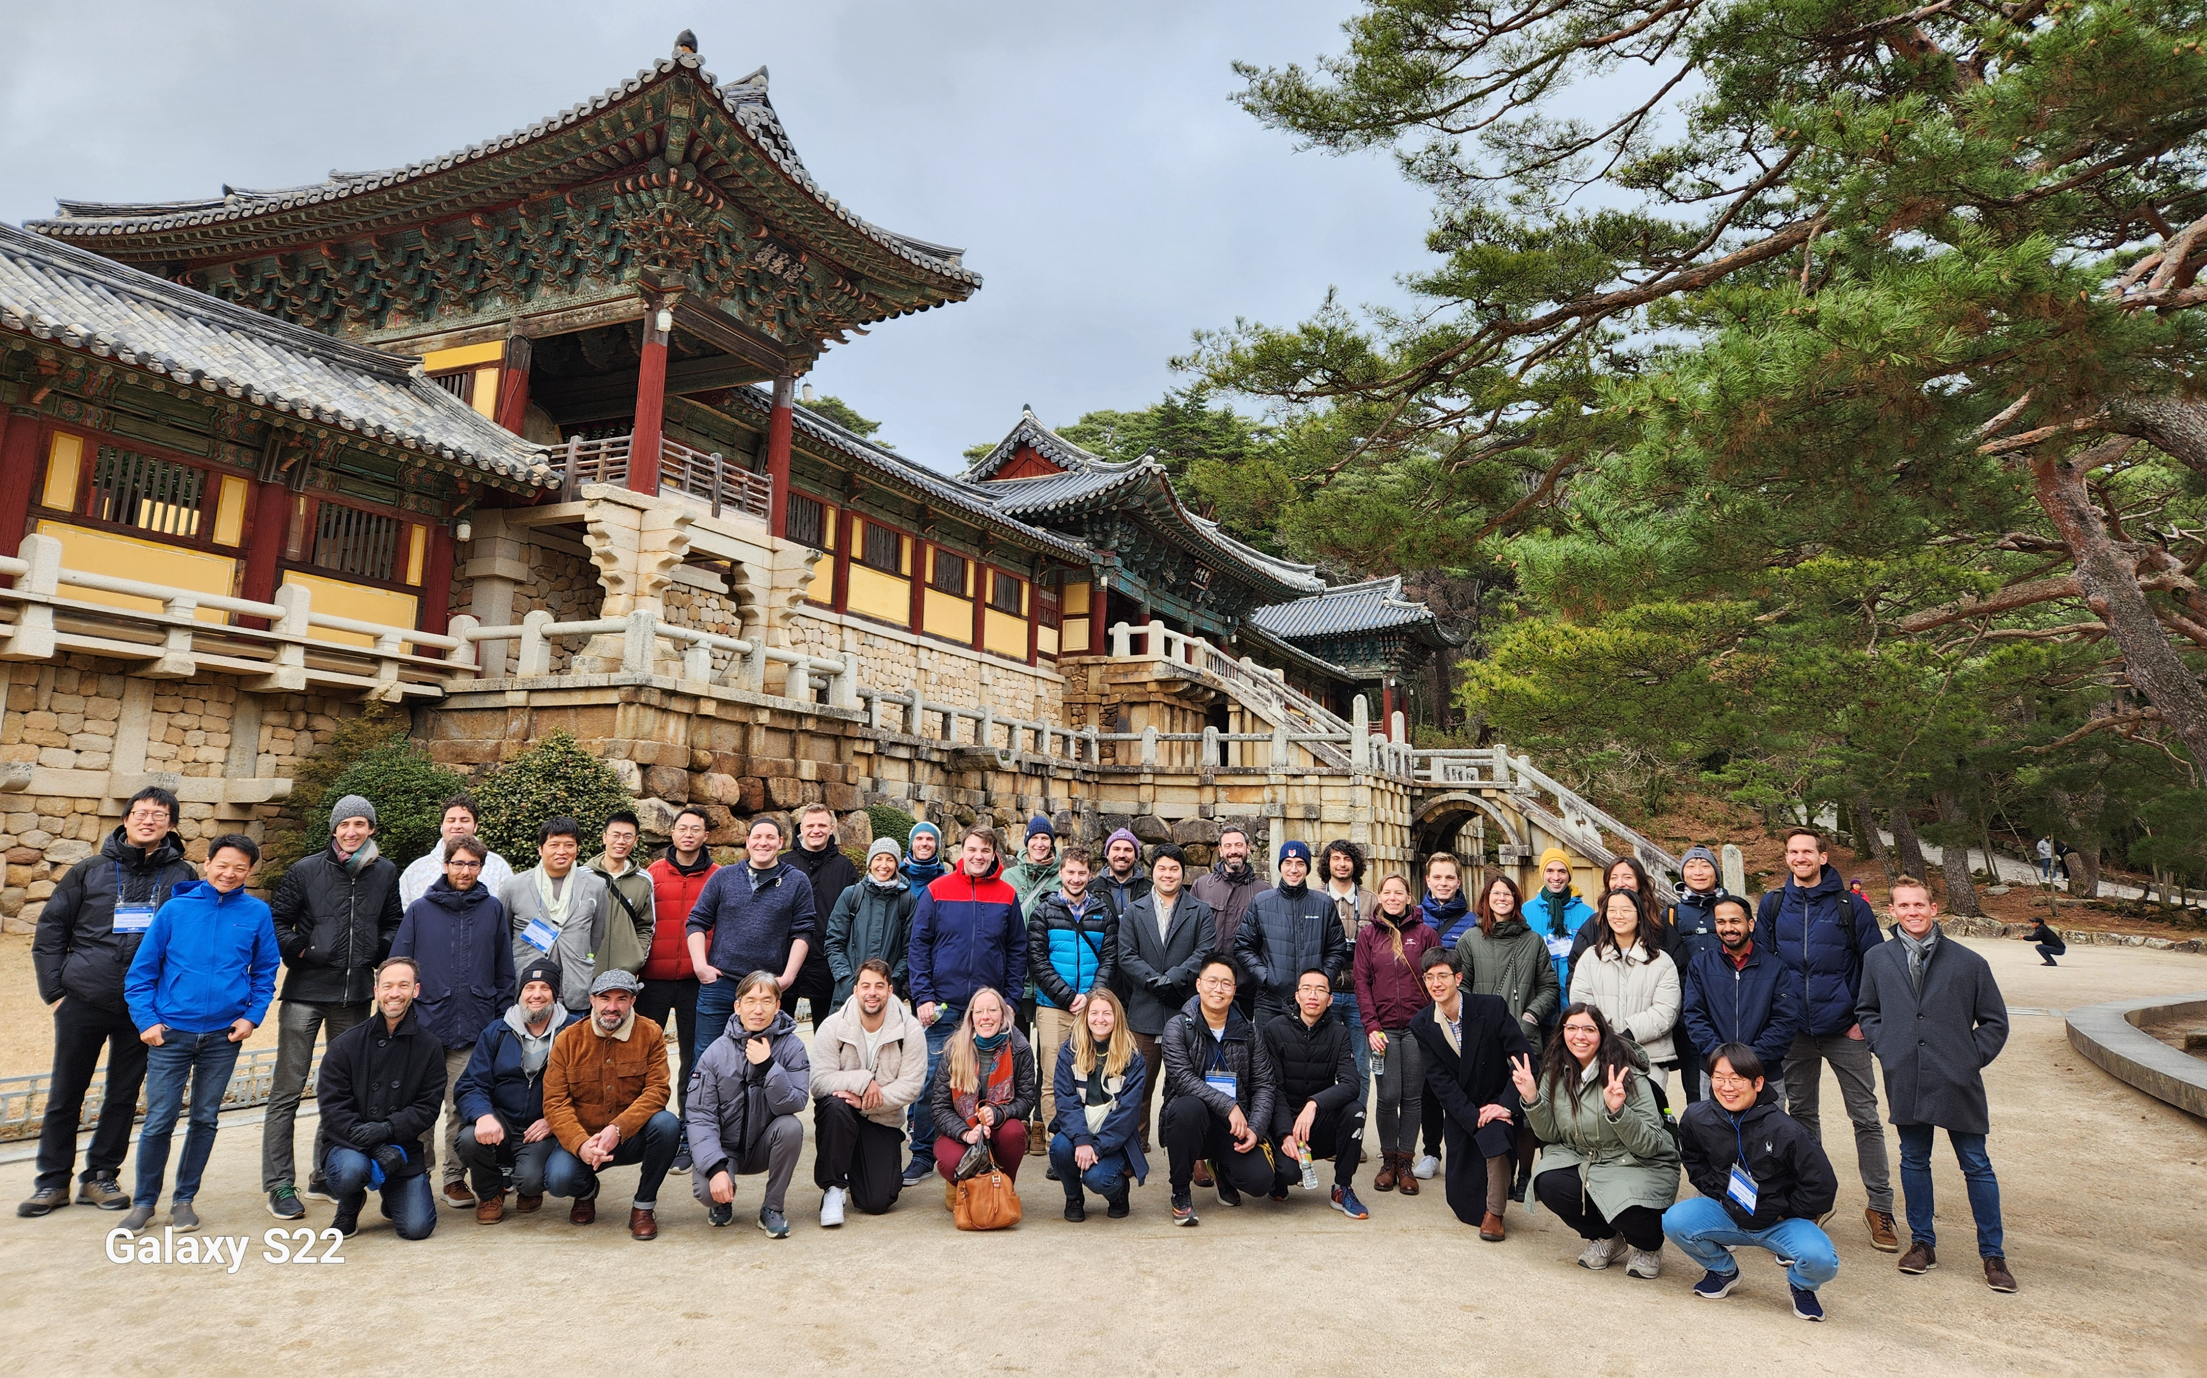
Lost of hard work (and play)
Bulguksa Temple

Slide 5
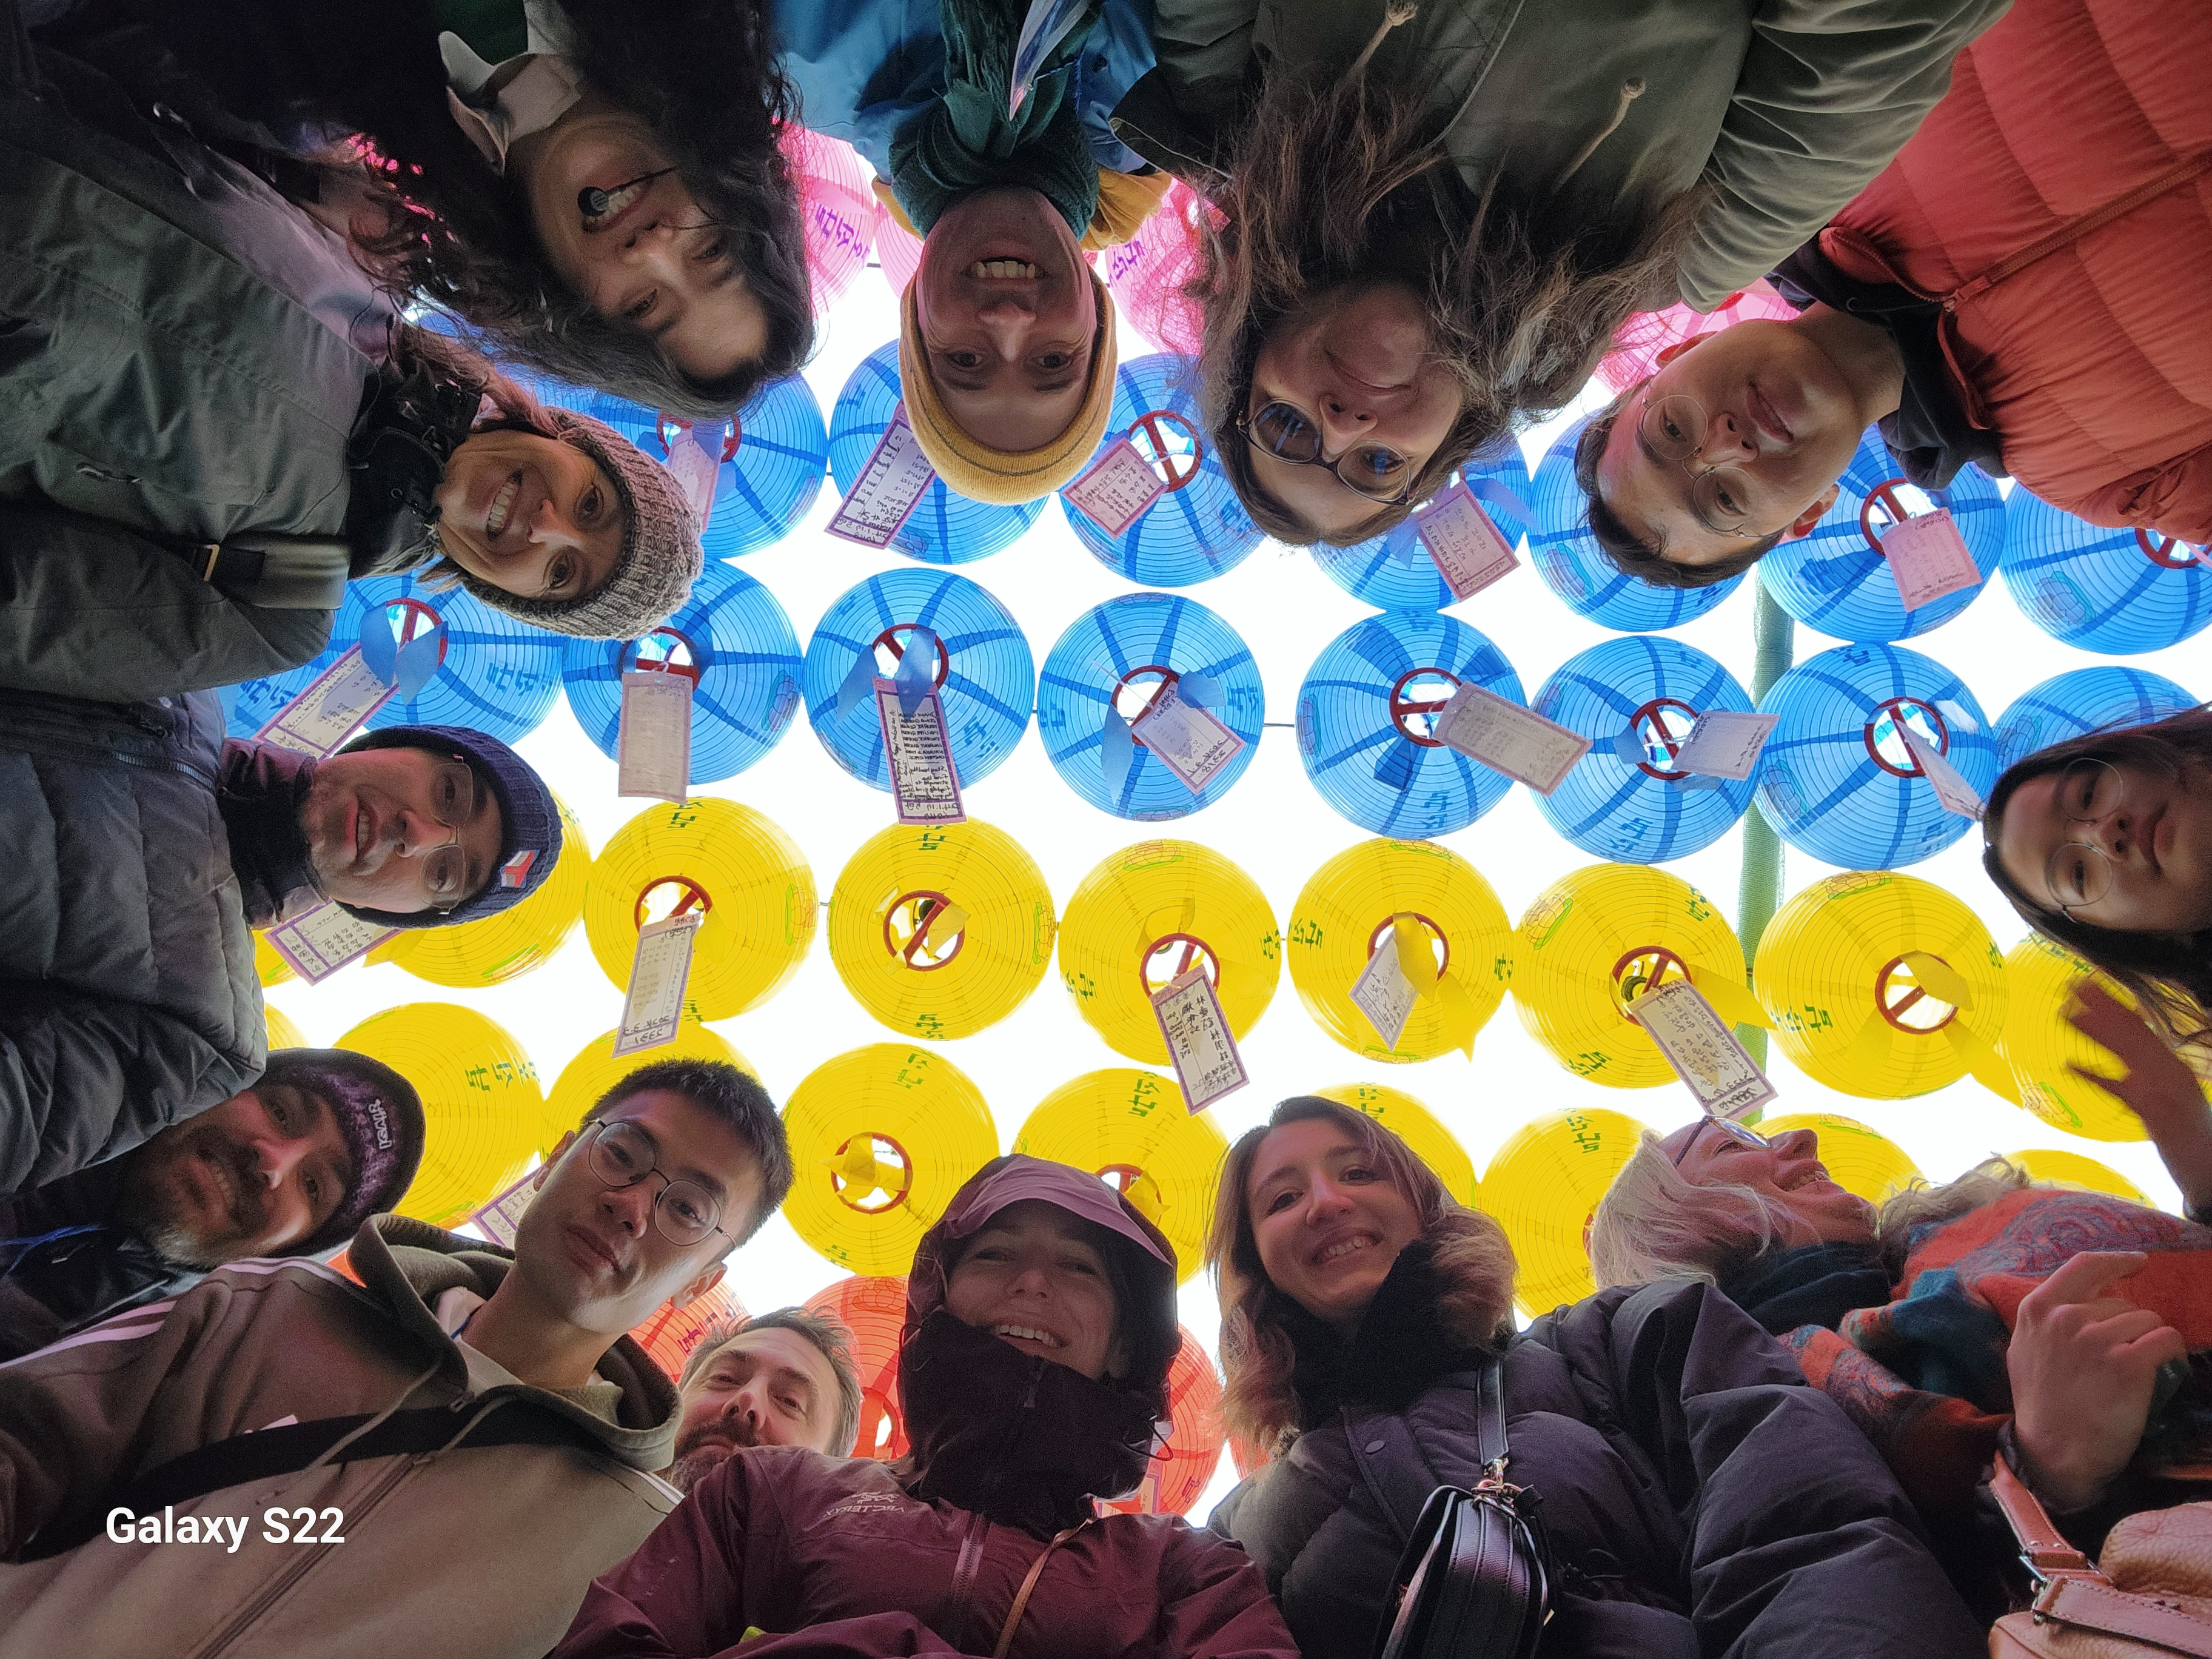
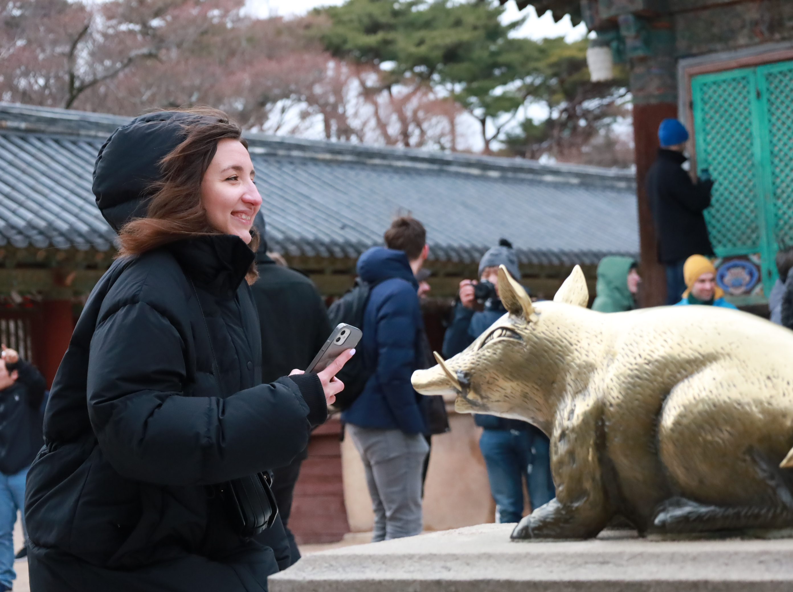
Lost of hard work (and play)
Bulguksa Temple

Slide 6
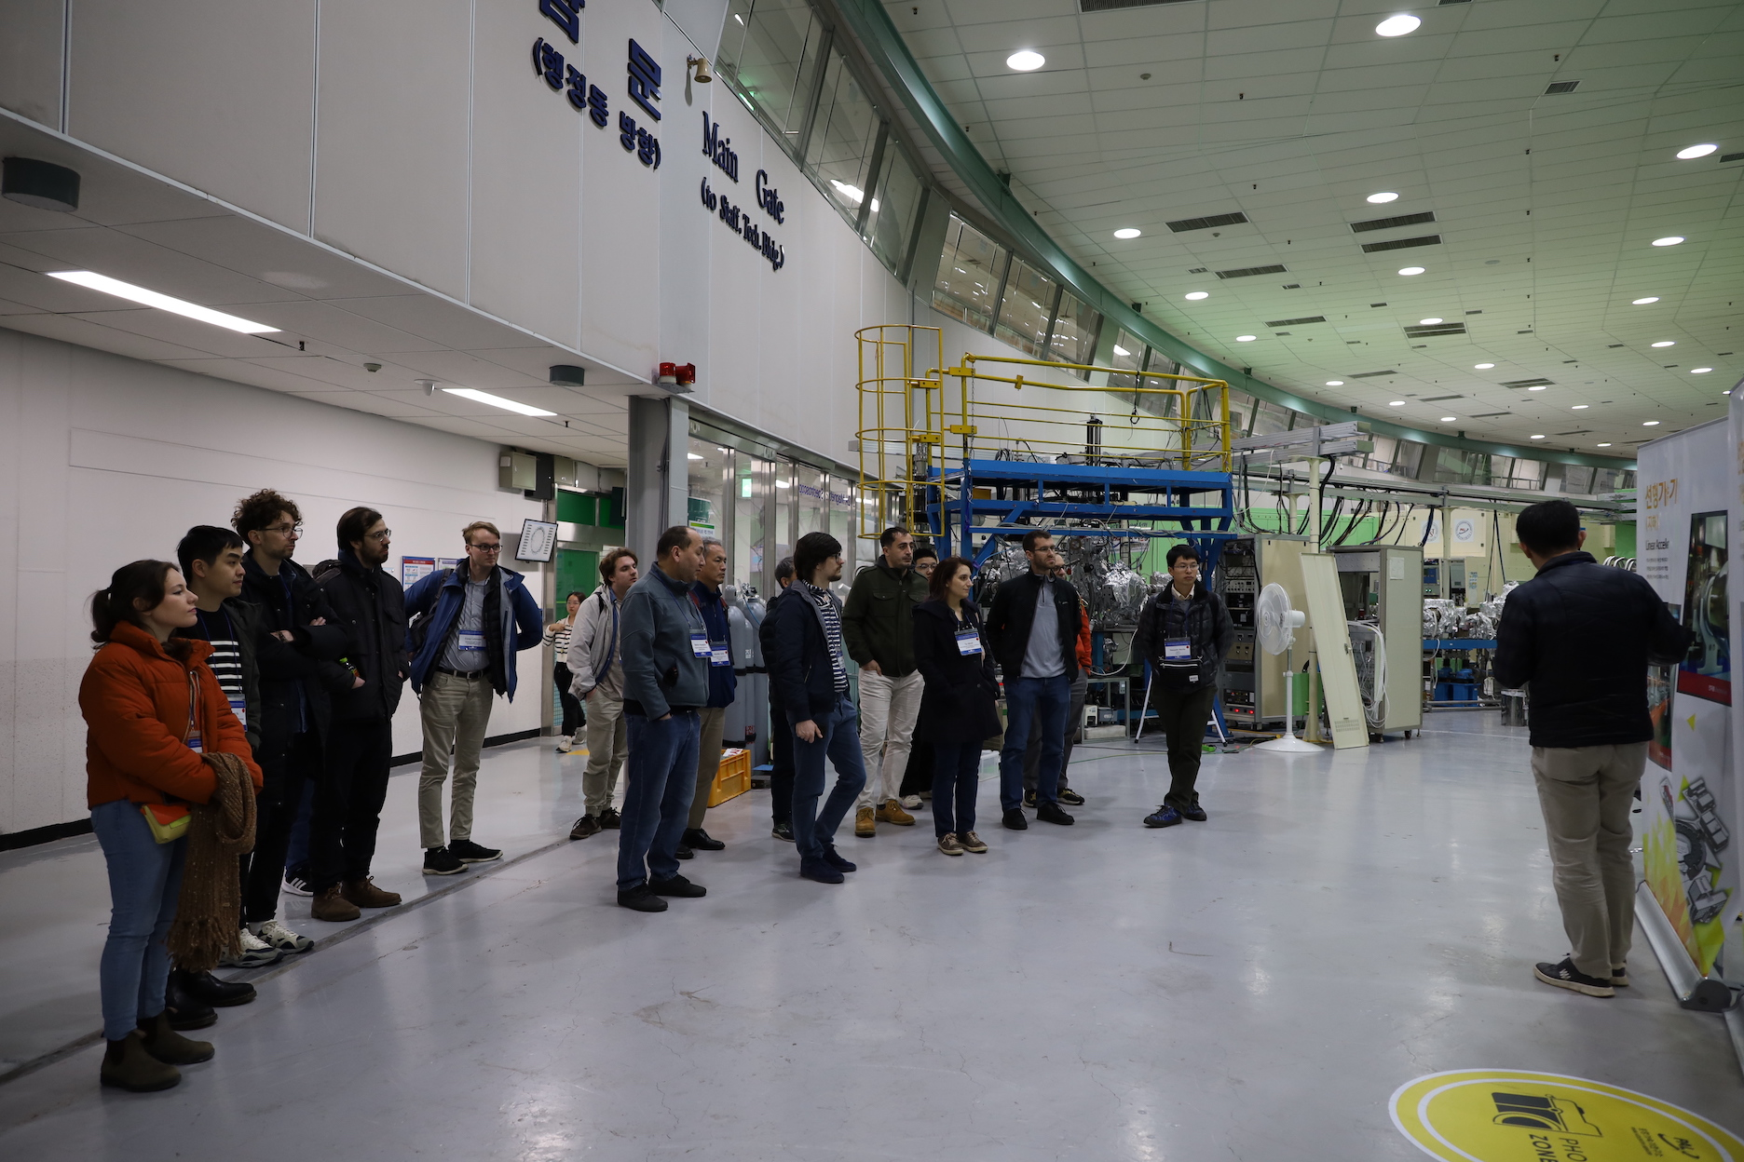
Lost of hard work (and play)
PAL Tour

Slide 7
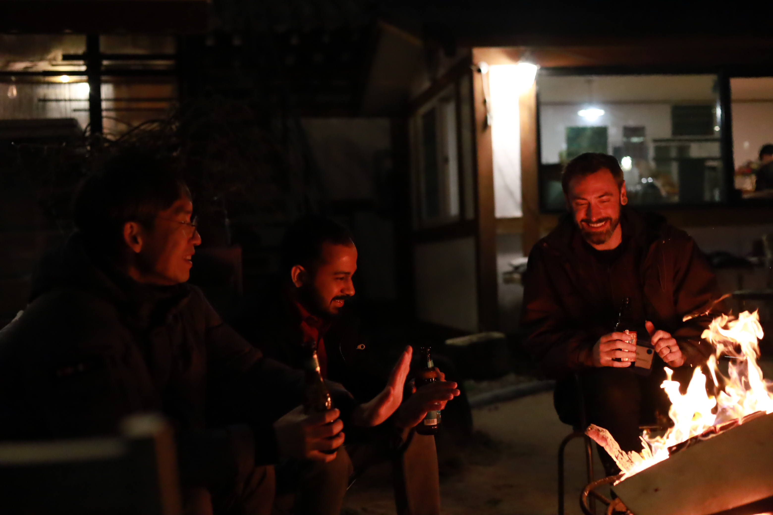
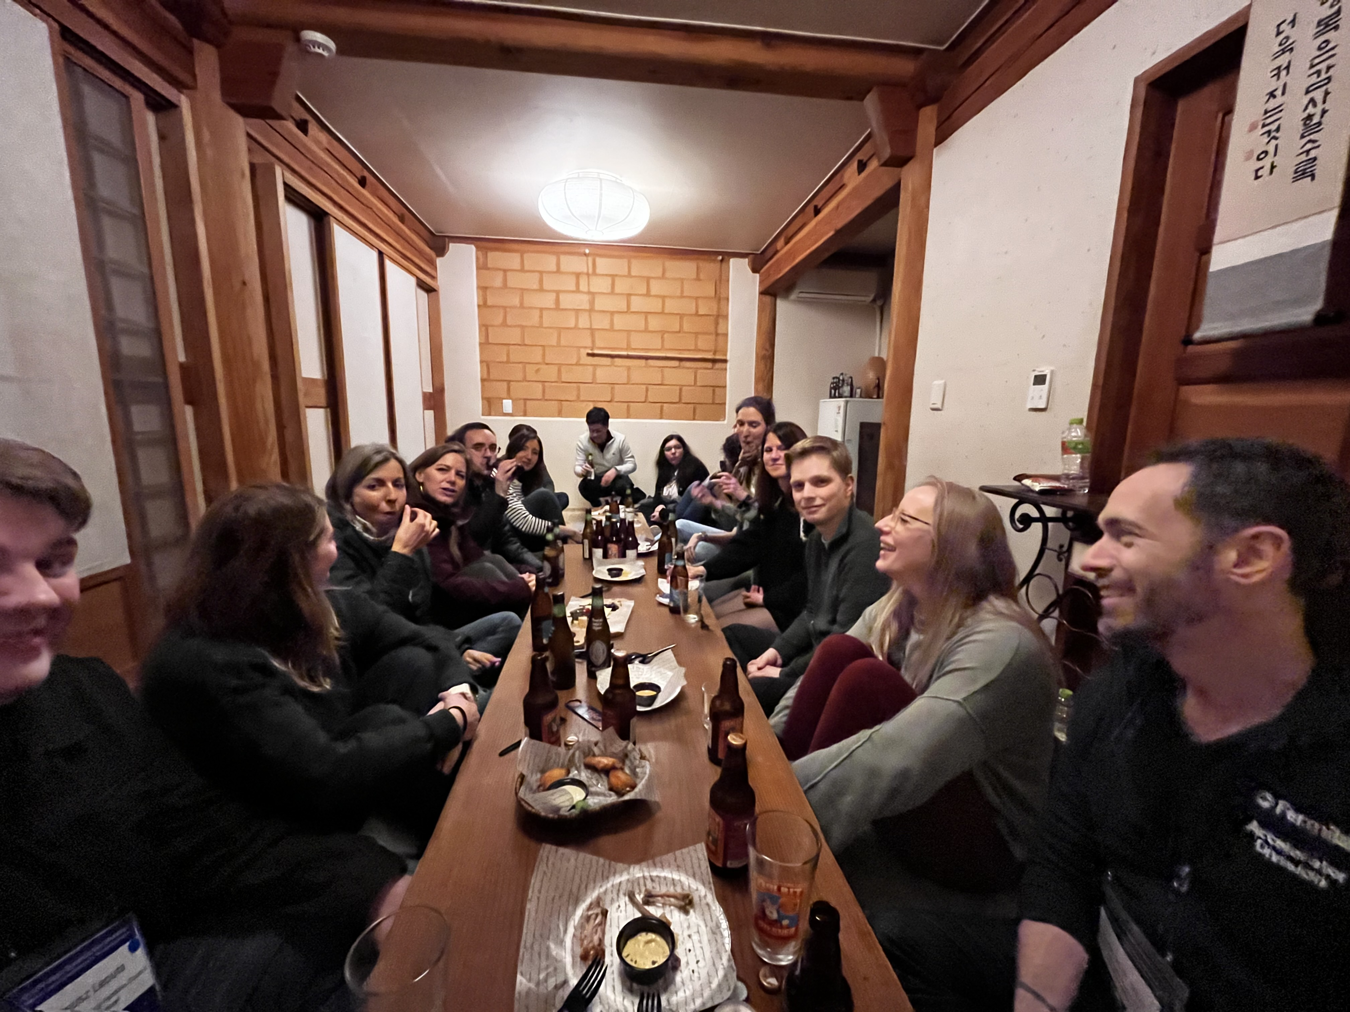
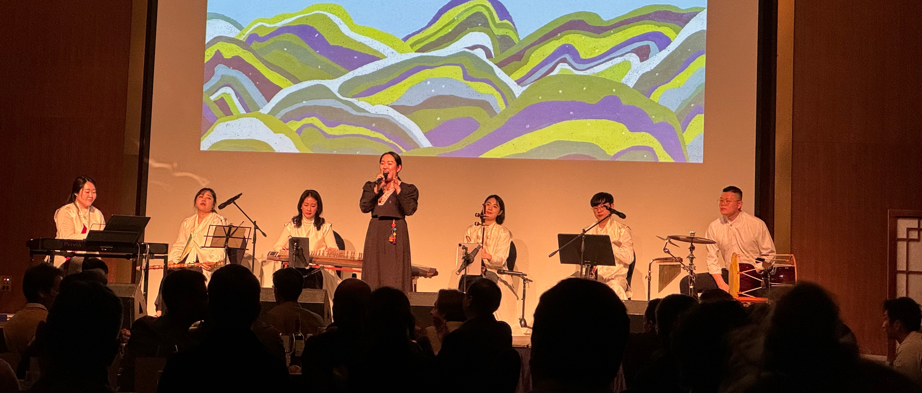
Lost of hard work (and play)
Social Events

Slide 8
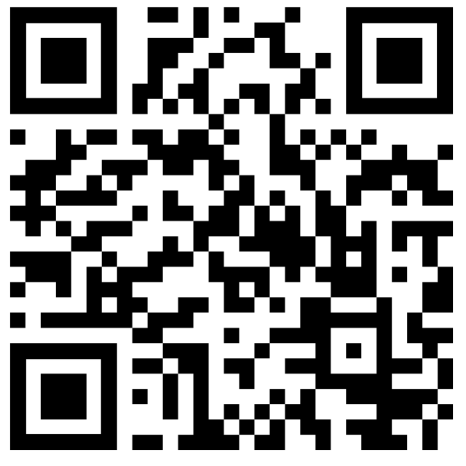
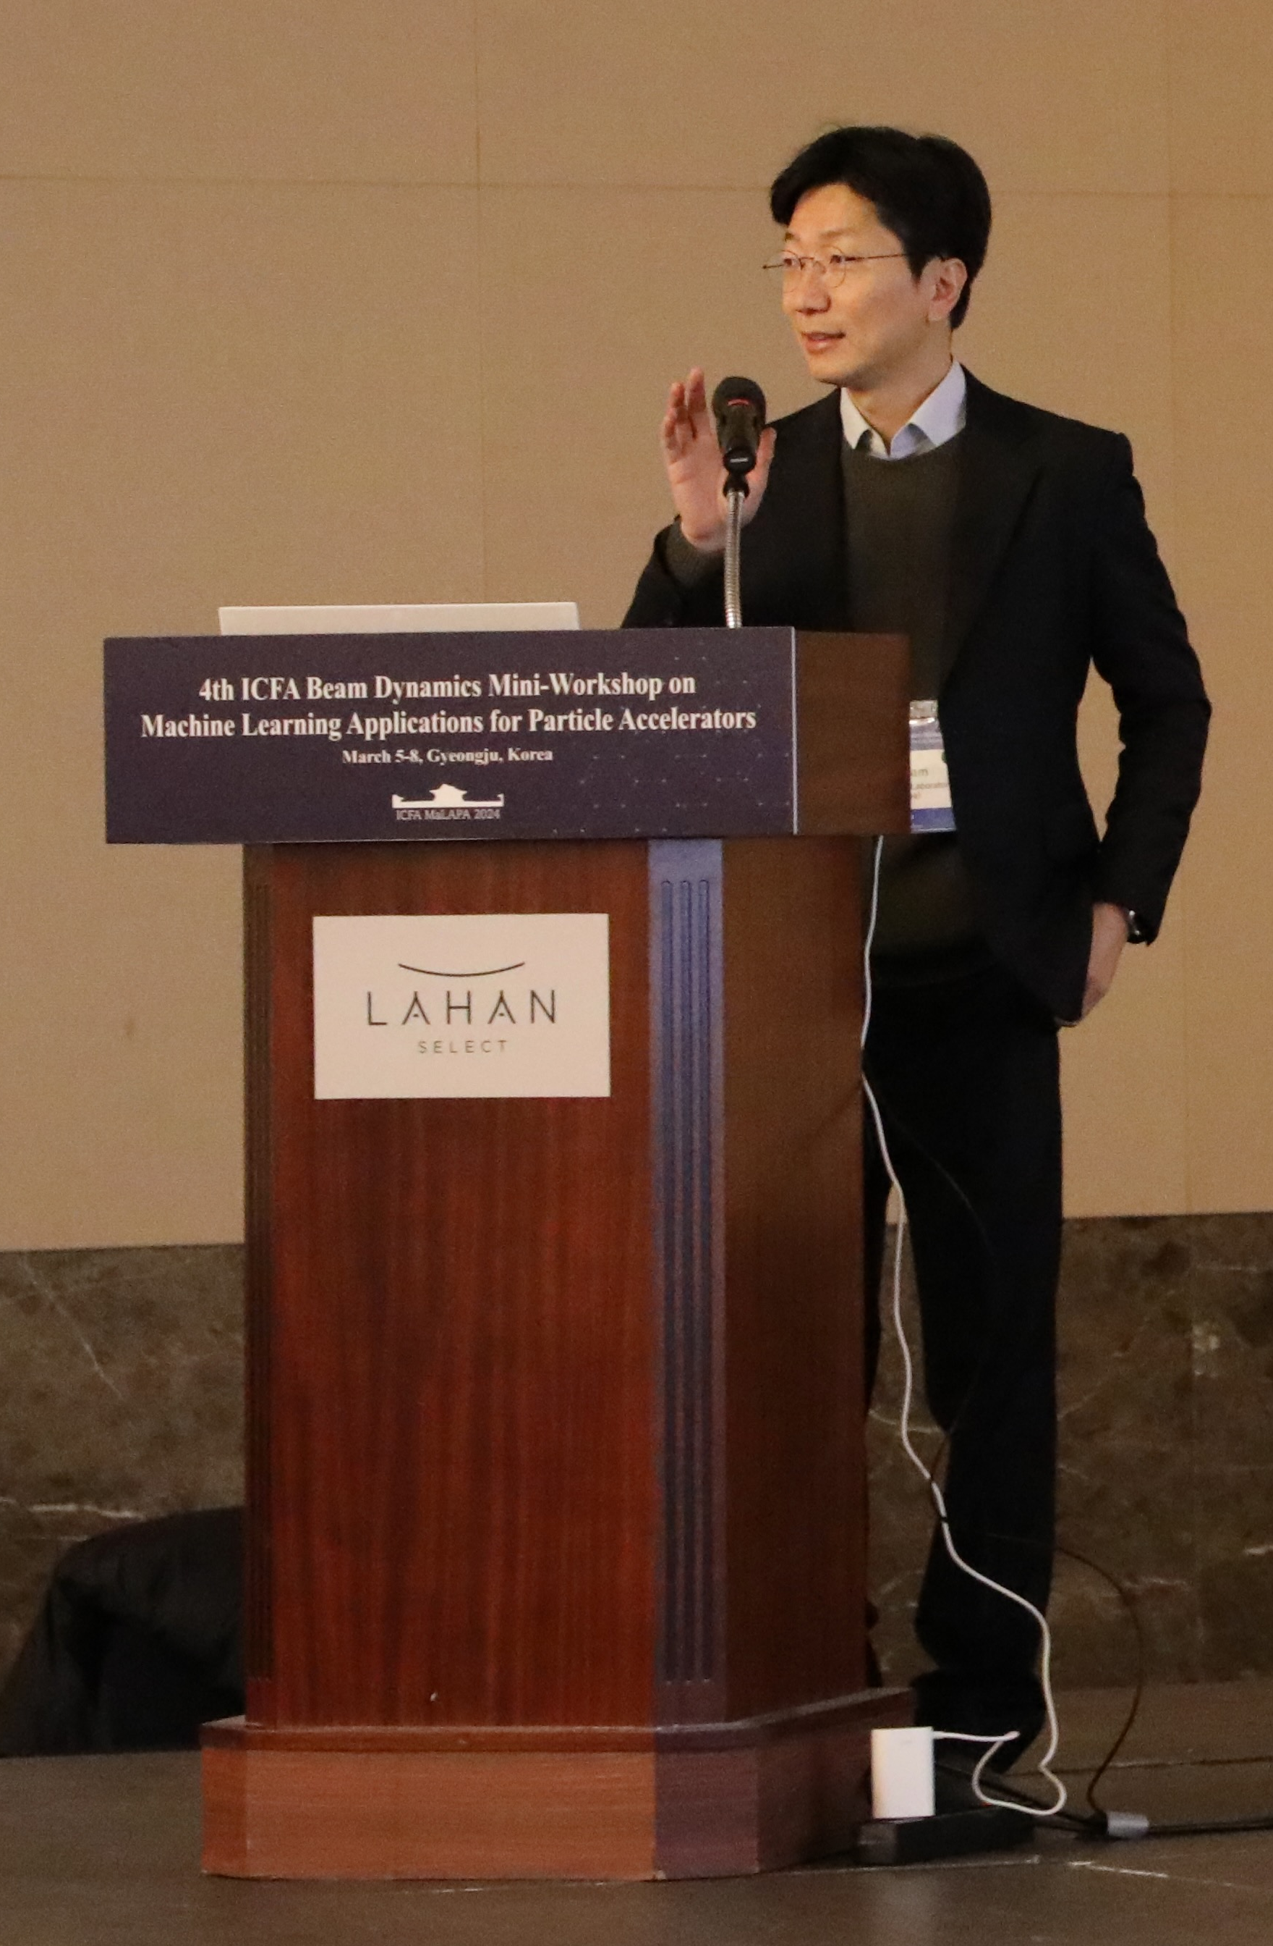
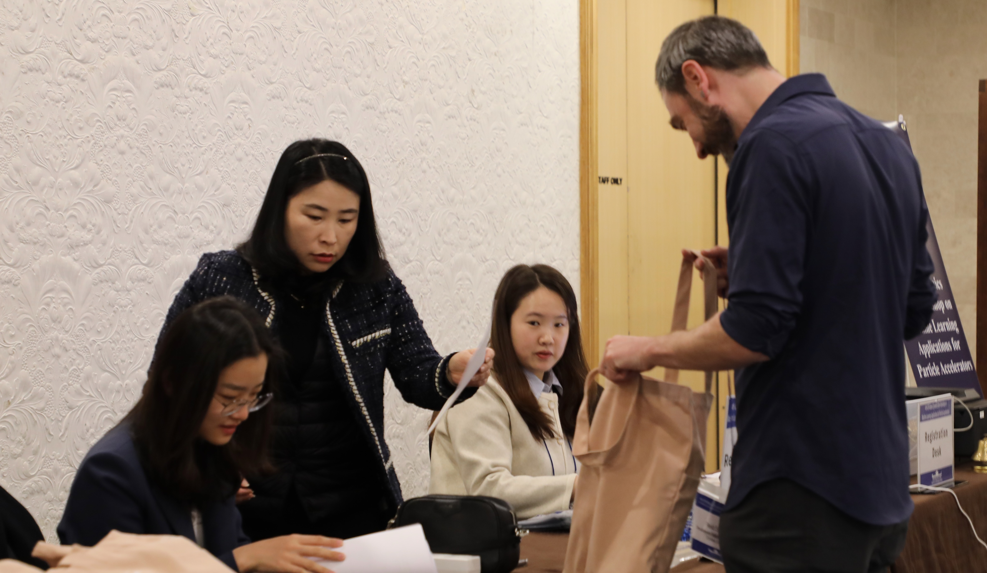
Thanks!
Thanks to everyone who made this possible!
Local organizing committee (Inhyuk, Gyujin, Heung-Sik, ...)
Scientific organizing committee (especially Tia!)
And of course all of us!
Give feedback!
https://forms.gle/1EiXATRy4uBpy4D87

Slide 9
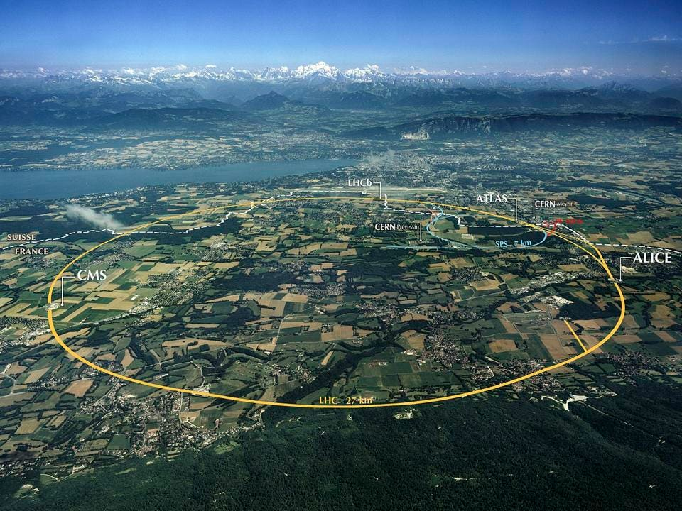
Next year at CERN!
5th ICFA MaLAPA Workshop to be at CERN!
Date TBD: mid February or early April
?
?

