Slide 1

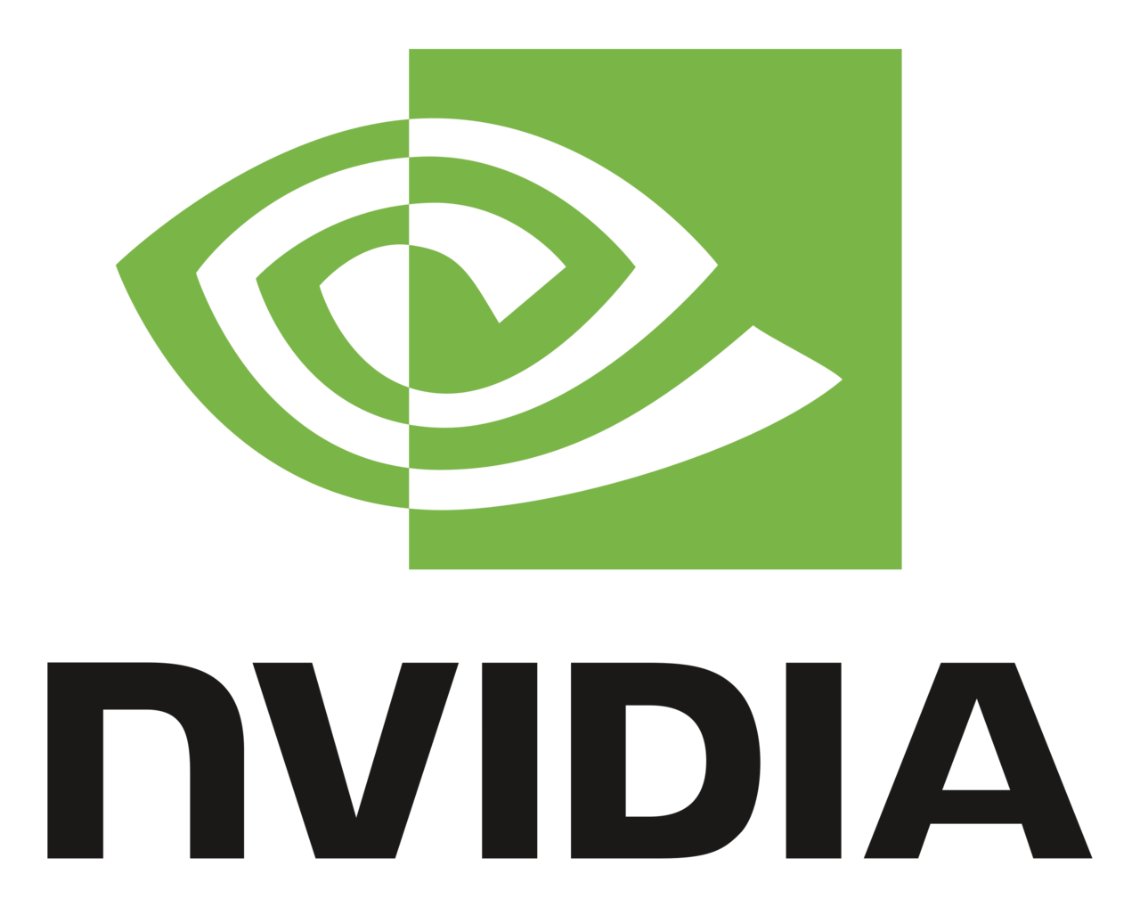


Interactive Visualization and Automated Analysis of Neutron Scattering Experiments
Matthew Kilpatrick*, David Bruhwiler, Evan Carlin, Gurhar Kalsa, Boaz Nash (RadiaSoft),
Christina Hoffmann, Zachary Morgan, Andrei T Savici, Matthew Tucker, Bogdan Vacaliuc (ORNL)
Alexander Kuhn, Jörg Mensmann, Peter Messmer, Marc Nienhaus, Steffen Roemer, Dragos Tatulea (NVIDIA)
*kilpatrick@radiasoft.net
March 7, 2024
ICFA 2024, Lahan Select Gyeongju, Republic of Korea
This material is based upon work supported by the U.S. Department of Energy, Office of Science, Office of Basic Energy Sciences DE-SC0021551.
Boulder, Colorado USA | radiasoft.net

Slide 2
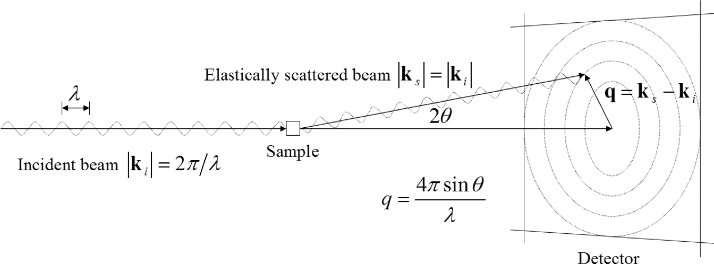
Neutron Scattering probes within Materials
Why do we shoot particles at things?
  X-ray scattering probes low-Z materials and are scattered by electrons
  Electron scattering is great for low-Z materials and is strongly interacting
Neutrons are weakly scattering!
  Neutrons will either pass straight through most materials or only single scatter off the atomic nuclei in the material
  Neutrons can penetrate materials that stop X-rays or electrons
  Beneficial for studying materials near absolute zero
https://www.ornl.gov/blog/what-makes-neutron-scattering-unique

Slide 3
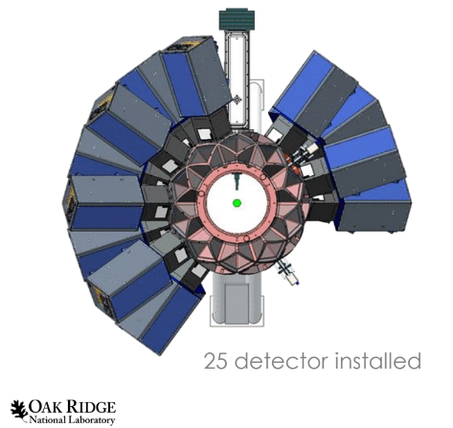
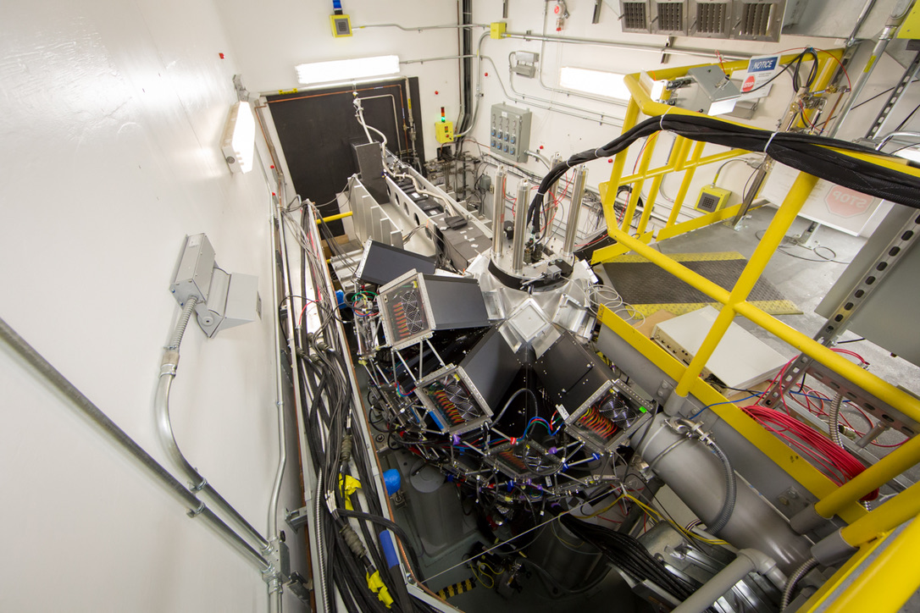
TOPAZ Single-crystal Diffractometer
Located at ORNL and receives neutrons from the Spallation Neutron Source
Samples can be measured with high precision for volumetric sampling in reciprocal space (momentum measurements)
  Samples are rotated to measure all aspects of the lattice
  Temperature control from 5 K - 450 K
  Broad Q coverage
https://neutrons.ornl.gov/topaz

Slide 4
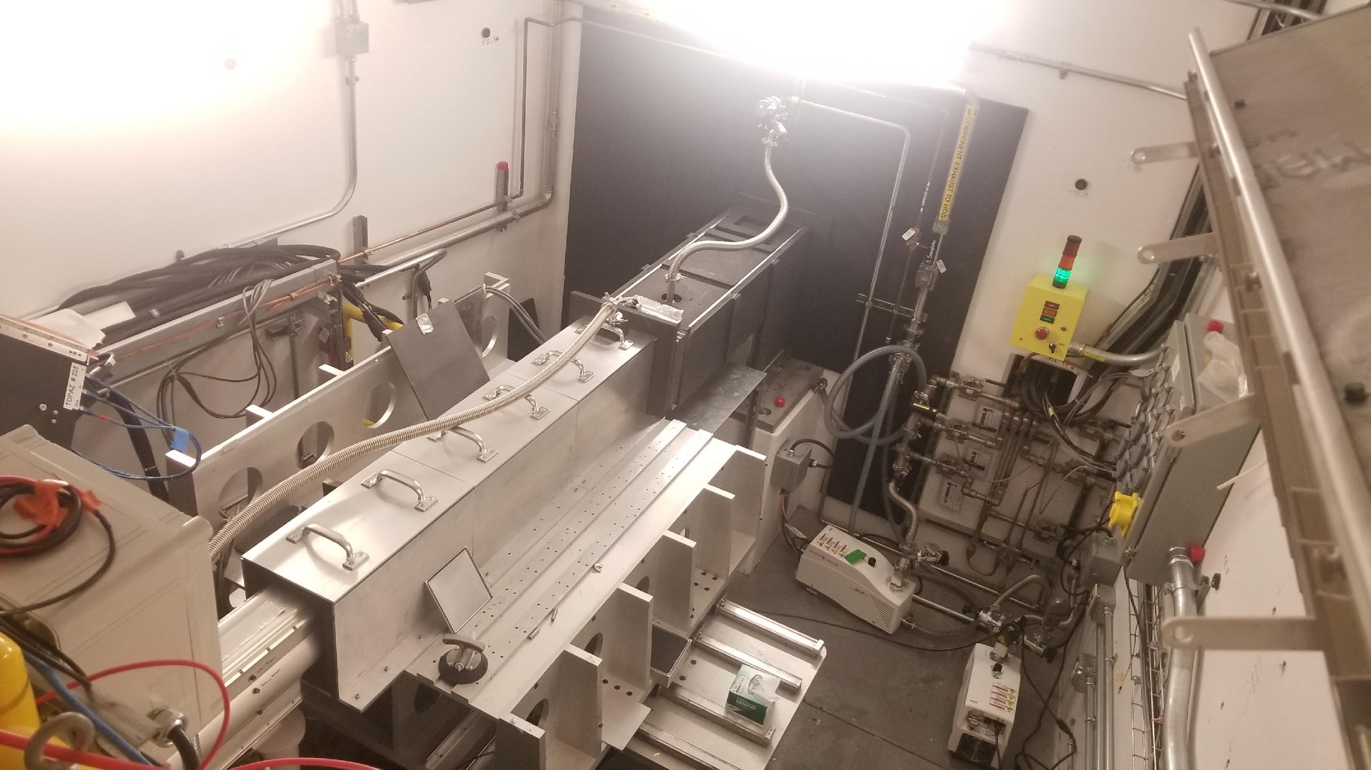
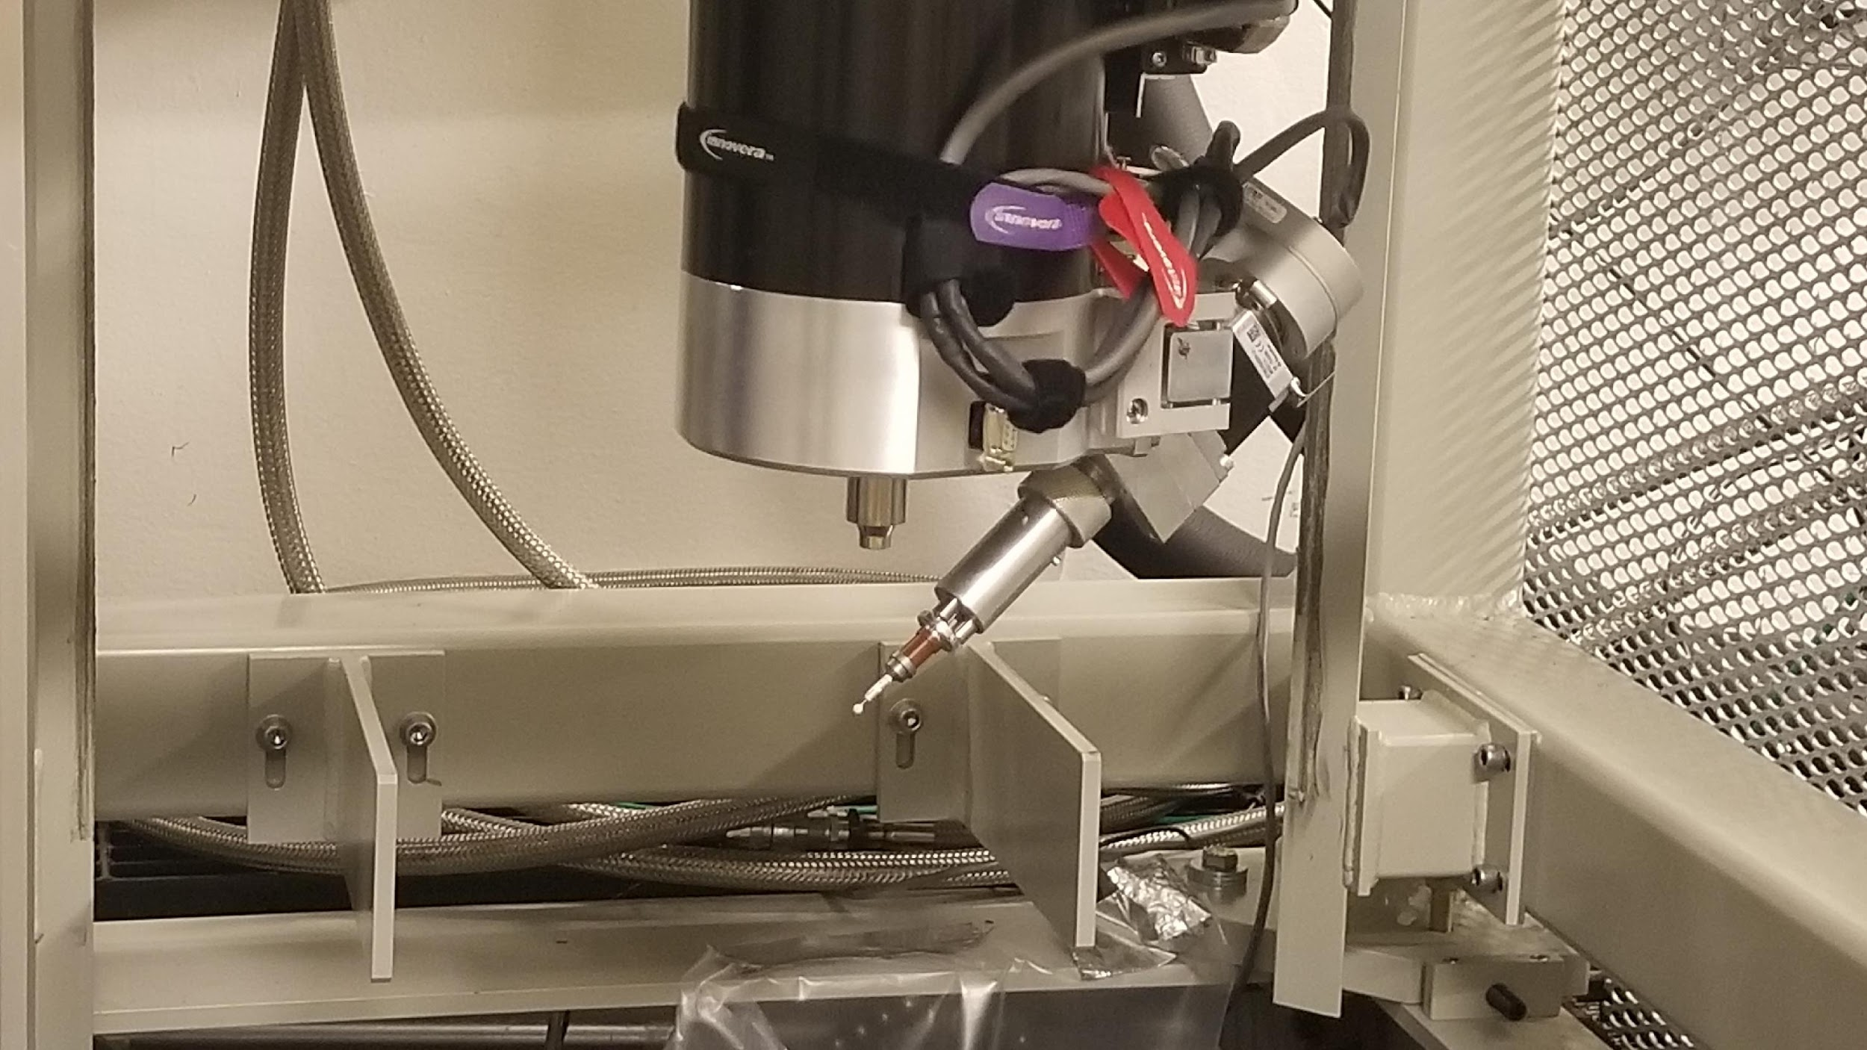
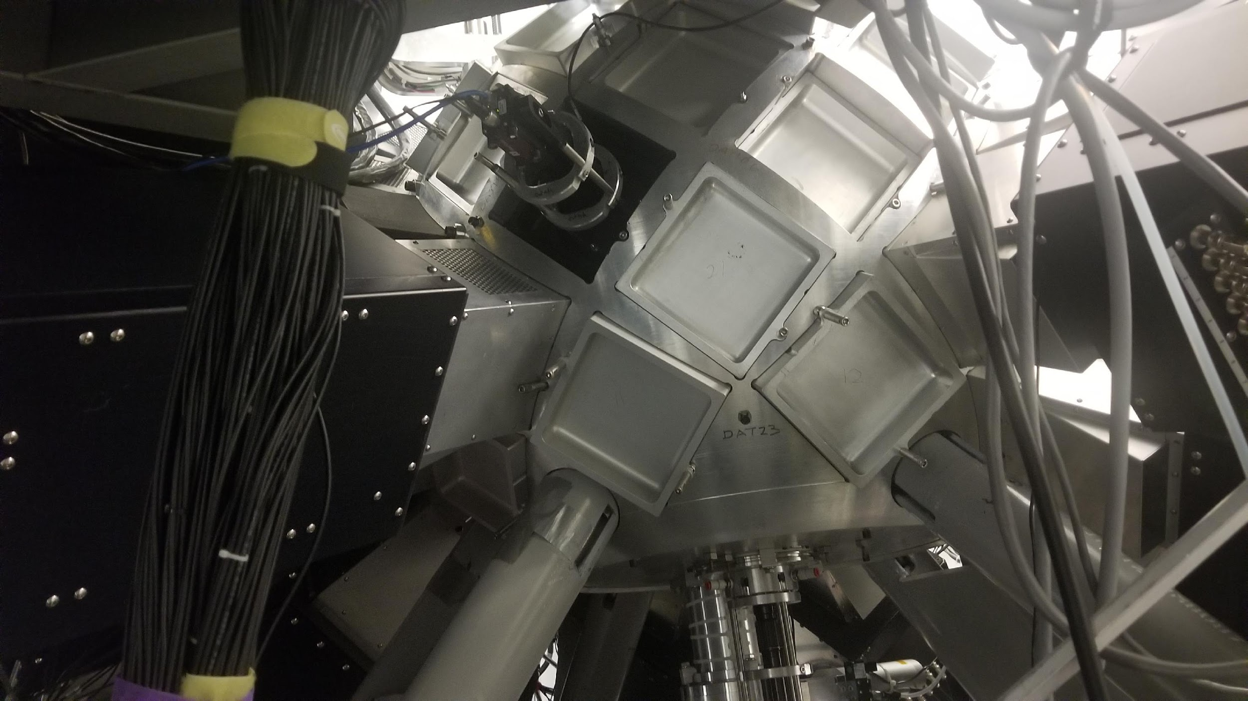
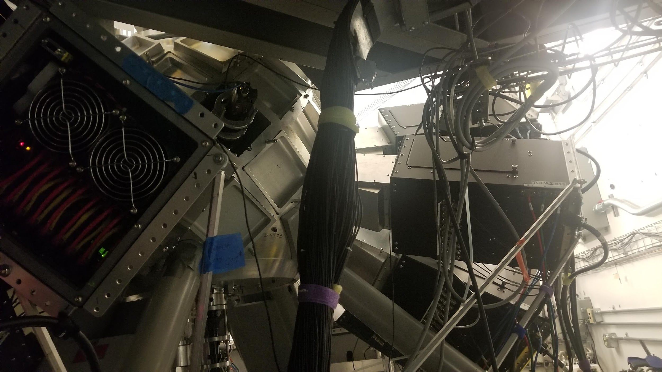
TOPAZ Single-crystal Diffractometer
Notes:
Top left to bottom right: TOPAZ beamline station, TOPAZ sample arm, TOPAZ sample chamber, detectors on TOPAZ chamber

Slide 5
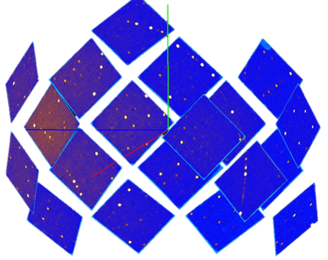
Analysis methods for TOPAZ data
Mantid
  Open source community developed application
  Algorithms use raw data processed within 2D slices of the 3D data
Some challenges faced by the community
  Large datasets can be up to 100 Gb in size and current tools limit interactivity
  Displaying data requires a high level of user interaction
  2D slices may miss key features of the diffraction data
  May be slow to run due to optimization shortfalls
  Timescale: 1-2 hours
Working collaboratively to leverage Mantid
  Machine learning – DBSCAN, U-Nets
  Automated Bragg peak identification
  Automated background subtraction
Also improving the interactivity of the data viz
  Close collaboration with the NVIDIA IndeX development team (Berlin)
Working towards combination of 3D viz and automated analysis
https://www.mantidproject.org/

Slide 6
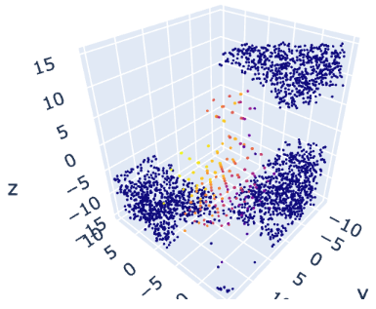
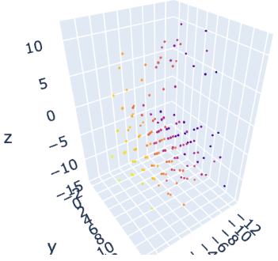

Analysis of Scattering Data for a Single Silicon Crystal
Preprocessing the data
  Measurements of the particles in momentum space
  Looking for pockets of constructive interference
  Measurements projected onto a 3D mesh
DBSCAN is a density based clustering algorithm
  Can identify oblong clusters and attribute data to noise if it doesn’t match anything
  Sparse background can be removed easily
  Provides real time identification of Bragg peaks
  Agrees with Mantid reconstruction of Bragg peaks
Silicon Cluster ID
https://scikit-learn.org/stable/modules/generated/sklearn.cluster.DBSCAN.html#sklearn.cluster.DBSCAN

Slide 7
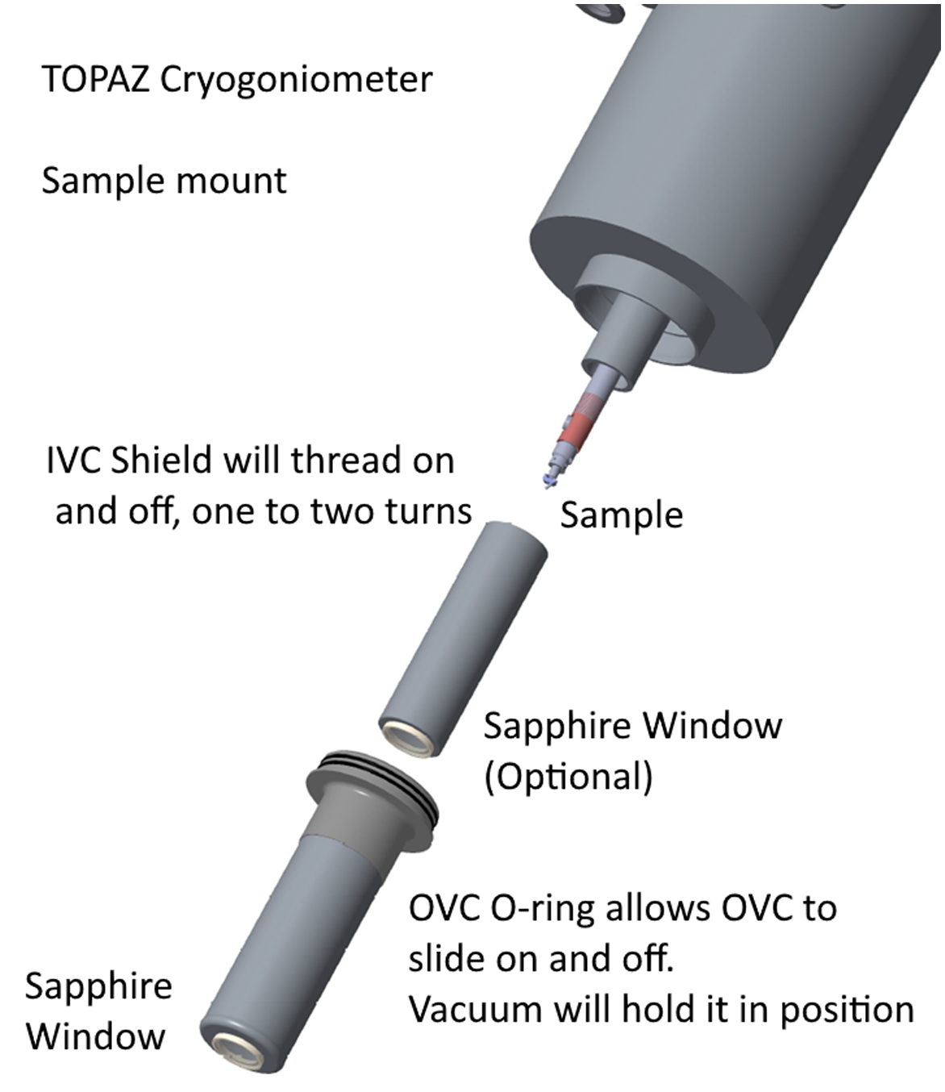
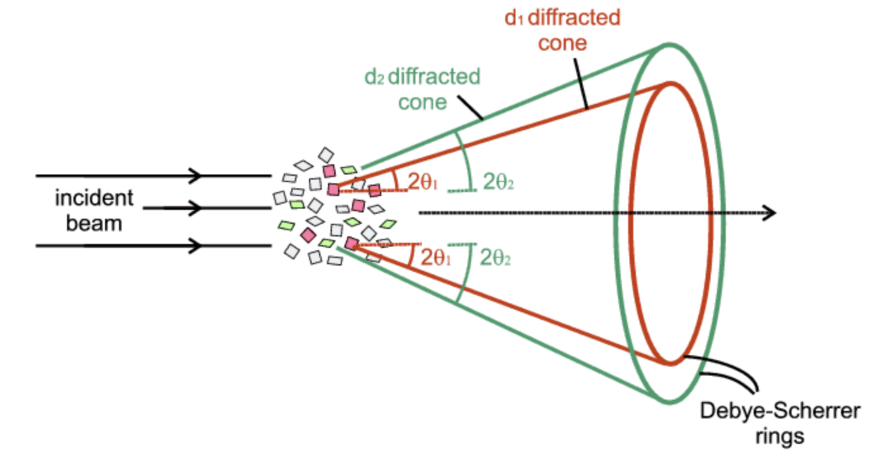
Background Removal Processes
Sample mounting
  Crystal sample can be tested at low temperatures
  Aluminum cylinders have a randomly oriented crystal structure
  These rings will scatter neutrons into a sphere or ring
Scattered neutrons
  Each plane orientation will create rings within reciprocal space
  Translates into a sphere in 3D representation

Slide 8
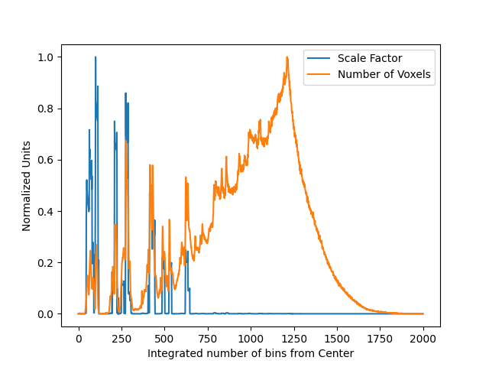

Identify Accurate Ground Truths
Properties of Aluminum Rings
  Monochromatic in neutron intensity
  Concentrated at a fixed radius
  Varies from sample to sample
Define a scale factor
  Simple clustering
    Tune DBSCAN parameters to get rings
  Gradient based definitial for clustering
    Normalized by the mean number of voxels
How do these two methods compare?
Add radius plots and scale factors

Slide 9
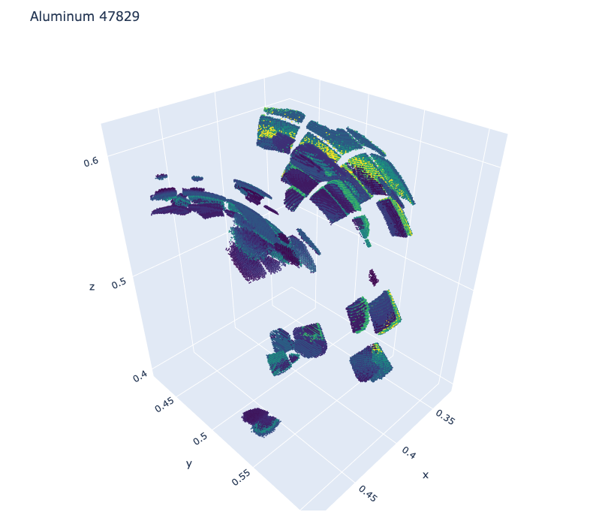
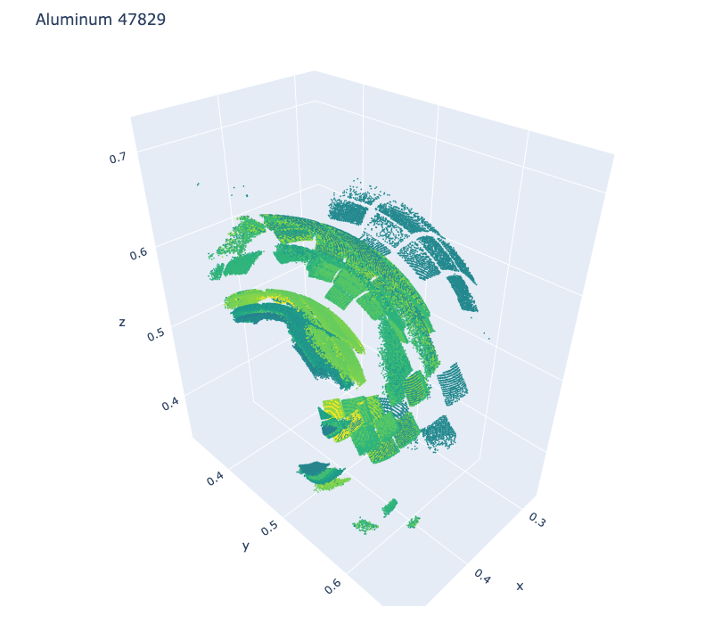
Aluminum Labels
DBSCAN
DBSCAN with SF

Slide 10
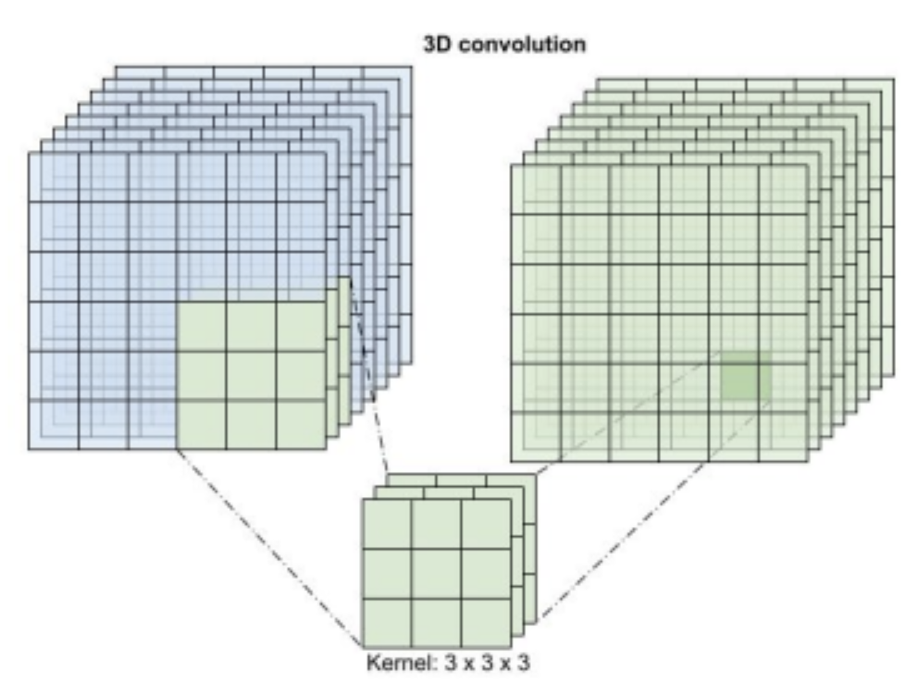
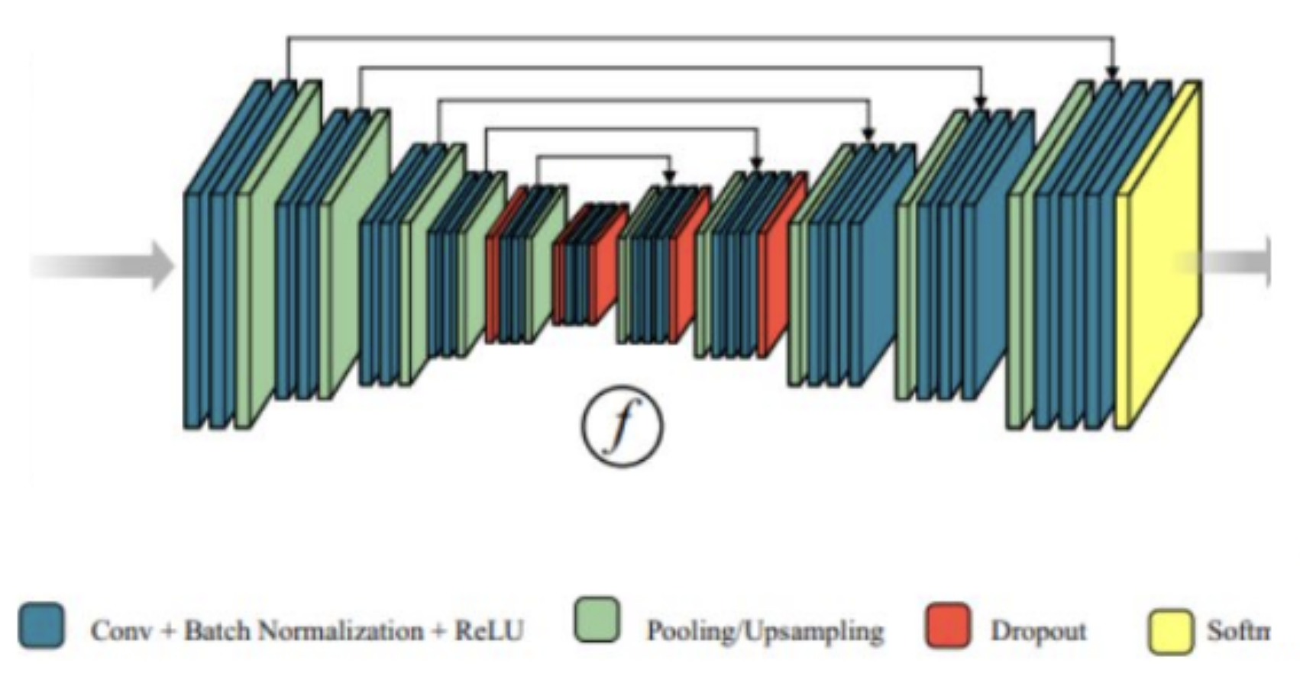
Identification of Aluminum Rings
Building a neural network
  Identify a 3D CNN to train and predict aluminum rings
  General Unet mainly used for image segmentation
    Fully connected
    Contraction and expansion paths
    3D Unet used for learning dense volumetric segmentation from sparse annotations
Conv + Batch Normalization + ReLU
Pooling/Upsampling
Dropout
Softmax

Slide 11
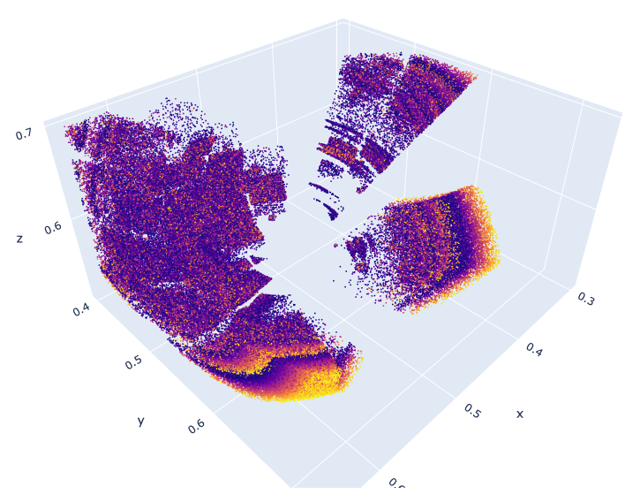
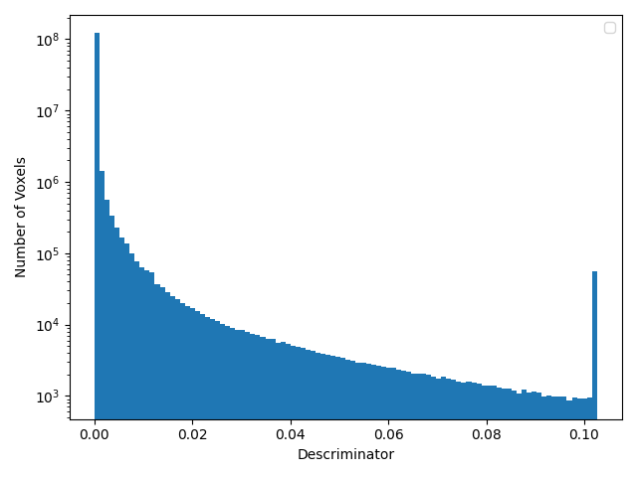
Identification of Aluminum Rings
Labelled Rings
Building a neural network
  Identify a 3D CNN to train and predict aluminum rings
  General Unet mainly used for image segmentation
    Fully connected
    Contraction and expansion paths
    3D Unet used for learning dense volumetric segmentation from sparse annotations
Full Sample
Number of voxels
Discriminator

Slide 12
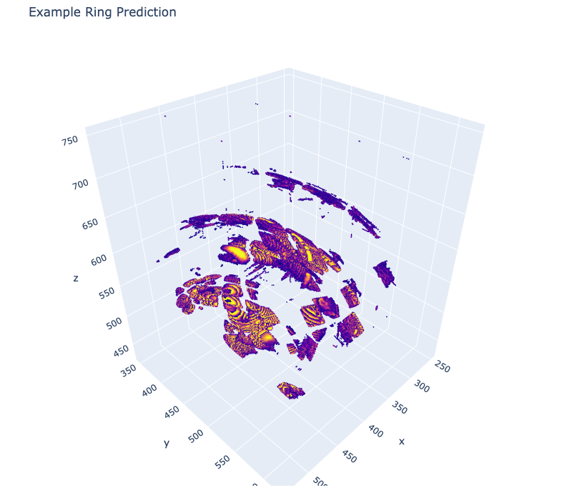
Identification of Aluminum Rings
Labelled Rings
Building a neural network
  Identify a 3D CNN to train and predict aluminum rings
  General Unet mainly used for image segmentation
    Fully connected
    Contraction and expansion paths
    3D Unet used for learning dense volumetric segmentation from sparse annotations
Full Sample
Predicted Rings

Slide 13
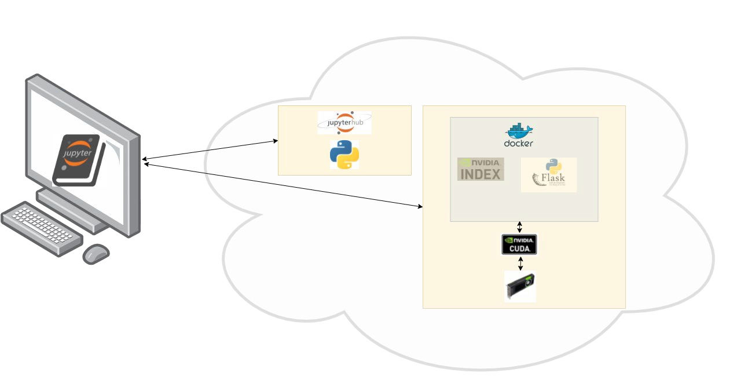
System Architecture, with JupyterHub Interface

Slide 14
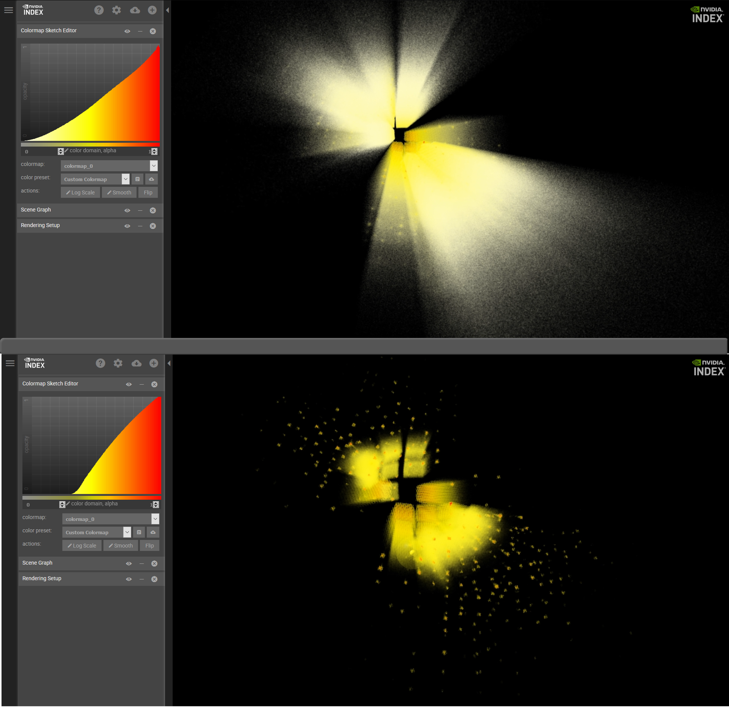
NVIDIA’s IndeX: Browser-based 3D visualization
IndeX: interactive 3D volumetric visualization framework
  rotate, pan, zoom into large 3D volumes
  executes remotely on a GPU server
  streams video to the user’s browser
TOPAZ event data is converted into a voxel database
  voxels are a regular 3D grid
  each is colored and/or made transparent based on the number of neutron events within it
  colors & transparency can be dynamically edited
The voxel database can be dense or sparse
  large fraction of voxels are empty, so the sparse data format is very efficient
Interactive response is robust to WiFi quality
  even with a poor network connection, the typical delay after a mouse click is < 0.25 s

Slide 15
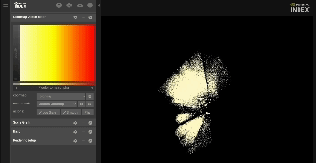

Slide 16
Summary
Take the user out of the loop
  Automated sample identification
  Real time sample visualization and analysis
  Information at your fingertips
3D visualization
  Integrated on a single GPU
  Interactive analysis
Open-source collaboration
  Applications to many real time 3D datasets
  Broad applications to samples within a beamline
THANK YOU!
Notes:
Equally applicable to x-ray experiments
Take the user out of the loop
Single GPU can visualize and interactively look and data

Slide 17
Acknowledgements
Our ORNL partners
  C. Hoffman, B. Vacaliuc, J. Taylor, J. Kohl, Z. Morgan, A. Savici,
NVIDIA
  M. Nienhaus, A. Kuhn, D. Tatulea, J. Mensmann, S. Roemer,
RadiaSoft
  D. Bruhwiler, E. Carlin, G. Kalsa, B. Nash
DOE Office of Science, Basic Energy Sciences
  SBIR and STTR Program, award # DE-SC0021551

Slide 18
Disclaimer
This report was prepared as an account of work sponsored by an agency of the United States Government. Neither the United States Government nor any agency thereof, nor any of their employees, makes any warranty, express or implied, or assumes any legal liability or responsibility for the accuracy, completeness, or usefulness of any information, apparatus, product, or process disclosed, or represents that its use would not infringe privately owned rights. Reference herein to any specific commercial product, process, or service by trade name, trademark, manufacturer, or otherwise does not necessarily constitute or imply its endorsement, recommendation, or favoring by the United States Government or any agency thereof. The views and opinions of authors expressed herein do not necessarily state or reflect those of the United States Government or any agency thereof.

