Slide 1


Predicting preventable Interruptions to Operations at NSLS-II
In collaboration with SLAC, ANL
Reid Smith : Speaker
Feng Bai : Postdoc researcher
Mar.07.2024
IFCA Beam Dynamics Workshop - MLAPA

Slide 2
Contents
  NSLS-II Accelerator Overview
  Context
    Reliability, Downtime, Types of Faults
    Magnet cooling & water systems
  Development
    Philosophy
    Structure
    Methods
  Application & Use
    Prediction parameters
    Use by System experts, Operations
    Next steps

Slide 3
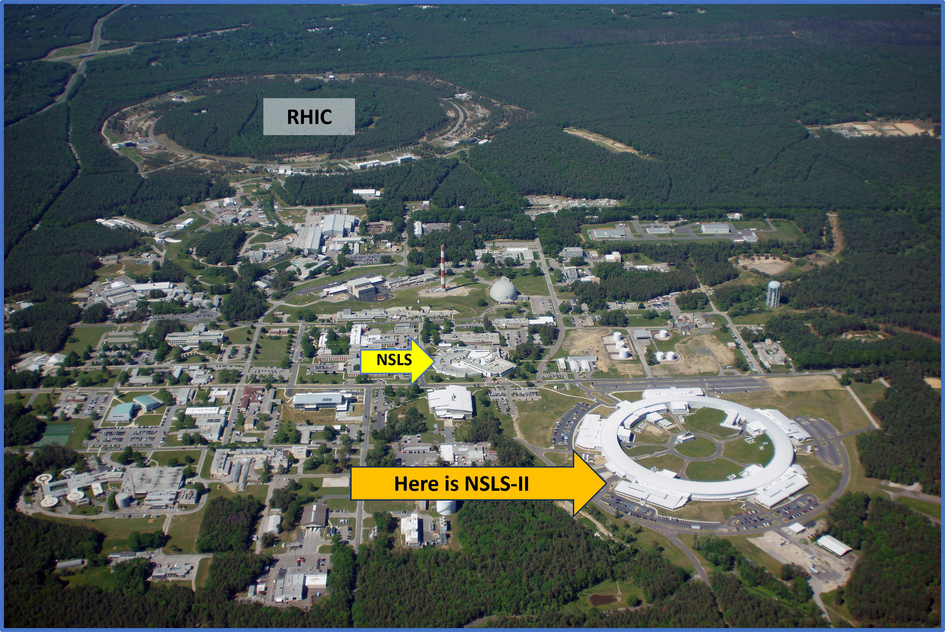
NSLS-II Accelerator Overview

Slide 4
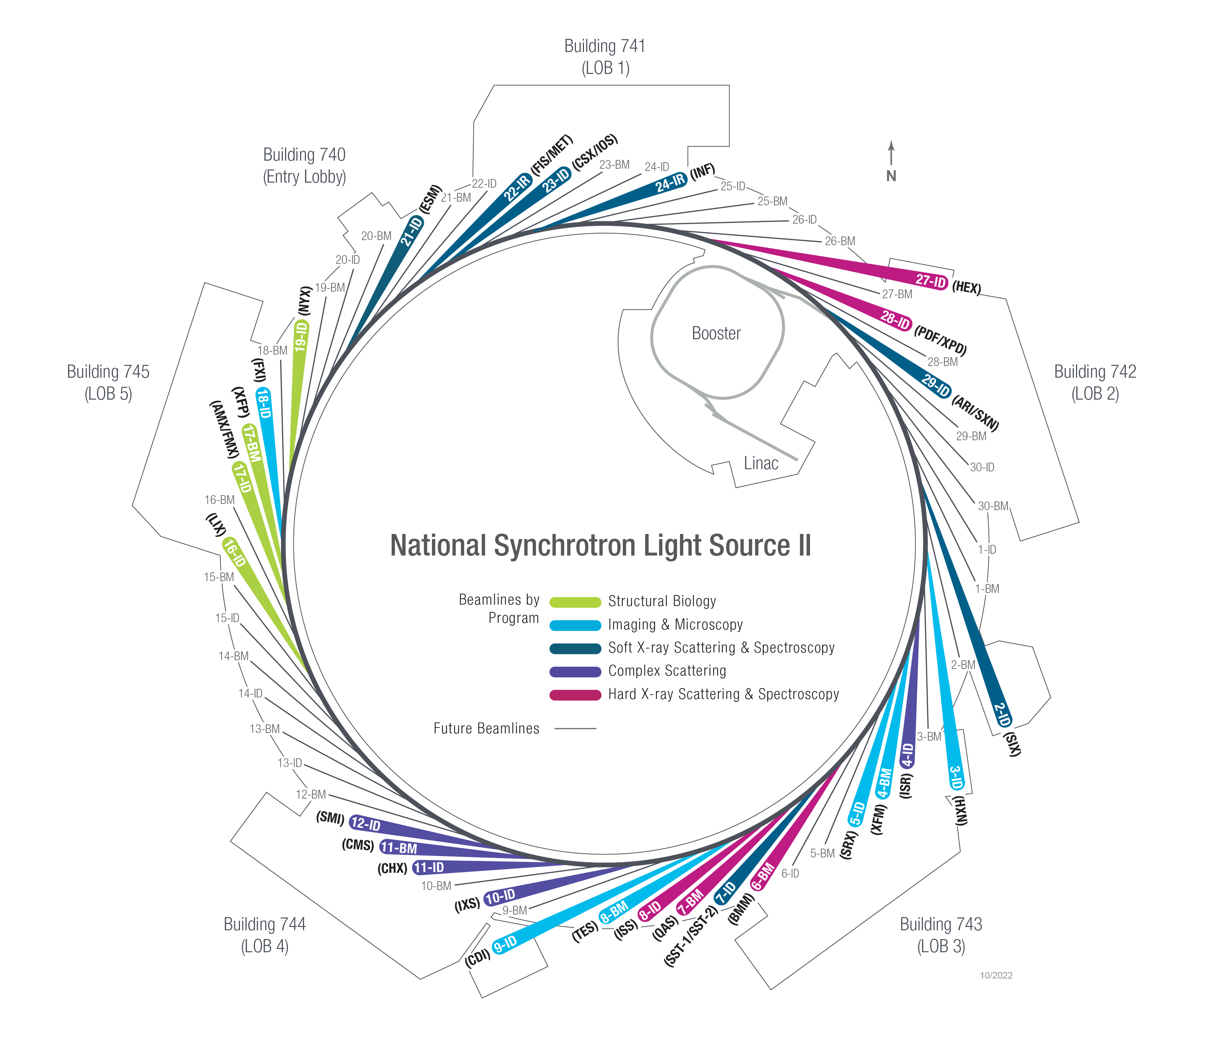
NSLS-II Accelerator Overview
STORAGE RING PARAMETERS
Ring circumference 792 m (.5 mile)
Ring Energy 3 Gev
Ring Current 500 mA
# Cells 30
Cell design type Double-Bend Achromat
Vertical emittance .008 nm-rad
Horizontal emittance .55 nm-rad
Time between bunches 2 ns
Revolution period 2.64 us
RF frequency 500 mHz
#RF Buckets 1320
# Bunches 1056
Active beamlines 31
Complex scattering 5
Hard X-ray scattering & spectroscopy 6
Soft X-Ray scattering & spectroscopy 12
Structural biology 5
Imaging & Microscopy 6

Slide 5
Accelerator Reliability
Reliability is % uptime when in Scheduled Ops.
Where can we reasonably gain in reliability?:
Fast Faults -
  Power dips, power supply trips, network outages, vacuum spikes, RF trips, cryo quenches, etc.
  Not especially predictable – actionable by system improvement, or reducing trip-recovery
Slow Faults
  Temperature, pressure, flow rate, ground current, etc.
  Trip usually initiated by Equipment Protection systems
  Actionable when caught early enough
Accelerator Reliability goal defined by DOE as 90%
NSLS-II Internal goal of 95%
NSLS2 regularly runs between 95-97% reliability
  …but 5% of 4800 hrs is still 240 hrs of downtime
Even in a reliable machine, downtime is a tangible burden on users.
How early?
One 2-day maintenance & one 1-day interlocks period w weekend studies, repeating every 3 weeks.
10 days minimum, 20 days preferred

Slide 6
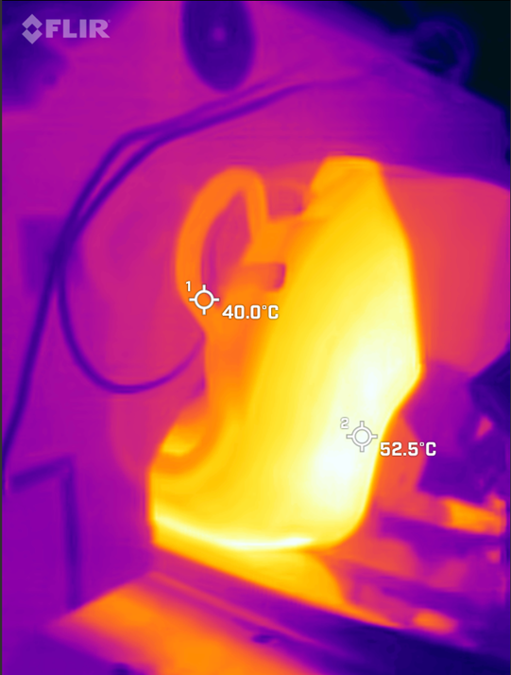
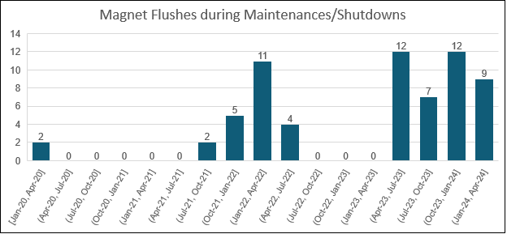
Magnet Temps & Cooling water system
Issue Summary: local clogs in magnet cooling-water system sporadically cause heating issues with magnets. Seen most in QM magnets.
Normal temps ~35C; Klixons will dump beam between 70-80C unless overridden; Experts will abort at 80C.
Overheating can cause permanent damage to magnets –
leading long & costly replacement.
Not the first time we’ve dealt with this issue
# of magnet cooling-water flushes, 3-month bins
Thermal camera image of a hot magnet.

Slide 7
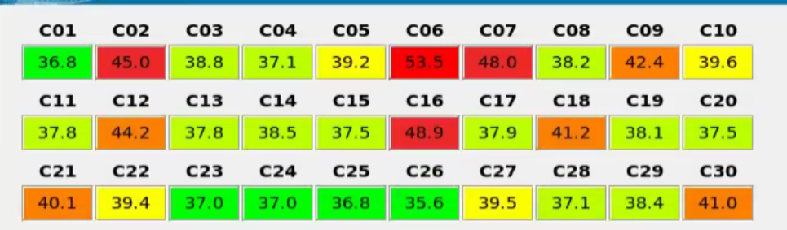
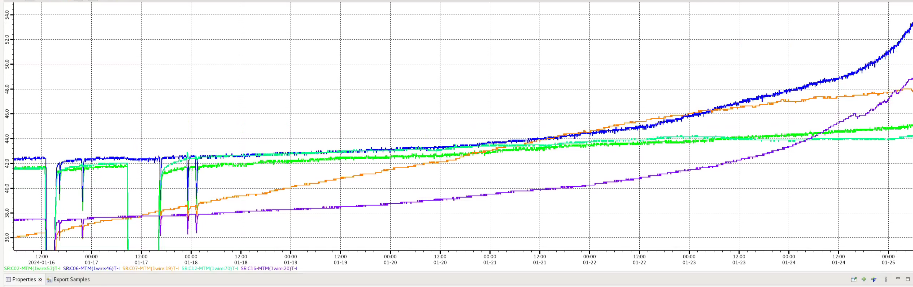
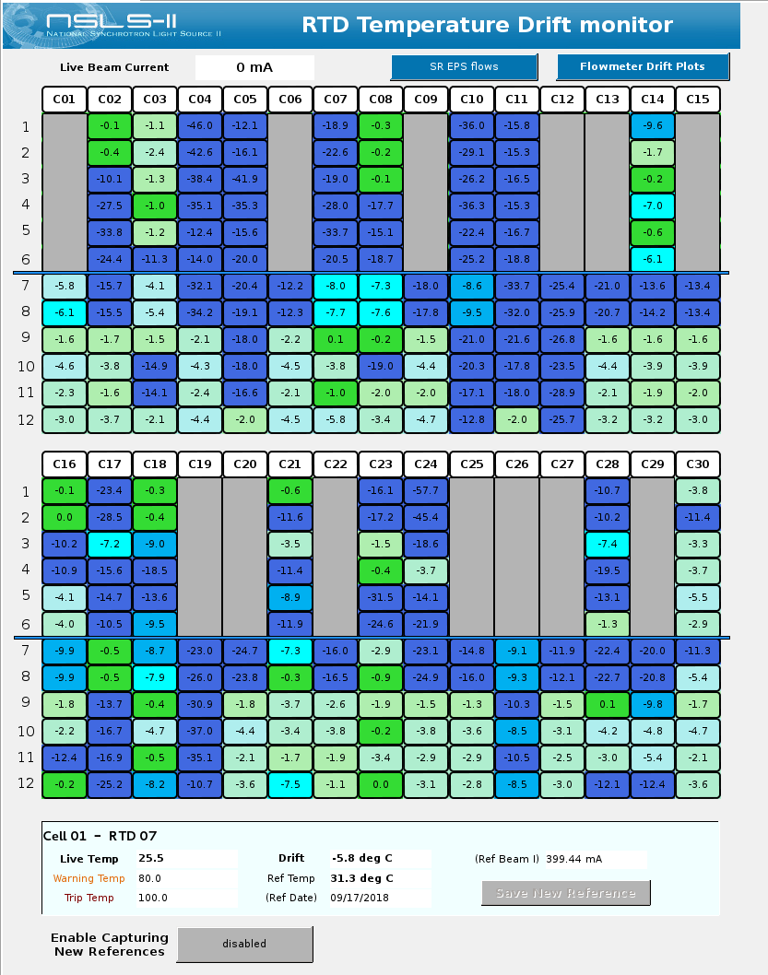
Magnet Temps: the run-up to Predictive Programs
Monitors:
  Plots (visual inspection)
  Alarms
  Calculating change over time (drift)
  Programmatic prediction…
2
1
Summary-alarm values of Magnet RTD temperatures. Alarms sound in the accelerator Control Room, email experts, etc.
3
Plot of quadrupole magnet temperatures in several ‘bad’ spots around the ring; rising over 10 days in January 2024.
Drift monitor shows difference between reference temp & current temp – colors indicate size of delta

Slide 8
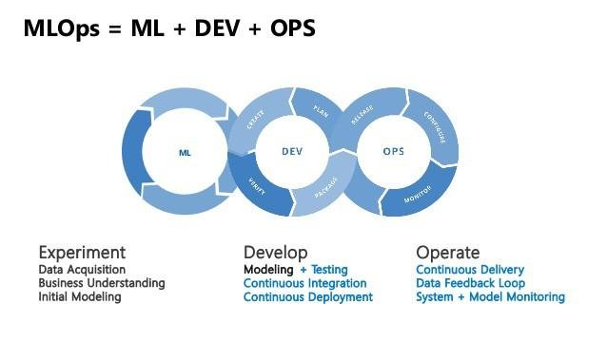
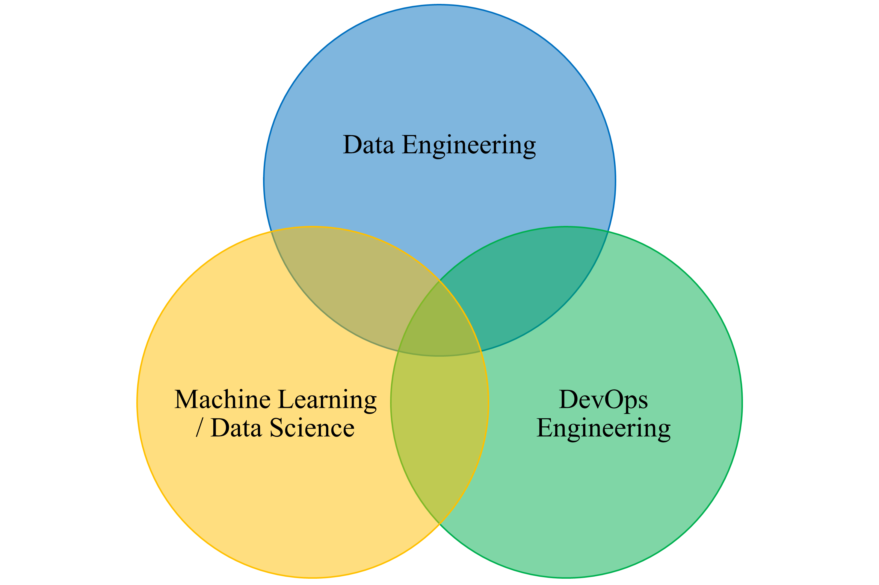
Machine Learning Operations
Development Philosophy
The name MLOps incorporates machine learning (ML), software development (DEV) and operations (OPS).
Machine Learning Operation is designed to incorporate machine learning engineering and DevOps to seek for data governance and deployment in production with reliability and scalability.
Slide content provided by Feng Bai

Slide 9
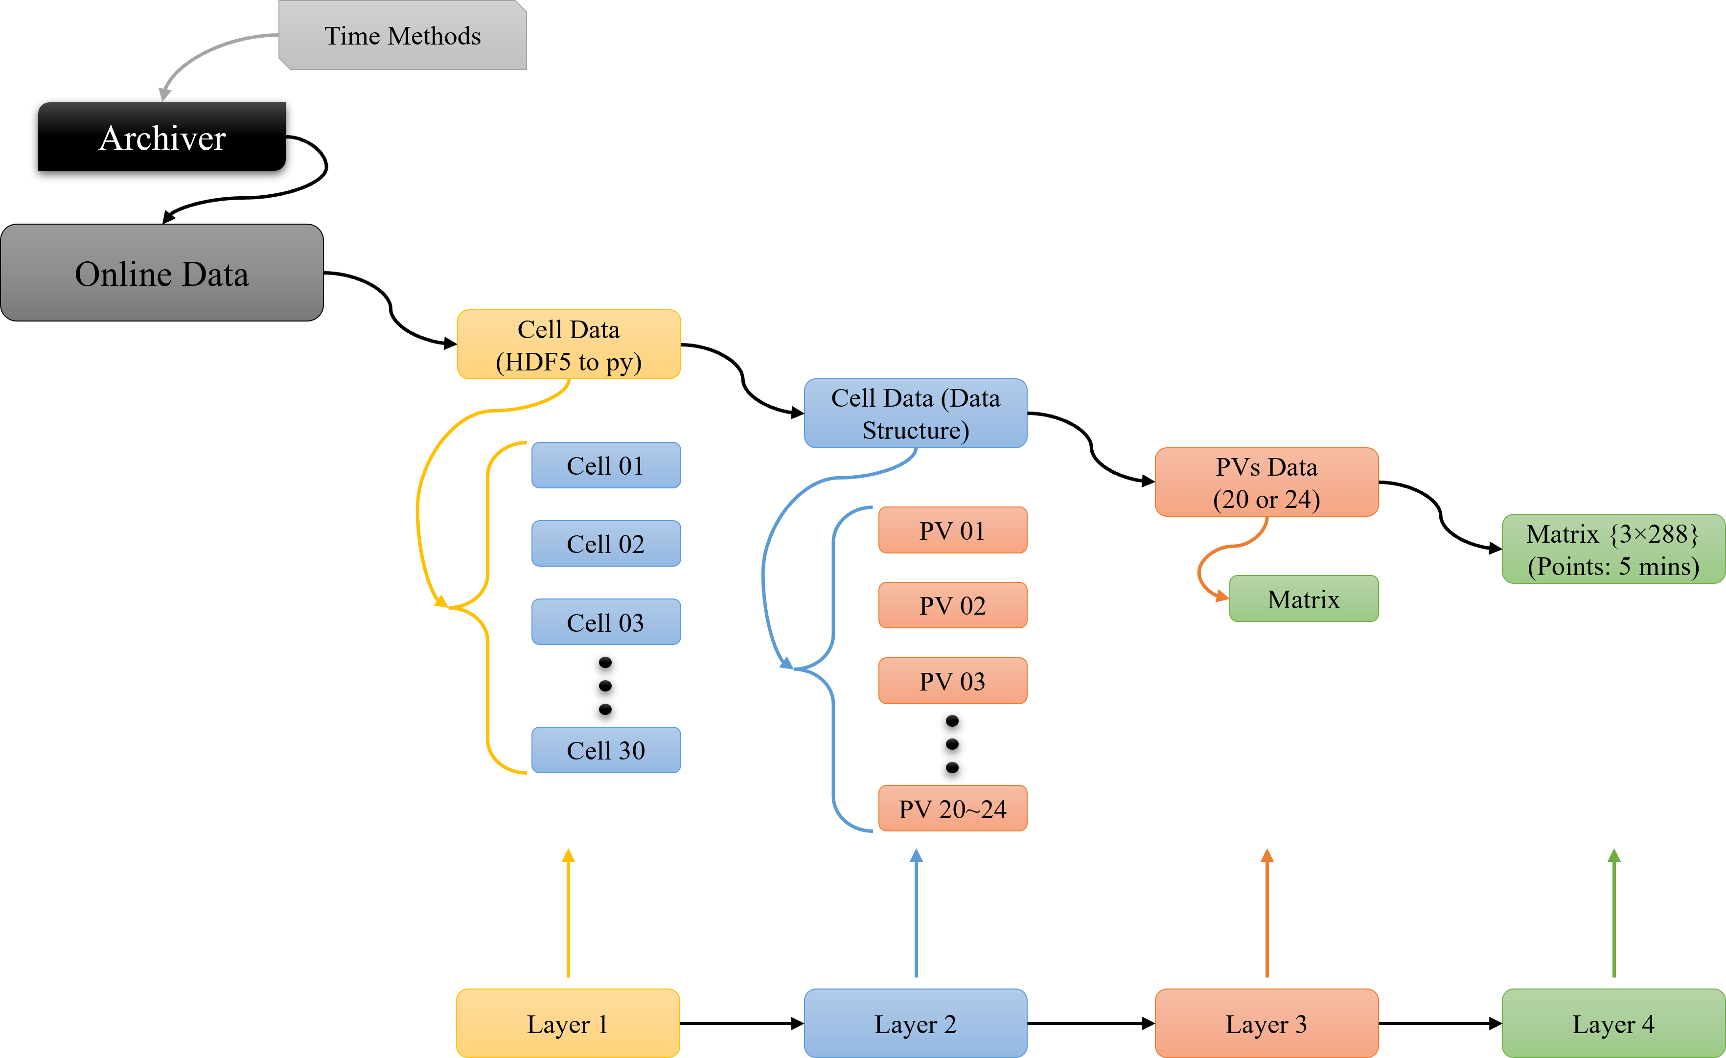
Data Structure for QM magnets
Data for all QM magnets around the ring handled in 4 layers:
Temperature data as a list of HDF5 files
30 Cells in NSLS-II storage ring.
4 sensors/magnet * 4-5 QM/cell =
20-24 PVs per cell
Temp data time series (288 meas/day @ 5 minute sampling rate) for each sensor
Slide content provided by Feng Bai

Slide 10
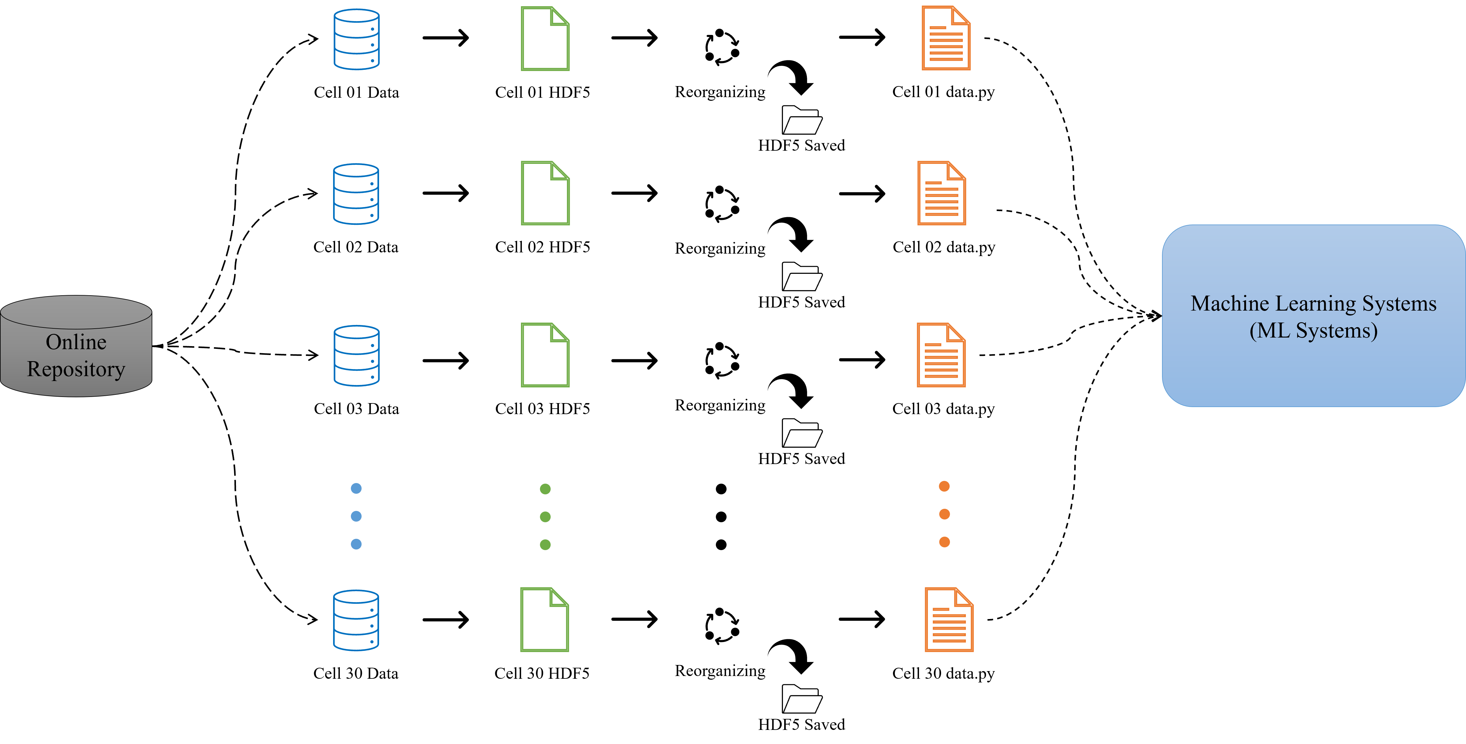
Data Engineering and Storage Systems
Data Structure for QM magnets
Q: What to do about asynchronous triggered data?
A: data sampled from archiver at fixed interval
(5 min by default)
Data Engineering includes:
1.) Data acquisition based on the network paths from online sensors.
2.) Raw data written into HDF5 files.
3.) Data transfer by reorganizing the raw data into self-structured data in .py files (we reorganize the sensor data into 5 minutes per point in time series)
Slide content provided by Feng Bai

Slide 11
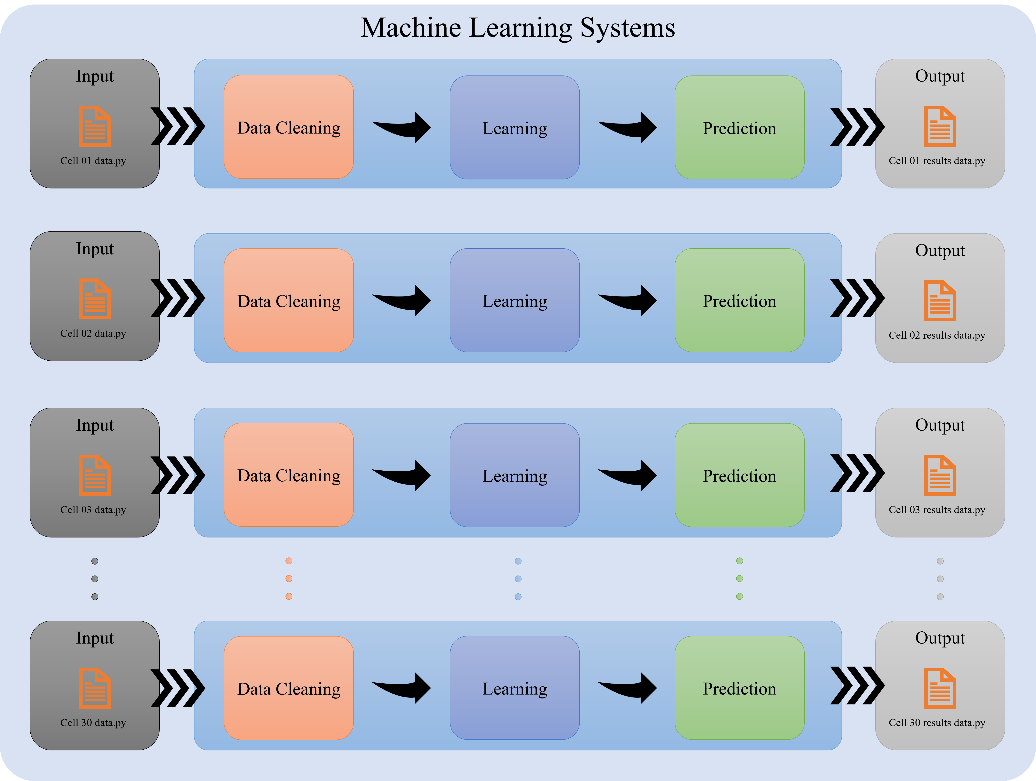
Machine Learning Systems (ML systems)
Data Structure for QM magnets
The input temperature data is retrieved from the archiver appliance, organized, processed, and the outputs are written to files and PVs.
There are three components in the ML systems that are parallelized:
Data Cleaning
Model/Learning
Prediction
Slide content provided by Feng Bai

Slide 12
1. Data Cleaning
Data Structure
Adjusting sensitivity to account for jitter “created by” sensor resolution
(0.125 C for our 1-wire sensors)
Filtering out outliers from sensor faults using isolation forest algorithm (over Euclid norms)
Outliers
Temperature
Temperature
Sensor Resolution
𝜀
regression model without outliers.
regression model including outliers.
regression model accounting for sensor resolution.
regression model without considering sensor resolution.
Time
Time
Outlier Detection (Linear regression case)
Sensor resolution (Linear regression case)
Slide content provided by Feng Bai

Slide 13
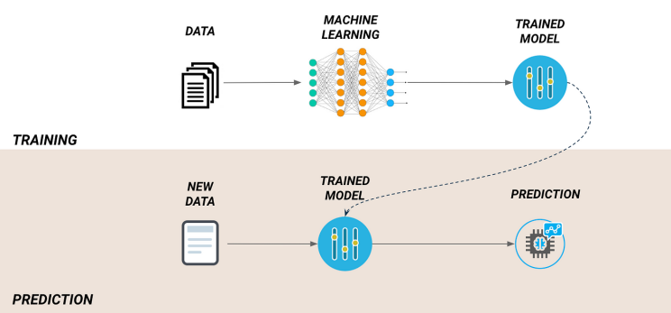
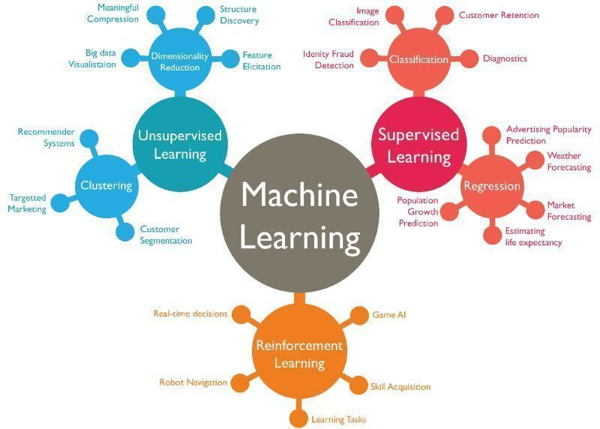
2. Modeling & Regression
Methods
3. Prediction
We use time-series data per PV make temperature prediction in the pipelines. We tried several regression methods and deep learning methods for online predictions.
1.) Linear Regression;
2.) Quadratic Regression;
3.) Nonlinear Exponential Regression;
4.) LSTM.
The newly trained ML models are used to model future behavior and predict temperatures at points in future.
Predictions/Parameters
ALL models:
Days to 40 C
T 3 days
T 7 days
T 14 days
T 30 days
Linear Fit:
Slope
Least sq error
Quadratic Fit:
Square coeff
Linear coeff
Least sq error
LSTM:
<shape parameters>
<error parameter(s)>
Slide content provided by Feng Bai

Slide 14
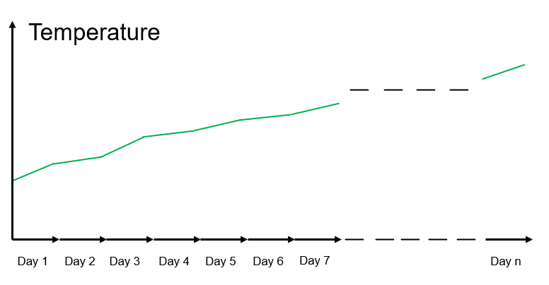
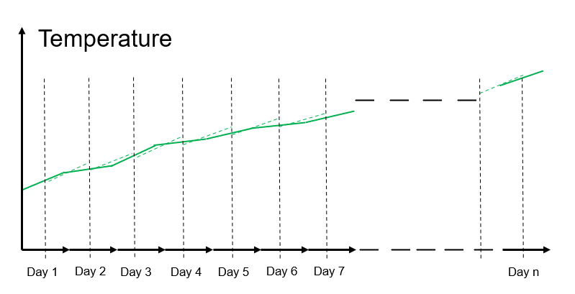

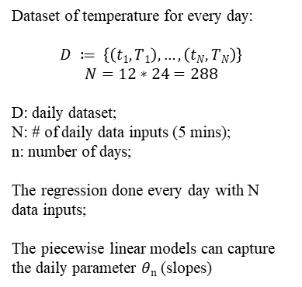

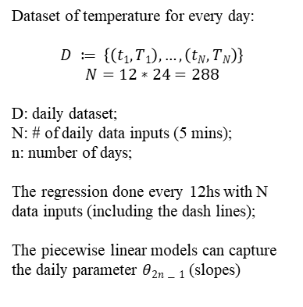
(Tested but Unused Prediction Models)
Piecewise Linear Model
Overlap Piecewise Linear Model
Dataset of temperature for every day:
$$D ≔ \left\{\left(t1,T1\right),…,\left(tN,TN\right)\right\}$$
$$N=12∗24=288$$
D: daily dataset;
N: # of daily data inputs (5 mins);
n: number of days;
The regression done every day with N data inputs;
The piecewise linear models can capture the daily parameter $θn$ (slopes)
Dataset of temperature for every day:
$$D ≔ \left\{\left(t1,T1\right),…,\left(tN,TN\right)\right\}$$
$$N=12∗24=288$$
D: daily dataset;
N: # of daily data inputs (5 mins);
n: number of days;
The regression done every 12hs with N data inputs (including the dash lines);
The piecewise linear models can capture the daily parameter $θ2n−1$ (slopes)
Linear Models, Lasso/ Ridge
1. Lasso
$\min_{θ∈𝕽}{\frac{1}{N}}\left\|T−Xθ\right\|$+λ$\left\|θ\right\|$₁
Strong Regularization
L1 Norm
2. Ridge
$\min_{θ∈𝕽}{\frac{1}{N}}\left\|T−Xθ\right\|$+λ$\left\|θ\right\|2$
Smooth Regularization
L2 Norm
Strong Regularization can feature the small parameters with the L1 norm distance to 0. However, Smooth Regularization just feature the characteristics of parameters gradually.
X: data inputs (daily time series temps), $θ$: output parameter
Slide content provided by Feng Bai

Slide 15
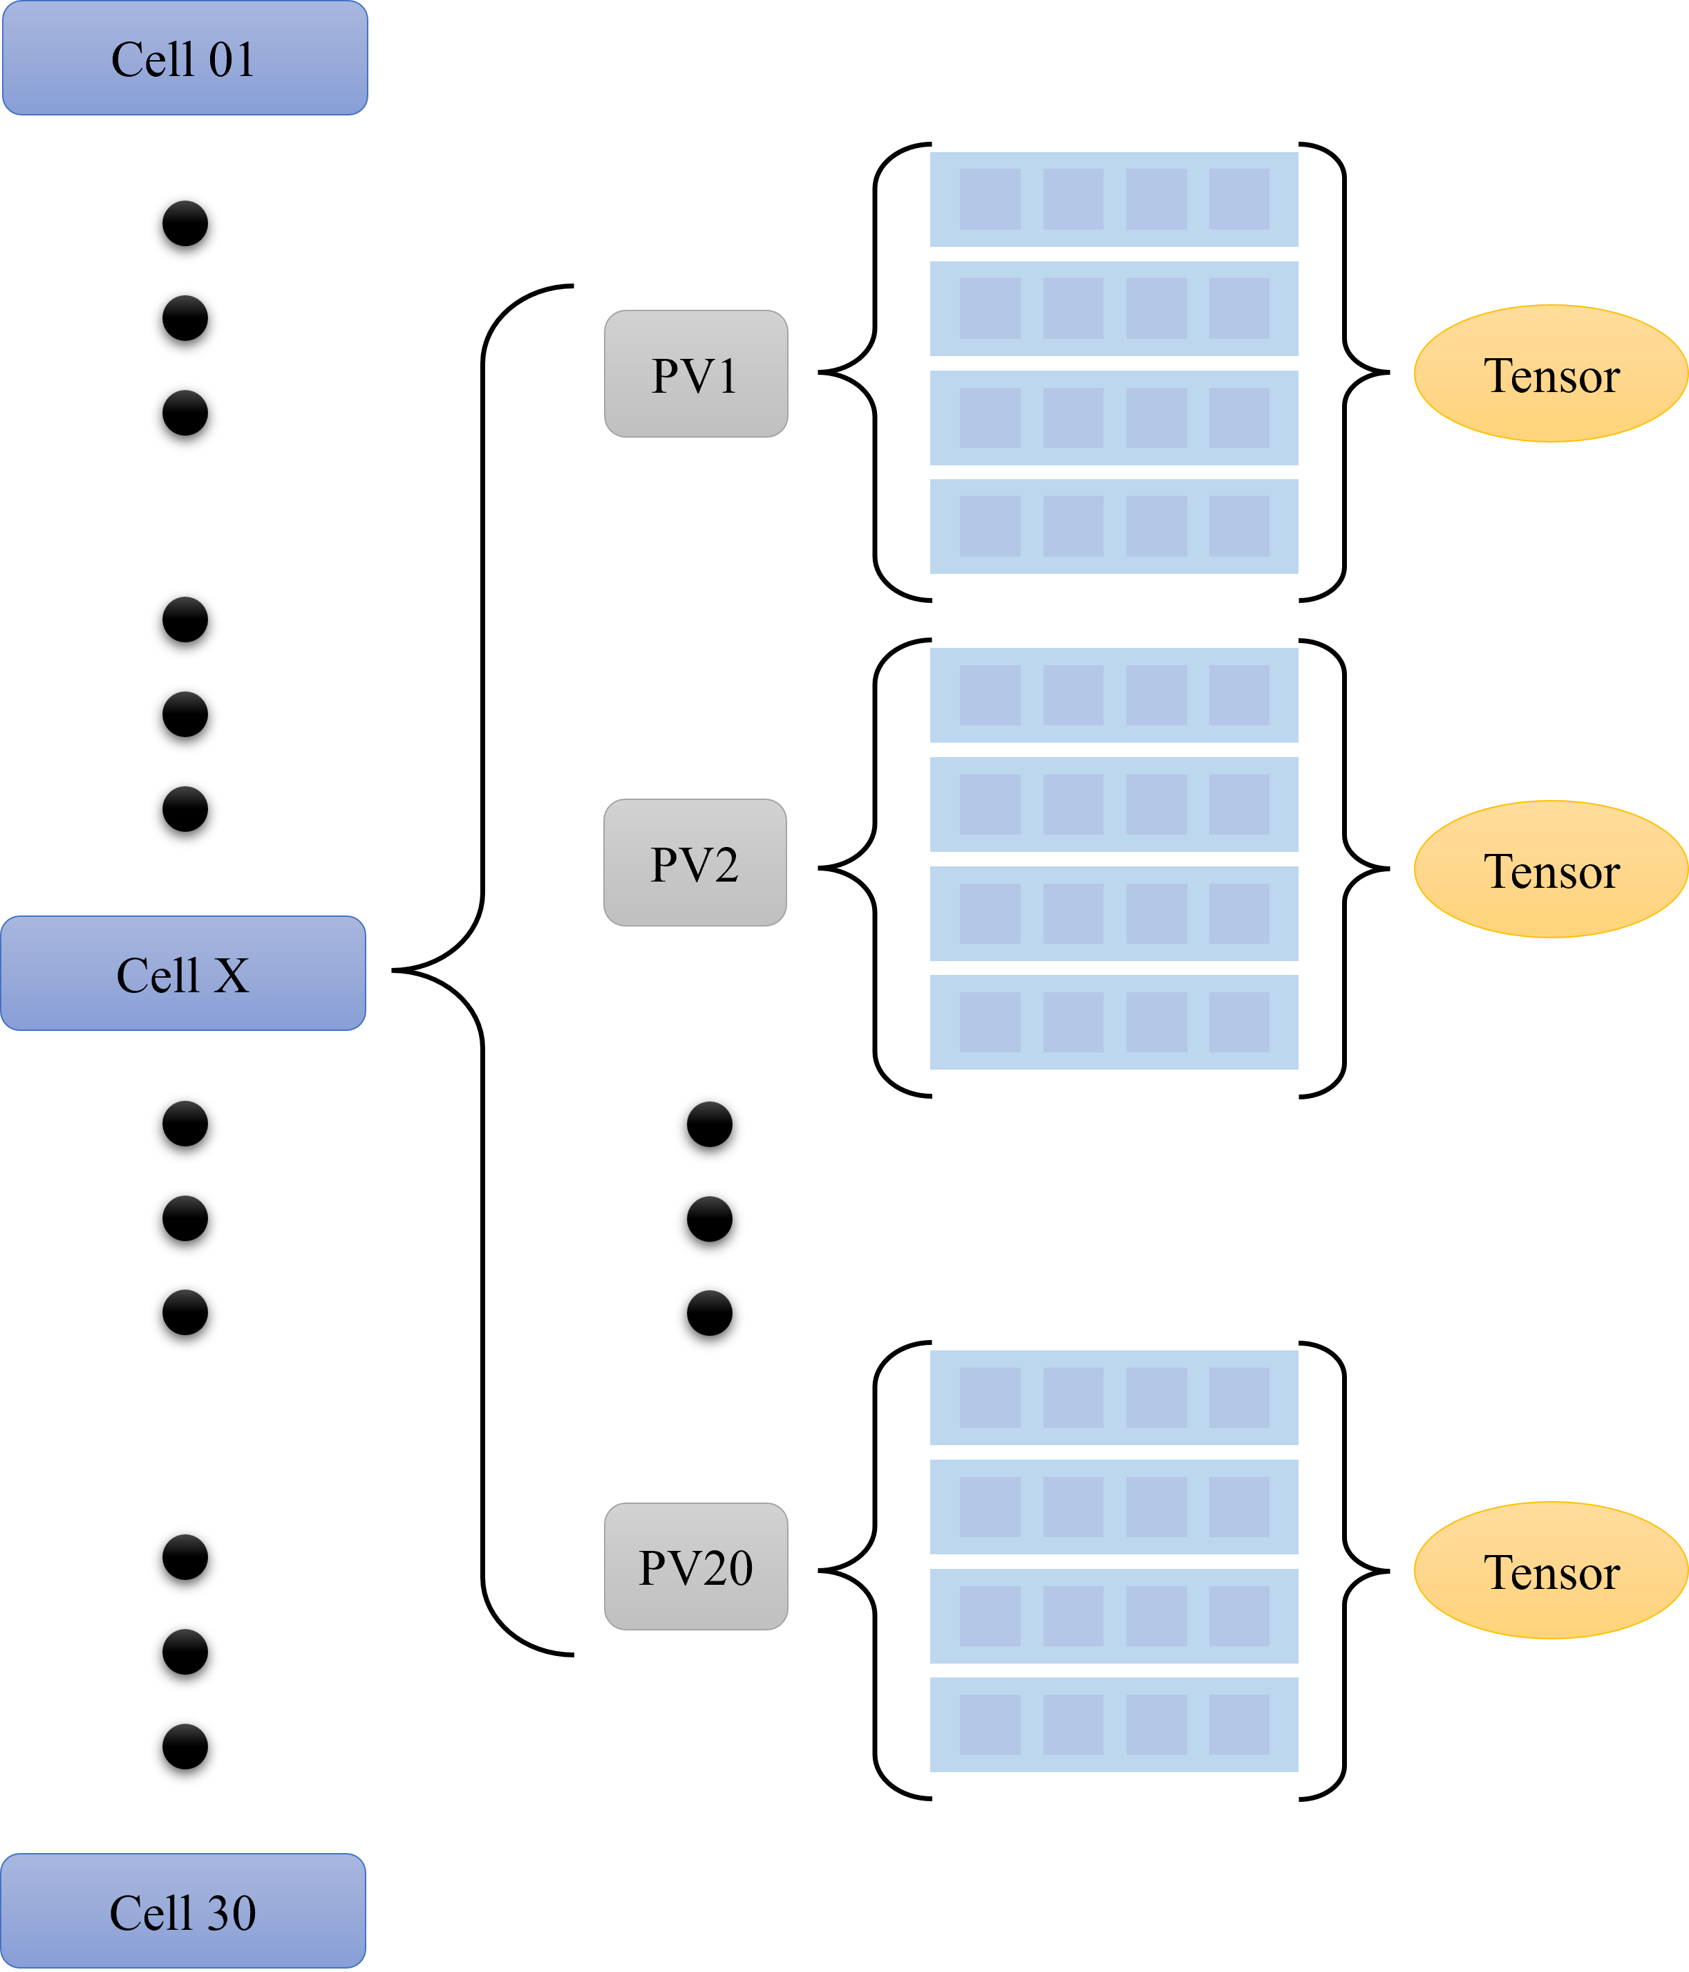
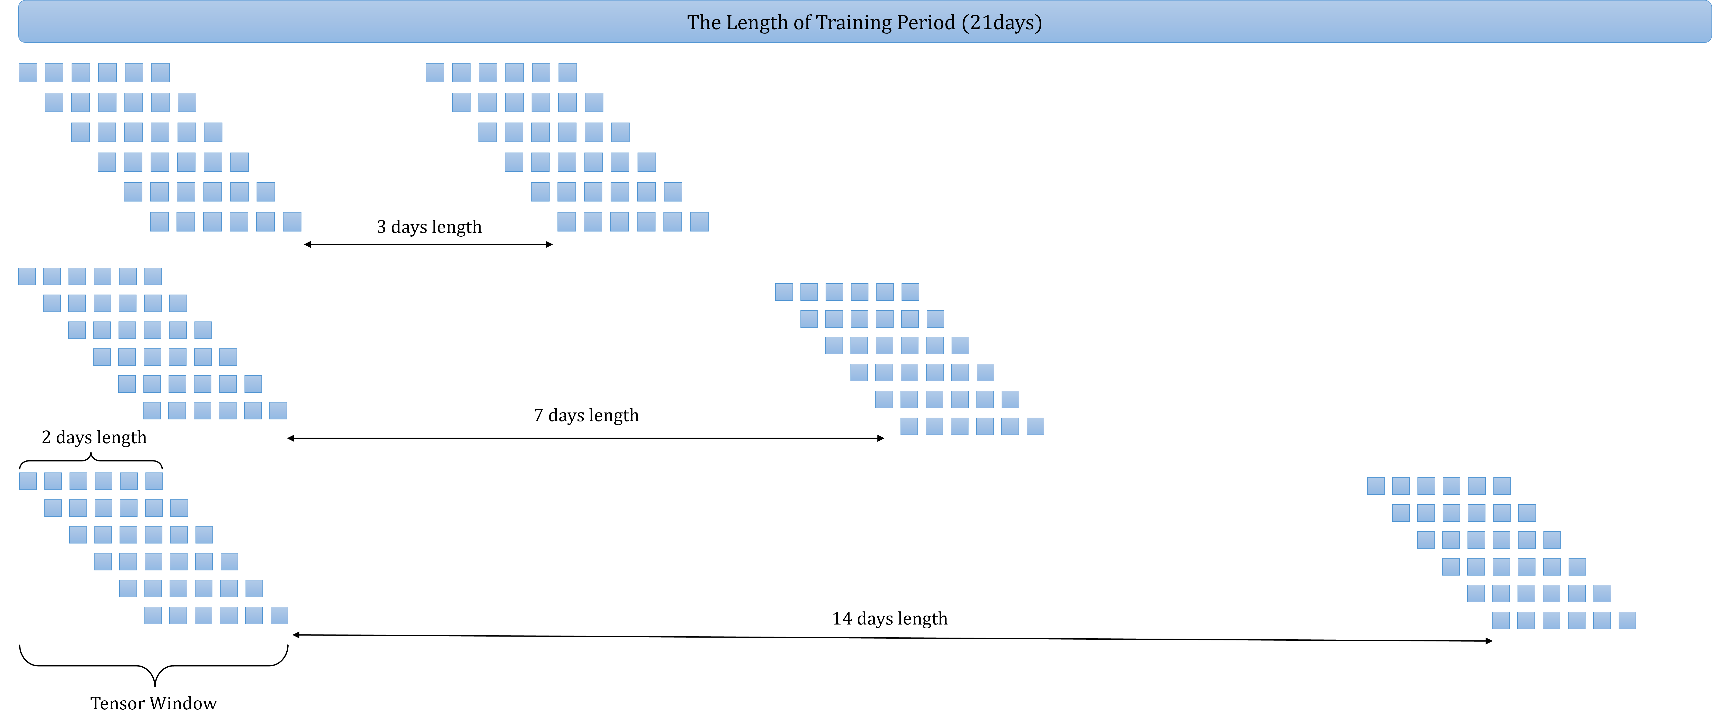
Machine Learning Methods: LSTM
(Tested but Unused Prediction Models)
The data structures in the LSTM are shown in distributed pipelines per PV, per cell.
The data in the training are displayed in tensor networks with the given period to form the “time window”.
Slide content provided by Feng Bai

Slide 16
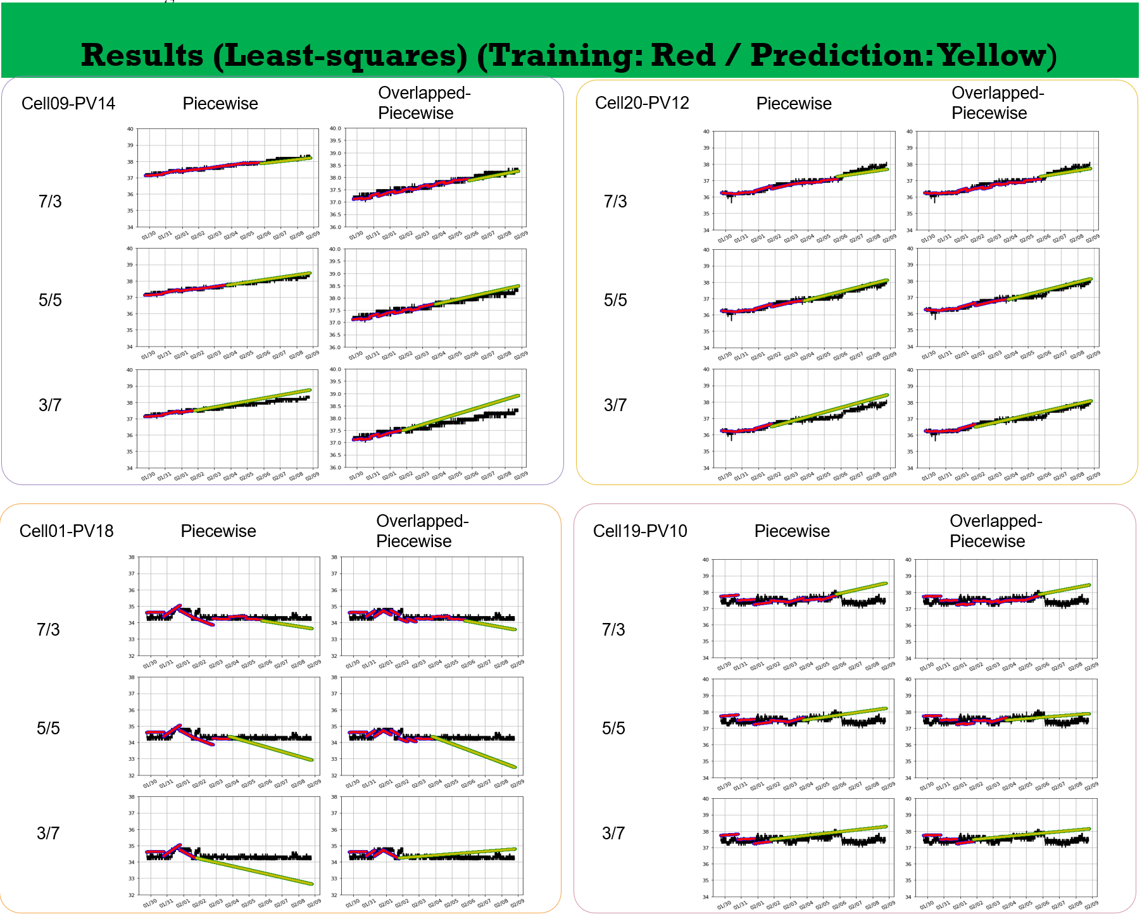
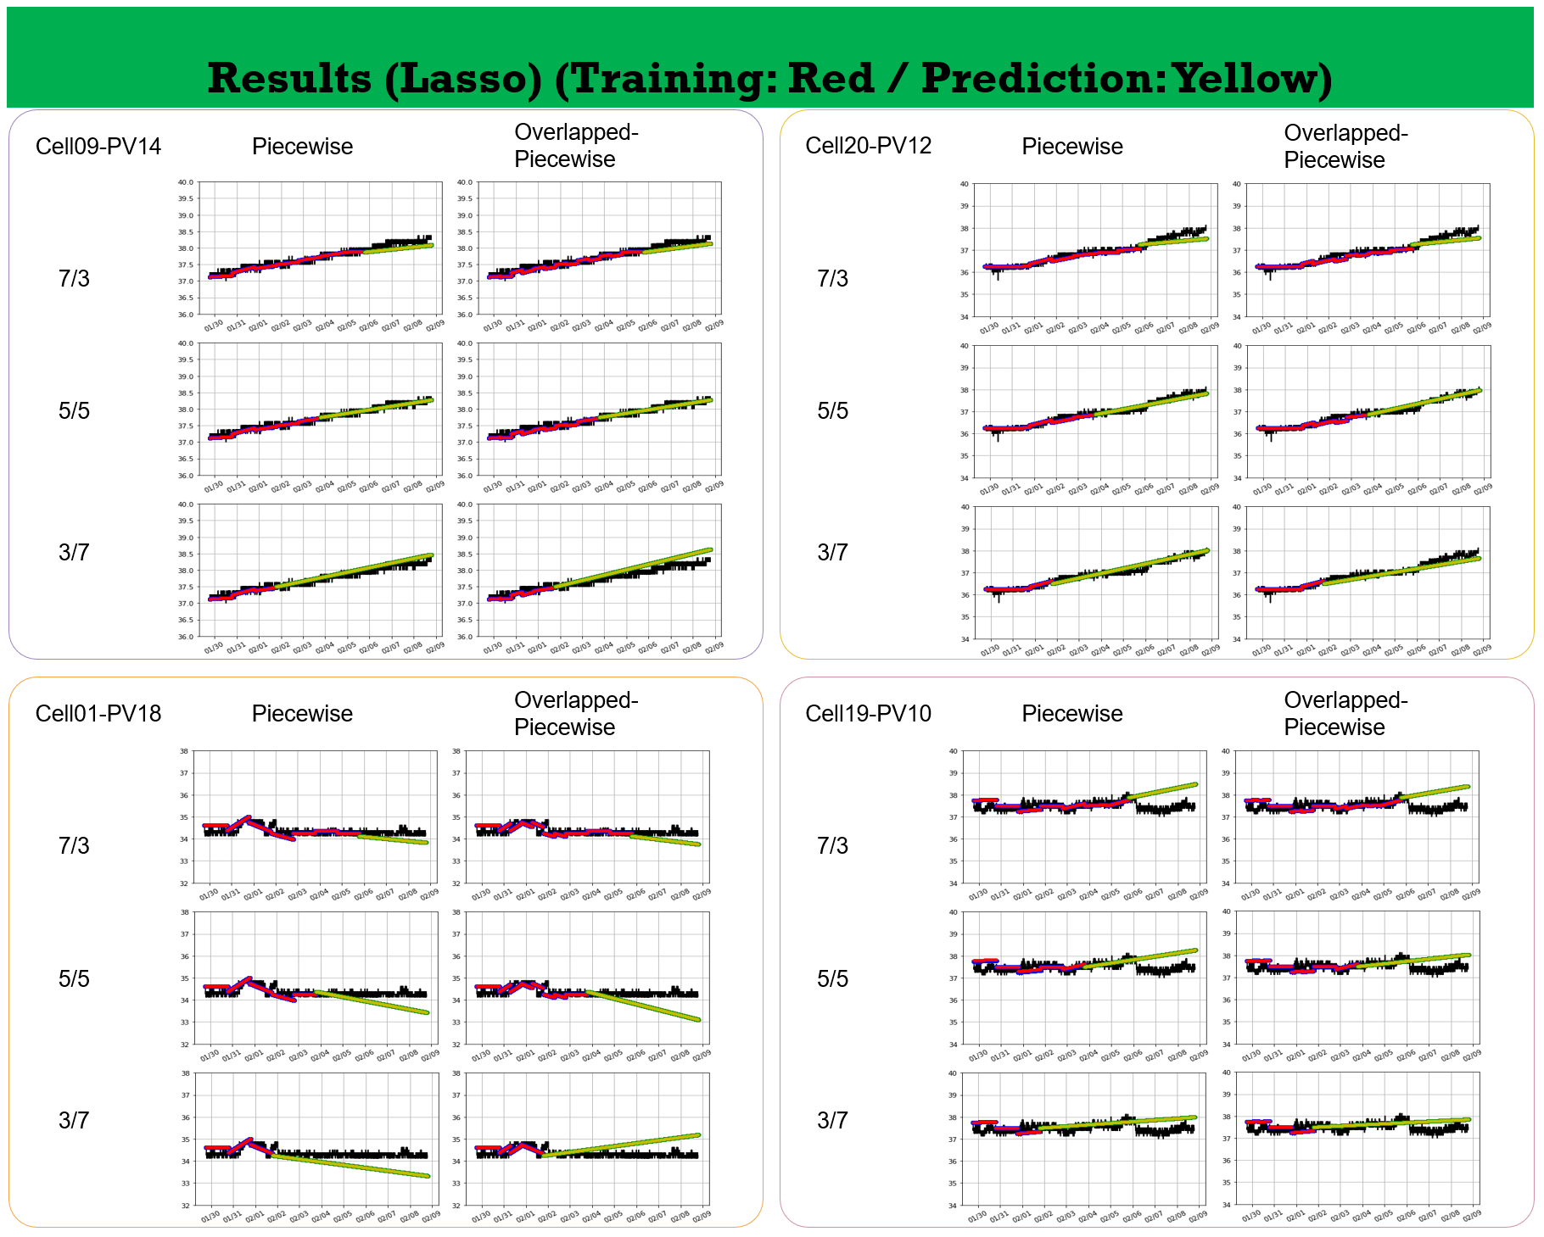
Results of Fitting
Shown: results of Linear/least-squares and Lasso models over a 10-day span.
In production: training and prediction periods are independent.
Better predictions with longer fitting dataset, EXCEPT:
Not able to deal with abnormalities in training set
Slide content provided by Feng Bai

Slide 17
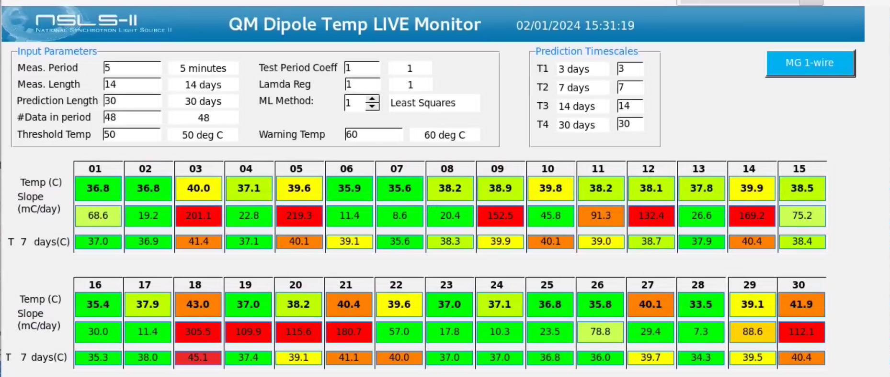
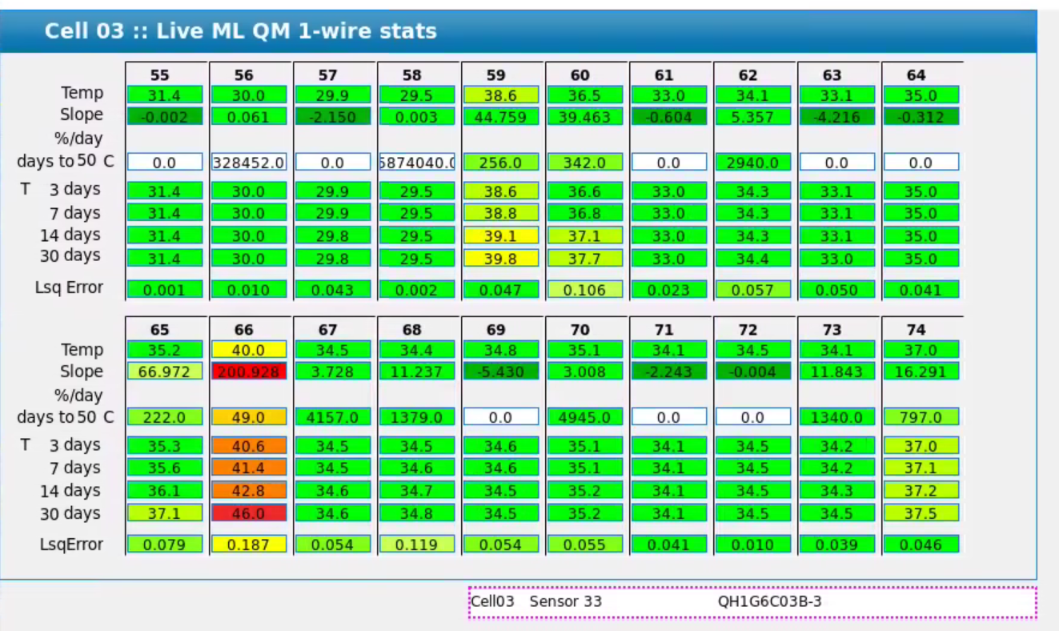
Predictions & Displays
Predictions/Parameters
Both models:
Days to 40 C
T in 3 days
T in 7 days
T in 14 days
T in 30 days
Linear Fit:
Slope
Least sq error
LSTM:
<shape parameters>
<error parameter(s)>
Using linear fit prediction right now.
Still testing learning-model fitting and prediction.

Slide 18
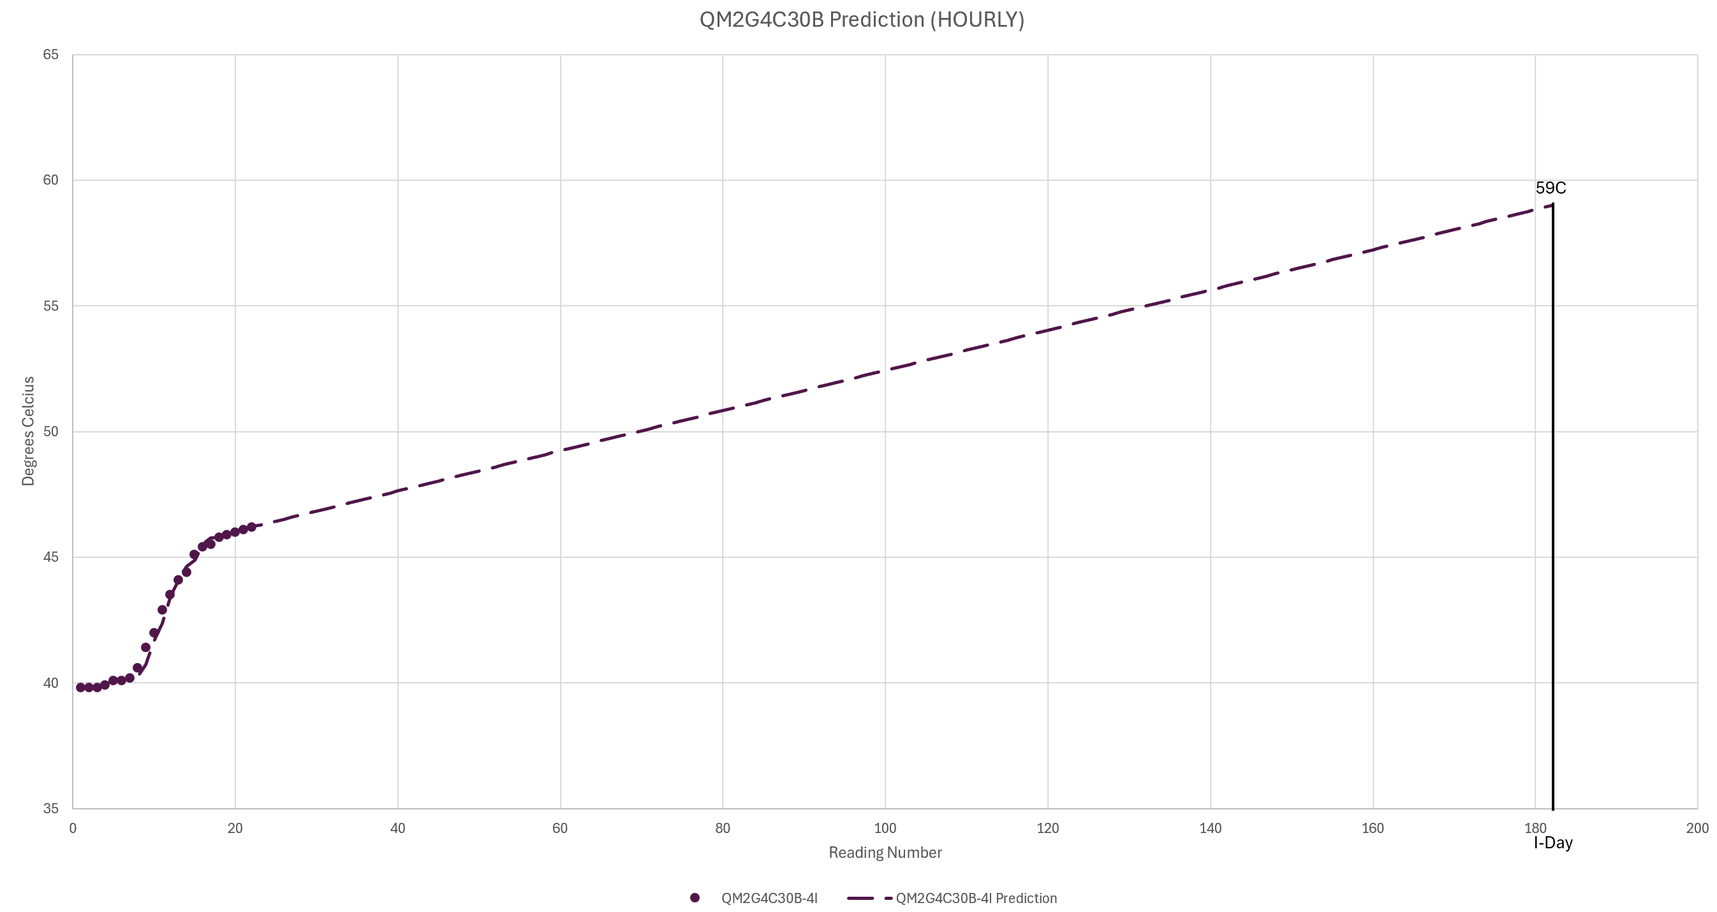
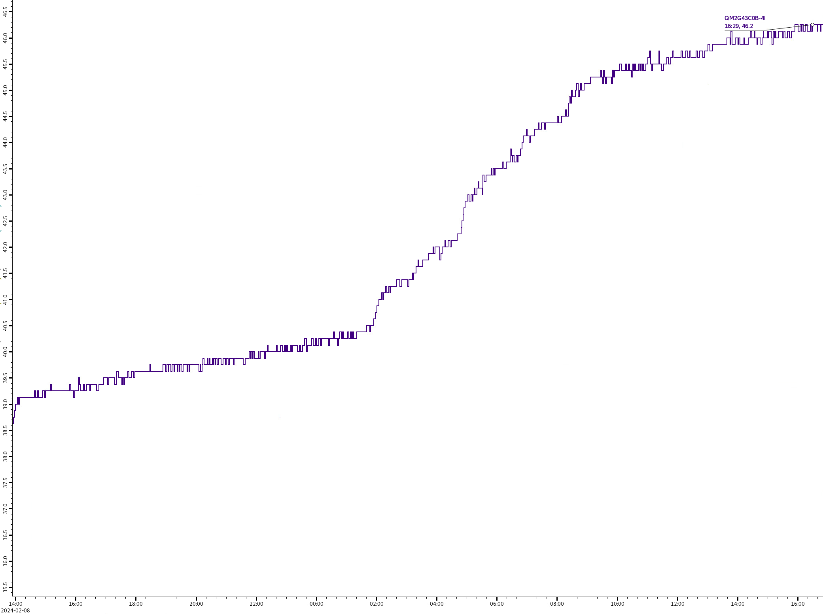
Use by Experts
Presently, EE & Mechanical groups are watching hot magnets.
Slope, temp predictions, and ‘time to threshold’ PVs are directing and replacing the same calculations being done by hand or in Excel, with much less time committed.
5 C
5 C

Slide 19
Strengths and limitations
Conclusions & Next Steps
Next steps & Future applications
+
Slope is a VERY helpful early warning.
Linear prediction catches magnets warming from ‘normal baseline’.
Changing time windows & thresholds can help adapt to situations.
Python; able to add features
-
Fitting models deal poorly with fast changes (repairs, clogs);
Even with perfect modeling, ‘sudden temp jumps’ in modeling time-window will result in bad predictions
LSTM learning model needs more data (both length & type) to be worth using
Next Steps
Expand ML model to use years of history, & other magnet/water readbacks
Decide if all QM temp datasets can be treated (& trained) interchangeably
Consider multivariable Transformer vs LSTM
Can we make a model to deal with sudden temp rise/drop separately?
Applied to QM Magnets
Need to expand scope to make learning model worthwhile:
  If ML is wanted, train using GPU cluster (for parallel processing)
Make the display easier for experts to use/scan:
Future Systems
Power supply ground currents
Possible use in RF and/or Cryo

Slide 20
Thanks to:
BNL: Feng Bai, Guimei Wang, Yoshi Hidaka, Jinhyuk Choi,
Wing Louie, Joseph Gormley, Brian Walsh, Michael Charumaneeroj
SLAC: Daniel Ratner, Finn O’Shea, Anwesha Das
ANL: Louis Emery, Nikita Kuklev, Ihar Lobach
Mar.07.2024

