Slide 1
Dynamic vacuum and temperature predictions for informed anomaly detection at the CERN-SPS
F.M. Velotti, M. Barnes, G. Favia, V. Kain

Slide 2
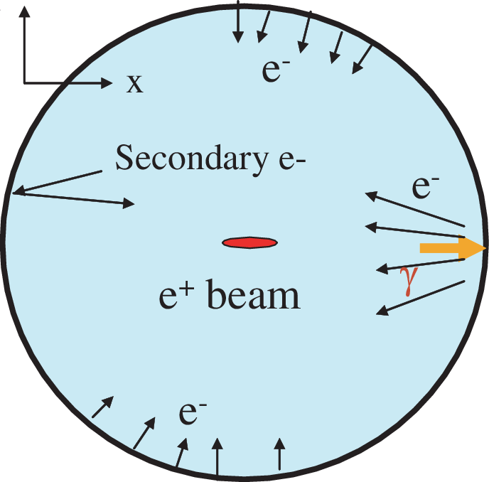
Motivation
Induced heating
Moving towards High Luminosity LHC → intensity effects induce high stress on sensitive equipment, e.g. kickers, septa…
Electron cloud, beam induced heating main responsible
Important source of unavailability of the CERN-SPS
  If kickers get too hot, risk to not be able to inject or damage them ➔ cool down needed
  If vacuum rises too much, high risk of breakdown in high voltage elements
~50% of call to stand-by service “just” for resets due to high vacuum/high temperature interlock trip
[Source]

Slide 3
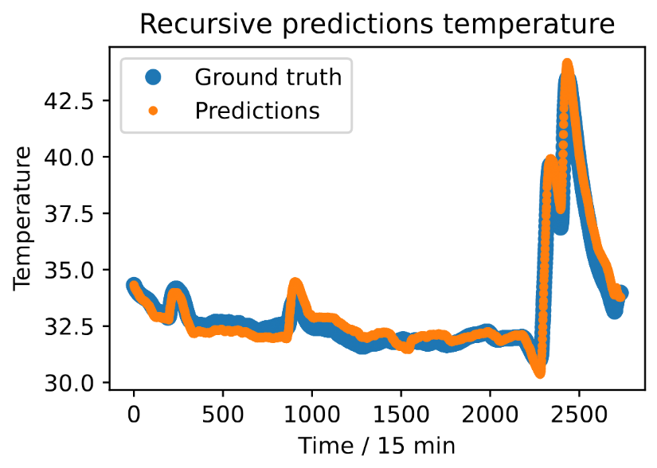
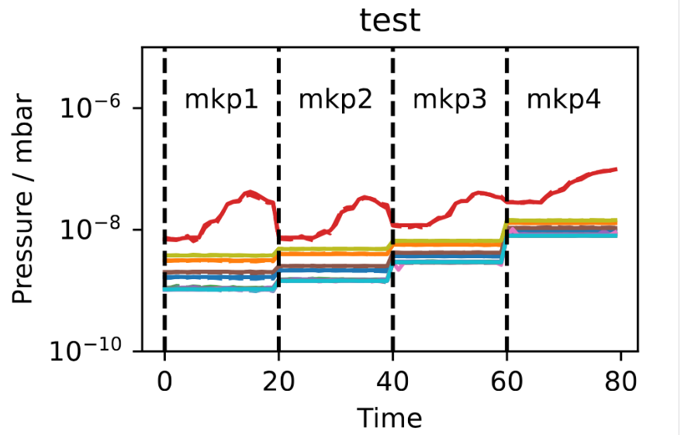
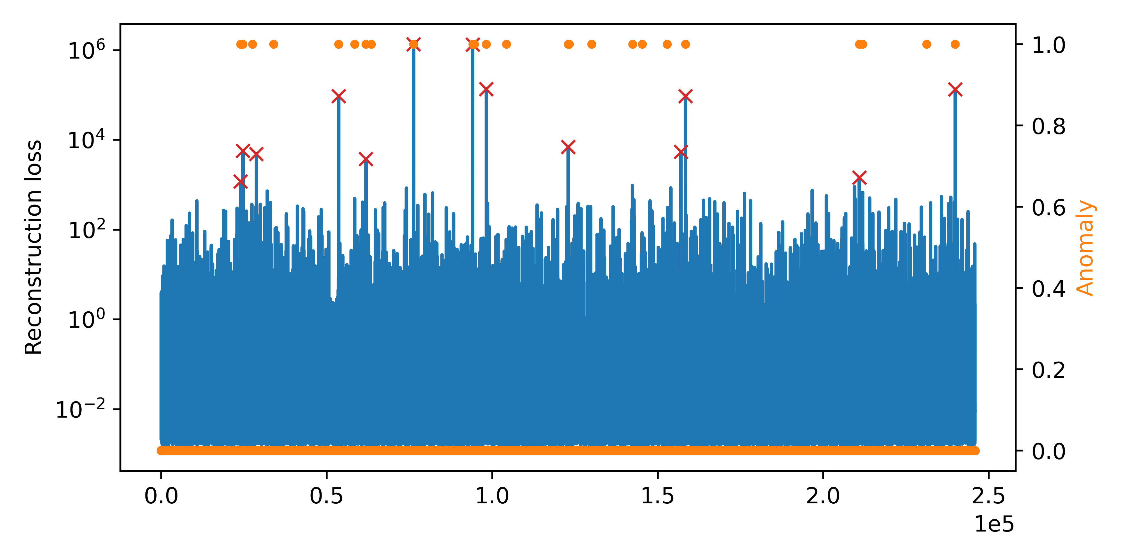
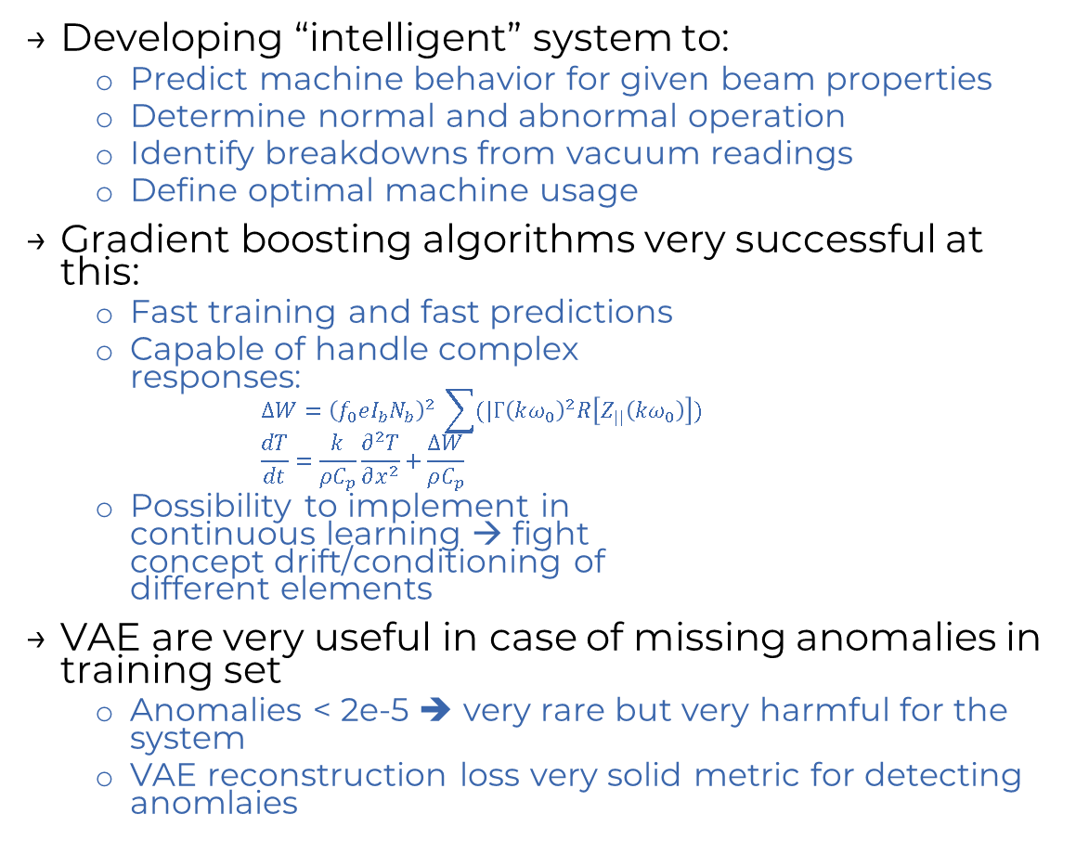
Possible solutions
Developing “intelligent” system to:
  Predict machine behavior for given beam properties
  Determine normal and abnormal operation
  Identify breakdowns from vacuum readings
  Define optimal machine usage
Gradient boosting algorithms very successful at this:
  Fast training and fast predictions
  Capable of handle complex
  responses:
  $ΔW={\left(f_{0}eI_{b}N_{b}\right)}^{2} \sum{(|Γ{\left(kω_{0}\right)}^{2}R\left[Z_{||}\left(kω_{0}\right)\right])}$
  $\frac{dT}{dt}=\frac{k}{ρC_{p}}\frac{∂^{2}T}{∂x^{2}}+\frac{ΔW}{ρC_{p}}$
  Possibility to implement in
  continuous learning → fight
  concept drift/conditioning of
  different elements
VAE are very useful in case of missing anomalies in training set
  Anomalies < 2e-5 ➔ very rare but very harmful for the system
  VAE reconstruction loss very solid metric for detecting anomlaies

