Slide 1
Transformers for Time Series
Not just for Natural Language tasks
Anton Lu
Verena Kain, Michael Schenk, Borja Rodrigo Mateos
Data Science for Beam Operations
Beams Department
CERN
ICFA MLAPA Workshop 2024, Gyeong-ju, Korea
Notes:
* Notebook prepared akin to tensorflow transformer for machine translation notebook
* Not so heavy on theory, will skim through notebook. Interested parties can look at it at the same time and later.

Slide 2
Contents
    Time series overview
    Deconstructing the Transformer
    Hands-on
    Advanced Architectures
    Conclusions

Slide 3
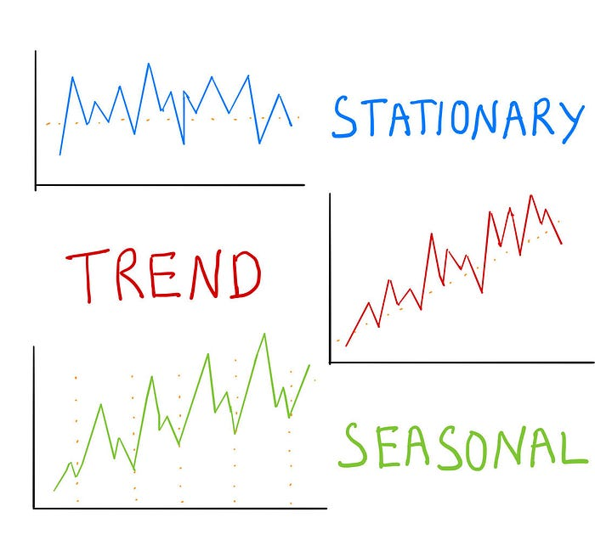
Time Series
Come in different forms
Time series consist of
  Data points ordered in time
  Preferably in regular intervals
  Typically, 3 (or 4) main components
Time axis not strictly needed but helpful to
  Order data
  Perform analysis, like in finance and prediction of natural or artificial phenomenon
  Temporal resolution of the time series depends on the use-case
    Often in minutes, hours, days, weeks, month, ...
    Sub-second resolution is not as common
Examples:
Electricity
Weather
Stock prices

Slide 4
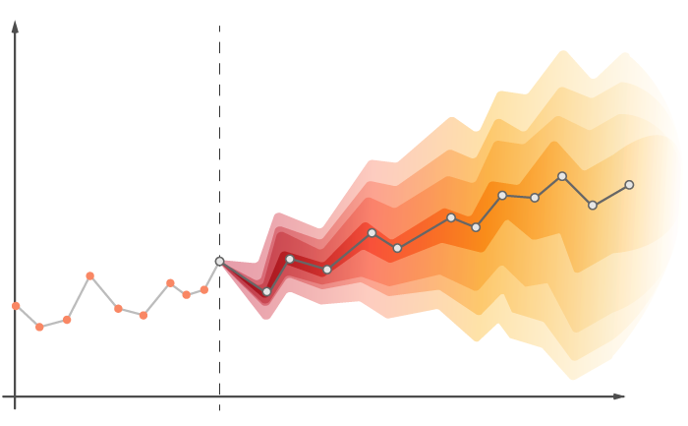
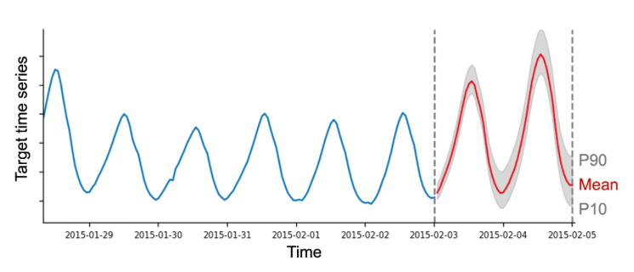
Time Series Forecasting
Predicting the future
Univariate forecasting
Multivariate forecasting
Single time series forecasting (with time)
  The future may be forecasted just by looking at the past
Analysis and ML forecasting methods for this is widely researched
  Simple methods like moving average, regression and basic neural networks can often be sufficient, depending on the accuracy required
Forecasting with multiple time series
  Access to conditional past and future data, both continuous and categorical
Accurate forecasting is a difficult task
  Dependency on multiple covariates
  Long-range dependencies
  Inherent uncertainty in input and target data
Long-term Time Series Forecasting (LTSF) a rapidly expanding field in ML
  But depending on the task, high-precision forecasting is not so commonly seen
Notes:
The one missing is irregular component (noise)
https://medium.com/@ritusantra/what-is-time-series-and-components-of-time-series-c80b69ad5cb9
Temperature prediction of cryostats
Magnetic field evolution as a function of current (and time…)
Can be seen as multivariate time series “forecasting”
Diagnostics systems in particle accelerators often read out data at k/M/G Hz that can be represented as a time series
The temporal axis is implicitly embedded in the data
Naïve univariate forecasting not possible if there are phenomenon that cannot be learned from data
Time series often have a lagging time dependency on other covariates, which can become apparent in higher temporal resolutions
Large amount of data makes forecasting challenging, especially for longer prediction horizons and high precision
Fast evolving dynamics over long time horizons AND dependency on other covariates are especially challenging

Slide 5
Time Series Forecasting
Predicting the future
Univariate forecasting
Multivariate forecasting
Single time series forecasting (with time)
  The future may be forecasted just by looking at the past
Analysis and ML forecasting methods for this is widely researched
  Simple methods like moving average, regression and basic neural networks can often be sufficient, depending on the accuracy required
Forecasting with multiple time series
  Access to conditional past and future data, both continuous and categorical
Accurate forecasting is a difficult task
  Dependency on multiple covariates
  Long-range dependencies
  Inherent uncertainty in input and target data
Notes:
Diagnostics systems in particle accelerators often read out data at k/M/G Hz that can be represented as a time series
The temporal axis is implicitly embedded in the data
Naïve univariate forecasting not possible if there are phenomenon that cannot be learned from data
Time series often have a lagging time dependency on other covariates, which can become apparent in higher temporal resolutions
Large amount of data makes forecasting challenging, especially for longer prediction horizons and high precision
Fast evolving dynamics over long time horizons AND dependency on other covariates are especially challenging

Slide 6
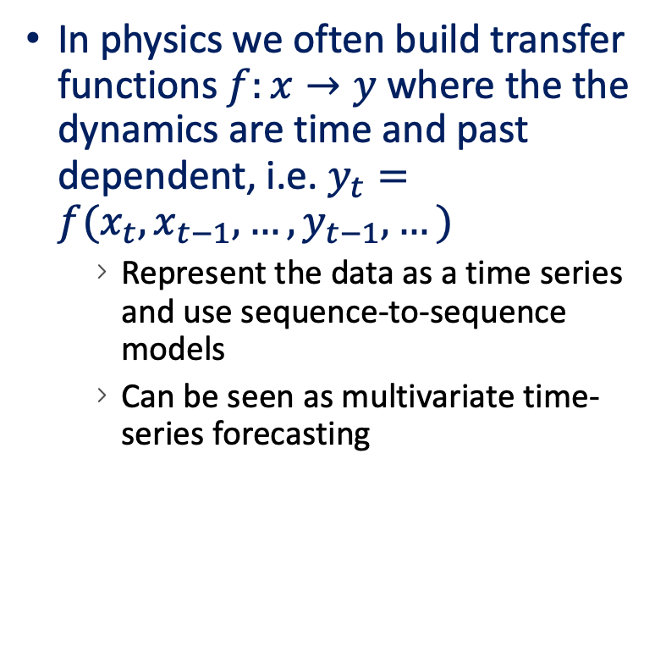
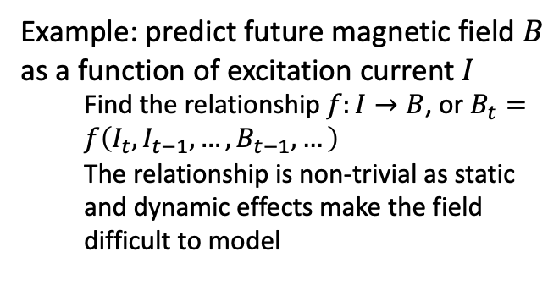
Sequence-to-Sequence neural models
Is this Forecasting?
Example: predict future magnetic field $B$ as a function of excitation current $I$
  Find the relationship $f:I→B$, or $B_{t}=f\left(I_{t}, I_{t−1}, …, B_{t−1}, …\right)$
  The relationship is non-trivial as static and dynamic effects make the field difficult to model
In physics we often build transfer functions $f:x→y$ where the the dynamics are time and past dependent, i.e. $y_{t}=f(x_{t}, x_{t−1}, …,y_{t−1},…)$
  Represent the data as a time series and use sequence-to-sequence models
  Can be seen as multivariate time-series forecasting
past
future
EXAMPLE

Slide 7
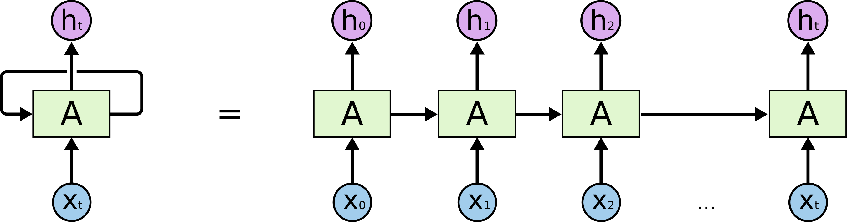

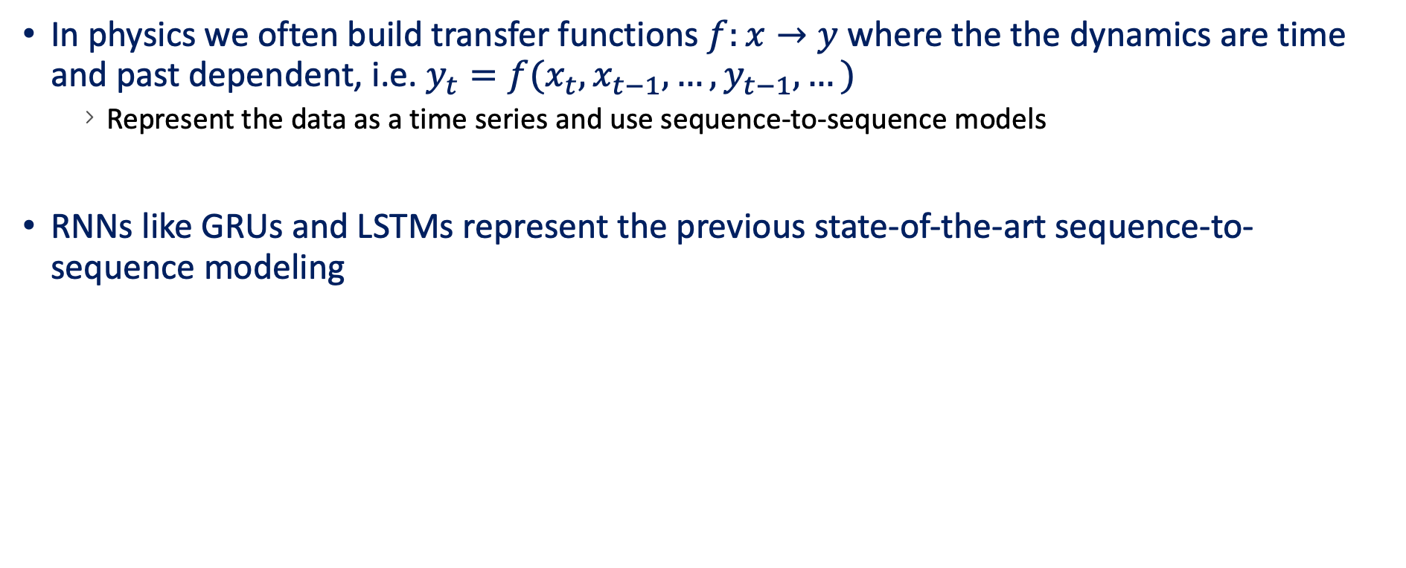



Sequence-to-Sequence neural models
Recurrent Neural Networks
In physics we often build transfer functions $f:x→y$ where the the dynamics are time and past dependent, i.e. $y_{t}=f(x_{t}, x_{t−1}, …,y_{t−1},…)$
  Represent the data as a time series and use sequence-to-sequence models
RNNs like GRUs and LSTMs represent the previous state-of-the-art sequence-to-sequence modeling
Example: $B→B$
$${\left\{B_{t}\right\}}_{t=0:T−1}$$
$${\left\{B_{t}\right\}}_{t=T:…}$$
$$f$$
Notes:
LSTM solves gradient vanishing and long-term dependency modeling, but are not easily parallizable, the recurrent architecture allowed passing of hidden state between timesteps

Slide 8



Sequence-to-Sequence neural models
Recurrent Neural Networks
In physics we often build transfer functions $f:x→y$ where the the dynamics are time and past dependent, i.e. $y_{t}=f(x_{t}, x_{t−1}, …,y_{t−1},…)$
  Represent the data as a time series and use sequence-to-sequence models
RNNs like GRUs and LSTMs represent the previous state-of-the-art sequence-to-sequence modeling
Example: $I→B$
$${\{I_{t}\}}_{t=T:…}$$
$${\left\{B_{t}\right\}}_{t=T:…}$$
$$f$$
Notes:
LSTM solves gradient vanishing and long-term dependency modeling, but are not easily parallizable, the recurrent architecture allowed passing of hidden state between timesteps

Slide 9


Sequence-to-Sequence neural models
Recurrent Neural Networks
In physics we often build transfer functions $f:x→y$ where the the dynamics are time and past dependent, i.e. $y_{t}=f(x_{t}, x_{t−1}, …,y_{t−1},…)$
  Represent the data as a time series and use sequence-to-sequence models
RNNs like GRUs and LSTMs represent the previous state-of-the-art sequence-to-sequence modeling
Example: $I→B$
$${\{I_{t}\}}_{t=0:…}$$
$${\left\{B_{t}\right\}}_{t=0:T−1}$$
$${\left\{B_{t}\right\}}_{t=T:…}$$
$$f$$
Notes:
LSTM solves gradient vanishing and long-term dependency modeling, but are not easily parallizable, the recurrent architecture allowed passing of hidden state between timesteps

Slide 10

Sequence-to-Sequence neural models
Enter the Transformer
The State-of-the-Art for sequence modeling
  Self attention
  No-recurrent units, allowing parallel computation
  Widely used in almost all language tasks now
    Machine translation
    Text generation
    Question answering
arXiv:1706.03762

Slide 11
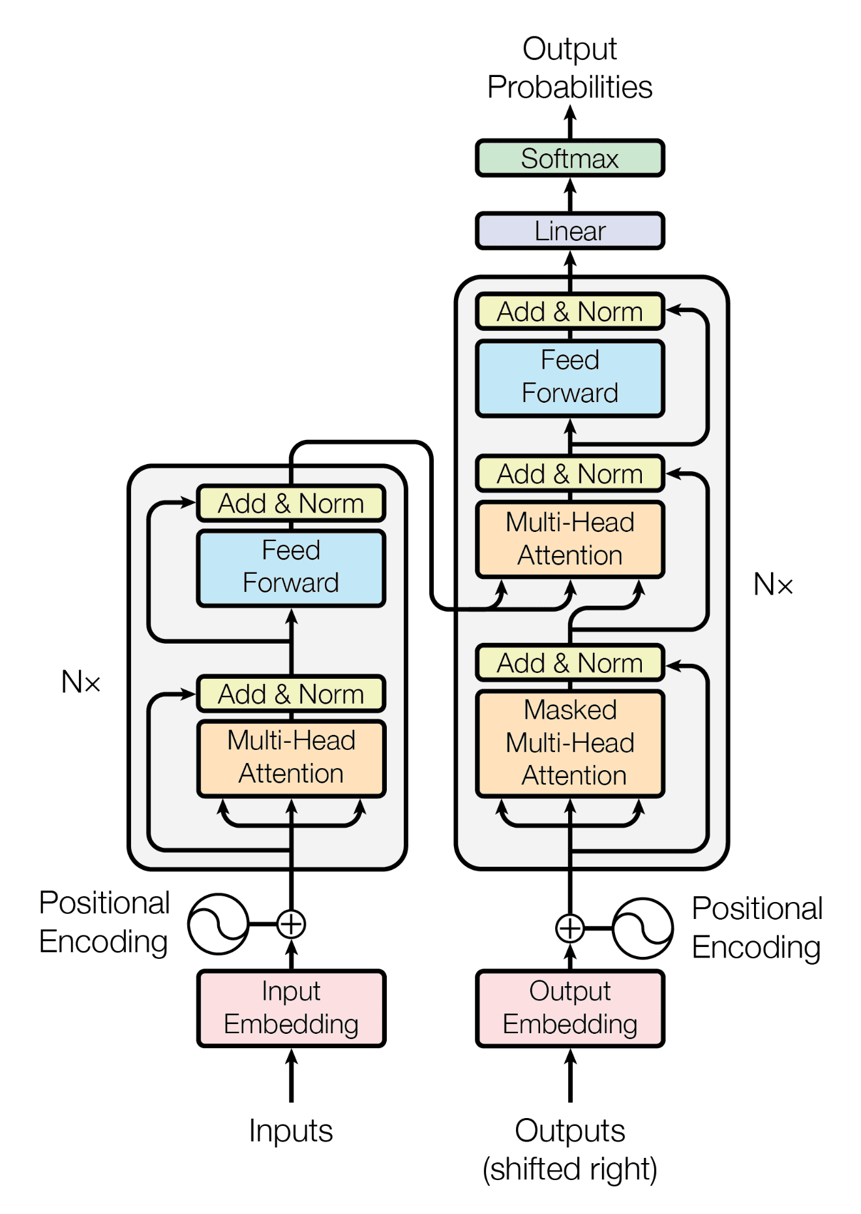
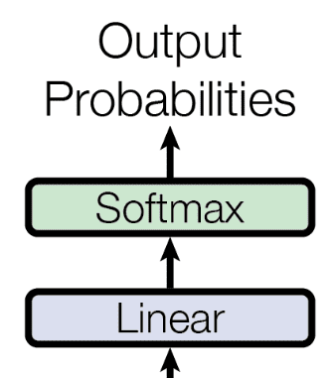
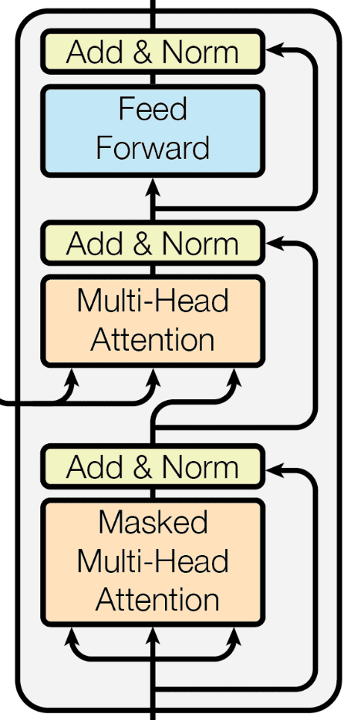
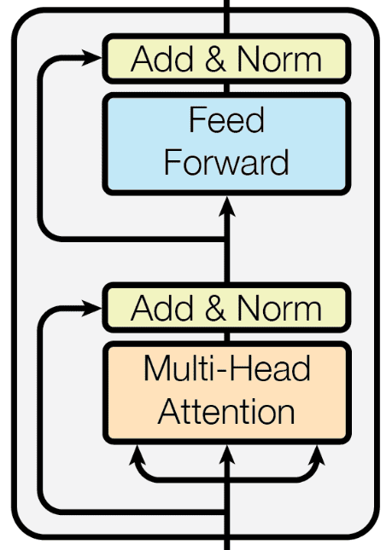
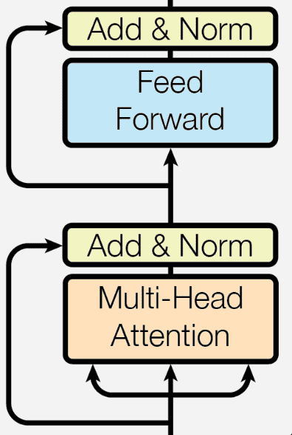
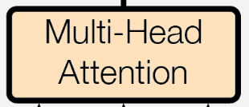

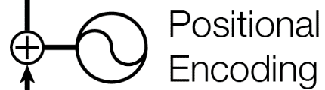
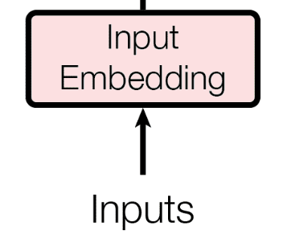
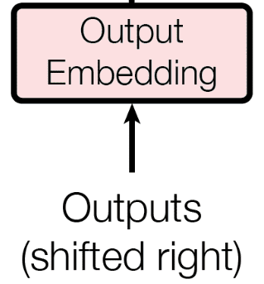
Sequence-to-Sequence neural models
Enter the Transformer
The State-of-the-Art for sequence modeling
  Powered by the multi-headed self-attention
  No-recurrent units, allowing parallel computation
  As opposed to RNNs, transformers have two inputs

Slide 12




Sequence-to-Sequence neural models
Enter the Transformer
Future B: ${\left\{B_{t}\right\}}_{t=T:…}$
Example: predicting future $B$, as univariate time series
This does not make any sense since we know that future $B$ depends on $I$
Past B: ${\left\{B_{t}\right\}}_{t=0:T−1}$
$$\{0\}$$

Slide 13






Sequence-to-Sequence neural models
Enter the Transformer
Future B: ${\left\{B_{t}\right\}}_{t=T:…}$
Example: predicting future $B$, conditioned on past and future $I$
  Multivariate time series “forecasting”
$$N ×$$
$$N ×$$
Past B: ${\left\{B_{t}\right\}}_{t=0:T−1}$
$$\{0\}$$
Past I: ${\left\{I_{t}\right\}}_{t=0:T−1}$
$${\left\{I_{t}\right\}}_{t=T:…}$$

Slide 14







Deconstructing the Transformer
Encoder-Decoder models
Future $B$
Process an input sequence (e.g. a sentence) and extract meaningful, context-aware representation
Encoder-only examples
BERT
arXiv:1810.04805
Generate an output sequence based on the context provided by the encoder, autoregressively
Decoder-only examples
GPT
arXiv:2005.14165
$$N ×$$
$$N ×$$
Past $B$
$$\{0\}$$
Past $I$
Future $I$

Slide 15






Deconstructing the Transformer
Future $B$
Let us break down the transformer piece-by-piece
$$N ×$$
$$N ×$$
Understanding the Encoder makes understanding the Decoder easy
Past $B$
$$\{0\}$$
Past $I$
Future $I$

Slide 16




Deconstructing the Transformer
Embedding and positional encoding
Future $B$
Past $B$
$$\{0\}$$
Past $I$
Future $I$

Slide 17




Deconstructing the Transformer
Embedding and positional encoding
The same steps are applied for inputs and outputs, just with different data
Past $B$
$$\{0\}$$
Past $I$
Future $I$

Slide 18


Deconstructing the Transformer
Embedding and positional encoding
Encoder
input
Embedded
past
Past $B$
Past $I$

Slide 19




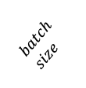




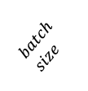
Deconstructing the Transformer
Embedding and positional encoding
Embedding
Inputs must be transformed from input space to embedded feature space
  Typically using linear layers or even RNNs
  In NLP this can be word embeddings like word2vec or BERT
Embedded
past
$$n_{dim}$$
$$batch \\ size$$
$$context seq. length$$
Past $B$
$$2$$
Past $B$
Past $I$
$$batch \\ size$$
Past $I$
$$context seq. length$$
Notes:
Transform $[size_{batch}, L_{seq}, N_{feat}]$ to $[size_{batch}, L_{seq}, N_{dim}]$

Slide 20

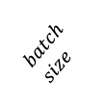




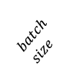

Deconstructing the Transformer
Embedding and positional encoding
Positional encoding
The transformer does not know the order of the inputs
  Add positional information with positional encodings
  Usually with a sin + cos encoding
  Add the position information point-wise to the embeddings
Encoder
input
$$n_{dim}$$
$$batch \\ size$$
$$context seq. length$$
$$[1, 2, 3, 4, 5, 6,…,]$$
Embedded
past
$$\{\}$$
$$n_{dim}$$
$$batch \\ size$$
$$batch \\ size$$
$$context seq. length$$
$$context seq. length$$
Past $B$
$$2$$
Past $B$
Past $I$
$$batch \\ size$$
Past $I$
$$context seq. length$$

Slide 21
Deconstructing the Transformer
Embedding and positional encoding
Embedding
Inputs must be transformed from input space to embedded feature space
  Typically using linear layers or even RNNs
  In NLP this can be word embeddings like word2vec or BERT
Positional encoding
The transformer does not know the order of the inputs
  Add positional information with positional encodings
  Usually with a sin + cos function
  Add the position information point-wise to the embeddings
Encoder
input
$$n_{dim}$$
$$batch \\ size$$
$$context seq. length$$
Embedded
past
$$n_{dim}$$
$$batch \\ size$$
$$context seq. length$$
Past $B$
$$2$$
Past $B$
Past $I$
$$batch \\ size$$
Past $I$
$$context seq. length$$

Slide 22



Deconstructing the Transformer
The Encoder Layer
Future $B$
Past $B$
$$\{0\}$$
Past $I$
Future $I$
Notes:
Receive all inputs all at once, processing them in parallel, as opposed to sequentially like RNNs
Fixed number of layers. Output of one is input of next.

Slide 23








Deconstructing the Transformer
The Encoder Layer
Encoder block
output
The block learns context-aware representations from attention
Repeated layers allow transformer to learn complex patterns
Residual connections allow information to propagate
$$n_{dim}$$
$$batch \\ size$$
$$context seq. length$$
Repeat $N$ times
Encoder block
input
Attention input
$$n_{dim}$$
$$sequence length$$
$$batch \\ size$$
$$context seq. length$$

Slide 24



Deconstructing the Transformer
Self-Attention
Self-Attention
Self-Attention
Attention input
Attention input
$$n_{dim}$$
Attention input
$$sequence length$$
$$batch \\ size$$

Slide 25



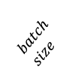






Deconstructing the Transformer
Multi-Head Self-Attention
Multi-head attention output
$$n_{dim}$$
$$batch \\ size$$
$$context seq. length$$
Concatenate
Self-Attention
Self-Attention
$M ×$
Q
K
V
…
Attention input
Attention input
$$n_{dim}/M$$
$$n_{dim}/M$$
$$sequence length$$
$$batch \\ size$$
$$sequence length$$
$$batch \\ size$$

Slide 26
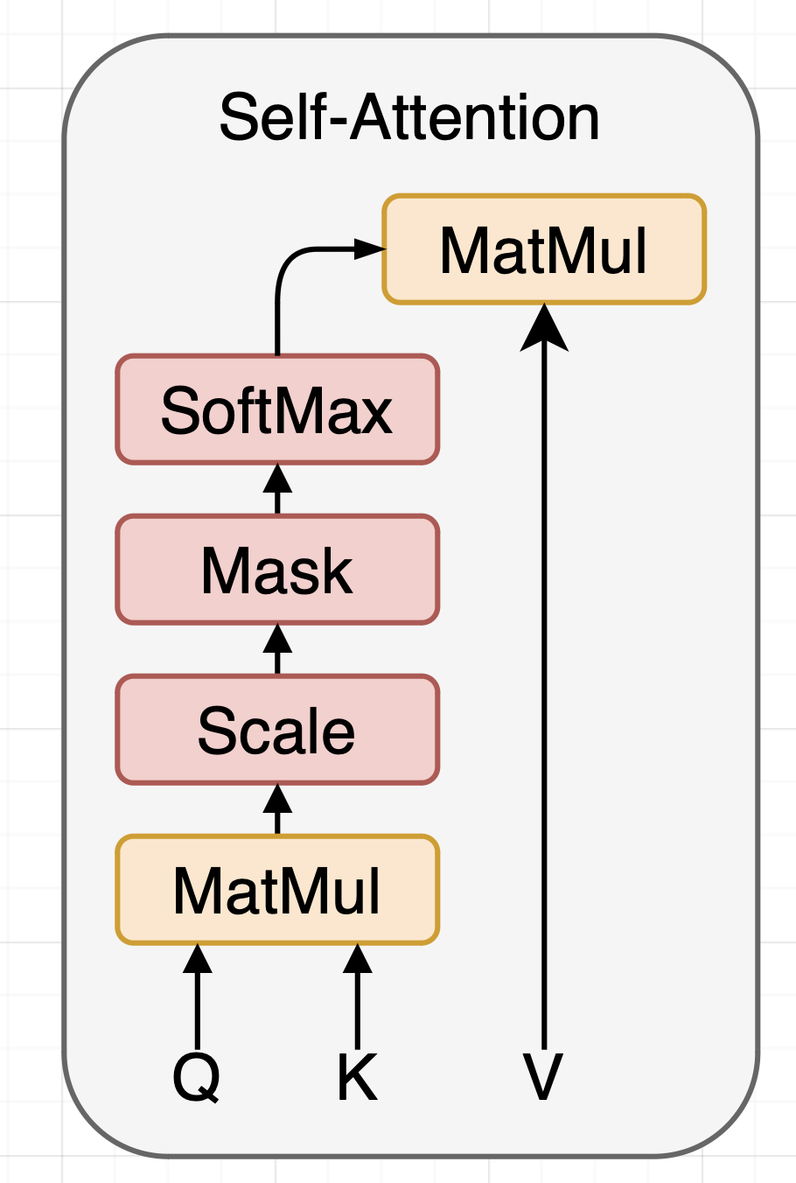

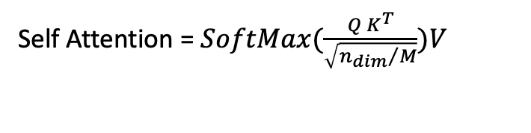



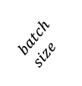
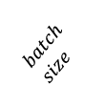


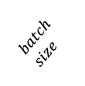
Deconstructing the Transformer
Multi-Head Self-Attention
Multi-head attention output
$$n_{dim}$$
Self Attention = $SoftMax(\frac{Q K^{T}}{\sqrt{{n_{dim}}/M}})V$
$$batch \\ size$$
$$context seq. length$$
Concatenate
Self-Attention
Self-Attention
$M ×$
Q
K
V
…
Attention input
Attention input
$$n_{dim}/M$$
$$n_{dim}/M$$
$$sequence length$$
$$batch \\ size$$
$$sequence length$$
$$batch \\ size$$
Notes:
Sequence “sees” whole sequence during self attention due to matrix multiplication

Slide 27
Deconstructing the Transformer
The Encoder Layer
Encoder block
output
The block learns context-aware representations from attention
Repeated layers allow transformer to learn complex patterns
Residual connections allow information to propagate
$$n_{dim}$$
$$batch \\ size$$
$$context seq. length$$
Repeat $N$ times
Encoder block
input
$$n_{dim}$$
$$batch \\ size$$
$$context seq. length$$

Slide 28
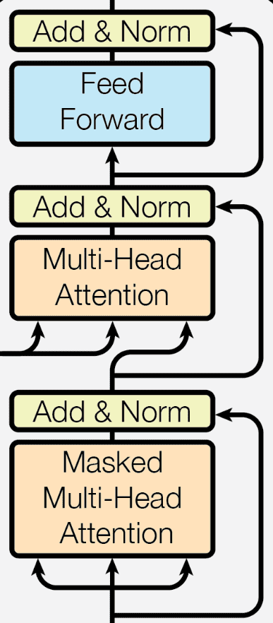
Deconstructing the Transformer
The Decoder Layer
Future $B$
Past $B$
$$\{0\}$$
Past $I$
Future $I$

Slide 29



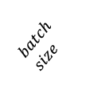


Deconstructing the Transformer
The Decoder Layer
Decoder block
output
Masked attention hides the future during decoding
Encoder output make the Query and Key in multi-head attention
Residual connections allow information to propagate
$$n_{dim}$$
$$target seq. length$$
$$batch \\ size$$
Encoder
Output
Repeat $N$ times
$$n_{dim}$$
$$context seq. length$$
Decoder block
input
$$n_{dim}$$
$$target seq. length$$
$$batch \\ size$$

Slide 30

Deconstructing the Transformer
Output projection
Future $B$
Past $B$
$$\{0\}$$
Past $I$
Future $I$

Slide 31
Deconstructing the Transformer
Output projection
In NLP, we predict the next token (classification)

Slide 32








Deconstructing the Transformer
Output projection
In NLP, we predict the next token (classification)
In time series, we want the future value (regression)
Use feed-forward layers to project embeddings to 1 (for point estimate), or many (for other loss functions)
Future $B$
Target Prediction
$$(1)$$
Future $B$
$$batch \\ size$$
$$target sequence length$$
Fully Connected
Decoder output
$$n_{dim}$$
$$target sequence length$$
$$batch \\ size$$

Slide 33

Deconstructing the Transformer
Loss function
Loss
Future $B$
Classic loss functions
  For point-estimates: MSE, MAE
  Quantile loss to learn prediction interval
  NLL to learn probability distribution
  Choice depends on task and data
    Does the data have a lot of inherent variance or outliers?
Fully Connected
Past $B$
$$\{0\}$$
Past $I$
Future $I$

Slide 34
Deconstructing the Transformer
Putting it all together
Loss
Future $B$
Fully Connected
Past $B$
$$\{0\}$$
Past $I$
Future $I$
Notes:
Self-attention in the Encoder — the input sequence pays attention to itself
Self-attention in the Decoder — the target sequence pays attention to itself
Encoder-Decoder-attention in the Decoder — the target sequence pays attention to the input sequence

Slide 35
Hands-On
Let’s get our hands dirty in Python

Slide 36
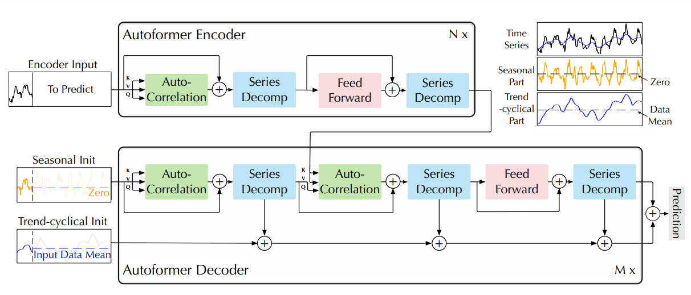
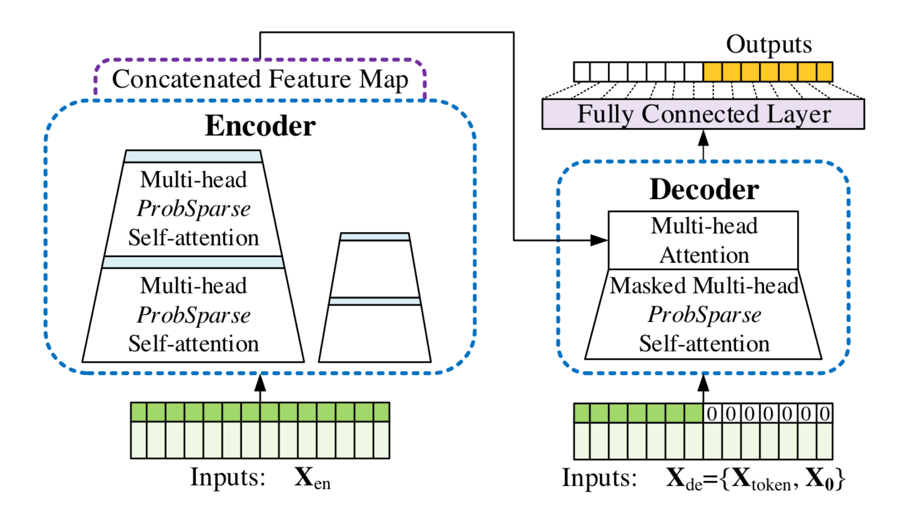
Advanced Transformer Architectures for Time Series
Autoformer and Informer
Autoformer – decomposing the time series components
Informer – for long term time series forecasting
arXiv:2106.13008
… and many more
arXiv:2012.07436

Slide 37
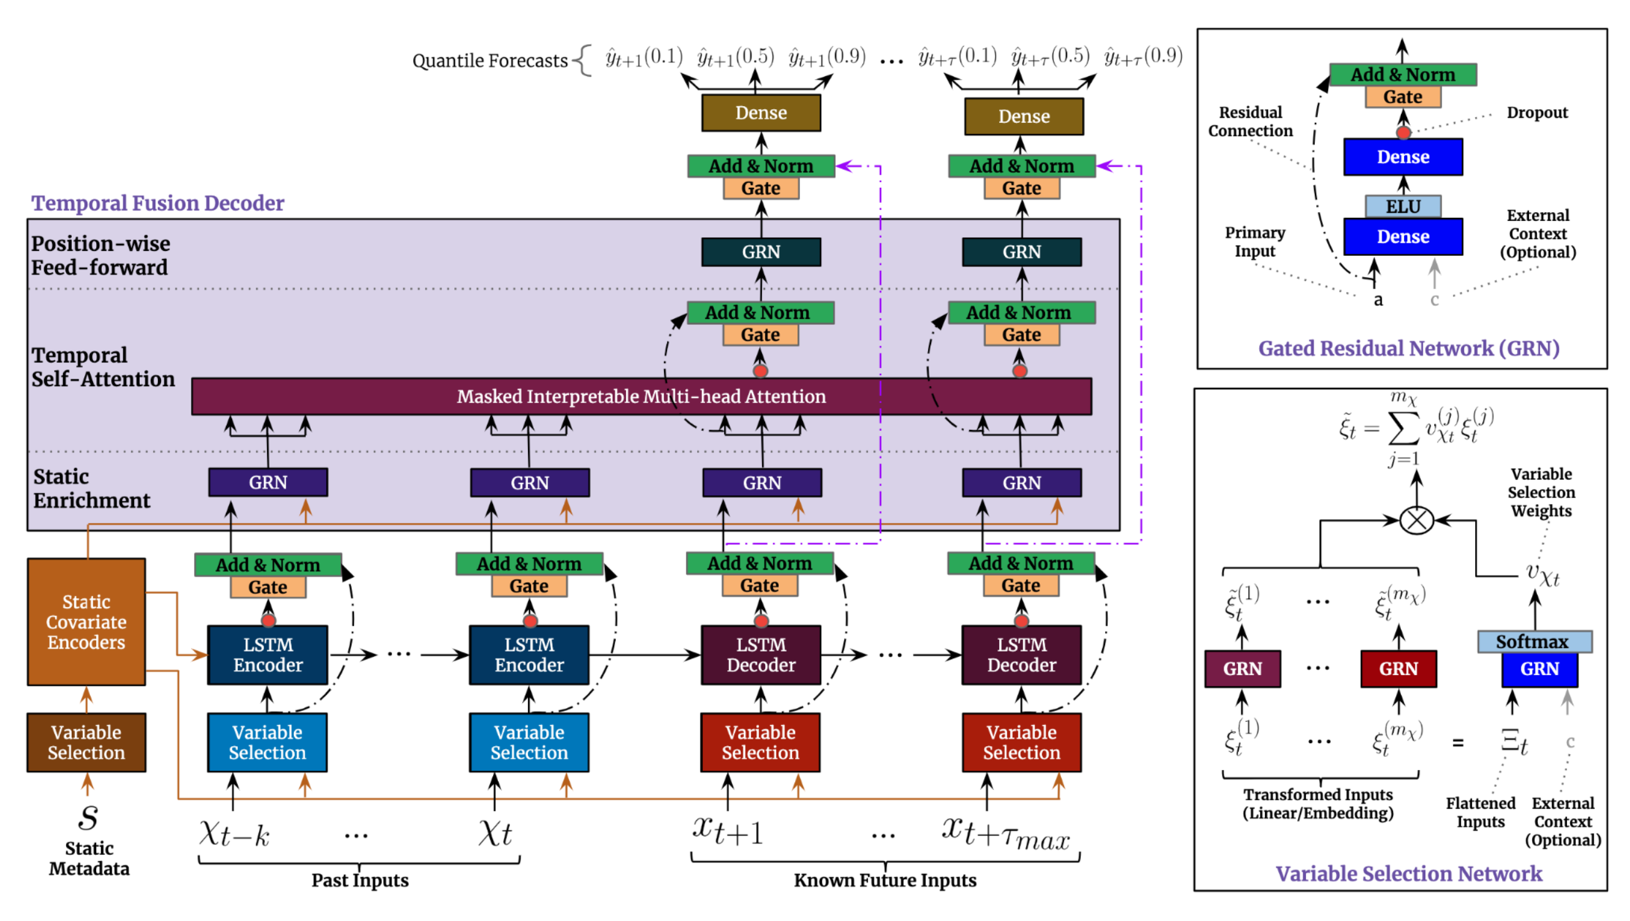
Advanced Transformer Architectures
Temporal Fusion Transformer
arXiv:1912.09363

Slide 38
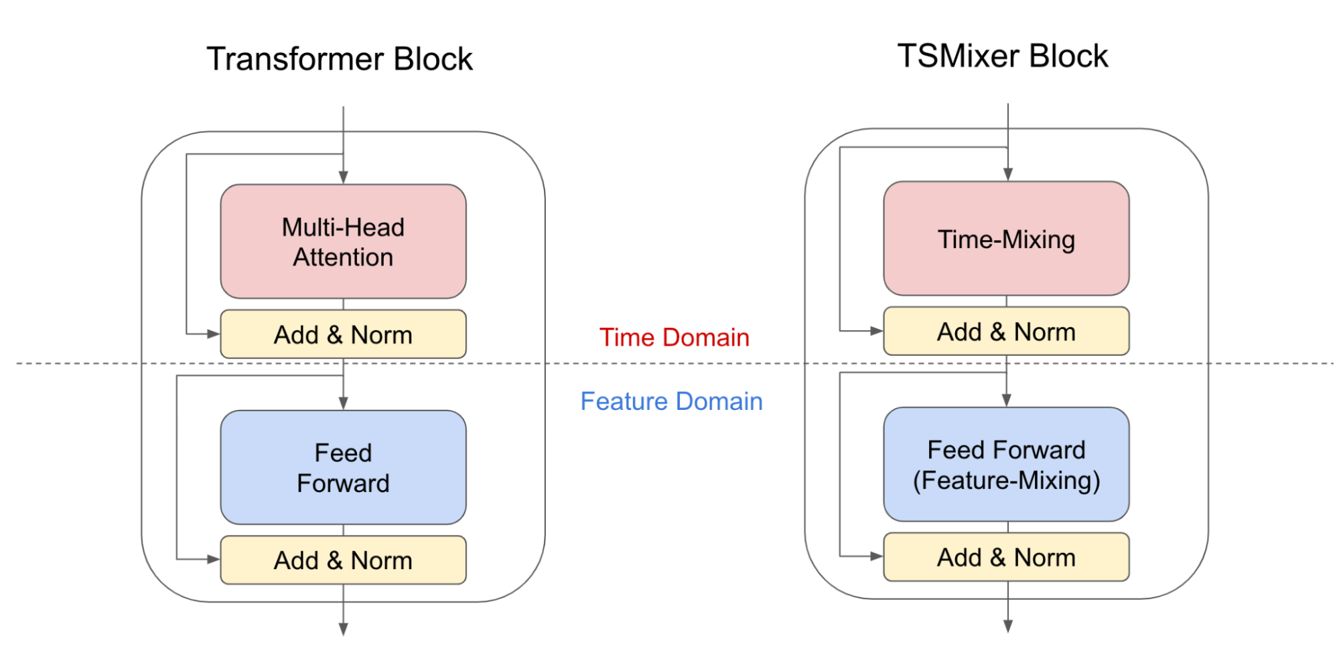
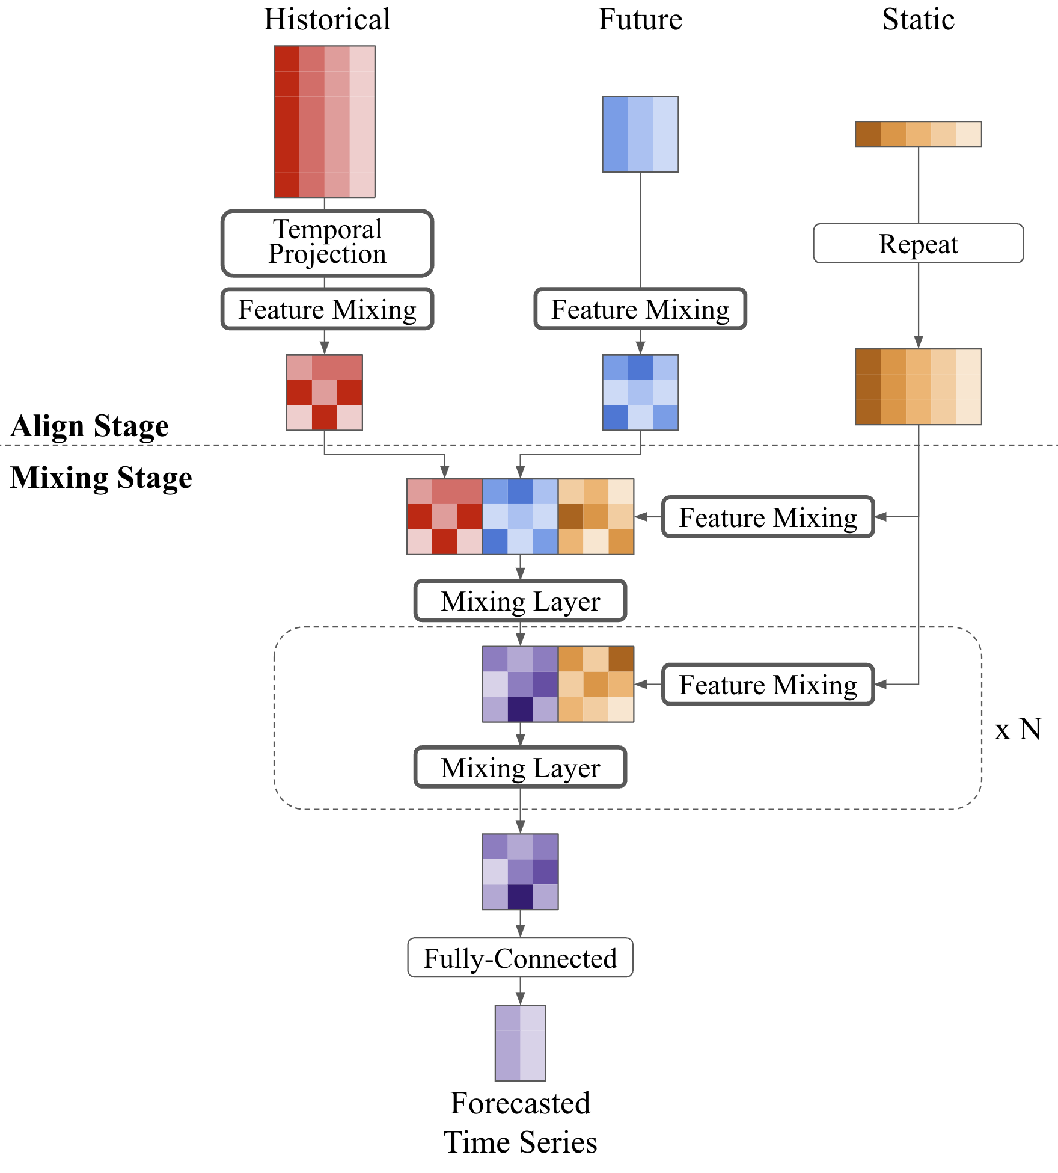
Transformer Alternatives for Time Series
TSMixer – An All MLP Architecture for Time Series Forecasting
arXiv:2303.06053

Slide 39
Conclusions
Loss
Future $B$
Multivariate time series forecasting is a challenging task
  Long prediction horizons and high accuracy is especially challenging
Transformers represent the state-of-the-art of sequence modeling
  Dominant in language tasks, but not for time series
We have seen today
  What goes in to a transformer …
  … and what comes out on the other side …
  … and how to do it in Python
Have fun playing around with transformers!
Fully Connected
Past $B$
$$\{0\}$$
Past $I$
Future $I$

Slide 40
Appendix

Slide 41
PyTorch Libraries with Transformer implementations for Time Series
Huggingface transformers
GluonTS
Dart
Neuralforecast
Pytorch-forecasting
Notes:
I’m also developing our own library for multivariate time series predictions at CERN

Slide 42
Deconstructing the Transformer REFERENCE
Encoder-Decoder models

