Slide 1
A Front-End Framework with Embedded ML Tools for Automating Neutron Scattering Experiments
This material is based upon work supported by the U.S. Department of Energy, Office of Science, Office of Accelerator R&D and Production award number DE- SC0021555
M. Henderson, J. Edelen, M. Kilpatrick (RadiaSoft LLC)
S. Calder, C. Hoffmann, B. Krishna, G. Taufer, B. Vacaliuc (ORNL)

Slide 2
Outline
Motivation & background
  Problem motivation
  Partner beamlines
  Image segmentation tasks
Automation methods
  Controls software
  Image recognition
Results & discussion

Slide 3
Background & motivation
The value of automation on neutron scattering beamlines

Slide 4
Background & Motivation
Sample alignment is tedious, but critical
  Currently requires human image processing
  Limited neutron production time, schedule constraints
Machine learning is a key automation tool
  For computer vision, convolutional neural networks (CNNs)
  For controls automated, reinforcement learning (RL)
Alignment protocols are distinct to a beamline
  Framework must be highly general & robust
  Opportunity to deploy transfer learning

Slide 5
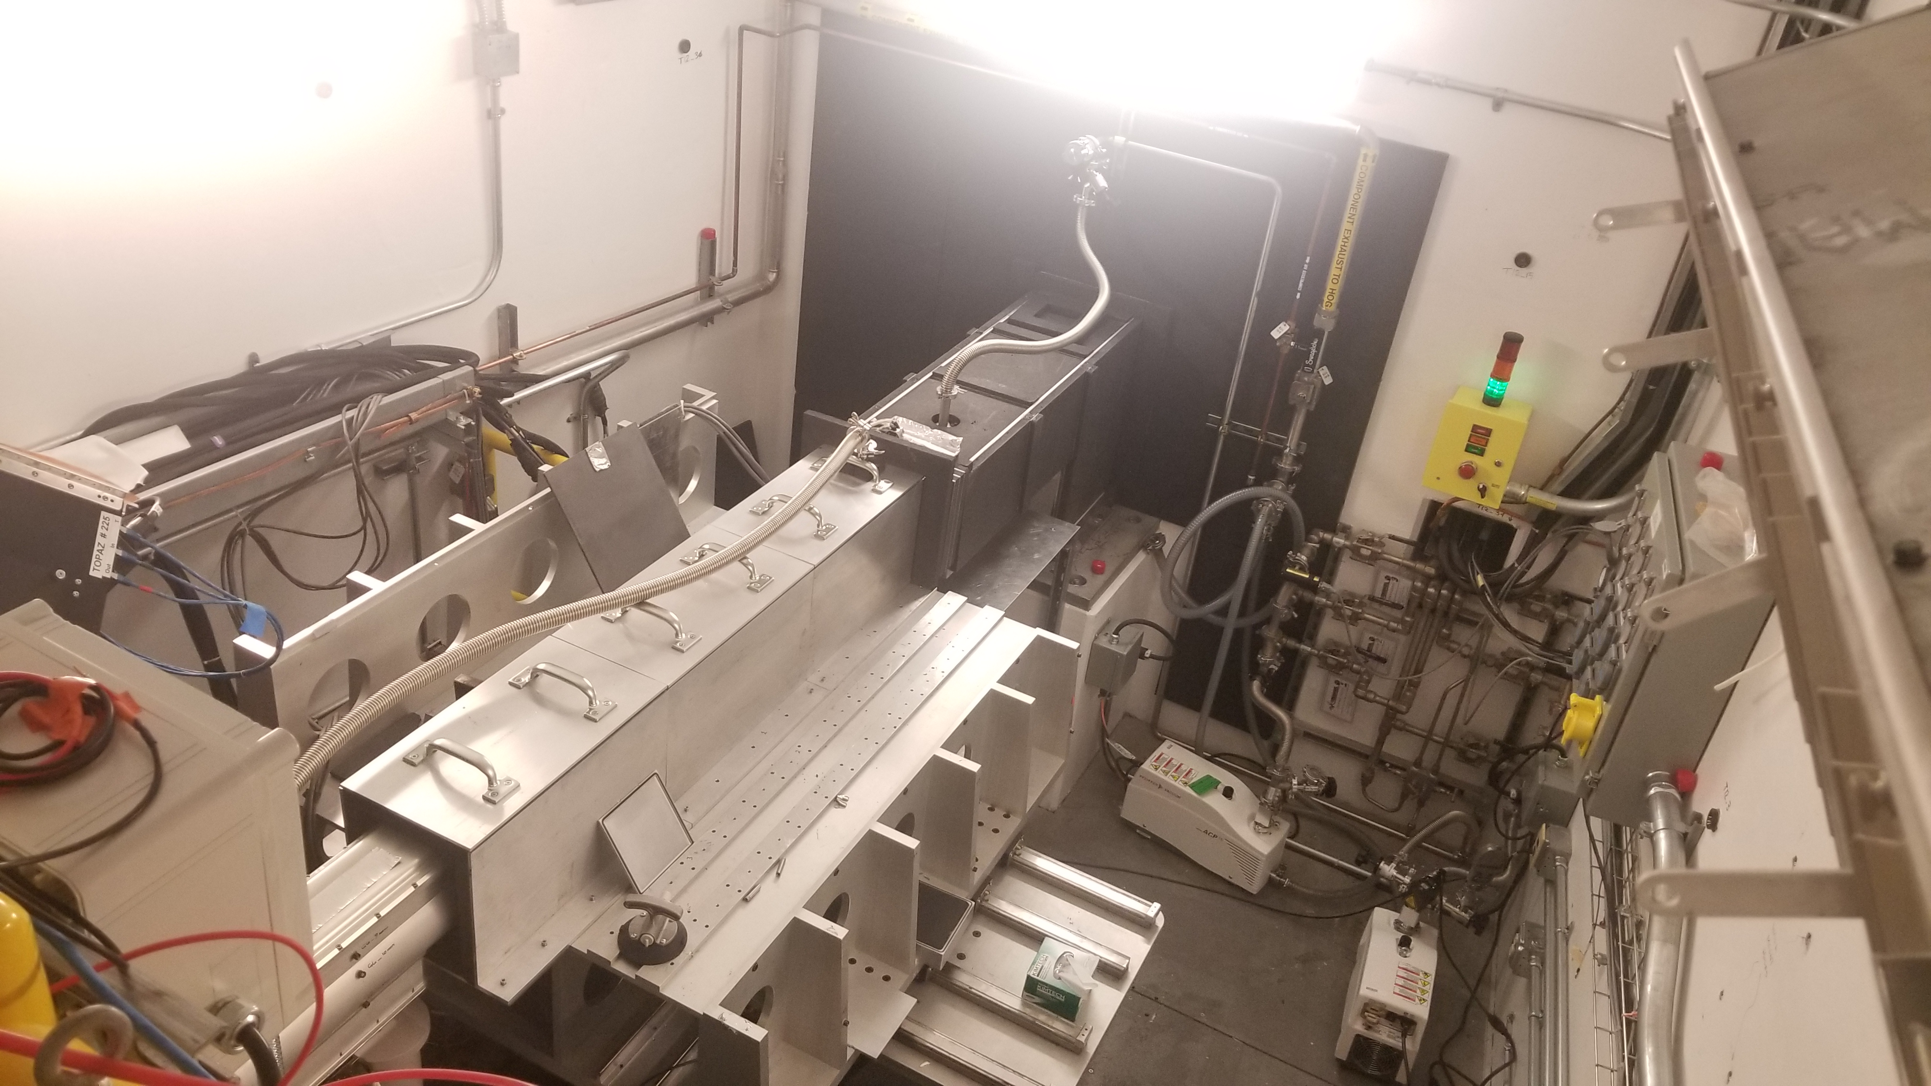
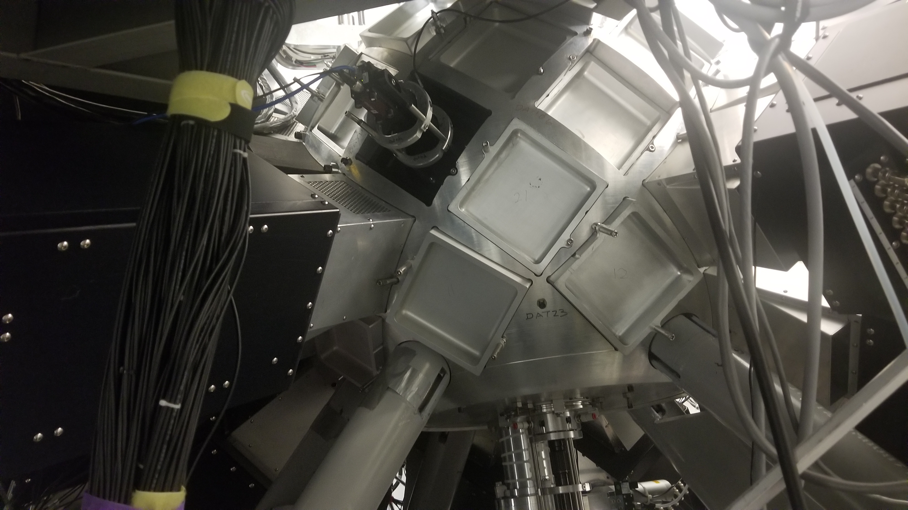
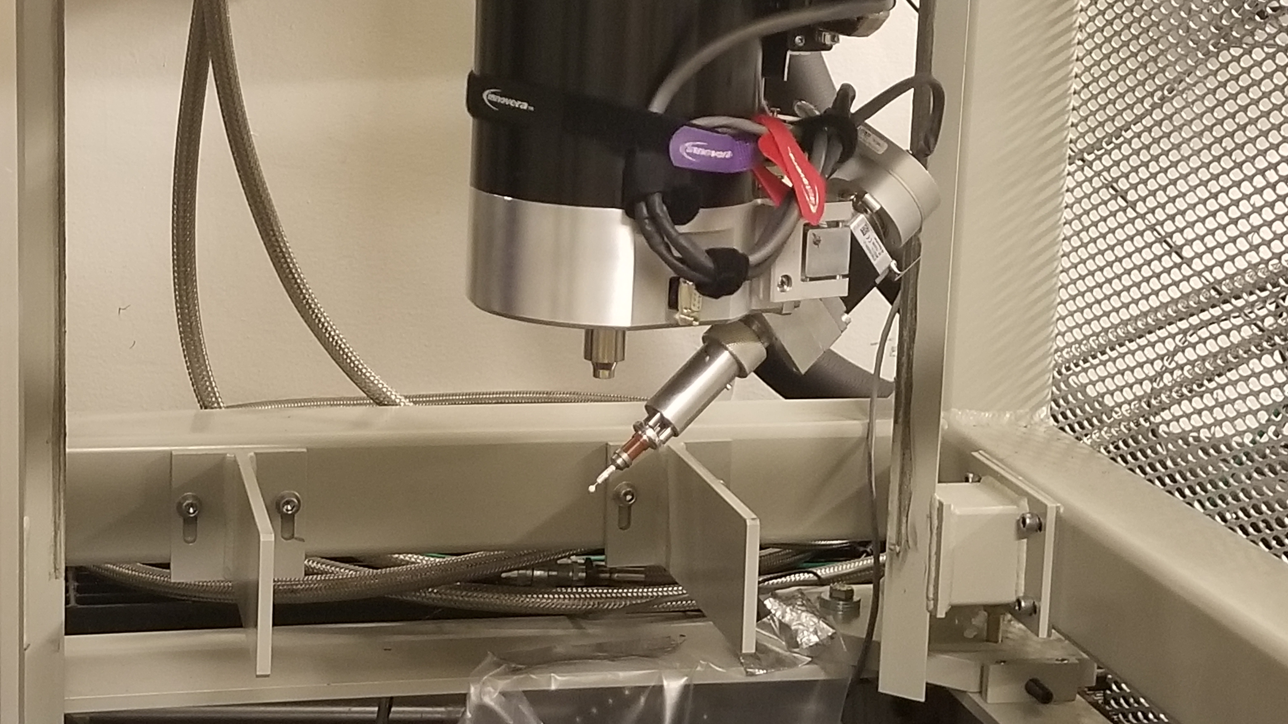
Partner Beamlines: TOPAZ
Fed by the Spallation Neutron Source (SNS)
Sample in a chamber
  Sample arm with 3 translational, 2 rotational axes
  Neutron detectors, cameras, & environmental controls
Highly developed controls system (EPICS)
  Plenty of control channels (PVs already exist)
  Pre-existing IOC software
    Includes point-and-click sample alignment
    Must consider interactions with our framework

Slide 6
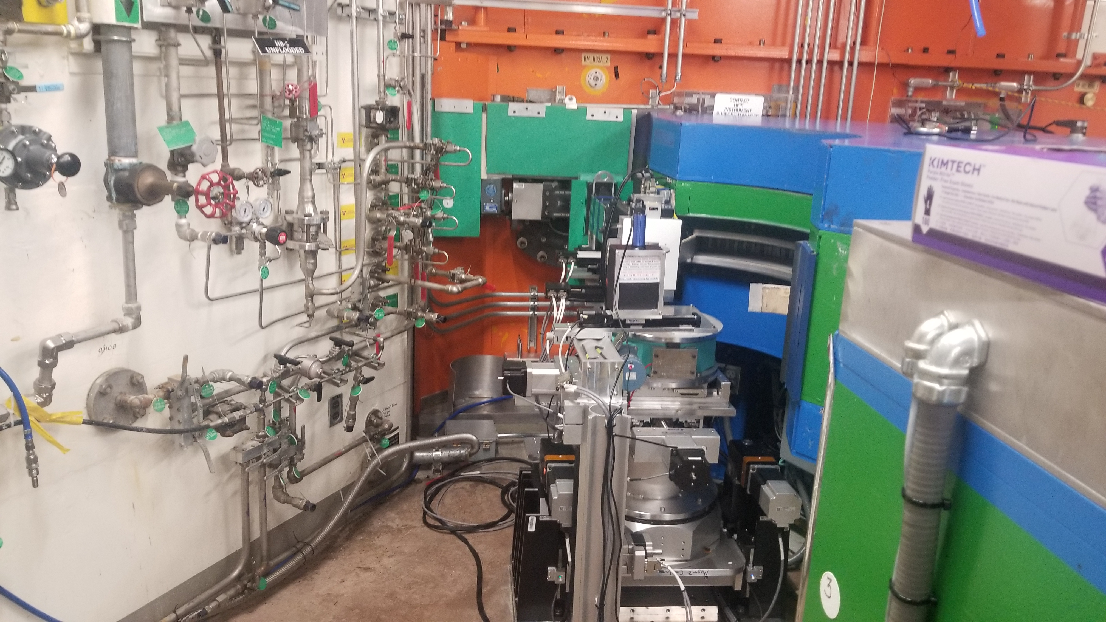
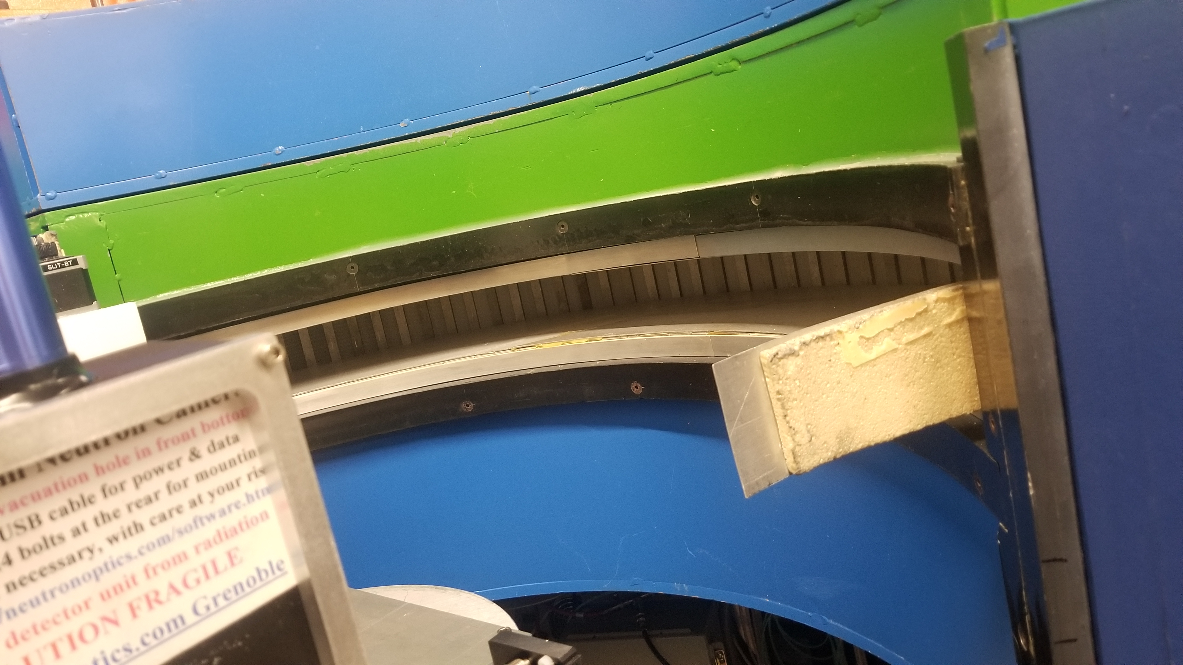
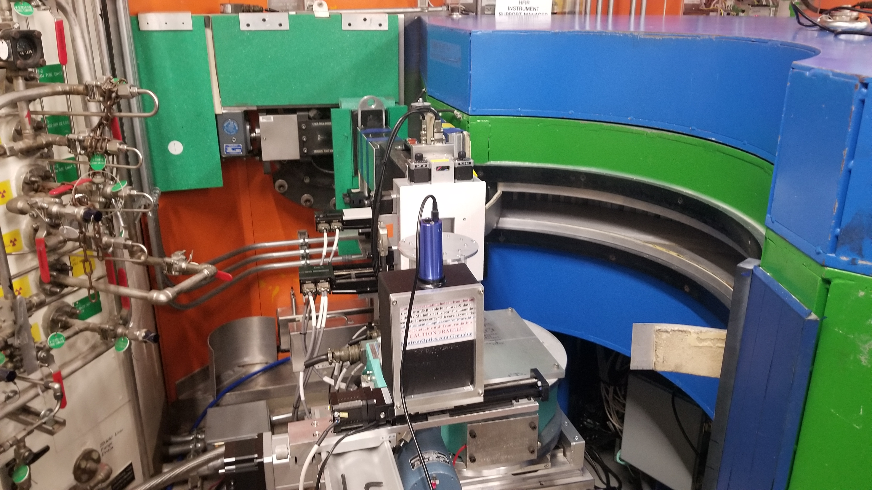
Partner Beamlines: HB-2A
Fed by the High-Flux Isotope Reactor (HFIR)
Samples in containers (cans) on a stage
  3 translational axes, stage & sample rotation axes
  Partially encircled by a neutron detector
  Diagnostics done with a neutron camera
Controls executed with SPICE (no EPICS)
  Required a “bridge” between software to use EPICS
  Sample alignment completely manual

Slide 7
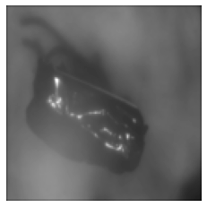

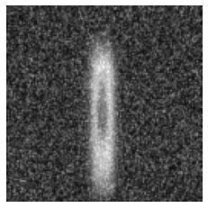

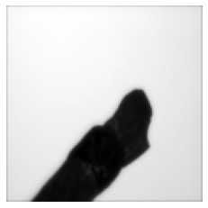

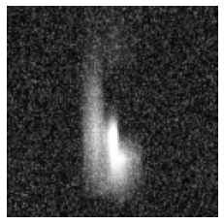

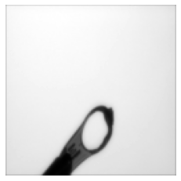

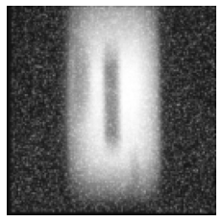

Image Segmentation Tasks
TOPAZ
HB2A

Slide 8
Automation methods
Approaches for removing humans from the loop

Slide 9
Controls Software
Require a means to deploy developed automation tools
  Machine learning models, control loops (e.g., PID), etc.
  Must be flexible to apply broadly to controls environments
Development & testing resulted in rscontrols
  Written in Python using existing EPICS tools (PyEpics, PCASPy, & P4P)
  Hardware (detectors, motors, etc.) represented in thin virtualization layer
    Connected via EPICS process variables (PVs)
  Handles for user-defined controls processes & served PVs
    Written & imported as Python modules, on the fly
  Dedicated embeddings for ML models

Slide 10
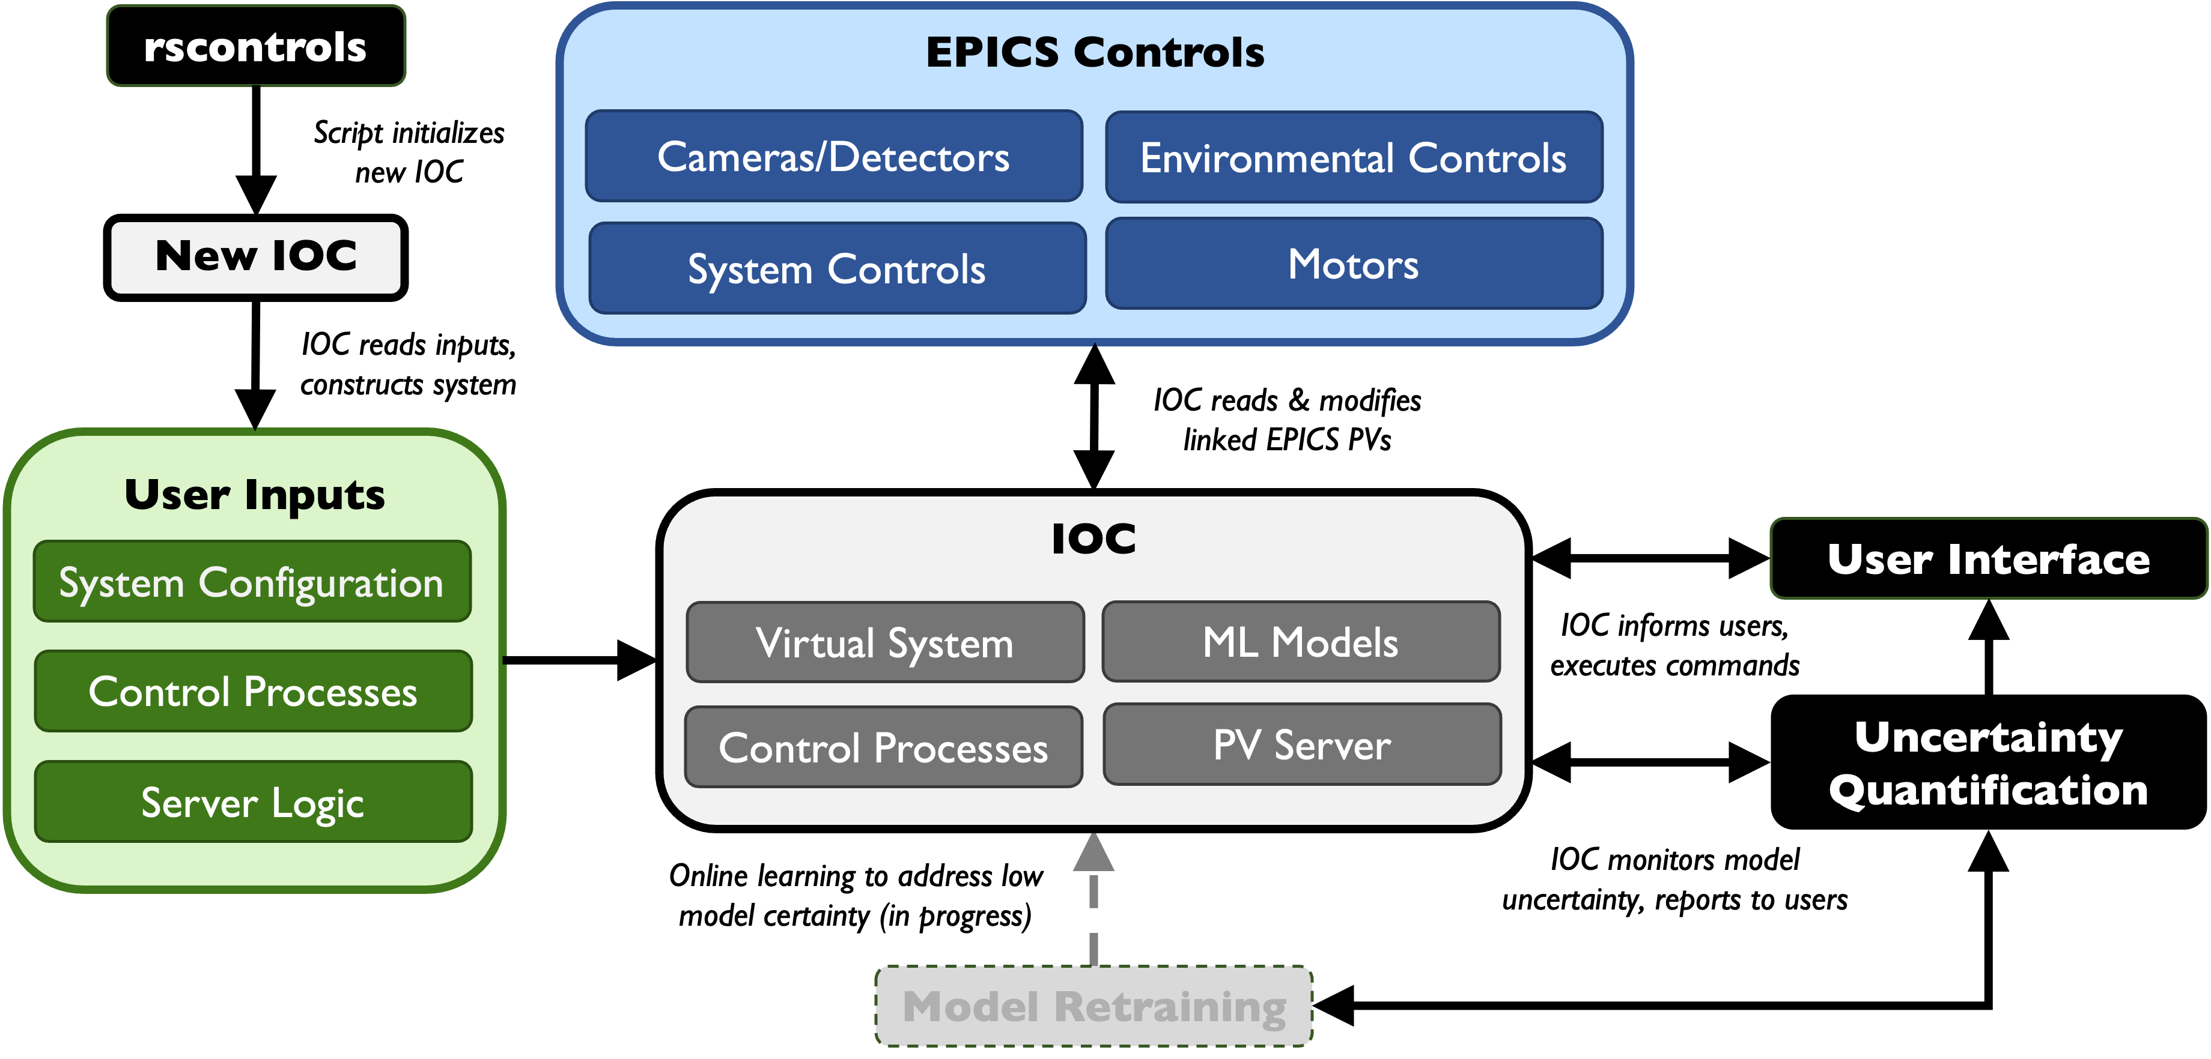
rscontrols Workflow

Slide 11


Image Recognition
Classic use-case for convolutional neural networks (CNNs)
  UNet specifically designed for image & semantic segmentation
  Labor-intensive supervised learning regimen
Must be robust to use cases
  No sample (TOPAZ & HB-2A)
  Multiple samples (HB-2A)
Regular Convolutions
Expand feature space
Regular Convolutions
Compress feature space
Input Image
Output Mask
Concatenations (Skip Connections
Improve spatial precision
Max Pooling
Reduce spatial dimensions
Up-Convolution
Expand spatial dimensions
Contraction Path $⟶$
Extract features, lose spatial information
Feature-space Representation
Expansion Path $⟶$
Expand features, regain spatial information

Slide 12
Results
rscontrols UI, model uncertainties, and sample alignment

Slide 13
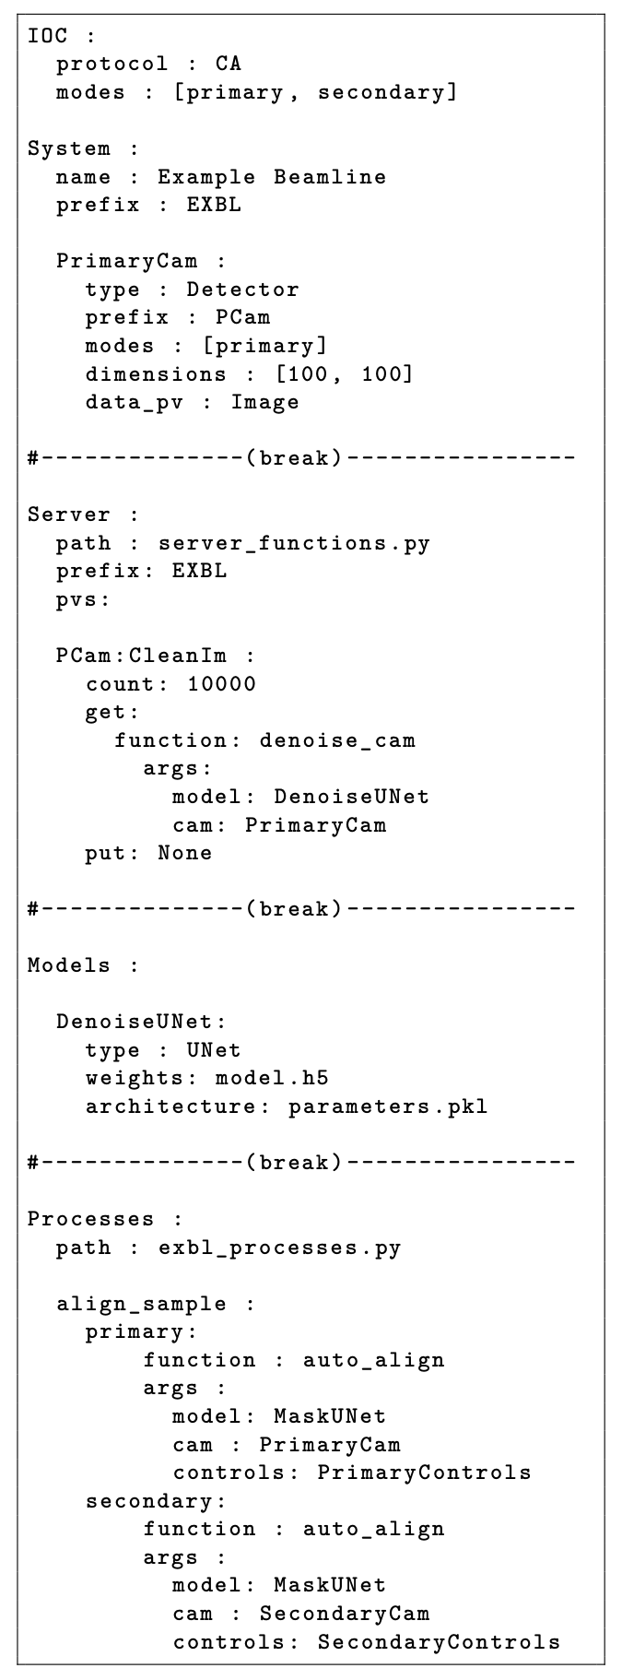
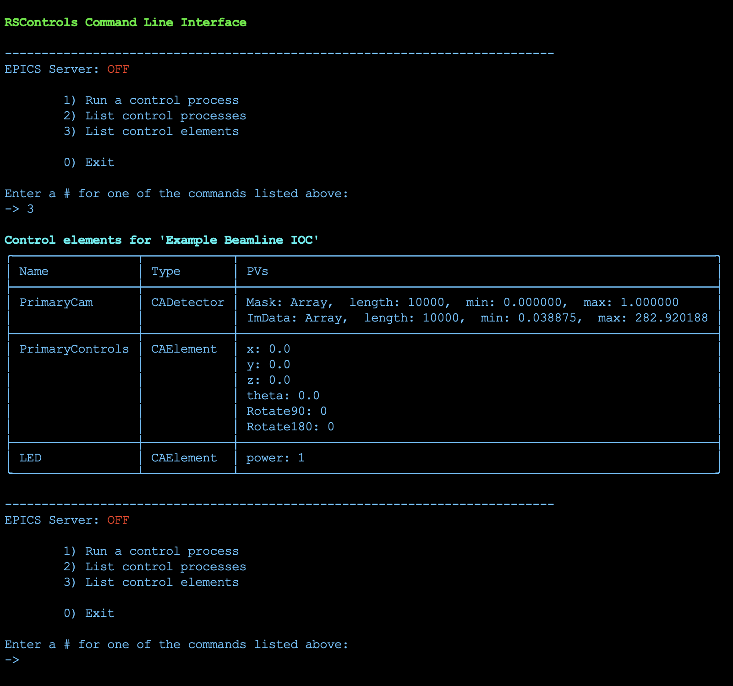
rscontrols, Simulated Beamline Example

Slide 14
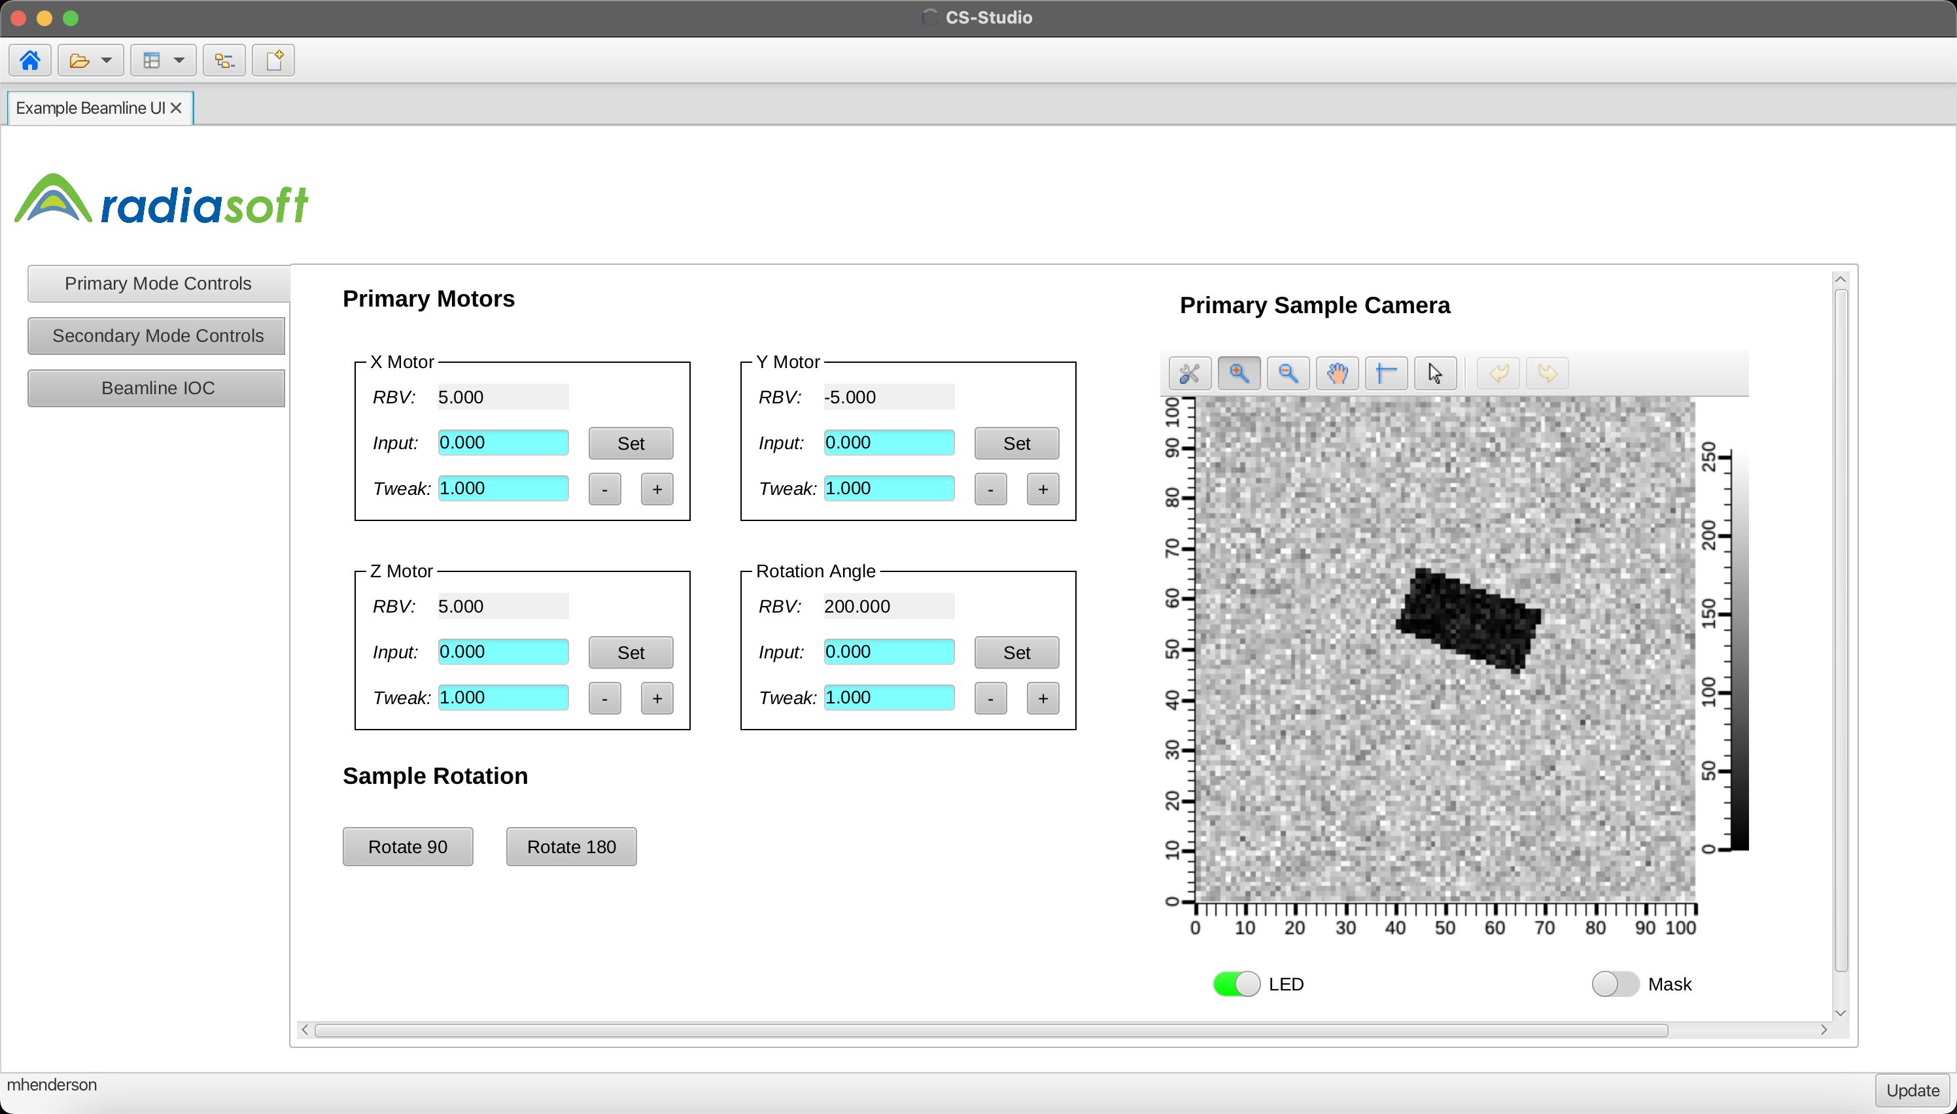
rscontrols, CS Studio UI

Slide 15
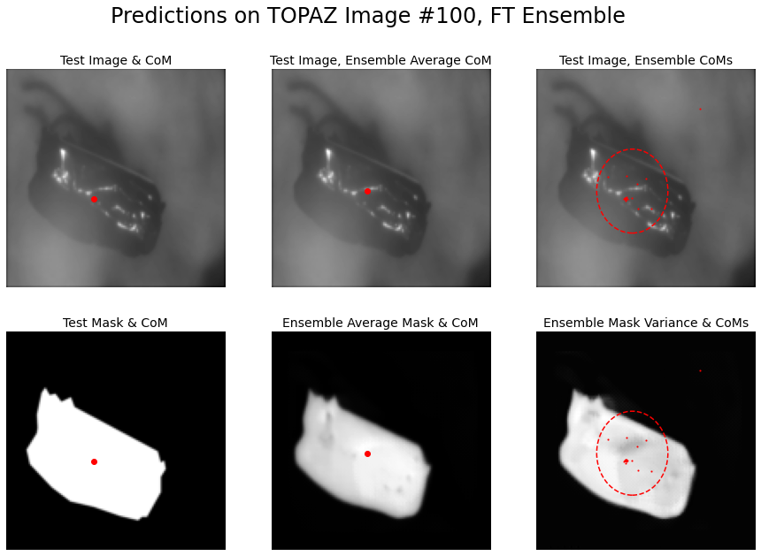
Unoptimized Ensemble Predictions

Slide 16
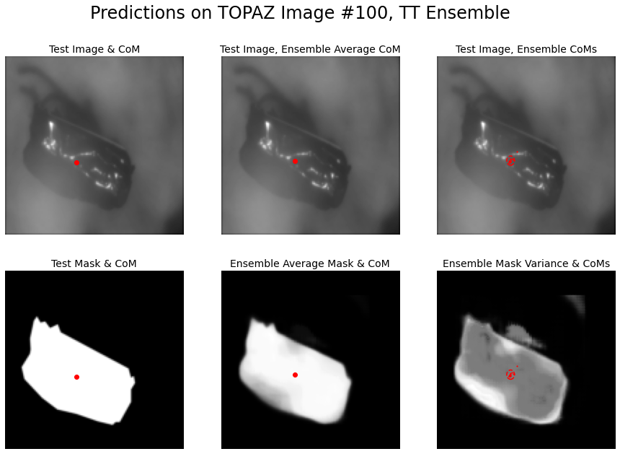
Optimized Ensemble Predictions

Slide 17
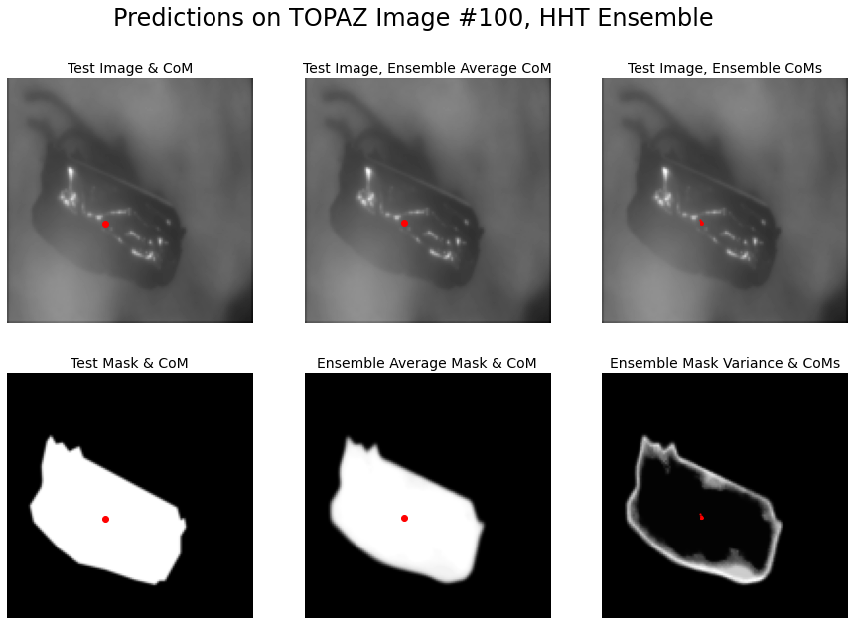
Optimized & Transferred Ensemble Predictions

Slide 18
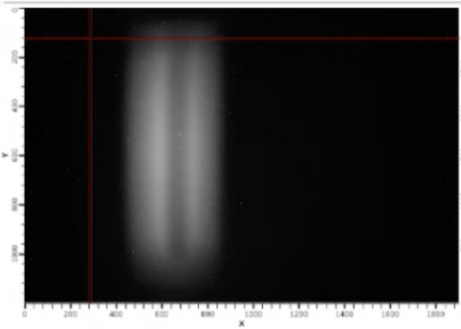
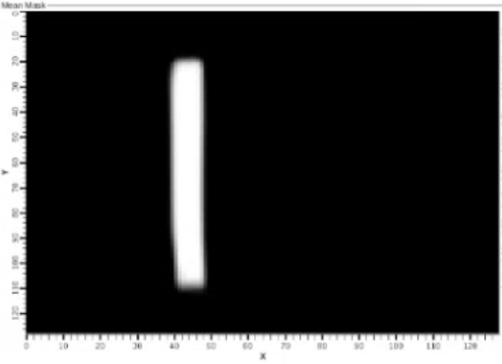
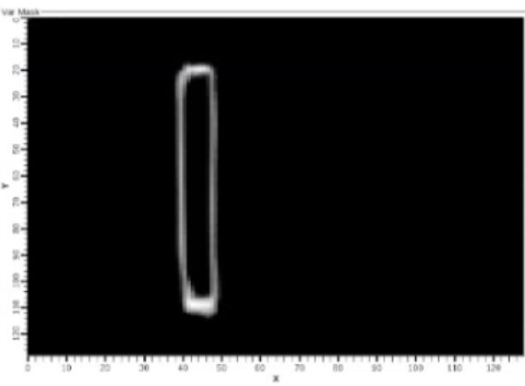
Live Uncertainty Reporting, HB-2A
Live Sample Image
Ensemble Mask Average
Ensemble Mask Variance

Slide 19
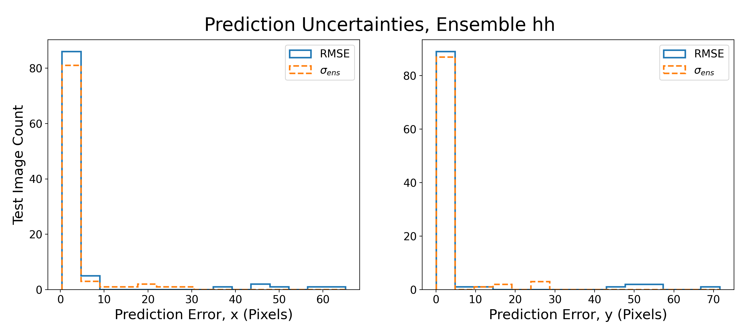
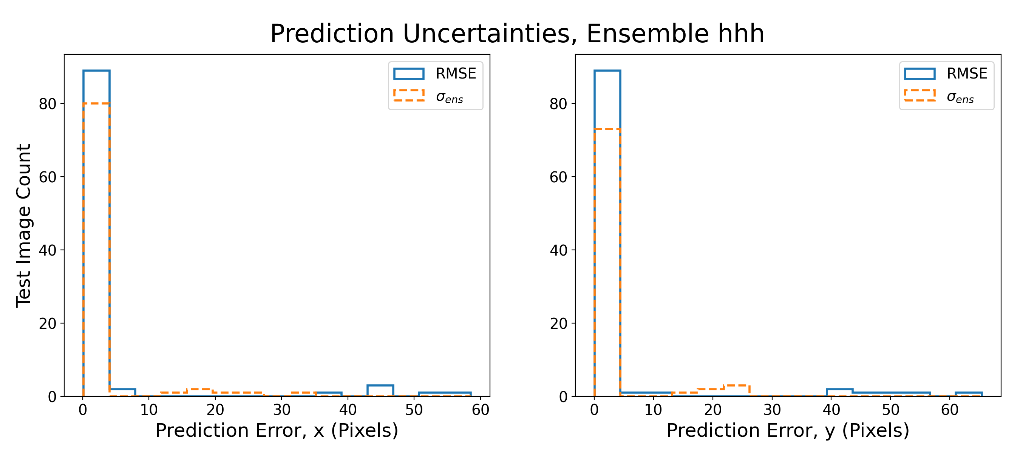
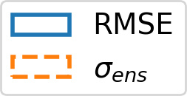
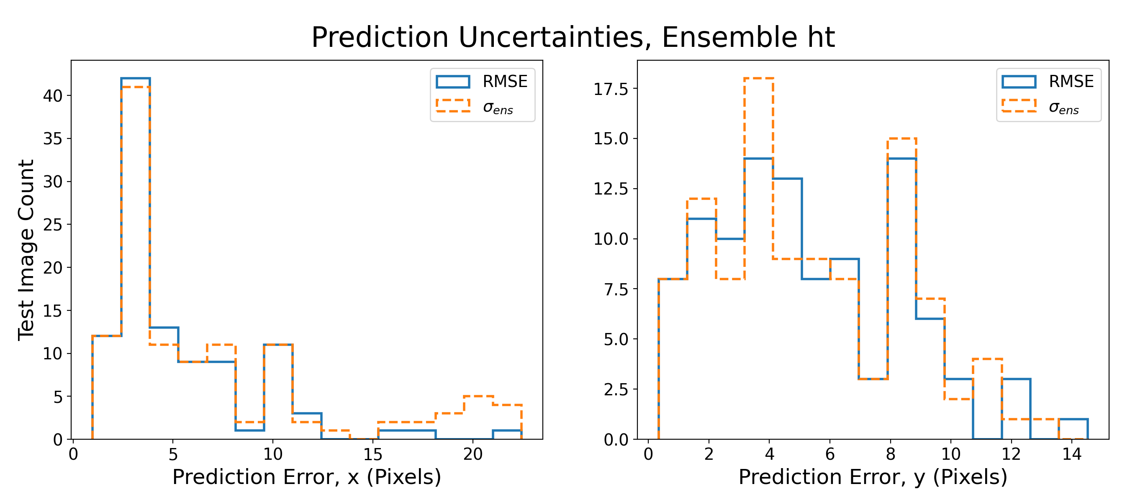
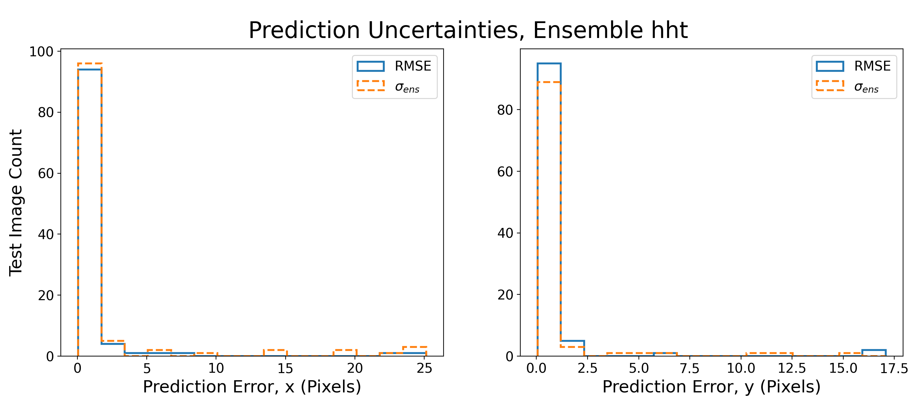
UNet Prediction Uncertainties

Slide 20
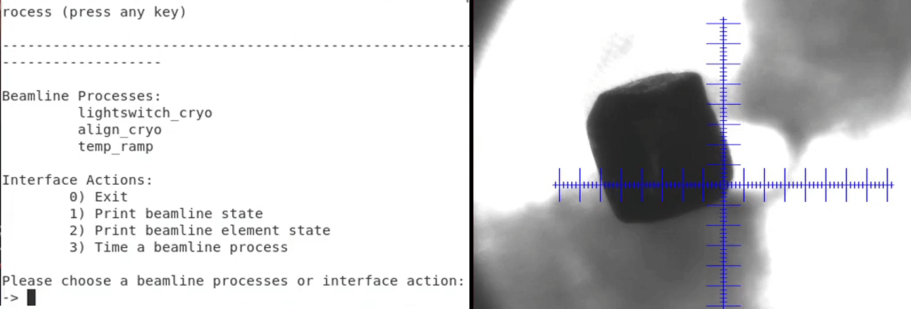

Automated Alignment, TOPAZ

Slide 21
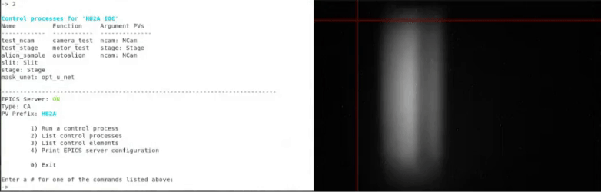

Automated Alignment, HB-2A

Slide 22
Ongoing & Future Efforts
Further improve rscontrols UI
Automate complete/more complex procedures
  Temperature ramping with constant realignment at TOPAZ
  Beam refinement at HB-2A
Develop reinforcement learning solutions
  Fuller automation at TOPAZ (less reliance on existing software)
  Detector-based alignment at TOPAZ & HB-2A
Synergize with RS 3D visualizer, also deployed at ORNL
Deploy at more partner beamlines

Slide 23
Government Disclaimer
This report was prepared as an account of work sponsored by an agency of the United States Government. Neither the United States Government nor any agency thereof, nor any of their employees, makes any warranty, express or implied, or assumes any legal liability or responsibility for the accuracy, completeness, or usefulness of any information, apparatus, product, or process disclosed, or represents that its use would not infringe privately owned rights. Reference herein to any specific commercial product, process, or service by trade name, trademark, manufacturer, or otherwise does not necessarily constitute or imply its endorsement, recommendation, or favoring by the United States Government or any agency thereof. The views and opinions of authors expressed herein do not necessarily state or reflect those of the United States Government or any agency thereof.

Slide 24
Unused Slides

Slide 25
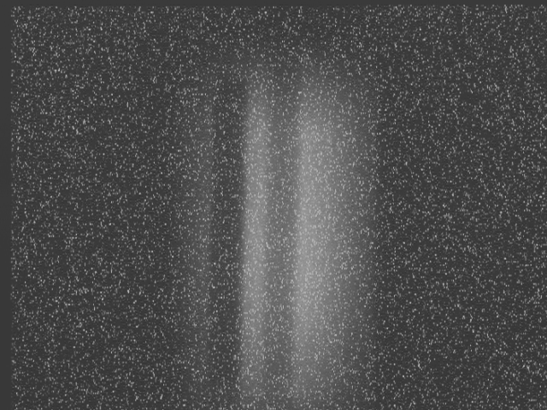
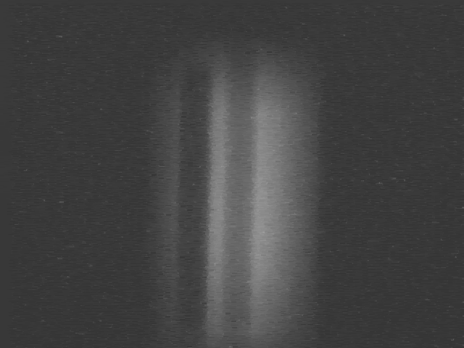
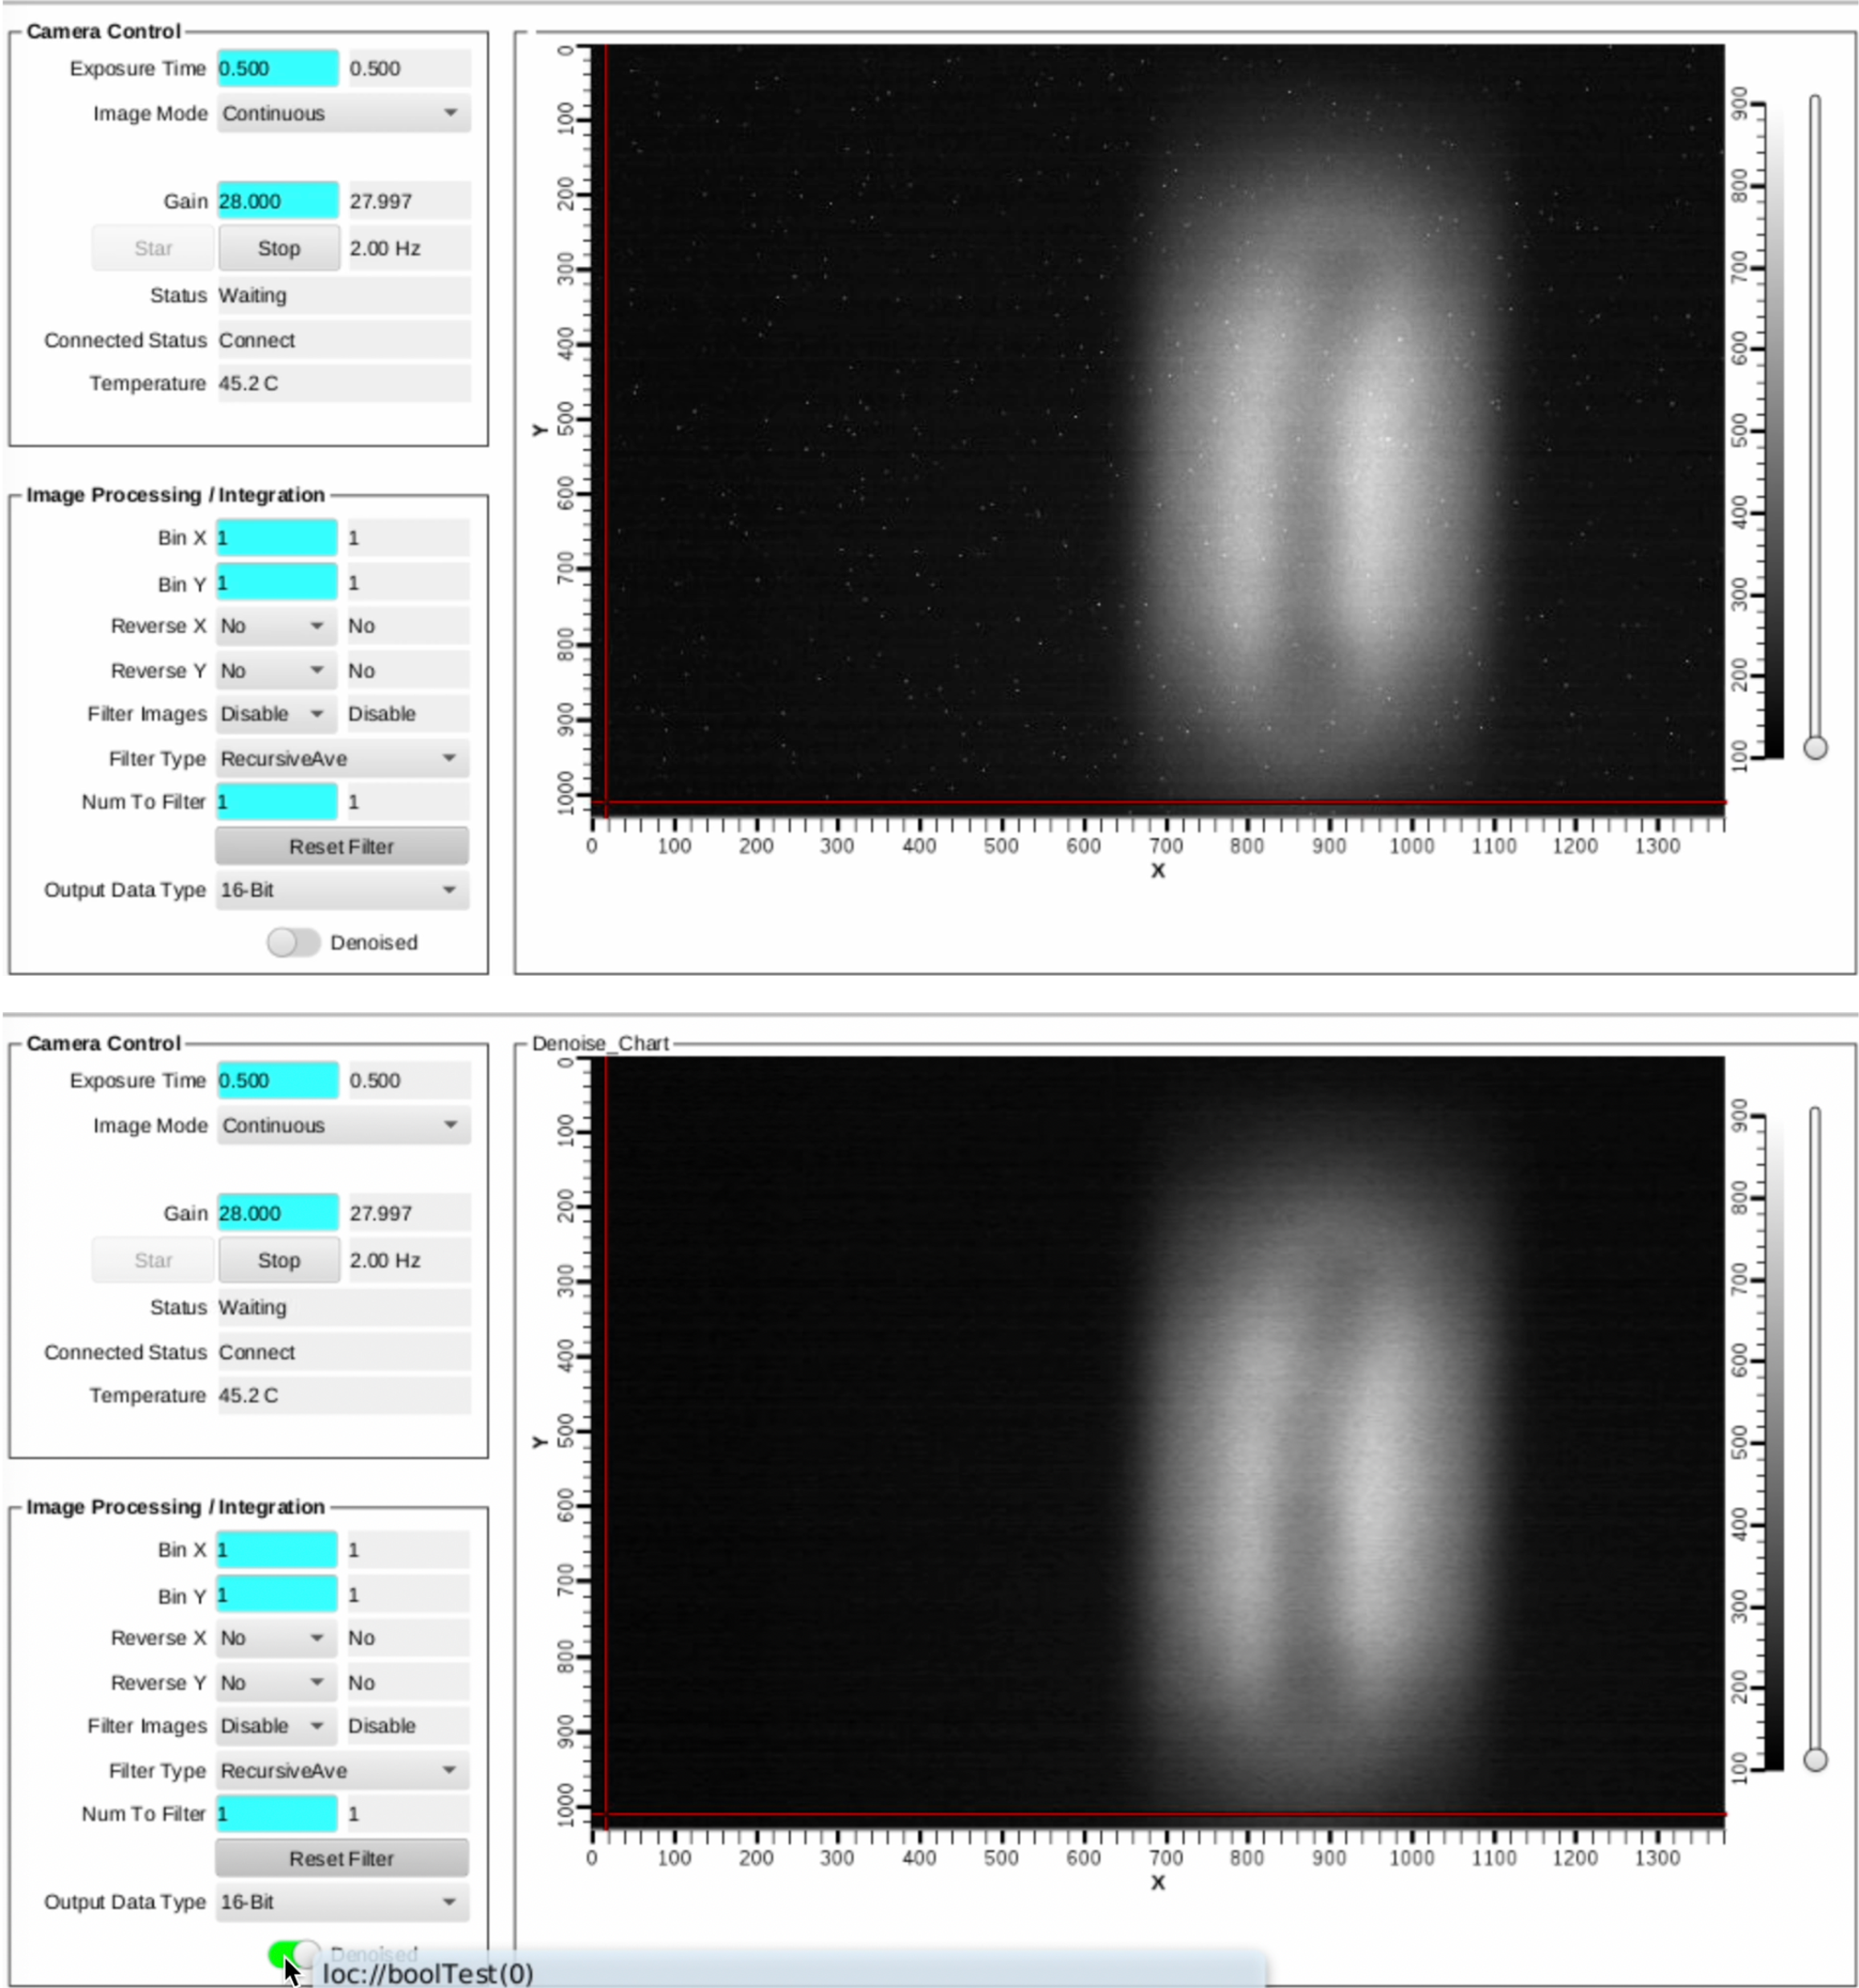
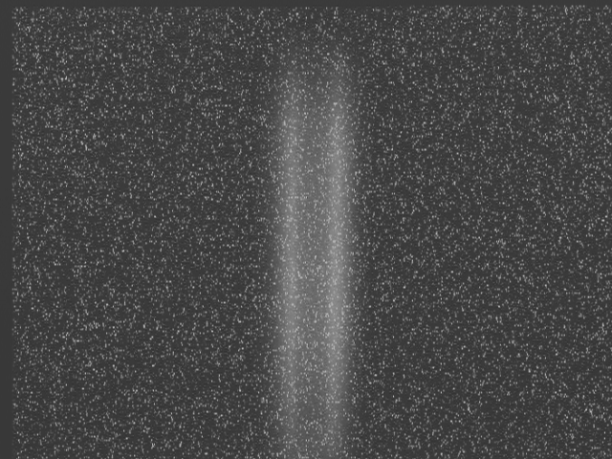
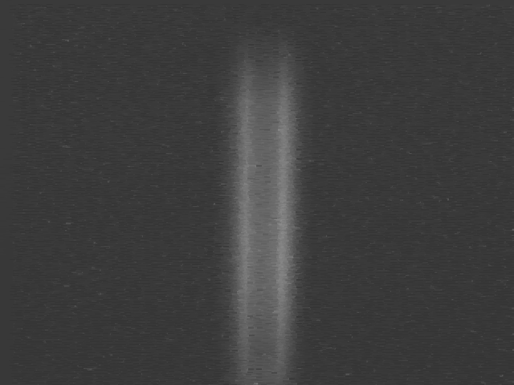
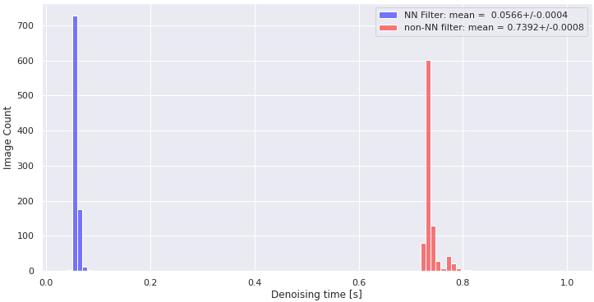
Denoising Results
Image denoising, regular filter
Image denoising, CNN filter
Execution time, regular vs. CNN filter

Slide 26
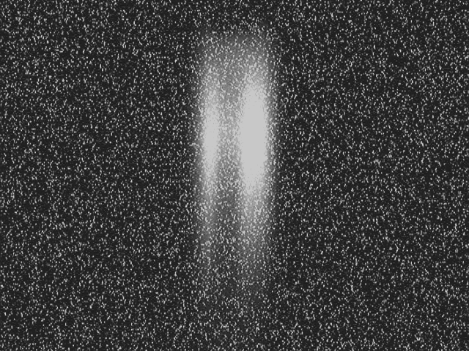
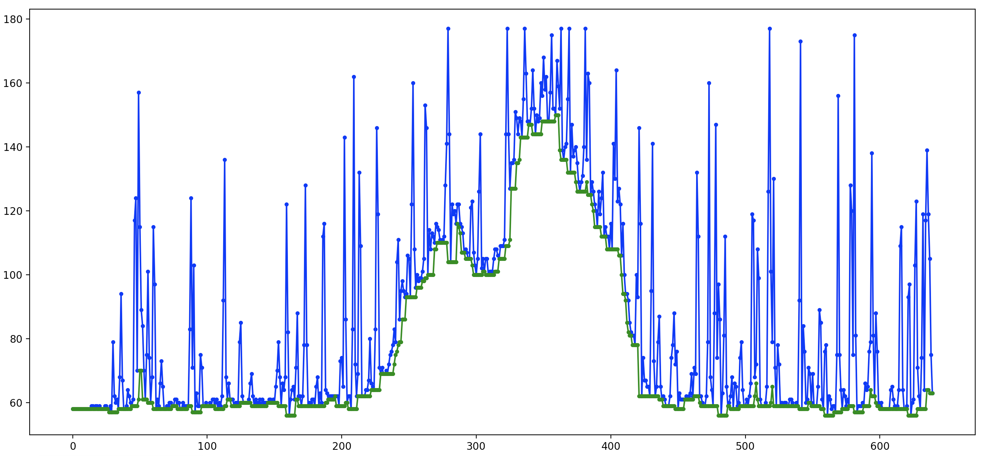
Neutron Camera Denoising
Neutron cameras are highly sensitive to noise
  Characteristic “salt-and-pepper” speckle pattern
  Signal condition degrades over time
Image recognition models are sensitive to noise patterns
  Trained on original (noisy)
Multiple possible solutions
  Simple analytic denoising algorithm
    e.g. “inscribed envelope”
  ML-based denoising solution
    Potentially faster execution
Typical raw image from HB-2A
Horizontal pixel trace & inscribed envelope

