Slide 1
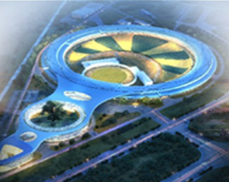
ML-2024, Gyeonju, Republic of Korea
Building a FAIR-Compliant Platform for AI-Ready Data in Particle Accelerators
Xiaohan Lu, Yu liang Zhang, Yi Jiao
2024-03-06
HEPS，Beijing

Slide 2
Outline
Introduction and Motivation
AI-Ready Dataset
Building FAIR-Compliant Platform for AI-Ready Data in Particle Accelerators
Conclusion

Slide 3
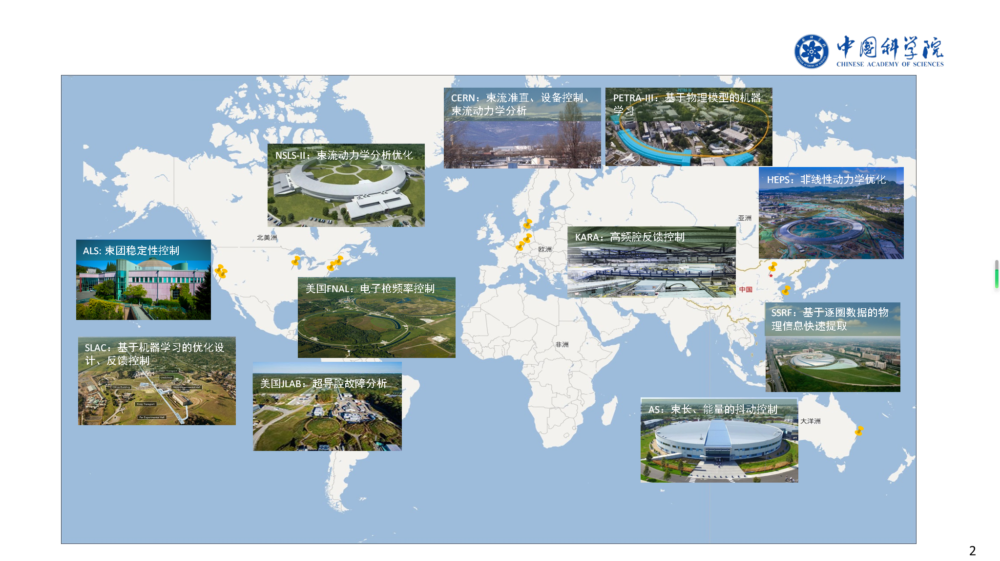
Numerous applications of ML in particle accelerator
CERN: Beam Collimation, Equipment Control, Beam Dynamics Analysis
PETRA-III: Physics-Based ML
NSLS-II: Beam Dynamics Analysis and Optimization
HEPS: Nonlinear Dynamics Optimization
KARA: High-Frequency Cavity Feedback Control
ALS: Bunch Stability Control
FANL: Electron Gun Frequency Control
SSRF: Physical Information Extraction Based on TBT-Data
SLAC: Optimization Design and Feedback Control Based on ML
JLAB: Superconducting Cavity Fault Analysis
AS: Bunch Length and Energy Jitter Control

Slide 4
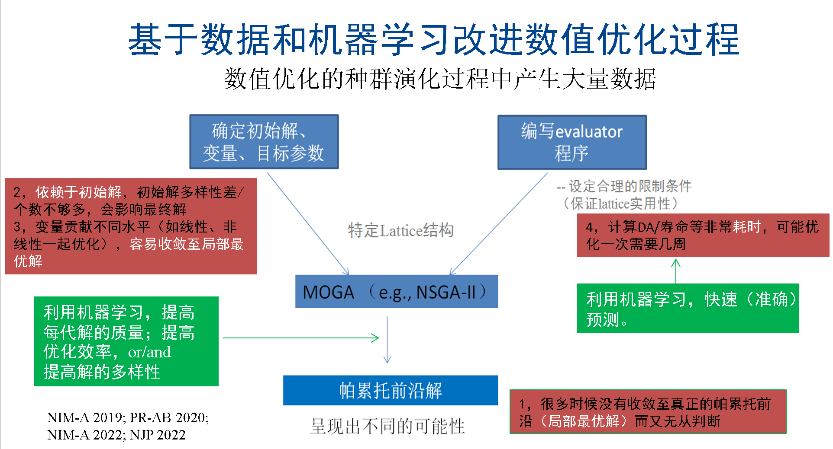
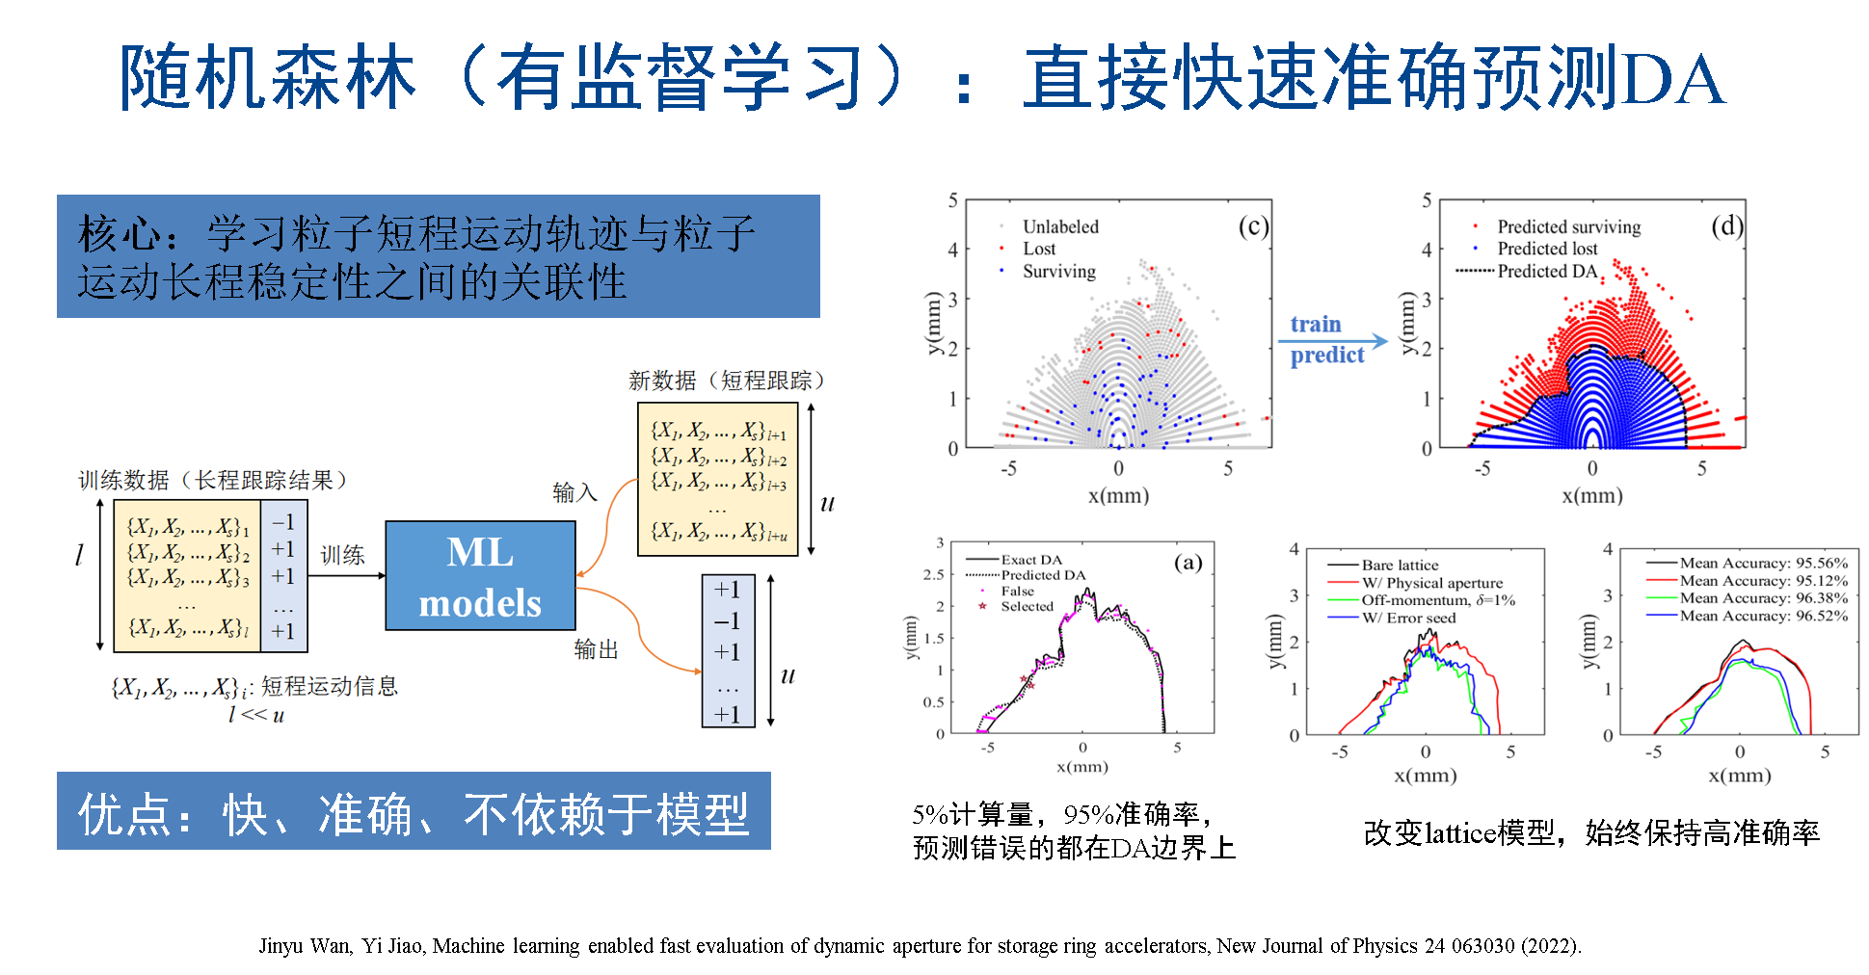
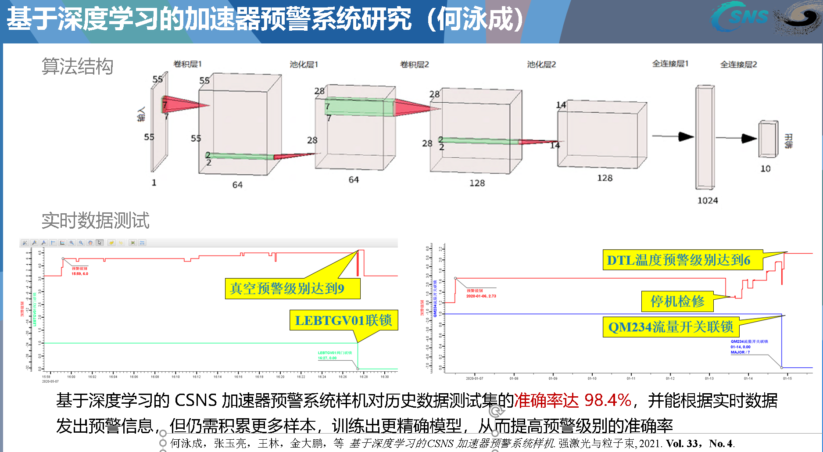
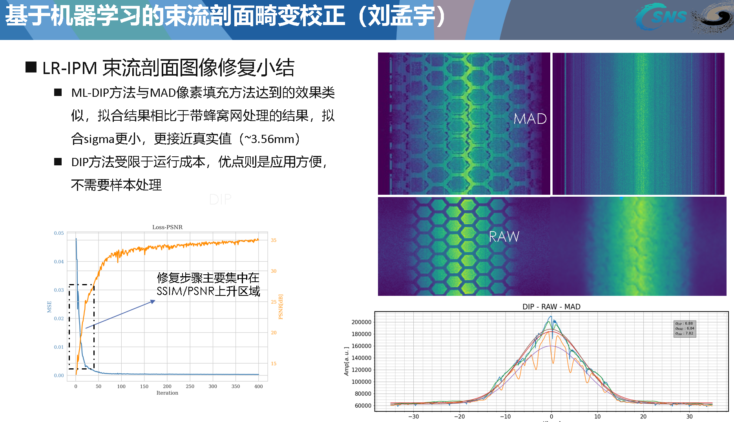
ML applications in our lab
Improvement of numerical optimization based on NN
Prediction of DA based on random forests
Deep learning based accelerator early warning system
ML-based correction of beam profile distortions

Slide 5
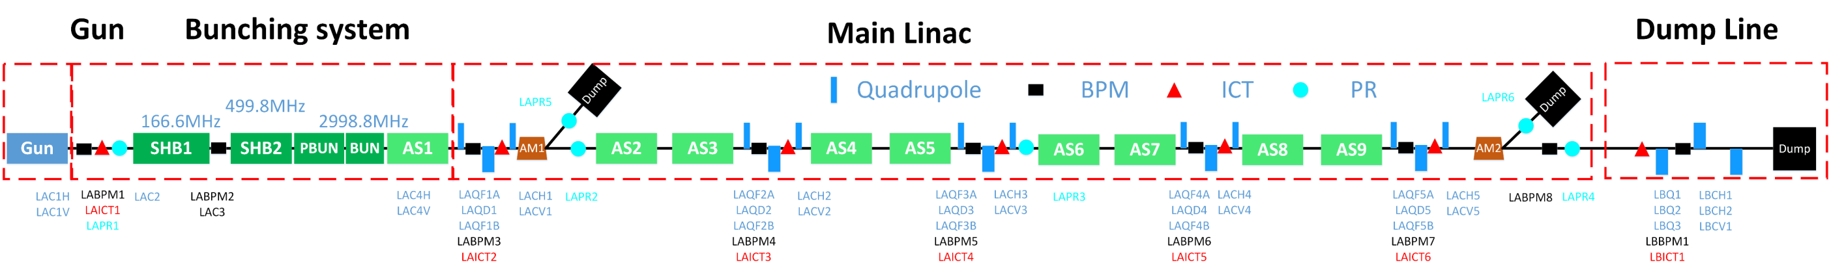
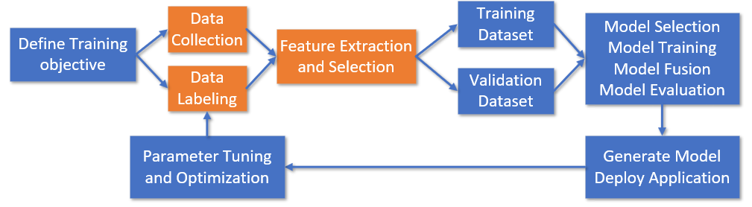
The Key for ML application in actual accelerators：
High-quality data

Slide 6
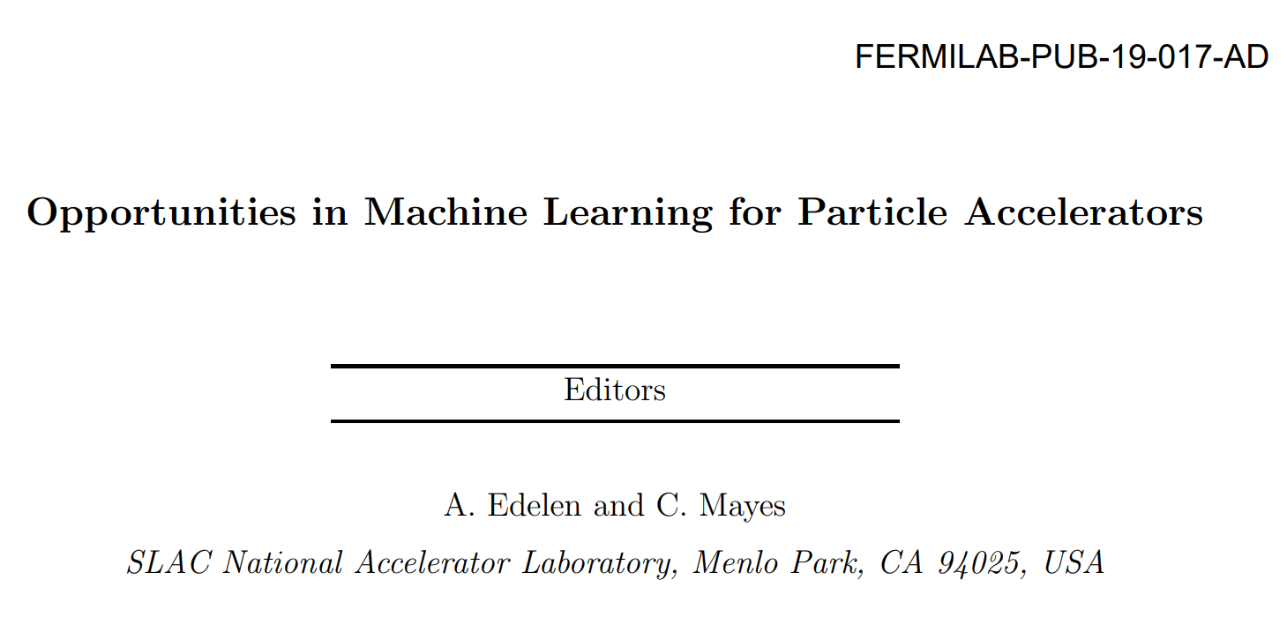
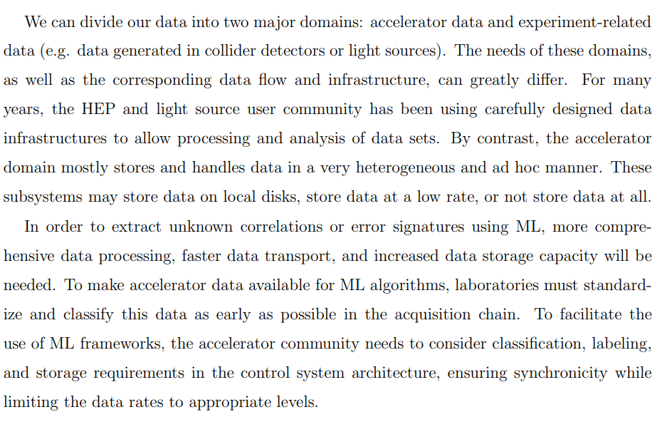
High-quality data problem in Particle Accelerator
Applying ML to uncover hidden correlations among machine parameters in research, we need:
  More comprehensive data processing approach
  Faster transmission speed
  Enhanced storage capacity
Standardize, categorize, and label the data as early in process as possible
Ensure data is synchronized at the appropriate frequency
Data in accelerator is typically stored in heterogeneous or temporary formats. Some subsystem may stored data on local disks or at low frequencies, or not store data at all.
ML-2018
Edelen, A. et.al., (2018). Opportunities in Machine Learning for Particle Accelerators. arXiv:1811.03172.

Slide 7
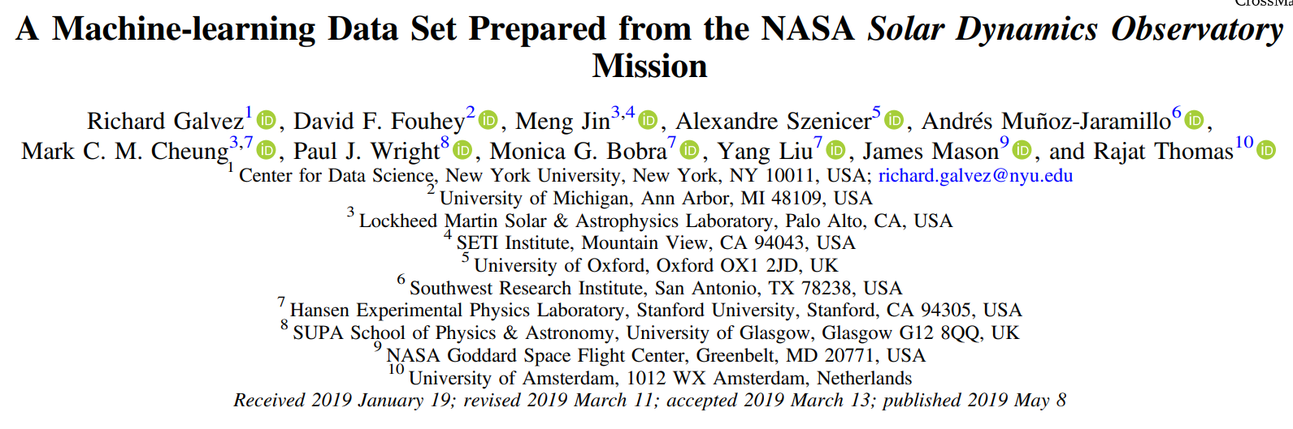
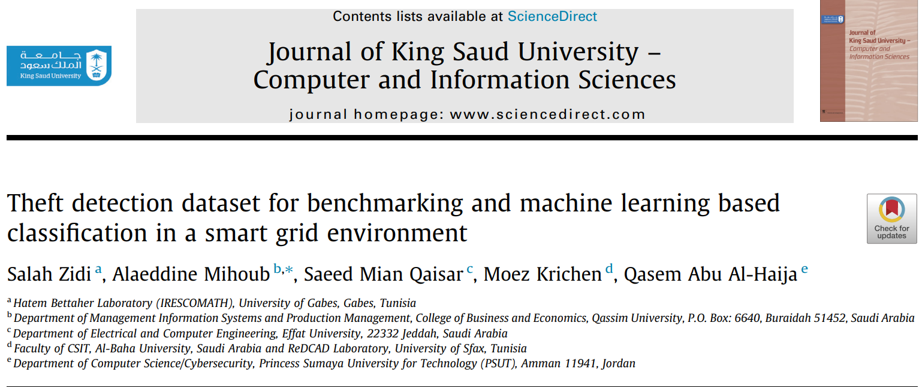
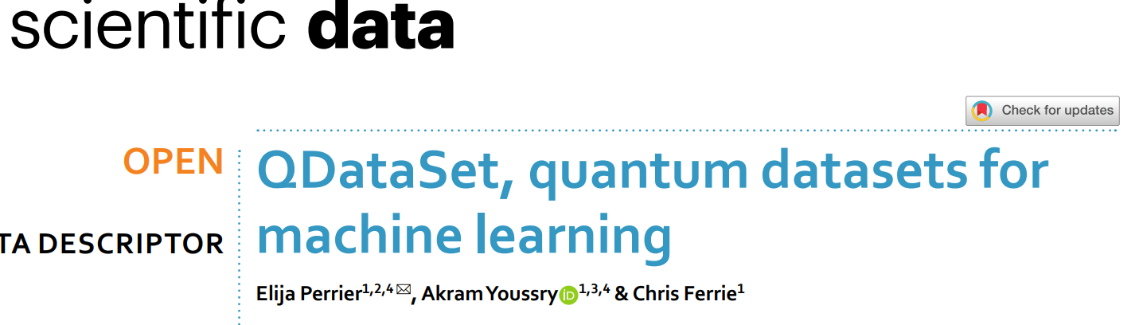
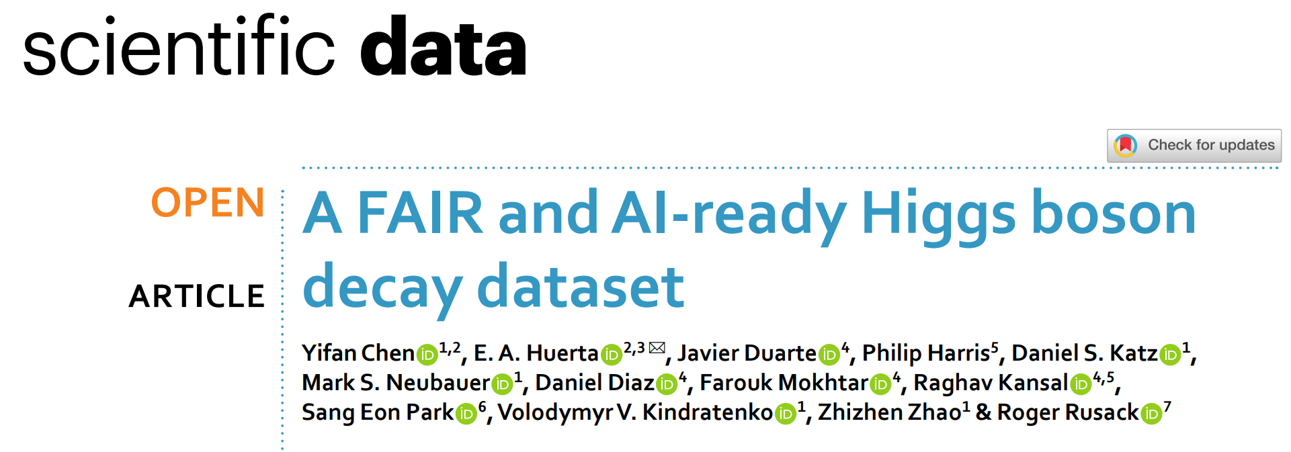
AI-Ready Dataset in other fields
NASA Solar Dynamics Observatory Dataset
Electricity Theft Detection Dataset
QDataSet: Quantum Dataset
Higgs Boson Decay FAIR Dataset

Slide 8
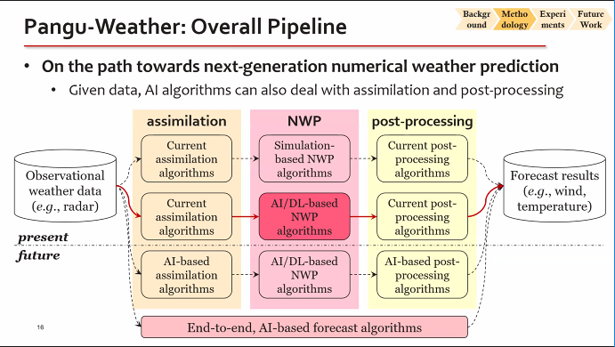
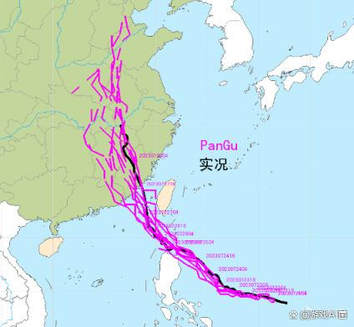
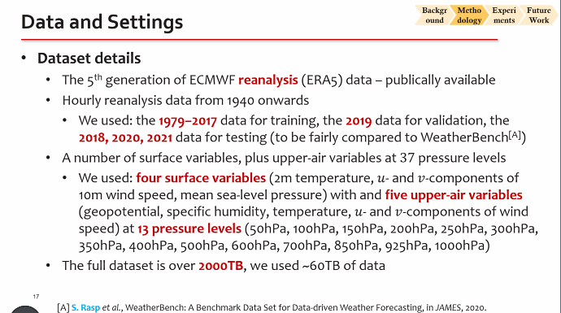
High-quality datasets:
The key to the success of large models like Pan Gu(“盘古”)
PanGu accurately predicted the typhoon path, achieving a predication speed 10000 times faster than traditional methods
Datasets from 1940 to the present（2000TB ）！
Using 60 TB of data for model training.

Slide 9
Introduction and Motivation
AI-Ready Dataset
Building FAIR-Compliant Platform for AI-Ready Data in Particle Accelerators
Conclusion

Slide 10
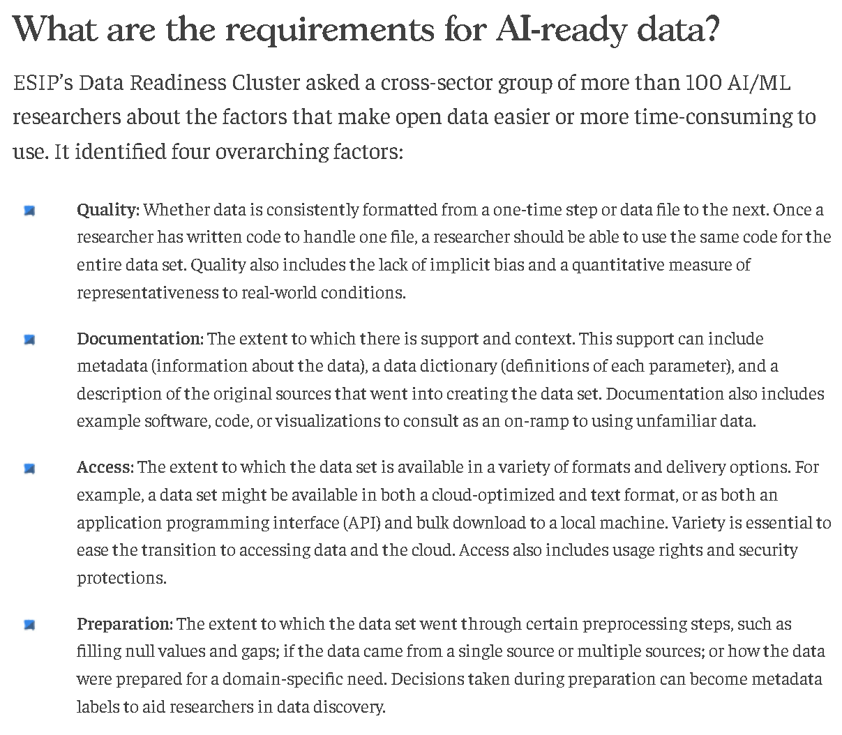

What are the requirements for AI-ready data
The Bipartisan Policy Center in the United States specifically discussed this issue at a forum
High data quality
Detailed metadata
Convenient data access
Rapid data processing
https://bipartisanpolicy.org/explainer/ai-ready-open-data/

Slide 11
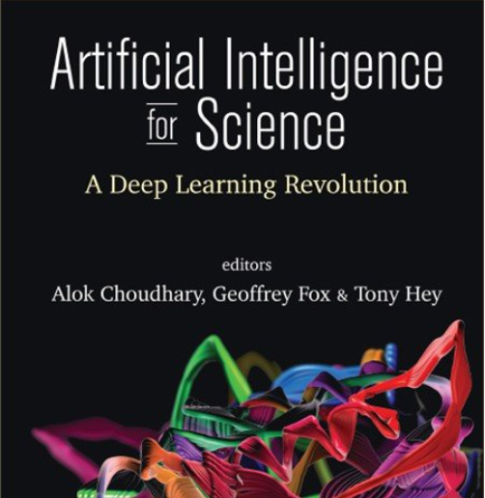





FAIR-Compliant AI-Ready Dataset
Creating AI-Ready datasets with FAIR principles
Accessible via SCPs
Metadata remains accessible
even if data is unavailable
Accurate and detailed descriptions
Clear and accessible publishing licenses
Accurate information from the data source
Findable
Accessible
Interoperable
Reusable
The importance of FAIR data：
Enables powerful new AI analyses
Facilitates access to machine learning and predictive data
Supports future human-machine collaboration and autonomous machine-to-machine communication
Unique Identifier
Rich Metadata
Searchable
Data format is standardized
Descriptions must be standardized
Wilkinson, M. D. et al. The FAIR Guiding Principles for scientific data management and stewardship. Sci. Data 3:160018 doi: 10.1038/sdata.2016.18 (2016).

Slide 12
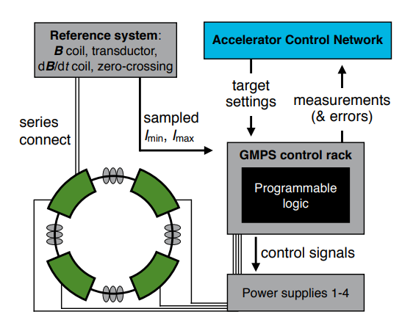
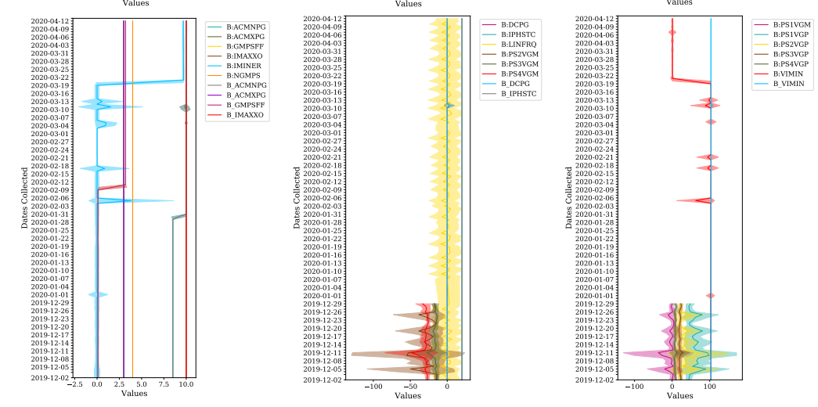
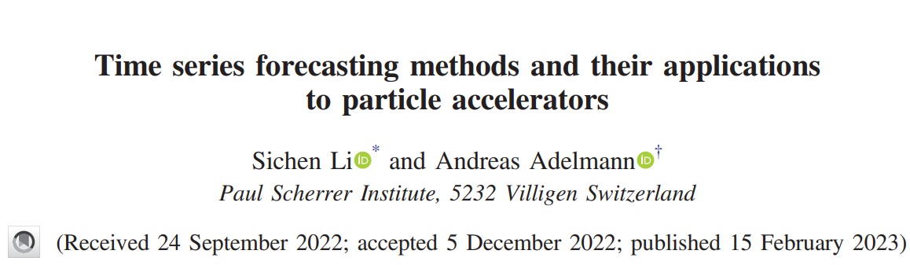
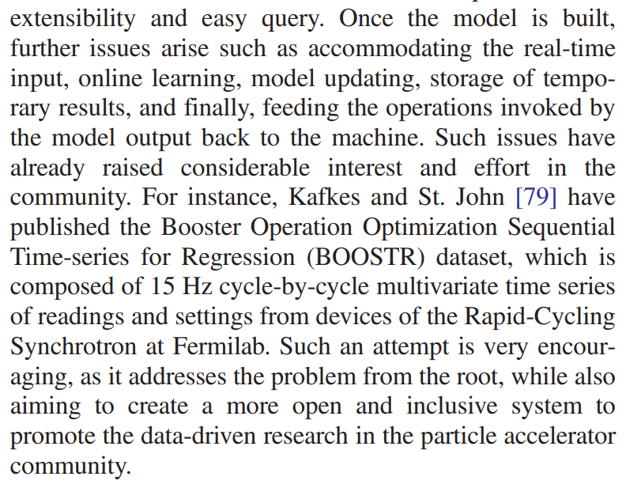
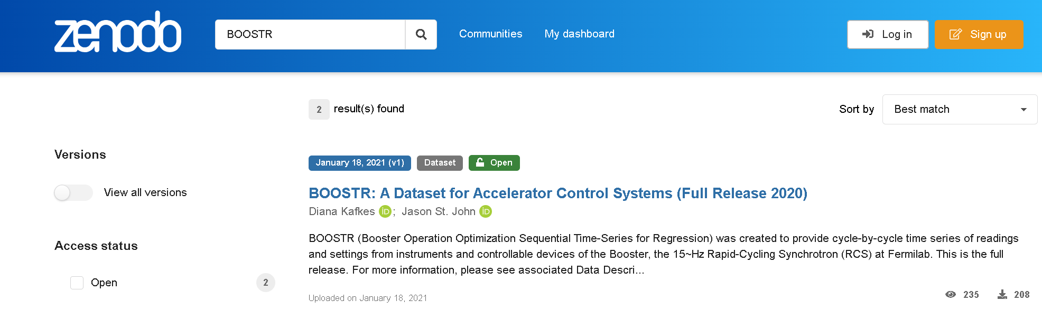
Fermilab developed a dataset generation system for gradient magnet power supply optimization
High praise to this work
D. Kafkes and J. St. John, BOOSTR: A dataset for accelerator control systems, Data 6, 42 (2021)

Slide 13
Introduction and Motivation
AI-Ready Dataset
Building a FAIR-Compliant Platform for AI-Ready Dataset in Particle Accelerator
Conclusion

Slide 14
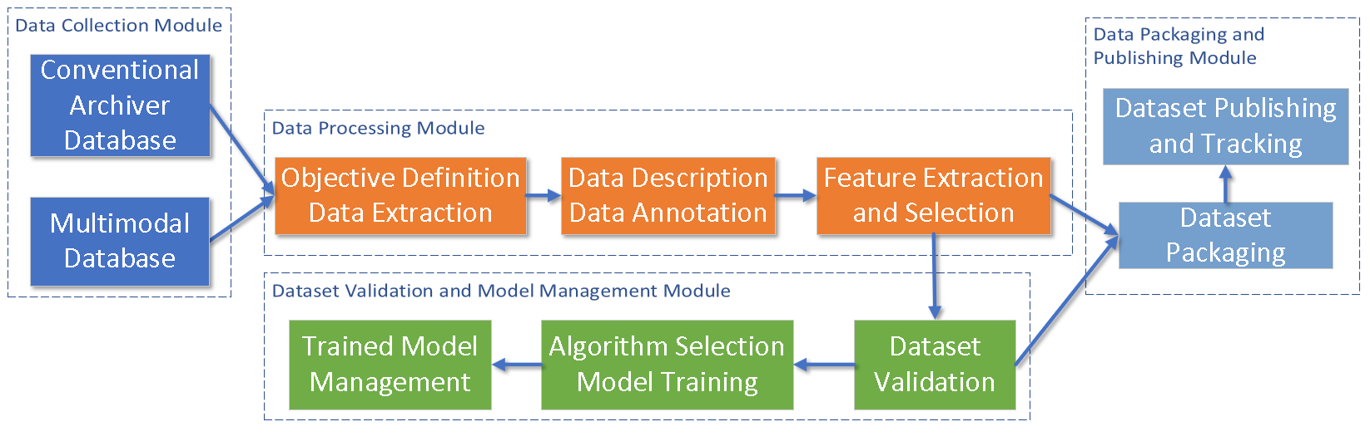
A FAIR-Compliant Platform for AI-Ready Data in Particle Accelerators
Based on the FAIR principle(Findable, Accessible, Interoperable, Reusable)
Develop and establish a comprehensive platform to generate AI-ready Data that meets the requirements for machine learning application.

Slide 15
A FAIR-Compliant Platform for AI-Ready Dataset in Particle Accelerator
Data Integration
Format Selection, e.g. HDF5
Dataset Metadata: Content Description, Creation Data, Methodology, Data Format, Keywords, Access Information, Publishing Institution
Data Publishing
Data integrity
Data synchronization
Multimodal database
Event-driven data storage
Time stamp alignment
Metadata: Time, Frequency, Channel Name, Data Type, Data Precision
Physical Information: Meaning, Unit, Physical Symbol
Data Feature Extraction
ML-Model Selection
Dataset Training
Trained Model Management

Slide 16
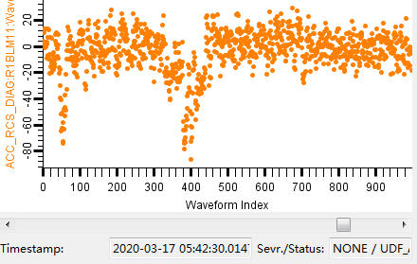
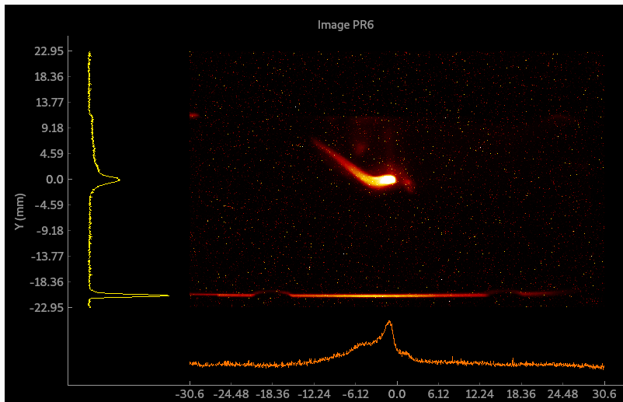
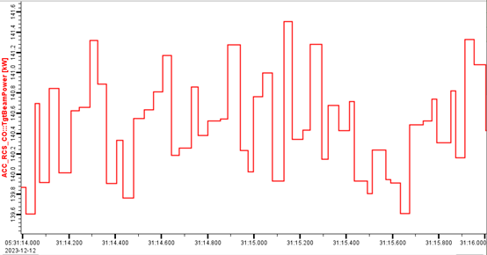
Multimodal Data Collection
Multimodal database, serving as supplements to conventional archiver database, primarily focus on the storage of waveform data, image data, and high repetition rate data. These data need large volumes. For instance, the beam loss monitoring system of the CSNS accelerator generates 41G of waveform data per hour.
The multimodal data collection module does not employ a real-time continuous storage approach. It stores data on demand with an event-triggered method.
Waveform
Image
High-Repetition Rate

Slide 17
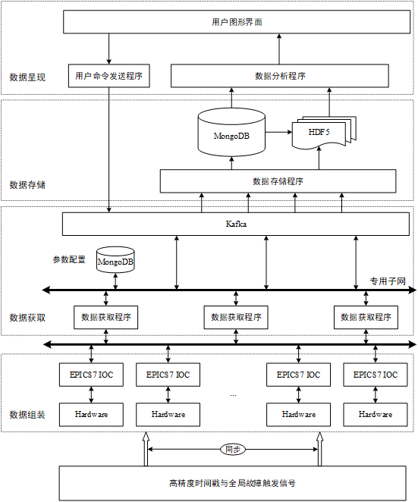
Data Acquisition and Storage
Device-level Data Caching: Ensuring High Temporal Resolution of Data
High-Precision Time Synchronization System: Achieves global data acquisition event distribution, ensuring the relevance of the collected data.
EPICS 7：Assembling and fully describing the locked data read from devices
Kafka：Data transmission and caching to reduce the network load.
MongoDB+HDF5：Storing metadata and waveform data.
HTTP REST Interface：Querying, plotting, and downloading multimodal data
Data acquisition event distribution

Slide 18
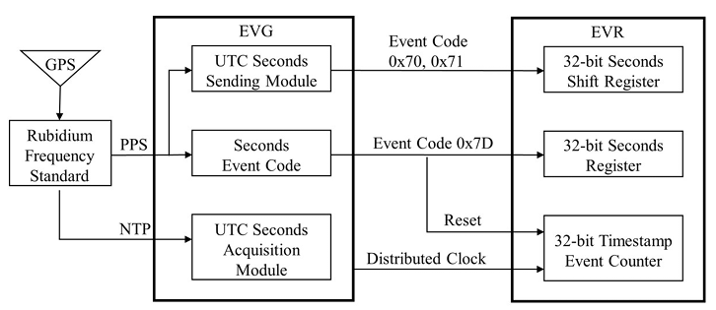
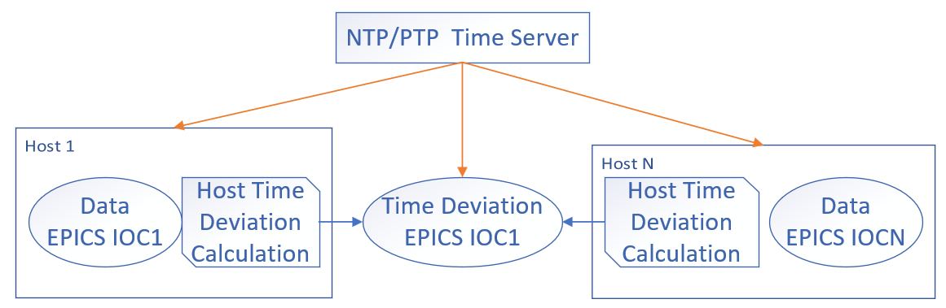
Data Synchronization
Global timestamp synchronization for the accelerator is achieved through a combination of event-based timing systems and NTP (Network Time Protocol)
Systems with configured event receivers：Global timing is synchronized through an event-based timing system.
For Systems unable to synchronize time using an event-based timing system: Time synchronization can be achieved using NTP or PTP, with real-time deviation calculations to calibrate data timing
Global high-precision timing through an event-based timing system
Timing and real-time deviation calculation based on NTP/PTP
18

Slide 19
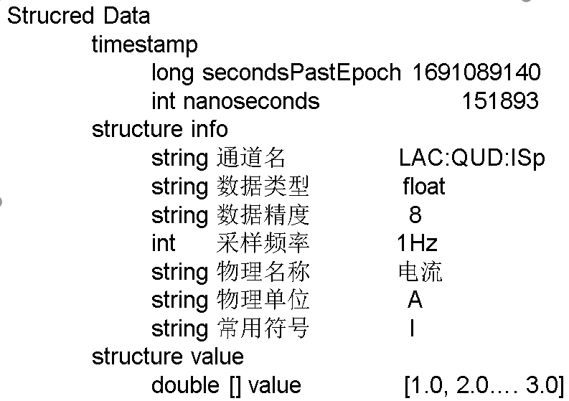
Module 2：Data Processing
Data should be with rich metadata, such as time, frequency, device, channel name, data type, data precision.
Add physical contents to the data, include physical name, meaning, units, and symbols
Timestamp alignment for data, filling in missing values, eliminating anomalous data, and labeling the data as necessary
Feature extraction from data, such as dimensionality reduction, normalization, standardization, and color histograms for image data.
Unique Identifier
Rich Metadata
Searchable
Data format is standardized
Descriptions must be standardized
Accurate and detailed descriptions
Clear and accessible publishing licenses
Accurate information from the data source
Findable
Accessible
Interoperable
Reusable
Notes:
从实际机器中取得的数据，多数据是不能直接应用到机器学习中。需要进行特征提取，选择合适的特征作为训练的输入数据。本项目拟针对不同的数据类型，提供多种特征提取方法，如对数据降维、归一化、标准化、图像数据的颜色直方图等

Slide 20
Module 3：Data Packing and Publishing
Packing and Publishing Dataset based on FAIR principle
Self-developed platform
Packaged into HDF5
Rich Metadata
With DOI as identifier
With CC license
Access with http（query、download）
Zenodo platform
Unique Identifier
Rich Metadata
Searchable
Access with SCPs
Metadata remains accessible
Data format is standardized
Clear and accessible publishing licenses
P.S.：
Zenodo is an internationally general platform for publishing dataset and related research outcomes, operated by CERN
Findable
Accessible
Interoperable
Reusable
Notes:
根据FAIR原则，数据集要有详细的元数据描述。如数据集内容描述、创建时间、方法、数据格式、关键字、访问信息、发布机构等。利于数据的分享和引用。
CC许可证，即“创作共用许可证”（Creative Commons license），是一套公共版权许可协议，旨在帮助内容创作者（如作家、艺术家、教育者和研究人员）以法律许可的形式分享他们的作品，同时允许他人在一定条件下使用这些作品。

Slide 21
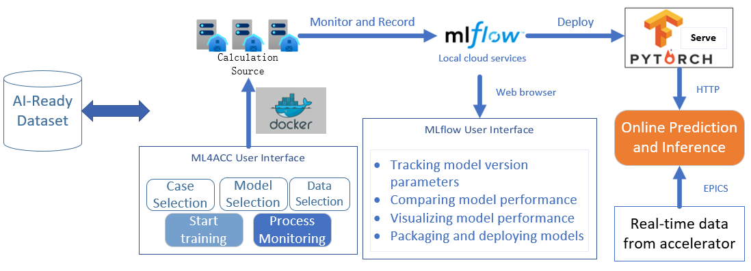
Module 4、Dataset validation and model management
Building a one-stop machine learning management platform, ML4ACC, to provide management and access to hyperparameters and models, thereby increasing the degree of automation in the model training workflow
Logic Define
Train Dataset
Process Dataset
Hyperparameters
Stoping Criteria
Label Samples
ML4ACC
ML Training
workflow

Slide 22
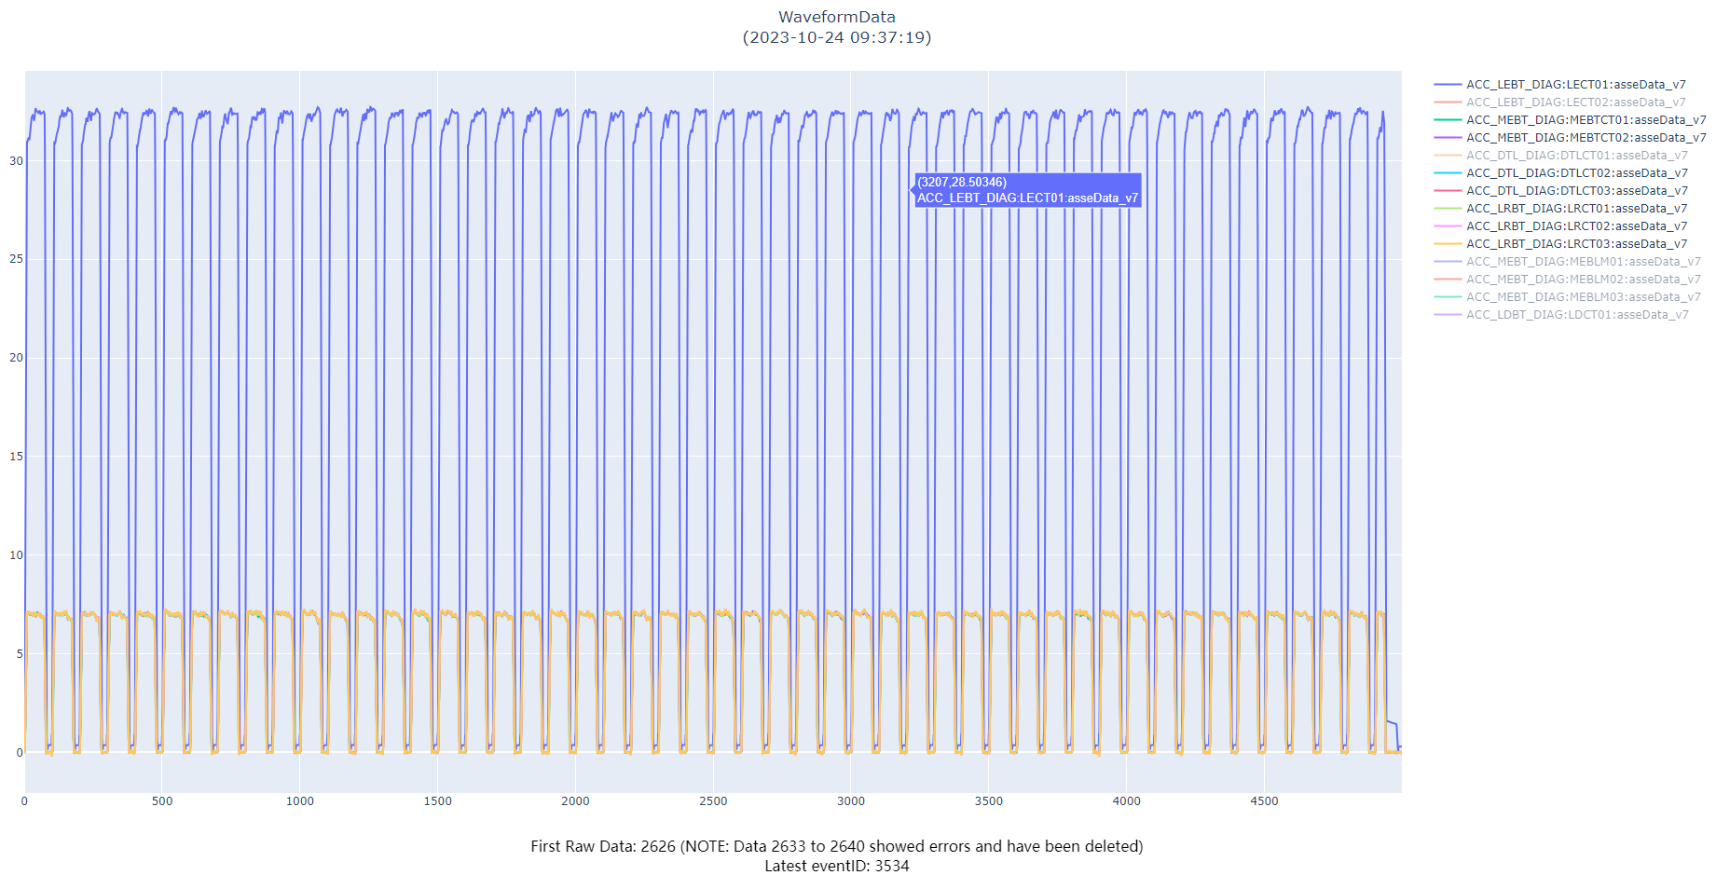
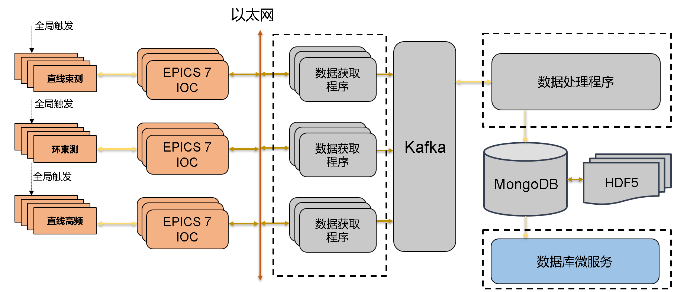
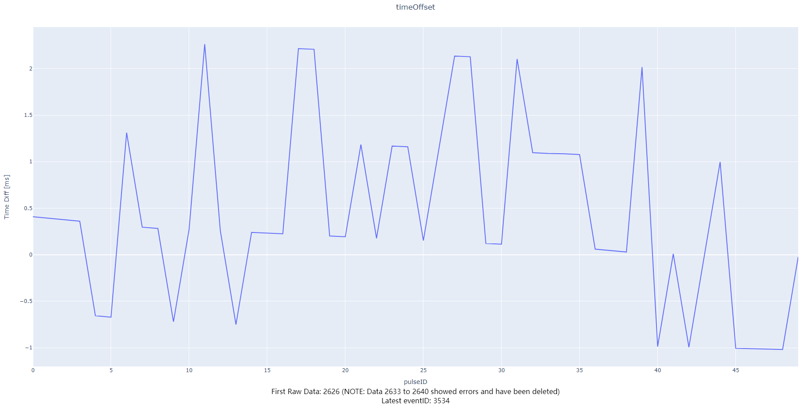
What we have done
Developed a data system for the CSNS accelerator using EPICS7, Kafka, Docker, and HDF5, handling data acquisition, storage, and access synchronized with the 25Hz beam cycle
MEBT Vs DTL
CT Waveform
2.5ms
-1ms
Time stamp difference between MEBT and DTL for a single trigger
Notes:
Apache Kafka 是一个流行的开源分布式事件流平台，由LinkedIn开发并于2011年贡献给Apache软件基金会。Kafka被设计用来处理高吞吐量的数据流，并且能够在分布式系统中高效地处理数据。它在大数据和实时数据处理领域中非常重要，被许多企业和组织广泛使用。

Slide 23
Introduction and Motivation
AI-Ready Dataset
Building FAIR-Compliant Platform for AI-Ready Data in Particle Accelerators
Conclusion

Slide 24
Conclusion
High-quality data is a key element in ML applications and the basis of all research
We are dedicated to developing a FAIR-Compliant platform to generate AI-Ready datasets.
We have currently completed part of the data synchronization experiments.
Thanks for your attention!
Any questions or suggestions: luxh@ihep.ac.cn

Slide 25
backup

