Slide 1

Automation at CERN progress with CERN’s accelerator fleet
A. Huschauer, V. Kain, M. Schenk, F. Velotti
on behalf of the extended EPA community
4th ICFA Beam Dynamics Workshop on ML for Particle Accelerators, Gyeongju, Korea 06. March 2024

Slide 2
Contents
    Efficient Particle Accelerators project
    transforming machine operations
    Infrastructure
    frameworks & building blocks
    Status & results
    some highlights
    Outlook & conclusions
    timeline

Slide 3
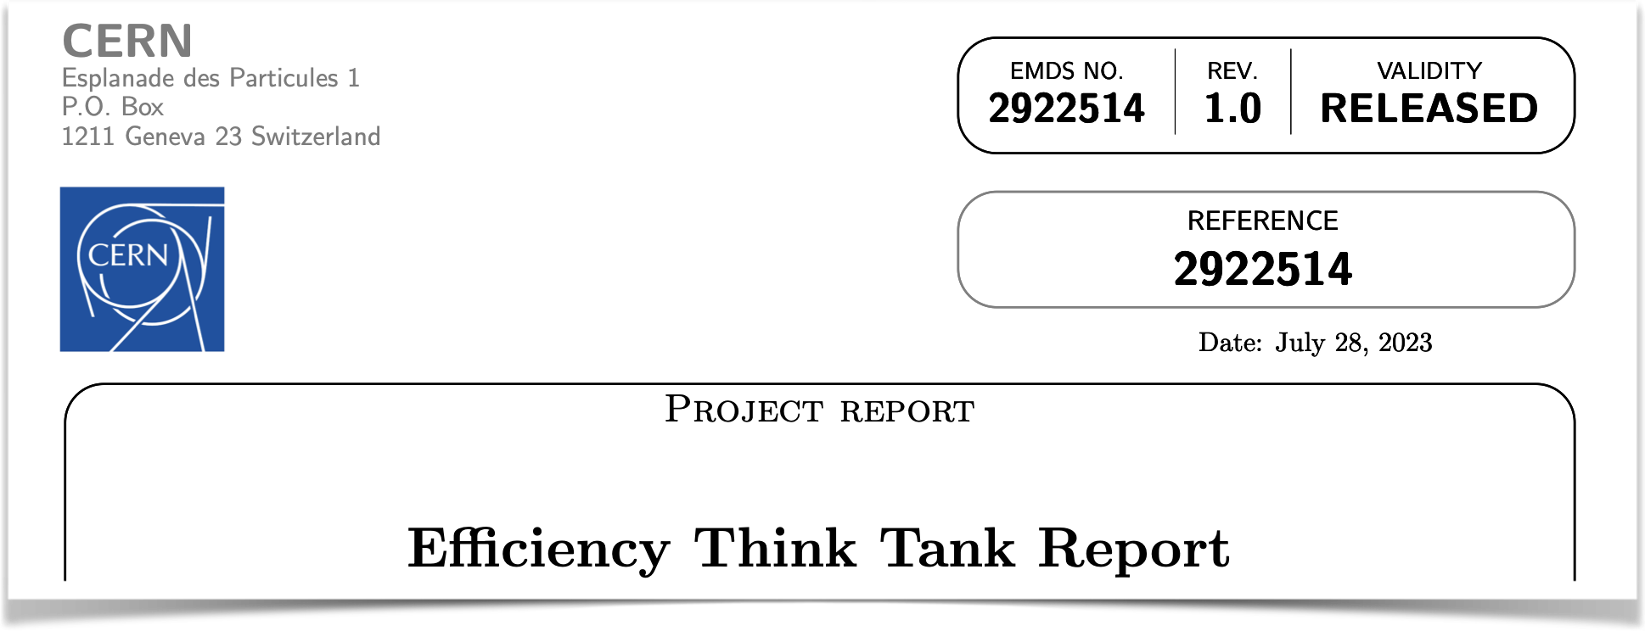
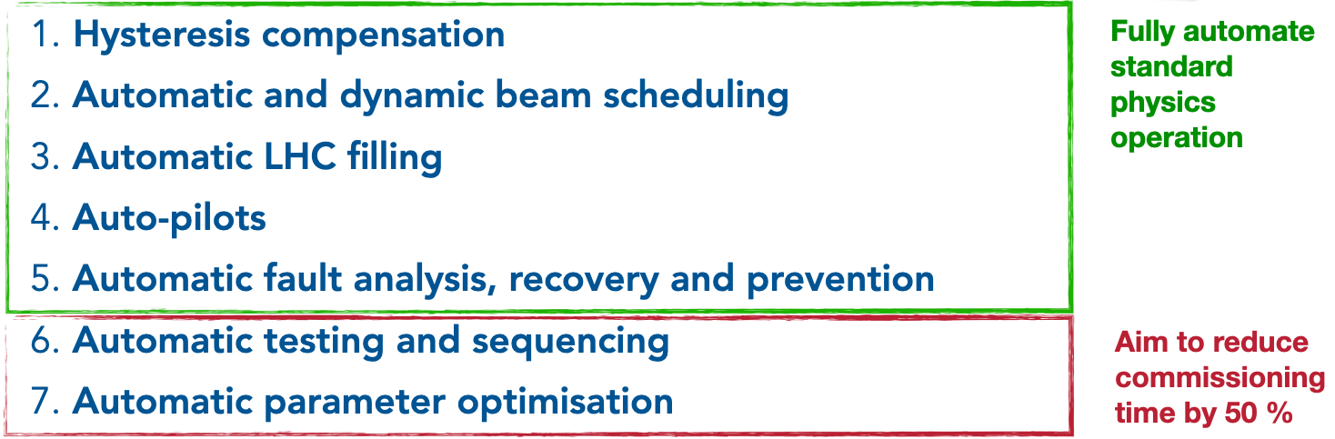
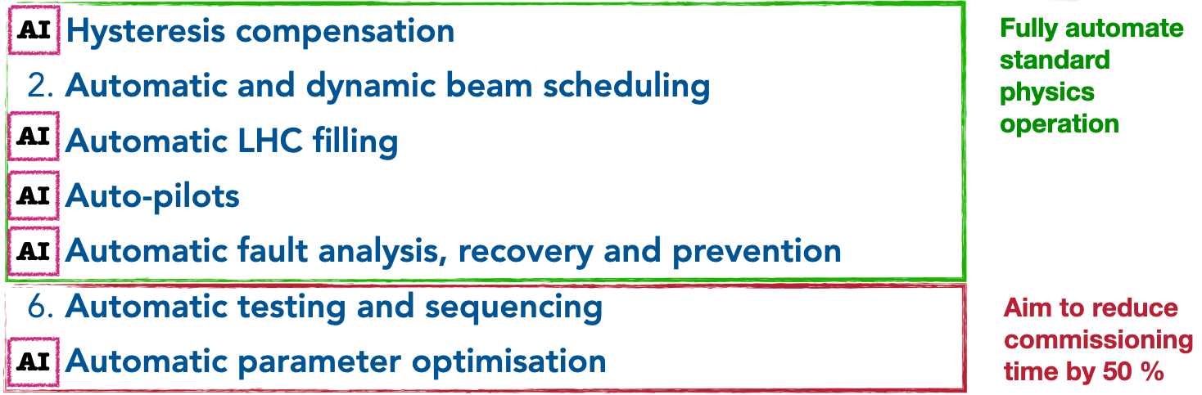
Motivation
Efficiency Think Tank
Question coming up repeatedly at CERN end-of-year workshops ‘21 & ‘22
How to best exploit the accelerator complex?
in terms of efficiency, reproducibility, flexibility, and performance
Efficiency Think Tank (ETT)
in 2023
7 strategic recommendations

Slide 4
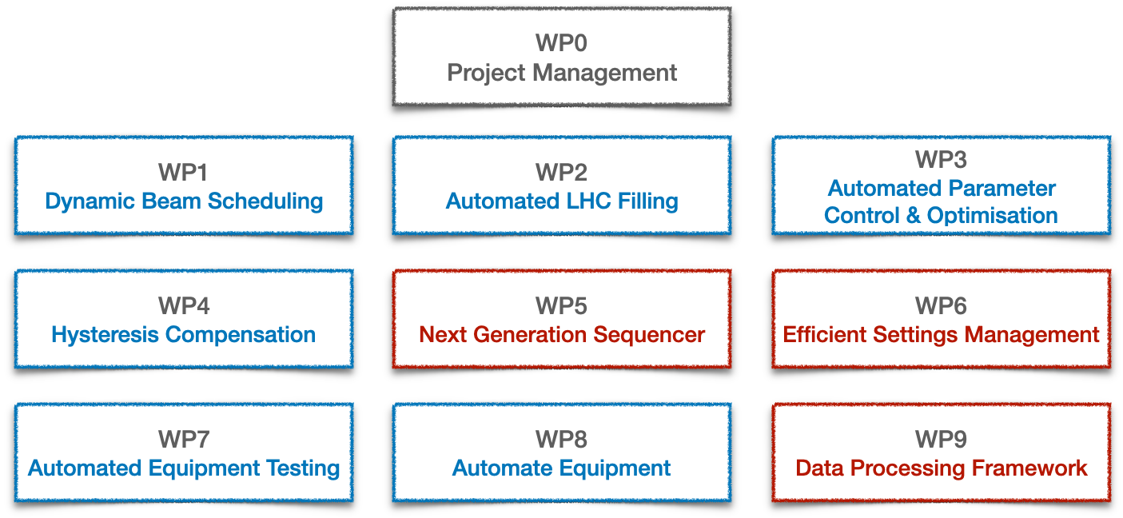
Efficient Particle Accelerators
From think-tank to project
ETT Efficient Particle Accelerators (EPA) project
Approved in autumn 2023 for a 5-year period
10 strongly interlinked work packages (WP)

Slide 5
Efficient Particle Accelerators
From think-tank to project
ETT Efficient Particle Accelerators (EPA) project
Approved in autumn 2023 for a 5-year period
10 strongly interlinked work packages (WP)
ETT recommendations
Infrastructure evolution

Slide 6
Contents
    Efficient Particle Accelerators project
    transforming machine operations
    Infrastructure
    frameworks & building blocks
    Status & results
    some highlights
    Outlook & conclusions
    timeline

Slide 7


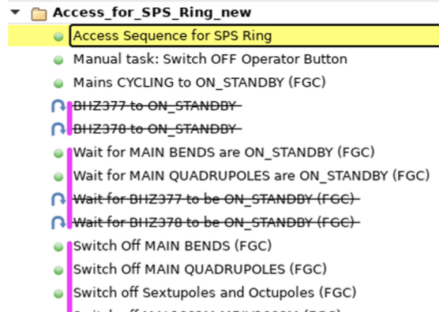
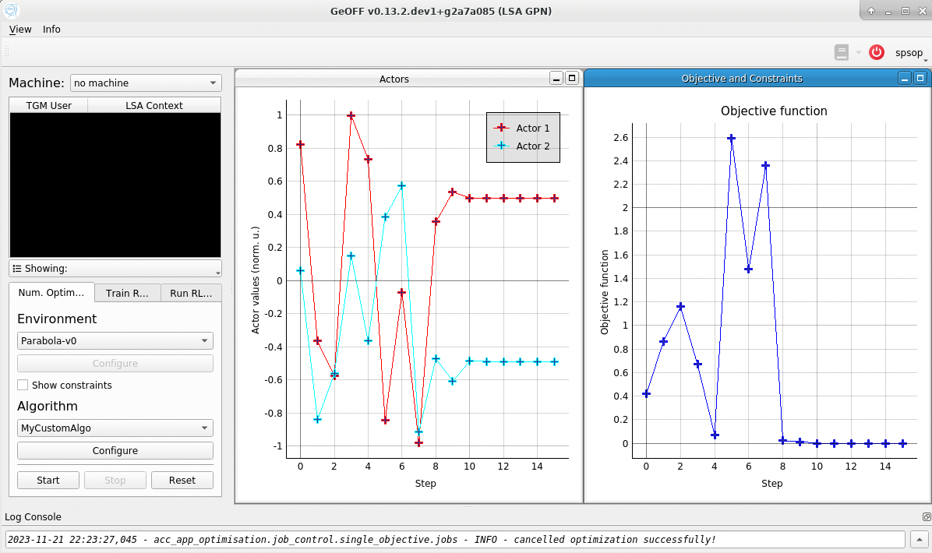
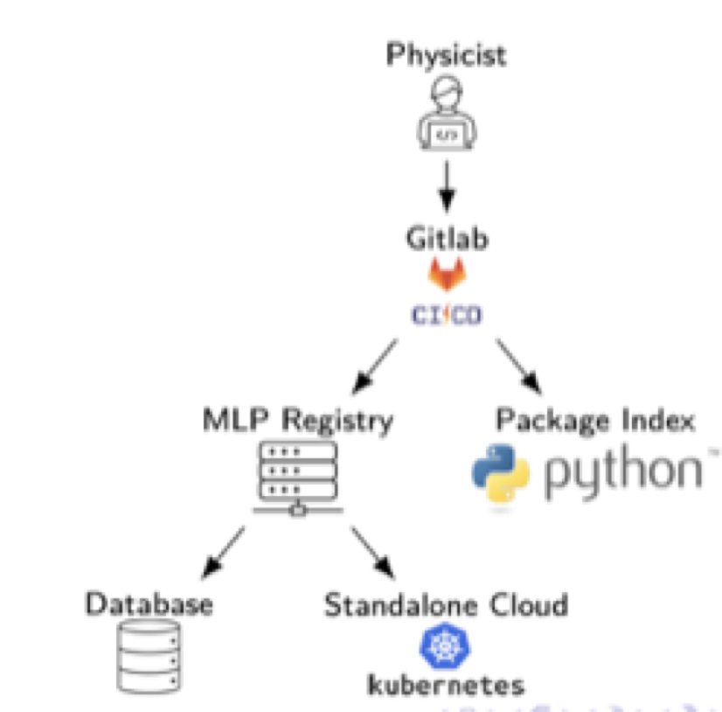
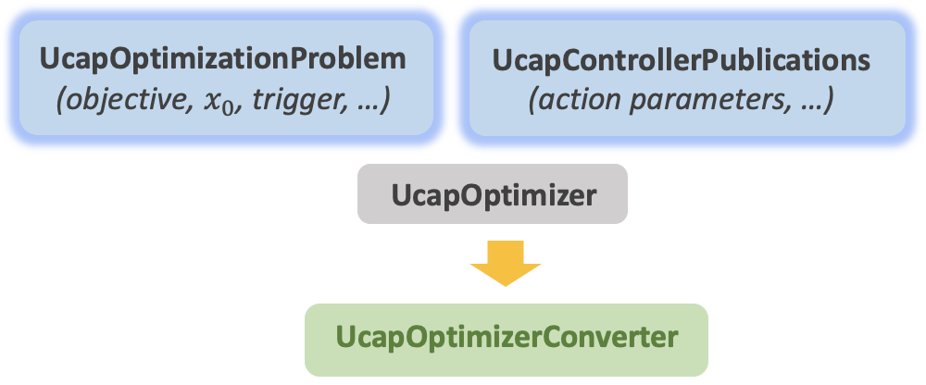
Infrastructure
Frameworks & building blocks
Acc-Py
“accelerating Python”
Full integration of Python
with control system
Online data acquisition, equipment access (set / get), app development, …
Python package index
Classical automation concepts
    UCAP
    Unified Controls Acquisition & Processing
Sequencer: programmatic execution of tasks
High-level parameter models
AccTesting
Virtual device service
Event-based, online data transformations
Further evolution with EPA
EPA: sequencer 2.0, equipment testing, efficient settings management
Enabling automation with AI / ML
    Auto-pilots & optimizers
    GeOFF
    Generic Optimization Framework and Frontend
Machine Learning Platform
Deployment & inference of
(ML) models
        Facilitate implementation of control problems
        Exploit & expose features of control architecture
        Maintain uniformity across complex
Train, store & share ML models with VC
Language agnostic
Available in control room
    acc-geoff4ucap
    Framework for optimization & control via UCAP

Slide 8

Infrastructure
Frameworks & building blocks
Acc-Py
“accelerating Python”
Full integration of Python
with control system
Online data acquisition, equipment access (set / get), app development, …
Python package index
Classical automation concepts
    UCAP
    Unified Controls Acquisition & Processing
Sequencer: programmatic execution of tasks
High-level parameter models
AccTesting
Virtual device service
Event-based, online data transformations
Further evolution with EPA
EPA: sequencer 2.0, equipment testing, efficient settings management
Enabling automation with AI / ML
    Auto-pilots & optimizers
    GeOFF
    Generic Optimization Framework and Frontend
Machine Learning Platform
Deployment & inference of
(ML) models
        Facilitate implementation of control problems
        Exploit & expose features of control architecture
        Maintain uniformity across complex
Train, store & share ML models with VC
Language agnostic
Available in control room
    acc-geoff4ucap
    Framework for optimization & control via UCAP

Slide 9
Infrastructure
UCAP & acc-geoff4ucap
UCAP
Framework & service to implement & run online data processing pipelines
Acquire
Subscribe to data sources
Group data via EventBuilder
Transform
Process incoming data
Java or Python
GPU support
Publish
Publish results
Can be hardware “sets”
UCAP pipelines can be chained and built into hierarchies
Conceptually simple, and very powerful

Slide 10
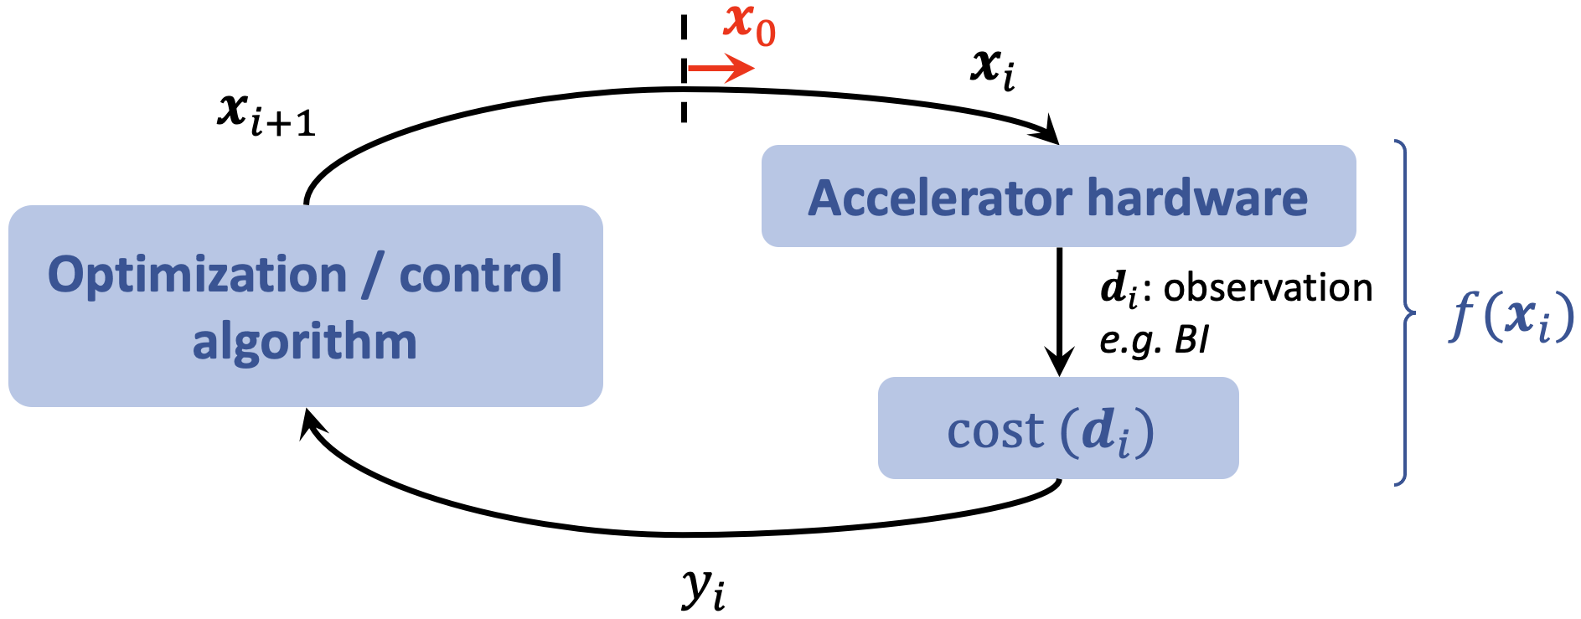
Infrastructure
UCAP & acc-geoff4ucap
UCAP
Framework & service to implement & run online data processing pipelines
acc-geoff4ucap
Use UCAP to implement the optimization / control loop on server
Acquire
Subscribe to data sources
Group data via EventBuilder
Transform
Process incoming data
Java or Python
GPU support
Publish
Publish results
Can be hardware “sets”
UCAP pipelines can be chained and built into hierarchies
Conceptually simple, and very powerful
Great infrastructure to run auto-pilots
continuous controllers or auto-launching optimizers

Slide 11
Contents
    Efficient Particle Accelerators project
    transforming machine operations
    Infrastructure
    frameworks & building blocks
    Status & results
    some highlights
    Outlook & conclusions
    timeline

Slide 12
Status & results
EPA: ETT recommendations

Slide 13
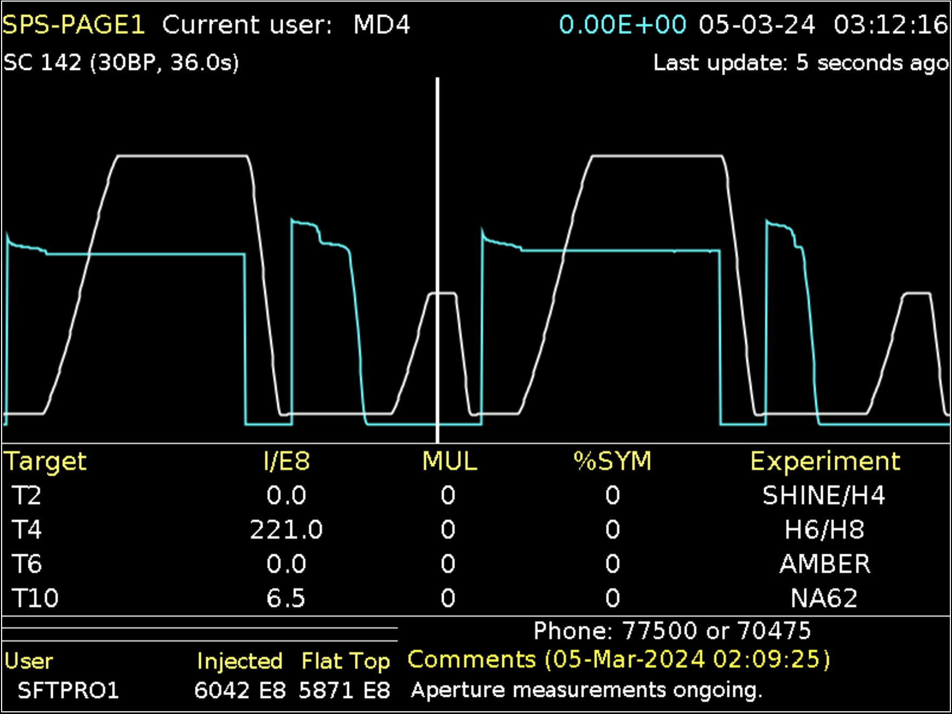
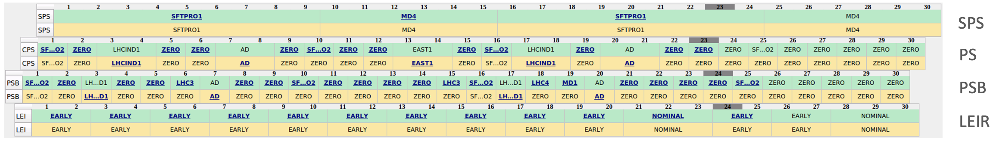
Status & results
WP1: Dynamic beam scheduling
Supercycle (SC): sequence of beam types / cycles played over and over
Programming SC is a constrained scheduling problem
Constraints: some beams cannot be adjacent, respect priorities, etc.
Manually defining SC has severe impact on efficiency & OP resources
Stats: SC change takes 2 - 25 min; 40 - 60 x / 24 h
Plans
  2024: template SC with placeholders to be filled in automatically
  2025: no programmed SC; schedule beams “as we go”
  Eventually: dynamic cycle length (“play beams only for time needed”)
Notes:
multi-destination machines
mention google OR-tools

Slide 14
Status & results
EPA: ETT recommendations

Slide 15
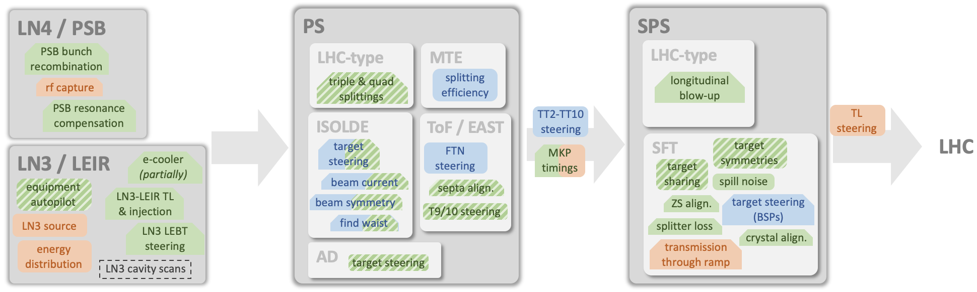
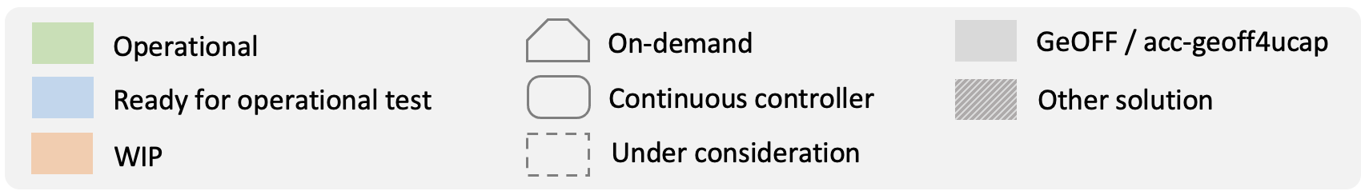
Status & results
Incomplete overview of auto-pilots and optimizers
Auto-pilots & optimizers are all across the injector complex
2023
  Many automatic solutions (20+ problems) in place and used in commissioning & day-to-day operation
  Plenty new ones under development
Trend 2024: from on-demand to continuous control infrastructure is key (UCAP)
Until end of Run 3: implement auto-pilots for remaining control problems in standard operation

Slide 16
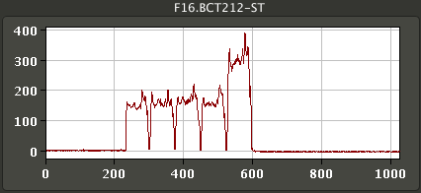

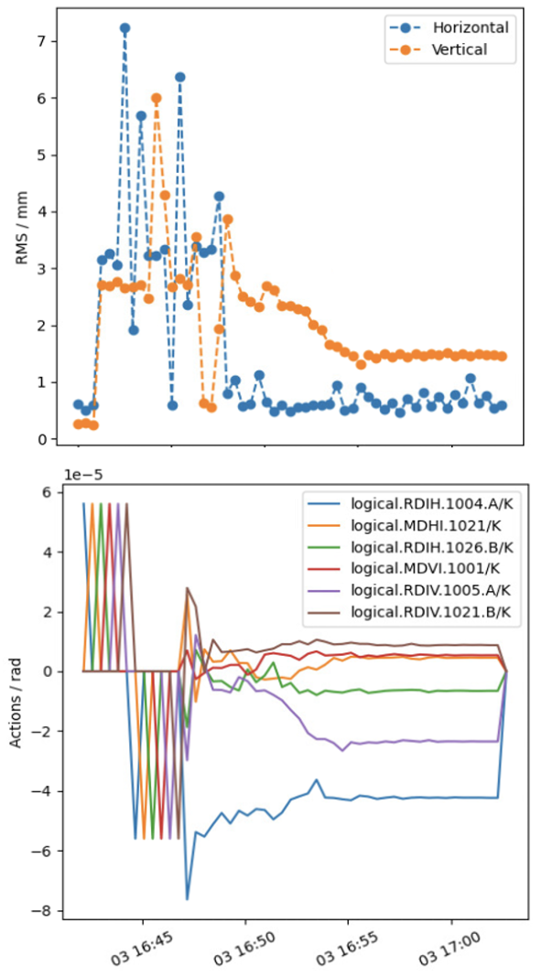
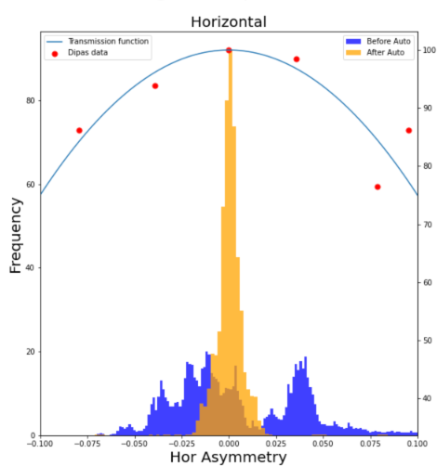
Status & results
Auto-pilots: a selection
PS Multi-Turn Extraction
  Automatic drift compensation
  Successfully tested and tuned in MDs with controllers on UCAP
  Hybrid agent: continuous controller interleaved with optimizer when far off
  Upcoming operational test
supercycle change
ES
BOBYQA
ES
A. Huschauer, M. Schenk, C. Uden
  Trajectory steering framework
  using acc-geoff4ucap
PS EAST: fixed target beam steering
  PID regulator on UCAP
  Simple & effective
  2024: integrate with acc-geoff4ucap
  Similar controller for TL towards AD
    Versatile objective
    Beam position, beam loss, …
    Generic settings & actors
    Various algorithms
    incl. Micado / SVD
    In 2024: PS2SPS, SPS2LHC
G. Trad, F. Velotti
J. McCarthy

Slide 17
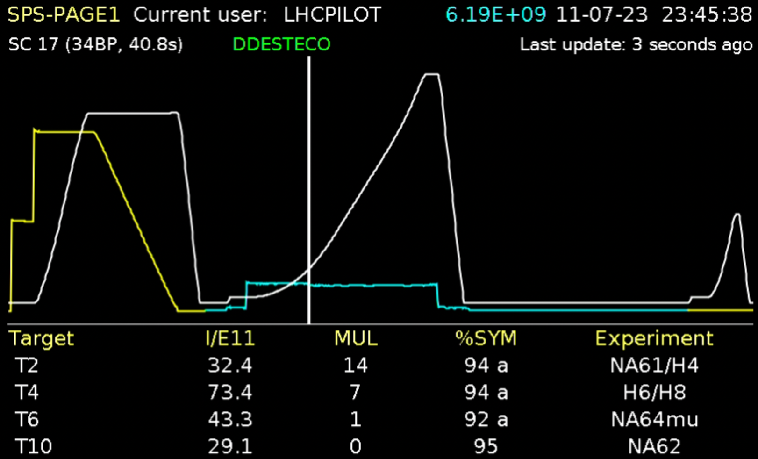
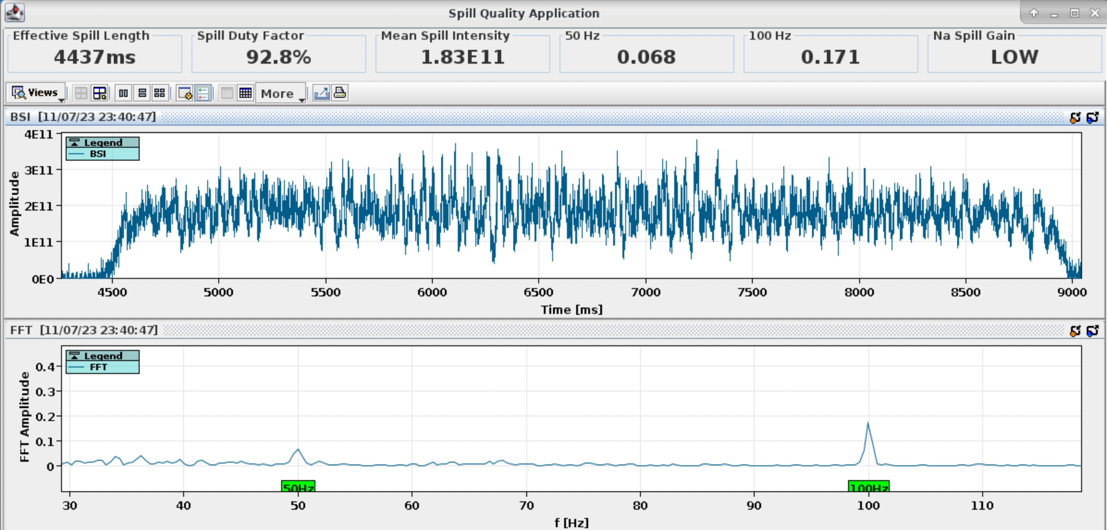
Status & results
Auto-pilots: spill noise cancellation
SPS slow-extracted beam current has 50 Hz & 100 Hz noise originating from quadrupole power converter ripple
2022: auto-launching numerical optimizer
  Effective for 50 Hz, but not for 100 Hz
  Phases of strong exploration
2023: continuous control & empty bucket channeling
  Adaptive Bayesian optimization (ABO)
  a spatio-temporal GP model
  Improvements throughout the run (UCAP GPU, EBC)
  Well within objective
  Occasional exploration spikes: use proximal biasing in 2024
P. Arrutia, V. Kain, M. Schenk, F. Velotti

Slide 18
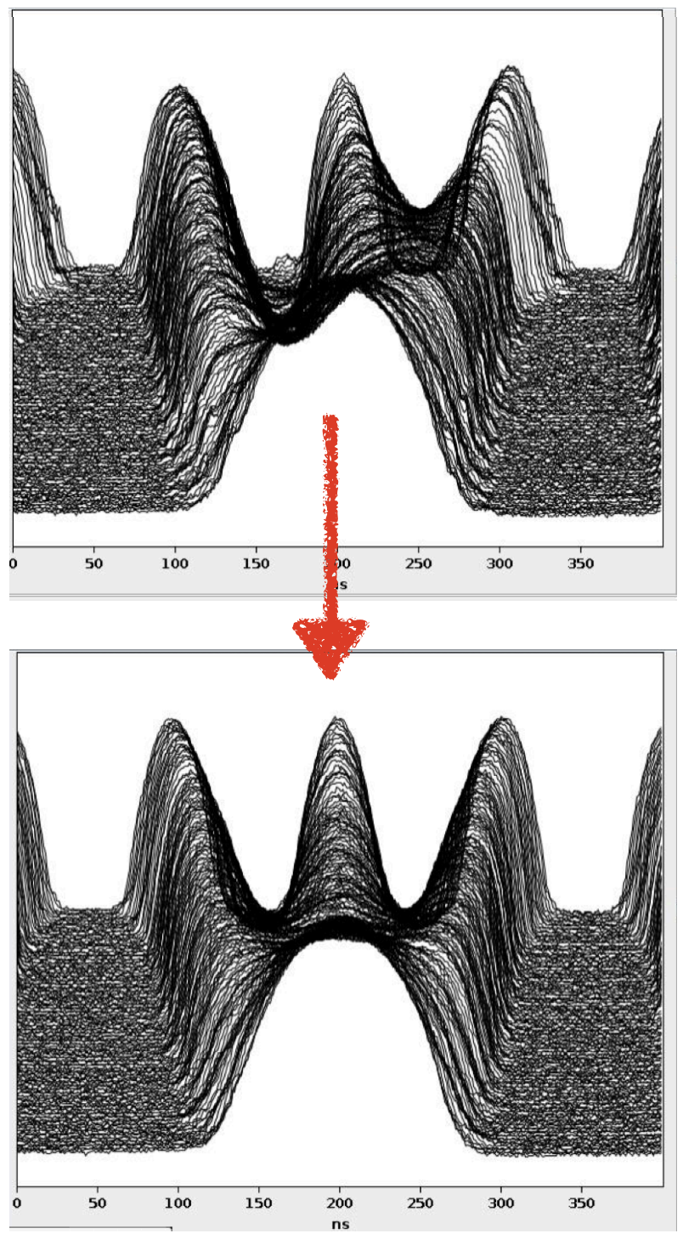
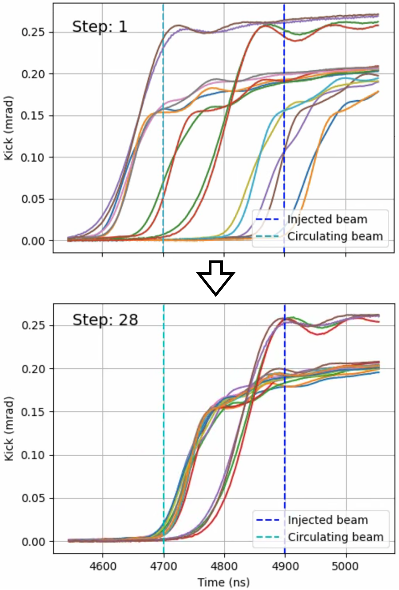
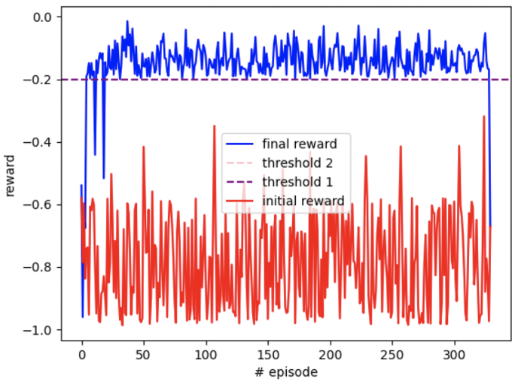
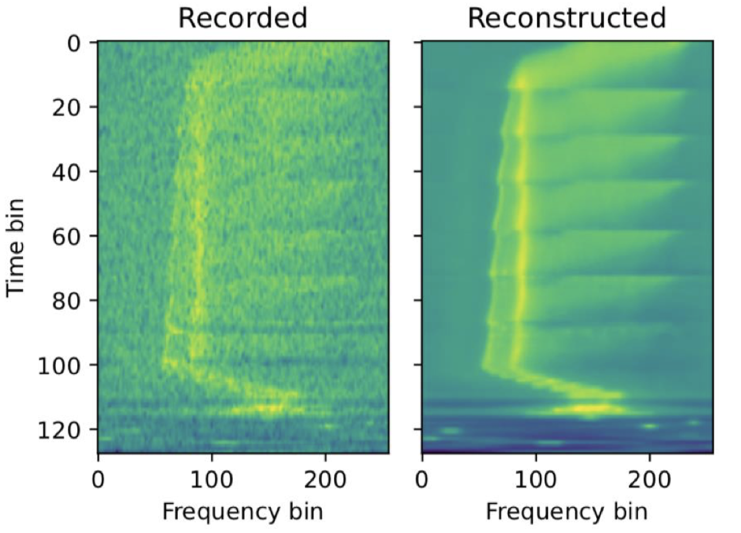
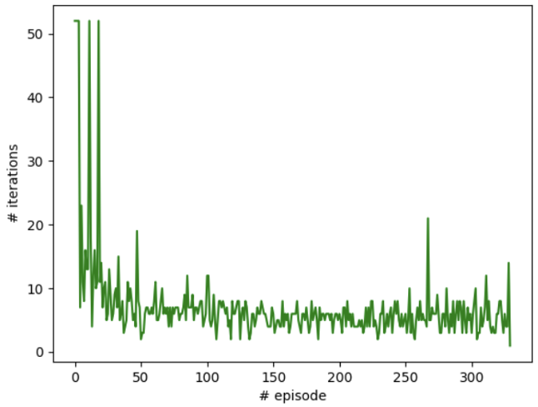
Status & results
Reinforcement learning: a selection
PS
PS to SPS
Correct RF phase & voltage for uniform bunch splitting (LHC beams)
Successful sim2real & fully operational
Multi-agent (SAC) & CNN for initial guess
Next: continuous controller (UCAP)
Adjust fine delays of SPS injection kicker
RL agent (PPO) trained on data-driven dynamics model
Ready for sim2real test
A. Lasheen, J. Wulff
M. Remta, F. Velotti
LINAC3 / LEIR
SPS
PhD project (B. Rodriguez):
control LINAC3 cavities for optimal injection efficiency into LEIR
RL state based on VAE-encoded Schottky spectra
Agent trained on data-driven dynamics model
Steer DC beams in TT20 TL using split-foil secondary emission monitors
Works well in simulations, with noise and varying emittances
Ready for sim2real test
V. Kain, N. Madysa
N. Bruchon, V. Kain

Slide 19
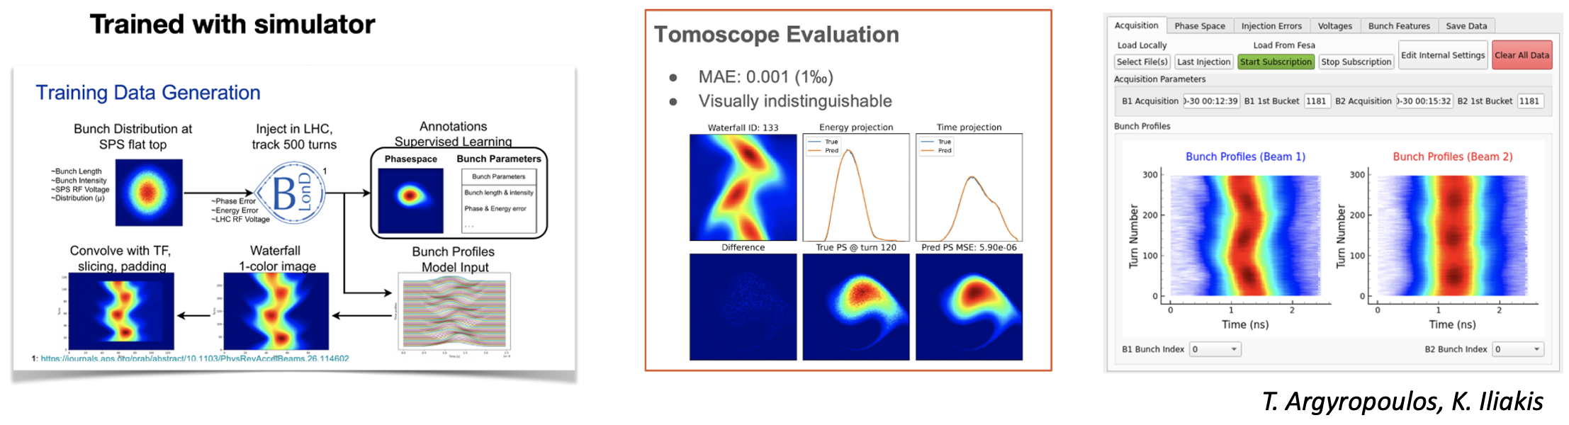
Status & results
Enhanced diagnostics: ML tomoscope in LHC
Tomographic bunch-by-bunch reconstruction in the LHC using auto-encoder ensemble
Not possible without ML
Fully operational and using Machine Learning Platform (MLP)
Ready to be used in the control room to measure injection errors

Slide 20
Status & results
EPA: ETT recommendations

Slide 21
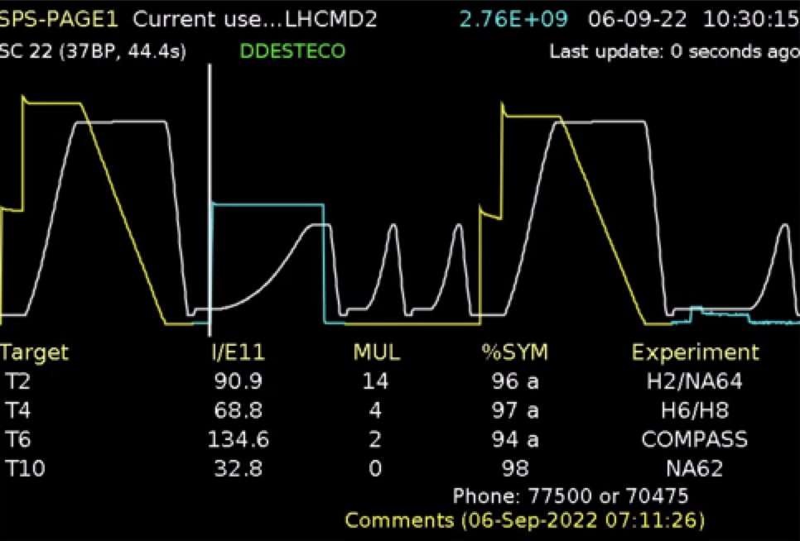
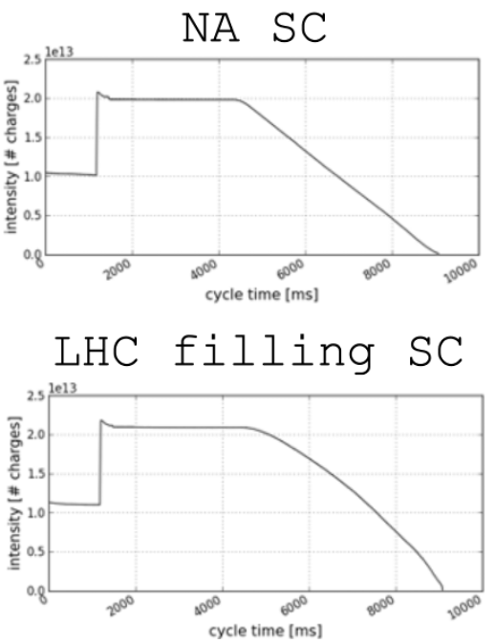
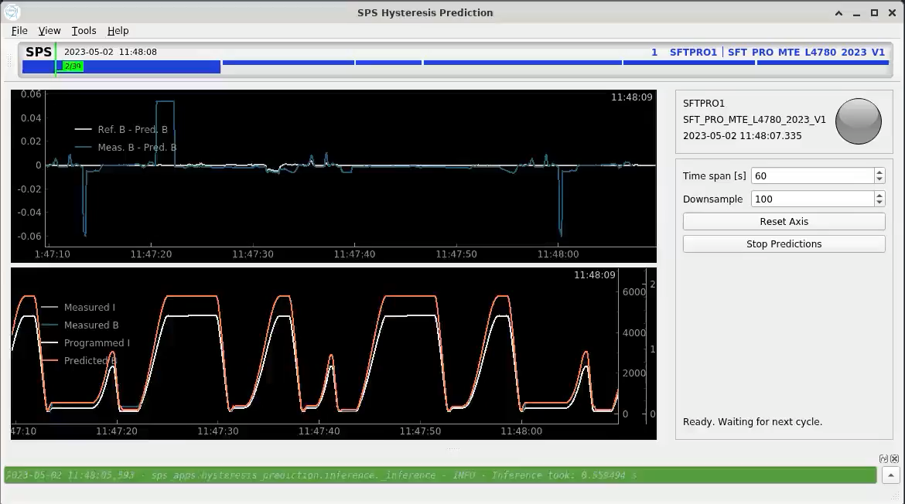
Status & results
WP4: Hysteresis compensation
Feed-forward correction to provide reproducible magnetic fields
  Saving cost & time
  Reproducible beams & slow-extraction spills
  Flexibility: dynamic beam scheduling
PhD project: PoC at SPS (A. Lu, V. Kain)
Progress
  First Phy-LSTM & Transformer models trained on
  main dipole data
  Inference and trim pipeline successfully tested
  in the control room
Outlook & challenges
  Generalizability & accuracy of model
  Further magnet measurements in lab and
  multipole modelling
A. Lu, V. Kain, V. Di Capua

Slide 22
Status & results
EPA: ETT recommendations

Slide 23
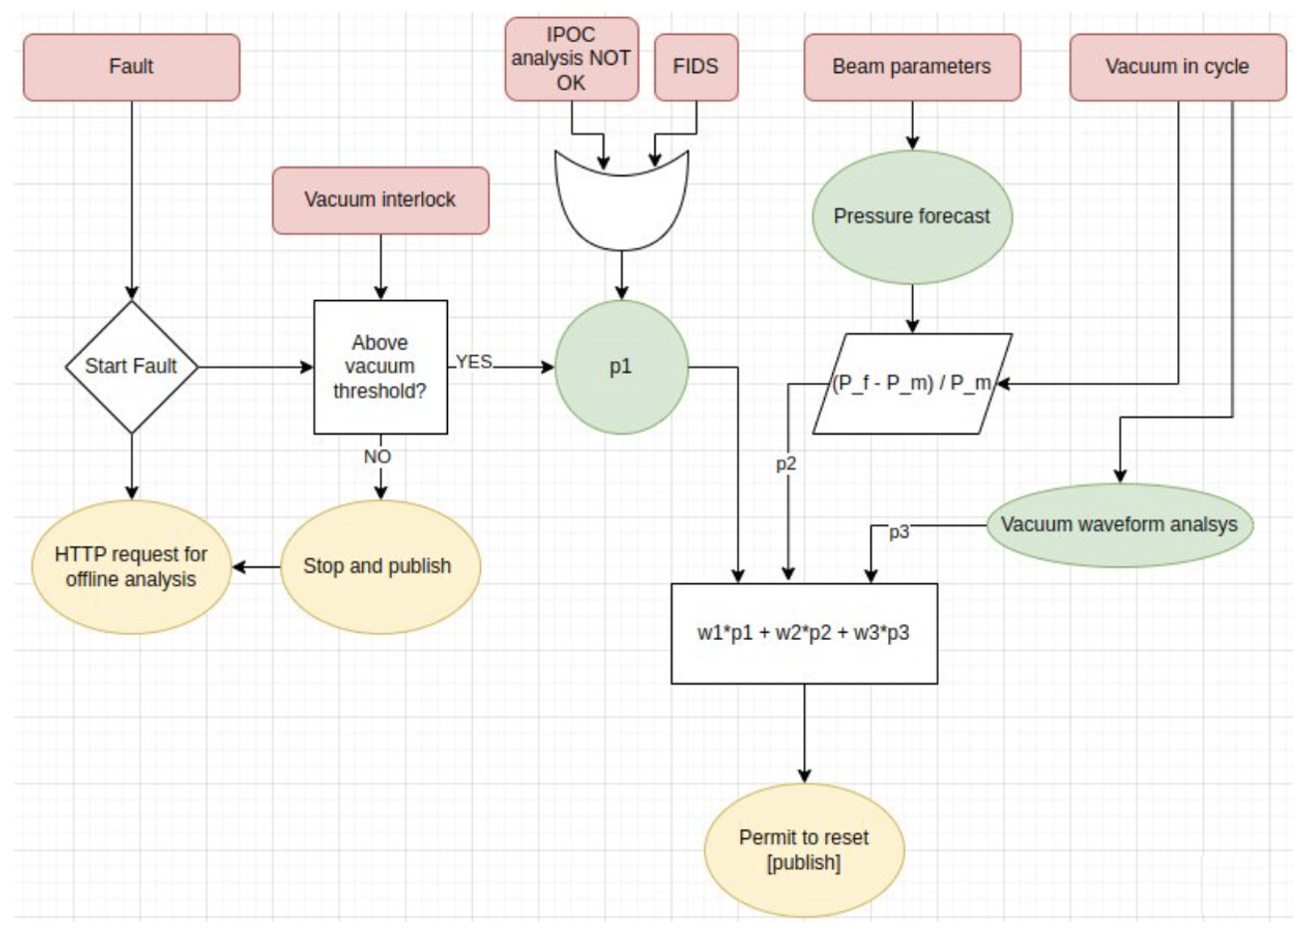
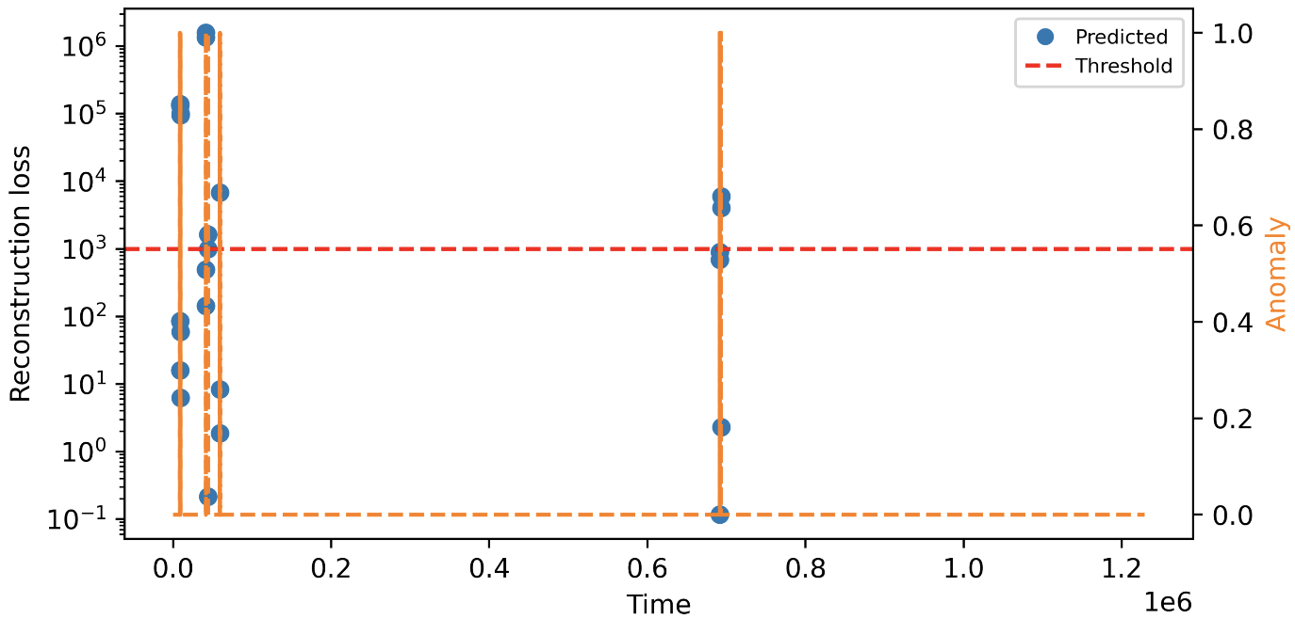
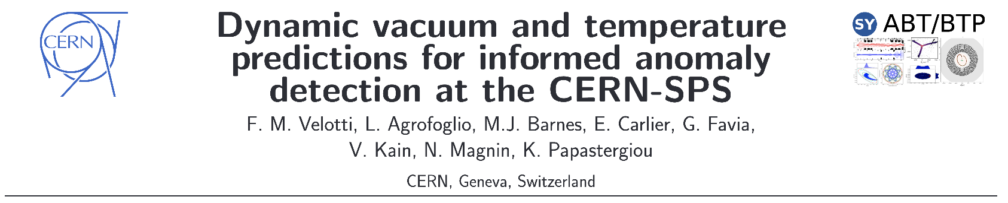
Status & results
WP8: Automate equipment
Example: auto-reset of SPS kicker following vacuum interlock
VAE for anomaly detection from vaccum pressure data
Define new paradigm of smart and agile equipment
e.g. aware of beam parameters, machine state, etc.
automate setup, fault analysis, and recovery
Plans 2024 & 2025
  Pilot implementations of parts of a new equipment
  automation framework
  Example: safe auto-resets following SPS kicker vacuum interlocks
Plans 2026 – 2028 (LS3): implement entire framework
Make sure to check out Francesco’s poster!

Slide 24
Contents
    Efficient Particle Accelerators project
    transforming machine operations
    Infrastructure
    frameworks & building blocks
    Status & results
    some highlights
    Outlook & conclusions
    timeline

Slide 25
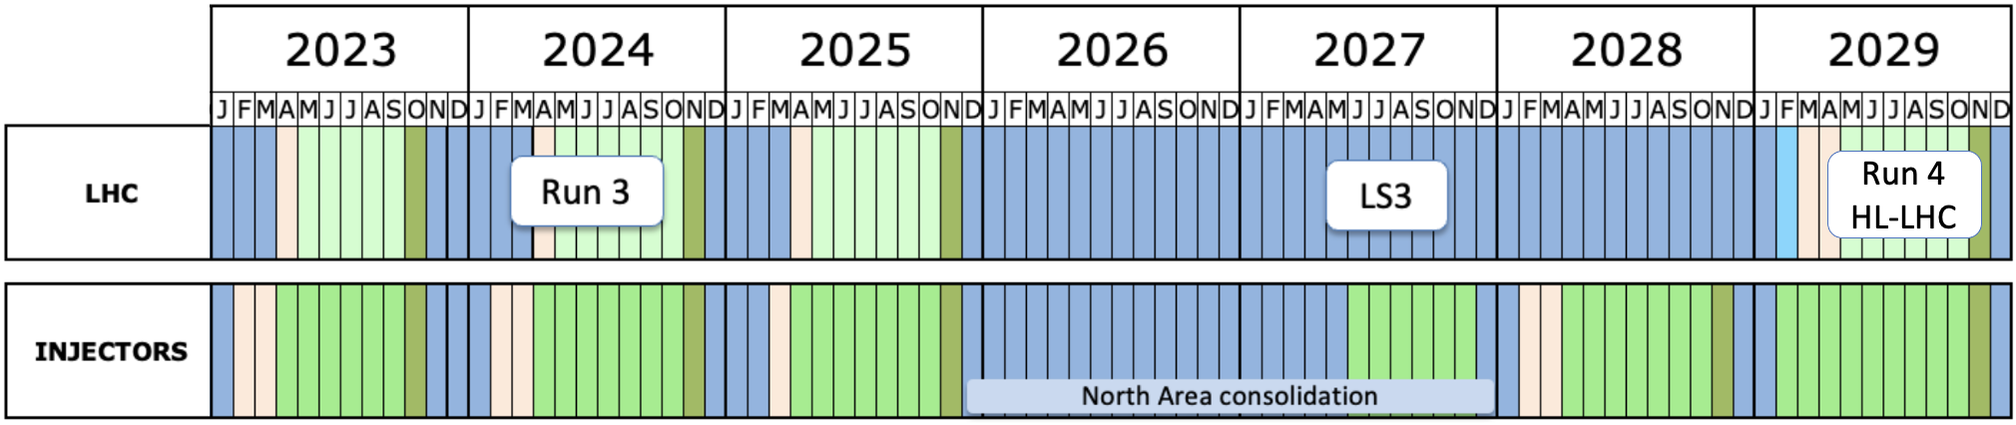
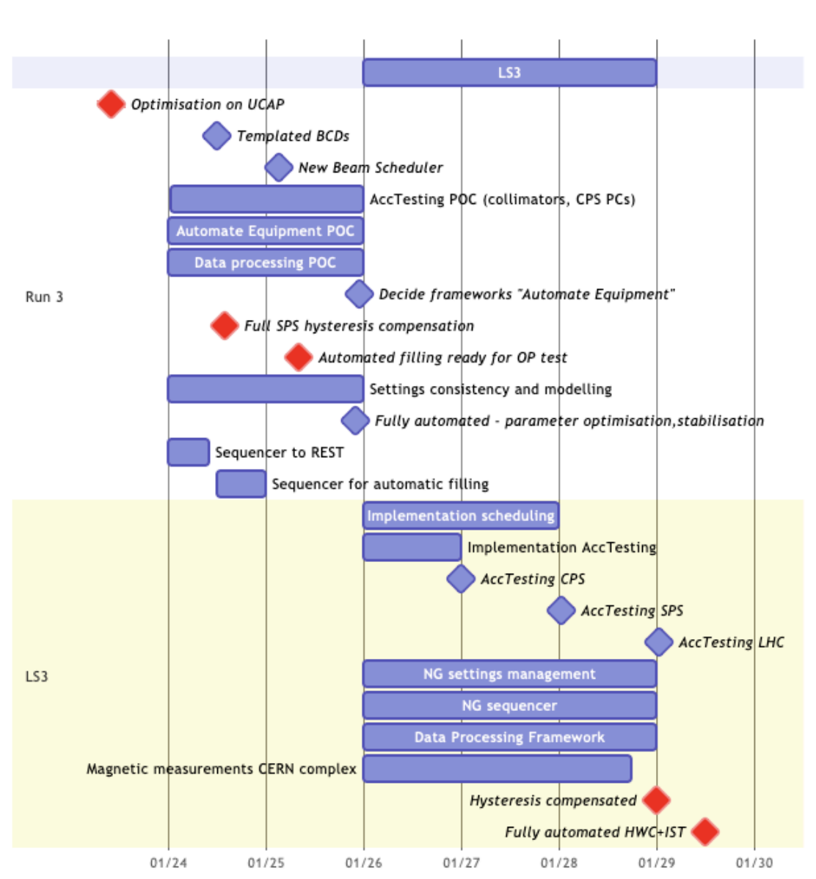
Outlook
EPA project timeline
EPA timeline
Today
End Run 3
Start Run 4
EPA: time-bound project for 5 years to have improvements ready for Run 4 starting in 2029
2 phases
  Prototyping & first operational tests in Run 3
  Full implementation during LS3 and sequential commissioning in Run 4

Slide 26
Conclusions
Efficient Particle Accelerators project put in place to systematically transform how we run the accelerator complex
Work has actually started several years ago and we have seen numerous improvements
CERN infrastructure is already in very good shape
  Continuous development has been crucial
  Most building blocks are available
EPA has 5 years to address further efficiency bottlenecks through
  systematic automation of accelerator operation & equipment
  improving efficiency of operations through models
  integrating AI / ML solutions at scale
Thank you

Slide 27
References
A. Huschauer, V. Kain, K. Papastergiou, F. Velotti, ETT report, 2023.
CERN Joint Accelerator Performance Workshop, Montreux, Switzerland, 2023.
CERN LHC Performance Workshop, Chamonix, France, 2024.
D. Anderson et al., “The AccTesting Framework: an extensible framework for accelerator commissioning and systematic testing”, ICALEPCS’13, California, 2013.
L. Cseppento, M. Buttner, “UCAP: A FRAMEWORK FOR ACCELERATOR CONTROLS DATA PROCESSING @ CERN”, ICALEPCS’21, China, 2021.
A. G. Wilson and R. P. Adams, “Gaussian Process Kernels for Pattern Discovery and Extrapolation”,
PMLR 28(3):1067-1075, Georgia, 2013.
K. Iliakis et al., Longitudinal Beam Diagnostics and Phase Space Reconstruction in the LHC Using ML, 6th Inter-Experiment Machine Learning Workshop, CERN, Geneva, Switzerland, 2024.
HL-LHC commissioning long-term plan, Mar 2024.

Slide 28
Backup

Slide 29
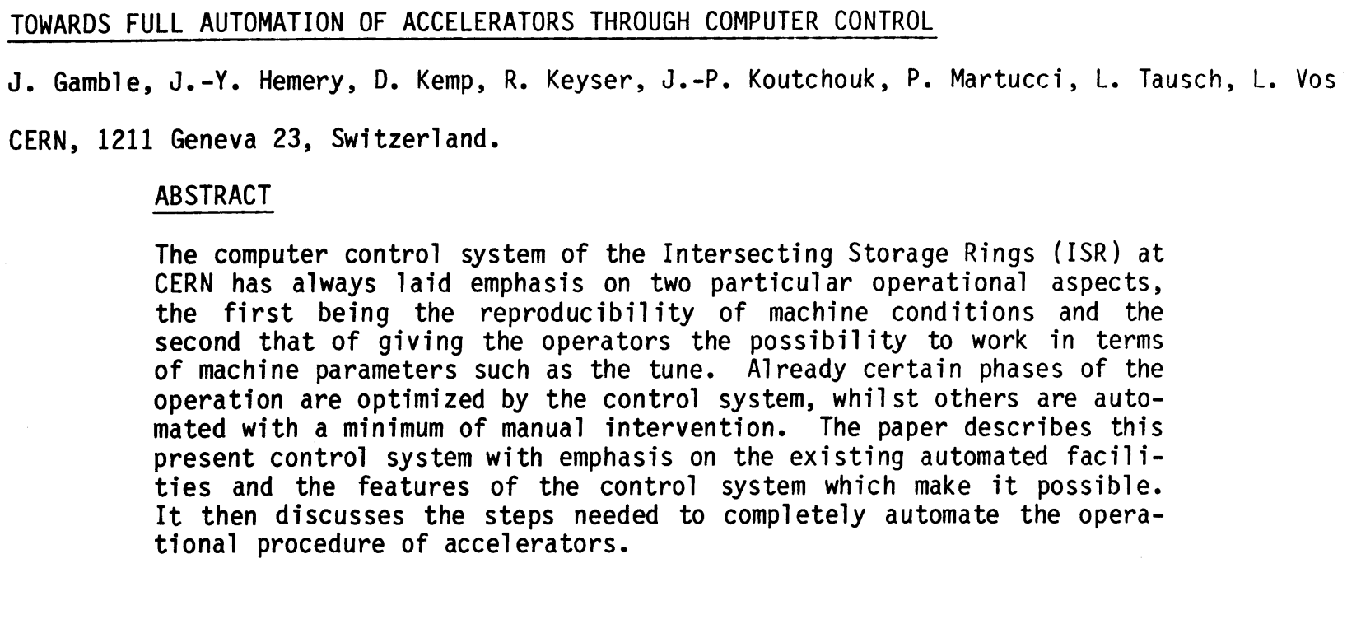

Efficient Particle Accelerators project
CERN automation history
Classical automation
    Reduce complexity
    through models
    LSA: high-level parameter models with hierarchies, value generation
    Sequencers, watchdogs & SW interlocks, classic control
Adding AI / ML
    Closing the loop: continuous
    control or auto-launch
    Infrastructure: server-based solutions
    Equipment: predictive maintenance, fault analysis, …
    High-level parameter control
    Conditional sequencing of actions
1980
2018
2006
2021 -
    Optimizers, ML, …
    Learn models if not available
    Infrastructure: Python & frameworks
    Typically on-demand

Slide 30
Efficient Particle Accelerators project
CERN automation history
Classical automation
    Reduce complexity
    through models
    LSA: high-level parameter models with hierarchies, value generation
    Sequencers, watchdogs & SW interlocks, classic control
Adding AI / ML
    Closing the loop: continuous
    control or auto-launch
    Infrastructure: server-based solutions
    Equipment: predictive maintenance, fault analysis, …
    High-level parameter control
    Conditional sequencing of actions
Key: building infrastructure to support full integration of AI / ML technologies into the control system
1980
2018
2006
2021 -
    Optimizers, ML, …
    Learn models if not available
    Infrastructure: Python & frameworks
    Typically on-demand

Slide 31
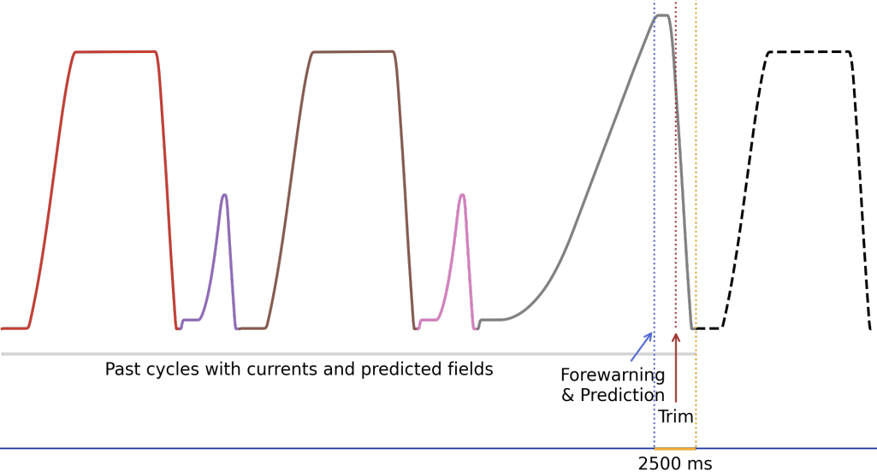
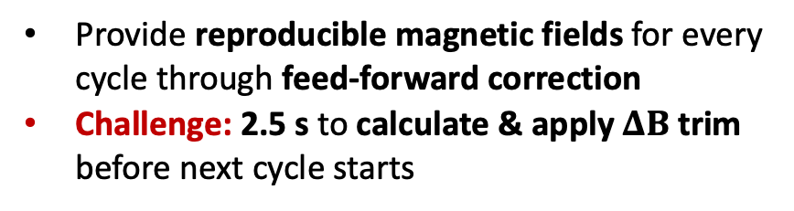
Status & results
Hysteresis compensation
Data
SPS B-Train (dipoles) & Lab (other multipoles)
  OP-parasitic: abundant, but lacking variability
  extend dataset by varying supercycles
  Outlook: measure multipoles in lab
  Challenges: pre-processing & securing adequate
  data variability
Model
Predict hysteresis & eddy-current effects based on past
  PhyLSTM: physics-inspired loss function
  Transformers: powerful, but data hungry & compute-intensive (see tutorial by A. Lu)
  Challenge: achieving sub-Gauss accuracy
Integration
Model deployment & integration into controls infrastructure
  Provide reproducible magnetic fields for every cycle through feed-forward correction
  Challenge: 2.5 s to calculate & apply $ΔB$ trim before next cycle starts
A. Lu, V. Kain, V. Di Capua

Slide 32
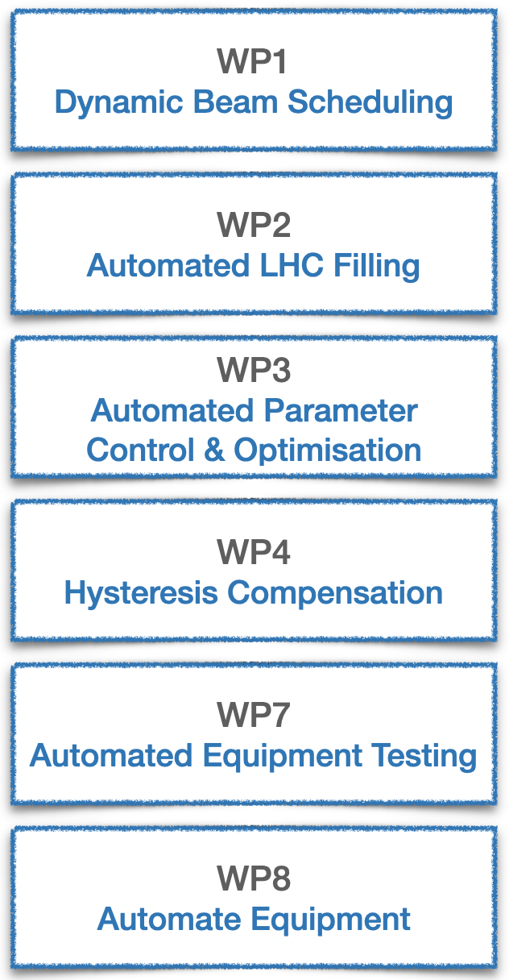
Efficient Particle Accelerators project
Work packages
Remove fixed supercycles by algorithmically & dynamically scheduling beams
Automate & standardise beam preparation in injectors and LHC filling;
Reduce impact on fixed target users and LHC turn-around time.
Requires: orchestration of task sequences, auto-pilots, beam quality metrics
Automate parameter optimisation & automatically contain drifts
Deterministic magnetic field control with the aim of decoupling cycles
AccTesting for “all” equipment for injectors & LHC
to automate hardware commissioning
Automation of equipment setup, fault analysis, and recovery; preparing the grounds for preventive maintenance

