Slide 1



Data-Based Condition Monitoring and Disturbance Classification in Actively Controlled Laser Oscillators
Arne Grünhagen, Annika Eichler, Marina Tropmann-Frick, Görschwin Fey

Slide 2
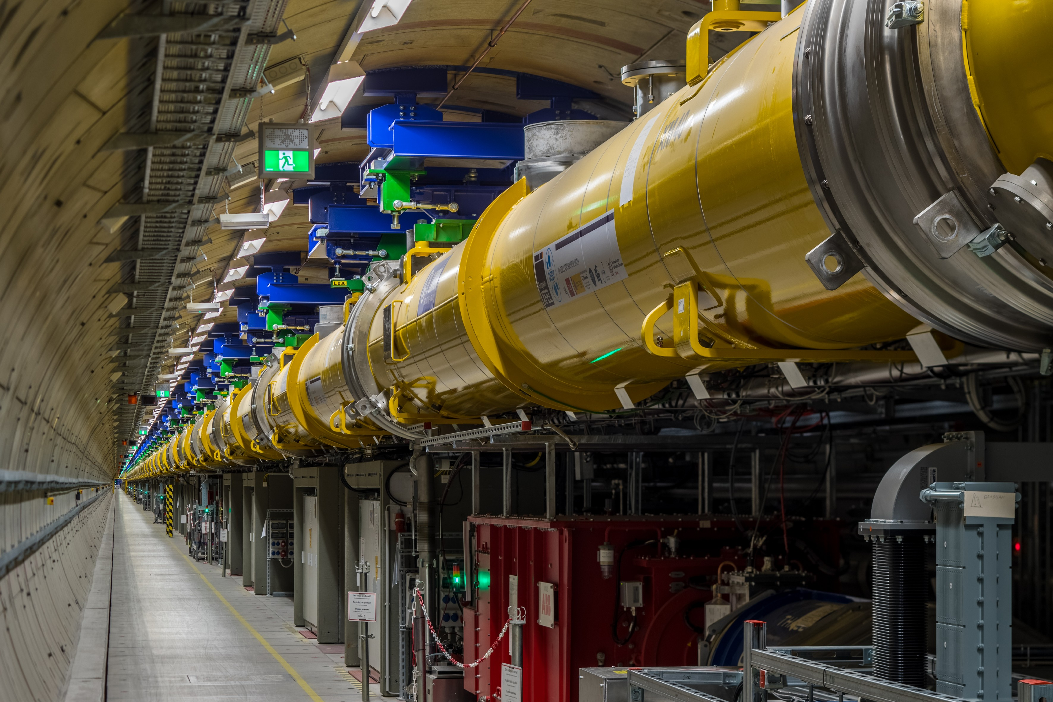
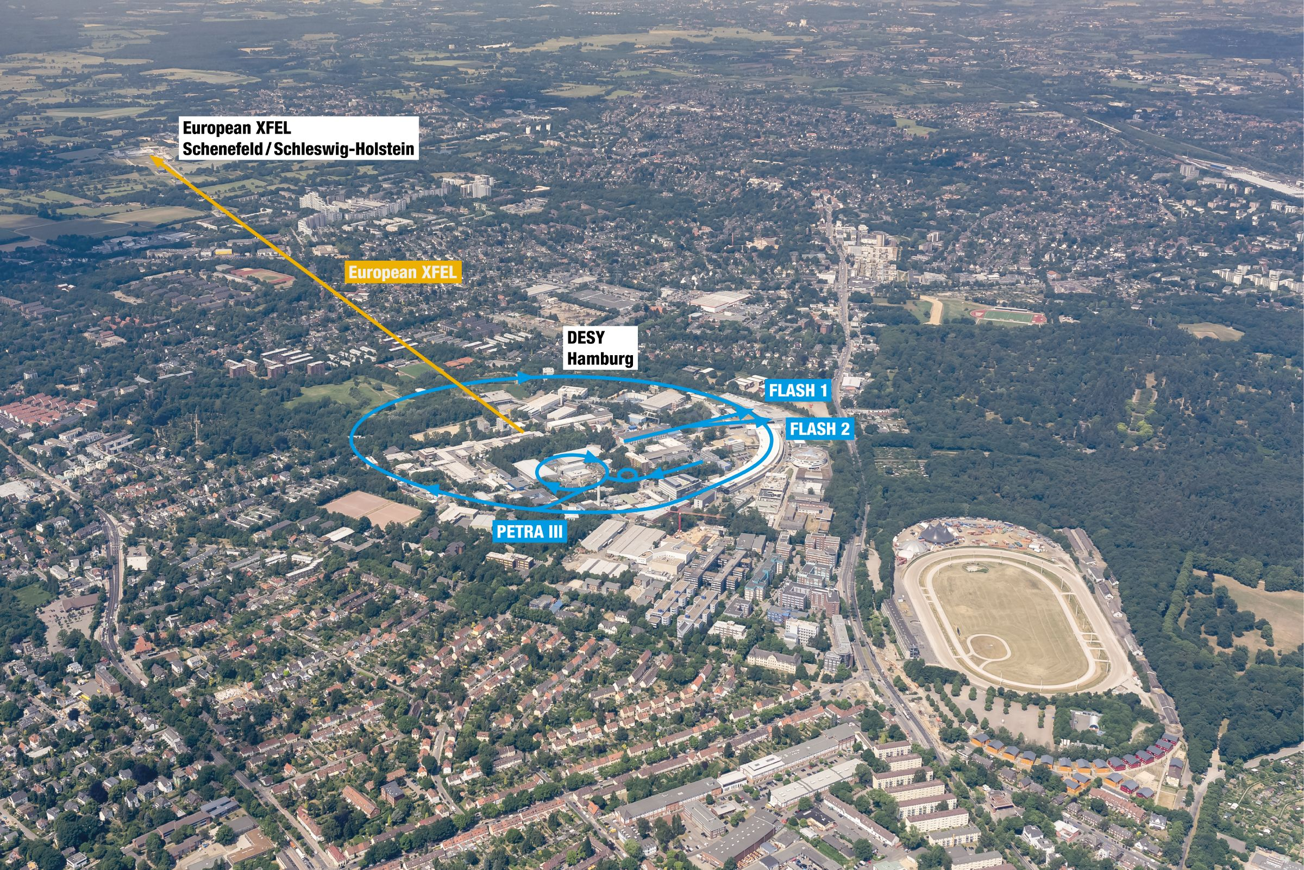
European X-ray Free Electron Laser
@ Deutsches Eletronen Synchrotron (DESY)
Linear particle Free Electron Laser producing intense, ultrashort X-ray pulses.
Source: European XFEL GmbH
Source: European XFEL GmbH

Slide 3
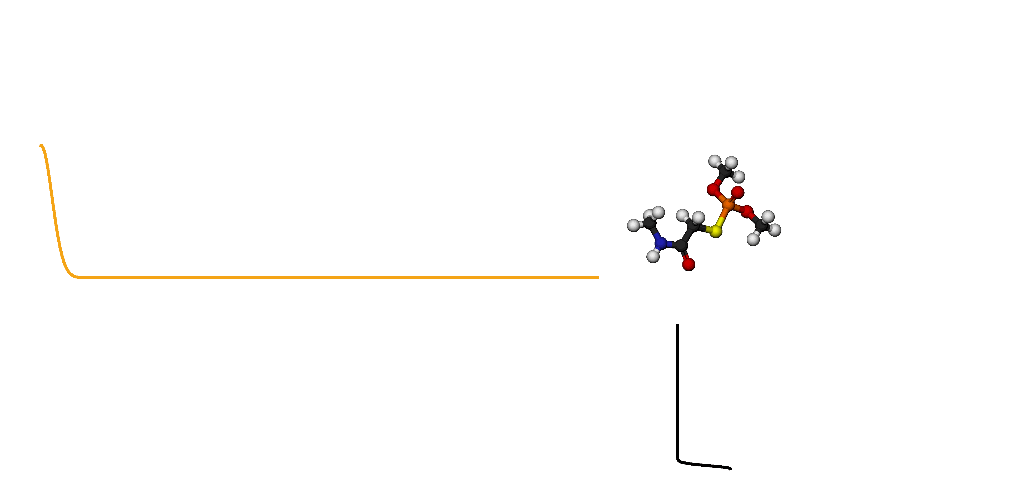

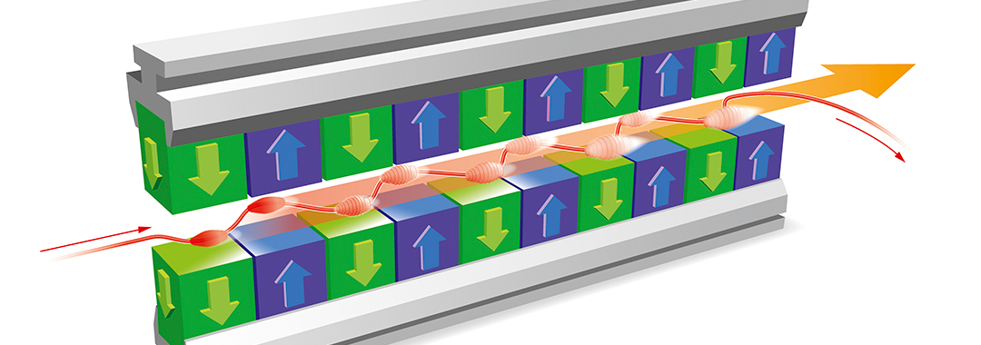

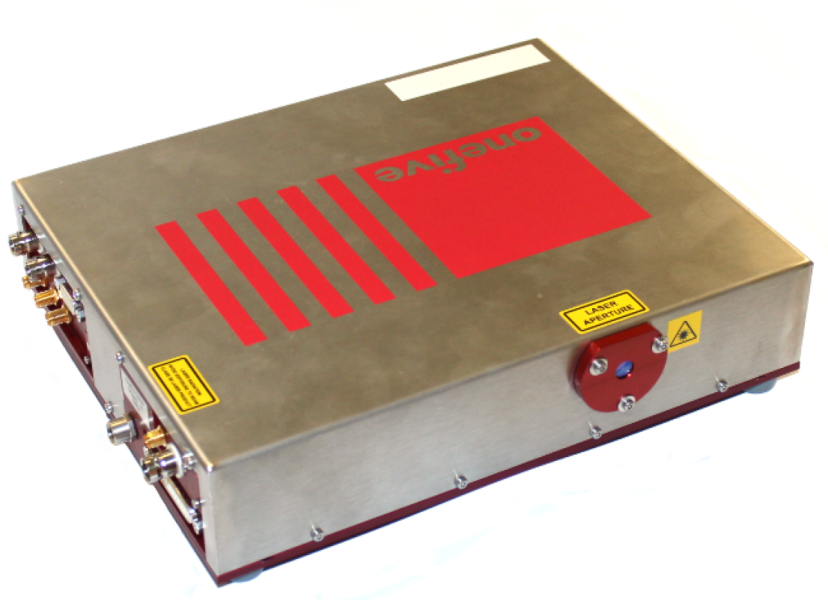
Laser-based Synchronization System
@EuXFEL
X-ray beam
detector
electrons
Source: European XFEL GmbH
optical synchronization
Pump Probe Experiments
Femtosecond synchronization between accelerator and PPL.
Laser Oscillator generates the synchronizing signal.
Links between laser oscillator and synchronized devices each are actively length-stabilized.

Slide 4
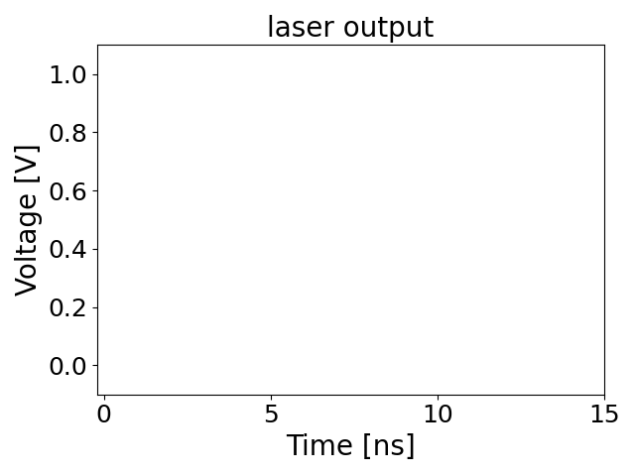
Laser-based Synchronization System
@EuXFEL
No pump-probe experiments possible if laser-based synchronization does not work at high performance.
Main component of the system: laser oscillator
  216.667 MHz signal (4.6 ns)
  Synchronization of other components via a stable phase
Synchronizing signal is influenced by different disturbances:
  Changes in the environment (temperature, humidity, air pressure, vibrations)
  Electrical, optical, mechanical
  Seismic activities
Active phase stabilization using Proportional Integral (PI) controller.
disturbances
PI - controller
controller output
phase error

Slide 5
Pipeline
Goal: Comparison of Feature Extraction and Diagnosis Methods
Controller Output
Phase error
Input: | CTRL output and phase error
Output: | time snippet and PSD
Data Preparation
Input: | time snippet and PSD
Output: | feature vector
Feature Extraction
Input: | feature vector
Output: | Assignment of disturbance classes at any time with certainty score
Diagnosis

Slide 6
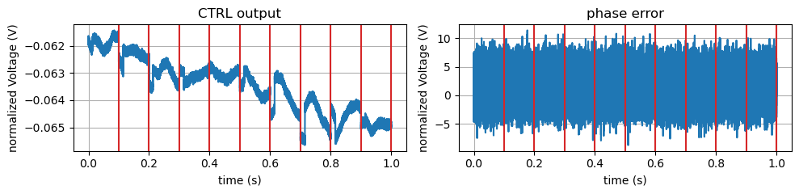
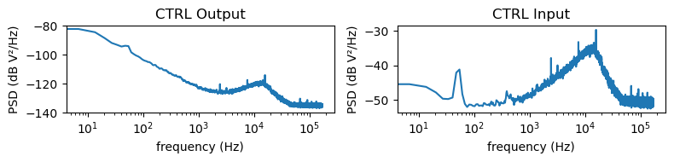
Data Preparation
Welch’s Method
Spectral Density Estimation using Welch’s method.
PSD reveals power distribution of a signal across different frequencies.
  Identify dominant frequencies.
  Detect periodic or noise components in a signal.

Slide 7

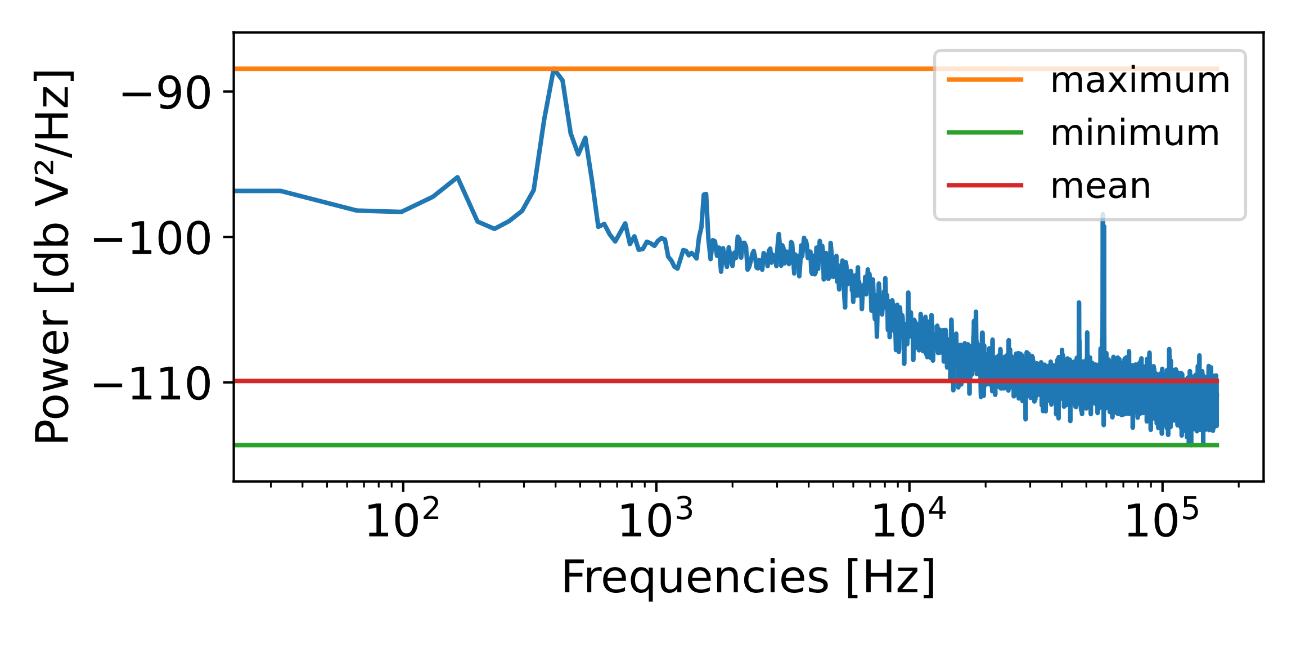
Feature Extraction
Statistics
Calculate a set of basic characteristics using from time snippet and PSD.
13 statistics are calculated for each time snippet or PSD.
Example: statistics from PSD
time (sec) | maximum | minimum | mean | standard deviation | variance | …
0.0 – 0.1 | -89.0351 | -114.0734 | -109.8984 | 2.3916 | 5.7201 | …
0.1 – 0.2 | -88.9563 | -113.9317 | -109.9277 | 2.3566 | 5.5538
…

Slide 8
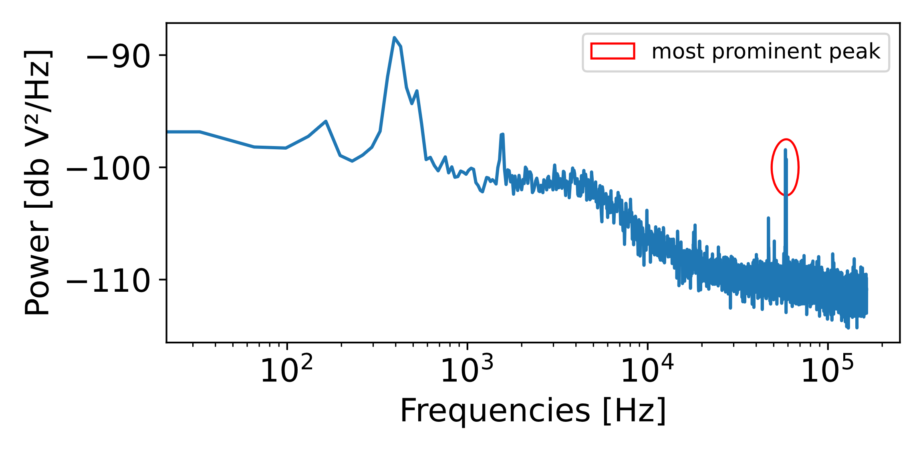
Feature Extraction
Peak Characteristics
Peaks are important characteristics of a PSD
Peak features
  Most prominent peaks
  Number of peaks having a minimum prominence per range. Each range covers 5000 kHz.
Example: peak characteristics from PSD
time (sec) | Peak 1 - prominence | Peak 1 - Hz | Peak 1 - power | …
0.0 – 0.1 | 30,23 | 60,322 | -99,36 | …
0.1 – 0.2 | 30,23 | 60,289 | -99,29 | …
… | … | … | … | …

Slide 9
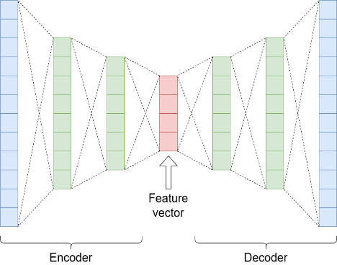
Feature Extraction
Autoencoder
Autoencoder is trained on 2500 dimensional PSDs.
10-dimensional latent space is used as feature vector.
Example: autoencoder feature extraction
time (sec) | latent 0 | latent 1 | …
0.0 – 0.1 | -0.5923 | 0.1238 | …
0.1 – 0.2 | -0.5303 | 0.0166 | …
… | … | … | …

Slide 10
Fault Detection, Fault Classification
Evaluation
Class | Certainty
healthy | health score
type 1 | class 1 score
type 2 | class 2 score
… | …
Detection
Feature vector of 0.1 s data
Classification
Detection (19 algorithms)
Semi supervised learning: compare unknown new data with known healthy data
Clustering algorithms (4)
  Data samples are grouped into categories with similar elements
Outlier detection algorithms (15)
  Identify rare items that differ significantly from most of the other items
Classification (4 algorithms)
supervised learning: fault/disturbance classes must be known
For each fault class, the classifier assigns a feature vector to the fault class with the maximum likelihood

Slide 11
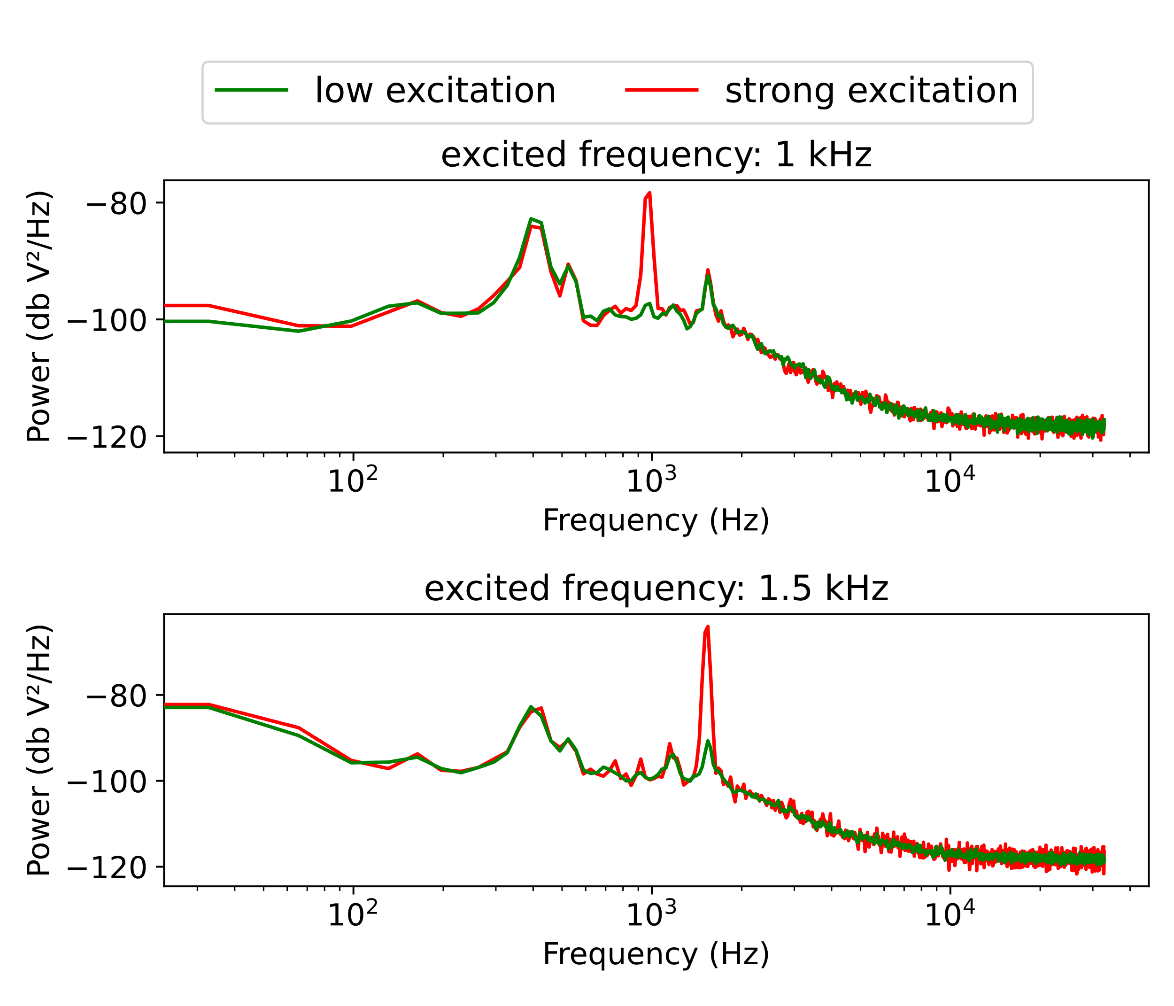
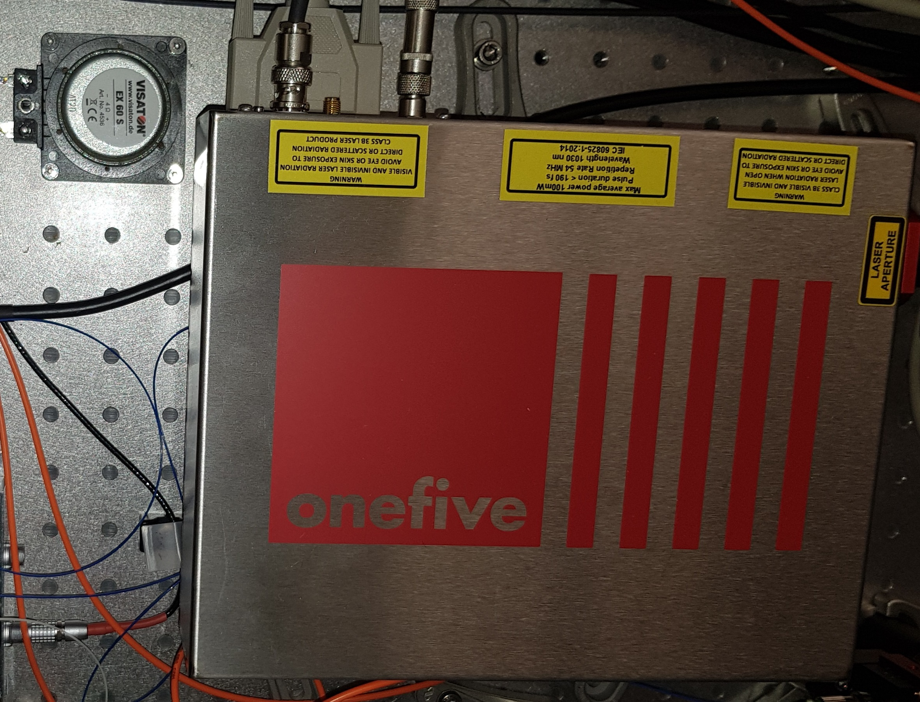
Experimental Evaluation
Acoustical Disturbance of a Laser Oscillator (Laboratory Environment)
loudspeaker
laser oscillator
Experiment Description
Sounds are played with individual frequencies with different intensities on a surface loudspeaker next to a laboratory laser oscillator
Dataset
Disturbed frequencies: 0.5 kHz, 1.0 kHz, 1.5 kHz, …, 4.5 kHz
4 different intensity levels
30 s of data for each combination of disturbed frequency and intensity level
60 s of data with no acoustical disturbance

Slide 12
Model Evaluation
Performance Criteria
Inference duration
  Feature extraction, fault detection and fault classification for a 0.1 s data snippet must be below 0.1s.
Prediction quality
  Area Under the Receiver Operating Characteristic (AUROC) score and Accuracies
Different hyperparameters were systematically selected for each algorithm.

Slide 13
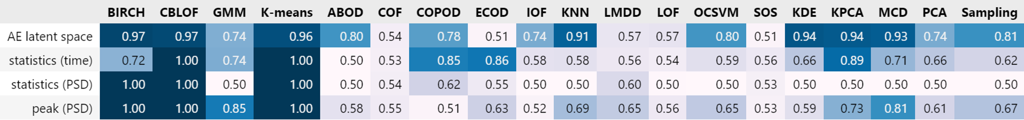
Results: Detection
Clustering
Outlier Detection
Inference Duration
for a selection of many neighbors (>80) ABOD needs more than 0.1 sec per sample.
All algorithms with good prediction results have an inference time < 0.001 s per 0.1 s data sample.

Slide 14
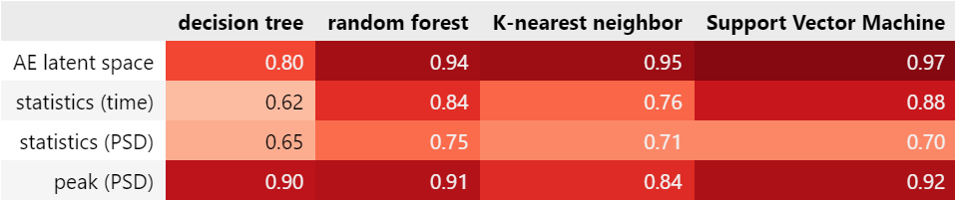
Results: Classification
Inference Duration
SVM on statistics of PSDs is the slowest with 0.0024s for a 0.1s data sample.
The other combinations require less than 0.0001s per 0.1s data sample.

Slide 15
Conclusion & Future Work
Goal
Comparison of existing methods to detect and classify acoustical disturbances influencing the performance of laser oscillators.
Experimental Evaluation
Simulation of one specific failure type for an experimental laser setup.
Peak detection works so well because that's exactly what we generate with the experiment
Disturbances and faults during real operation are not so easy to detect.
In real operation, peaks and changes in PSDs indicate different disturbances and causes of faults.
Ongoing Work
Apply the evaluated pipeline to operational data from different laser setups.
Changes to the configuration of the setup causes previously trained diagnostic models to become invalid.

Slide 16
Thank you.
Arne Grünhagen
Arne.Gruenhagen@desy.de
Arne.Grunhagen@haw-hamburg.de
Check the paper:
https://ebooks.iospress.nl/volumearticle/66251

Slide 17
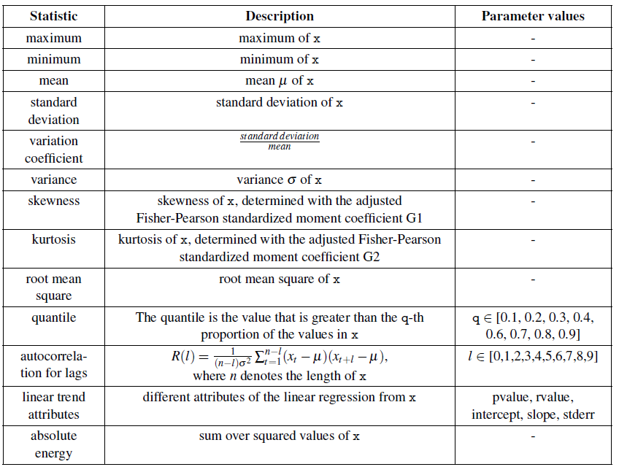
Statistics

Slide 18
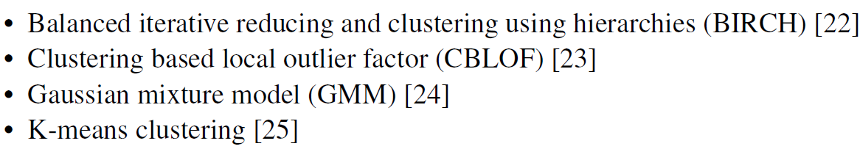
Algorithms
Clustering

Slide 19
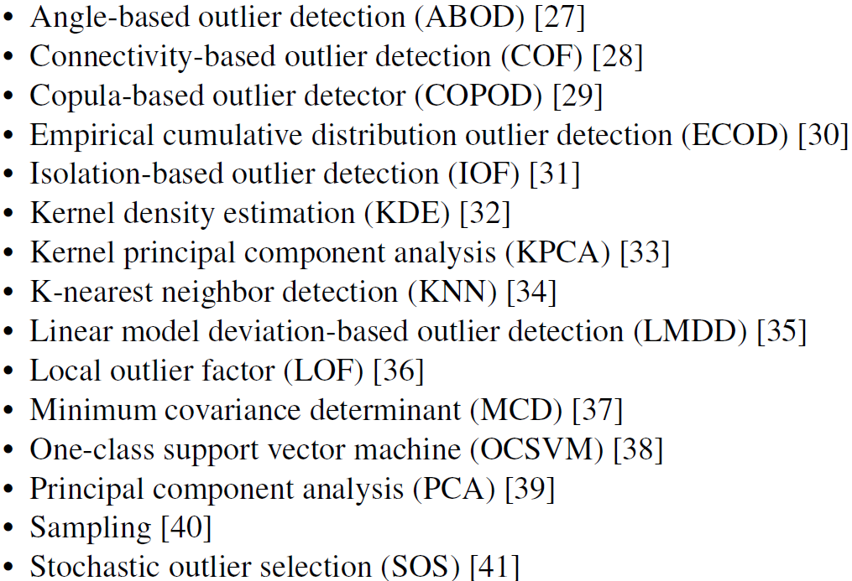
Algorithms
Outlier Detection

Slide 20
Hyperparameters
Algorithm | Parameter | Values
Birch | threshold | 0.2, 0.4, …, 3.8, 4.0
 | branching factor | 20, 40, 60, 80, 100
CBLOF | # clusters | 2, 3, 4, 5, 6, 7, 8, 9, 10, 15
 | alpha | 0.5, 0.6, 0.7, 0.9
 | beta | 1.5, 2, 5, 7, 10, 15
GMM | # components | 2, 3, 4, 5, 6, 7, 8, 9, 10, 15
K-means | # clusters | 2, 3, 4, 5, 6, 7, 8, 9, 10, 15
Algorithm | Parameter | Values
ABOD | # nearest neighbors | 5, 10, …, 95, 100
COF | # nearest neighbors | 5, 10, …, 95, 100
COPOD | - | -
ECOD | - | -
IOF | - | -
KNN | # nearest neighbors | 5, 10, …, 95, 100
LMDD | - | -
LOF | # nearest neighbors | 5, 10, …, 95, 100
OCSVM | - | -
SOS | perplexity | 5, 10, …, 95, 100
Algorithm | Parameter | Values
KDE | bandwidth | 0.4, 0.6, …, 2.0, 2.2
KPCA | # components | 1,2, …, 10
MCD | - | -
PCA | # components | 1,2, …, 10
Sampling | - | -

