Slide 1
Fast 6-Dimensional Phase Space Reconstructions using Generative Beam Distribution Models and Differentiable Beam Dynamics
Ryan Roussel
rroussel@slac.stanford.edu

Slide 2
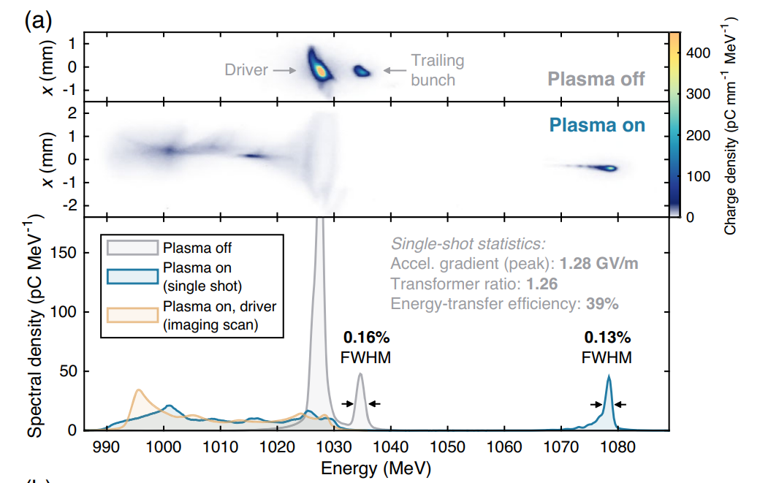
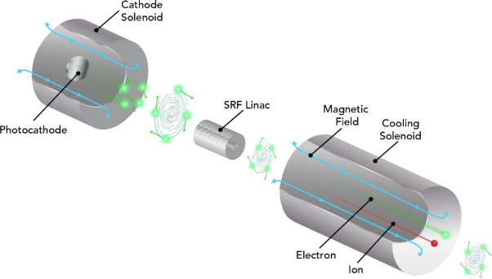
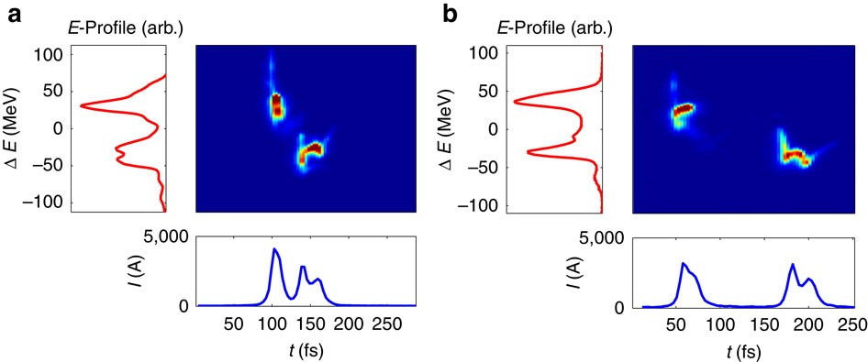
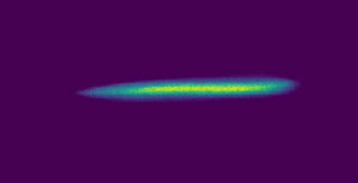


Modern Challenges in Beam Control
Modern accelerator technologies require precise control over high dimensional beam structure
Beam shaping for high efficiency PWFA
$$x={\left(x, p_{x},y,p_{y},z,p_{z}\right)}^{T}$$
RMS quantities → Exact beam structure
C. A. Lindstrøm, et al. Phys. Rev. Lett. 126, 014801
Magnetized beams for hadron cooling @ EIC
Free electron lasers
Flat beams for colliders
$$ε_{y}≪ε_{x}$$
Chen, P., and K. Yokoya. (1991): 91-2.
Marinelli, A., et al. Nature communications 6.1 (2015): 6369.
Wijethunga, S. A. K., et al. NIMA 1051 (2023): 168194.

Slide 3
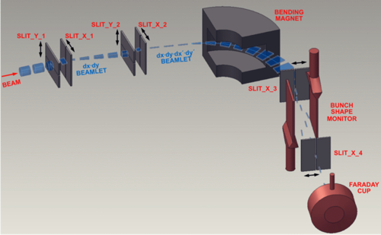
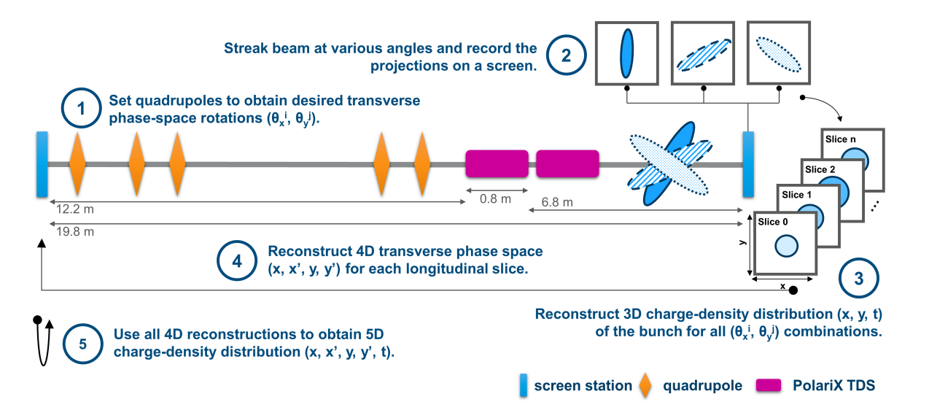
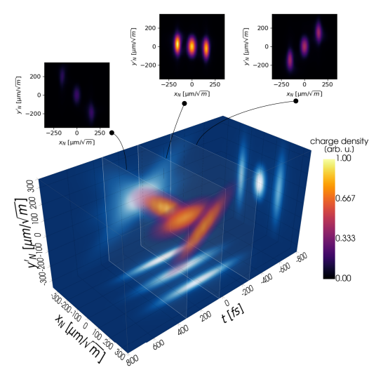
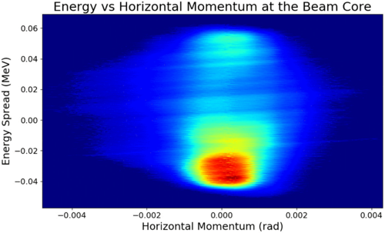
Measuring 6D Beam Distributions
Multiple scanning slits with dipole and bunch shape monitor @ SNS (ORNL)
5D tomography with polarizable X-band TDC @ ARES (DESY)
Jaster-Merz, S., et al Proc. IPAC’22 (2022): 279-283.
Cathey, Brandon, et al. PRL 121.6 (2018): 064804.

Slide 4
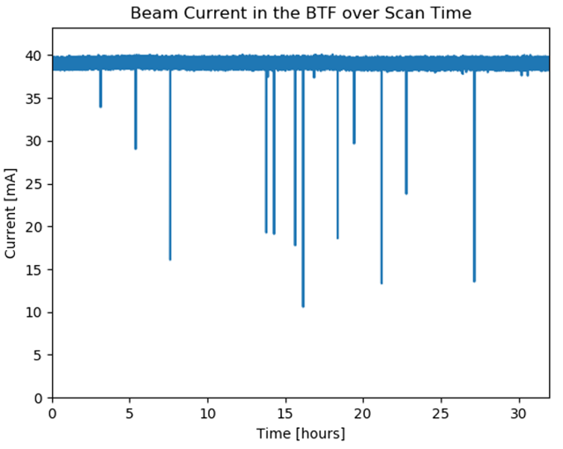
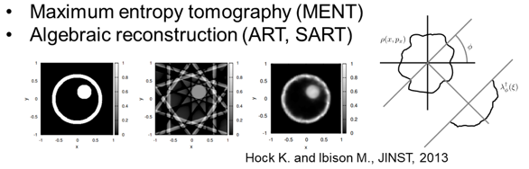
Progress on Measuring 6D Beam Distributions
Multiple scanning slits with dipole and bunch shape monitor @ SNS (ORNL)
5D tomography with polarizable X-band TDC @ ARES (DESY)
Jaster-Merz, S., et al Proc. IPAC’22 (2022): 279-283.
Cathey, Brandon, et al. PRL 121.6 (2018): 064804.
960 measurements ~ 28 hrs
Tomographic reconstruction ~ 24 hrs
5 million (!) measurements ~ 32 hrs

Slide 5
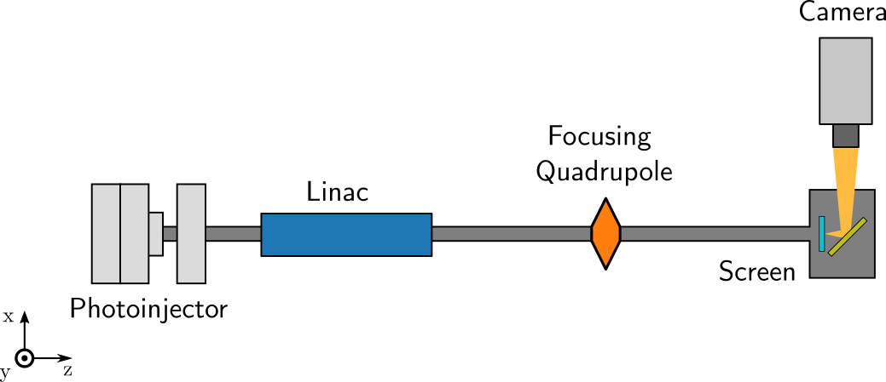
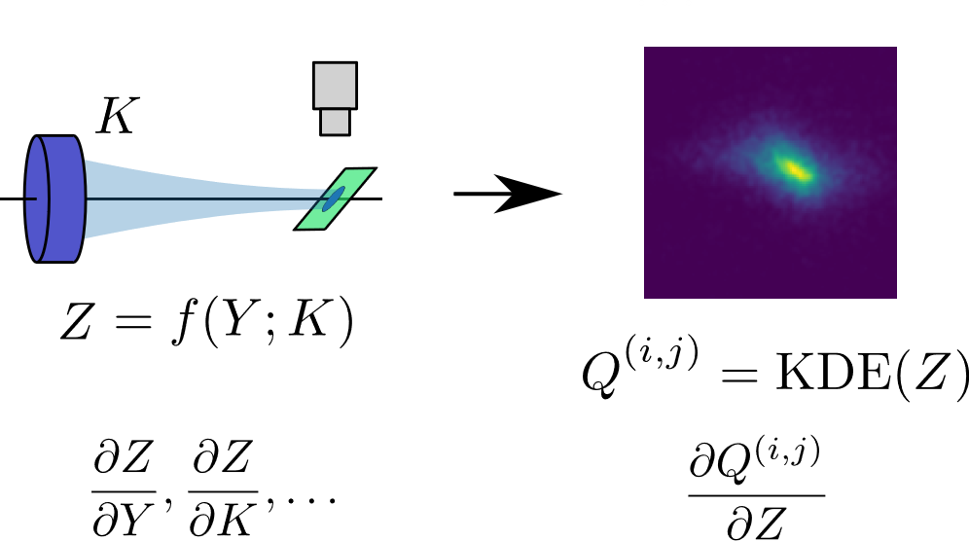
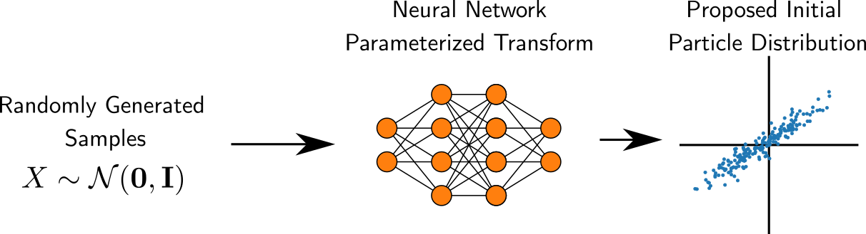
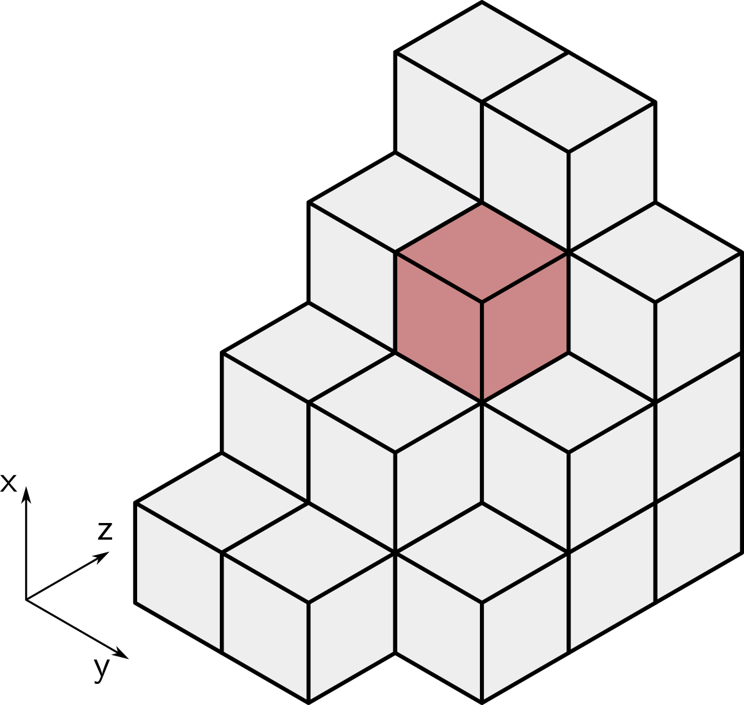
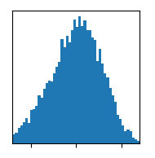
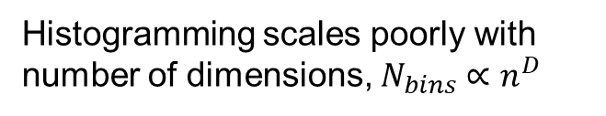
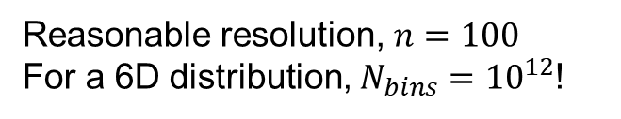

Why Is This So Difficult?
Information compression
Costs of detailed beam representations
6D distribution
2D image
Histogramming scales poorly with number of dimensions, $N_{bins}∝n^{D}$
$$\{<x>,σ_{x}\}$$
Reasonable resolution, $n=100$
For a 6D distribution, $N_{bins}={10}^{12}$!
1D projection(s)
Scalar values
Often required by analysis constraints (analytical tractability, optimization simplicity, etc.)

Slide 6
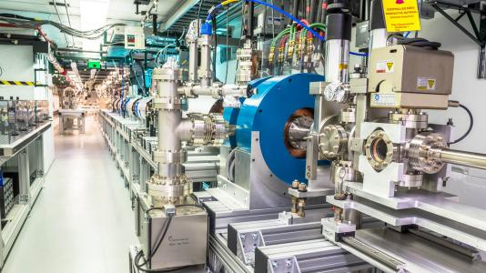

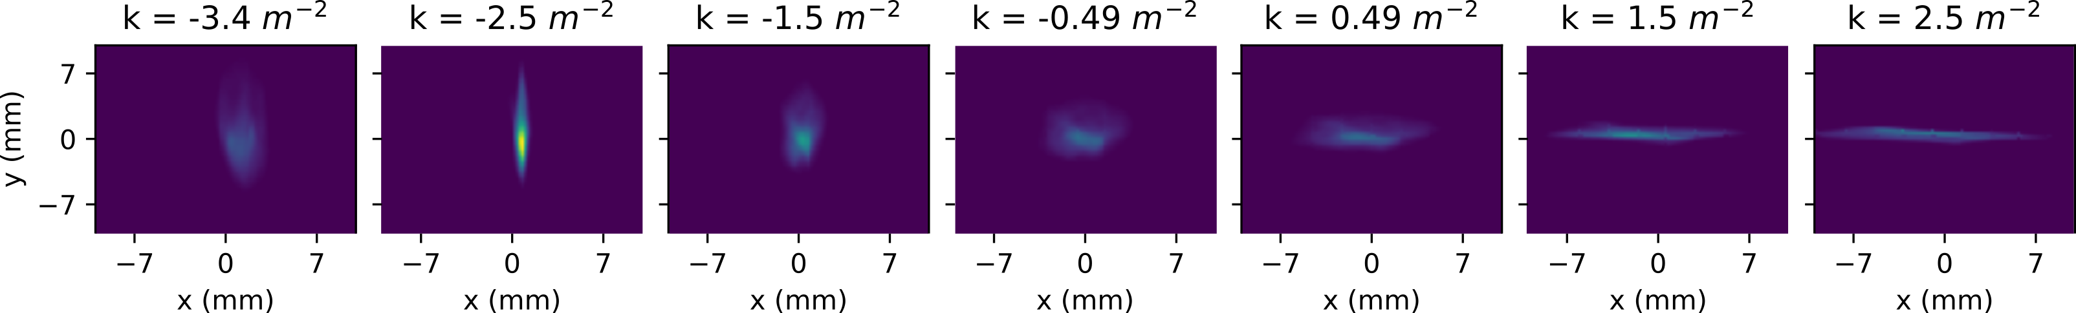
Example: Quadrupole Scan @ AWA
Drive beamline

Slide 7
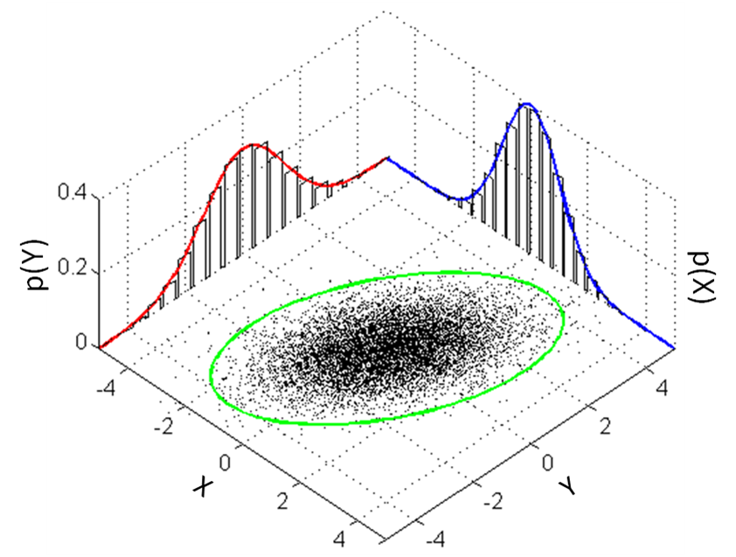
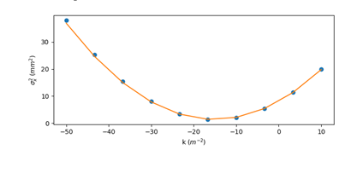
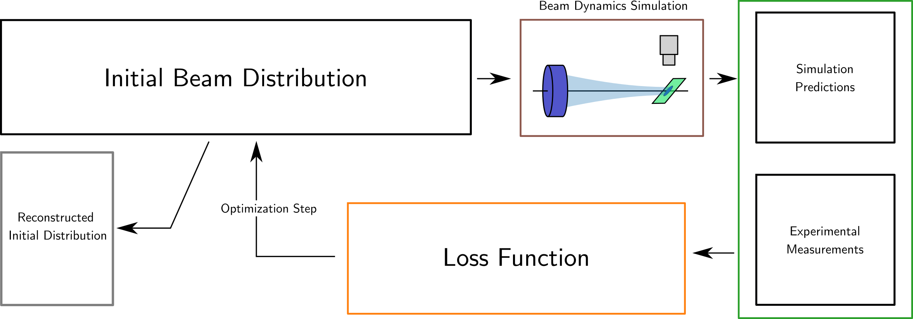



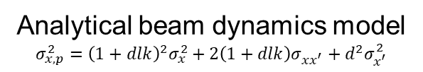
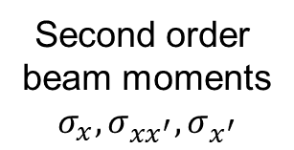
Using Optimization to Reconstruct Distributions
Second order
beam moments
$$σ_{x}, σ_{xx^{′}},σ_{x^{′}}$$
Analytical beam dynamics model
$$σ_{x,p}^{2}={\left(1+dlk\right)}^{2}σ_{x}^{2}+2\left(1+dlk\right)σ_{xx^{′}}+d^{2}σ_{x^{′}}^{2}$$
$$σ_{x,p}$$
$$σ_{x,m}$$
$$l=∑{\left(σ_{x,p}−σ_{x,meas}\right)}^{2}$$

Slide 8
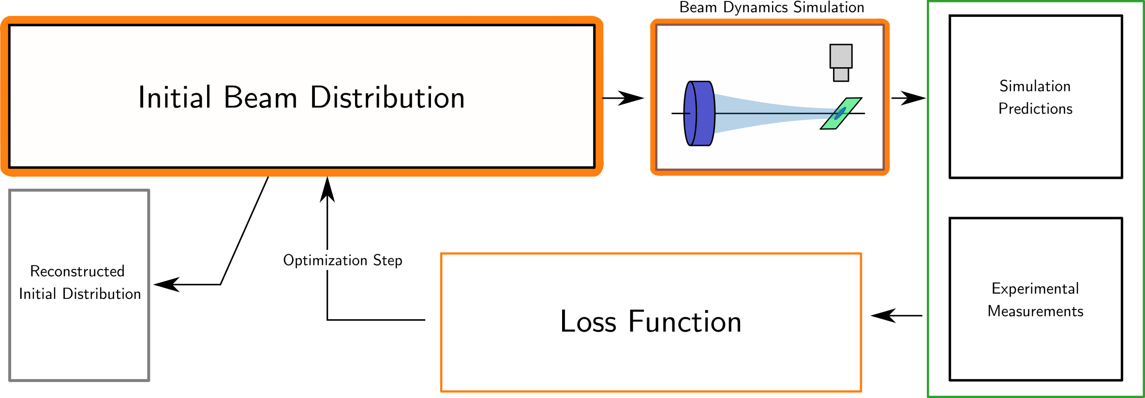
The Road to Efficient 6D Reconstructions
(1) Parameterize complex 6D beam distributions using generative ML
(2) Implement differentiable beam dynamics simulations to enable learning

Slide 9

Machine Learning Based Beam Representations
Use a generative machine learning model to create arbitrary beam distributions
Example: arrange particles to make the SLAC logo
O(~1000) parameters of the neural network control the distribution of particles in 6D phase space
Learn the NN parameters → learn the beam distribution

Slide 10
The Road to Efficient 6D Reconstructions
(2) Implement differentiable beam dynamics simulations to enable learning

Slide 11
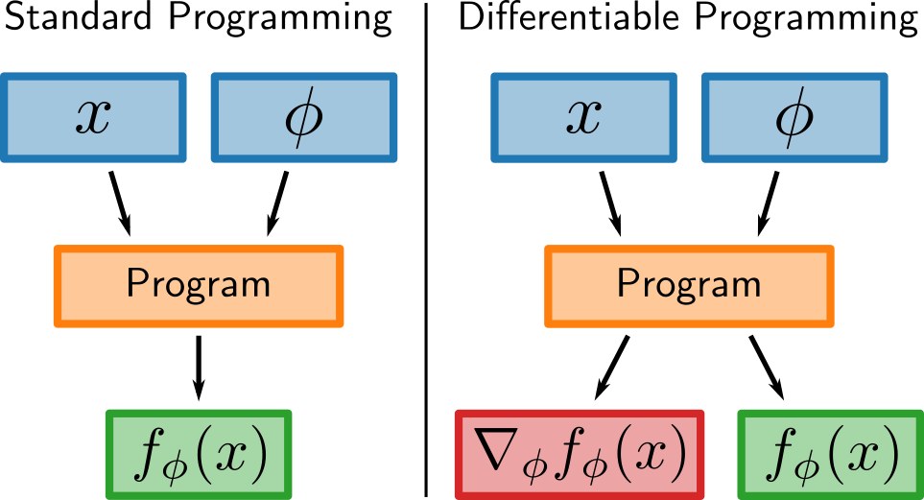
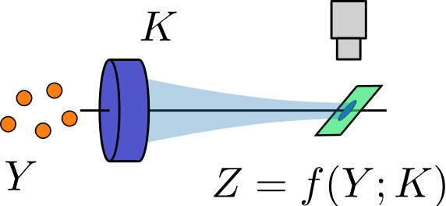
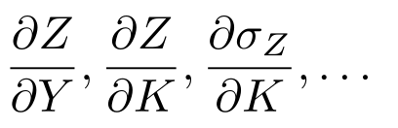


Differentiable Beam Physics Simulations
Differentiable Beam Dynamics in Bmad-X
Differentiable sims keep track of derivative information during every calculation step.
Gonzalez-Aguilera, J., et al. Proc. IPAC 23 (2023): 1725-1729.
$$\frac{∂Z}{∂Y},\frac{∂Z}{∂K},\frac{∂σ_{Z}}{∂K},…$$
$$\frac{∂Q^{(i,j)}}{∂Y},\frac{∂Q^{(i,j)}}{∂K}$$
Enables cheap gradient evaluations which enable optimization of >10k free parameters.
Allows us to extract information from the individual pixels of an image.

Slide 12
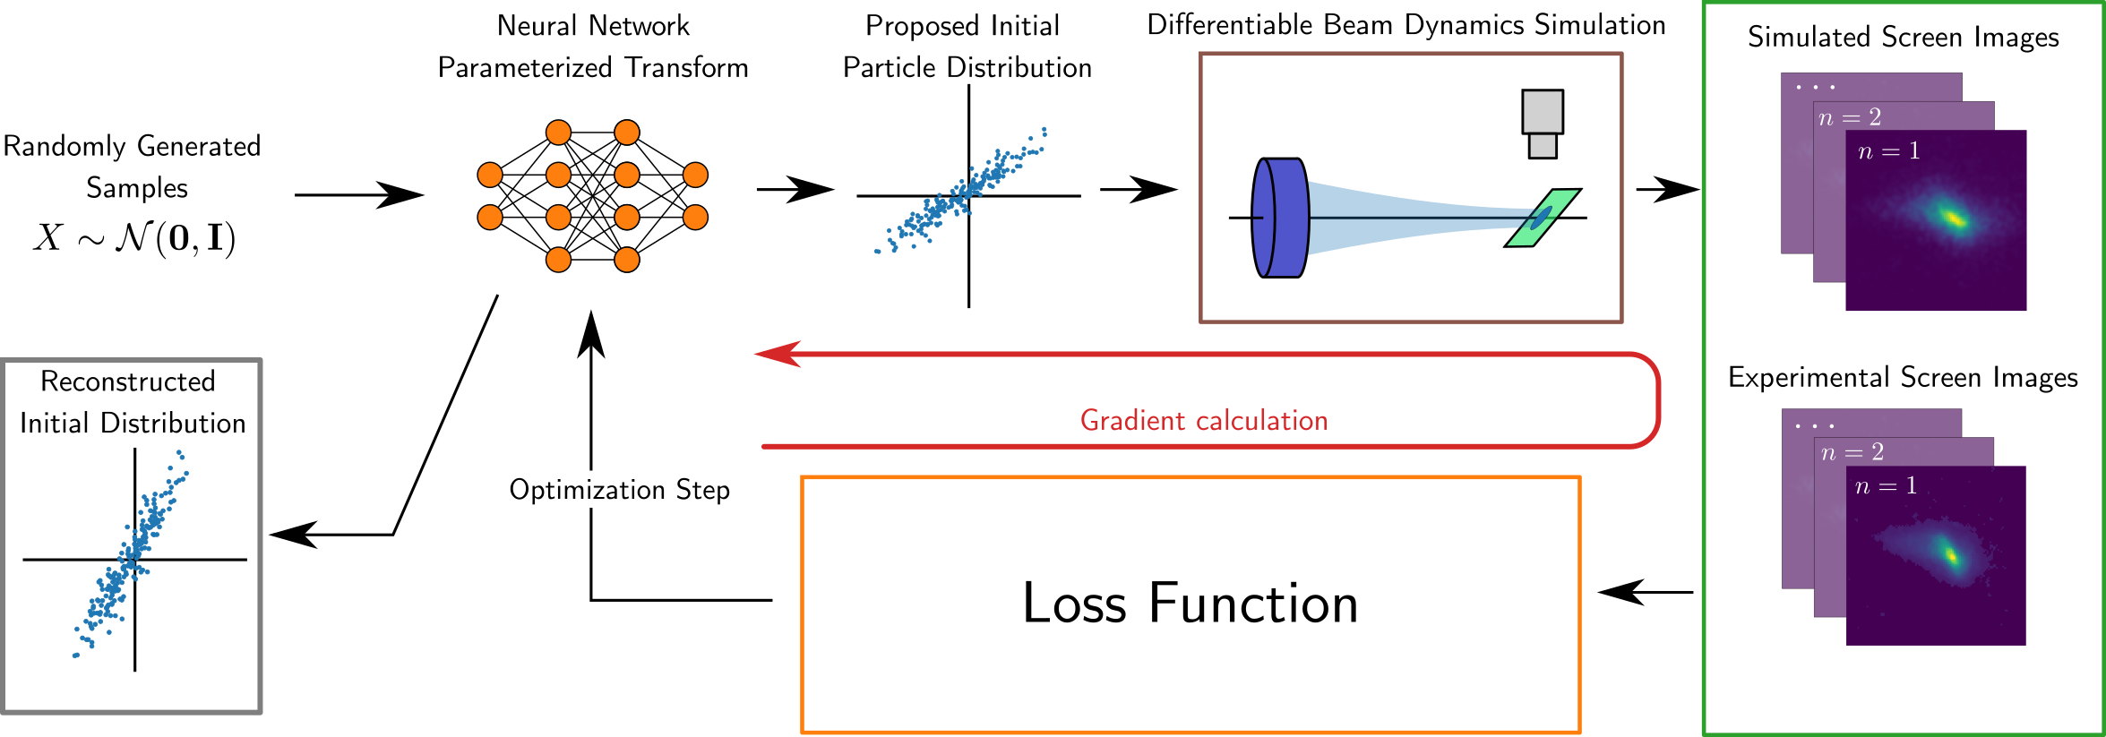
Generative Phase Space Reconstruction (GPSR)
Now we can use gradient descent to optimize (train) beam parameters → necessary for learning O(~1000) parameters
Roussel, Ryan, et al. PRL (2023)

Slide 13
Transverse Beam Tomography @ AWA
Drive beamline

Slide 14
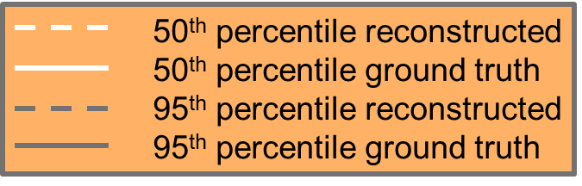
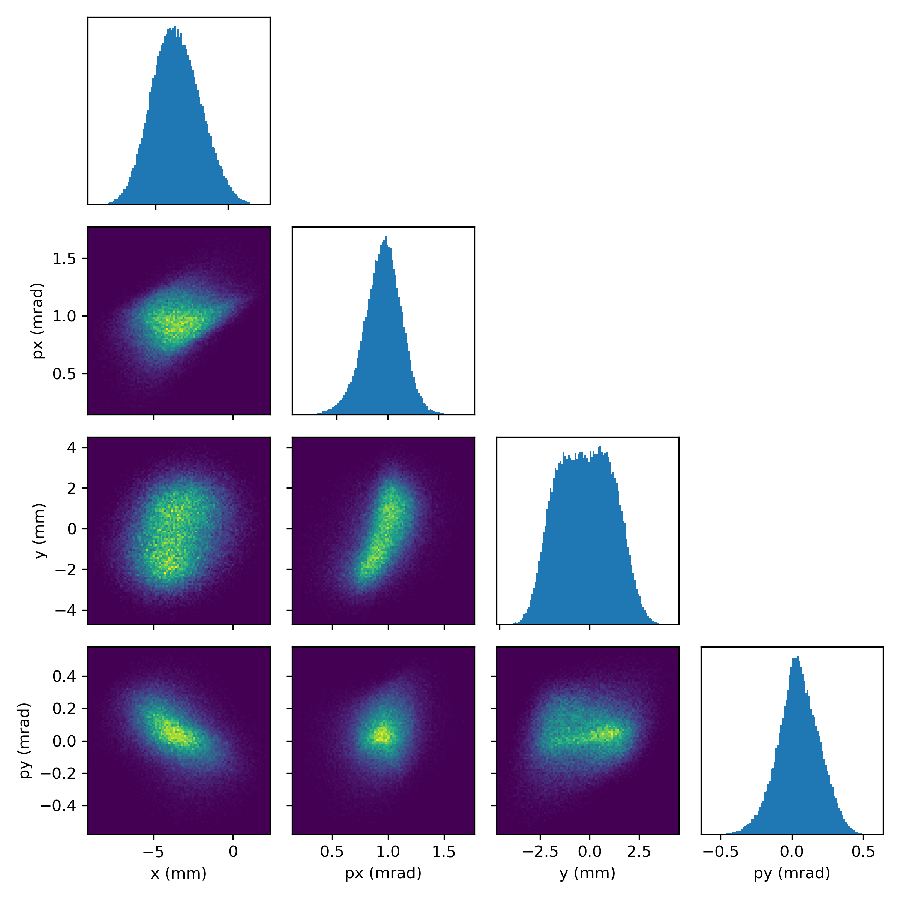
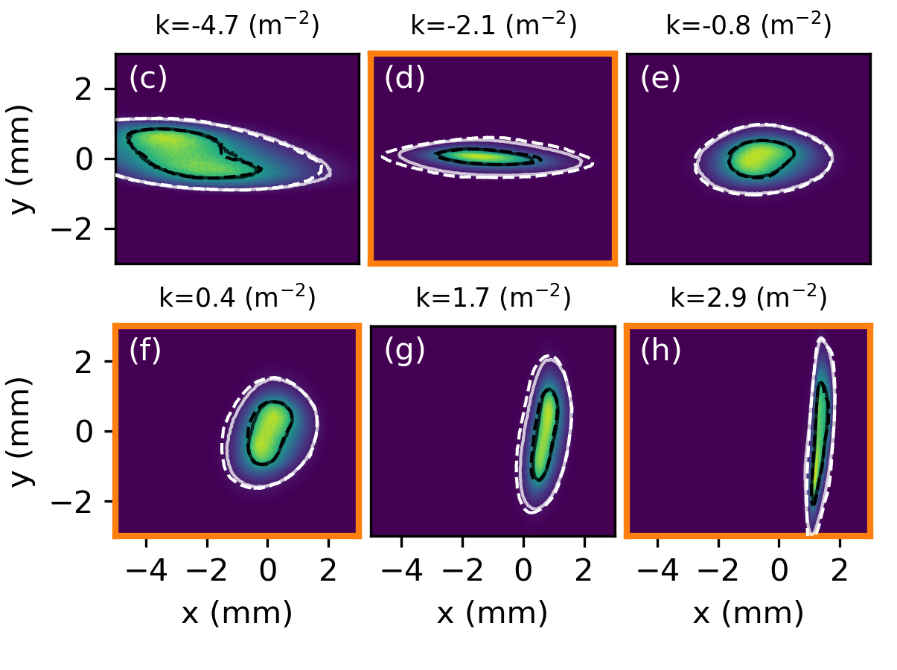
AWA Reconstruction Results
Reproduces detailed beam features
Reconstructed
4D distribution
Accurate 4D reconstructions using 10 measurements!
Reconstruction (training) time < 5 mins
No prior training data needed!!
Roussel, R, et al. PRL (2023)
Accurately predicts beam distributions outside the training set

Slide 15
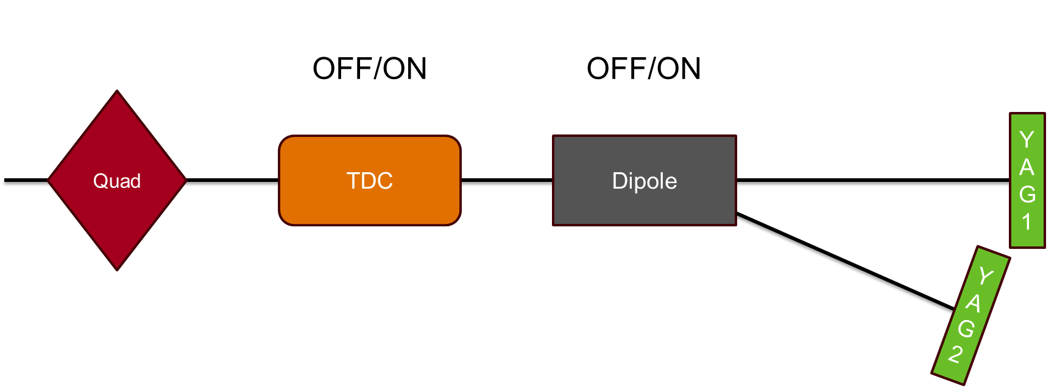
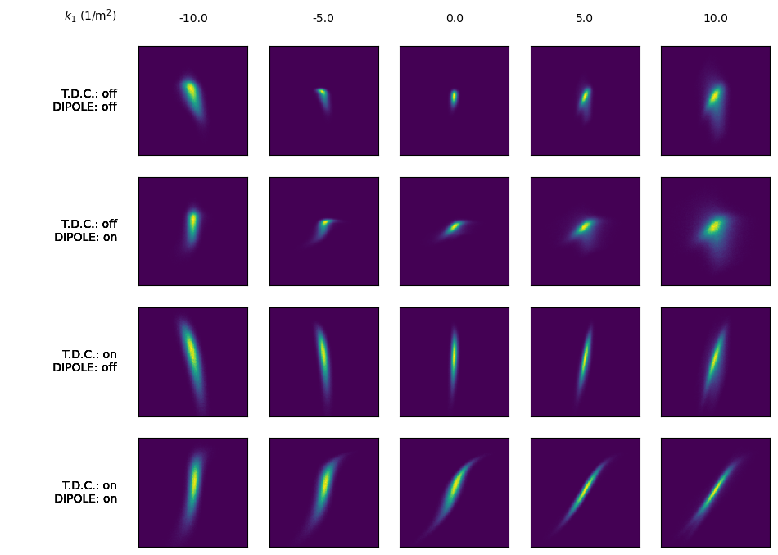
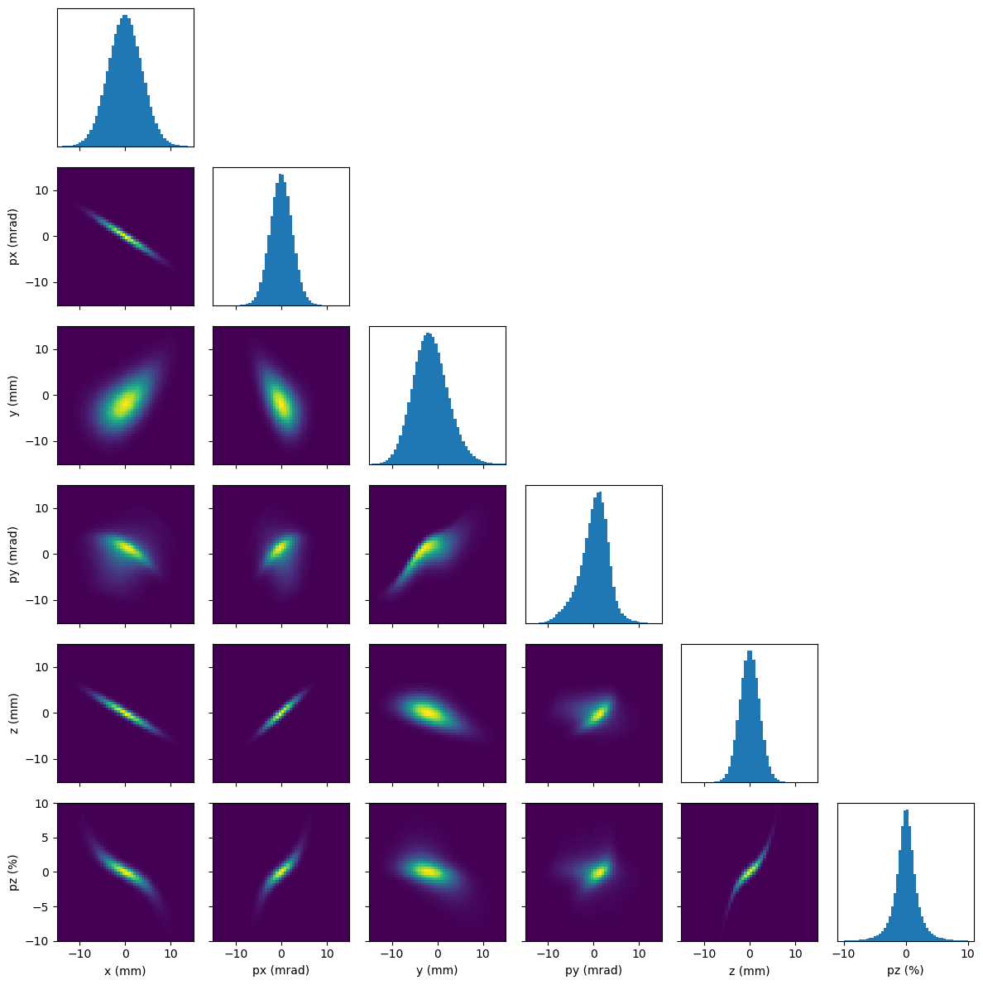
6D Phase Space Reconstruction (Test Beam)
Logical next step, combine 4D reconstructions from quad scans with single shot longitudinal phase space diagnostics
Fully correlated test beam
20 simulated measurements

Slide 16
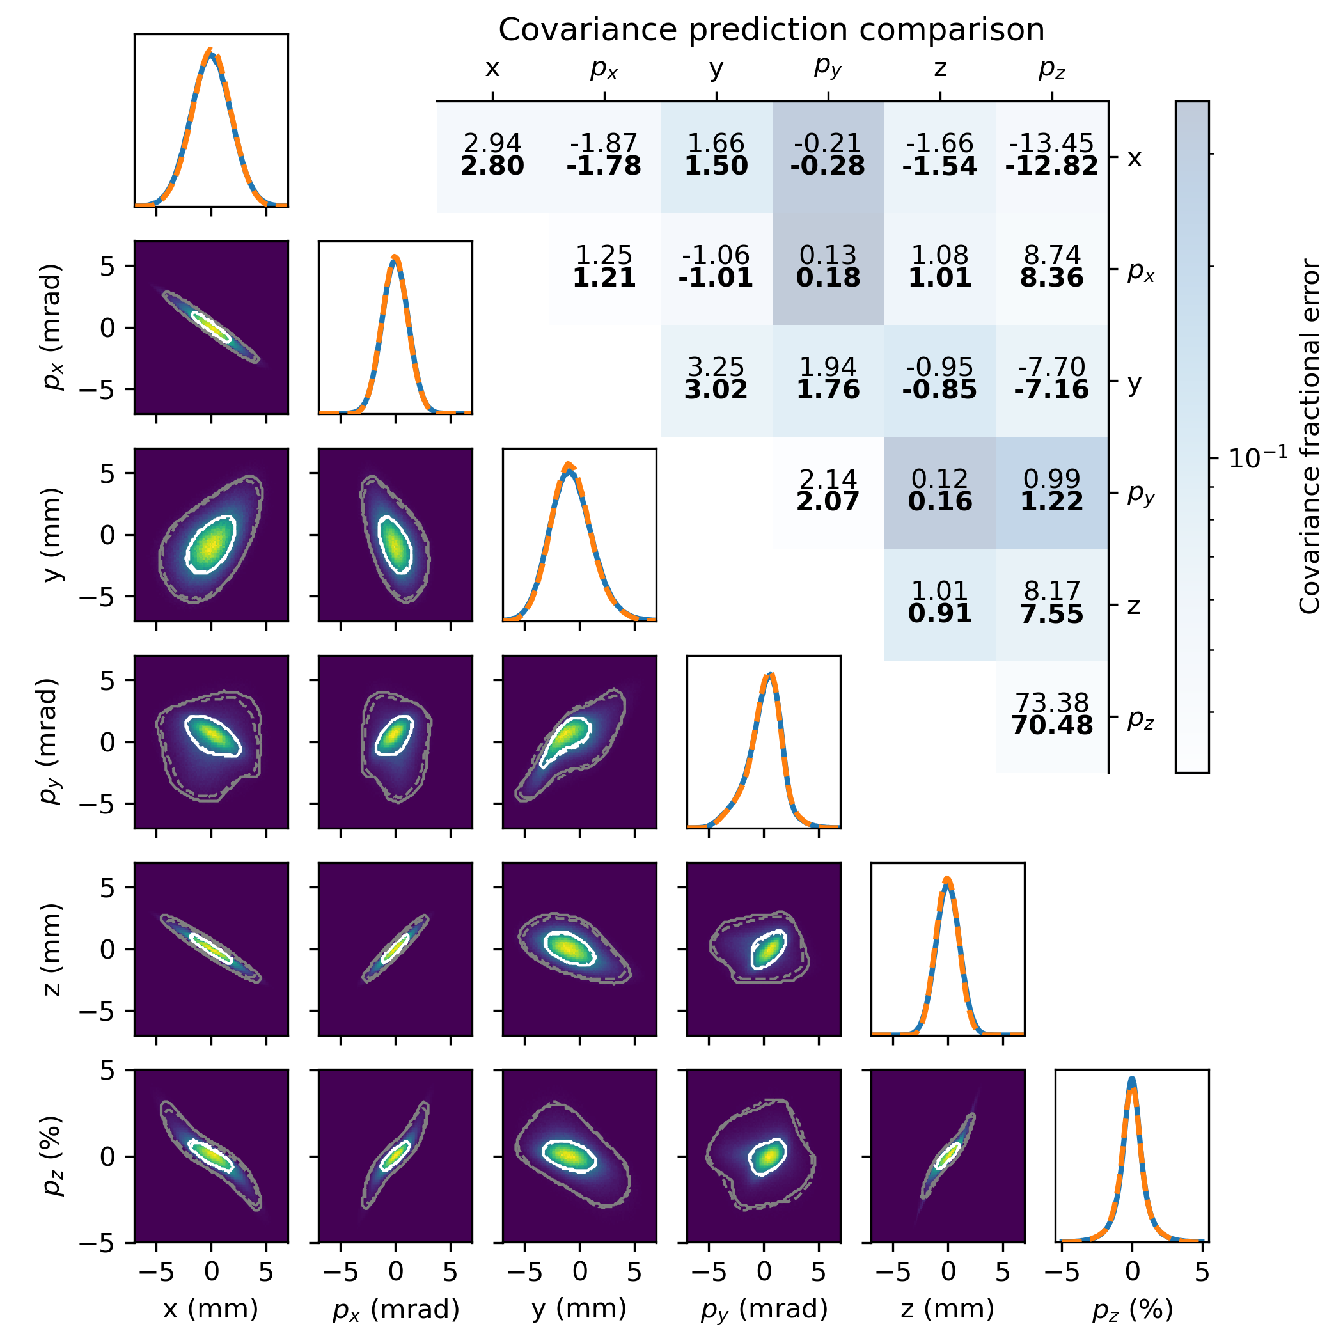
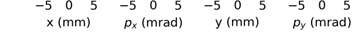
Reconstruction Results (Test Beam)
Transverse phase space
Transverse-longitudinal phase space
Successful reconstruction with 20 measurements, ~8 min computation time

Slide 17
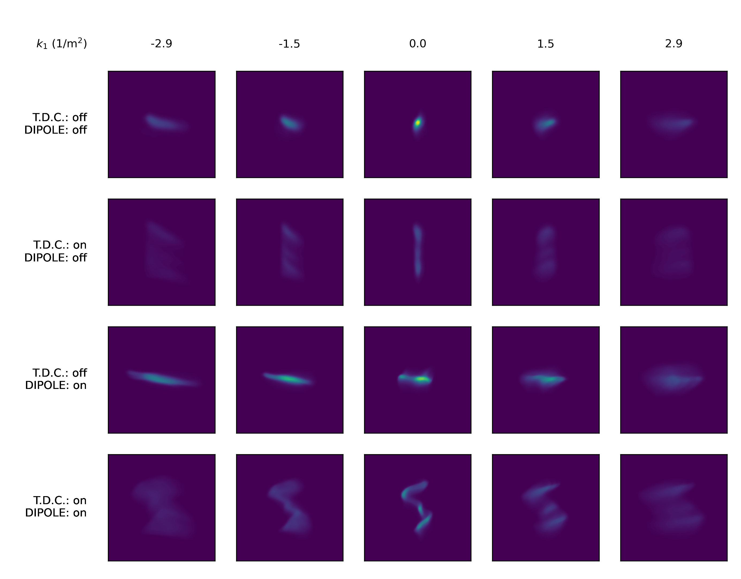
Preliminary Experimental Results from AWA
Training data

Slide 18
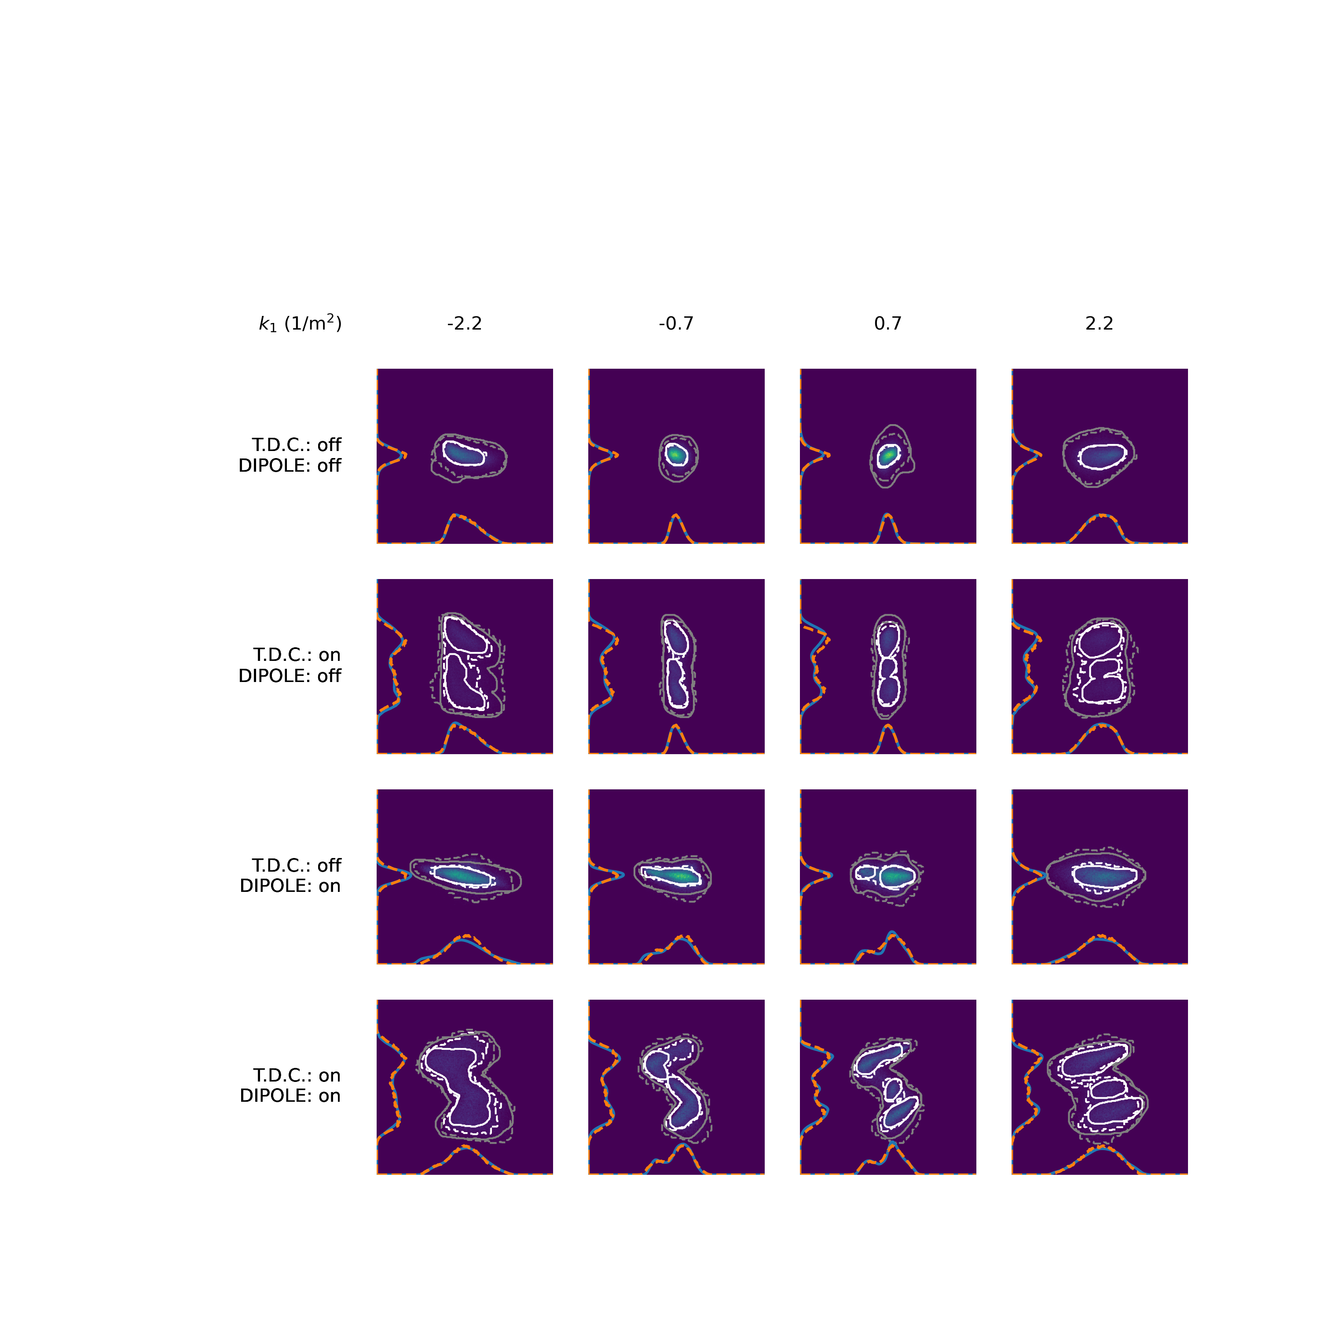
Preliminary Experimental Results from AWA
Reconstruction predictions on test data

Slide 19
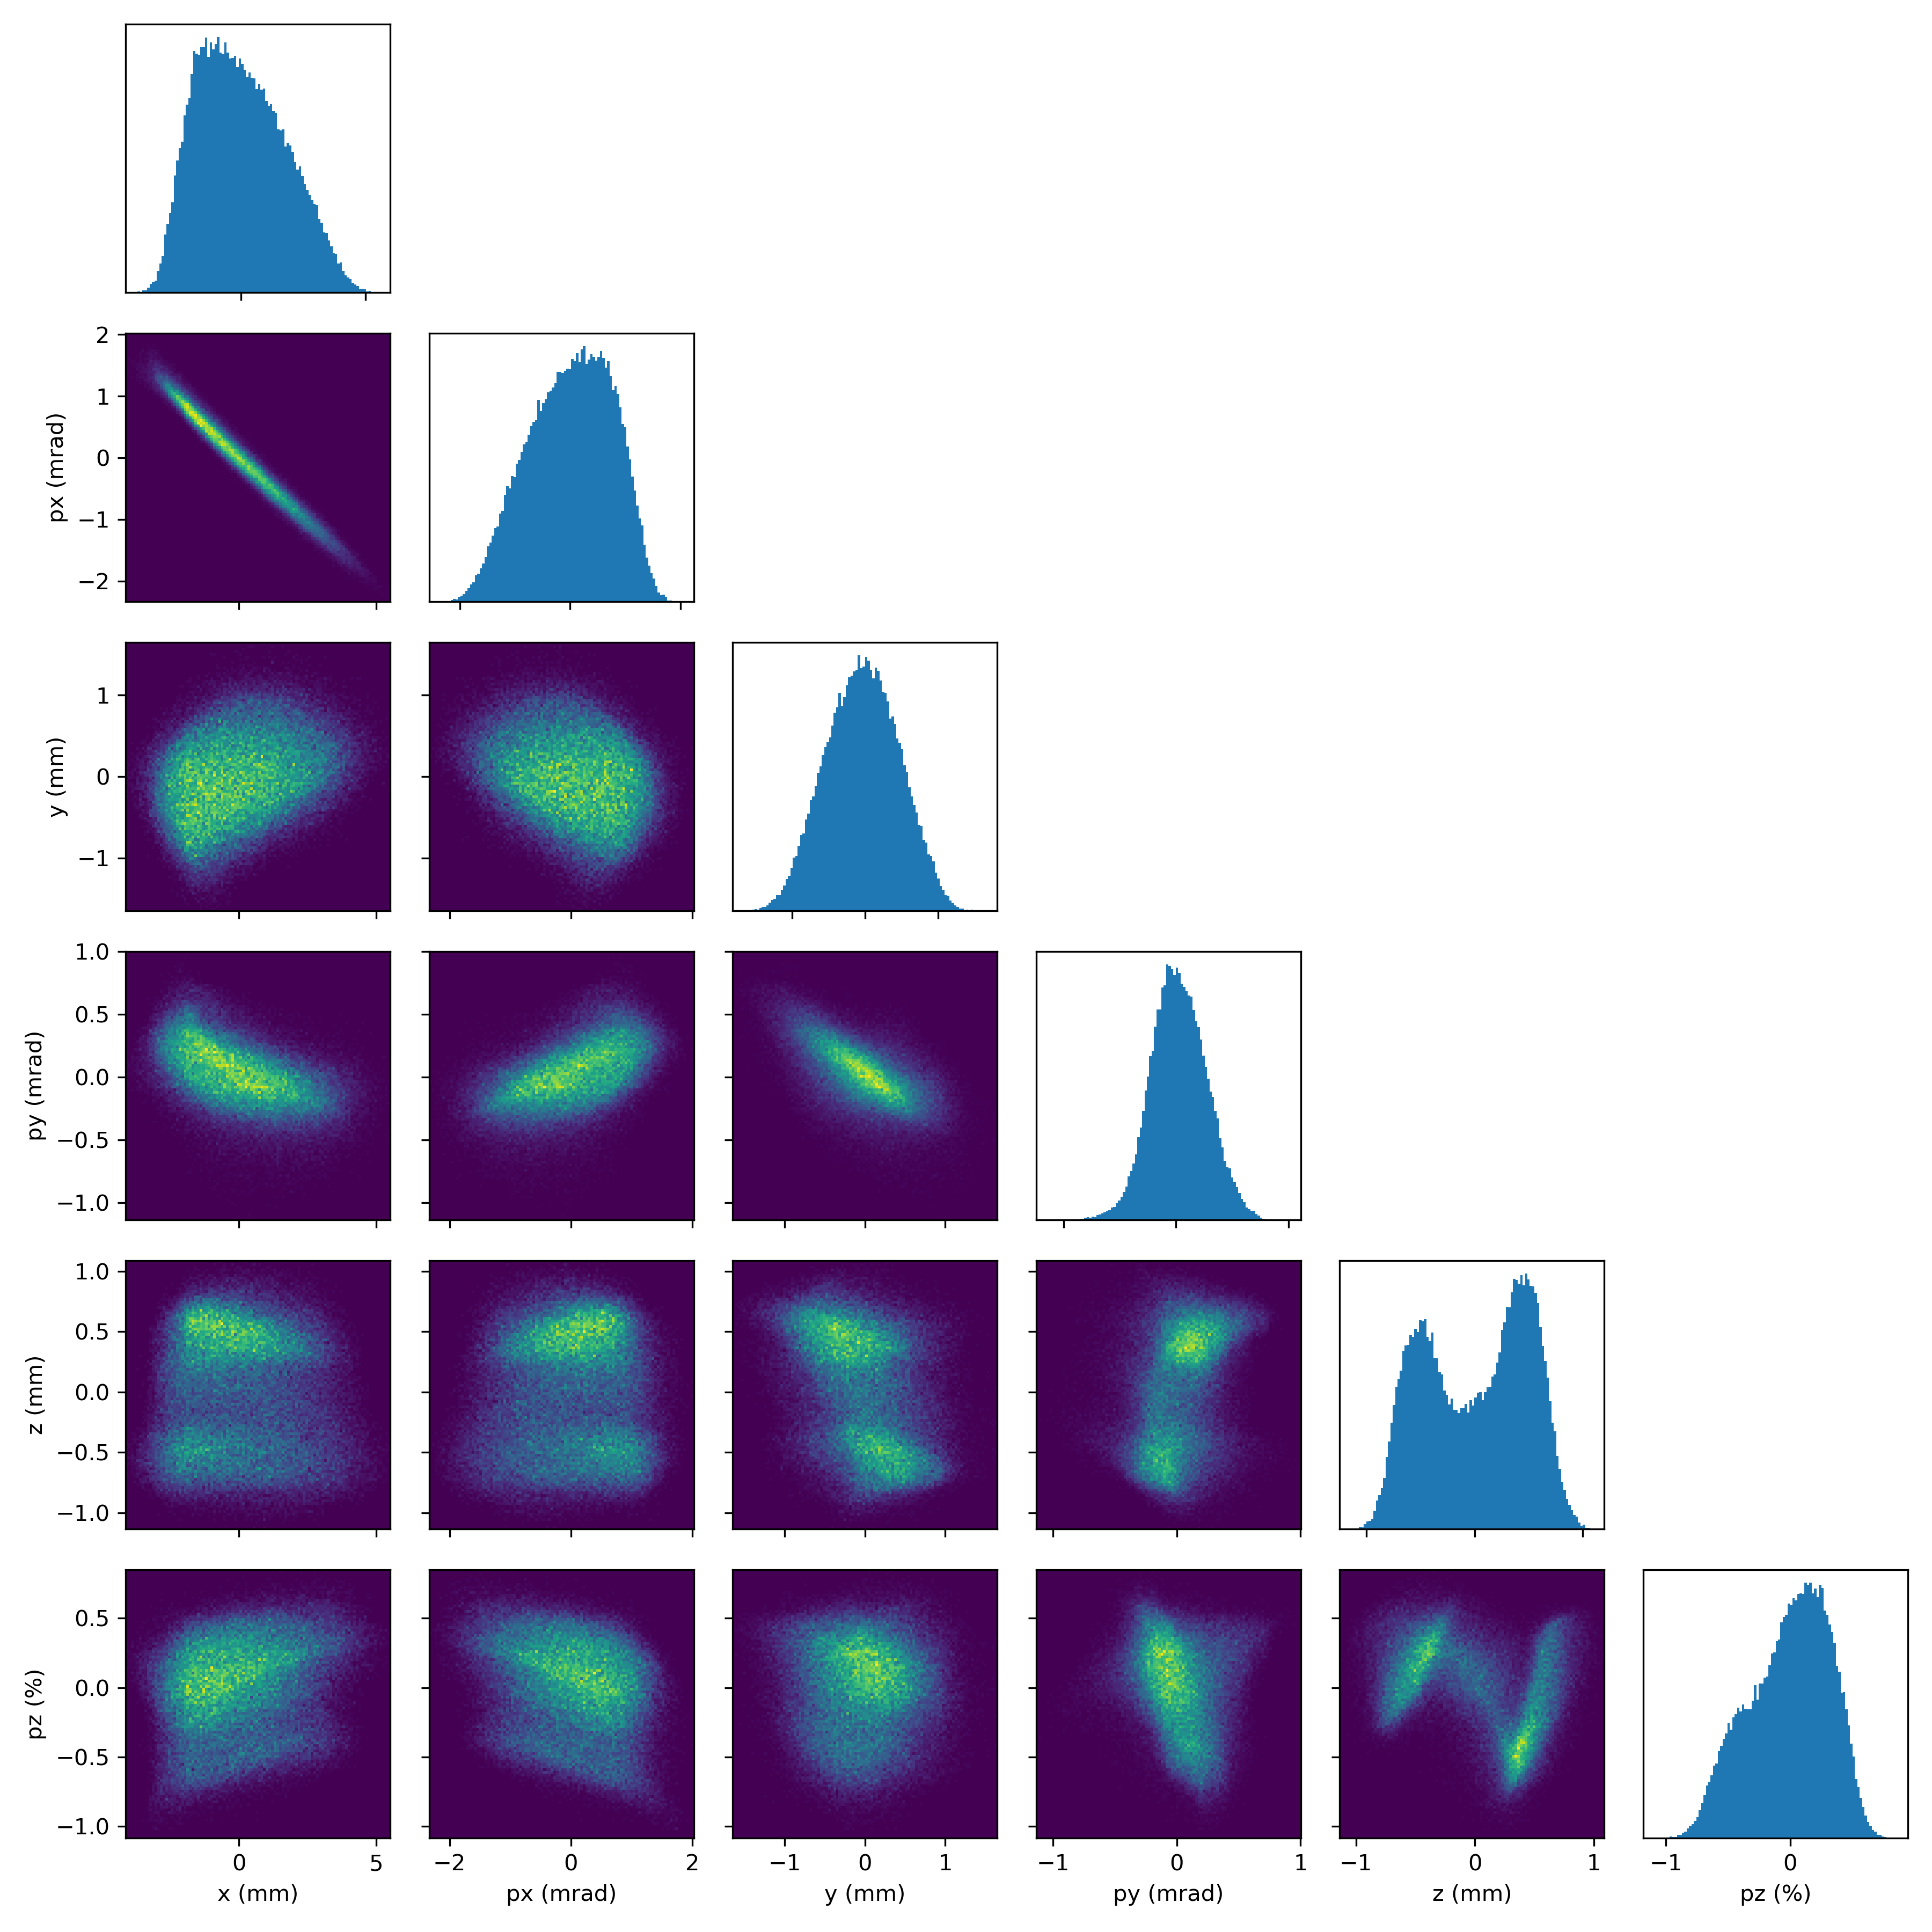
Preliminary Experimental Results from AWA
Magnetization due to solenoid focusing
Temporal structure likely to laser homogenization optics
Reconstructed 6D distribution
Measurement: ~8 mins
Training: ~8 mins
Roughly 100x faster than previous demonstrations

Slide 20
Conclusion
Generative modeling + differentiable physics simulations (GPSR) → substantial improvements in analysis capabilities
Experimental demonstration at AWA → reconstructions + analysis in ~ 15 mins
Enables better understanding of beam distributions in experiment → better wakefield accelerators, beams for colliders/cooling, better understanding of beam physics (CSR)
See next two talks by Juan Pablo and Seongyeol!

Slide 21
Questions?
SLAC
Auralee Edelen
Chris Mayes
Daniel Ratner
U. Chicago
Juan Pablo Gonzalez-Aguilera
Argonne Wakefield Accelerator
Seongyeol Kim
John Power
Eric Wisniewski
Wanming Liu
Alexander Ody
Thanks to the team!

Slide 22
Backup

Slide 23
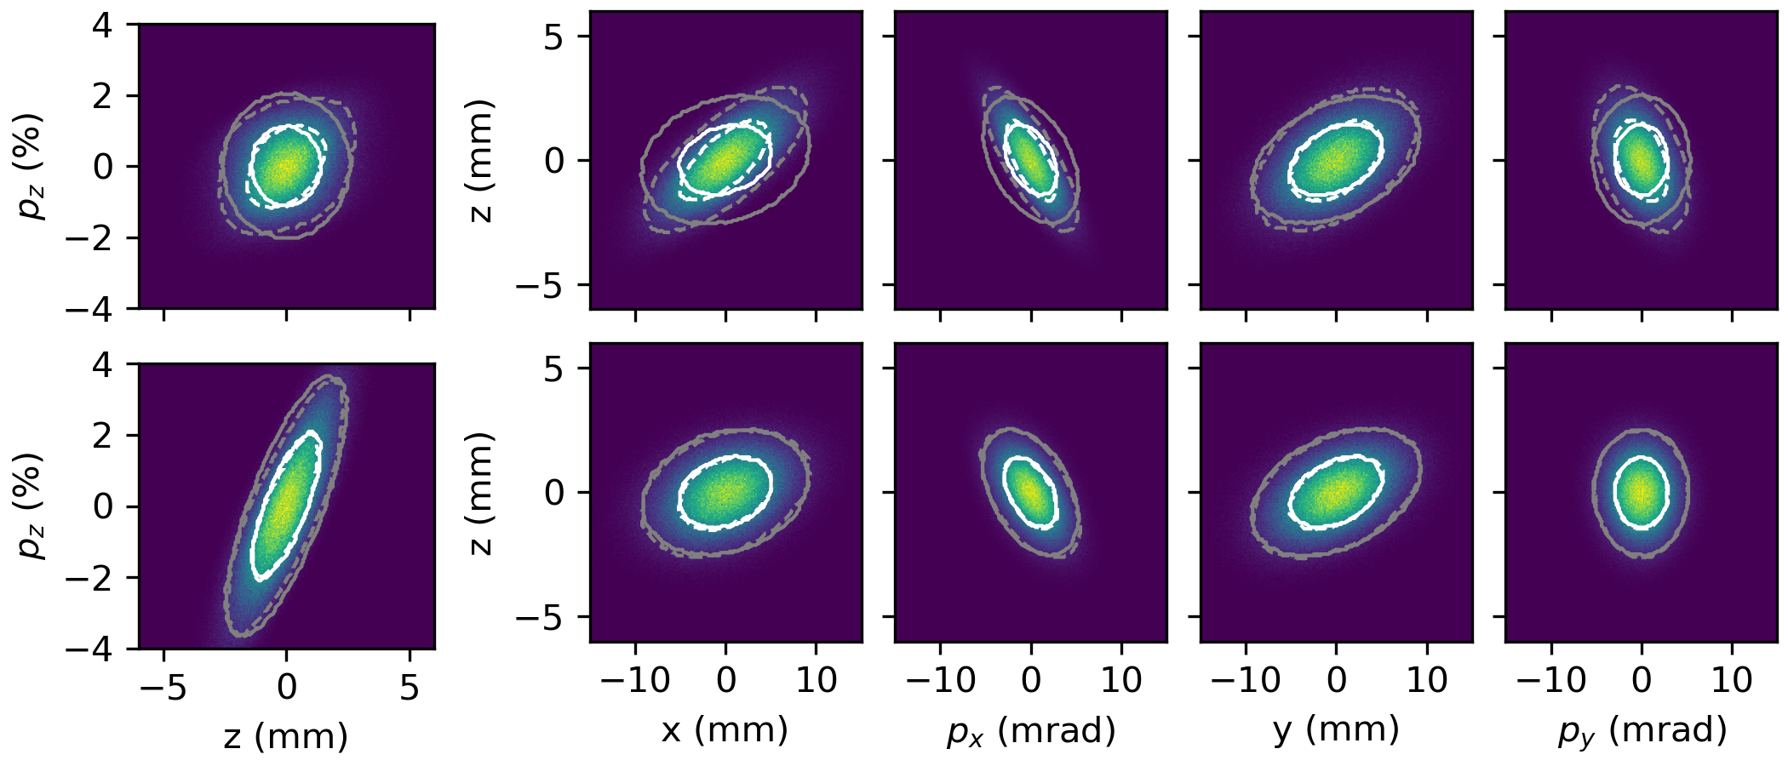
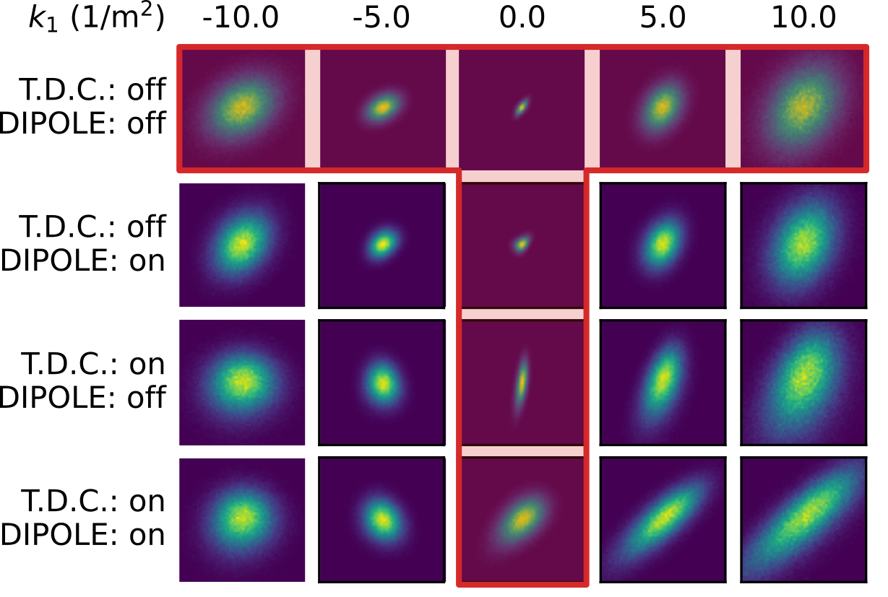
T-Scan Results

Slide 24
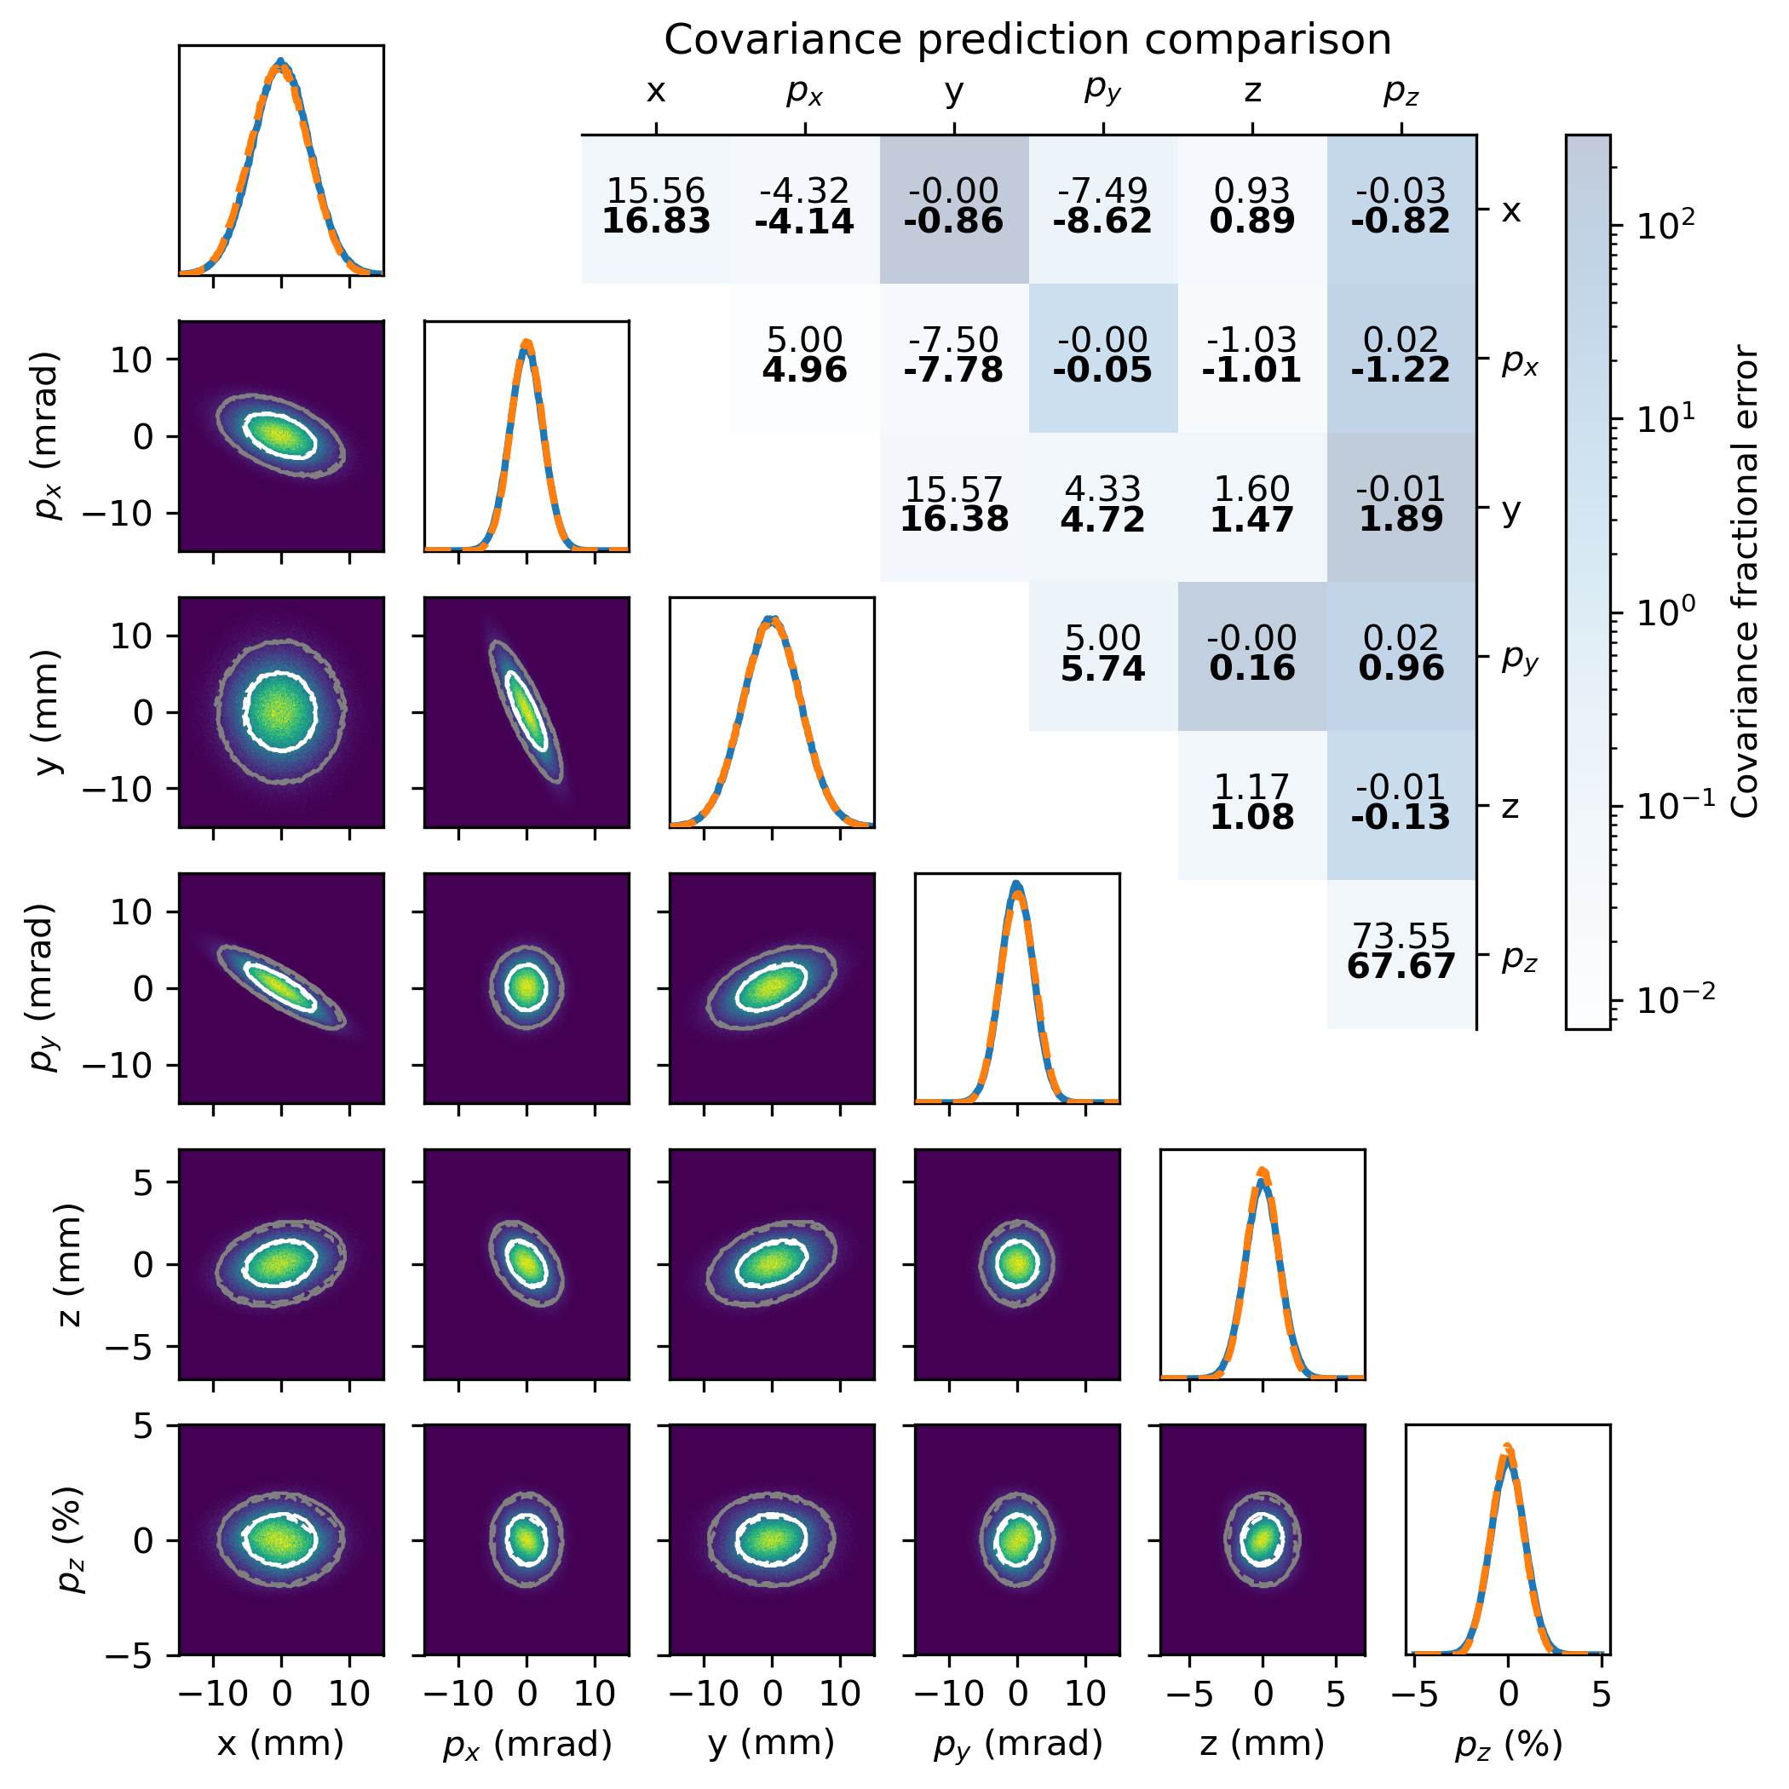
Reconstruction Results (Gaussian Beam)

Slide 25
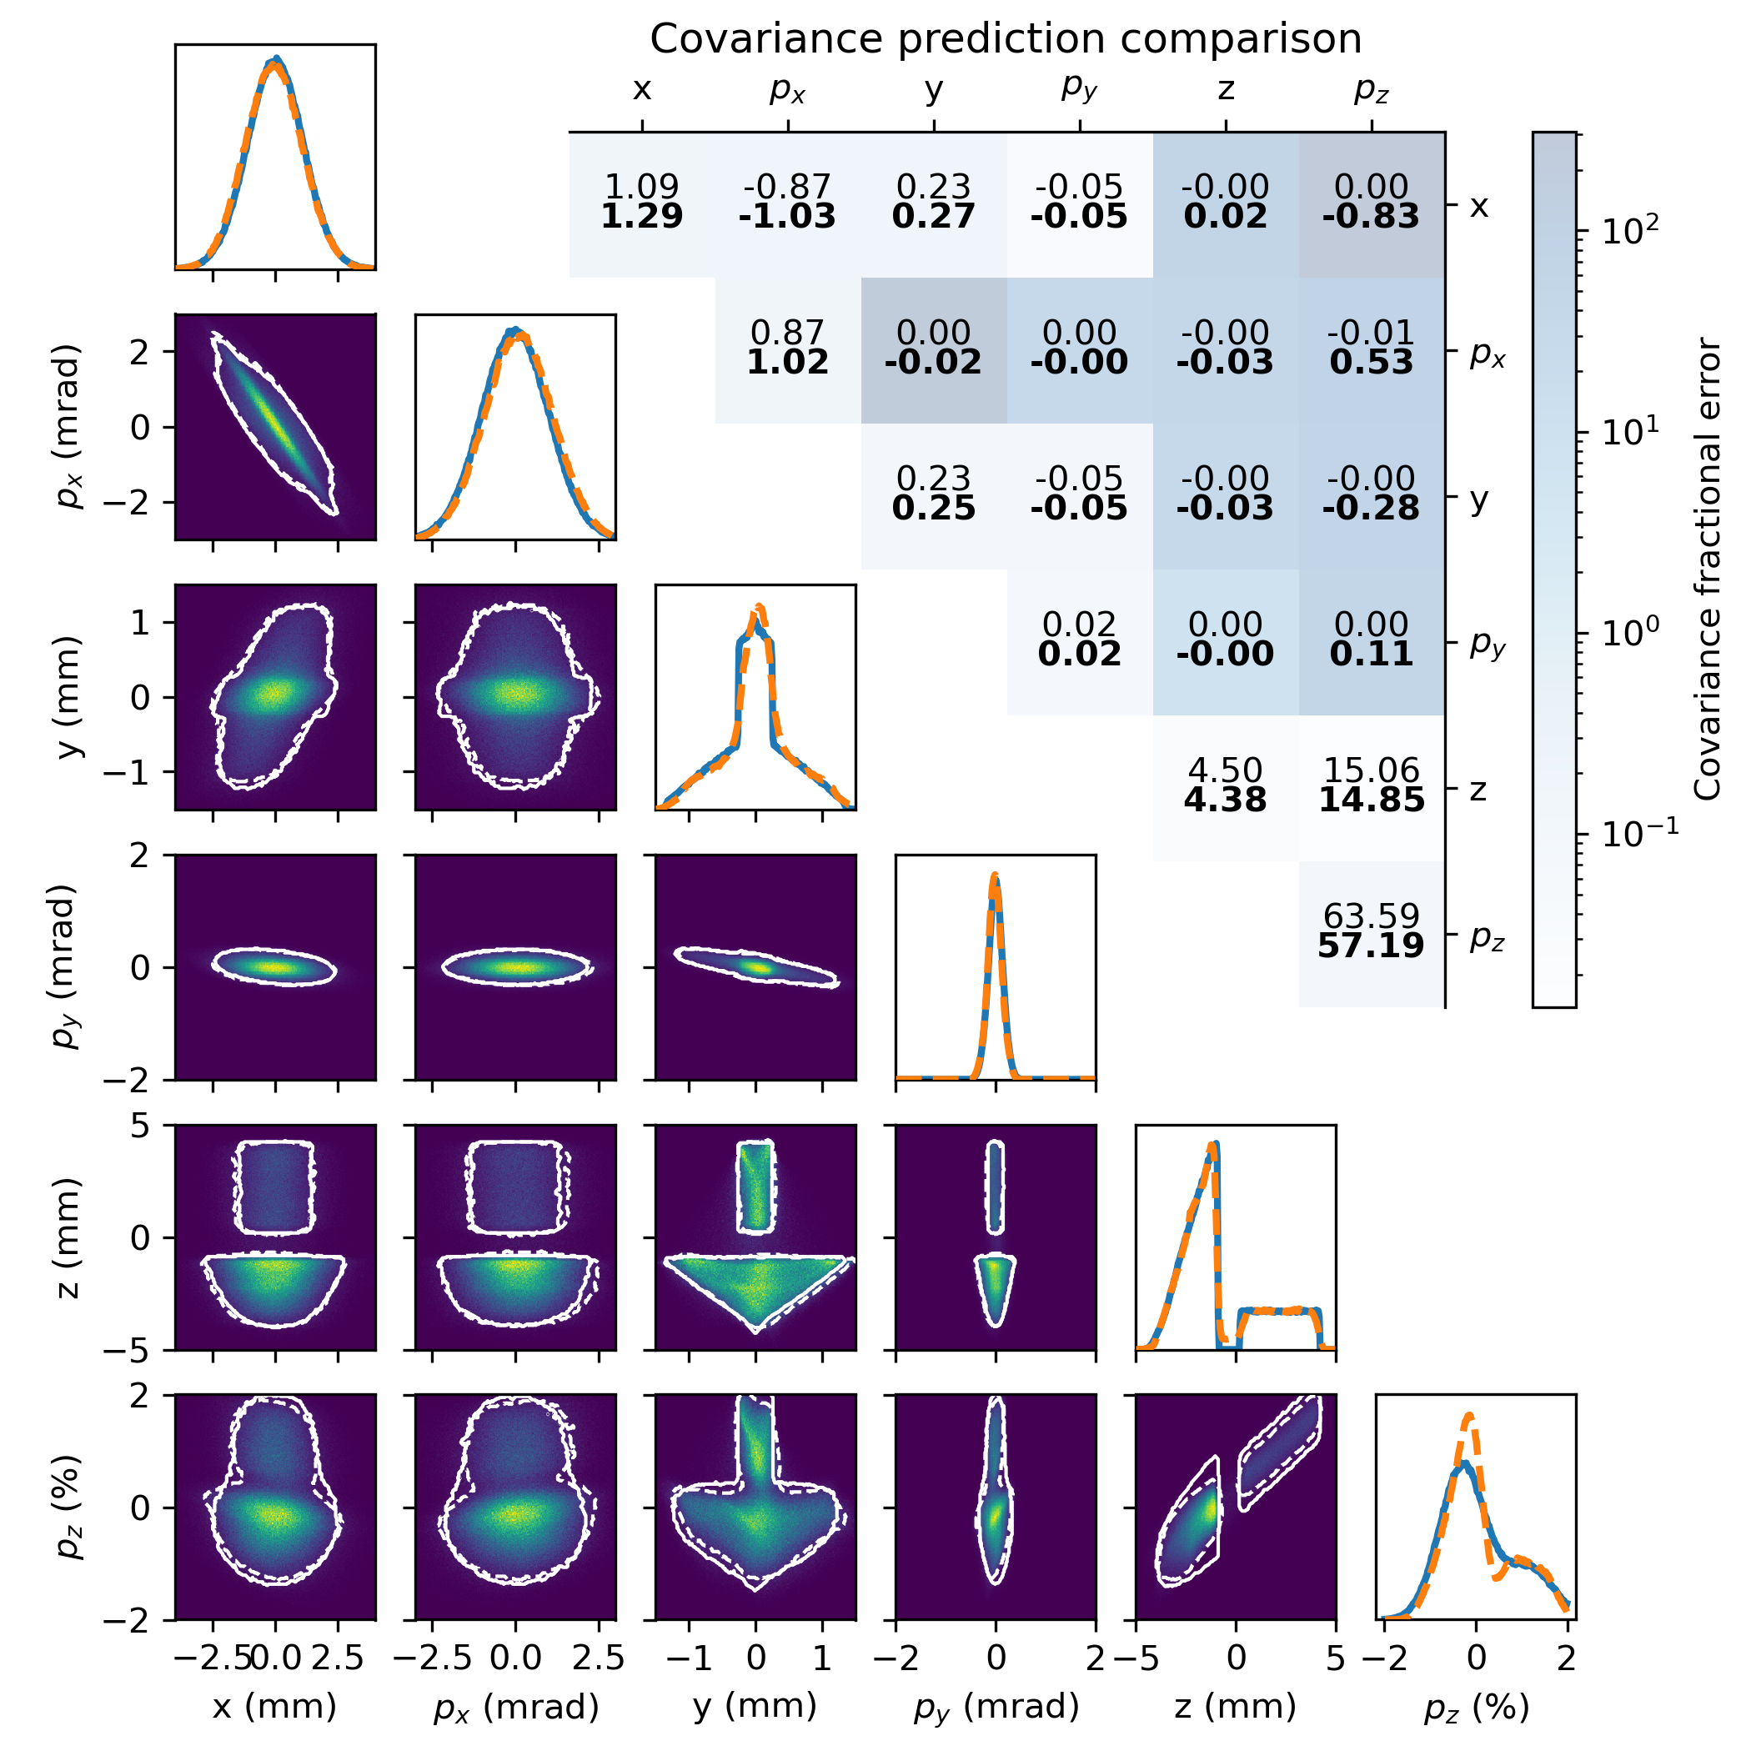
Reconstruction Results (EEX Beam)

