Slide 1
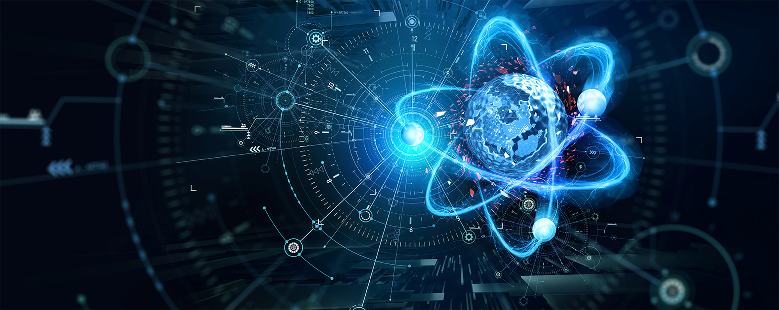
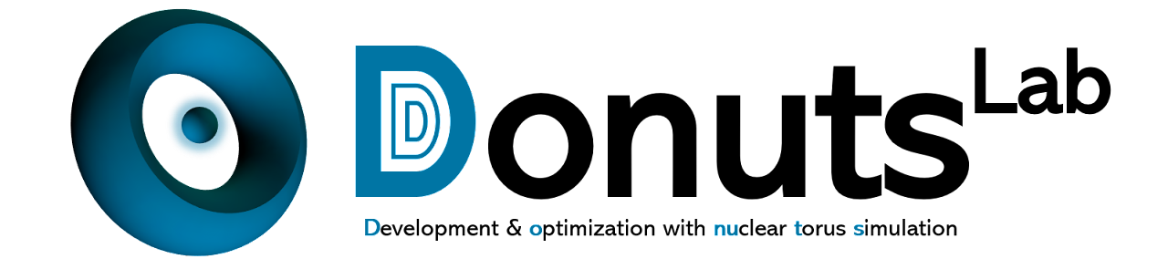
Controlling fusion plasmas with deep reinforcement learning
Jaemin Seo
Physics, Chung-Ang University

Slide 2
Contents
Introduction
  Tokamak operation design
  Reinforcement learning (RL)
Surrogate model for the KSTAR tokamak
Tokamak operation design and control with RL
  Tokamak operation design with RL
  Tokamak operation control with RL
Summary

Slide 3
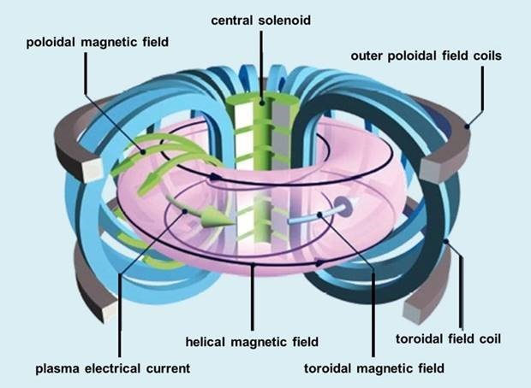
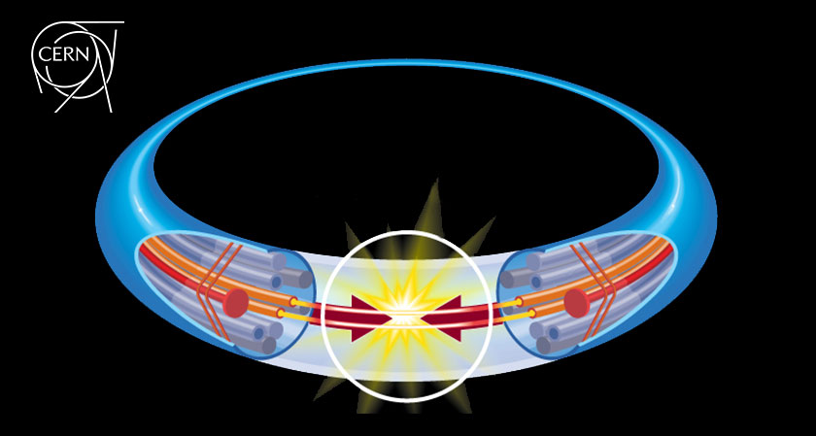
Introduction – Tokamak vs Accelerator
Tokamak
Accelerator
Bulk fluids (Plasma)
keV-MeV
For nuclear fusion
Localized particles
~TeV
For collision
Both need control & optimization

Slide 4

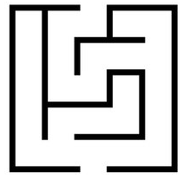

Introduction – Tokamak operation design
How have we achieved high performance in a tokamak?
Human trials and errors in tokamak experiments
Map
Guided by physics modeling
However,
Some phenomena are unpredictable by conventional modeling.
Hard to manually find the operation trajectory for every desired targets.
Therefore, let’s use AI to …
Predict a realistic plasma response in a tokamak.
Design operation trajectories for given physics objectives.
Data-driven simulator
AI operation design algorithm

Slide 5


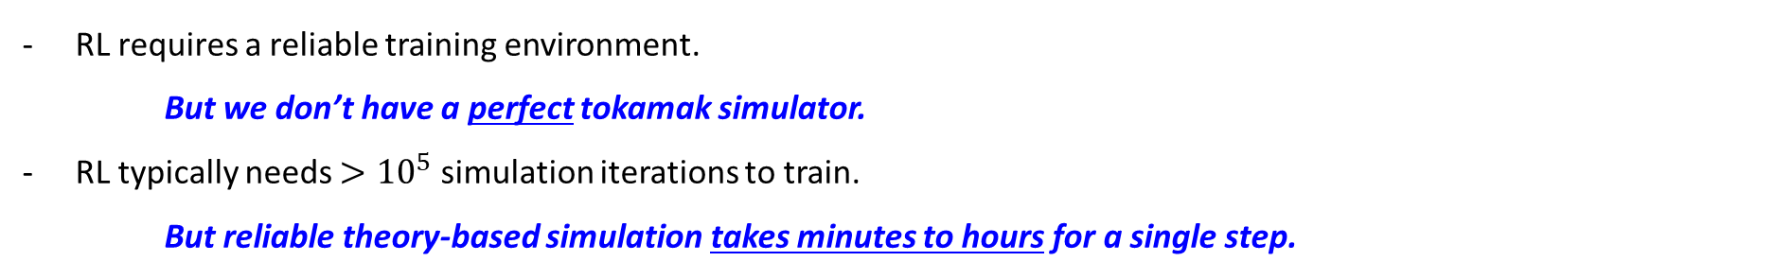

Introduction – Reinforcement learning (RL)
[1] V Mnih et al, Nature 518 (2015) 519
Deep reinforcement learning (RL) [1]
“Finding the best decision-making policy”
$$Reward≈f\left(obs,act\right)$$
Time
Action
Action | Bad | Good | Bad | Good | Good
Reward | -1 | +1 | -1 | +1 | +1
AI (RL agent)
Observation,
Reward
The AI takes actions that yield higher rewards.
It gradually learns the optimal decision-making policy.
Environment
Difficulties of RL application in nuclear fusion research
RL requires a reliable training environment.
But we don’t have a perfect tokamak simulator.
RL typically needs $>{10}^{5}$ simulation iterations to train.
But reliable theory-based simulation takes minutes to hours for a single step.

Slide 6
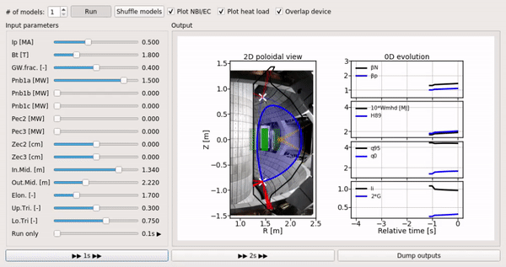
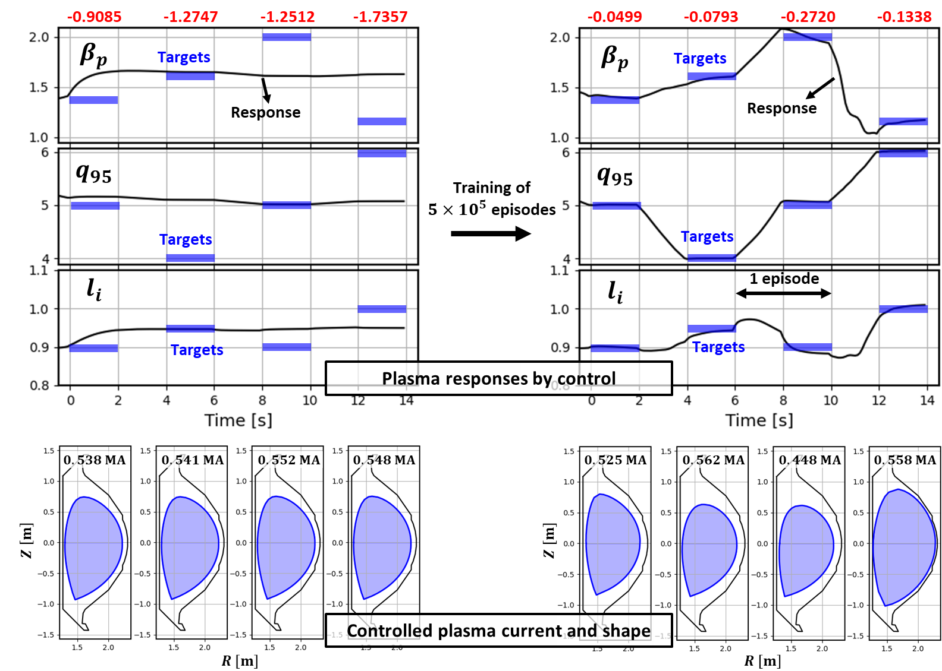
Introduction – Spoiler
[1] J Seo et al, Nucl. Fusion 61 (2021) 106010
[2] J Seo et al, Nucl. Fusion 62 (2022) 086049
In this work,
Make a fast surrogate environment
  We have 10-year exp data in KSTAR.
  So, let’s build a data-driven simulator!
Then, use RL for tokamak operation design/control
  On the simulator above, we trained an AI that controls the tokamak actuators to achieve given targets.

Slide 7
Contents
Introduction
  Tokamak operation design
  Reinforcement learning (RL)
Surrogate model for the KSTAR tokamak
Tokamak operation design and control with RL
  Tokamak operation design with RL
  Tokamak operation control with RL
Summary

Slide 8


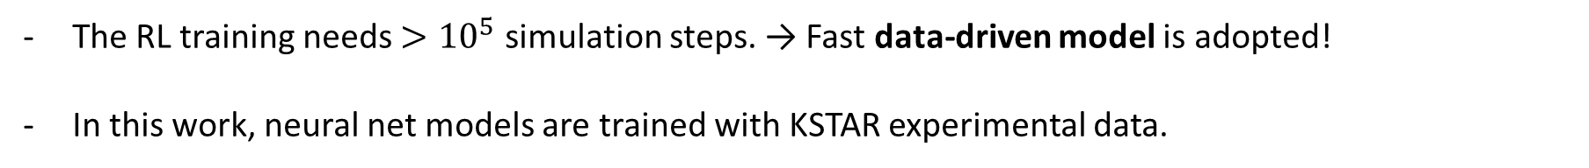
Surrogate model for the KSTAR tokamak
The need for data-driven simulator
In order for AI to explore the tokamak operation, we need a simulation environment.
Integrated modeling
Data-driven model with DNN
Predict with integrated physics models
Physically interpretable
Limited by the model’s validity
Computationally costly and slow
Predict from patterns of the data
Black box
Experimentally relevant
Fast enough
vs
The RL training needs $>{10}^{5}$ simulation steps. → Fast data-driven model is adopted!
In this work, neural net models are trained with KSTAR experimental data.

Slide 9
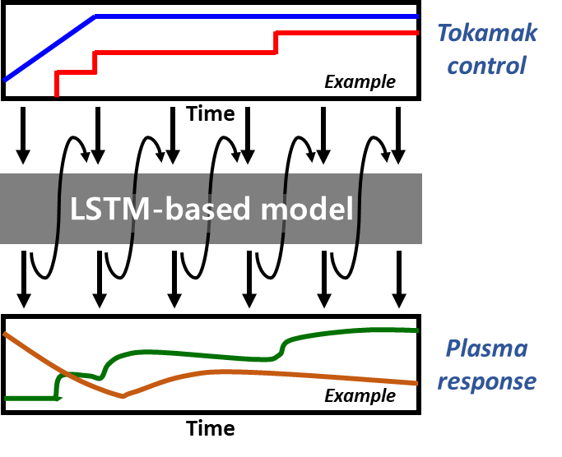
Surrogate model for the KSTAR tokamak
Idea
Input
Output
We have experimental data of both tokamak actuators and plasma responses.
Then, we can train the neural network that mimics the plasma response.
Input
Plasma current, heating power, boundary shape, …
What we want to make: Predicting plasma states from actuators
Output
Plasma pressure ($β_{N}, β_{p}$), safety factor ($q_{95}, q_{0}$), internal inductance ($l_{i}$)…

Slide 10





Surrogate model for the KSTAR tokamak
Prediction of plasma states
We want a model that predicts the plasma responses by learning the pattern of the experimental data.
Plasma response is time-dependent. → RNN or LSTM (or Transformer soon)
Time
Plasma current, $I_{p}$
0.4 | 0.5 | 0.6 | 0.6
0.4 | 0.5 | 0.6 | 0.6
0.4 | 0.5 | 0.6 | 0.6
0.6
0.6
0.6
Tokamak control
Heating power, $P_{NB}$
1.5
0.0 | 0.0 | 0.0 | 1.5
1.5
0.0
0.0 | 0.0 | 0.0 | 1.5
0.0 | 0.0 | 0.0 | 1.5
$$⋮$$
Norm. beta, $β_{N}$
1.1 | 1.2 | 1.3
?
?
?
1.1 | 1.2 | 1.3
1.7
1.9
1.7
Plasma states
Edge safety factor, $q_{95}$
4.3
4.3
6.5 | 5.5 | 4.5
4.3
6.5 | 5.5 | 4.5
$$⋮$$
100 ms

Slide 11
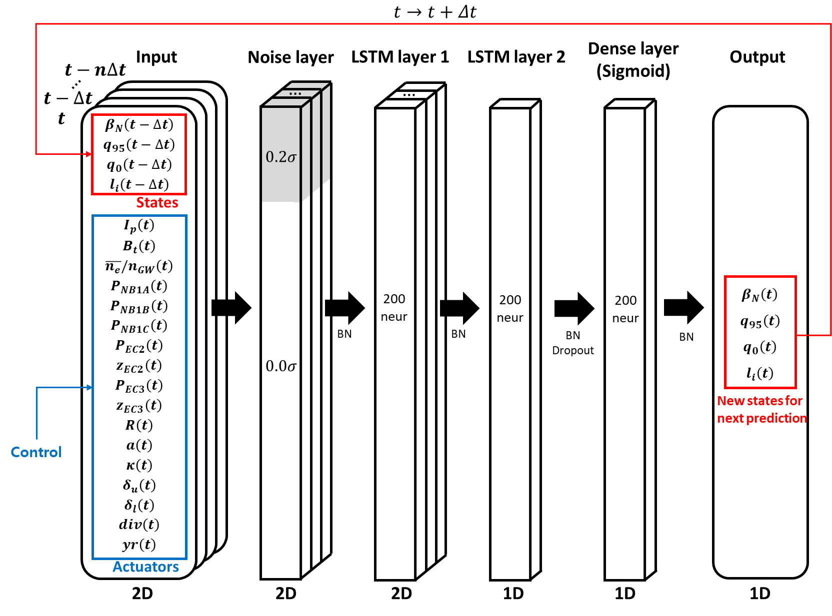
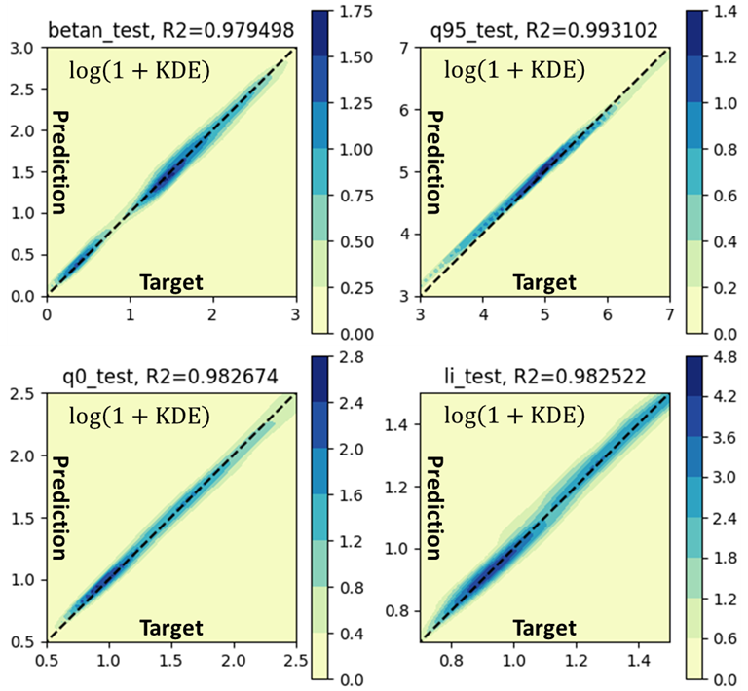
Surrogate model for the KSTAR tokamak
Neural network architecture
Previous state
Field variable
Heating
Geometry
Regression plot for testset

Slide 12
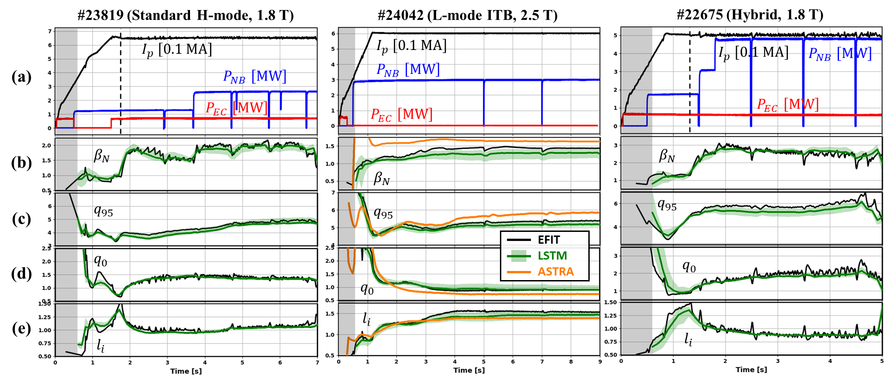
Surrogate model for the KSTAR tokamak
Predictive simulation in KSTAR with the trained model
Given
True & Prediction
Predict
From the initial condition, the entire discharge can be sequentially predicted from the given actuator scenario.
The model successfully predicts the plasma evolution in different scenarios.

Slide 13
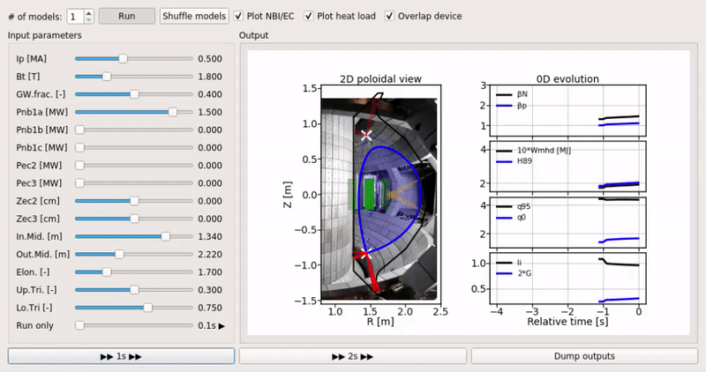
Surrogate model for the KSTAR tokamak
Interactive GUI for predictive modeling
We can perform a virtual experiment in real-time.
Also can be used for the RL training environment.
https://github.com/jaem-seo/KSTAR_tokamak_simulator

Slide 14
Contents
Introduction
  Tokamak operation design
  Reinforcement learning (RL)
Surrogate model for the KSTAR tokamak
Tokamak operation design and control with RL
  Tokamak operation design with RL
  Tokamak operation control with RL
Summary

Slide 15
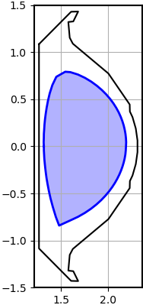
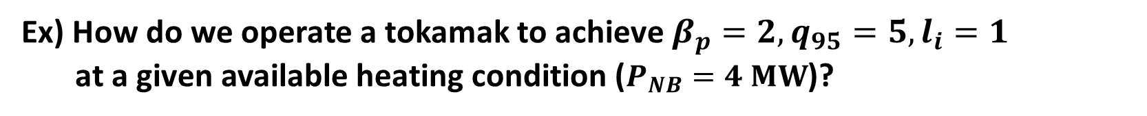
Tokamak operation design with RL
Idea
Now, we have a training environment for RL.
Then, we want an AI that designs a probable operation trajectory to achieve a target plasma state.
Goal
Ex) How do we operate a tokamak to achieve $β_{p}=2, q_{95}=5, l_{i}=1$
at a given available heating condition ($P_{NB}=4 MW$)?
Constraints
Plasma current: 0.6 MA
Plasma boundary shape:

Slide 16
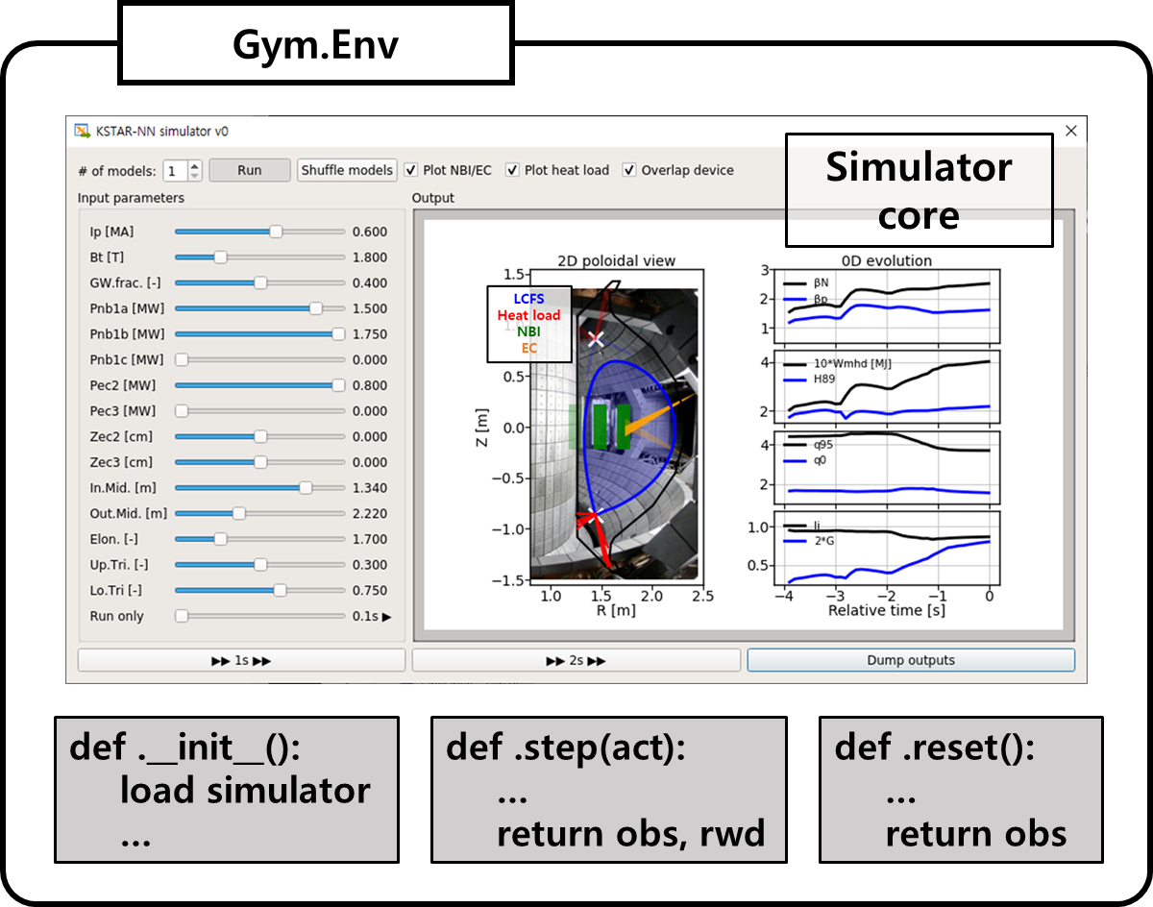
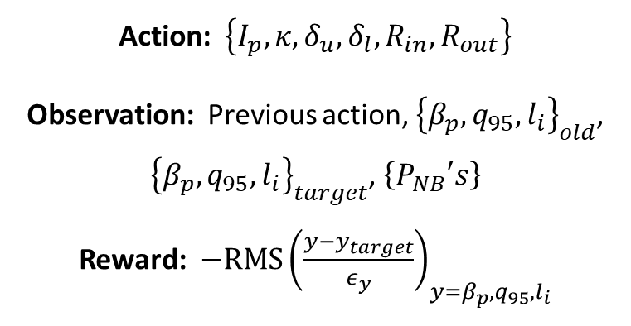
Tokamak operation design with RL
[1] G Brockman et al, ArXiv preprint, ArXiv1606.01540 (2016)
[2] S Fujimoto et al, 35th ICML (2018)
[3] A Hill et al, https://github.com/hill-a/stable-baselines (2018)
RL training for operation design
For the AI to interact with the simulator, we need to wrap it into a standard format, OpenAI Gym environment [1].
The AI was trained by TD3 [2] implementation from Stable Baselines [3].
Action: $\left\{I_{p}, κ, δ_{u}, δ_{l}, R_{in}, R_{out}\right\}$
Observation: Previous action, ${\left\{β_{p}, q_{95}, l_{i}\right\}}_{old}$, ${\left\{β_{p}, q_{95}, l_{i}\right\}}_{target}$, $\left\{P_{NB}′s\right\}$
Reward: $−RMS{\left(\frac{y−y_{target}}{ε_{y}}\right)}_{y=β_{p},q_{95},l_{i}}$
Observation
Reward
Action
The closer to the target, the higher the reward is.

Slide 17
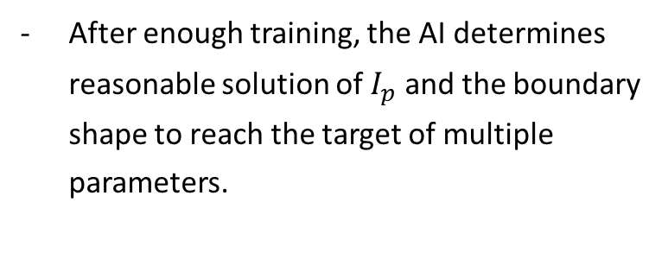
Tokamak operation design with RL
Validation in the simulation
Reward
After enough training, the AI determines reasonable solution of $I_{p}$ and the boundary shape to reach the target of multiple parameters.
https://github.com/jaem-seo/AI_tokamak_control
Before training
After training

Slide 18
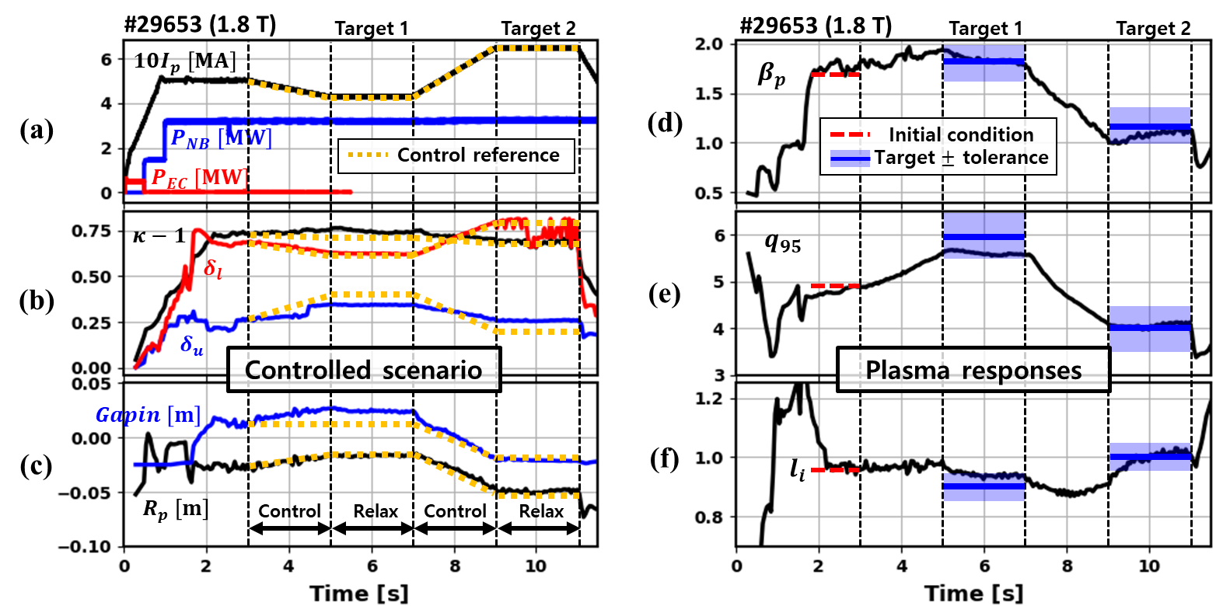
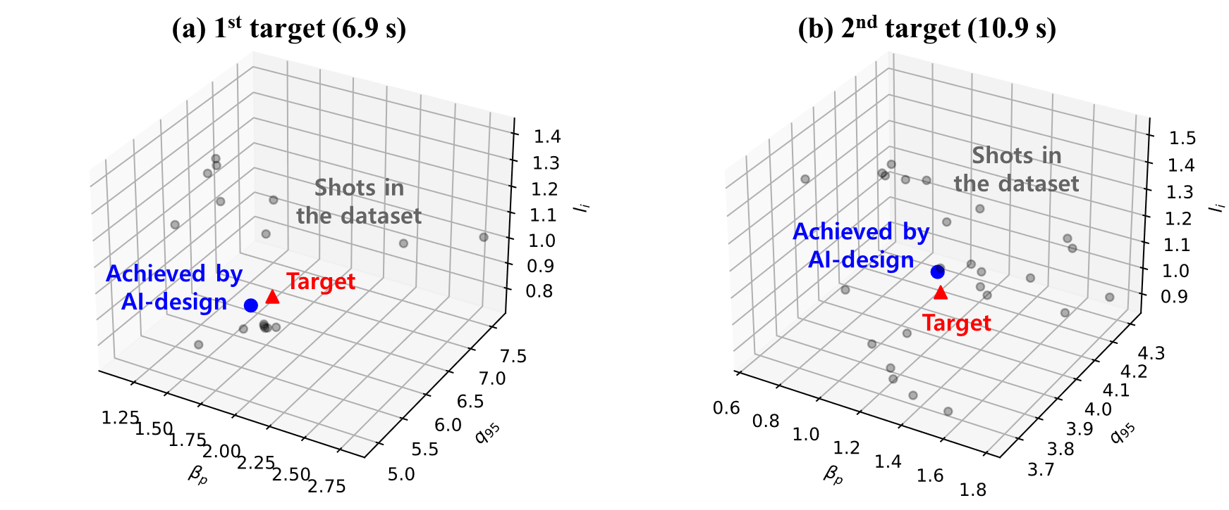
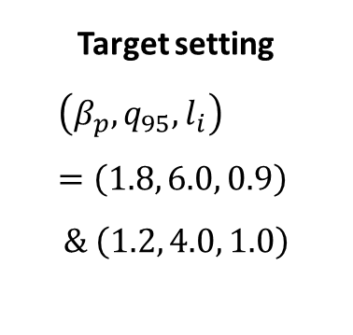
Tokamak operation design with RL
Validation in the KSTAR experiment
Target setting
$$\left(β_{p}, q_{95}, l_{i}\right)=\left(1.8, 6.0, 0.9\right)$$
$$\& \left(1.2, 4.0, 1.0\right)$$
The plasma response followed the preset targets.
However, actual shape controls were not perfect.
→ Control/diagnostics uncertainty should be reflected later.

Slide 19
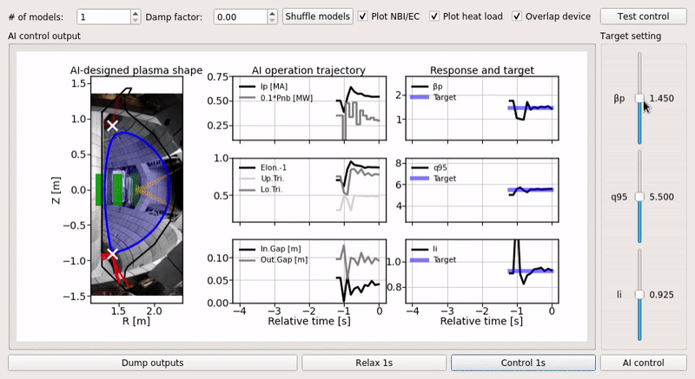
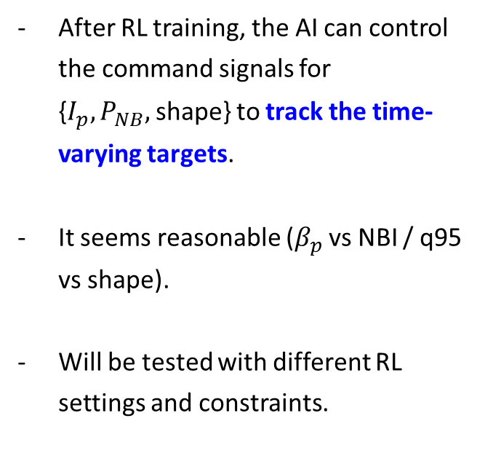
Tokamak operation control with RL
https://github.com/jaem-seo/AI_tokamak_control
Now, let’s try real-time control
After RL training, the AI can control the command signals for {$I_{p}, P_{NB},$shape} to track the time-varying targets.
It seems reasonable ($β_{p}$ vs NBI / q95 vs shape).
Will be tested with different RL settings and constraints.
AI-determined plasma shape
AI-determined command signals
Target & plasma response
Target setting

Slide 20
Contents
Introduction
  Tokamak operation design
  Reinforcement learning (RL)
Surrogate model for the KSTAR tokamak
Tokamak operation design and control with RL
  Tokamak operation design with RL
  Tokamak operation control with RL
Summary

Slide 21
Summary
1. Data-driven KSTAR simulator was developed, which is fast and experiment-relevant.
2. AI operation design algorithm was developed with RL, that provides an operation trajectory to achieve given targets.
3. RT feedback controller is being developed.
Before training
After training
[1] J Seo et al, Nucl. Fusion 61 (2021) 106010
[2] J Seo et al, Nucl. Fusion 62 (2022) 086049

Slide 22


Thank you for your attention!

