Slide 1
Lean MLOps stack for development and deployment of Machine Learning models into an EPICS Control system
Mateusz Leputa
ICFA 4th MaLAPA, Gyeongju, South Korea
6th of March 2024

Slide 2

Overview
Challenges and Motivation
Development to Deployment
Examples
Workflow summary
Future developments

Slide 3
Motivation and Challenges
Distilled Issues
Partially done work
Task switching & waiting
Identifying bugs/performance issues.
Maintenance
Knowledge siloing
(almost all flavours of muda, see Lean)
Objectives
Fast delivery
Getting user feedback faster
Generality of tooling
Use as much “off-the-shelf” as possible.
Challenges day-to-day
Resource constrained
Frequent shelving and “re-heating”
Management Visibility
Code rot and ML rot (e.g. parameter drift)
User feedback, objective alignment etc.
Lots of ML time is spent on non-ML tasks. i.e. tasks that don’t deliver value to the “customer”
Notes:
We are a small team of 4 developers working part time …
Shared responsibilities …
Projects on hold …
We want to adapt existing DevOps practices and elements
Especially …
And ultimately prevent …

Slide 4
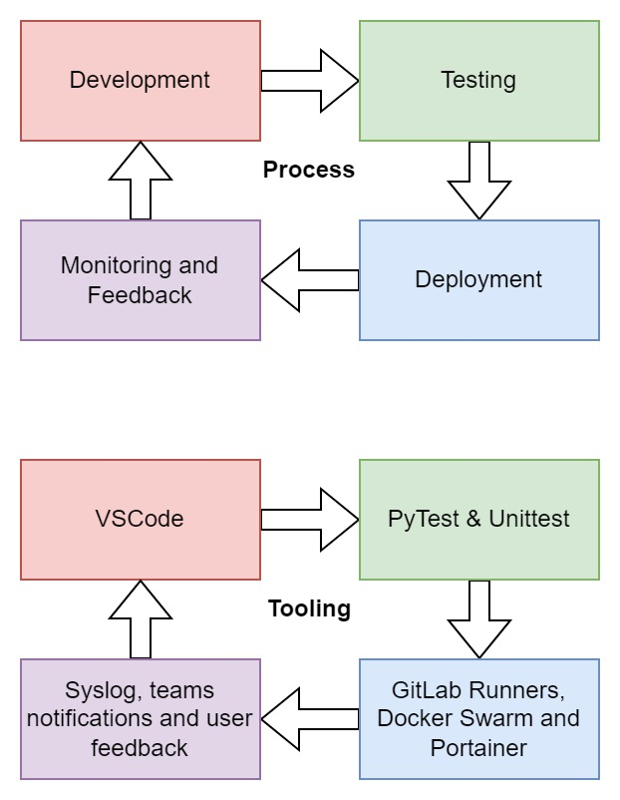
Motivation – Software development practices we implement already
DevOps we adopted already:
CI/CD – Continuous Integration and Continuous Deployment
Version control systems for models and data
Testing tools
Modular Architecture with majority “off-the-shelf” components.
For ML we also want to:
Model Version Control Systems
Blob and artifact Version Control Systems
Quickly deploy to production and swap out models.
Reuse as many components as possible.
Work with out users to improve the model and how they interact with it.
Relevant Lean Objectives:
Minimal task switching and waiting – long training times
Minimise Handoffs/overs – non-standardised boilerplate
Empower the team – Work with users to better align objectives

Slide 5
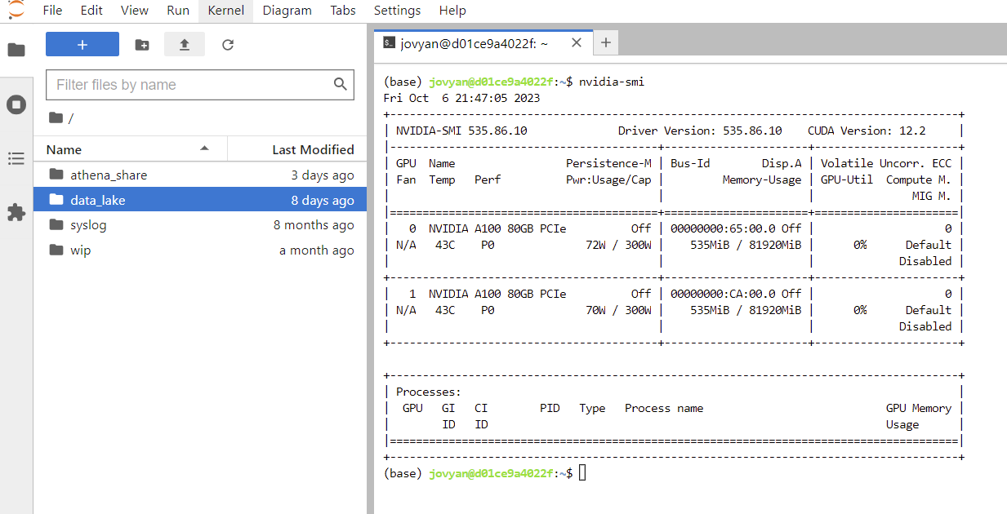

Remote Workspaces/Development Environment
Stack: JupyterLab and Hub
Developers are already familiar with JupyterLab
NFS – facilitates data transfers and collaboration spaces
High spec servers – GPUs, high spec CPUs, RAM etc.
24/7 uptime – no need to leave PC on or wait for jobs to finish.
Optional but helpful!
Key advantage was the speed increase due to access better hardware. Self-hosting had no upside for us
https://jupyter.org/hub

Slide 6
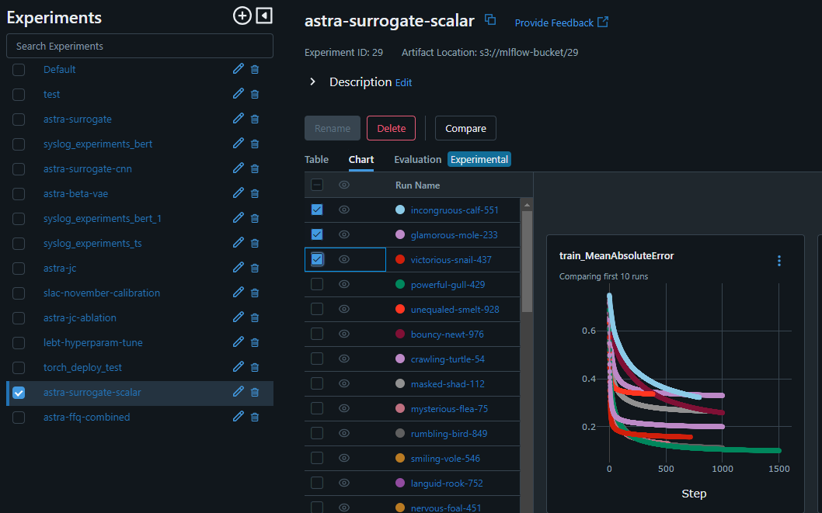
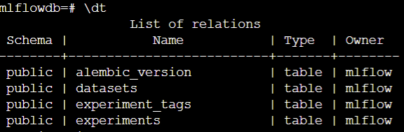
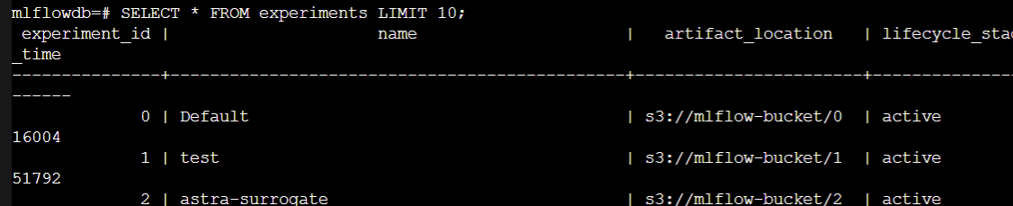
Experiment, Model and Data Archiving
Stack: MLflow, MINIO, PosgreSQL
Comes with a web GUI.
Saves experiment setup, performance metrics, datasets (tabular) and model (blob).
Provides an API to programmatically upload and download models, query experiment results and charts etc.
Comes with its own model serving utilities.
Mutable model labels (latest, nightly, etc).
Very active development with a big community.
Purpose built version control system/ database – core of the MLOps system
Notes:
Model archiving and comparison super important!
API!

Slide 7
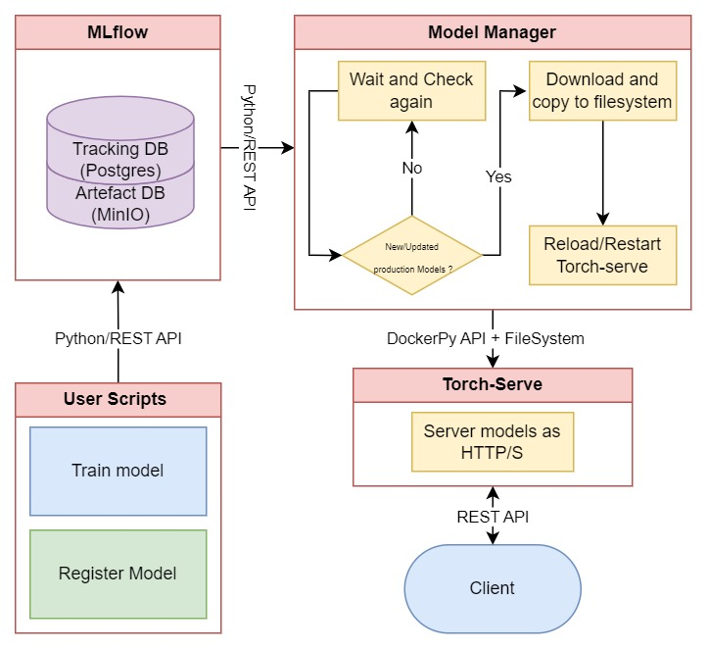
Model Manager
Storing custom model artefact (TorchServe ready)
Monitor for production tagged models and deploy to TorchServe containers
Servers models as HTTP/S endpoints

Slide 8
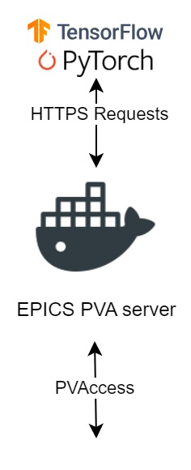
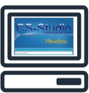
Deployment to EPICS
Stack: Torch-serve & p4p python library
Originally built with TF-serve but fond Torch-Serve is a bit more flexible – can wrap around other frameworks.
Latency of 16-40 ms for small models (mostly attributed to network latency).
HTTP/S to EPICS P4P server deployed as a service.
These containers are highly templatable.
Notes:
EPICS containers are the mostly automated!

Slide 9
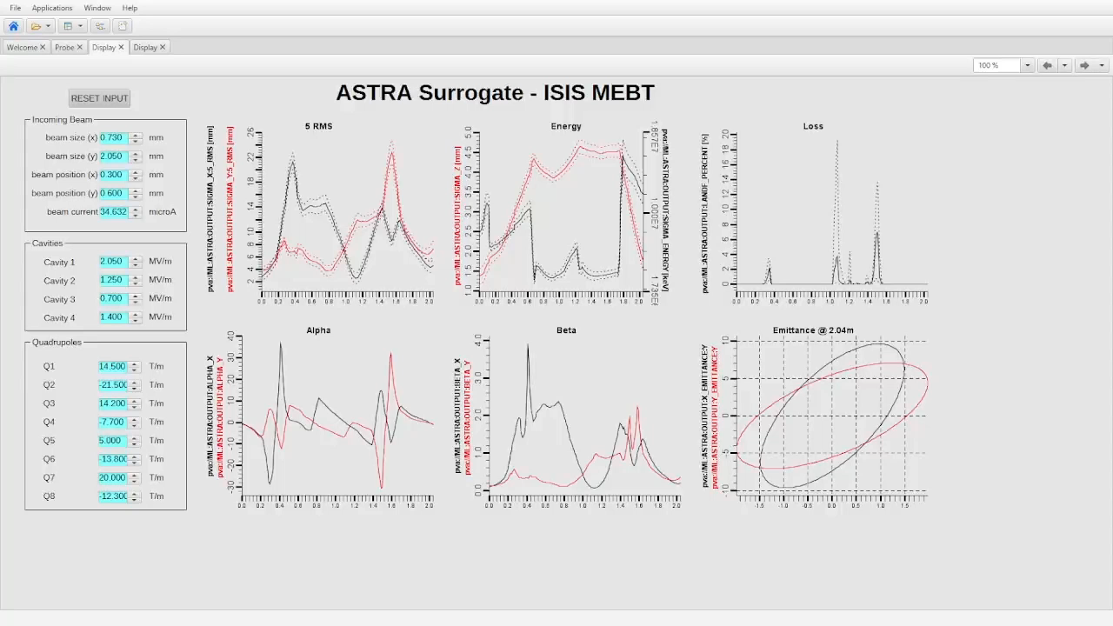
Example 1 – ASTRA Surrogate – ISIS MEBT
Notes:
CI/CD for models, gets model out quickly, it makes it easy to bring agile to ML, swap a model easily and no need to redistribute it.

Slide 10
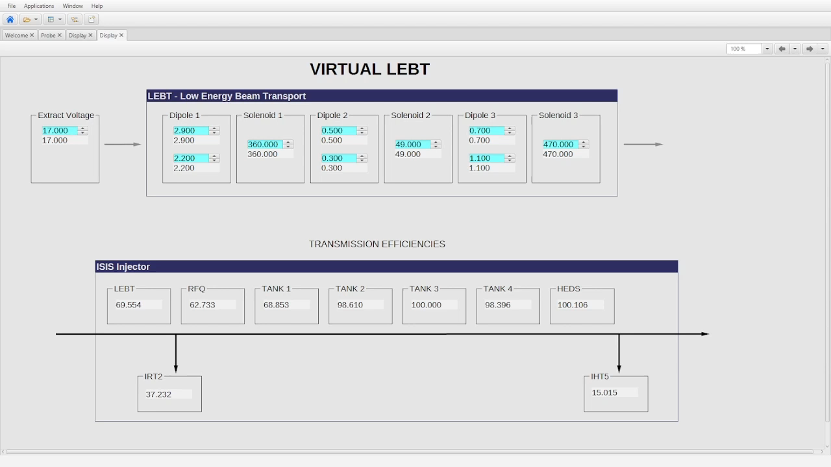
Example 2 - LEBT

Slide 11
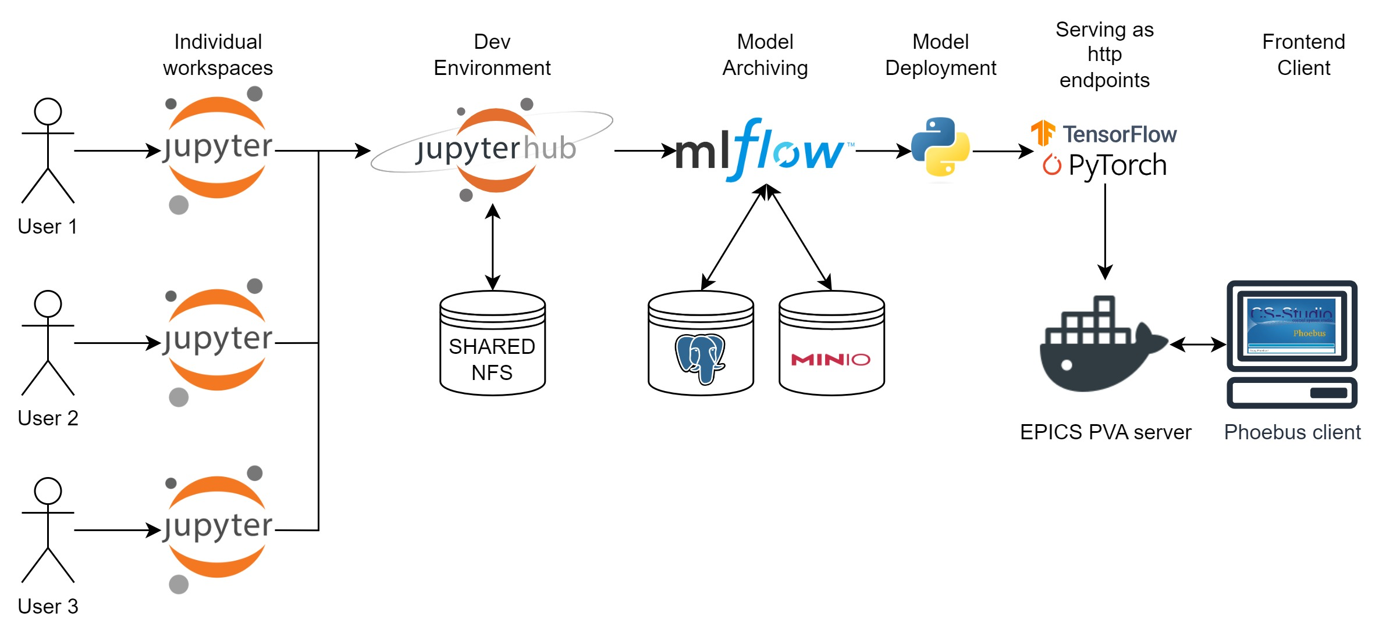
Workflow - Summary
Mostly off the shelf!
Makes delivery of new models faster
Further “low-hanging-fruit” for automation/templationg
Dovetails nicely into other MLOps initaitves.

Slide 12

Further Developments
Swarm to k8s conversion
Refactor model manager to a more generic deployment interface
Integration into the LUME ecosystem
Model monitoring and evaluation systems – towards continual learning
Automated MLOps workflows built on top of the above!

Slide 13
Thank You
mateusz.leputa@stfc.ac.uk
Special thanks to the ML Team at ISIS!

Slide 14
In Practice
We want to:
Model VSC.
Blob and artifact VCS
Quickly deploy to production and swap out models.
Reuse as many components as possible.
Work with out users to improve the model and how they interact with it.

