Slide 1



From Simulation to Reality: Real-Time Control of
Superconducting Linear Particle Accelerator using
a Trend-Based Reinforcement learning Algorithm
Authors: Xiaolong Chen, Chunguang Su, Zhijun Wang, Yuan He
Speaker: Chunguang Su

Slide 2
Outline
Motivation and background
Method
Experiments and Results
Summary
1

Slide 3
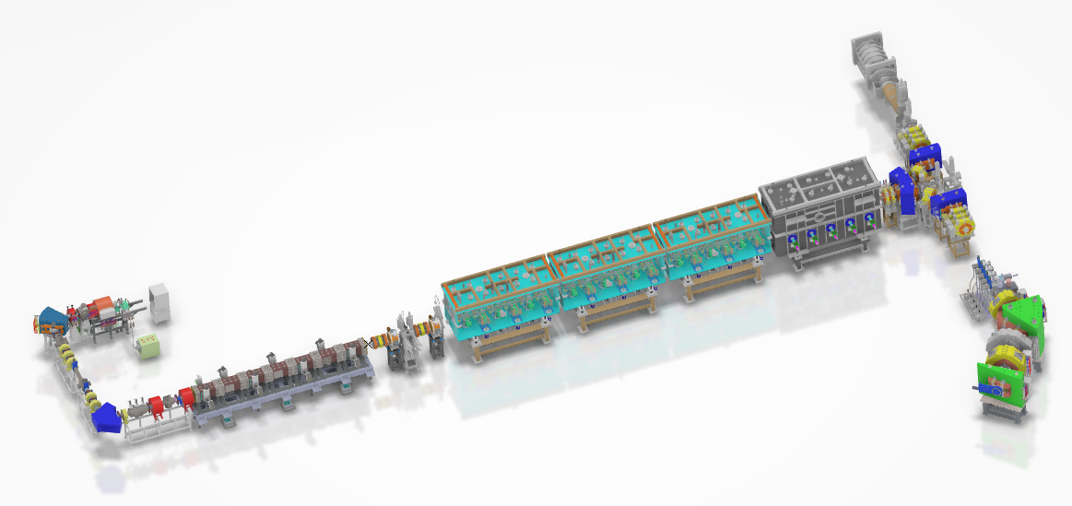
Motivation
CAFe II —— An ion particle accelerator
China Accelerator Facility for superheavy Elements
Features：
  Highly non-linearity: Beam dynamics and control strategies
  Hard to tuning and time consuming
  Complex beam requirements
CAFe II : significant potential to compress accelerator beam commissioning time.
Goal: Design a automatic and robustness controller for beam tuning to save precious beam time for other fundamental physic experiments.
2

Slide 4
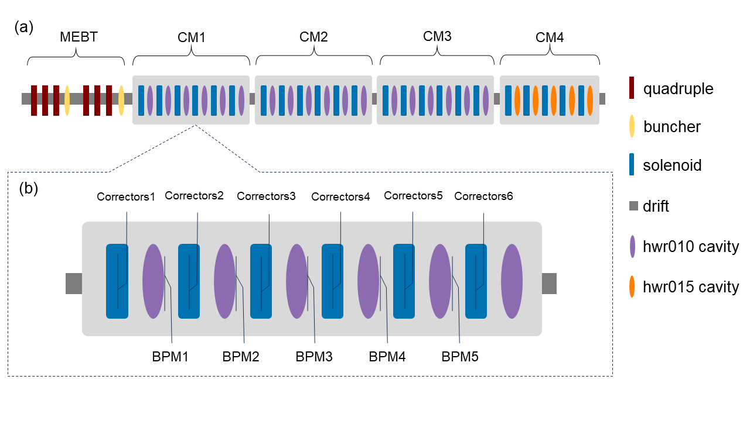
Orbit correction in superconducting section in CAFe II
CAFe II Control System:
Matching complex beam requirements,
configuration readjustments at least once a week.
Orbit correction task of SC
Human tuning:
Typically 30 mins-180mins.
Reason: Non-linear effects from solenoids.
Example: Horizontal corrections affect both horizontal and vertical BPM readings.
Observations:
5 groups of BPMs (10 dimensions)
Control Variables:
First 5 groups of correctors (10 dimensions)
Goal: Achieve BPM readings as close to 0 as possible.
Structure of the superconducting section in CAFe II
3

Slide 5
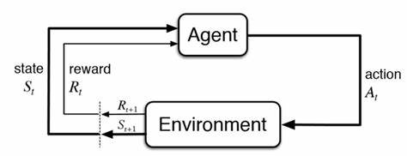
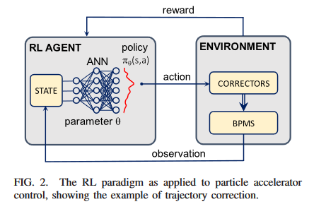
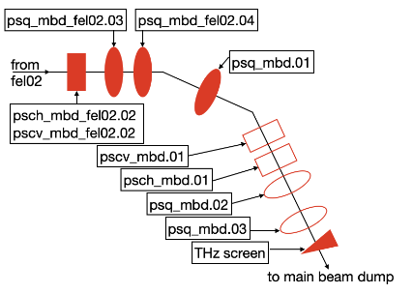
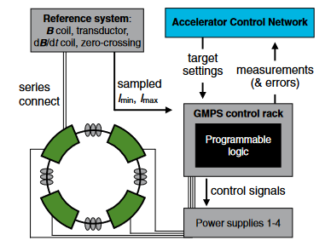
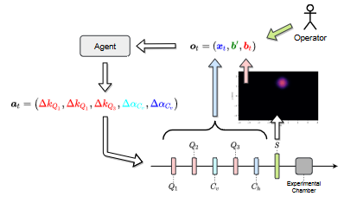
RL for accelerator beam commissioning
Reinforcement Learning(RL): A powerful tool for realizing an accelerator controller.
Goal of RL: Maximize the expected reward after an episode.
Urgent issues in need of resolution:
Accelerator system beam information incompleteness hinders the training efficiency of the agent.
Challenges persist in overcoming online training limitations: Precious beam time
The well trained agents struggle in generalization performance with changes in accelerator or beam state.
CERN:Orbit Correction/PRAB 2020
Fermi :Optimization of FEL/PRAB 2020
DESY：optimization of FEL/ICML 2022
Fermi: Magnet control, PRAB 2021
RL: a promising method for beam tuning
4

Slide 6
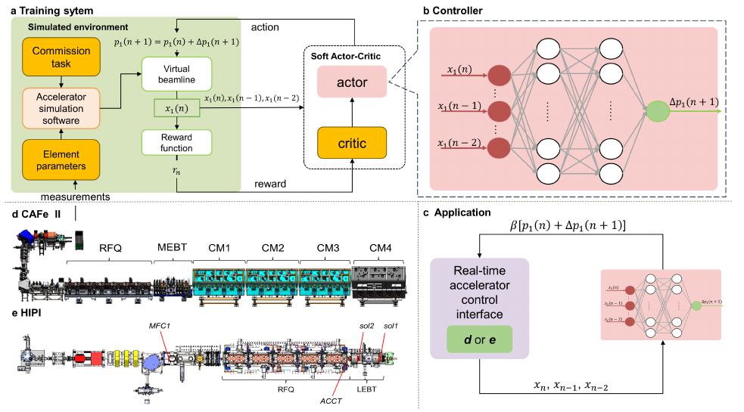
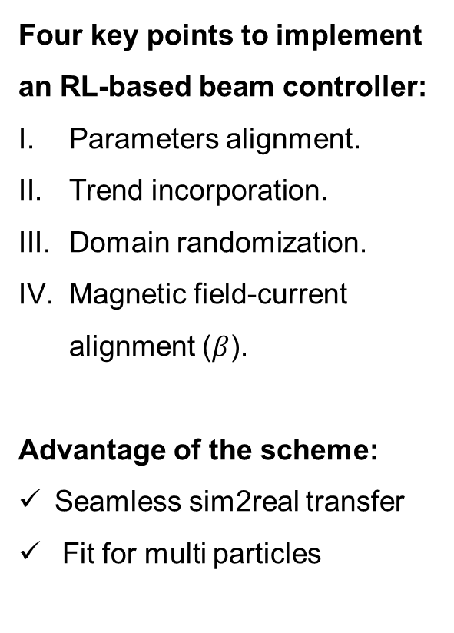
The scheme of the RL-based beam controller
Four key points to implement an RL-based beam controller:
Parameters alignment.
Trend incorporation.
Domain randomization.
Magnetic field-current alignment ($β$).
Advantage of the scheme:
Seamless sim2real transfer
Fit for multi particles
5

Slide 7
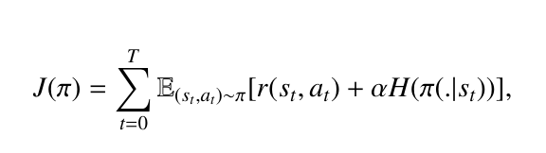
Why SAC ? What’s trend?
Feature of the accelerator during beam commissioning:
  Noise in data collected from the beam diagnostic device.
  Accelerator system：Partial observable system .
Traditional RL: Maximize the expected cumulative rewards.
SAC: A reinforcement learning algorithm with max entropy.
Entropy boost improves agent's exploration in complex environments.
Better cope with the uncertainties present in the accelerators with significant noise data.
What’s trend?
The time sequence data of the beam diagnostic device.
In RL training process:
Time sequence data instead of the current accessed data
Advantages:
      Enhanced information completeness.
      Well-suited for accelerator dynamic systems.
      Improved generalization ability
Verification: Typical control task-orbit correction
6

Slide 8
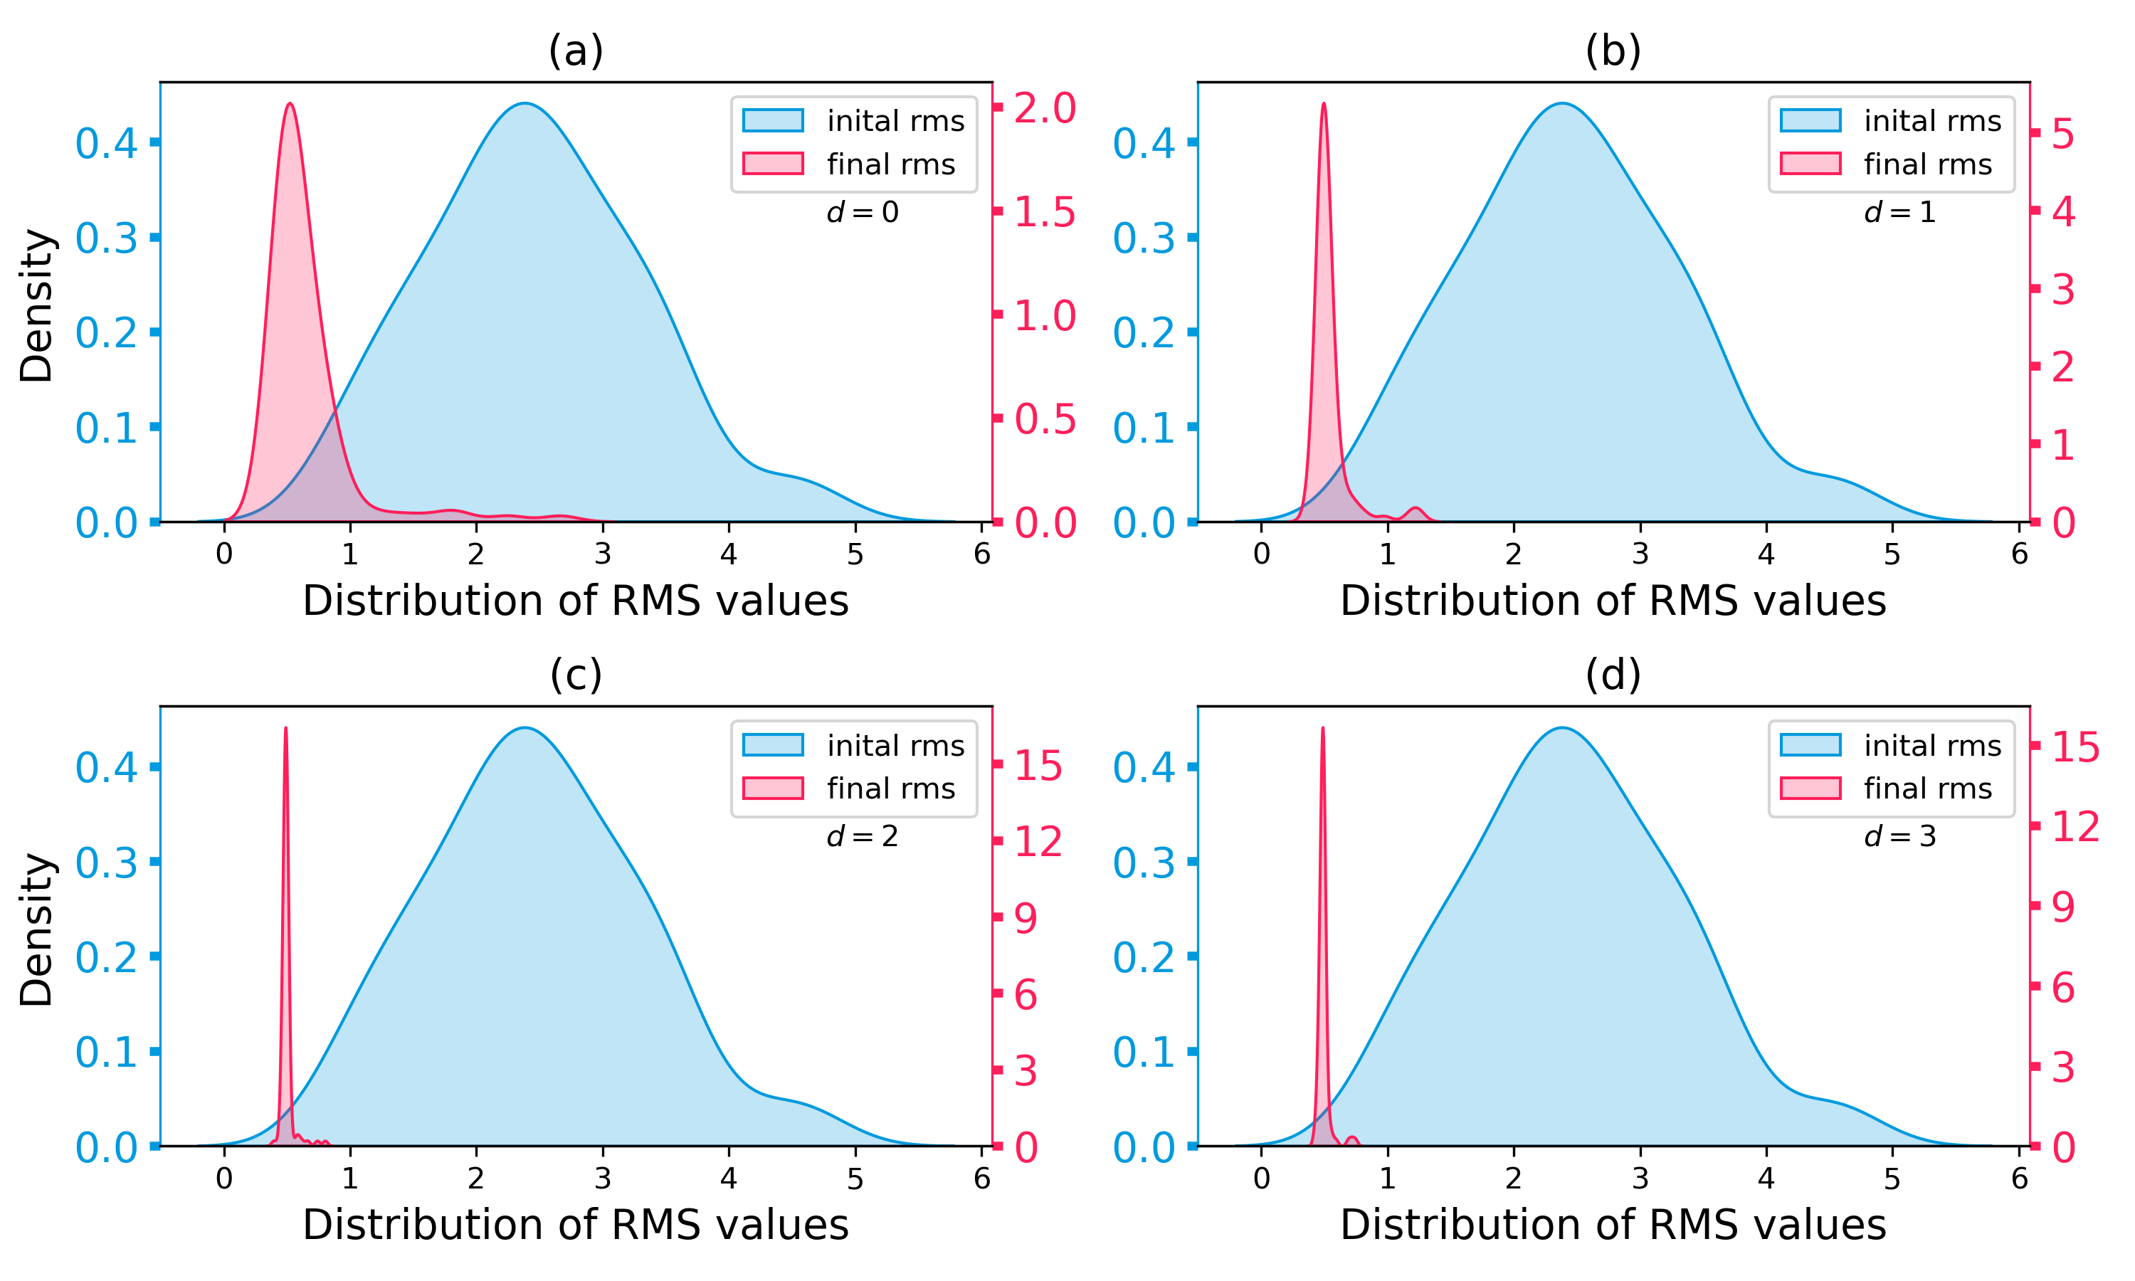
Orbit correction experiments in CAFe II: Simulation
Simulation Results of 100 comparative experiments：The agent is trained based on the Tracewin-based environment with the particle $40{Ar}^{12+}，$in CM1.
Time sequence length =1
Time sequence length =2
Training process:
Total training steps: 20000
Time spends： 5 hours on a single RTX 3090
Blue indicate the initial RMS distribution of the 100 experiments.
Red indicate the corrected RMS distribution of the 100 experiments.
The performance of the agent increased significantly with the increase of the time sequence length.
Next Sim2Real experiments:
Time series length of 3.
Time sequence length =3
Time sequence length =4
7

Slide 9
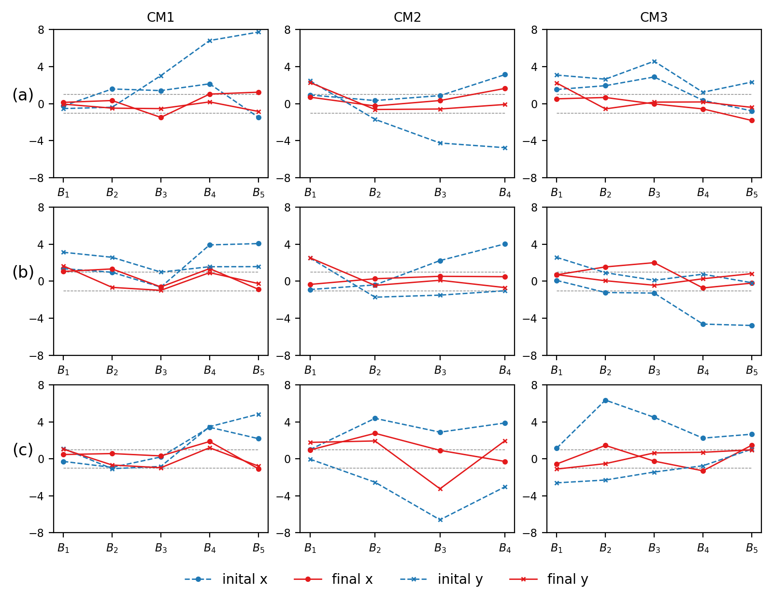



Orbit correction experiments in CAFe II: Sim2Real
Sim to Real experiments: Under ${40Ar}^{12+}$, $H^{+}$, and ${48Ca}^{14+}$ on CM1, CM2, CM3.
Agent Features:
Achieves an RMS of the corrected orbit below 1mm (Comparable to or surpassing human tuning).
Rapid correction within 1 minute per module (At least tenfold faster than human).
Enable seamless sim-to-real transfer.
By adjusting parameter 𝛽 ，method suitable to tune multiple types of particle beams.
${40Ar}^{12+}$- ${40Ar}^{12+}$
${40Ar}^{12+}$- $H^{+}$
Worth to mention：
Effectively operates even with some malfunctioning BPMs, reducing RMS from 3.2mm to 1.74mm.
Even better results：
By masking the readings to a fixed value.
e.g., 1mm, the RMS can be further reduced to 1mm.
${40Ar}^{12+}$- ${48Ca}^{14+}$
8

Slide 10
Summary
RL beam commissioning tools are now used daily in CAFe II, saving a significant amount of time.
Incorporating time sequence data enhances the algorithm's robustness.
Parameters alignment and domain randomization facilitate sim2real transfer.
A conversion coefficient between magnetic field to current is beneficial for diverse beams and lattices.
Sim2real is advantageous!
Future:
  Try higher dimensional tasks.
  More complex optimization problems.
9

Slide 11
Thank you
Email: chenxiaolong@impcas.ac.cn
10

