Slide 1
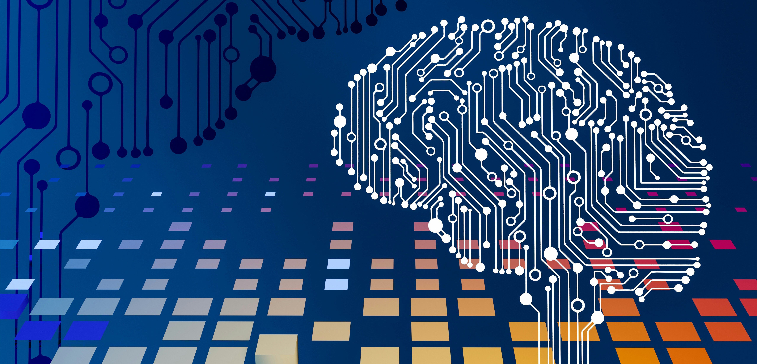
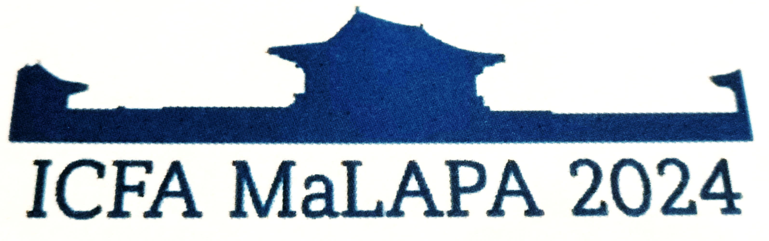
Computer vision for laboratory assistance tools Ilya Agapov, Klaus Flöttmann, Francois Lemery, Frank Mayet, Bianca Veglia
4th Beam Dynamics Mini-Workshop on Machine Learning for Particle Accelerators, Gyeongju, South Korea

Slide 2
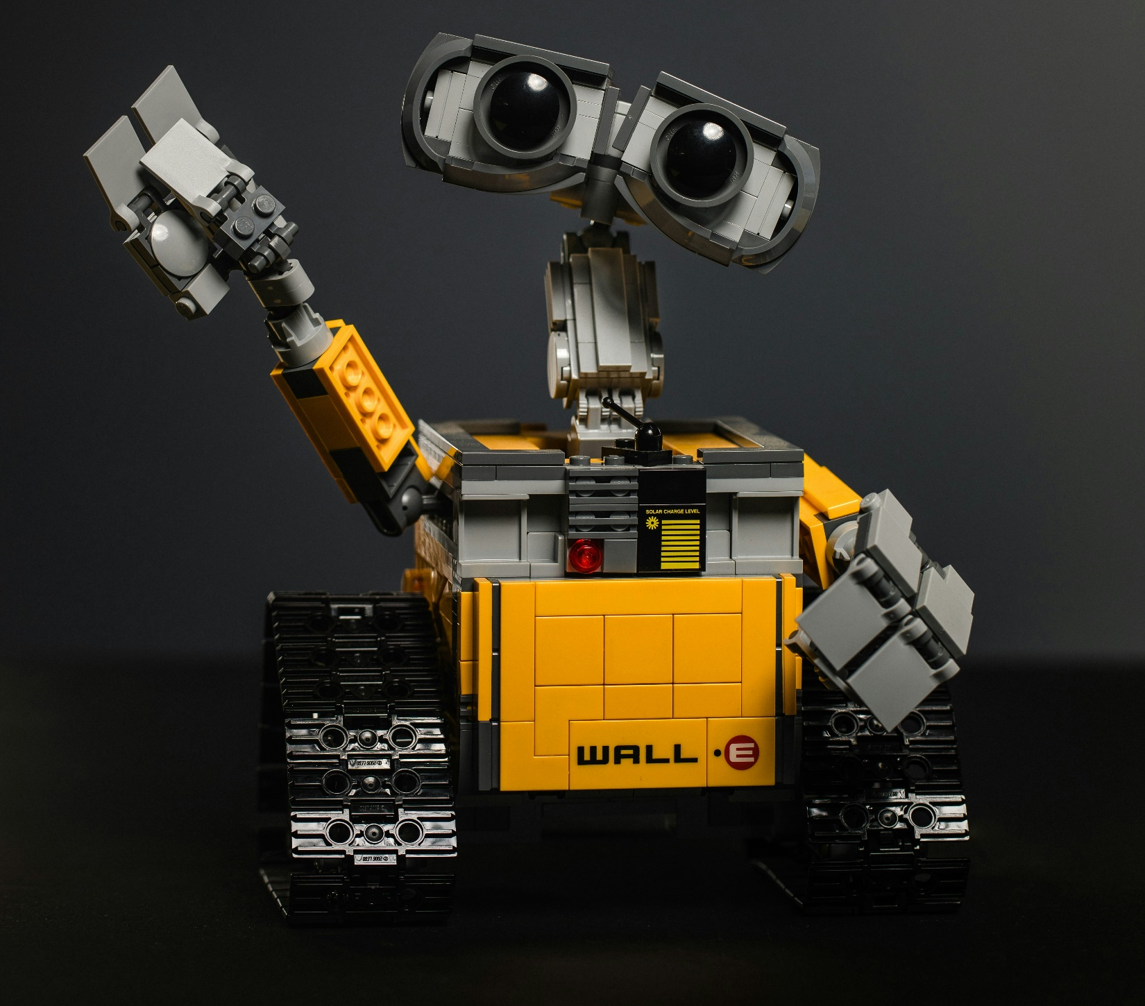
Computer Vision
“Vision is the act of knowing what is where by looking.” -Aristotle
The goal of computer vision is to compute geometric and semantic properties of the three-dimensional world from digital images.
Overall, computer vision plays a crucial role in a wide range of applications. Its ability to analyse and interpret visual data enables machines to perceive and understand the world around them, leading to numerous practical benefits and advancements in technology.
Notes:
This study focuses on the use of computer vision algorithms to improve the efficiency of laboratory tasks, data collection, and process monitoring. By deploying computer vision systems in the laboratory environment, various tasks can be automated and streamlined. This includes recognizing and tracking hardware, verifying positioning and providing AR modelling. Here we present a project aimed at assisting laser laboratory operations by locating and uniquely identify equipment while tracking the relative position, as well as providing real-time assistance by accessing parameter settings and relevant information. The program combines object detection with optical character recognition and space mapping techniques. The real-time object classification is performed using the YOLO (You Only Look Once) model [1], a single-shot detector based on a Convolutional Neural Network backbone to form image features. This contribution also discusses the challenges and potential limitations associated with implementing computer vision systems in laboratories, such as hardware requirements, data management concerns, and the need for machine learning models fine-tuned to the specific laboratory environment. In conclusion, the integration of computer vision techniques into laboratories represents a promising step towards more efficient and capable laboratory assistants.

Slide 3

Computer vision is essential in many fields and applications for several reasons
Perception and Understanding: Computer vision enables machines to perceive and understand the visual world, similar to how humans do. Recognize objects, scenes, and patterns, which is crucial for tasks such as object detection, image classification, and scene understanding.
Automation: This includes quality control in manufacturing, sorting and categorizing items in logistics, and monitoring processes in various industries. By automating these tasks, computer vision improves efficiency, reduces errors, and frees up human resources for more complex tasks.
Augmented Reality (AR) and Virtual Reality (VR): Fundamental to AR and VR technologies, which overlay digital information onto the real world or create immersive virtual environments.
Medical Imaging: Tasks such as MRI and CT image analysis, cancer detection, and diagnostic support. Algorithms can analyse medical images to detect abnormalities, assist radiologists in interpretation, and aid in treatment planning.

Slide 4
Computer vision is essential in many fields and applications for several reasons (cont’d)
Surveillance and Security: applications include video surveillance, facial recognition, and anomaly detection.
Autonomous Vehicles: Computer vision is a critical component of autonomous vehicles, enabling them to perceive and interpret the surrounding environment. Computer vision systems in autonomous vehicles can detect and track objects such as pedestrians, vehicles, and traffic signs, allowing the vehicle to navigate safely and make informed driving decisions.
Environmental Monitoring: environmental monitoring and analysis tasks such as satellite image analysis, wildlife tracking, and agriculture monitoring. By analysing visual data from various sources, it can help monitor environmental changes, assess biodiversity, and support conservation efforts.
Human-Computer Interaction: Gesture recognition, eye tracking, and facial expression analysis are examples of applications that enhance human-computer interaction in areas such as gaming, user interfaces, and assistive technologies.

Slide 5
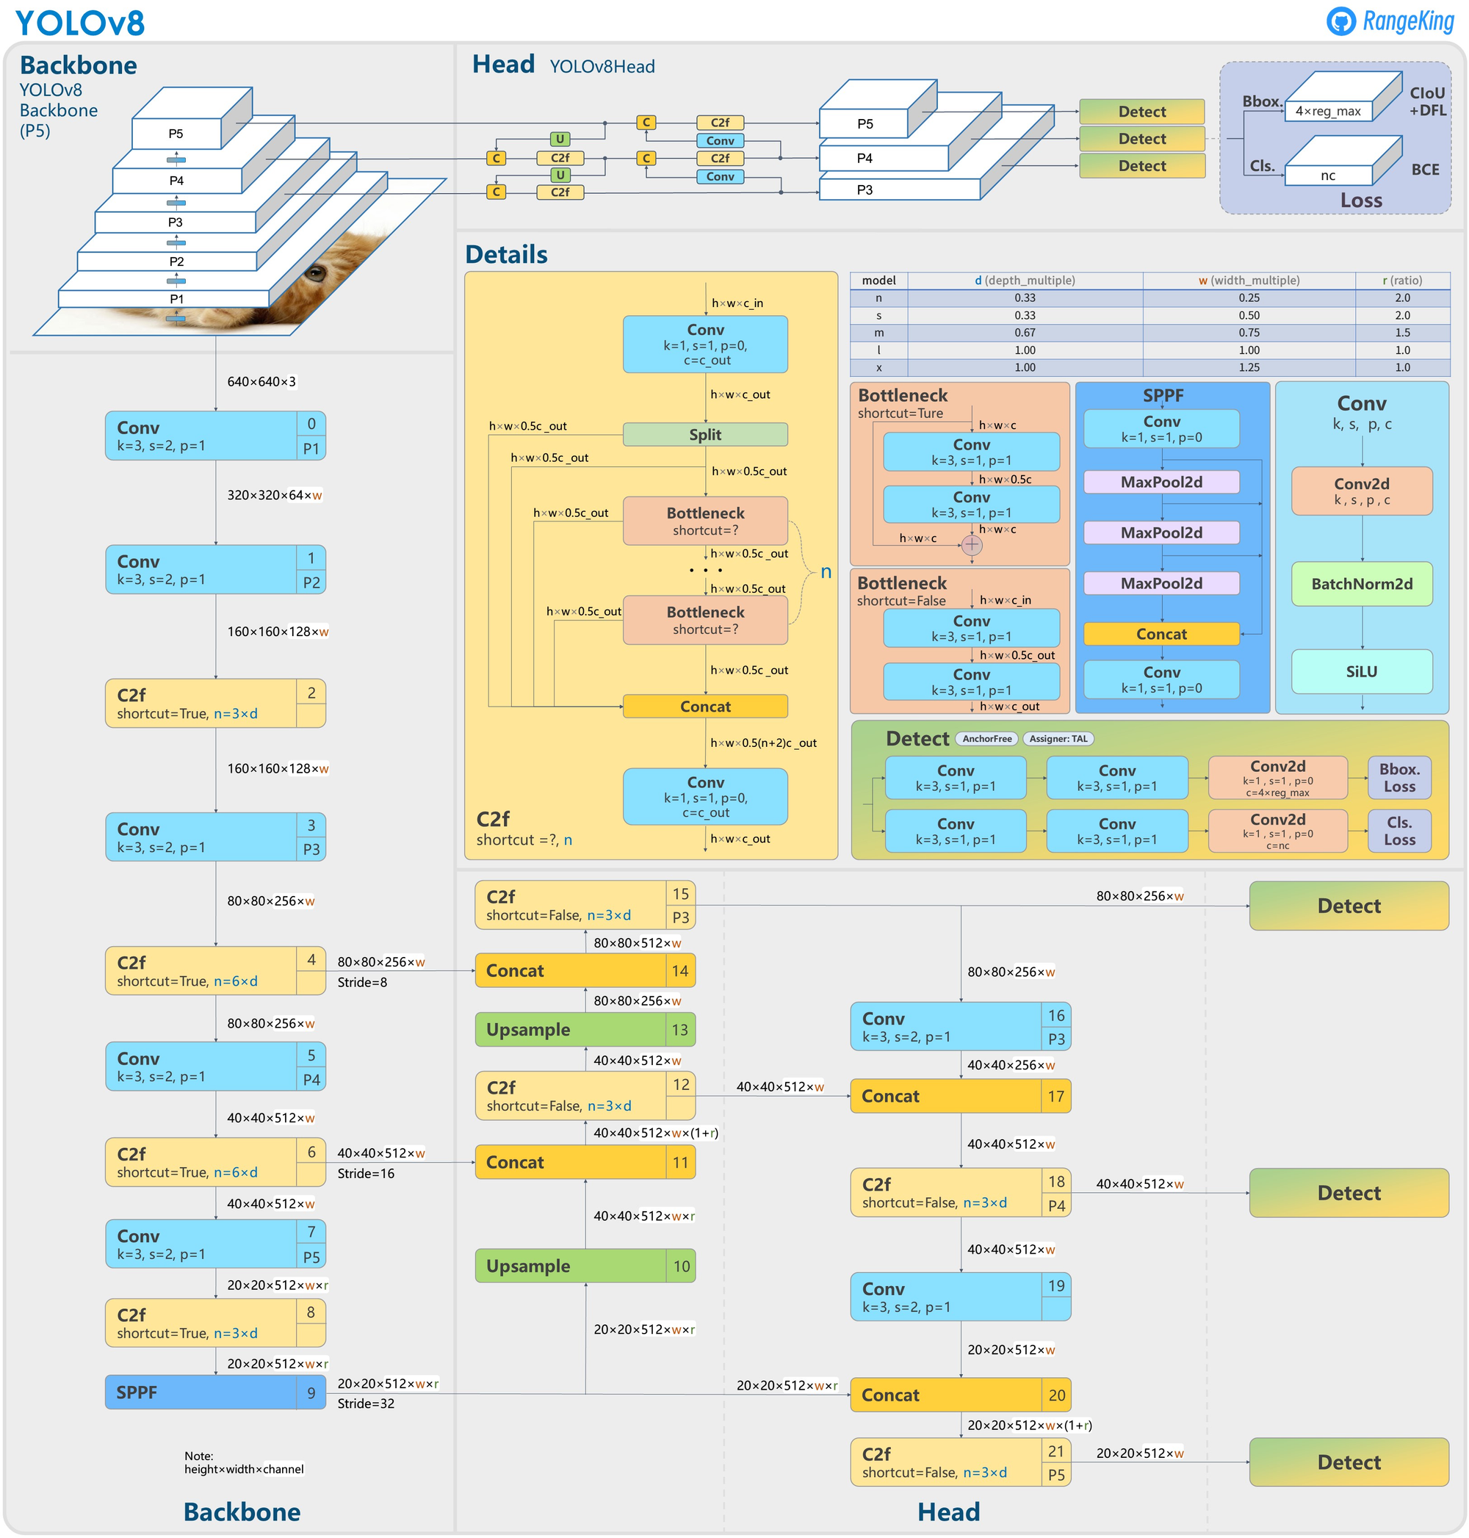
YOLO (You Only Look Once)
YOLO is a family of computer vision models
Initially introduced (in 2016) as the first object detection model that combined bounding box prediction and object classification into a single end to end differentiable network. It was written and is maintained in a framework called Darknet. From v5 models are written in the PyTorch framework.
In treating the detection task as a single shot regression approach for identifying bounding boxes, YOLO models are often very fast and very small – often making them faster to train and easier to deploy, especially to edge devices.
YOLOv8 augments images during training online. One of those augmentations is called mosaic augmentation. This involves stitching four images together, forcing the model to learn objects in new locations, in partial occlusion, and against different surrounding pixels.

Slide 6
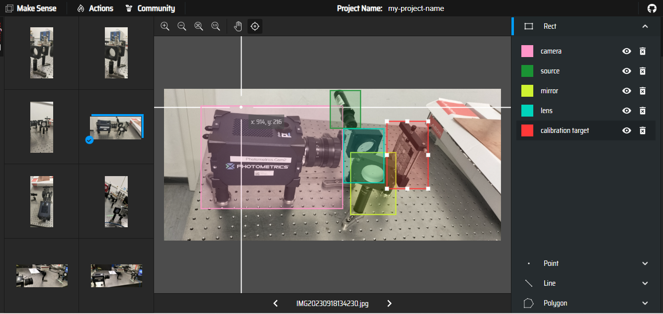
Data problem
Large amount of images properly annotated.
To train an object detector, we need to supervise its learning with bounding box annotations. If the objects and environment are uncommon, the data need to be labelled MANUALLY.
Limited Data Availability: Collecting a large and diverse dataset for object detection can be challenging, especially for custom or specialized domains. Limited data can lead to overfitting, where the model fails to generalize well to unseen data.
Annotation Quality: Annotating objects in images with bounding boxes or segmentation masks requires manual effort and expertise. Poorly annotated data can negatively impact model training and performance.

Slide 7
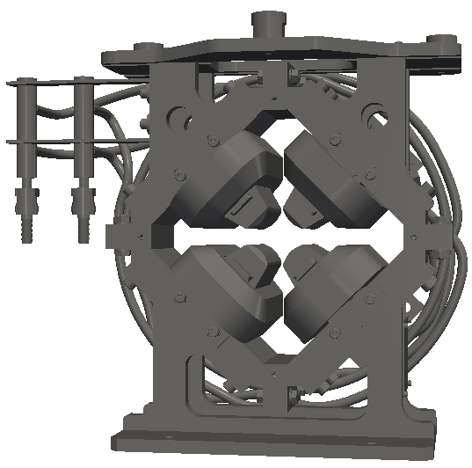
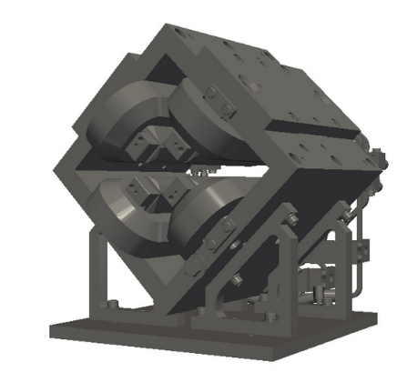
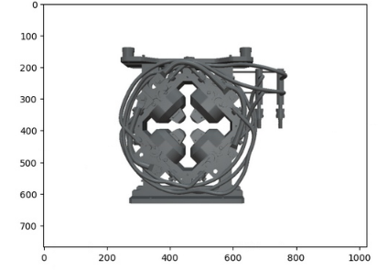
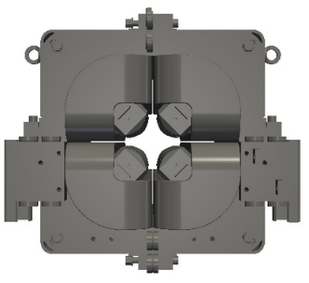
CAD images
CAD models can be used to produce large amount of images (same object different view angle) and allow for automated labelling.
When model trained in combination with real-life images it improved its prediction accuracy.

Slide 8
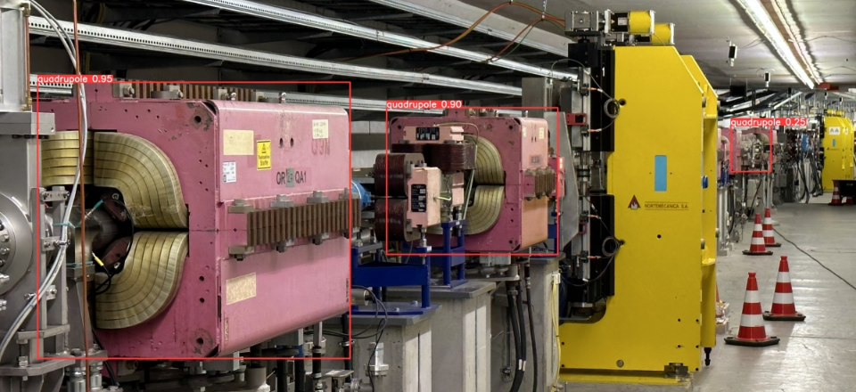
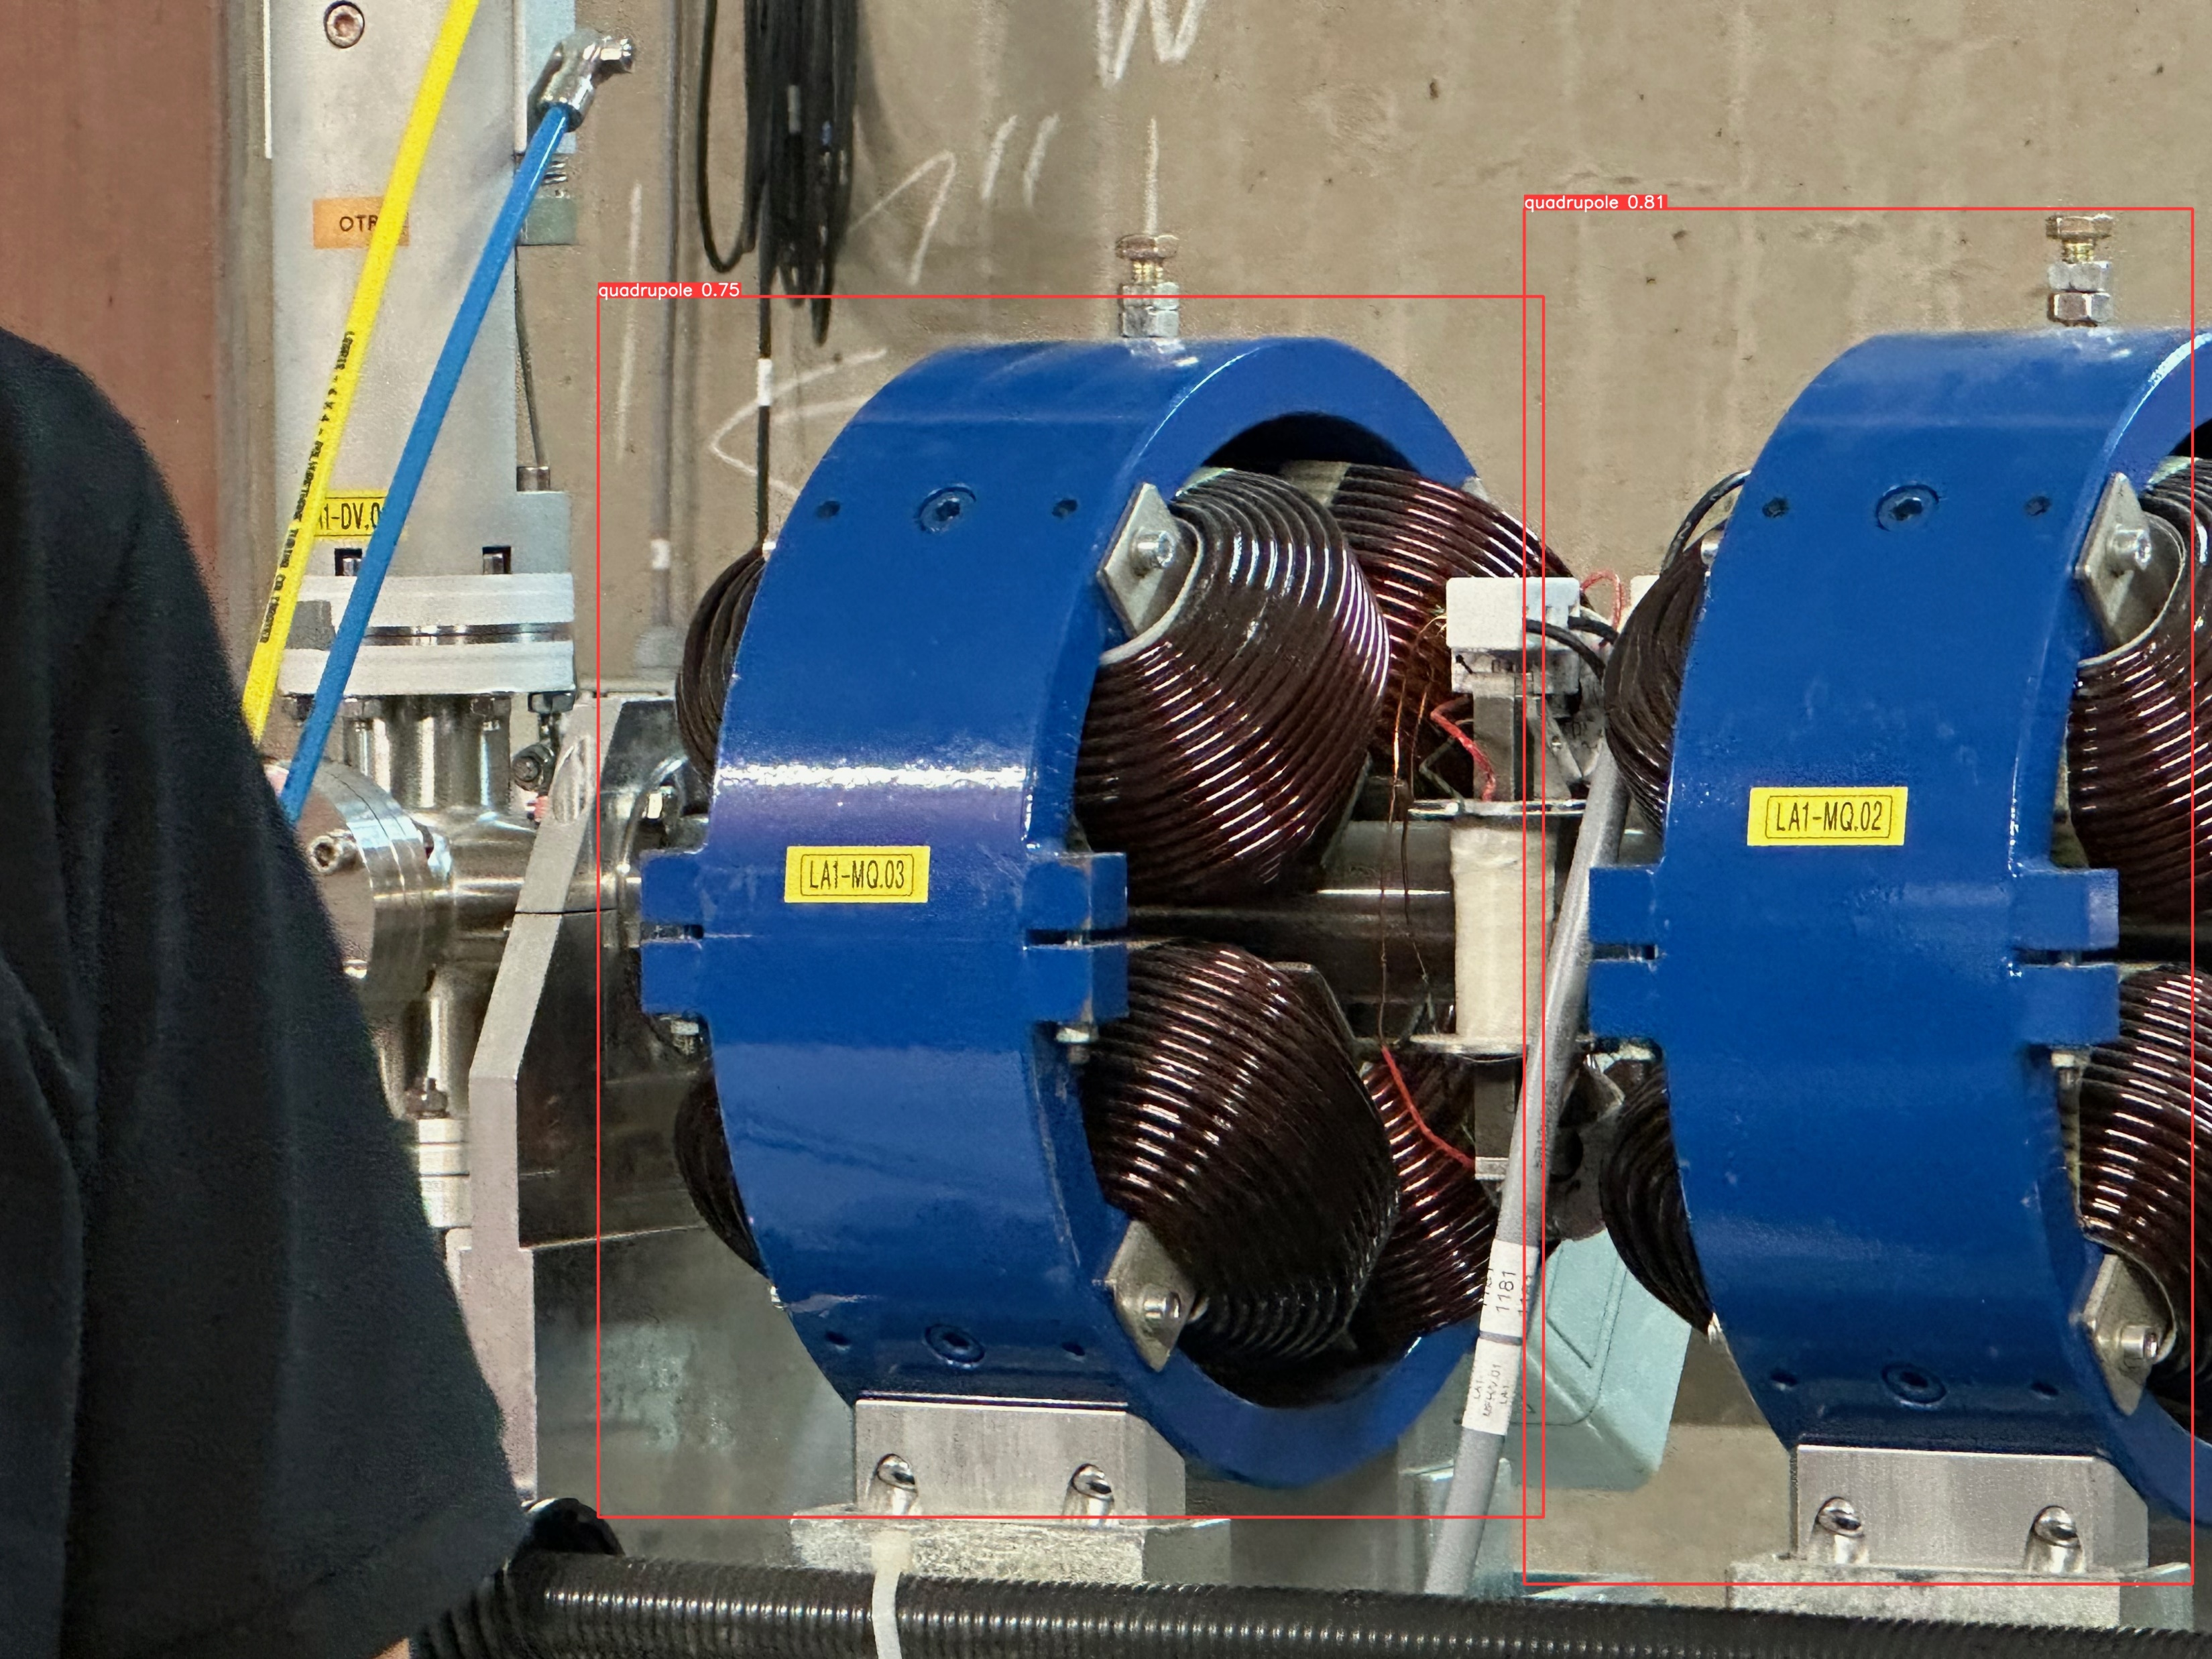
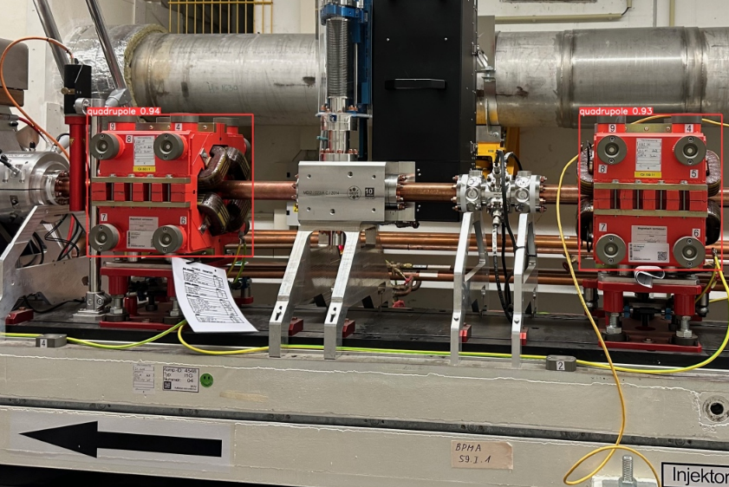
Detect
200 views of the different CAD models + 90 real images: VERY GOOD PREDICTIONS!
quadrupole 0.95
quadrupole 0.90
quadrupole 0.81
quadrupole 0.75
quadrupole 0.94
quadrupole 0.93

Slide 9
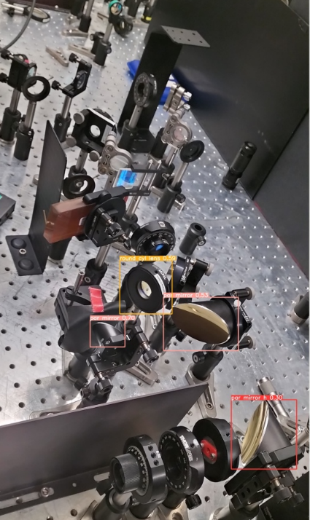
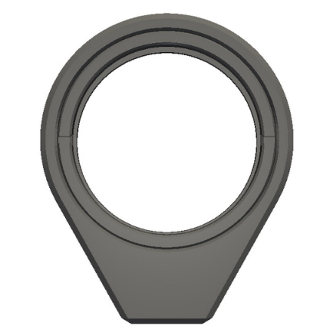
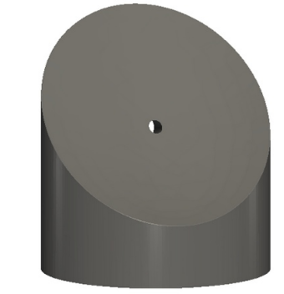

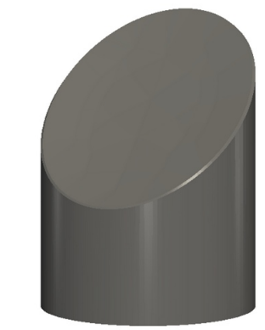
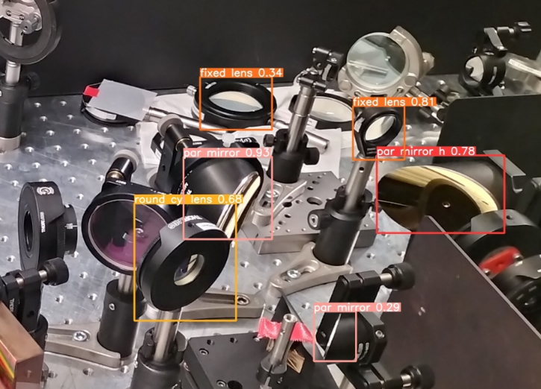
REGAE laser optics (4 classes, 144 CAD images each, only 5 photos)…ok but not great.

Slide 10
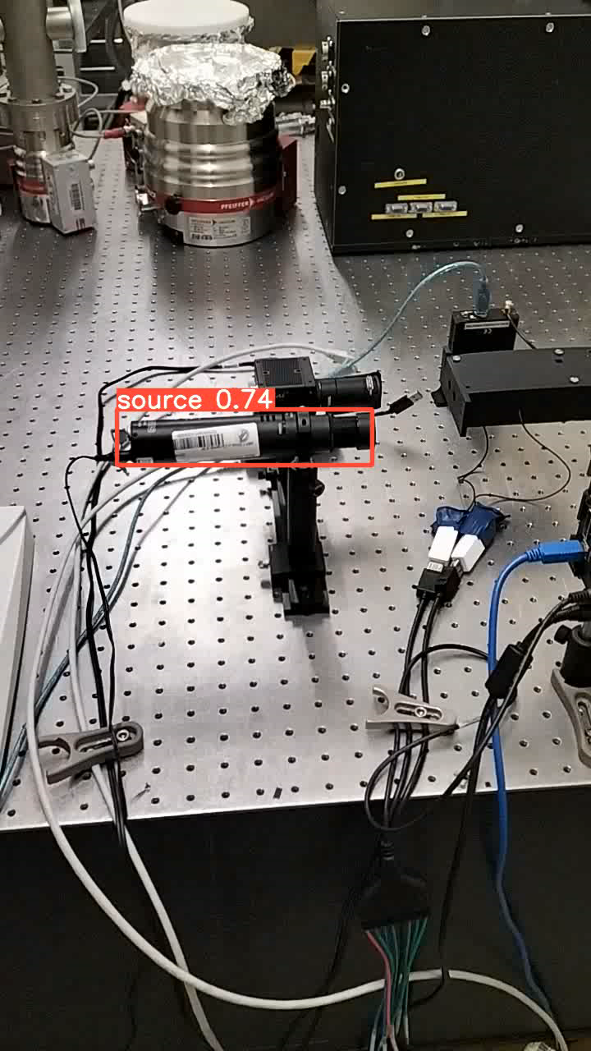
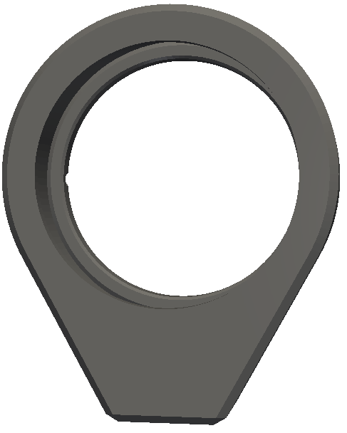
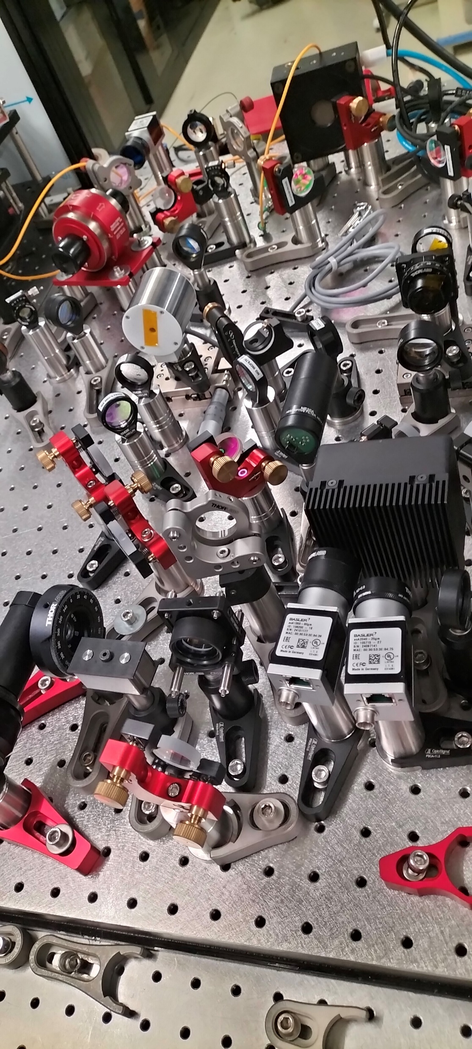


Identify
Some objects cannot be univocally recognized.
For example optics elements are hard to tell apart and the same type of mounting could be used for different objects (CAD models won’t help here).
Calibration target model (?!?)
Mirror or lens?

Slide 11
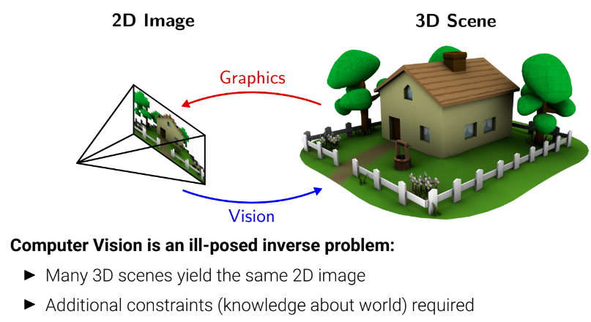
Space
To develop a tool assisting in various lab tasks not only object detection but also spatial relations between objects.
Measuring the distance of each pixel relative to the camera. Depth is extracted from either monocular (single) or stereo (multiple views of a scene) images.
Traditional methods use multi-view geometry to find the relationship between the images.
Newer methods can directly estimate depth by minimizing the regression loss, or by learning to generate a novel view from a sequence.

Slide 12
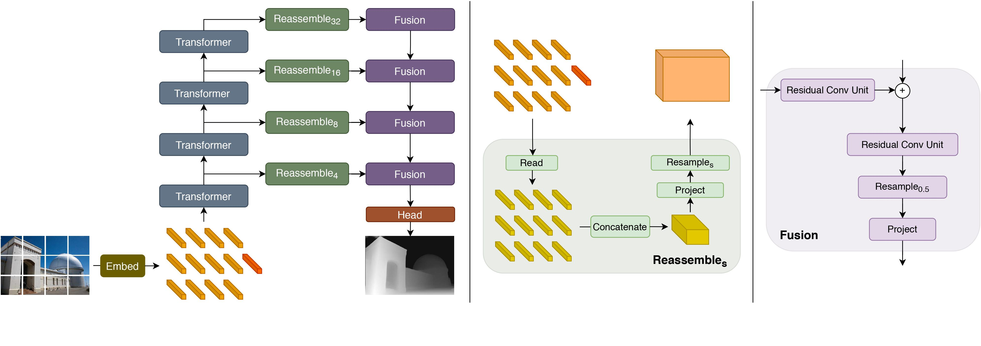
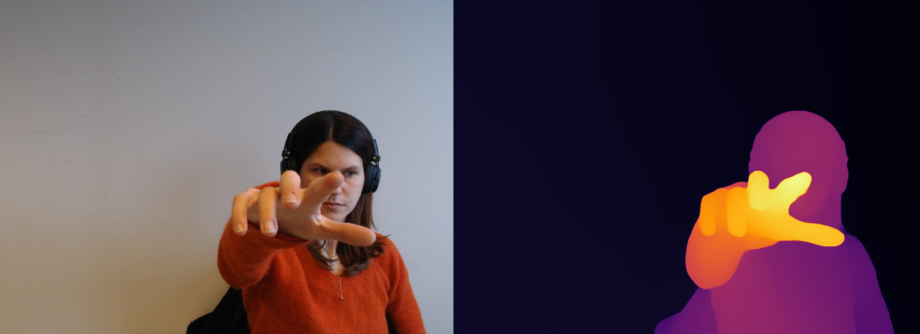
Depth Estimation
Using DPT (Dense Prediction Transformers), a segmentation model released by Intel in March 2021 that applies vision transformers (ViT) to images.
DPT models are trained on 1.4 million images for monocular depth estimation. DPT uses the ViT as backbone and adds a neck + head on top for monocular depth estimation.

Slide 13
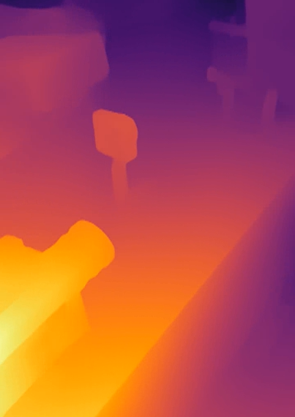
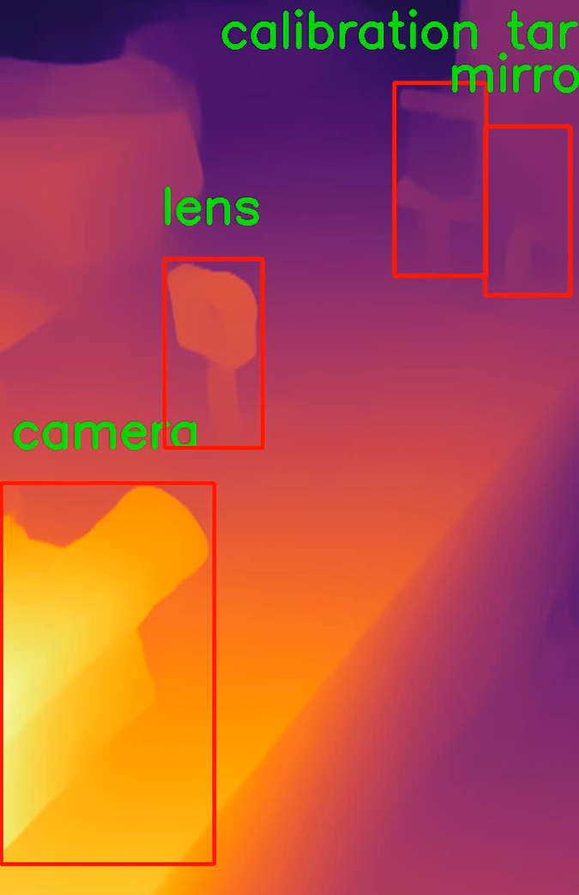
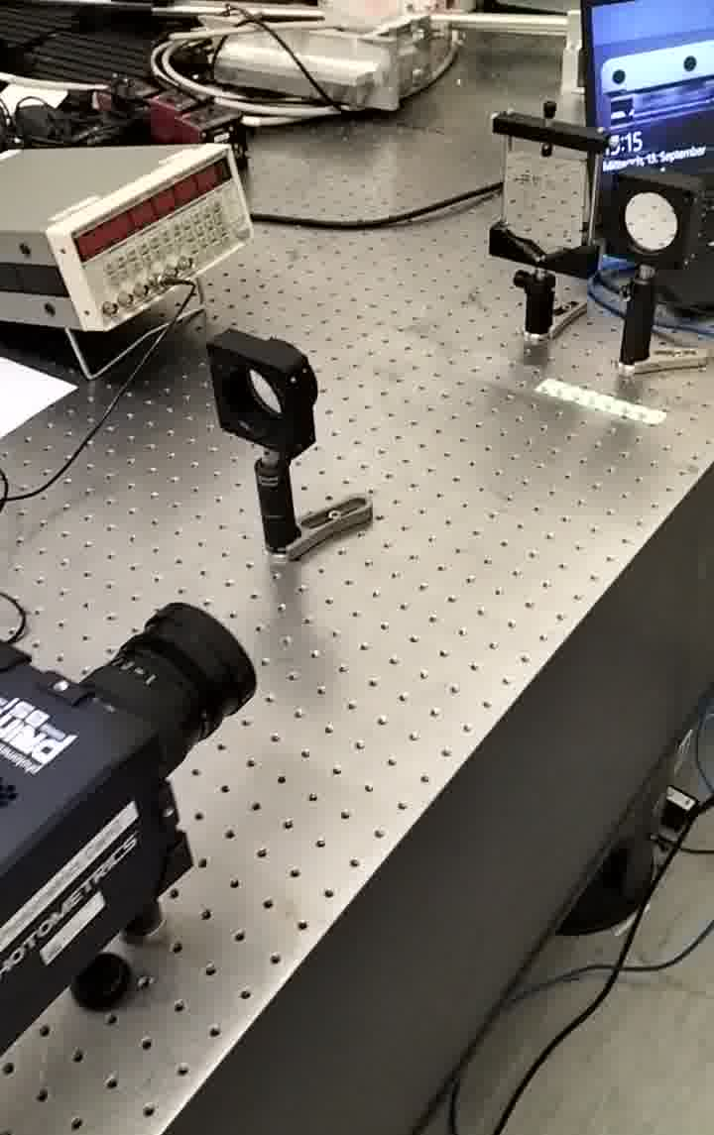
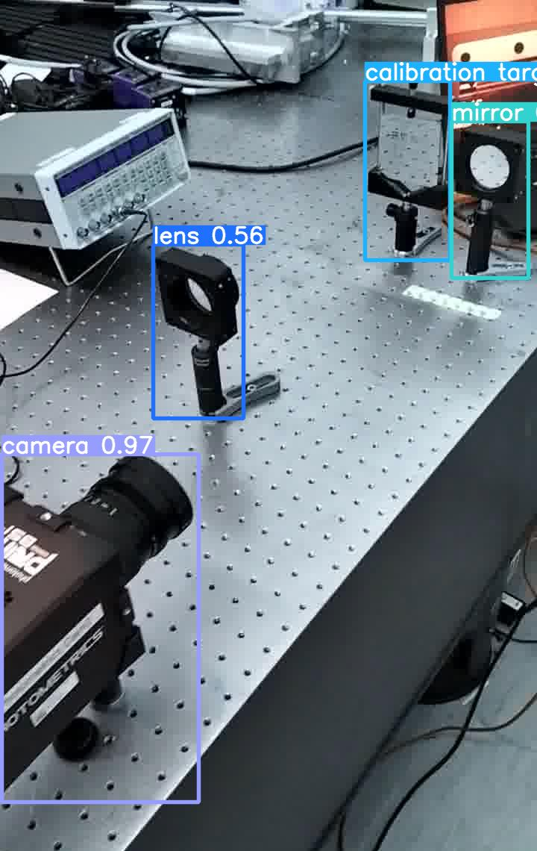
Depth
DPT
Combined result
Source image
Relative location in 3D space
DPT+YOLO
Object localization
YOLO

Slide 14
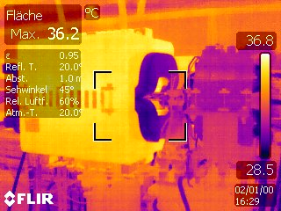
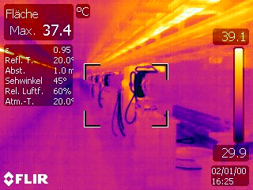
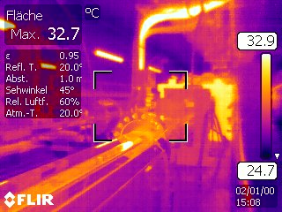
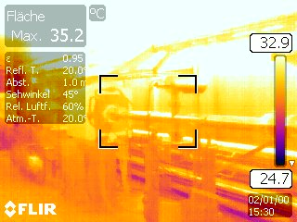
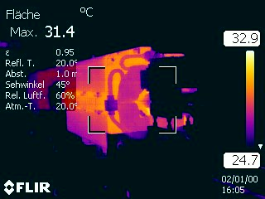
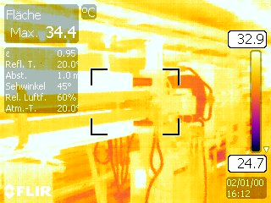
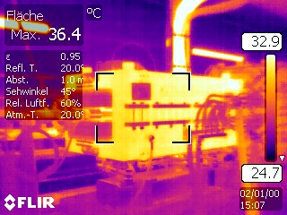
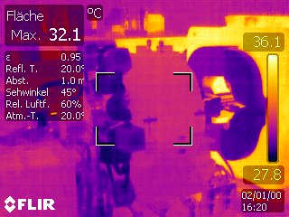
Thermal imaging

Slide 15
Summary and outlook
First approach with CV for lab assistance tools.
Object detection requires large training datasets. For unequivocal identification physically labelling the objects might be the best option. Plus it allows to access additional information.
Reconstructing 3D space from bi-dimensional images seems possible with DPT (pre-trained).
Extracting the relevant information from the depth predictions to facilitate lab tasks.
Fine tuning of the model to obtain reliable 3D mapping for applications.

Slide 16
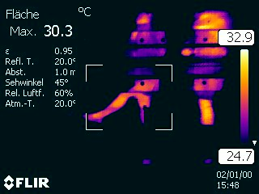

Thank you!
Contact
Bianca Veglia
MPY
bianca.veglia@desy.de
Deutsches
Elektronen-Synchrotron
www.desy.de

