Slide 1
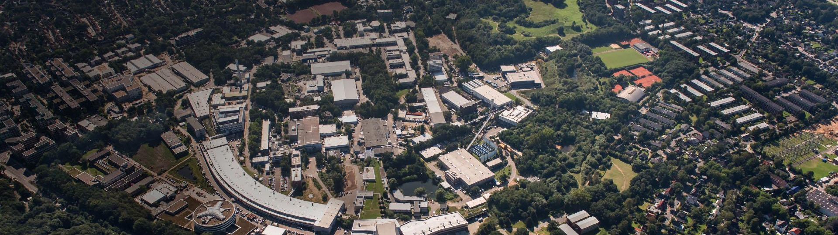

Enhanced Quench Detection at the EuXFEL
Through a Machine Learning-Powered Approach
Lynda Boukela, Annika Eichler, Julien Branlard, Nur Zulaiha Jomhari (DESY)
4th ICFA Beam Dynamics Mini-Workshop on Machine Learning Applications for Particle Accelerators
Mar 5 - 8, 2024
Gyeongju, South Korea

Slide 2


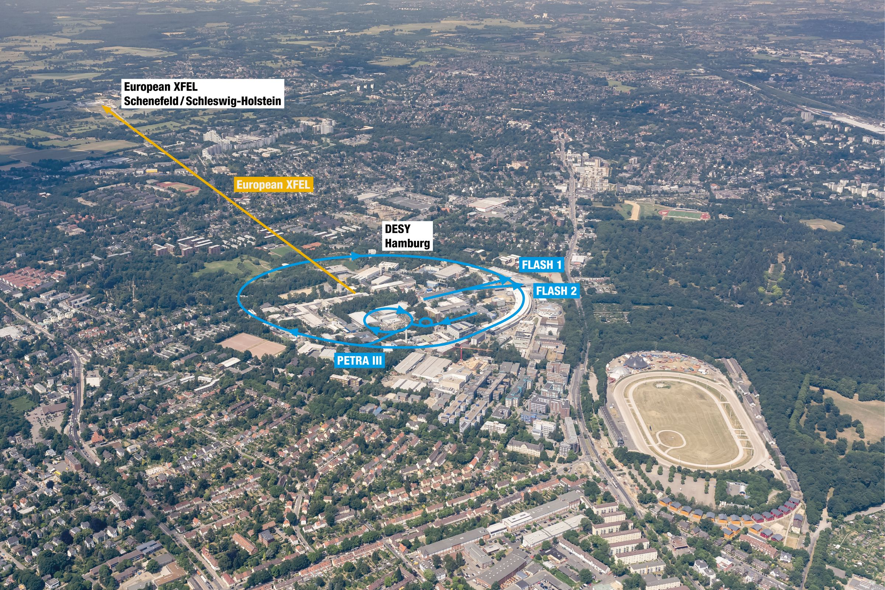
The EuXFEL
Anomaly Detection
Quench Detection
Deployment
Outlook
1
The EuXFEL
  Located in Hamburg, Germany
  Total length of 3.4 kilometers
  Electron acceleration to high energies of up to 17.5 GeV
  © DESY / R. Schaaf und D. Schröder
The course of the European XFEL

Slide 3
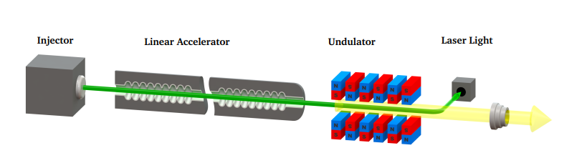
The EuXFEL
Anomaly Detection
Quench Detection
Deployment
Outlook
1
1
The EuXFEL
© A. Nawaz
Operated at 10 Hz, in a pulsed mode, duration 1.8 ms, 2700 bunches/pulse

Slide 4
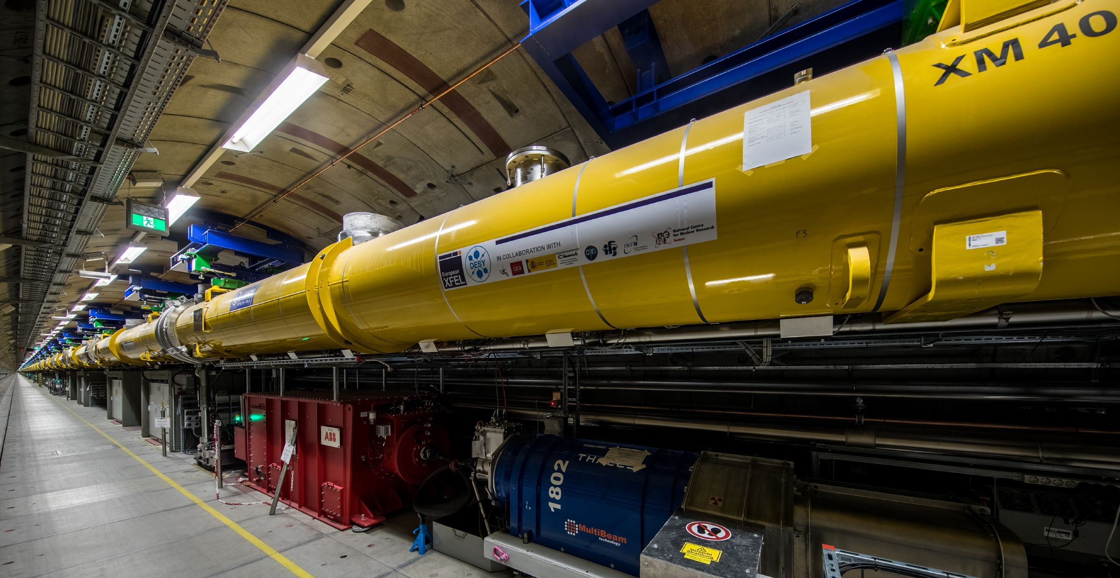
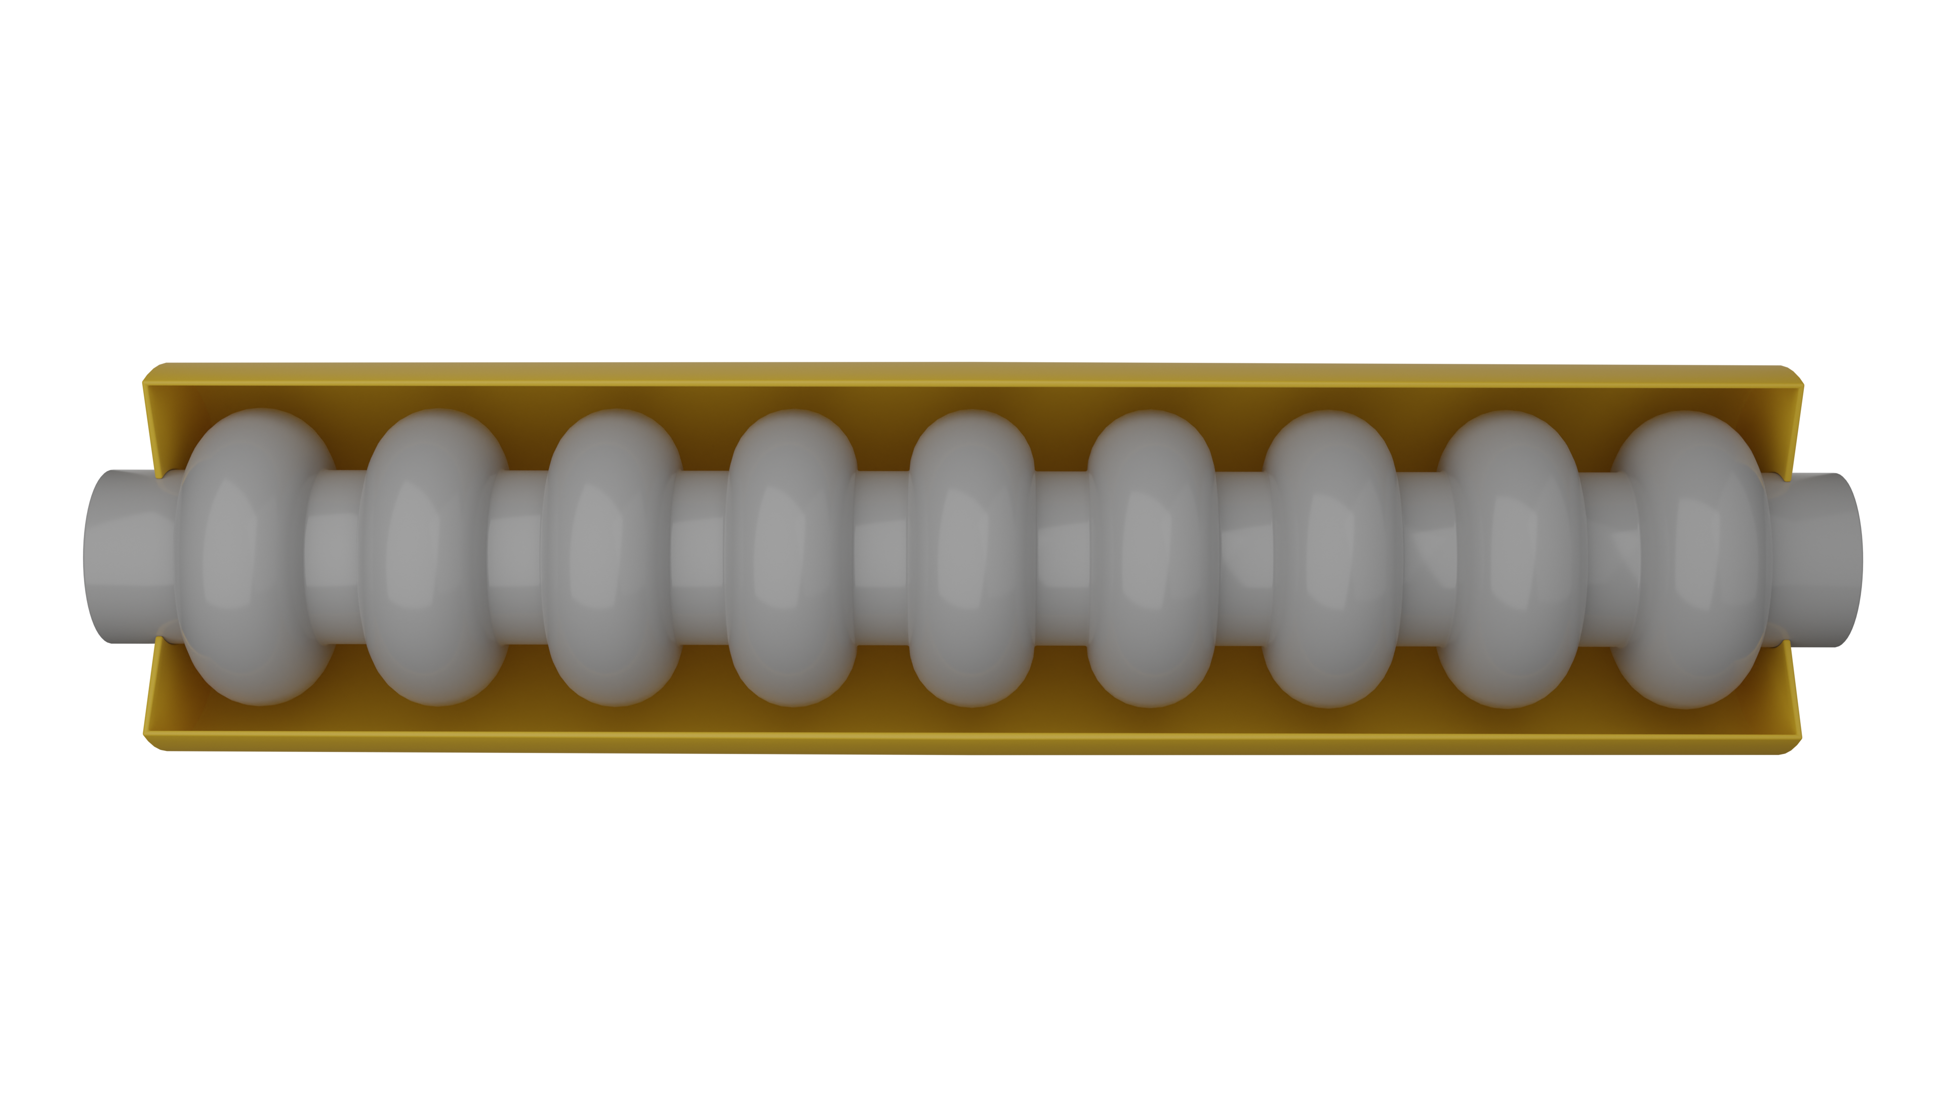
The EuXFEL
Anomaly Detection
Quench Detection
Deployment
Outlook
1
1
The EuXFEL
Linac
SRFC
© A. Nawaz
Operated at 10 Hz, in a pulsed mode, duration 1.8 ms, 2700 bunches/pulse
The Linac uses 808 superconducting radio frequency cavities (SRFCs) of 1.3 GHz (25 stations, total of 32 SRFCs per station)
Cavities controlled and monitored with the LLRF system
Safe and optimal operation is crucial, fault detection and isolation required
Quenches are a priority, Significant down-time

Slide 5
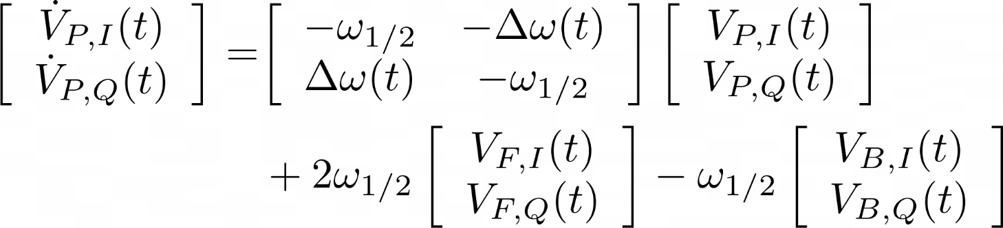
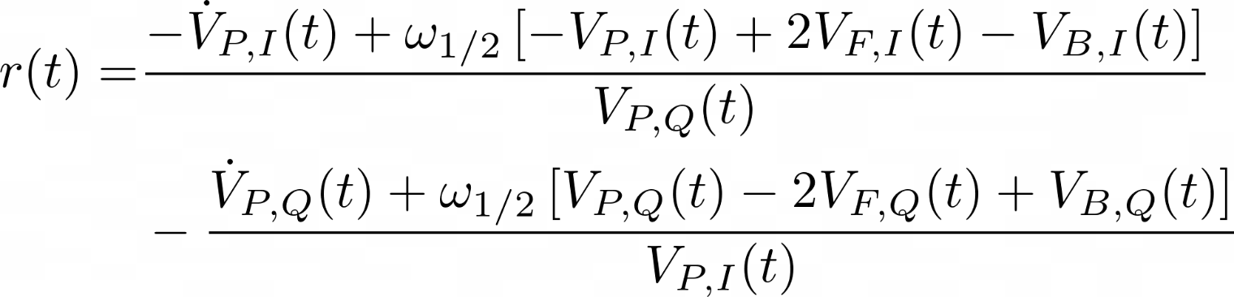
The EuXFEL
Anomaly Detection
Quench Detection
Deployment
Outlook
1
2
Anomaly Detection
Model-based
  © DESY 2017
Electromagnetic dynamics
Residuals (parity space)
Statistical test (GLR)
Eichler A. et al."Anomaly detection at the European X-ray Free Electron Laser using a parity-
space-based method.“ Physical Review Accelerators and Beams 26.1 (2023)

Slide 6
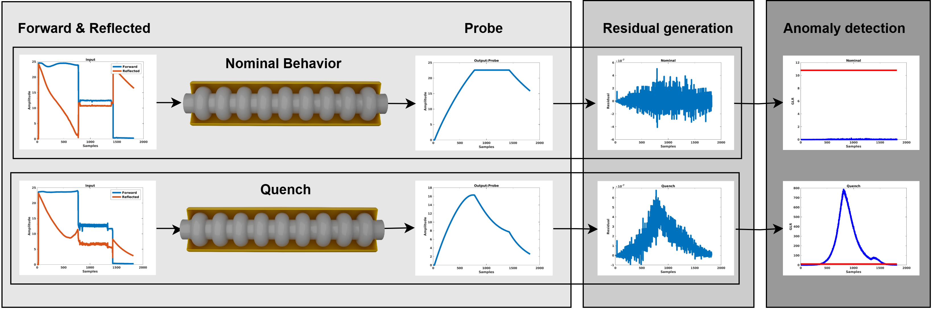
The EuXFEL
Anomaly Detection
Quench Detection
Deployment
Outlook
1
2
Anomaly Detection
Model-based
  © DESY 2017
Eichler A. et al."Anomaly detection at the European X-ray Free Electron Laser using a parity-
space-based method.“ Physical Review Accelerators and Beams 26.1 (2023)

Slide 7
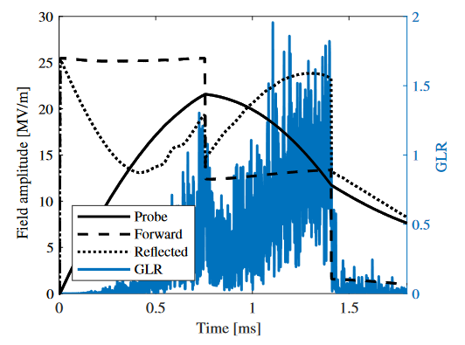
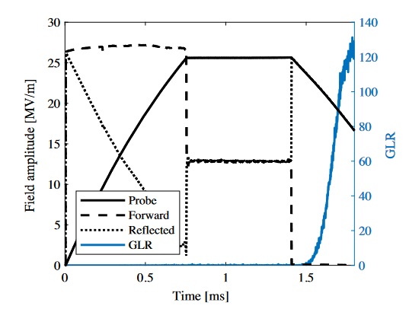
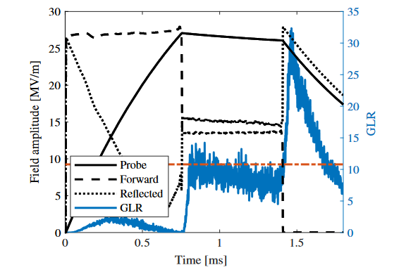
The EuXFEL
Anomaly Detection
Quench Detection
Deployment
Outlook
1
2
Anomaly Detection
Model-based
  © DESY 2017
Q_{L} Change
Detuning Change
Eichler A. et al."Anomaly detection at the European X-ray Free Electron Laser using a parity-
space-based method.“ Physical Review Accelerators and Beams 26.1 (2023)

Slide 8
The EuXFEL
Anomaly Detection
Quench Detection
Deployment
Outlook
1
2
Anomaly Detection
Model-based
  © DESY 2017
Q_{L} Change
Detuning Change
Quench
Eichler A. et al."Anomaly detection at the European X-ray Free Electron Laser using a parity-
space-based method.“ Physical Review Accelerators and Beams 26.1 (2023)

Slide 9
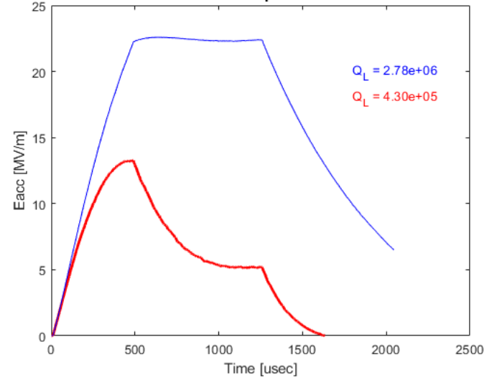
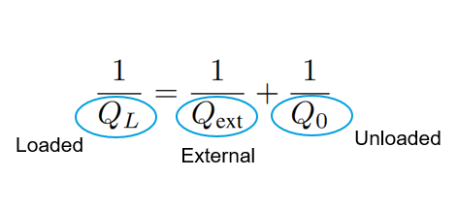
The EuXFEL
Anomaly Detection
Quench Detection
Deployment
Outlook
1
3
Quench Detection
QDS
Diagnosis through the QDS
  - Q_{L}-based, thresholding over the average of previous 100 pulses
  - Robustness issues
  © DESY 2017
  - External: power dissipation induced by the coupling process
  - Unloaded: power dissipation through the cavity walls
Branlard J. et. al. Superconducting cavity quench detection and prevention for the European XFEL. ICALEPCS (2013)

Slide 10
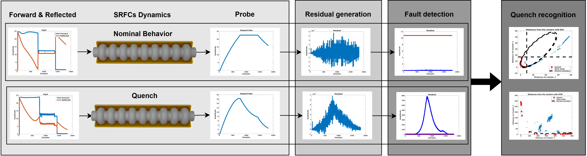
The EuXFEL
Anomaly Detection
Quench Detection
Deployment
Outlook
1
3
Quench Detection
ML-based
GLR+K-medoids
  © DESY 2017
  © DESY 2017
  © DESY 2017

Slide 11
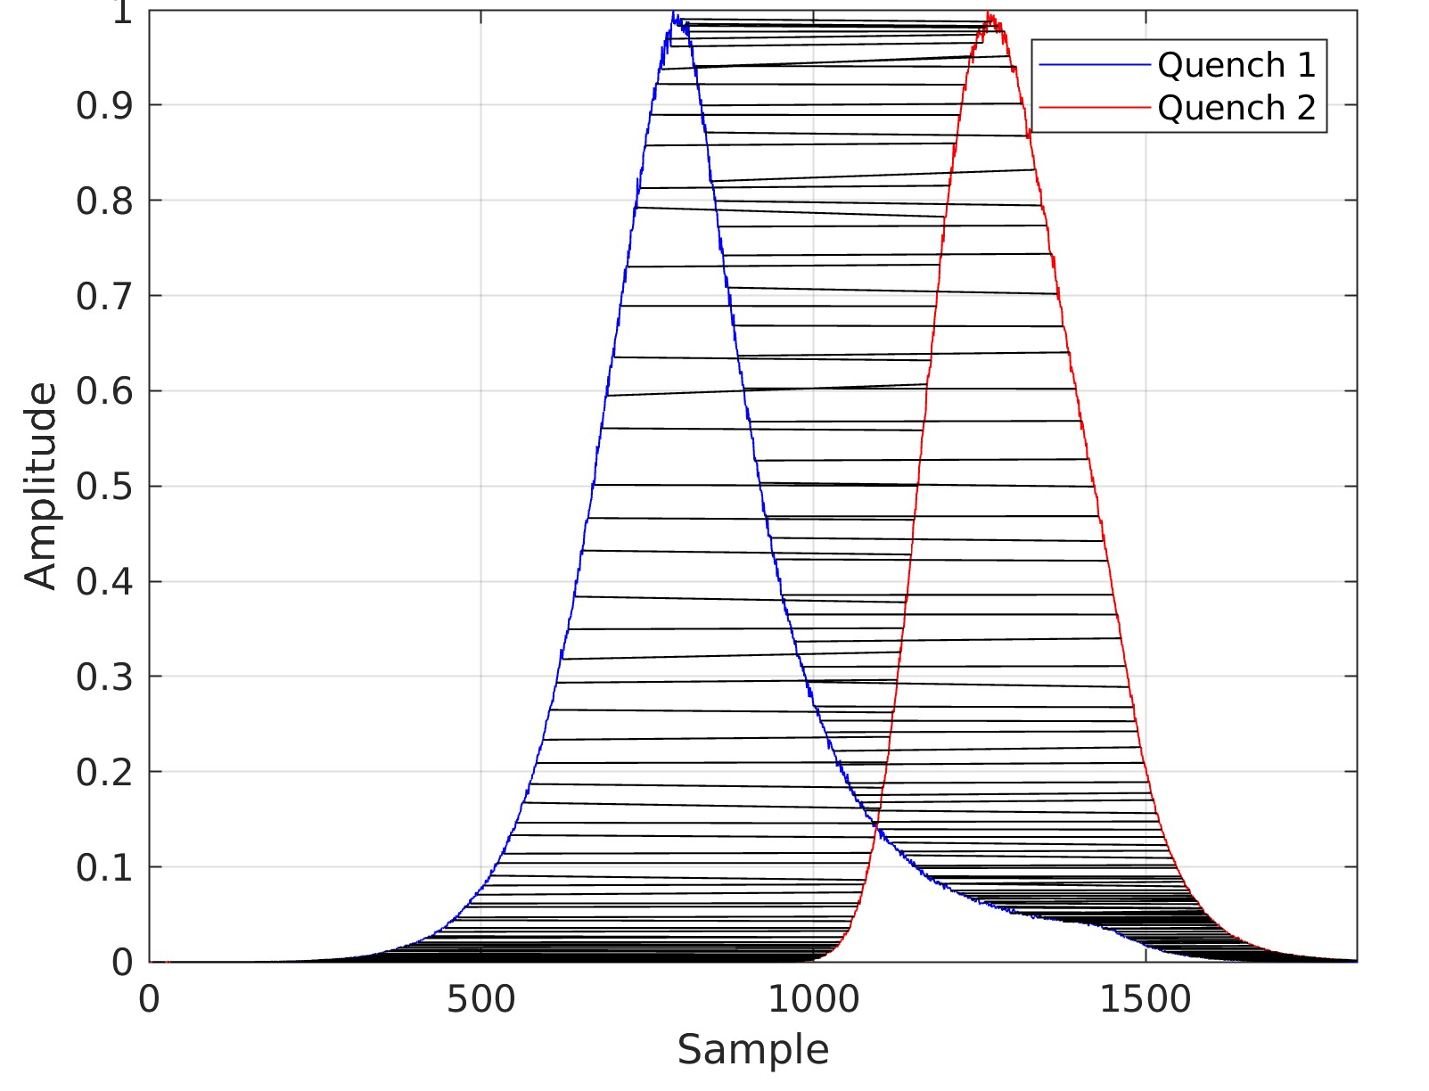
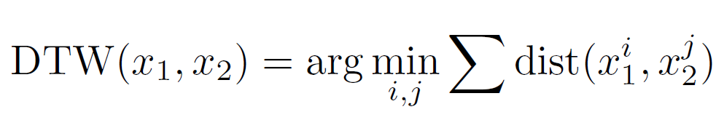
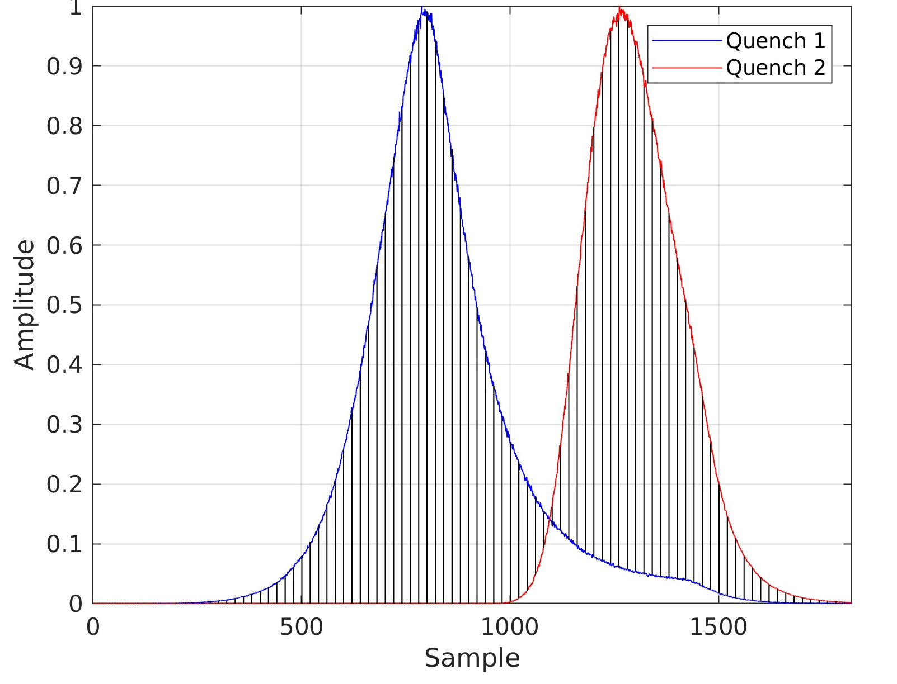
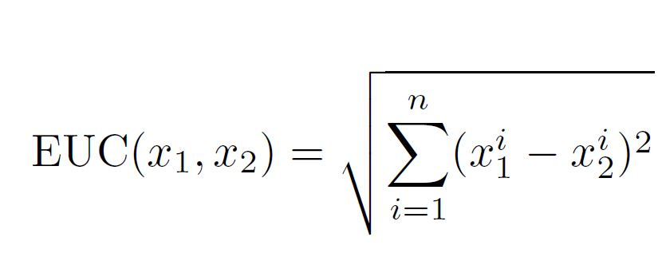
The EuXFEL
Anomaly Detection
Quench Detection
Deployment
Outlook
1
3
Quench Detection
ML-based
  © DESY 2017
  © DESY 2017
K-medoids for clustering
Based on quench traces
Two models, based on two similarity measures
The traces are normalized and / or reduced
  © DESY 2017

Slide 12
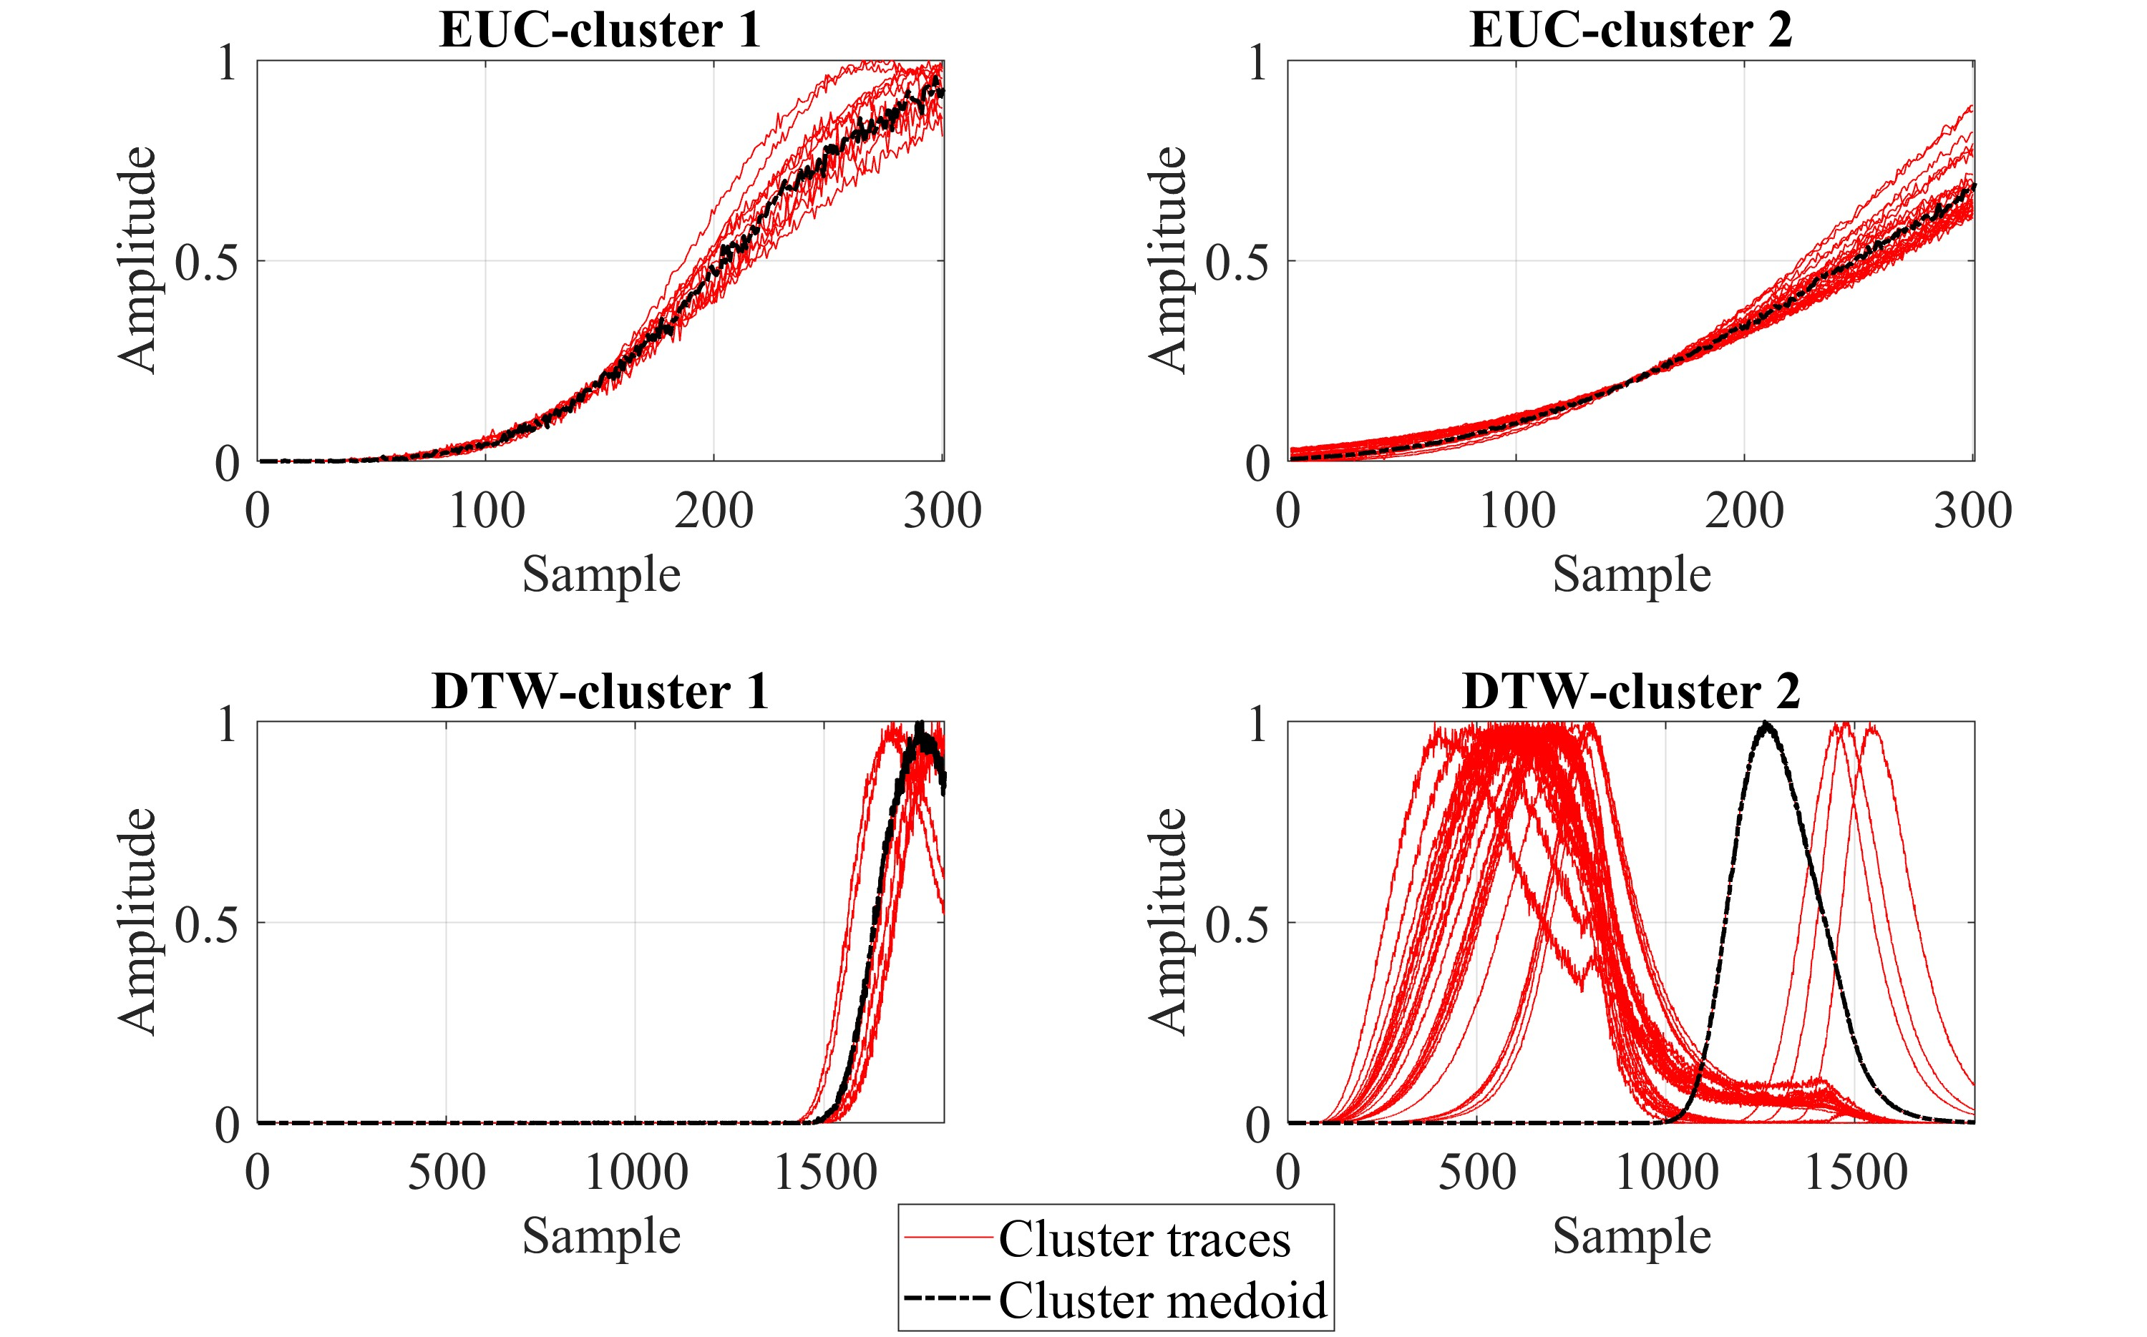
The EuXFEL
Anomaly Detection
Quench Detection
Deployment
Outlook
1
3
Quench Detection
ML-based
With both models, two clusters and medoids are obtained
Assignment mainly with respect to time of occurrence of the quenches

Slide 13
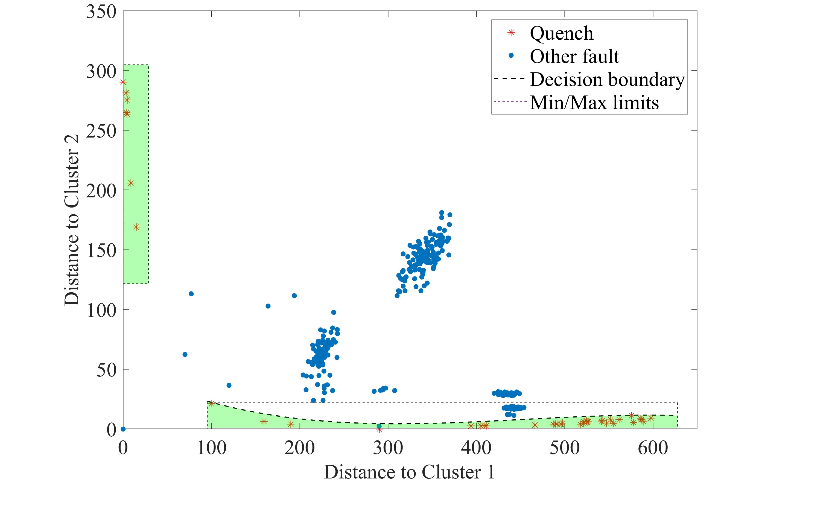
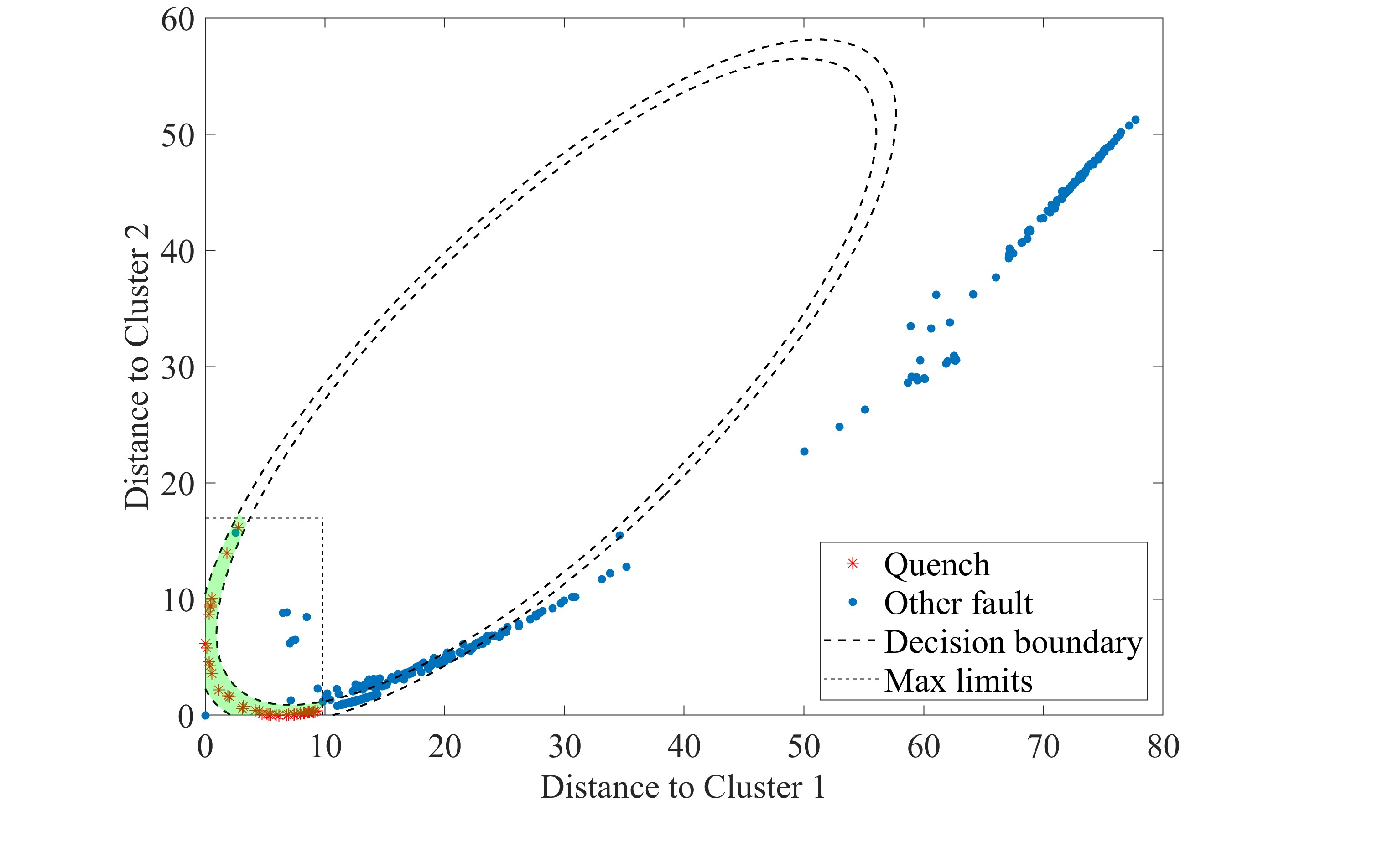
The EuXFEL
Anomaly Detection
Quench Detection
Deployment
Outlook
1
3
Quench Detection
ML-based
Inference
  In distance space
  Fitting different based on the similarity measure
  Thresholds & decision boundaries
DTW
EUC

Slide 14
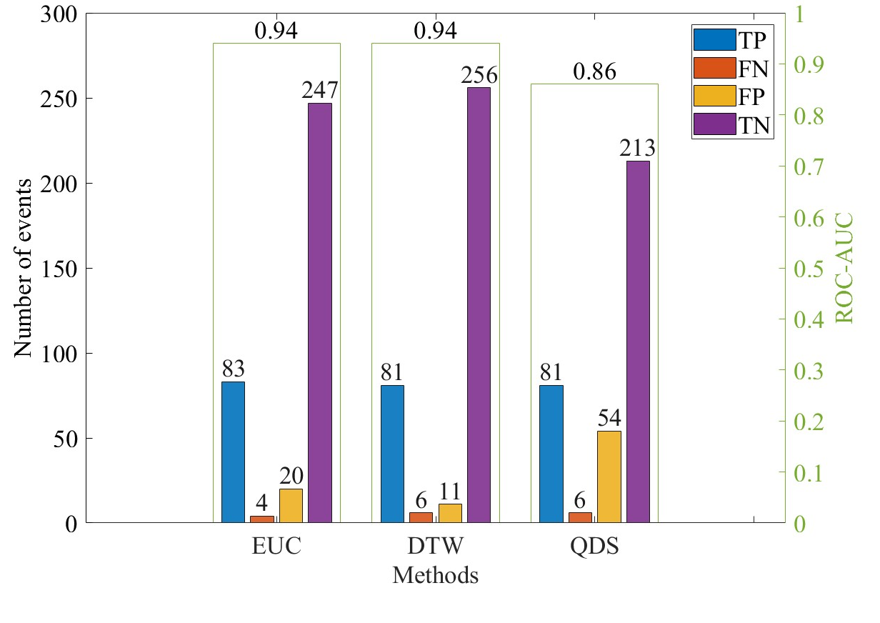
The EuXFEL
Anomaly Detection
Quench Detection
Deployment
Outlook
1
3
Quench Detection
ML-based
Inference
  In distance space
  Fitting different based on the similarity measure
  Thresholds & decision boundaries
Improvement of event-wise detection
DTW
TP : the method accurately identified a quench
TN : the method accurately recognized a fault was not a quench
FP : the method identified a quench that’s in reality not a quench
FN : the algorithm failed to identify a real quench
EUC

Slide 15
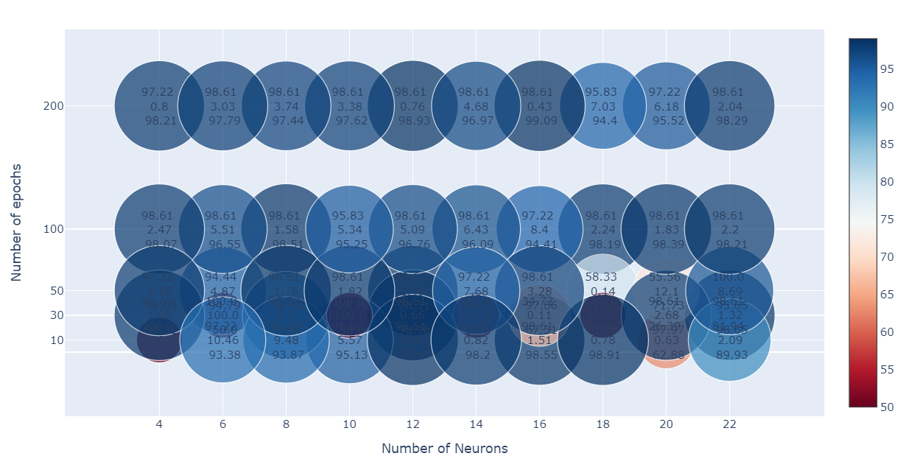
The EuXFEL
Anomaly Detection
Quench Detection
Deployment
Outlook
GLR+K-medoids+MLP
1
3
Quench Detection
ML-based
GLR+K-medoids
  © DESY 2017
1st value: TPR
2nd value: FPR
3rd value: ROC-AUC
MLP
Three hidden layers
Imbalanced data
Based on EUC

Slide 16
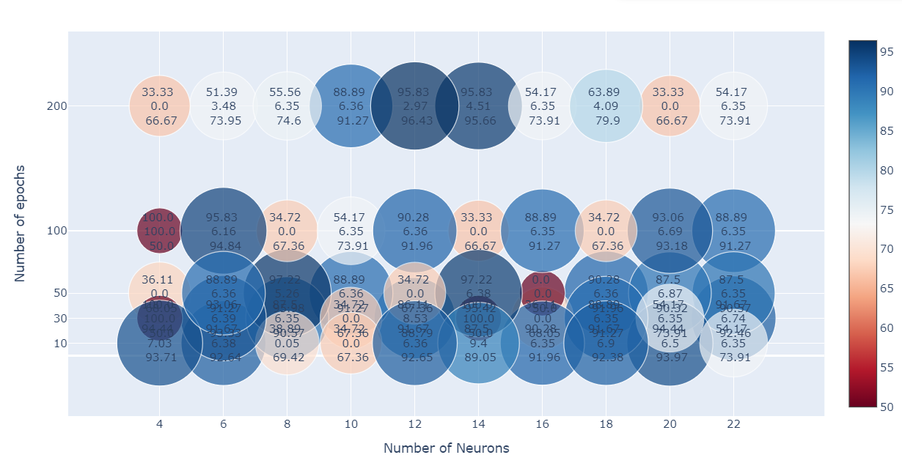
The EuXFEL
Anomaly Detection
Quench Detection
Deployment
Outlook
GLR+K-medoids+MLP
1
3
Quench Detection
ML-based
GLR+K-medoids
  © DESY 2017
1st value: TPR
2nd value: FPR
3rd value: ROC-AUC
MLP
Three hidden layers
Imbalanced data
Based on DTW

Slide 17
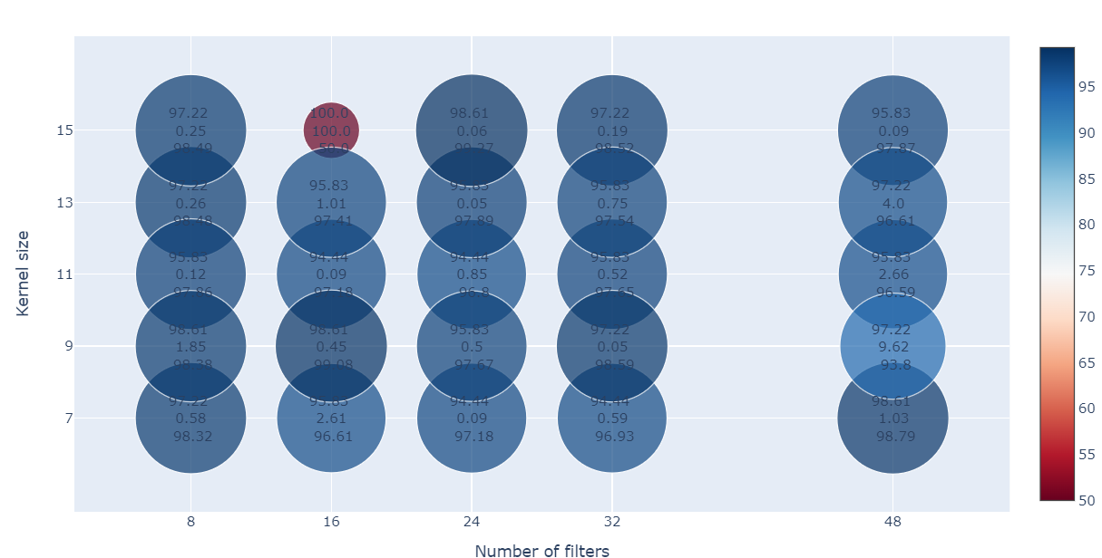
The EuXFEL
Anomaly Detection
Quench Detection
Deployment
Outlook
GLR+K-medoids+MLP
1
3
Quench Detection
ML-based
GLR+CNN
GLR+K-medoids
  © DESY 2017
1st value: TPR
2nd value: FPR
3rd value: ROC-AUC
CNN
Three hidden layers
Max normalization
Imbalanced data

Slide 18
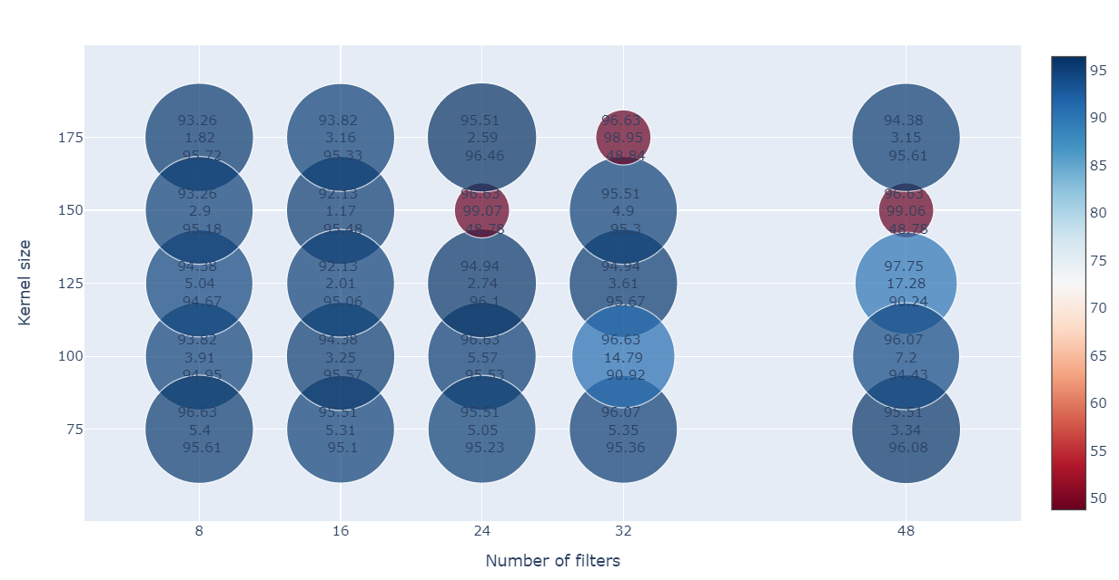
The EuXFEL
Anomaly Detection
Quench Detection
Deployment
Outlook
GLR+AE
GLR+K-medoids+MLP
1
3
Quench Detection
ML-based
GLR+CNN
GLR+K-medoids
  © DESY 2017
1st value: TPR
2nd value: FPR
3rd value: ROC-AUC
AE-based quench profile
Two layers in each part
Max normalization
Mean absolute error or mean squared error for the reconstruction
MAE

Slide 19
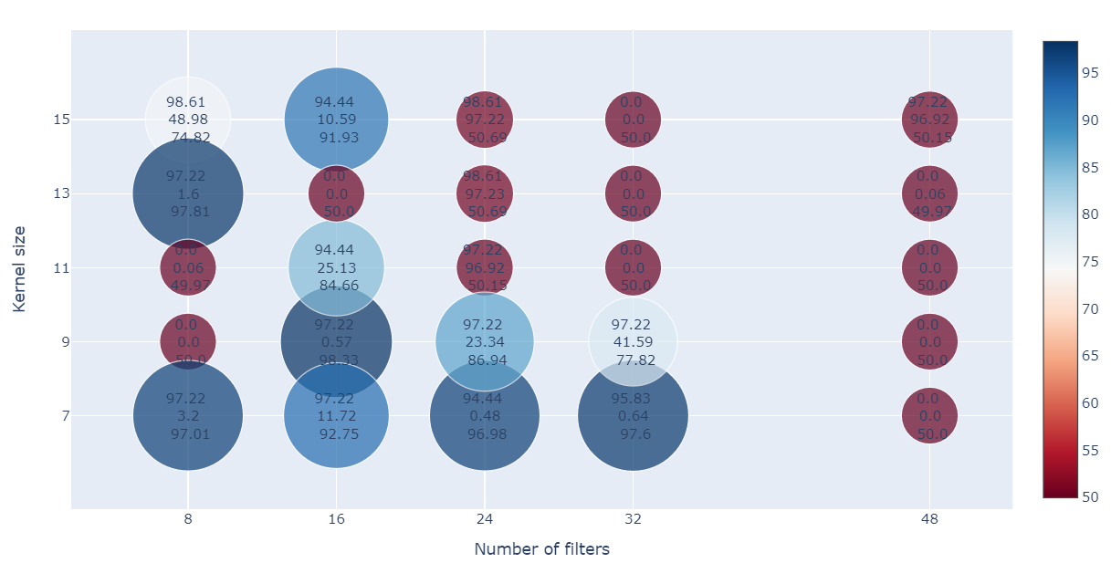
The EuXFEL
Anomaly Detection
Quench Detection
Deployment
Outlook
GLR+AE
GLR+K-medoids+MLP
1
3
Quench Detection
ML-based
RF+CNN
GLR+CNN
GLR+K-medoids
  © DESY 2017
1st value: TPR
2nd value: FPR
3rd value: ROC-AUC
CNN
Three hidden layers
Based on the three signals
Imbalanced data

Slide 20
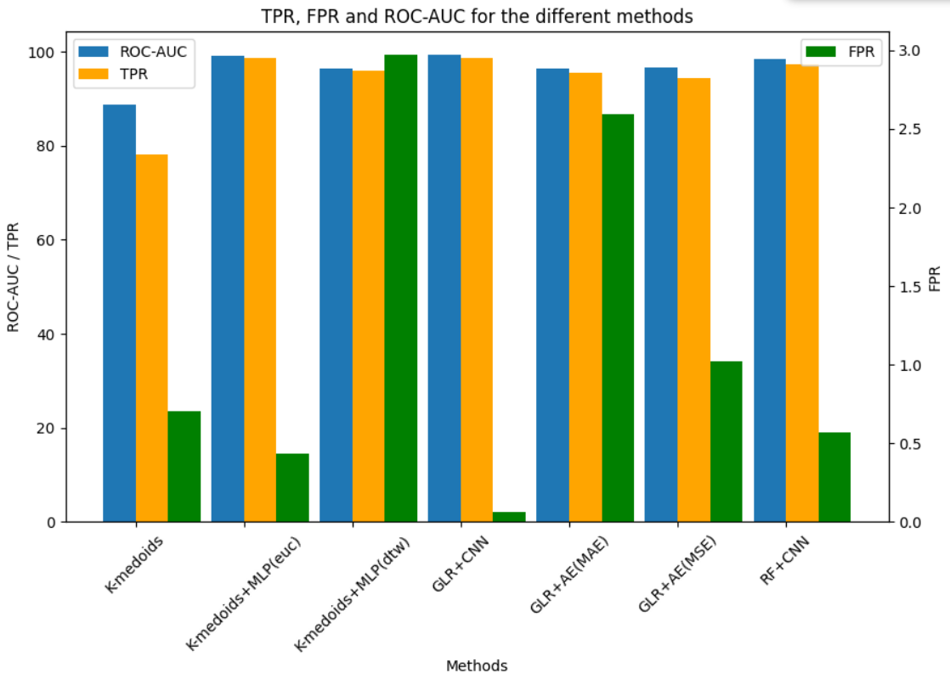
The EuXFEL
Anomaly Detection
Quench Detection
Deployment
Outlook
1
3
Quench Detection
ML-based
(euc)
ROC-AUC=99.3
FPR=0.06
TPR=98.6

Slide 21
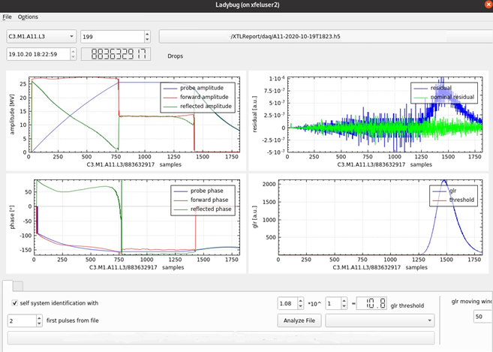
The EuXFEL
Anomaly Detection
Quench Detection
Deployment
Outlook
1
4
Deployment
Data
  Postmortem snapshot files, 250 pulses (50 first nominal)
  RF signals sampled at 1 Mhz
  Fault detection included in the trip event logger (TEL), including a visualization tool
  The TEL runs daily along with the ML-based quench identification (GLR+K-medoids)
Timm, J., et al. The trip event logger for online fault diagnosis at the European XFEL.IPAC, (2021)

Slide 22
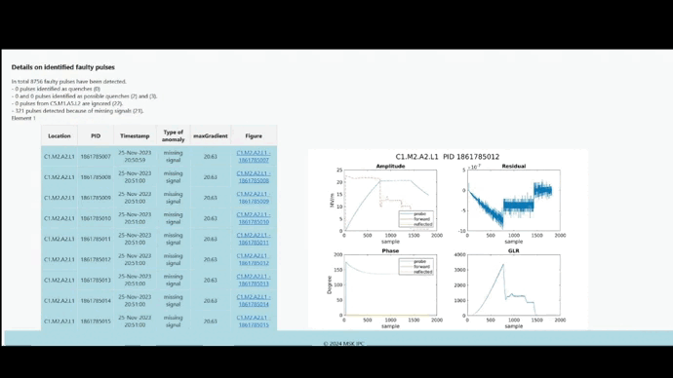
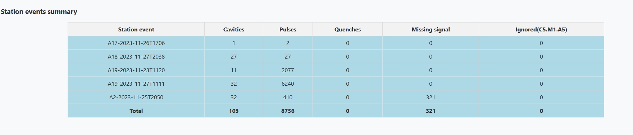
The EuXFEL
Anomaly Detection
Quench Detection
Deployment
Outlook
1
4
Deployment
Insights
  Reports are generated to gain insights
  Emails, Web interface
Number of affected cavities
Number of faulty pulses
Number of quenching pulses
Number of missing signals
Affected stations
Ignored cavity
Daily reports

Slide 23
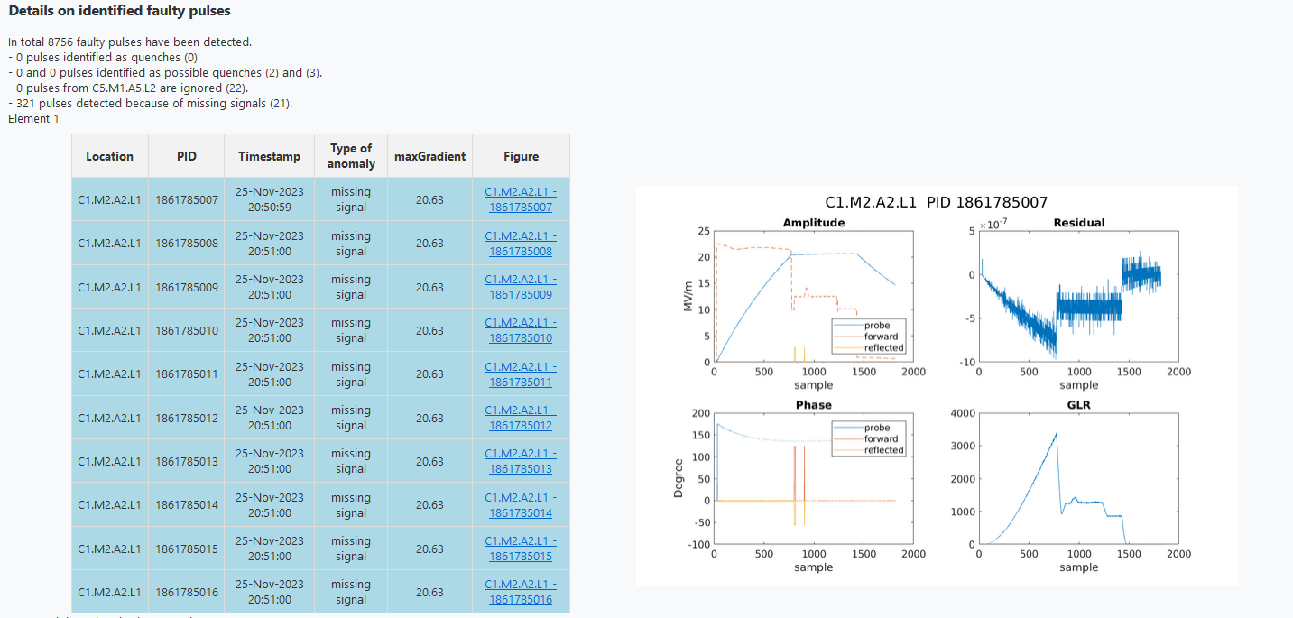
The EuXFEL
Anomaly Detection
Quench Detection
Deployment
Outlook
1
4
Deployment
Insights
  Reports are generated to gain insights
  Emails, Web interface
Details on the known faulty pulses
RF signals, residuals and GLR of the known faulty pulses
Daily reports

Slide 24
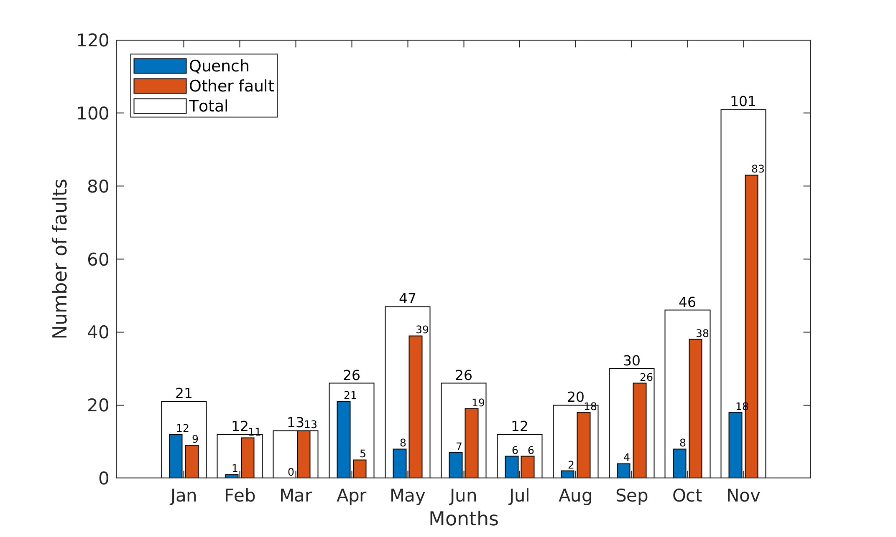
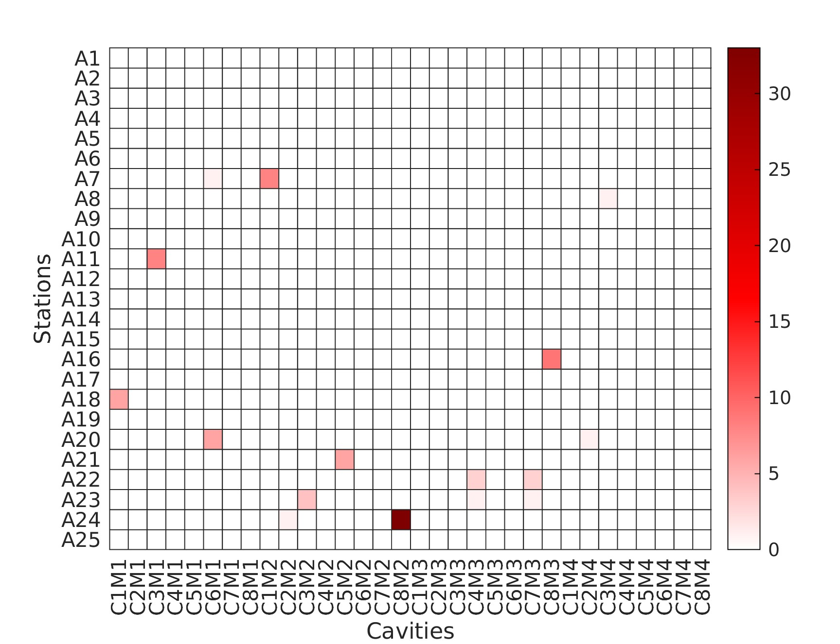
The EuXFEL
Anomaly Detection
Quench Detection
Deployment
Outlook
1
4
Deployment
Insights
  Reports are generated to gain insights
  Emails, Web interface
Distribution of the faults and quenches over the year 2022
Distribution of the quenches over the stations and the cavities in 2022
Yearly / half-yearly reports

Slide 25
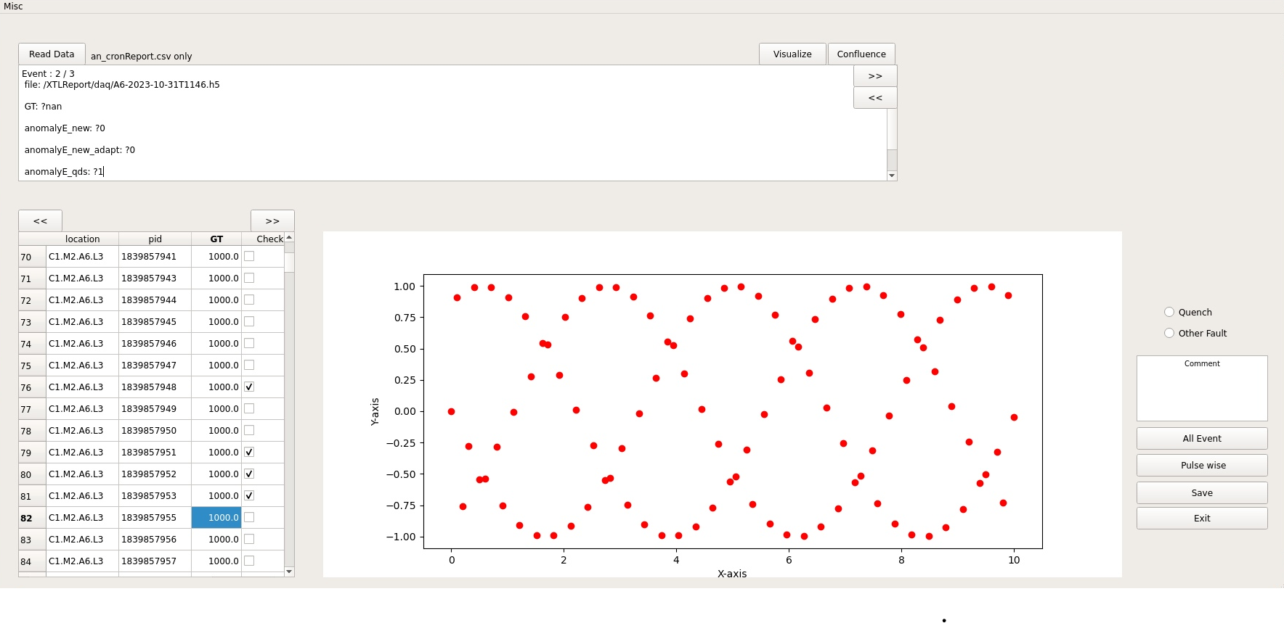
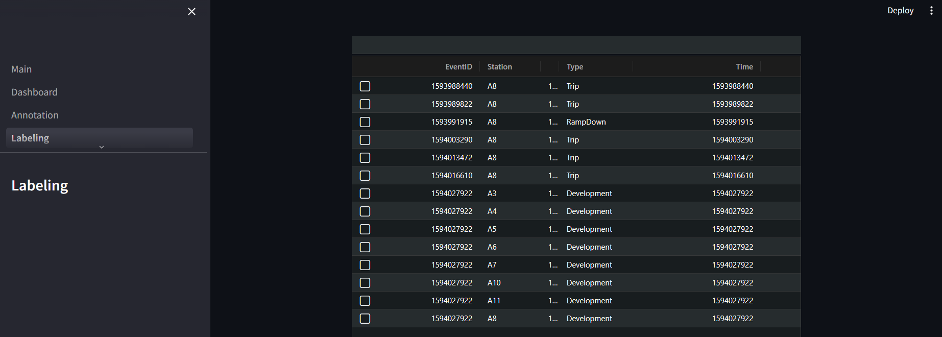



The EuXFEL
Anomaly Detection
Quench Detection
Deployment
Outlook
1
  Help from the LLRF group with the data labeling
  Difficult and time-consuming task, thousands of traces
  A GUI and a web application are being developed
4
Deployment
Labeling
Help in the process through the QDS findings with the station events, and the ML predictions with the pulses

Slide 26
The EuXFEL
Anomaly Detection
Quench Detection
Deployment
Outlook
1
5
Outlook
Results validation, more data, but smarter labeling ( with an expert-in-the-loop strategy)
Explore other architectures (such as transformers) for the quench detection
Go online, firmware implementation has already started
Explore the possibility of early detection
Incremental learning to scale up and detect more anomalies

Slide 27
Thank you !
3
Lynda Boukela
Deutsches Elektronen-Synchrotron DESY, Hamburg, Germany
lynda.boukela@desy.de

