Slide 1
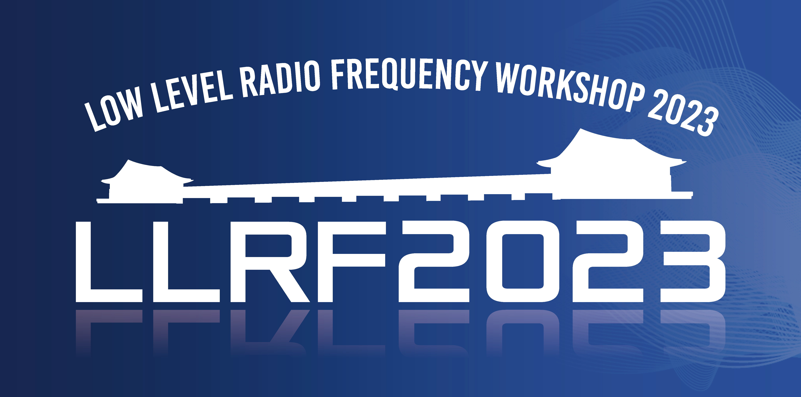
Closing Remarks

Slide 2
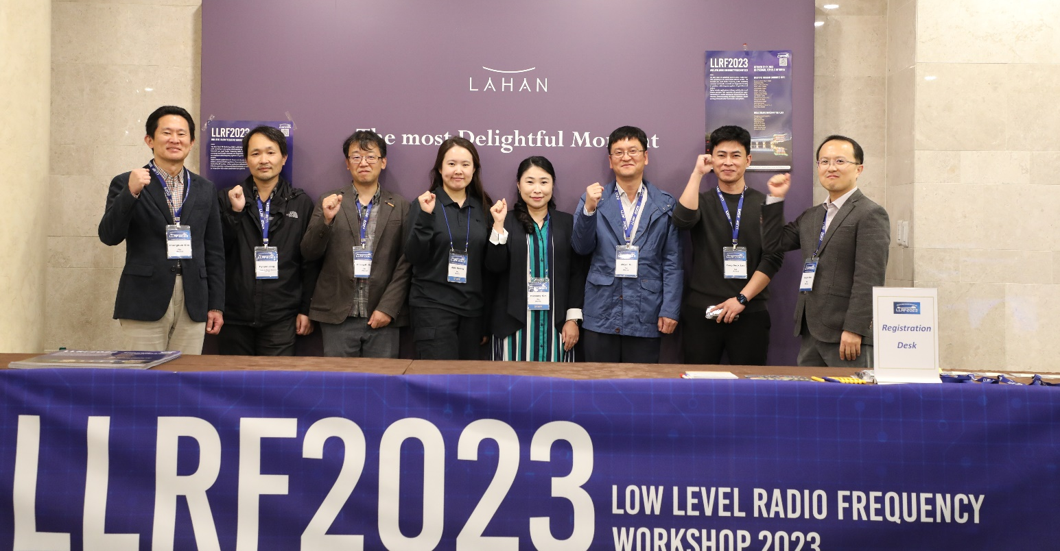
Local Organizing Committee
Changbum Kim - chair
Jinyul Hu
Abin Hwang
Hyojae Jang - IBS
Young-Do Joo
Nayoung Kim
Yong-Seok Lee
Chang-Ki Min

Slide 3
The Scientific Program Committee
Alessandro Ratti (chair), LBL
Tim Berenc, Argonne
Brian E. Chase, FNAL-ret
Mark Crofford, Oak Ridge
Larry Doolittle, LBNL
Zheng Gao, IMP
Zheqiao Geng, PSI
Mariusz Grecki, DESY
Wolfgang Hofle, CERN
Curt Hovater, Jefferson Lab
Xiao Li, IHEP
Toshihiro Matsumoto KEK
Chang-Ki Min, PAL
Tomasz Plawski, Jefferson Lab
Kevin Smith, BNL
Dmitry Teytelman, Dimtel, Inc.
Zhao Yubin, SINAP
Zeran Zhou, USTC

Slide 4
The numbers
Registered participants: 103
early registration = 49
late registration = 48
Student = 5
Exhibitors: 6
Submitted abstracts: 105
Lab talks: 9 (1 lab talk not presented)
Invited talks: 5
Contributed talks: 26 (1 not presented)
Posters: 62 (8 not presented)
Tutorials: 3
Special Topics: 2

Slide 5
Classification | Oral | Poster | Total
Lab Talk | 9 | - | 9
Tutorial | 3 | - | 3
IQ Award | 1 | - | 1
Special | 2 | - | 2
Measurement & Control | 9 | 14 | 23
System & Operation | 8 | 15 | 23
Hardware | 3 | 16 | 19
SRF Control | 5 | 5 | 10
Software | 0 | 7 | 7
Other | 2 | 2 | 4
Timing | 2 | 1 | 3
Total | 43 | 60 | 104

Slide 6
Attendance Profile – by Region
At LLRF22
Europe – 66%
America – 25%
Asia – 9%

Slide 7
Participation by Country
 | Country | Number
1 | China | 27
2 | United States | 19
3 | Korea | 17
4 | Germany | 7
5 | Swiss | 7
6 | Japan | 5
7 | Italy | 3

Slide 8
Participation by Country - cont
 | Country | Number
7 | Poland | 3
9 | Canada | 2
9 | France | 2
11 | England | 1
11 | Spain | 1
11 | Sweden | 1
11 | Colombia | 1

Slide 9
Participation by Country – Asia (49 tot.)

Slide 10
Participation by Institute – Asia (49 tot.)
Affiliation | Number
Institute of Modern Physics | 7
Shanghai Advanced Research Institude | 5
Institute of High Energy Physics | 4
Shanghai Synchrotron Radiation Facility | 3
Chengdu Wattsine Electronic Technology | 2
Dalian Institute of Chemical Physics.CAS | 2
Institute of Advanced Science Facilities | 2
Beijing Conveyi Limited | 1
Tsinghua University | 1

Slide 11
Participation by Country – America (22 tot.)

Slide 12
Participation by Institute – America (19)
Affiliation | Number
Lawrence Berkeley National Laboratory | 5
SLAC National Accelerator Laboratory | 4
Los Alamos National Laboratory | 3
Fermi National Accelerator Laboratory | 2
RadiaSoft LLC | 2
Thomas Jefferson National Accelerator Facility | 1
Oak Ridge National Laboratory | 1
Dimtel, Inc. | 1

Slide 13
Participation by Country – Europe (24)

Slide 14
Participation by Institute – Switzerland+Germany
Nation | Affiliation | Number
Swiss | CERN | 6
Paul Scherrer Institut | Paul Scherrer Institute | 1
Germany | Deutsches Elektronen-Synchroton | 4
Helmholtz Zentrum Berlin | Helmholtz Zentrum Berlin | 2
Cycle GmbH | Cycle GmbH | 1

Slide 15
Notes from the IOC
Back on track
Odd year workshops
Expanded the committee for better regional balance
Established the IQ award
Proceedings are now a regular feature
Considering a topical workshop
Always welcome your feedback

Slide 16
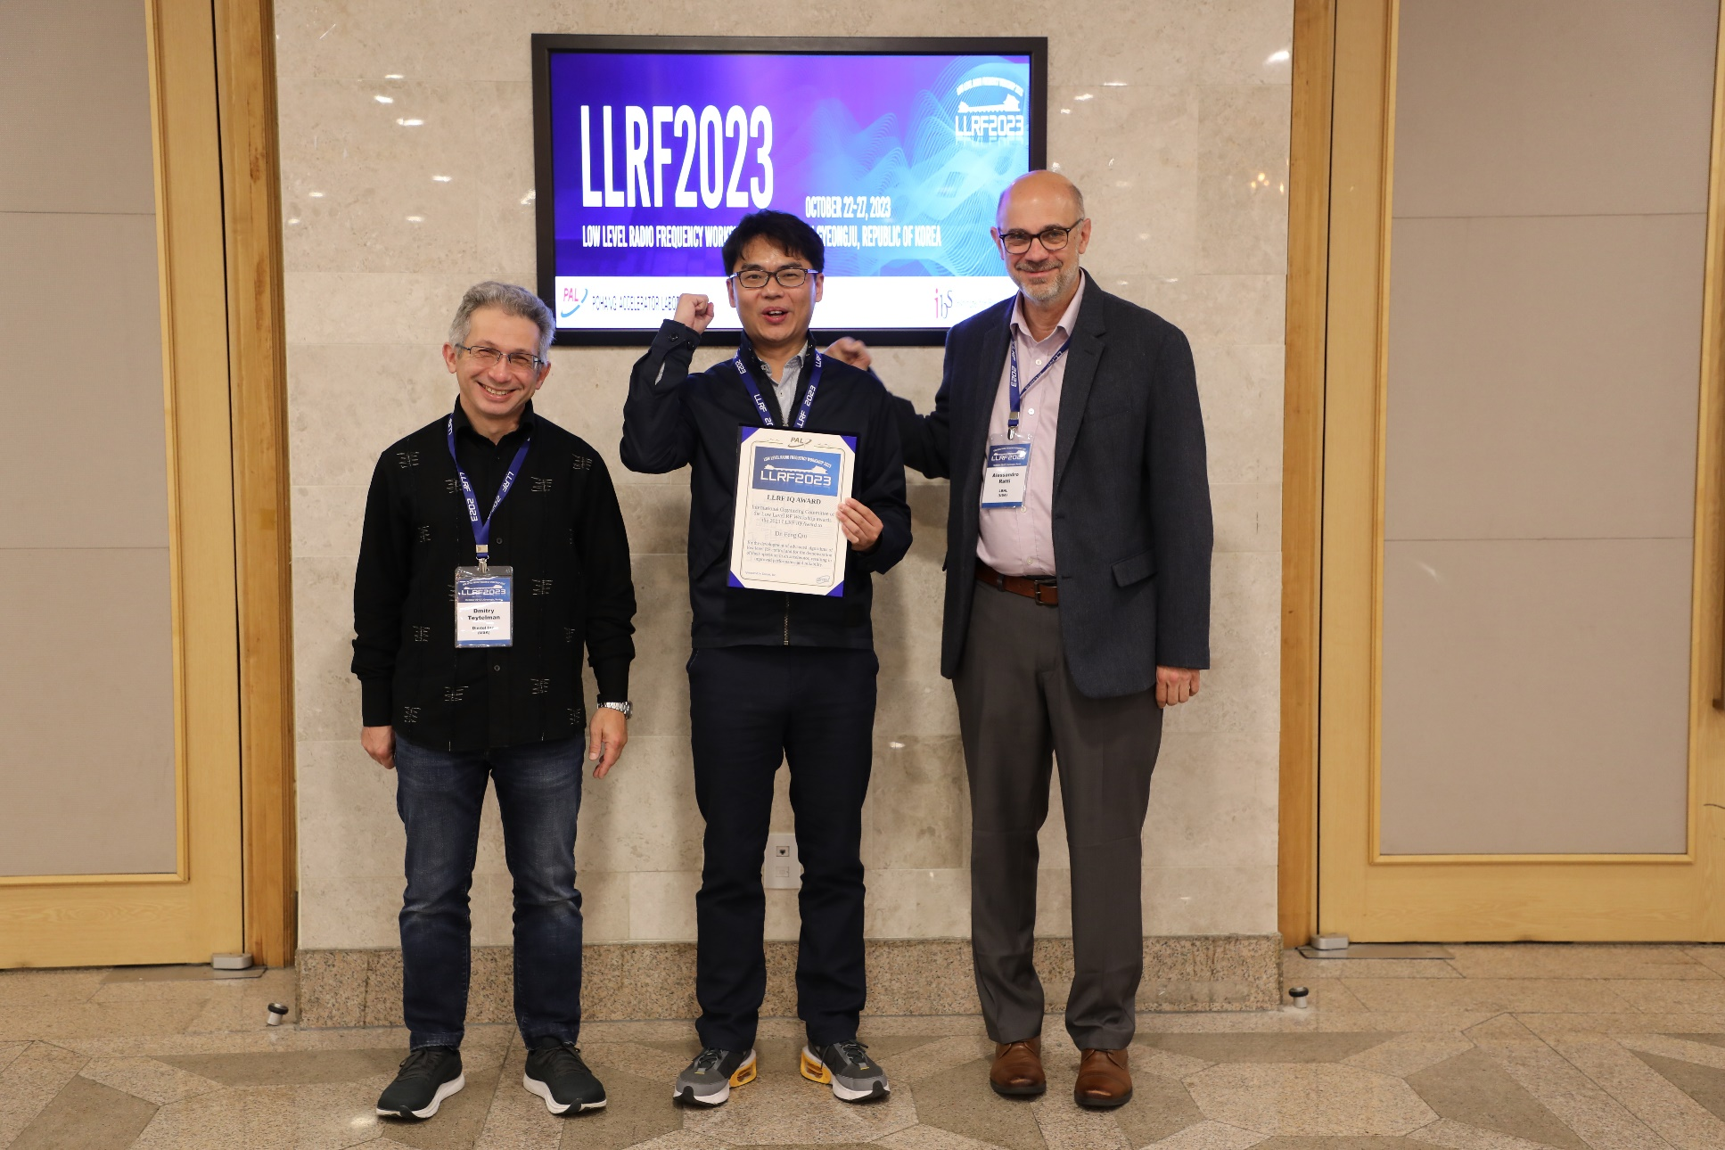
IQ Award
To recognize and reward outstanding individual or group contributions, achievements, and advancements in the worldwide accelerator Low Level RF community.
Plan to continue in future workshops

Slide 17
Proceedings
A feature since 2017
An opportunity to publish your contributions
Not mandatory
Not refereed
Proofread by the IOC
Dmitry can answer questions at the workshop

Slide 18
Publications
Submitted: 13
Complete: 5
Need meta data changes: 3
Missing ID: 5
https://arxiv.org/html/2310.03199

Slide 19
Topical Workshops
Opportunity to address critical aspects and reach out including other communities with common interests and complementary knowledge
Microphonics and Resonance Control in 2018
Increasing support for organizing a topical next year
Several ideas under consideration

Slide 20
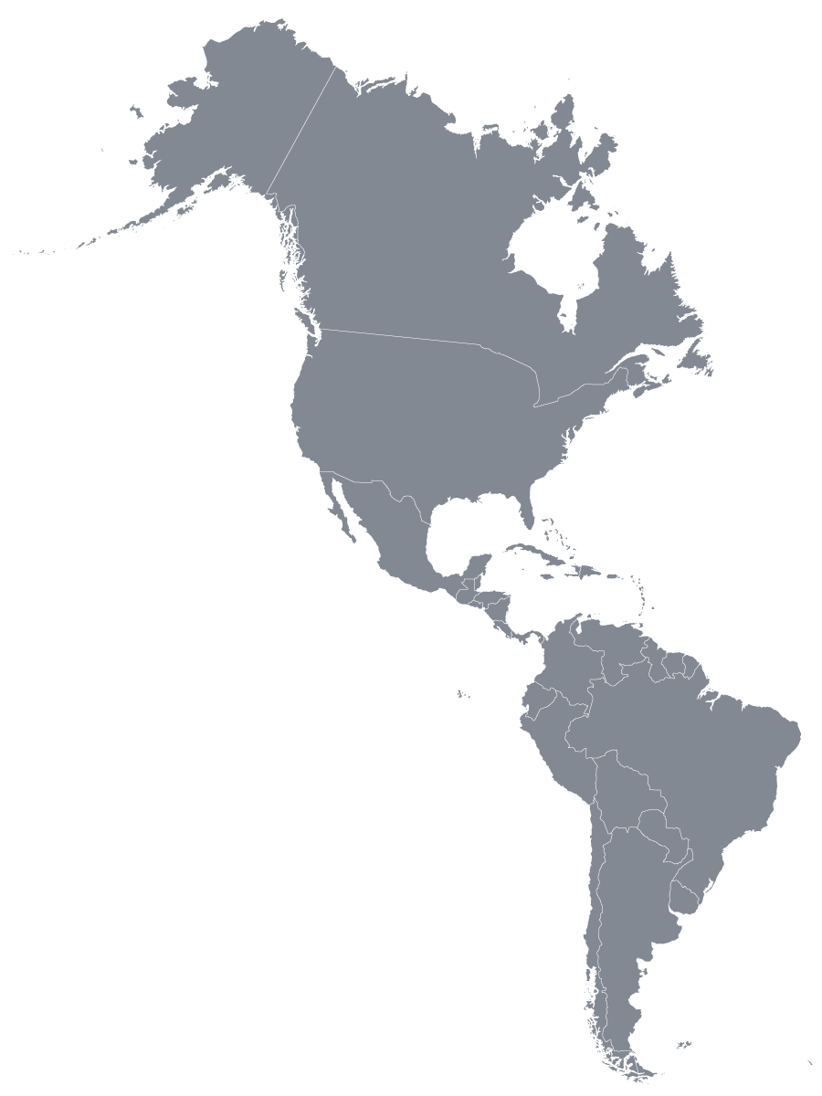
Future Events
LLRF25
Asked BNL and Jefferson Lab to prepare a proposal
Topical Workshop
Considering one for 2024
In Europe

Slide 21
THANK YOU

Slide 22
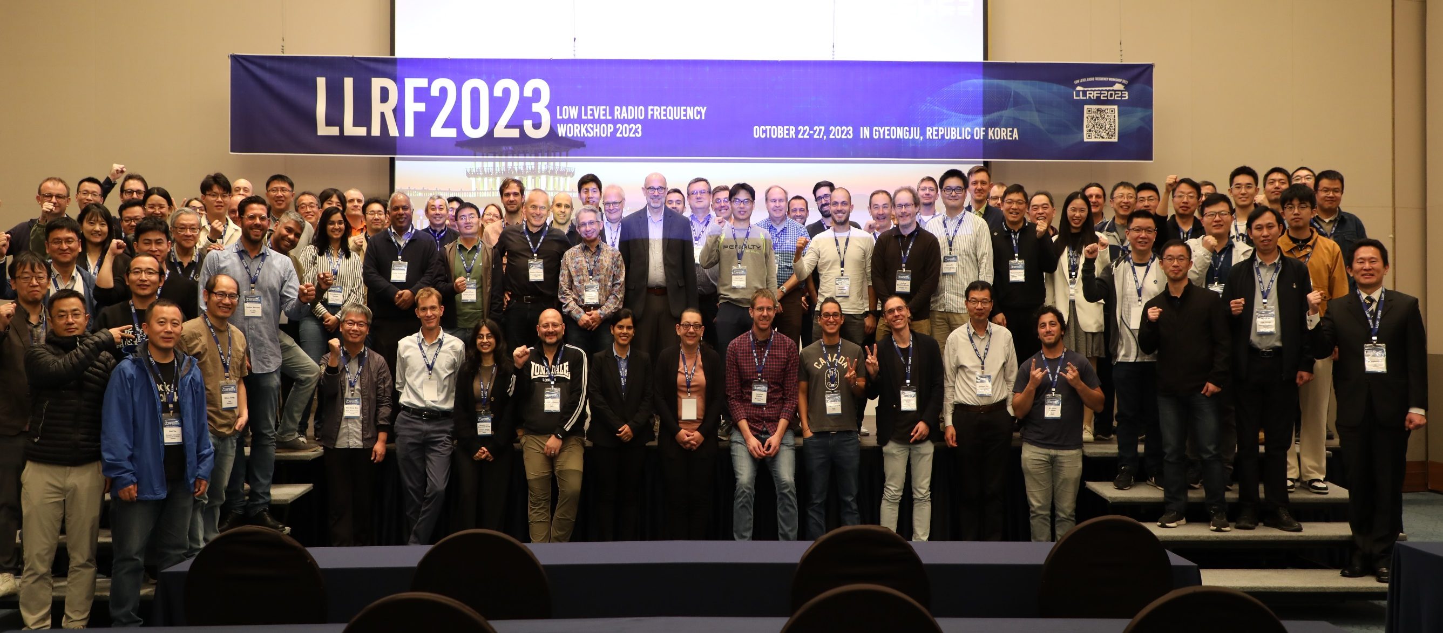
Thank You

