Slide 1
Round Table 1
Reliability and Anomaly Detection
Julien Branlard, for DESY Gyeangju, Republic of Korea, 23.10.2023

Slide 2
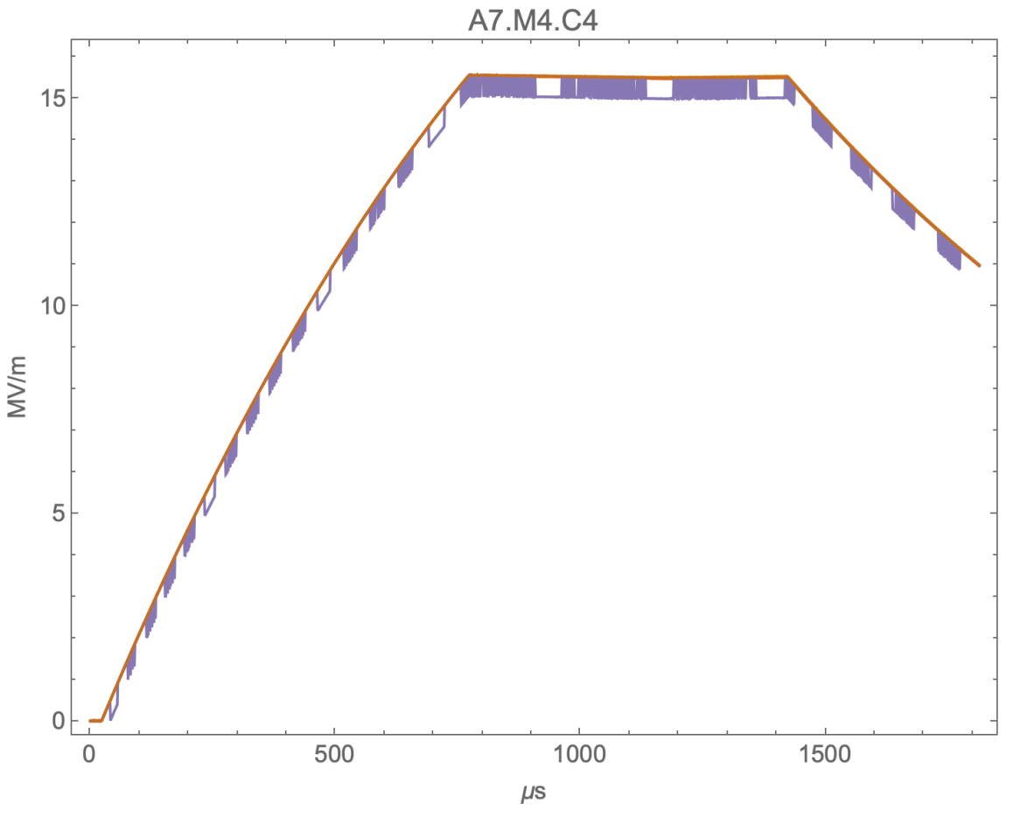
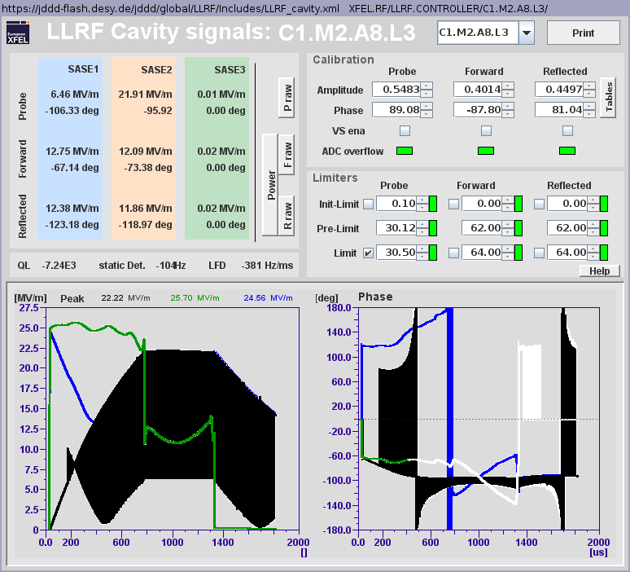
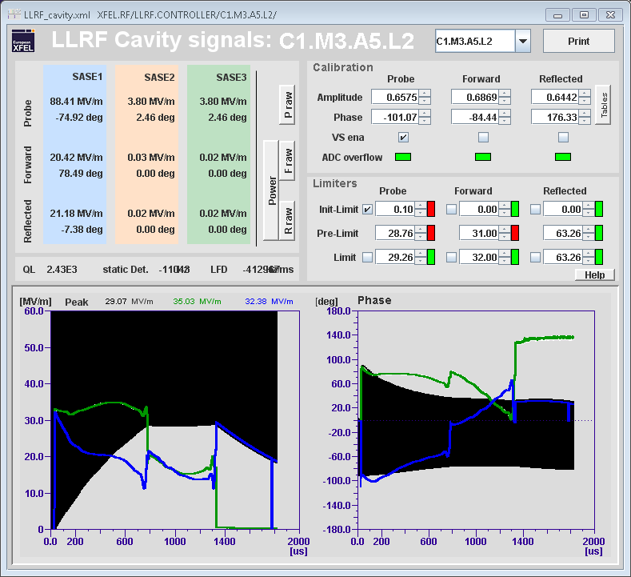
Examples of anomalies
FW corruption
Traces are jumping back and forth between 2 values
→ often indication of FW corruption

Slide 3
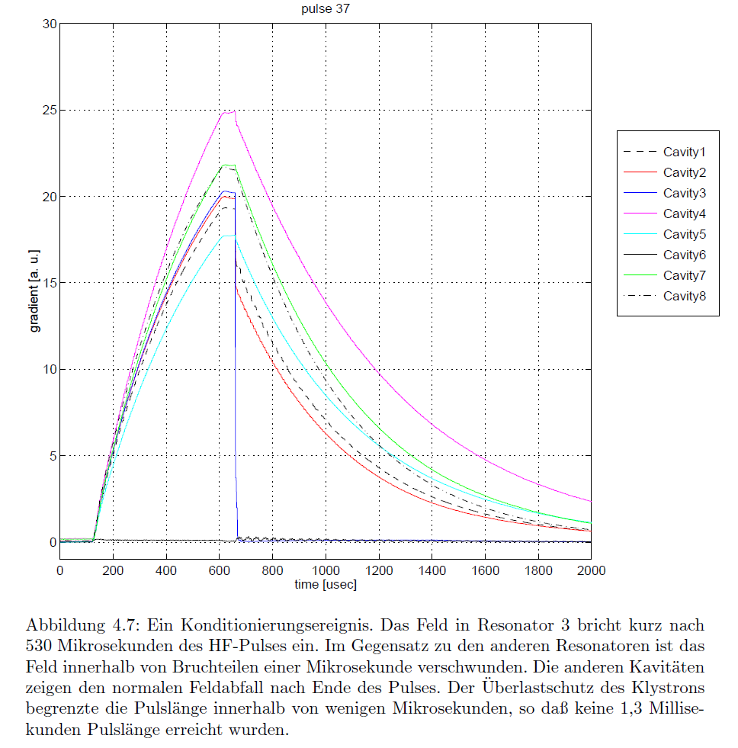
Examples of anomalies
HW: cavity events
Instantaneous “plasma” discharge
Transient ringing
→ Time constants can give an hint if the anomaly takes place inside the cavity or at the drive level.

Slide 4
Examples of anomalies
SW / FW : DMA access during write
RF pulse “compression”
or
corrupted data transfer
Software bugs can appear when the CPU load is high (i.e. cron job at Sunday 00:00)
→ Time stamp can be a hint towards a SW bug

Slide 5
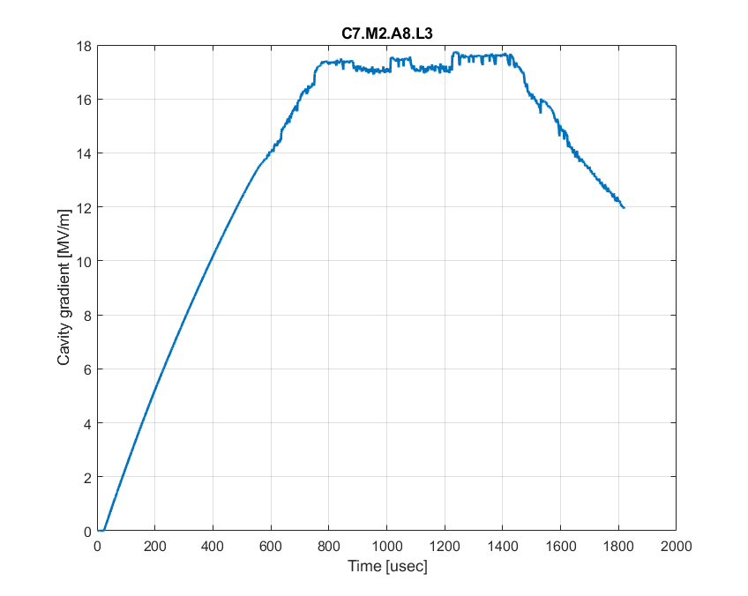
Examples of anomalies
HW : external components, detection chain
Loose N-type connector
Contact between capacitor and shielding
Hardware bugs usually have very distinct signatures, but can be intermittent depending on ambient temperature for example
→ Divide and conquer, swapping components
Faulty piezo driver corrupting the RF pulse

Slide 6
Types of system anomalies
Non-exhaustive list
HW failure
i.e. power supply, waveguide sparks, cavity event
FW failure
i.e. bit stream corruption because of SEU, write during read
SW failure
i.e. delayed interrupts due to CPU load
High-level algorithms
i.e. race condition / run away situation between diverse feedback SW algorithms
Human factor
i.e. wrong config, safety bypass left enabled by mistake, etc...

Slide 7
Anomaly detection
“Traditional” approach
Threshold (or envelope) monitoring
2-level zones : warning and alarm
Typically implemented on the control system (i.e. actually routinely used in accelerators)
“Modern” approach
Data driven, machine learning
Problem is often getting nominal data, tagged data
Still on an R&D level : few examples of deployed ML-based anomaly detection routinely used in accelerator
This is my impression, maybe this is NOT true → discussion

Slide 8
Possible discussion points
Suggestions
Q1: Is anomaly detection a hot topic in your lab ?
because of impact of faults on machine availability ?
because of interest for promising results using machine learning techniques ?
Q2: What kind of architecture is in place to support ML-based anomaly categorization ?
database ?
integrated to control system ?
Q3: How is data labeled for ML-based anomaly detection ?
Expert reviews trips and tags them
First define catalogue then data is automatically tagged (“walks like a duck, quacks like a duck”…)
Make use of additional knowledge (for example time constants, or additional interlock info) to best guess category and have expert confirm
Q4: What about predictive maintenance ?
Often presented as the Holy Grail of anomaly detection, any experience ?
“Don’t run touch a running system” → Is anyone actually doing preventive maintenance ?
Q5: anomaly detection is the first step towards reliability, what’s the next step?
IMO, to really increase reliability, a careful review of every trip is necessary, followed by implementation of countermeasures
How is this topic approached in your lab ?

