Slide 1
Unleashing the Full Potential of LLRF Algorithms:
Enhancing Stability, Reliability, and Accuracy in RF Systems
—— IQ Award Presentation (LLRF2023)
Feng Qiu, on behalf of LLRF grp of KEK & IMP
Institute of Modern Physics (IMP), Chinese Academy of Science
Notes:
I'm really excited to have won the IQ Award, and it's a big honor for both myself and my Institute. Now, I'll start my award presentation at first

Slide 2
01
Self-Introduction
02
Research Activities
CONTENTS
03
Sum. & Acknowledgment

Slide 3

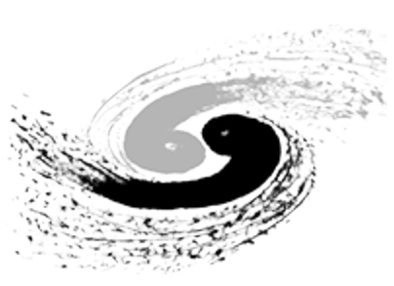



Self Introduction
F. Qiu, Senior Staff Scientist, 1985/07/05, Affiliation: Institute of Modern Physics (IMP), China
  PhD degree @ IHEP (Beijing), Assistant Prof. @ KEK (previous affiliation)
Research Direction
LLRF algorithm
Application of AI-technique in ACCLs
2007-2012，IHEP, PhD
2020/12 @ IMP, Staff Scientist
2020/11, from KEK to IMP
From 2024
2012-2020，KEK, RF grp.， Assistant Prof.（Permanent）
China initiative ADS （CiADS）
Notes:
I obtained my PhD degree from the IHEP in 2012. Afterward, I came to Japan and worked as a postdoctoral researcher at KEK. In 2014, I was promoted to the position of Assistant Professor. In 2020, I transitioned from KEK to work at the IMP. Currently, I hold the position of staff at IMP. In the next year, we will move to the southern China to attend the China initiative ADS project.

Slide 4
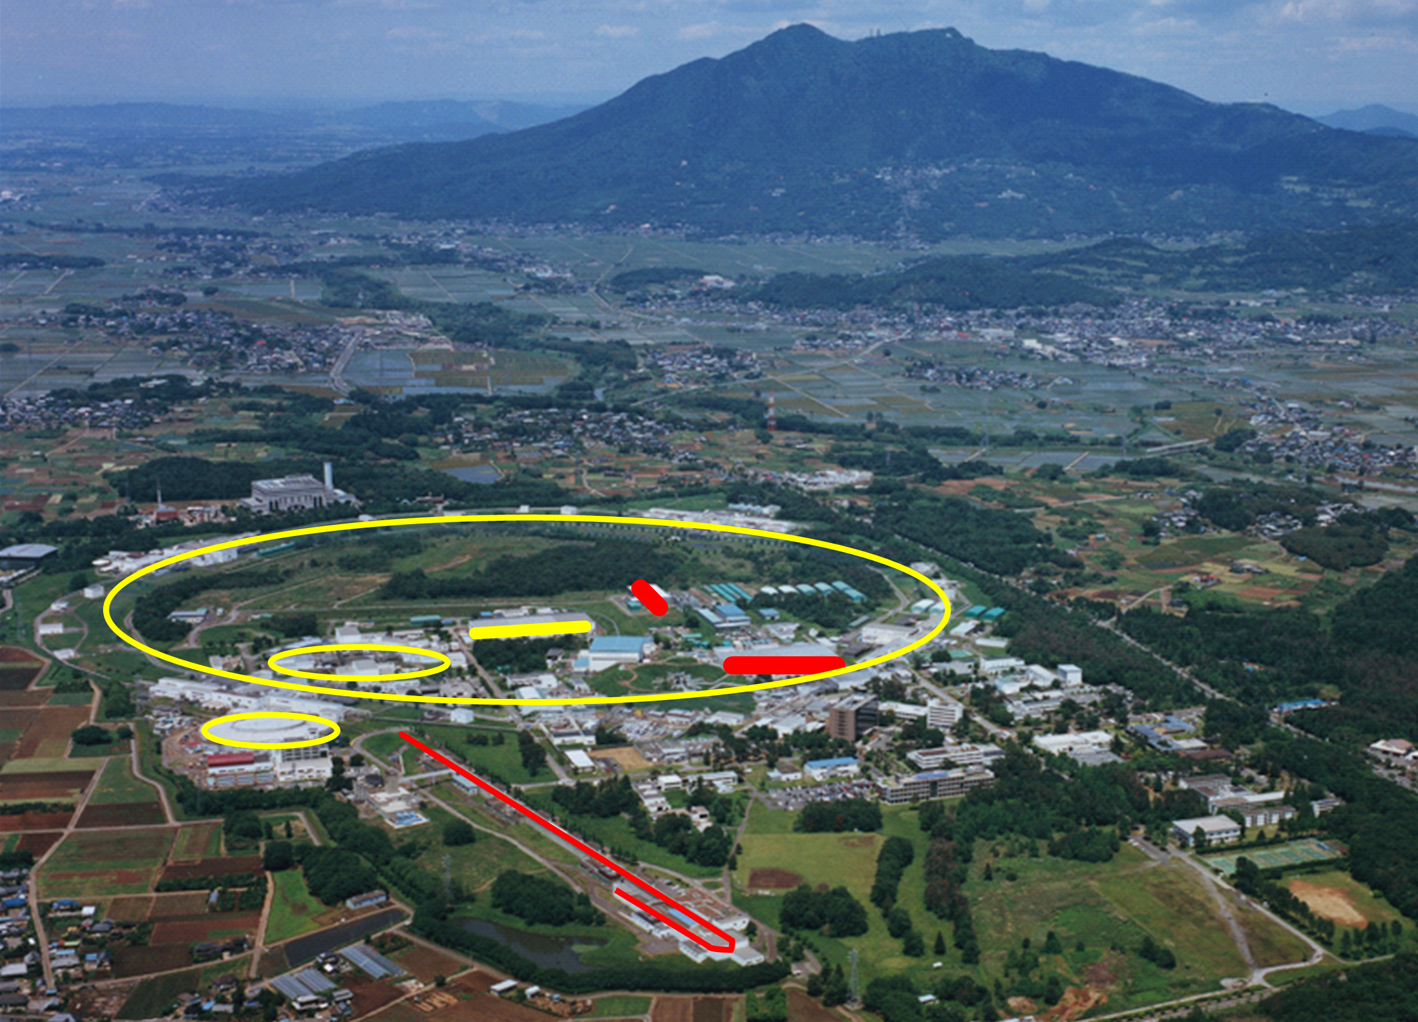
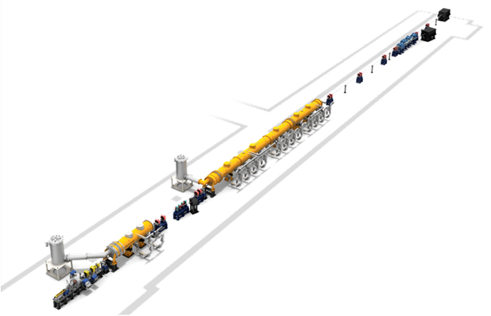
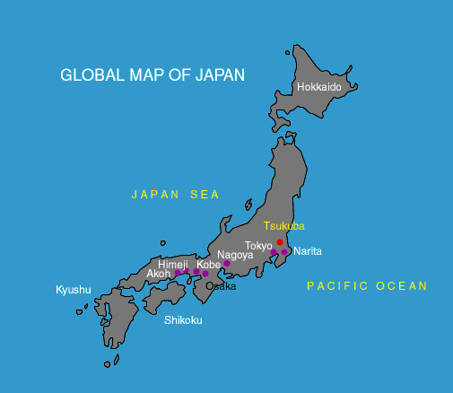
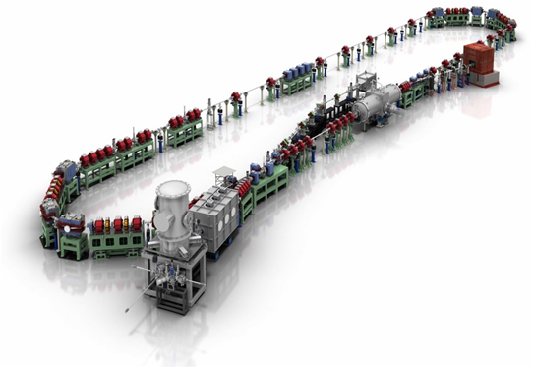
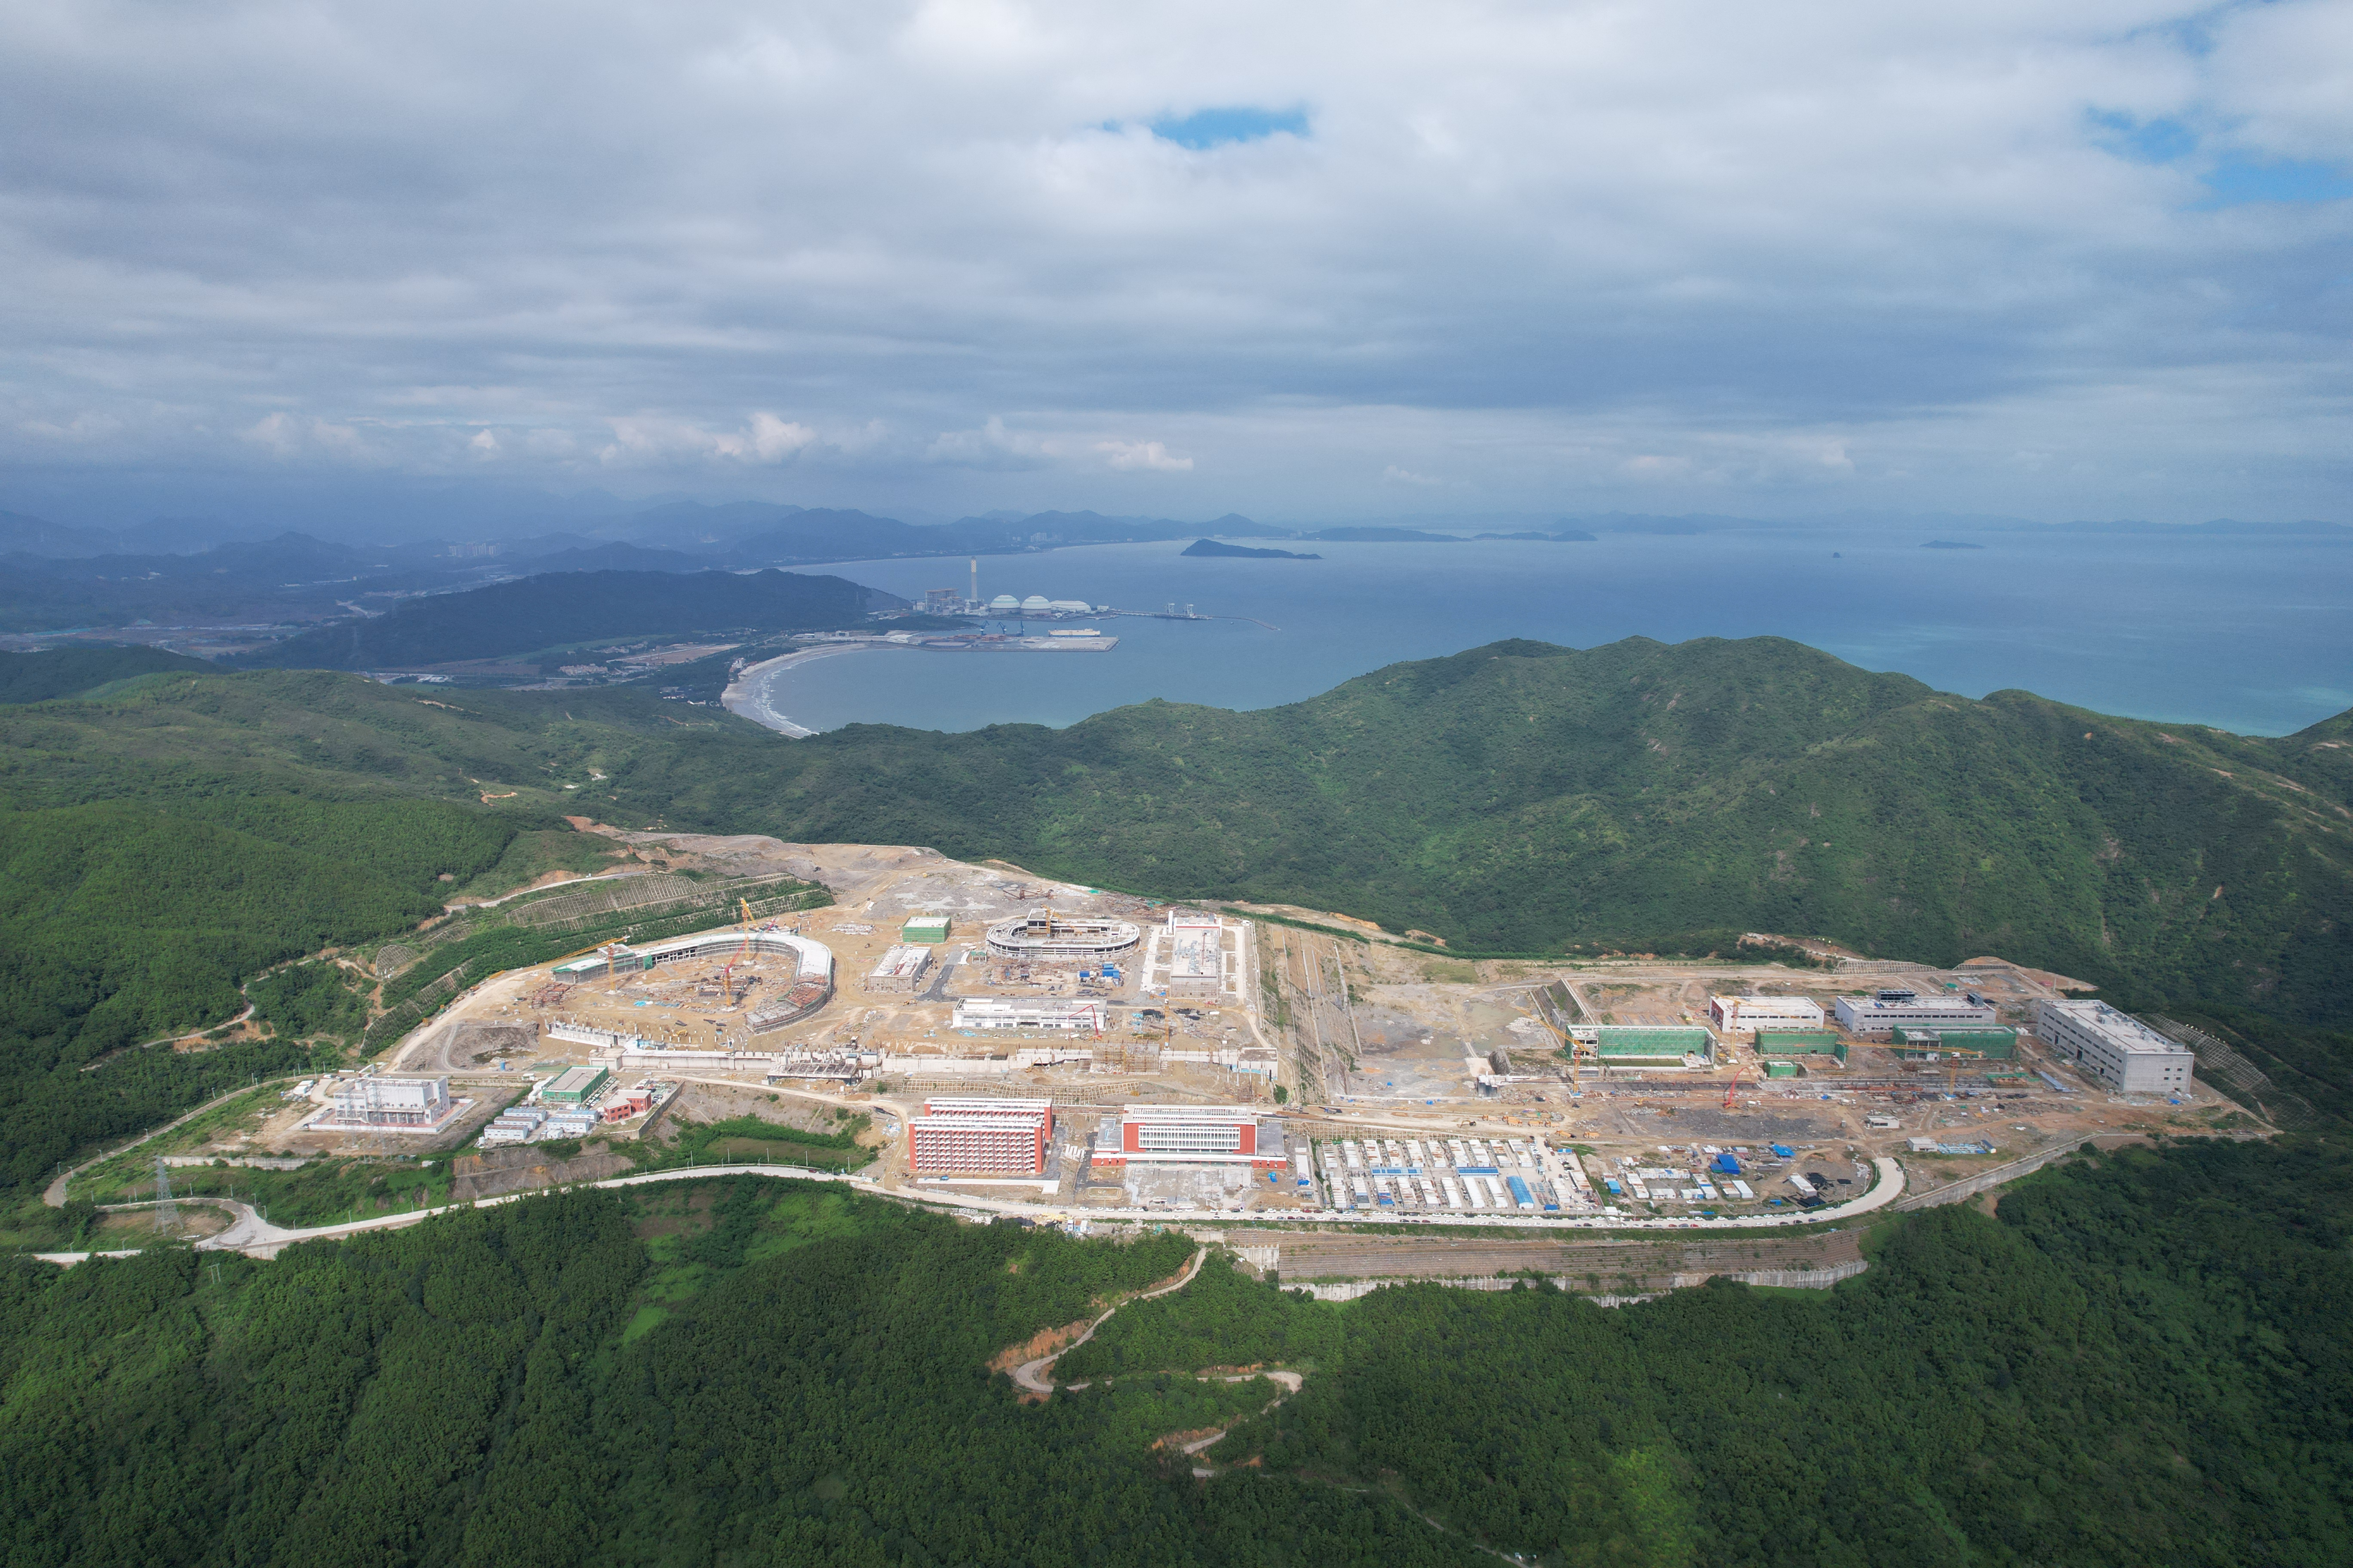
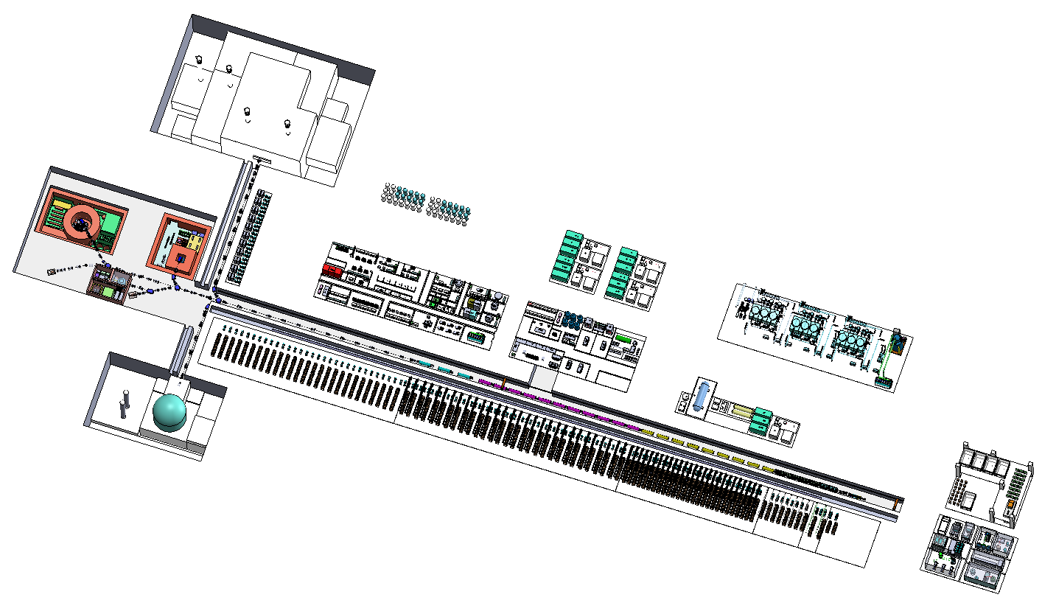
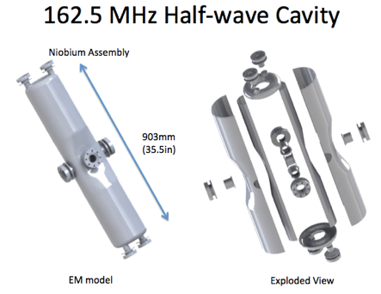
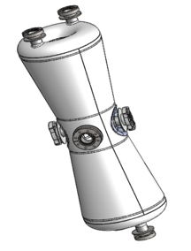
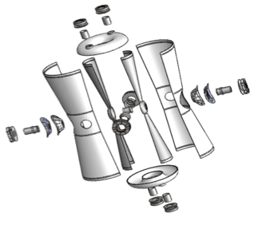
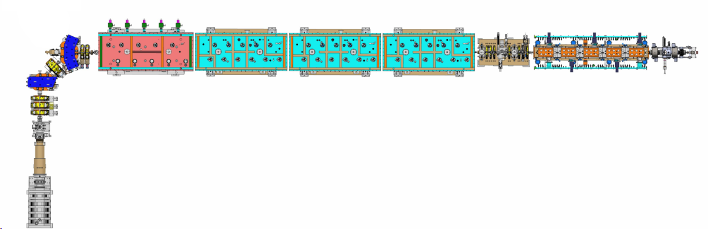
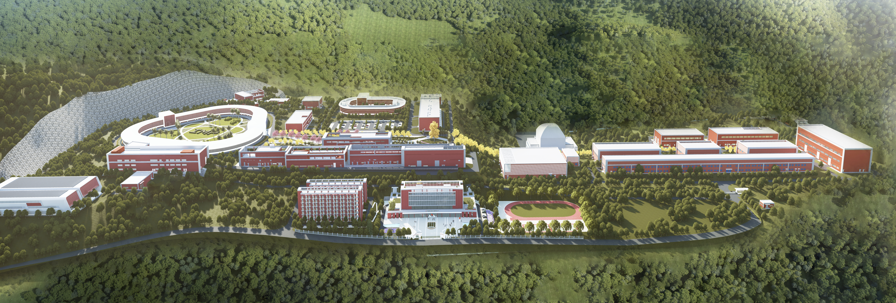
Self Introduction (cont’d)
Main project involved: cERL and STF @ KEK; CiADS (& its prototype facility: CAFe) @ IMP
KEK
STF（Superconducting test-facility）
Cav | Q_{L} | RF Source
Bun | 1.1e5 | 8 kW SSA
Inj₁ | 1.2e6 | 25 kW Kly.
Inj₂ | 5.8e5 | 300 kW Kly.
Inj₃ | 4.8e5
ML₁ | 1.3e7 | 8 kW SSA
ML₂ | 1.0e7 | 16 kW SSA
@Tsukuba
Mont. Tsukuba
SRF
cERL (compact ERL)
~20 MeV
KEKB-LINAC
SRF
cERL 1.3 GHz, CW
CiADS
@Huizhou
Sep. 2023
CiADS
~20 MeV, 10 mA
1 RFQ+ 23 SC
Q_{L}: 5e5~1e6
10 kW SSA
Aerial View
SRF
Architectural Rendering
RFQ
HWR₀₁₀ (β=0.1)
HWR₀₁₅ (β=0.1)
Linac Prototype
HIAF (High Intensity heavy-ion Accl. Facility)
CAFe (Chinese ADS Front-end), 162.5 MHz, CW
Notes:
In KEK, I was

Slide 5
LLRF Algorithms (Achievements in the last 3 years)
Advanced LLRF algorithms are crucial for improving the beam quality
Academic Achievements
Disturbance Observer-based Ctrl.
PRAB, 24:012804, 2021
NST, 32:56, 2021
Beam
Active Noise Control
NIM-A, 955:163820, 2020
LLRF
Ctrl. Algorithm
RF/Beam
Commissioning
Signal Cali. / Meas.
& Sys. Identification
Modified Iterative Learning Ctrl.
NIM-A, 1026: 166237, 2022
Beam Quality
FF-based Rapid Phase Tuning
IEEE-TNS, 70:2, 2023
LLRF
Algorithm
Novel RF Pulse Shaping Scheme
NIM-A, 985: 164660, 2021
Burst-noise Mitigation
NST, 32:140, 2022
RF Stability
Reliability
Channel Crosstalk Calibration
NIM-A, 1034: 166769, 2022
NST, 33:4, 2022
Loaded Q and Detuning Cali.
NST, 34:123, 2023
LFD Transfer Function Meas.
NIMA, 1012:165633, 2021
RF & linac
KEK Work
IMP Work
Notes:
Advanced LLRF algorithms are essential for improving RF stability and reliability, as well as the beam quality. I focus on the LLRF algorithms from three aspects: advanced control algorithms, Algorithms in RF/Beam commissioning, and signal calibration algorithm. Here are the academic achievements I have made in the last three years. The orange color indicates my works in KEK and the blue colors represent my IMP work

Slide 6
LLRF Algorithms (Achievements in the last 3 years)
Advanced LLRF algorithms are crucial for improving the beam quality
Academic Achievements
Disturbance Observer-based Ctrl.
PRAB, 24:012804, 2021
NST, 32:56, 2021
Beam
Active Noise Control
NIM-A, 955:163820, 2020
LLRF
Ctrl. Algorithm
RF/Beam
Commissioning
Signal Cali. / Meas.
& Sys. Identification
Modified Iterative Learning Ctrl.
NIM-A, 1026: 166237, 2022
Beam Quality
FF-based Rapid Phase Tuning
IEEE-TNS, 70:2, 2023
LLRF
Algorithm
Novel RF Pulse Shaping Scheme
NIM-A, 985: 164660, 2021
Burst-noise Mitigation
NST, 32:140, 2022
RF Stability
Reliability
Channel Crosstalk Calibration
NIM-A, 1034: 166769, 2022
NST, 33:4, 2022
Loaded Q and Detuning Cali.
NST, 34:123, 2023
LFD Transfer Function Meas.
NIMA, 1012:165633, 2021
RF & linac
KEK Work
IMP Work
Notes:
Today, because of the time limitation, I only focus on these four topics.

Slide 7
01
Self-Introduction
02
Research Activities
CONTENTS
Disturbance Observer-based Ctrl.
Modified Iterative Learning Ctrl.
Burst-noise Mitigation
Channel Crosstalk Calibration

Slide 8
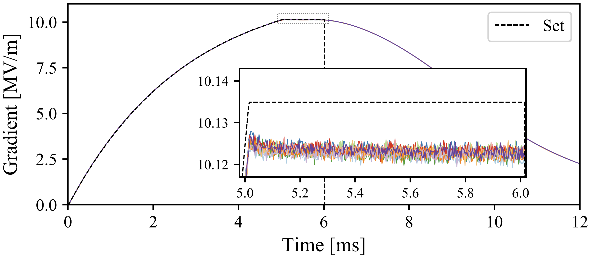
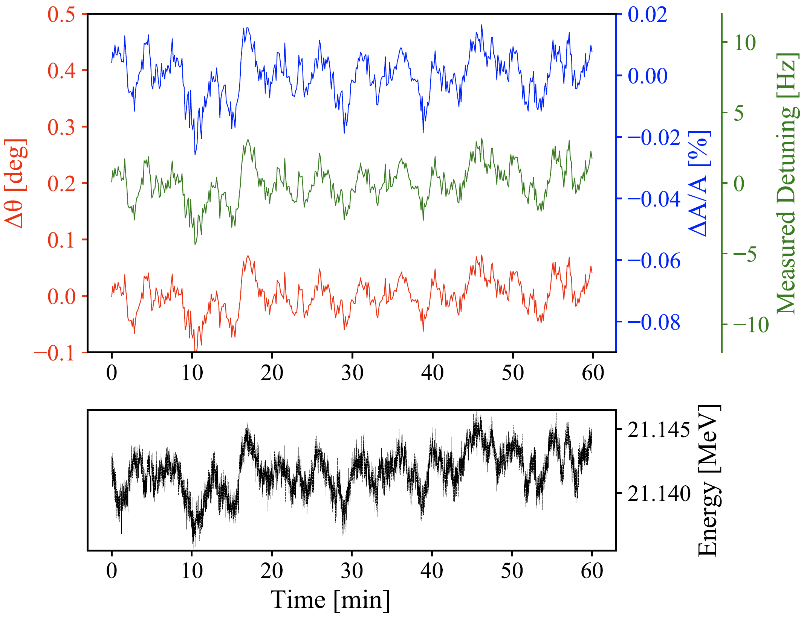
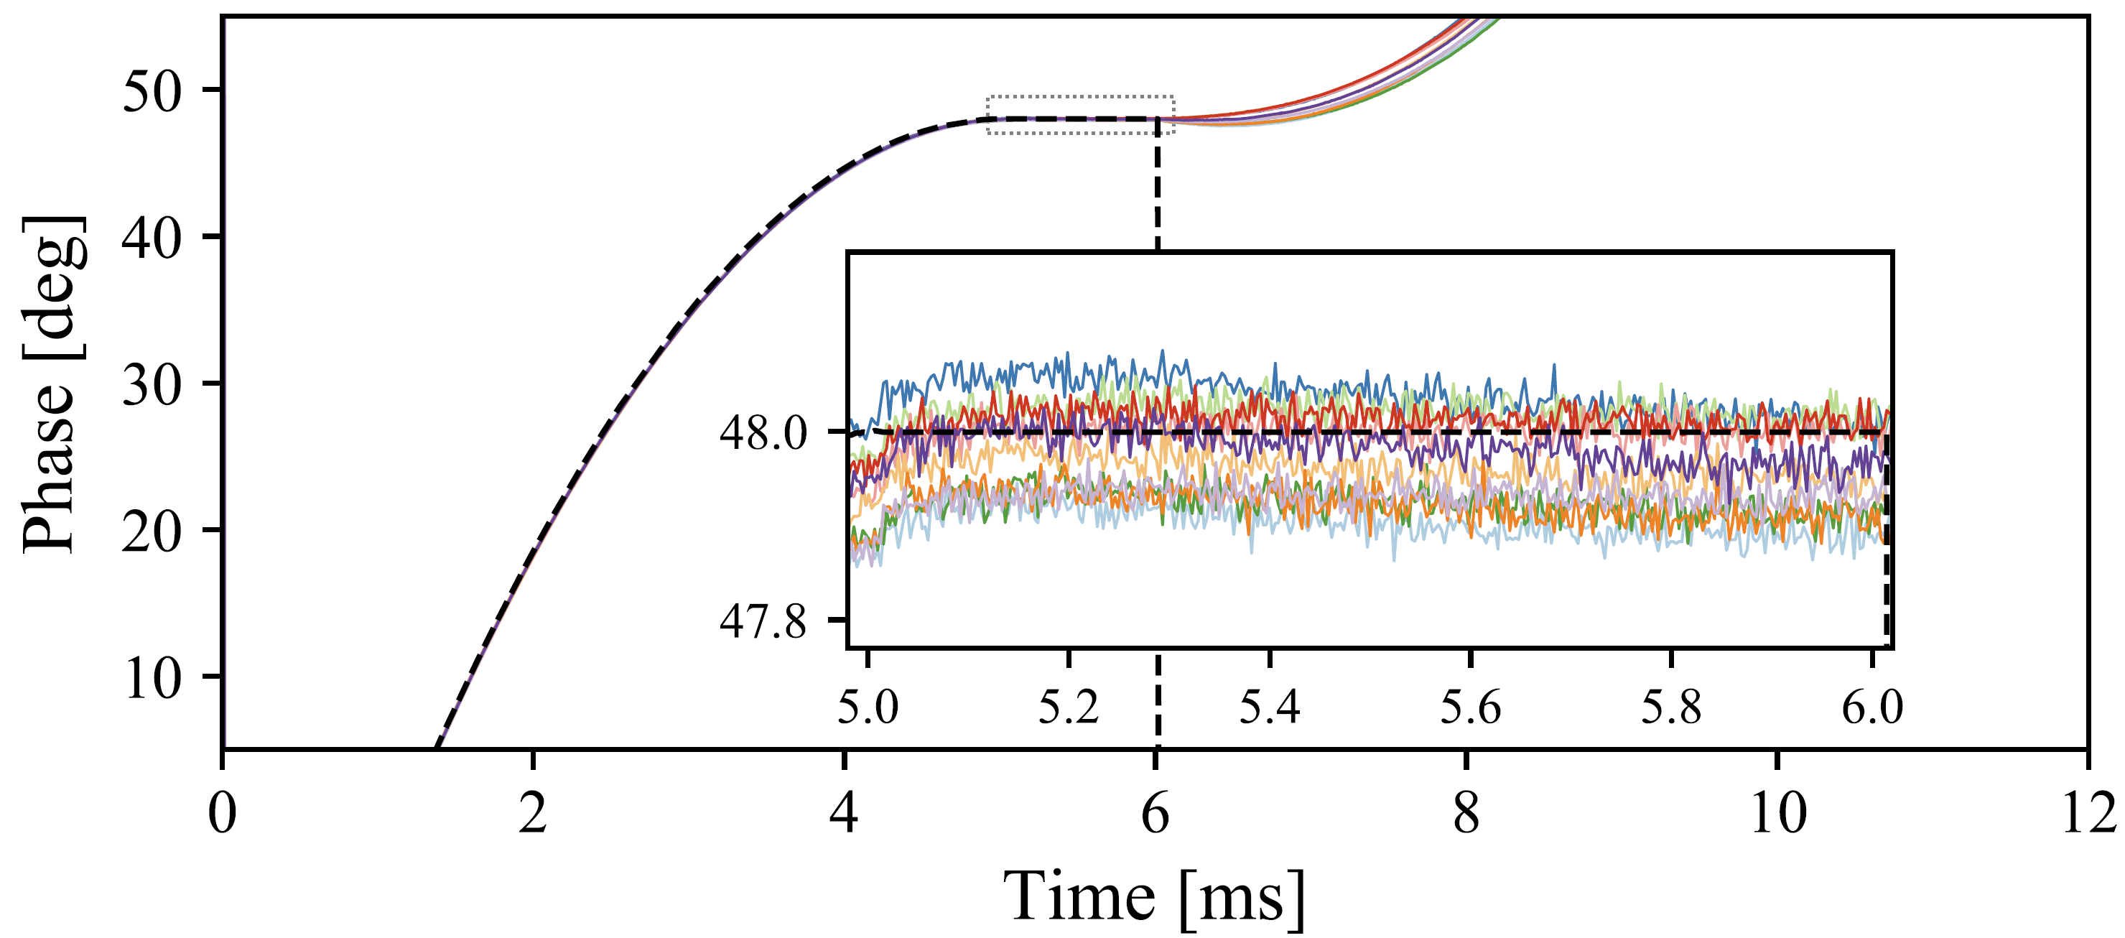

Pulse Mode Operation @ cERL
Operated cERL in pulse mode to increase the beam energy (for isotope production)
Encountered poor pulse-to-pulse stability under PI ctrl (Intra-pulse stability looks good)
Observed fluctuations in the measured beam energy
Pulse shape
RF Stability (Pulse-to-pulse)
Amp
Detuning
Phase
Beam Energy Stability
Pulse-to-pulse
F. Qiu*, et al., Application of disturbance observer-based control on pulsed superconducting radio frequency cavities Phy. Rev. Accel Beam 21, 032003 (2018)
Notes:
During the pulsed mode beam operation at cERL, we have encountered poor pulse-to-pulse stability under the traditional PI ctrl, the intra-pulse stability seems not bad. From one hour of beam energy data, it can be observed that there is a significant fluctuation in beam energy, and this fluctuation is closely related to the pulse-to-pulse RF stabilities.

Slide 9


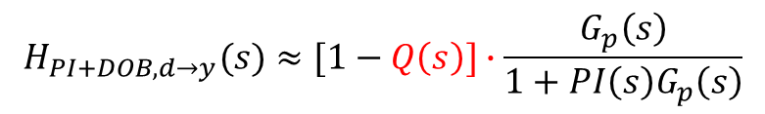
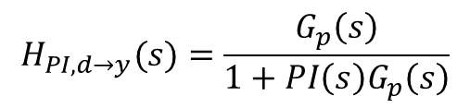

Disturbance Observer-based (DOB) Control
Disturbance Observer (DOB) ctrl.: Reconstruct disturbance estimation ( ), then cancel d with from the LLRF control loop
$$\hat{d}$$
$$\hat{d}$$
Cav
PI
y
d
y
$$H_{PI,d→y}(s)=\frac{G_{p}\left(s\right)}{1+PI\left(s\right)G_{p}\left(s\right)}$$
$$\hat{d}$$
Re-construct
$$H_{PI+DOB,d→y}(s)≈[1−Q\left(s\right)]∙\frac{G_{p}\left(s\right)}{1+PI\left(s\right)G_{p}\left(s\right)}$$
$$s=jω→0, Q\left(s\right)≈1,→ 1−Q(s)≈0$$
Notes:
Assuming that external disturbances, such as the beam, is 'd,' and the cavity's output is 'y,' we can then reconstruct the disturbance signal 'dhat’ from y using the inverse cavity model. Subsequently, we can eliminate 'dhat' from the control loop. Please note that a low-pass 'Q' filter is required to remove high-frequency components

Slide 10
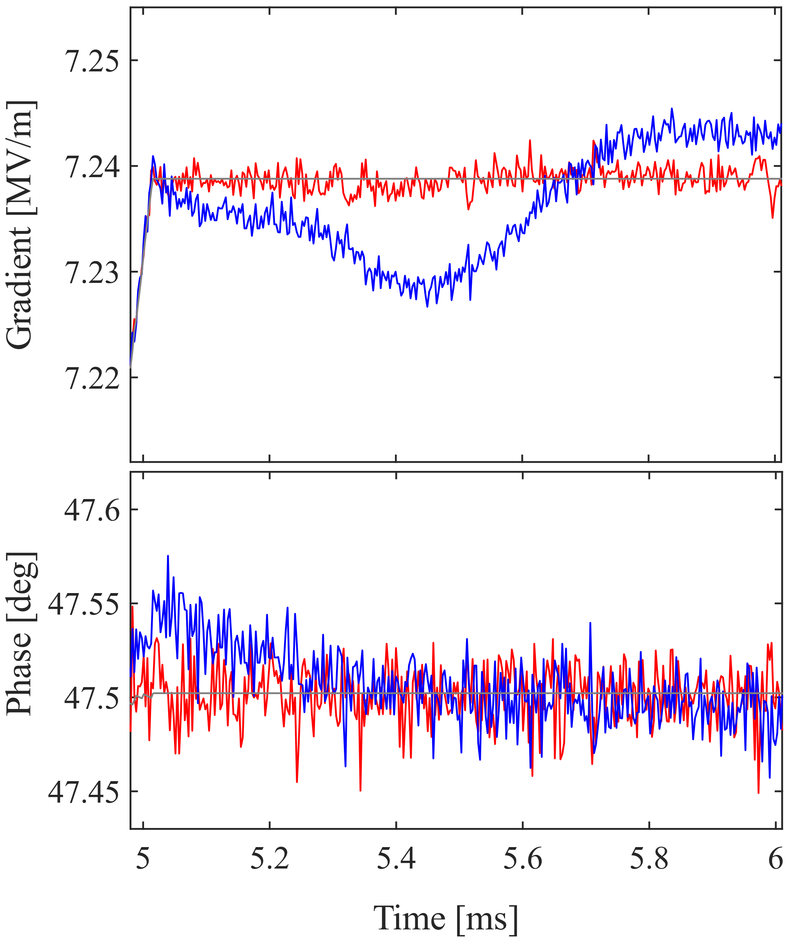
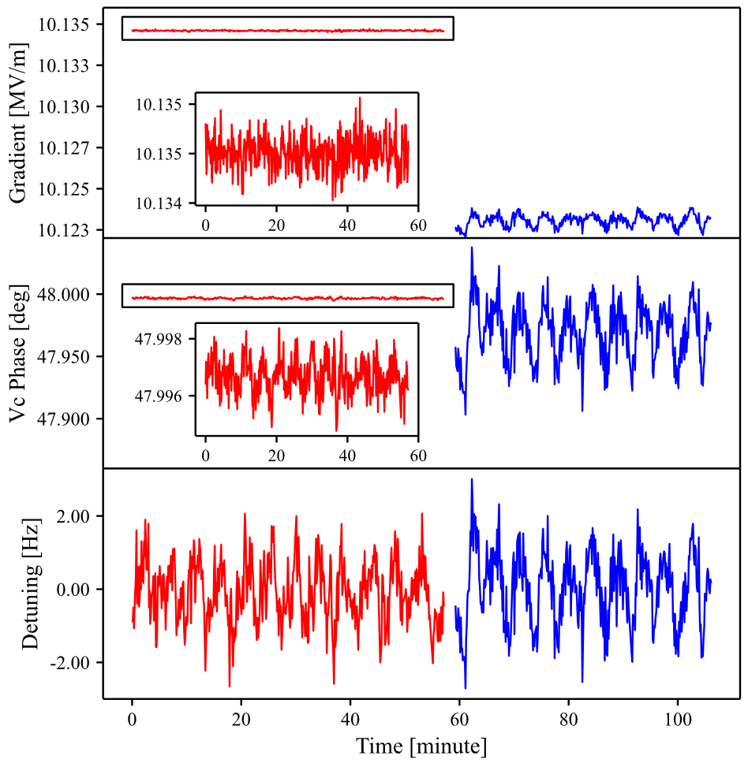
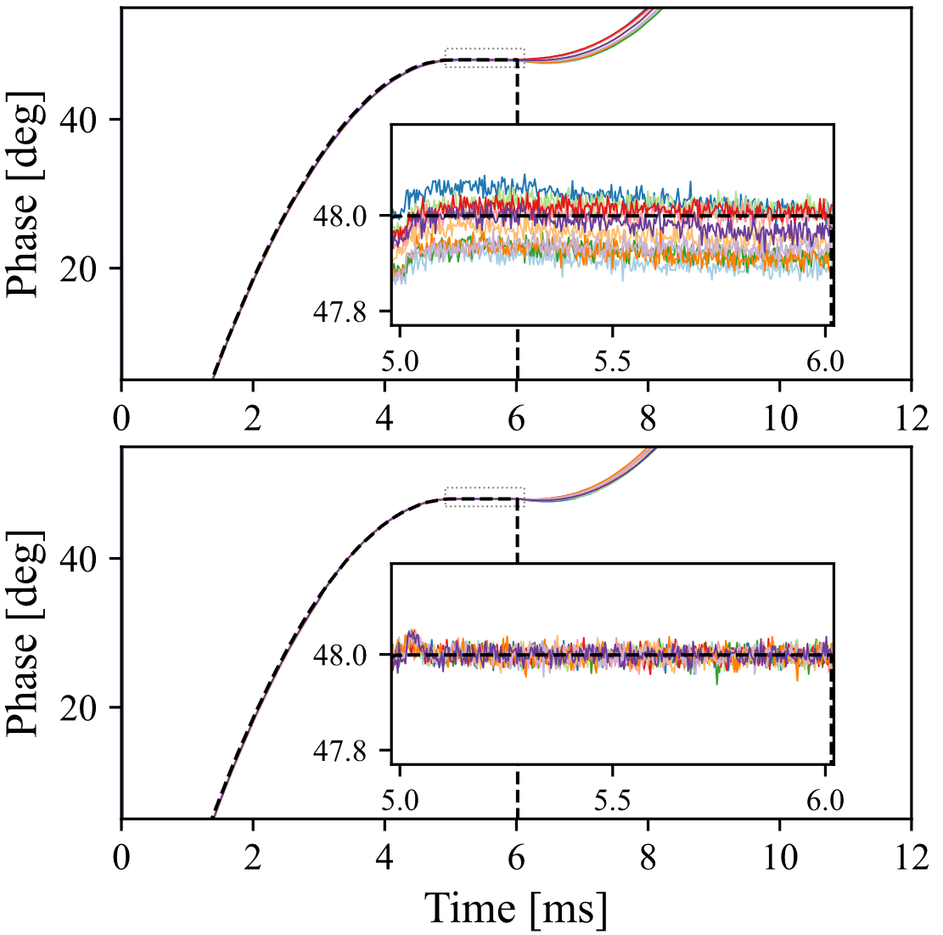
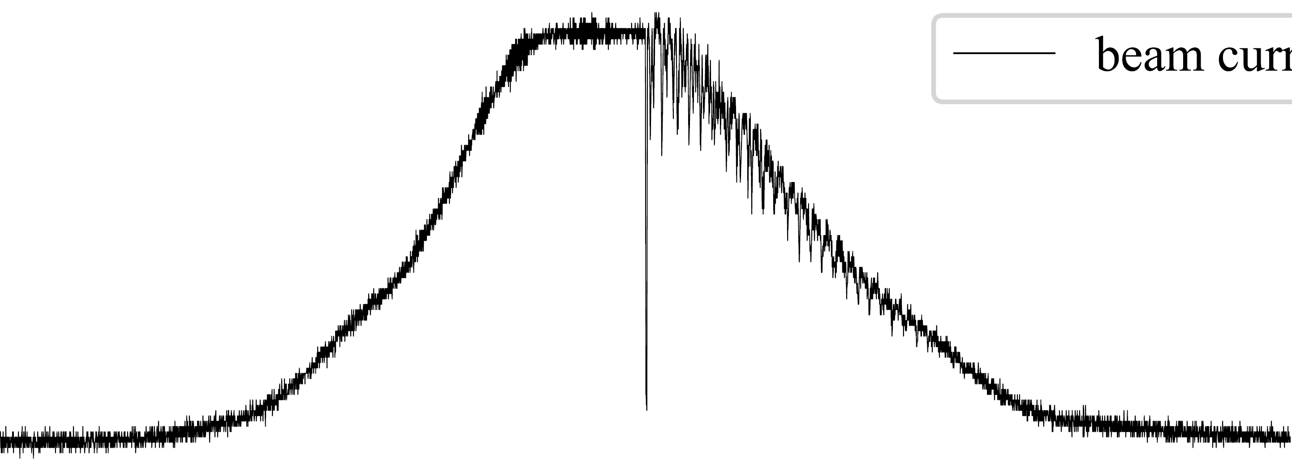
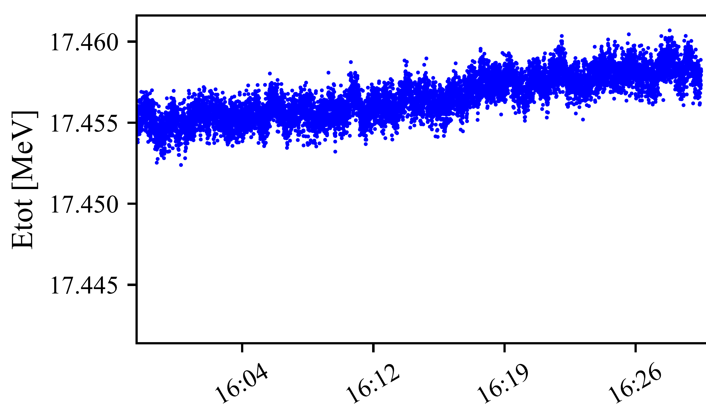
DOB Control (cont’d)
High RF stabilities and beam energy stability have been achieved
RF stabilities (intra-pulse)
RF stabilities (Pulse-to-pulse)
Beam
PI+DOB
PI
PI
PI+DOB
PI
PI+DOB
Beam Energy
(NO fluc.)
F. Qiu*, et al., Application of disturbance observer-based control on pulsed superconducting radio frequency cavities Phy. Rev. Accel Beam 21, 032003 (2021)
F. Qiu*, et al., Combined disturbance-observer-based control and iterative learning control design for pulsed superconducting radio frequency cavities, Nucl. Sci. Tech. 32:56 (2021)
Notes:
We have applied the PI+DOB control in cERL LLRF systems. Here is the results of the intra-pulse in the presence of a approximately 1 mA beam. As you see that the beam induced RF transient is well compensated by the proposed DOB control. Here is the result of the pulse-to-pulse RF stabilities. As is shown The DOB control can significantly improve pulse-to-pulse stability. Meanwhile the fluctuation in the beam-energy was removed.

Slide 11
01
Self-Introduction
02
Research Activities
CONTENTS
Disturbance Observer-based Ctrl.
Modified Iterative Learning Ctrl.
Burst-noise Mitigation
Channel Crosstalk Calibration

Slide 12
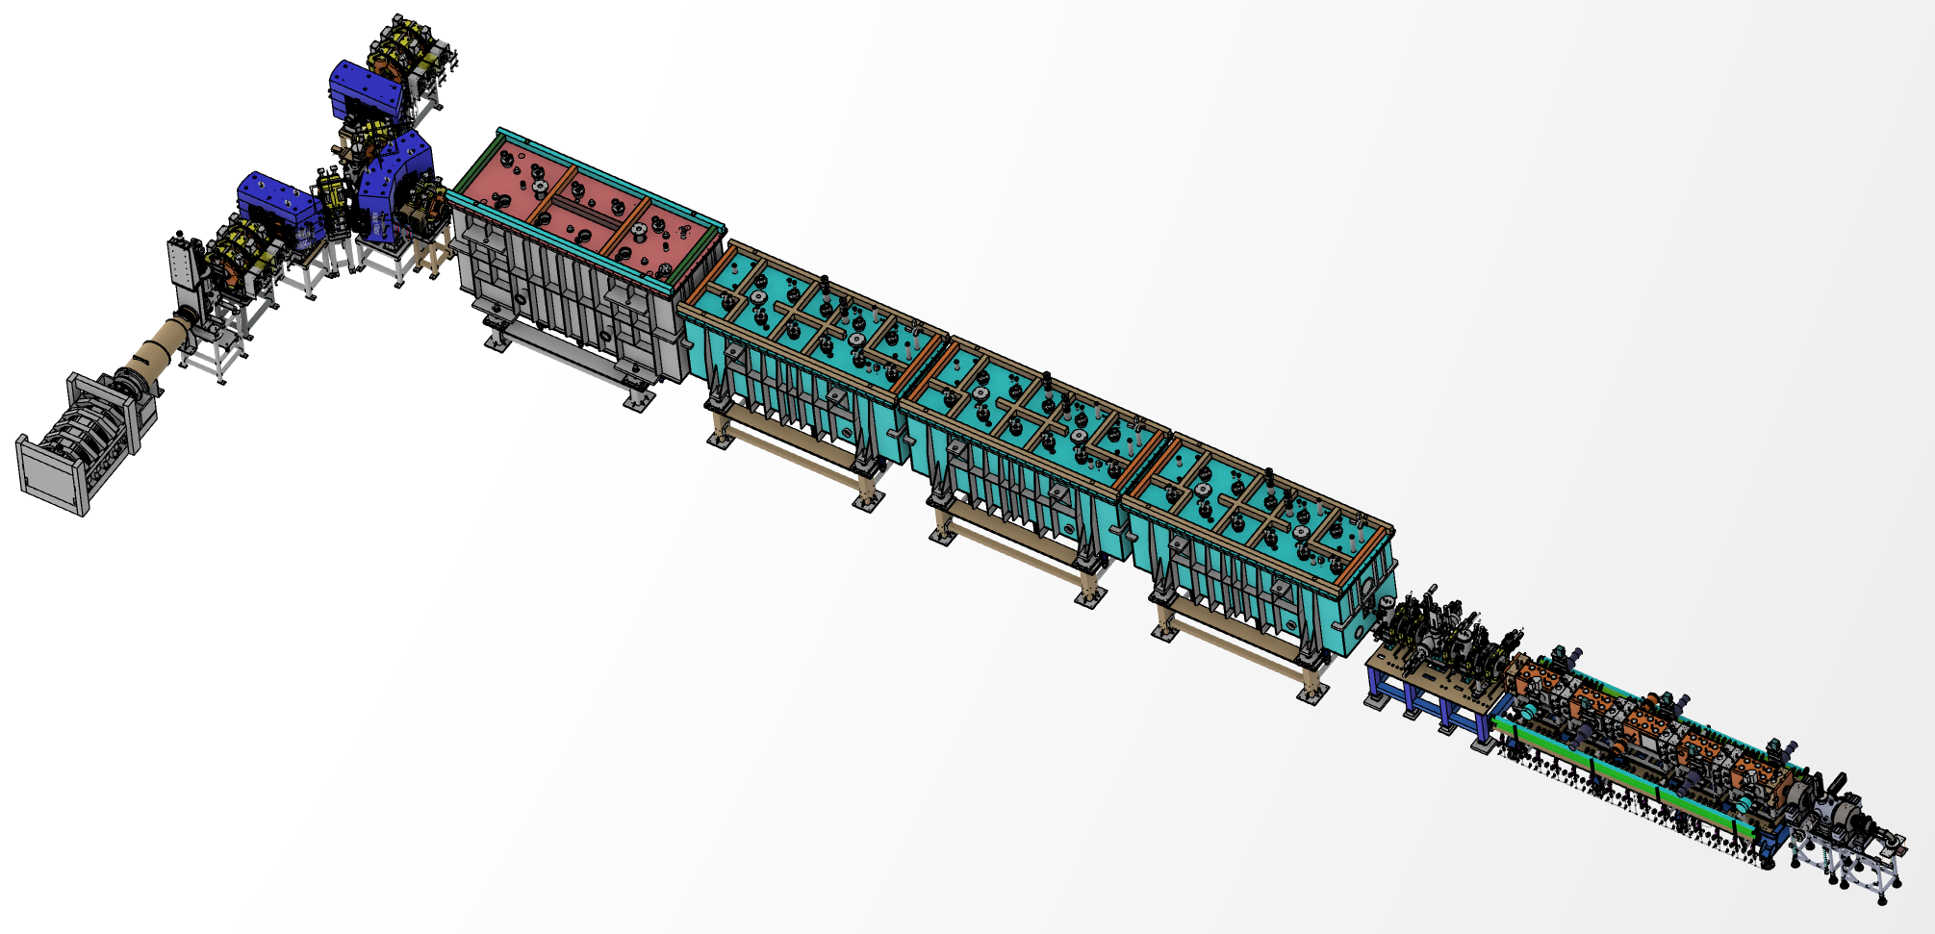

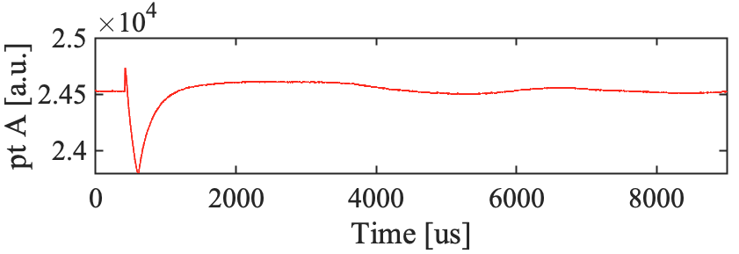
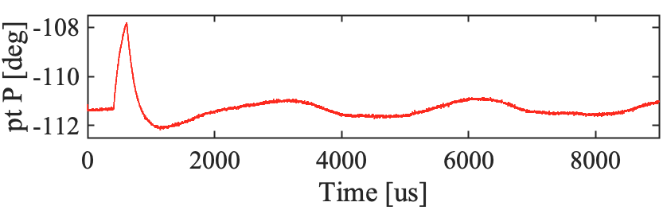
Transient Loading of 10 mA Beam @ CAFe
CAFe → Stable operation of 10 mA proton beam
  In March 2021，CAFe achieved stable operation at hundreds of kW for 100 hours, confirming the feasibility 10 mA beam operation. The average beam current set new world records for proton linear SRF accelerators
Fault
SRF cavities
Operation
Self-recovery
Pulse
CW Operation
10 mA
Recovery within second-level
10 mA
CAFe
0 mA
CERN-COURIER evaluates this achievement as an outstanding accomplishment and a milestone breakthrough in the field of ADS
Transient beam-loading @10 mA
Amp. [a. u.]
ΔA/A ~ 3%
The transient loading of a 10 mA beam is the most critical technical challenge!!
Δθ ~ 3 deg
Pha. [deg]
Time [μs]
Notes:
In this achievement, one of the challenge issue is the transient loading of a 10mA beam. As a complex system, faults cannot be avoided in CAFe. When a fault occurs, we have to stop the beam, wait for the fault to be recovered, and then reload the pulsed beam. The transient load of the 10mA beam may cause RF instability.

Slide 13
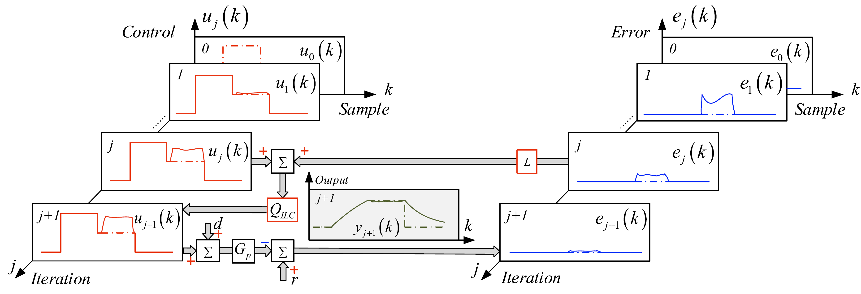
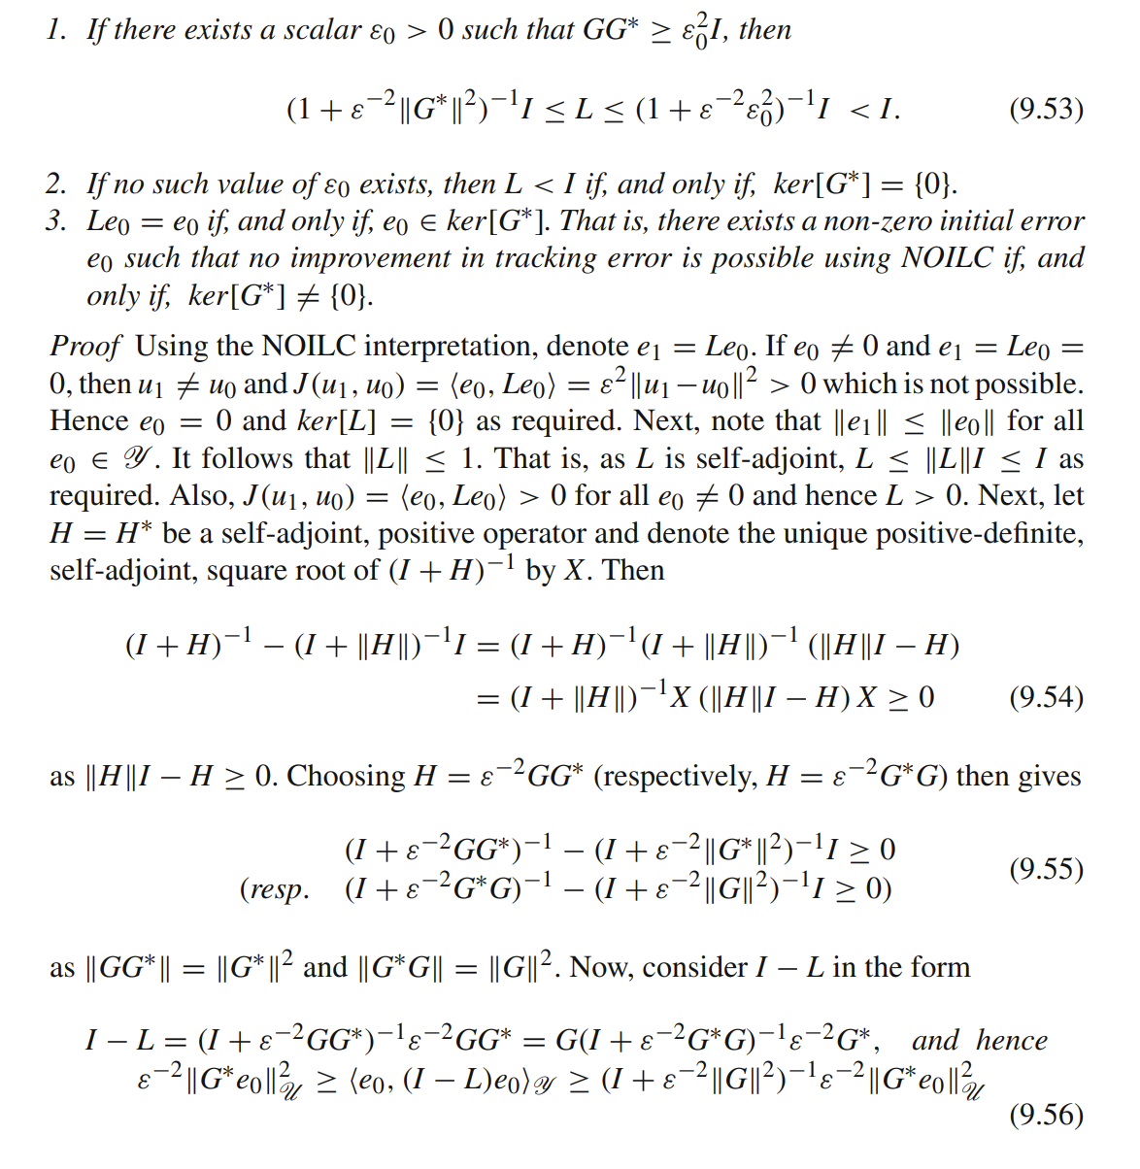

Iterative Learning Control（ILC）
Iterative Learning Control (ILC) →widely used for beam-loading compensation
Step1： Calibrate the error between the reference signal (r) and cavity pick-up signal (y)
e_{j} (k)=r_{j} (k)-y_{j} (k)
Step2： Update the current feedforward (FF) output (u_{j+1}) using the previous FF (u_{j}) and error (e_{j})
A matrix or a zero-phase filter
u_{j+1} (k)=Q_{ILC} [u_{j} + L(e_{j} )]
A matrix or a plant-inversion-model or PID
E.g. Norm Optimal ILC
Complicated
The main ILC algorithm is usually implemented outside FPGA
—— D. H. Owens, Springer, 2015
Notes:
The traditional ILC algorithm is usually implemented outside of FPGA due to the high computational cost, which may reduce its real-time capabilities.

Slide 14
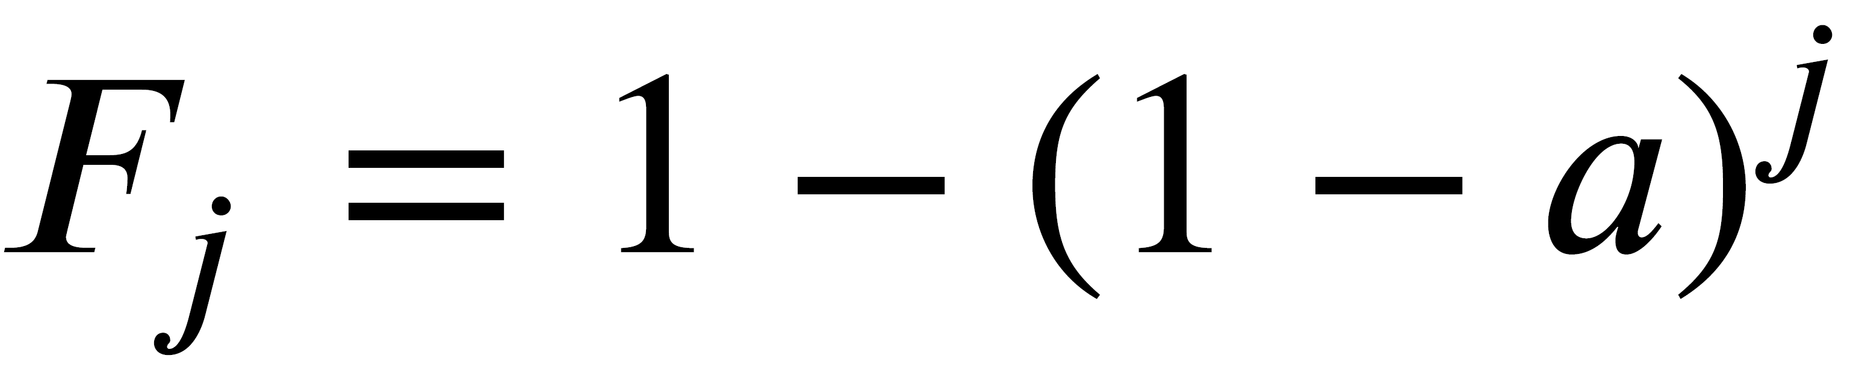
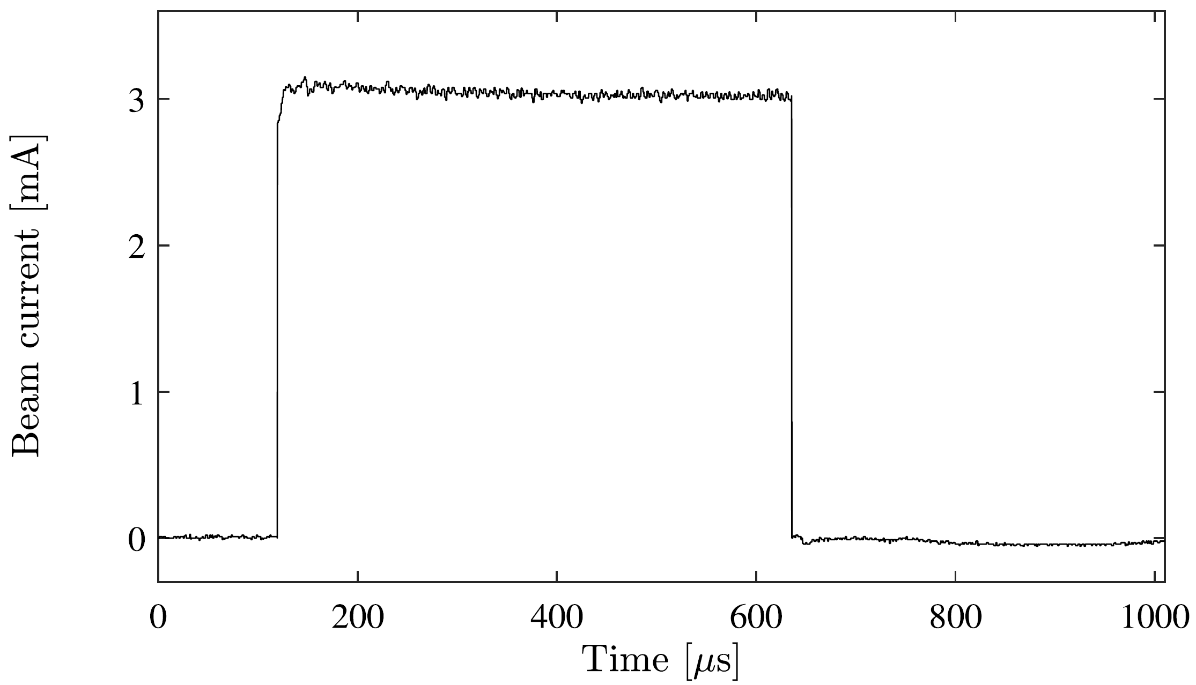
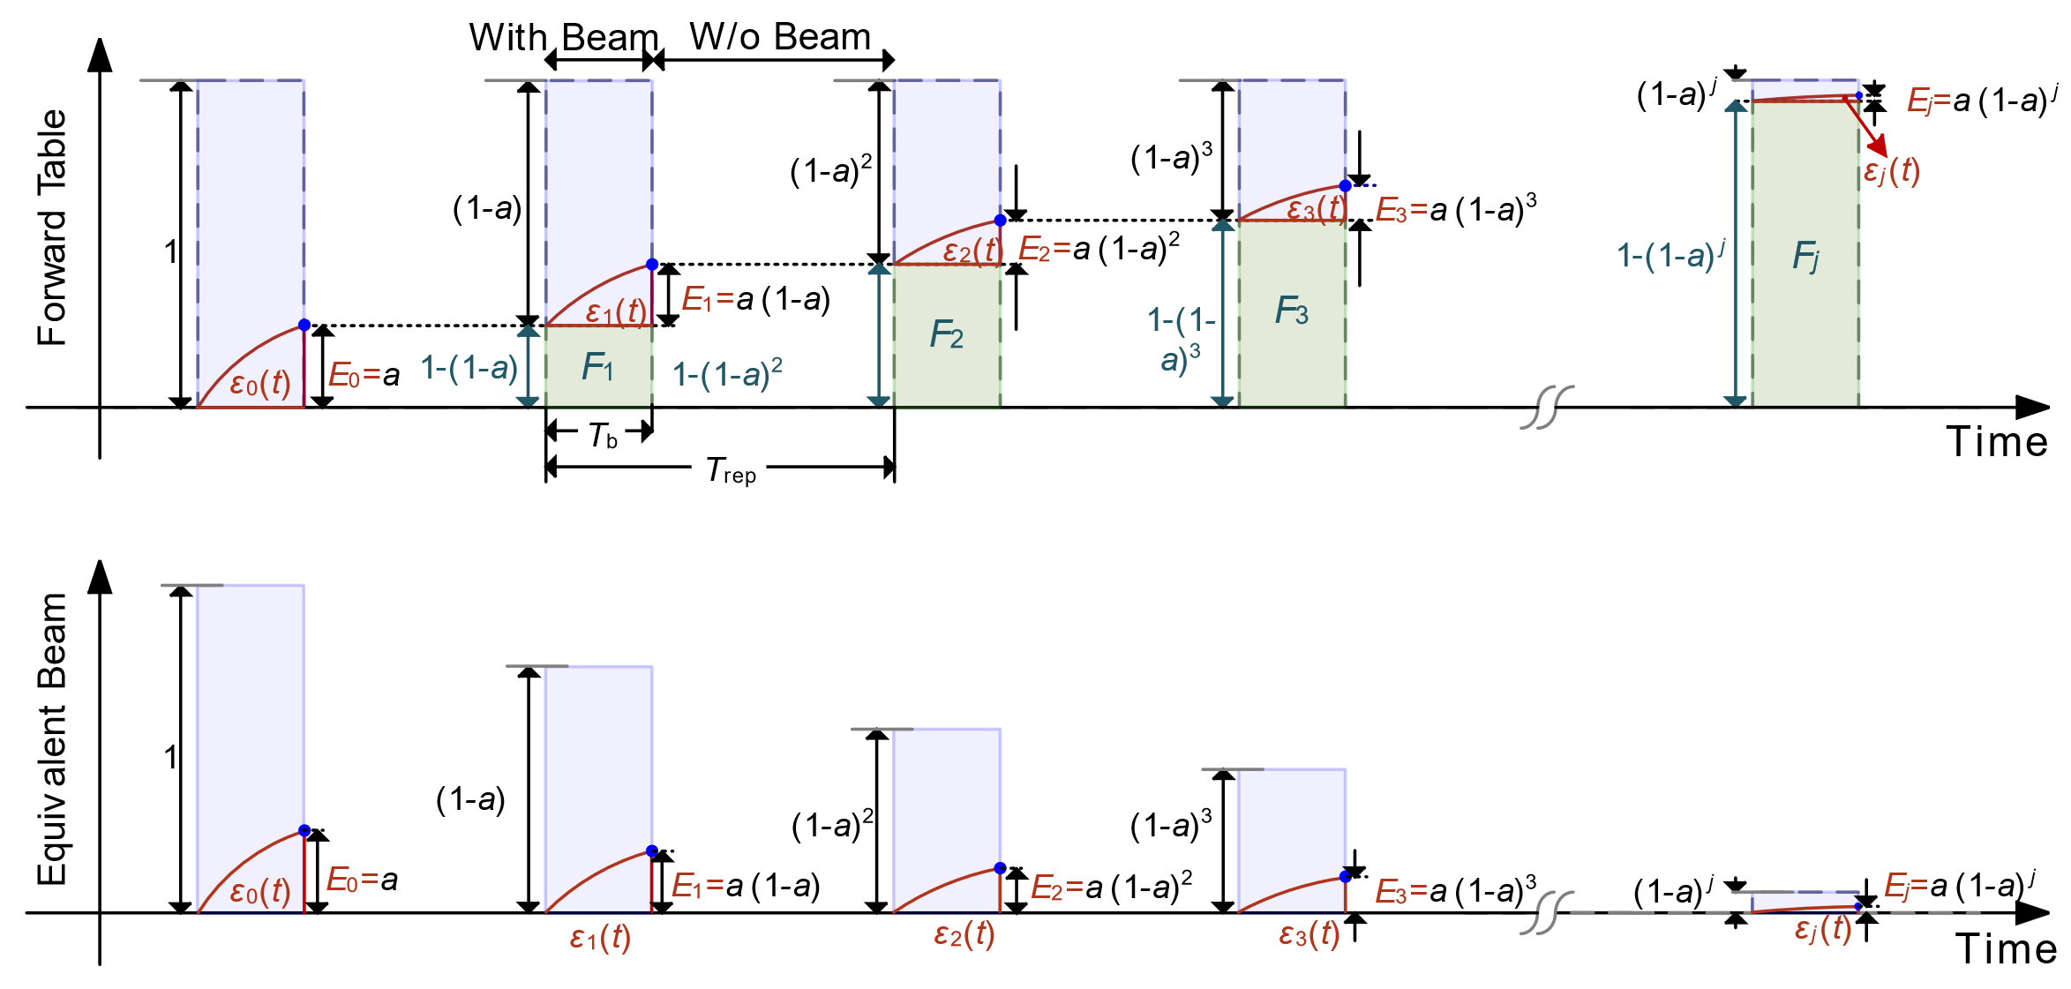
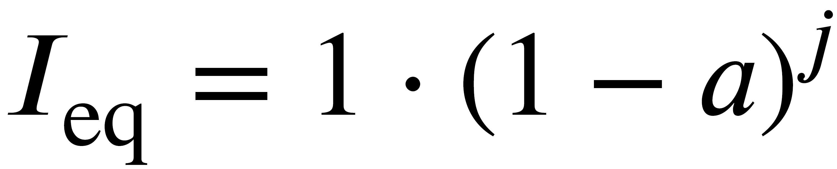
FPGA-based ILC (Basic Idea)
In most cases, a beam pulse can be considered quasi-rectangular, which means the FF could also be rectangular pulse. This assumption may significantly simplify the update law
Beam profile @ CAFe
FF
“quasi-rectangular”
u_{j+1} (k) = Q_{ILC} [u_{j} + L(e_{j} )]
u_{j+1} (k) = ε_{j} + F_{j} , ε_{j} = L(e_{j})
F_{j+1} = F_{j} + E_{j}
Constant Value (only a register inside FPGA)
Notes:
In most cases, a beam pulse can be considered a quasi-rectangular, which means the FF could also be rectangular pulse. This assumption may significantly simplify the update law

Slide 15
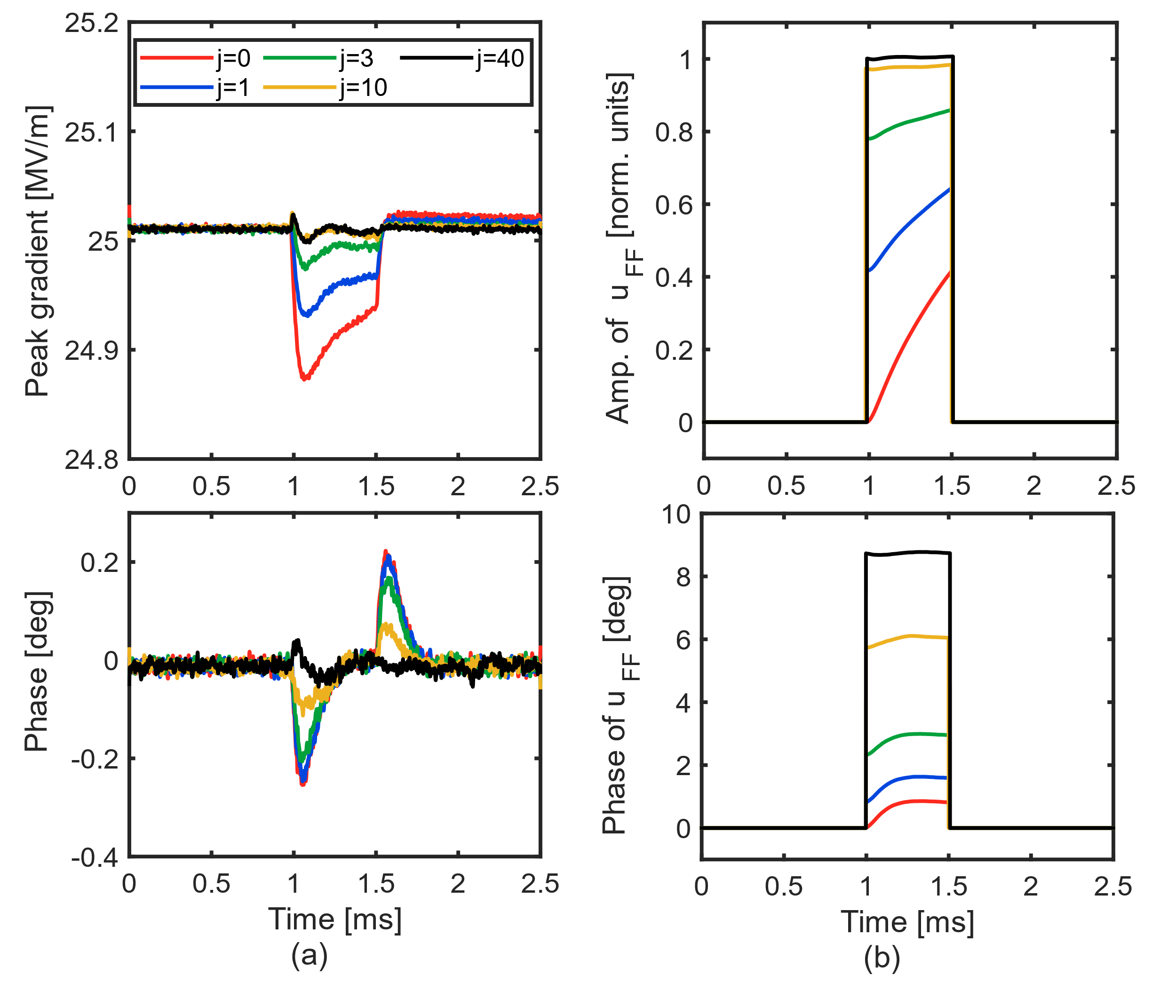
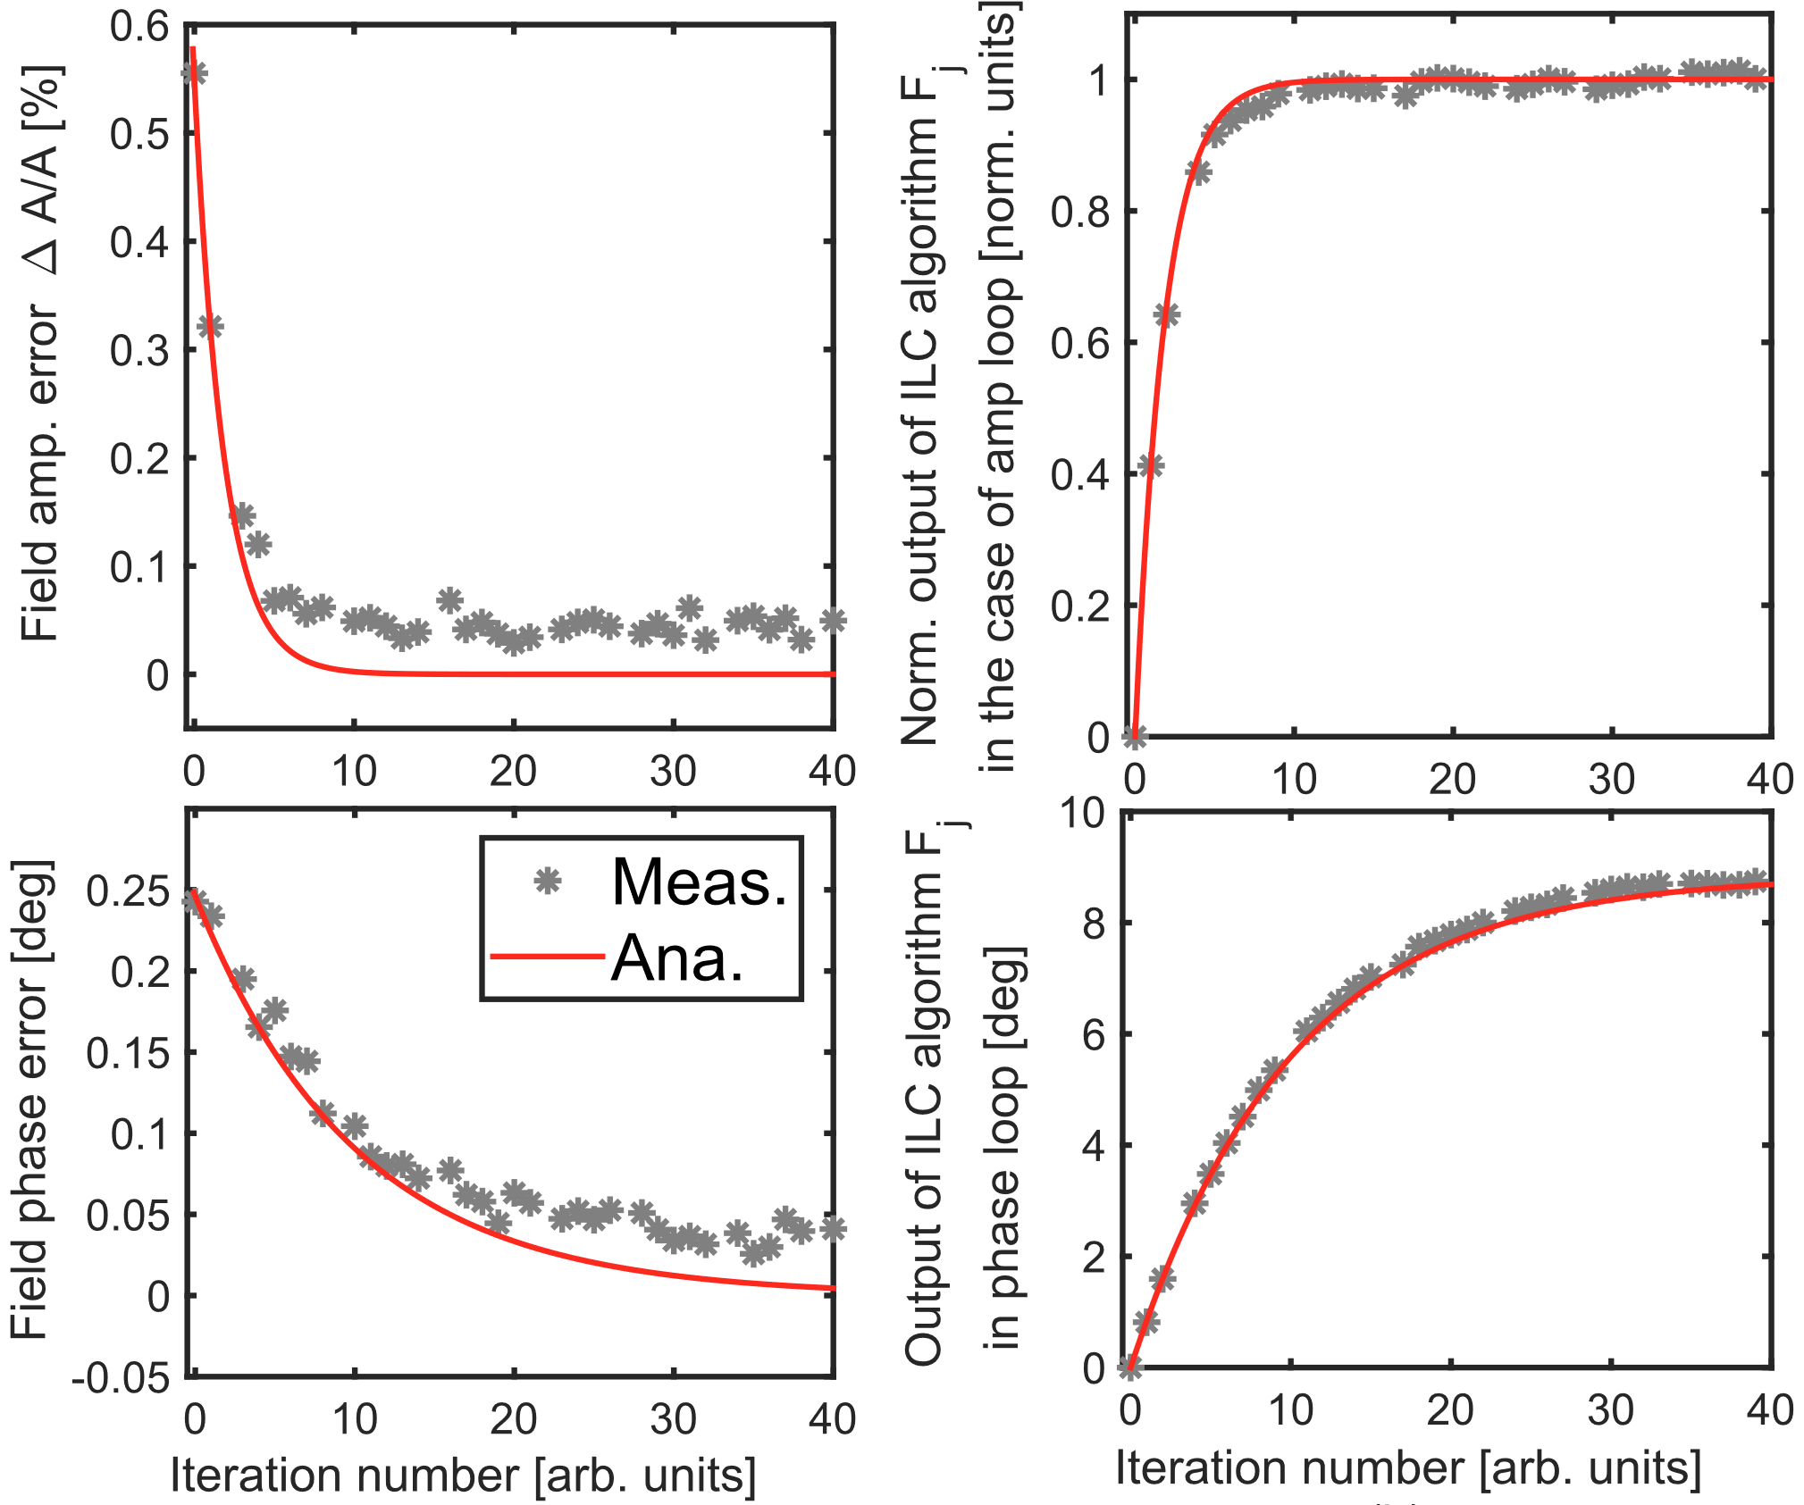
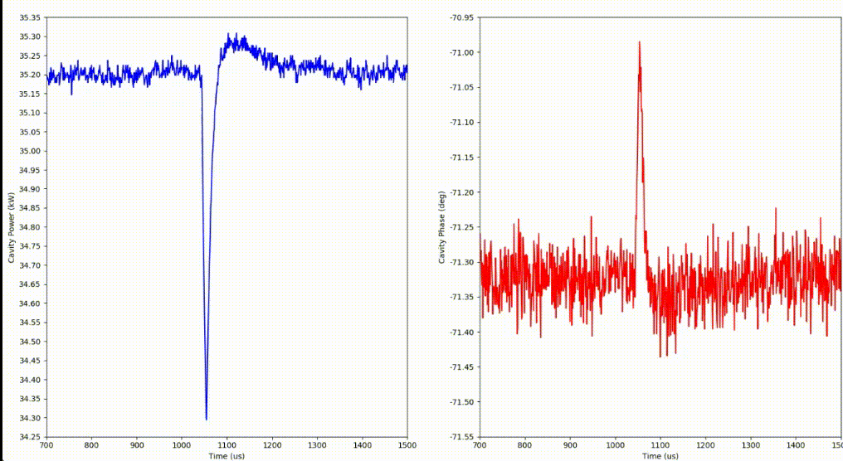
FPGA-based ILC (Confirmation)
The new ILC algorithm was demonstrated during the CAFe beam-commissioning
  High rep. rate: works in 1 kHz ~ 1 MH; High bandwidth (NO Q-filter)
RF waveforms during iter. proc.
Convergence curve
Cav. Field
FF
Cav. Field
FF
Implementation
Field Amp.
Field Pha.
20 μs beam
C. Xu，Z. Zhu，F. Qiu* et al., Application of a modified iterative learning control algorithm for superconducting radio-frequency cavities, Nucl. Instrum. Methods. A . 955,166237 (2022)

Slide 16
01
Self-Introduction
02
Research Activities
CONTENTS
Disturbance Observer-based Ctrl.
Modified Iterative Learning Ctrl.
Burst-noise Mitigation
Crosstalk Cali. & φ_{b} Cali.

Slide 17
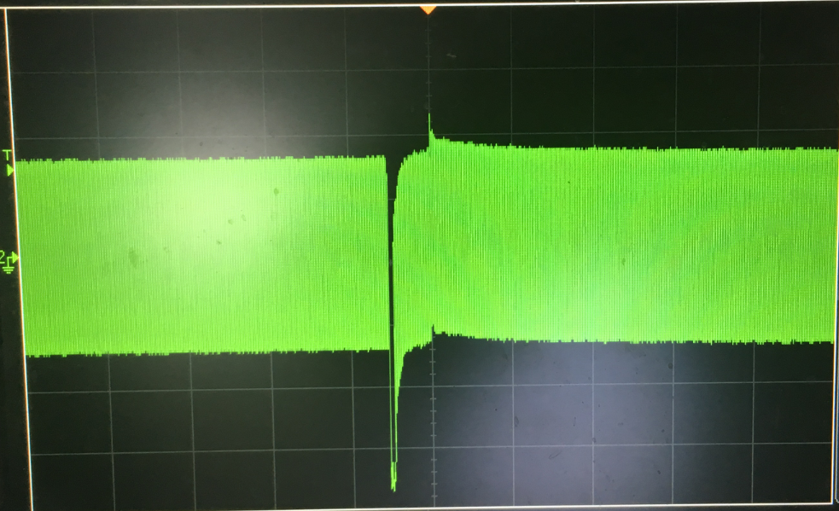
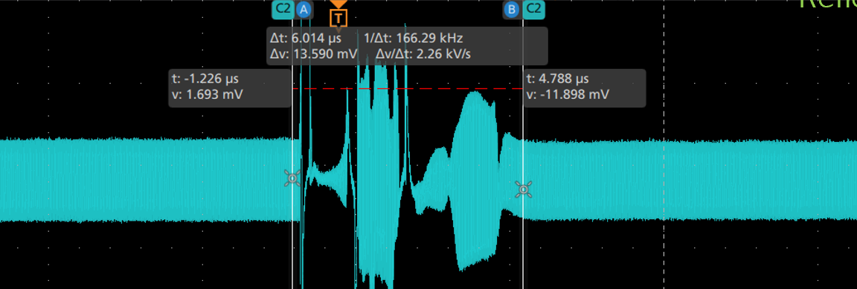
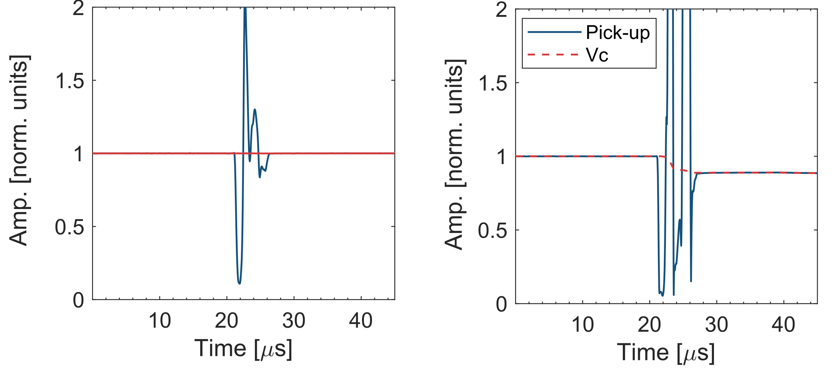
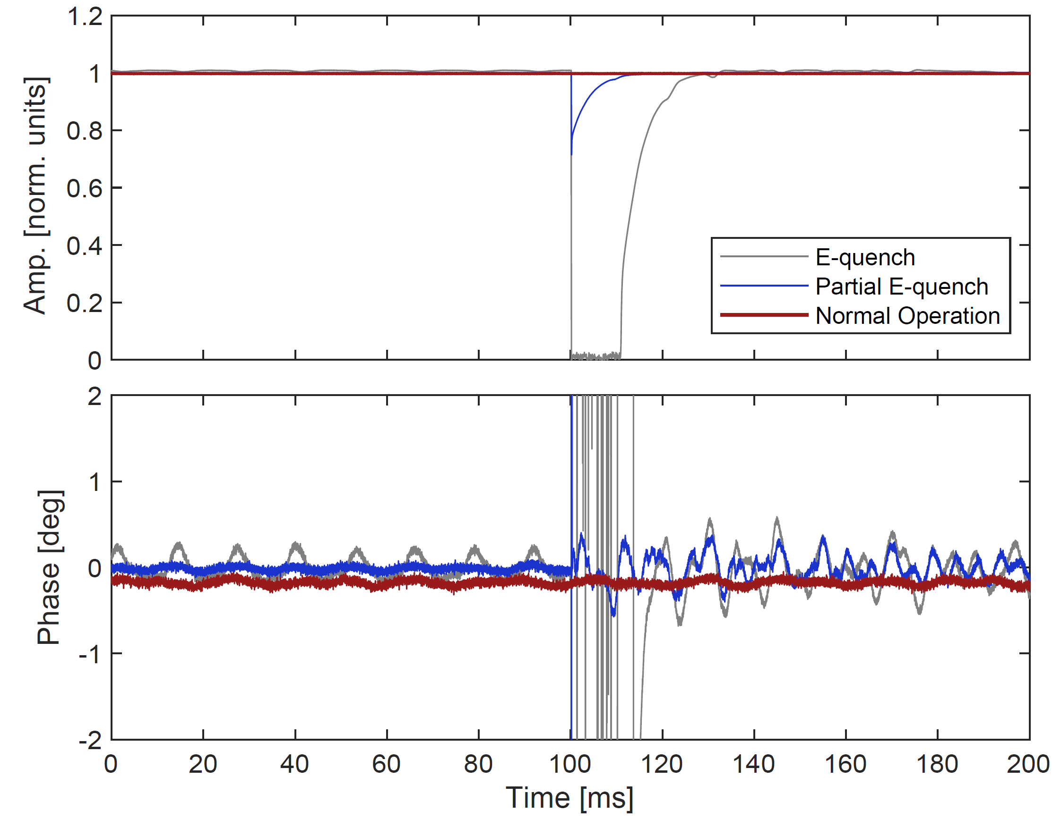
Burst-noise and its implication
Two types of burst noise signals induced by field emission
  Flashover & (Partial) E-quench
Item
Flashover
Partial E-quench
Total E-quench
Range
>15 MV/m
>25 MV/m
>35 MV/m
E_{acc} loss
None
2% ~ 30%
100%
Duration
< 5 μs
5 ~ 7 μs
~ 1 μs
FE
Flashover
E-quench
6 μs
2 μs
Pick-up
Pick-up
Flashover
burst noise
burst noise
burst noise
Amp [norm. units]
Amp [norm. units]
Partial E-quench
V_{c} Amp [norm. units]
Vc
Pick-up
Total E-quench
Flashover: Discharge at pick-up antenna, the actual field remains unchanged
(Partial) E-quench: Discharge at cavity inner conductor, the actual field rapidly decreases
Time [ms]
The burst noise can lead to an unexpected LLRF response, eventually causing a cavity fault
Notes:
During CAFe commissioning, we have observed many FE-induced cavity faults. Generally, there are two types of faults with different mechanisms: flashover and E-quench. In both of these two cases, a burst noise signal appears in the cavity pick-up. This burst noise signal can lead to an unexpected LLRF response, eventually causing a cavity fault.

Slide 18
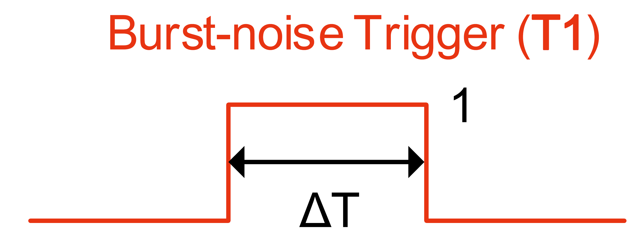
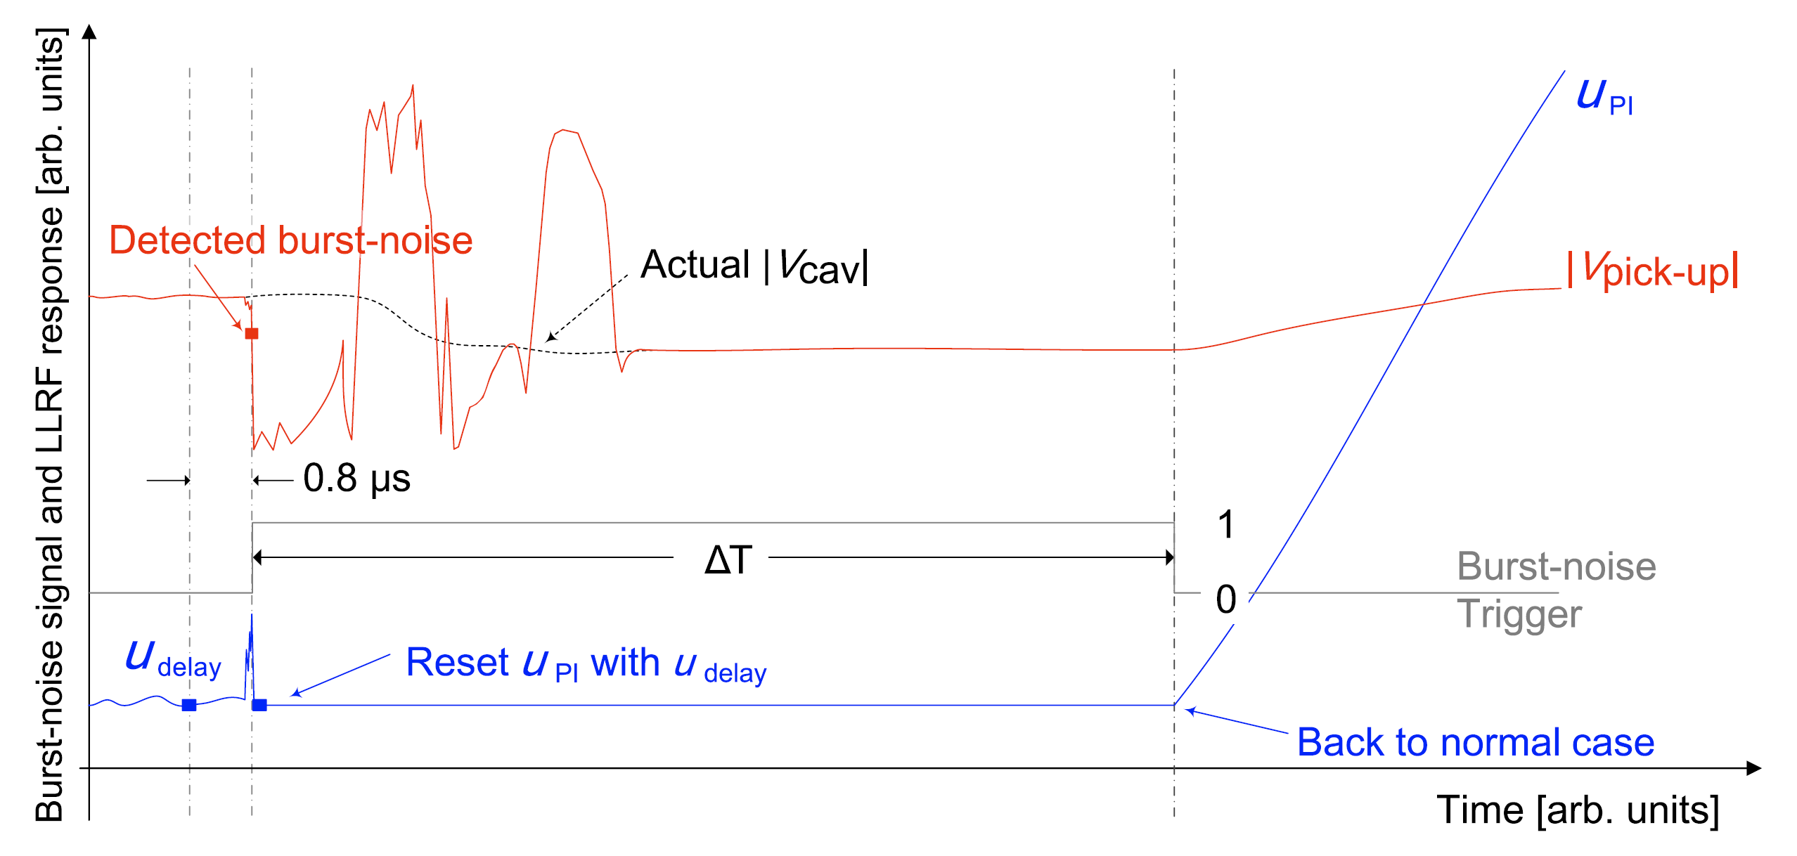
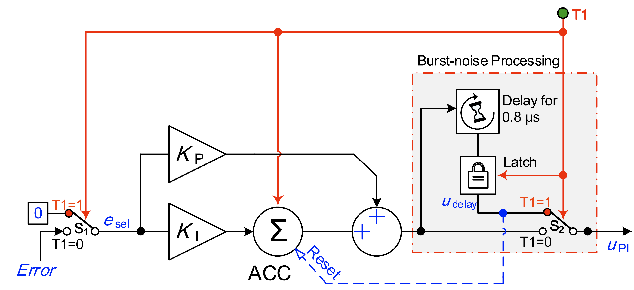
Burst-noise Processing Algorithm (Basic Idea)
When the LLRF system detects the burst-noise events, a burst-noise trigger is immediately emitted and is held for a time interval of ∆T (>15 μs)
The PI output (u_{PI} ) is overwritten by u_{delay} which retains the data from u_{PI} 0.8 μs prior to burst-noise trigger; then the u_{PI} is maintained until the trigger is over
0.8 μs
PI output
u_{delay}
u_{PI}
Implementation
reset
Pick-up
∆T
u_{delay} is the reasonable PI output

Slide 19
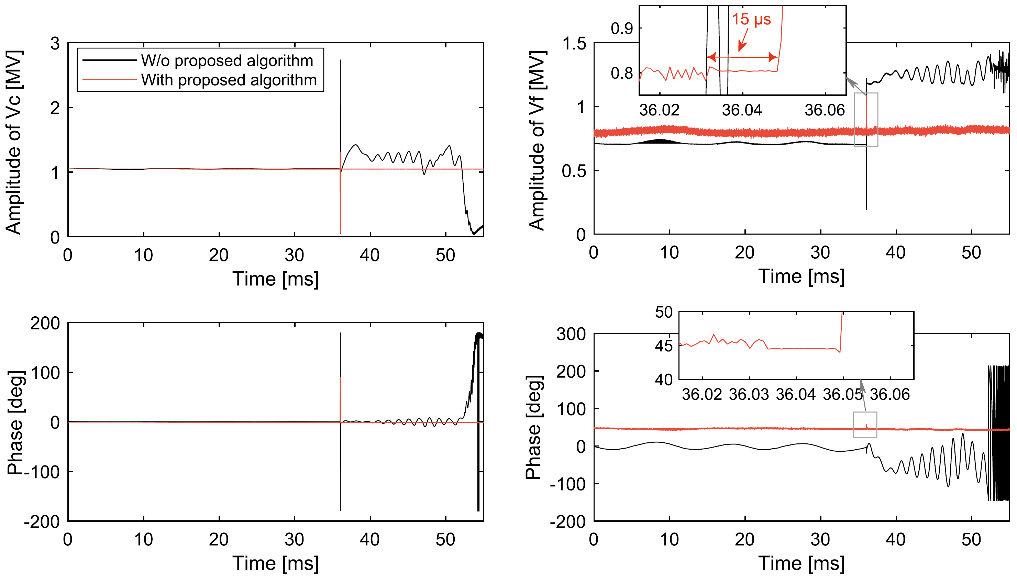
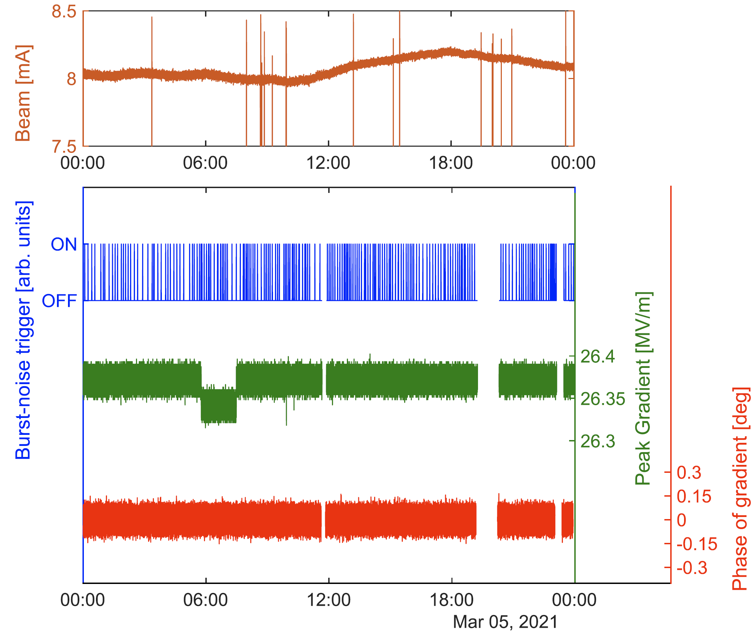
Burst-noise Processing Algorithm (Results)
The unexpected LLRF response can be eliminated
The effectiveness of the proposed algorithm was confirmed during the long-term operation
Cavity pick-up
Cavity forward
Beam
W/o proposed algorithm
With proposed algorithm
Beam
Burst-noise trigger
Field amp.
Field pha.
24 hours

Slide 20
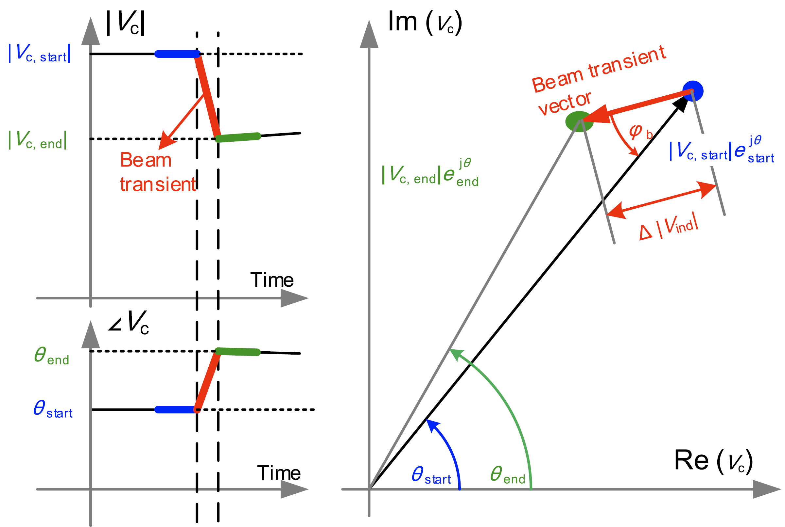
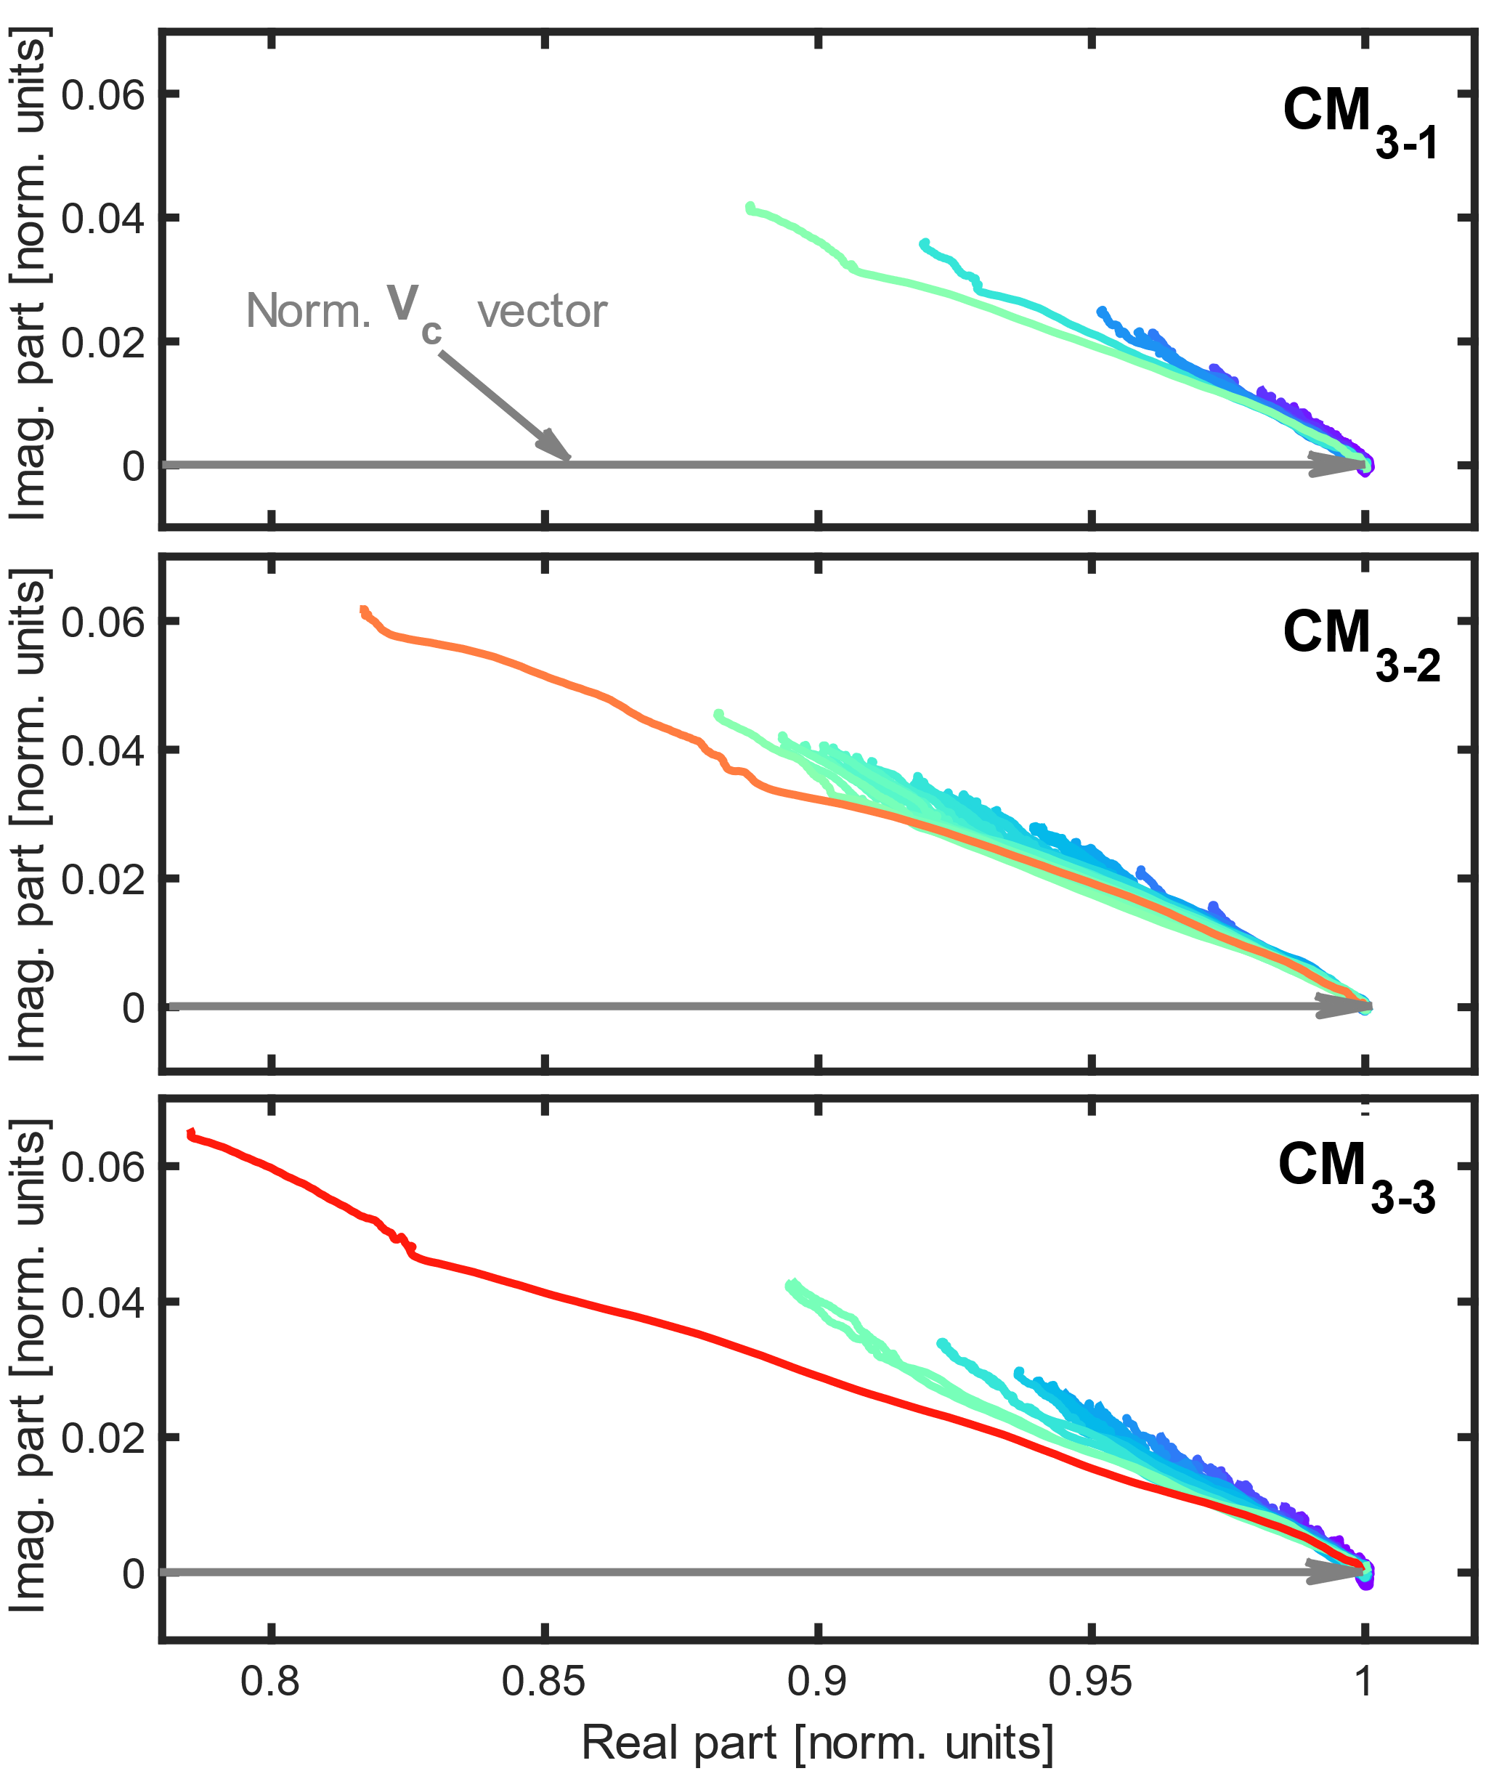
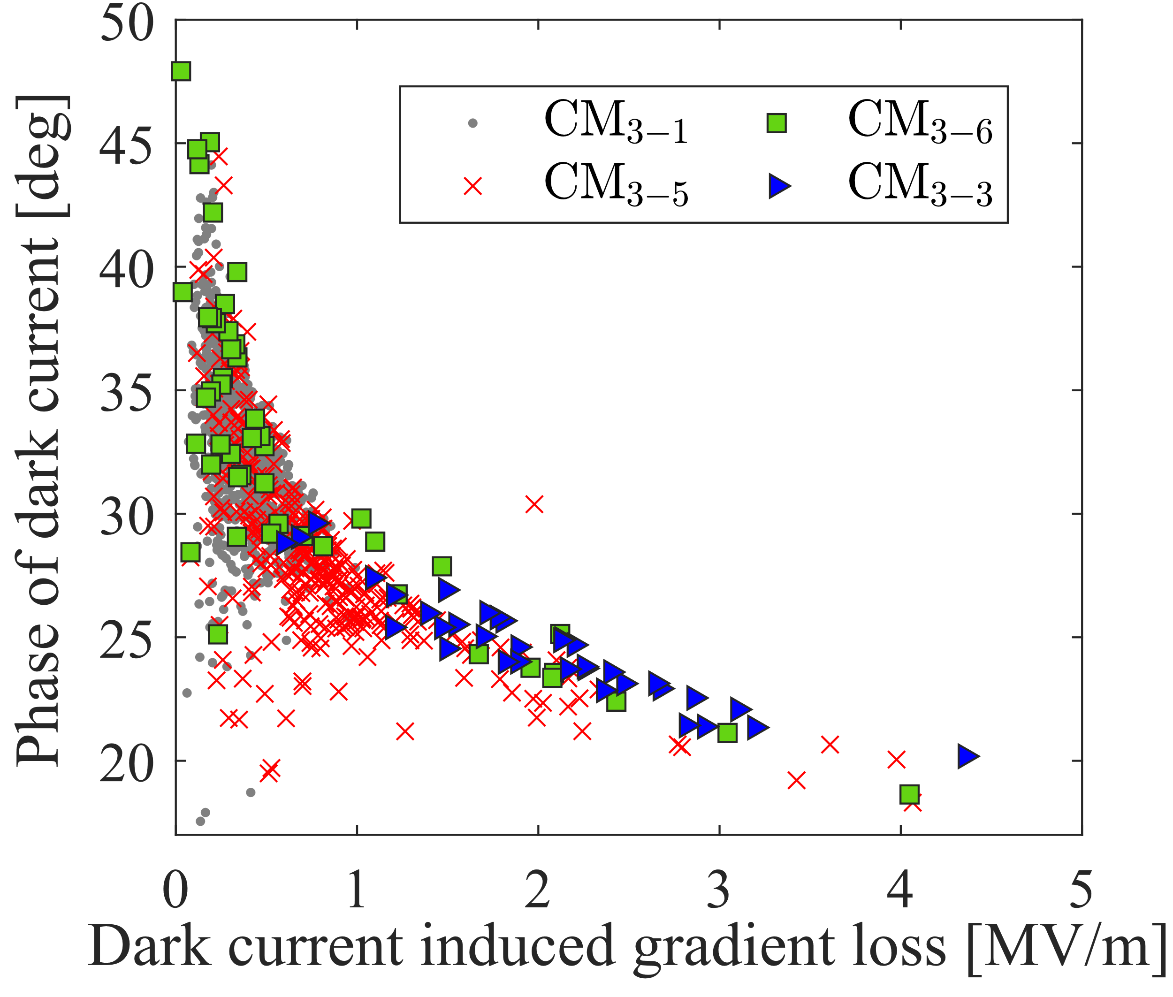
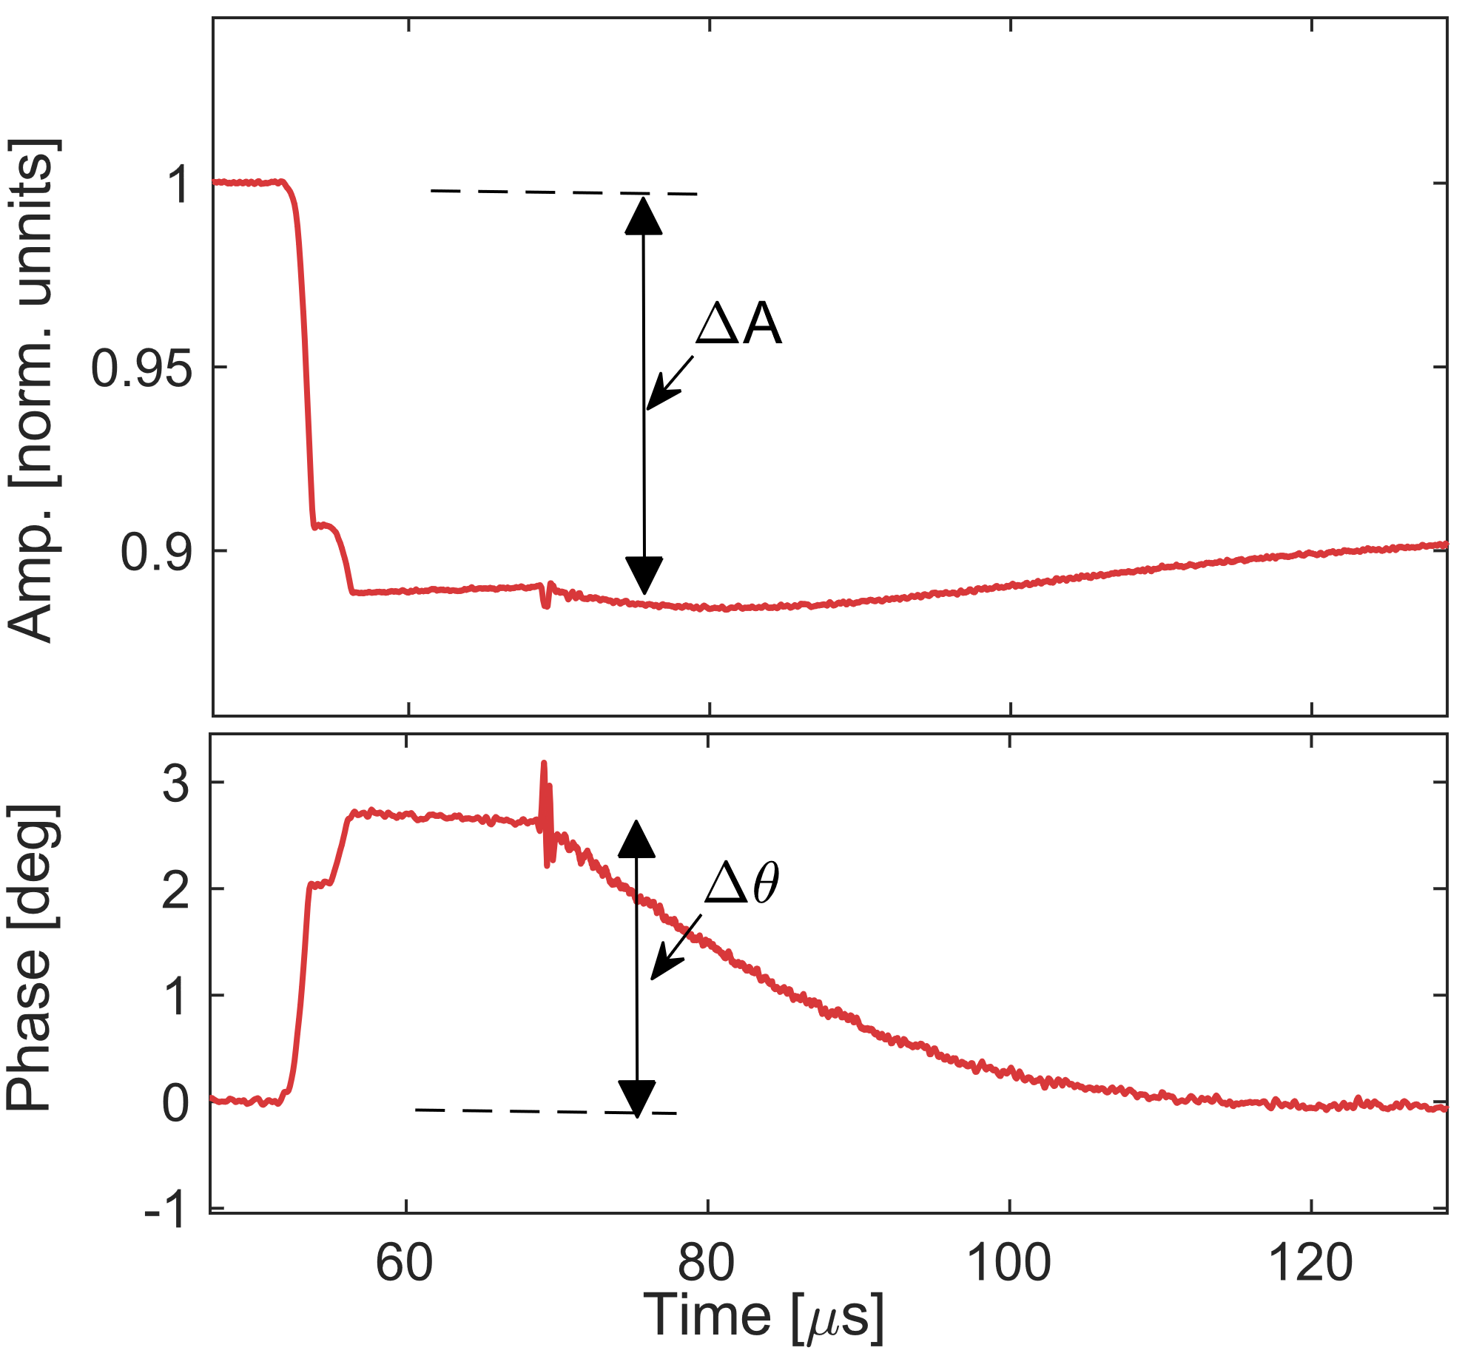
The “partial E-quench” caused dark-current can be seen as a kind of beam-loading. It is possible to characterize the dark current using the “beam (dark-current)”-induced RF transient
Dark-current Characteristic
The “partial E-quench” is accompanied by dark-current which can be seen as a kind of beam-loading. It is possible to characterize the dark current using the “beam induced RF transient”
“dark-current”-induced transient (I/Q)
Statistical Distribution
Partial E-quench
Imag. Part [norm. units]
Phase of dark-current [deg]
“dark-current”-induced RF transient
CM2-5
Real part [norm. units]
Dark-current induced gradient loss [MV/m]
F. Qiu* et al., In-situ mitigation strategies of field emission induced cavity fault using low-level radio-frequency system, Nucl. Sci. Tech. 33:140, 2022
Notes:
It is evident that the intensity and phase of the dark current conform to a specific distribution, it is very interesting even the mechanism remains unclear

Slide 21
01
Self-Introduction
02
Research Activities
CONTENTS
Disturbance Observer-based Ctrl.
Modified Iterative Learning Ctrl.
Burst-noise Mitigation
Channel Crosstalk Calibration

Slide 22
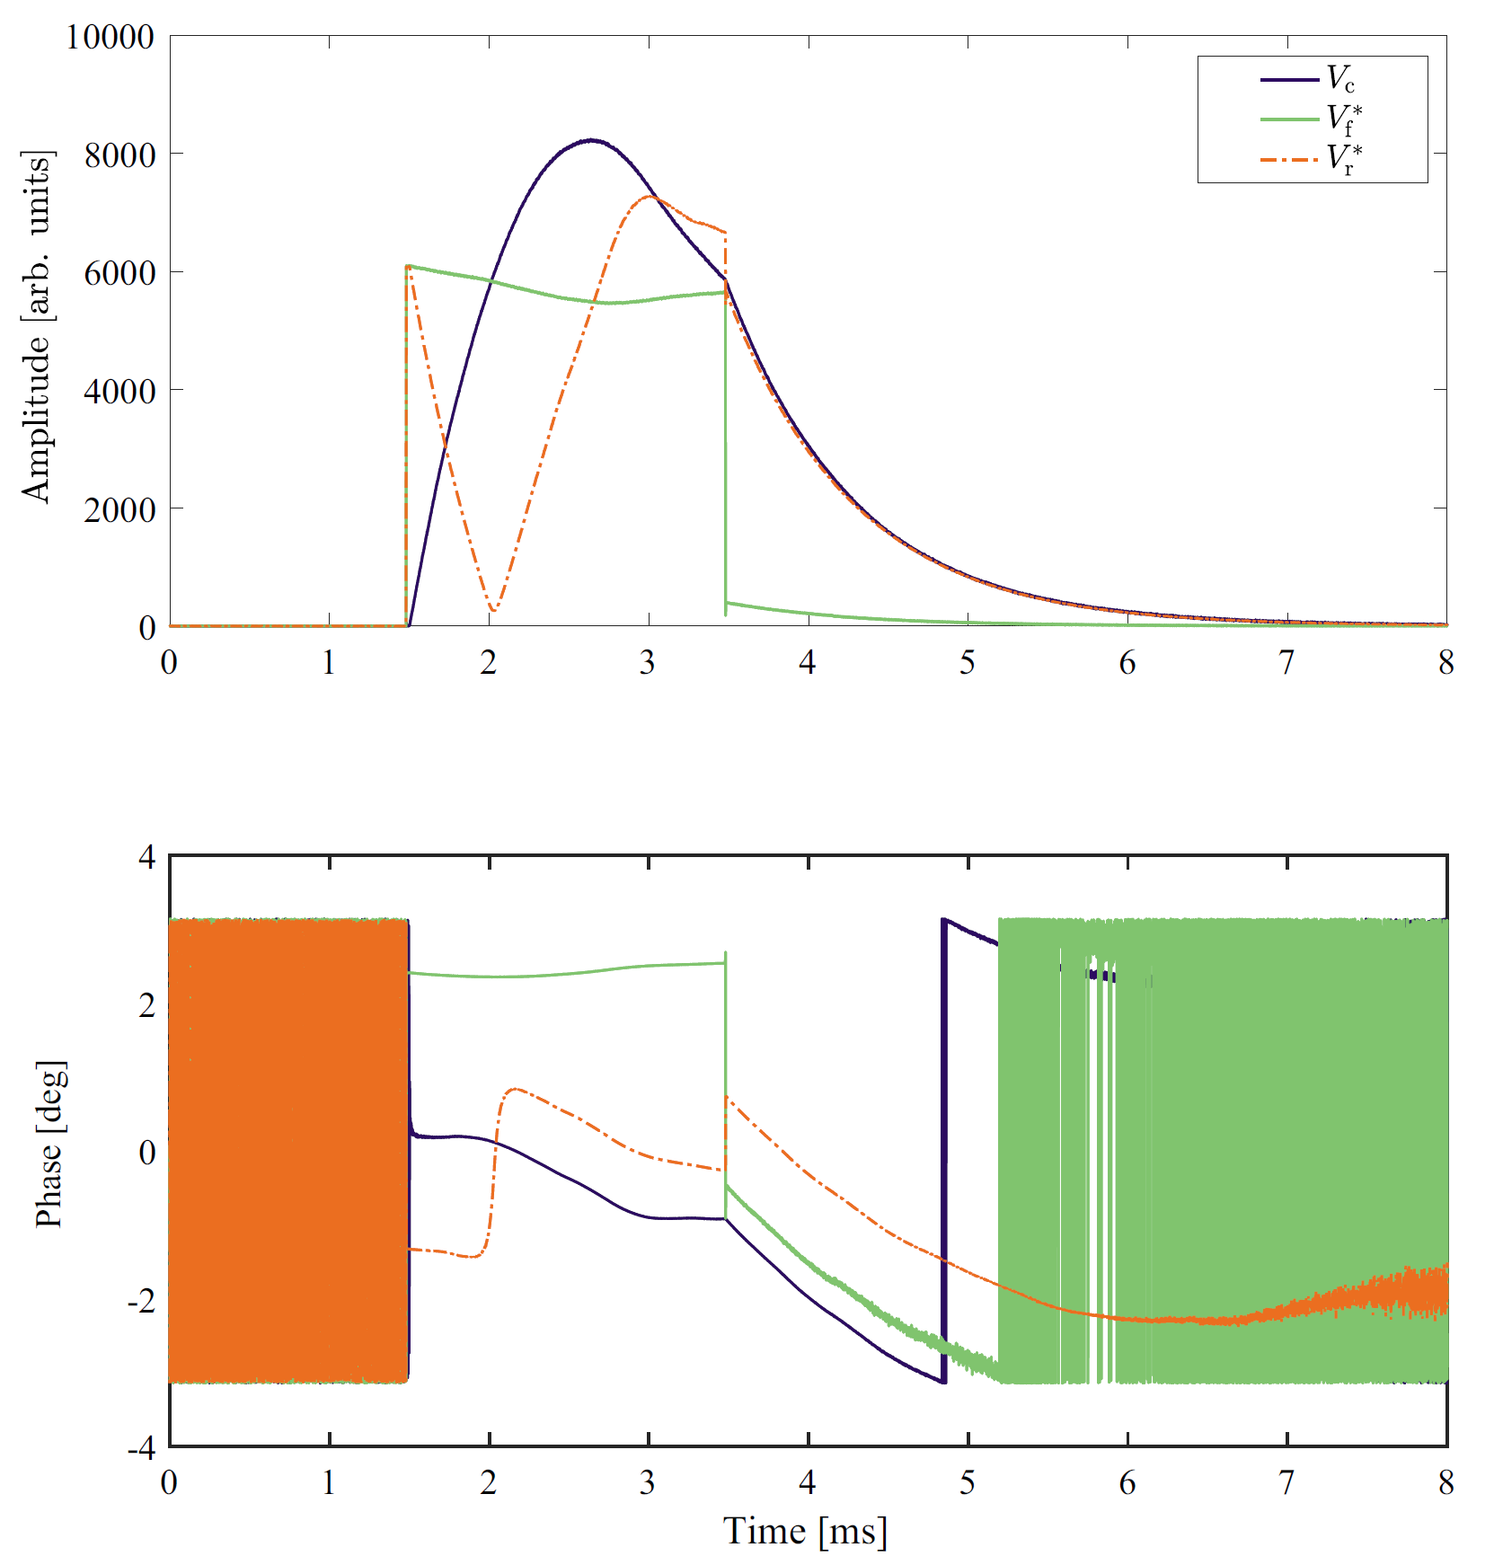
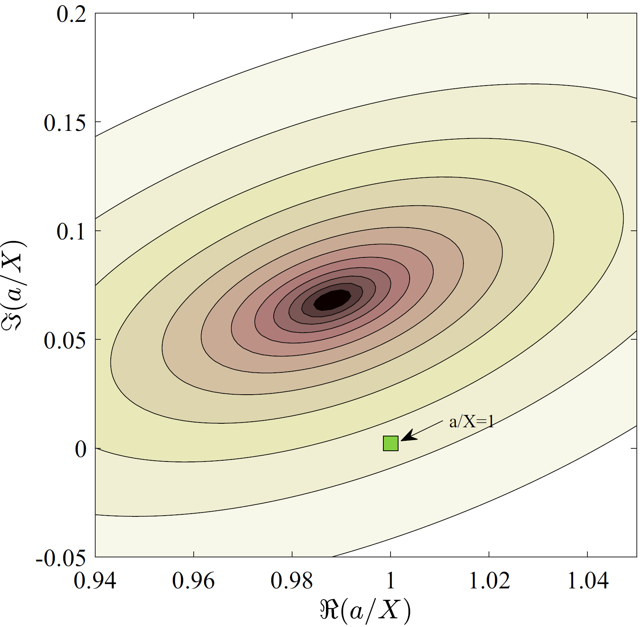
Issues impacting RF Signal Measurements
Measurement accuracy of RF signals is mainly affected by two factors:
  Crosstalk between the meas. channels (e.g., dir. coupler)
  Impedance mismatch of high-power RF components (RF source or Circulator) → See J. Y. Ma’s Poster （ID: 09）
DESY’s
Method
May impact the field decay process and cause the inaccurate meas. of Q_{L} ^{[1]}
The coefficients a b c d can be calibrated using the cav. diff. equation under pulse mode op.^{[2]}
Imag. part [norm. units]
May impact the measurement of V_{f} signal
Real part [norm. units]
[1] J. Y. Ma, …F. Qiu* et al., Measurement of the cavity‑loaded quality factor in superconducting radio‑frequency systems with mismatched source impedance, Nucl. Sci. Tech. 33:123, 2023
[2] A. Brandt, PhD thesis, Universitt Hamburg, 2007

Slide 23
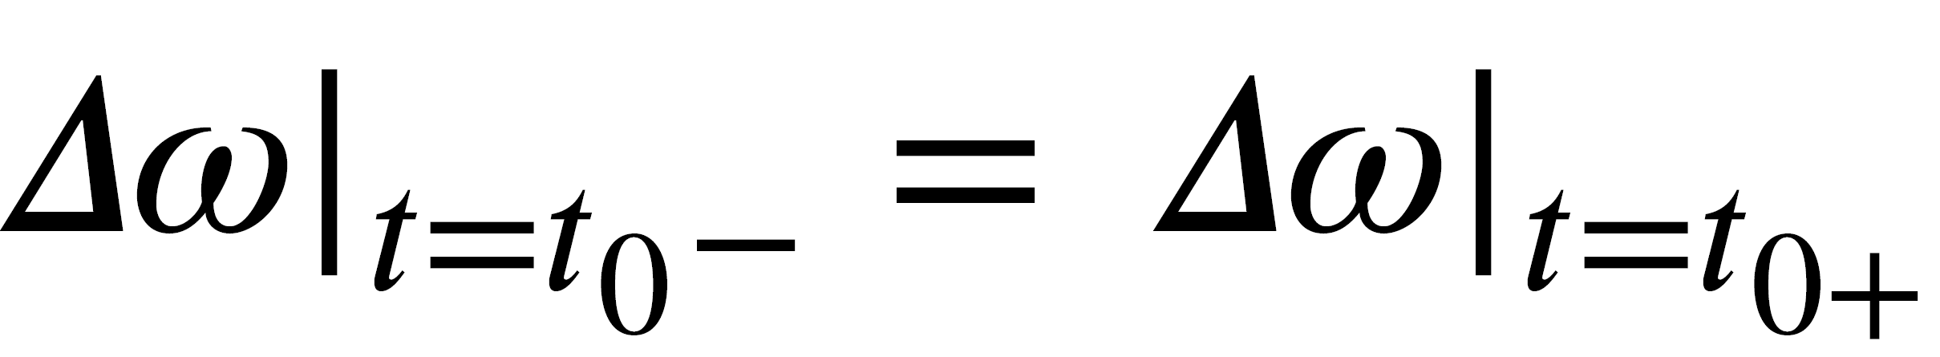





Novel Signal Calibration Algorithm
We proposed a novel signal calibration algorithm more suitable for CW mode machine
For CW machine, we have:
Condition 1:
Vectors Identity
Condition 2:
Detuning Continuity
$$\frac{ⅆV_{c}}{ⅆt}≈0$$
Ellipse→strip
We can’t locate the opt. coef. (using DESY’s method)
Notes:
For a CW machine, the cavity voltage Vc is constant, thus its derivative is approximately equal to 0. In this case, it is difficult to locate the optimal coefficient using DESY’s method. Here, we propose a new signal calibration algorithm that is more suitable for a CW mode machine. There are three conditions that must be satisfied:
Condition 1: The real part of 2Vf in the steady-state should be the same as the real part of Vc. Condition 2: The detuning just before and after RF is turned off should be identical

Slide 24



Novel Signal Calibration Algorithm (Results)
The proposed algorithm was confirmed at CAFe
Proposed Algorithm (CW)
DESY’s Algorithm (Pulse)
Cond. 2
Cond. 1
J. Y. Ma, F. Qiu* et al., Precise calibration of cavity forward and reflected signal using low-level radio-frequency system, Nucl. Sci. Tech. 33:4, 2022
F. Qiu* et al., Approach to calibrate actual cavity forward and reflected signals for continuous wave-operated cavities, Nucl. Instrum. Methods. A . 955,166237 (2022)
Notes:
Using the RF-off data, we have applied the proposed algorithm to our cavities. Firstly, we apply the first condition, resulting in a blue straight line. In the next step, we apply the second condition, resulting in a green straight line. The crossing point is then the optimal calibration coefficient. We have compared our method with DESY's method, and they are in good consistency with each other.

Slide 25


Beam Phase Calibration (application)
Within the calibrated optimal coefficients, it is possible to accurately calculate the RF vectors, as well as the beam phase
Beam Phase using RF
BPM Meas.
Imaginary part [norm. units]
With cali.
W/o cali.
φ_{b}
I_{b}
Cross-talk was considered
Real part [norm. units]

Slide 26
01
Self-Introduction
02
Research Activities
CONTENTS
03
Sum. & Acknowledgment

Slide 27
Summary
Innovatively applying DOB control in the LLRF community, achieving precise beam energy spread control with remarkable results at cERL
Leveraging prior knowledge of the beam profile to develop a FPGA-based real-time ILC control, successfully suppressing RF transient instabilities caused by the10 mA CW proton beam at CAFe
Developing a real-time digital filter with robustness to FE-induced burst noise, resolving RF instability and improving machine reliability of CAFe
Proposing a novel cross-talk calibration algorithm for SRF cavities operated in CW mode
26

Slide 28
Acknowledgments
I would like to express my gratitude to LLRF SPC & LOC for this incredible honor. I would also like to thank the members of the Selection Committee for their diligence and hard work in choosing me for this award. Special thanks to generous Dimtel Inc. for their invaluable support
I want to acknowledge the unwavering support of RF group and Beam-commissioning team in KEK and IMP
  KEK: S. Michizono (Supervisor, Division Head), T. Matsumoto, T. Miura, K. Furukawa, Z. Fang, H. Sakai, M. Omet, D. Arakawa, S. Matsumoto, E. Kako, K. Umemori, H. Katagiri, S. Fukuda, T. Furuya, T. Miyajima, T. Obina…
  IMP: Y. He (Division Head), Z. J. Wang, G. R. Huang, L. P. Sun, Z. Gao, T. C. Jiang, Z. L. Zhu, Q. Chen, L. B. Xu, Z. H. Xue, J. Y. Ma, L. J. Yang, C. Y. Xu, Z. L. Zhang, T. Tan, M. X. Xu, Z. Q. Yang, A. D. Wu, C. Y. J. Wong, D. D. Luo…
I owe a debt of gratitude to my family, colleagues, and friends
Finally, thanks again for this incredible honor. I am deeply moved and inspired to continue my work with renewed passion and dedication
27
Notes:
I would like to express my heartfelt gratitude to LLRF SPC & LOC for this incredible honor. I would also like to thank the members of the selection committee for their diligence and hard work in choosing me for this award.
I want to acknowledge the unwavering support of RF group and Beam-commissioning team in KEK and IMP, If there is no good team and research platform, it is impossible to achieve good results
I owe a debt of gratitude to my family, colleagues, and friends. Thank you for their companionship when I encountered difficulties
I would like to every colleges in the LLRF community. Engaging in discussions with all of you has provided me with many new ideas.
Finally, thank you for this incredible honor. I am deeply moved and inspired to continue my work with renewed passion and dedication

Slide 29
Thanks for your attention
감사합니다

Slide 30
Back-up Slides

Slide 31

SRF faults at CAFe
SRF faults account for most beam trips (Eu-XFEL/CEBAF/ELBE/CAFe)
Problem: Minimize cavity faults to enhance beam availability, reliability, and stability
Solution: Gain a deep understanding of the unstable mechanisms behind cavity faults
CAFe @ 2.5 mA, 45 kW
CAFe @ 10 mA, 200 kW
Cry: 2% PS: 2%
Vac: 2% PS: 1%
Requirements
Rad: 3%
Diag: 7%
Human: 5%
Ctrl: 8%
Ctrl: 6%
Stability
He Fluc.
IS: 9%
Quench
IS: 21%
Cav. FE
Availability
Reliability
SRF: 64%
SRF: 73%
…
RF Trips
SRF faults contribute to the dominant beam trips
Notes:
During the long-term operation of accelerators, various types of faults can occur. Based on the experience of major international laboratories, superconducting cavity malfunctions constitute a significant portion of the total faults. Common issues include the complexity and diversity of superconducting cavity faults. Addressing the challenge of reducing superconducting cavity faults to enhance beam reliability is an international issue. Resolving this problem requires an in-depth study of the unstable physical mechanisms and fault patterns of superconducting cavities.

Slide 32





SRF faults at CAFe (cont’d)
Digtial low-level RF
Capture fault waveform
Analyze fault patterns & mechanisms
Flashover & E-quench
LLRF trip & Ponderomotive
Vc phase (LLRF trip)
Vc phase (Ponderomotive)
闪断
E-Quench
Spectrum
Spectrum
Thermal quench
Helium fluc.
Δf
Δf
Features of the DAQ：
  10 kHz ~ 100 kHz rates
  0.5 s ~ 5 s waveforms
  8 ADC channels
Q_{L}
Q_{L}
Notes:
During this beam tuning process, we also observed a significant number of superconducting cavity faults. Before and after each fault occurrence, the LLRF system records a amount of fault data. Through data analysis, we can further identify fault patterns and study the physical mechanisms behind these faults

Slide 33







ML-based SRF faults Classification
Raw fault signals
Signal Preprocessing
Feature Extraction
ML classification
Q_{id}
E_{id}
F_{max}
E_{fmax}
Std_A₁
Std_A₂
Mean_P_{diff}
Max_ P_{diff}
Diff_P_{f}
…
SVM (support vector machine)
Radom Forest
K-means
…
Model-based
Amp.
FFT & Wavelet
Confusion matrix
Phase
Statistical Features
Q_{L}
PCA plot
Principal Component Analysis
Detuning

Slide 34



ML-based SRF faults Classification (cont’d)
Precision: Roughly > 90% (compared with expert predictions), seems promising
PCA analysis: Which patterns are prone to confusion?
Feature importance analysis: Which features have the greatest impact on the results?
True Patterns
PCA2
Importance
Predicted Patterns
PCA1
Features

Slide 35

Beam Phase Calibration
The cavity forward power would be different in the case of with and w/o beam
Characterize the beam vectors V_{b} using V_{f} signal with beam (U_{wb}) and w/o beam (U_{nb})
Waveform Plots
Vector Plots (in steady-state)
V_{b}= U_{nb}- U_{wb}
φ_{b}= ∠V_{b}
I_{b} = |V_{b}|
ALL the RF signals reaches steady-state (I_{b} , V_{c} , V_{f} )
Good measurement accuracy (cross-talk cali.)

Slide 36

Beam Phase Calibration (@ IMP-CAFe)
The preliminary experiment was confirmed at IMP
Proposed Method
steady-state
steady-state
BPM
With cali.
W/o cali.
φ_{b}
I_{b}
F. Qiu* et al., Approach to calibrate actual cavity forward and reflected signals for continuous wave-operated cavities, Nucl. Instrum. Methods. A . 955,166237 (2022)

