Slide 1
SSRF Lab talk
Yubin Zhao
2023-10-23
Shanghai advanced research institute. CAS
LLRF workshop 2023 in Gyeongju Korea

Slide 2
content
SSRF and update
Soft X FEL
SHINE
summary
LLRF workshop 2023 in Gyeongju Korea

Slide 3
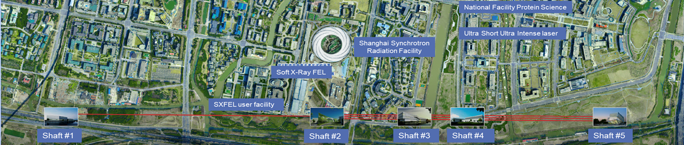
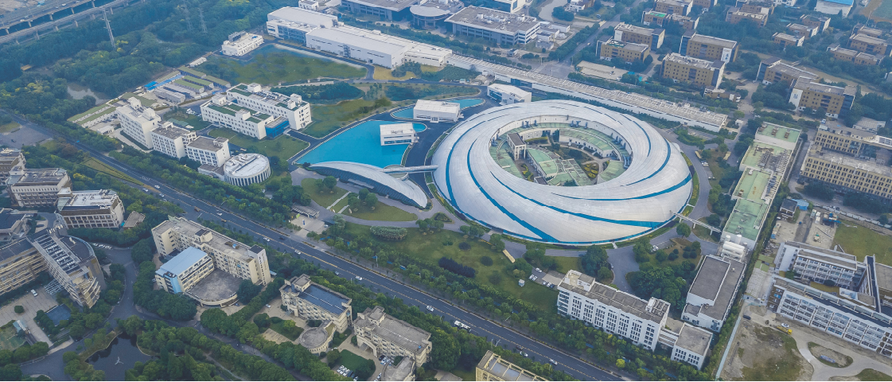
Three facilities
SSRF 2004~
Soft X FEL 2014~
SHINE 2018~
LLRF workshop 2023 in Gyeongju Korea

Slide 4
SSRF

Slide 5
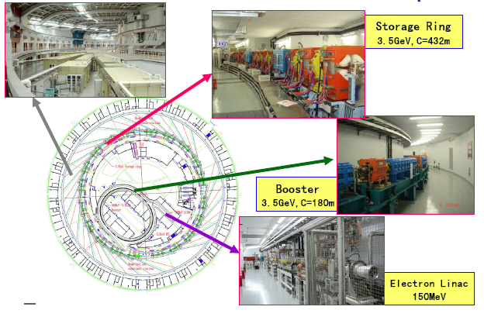
Layout of the SSRF complex
LINAC
Output Energy is upto 150MeV
BOOSTER
Full energy booster ,optimized for top-up injection;
Beam emittance about 100 nm-rad @3.5 GeV for clean top-up operation;
A circumference of 180m and a injection energy of 150MeV;
Repeat rates up to 2Hz;
Storage ring
Energy：3.5 GeV；
Circumference：432m；
Current：5/300 mA (S/M bunch)；
emittance：3.9 mm-mrad；
RF voltage：4-6 MV
LLRF workshop 2023 in Gyeongju Korea

Slide 6
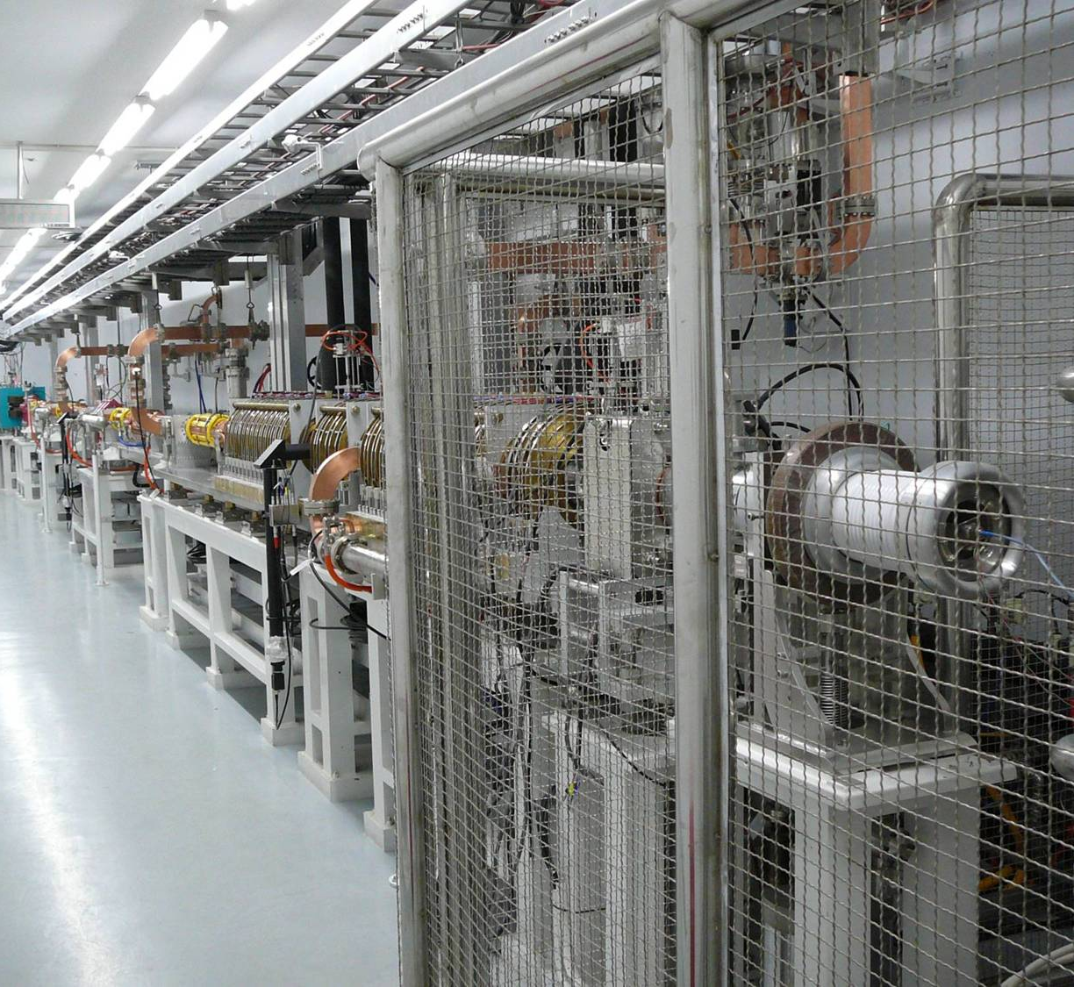
LINAC RF
499.654MHz MO
LINAC
X6
Phase shifter
Booster
Storage ring
Phase shifter
Phase control system
Phase control system
Attenuator
SSA
SSA
SSA
modulator
45MWKlystron
modulator
45MWKlystron
6dB power splitter
High power phase shifter
3dB Power splitter
3dB Power splitter
LINAC tunnel
WCM1
WCM2
WCM4
A1
A2
A3
A4
WCM3
GUN
buncher
Accelerator tube
Beam measurement
Harmonic buncher
magnet
LLRF workshop 2023 in Gyeongju Korea

Slide 7
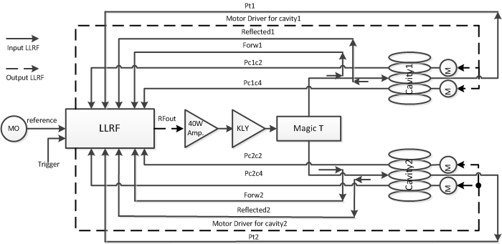
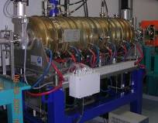
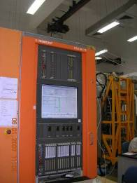
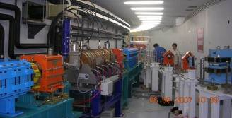
Booster RF
Architecture of booster RF system
There are only six channels ADC, but the signal sampled are 11. so we use two second generation LLRF controller to deal with those signals, one is used to control the amplitude and phase, another is used to control the field flat and tuning control。
LLRF workshop 2023 in Gyeongju Korea

Slide 8
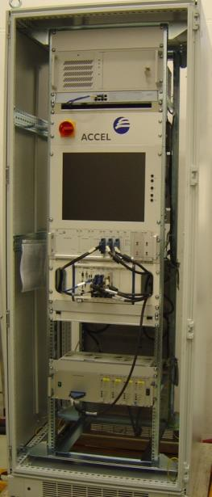
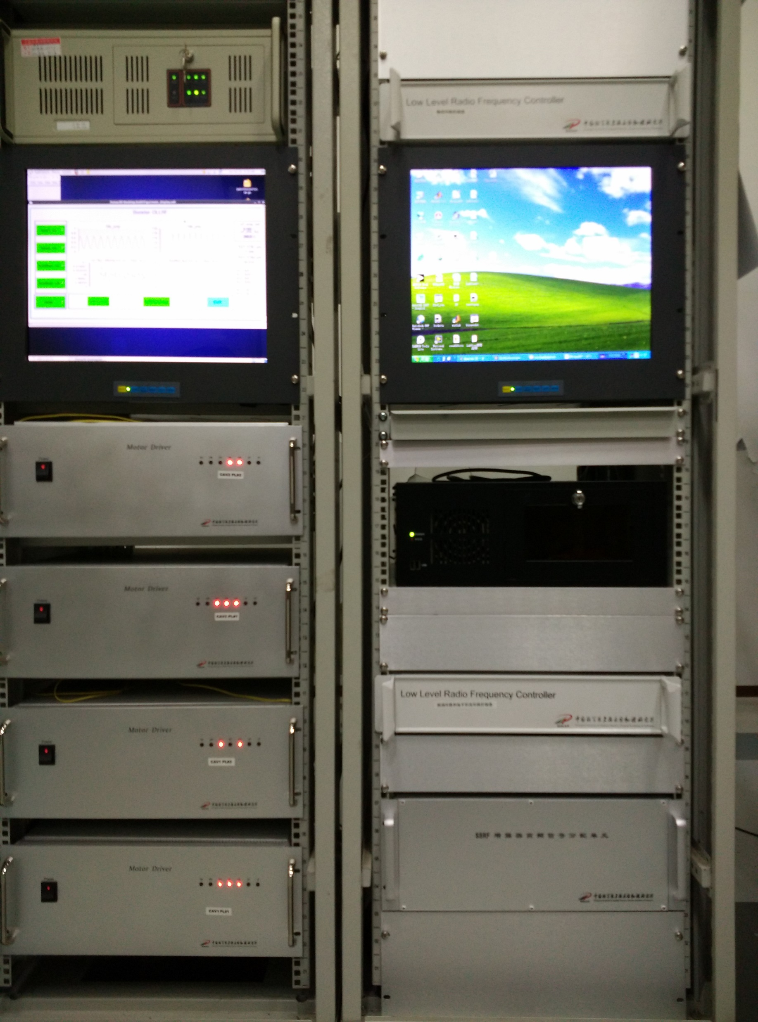
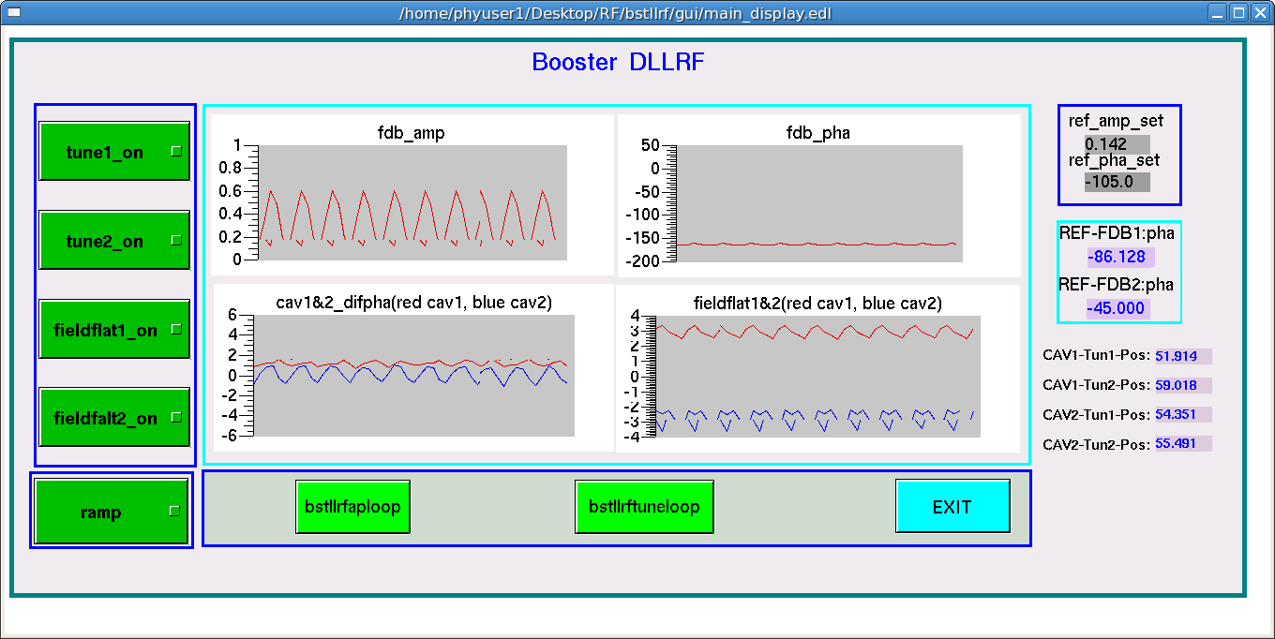
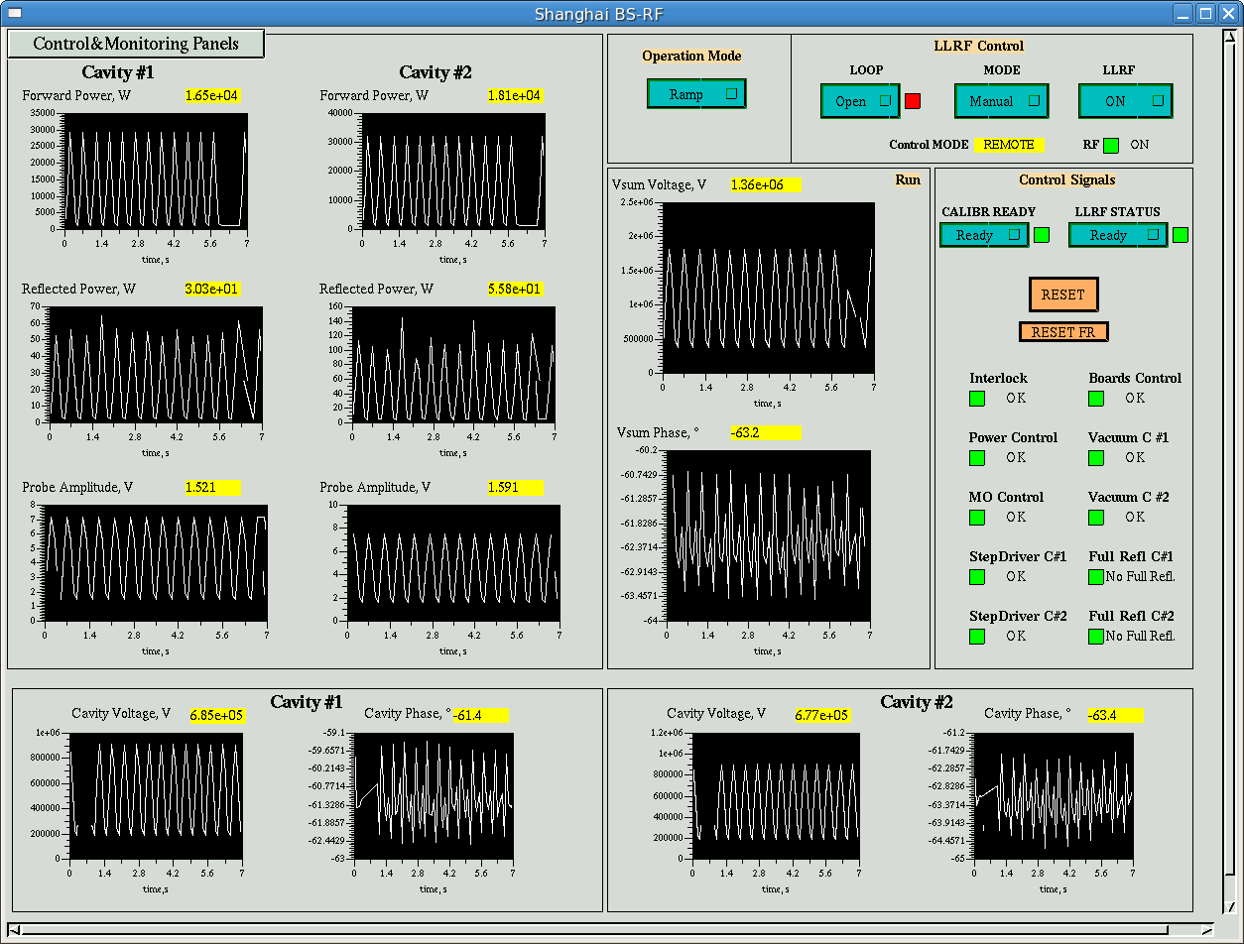
Update of Booster LLRF
Update reasons:
Accel did not provide the hardware
PXI controller and software update
When ramping mode, there happen stopping ramping
Communication complex（LabView+Sharememory）
Maintenance cost （power supply ，motor driver）
Analog LLRF from ACCEL
DLLRF
ALLRF GUI
DLLRF GUI
LLRF workshop 2023 in Gyeongju Korea

Slide 9
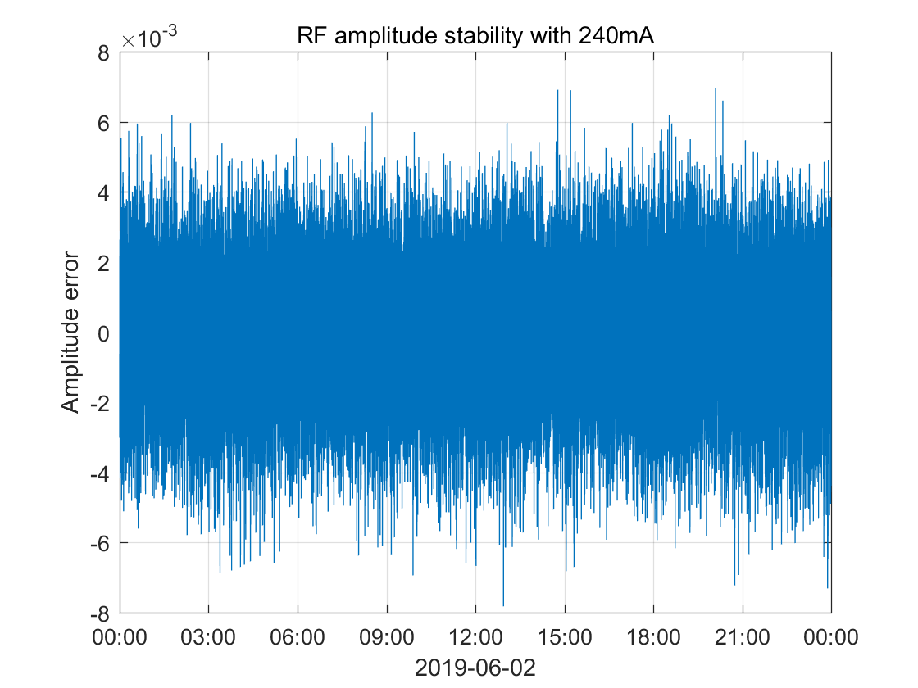
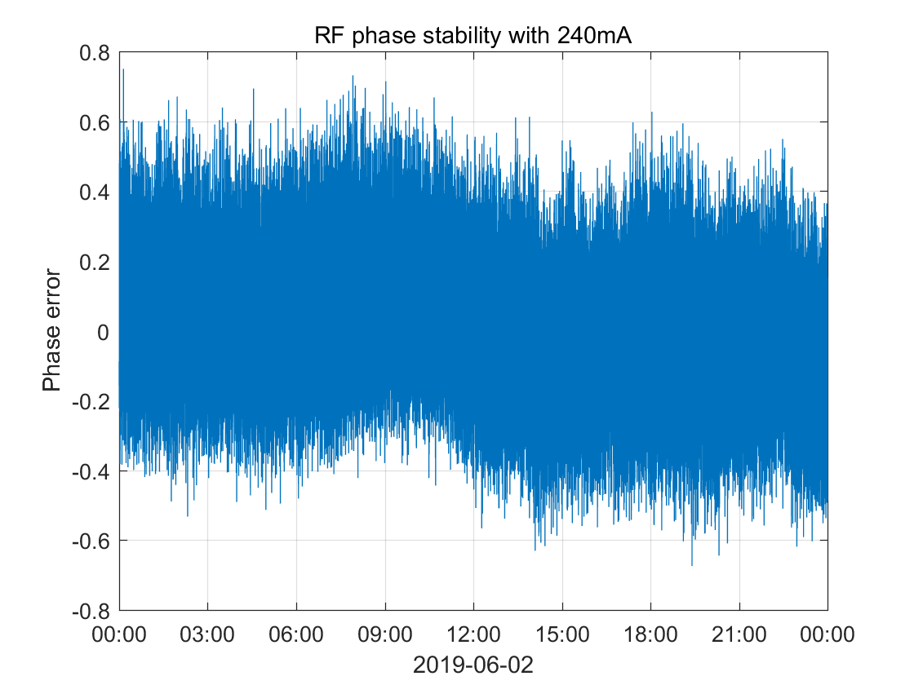
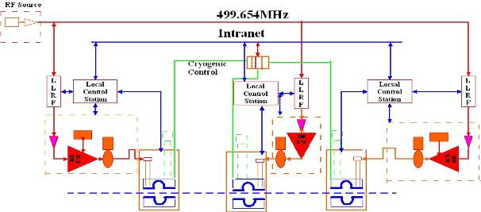
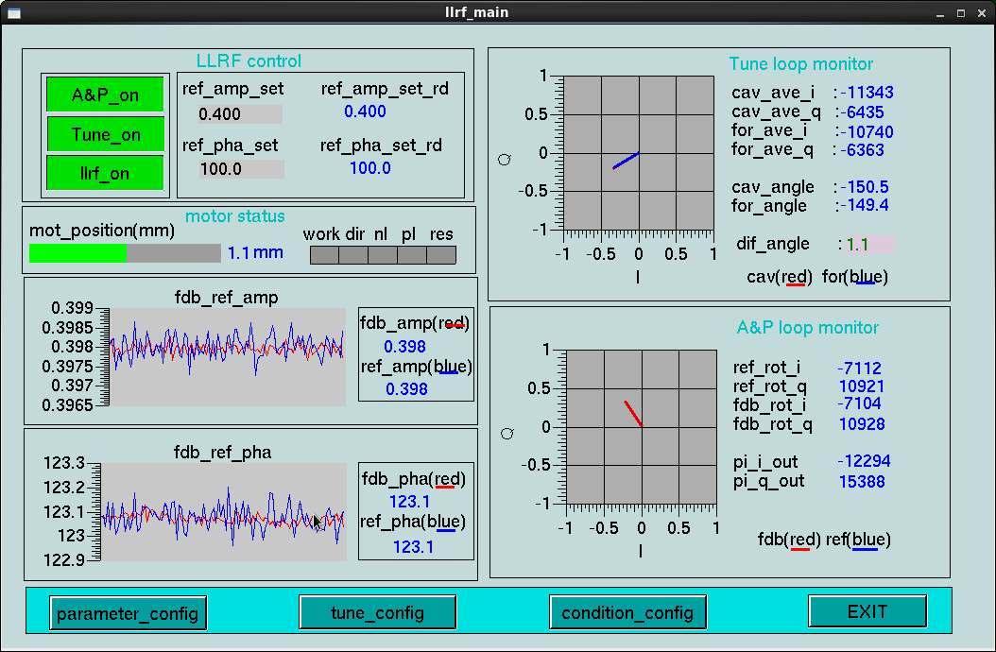
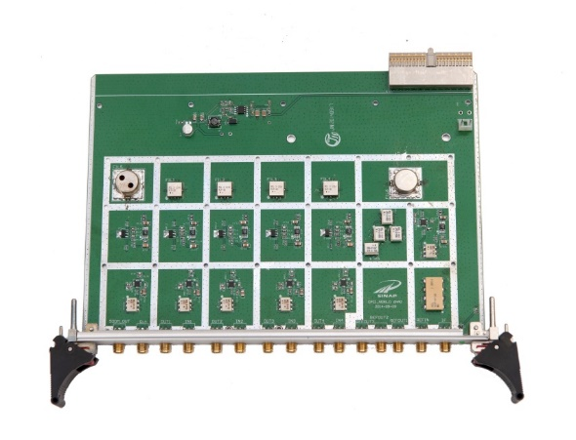
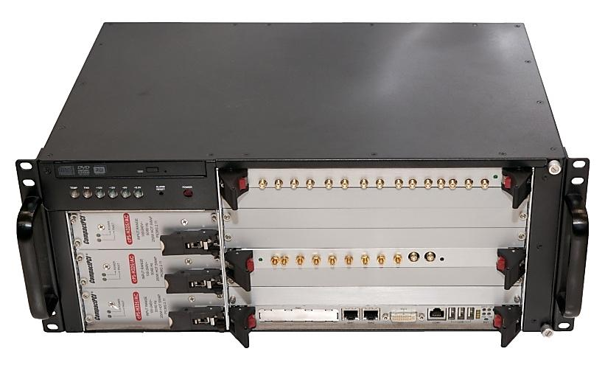
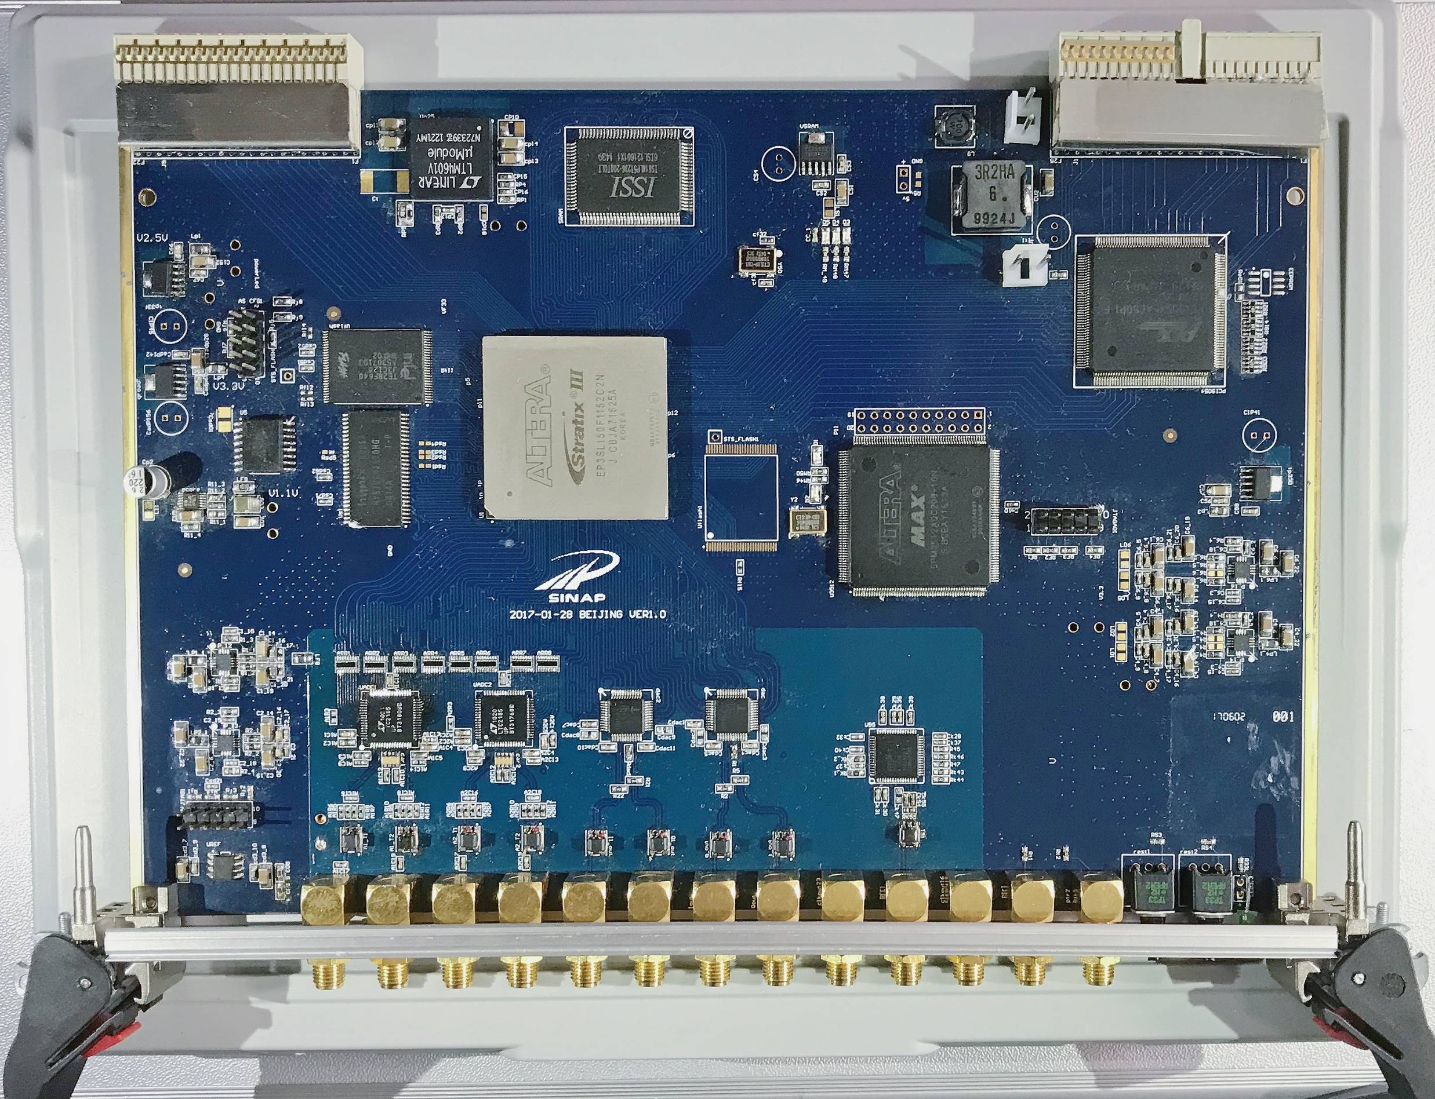
LLRF controller in storage ring
2
3
1
To motor driver
LLRF Interface
Board with CPCI package，
4 Channel ADC.125MSPS
2 Channel DAC，275MSPS
4 down-converter and one up-converter channel
Linear is better than 60dB, isolate is better than 80dB
CPCI communication.
EPICS interface
Controller Box
DSP board
Front-end board
LLRF workshop 2023 in Gyeongju Korea

Slide 10
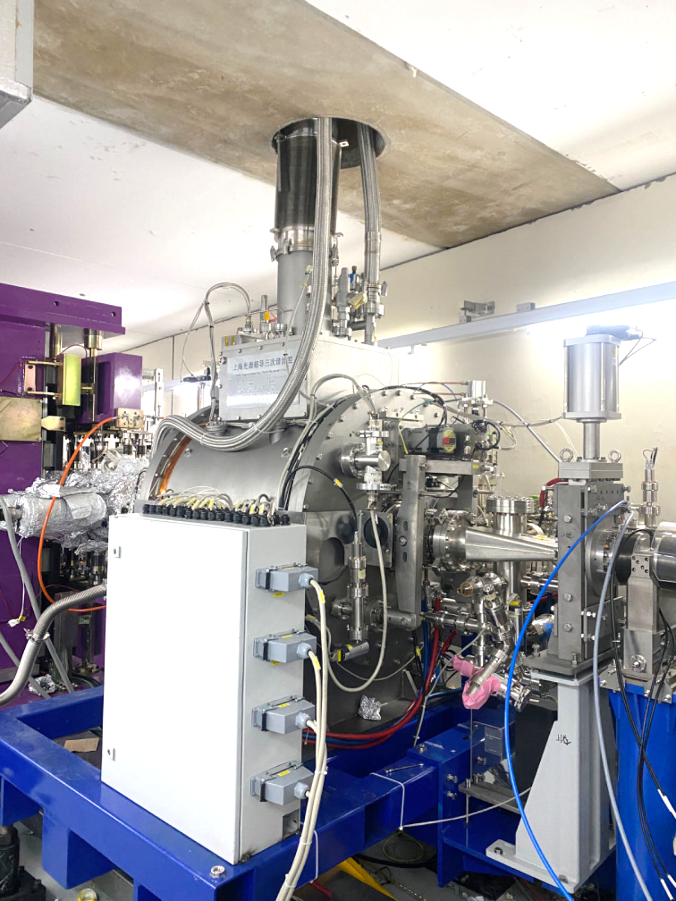
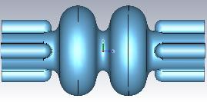
Three harmonic SC cavity
Increase the Beam life time by lengthen the bunch
Passive mode
Specification
parameters | value
Times of beam length | ≥2
Times of beam Life time | ≥2
Harmonic frequency / MHz | 1498.96
Harmonic voltage / MV | 1.4 ~ 1.8
Temperature / K | 4.0
Static loss of thermostat/ W | ≤10
dynamic power consumption/ W | ≤5 @ V_{h}=1.8 MV
Q₀ | ≥1E10 @ V_{h}=1.8 MV (Vertical test)
Adjust frequency bandwidth / kHz | +/- 500
Power of high order mode absorber / W | ≥ 400
Harmonic voltage stability % | ≤ +/- 1%
LLRF workshop 2023 in Gyeongju Korea

Slide 11
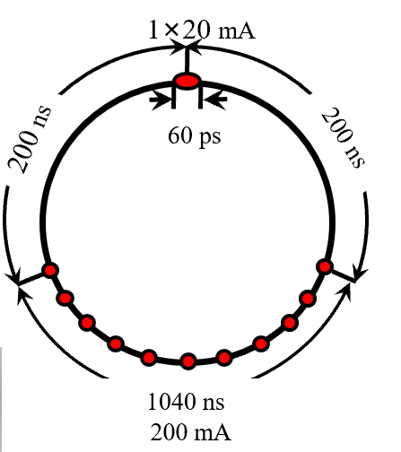
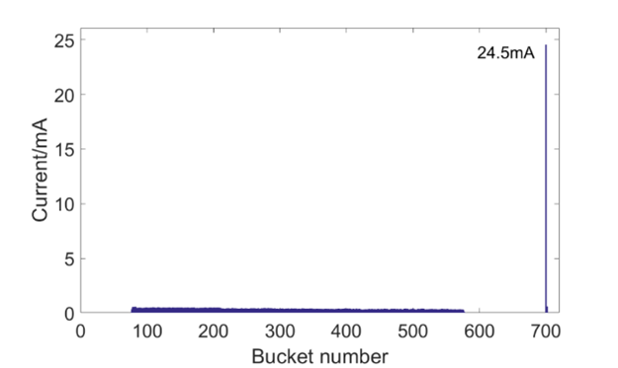
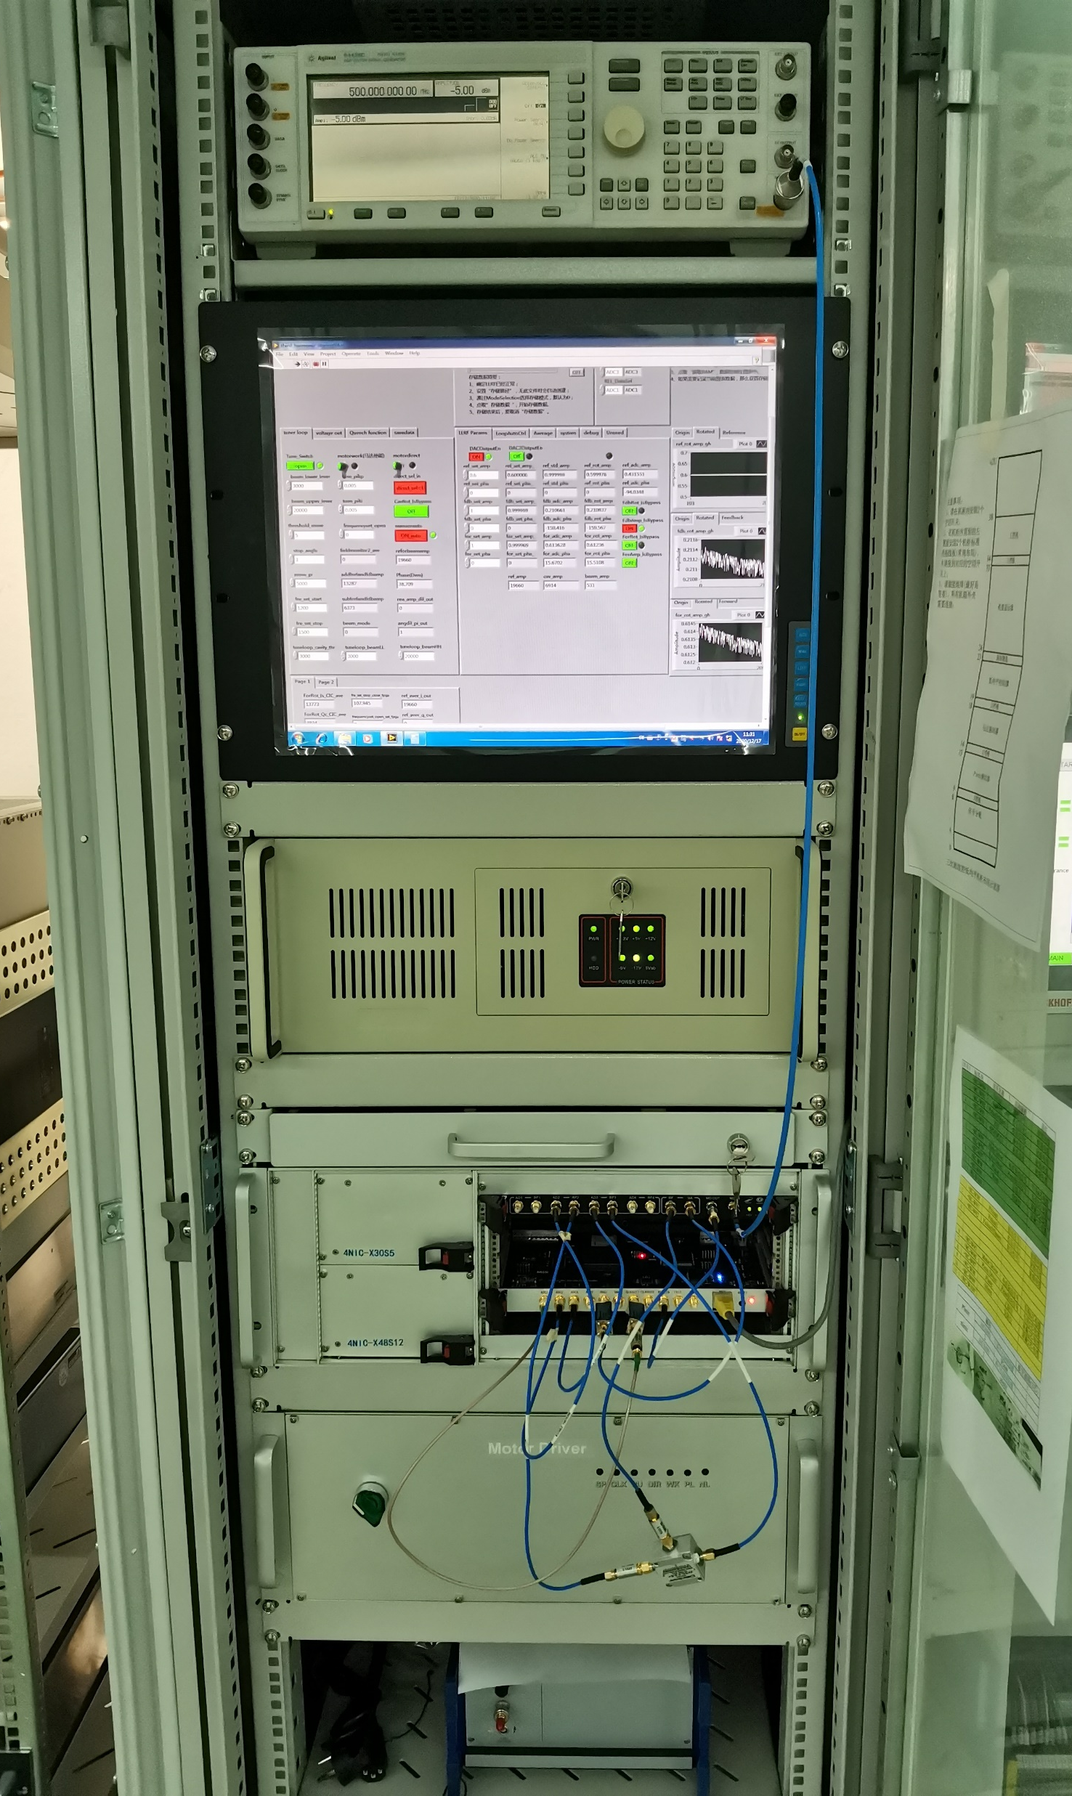
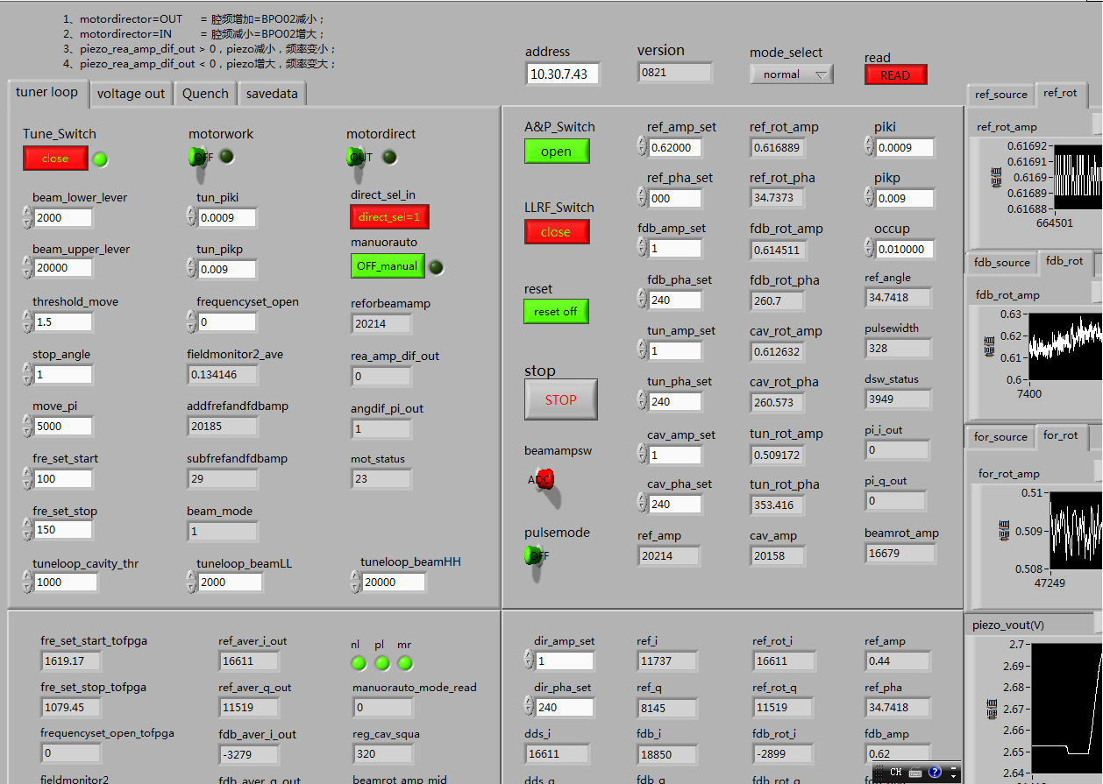
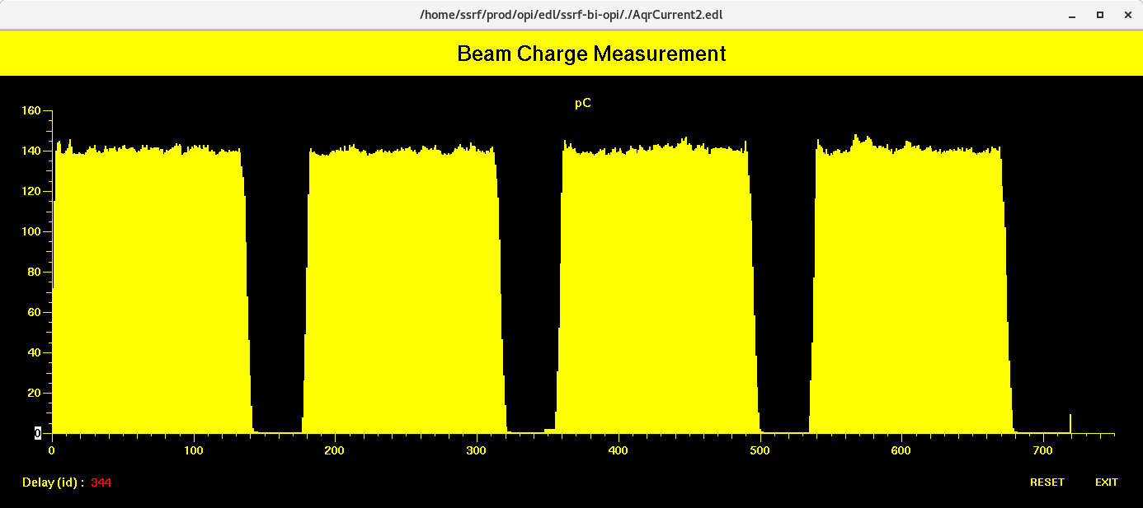
Harmonic cavity operation
Two filling pattern ：1）four short bunch trains with ion-clearing gaps；2）mixed filling pattern
Mode 1: beam length longer 2.24 times
Mode 2: beam length longer 2.98 times
LLRF workshop 2023 in Gyeongju Korea

Slide 12
SSRF--SXFEL
LLRF workshop 2023 in Gyeongju Korea

Slide 13
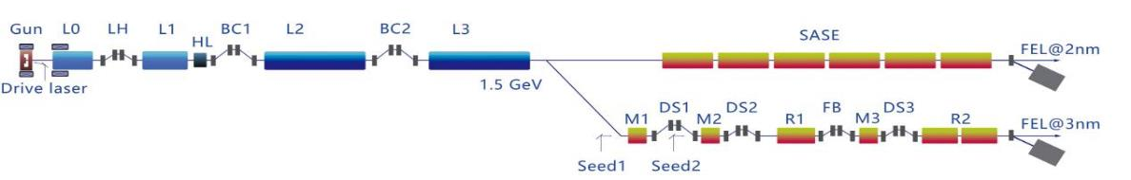
SXFEL layout
Shanghai soft X ray FEL length is 532. It includes injector, LINAC, two undulator line (seeding + SASE), two beam line and 5 experiment station. the energy is 1.5GeV
2014 start，2022 to user stage
LLRF workshop 2023 in Gyeongju Korea

Slide 14
SXFEL LINAC RF
S1
S2
S3
S4
S5
KX
C1
C2
C3
Gun
L0-1
L0-2
TDS1
L1-1
L1-2
LX
BC1
TDS2
L2-1
L2-2
L2-3
L2-4
L2-5
L2-6
BC2
C4
C5
C6
C7
C8
C9
C10
C11
L3-1
L3-2
L3-3
L3-4
L3-5
L3-6
L3-7
L3-8
L3-9
L3-10
L3-11
L3-12
L3-13
L3-14
cTDS
5 S-band klystron drive 4 accelerator structure and one transverse deflecting structure
11 C-band klystron drive 20 C-band accelerator structure and one transverse deflecting structure
1 X-band klystron drive one linear X-band structure
LLRF workshop 2023 in Gyeongju Korea

Slide 15
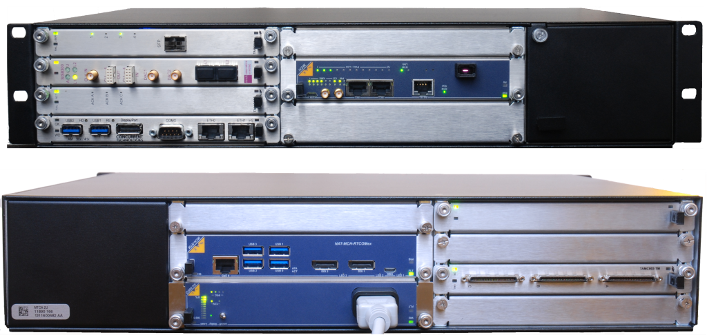
SXFEL LLRF
Table: LLRF specification
parameters | value | value | value | units
Operation frequency | 2856 | 5712 | 11424 | MHz
repetition | 10 | 10 | 10 | Hz
Energy gain（2） | ≥108 | ≥126 | 20(1) | MeV
Amplitude (RMS) | ≤0.04* | ≤0.04 | ≤0.15% | %
Phase (RMS) | ≤0.09* | ≤0.18 | ≤0.15 | °
Micro TCA chassis
Typical RF station
LLRF workshop 2023 in Gyeongju Korea

Slide 16
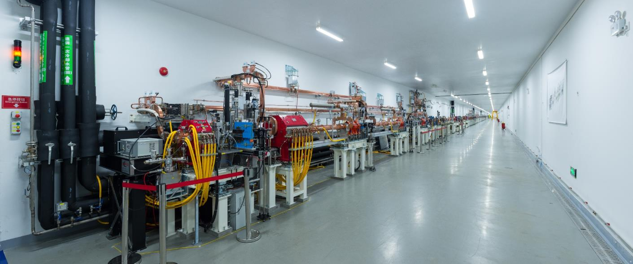
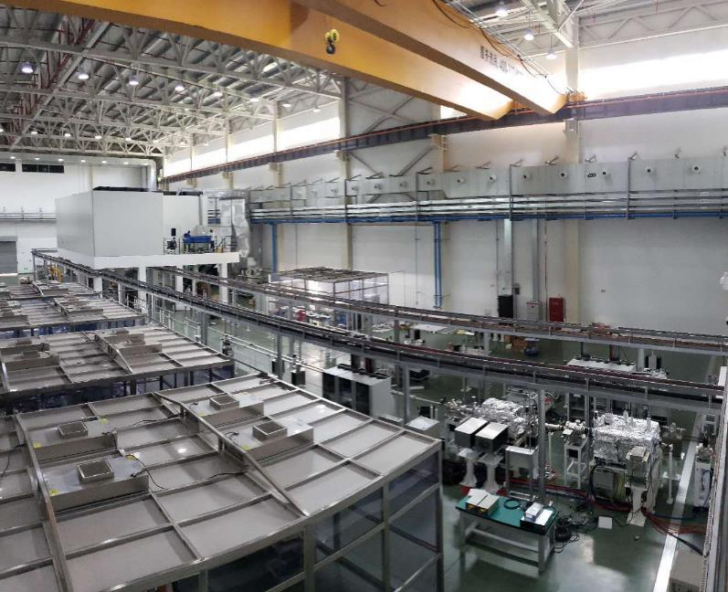
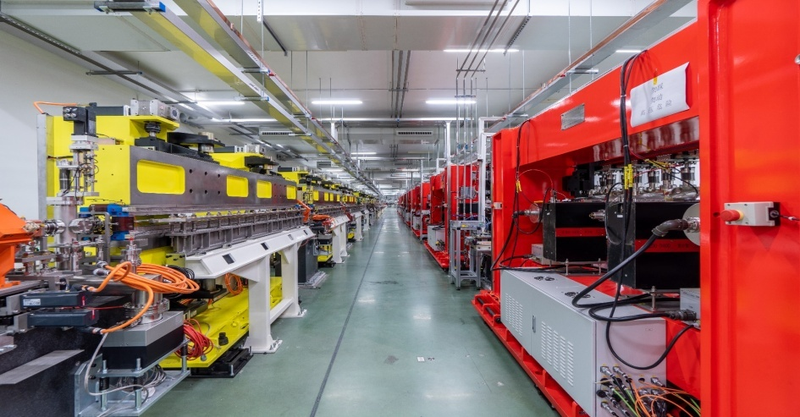
SXFEL Photos
LINAC TUNNEL
UNDULATOR TUNNEL
EXPERIENCE HALL
LLRF workshop 2023 in Gyeongju Korea

Slide 17
SHINE
LLRF workshop 2023 in Gyeongju Korea

Slide 18
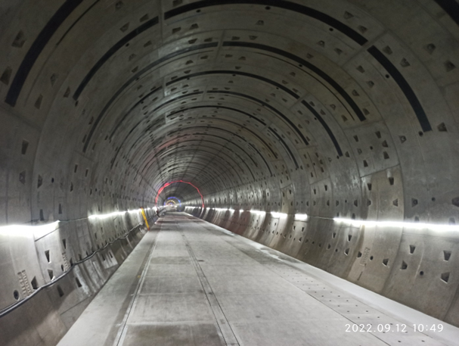
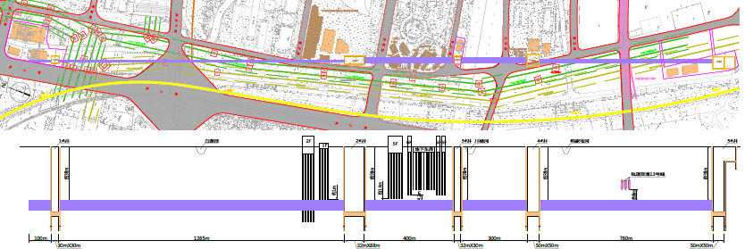
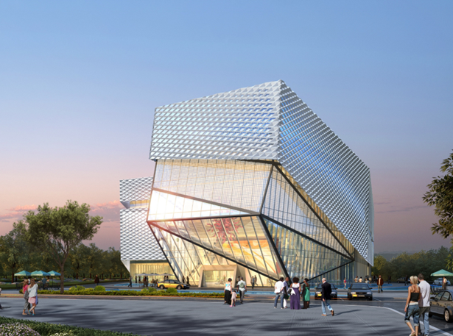
SHINE
SC linac
undulator
beamline
Long beamline
Gun
Switchyard
dumps
Exp. Hall
Far Hall
0 m 1400 m 1900 m 2300 m 3100 m
LLRF workshop 2023 in Gyeongju Korea

Slide 19
SHINE LINAC Layout
VHF gun
LH
L1
HL
BC1
L2
BC2
L3
Dechirper
L0
L4
E_{beam}=100MeV
2 CM
2 CMH
18 CM
24 CM
30 CM
Injector：VHF GUN，buncher，single cavity cryomodule with two coupler，ABBA cryomodule，S-band transverse deflecting structure(0.5m)
LINAC：75 cryomodule (8 9-cell cavities) of 1.3GHz， S-band transverse deflecting structure (one meter)，16 X-band Deflecting structure ，two cryomodule of 3.9GHz（ 8 9-cell cavities ）
1.3GHz cavities basic requirement：At 2K: Q₀≥2.7E+10 @ Eacc= 16 MV/m, max Eacc>19 MV/m
3.9GHz cavities basic requirement ： Q0≥2E+9@13.1MV/m
X-band: LLRF + 1 X-band Klystron + 4 X-band deflecting structure
Other: LLRF + high power + cavity
LLRF workshop 2023 in Gyeongju Korea

Slide 20
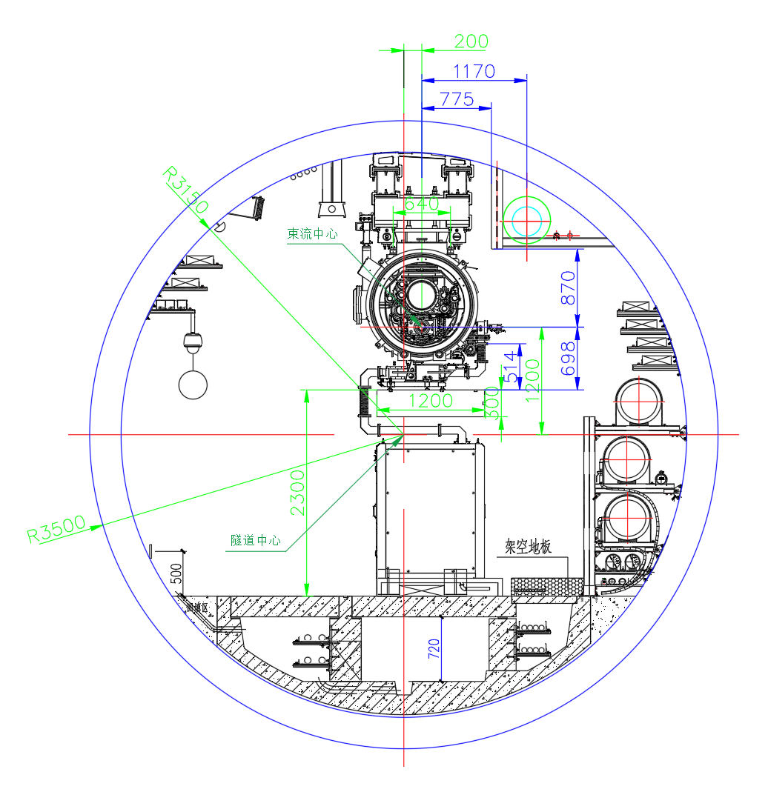
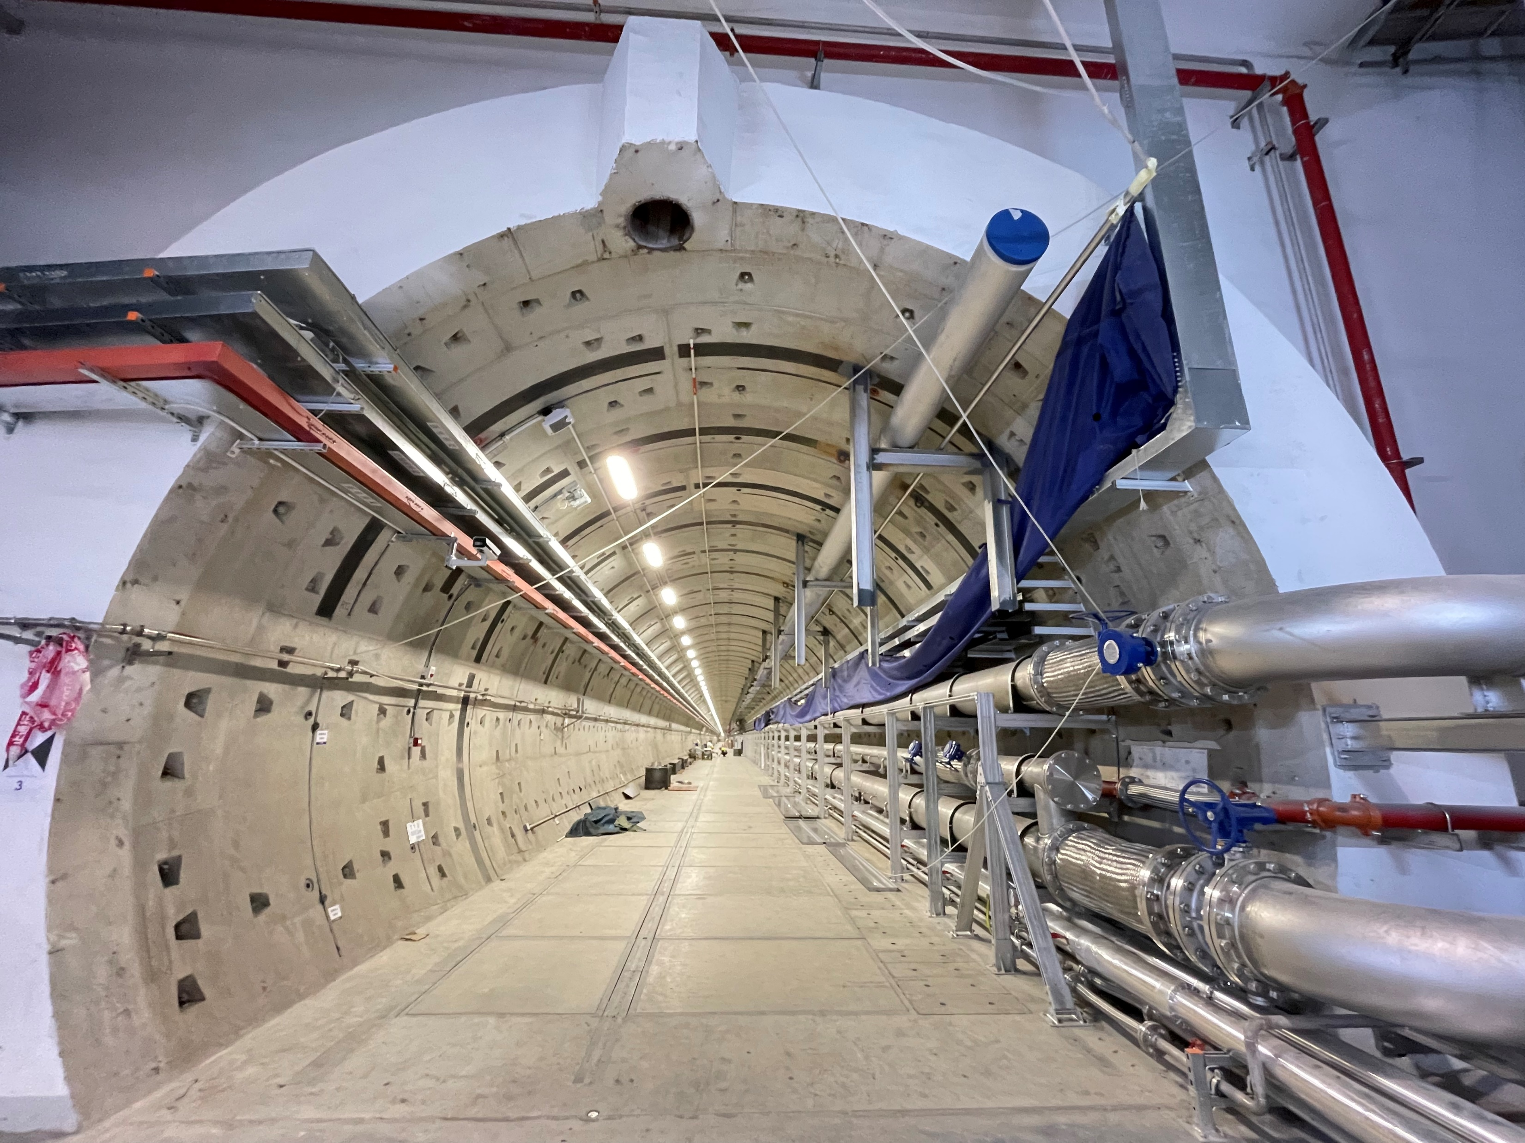
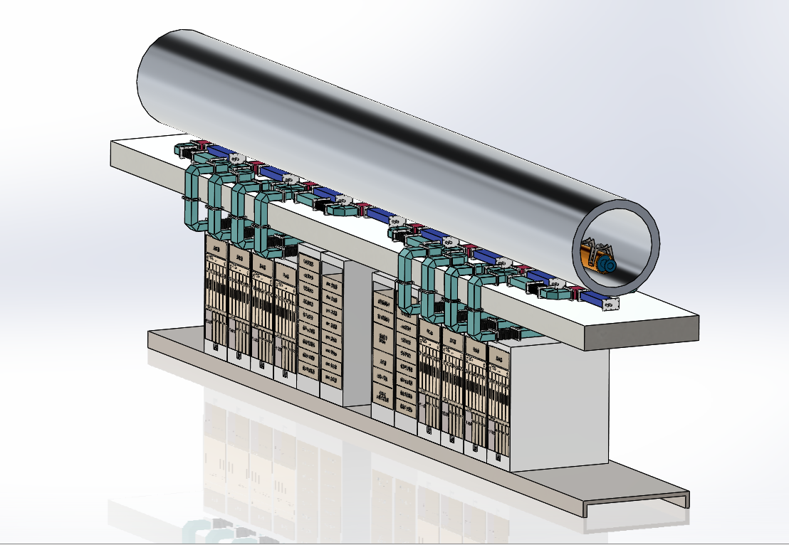
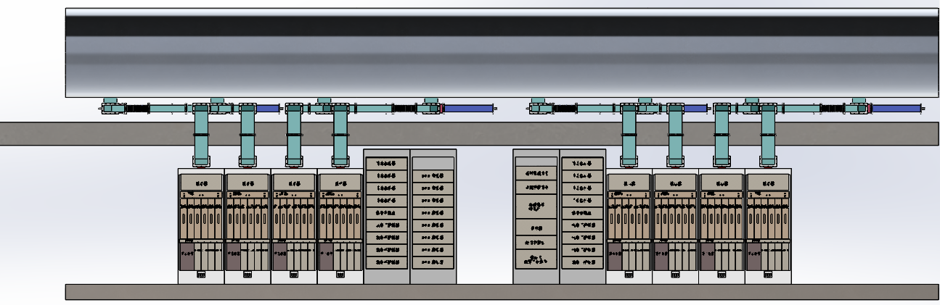
SHINE Tunnel Layout
Inside diameter：6.3m
LLRF workshop 2023 in Gyeongju Korea

Slide 21
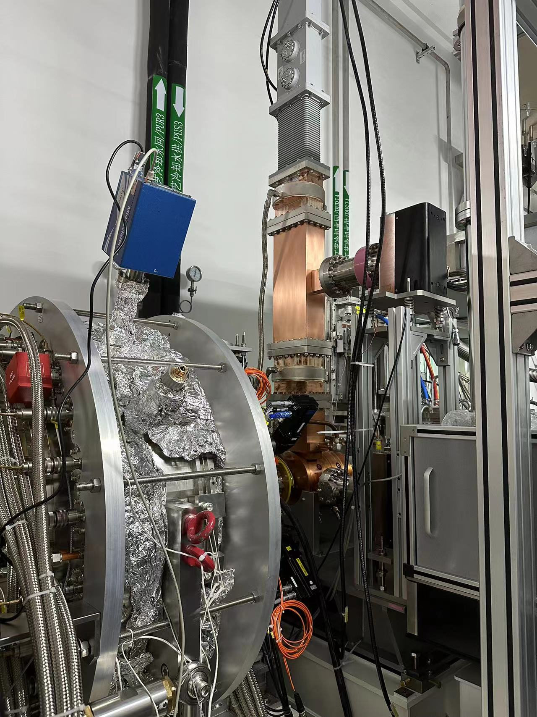
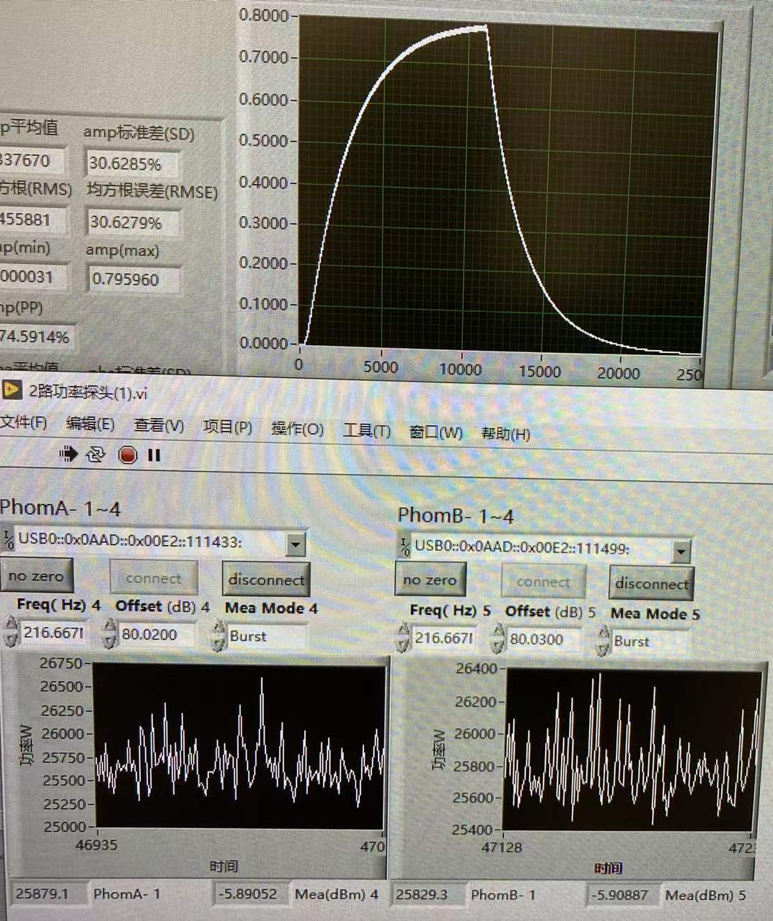
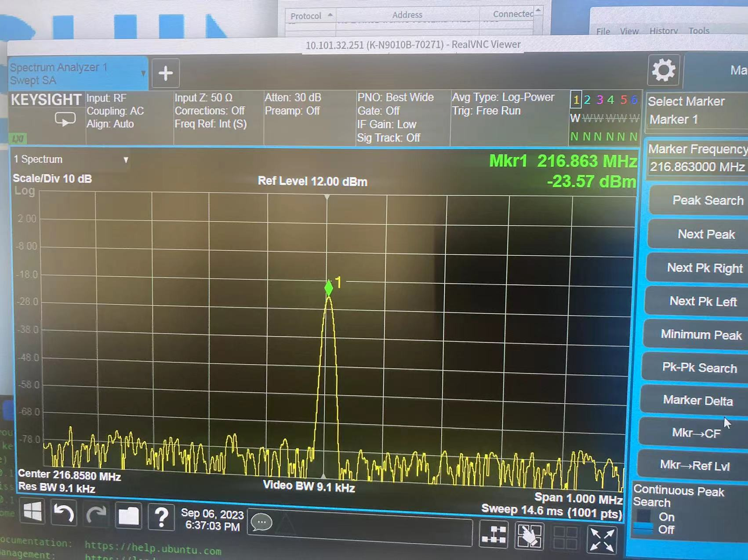
Injector status
VHF gun and buncher had been installed before August 31.
VHF gun : SEL，CW 70kW
Buncher: Pulse duty 50% 8kW
LLRF workshop 2023 in Gyeongju Korea

Slide 22
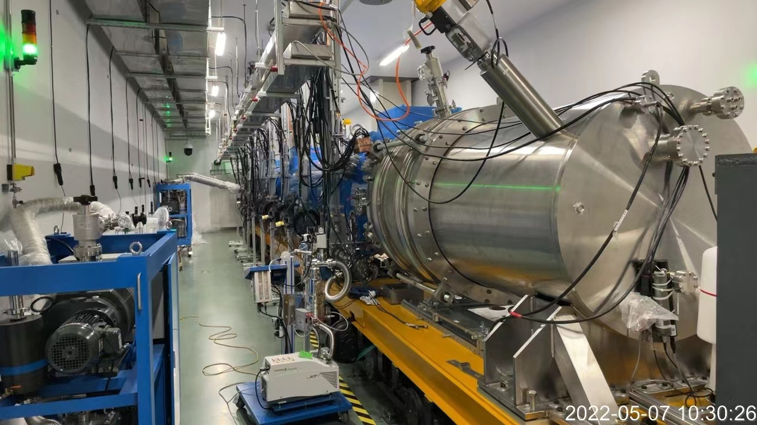
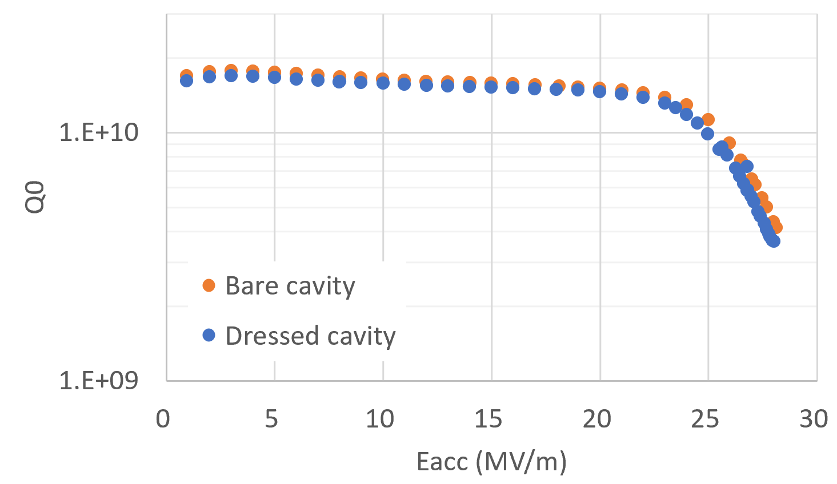
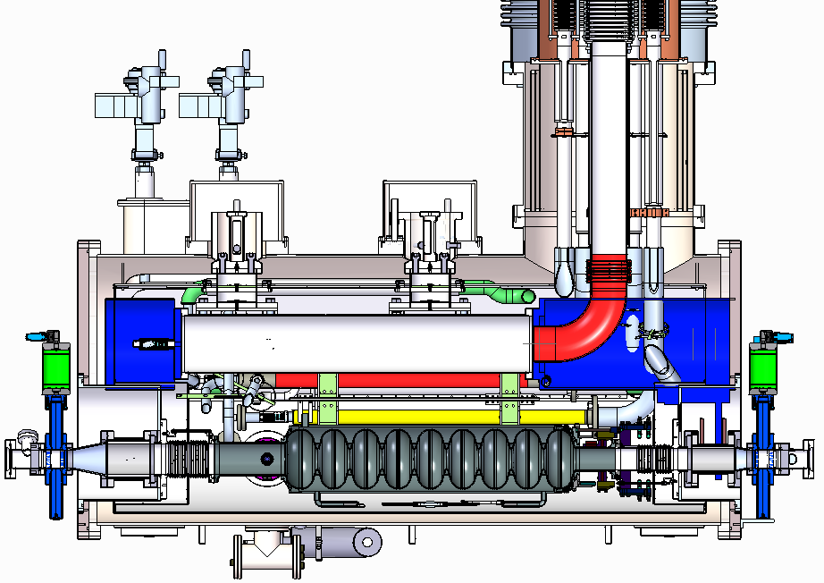
CMs development
CM1 prototype in horizontal test stand
Two complete CM prototypes with 8 cavities were assembled, tested and studied in the past two years
CM1 Prototype：standard 8-cavities (BCP refurbished), tested in June 2022, reached its basic goal (V_{tot}>128 MV, average Q₀>1.0E+10, I_{dark}<1 nA).
CM2 Prototype：standard 8-cavities, including 6 midT-baked, 1 N-doped prototype cavities and 1 LG cavity, preliminary tested in Jan 2023.
  Max voltage in CW > 136 MV;
  High Q₀ are preserved in HT;
Two special CMs for injector are under preparation.
2K vertical test results of the twin-FPC cavity
3.E+10
2.E+10
LLRF workshop 2023 in Gyeongju Korea

Slide 23
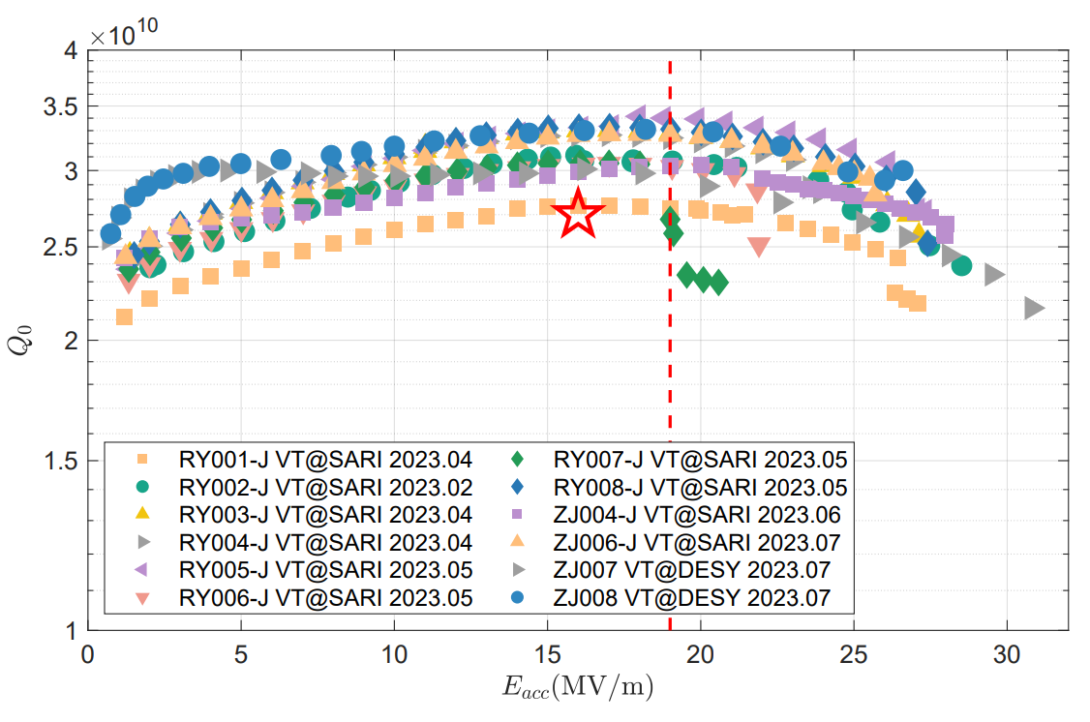
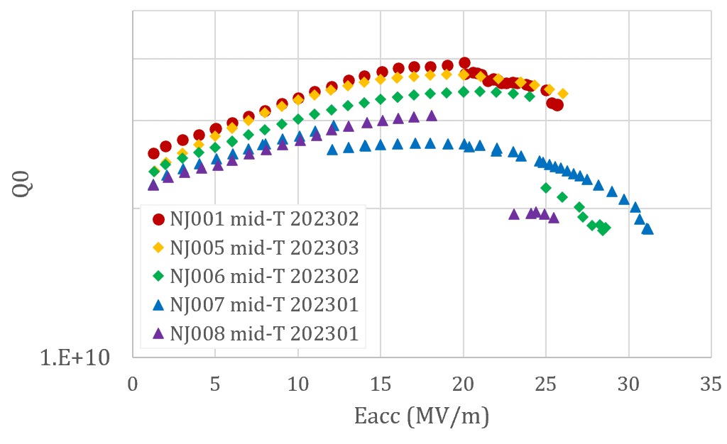
Key components – High-Q Cavities
After the development of prototype cavities, 264 cavities for SHINE project have been ordered from both domestic and international manufactures (~ half half)
High-Q recipes: N-doping and mid-T baking
High-Q are stably achieved on the upcoming 1st batch cavities (8 per manufacture)
N-doped cavities of the 1st small batch
Mid-T baked cavities of the 1st small batch
MP quenches
5.E+10
MP quenches
(Under he-tank welding)
<Eacc> = 27.9 MV/m
<Q0> = 3.3 E+10
<Eacc> = 26.3 MV/m
<Q0>= 3.2 E+10
LLRF workshop 2023 in Gyeongju Korea

Slide 24
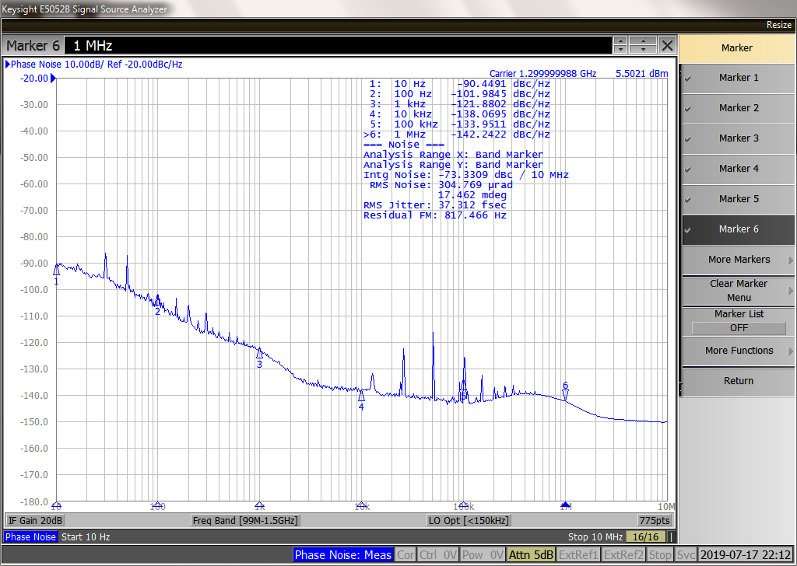
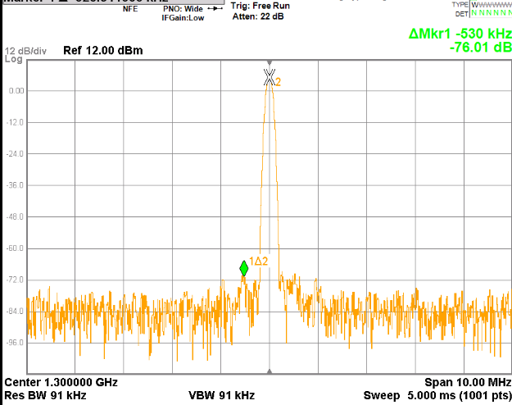
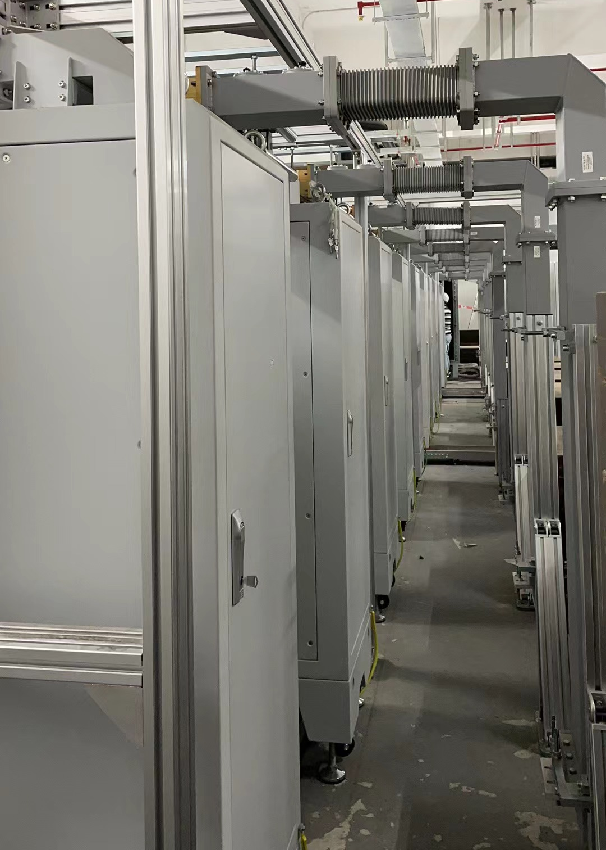
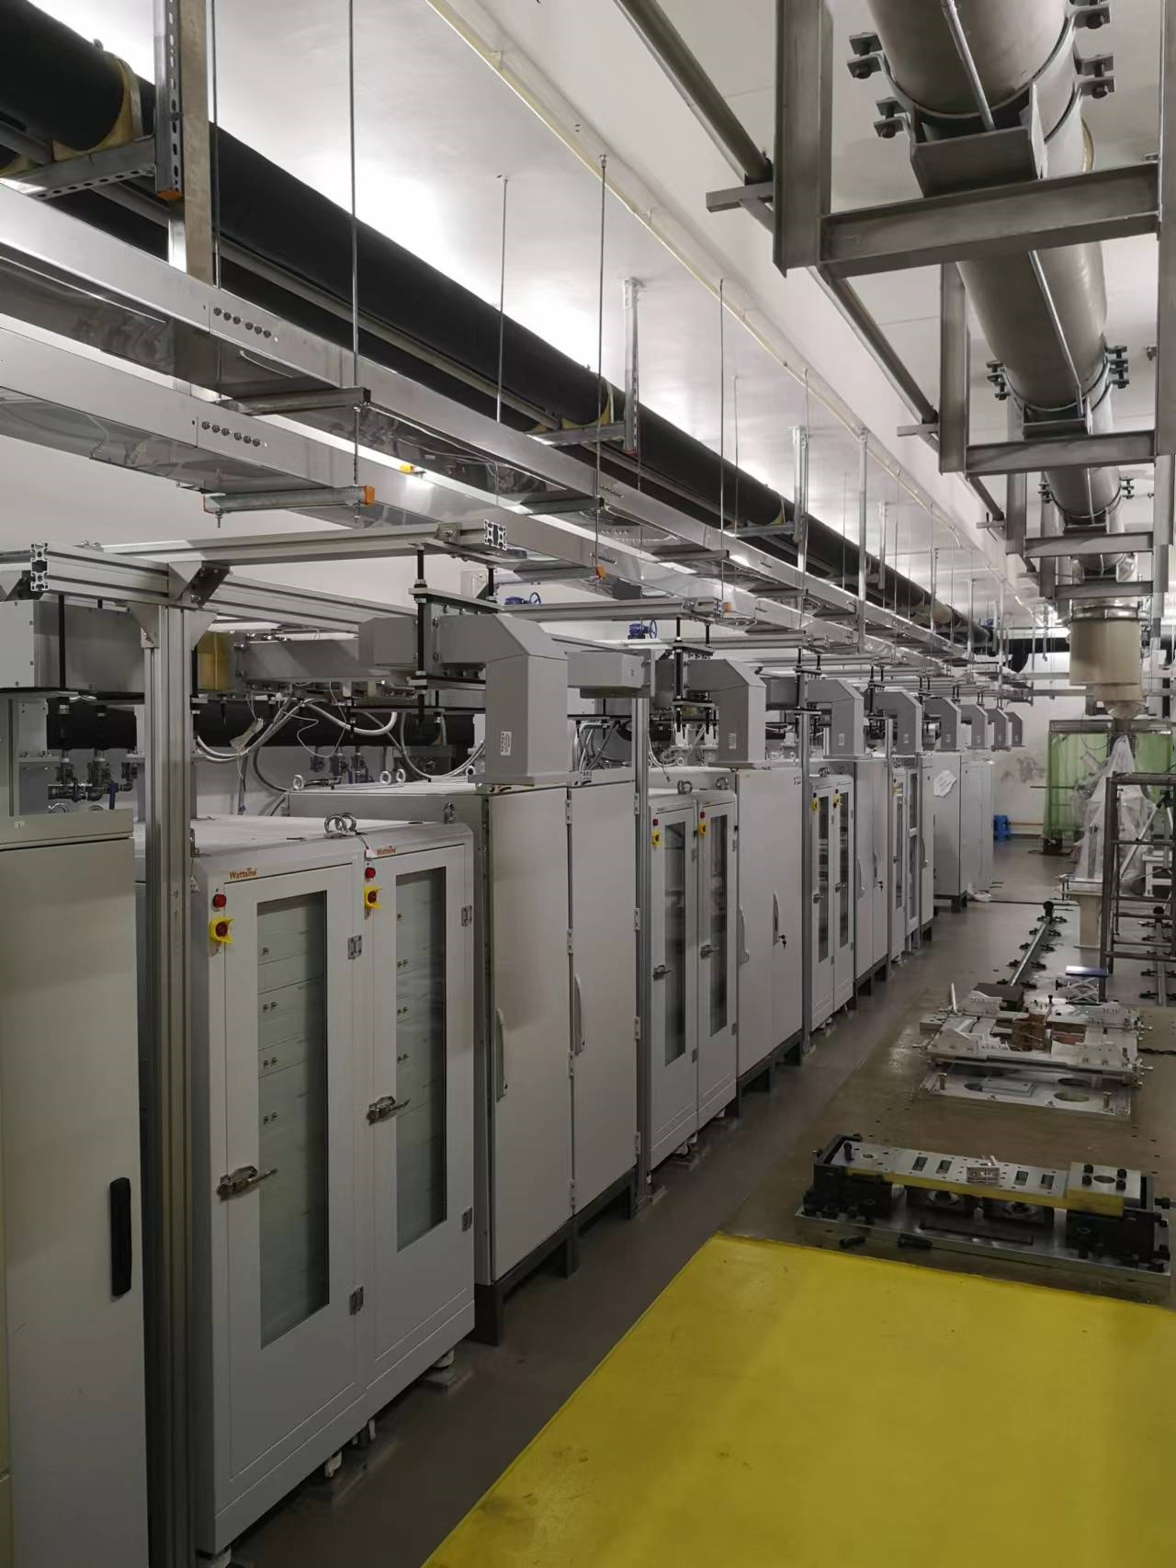


High power
Finished high power
4 1.3GHz/5.2kW prototypes
68 1.3GHz/5.2kW SSAs
1 1.3GHz/15kWSSA for Buncher
2 216MHz/60kW SSA for gun
1 3.9GHz/2kW prototype
2 S-band45MW klystron and 1 X-band 10MWklystron
Other high power hardware
1.3GHz SSA phase noise 37fs（10Hz~5MHz）
spur：-70dBc
Injector SSA
Beam current test platform
VHF gun SSA
Cavity horizontal test SSA
LLRF workshop 2023 in Gyeongju Korea

Slide 25
LLRF requirement
VHF gun LLRF requirement
Parameters | value | Units
Frequency | 216.67 | MHz
Amplitude(RMS) | 0.02 | %
Phase(RMS) | 0.02 | Deg
Operation mode | CW
Buncher LLRF requirement
Parameters | value | Units
Frequency | 1300 | MHz
Amplitude(RMS) | 0.02 | %
Phase(RMS) | 0.02 | Deg
Operation mode | CW
1.3GHz cryomodule LLRF requirement
Parameters | value | Units
Frequency | 1300 | MHz
Amplitude(RMS) | 0.02 | %
Phase(RMS) | 0.02 | Deg
Detuning (RMS) | 5 | Hz
Detuning (peak) | 10 | Hz
Gradient | 16 | MV/m
Operation mode | CW
3.9GHz cryomodule LLRF requirement
Parameters | value | Units
Frequency | 3900 | MHz
Amplitude(RMS) | 0.02 | %
Phase(RMS) | 0.02 | Deg
Detuning (RMS) | 5 | Hz
Detuning peak | 30 | Hz
Gradient | 13 | MV/m
Operation mode | CW
S-band LLRF requirement
Parameters | value | Units
Frequency | 2997.22 | MHz
Amplitude(RMS) | 0.04 | %
Phase(RMS) | 0.1 | Deg
Operation mode | 50 | Hz
X-band LLRF requirement
Parameters | value | Units
Frequency | 11988.889 | MHz
Amplitude(RMS) | 0.15 | %
Phase(RMS) | 0.15 | Deg
Operation mode | 50 | Hz
LLRF workshop 2023 in Gyeongju Korea

Slide 26



RF Front-end
Types | Ref in/MHz) | frequency/MHz | LO/MHz | IF/MHz | Ref out/MHz)
VHF gun | 1300 | 216.67 | 236.4 | 19.7 | 1300
Buncher | 1300 | 1300 | 1319.70 | 19.7 | 1300
S TDS | 1300 | 2997.2 | 3016.9 | 19.7 | 1300
X TDS | 1300 | 11988.9 | 11700+308 | 19.7 | 1300
1.3GHz | 1300 | 1300 | 1319.70 | 19.7 | 1300
3.9GHz | 1300 | 3900 | 3919.7 | 19.7 | 1300
1.3GHz LLRF front-end signa flow
L,S-band RF front-end
X-band RF front-end
X-band LO, up and down converter
LLRF workshop 2023 in Gyeongju Korea

Slide 27



LLRF DSP
6U Compact-PCI package
4 ADC channels ，2 DAC channels
  ADC：forward、reflected、pick-up
  DAC：SSA(high power)
One trigger in port
ZYNQ
  FPGA(PL): algrithme
    4Gb DDR3，save ADCs data
  ARM(PS):
    OS：LINUX
    4Gb DDR3
  Inner communication：AXI4
1000M ethernet：to center room
64G MMC Memory：save data
Two SPIs： control ATT of RF front-end
Standard 1.3GHz DSP X-band DSP (10 channel ADC’s)
LLRF workshop 2023 in Gyeongju Korea

Slide 28

LLRF algorithm
Amplitude and phase loop：
  1、PI
  2、SEL
  3、Pulse
Slow tuning：
  1、PI
  2、monitor
Fast tuning：
  1、PI
  2、microphonic suppresion
others：
  1、QL measure online
  2、interlock
LLRF workshop 2023 in Gyeongju Korea

Slide 29
summary
SSRF RF system work well and three harmonic cavity have been used in storage ring
SXFEL had been finished. Now it is open to user.
SHINE is under construction. development and manufactory of RF cavity, cryomodule, high power and LLRF is in progress.
LLRF workshop 2023 in Gyeongju Korea

Slide 30

Thanks
LLRF workshop 2023 in Gyeongju Korea

