Slide 1
SLAC highlights
Oct 2023

Slide 2
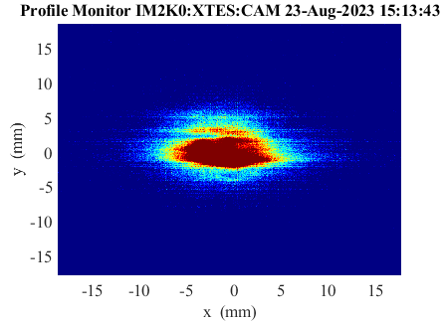
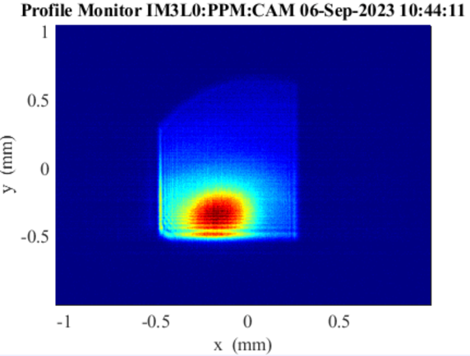
LCLS-II First Light from SC Linac
SXR Undulator lasing achieved on 8/23/23
HXR Undulator followed on 9/6/23
A. Benwell – Monday PM

Slide 3
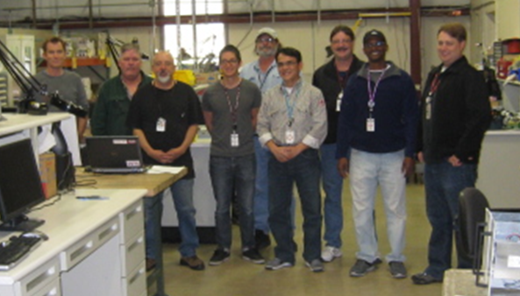
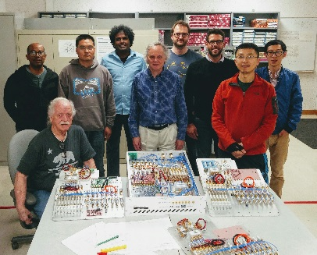
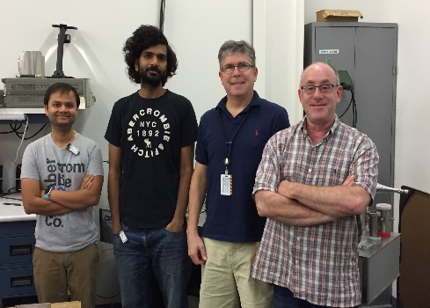
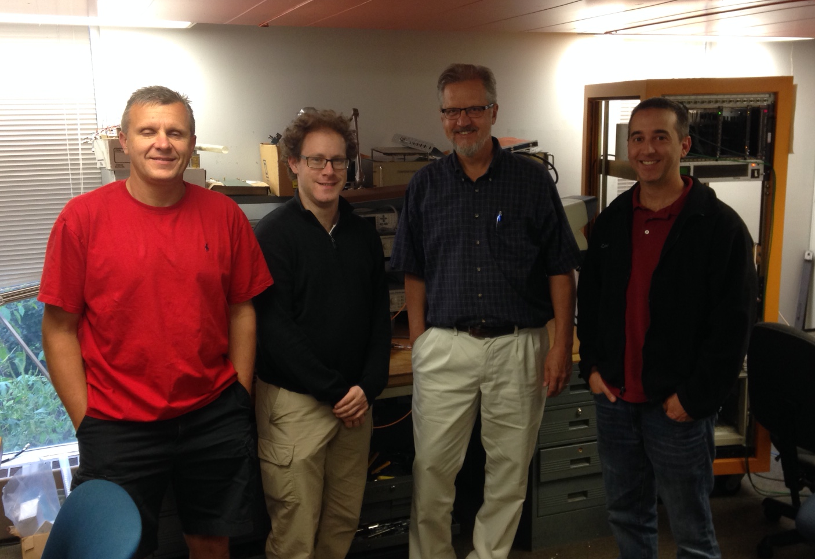
Special thanks to the entire LCLS-II collaboration for all their hard work to make this possible!

Slide 4
SRF Accelerator Overview

Slide 5
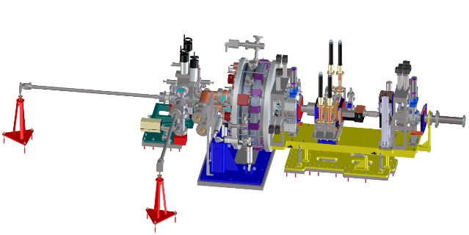
SRF Accelerator Overview
RF Photocathode Gun
35 1.3 GHz Cryomodules
2 3.9 GHz Cryomodules
Photocathode Gun
750 keV electrons

Slide 6
Relevant Performance Metrics
Performance Measure​ | Threshold (5 kW beam)​ | Final objective (120 kW beam)​ | Measurements​
Variable gap undulators​ | 2 (soft and hard x‑ray)​ | 2 (soft and hard x‑ray)​ | ​
Superconducting linac-based FEL system​ |  |  | ​
Superconducting linac electron beam energy​ | 3.5 GeV​ | ≥ 4 GeV​ | Spectrometer bend (magnet strength, screen)​
Electron bunch repetition rate​ | 93 kHz​ | 929 kHz​ | BPM’s, laser rate​
Superconducting linac charge per bunch​ | 0.02 nC​ | 0.1 nC​ | Toroid, Faraday cup​
Photon beam energy range​ | 250–3,800 eV​ | 200–5,000 eV​ | Absorption edges, spectrometer​
High repetition rate capable end stations​ | ≥ 1​ | ≥ 2​ | N/A​
FEL photon quantity (10⁻³ BW) per bunch​ | 5x10⁸ (10x spontaneous) @2,500 eV​ | > 10¹¹ @ 3,800 eV​ | Gas energy monitor, GMD, Spectrometer​
Normal conducting linac-based system​ |  |  | ​
Normal conducting linac electron beam energy​ | 13.6 GeV​ | 15 GeV​ | Spectrometer bend (magnet strength, screen)​
Electron bunch repetition rate​ | 120 Hz​ | 120 Hz​ | BPM’s, laser rate​
Normal conducting linac charge per bunch​ | 0.1 nC​ | 0.25 nC​ | Toroid, Faraday cup​
Photon beam energy range​ | 1–15 keV​ | 1–25k eV​ | Absorption edges, spectrometer​
Low repetition rate capable end stations​ | ≥ 2​ | ≥ 3​ | N/A​
FEL photon quantity (10⁻³ BWª) per bunch​ | 10¹⁰ (lasing @ 15 keV)​ | > 10¹² @ 15 keV​ | Gas energy monitor, GMD, Spectrometer​

Slide 7
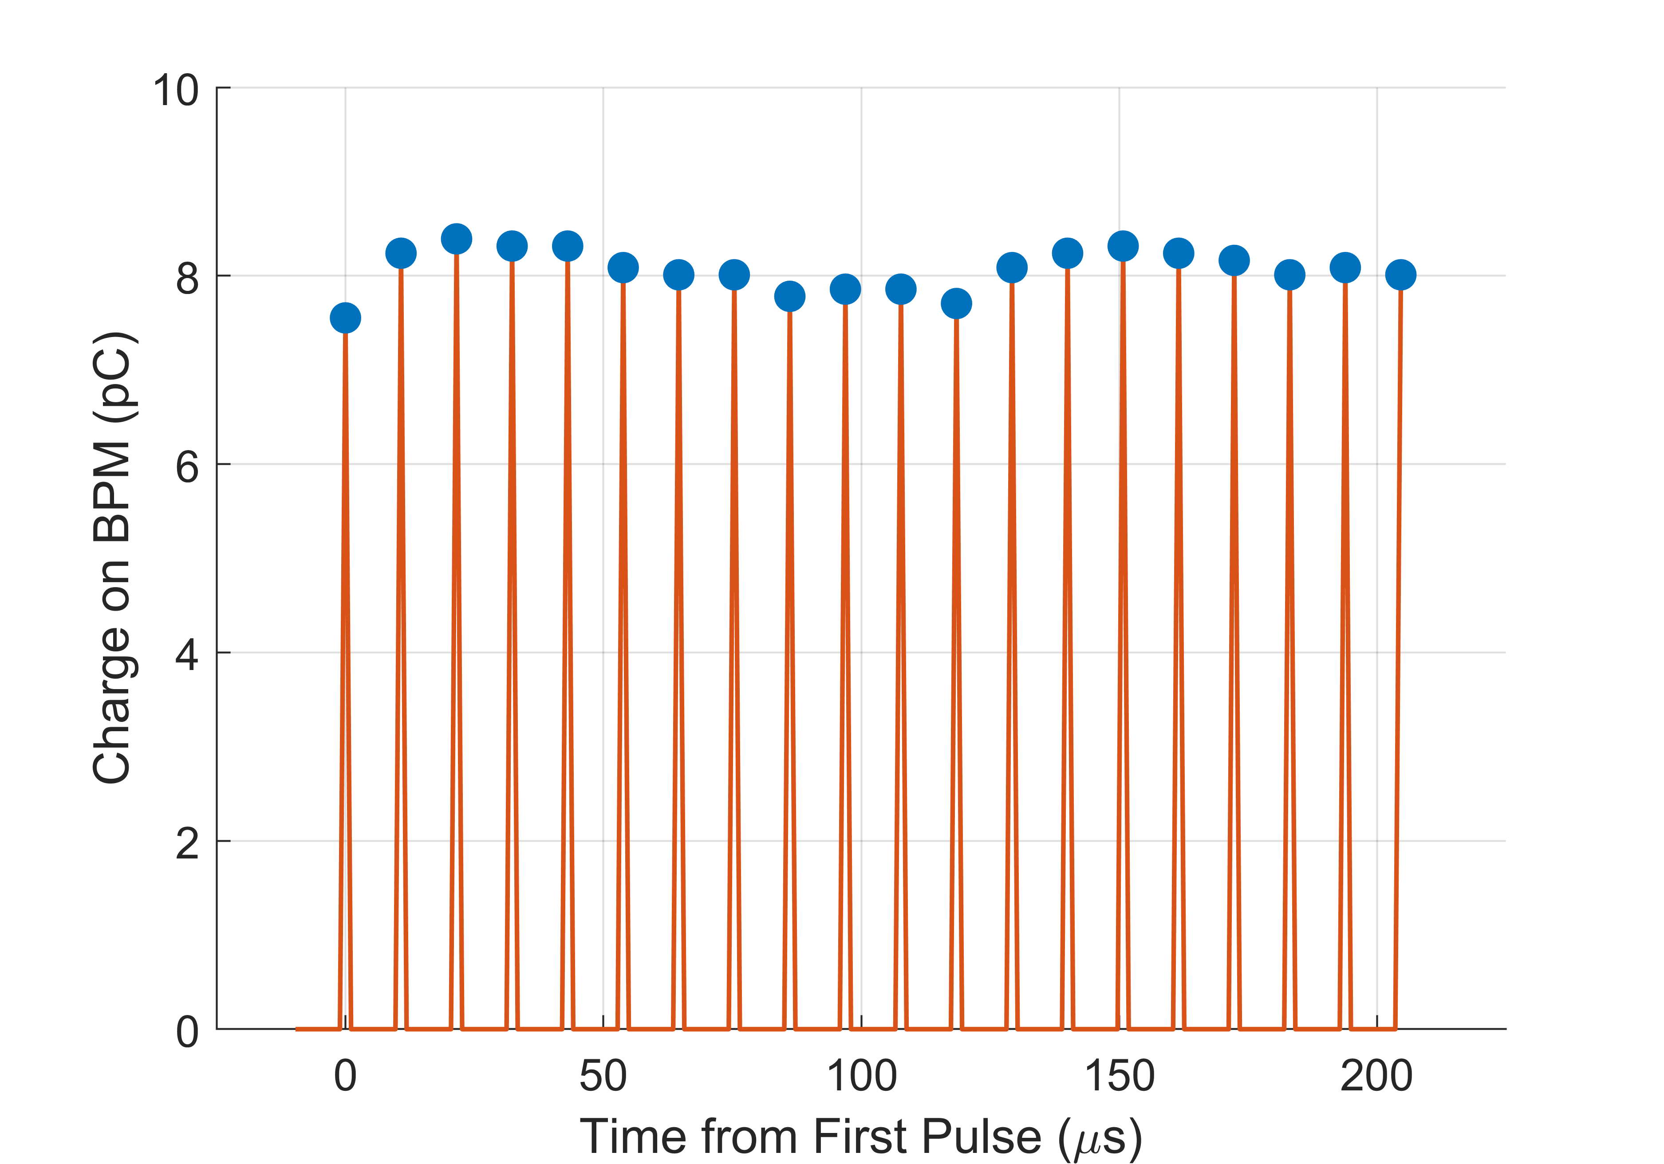
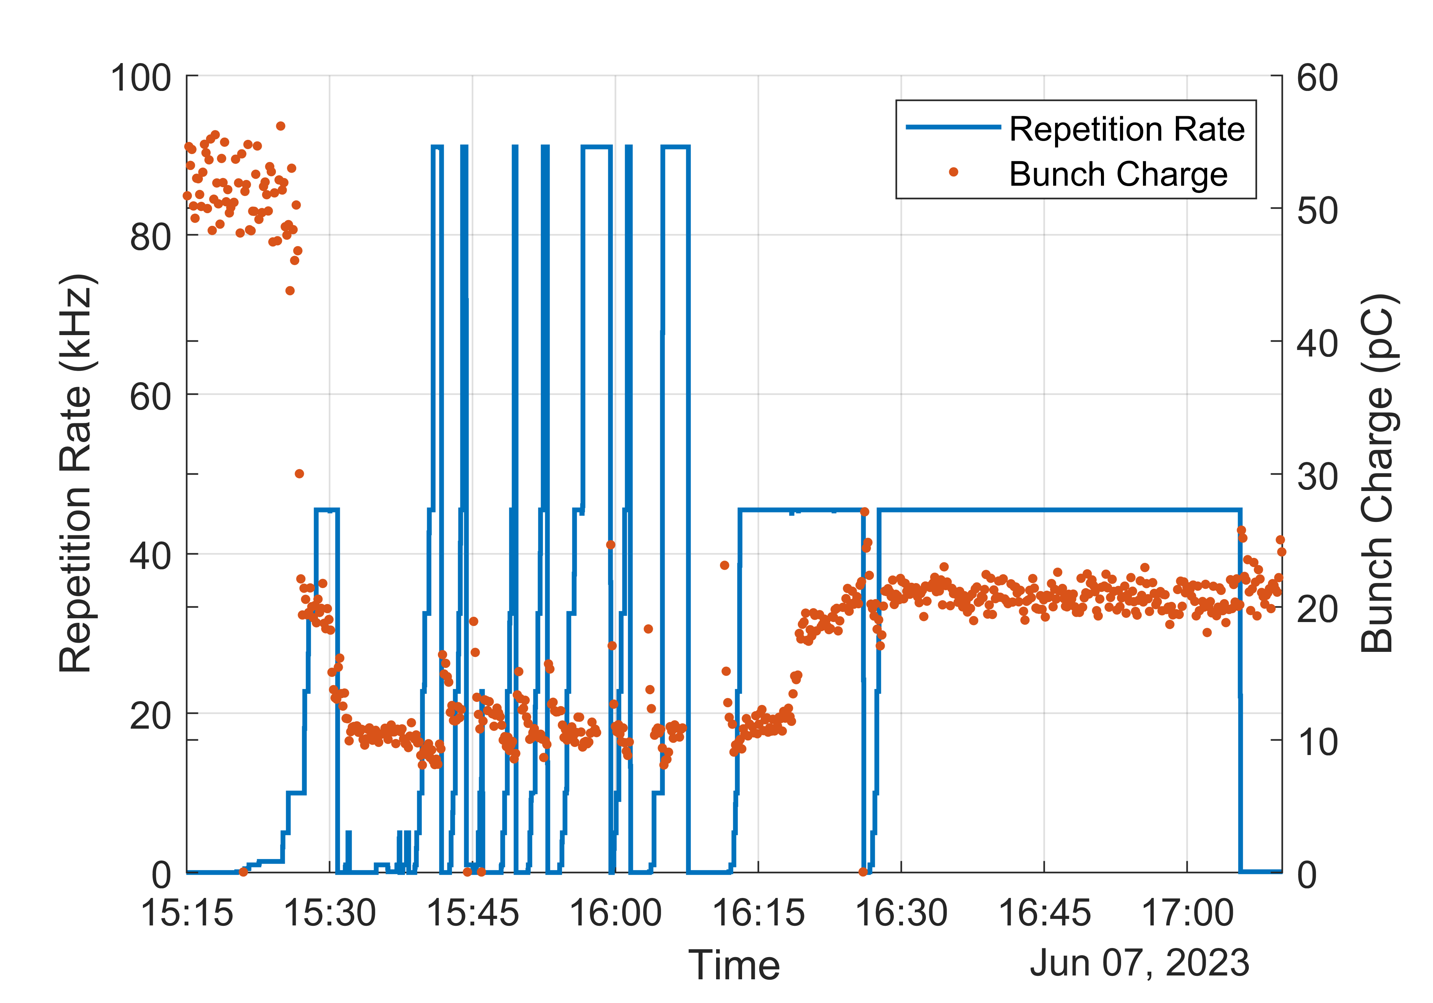
LCLS-II High Rep Rate
Repetition rate is set in the control system and verified by the last BPM prior to the beam dump
Repetition rate was ramped up to 93 kHz on 6/7 for the first time
Subsequent measurements were carried out at half the rate but at same beam power for additional testing
Pulse Spacing Measurement on Last BPM
Spacing of ~10.7 µs between pulses demonstrates 93 kHZ

Slide 8
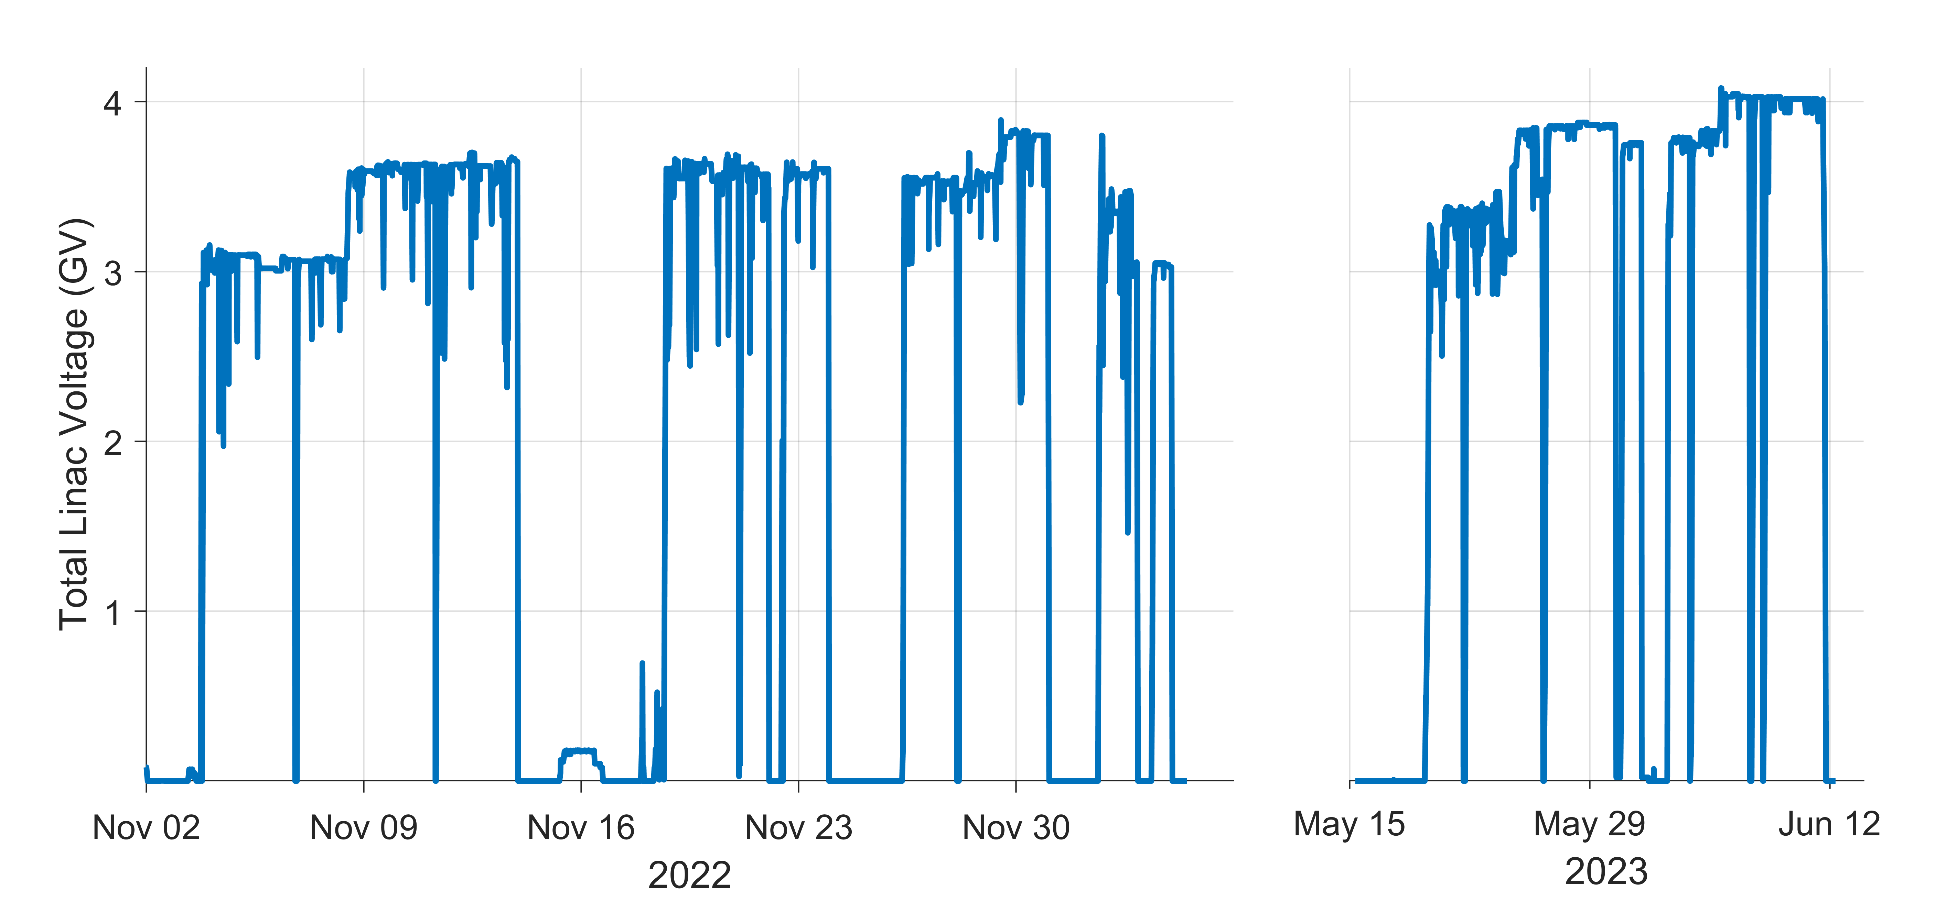
3.5 GeV Beam
Stable 3 GeV beam to BSY achieved on 10/28/22
Stable 3.5 GeV beam (on crest) to BSY achieved on 11/8/22
Ran stably through end of November
3.5 GeV beam with L1 and L2 at nominal phase (off crest) at end of November
Lowered to 3 GeV for remaining beam tasks until December break
Following restart in May 2023, 3.5 GeV beam has been used exclusively
Total Cavity Voltage
2
3
5
1
4
A. Benwell – Monday PM

Slide 9
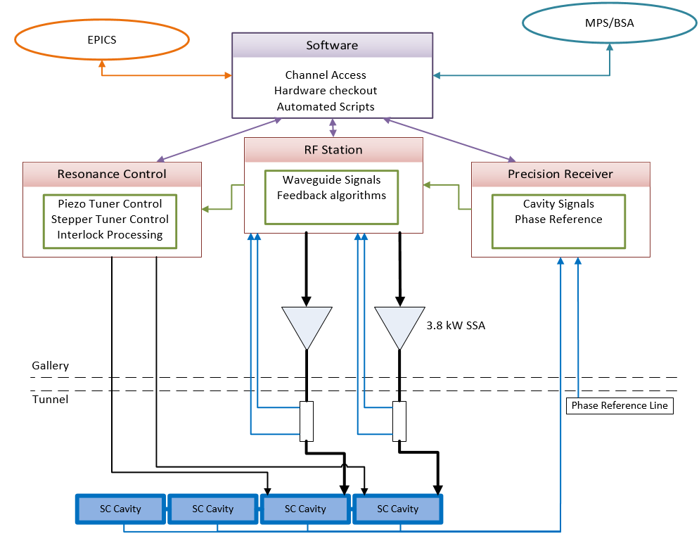
LCLS-II LLRF System Overview
Hardware/Firmware
Precision Receiver Chassis (PRC)
Exclusively for cavity signals
Fiber communication for high Isolation necessary for 0.01°/0.01%
RF Station (RFS)
Generates independent RF signal for 2 cavities
Forward, Reverse and SSA Drive signals
Detune frequency calculation, PI loop control
Resonance Control
Piezo Tuner Control
Stepper Motor Control
Temperature Monitoring
Interlock processing
Software
Automated Scripting
Cavity and SSA characterization
Smooth transition between modes
Channel Access
EPICS
All control displays and waveform readouts
Cavity control interface
Modes of Operation
Hardware health
7 kW
LCLS-II-HE will have only minor LLRF system changes

Slide 10
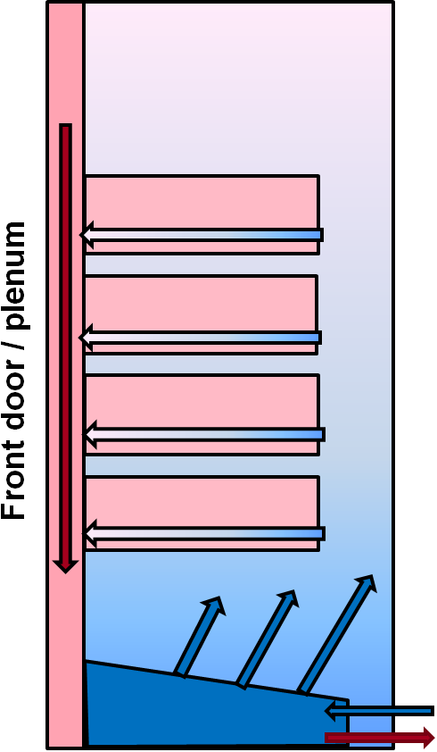
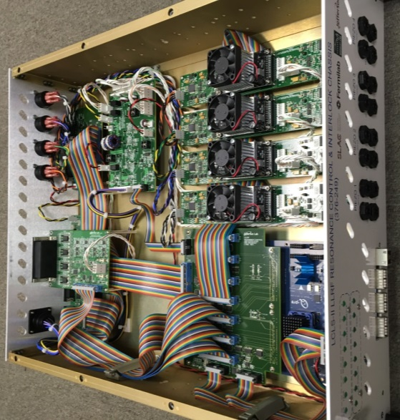
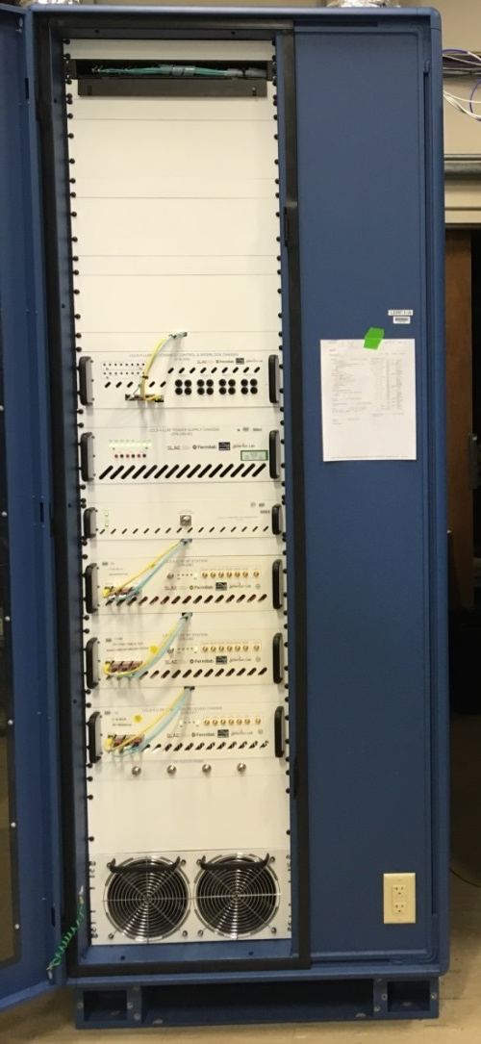
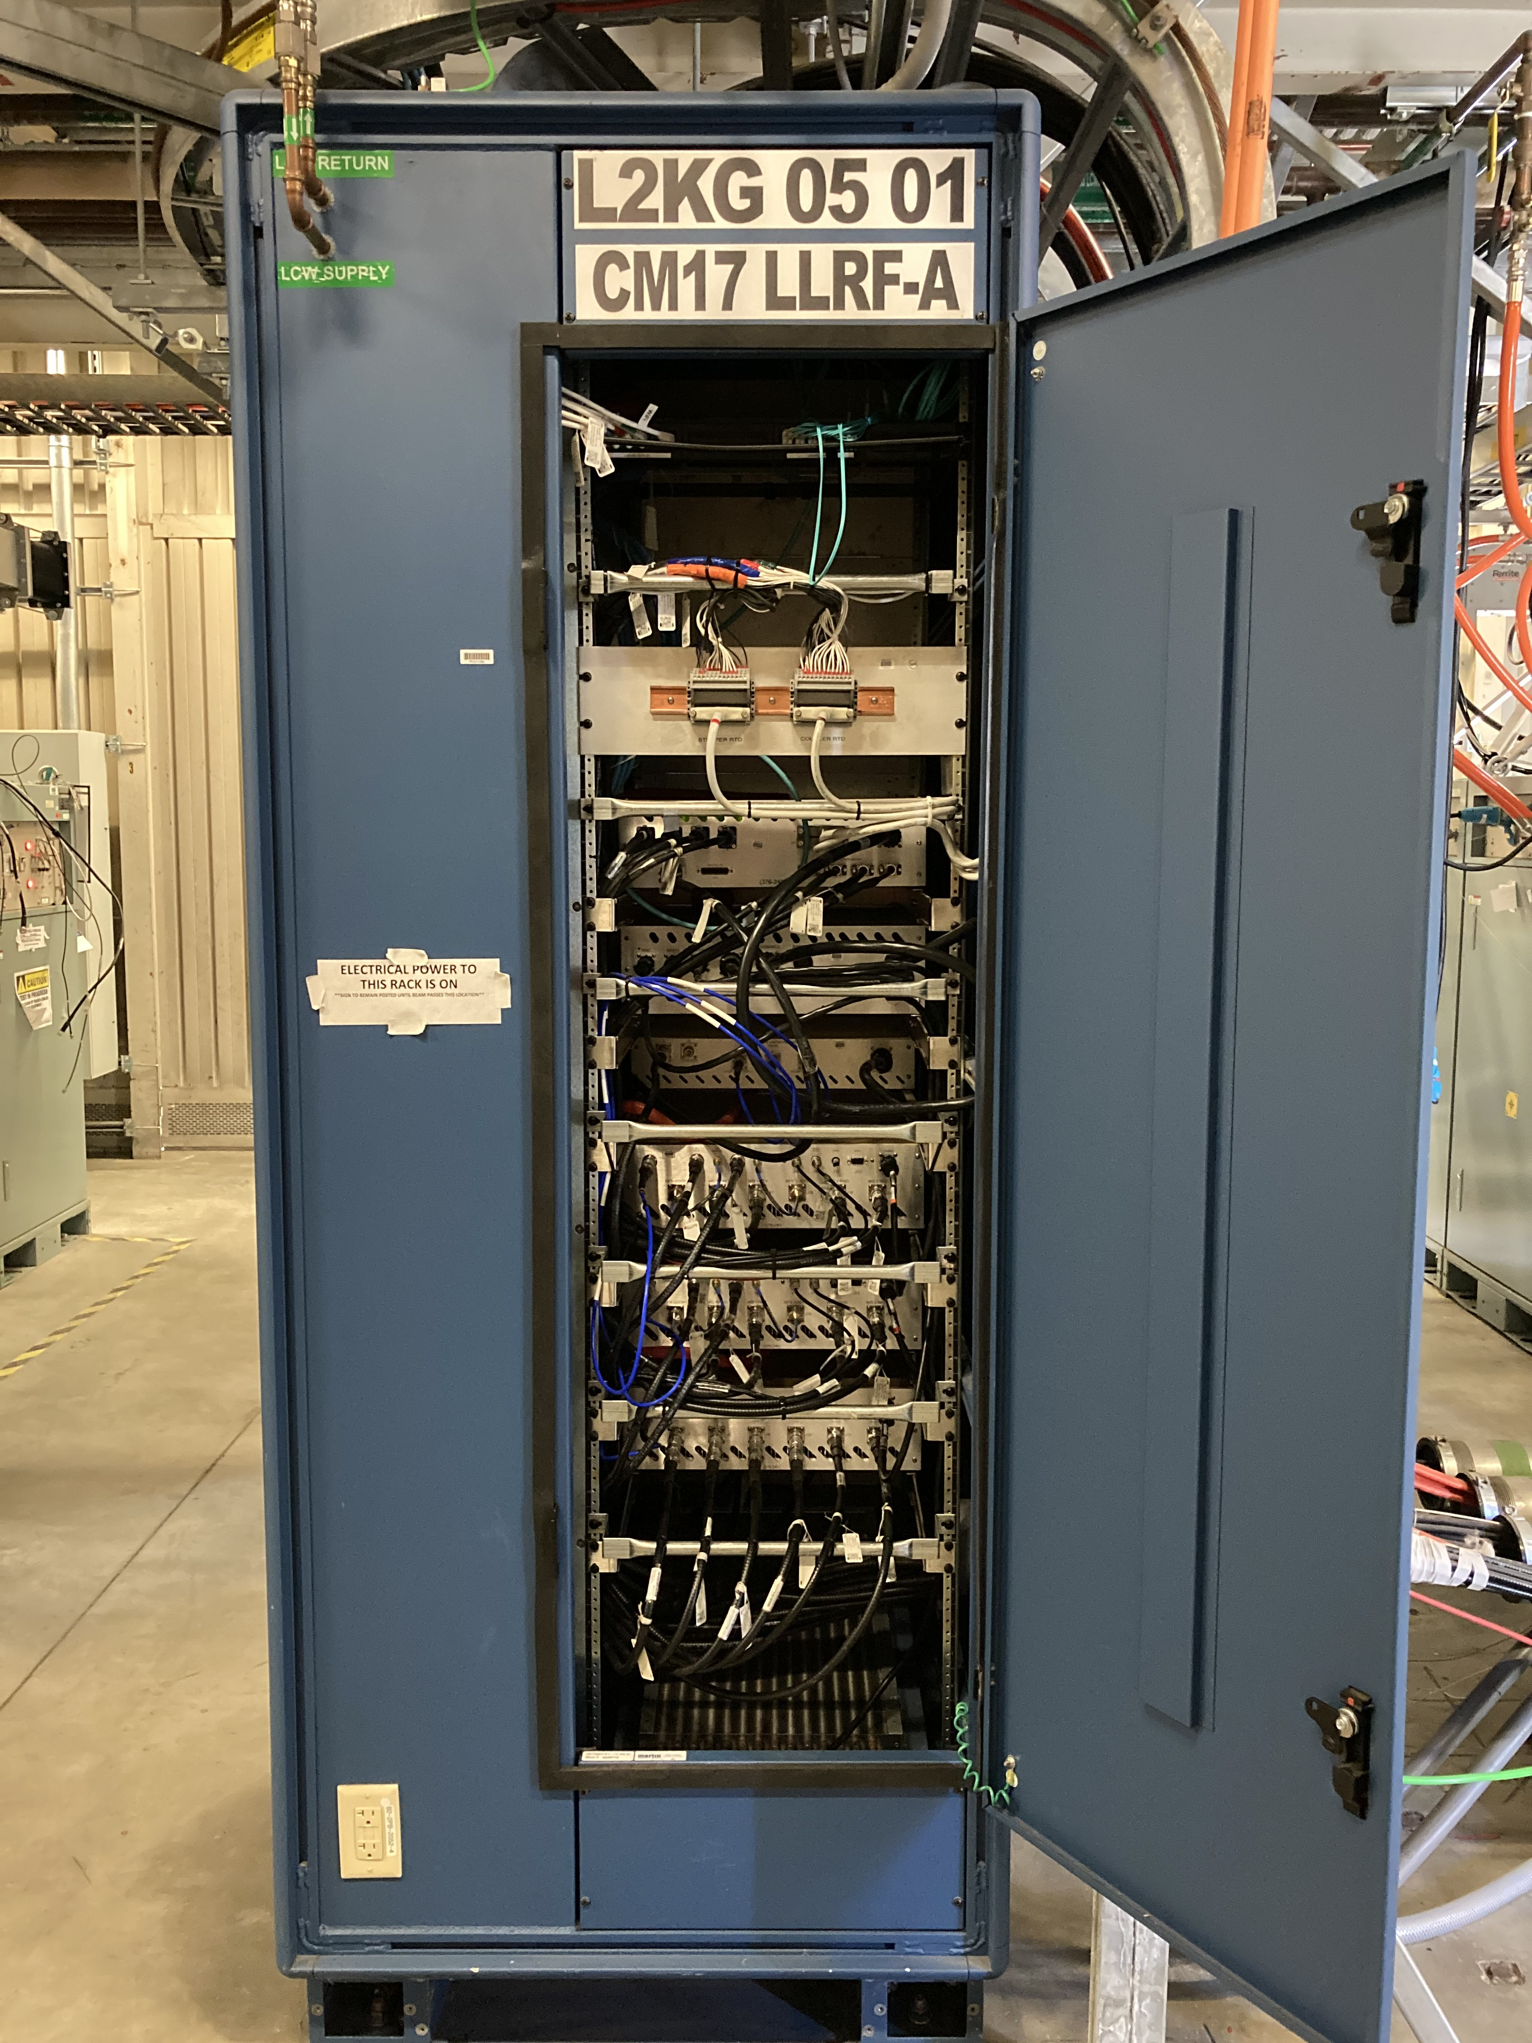
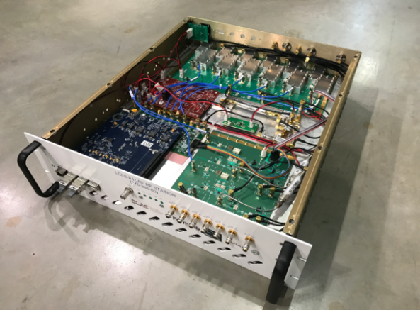
LCLS-II LLRF Hardware
Coupler/Stepper
Temperature
Resonance Control
Stepper tuner
driver
Power
FMC Breakout
Piezo tuner
drivers (x4)
Digital Carrier (FPGA)
Fiber links
RF Station
Power Board
Down
Converter
Digitizer
Digital Carrier
(FPGA)
Up
Converter
10

Slide 11
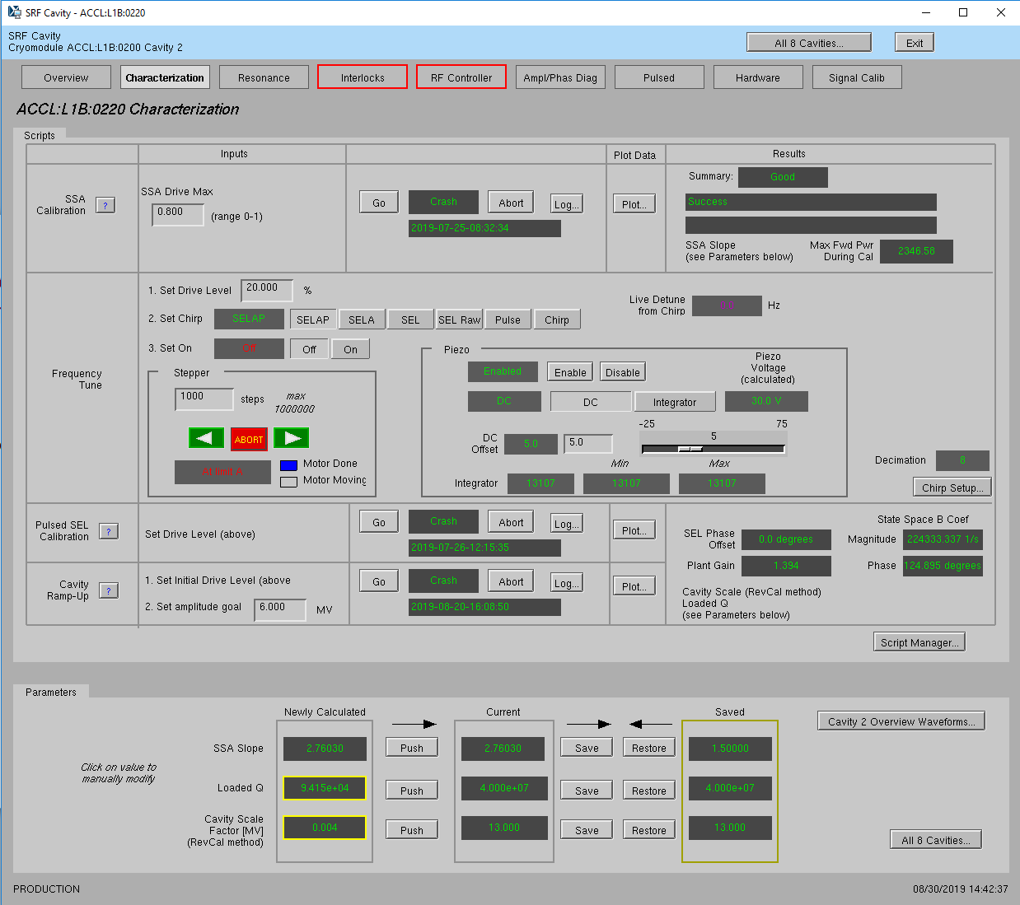
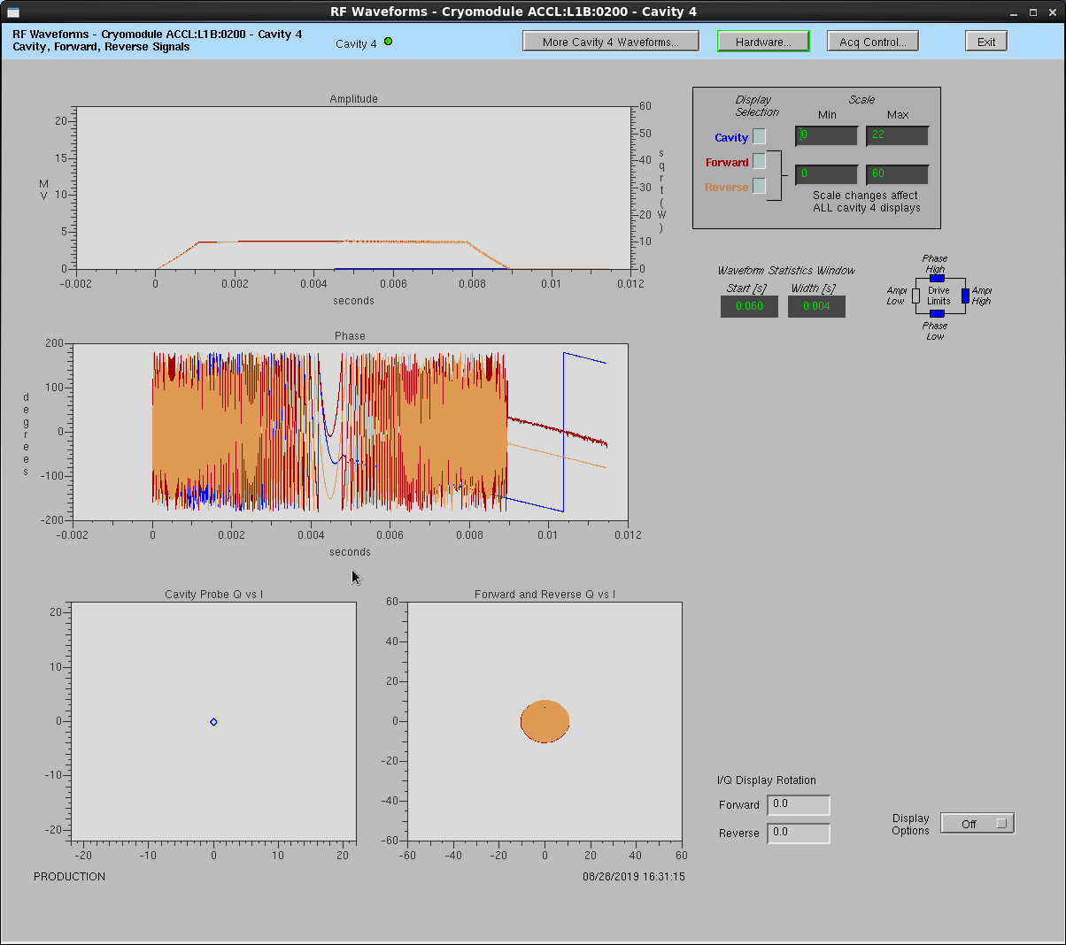
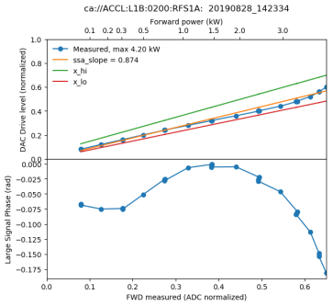
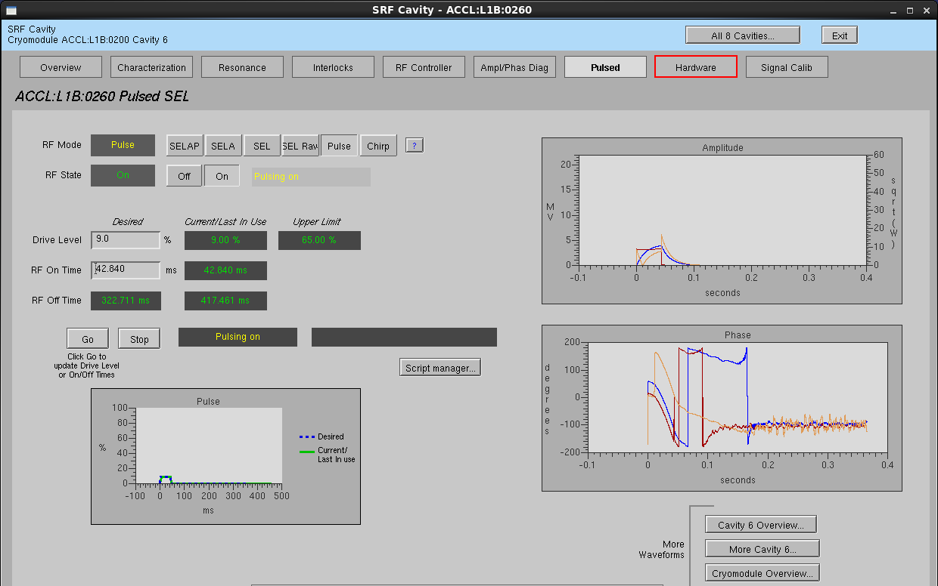
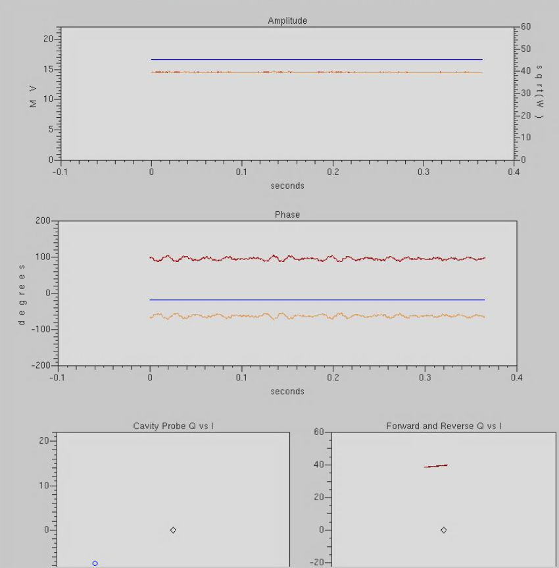
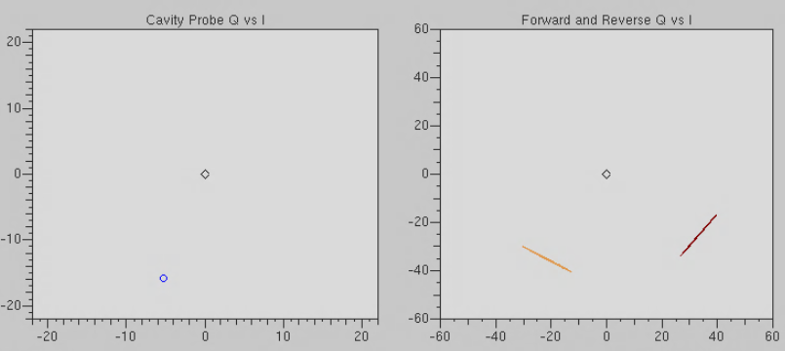
RF Cavity Setup & Control
4-Step Process
SSA calibration
Chirp detune scan
Immediately “find” cavity and enter in SEL mode
Enable piezo tuner response to center cavity at nominal frequency
Pulsed SEL calibration
Measures loaded Q of cavity
Calculates cavity scale factor, based on energy integration
Set to target field in SELAP mode
* Some user interfaces have been updated in production
Cavity Forward Reverse
11

Slide 12
LCLS-II High Energy Upgrade Project
Install 23 additional cryomodules (L4 Linac) to increase the LCLS-II accelerator energy to 8 GeV.
Install new cryogenic distribution system between Cryoplant-2 and the new L4 Linac.
Upgrade soft X-ray undulator for 8 GeV operation.
Upgrade the X-ray Pump Probe (XPP) instrument for MHz beam and data rates and upgrade the photon transport optics and beamline components through the Hard X-ray instruments.
For extended hard X-ray performance, develop conceptual design of a Low-Emittance Injector (LEI) including a tunnel design to support its construction. Also fund construction of a prototype high gradient SRF gun (30 MV/m cathode field) for the LEI.
A. Benwell – Monday PM
12

Slide 13
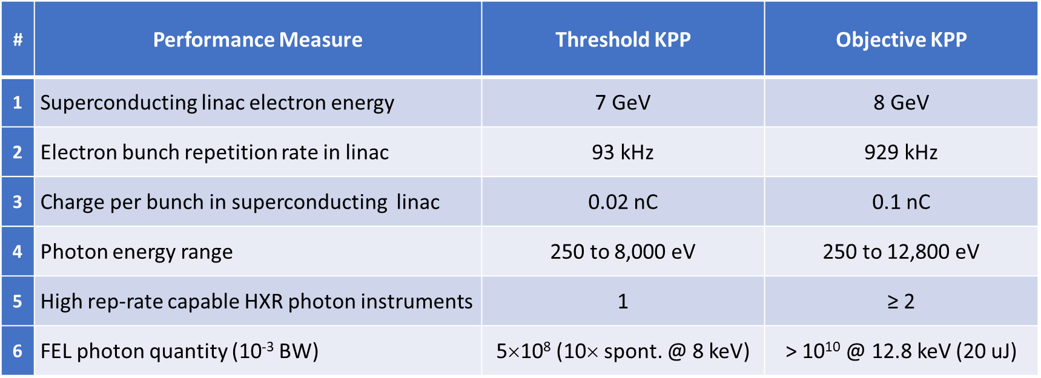
LCLS-II-HE Project Goals

Slide 14
LCLS-II-HR RF System Overview
Section | # of CM | # of Cavities | Minimum Gradient [MV/m] | QL | SSA Power [KW]
L0 | 1 | 8 | 16.3 | 4.1e7 | 3.8
L1 | 2 | 16 | 13.6 | 4.1e7 | 3.8
L2 | 12 | 96 | 15.5 -> 16 | 4.1e7->6.0e7 | 3.8
L3 | 20 | 160 | 15.5 -> 16 | 4.1e7->6.0e7 | 3.8
L4 | 23 | 184 | 20.8 | 6.0e7 | 7.0
No major changes to RF control, but LLRF system must regulate higher gradient with higher loaded Q
RF regulation at > 0.1 Hz remains the same
0.01° RMS in phase
0.01% RMS in amplitude
RF regulation assumes
< 1% beam current fluctuation
< 10 Hz microphonic detuning
Resonance Control regulation
Piezo tuner setting accuracy < 1Hz
HE Linac changes
L2 and L3 gradient increased
L2 and L3 cavity QL increased
L4 – new, with increased gradient
14

Slide 15
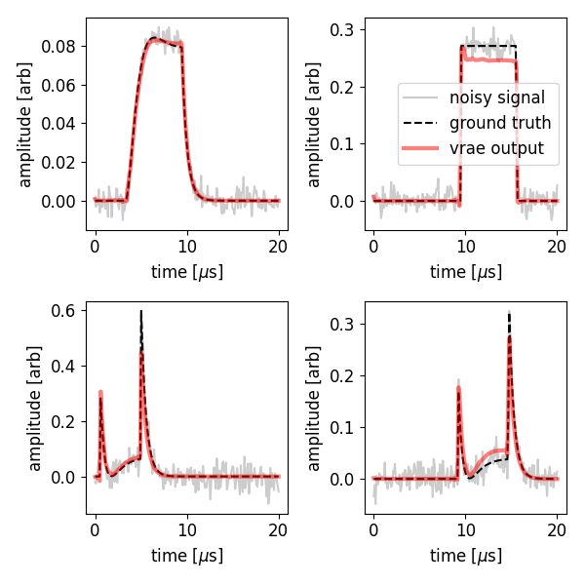
Variational autoencoders for noise reduction in industrial LLRF systems
Industrial systems are becoming increasingly complex → this increases the need for automation and more sophisticated control systems
Comparison of noise reduction on RF signals of a simulated room temperature s-band system, using feedforward autoencoder, convolutional networks, variational recurrent autoencoder, and Kalman filters
J. Edelen – Tue. AM

Slide 16
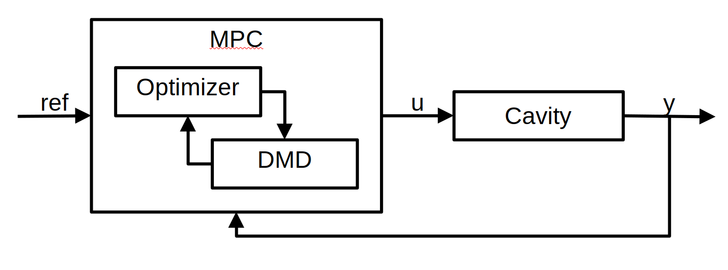
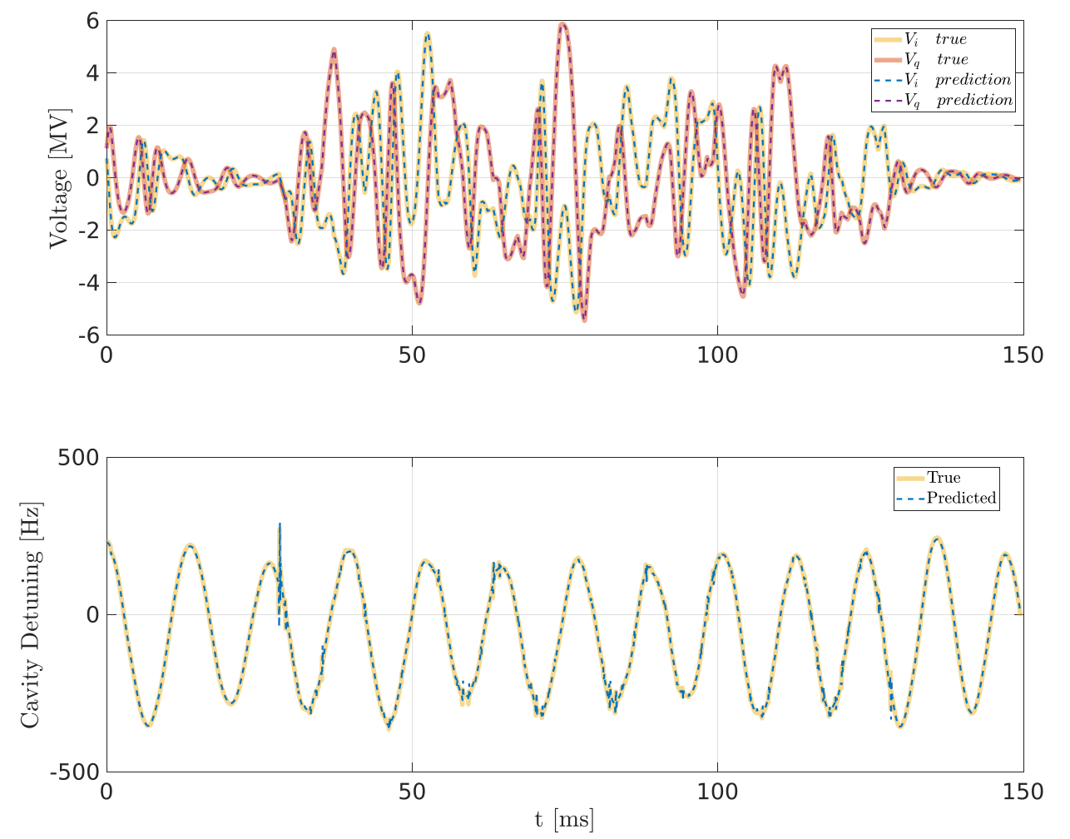
SRF cavity field and resonance controller based on DMD Initial Results
Motivation: Decrease RF power consumption, cryogenic heat loads and costs by minimizing SRF cavity detuning due to microphonics
Goal: Enhance SRF cavity stability and minimize SRF cavity detuning with a data-driven Model Predictive Control (MPC) based on the Dynamic Mode Decomposition (DMD) method
The MDM model and the MPC controller have been validated with simulations. Results are promising → implementing the controller in a LCLS-II LLRF system.
Collected RF and piezo waveforms from LCLS-II cavities, under specific conditions, to train the DMD model, and the prediction error is less than 3%
Implementing the MPC on an FPGA of the resonance control chassis of the LCLS-II LLRF system
J. Diaz – Wed. AM

Slide 17
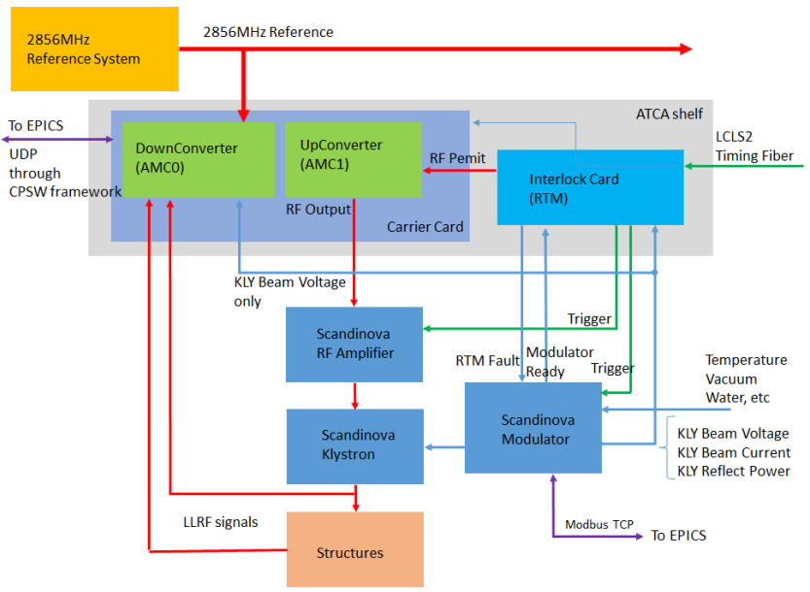
S-BAND TRANVERSE DEFLECTOR SYSTEM FOR LCLS-II
The S-band Transverse Deflector (STCAV2) is a 2856 MHz deflecting cavity used for longitudinal beam diagnostics, such as, absolute electron bunch length, slice energy spread, and vertical slice emittance
The ATCA-based LLRF system consists of two advanced mezzanine cards (AMC cards) into a carrier with an FPGA for all signal processing, timing/triggers, interface to RTM and EPICS
370 MS/s ADCs and DACs
N. Ludlow – Poster

Slide 18
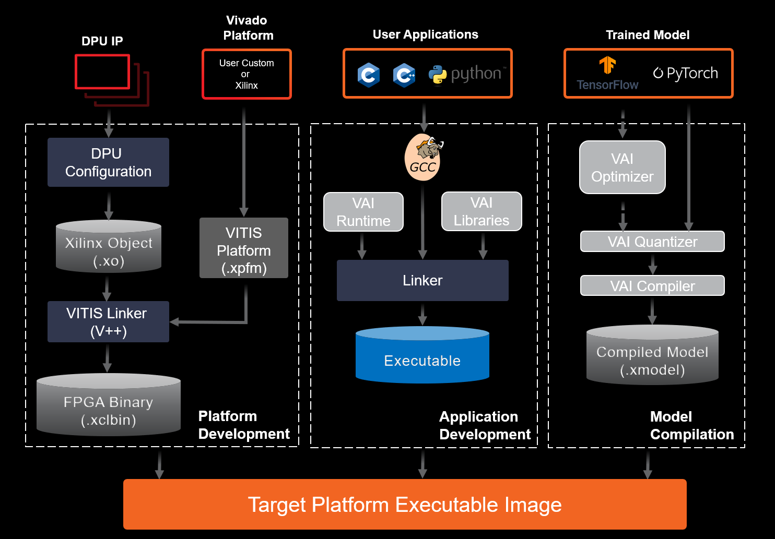
Other Activities
FW/SW Framework for SRF control
CI/CD pipeline for testing and deploying the FPGA FW and embedded SW for the AMD Xilinx MicroBlaze processor
First application is the ML based active resonance control system for LCLS-II cavities
Drift correction and compensation in LCLS-II
SRF gun development for new low emittance injector
RF based synchronization for LCLS complex
M. Donna – Poster
S. Murthy – Talk Monday PM
Not presented here

Slide 19
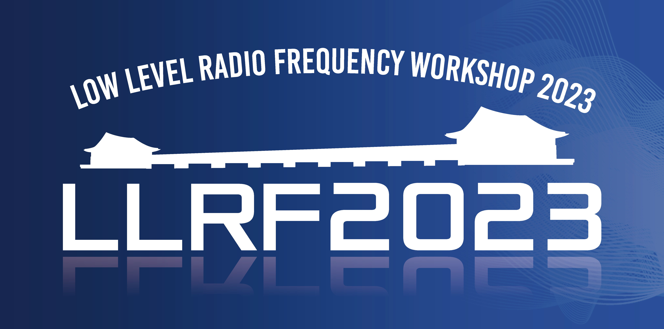
Thank you
감사합니다

