Slide 1
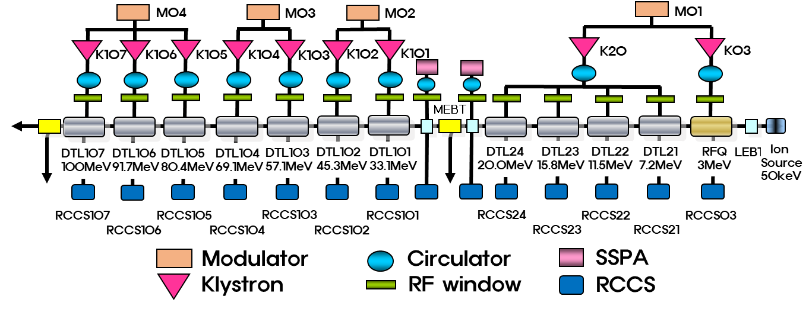
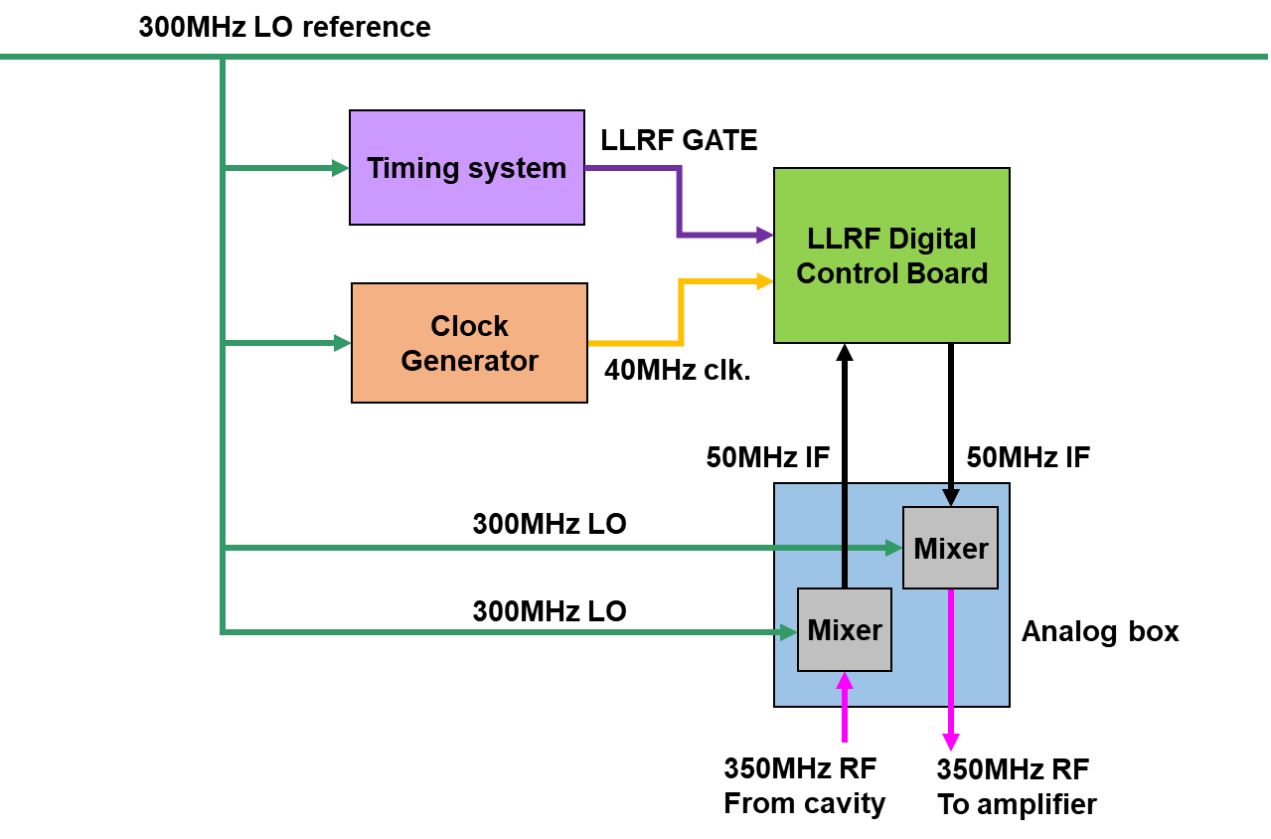
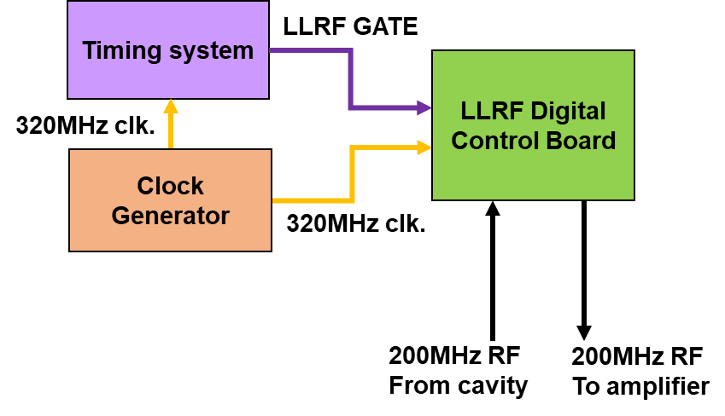
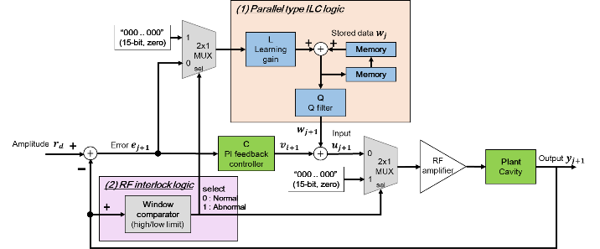
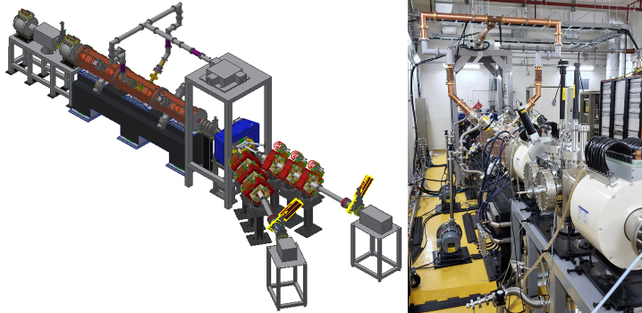
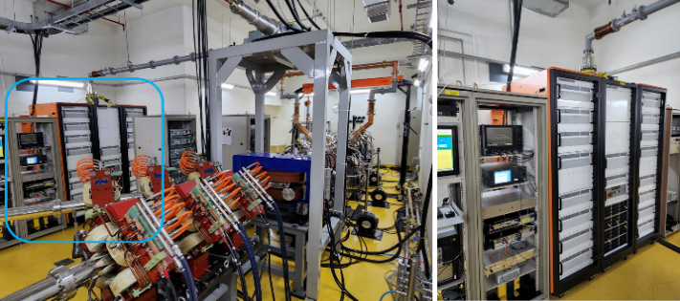
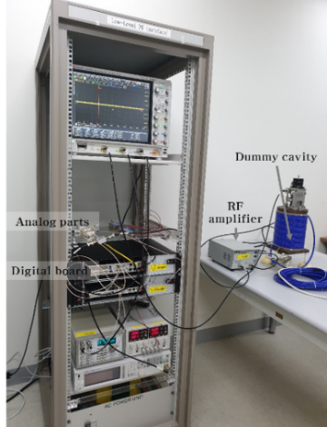
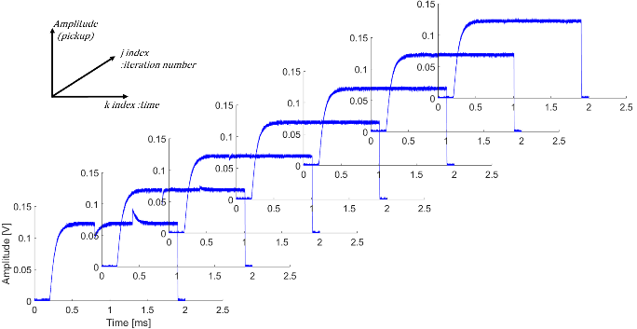
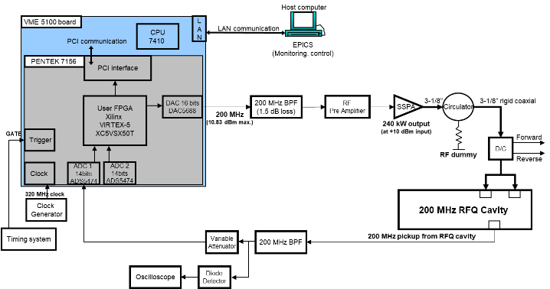
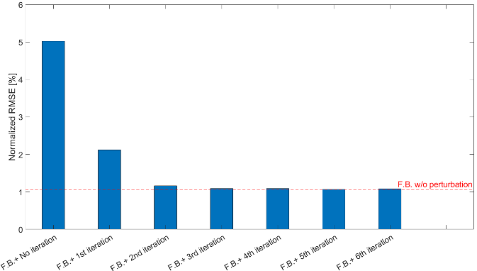
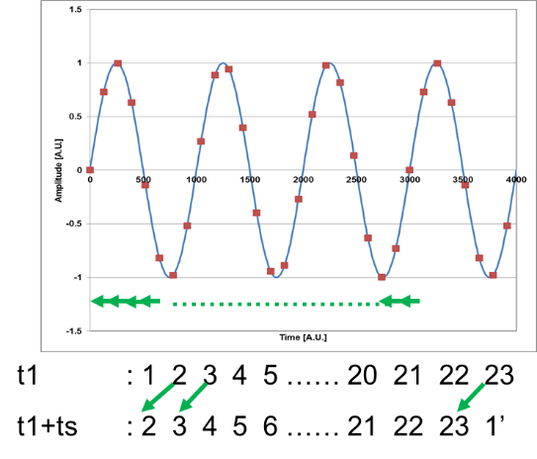
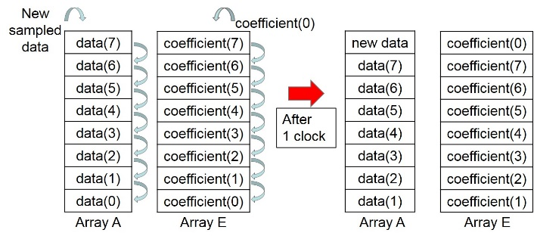
ID:102 Oct.22 ~ Oct.27, LLRF2023, Gyeongju, Korea
Development status of LLRF system for KOMAC
H.S. Jeong#, J.H. Kim, Y.G. Song, H.S. Kim, H.J. Kwon
Korea Multi-purpose Accelerator Complex, KAERI, Gyeongju, Korea
Haeseong Jeong, jeonghs@kaeri.re.kr, phone: +82-54-750-5576
Introduction
A 100-MeV proton accelerator has been developed, and the beam service started at the Korea Multi-purpose Accelerator Complex (KOMAC) in July 2013. The accelerator consists of a 50-keV proton injector, a 3-MeV radio-frequency quadrupole (RFQ) and a 100-MeV drift tube linacs (DTLs). Total 9 pulsed klystrons with 1.6 MWpeak are used to provide RF power to the cavities with 350 MHz of operating frequency. As the demand for high intensity beam service increased, the feedforward controller was implemented to mitigate the heavy beam loading effect. This poster introduces the concept of a feedforward controller for KOMAC as well as the experimental results performed in low-level RF (LLRF) test stand. In addition, a LLRF system for a newly developed 200-MHz RFQ, based on non-IQ sampling techinque will be presented briefly.
Table 1: KOMAC LLRF system status
 | 100 MeV proton Linac LLRF | 1 MeV/n RFQ LLRF
Sampling | IQ | Non-IQ
 | Up/Down conversion | Direct sampling
RF | 350 MHz | 200 MHz
LO | 300 MHz | -
IF | 50 MHz | -
Sampling frequency | 40 MHz | 320 MHz
Logic device | Virtex-4 | Virtex-5
Beginning year of Linac operation | 2013 | 2022
Figure 3: 1 MeV/n RFQ LLRF config.
Figure 1: 100 MeV Linac RF system layout
Figure 2: 100 MeV Linac LLRF configuration
Feedforward controller in 100 MeV Linac
1 MeV/n RFQ LLRF system
Figure 4: Implemented feed-forward control diagram
Figure 7: 1 MeV/n RFQ layout and installation
Figure 8: 200 MHz 240 kWp SSPA (TOMCO)
Figure 9: 1 MeV/n RFQ RF chain diagram
Figure 5: LLRF test stand setup
Figure 6: ILC logic test results
The parallel type ILC(Iterative Learning Control) logic was implemented in the FPGA of digital LLRF.
An abnormal circumstance where the RF field in the cavity becomes unstable, this logic has a feature to bypass the learning data using 2x1 multiplexer.
The transient response of a heavy beam loading was immediately compensated with a few iterations because of the fast processing capability of the FPGA, as illustrated in Fig. 6. This test was conducted in 350 MHz dummy cavity.
ILC with feedback control is capable of compensating for transient response to the same extent as feedback control without transient response.
Adapt F.F. logic to single RF section of Linac. Under verifying in this month.
Figure 10: Non-IQ detection using fast upadate rate FIR filter
1 MeV/n RFQ was commissioned in 2022
and works in service as a B.T.S. (Beam Test Stand)
Non-IQ detection implemented in FPGA (320 MHz sampling frequency)
DDS in FPGA makes 40 MHz, NCO in DAC makes 160 MHz
Direct RF sampling scheme makes it possible to eliminate the analog mixer.
Using fast update rate FIR, the I&Q were obtained per every clk.
Future works
Feedforward logic under verifying in the single section of 100 MeV Linac this month.
After that, all cavities in 100 MeV Linac will adapt adaptive F.F. logic by next year.
References
[1] D.A. Bristow et al., “A survey of iterative learning control” , IEEE Control Systems Magazine, vol. 26, no. 3, 2006, pp. 96-114.
[2] M. Laverty et al., “An iterative learning feedforward controller for the TRIUMF e-linac”, in Proc. 28th Linear Accelerator Conf. (LINAC’16), East Lansing, MI, USA, Sep. 2016, paper TUPLR009, pp. 485-487.
[3] L. Song, “Development of adaptive compensation of heavy beam loading for J-PARC LINAC”, Ph.D. Thesis, 2019.
[4] L. Doolittle, H. Ma, M. Champion “Digital low-level RF control using non-IQ sampling”, LINAC 2006, THP004, August 2006
[5] H.S. Jeong et al., “Development of 200 MHz digital LLRF system for the 1 MeV/n RFQ at KOMAC” , in Proc. 7th Int. Particle Accelerator Conf. (IPAC’16), Busan, Korea, May 2016, paper WEPOR039, pp. 2758-2760.
[6] H.S. Jeong et al., “Test of the feedback and feedforward control loop for digital LLRF system of 1 MeV/n RFQ” , in Proc. 8th Int. Particle Accelerator Conf. (IPAC’17), Copenhagen, Denmark, May 2017, paper THPAB131, pp. 4028-4030.
[7] H.S. Jeong et al., “Initial High Power RF Driving Test Using Digital LLRF for RF Conditioning of 1 MeV/n RFQ at KOMAC”, in Proc. LINAC'22, Liverpool, UK, Aug.-Sep. 2022, pp. 781-784. doi:10.18429/JACoW-LINAC2022-THPOPA19
Acknowledgement: This work has been supported through KOMAC operation fund of KAERI by Korean government (MSIT, KAERI ID:524320-23)

