Slide 1

Fermilab Update
P. Varghese
23 October 2023

Slide 2
Outline
PIP-II Linac Progress
LLRF Systems for PIP-II
Accelerator Upgrades to Main Injector and Booster
Muon g-2 and Mu2e Experiments
LBNF-DUNE

Slide 3
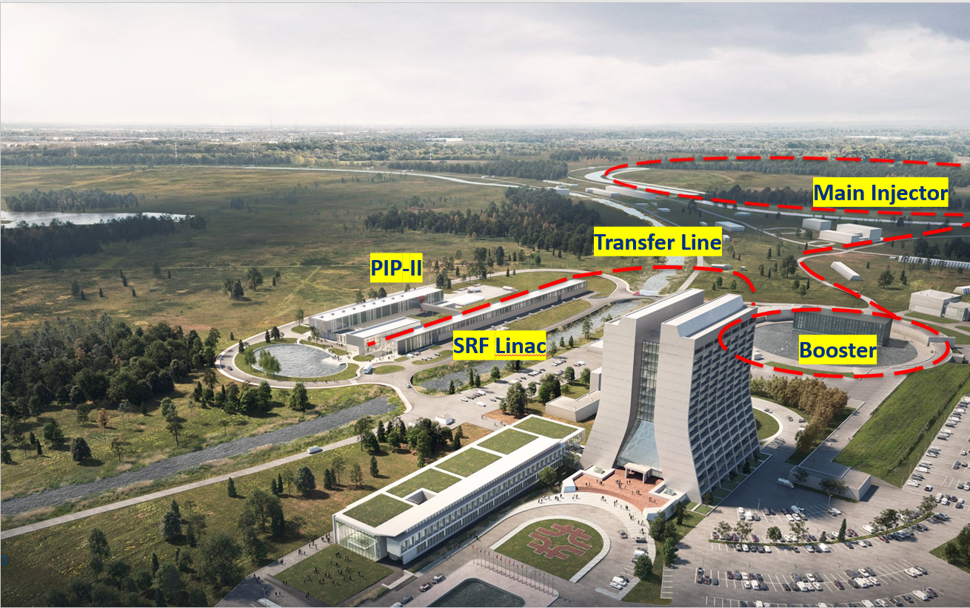
PIP-II Linac and Beam Line
Project received DOE CD-3 approval in 2022
LLRF System final design review in 2024
Production stage
2024/25
Upgrades for Booster and Main Injector for higher beam power

Slide 4




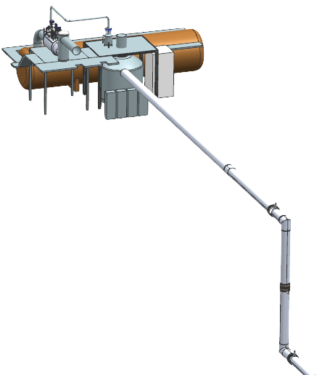

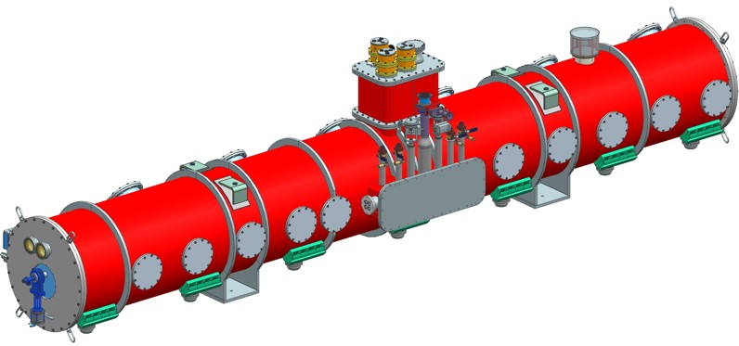
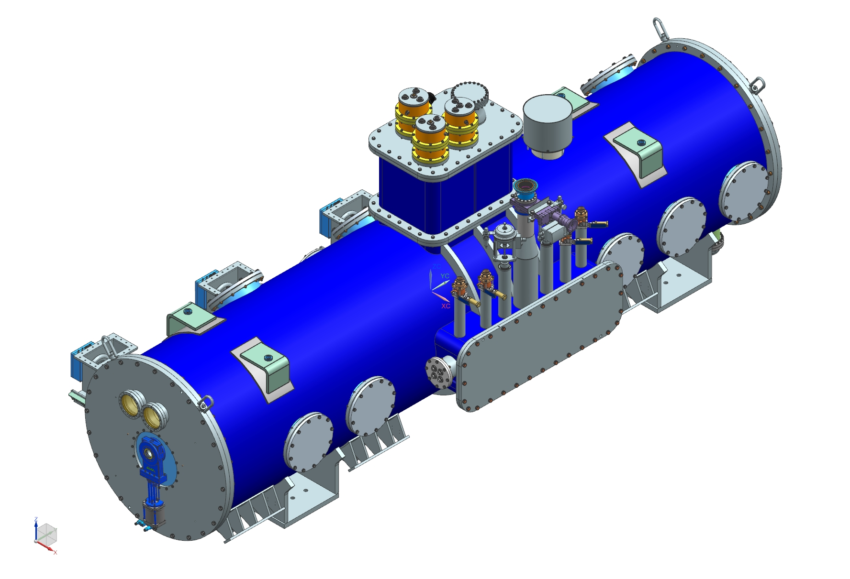

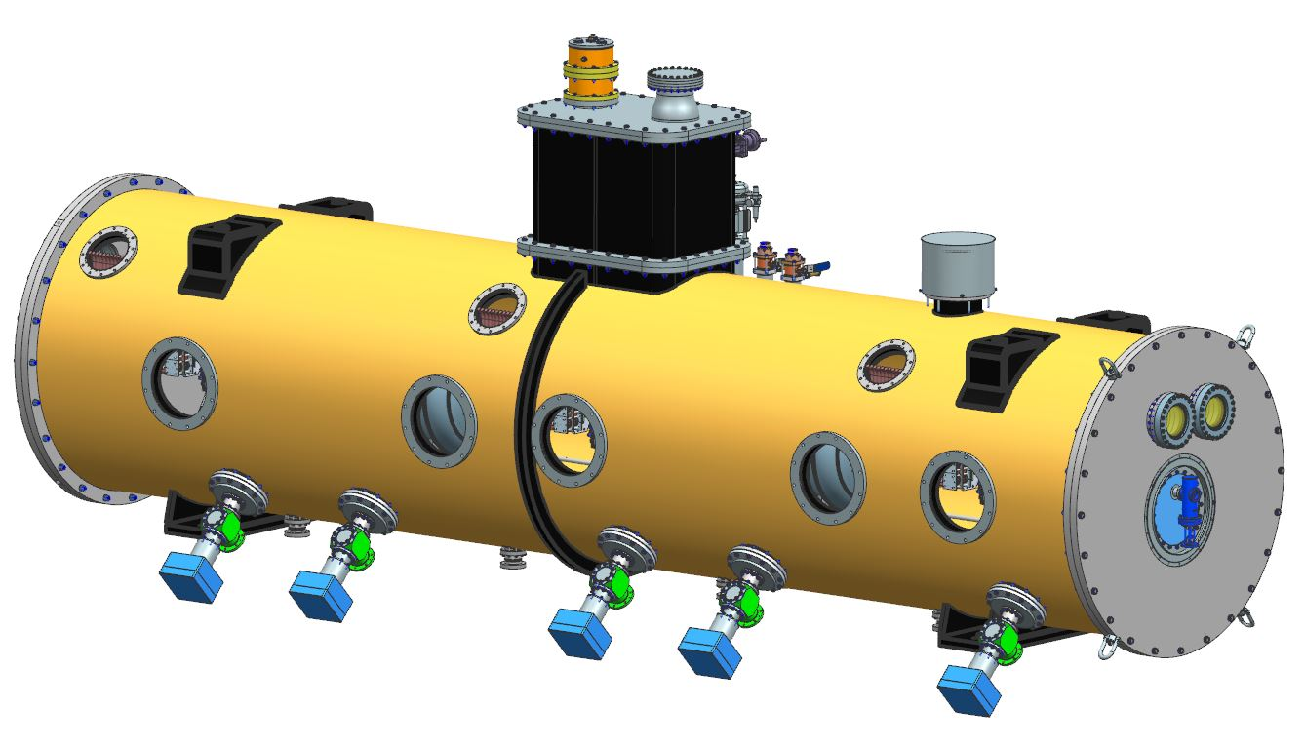
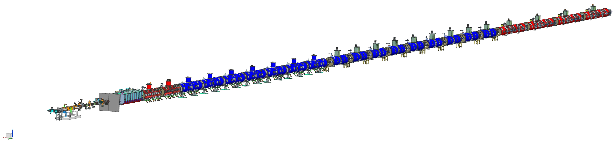
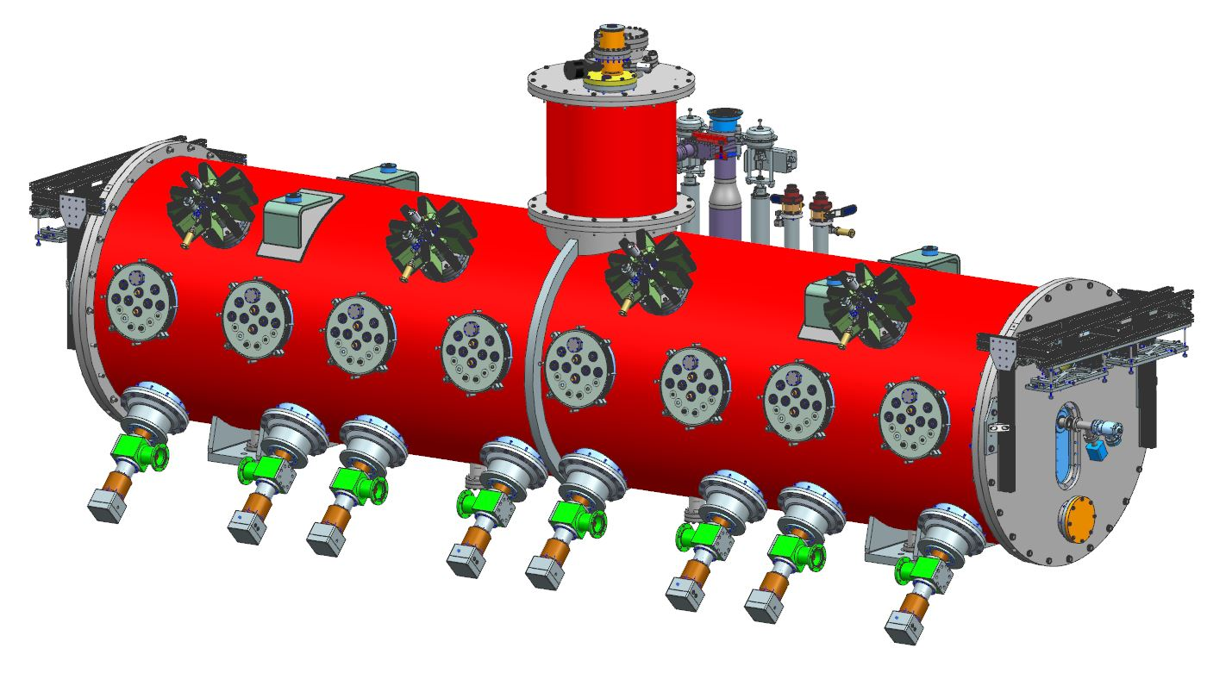
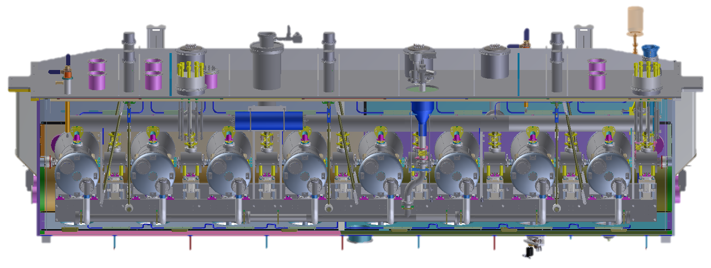
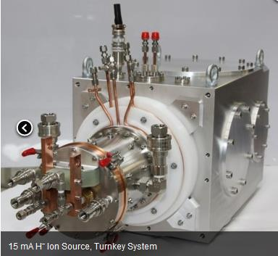
PIP-II Superconducting RF CW Linac, 800 MeV Consists of
Five Types of Cryomodules
Elliptical
HB650 X 4
24 Cavities
650 MHz
Cryoplant
Elliptical
LB650 X 9
36 Cavities
650 MHz
Single Spoke
SSR2 X 7
35 Cavities
325 MHz
Single Spoke
SSR1 X 2
16 Cavities
325 MHz
HWR
8 Cavities
162.5 MHz
CDS
833 MeV
H- Ion source
516 MeV
177 MeV
Superconducting
RFQ
32 MeV
10 MeV
2.1 MeV
Room Temperature

Slide 5



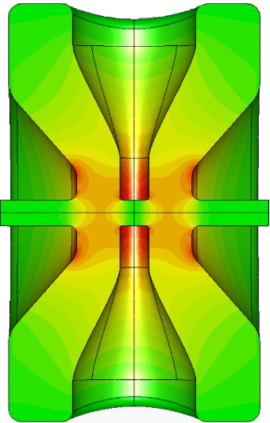
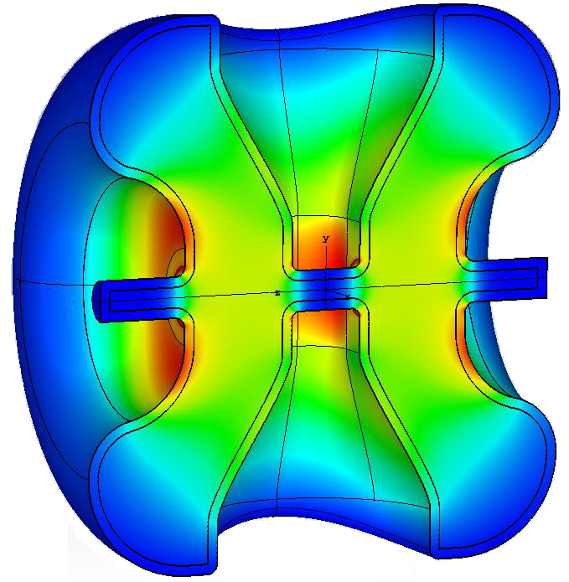
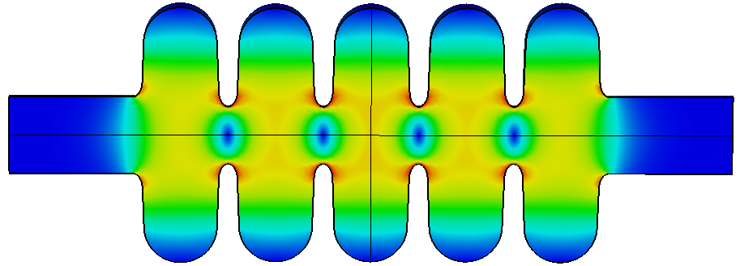
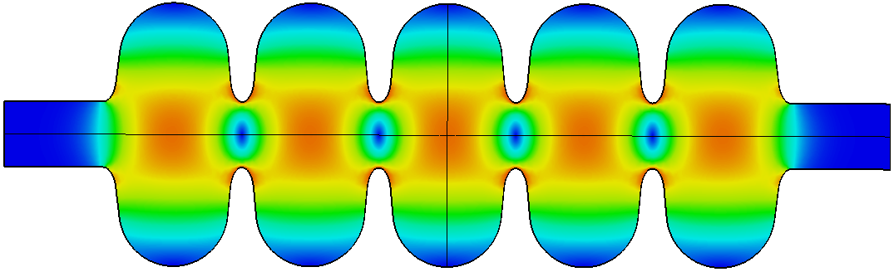
PIP-II Superconducting Cavities
2024/25
2024/25
2023
5.9 m
5.3 m
5.5 m
9.9 m
6.5 m
2023
Single Spoke
SSR1
β=0.22 Q₀ =0.82x10¹⁰
Single Spoke
SSR2
β=0.47 Q₀ =0.82x10¹⁰
Half Wave Resonator
β=0.11 Q₀ =0.85x10¹⁰
Elliptical
LB650
β=0.61 Q₀ =2.4x10¹⁰
Elliptical
HB650
β=0.92 Q₀ =3.3x10¹⁰
Performance validated
Testing in progress
Dates: component built

Slide 6
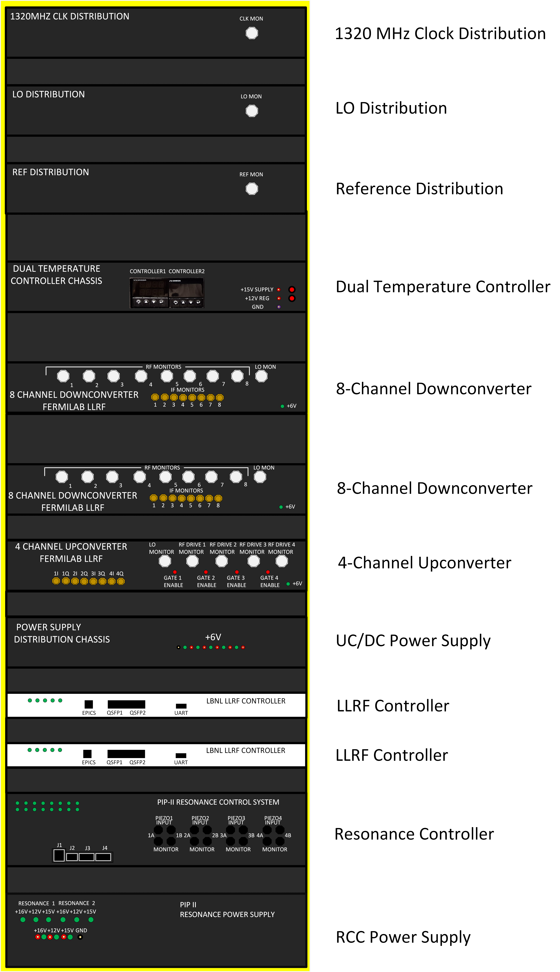
LLRF Station Configurations For PIP-II
4-Cavity Station Control Rack
See Posters ID-26,27,64
For PIP-II related topics
 | Station1 | Station2 | Station3 | Station4 | Station 5 | Station6 | Station7 | Station8 | Station9 | Station10 | Station11 | Total
 | RFQ, B1-4 | HWR | SSR1-1,2 | SSR2-1,2,3 | SSR2-4,5 | SSR2-6,7 | LB650-1,2,3 | LB650-4,5,6 | LB650-7,8,9 | HB650-1,2 | HB650-3,4
Number of cavities | 6 | 8 | 16 | 15 | 10 | 10 | 12 | 12 | 12 | 12 | 12 | 125
RF Freq (MHz) | 162.5 | 162.5 | 325 | 325 | 325 | 325 | 650 | 650 | 650 | 650 | 650

Slide 7
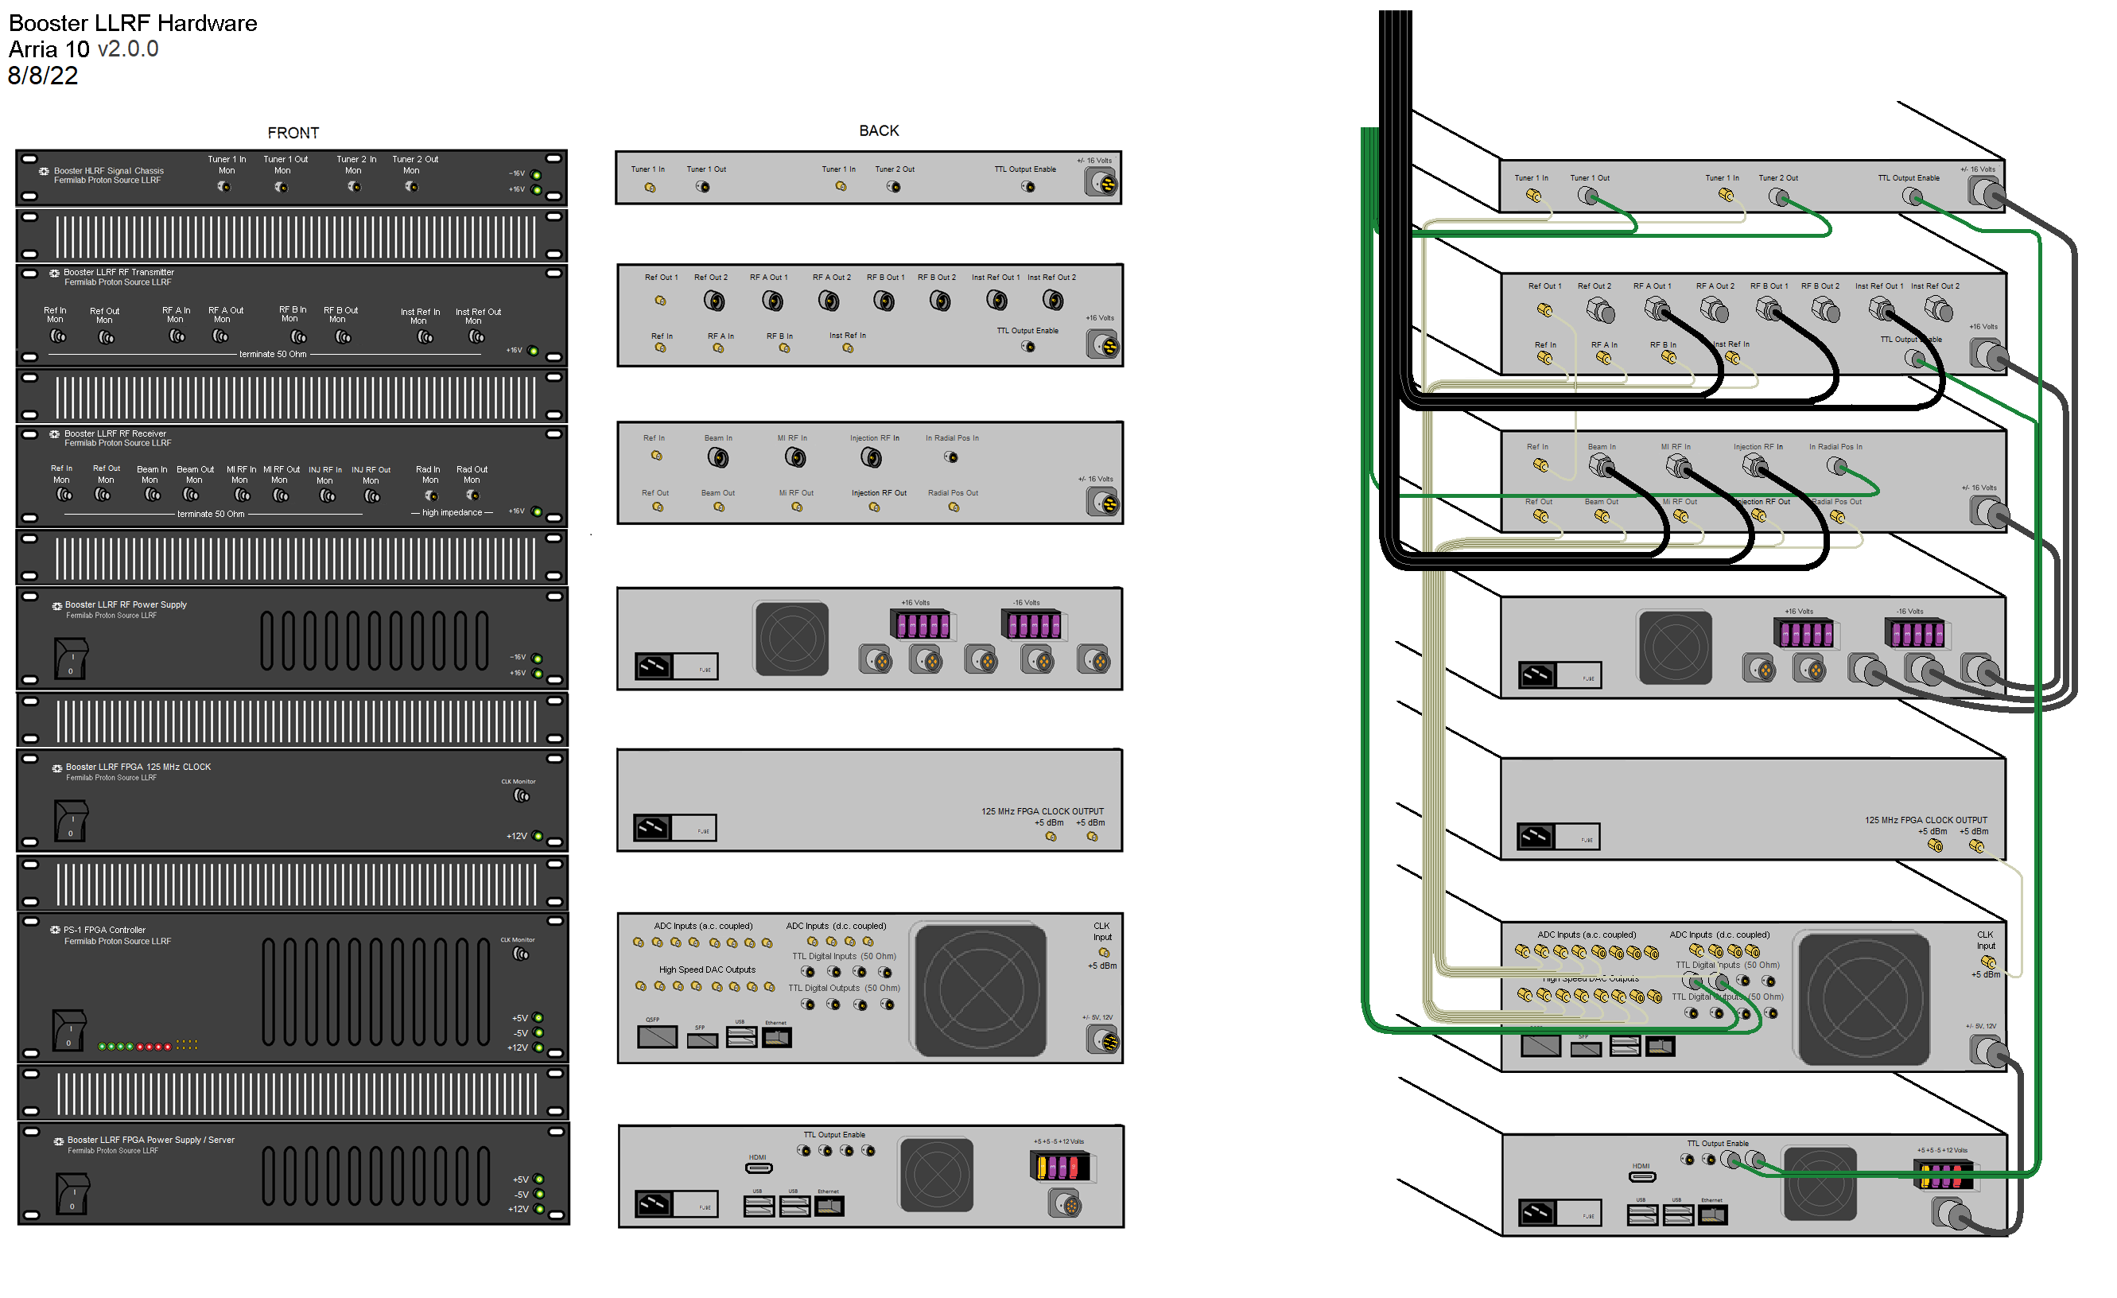
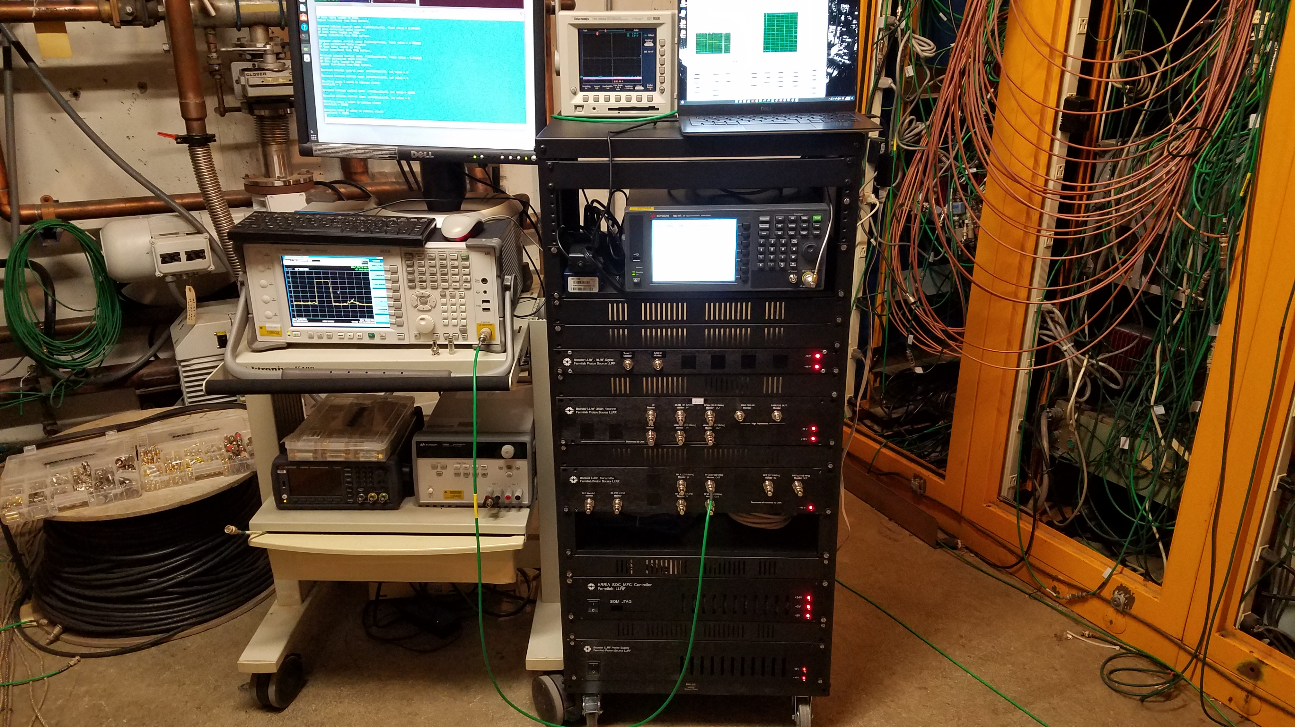
Booster Upgrades
Prototype LLRF System
New LLRF System
Single SoC FPGA controller for
vector control of 19 NC RF cavities
And 1 controller per cavity for
Cavity control
New FPGA board being developed will be used by the PIP-II warm front-end
LLRF systems

Slide 8
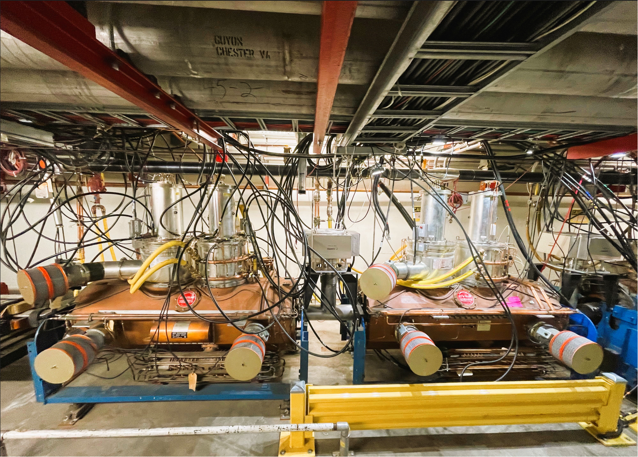
MI Cavity Upgrades
Cavities are being upgraded during annual shutdowns

Slide 9
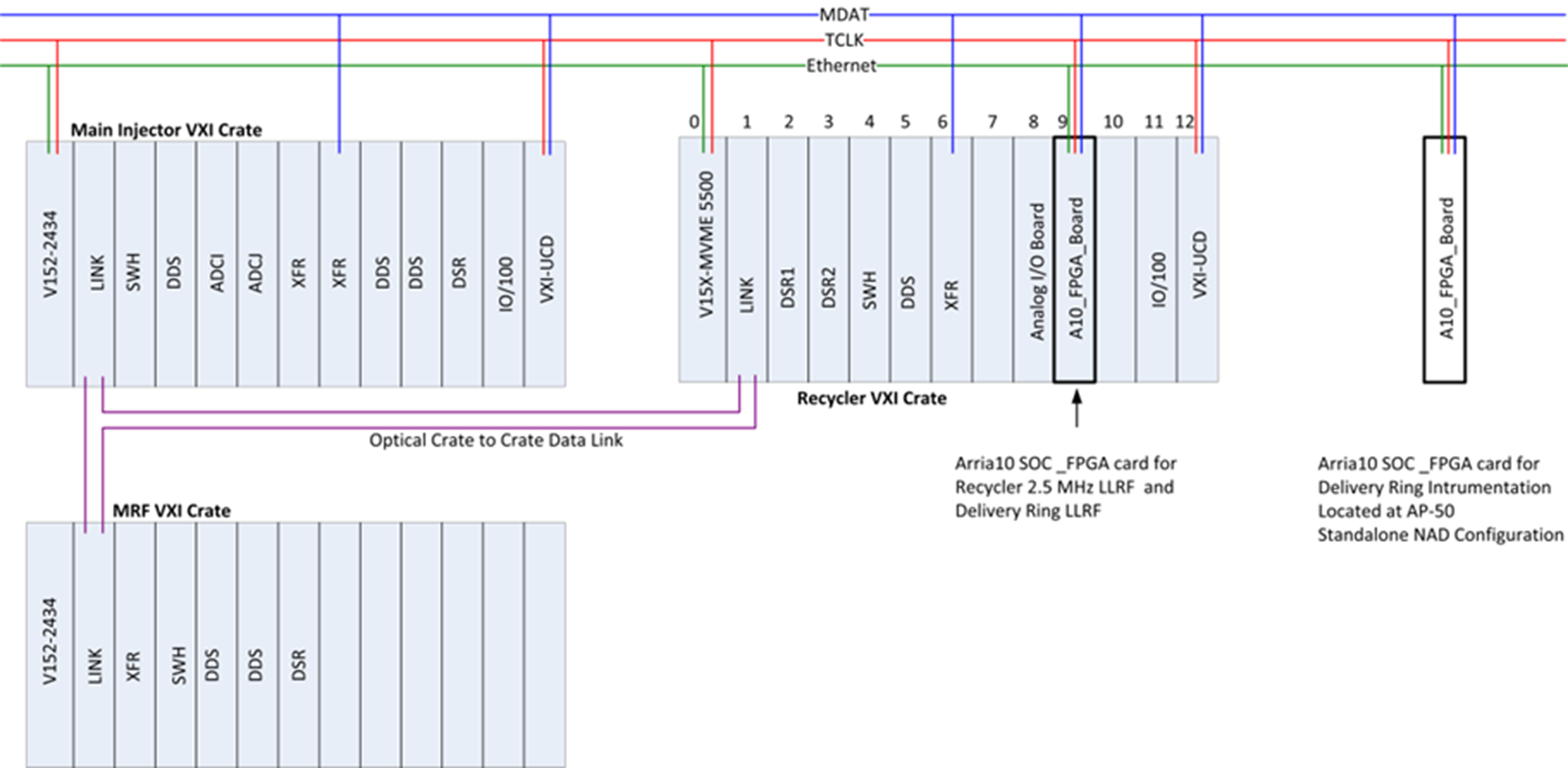
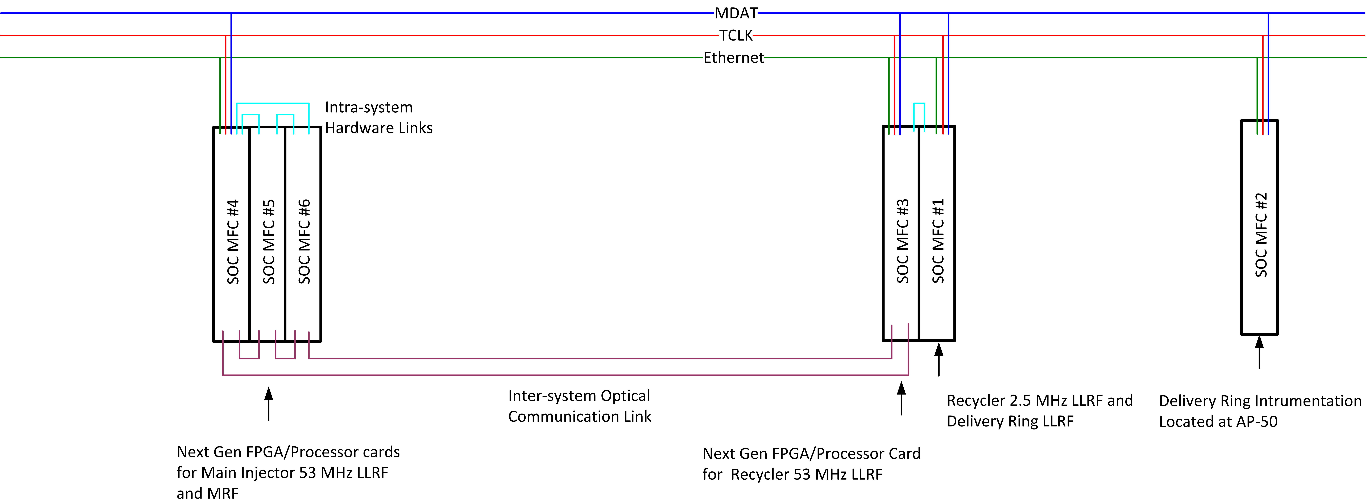
Main Injector/Recycler LLRF Upgrade
Existing VXI Crate based LLRF systems to be upgraded
Network Attached Device(NAD) Hardware a possible alternative

Slide 10
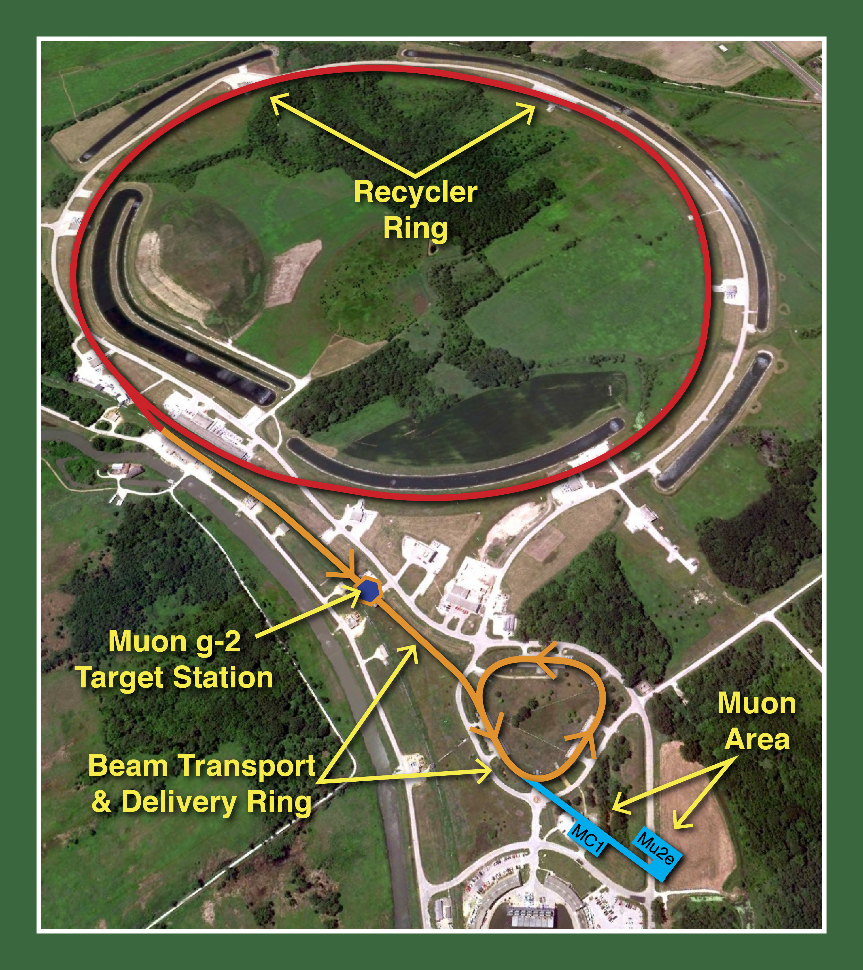

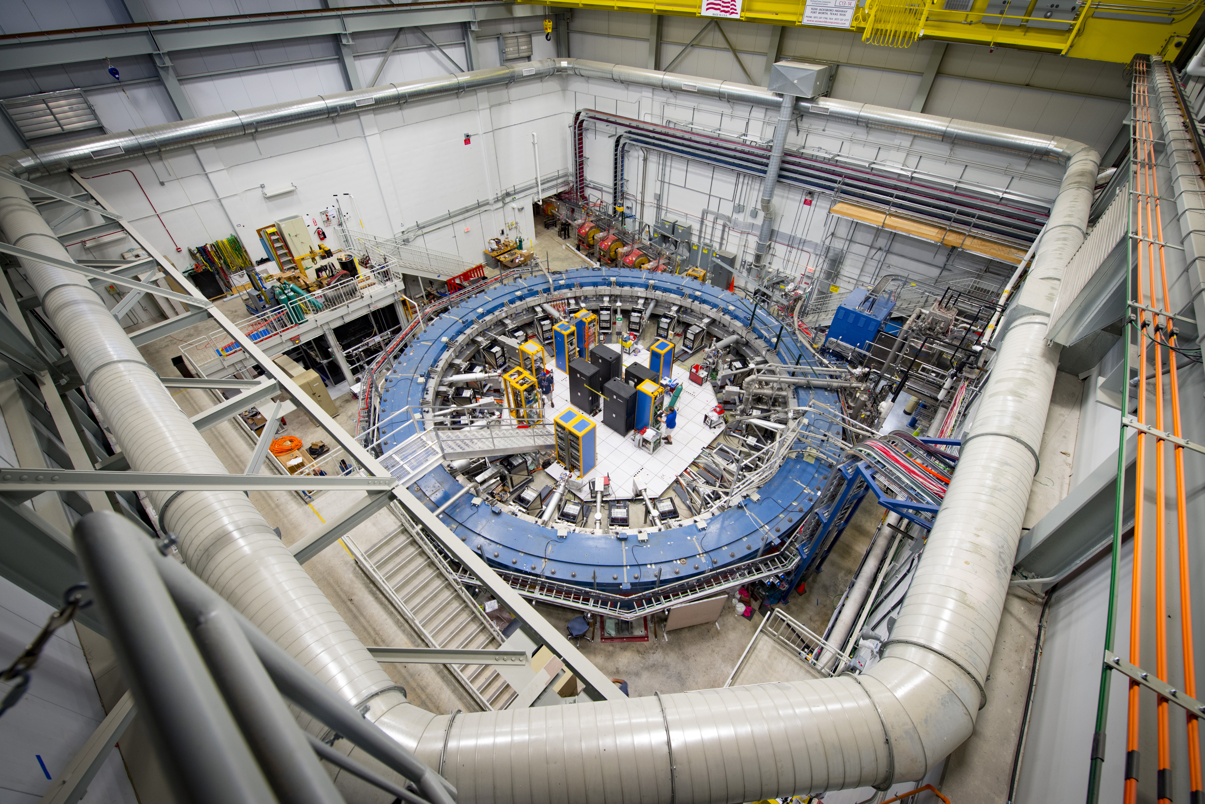
Muon g-2 Experiment
Muon g-2 run has ended
Data from first two years has
Provided a measurement that is accurate to about 5.3 σ

Slide 11
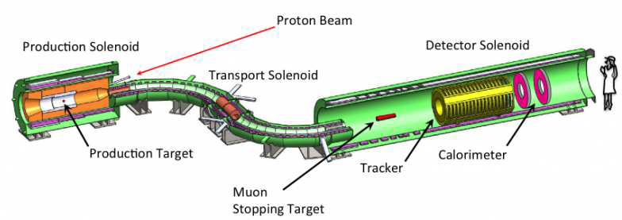
Mu2e Experiment
Mu2e construction is under way. A first run in 2025-2026 is expected.
A second run will follow PIP-II installation, starting in 2029.
See Poster ID-65

Slide 12
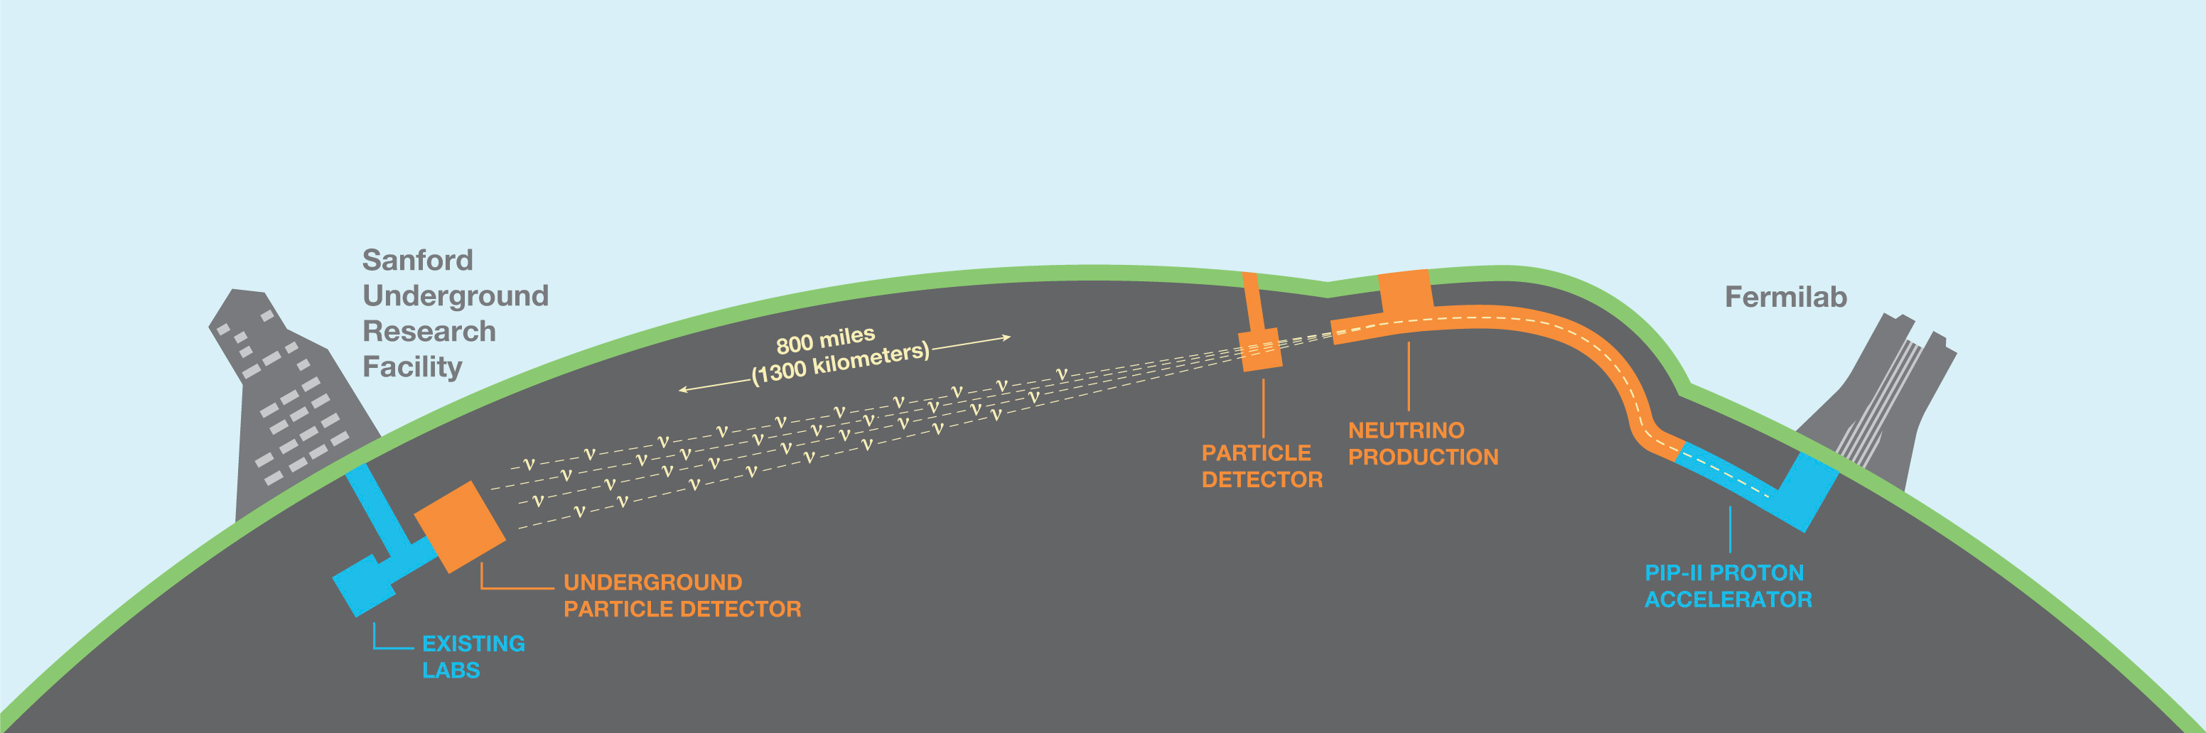
LBNF - DUNE
The 1.2 MW proton beam on a graphite target produce other particles with electric charge that are focused into a tight beam by a series of magnets called horns
The DUNE near detector is 60 meters (200 feet) underground at the Fermilab site

Slide 13
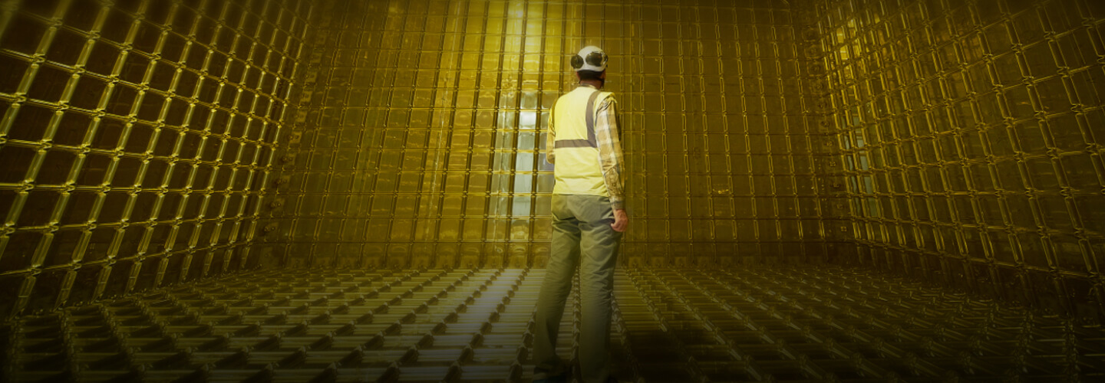
LBNF - DUNE
DUNE will compare the rates of neutrino and antineutrino oscillations
Recent contracts signed with CERN and Unniversity of Campinas for LBNF participation

Slide 14
Conclusion
PIP-II LLRF systems will enter the production phase in 2024
Initial assessments to replace LLRF systems for Main Injector and
  Recycler
Mu2e experiment construction is in full swing
Thank You !

