Slide 1
LCLS-II Project Status
Andy Benwell, on behalf of the LCLS-II RF collaboration
LLRF Workshop 2023
Gyeongju
23 October 2023

Slide 2
Outline
SRF Accelerator Overview
RF Installation and Checkout
Linac Commissioning
RF Performance
Cavity Performance
Summary

Slide 3
SRF Accelerator Overview

Slide 4
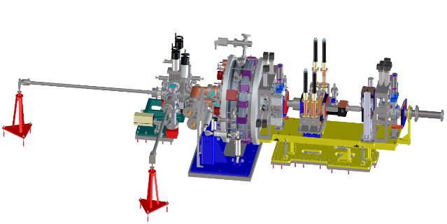
SRF Accelerator Overview
RF Photocathode Gun
35 1.3 GHz Cryomodules
2 3.9 GHz Cryomodules
Photocathode Gun
750 keV electrons

Slide 5
Relevant Performance Metrics
Performance Measure​ | Threshold (5 kW beam)​ | Final objective (120 kW beam)​ | Measurements​
Variable gap undulators​ | 2 (soft and hard x‑ray)​ | 2 (soft and hard x‑ray)​ | ​
Superconducting linac-based FEL system​ |  |  | ​
Superconducting linac electron beam energy​ | 3.5 GeV​ | ≥ 4 GeV​ | Spectrometer bend (magnet strength, screen)​
Electron bunch repetition rate​ | 93 kHz​ | 929 kHz​ | BPM’s, laser rate​
Superconducting linac charge per bunch​ | 0.02 nC​ | 0.1 nC​ | Toroid, Faraday cup​
Photon beam energy range​ | 250–3,800 eV​ | 200–5,000 eV​ | Absorption edges, spectrometer​
High repetition rate capable end stations​ | ≥ 1​ | ≥ 2​ | N/A​
FEL photon quantity (10⁻³ BW) per bunch​ | 5x10⁸ (10x spontaneous) @2,500 eV​ | > 10¹¹ @ 3,800 eV​ | Gas energy monitor, GMD, Spectrometer​
Normal conducting linac-based system​ |  |  | ​
Normal conducting linac electron beam energy​ | 13.6 GeV​ | 15 GeV​ | Spectrometer bend (magnet strength, screen)​
Electron bunch repetition rate​ | 120 Hz​ | 120 Hz​ | BPM’s, laser rate​
Normal conducting linac charge per bunch​ | 0.1 nC​ | 0.25 nC​ | Toroid, Faraday cup​
Photon beam energy range​ | 1–15 keV​ | 1–25k eV​ | Absorption edges, spectrometer​
Low repetition rate capable end stations​ | ≥ 2​ | ≥ 3​ | N/A​
FEL photon quantity (10⁻³ BWª) per bunch​ | 10¹⁰ (lasing @ 15 keV)​ | > 10¹² @ 15 keV​ | Gas energy monitor, GMD, Spectrometer​

Slide 6
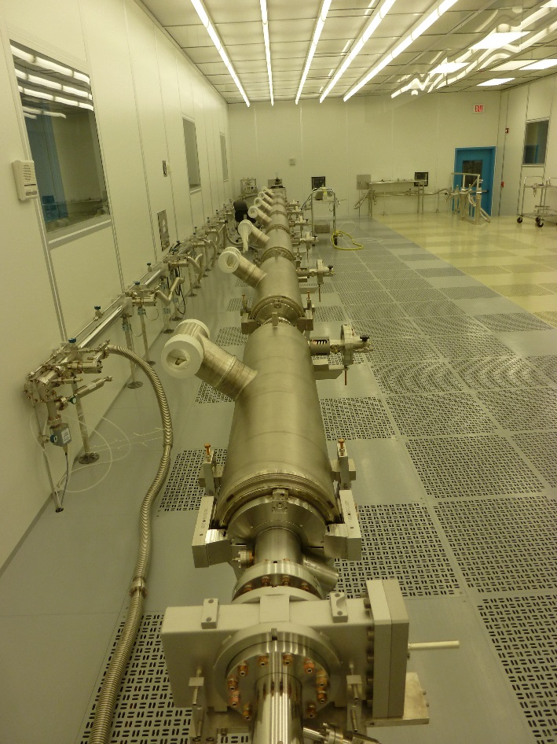
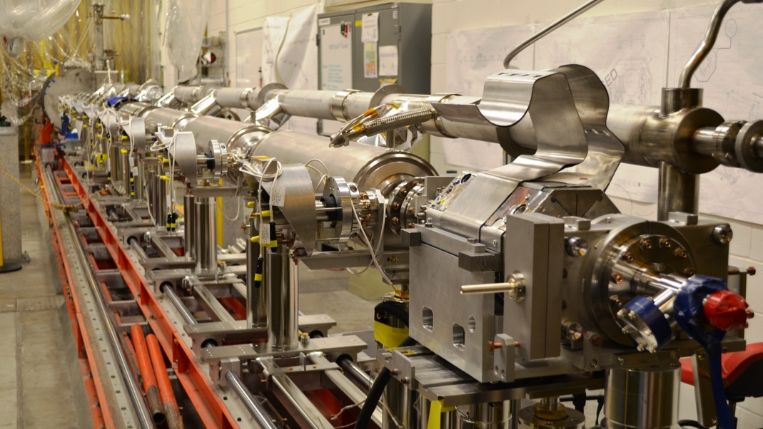
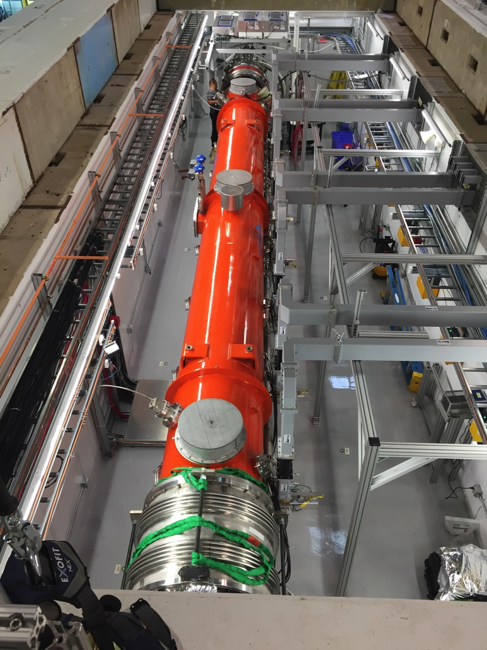
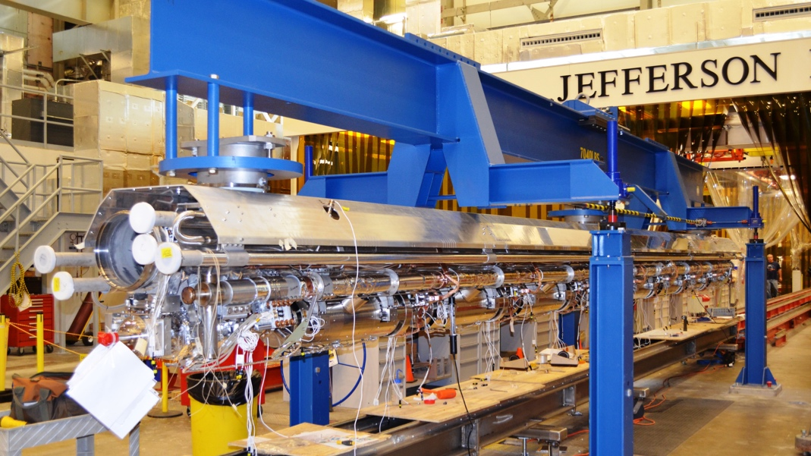
Cryomodule Production
String Assembly
Cryomodule Construction
CM Testing

Slide 7
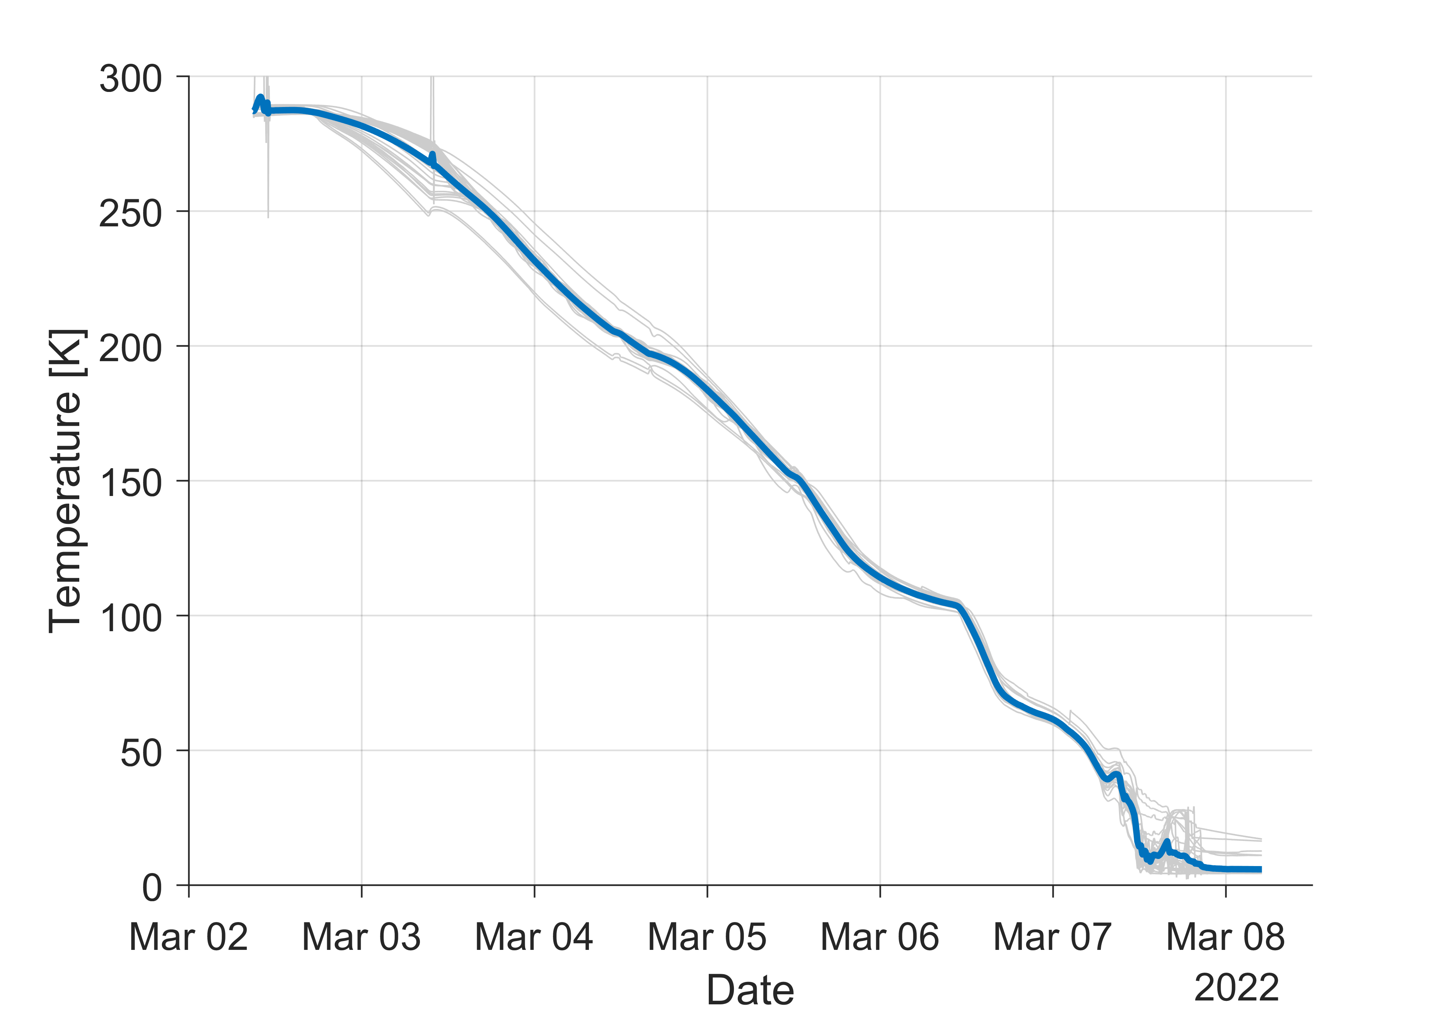
Installation System Overview
Cryomodule Installation Completed in 2021
Cooldown began in early 2022
2-3 K/hr

Slide 8
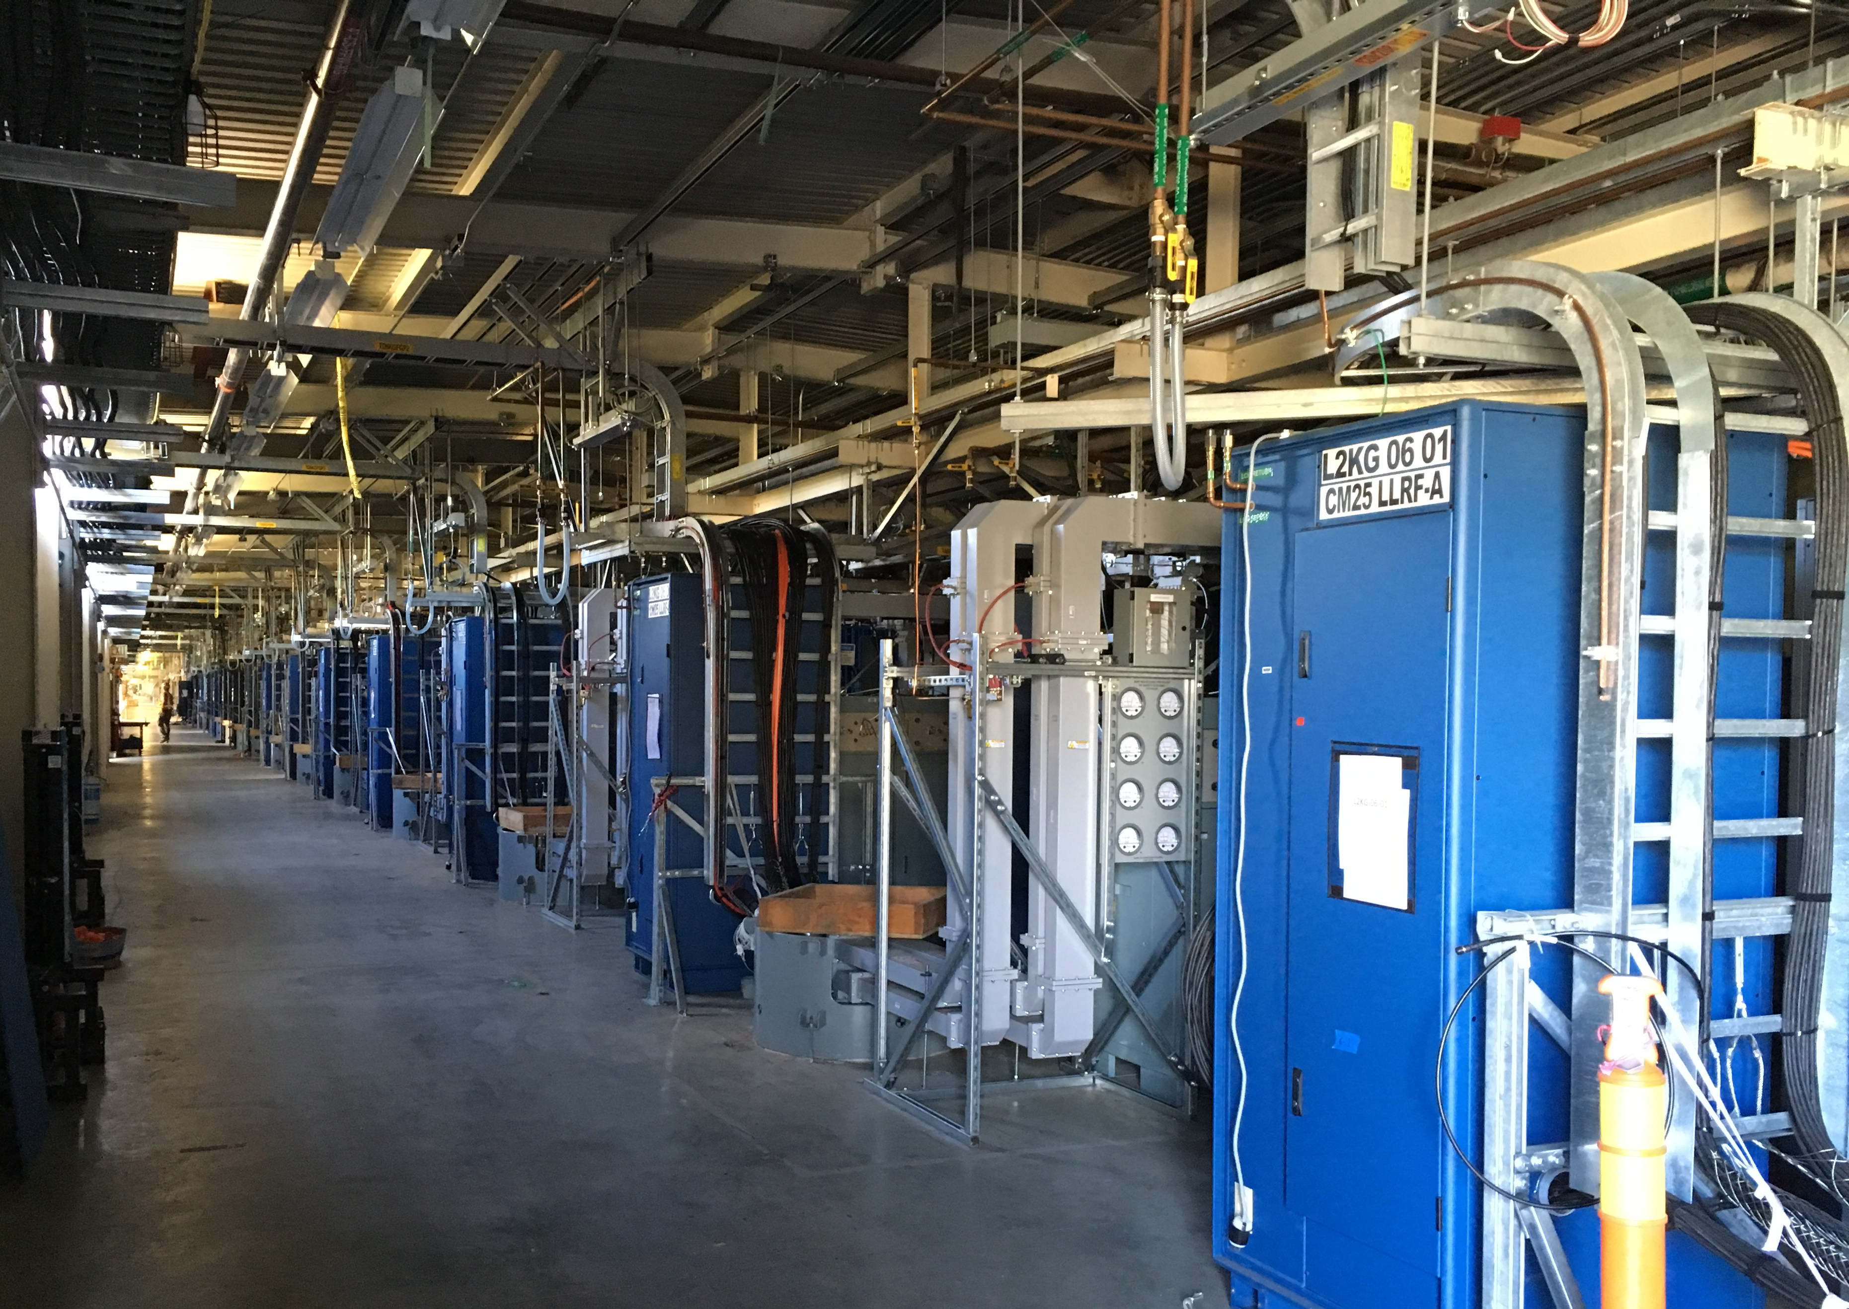
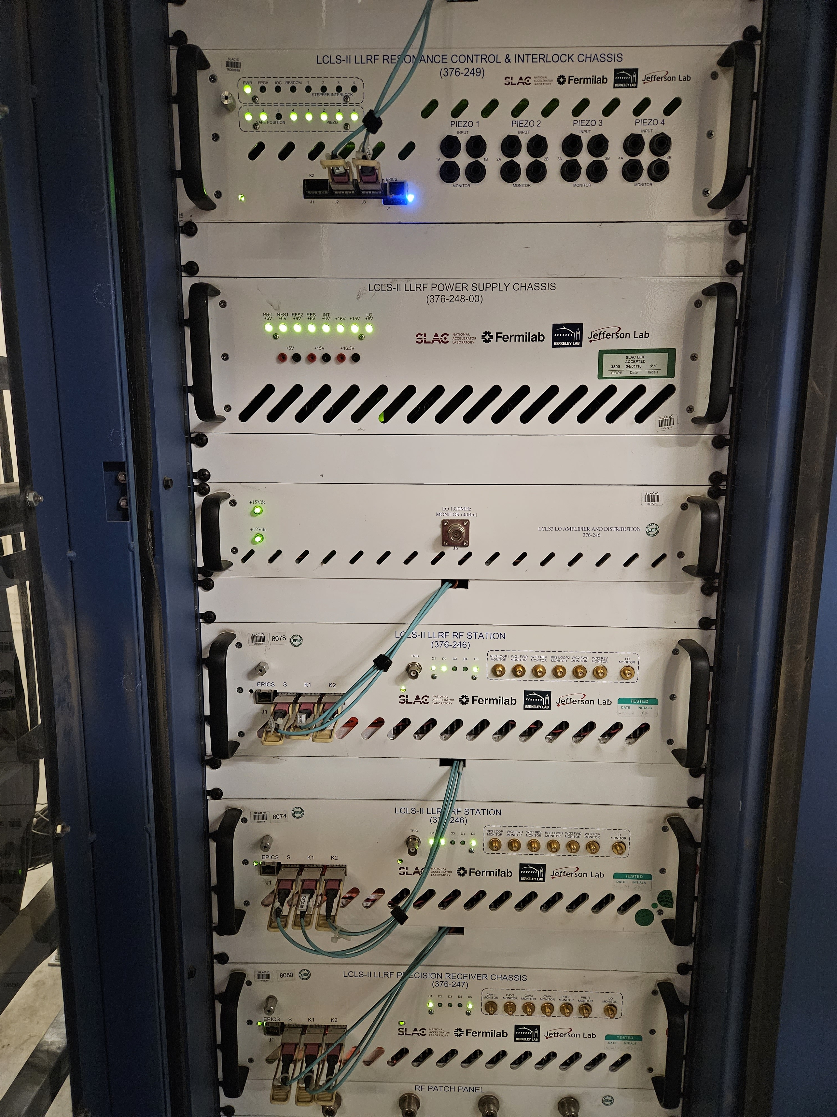
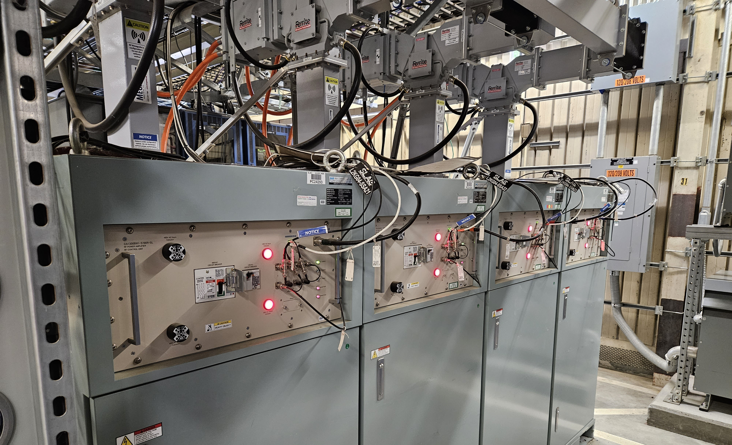
HPRF / LLRF Installation
77 total LLRF racks, each rack contains entire field control system for 4 superconducting cavities
296 HPRF Solid State Amplifiers (SSAs)
236 RF field control chassis (RFS or PRC)​
74 cryomodule cavity resonance control chassis​
78 power distribution chassis​
84 LO timing distribution chassis​
1536 heliax cables
3,850 fiber optic connections (in the LLRF racks alone)

Slide 9
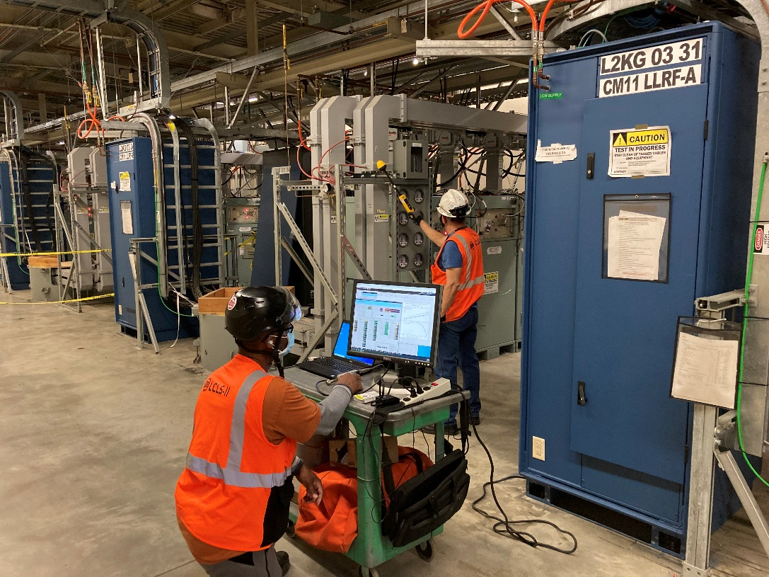
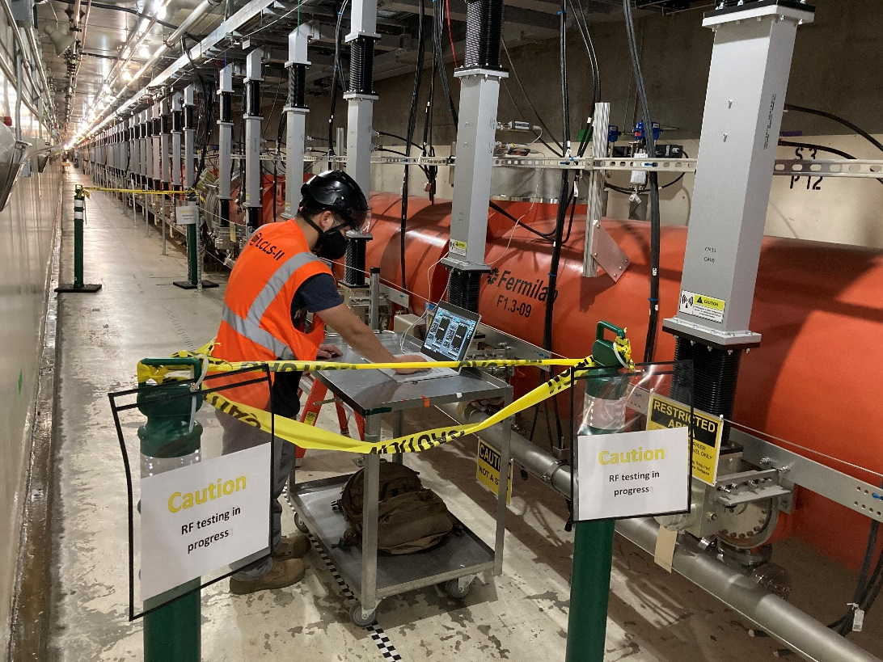
Integrated RF Checkout
During the summer and fall of 2021, HPRF was delivered from the full RF system to warm cryomodule cavities
LLRF drives SSAs at 400 W to warm CM cavities
Waveguide non-ionizing radiation (NIR) surveys
Power measurements are made at the directional couplers…
…and compared with real time values in the LLRF system
SSAs are briefly (<200 µs) chirped to 4 kW and the SSA health is characterized
Issues discovered during HPRF checkout include:
Swapped permit cables
Swapped RF heliax
Low RF drive
Poor water flow
failed SSA electronics components
Calibration error > 5%

Slide 10
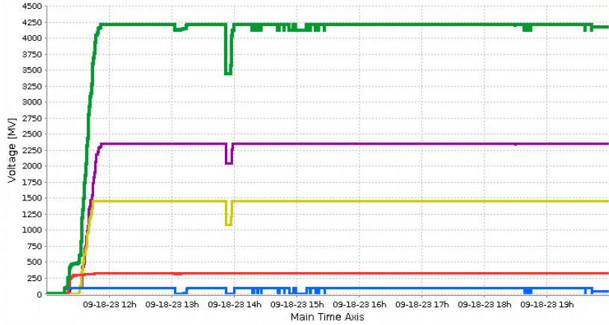
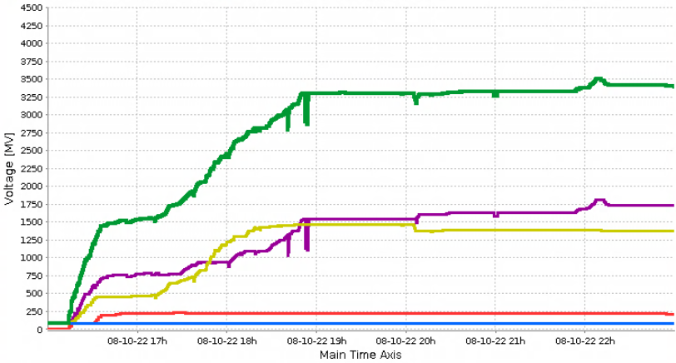
Linac Total Voltage
First full SRF linac run 8/10/22
LCLS-II powered on all of the 1.3 GHz cavities
Demonstrated that controls systems for LLRF and cryogenic systems are working well
All available cavities powered on in less than 30 minutes
Maximum achievable energy reached in ~3 hours
Total energy: 3.495 GeV
Linac Voltage
Total
L3
L2
L1
L0
Recent linac recovery – 9/18/23
All cavities powered on and at full energy in about 20 minutes
Total energy: 4.2 GeV

Slide 11
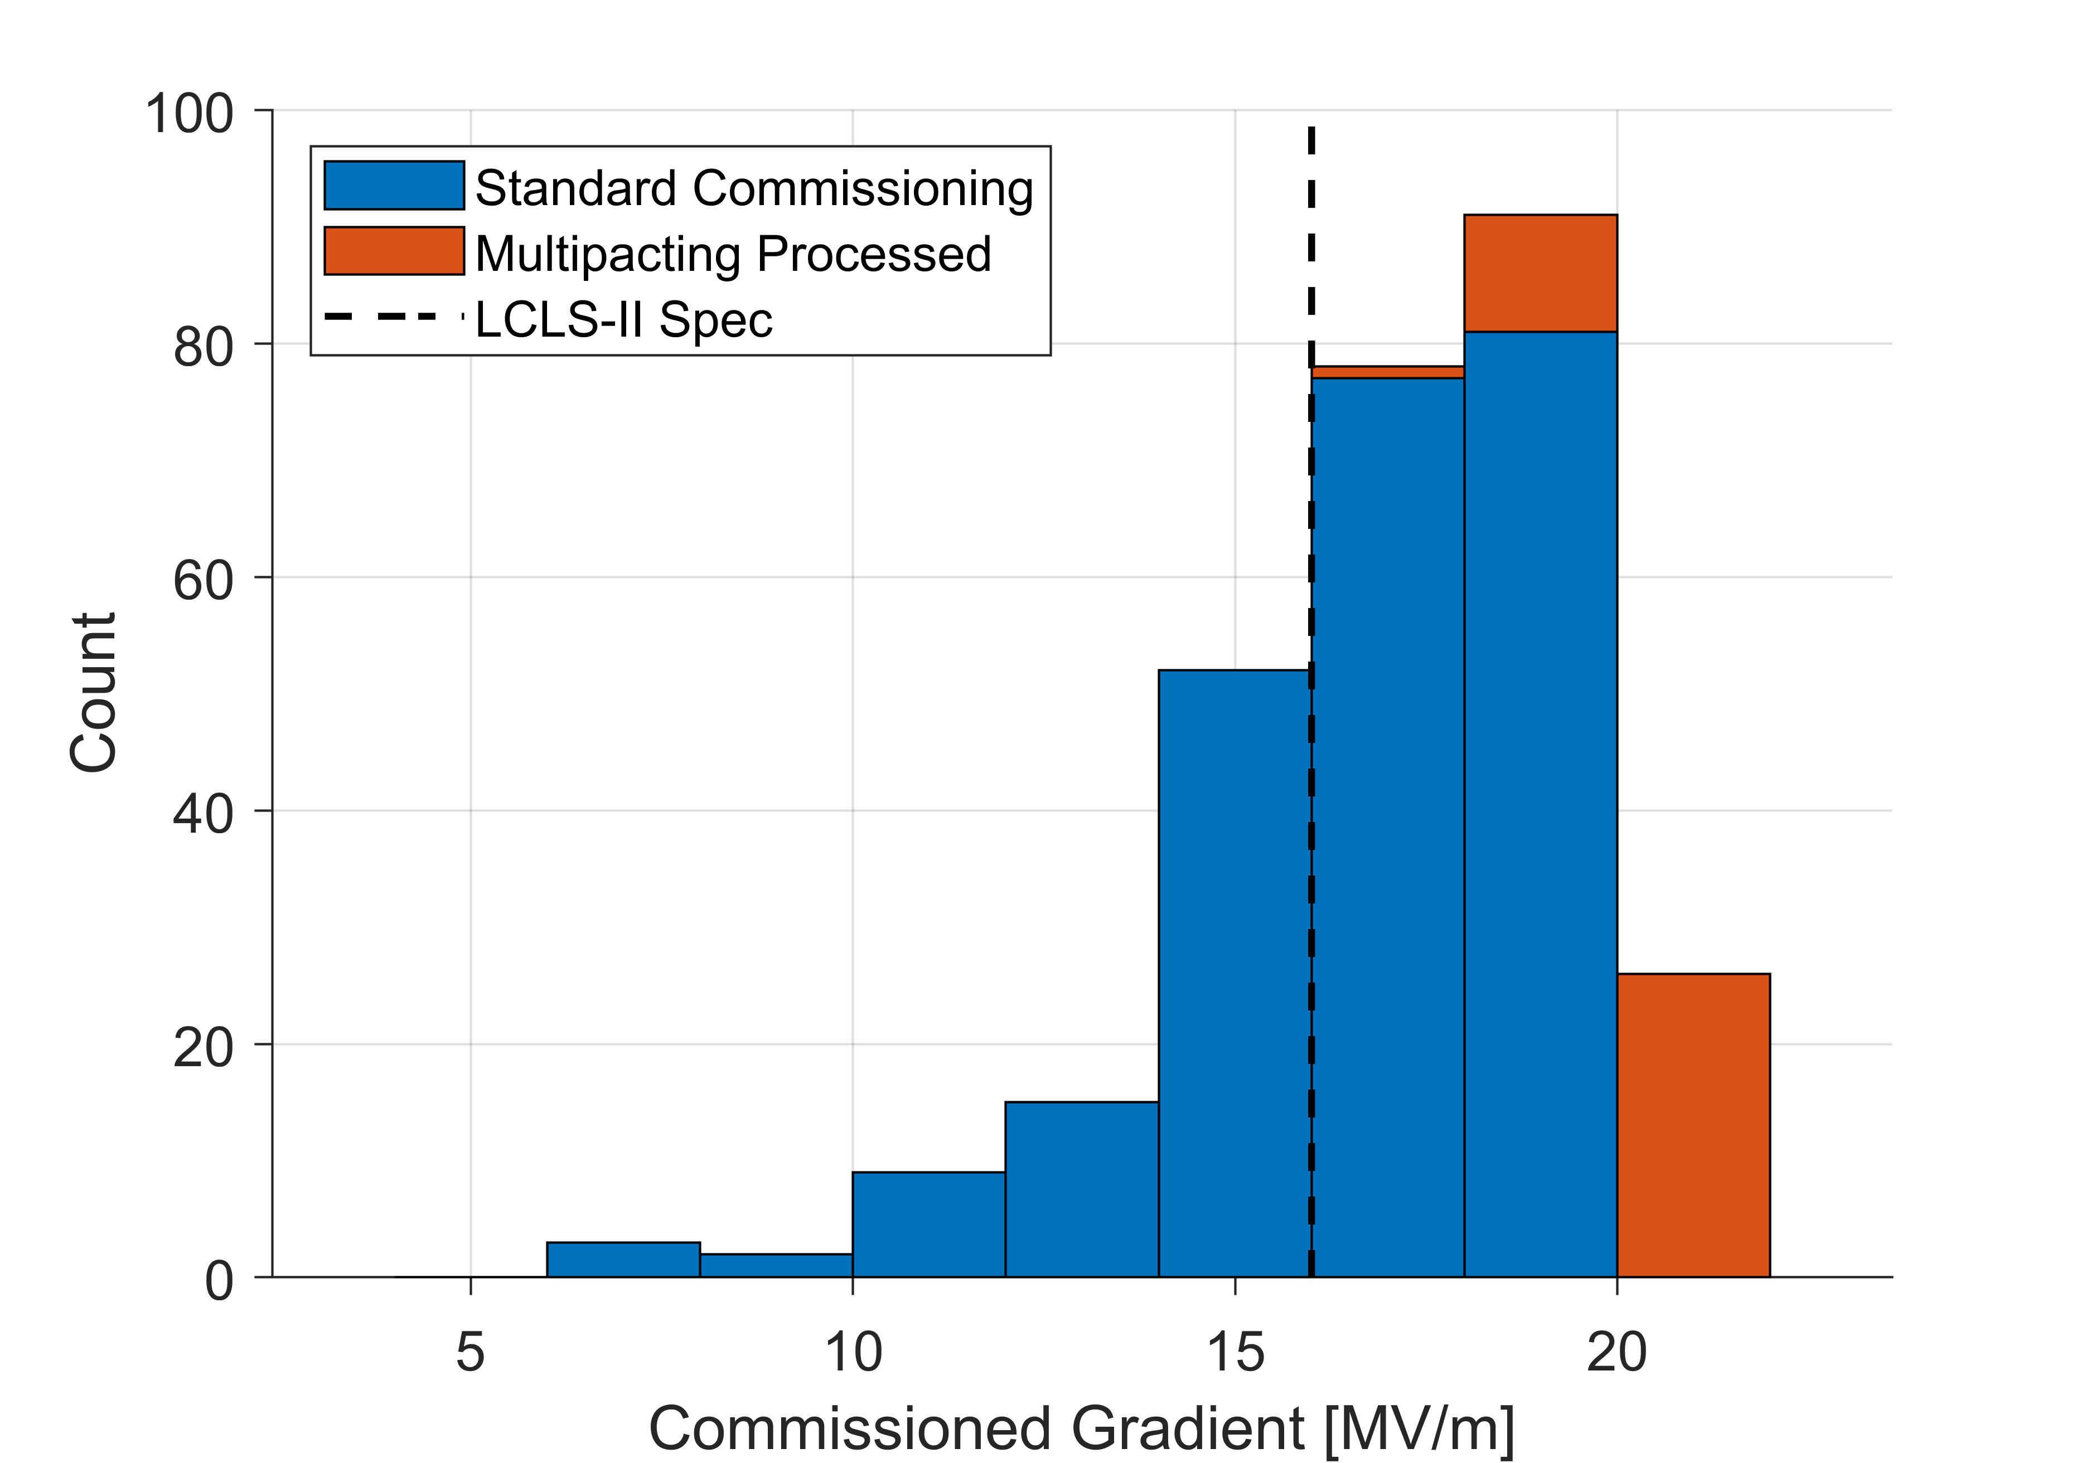
Overall SRF Commissioning Status
Gradient Performance
Cryomodule commissioning has been very successful
97% of installed cavities fully operational (planned 94%)
Majority of testing included an admin limit of 18 MV/m
Total commissioned voltage exceeds design by >20%
Total Commissioned Cavity Voltage: 4.9 GV

Slide 12
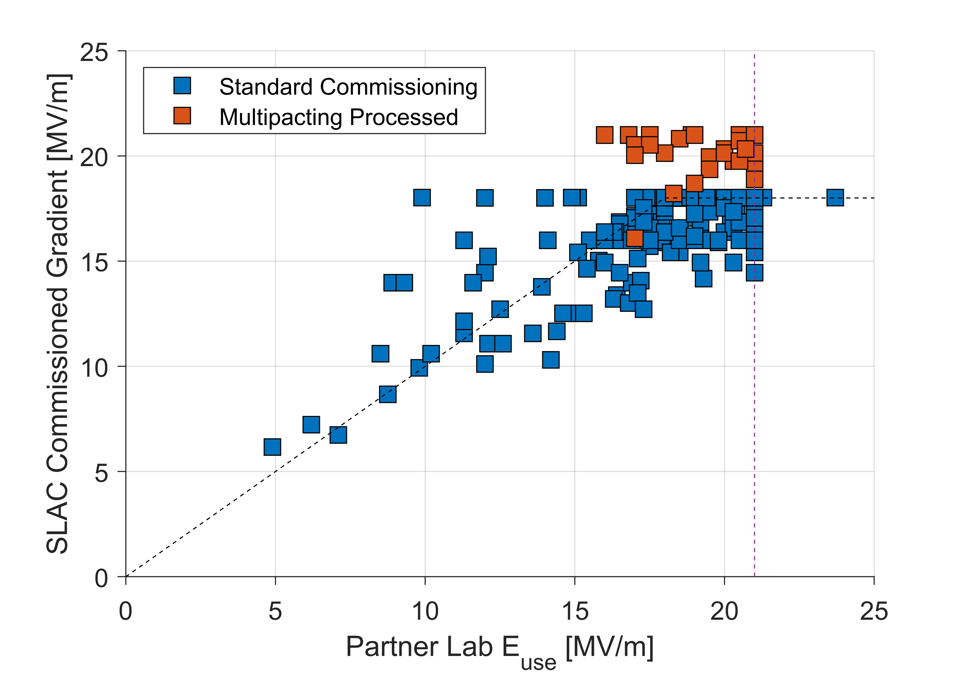
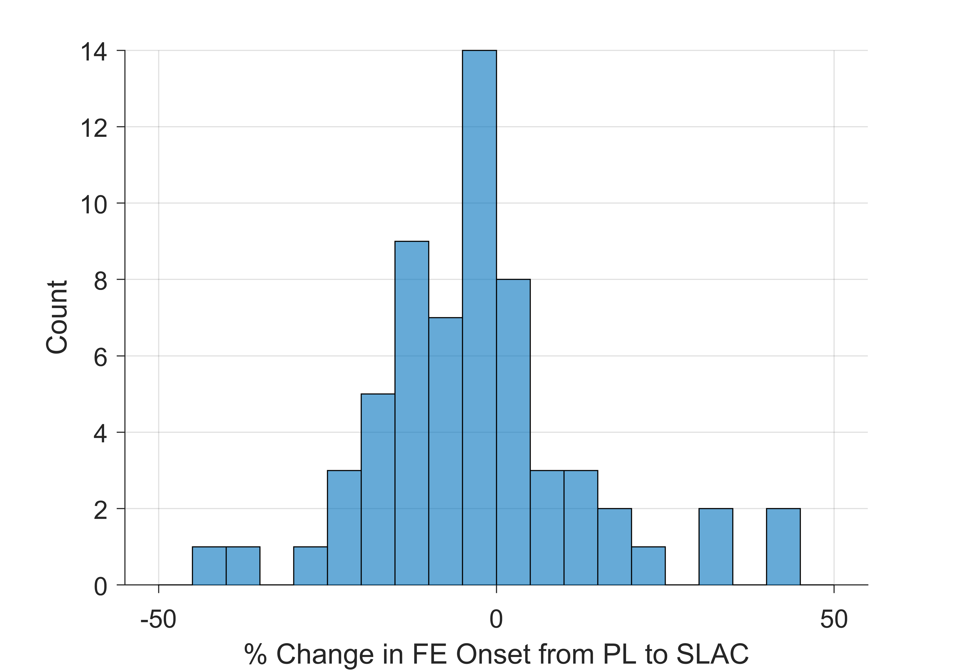
Gradient Performance
Comparison with Acceptance Test
Gradient performance is in line with CM acceptance test measurements
No observable change in field emission onsets or magnitude from installation
Remarkable achievement by SLAC, the partner labs, and the installation team
Change in FE Onset
$$\overline{Δ}=\left(−1±18\right)\%$$
Admin limits:
18 MV/m in commissioning
21 MV/m in acceptance test

Slide 13
Achieved Performance Compared with Requirements
Parameter | Required | Achieved
# 1.3 GHz CMs | 35 | 35
# SRF Cavities | 280 | 280
Installed Voltage | 4.65 GV* | 4.9 GV*
Q₀ at Operating Gradient | 2.7x10¹⁰ | 2.8x10¹⁰ (average)
Unpowered Cavities in Operation | ≤18 (~6%) | 6 (~2%)
1.3 GHz
*Corresponds to 16 MV/m average for 1.3 GHz and 13.4 MV/m for 3,9 GHz
Parameter | Required | Achieved
# 1.3 GHz CMs | 2 | 2
# SRF Cavities | 16 | 16
Installed Voltage | 0.072 GV* | 0.085 GV*
Q₀ at Operating Gradient | 2.8x10⁹ | To Be Measured
Unpowered Cavities in Operation | ≤2 | 0
3.9 GHz

Slide 14
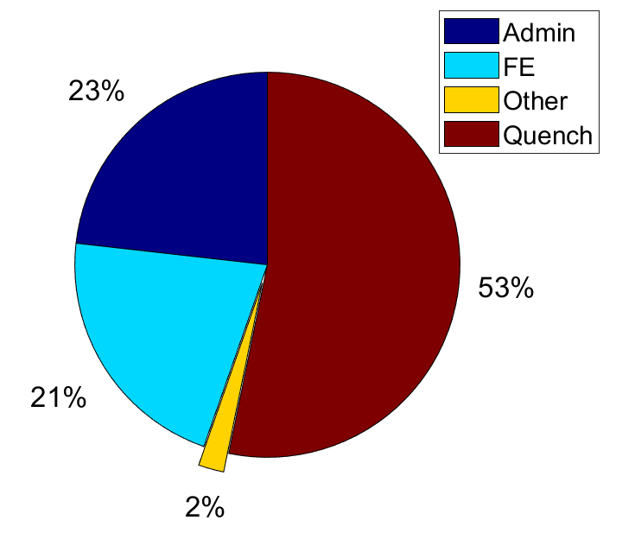
SRF Cavity Limitations
The majority of cavities were limited by quench below the admin limit of 18 MV/m
It is suspected that many of these are limited by multipacting which could be processed
About one-quarter of the cavities reached the admin limit
About one-fifth of the cavities were limited by field emission
The remaining 2% of cavities are unable to be used:
2 cavities: poor contact between coupler warm and cold ends
4 cavities: tuners not functioning properly
It is expected that all 6 of these cavities could be repaired in situ at room temperature
80% of cavities reach ≥16 MV/m

Slide 15
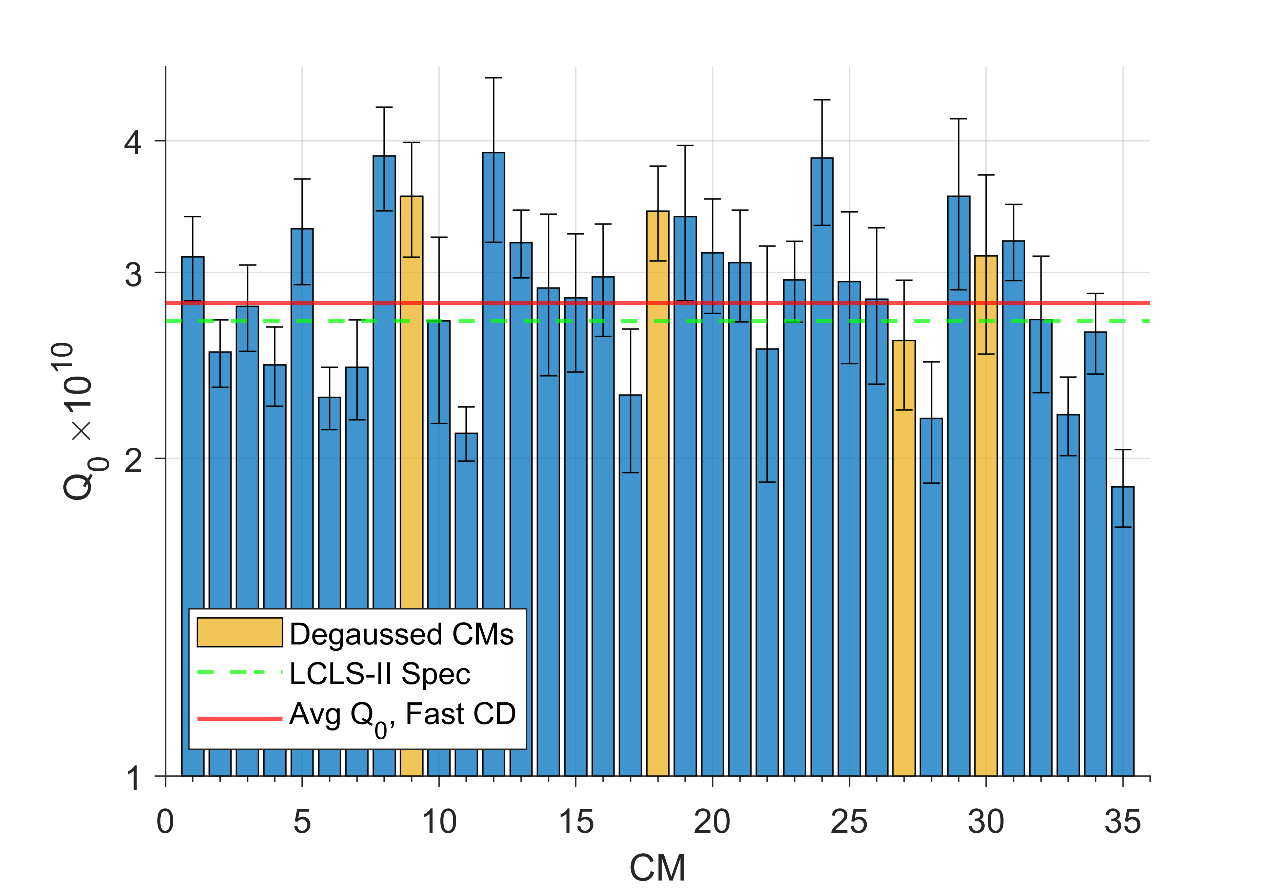
CM Q₀ Performance
Average CM Q₀
Due to the strong coupling in the CM, Q₀ is measured cryogenically
Full CM average Q₀ results look promising
Across the linac an average of 2.8x10¹⁰ has been observed, exceeding the spec of 2.7x10¹⁰
Low performers can likely be improved by additional CM degaussing
Demonstrates High Q₀ in an installed linac for the first time

Slide 16
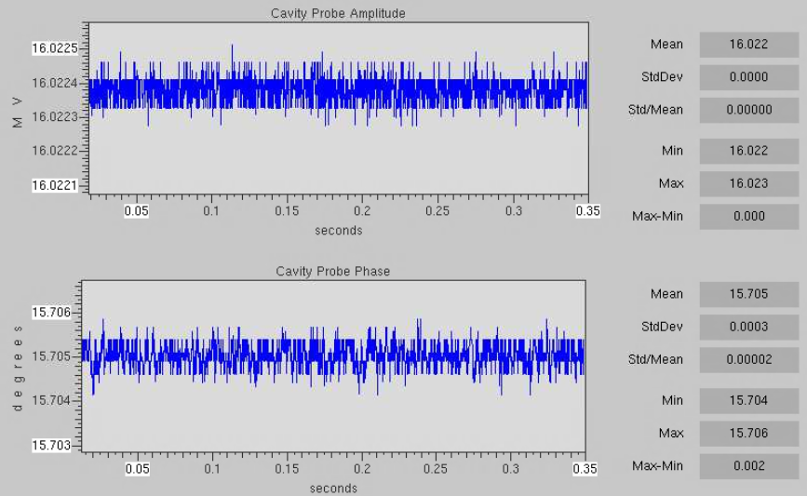
In-loop stability - 9/24/2023
Field probe amplitude and phase at 16 MV, CM01
In-loop stability
Amplitude regulation: 0.003 %
Phase regulation:
0.002 deg

Slide 17
Measurement of Beam Energy
Electron beam energy is measured at the end of the L3, in a dispersive region
A bending magnet and BPM are used for the measurement
The bending magnet dipole field rms stability is ~0.01% and the BPM position tolerance (alignment, drift, electrical probe offset) is about 1 mm
This provides an energy measurement accuracy of better than 0.5%

Slide 18
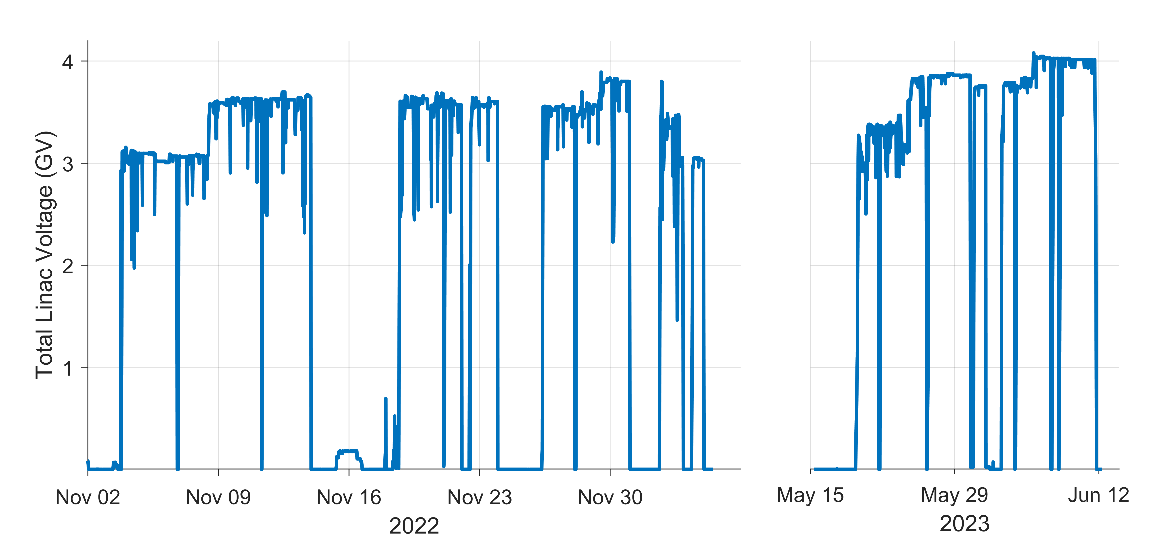
Demonstration of 3.5 GeV Beam
Stable 3 GeV beam to BSY achieved on 10/28/22
Stable 3.5 GeV beam (on crest) to BSY achieved on 11/8/22
Ran stably through end of November
3.5 GeV beam with L1 and L2 at nominal phase (off crest) at end of November
Lowered to 3 GeV for remaining beam tasks until December break
Following restart in May 2023, 3.5 GeV beam has been used exclusively
Total Cavity Voltage
2
3
5
1
4

Slide 19
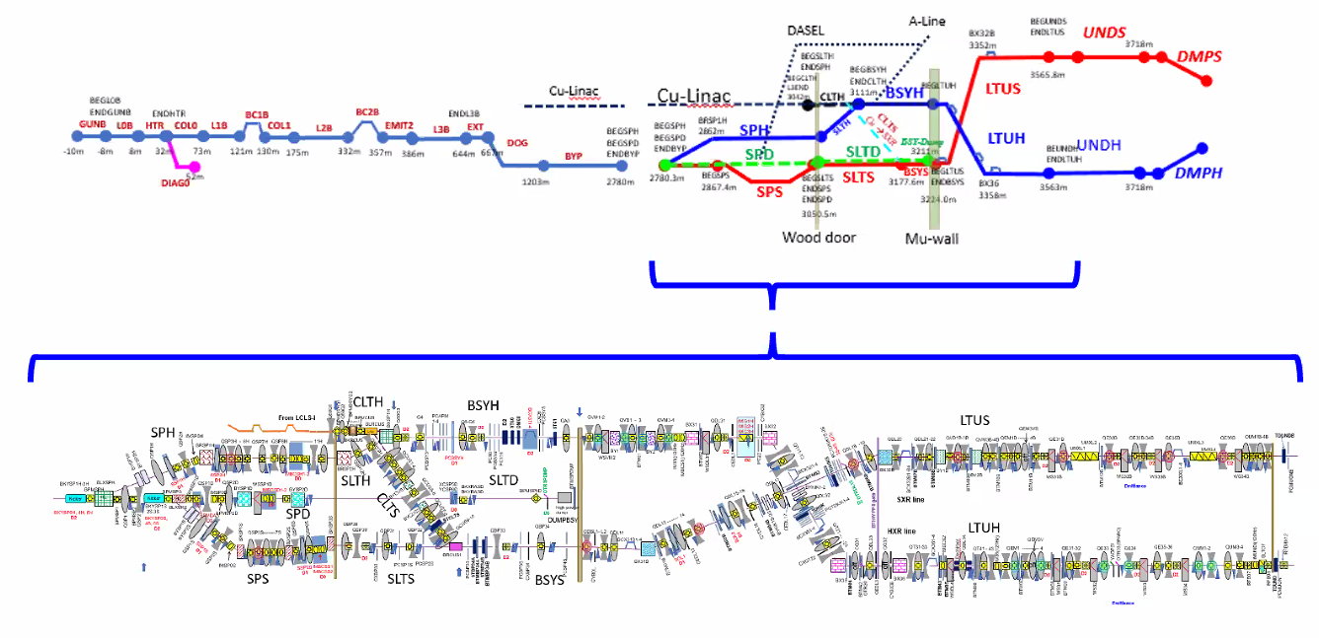
First SC linac based lasing

Slide 20
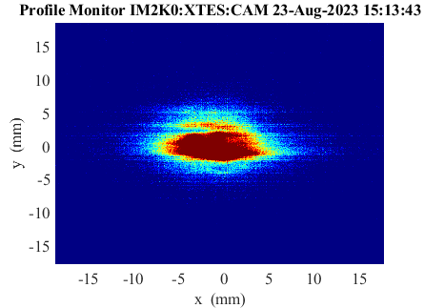
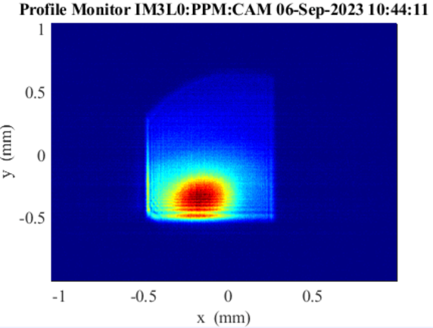
First SC linac based lasing
SXR Undulator lasing achieved on 8/23/23
HXR Undulator followed on 9/6/23

Slide 21
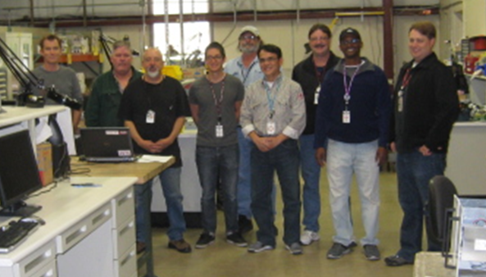
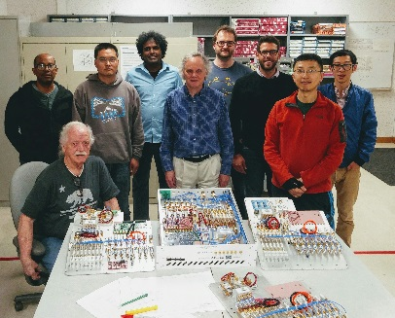
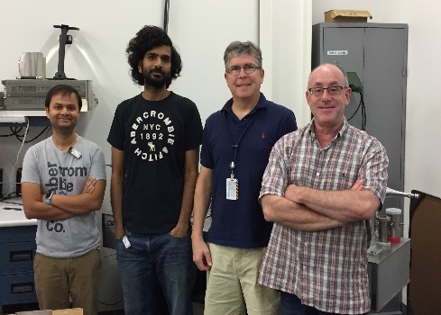
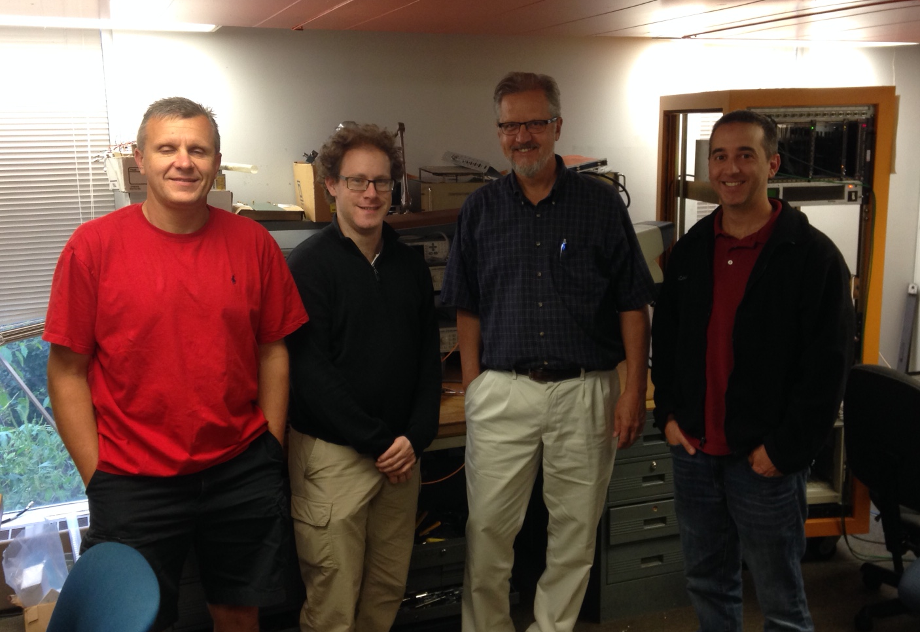
Special thanks to the entire LCLS-II LLRF collaboration for all their hard work to make this possible!

Slide 22
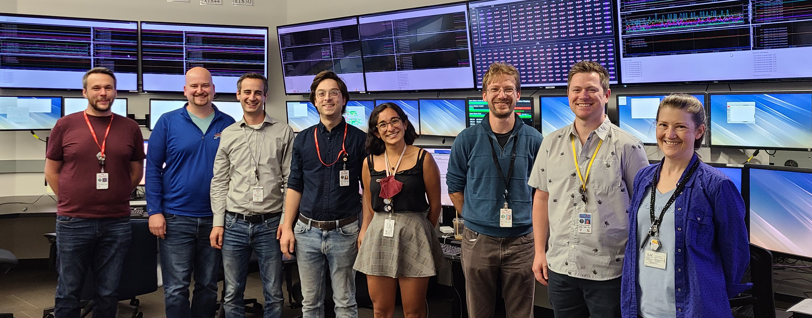
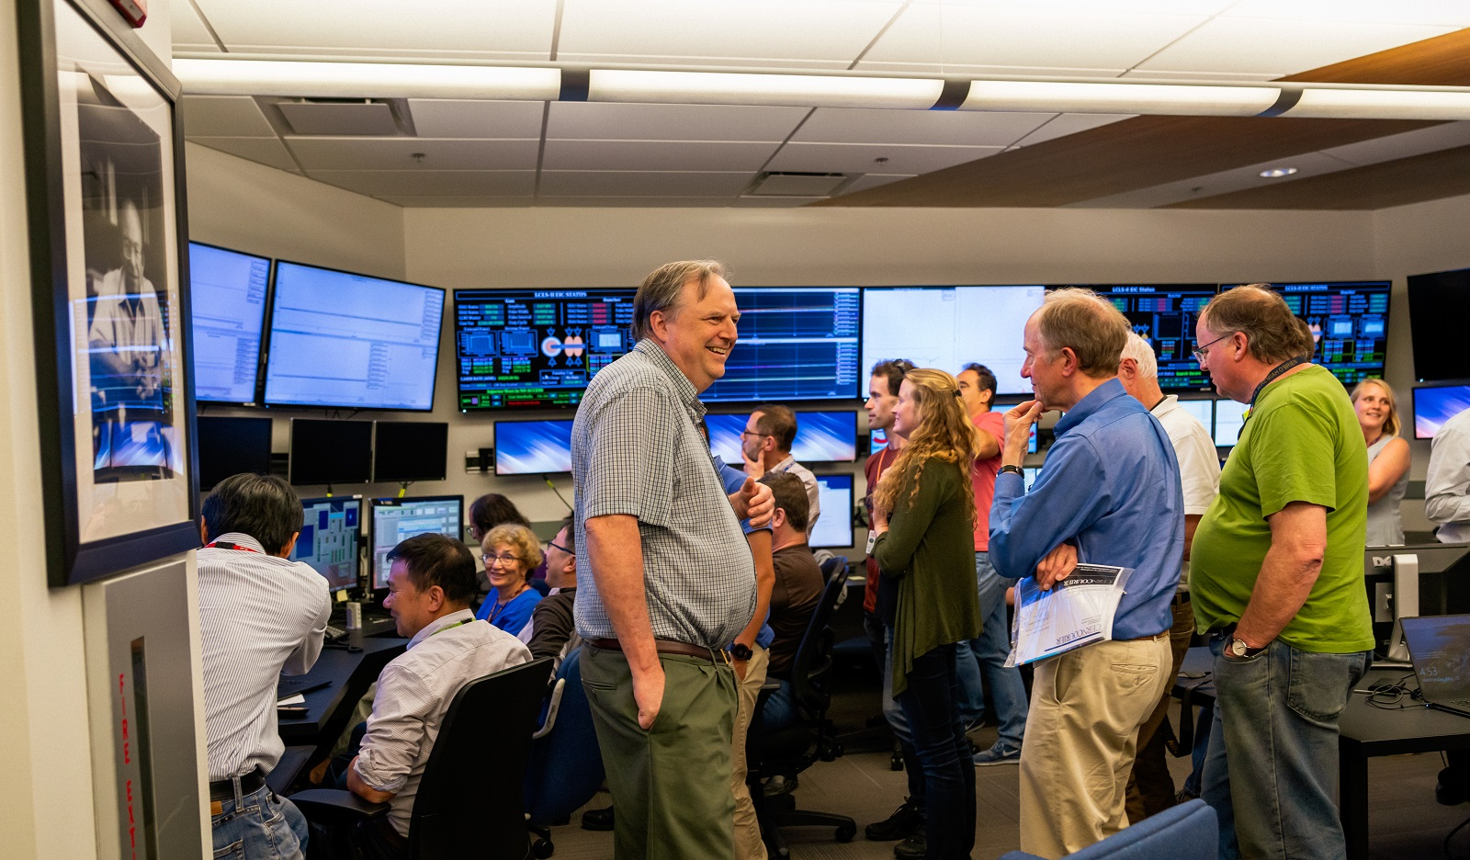
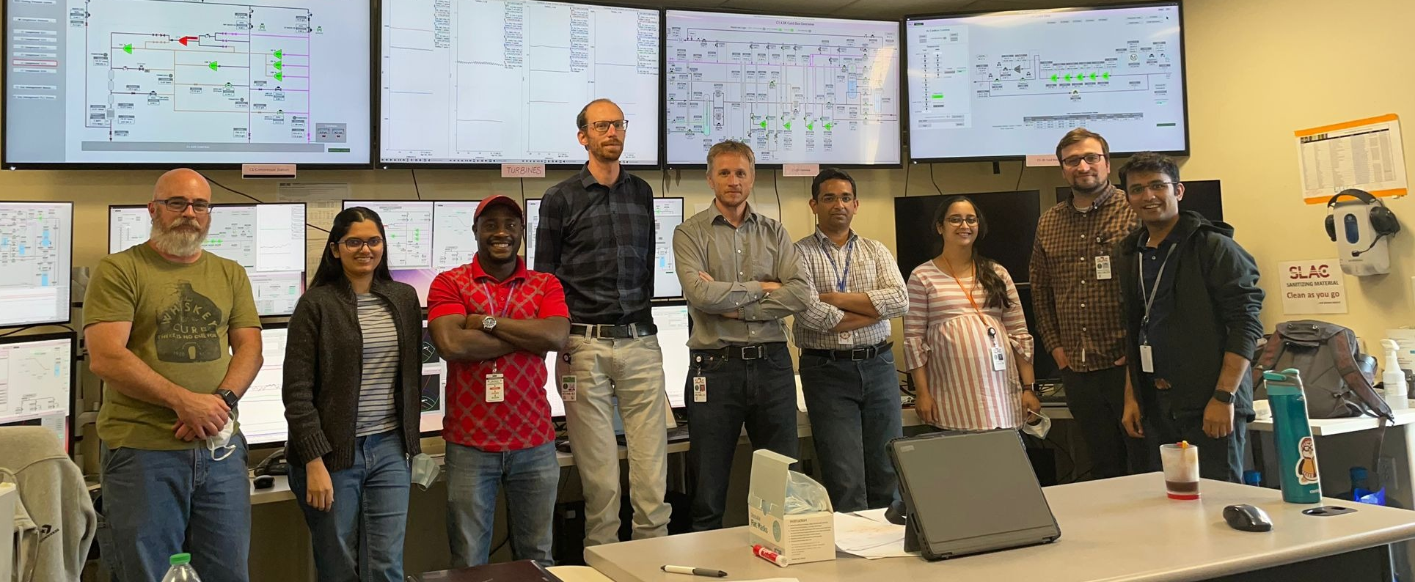
Well done to the entire LCLS-II collaboration!

Slide 23
감사합니다

Slide 24
Limits for Achievable Beam Energy
Available cryoplant capacity (~850 W of capacity at 3.5 GeV in current configuration)
Higher than expected static heat load: additional ~250 W of static heat due to a helium line leak
Cavity Q₀
Fast cool down was required to achieve sufficient Q₀ to achieve 3.5 GeV
Significant room for improvement available: degauss of additional CMs indicates >2.7x10¹⁰ can be achieved on every CM to further increase cryoplant margin
Available cavity gradient (4.9 GV total commissioned voltage, lose some of that to phasing and beam dynamics required)
With available cryoplant capacity, current cavity Q₀’s, and available gradient, 4 GeV may be reached with approximately ~200 W of cryoplant margin remaining

Slide 25
Backup: How to Achieve 4 GeV
Parameter | Value
Beam Energy as of 9/22 | 3.75 GeV
Remaining Cryogenic Capacity | ~600 W
Available Headroom Reduction | 40 MeV
Remaining Cavity Voltage in L3 | ~300 MV
Estimated Reduction in Cryo Capacity by Increasing L3 | ~340 W
Final Beam Energy | 4.09 GeV
Remaining Cryo Capacity | ~260 W
Energy can be further increased by one or more of the following:
Increase energy at BC2 to 1.6 GeV
Reduction in L2 Overhead and/or chirp
Multipacting processing in L3

Slide 26
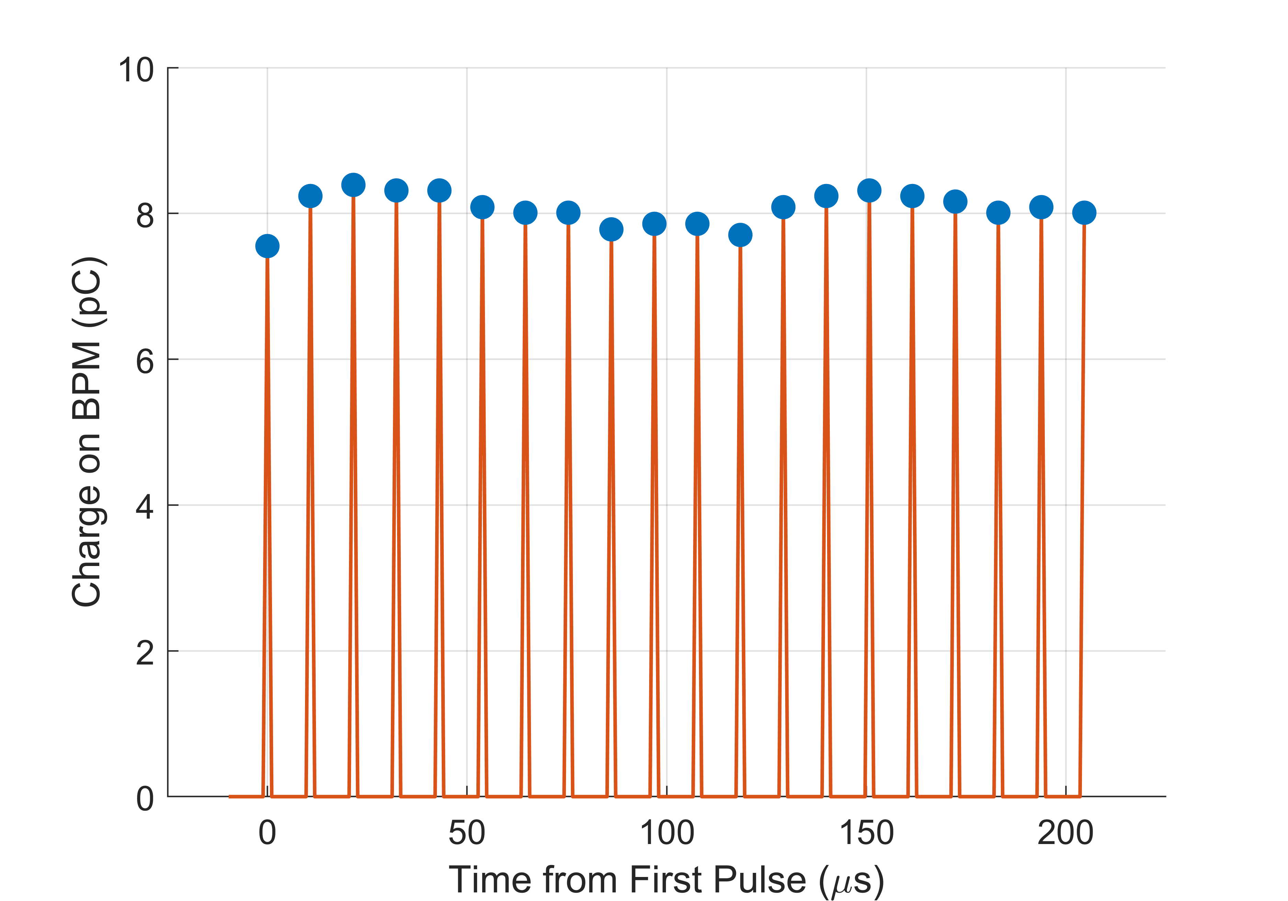
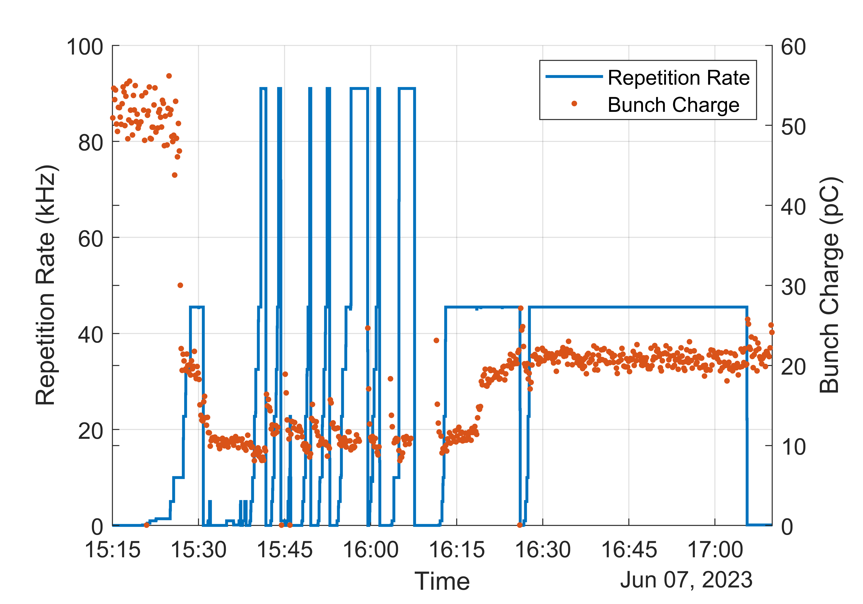
Demonstration of Threshold Repetition Rate
Repetition rate is set in the control system and verified by the last BPM prior to the beam dump
Repetition rate was ramped up to 93 kHz on 6/7 for the first time
Subsequent measurements were carried out at half the rate but at same beam power for additional testing
Pulse Spacing Measurement on Last BPM
Spacing of ~10.7 µs between pulses demonstrates 93 kHZ

