Slide 2
CERN Lab talk
W. Höfle
Acknowledgement: Contributors in SY-RF-FBM, SY-RF-LHS, SY-RF-CS, SY-RF-BR
CERN, Geneva, Switzerland

Slide 3

Overview of CERN Accelerators

Slide 4
LLRF challenges at CERN
Exploring data from RF related measurements
  accuracy and precision needed
    cavity voltage and relative cavity phasing (slip-stacking, power limitations)
    benchmarking for LLRF loops with beam dynamics simulations
    data collection (“obs box” system, LLRF embedded acquisition)
Consolidation and upgrade for existing RF systems
  upgrade of the PS LLRF system to the latest VXS standard used in small CERN synchrotrons
Monitoring and increasing reliability of LLRF systems
  LHC injectors with LINAC4 (H-) first in chain, receive a particular attention
HL-LHC Project (High-Luminosity LHC Upgrade)
  LHC crab cavity LLRF (16 cavities) to be installed by 2028
      challenging from point of view of the low noise requirements
      new feedback systems needed to counteract the effect of noise
      interfacing to existing LLRF system of main LHC RF system → some modifications / consolidation required

Slide 5
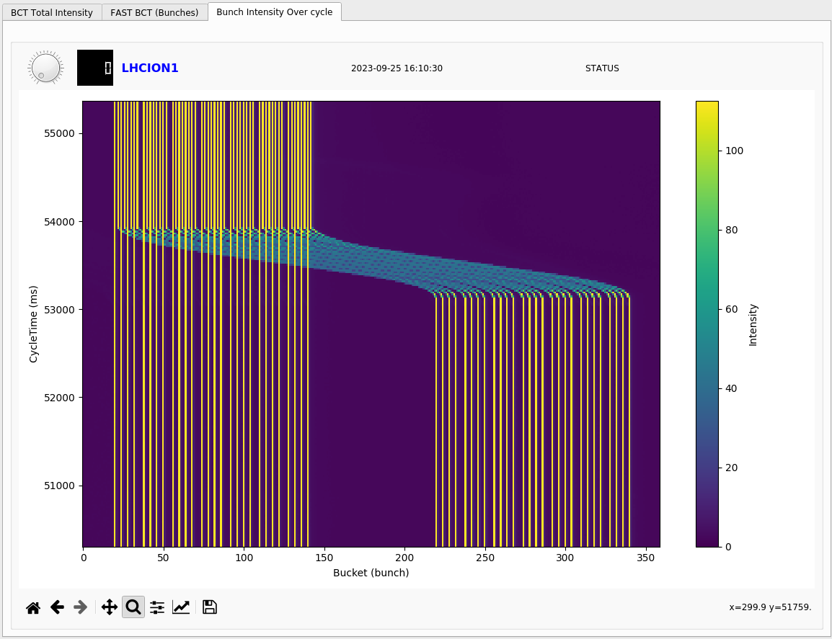
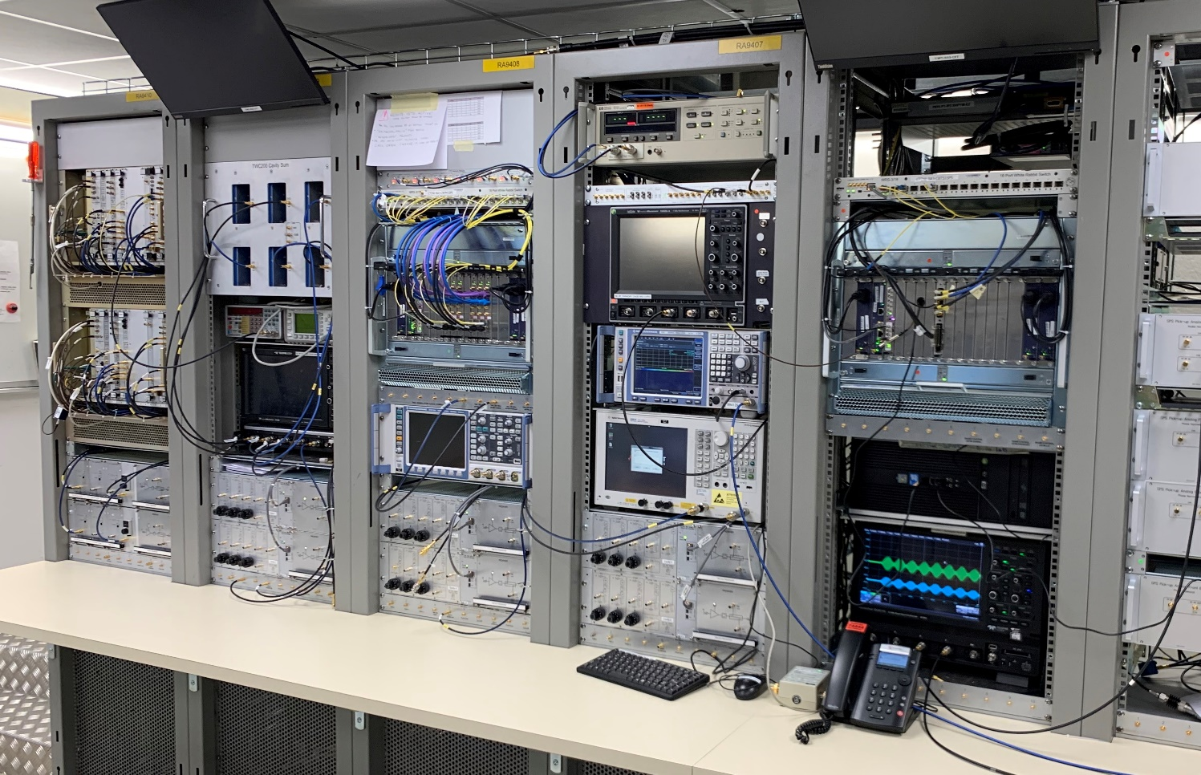
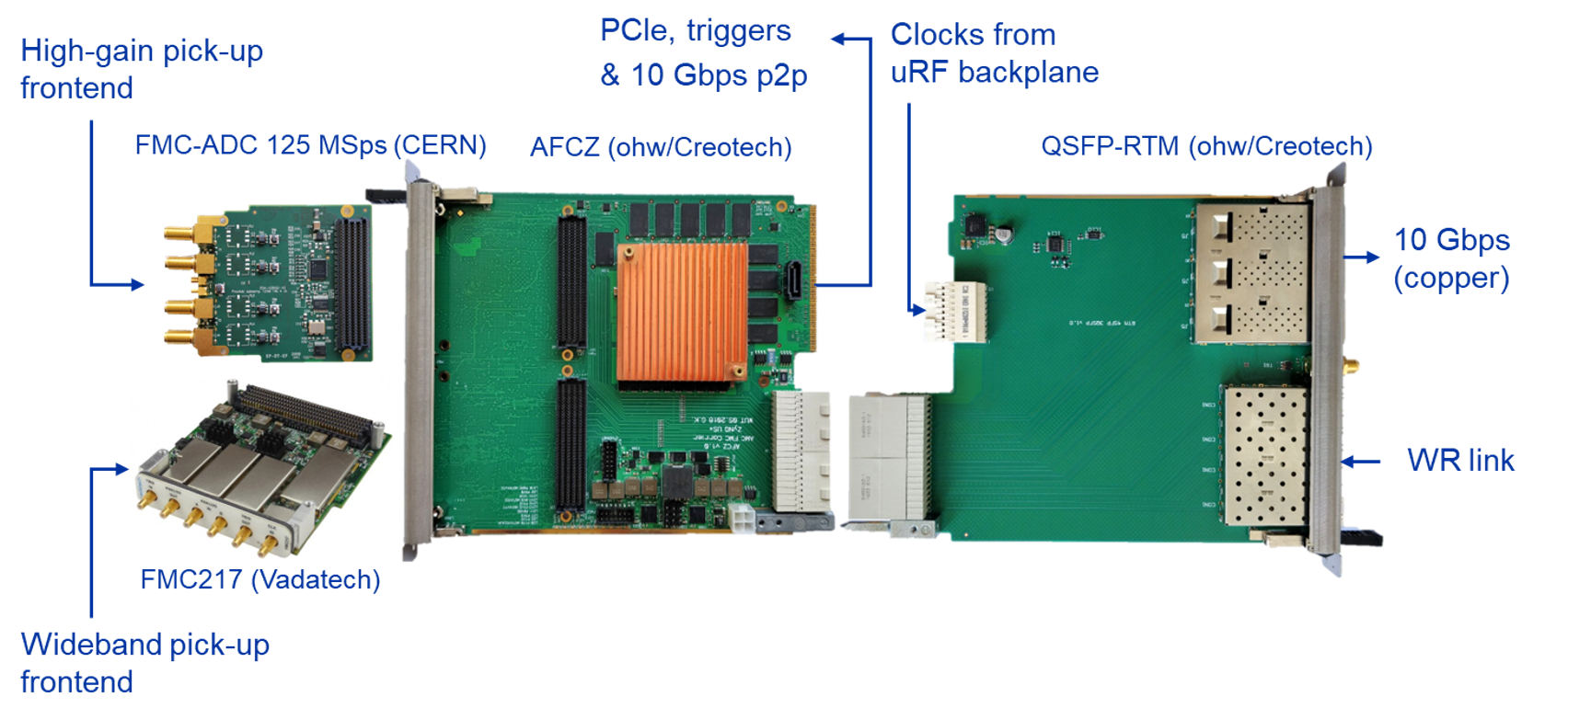
Progress SPS
full exploitation of the new MicroTCA LLRF system for 200 MHz system
  six 200 MHz travelling wave cavities, two groups
  two 800 MHz travelling wave cavities
  enhanced settings generations and observation capabilities
  Pb ions acceleration in SPS for LHC and for fixed target Physics
slip-stacking for Pb operational
100 ns spacing → 50 ns interleaving
A. Spierer, G. Hagmann et al. Poster #53 LLRF23
R. Borner et al. IPAC23, paper THPA093
New LLRF with MicroTCA
G. Hagmann et al. #67 (talk LLRF22)

Slide 6
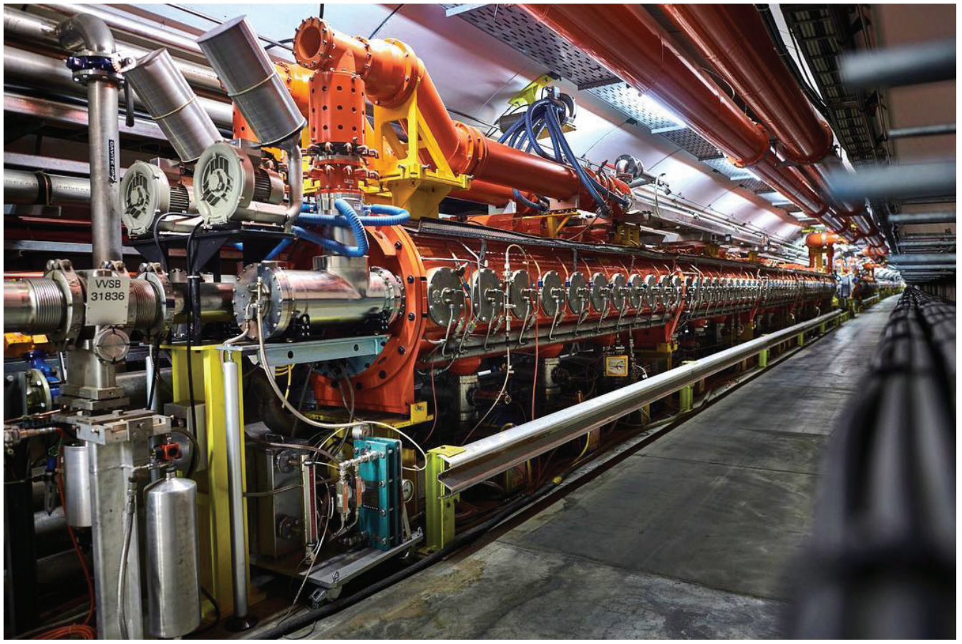
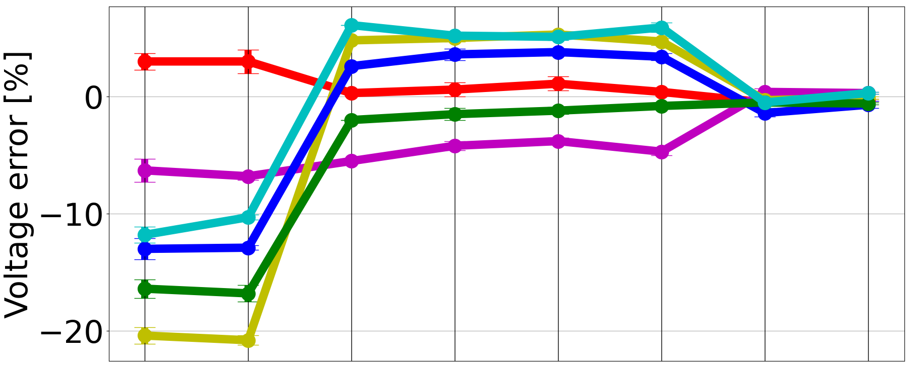
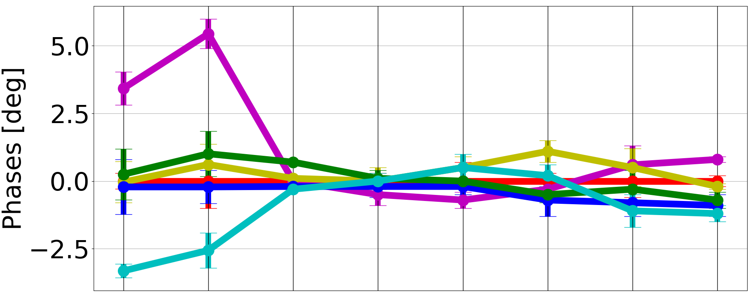
SPS 200 MHz system RF voltage calibration
Correction factors applied in the LLRF
accurate voltage calibration desired as well as phase alignment of six travelling wave cavities
  techniques using cavity return electrical signals limited in accuracy, need for calibration of real voltage seen by beam
  correction factors derived with beam based tomography
technique also applied to
  SPS 800 MHz system and with dual harmonic operation (200 MHz / 800 MHz)
  PSB RF systems
tomographic reconstruction is case for machine learning
Refined electrical voltage calibrations
C1 C2 C3 C4 C5 C6
2021
Jul
FB
2021
Oct
FB
2022
Mar
FB
2022
May
FB
2022
Jul
FB
2022
Jul
FT
2023
Mar
FB
2023
Mar
FT
D. Quartullo et al. (LLRF23, #45, Talk Tuesday)

Slide 7
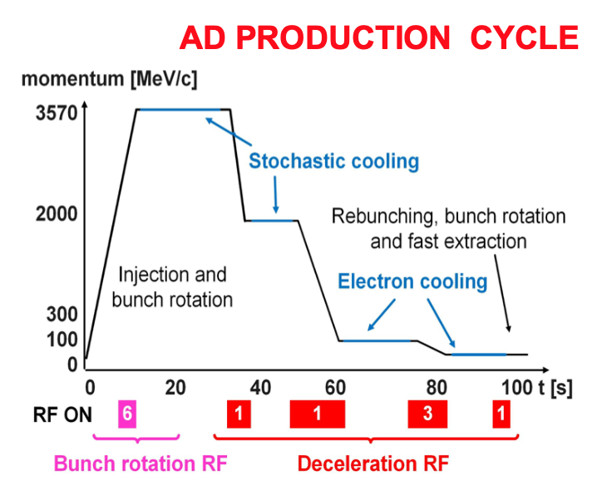
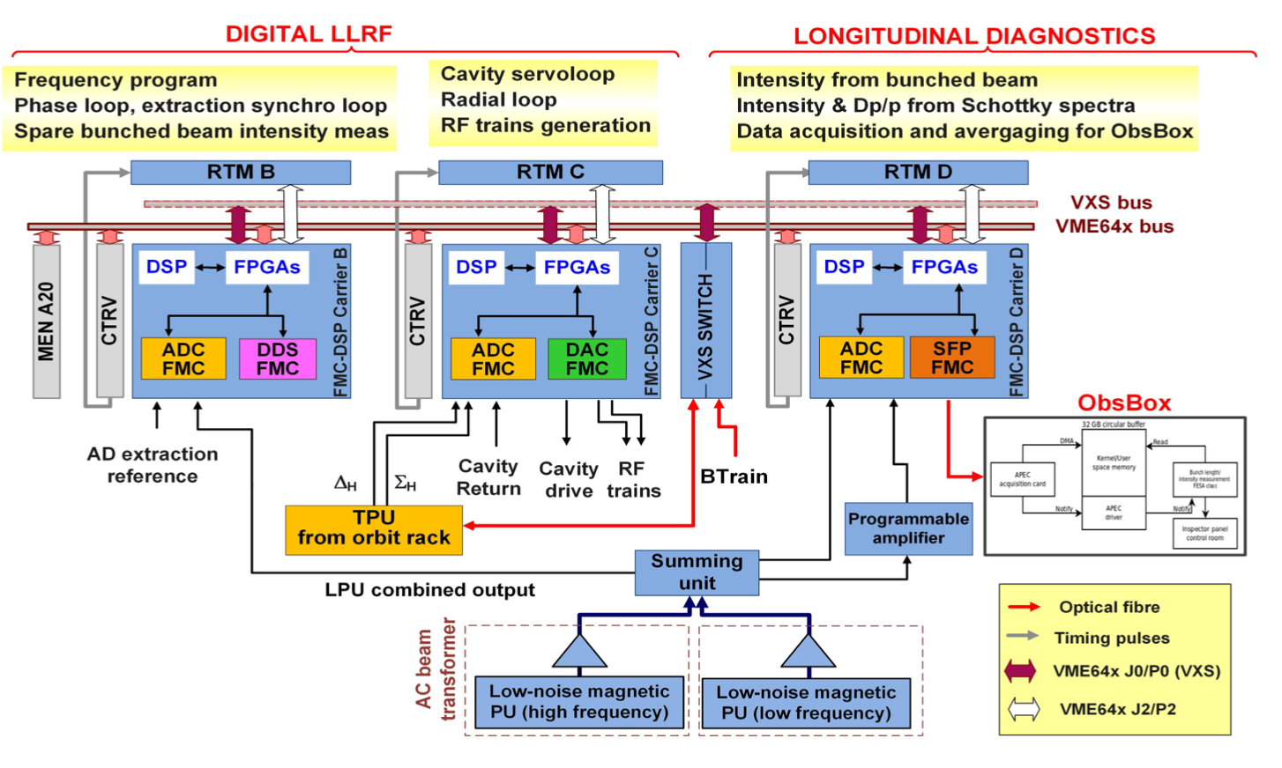
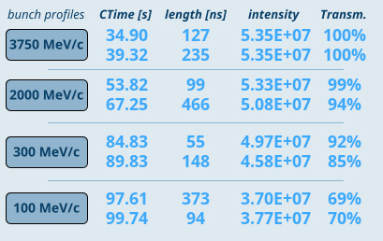
Obs Box system for data extraction from VME and VXS systems (streaming of data to server)
originally conceived for observing bunch-by bunch position position data in LHC on the VME system (in particular transverse damper)
allows processing of data from beam on a separate server with low latency
transfer of data via custom fiber links
anti-proton deceleration
measurements by LLRF
remarkable progress: deceleration efficiency
overall AD transmission larger than 90% after latest improvements
M. E. Angoletta, M. Nicollini
see also Poster LLRF22 #69

Slide 8
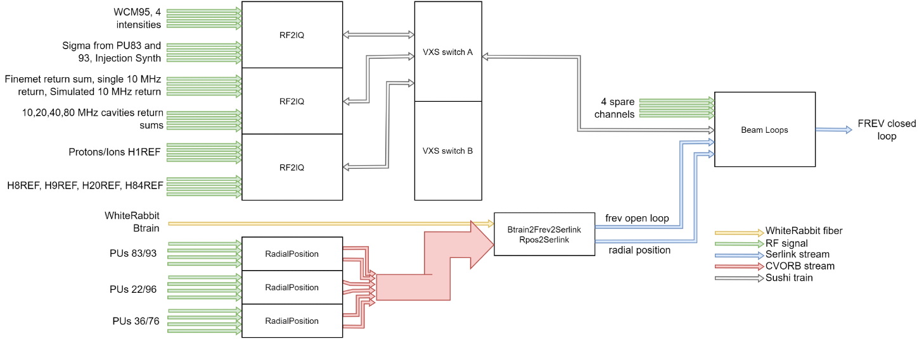
Beam Control upgrade in CERN PS (VXS)
PS beam phase and synchonization loops
mix of techology and large variety of RF systems:
  cavity controllers and coupled bunch feedbacks in VME technology
  beam control is now being consolidated with same technology as in the smaller CERN synchrotrons (VXS)
cavities: 10 MHz, 20 MHz, 40 MHz, 80 MHz
200 MHz will be in MicroTCA
D. Barrientos, LLRF23 Poster #52

Slide 9
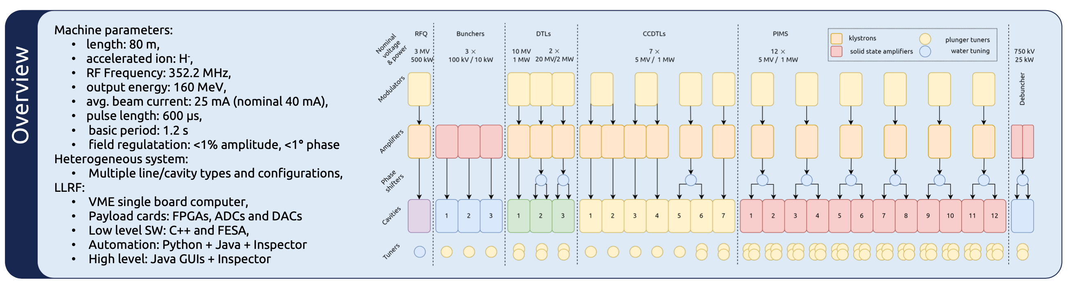
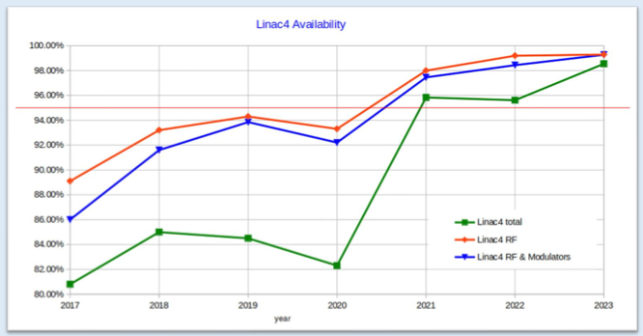
Progress with LINACs
LINAC3 (ions): consolidation ongoing, moving from analog to digital; reliable new digital LLRF roll-out in parallel to power system consolidation (tubes → solid state)
LINAC4 (H-): very good reliability
LINAC4 operational experience
B. P. Bielawski, LLRF23 Poster #53

Slide 10
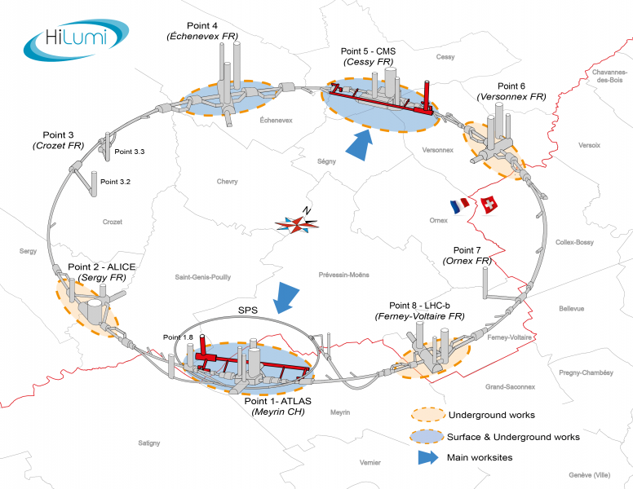
HL-LHC Project (High-Luminosity LHC)
400 MHz Main RF
400 MHz CC RF
Point 4 Surface (SR4)
  Beam-Control
  (WR frame master)
Point 4 underground (UX45)
  Accelerating cavities (ACS)
Point 1 underground (ATLAS)
  RFD Crab-cavities
Point 5 underground (CMS)
  DQW Crab-cavities
25 ns bunch spacing, >2000 bunches
bunch intensity 2 x nominal : 2.2x10¹¹
tenfold integrated luminosity
400 MHz CC RF
G. Hagmann
Talk LLRF23 #56

Slide 11
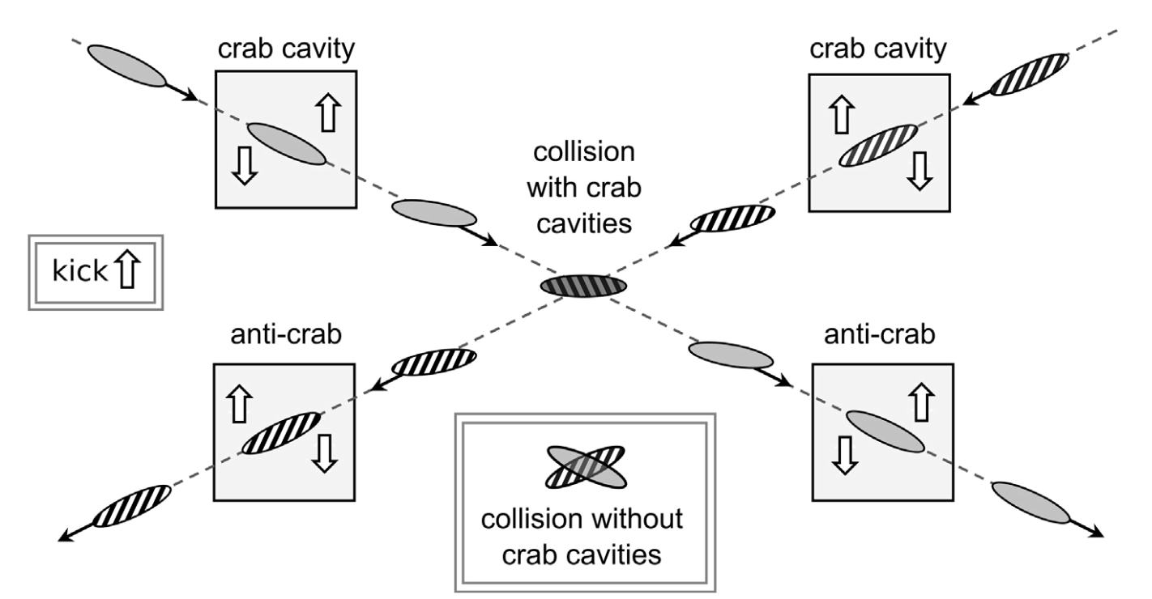
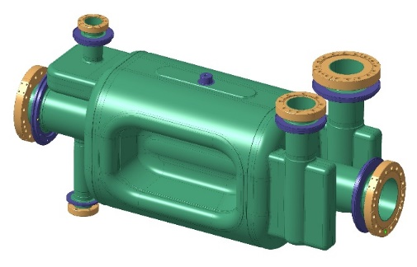
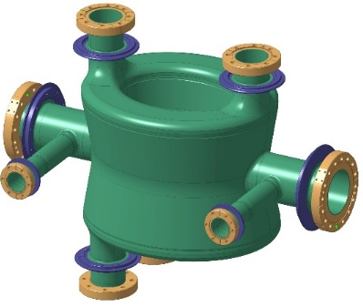

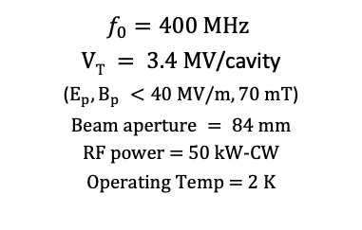
HL-LHC (superconducting) crab cavities
RF Dipole (RFD),
crabbing in horizontal plane
(IP1, ATLAS)
Double Quarter Wave (DQW) resonator,
crabbing in vertical plane
(IP5, CMS)
8 cavities
8 cavities
$f_{0}=400 MHz$
$VT = 3.4 MV$/cavity
($E_{p}, B_{p} <40 MV/m, 70 mT$)
$$Beam aperture = 84 mm$$
RF power = 50 kW-CW
Operating Temp = 2 K
G. Hagmann
Talk LLRF23 #56
  LHC: θ_{c} = 320 μrad, β*=0.3 → R=0.6
  HL-LHC: θ_{c} = ~500 μrad, β*=0.15 → R= 0.35
  → operate with crab cavities to recover peak luminosity

Slide 12
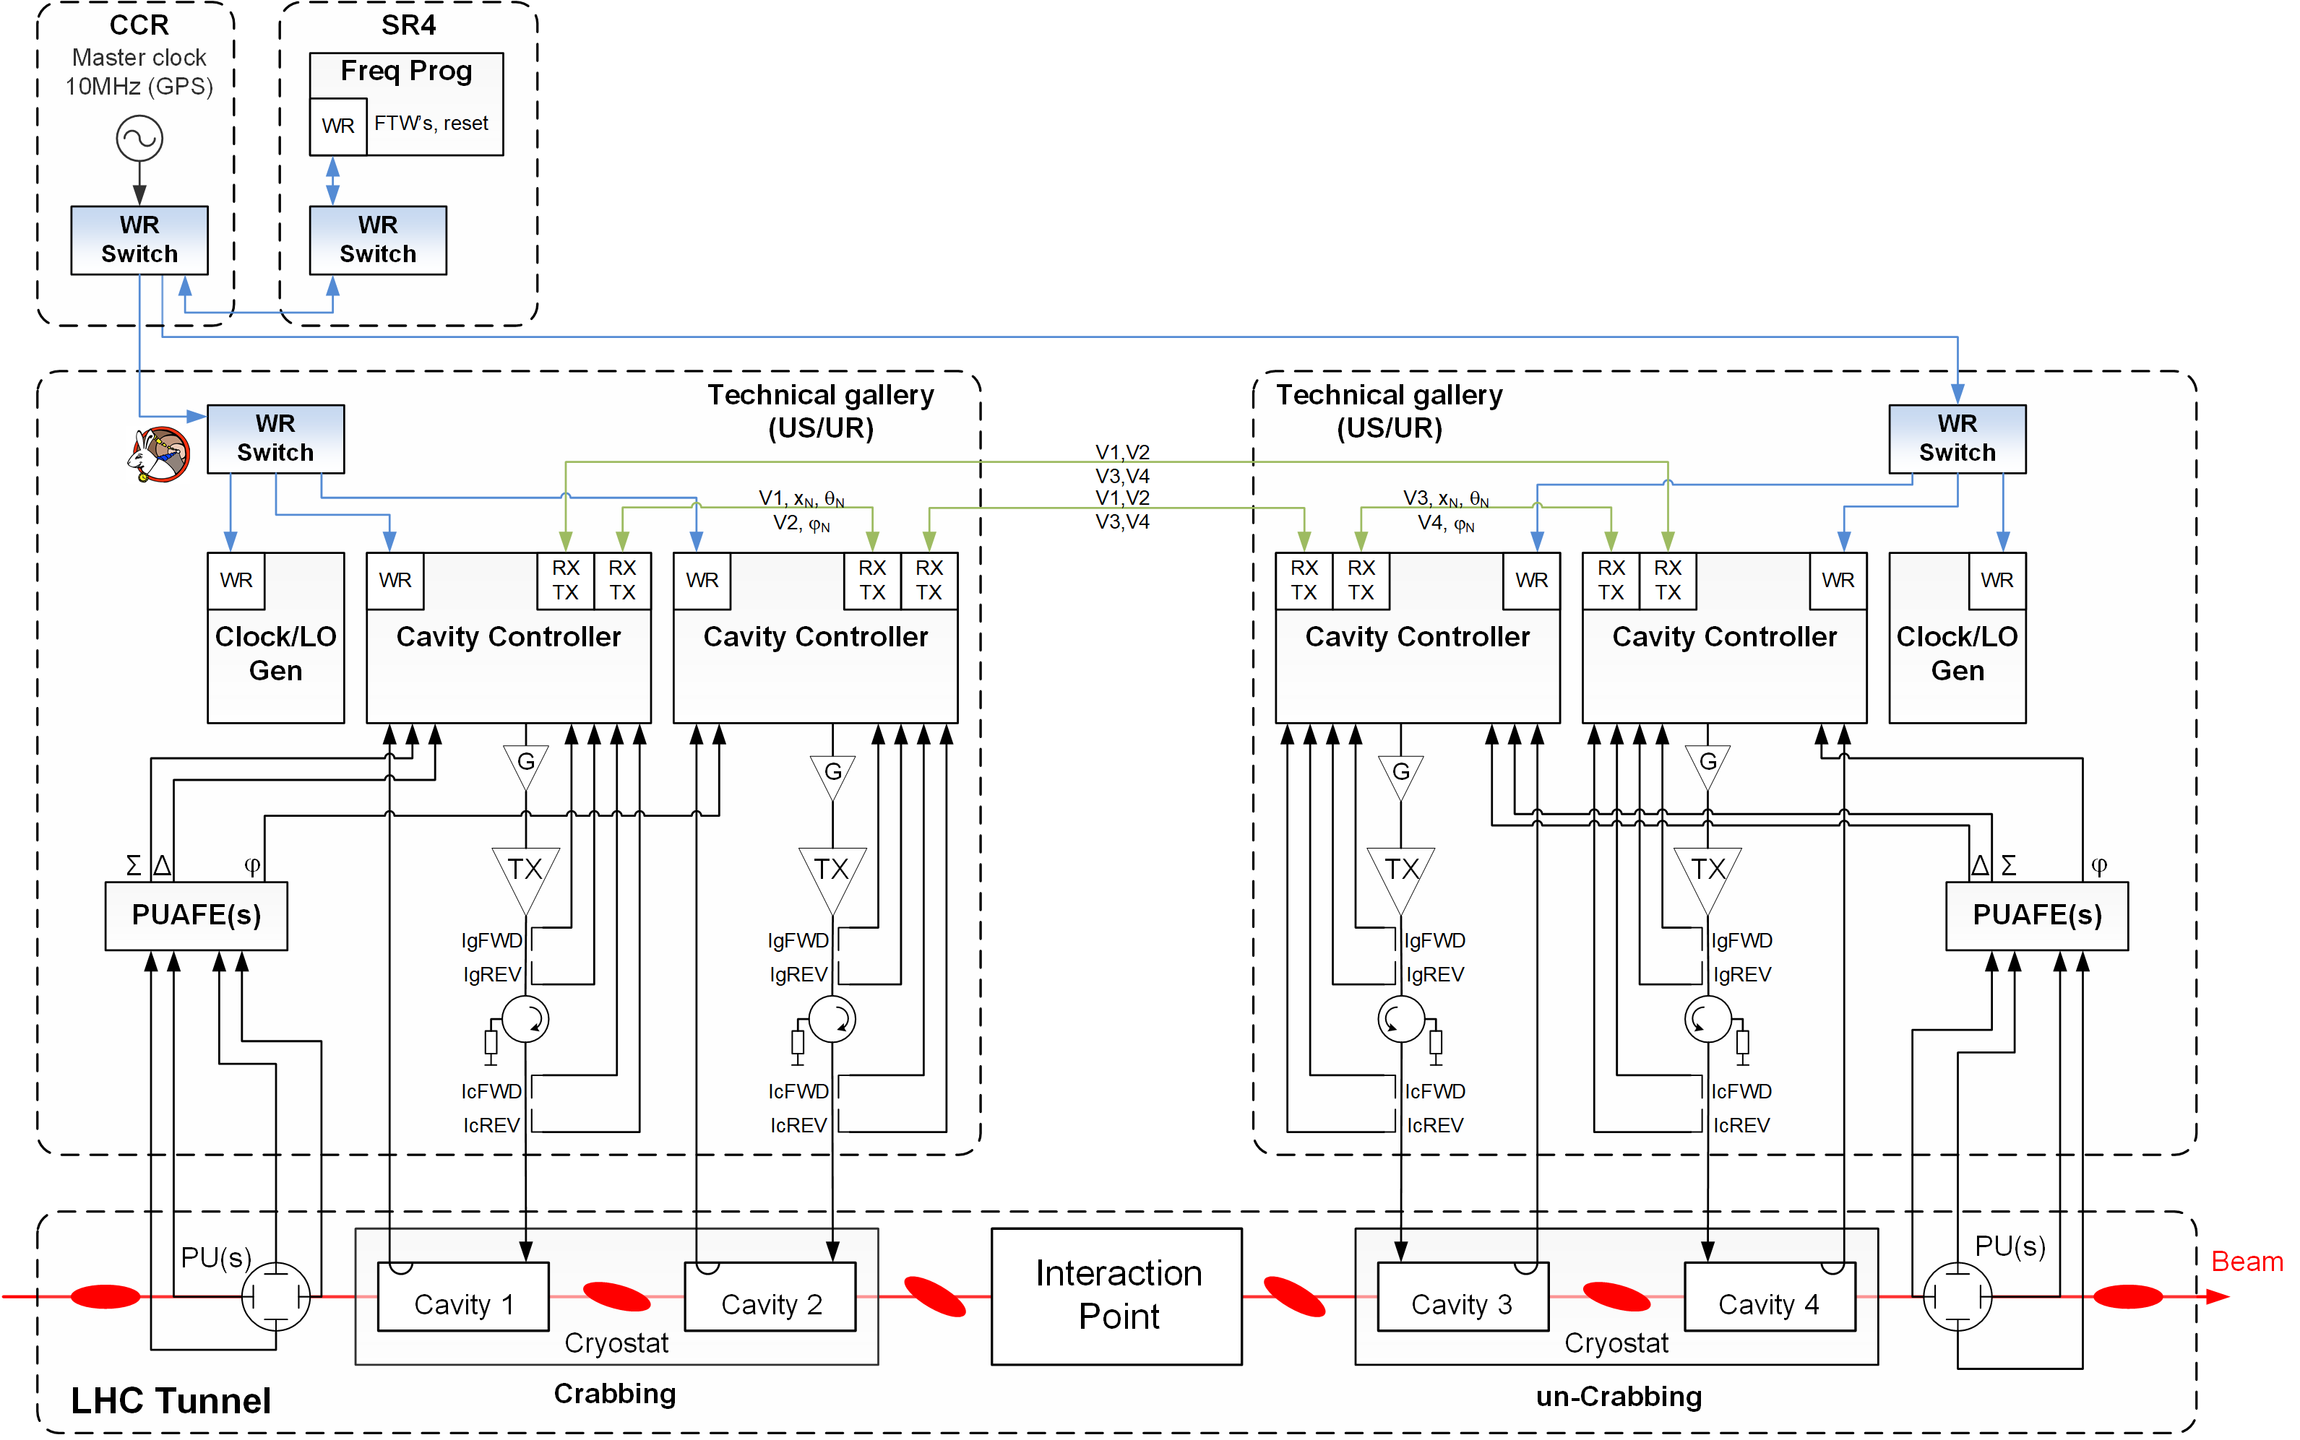
HL-LHC LLRF architecture
RF distribution (FTW) over White-Rabbit
G. Hagmann
Talk LLRF23 #56
Gb links for global regulation V∑
Cavity field regulation
Same cable type/ length
For Beam phase tracking and RF noise feedback

Slide 13
spare

Slide 14
Thank you!

Slide 15
Variety of LLRF from analog to MicroTCA
VXS and VME digital systems deployed in a wide range of machines since 2006
  VXS: AD, ELENA, PSB, PS, LEIR → small synchrotrons varying revolution frequency
  VME: LHC, SPS partially, PS, LINAC3 (ions), LINAC4 (H⁻), HIE-Isolde, AWAKE, small frequency swing or fixed RF frequency
MicroTCA technology rolled out in SPS for 200 MHz RF system, and now fully commissioned, move to optimizing operational performance of RF system
Legacy, mostly analog systems for e-beam acceleration used in CLEAR and AWAKE (3 GHz RF system), future upgrades being planned
Future evolution towards more use of MicroTCA.4 based on positive experience with this technology in SPS
  New LLRF for PS 200 MHz RF system to be commissioned
  AWAKE + with new LLRF for 3 GHz under planning
Large number of accelerators, continuously running make it difficult to roll-out common technology; adaptation of technology to different requirements takes time and technology changes fast

Slide 16
Injector transverse feedbacks at CERN
LHC Injector transverse feedbacks at CERN and studies
  next “upgrade to digital” opportunity for LEIR
Accelerator / energy | Kicker / power per electrode frequency band | Processing used | Last upgrade
LEIR | striplines up to 100 MHz | 2 pick-ups | 2005
4.2 MeV/u – 72 MeV/u (kin. E) | 100 W, 50 Ω, up to 100 MHz | analog, vector sum
PS Booster | striplines up to 100 MHz | 1 pick-up | 2020
160 MeV – 2 GeV | 800 W, 50 Ω | digital
PS | striplines with impedance transformer | 1 pick-up (+spare) | 2020
2 GeV – 26 GeV/c | 5 kW, 125 Ω, up to ~ 60 MHz | digital
SPS | electric field kickers, high impedance | striplines, electro-static | 2014
14, 26 GeV/c – 450 GeV/c | tetrodes, 30 kW, 180 Ω, up to 20 MHz | digital, pick-up pairs
SPS for wideband feedback study | 2 short striplines and 1 Faltin type kicker | 1 stripline exponential PU | 2008
26 GeV/c | 250 W, 50 Ω, 5 MHz – 1 GHz | Digital up to 4 GS/s (3.2 Gs/s) | to 2018
study

Slide 17
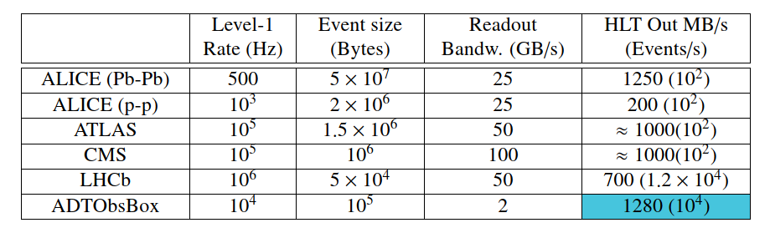
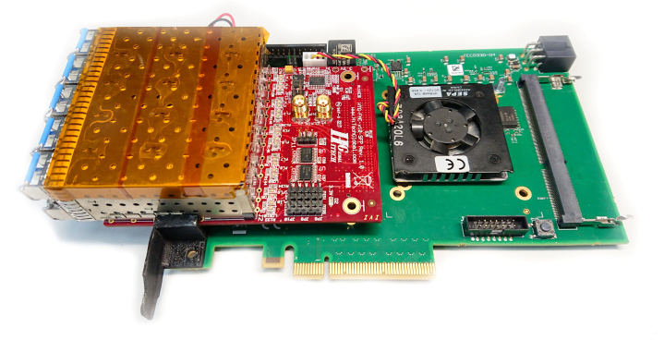
ADT ObsBox for data recording from feedback
data recording from feedback systems
M. Söderén, D. Valuch
EPJ Web of Conferences 245, 01036 (2020)
CHEP 2019,
https://doi.org/10.1051/epjconf/202024501036

Slide 18
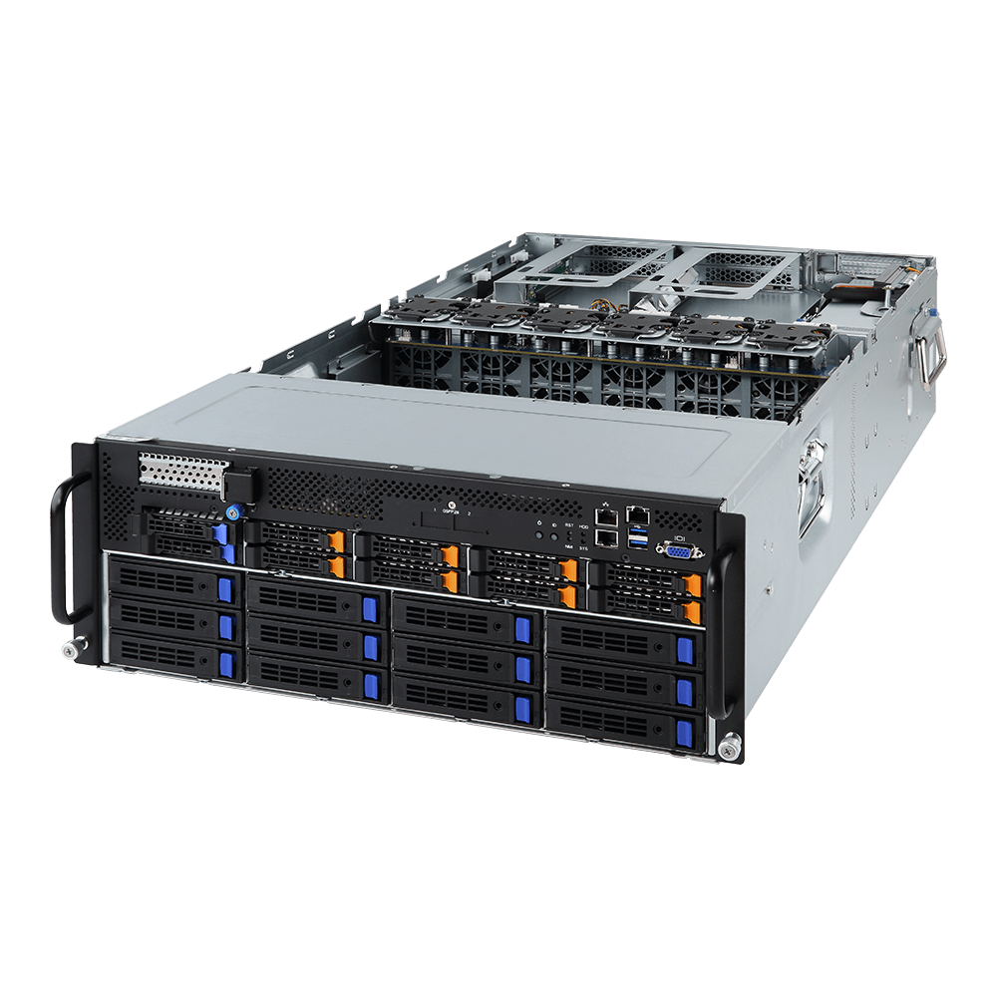
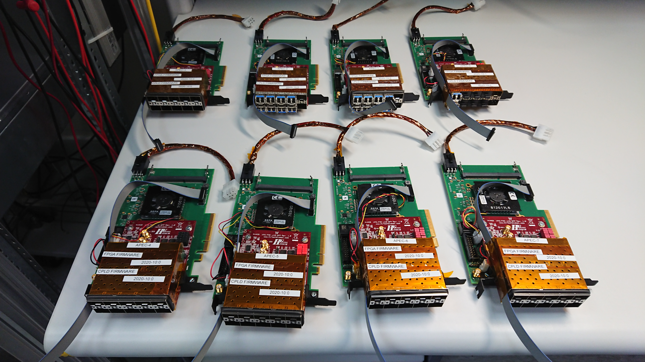
Hardware in LHC transverse plane for ObsBox
Hitech Global HTG-FMC-X10SFP+ FMC mezzanine
Trenz Electronics TEC0330-4 FMC carrier
Xilinx Virtex7 FPGA
PCIe 3.0 x8 resulting in transfer rate to the host of 7.88GB/s
Own firmware and driver
Up to 10 channels @ 5 Gbps
GIGABYTE G481-HA0
2 x Intel Xeon ‘Skylake’ 8260 24 Core 48 Threads 2.4GHz
768 GB DDR4 RAM
10 x 3.0 16x PCIe FH FL DW
2 x 10Gb/s BASE-T LAN ports
Runs Centos 7 real-time kernel
Configured as a front-end computer
Runs FESA classes
GPGPU ready
M. Soderen et al.
M. Söderén, D. Valuch
EPJ Web of Conferences 245, 01036 (2020)
CHEP 2019,
https://doi.org/10.1051/epjconf/202024501036
18
Notes:
18

Slide 19
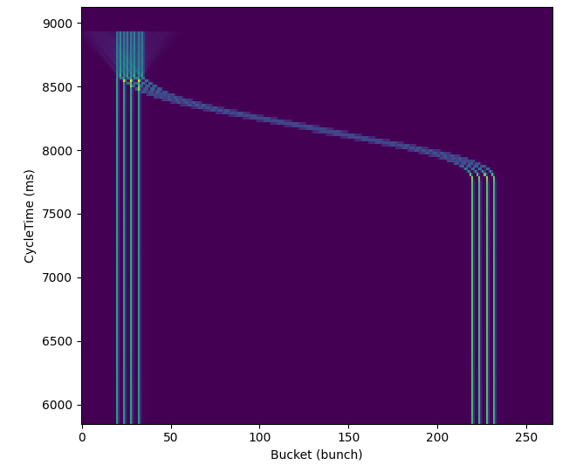
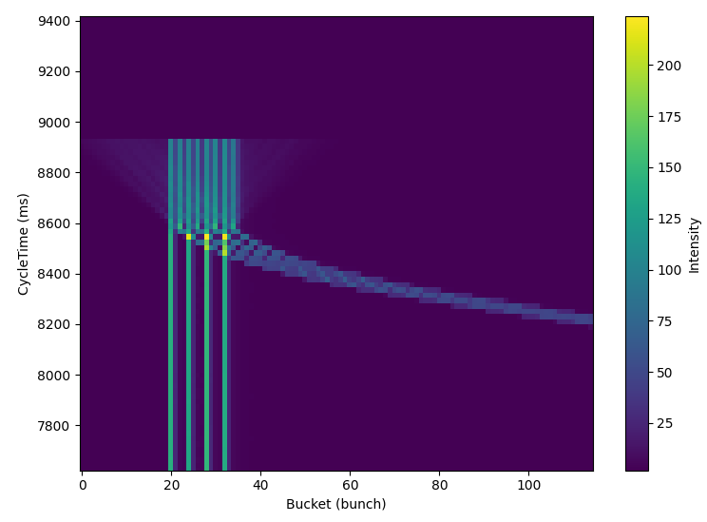
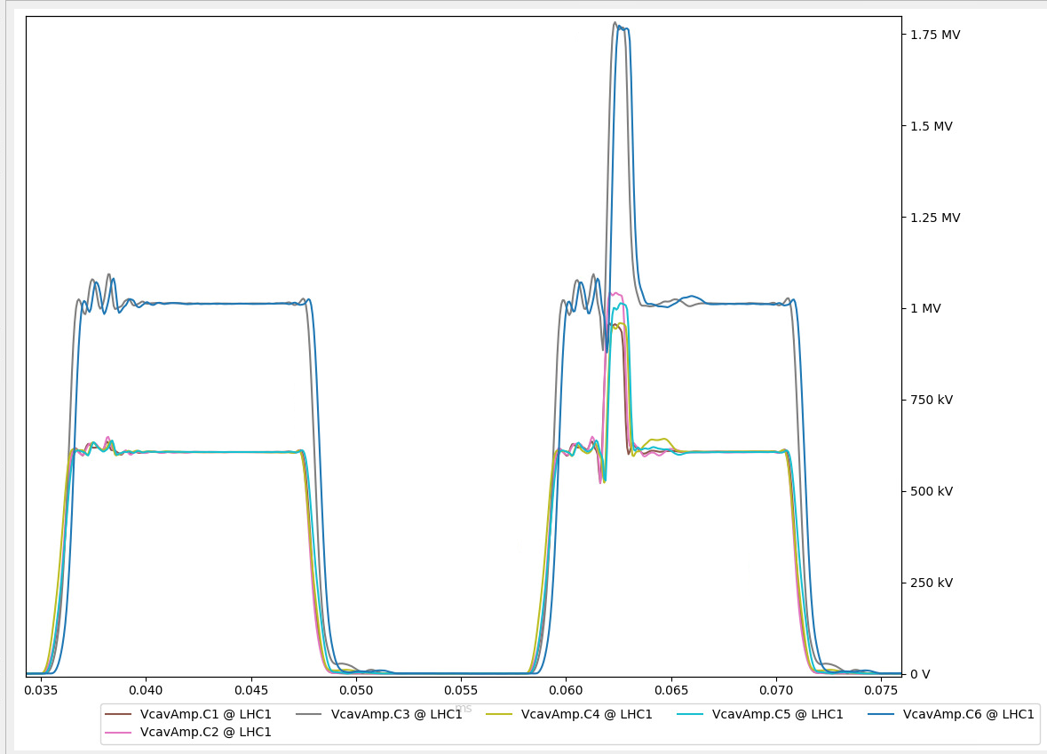
SPS Beam & results (2022)
Protons
Intensity achieved for LHC beam:
  1.84e11 p/bunch, 72bunches, 25ns spacing
  1.4e11 p/bunch, 4x 72bunches, 25ns spacing
Intensity achieved for AWAKE:
  3e11 p/bunch, 1 bunch, 1ns
Ions
slip-stacking from 100ns to 50ns bunch spacing
Commissioning completed in 2023
8 bunches
50ns
8 bunches
50ns
2nd inj: +750kV
1st inj
1MV
4 bunches
100ns
4 bunches
100ns

Slide 20
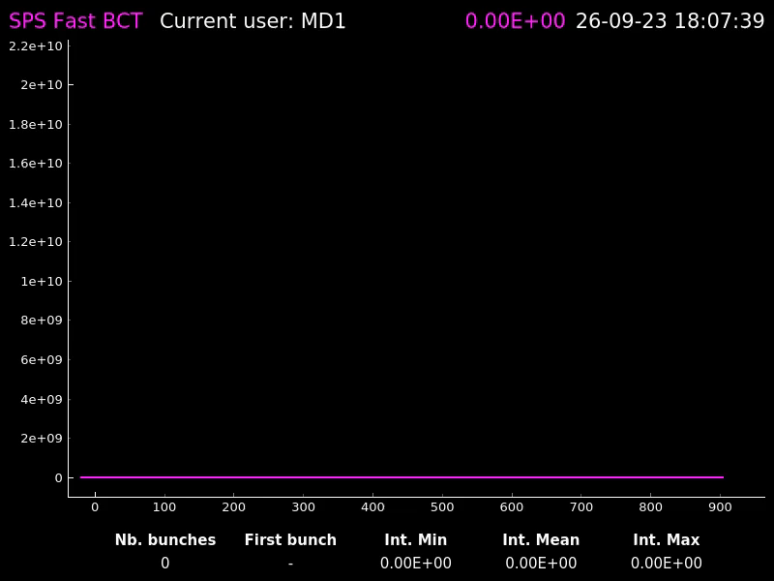
SPS slip-stacking for LHC filling (2023)
A. Spierer et al.

