Slide 1
Approach to Calibrate Beam Phase Using Steady-State RF Forward Signal under Closed-Loop Operation
  ---- Pioneering Innovative Accelerator Applications from Aspects of RF-Cavity-Beam Interaction
Joint effort between ESS and IMP
Rihua Zeng(ESS), Feng Qiu(IMP), Chengye Xu(IMP)
LLRF Workshop 2023
2023-10-24

Slide 2
Outline
    ESS Project Status
    Motivation
    Verification results
    Potential application
    Further plans

Slide 3
Motivation
Why we want to do it
    The technology is highly advanced
      Very good hardware platform
      Powerful cavity model
      Flexible software tools and intelligent algorithm
    The demand for this application is substantial
      In the context of proton machines, the conventional BPM-based time-of-flight beam-phase measurement method has several limitations. Its primary drawback is its offline nature, rendering it incapable of establishing a real-time correlation between the beam and RF.
      There is also significant effort needed for smooth operation. It provides users great benefit if able to continuously monitor key system parameters!
    Understanding the basic parameters on cavity-RF-beam interaction: RF powers, RF phase, detuning, Ql and R/Q.

Slide 4
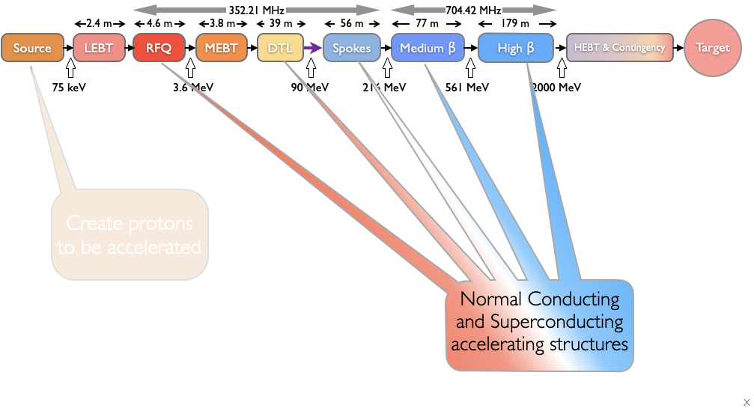
About ESS
Ion Species | Protons
Output Energy | 2 | GeV
Frequency | 352.21/704.42 | MHz
Pulse Length | 2.86 | Ms
Peak Current | 62.5 | mA
Protons per Pulse | 1.1 x 10¹⁵
Repetition Rate | 14 | Hz
Duty Cycle | 4 | %
Average Beam Power | 5 | MW
Accelerating Structures | RFQ, DTL, SC Spokes/Elliptical
Accelerator Length | ~365 | m
Courtesy of C. Plostinar

Slide 5
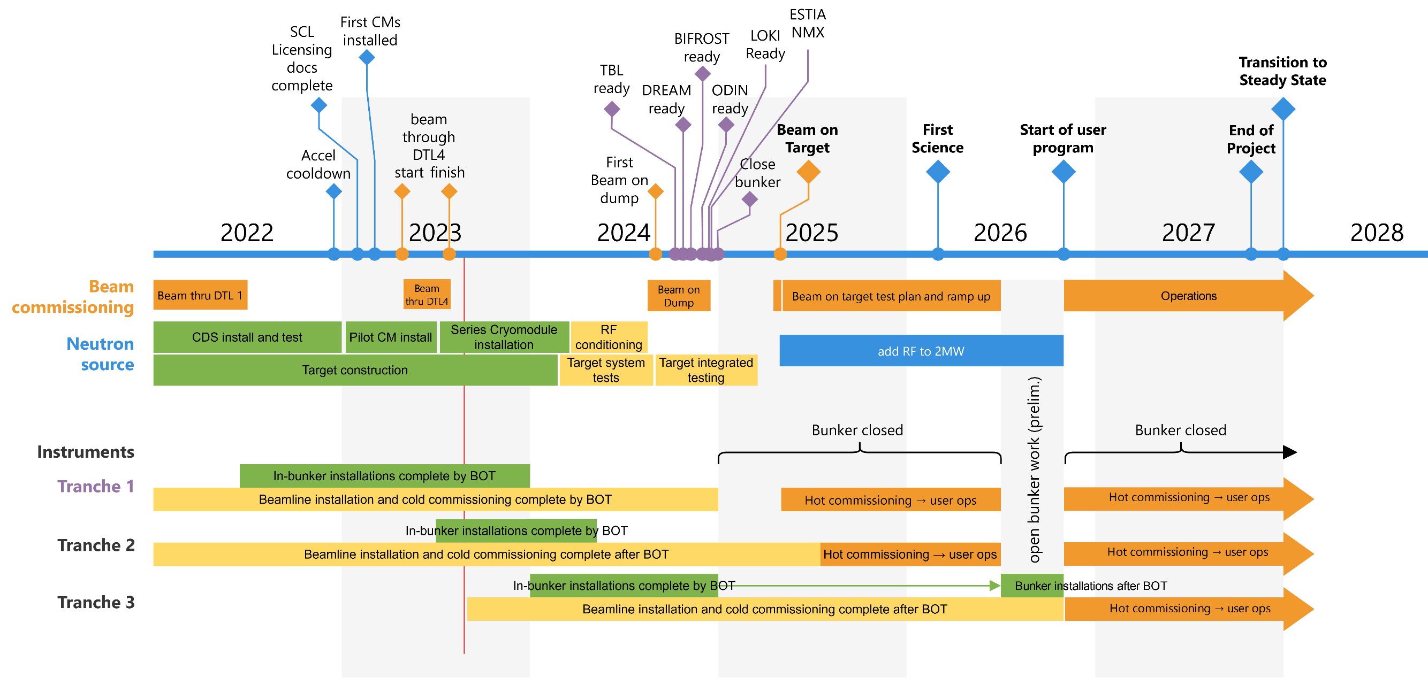
Project Timeline
Courtesy of C. Plostinar

Slide 6
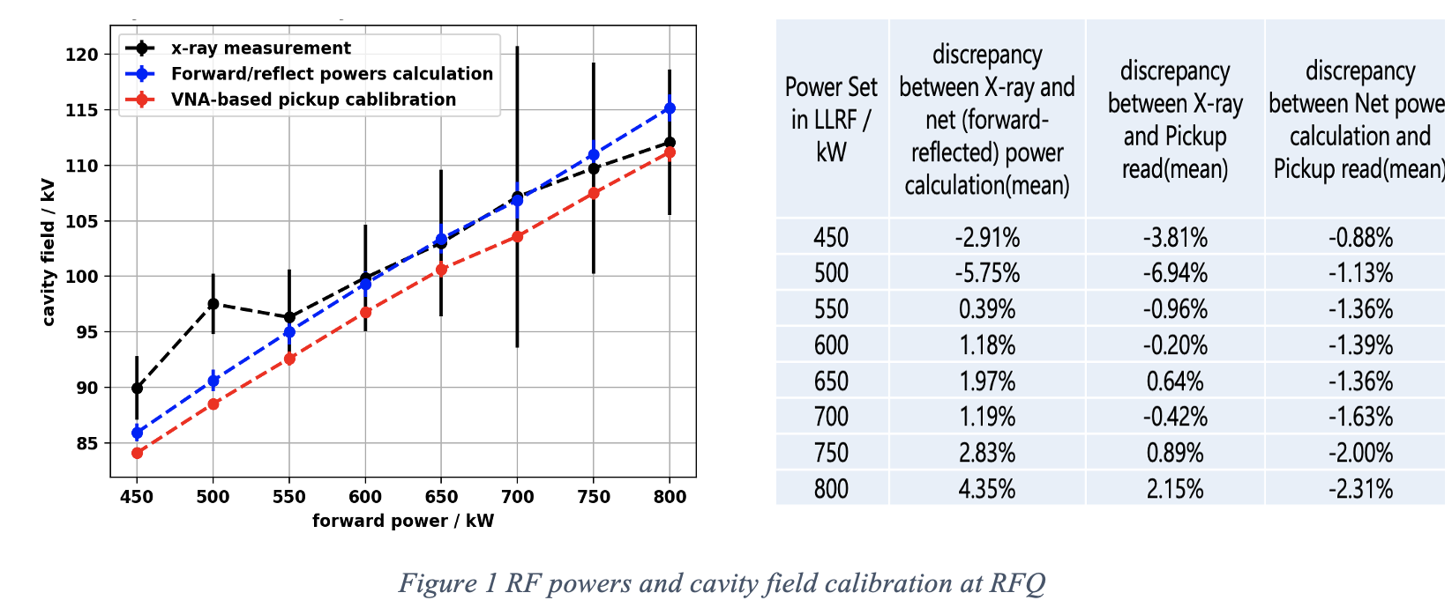
RF-Cavity Basic Parameters and Performance at ESS
RF Power Calibration
2023-10-13
PRESENTATION TITLE/FOOTER

Slide 7
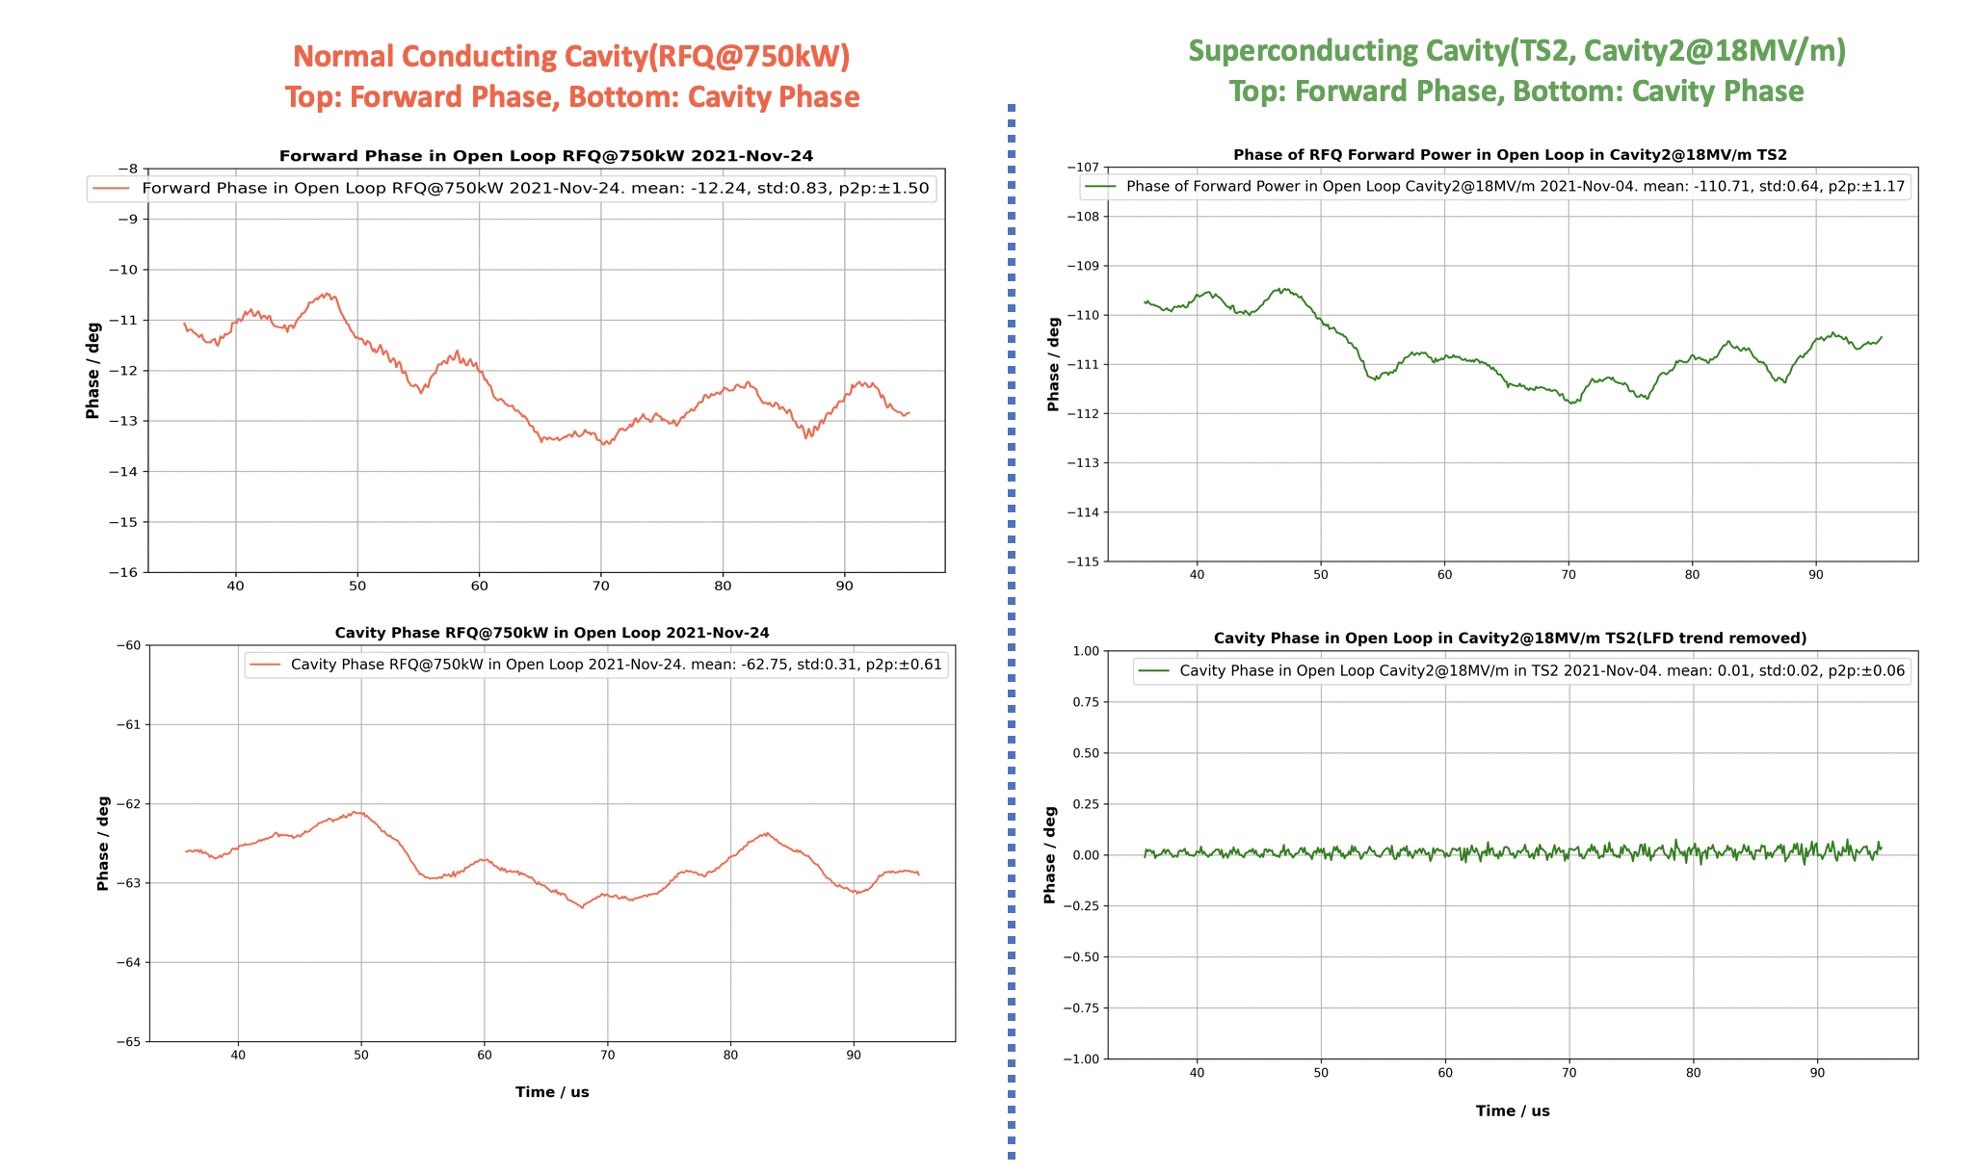
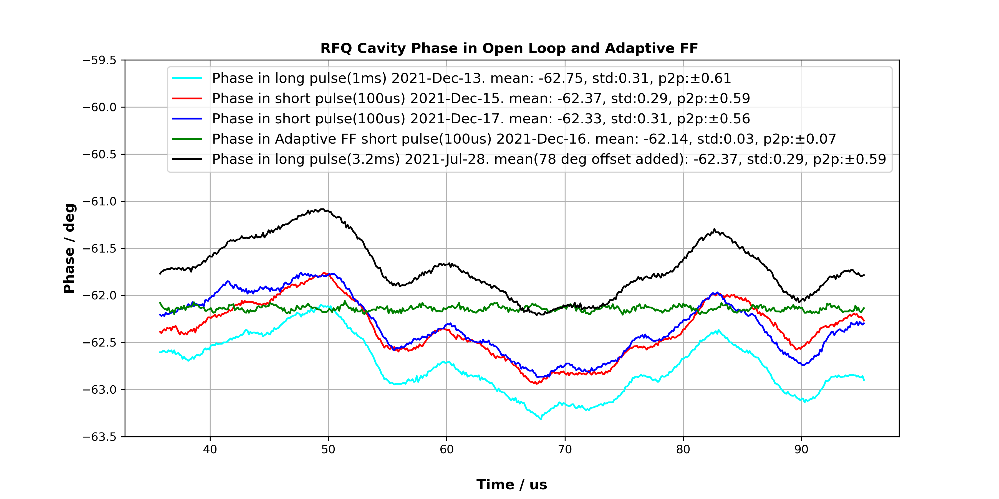
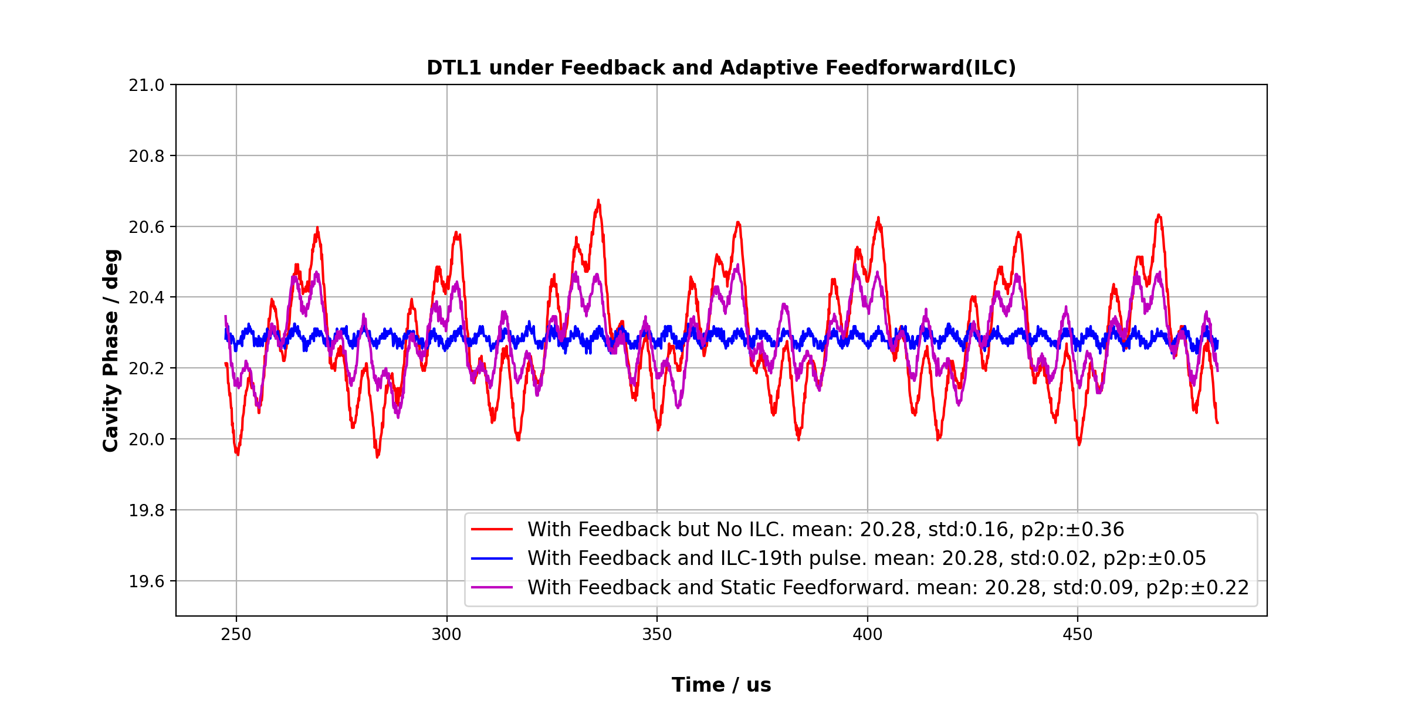
RF-Cavity Basic Parameters and Performance at ESS
RF Phase

Slide 8
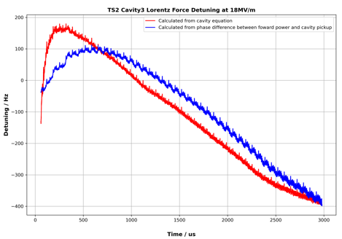
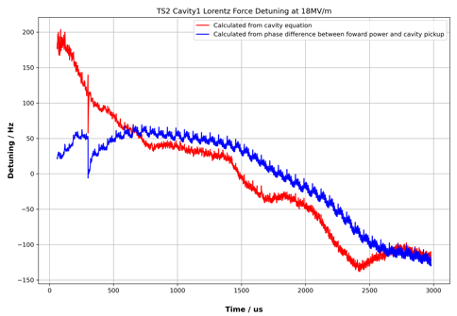
RF-Cavity Basic Parameters and Performance at ESS
Dynamic Detuning over RF pulse and Comparison between Cavity Equation Based Method and Phase Difference Method

Slide 9
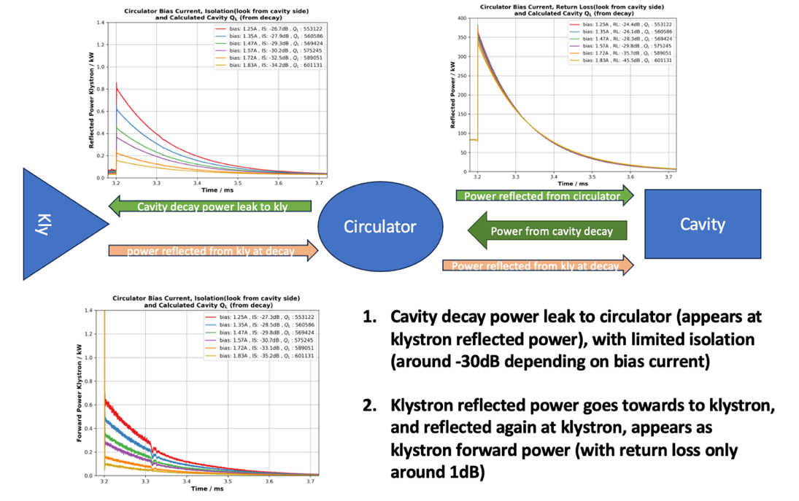
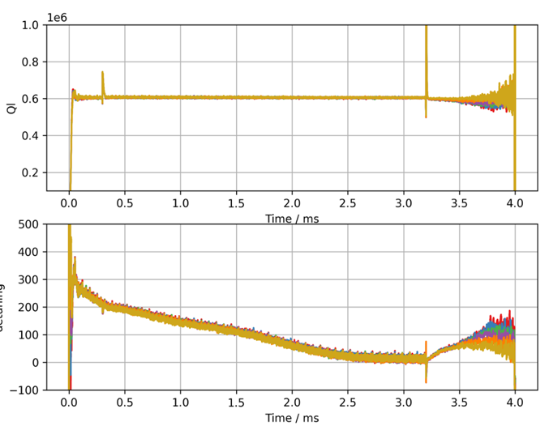
RF-Cavity Basic Parameters and Performance at ESS
Ql Measurement and Comparision between Decay-Based Method and Equation-Based Method
Decay-based method suffering from limited circulator return loss
It is also affected by directivity of directional coupler (not a problem at ESS due to 40dB directivity coupler used)
Cavity equation based method (forwarded power are calibrated) needs a good calibration of Qext at low power

Slide 10
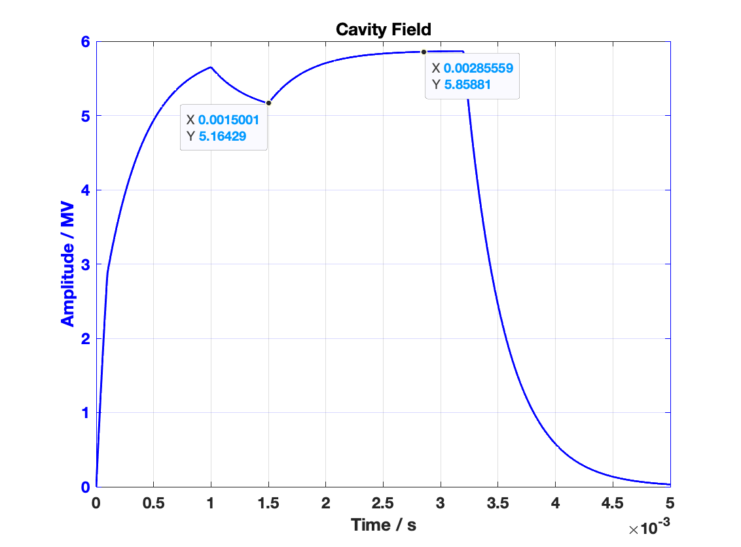

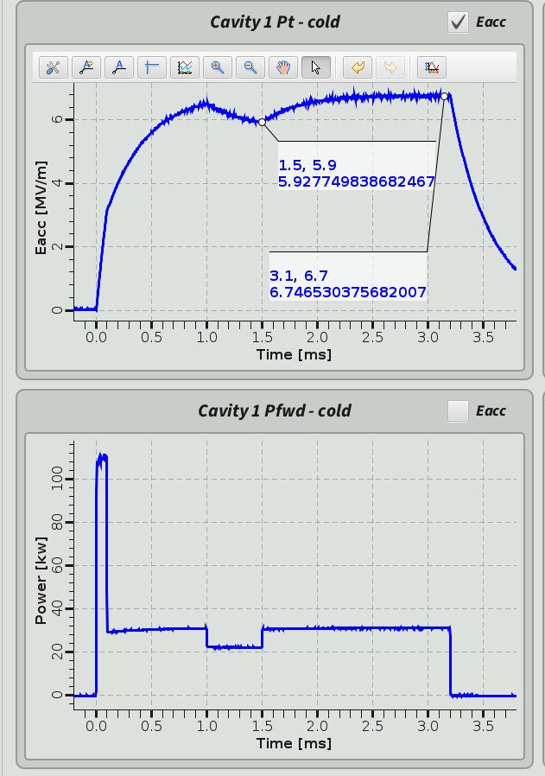
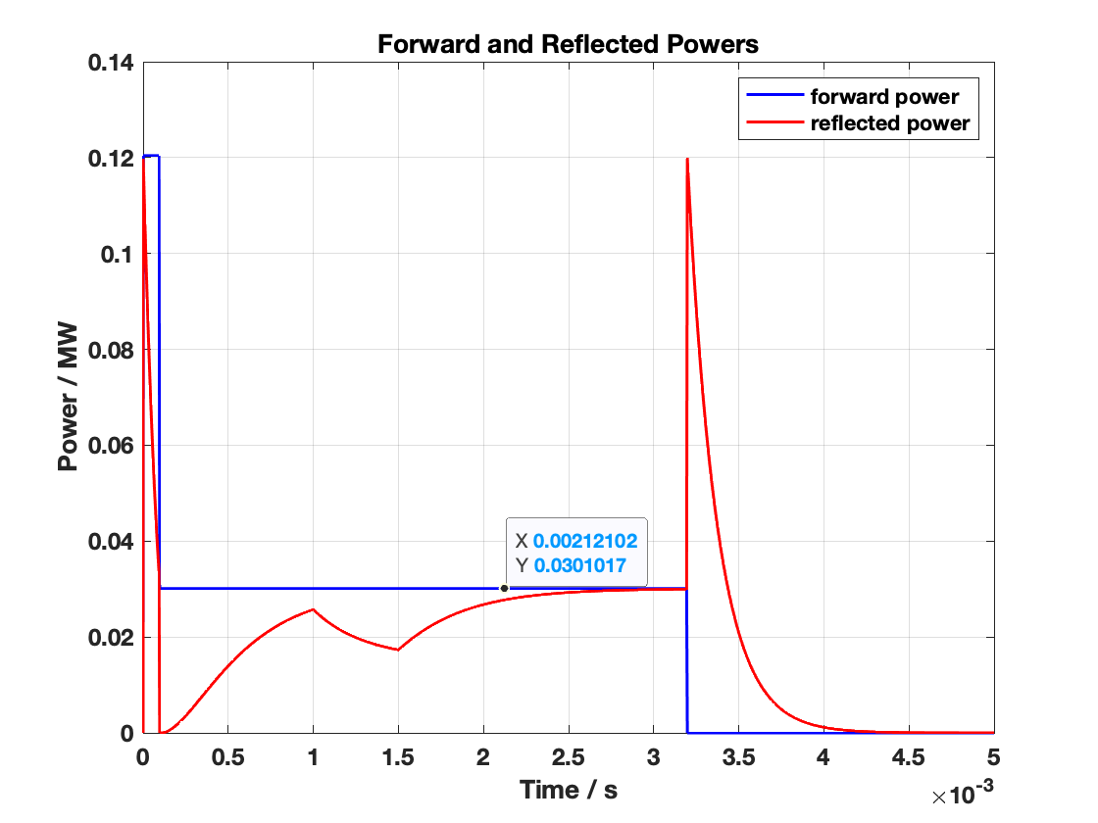
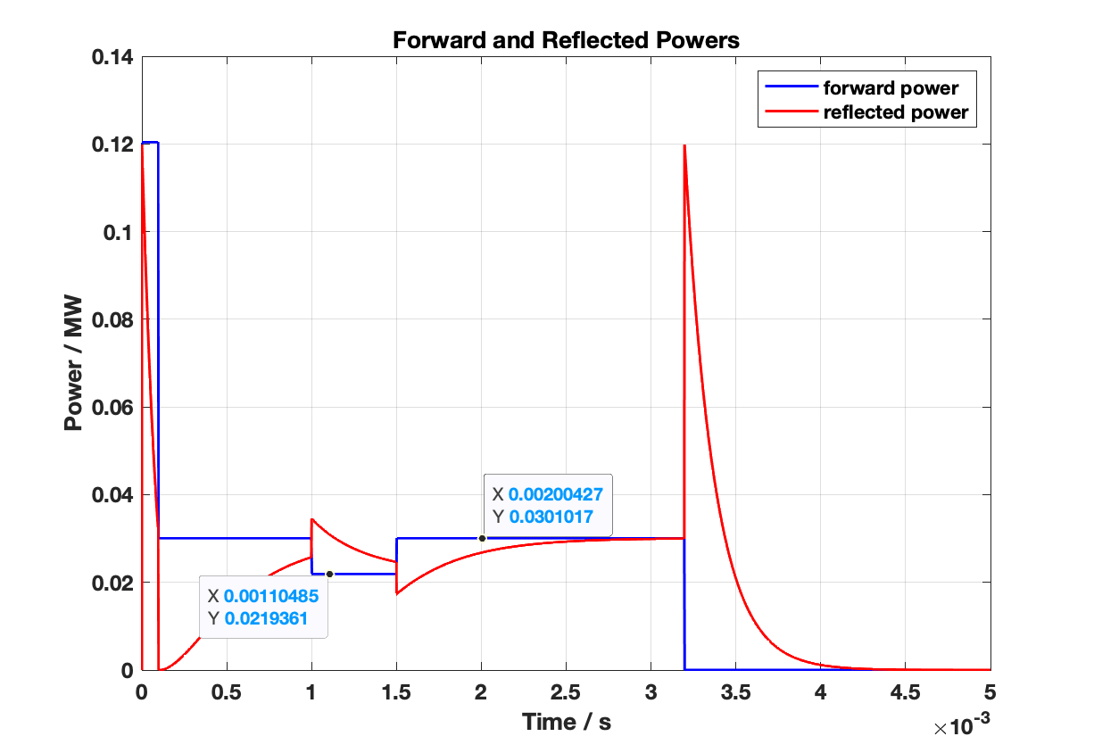
“Simulated” beam in real cavity for R/Q Measurement
Cavity modeling: “beam” injected from other channel
Cavity modeling: “beam” injected from feedforward table
Real cavity: “beam” injected from other channel

Slide 11
Things Get Interesting but Complicated with Beam
V_{c} is the absolute value of line integral of electric field seen by the beam along accelerating axis, which reflects maximum achievable energy gain for beam acceleration
φ_{b} is, for a given particle traversing the cavity, the phase shift from RF phase at which it obtain the maximum energy gain.
R/Q relates stored energy and maximum accelerating voltage acting on the beam, which depends only on cavity shape at a given resonant mode.
They also inter-connect to each other, and almost impossible to take care of only one while seperating the other two.
For proton beam accelerator at low velocity, these parameters affected by beam velocity and bunching length!!!

Slide 12
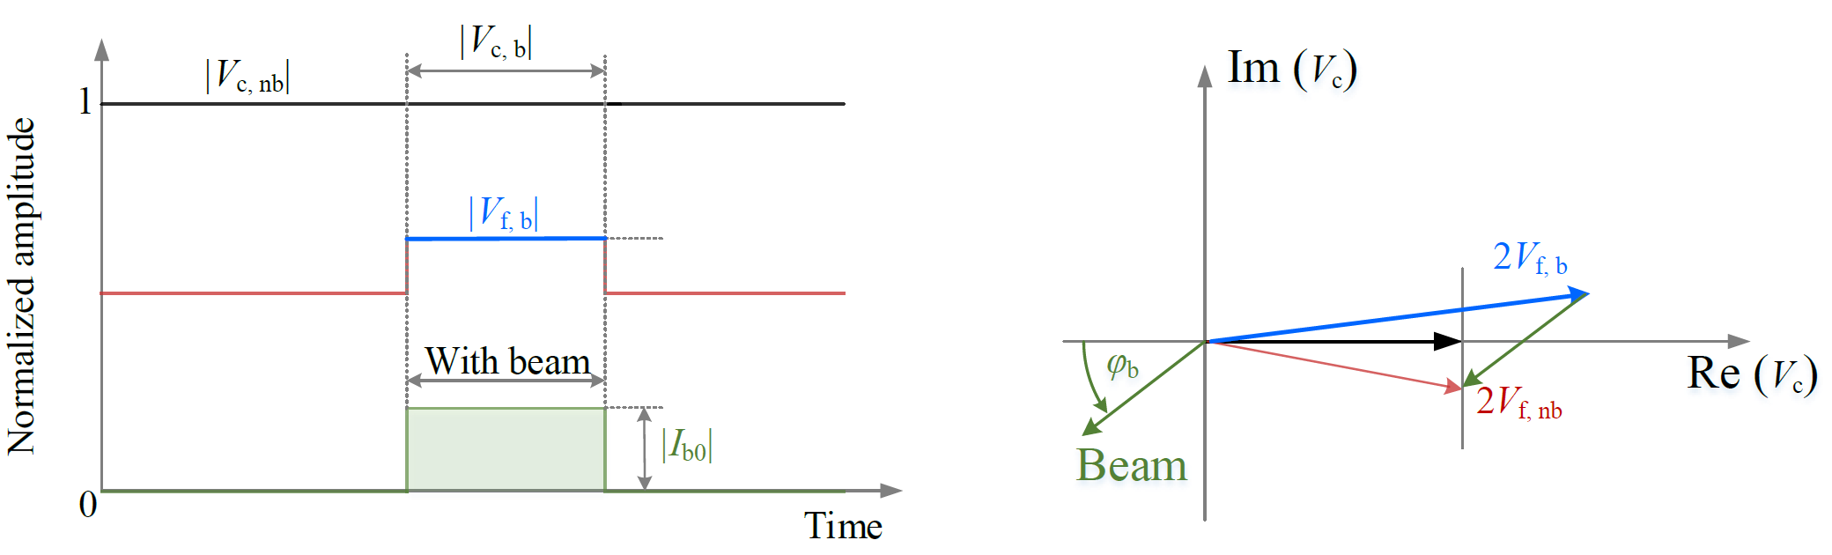
The Solutions for Beam Phase Measurement
Method 1: RF & Beam Vectors in Steady State
2023-10-13
PRESENTATION TITLE / FOOTER

Slide 13
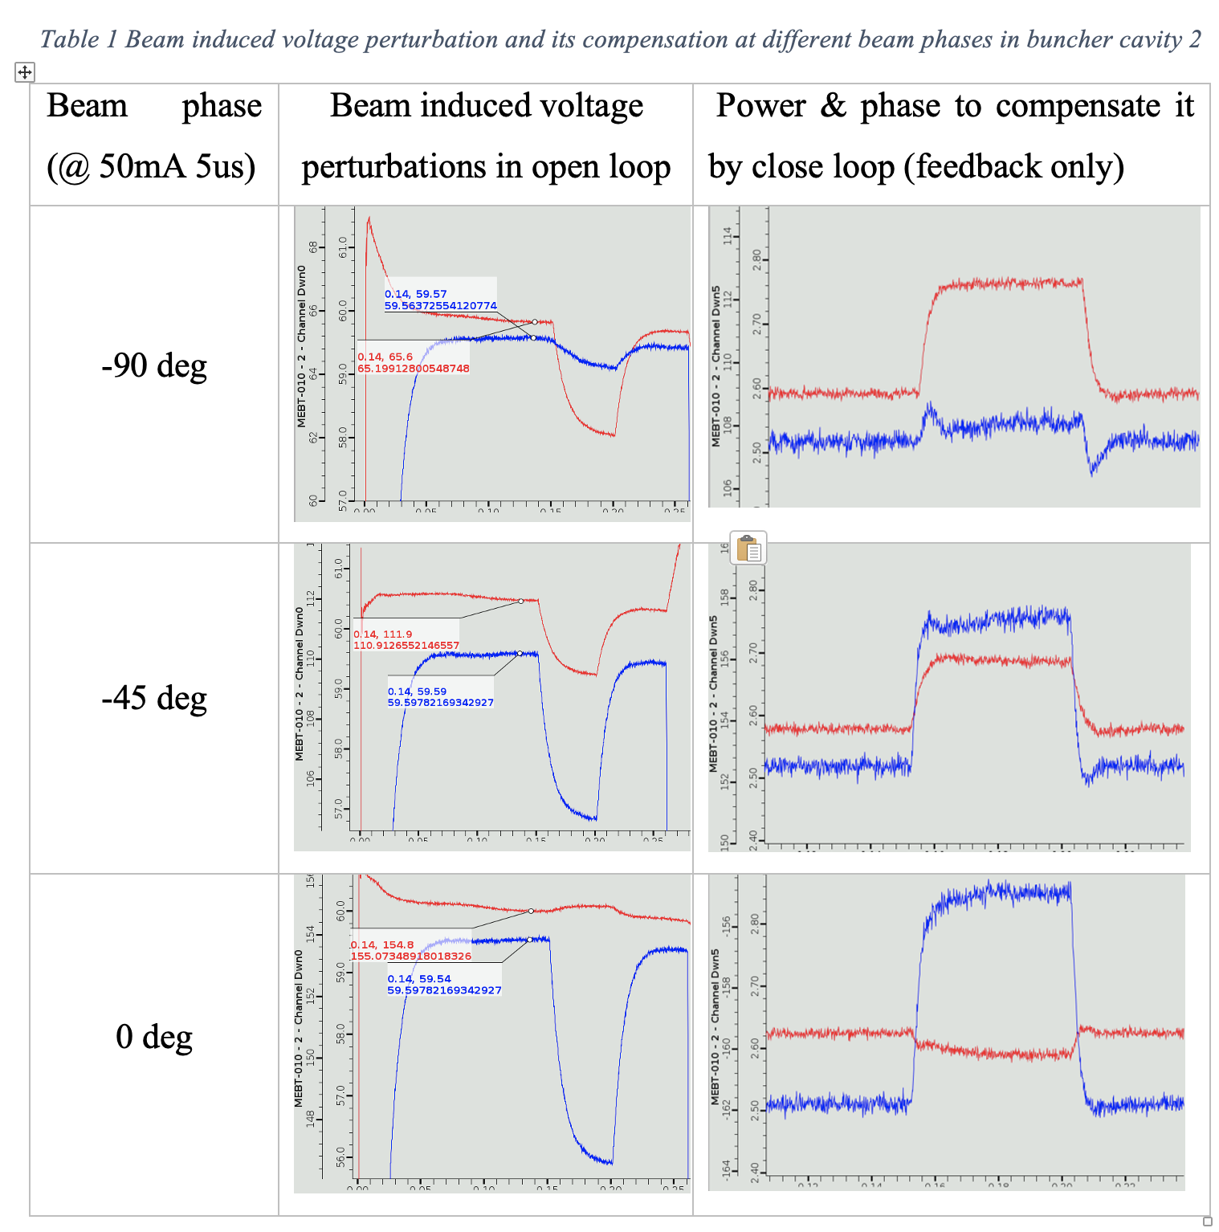

Slide 14
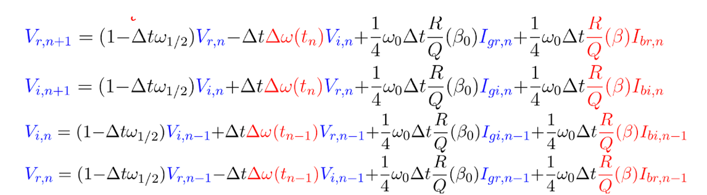
The Solutions for Beam Phase Measurement
Method 2: Differential Equation Based Calculation

Slide 15
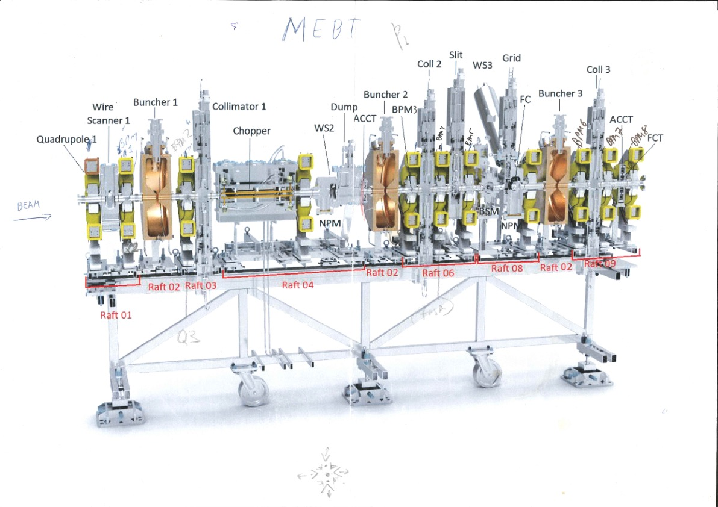
Verification Results on Bunchers
ESS-MEBT

Slide 16
Results on Buncher Cavity
Comparision between two methods and BPM/BCM
2023-10-13
PRESENTATION TITLE / FOOTER

Slide 17
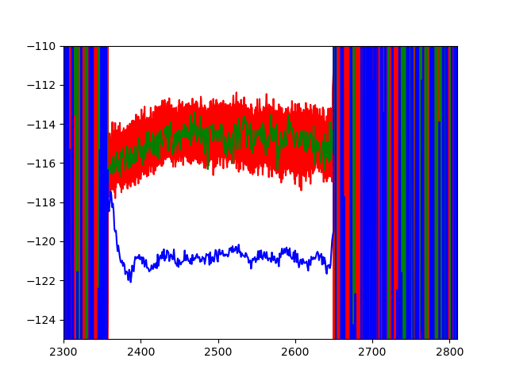
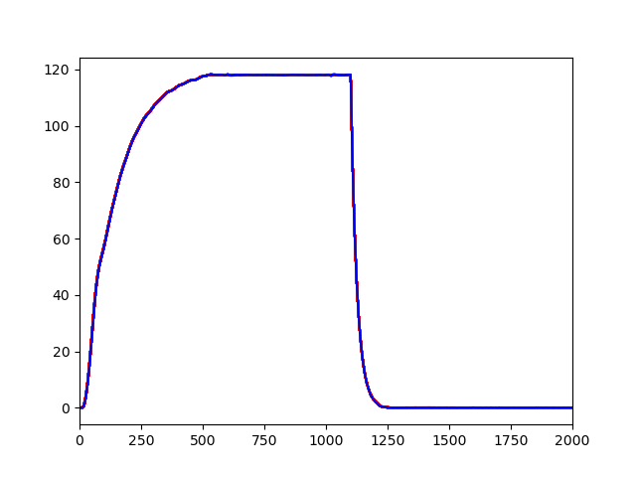
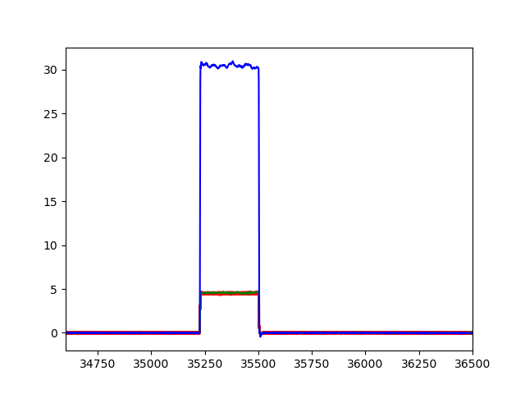
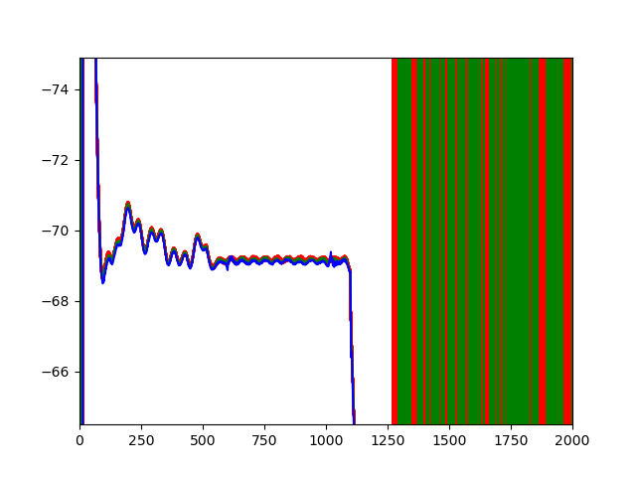
Beam Phase over Pulse and Current
Measurement by BPM/BCM at Output of RFQ
4mA 50us (red&green, 160 pulses 1Hz)
30mA 50us (blue, 1 pulse)
Beam phase measured by BPM very noise at low beam current
RFQ cavity field (100us RF pulse) keeps constant and demotrated fantastic reproducibility over 160 pulses

Slide 18
Beam Phase and Current over Pulse
Result from Differential Equation Based Method and Comparison with BCM/BPM

Slide 19
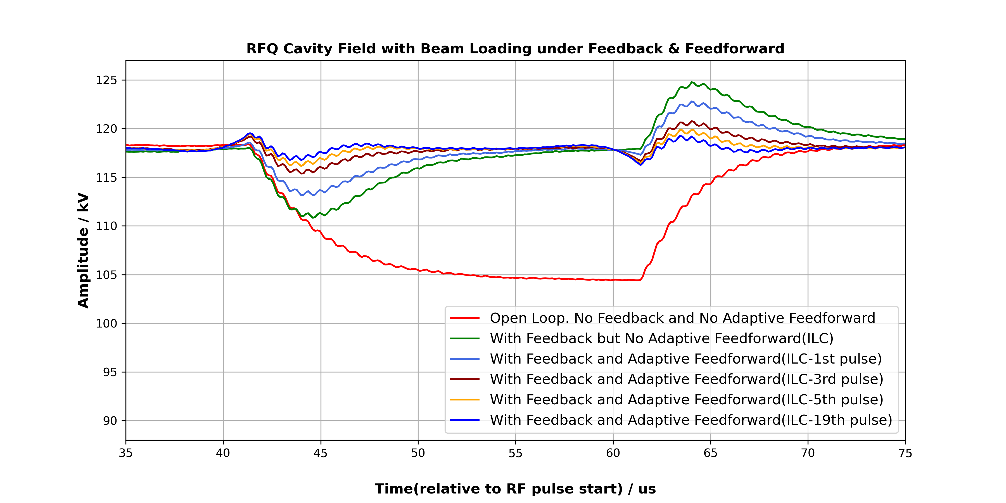
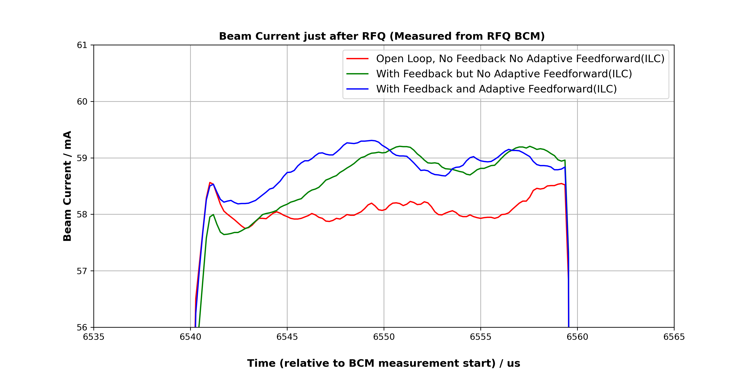
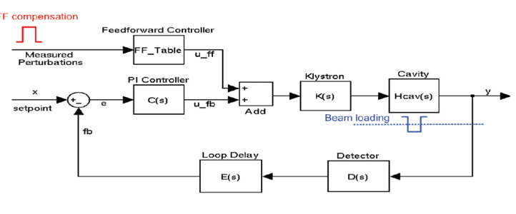
Potential Applications
Beam Loading and its compensation
Beam loading is very hard to fully compensate in NCL, which affects both beam transmission, and beam phase (more than 10 deg beam phase changes observed when adaptive feedorward is not on (feedback only) for RFQ)
Static feedforward is necessary, but knowing beam information in real time (beam current, beam on/off status) is hard

Slide 20
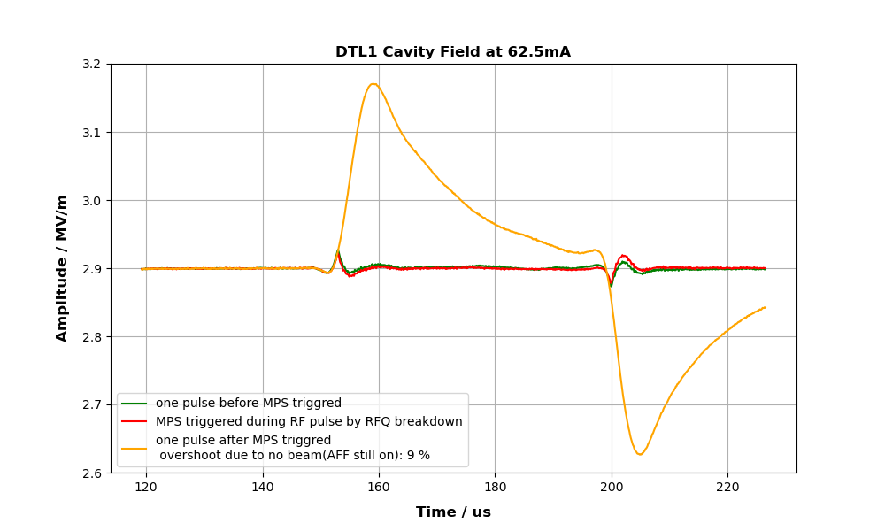
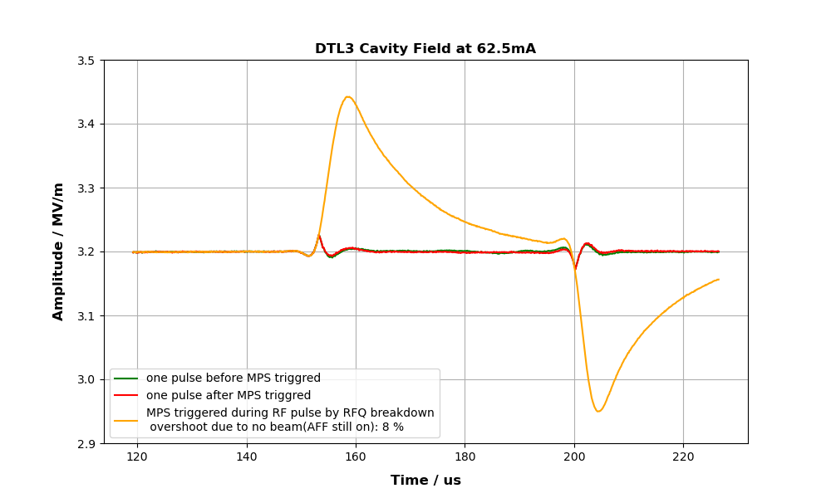
Potential Applications
Beam Trip and Its Recovery
Overshoot at beam on | 62.5mA | 63.5mA
RFQ | 5% | 5%
DTL1 | 9% | 11%
DTL2 | 8% | 8%
DTL3 | 8% | 8%
DTL4 | 7% | 7%
* for SRF cavity, simulated beam tried in TS2 and overshoot ~5% in 20mA
Challenging for multiple cavities/cryomodules operation
                Re-synchronization and phase and energy-gain control
    Complex feedback and adaptive feedforward dynamics and reconfiguration
Cascading effect of overcompensation and instability in downstream cavities
Ability to detect beam trip, disclose beam information (status, phase, current, energy gain, etc) is essential (being developed at ESS)
2023-10-13
PRESENTATION TITLE/FOOTER

Slide 21
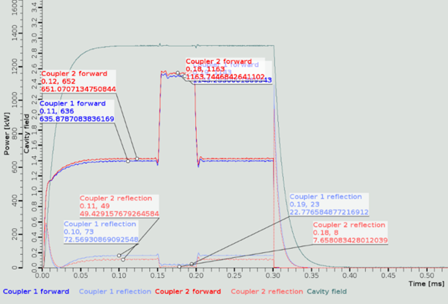
Potential Applications
Energy Gain and Power Transfer between Beam and Cavity
 | DTL1 | DTL2 | DTL3 | DTL4
Measured power delivered to beam / kW | 1113 | 1169 | 1075 | 1096
Design power for beam energy gain / kW | 1103 | 1113 | 1103 | 1103
Discrepancy between measurement and design | 0.91% | 5% | -2.5% | -0.6%
Powerful diagnostics for beam energy gain during commissioning and operation
                Easy to implement (but need to know beam current in advance!)
                Precise RF power calibration are extremely important here
                Can be used for cross-checking RF based power calibration
                Useful in re-configure the linac in fast-fault recovery
2023-10-13
PRESENTATION TITLE/FOOTER

Slide 22
Potential Applications
Pioneering Innovative Accelerator Applications
Beam Induced Voltage, Bunch Length and Beam Velocity
In close loop, beam induced voltage is an indirectly measurement ( but can be compared with direct measurement in open loop)
Essential parameter to reveal deep beam and cavity longitudinal interaction
Synchronous Phase Origination, Evolution and Synchronicity Condition
For efficient acceleration particles must be synchronized with the rf fields. The distance between the center of two adjacent gaps must be equal to the travel time of the particles from one gap to the next.
understand evolvement of synchronous phase along the accelerator
identify effective method to determine range of operating parameters where meets synchronous condition
Effects of Other Factors on Beam-Cavity Interactions
Nonlinear effect problem
Cavity structure design
Beam injection method
Accumulated instabilities caused by sequential interactions of beam with perturbations, detuning, phase jitters, and high order modes from multiple cavities
2023-10-13
PRESENTATION TITLE/FOOTER

Slide 23
Looking Ahead: The Short Term
Preparation for Next Beam Commissioning
Integrated Test to Identify System Limit and Operation Boundary
More than 60 cavities will be under running at next beam commissioning, RFQ, bunchers, DTLs, spokes and medium beta cavities.
Basic RF-cavity parameters in different operation scenarios (low duty cycle, high duty cycle, open loop, close loop, etc).
Interlocks and security testing.
Fault and recovery testing
Cavity data without beam
Cavity medium level IOC and high-level application framework
Development of common tools, shared libraries, and medium level software interfaces.
Development of high-level application framework.
Integrate cavity data collecting, processing tools and waveform analyzing application into the framework
Based on Python
Migrating Cavity State-Space Model to Python and Simplified Longitudinal Cavity-Beam Model
General cavity state-space model in Matlab for all type of cavities: RFQ, Bunchers, DTLs, Spoke, and Elliptical Cavities. It has been challenged many times over RF conditioning/beam commissioning, but physics stands ): .
Simplified longitudinal cavity-beam interaction model (from SPL project) is available in C (based on CERN framework root), which was developed for investigating instabilities caused by high order modes in SCL linac.
Plan to migrate to python so as to be integrated into high-level framework

Slide 24
The Long Term
Cavity Datasets, Cavity Modeling with Beam, and AI
Waveform data array collected in high resolution and real time, captures a wealth of and provides timey and continuous time-domain details of interaction between systems
data archiving for waveform data-arrays: significant effort have been made by ICS and network Infrastructure team at ESS
For cavity and RF studies, more than 200GB waveform data saved and sorted during last beam commissioning up to DTL4, including BPM, BCM, RF forward, reflected, and cavity field waveforms
Open cavity dataset?
Combination of large data arrays and physics models leverages the strengths of empirical observations and theoretical understanding, which is the case for cavity-state-space model for single cavity with ideal beam.
For hundreds of cavities, together with hundreds of beam diagnostics, data-driven model assisted by AI technology might be a feasible way.
identify empirical relationships that may not be immediately apparent through physics-based approaches
optimize model parameters to minimize the difference between model predictions and observed data, leading to improved model accuracy.
identify correlations and dependencies within data
Anomaly detection
…..

Slide 25
Thanks!

