Slide 1



Preliminary Design
of Scalable Hardware Integrated Platform
for LLRF Application
Tao Xue
Lin Jiang、Jingjun Wen、Jingjun Wen Haoyan Yang、Qiutong Pan、Bo Liang、Liangjun Wei
Jianmin Li、Yinong Liu
Department of Engineering Physics, Tsinghua University
2023/10/24

Slide 2
Outlines
Background and motivation
The architecture of SHIP4LLRF
Hardware design and challenges
Hardware performance test
Summary and prospect

Slide 3
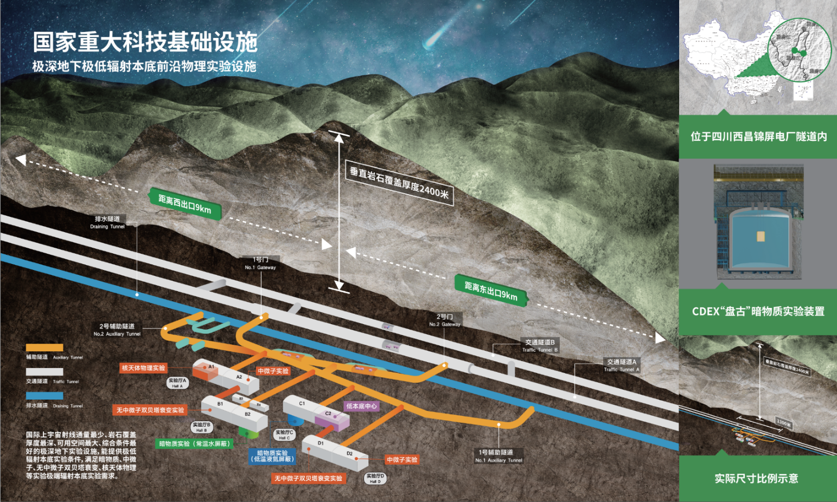
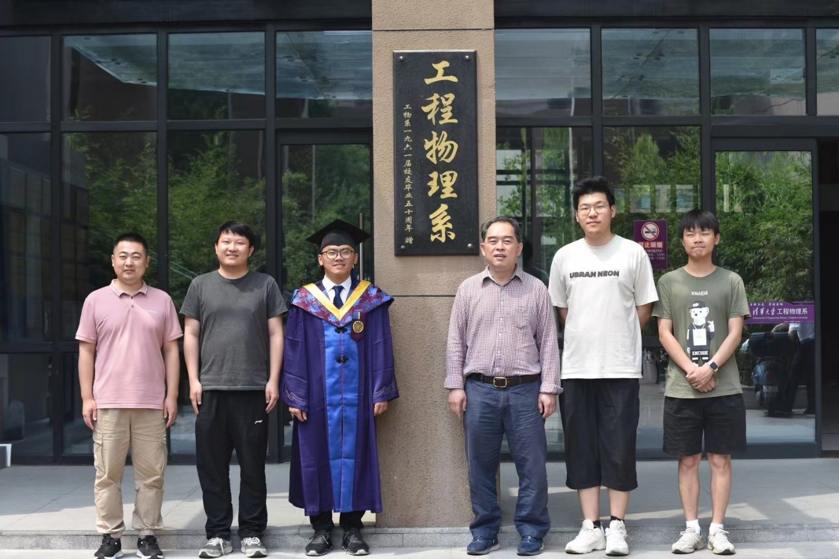
Background
Who am I ?
The main research of our group is focusing on development of high-speed/high-precision pulse digitization and readout electronic systems for cutting-edge physics experiments.
Such as the CDEX experiment, which aims to search for dark matter in the low energy region and observe neutrino-less double beta decay.
And the Jinping Neutrino Experiment, whose main goal is to observe solar/earth neutrinos in the MeV energy region.
Notes:
The main research direction of our group is the development of high-speed and high-precision readout electronic systems for cutting-edge physics experiments.
Such as the CDEX experiment, which aims to search for dark matter in the low energy region and observe neutrino-less double beta decay. And the Jinping Neutrino Experiment, whose main goal is to observe solar neutrinos in the MeV energy region.

Slide 4
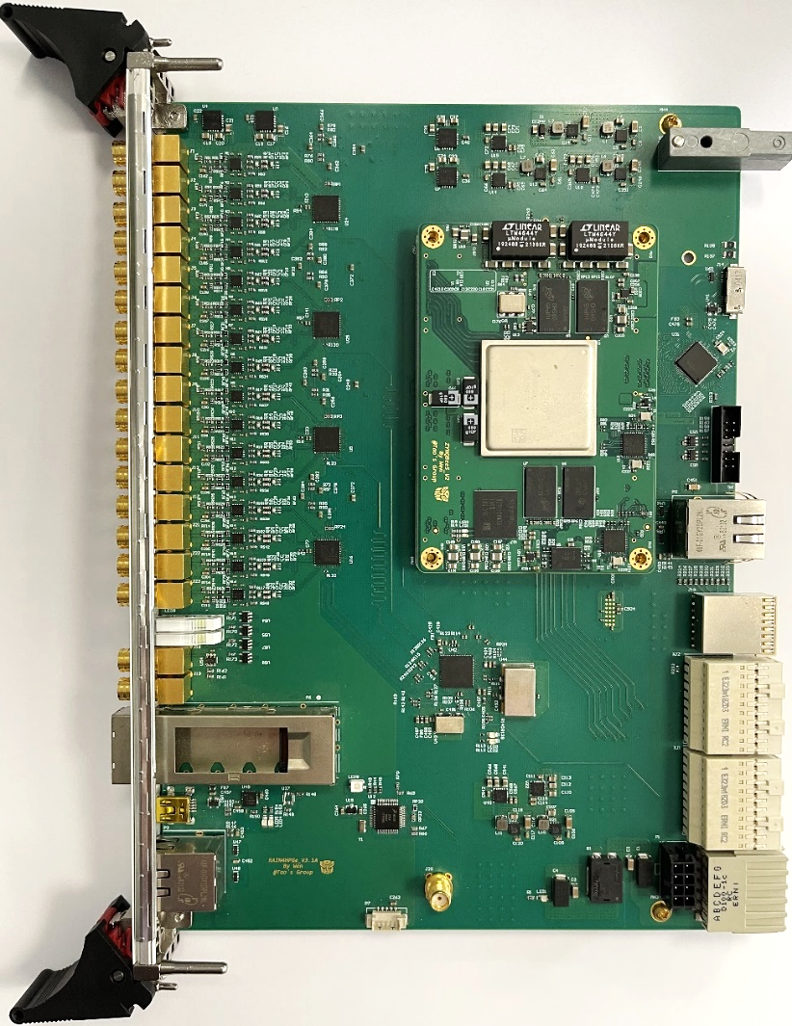
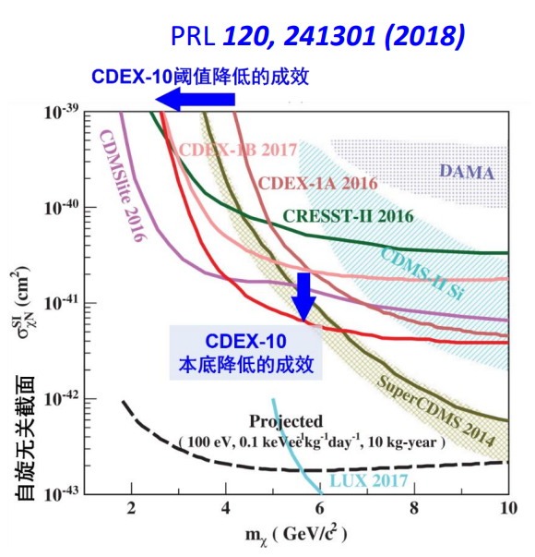
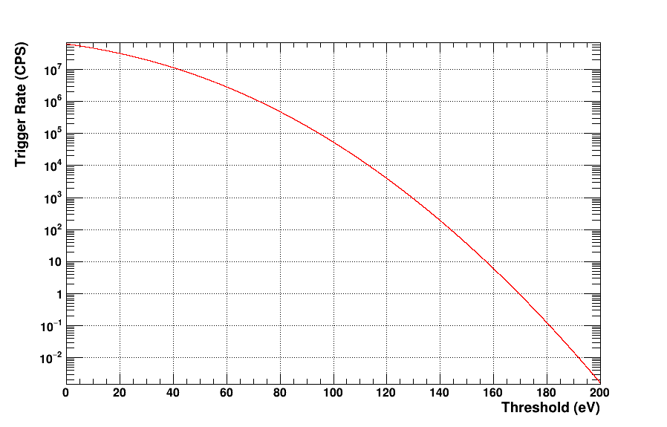
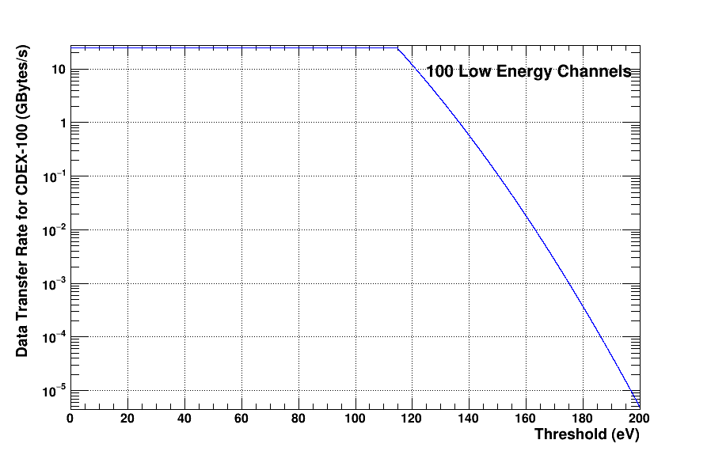
Background
CDEX：Direct detection of dark matter
WIMP (Weakly interacting massive particle) detection
HPGe detector ROI：0~20 keV
Experimental key
  Background
  Detection threshold
  Exposure
CDEX Current situation and goals：
  Background：2 cpkkd → 0.01 cpkkd @1keV
  Data analysis threshold：160 eV → 100 eV
  CDEX-10 → CDEX-50 → CDEX-300，10kg ∙ year → 50kg ∙ year → 300kg ∙ year
  Waveform digitizer：125MSps/16-Bit 1800 channels/1GSps/12-Bit 600 channels
Lower detection threshold
  Reduce the noise contribution of ASIC preamplifier and readout electronic systems
  “Trigger-less” readout
  Complex digital filtering method and neural network online trigger selection
  High bandwidth readout electronics system
Noise false trigger rate vs. energy threshold
Data transmission bandwidth vs. energy threshold
Notes:
In the CDEX experiment, we use high-purity germanium detectors to detect dark matter in the low-energy region. The detection threshold is one of the keys to the experiment.
In response to the current situation where system noise has reached an almost irreducible level, we propose trigger-less readout, which is based on high-bandwidth readout electronics and combined with online complex filtering algorithms to complete the extraction of weak signals.

Slide 5
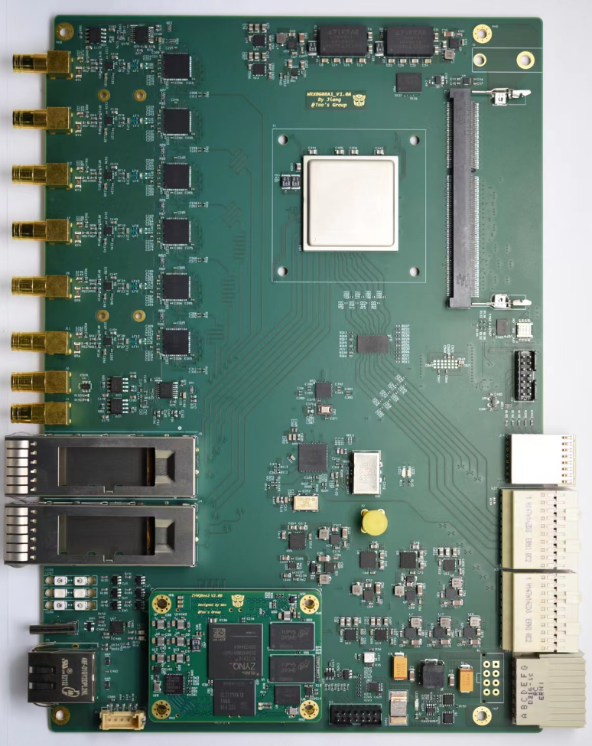
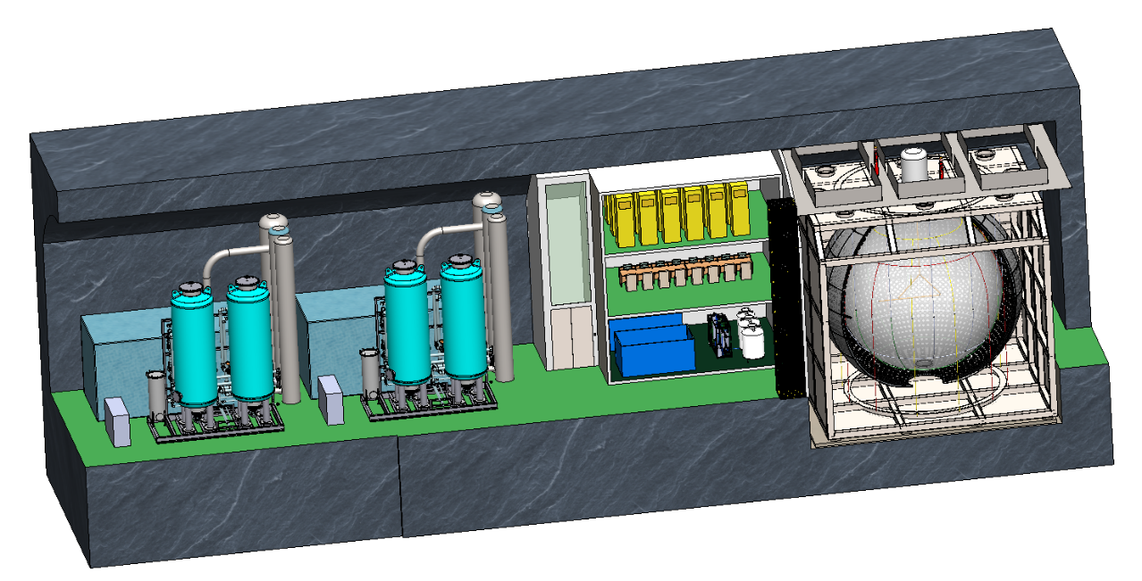
Background
Jinping Neutrino Experiment: MeV-level solar neutrinos, Earth neutrinos and supernova remnant neutrinos
Doped (Li) liquid scintillation/other target materials
Experimental key
  Neutrino energy spectrum
  Detect media type and volume
  High-speed, high-bandwidth multi-channel
  readout electronics
  Current status and goals of Jinping Neutrino Experiment：
  Liquid scintillation quality：1-ton → Hundred tons（2026） → Kilo-tons
  PMT：30 → 2000~4000（diameter:20cm）
  Waveform digitizer：1Gsps/12-Bit 4000 channels
  Trigger and clock synchronization ：sub-ns
Trigger mode
  multiplicity trigger
  “Trigger-less” readout
  Vertex reconstruction
  Neural network time reconstruction
  Neural network energy reconstruction
Notes:
For the Jinping neutrino experiment, thousands of channels of readout electronics system put forward requirements for the triggering method.
Traditional multiplicity triggering methods cannot obtain lower energy signals. Likewise, bringing all data together in a trigger-less method and running high-level triggering algorithms can help us with physics-centric triggering

Slide 6
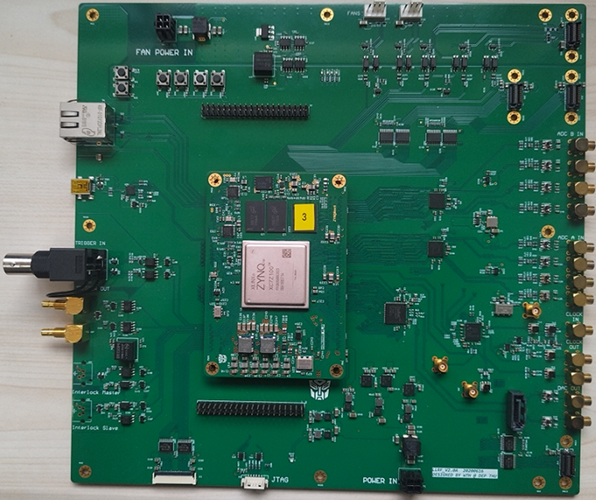
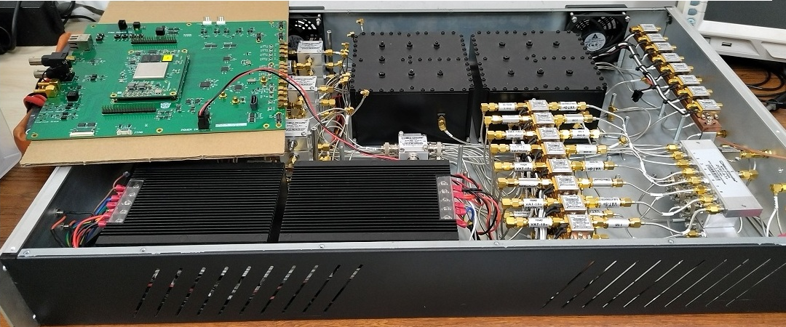
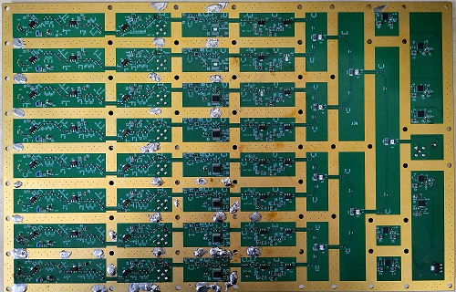
Motivation
From 2020 to 2023
We also contribute some hardware/firmware to demand of LLRF from the Accelerator Laboratory in our department
  Development of Low-Level RF system for VHF electron gun test platform in Tsinghua University
  LLRF is implemented based on the ZYNQ module as same as the readout electronics for Dark Matter and Neutrino related experiments
  Amplitude stability: 0.0041%
  Phase stability: 3.01 fs, 0.0014 degrees
Notes:
In terms of LLRF application, we have currently completed a high-precision synchronized low-level system for VHF electron gun test platform, which based on ZYNQ7Z100.
Actual test results show that the amplitude stability can reach: 0.0041% and the phase stability can reach: 3.01 fs, 0.0014 degrees

Slide 7
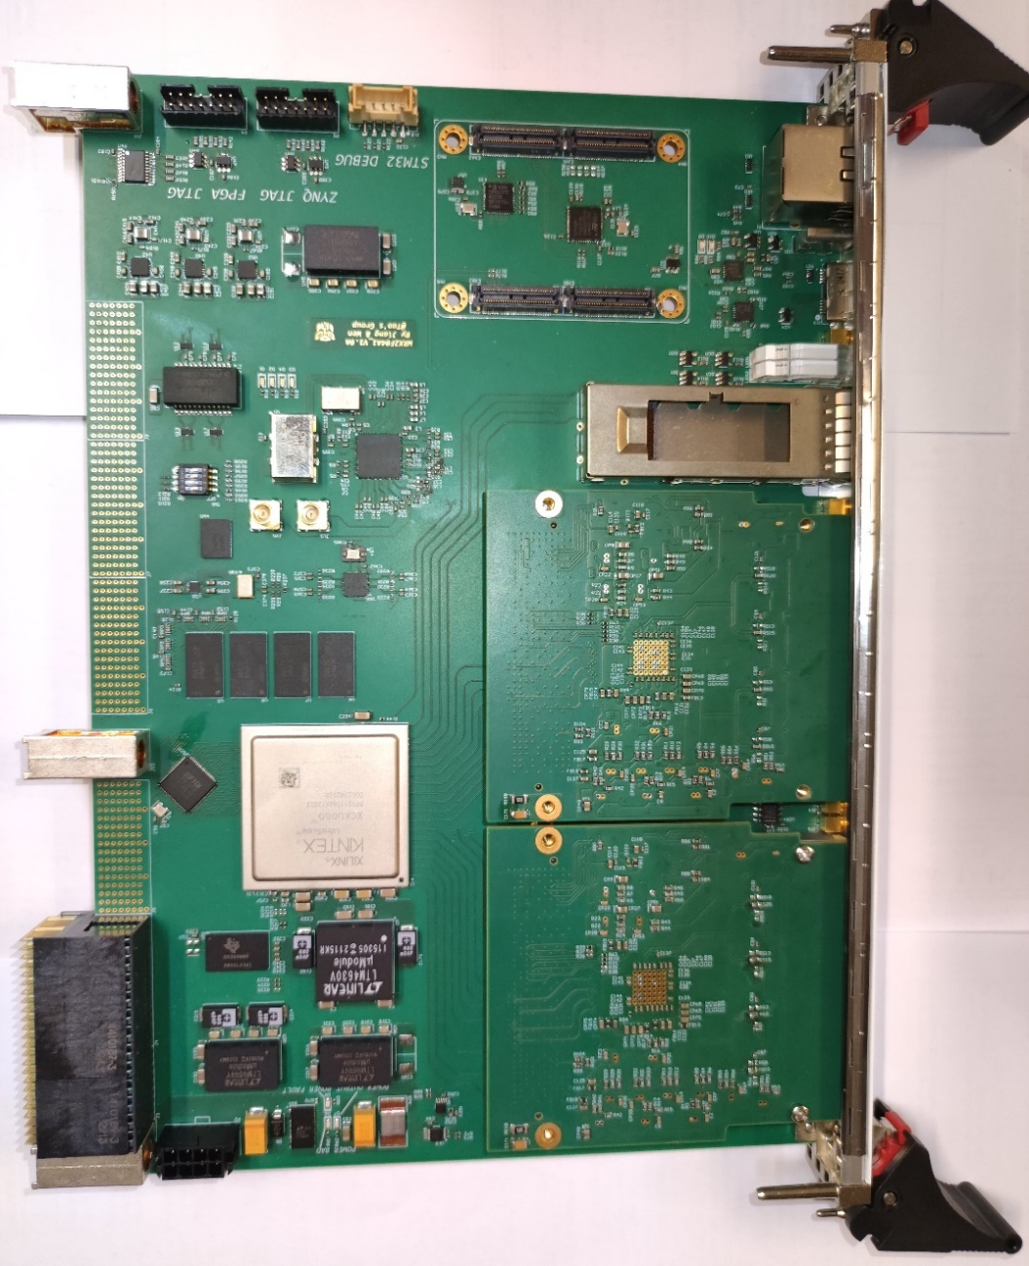
Motivation
A more dedicated Platform for LLRF/BPM is preferred.
Some advanced and demonstrated technology and architecture are preferred.
In the future
  More channels (such as 200 LLRF modules)
  Higher readout and data exchange bandwidth (up to 25/100Gbps)
  Higher sampling rate and sampling accuracy (1GSPS/16-Bit)
  Clock synchronization
  A more flexible test/verify platform for ADC/DAC and RF sub-system
 | GTY (32.75Gbps) | GTH （16.3Gbps） | DSP Slice | LUTs (k) | DDR
Kintex UltraSCALE KU060 | -- | 28 | 2760 | 331.68 | DDR4 2400MHz 19.2GB/s
Vertex UltraSCALE+ VU37P | 96 | -- | 9024 | 1340 | HBM (8GB) 460GB/s
Notes:
However, we hope to design more complex and higher performance LLRF systems
Such as large LLRF system with up to 200 channels;
Higher readout bandwidth (up to 100Gbps)
Higher sampling rate and sampling accuracy (1GSPS/16-Bit)
Clock synchronization within the system
A more flexible testing platform

Slide 8
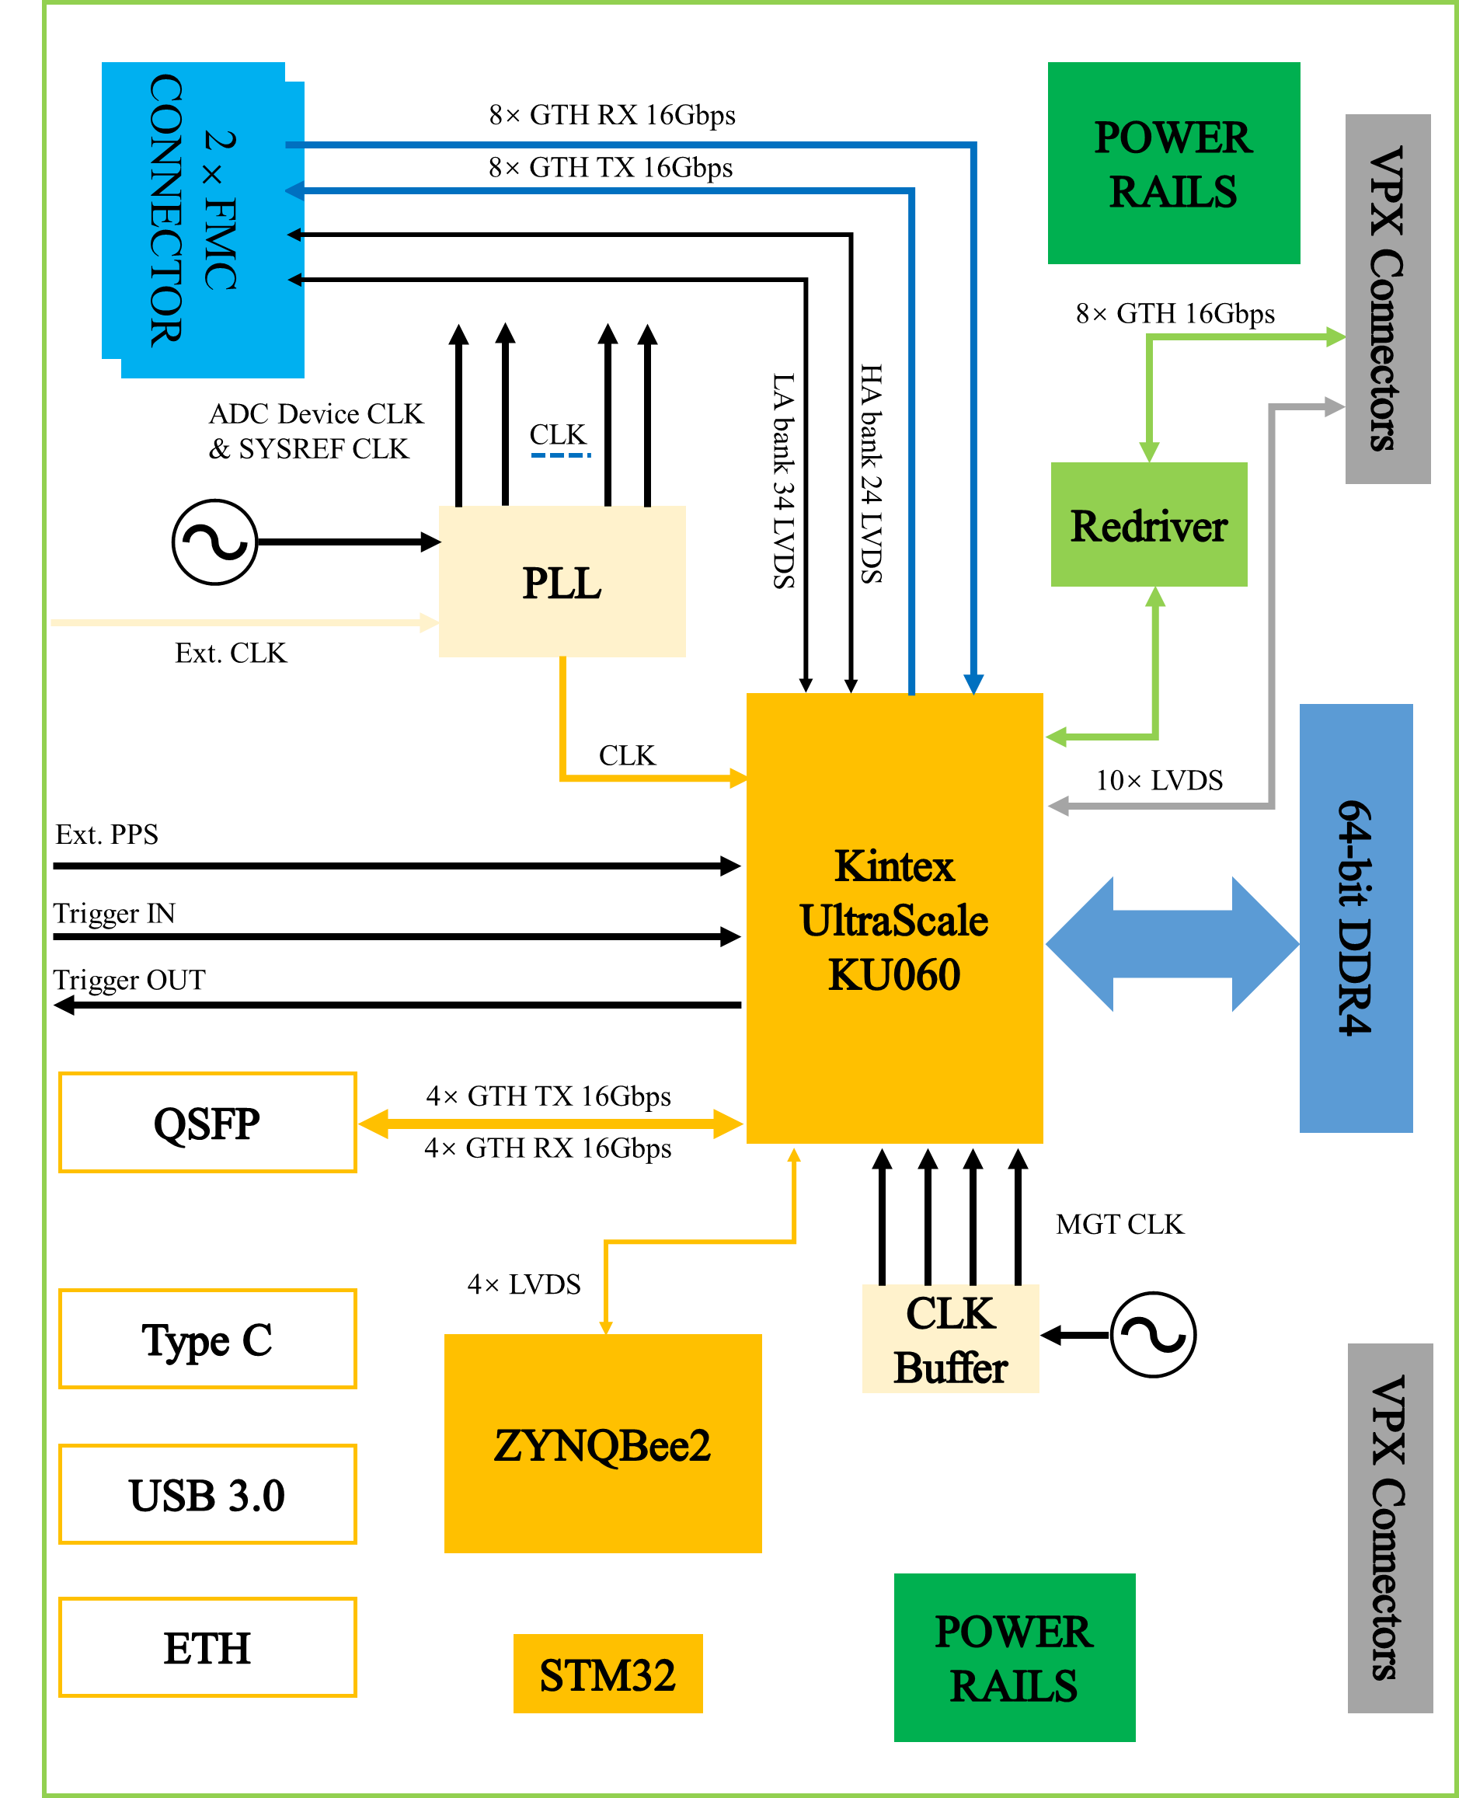
2. The architecture of SHIP4LLRF
Basic
  FMC mezzanine card + FPGA carrier board
  Kintex Ultrascale KU060
  LMK04828 jitter cleaner for JESD204B subclass 1
  2×FMC connectors
  4GB 64-bit DDR4 SDRAM
  ZYNQBee2 module based on ZYNQ7010 for Slow Control
  STM32 for board bring-up
Readout
  USB3.0 (read and write speed>2.8Gbps)
  8 pairs of GTH high-speed transceiver links on the backplane (16Gbps)
  Front panel QSFP interface (40Gbps)
Slow control
  ZYNQBee2 module
  Front panel Ethernet and Type-C interfaces
  External input reference clock and PPS signal
  Trigger input and trigger output
Notes:
This PPT page shows The architecture design of SHIP4LLRF ( Scalable Hardware Integrated Platform for LLRF )
We adopt the design architecture of FMC mezzanine card + FPGA carrier card
The main control chip is based on Xilinx's KU060, and the clock scheme is based on LMK04828 jitter cleaner
The ZYNQBee2 module based on ZYNQ7010 is used for slow control
In addition, the system has rich readout interfaces, including USB3.0, backplane GTH transceiver and front panel QSFP interface

Slide 9
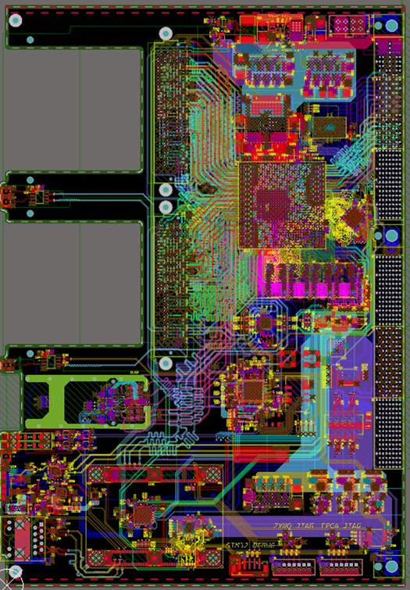
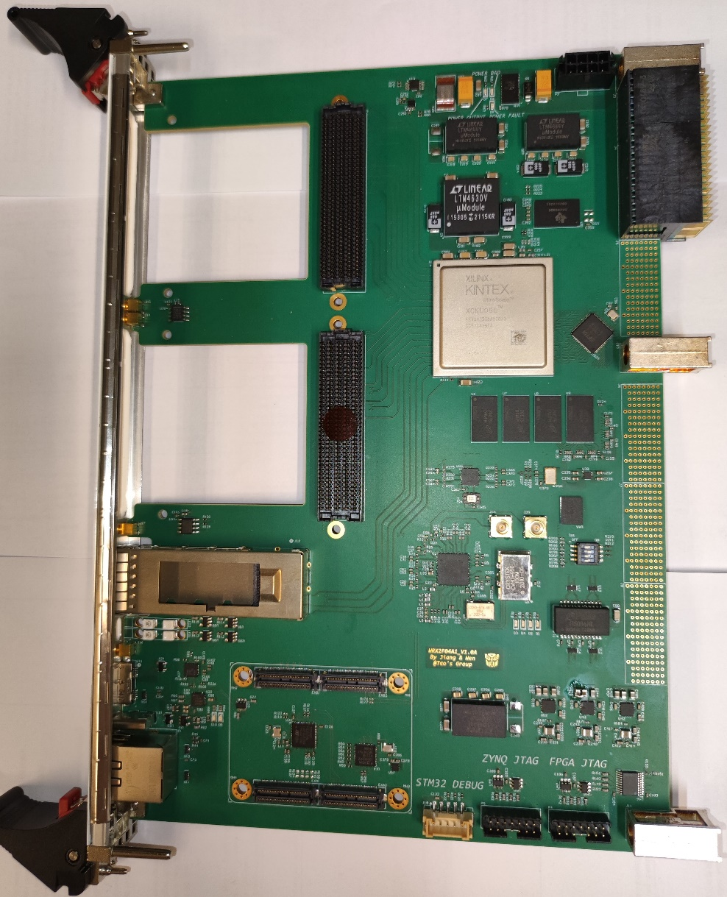
3. Hardware design and challenges
  6U-VPX standard as reference
  160×233.35 mm
  FMC mezzanine card + FPGA carrier card
  16-layers via-in-pad
  Each FMC mezzanine card is allocated 58 pairs of LVDS IO
  Each FMC mezzanine card is assigned 16 pairs of GTH transceivers

Slide 10
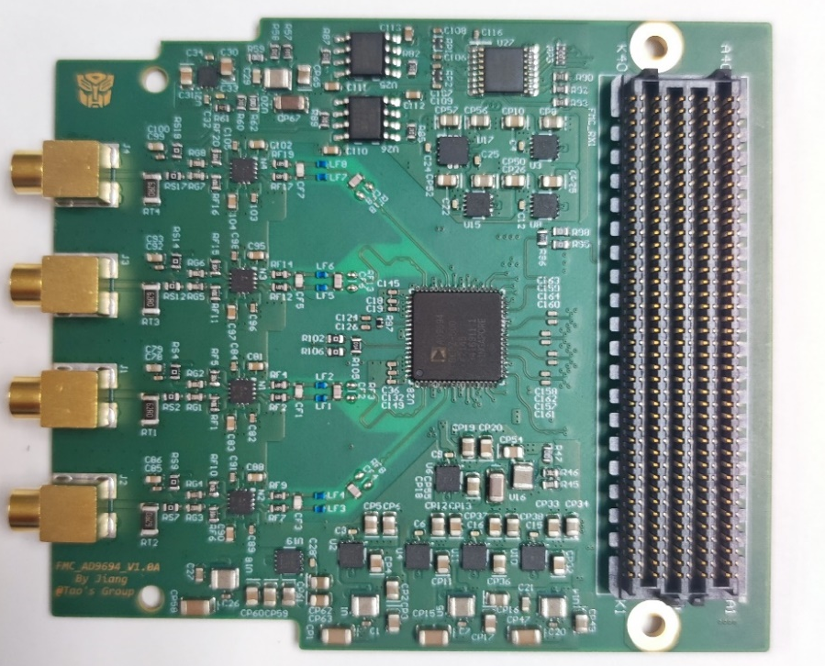
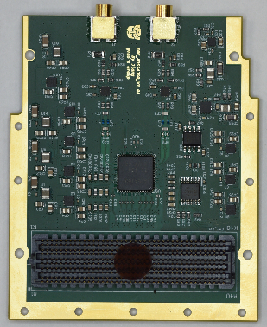
3. Hardware design and challenges
FMC/ADC developed for SHIP4LLRF
500MSPS ADC FMC mezzanine card
  Based on ADI AD9694
  4-chs, 500MSPS, 14-Bit
  JESD204B standard
1GSPS ADC FMC mezzanine card
  Based on TI ADS54J60
  2-chs, 1GSPS, 16-Bit
  JESD204B standard
10GSPS ADC FMC mezzanine card
  Based on TI ADC12DJ5200RF
  2-chs, 5GSPS, 12-Bit
  1-ch, 10GSPS, 12-Bit
  JESD204B standard

Slide 11
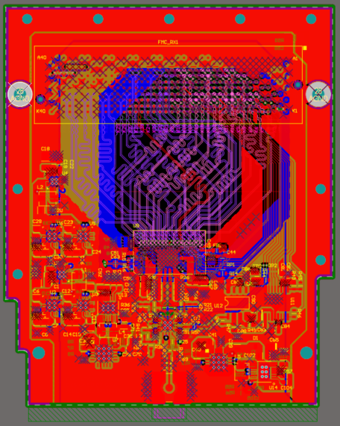
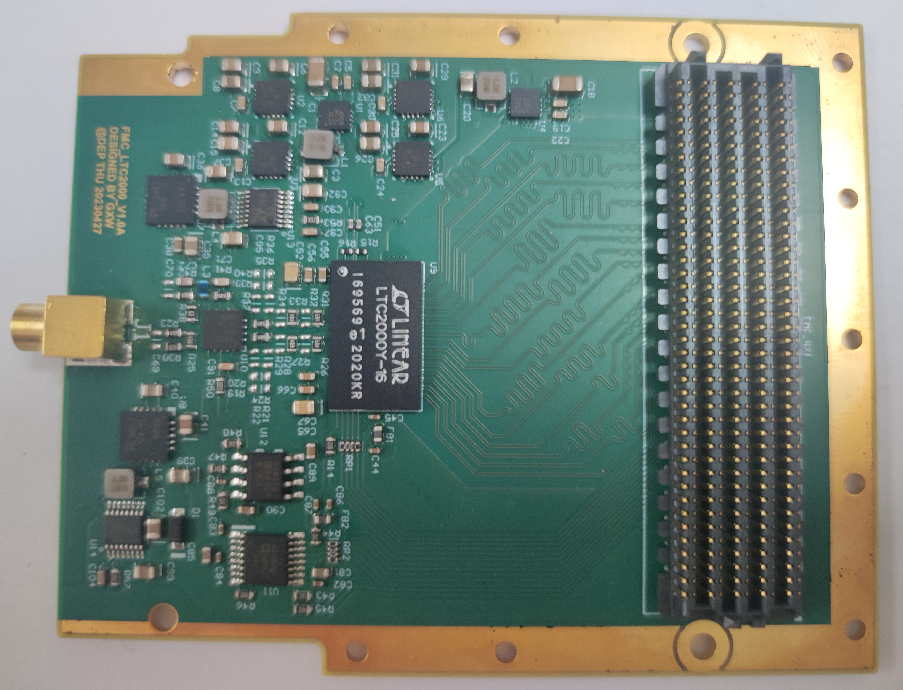
3. Hardware design and challenges
FMC/DAC developed for SHIP4LLRF
2.5GSPS DAC FMC mezzanine card
  Based on ADI LTC2000-16
  1-chs, 2.5GSPS, 16-Bit
  LVDS standard

Slide 12
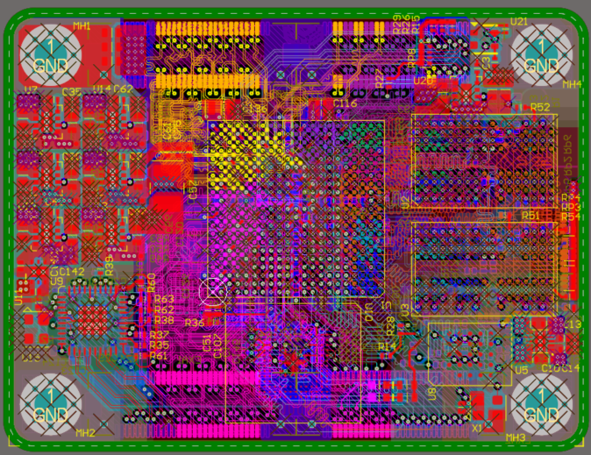
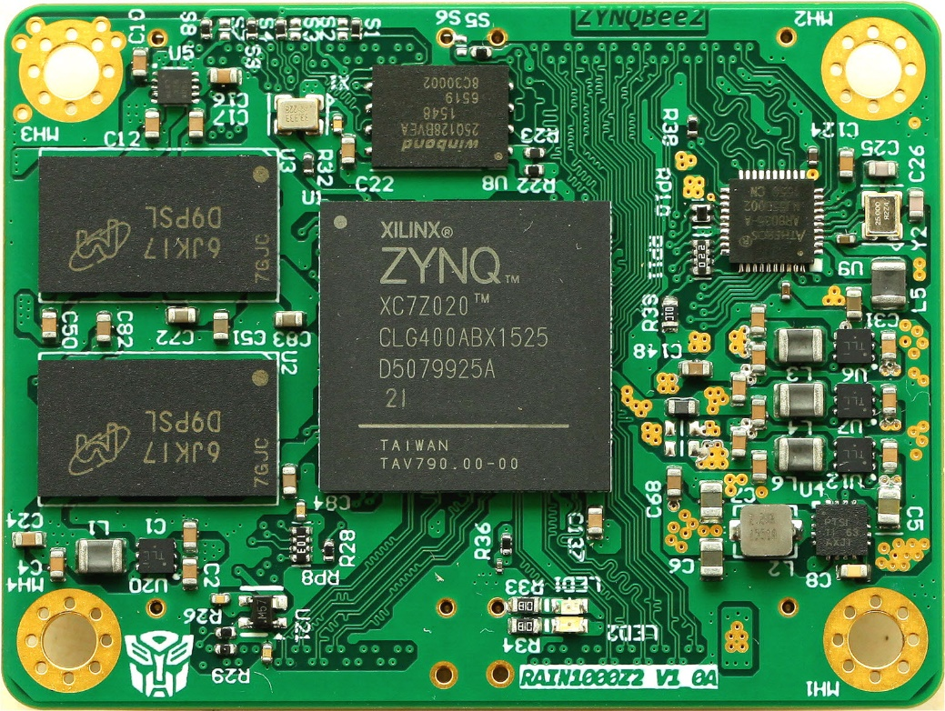
3. Hardware design and challenges
ZYNQBee2 module
  Based on Xilinx ZYNQ7010
  1GB DDR3 SDRAM
  ADIN1300 Gigabit Ethernet transceiver
  32MB flash
  16GB eMMC
  48 pairs of LVDS IO
  14-layers
  55.2×41.6 mm
  For slow control such as EPICS

Slide 13
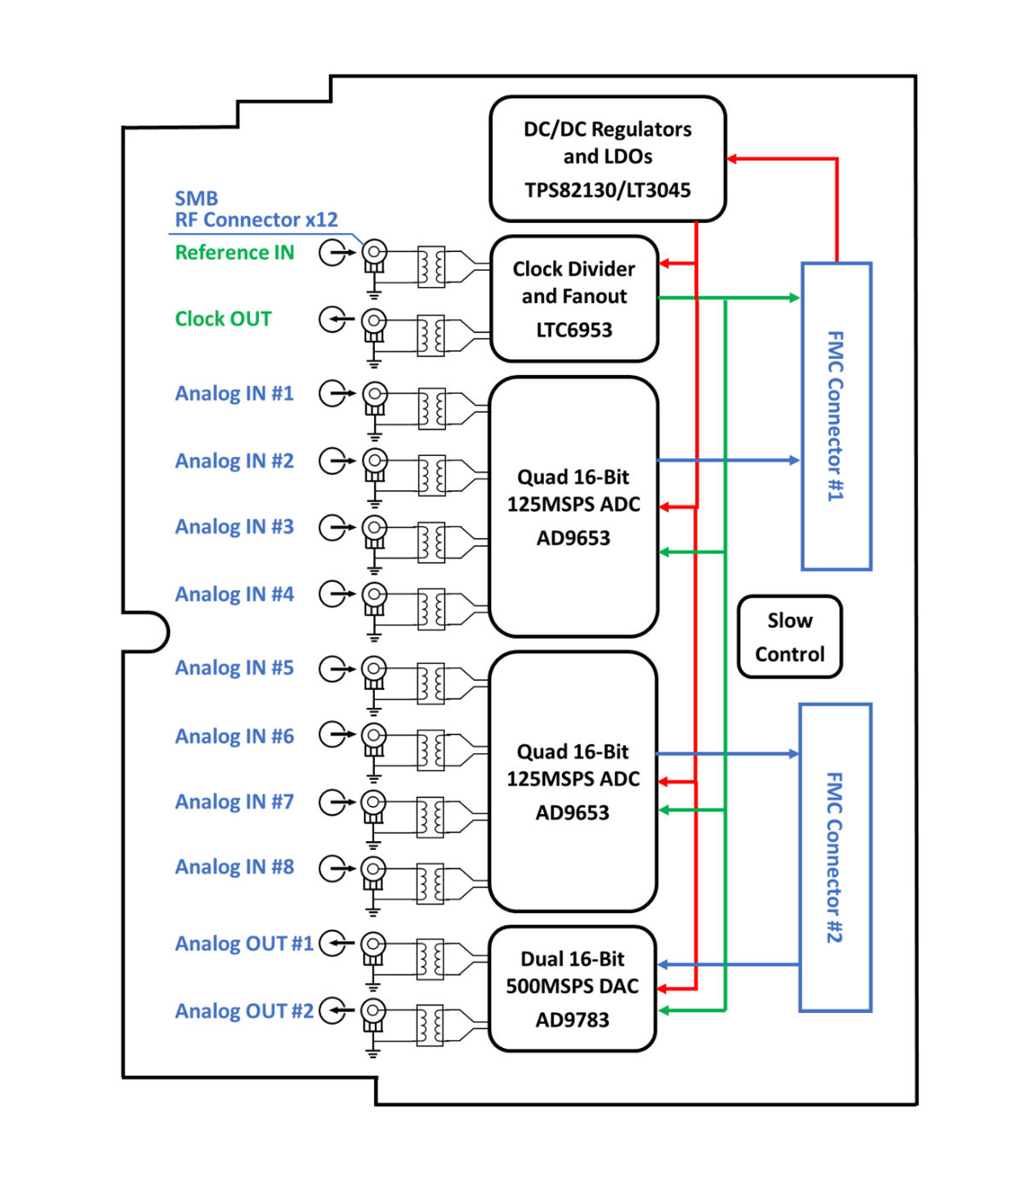
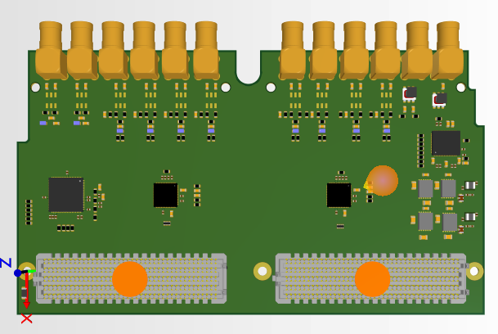
3. Hardware design and challenges
FMC mezzanine card for LLRF
  Dual width FMC
  4-chs 125MSPS 16-Bit AD9653
  2-chs 500MSPS 16-Bit AD9783
  LTC6953 clock distributor
  LT3045 ultralow noise, ultrahigh PSRR linear regulator

Slide 14
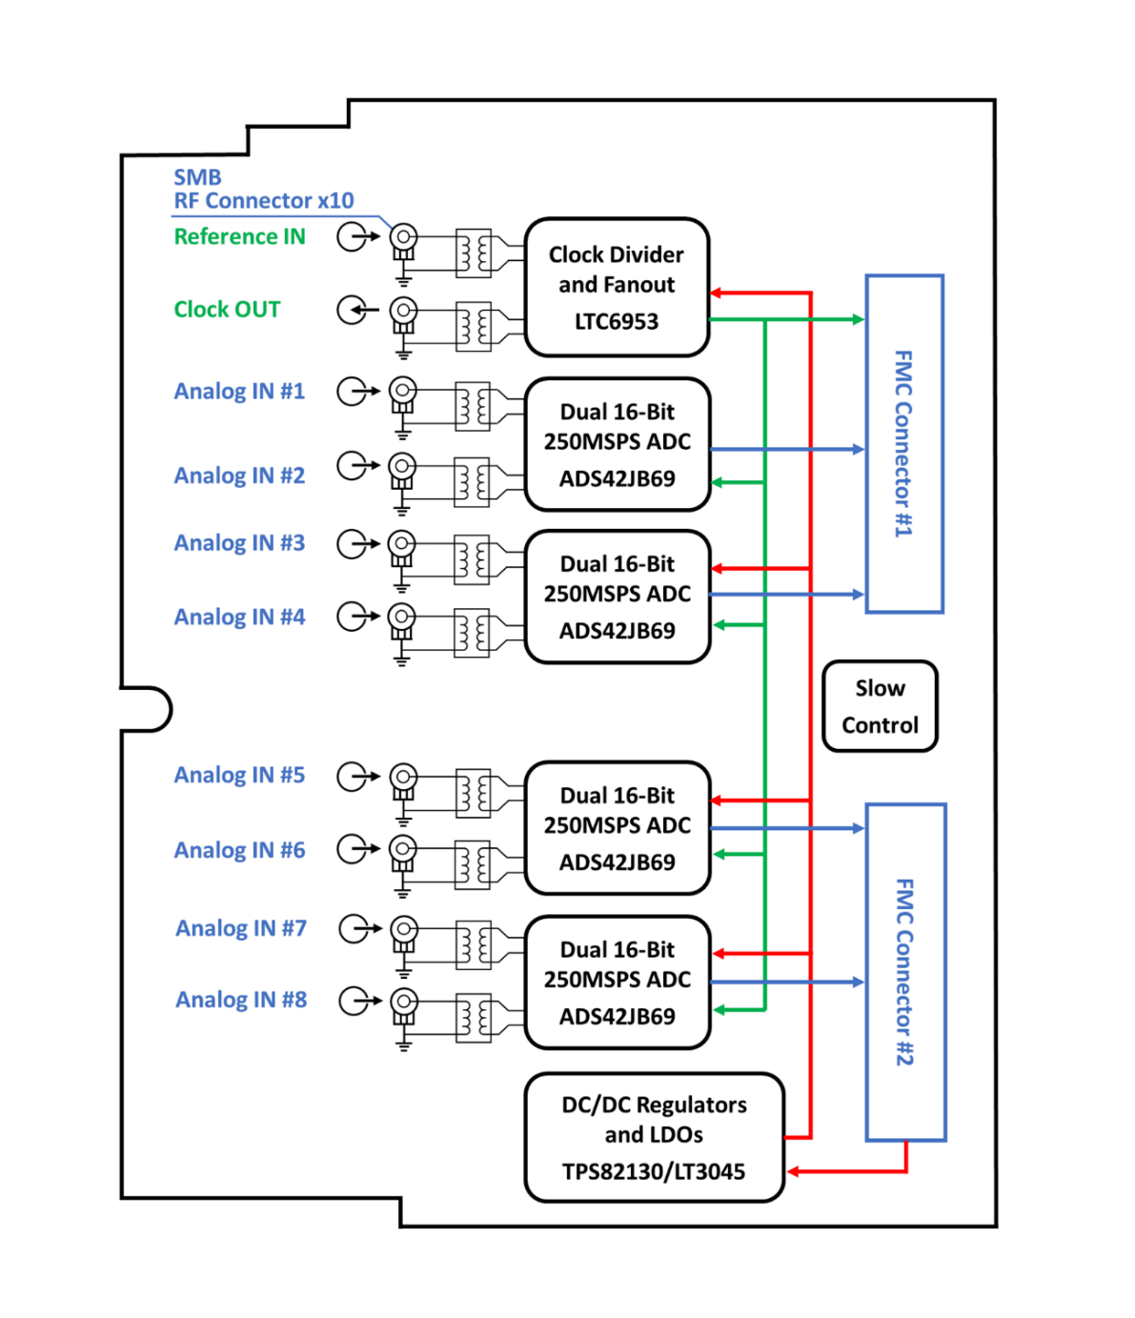
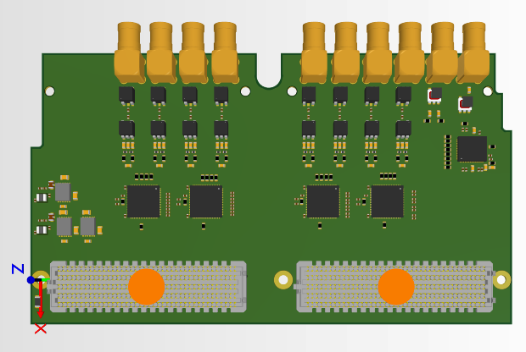
3. Hardware design and challenges
FMC mezzanine card for BPM
  Dual width FMC
  2-chs 250MSPS 16-bit ADS42JB69
  LTC6953 clock distributor
  LT3045 ultralow noise, ultrahigh PSRR linear regulator

Slide 15
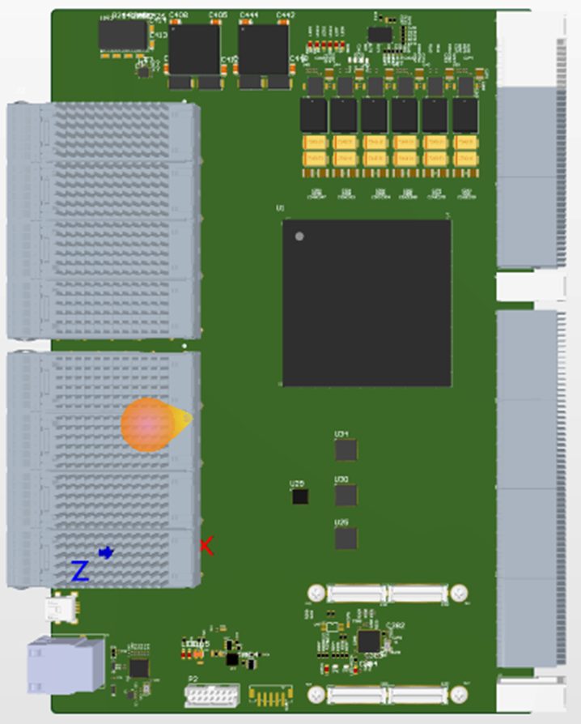
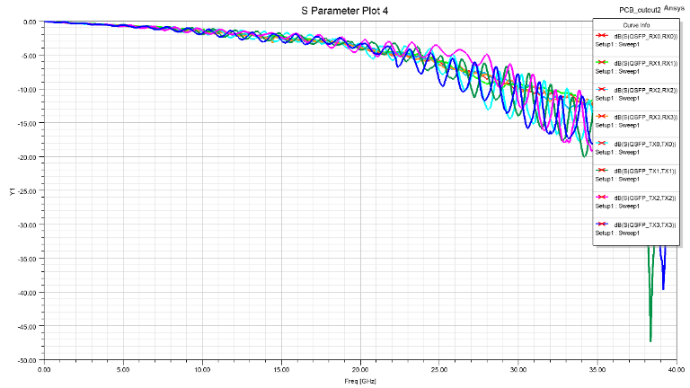
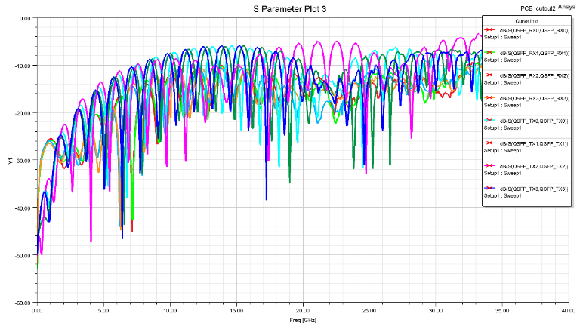

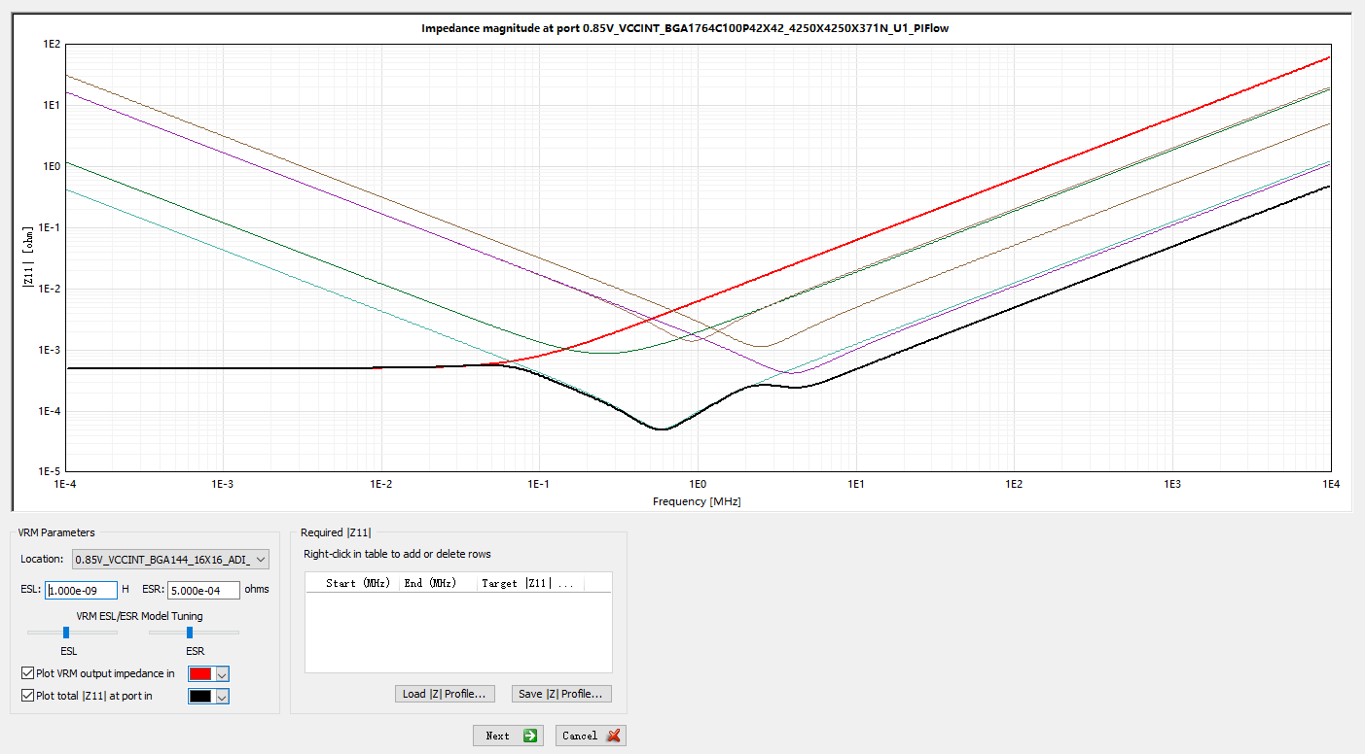
3. Hardware design and challenges
As an example: Synchronous clock distribution board
  22 layers Backdrill PCB
  Signal integrity simulation and optimization based on 100G Ethernet transmission
  Power integrity simulation and optimization based on 70A main rail current

Slide 16
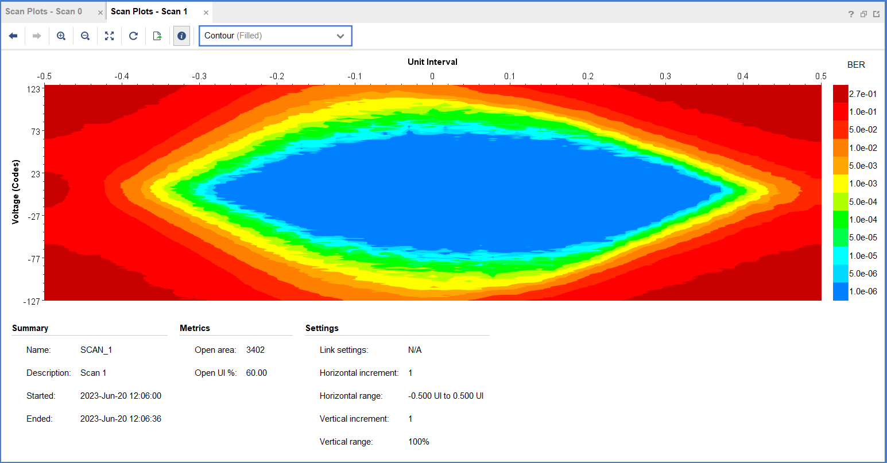
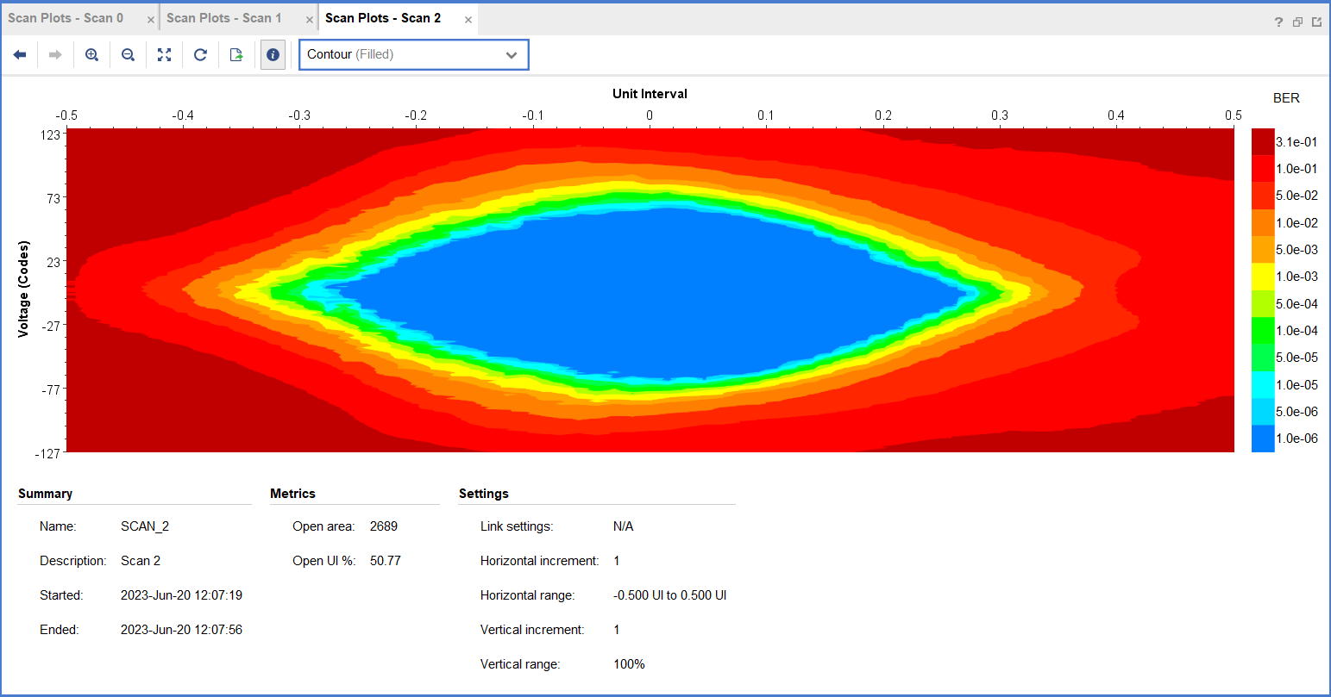
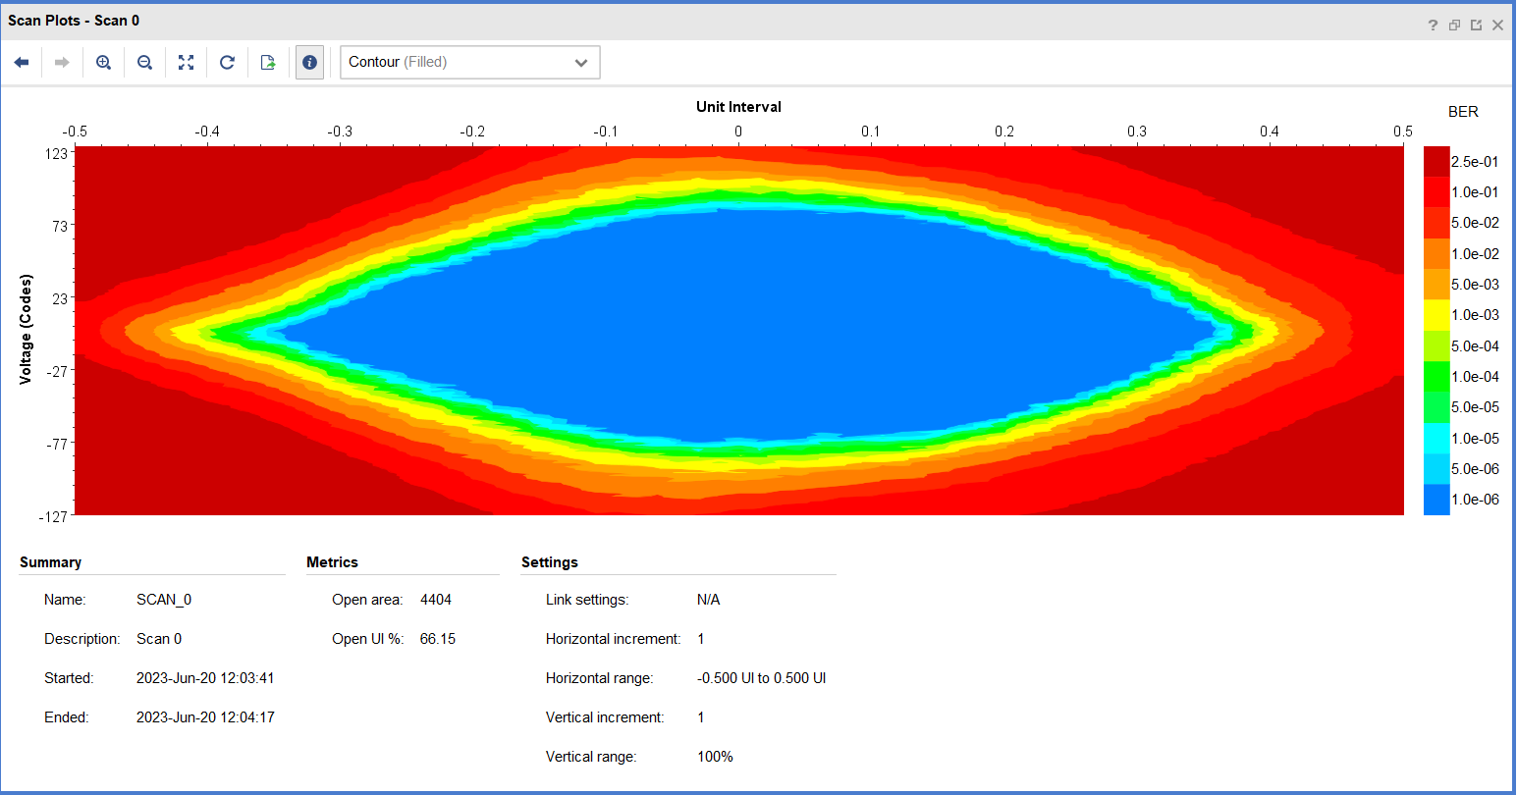
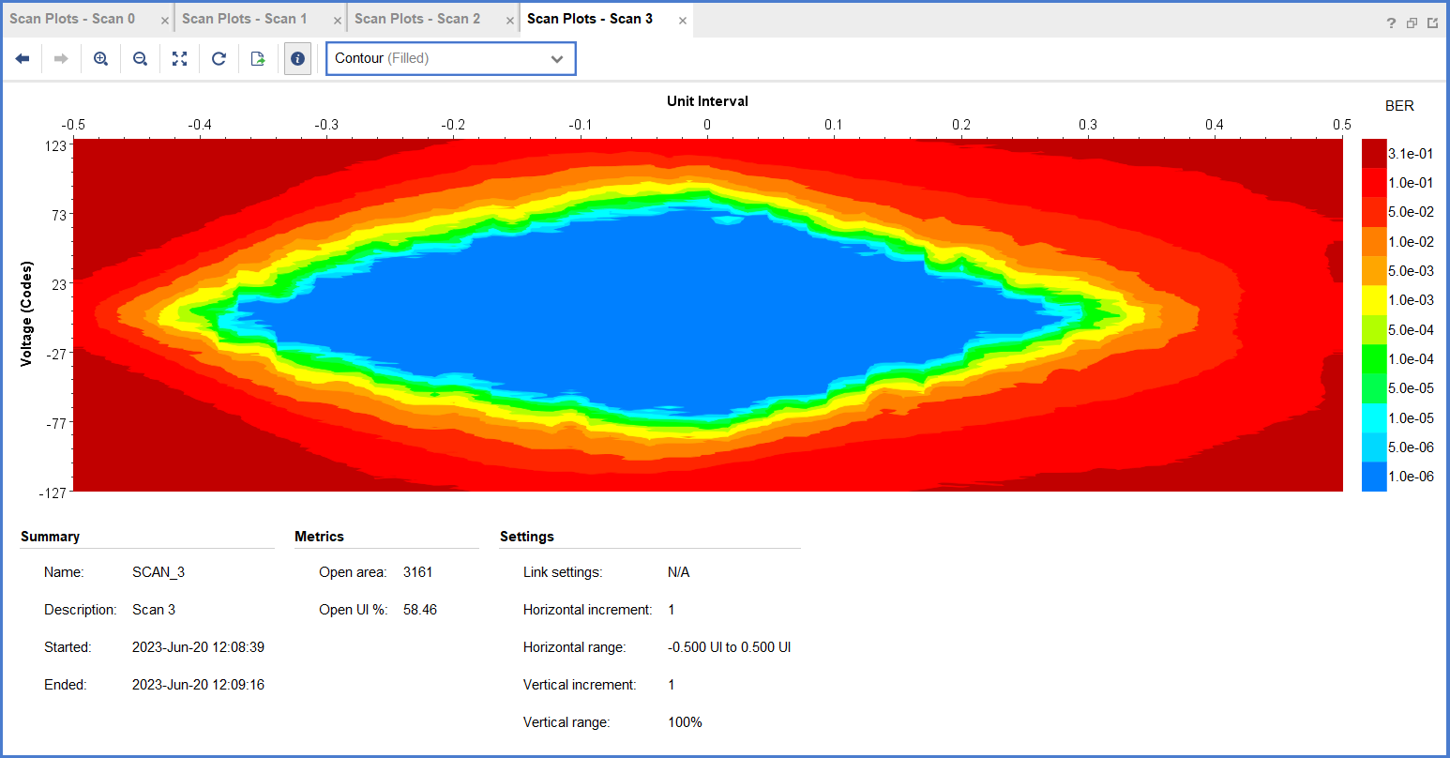
4. Hardware performance test
  Test Conditions：16.25 Gbps / 156.25 MHz/PRIBS-31
    Crystal oscillator + LMK00334 100G QSFP28 loopback module
MGT_B112 Channel | Open Area | Open UI
Channel 1 | 4404 | 66.15%
Channel 2 | 3402 | 60.00%
Channel 3 | 2689 | 50.77%
Channel 4 | 3161 | 58.46%

Slide 17
5. Summary and prospect
  We have accumulated extensive experience on Pulse Digitization and Readout electronics. Especially on Hardware Design. Thousands channels of electronics is deployed for Dark Matter and Neutrino Experiments.
  Thanks to Committee for this chance to introduce our group. Last 10 years, we contribute a little on LLRF/BPM, but now we start to dive deeper into the field of LLRF and enjoy.
  The 6U Dual FMC Carrier Board(SHIP4LLRF) is running and ready for LLRF.
  Two Double Width FMC mezzanine cards are being designed, which will be used in LLRF and BPM respectively. We will develop more detail test and verification, look forward to share more valuable information next meeting.

Slide 18

Thanks!
谢谢!
감사합니다!

