Slide 1
High-precision RF voltage measurements using longitudinal phase-space tomography in the CERN PSB and SPS D. Quartullo, S. Albright, H. Damerau, G. Papotti Acknowledgements: I. Karpov, A. Lasheen, PSB and SPS LLRF teams
ID 45

Slide 2
Contents
Motivations.
Principles of RF voltage measurements using tomography.
Voltage measurements for the PSB Finemet cavities.
Voltage and phase measurements for the SPS travelling-wave cavities.
Consistency checks and accuracy of the voltage errors.
Conclusions.

Slide 3
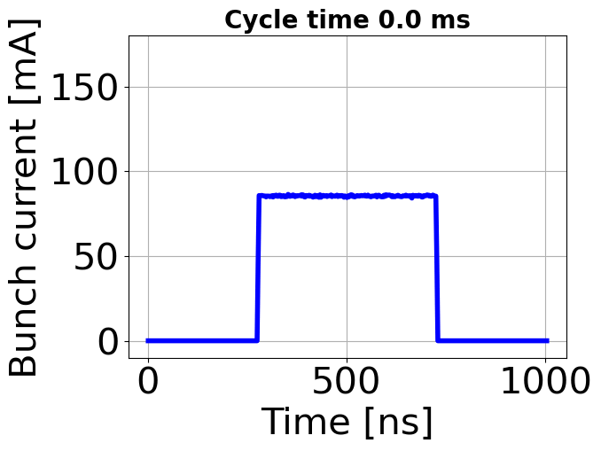
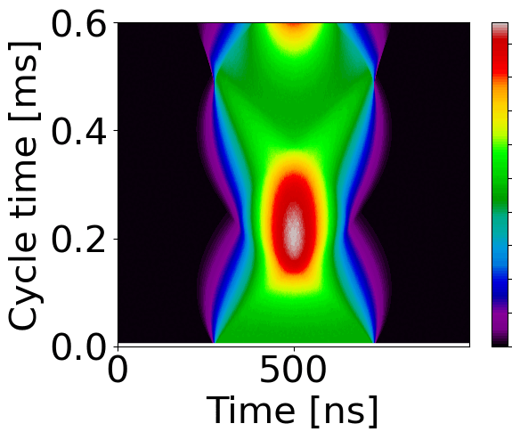
Motivations
Longitudinal bunch profiles
Knowing the gap voltage in an RF cavity allows to:
evaluate the transmitted RF power and determine the cavity performance;
perform more accurate beam-dynamics calculations;
correctly calibrate the LLRF feedbacks, e.g. for beam-loading compensation.
However, measurements of the RF voltage with conventional techniques can be affected by large uncertainties.
E.g., measured power is converted to voltage, assuming a certain shunt impedance and cavity model.
Uncertainties in power, impedance and model.
Alternatively, beam-based techniques measure the RF voltage by analysing the longitudinal profiles of an oscillating bunch.
One of these techniques uses longitudinal phase-space tomography.
$V_{rf}$ = ?
Mountain-range plot

Slide 4
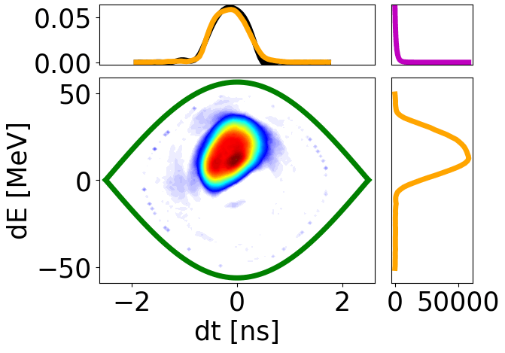
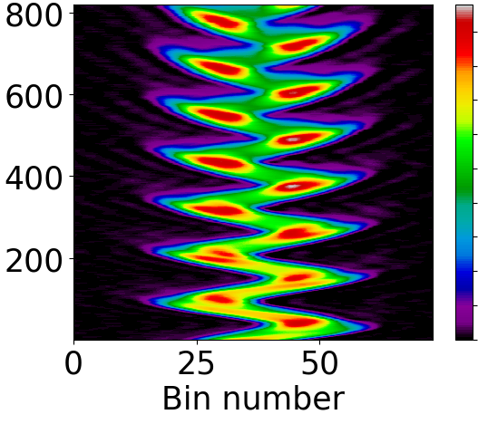
Longitudinal phase-space tomography
Tomography reconstructs the bunch distribution in longitudinal phase-space, starting from a set of input bunch-profiles.
The discrepancy $D$ is the averaged difference between input and reconstructed profiles.
Tomography is an iterative algorithm: $D$ decreases at each iteration until it approaches an asymptotic $D_{∞}$.
$$D=\sqrt{\frac{\sum_{j=1}^{N}{\sum_{n=1}^{L}{{\left(P_{inp}^{j,n}−P_{rec}^{j,n}\right)}^{2}}}}{NL}}$$
$N$ = number of profiles
$L$ = number of bins per profile
$D$ vs iteration number
Longitudinal profiles
Measured
Reconstructed
$$D_{∞}$$
Profile
Energy projections
From 1D profiles to 2D distribution

Slide 5
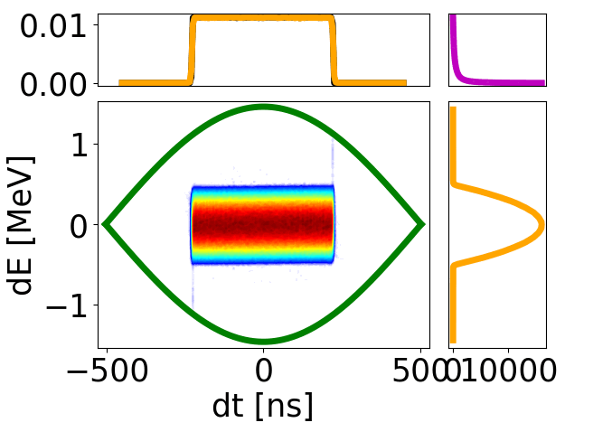
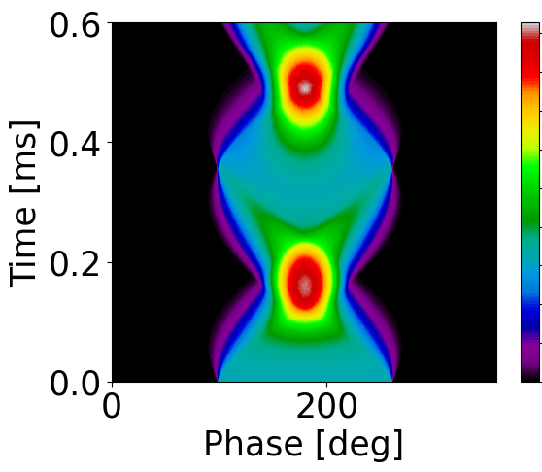
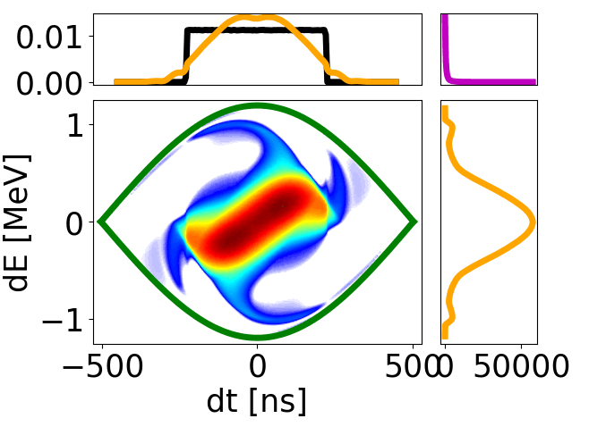
Voltage and phase measurements in a single-RF system
The accuracy of a tomographic reconstruction strongly depends on the knowledge of the RF voltage ${\hat{V}}_{rf}$ and of the bucket-centre phase ${\hat{φ}}_{s}$.
$D_{∞}$ is a function of $V_{rf}$ and $φ_{s}$, with minimum at ${\hat{V}}_{rf}$ and ${\hat{φ}}_{s}$.
A voltage and phase measurement using tomography consists in determining ${\hat{V}}_{rf}$ and ${\hat{φ}}_{s}$ which minimize $D_{∞}$.
Bunch oscillations are needed, otherwise the voltage can’t be uniquely determined.
${\hat{V}}_{rf}=7.5$ kV, ${\hat{φ}}_{s}=180$ deg
0.0
Best
Input profiles
Voltage measurement
$V_{rf}=5.0$ kV, ${\hat{φ}}_{s}=180$ deg
1.9
${\hat{φ}}_{s}$ = ?
$φ_{s}$ [deg]
$D_{∞}$ [1]
$${\hat{φ}}_{s }$$
${\hat{V}}_{rf}$ = ?
$${\hat{V}}_{rf }$$
Wrong
$V_{rf}$ [kV]

Slide 6
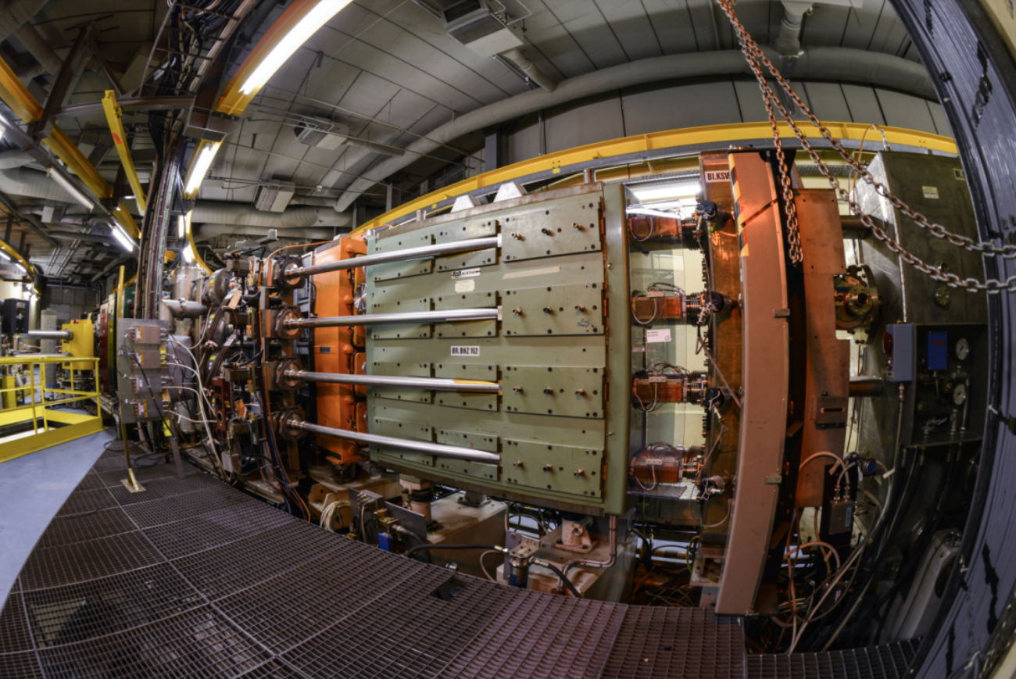
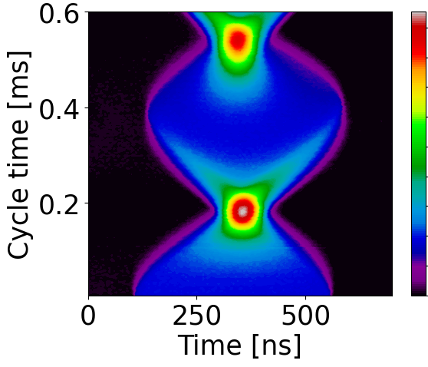
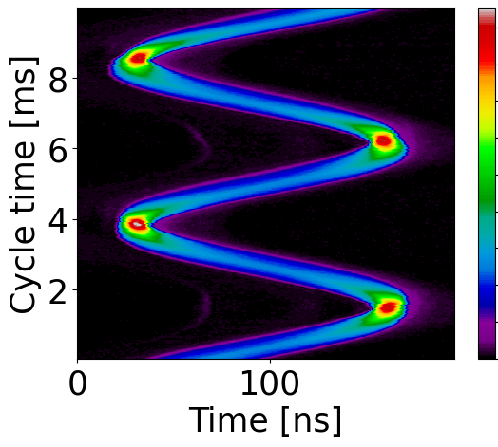
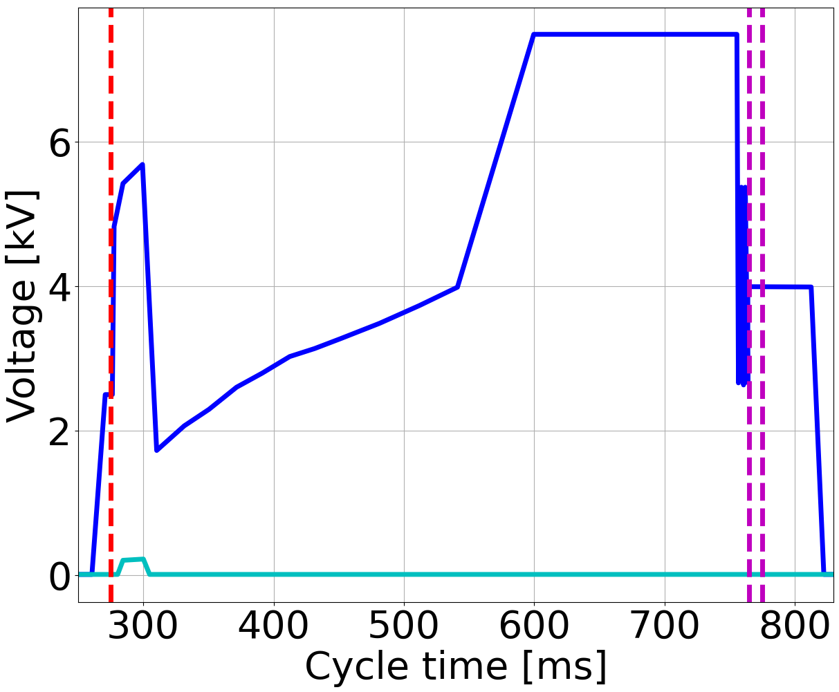
Setup for beam measurements in the PSB
3 identical broad-band Finemet cavities (S5, S7, S13) in each ring.
Measurements for each cavity at $h=1$.
At injection (160 MeV), quadrupole oscillations due to the mismatch of bunches coming from Linac4.
At extraction (2 GeV), voltage jumps enhanced quadrupole oscillations, opening the phase loop led to dipole oscillations.
Low bunch-intensities to limit the contribution from collective effects.
LLRF beam-loops turned off to avoid damping the bunch oscillations.
The PSB four rings
Ring 4
Ring 3
Ring 2
Ring 1
Measured profiles in ring 1 with only cavity S13 active
Programmed RF voltages
Flat
bottom
Flat bottom
Flat top
Voltage jumps
Longitudinal shaving
Flat top

Slide 7
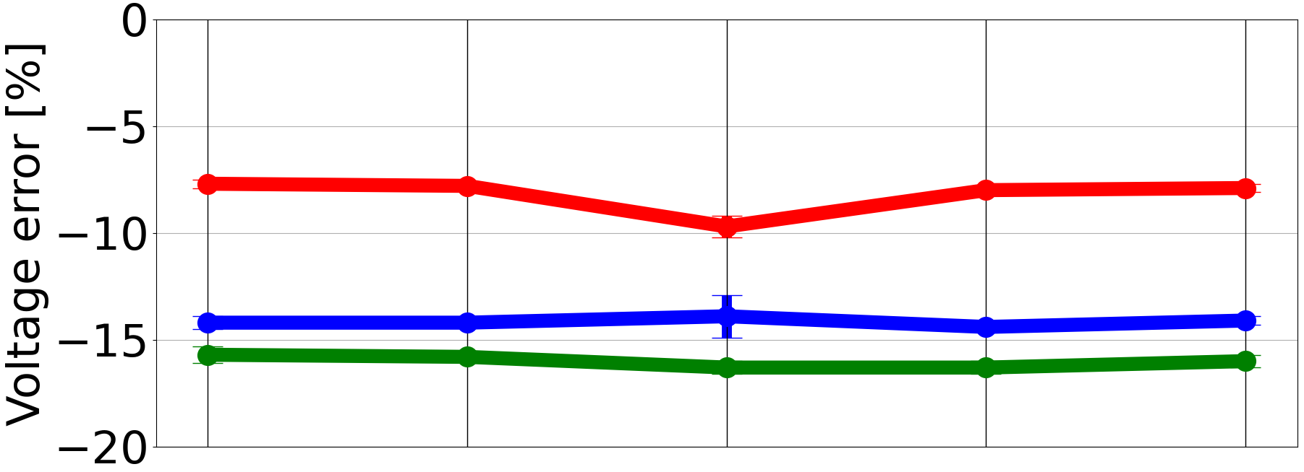
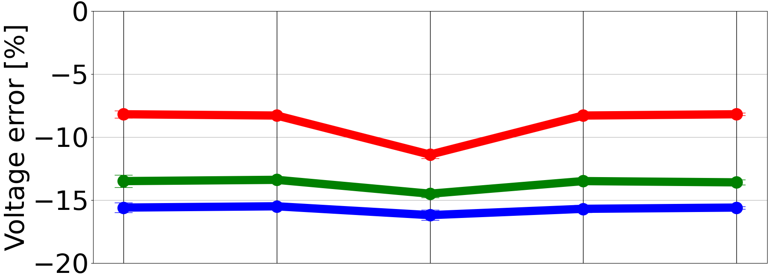
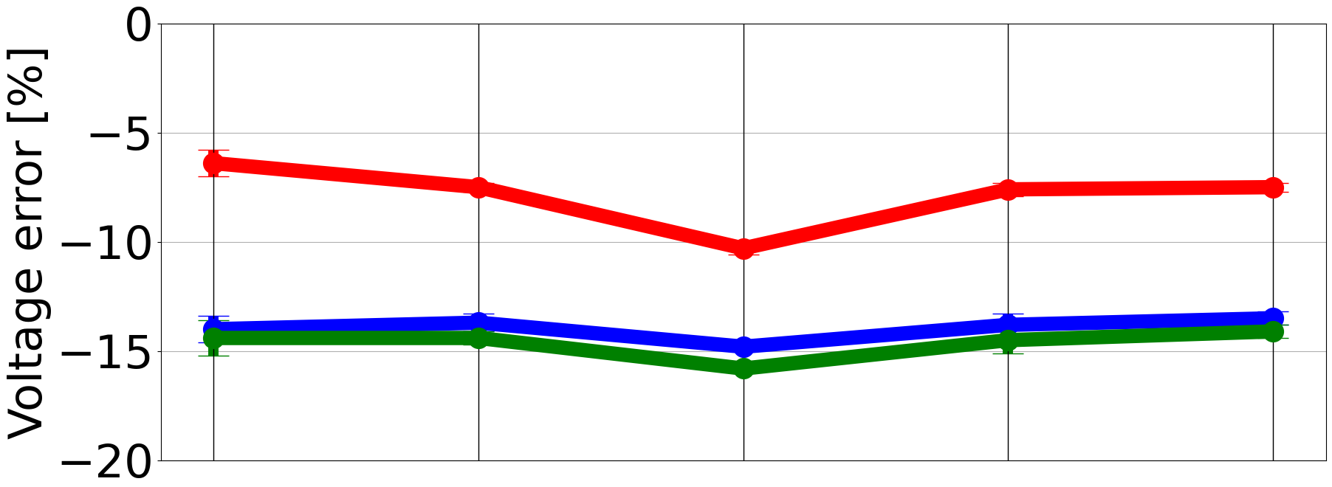
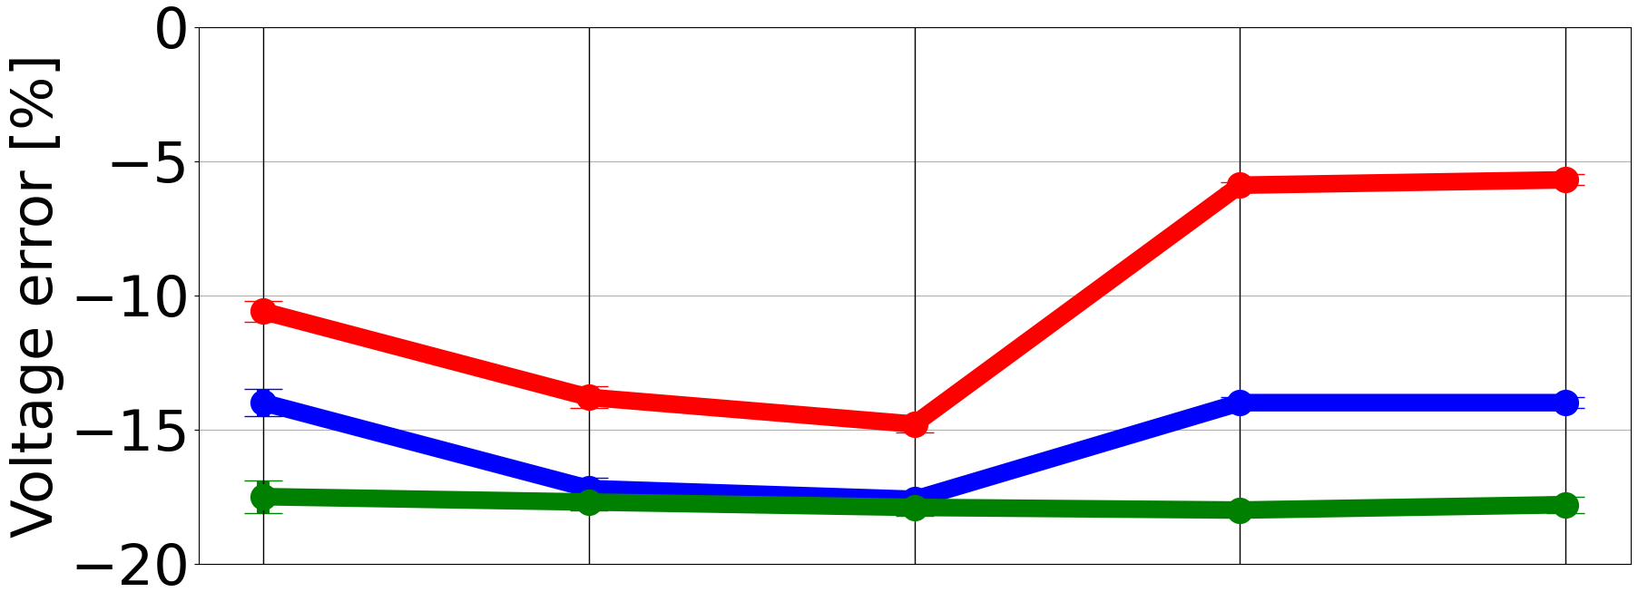
Voltage errors for the PSB cavities
Voltage errors up to $18\%$ (measured < programmed voltages).
Patterns are visible, e.g. lowest error for S7 in each ring.
For a given cavity, the variation of the error over time is small.
The error bars are the spreads due to different $V_{p}$: very good linearity.
measured
$$=\frac{{\hat{V}}_{rf}−V_{p}}{V_{p}}$$
Voltage error $ξ_{e}$
programmed
Ring 1
Ring 2
S5
S7
S13
Ring 3
Ring 4
2021
Apr
FB
2022
Mar
FB
2022
Mar
FT
2022
Jul
FB
2022
Aug
FB
2021
Apr
FB
2022
Mar
FB
2022
Mar
FT
2022
Jul
FB
2022
Aug
FB

Slide 8
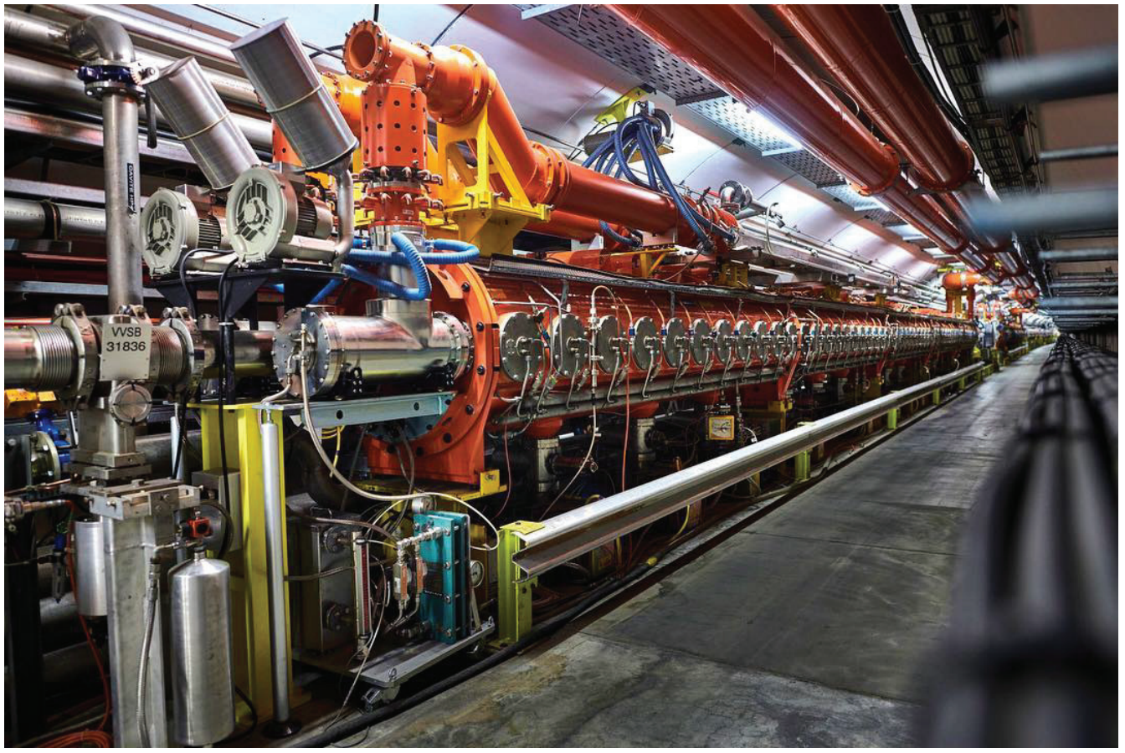
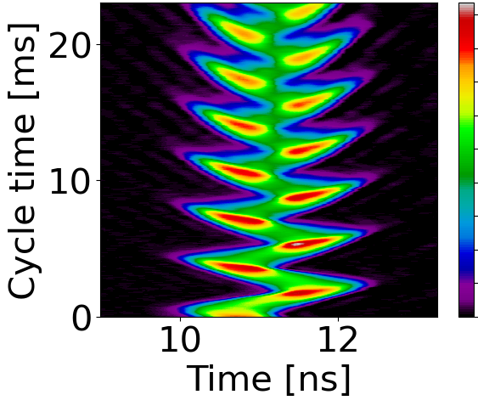
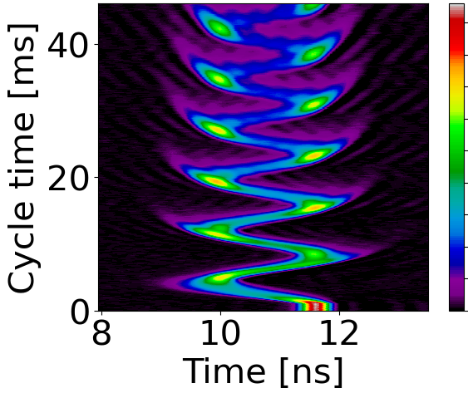
Measurement setup for the SPS 200 MHz cavities
200 MHz cavity in the SPS
Six traveling-wave accelerating cavities (C1, …, C6).
Measurements for each cavity.
At injection ($26$ GeV/c), dipole oscillations due to injection phase-errors.
At flat-top ($200$ GeV/c), dipole oscillations excited by RF-phase jumps.
Measured profiles with only cavity C1 active
Flat
bottom
Flat
top
Low injected bunch-intensities.
LLRF beam-loops turned off.
Injection phase
error
Phase jump

Slide 9
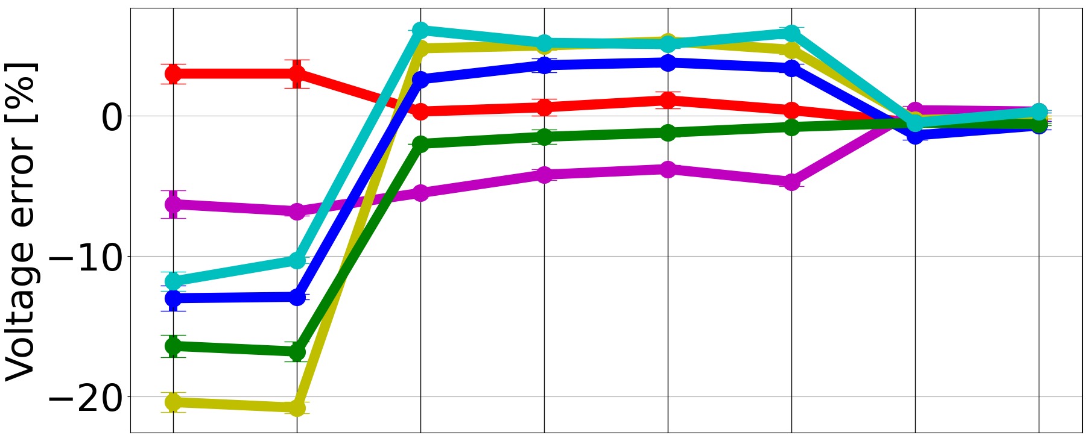
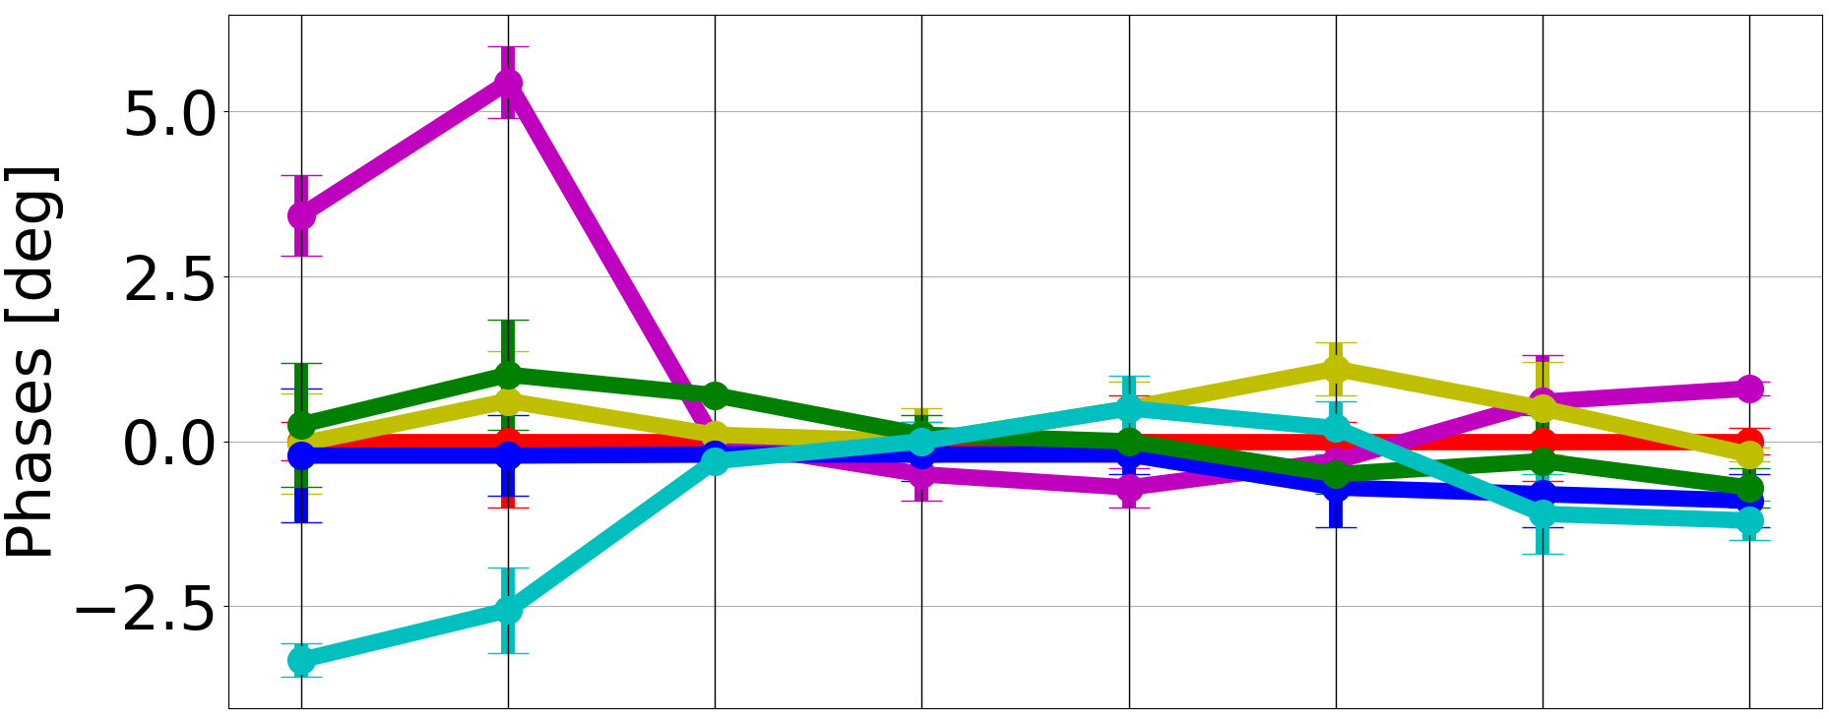
Voltage and phase errors for the SPS 200 MHz cavities
Voltage errors:
up to $21\%$ in $2021$.
A careful inspection revealed incorrect settings in the LLRF.
Refined electrical voltage calibrations led to errors within $6\%$ in $2022$.
In $2023$, the correction factors were applied in the LLRF, leading to errors within just $1\%$.
Phase errors:
Cavities misalignment of $8$deg in $2021$.
Cavities very well aligned within $2$ deg in $2022$ and $2023$.
Correction factors applied in the LLRF
Refined electrical voltage calibrations
C1 C2 C3 C4 C5 C6
2021
Jul
FB
2021
Oct
FB
2022
Mar
FB
2022
May
FB
2022
Jul
FB
2022
Jul
FT
2023
Mar
FB
2023
Mar
FT

Slide 10
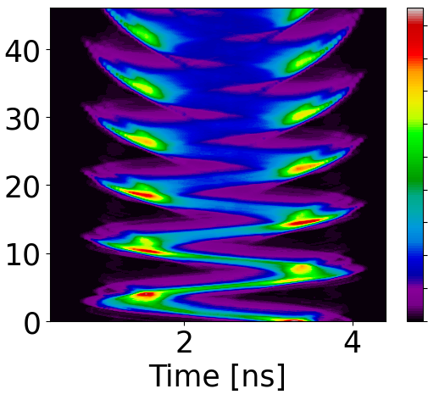
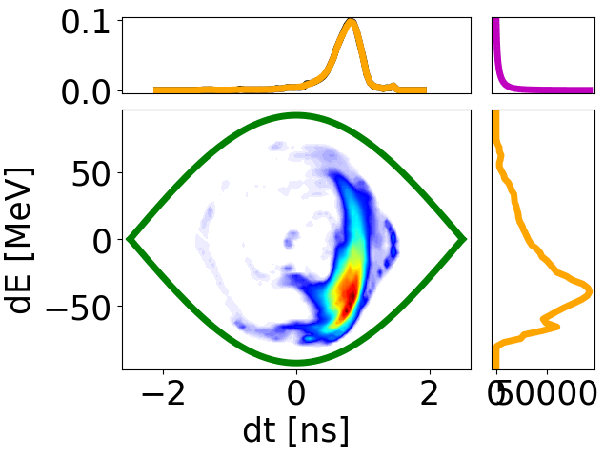
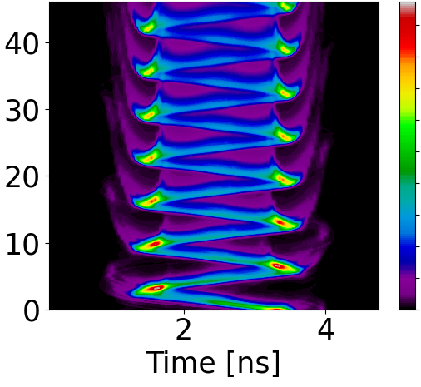
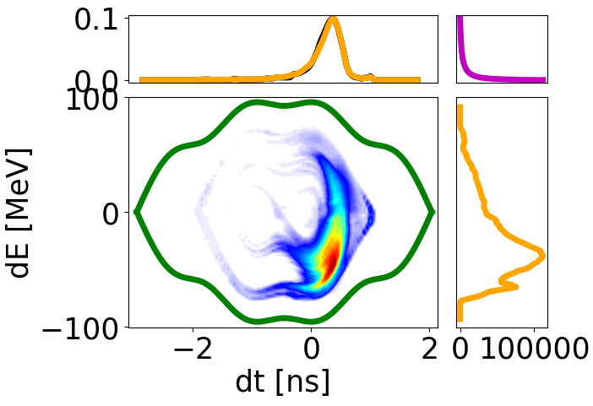
Voltage and phase measurements in a double-RF system
In a double-RF system, $D_{∞}$ depends on $V_{rf,1},φ_{s},V_{rf,2}$ (higher-harmonic voltage), $φ_{12}$ (relative phase).
Challenging 4-parameter minimization: time consuming, local minima in the parameter space.
An alternative simpler way is to perform a two-step voltage measurement.
Input profiles
Voltage measurement
Reconstructions
Single-RF voltage measurement to determine ${\hat{V}}_{rf,1}$ and ${\hat{φ}}_{s}$
$φ_{s}$ [deg]
$${\hat{φ}}_{s }$$
$D_{∞}$ [1]
$${\hat{V}}_{rf,1 }$$
Inputs
${\hat{V}}_{rf,1}$, ${\hat{φ}}_{s}$
$V_{rf,1}$ [kV]
Double-RF voltage measurement to determine ${\hat{V}}_{rf,2}$ and ${\hat{φ}}_{12}$
$${\hat{φ}}_{12 }$$
$φ_{12}$ [deg]
$D_{∞}$ [1]
$${\hat{V}}_{rf,2 }$$
$V_{rf,2}$ [kV]

Slide 11
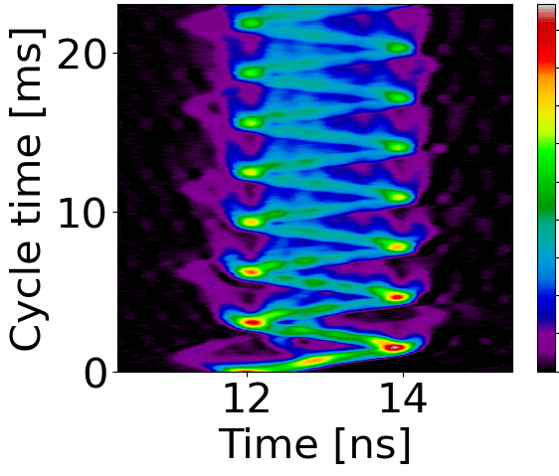
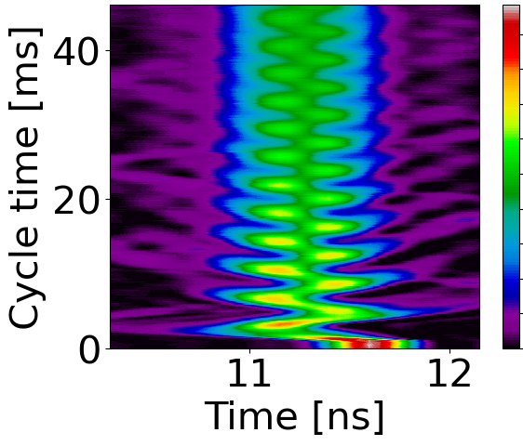
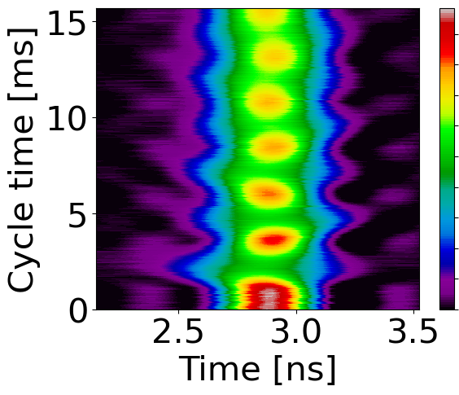
Measurement setup for the SPS 800 MHz cavities
Two $800$ MHz traveling-wave cavities ($C1_{800}$, $C2_{800}$) used with the $200$ MHz ones for beam stability.
Measurements of voltage and relative phase in double RF were performed at $26$ GeV/c and $200$ GeV/c.
Different programmed relative-phases tested (e.g. bunch shortening and lengthening modes).
The voltage of the $800$ MHz cavities can be alternatively determined with single-RF voltage measurements.
Bucket length reduced by factor 4, so measurements only at $200$ GeV/c where the bunch is the shortest.
Profiles showing particle losses should be discarded, since tomography assumes that the bunch charge is preserved.
Measured profiles with only $C1_{800}$ active
Measured profiles with only $C1$ and $C1_{800}$ active
Flat
bottom
Flat
top
Flat
top
Injection phase
error
Turn off
C1
Phase jump

Slide 12
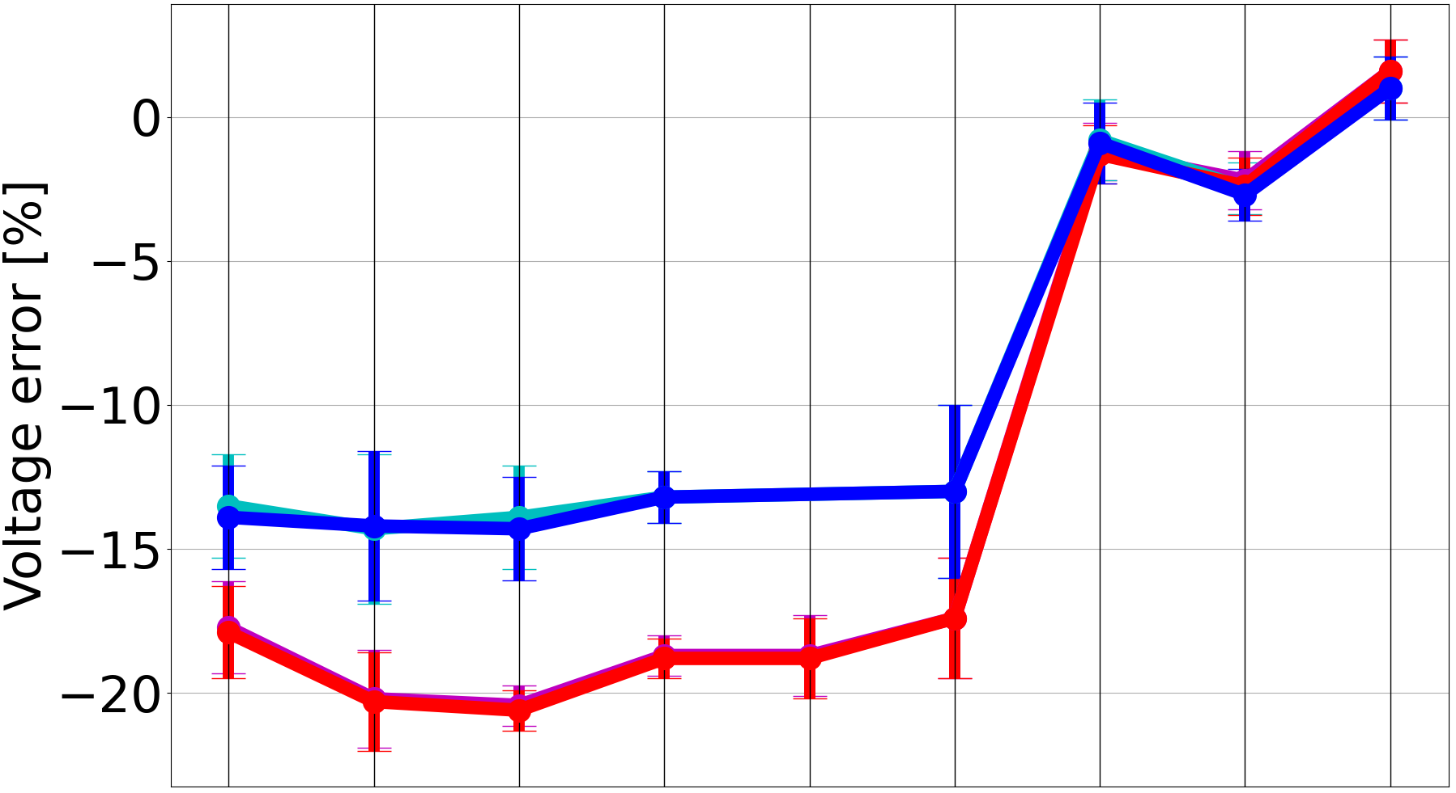
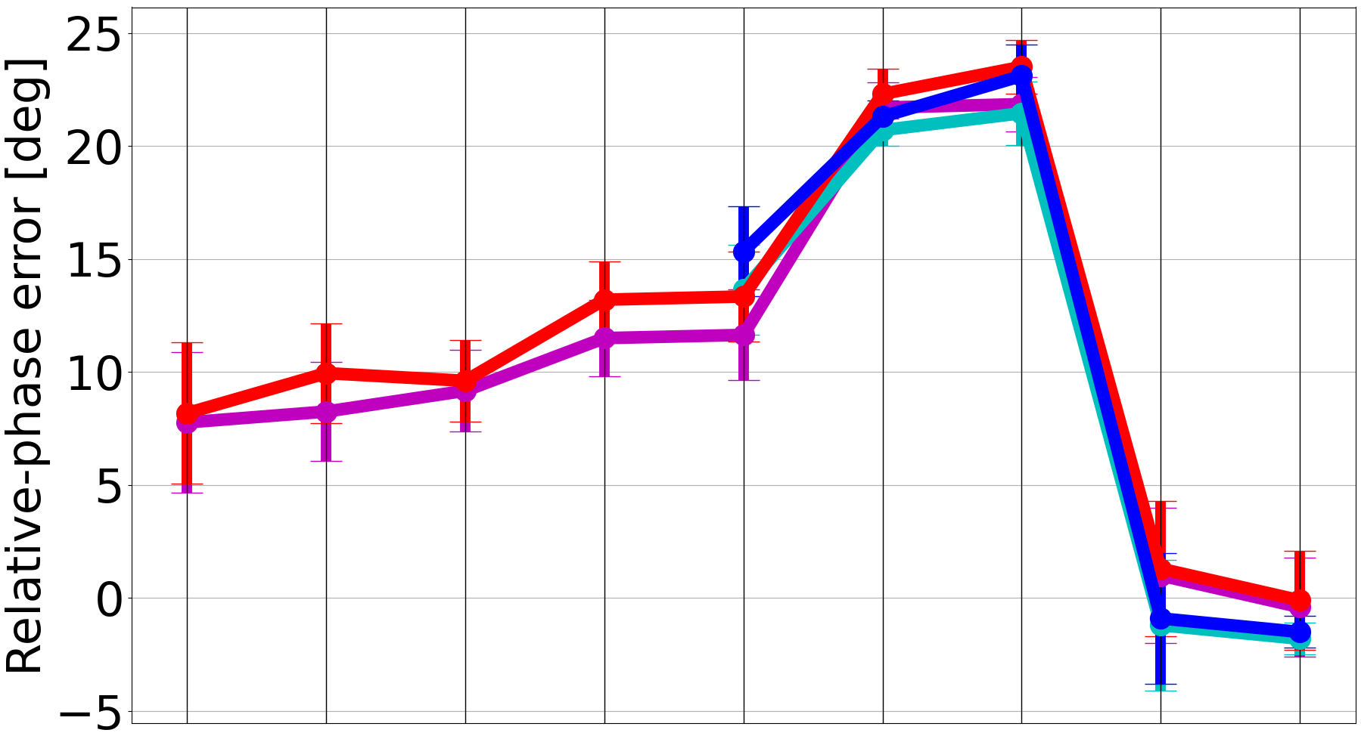
Voltage and phase errors for the SPS 800 MHz cavities
Voltage errors up to $18\%$ in $2022$, from measurements in single and double RF, at flat-bottom and top.
Errors within just $2\%$ after correction in $2023.$
$φ_{12}$ errors up to $14$ deg in $2022$: calibration done by analysing the profile tilt versus the programmed $φ_{12}$.
Errors of $23$ deg in the beginning of $2023.$ After correction, errors reduced to only $2$ deg.
Small differences when voltage and phase errors are corrected by removing the collective-effects contribution.
$$C1_{800}$$
$C1_{800}$, corrected
$C2_{800}$
$C2_{800}$, corrected
800 MHz voltage error [%]
Correction factors applied in the LLRF
Correction factors applied in the LLRF
2023
Apr
FT BS
2022
May
FB BS
2022
Jul
FB BL
2023
Mar
FB BS
2023
Apr
FB BS
2023
Apr
FB BS
2023
Apr
FT BS
2023
Apr
FB BL
2022
Jul
FB BS
2022
Jul
FT BL
2023
Mar
FB BL
2022
Jul
FB BS
2022
May
FB BL
2022
May
FB BS
2022
May
FB BL
2022
Jul
FB BL
2022
Jul
FT BL
2022
Jul
FT 1RF

Slide 13
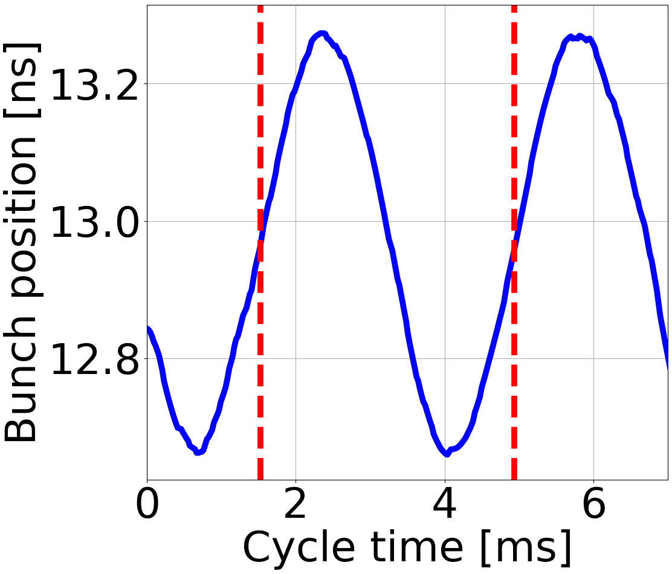
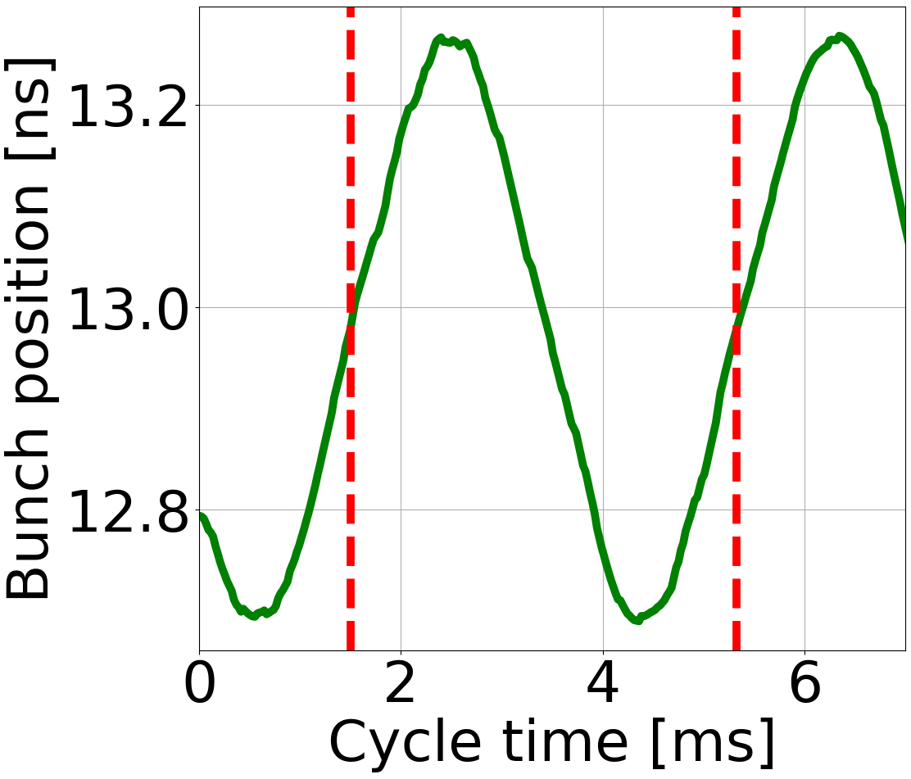
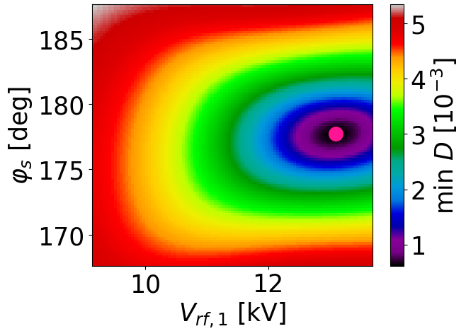
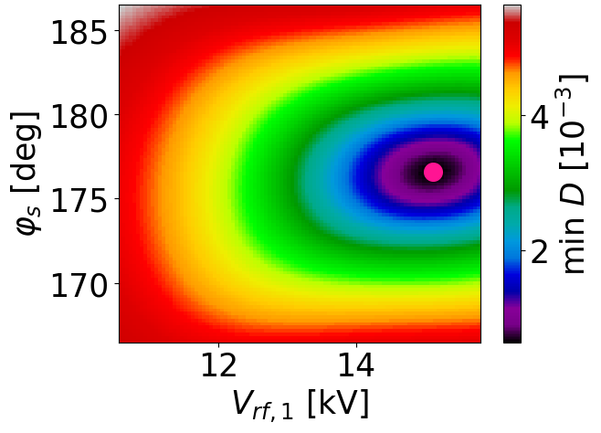
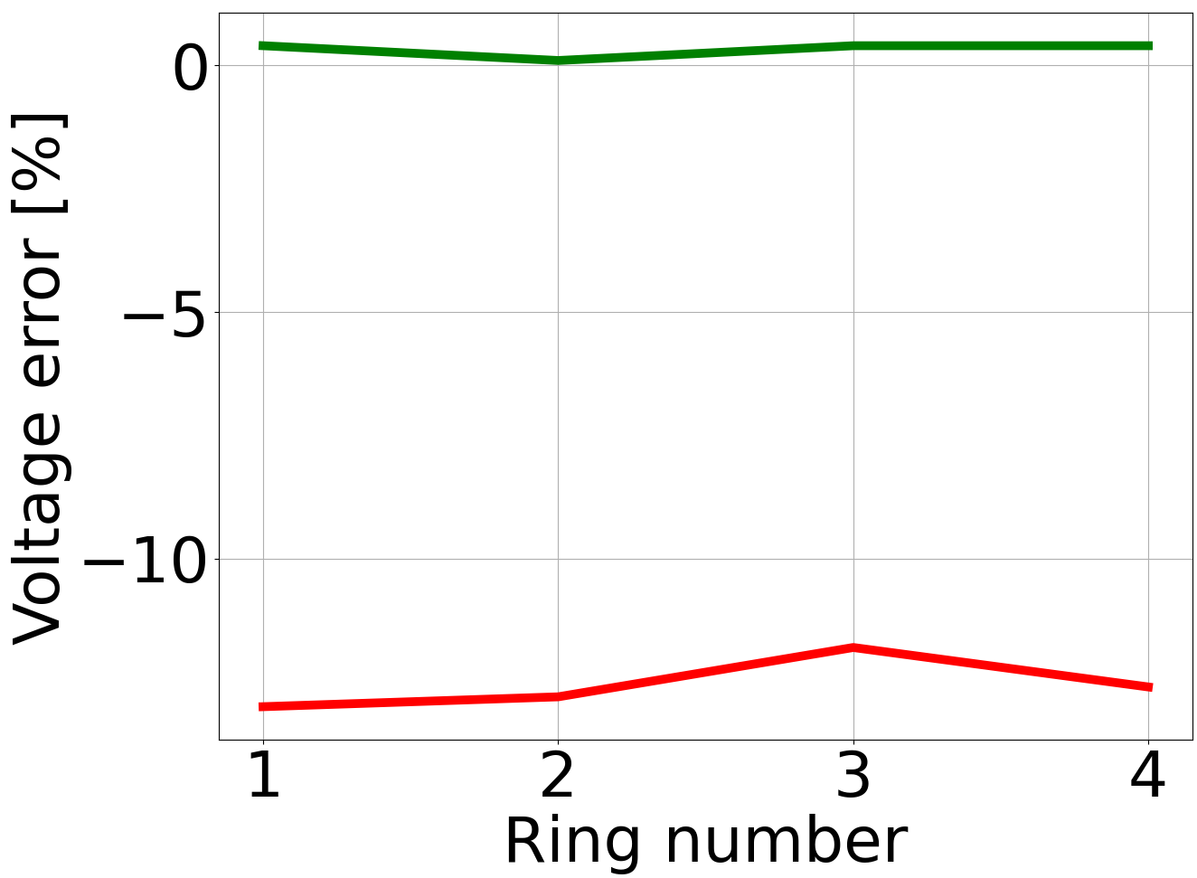
Consistency checks
In each ring, voltage measurements at flat bottom using the three cavities together ($V_{p}$ = 15 kV), before and after correction.
Analysis of the bunch dipole-oscillations.
20% less measured voltage leads to a 10% larger synchrotron period, as expected.
PSB
SPS
Ring 1,
before correction
Ring 1,
after correction
$C1$, $ξ_{e}=3\%$
$C5$, $ξ_{e}=−17\%$
-12.6%
0.8%
3.41 ms
3.83 ms
2021 data
The measured voltage of a pair of cavities is close to the sum of the single-cavity voltages.
Voltage errors from $13\%$ to $1\%$ in each ring.
Cavities | ${\hat{V}}_{rf}$ [MV] | $\sum{{\hat{V}}_{rf}}$ [MV] | ${\hat{V}}_{rf}−\sum{{\hat{V}}_{rf}}$ [%]
1 & 2 | $$1.88$$ | $$1.86$$ | $$0.8$$
4 & 5 | $$1.93$$ | $$1.93$$ | $$0.0$$
3 & 6 | $$3.36$$ | $$3.36$$ | $$0.1$$
After correction
Before correction

Slide 14
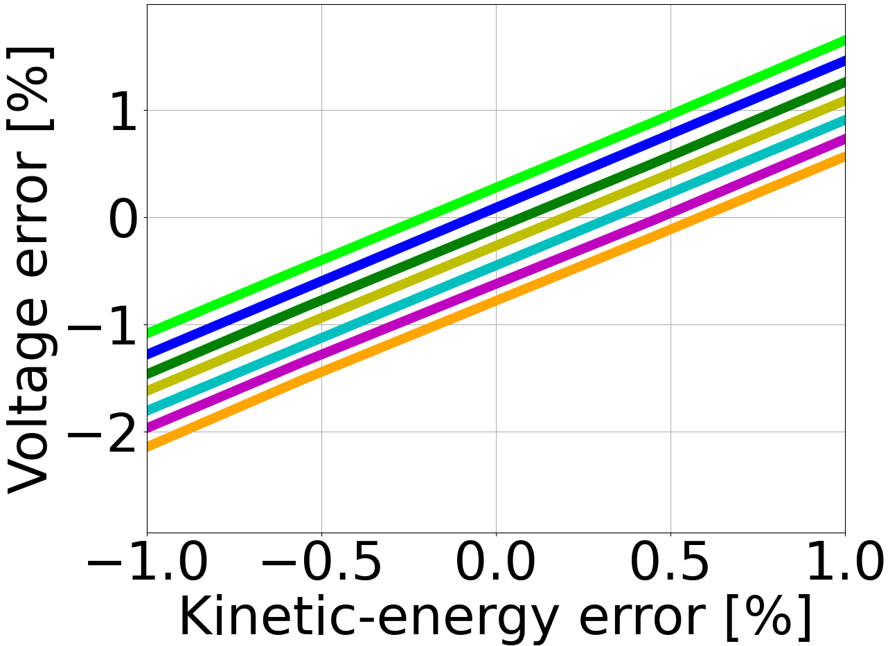
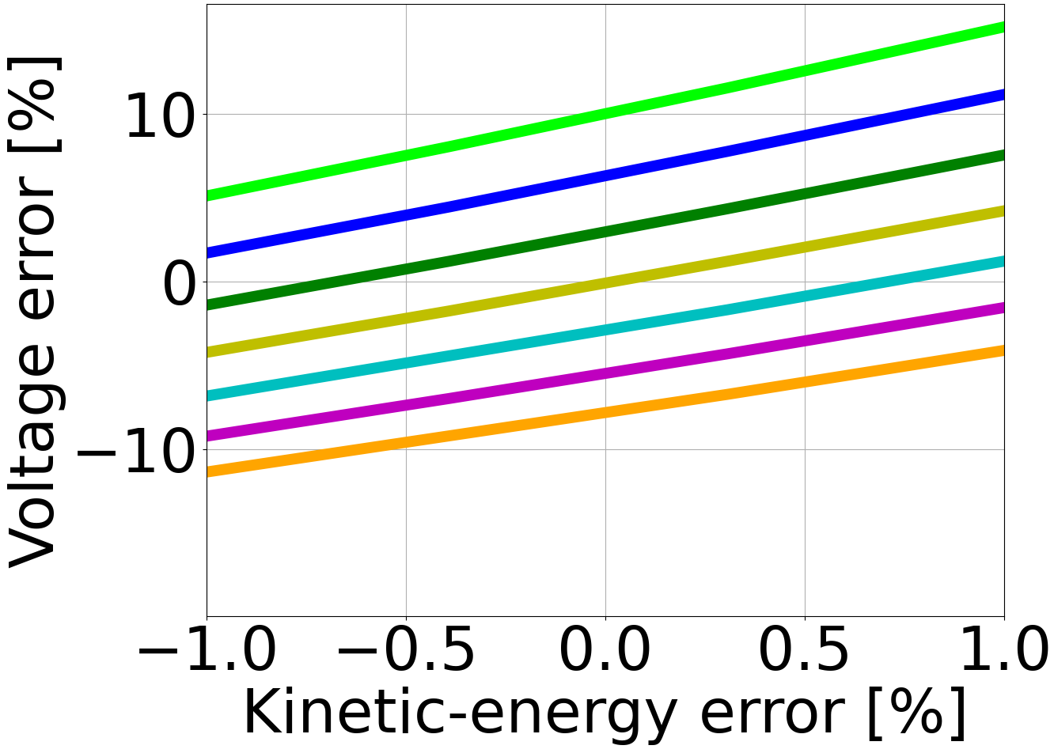
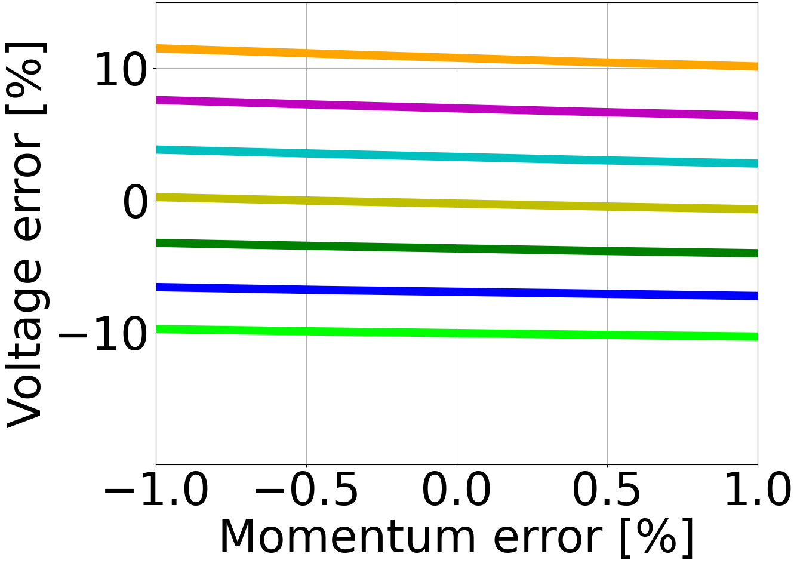
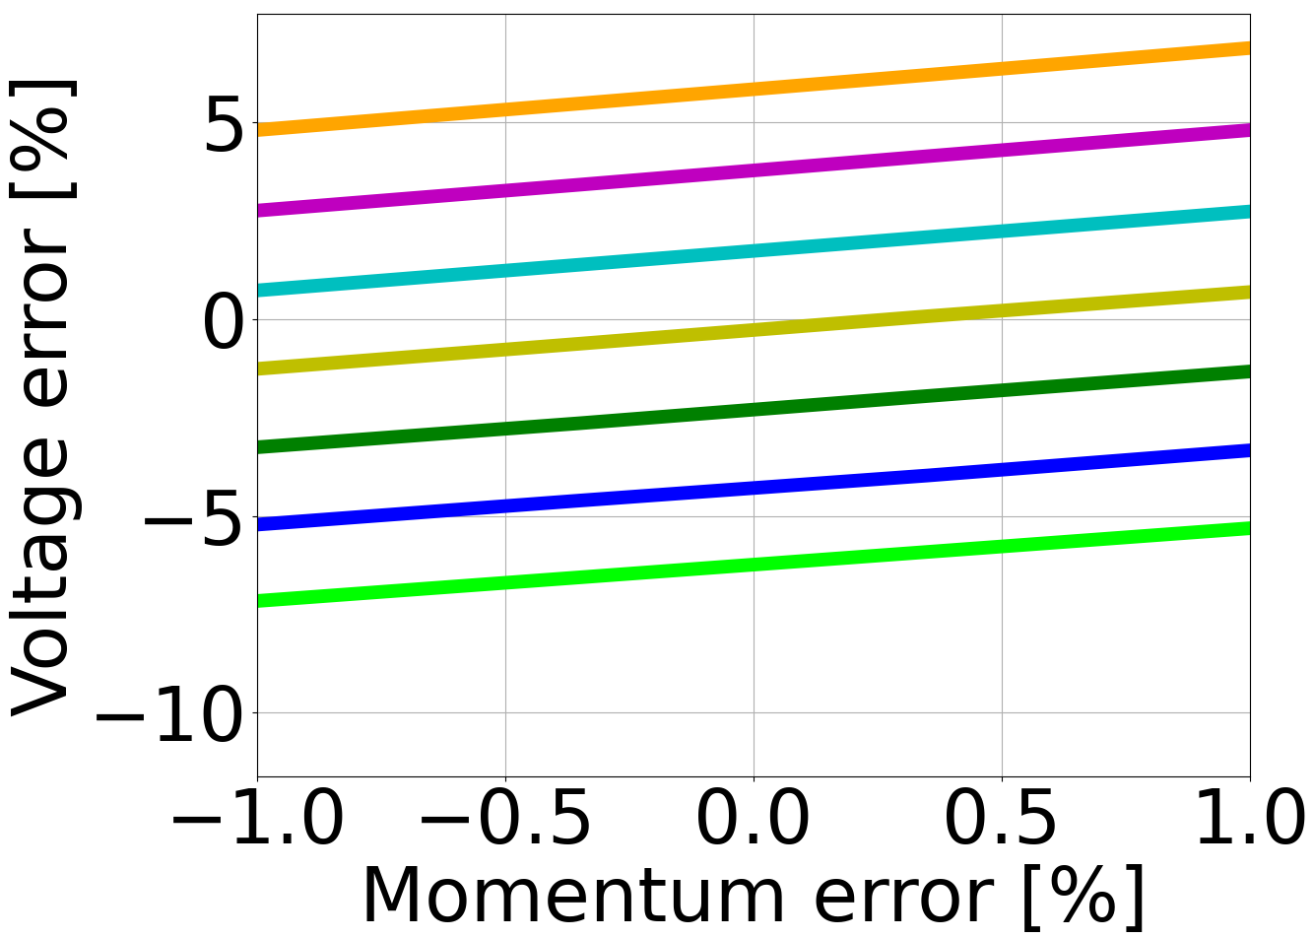
Accuracy of the voltage errors
The accuracy of the voltage errors depends on the uncertainties in nominal energy and transition gamma.
Macro-particle tracking simulations were performed, where the voltage, nominal energy and transition gamma are known.
Simulated profiles used as input for voltage measurements, introducing intentionally errors in energy and transition gamma.
If no uncertainties in energy and transition gamma -> $0.3\%$ accuracy.
The expected accuracies are very good:
PSB: $1\%$ at $160$ MeV;
SPS: $1\%$ at $200$ GeV/c.
$$ξ_{e}[\%]≈ {1.4 E}_{kin,err}[\%]$$
$$ξ_{e}[\%]≈ {−0.2 γ}_{t,err}[\%]$$
$$ξ_{e}[\%]≈ {4.2 E}_{kin,err}[\%]$$
$$ξ_{e}[\%]≈ {−3.0 γ}_{t,err}[\%]$$
PSB at 160 MeV
PSB at 2 GeV
$$ξ_{e}[\%]≈ {−0.4 p}_{0,err}[\%]$$
$$ξ_{e}[\%]≈ {3.5 γ}_{t,err}[\%]$$
$$ξ_{e}[\%]≈ {1.0 p}_{0,err}[\%]$$
$$ξ_{e}[\%]≈ {2.0 γ}_{t,err}[\%]$$
Transition-gamma error [%]
SPS at 26 GeV/c
SPS at 200 GeV/c
$−3$ $−2$ $−1$ $0$ $+1$ $+2$ $+3$

Slide 15
Conclusions
The RF voltages and phases of the CERN PSB and SPS cavities were measured by using an accurate technique based on beam-profile measurements and tomographic reconstructions.
Initial voltage errors up to $18\%$ for the PSB Finemet cavities.
Errors reduced to $1\%$ after correction.
Initial voltage errors up to $21\%$ for the SPS 200 MHz cavities.
Errors decreased to $6\%$ with refined electrical voltage calibrations.
After correction, errors further reduced to $1\%$.
A very good phase alignment of the cavities could also be checked.
Initial voltage errors up to $18\%$ and relative-phase errors up to $14$ deg for the SPS 800 MHz cavities.
The errors respectively decreased to $2\%$ and $2$ deg after correction.
Given their high precision, tomography-based measurements are expected to become the baseline choice for voltage and phase measurements in all synchrotrons at CERN.

