Slide 1
Flat gateware architecture for low level RF control
Gang Huang, Larry Doolittle
Lawrence Berkeley National Laboratory
Low Level Radio Frequency Workshop
Gyeongju, Korea
Oct. 23 2023

Slide 2
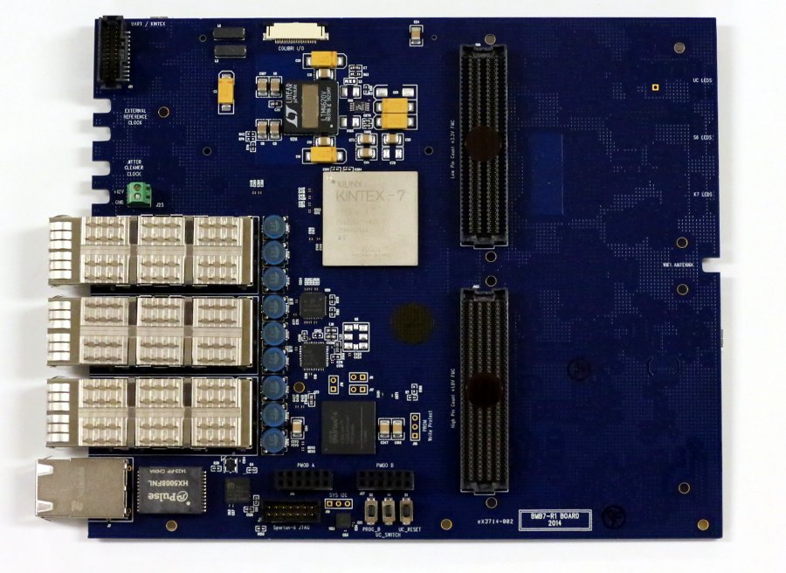
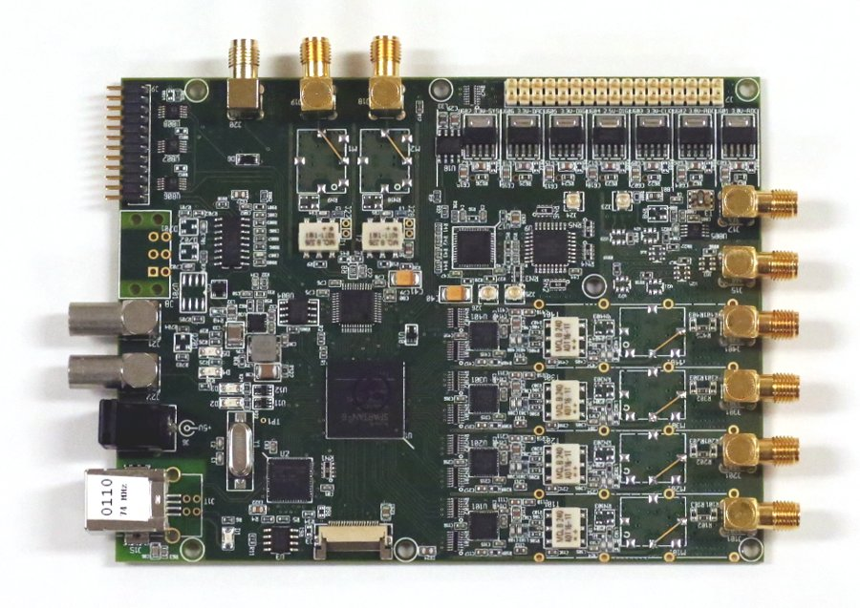
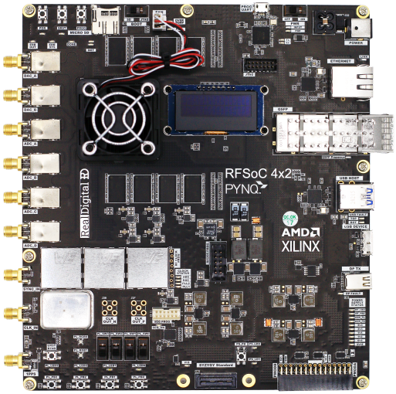
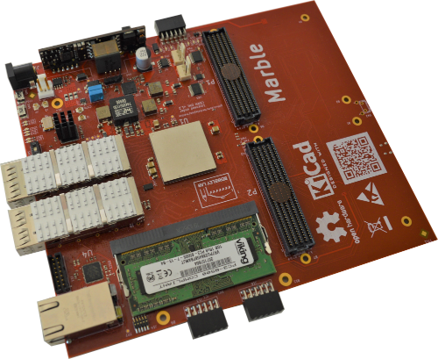
The challenge
The life cycle mismatch
Accelerator projects, ~10s years
R&D
Operation
Upgrade
Electronics hardware, ~ years
FPGA chip / Boards
Peripheral chips / board
Popular framework / interface ~ years - 40 years
Application ~ years
LLRF
Timing
EPS
Control system software, ~ years
Control algorithm
PID ~ forever
AI/ML ?
… ?
Notes:
Chassis image, qf2 image, RFSoC image

Slide 3
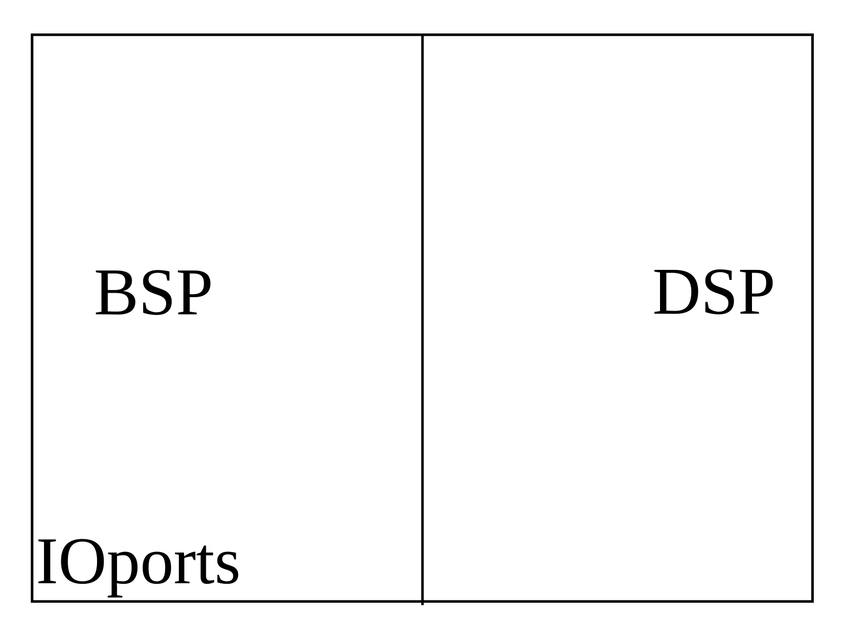
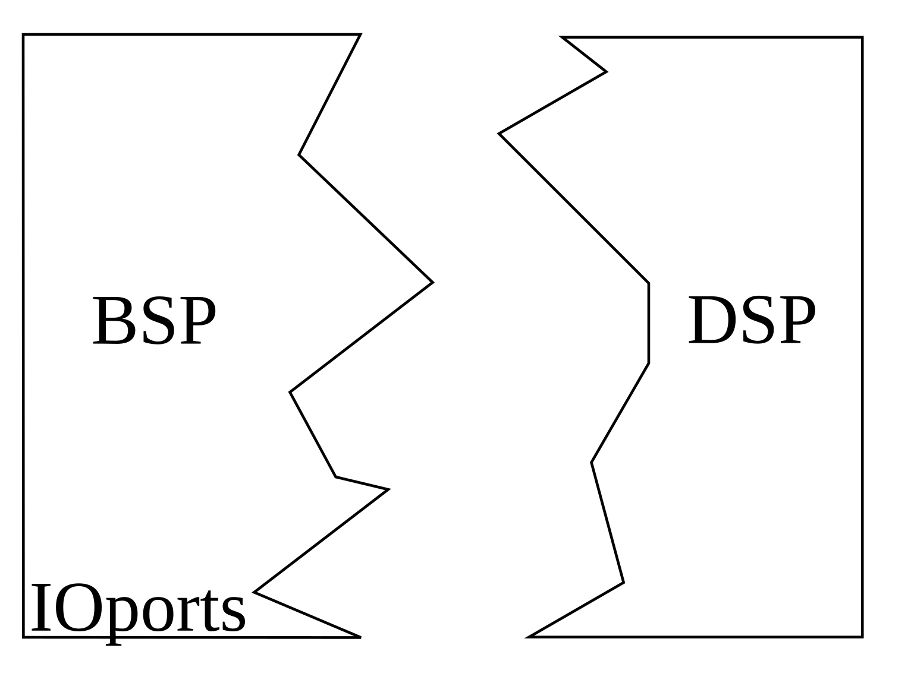
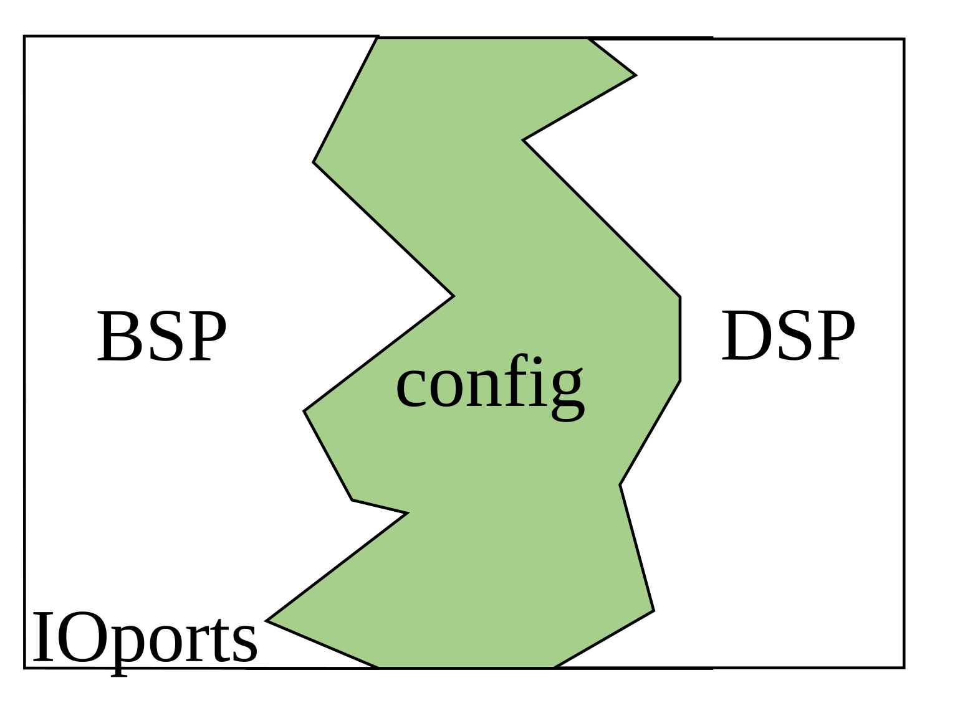
BSP and DSP
Board support package (BSP)
Describe the hardware
Minimal necessary configuration
Write once run anywhere
Simulatable
Digital signal processing (DSP)
Implement the algorithm
Configurable optimization
Resource
Timing
Power
…
Ports with meaningful name
Simulatable
IO pin/direction/standard…
INOUT pins

Slide 4
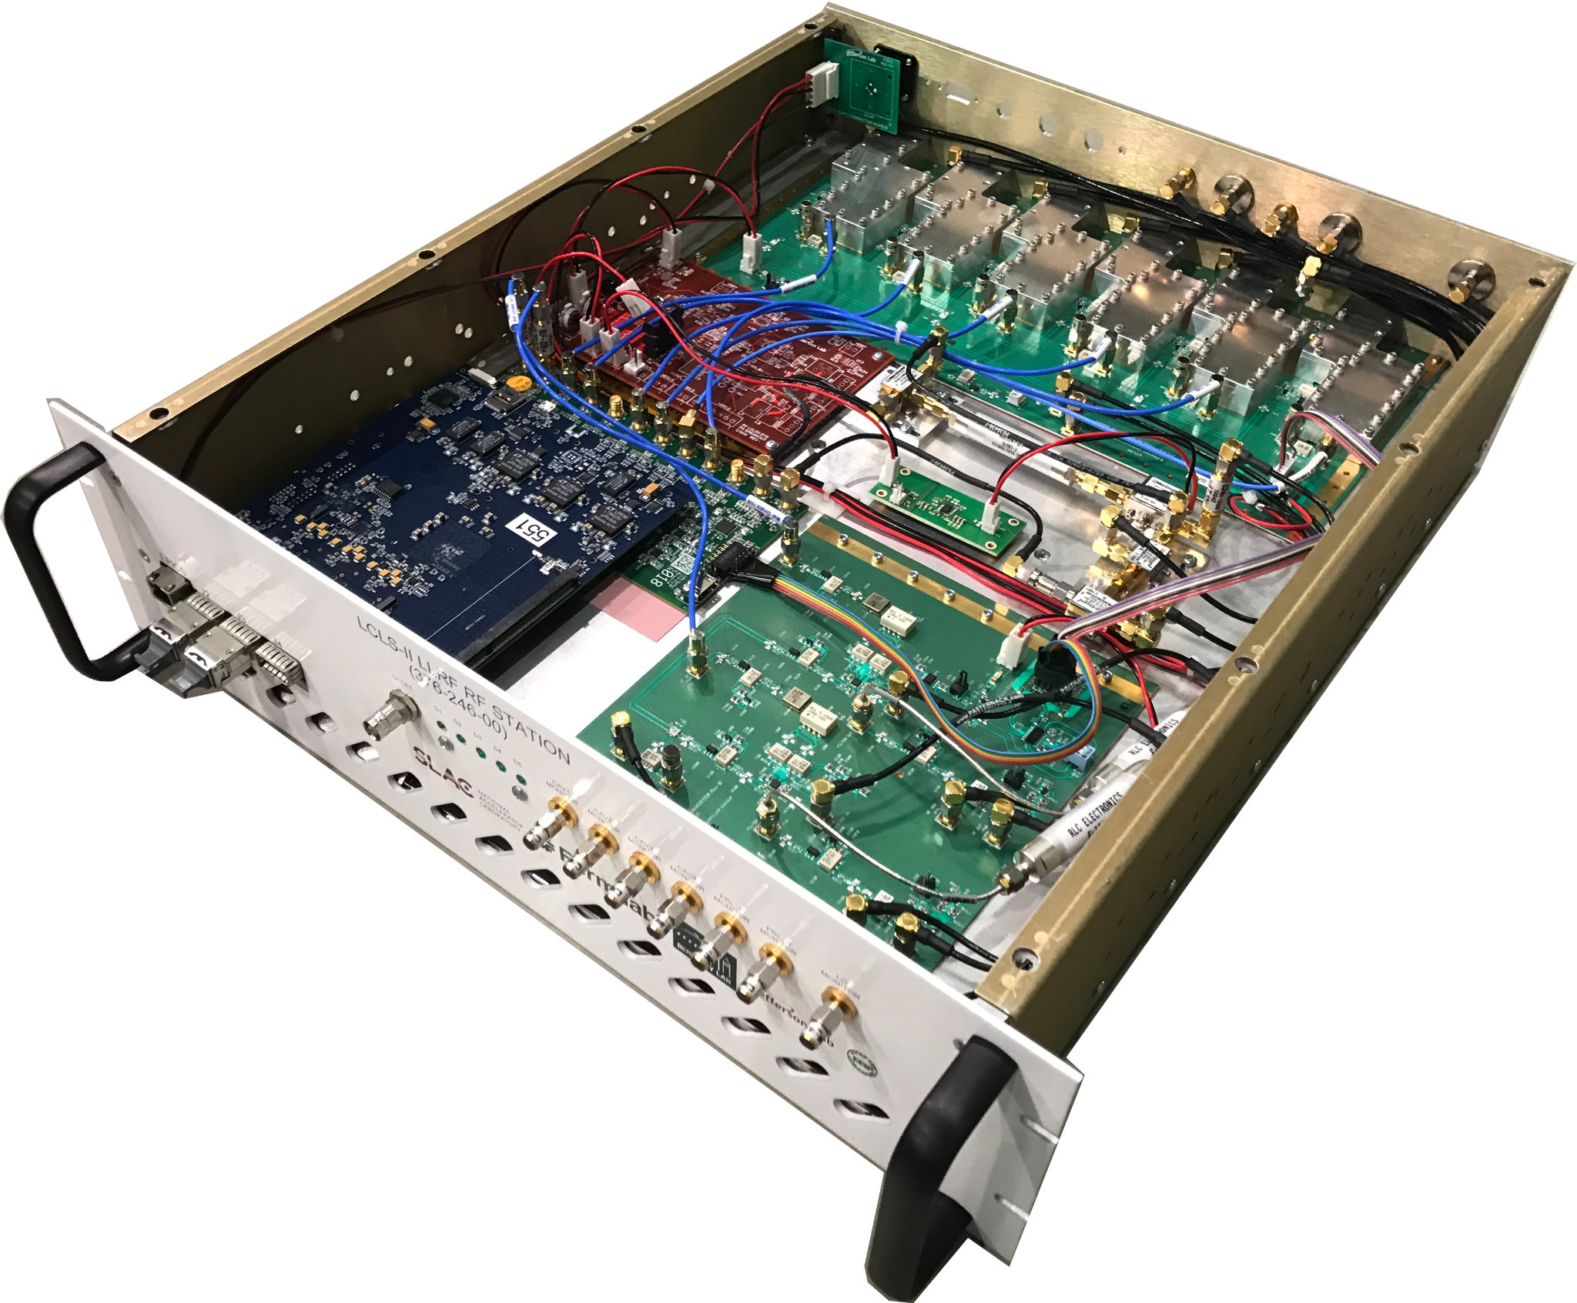
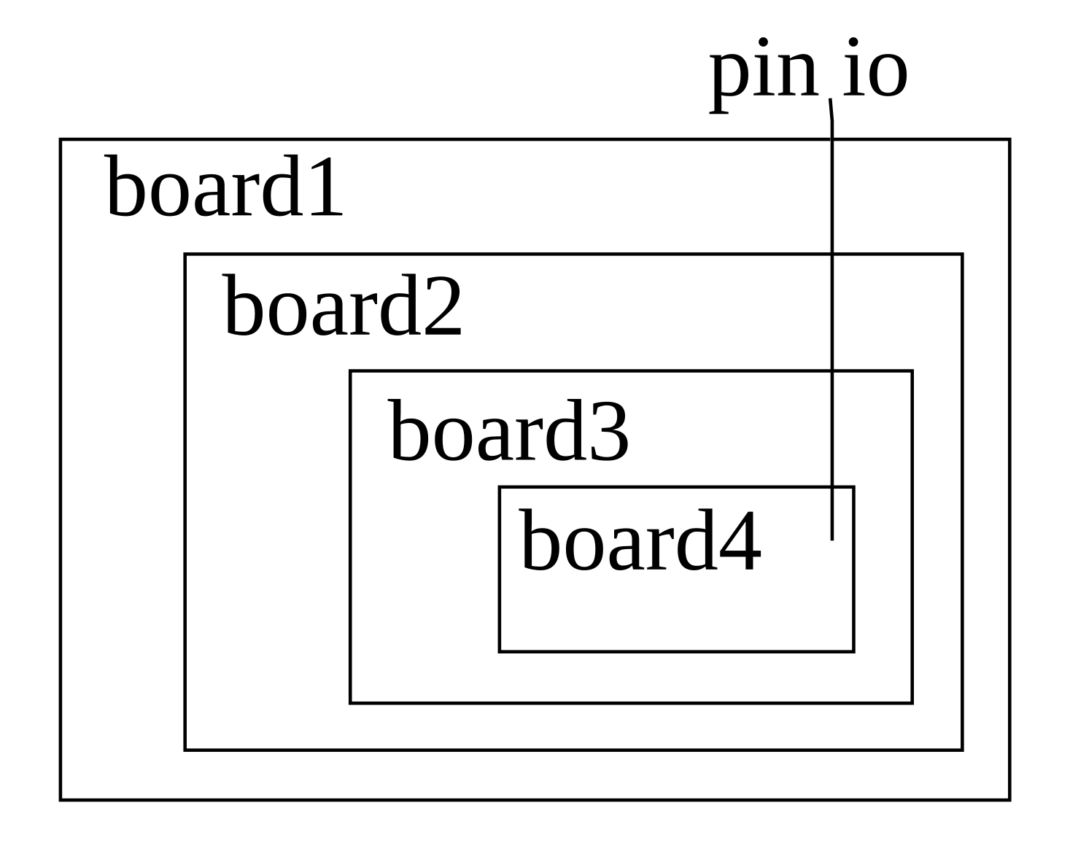
Boards interconnection
One system contain multiple PCB boards interconnected
For example
Board1 FMC connector
Board2 FMC, Pmod connector
Board3 Pmod
Board4 Pmod
The pin direction only defined when fully connected
Options:
One hardware module
Nested hardware module
One FPGA module per PCB board - flat architecture
Inout port between board until the pin consumer
Need vendor support of inout between modules
Lots of pins between boards
1
4
2
3

Slide 5
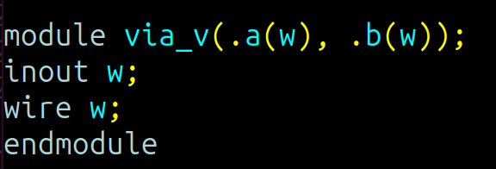
Inout between modules
Inspired by the discussion on Xilinx forum
 | Verilog IEEE Std 1364-2005, 12.3.3 | Systemverilog IEEE std 1800-2017
Icarus verilog | Y | Y
Verilator | N | Y
Vivado Xsim | Y | N
Vivado synthesis | Y | Y

Slide 6
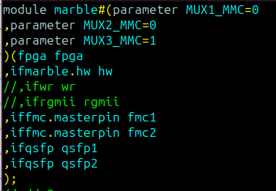
Systemverilog interface
Encapsulate communication between blocks
Add/Modify/Remove signal for existing connection
Support arrays
Encapsulate functionality
Interface specific action, combination or sequential
Contain parameters, ports
Similar as a module
Nested interface
Not officially supported by vivado (in 2023.1)
Basic functional, need more debug/verification
Modport
module port direction
FPGA pin interface
Interface to
driver / configure
Board to board interconnection

Slide 7
Top level module and constraints
Ports list in top module
FPGA interface: All IO pins for the chip https://www.xilinx.com/support/packagefiles
Use the pin location as its name, e.g. AB21, AC22…
FPGA Board: board design file, simplified netlist
Daughter boards, peripheral board, simplified netlist
Unused pins dropped by synthesizer
Special handle for gigabit transceiver pins by checking the pin property
Ports direction in top module
Each board set known direction based on the board design in tcl dict using its own name
Combine them and update a header for the top level port direction
LOCation and IOSTANDARD constraints
Direct map the pin location based on the naming convention
Board design provide voltage information for each bank
TCL dictionary for each bank default IOSTANDARDs (Single ended vs differential)
Read pin property DIFF_PAIR_PORT to determine which to use
Can be text based design or block design for ZYNQ

Slide 8
Host interface
Register, memory read and write
Source: json file contain configuration
Generate systemverilog interface based on the bus configuration, e.g. localbus, axi4 etc
r|w strobe, gate, value,
Assign base address for registers
Optional: keep the existing base address, avoid conflict between multiple json
Default modport, sometimes manually modports as well
Pass the interface as port, use the register/memory in the module, penetration through layers
Multiple json file, e.g. one per clock domain
name | access | addr_width | data_width | sign | init | base_addr
string | string | int | int | string | int | int or None
 | r|w|rw | Register:0; memory: >0 |  | signed|unsigned |  | None for unassigned

Slide 9
Gigabit transceiver (GT P/H/X/Y/Z…)
Requirement
Reproducible module from scripts
Allow independent configuration for each channel
Use the default state machine for the initialization if possible:q
Collect configuration with help from GUI
Start from GUI and save the journal as tcl script
All default setting generate module source as reference
Adjust the configuration on GUI
Python parse the difference relative to the default, store in json and decide the connection type
Value: constant
Port: connection to common/FSM etc
Interface: connection to application via an ifgtchan systemverilog interface
Use the module
Generate the module by script using default setting and stored modification
Instantiate the module

Slide 10
Simulation tools
XSim
Come with vivado
Mixed language simulation
Xilinx IP simulation
Slow to start
HDL simulation, no connection to VPI
Verilator
Open source
Support verilog/systemverilog
Not easy to simulate Xilinx IP
C based simulation, fast
Support VPI
Cocotb
Open source
Python based verification framework
Support multiple backend, including verilator
Hardware
Verilator simulatable: driver
Lower level only simulatable by Xilinx or …: config
DSP
Single clock domain
Verilator-cocotb simulatable
Use parameter instead of `define if possible
Localized in the module
Can be shown in the simulation

Slide 11
Local version control
Automatically commit git and all submodules at each synthesis with commit message “Makefileautomatedcommit”
Automatically amend the commit if the last commit is done automatically
Store successfully built bit/bin/ltx with the commit and build datetime in filename
Manually amend if the bit is tested successfully
Note file for index
Python based auto commit

Slide 12
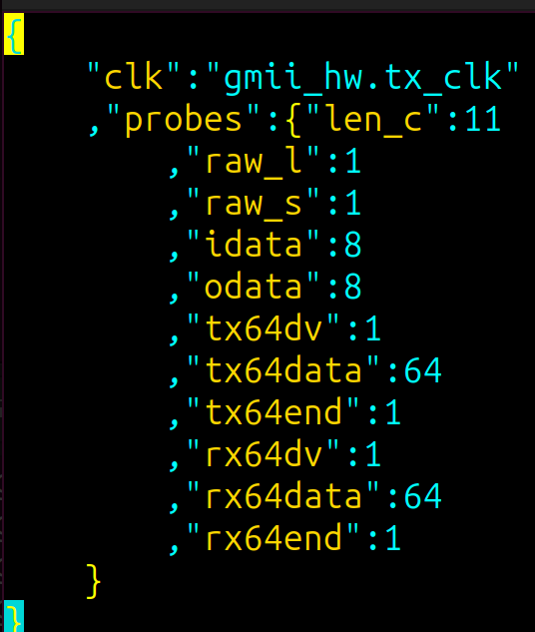
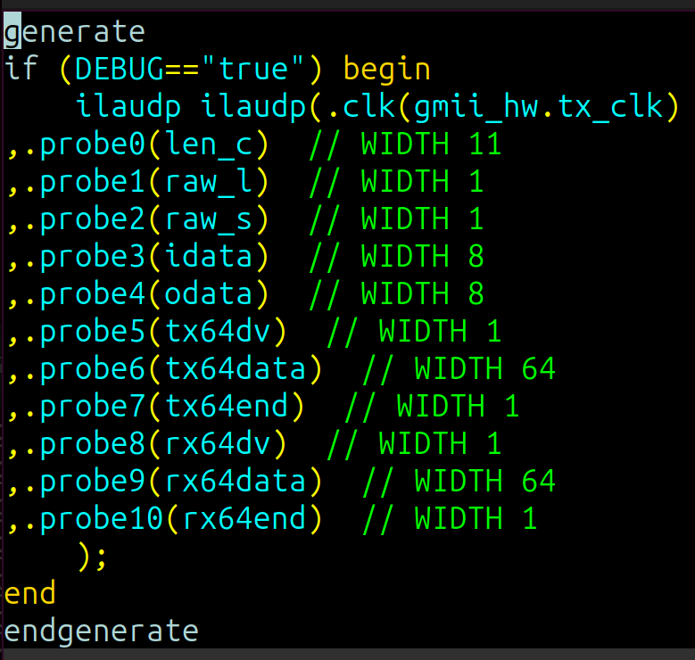
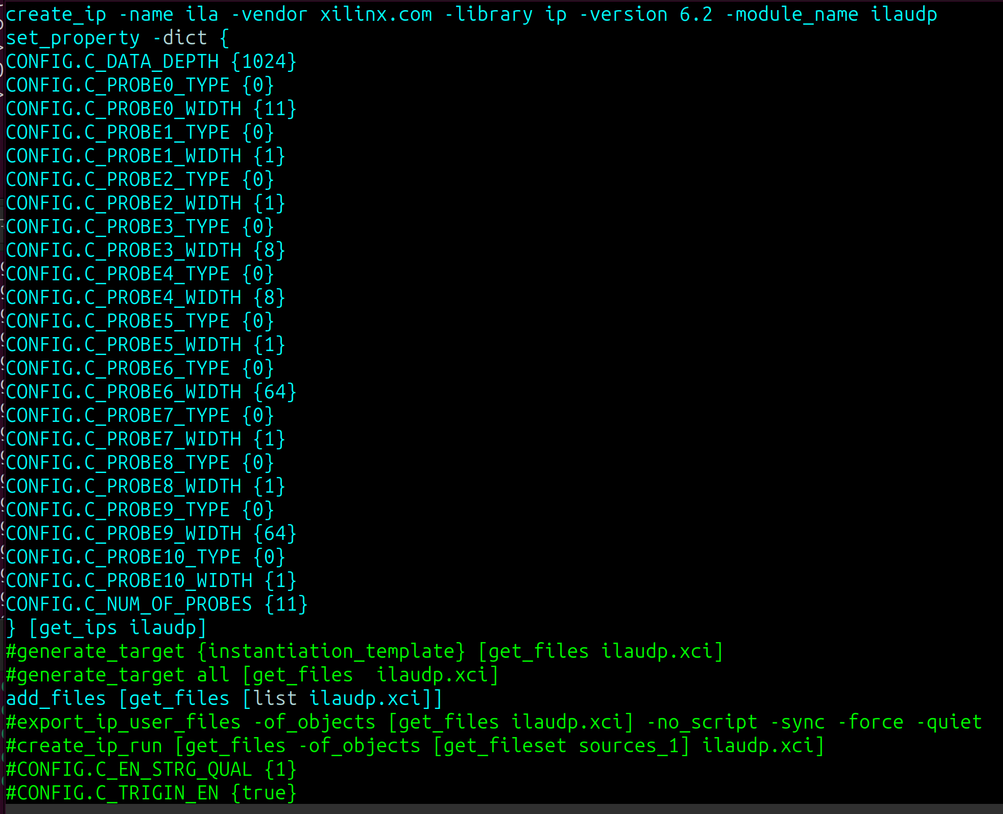
Chip scope
Start from json file specify clock and probes name and its width
Python script to generate .tcl and .vh and .v(for simulation only)
`Include “???.vh” in the source where we can see the signals
Add the .tcl and .vh to dependency (.d) file
.json
.vh
.tcl

Slide 13
Where every module belongs
 | Hardware independent | Hardware dependent
Application dependent | DSP algorithm | HW config Initialization Host communication Synchronization IP core config (GT)
Application independent | Common hdl Softcore Hardcore ……. | Board support ADC chips DAC chips CLOCK chips …….
Explicitly list all the dependency files

Slide 14
Summary
FPGA gateware is the core component for the accelerator LLRF system
A flatten architecture is introduced to improve the system modularity and the code maintainability
Utilizes few new capability introduced in the systemverilog
Interface and alias
Cocotb+verilator simulation
A series of python and tcl scripts are developed to simplify the streamline operation
Gigabit transceiver module implementation
Register/memory name and address handling as well
Verilog top level generation, Iostandard/package pin assignments etc.
The architecture is still under development to be adopted by LLRF projects
Pieces demonstrated in other projects
Preliminary bench testing with the LCLS-II LLRF system and the compatibility analyze in progress

Slide 15
Thank you
This work was supported by the LCLS-II Project and the U.S. Department of Energy, Contract n. DE-AC02-05CH11231.

